Slide 1
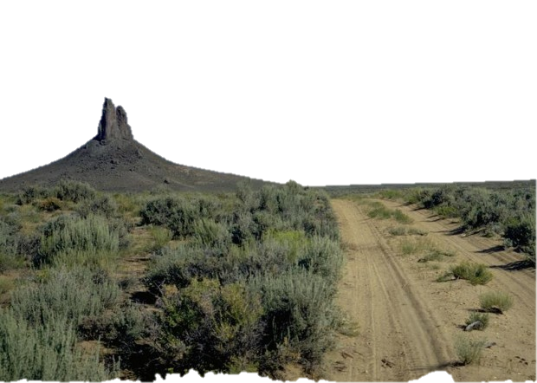
Travel and Transportation Management for Managers
National Training Center Course #8300-26
The Basics
Why, What & How?

Slide 2
Travel and Transportation Management for Managers
National Training Center Course #8300-26
Summarized version of the National TTM training.
For use to educate and train field staff and managers in times not suitable for the two day course.
Particularly helpful when establishing a TTM timeline for field offices.
Notes:
State Leads can utilize this training to help with the following:

Slide 3
Travel and Transportation Management for Managers
National Training Center Course #8300-26
The Basics
Why?

Slide 4
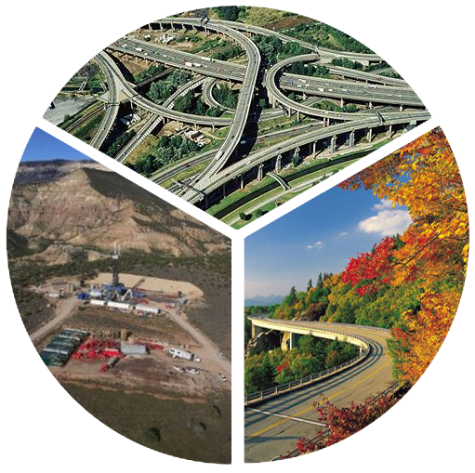
Why are there routes?
Connectivity
Access
Experience
Notes:
The three primary reasons we see routes on the landscape are:
Access (getting to a specific location)
Connectivity (providing a way to get from point a to point b which considers the larger landscape. E
Experience; routes provide users a certain type of experience while going from point A to B etc.

Slide 5
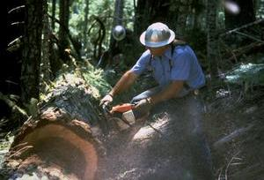
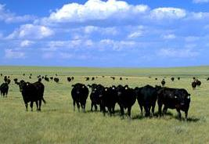
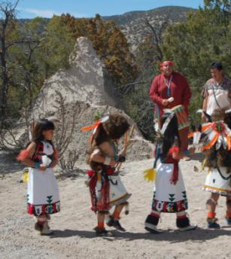
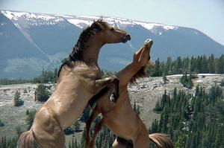
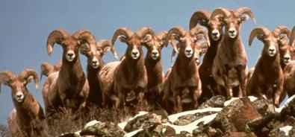
BLM Mission
It is the mission of the Bureau of Land Management to sustain the health, diversity, and productivity of the public lands for the use and enjoyment of present and future generations.
Notes:
Transportation systems address the transportation needs to meet the BLM’s multiple use mission. Route networks are a combination of linear features created in response to the publics needs to access public lands.

Slide 6
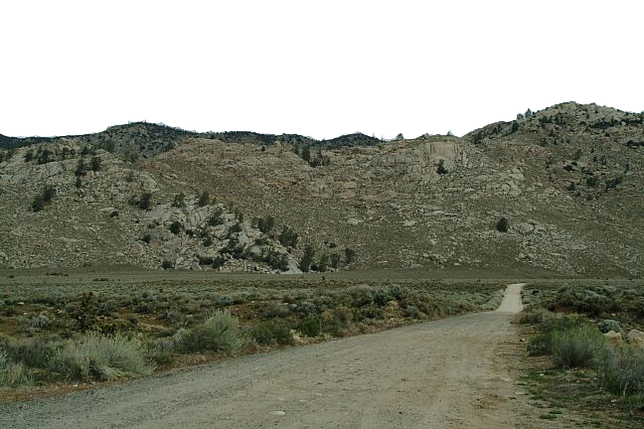
Why Manage Routes?
Provision of Access and Experience
Maintain Connectivity
Increase Efficiency
Reduce Impacts
Notes:
The BLM manages routes either actively or passively for the following reasons. It is important to get across to the audience that just because the BLM may not have designated route networks does not mean they are not managed. The problem comes when we expect that the existing route network meets the BLM multiple use management mandate to provide for the access, connectivity and experience needs in a way which helps with the accomplishment of the local resource goals, objectives.

Slide 7
Authority & Guidance for Travel Management Planning
Executive Order No. 11644, February 8, 1972
Executive Order No. 11989, May 25, 1977
43 Code of Federal Regulations Part 8342
National Management Strategy for Motorized Off-Highway Vehicle Use on Public Lands (BLM 2001)
Travel and Transportation Management Manual (BLM Manual 1626, September 27, 2016)
Travel and Transportation Management Handbook (BLM Handbook H-8342-1, 2012)
Notes:
The history of why the BLM manages travel and transportation networks and systems is one that is longstanding, but only recently received clarification to encourage consistency and defensibility. The BLM has been given direction since the 1970’s. The early executive orders were issued largely in response to concerns related to unregulated travel in the California desert(Nixon and Carter). Those executive orders were codified into what we know as the Bureaus OHV regulations in 43 CFR part 8340. In the decades following; interpretation of how to apply the OHV regulations were done largely in via Internal Memorandums and NEPA Handbooks until 2010 and 2012 with the issuance of the Bureaus first TTM Manual and Handbook. Revision to the Manual cam in 2016 and revision to the Handbook is underway.
Exective orders issued by Nixon and Carter.

Slide 8
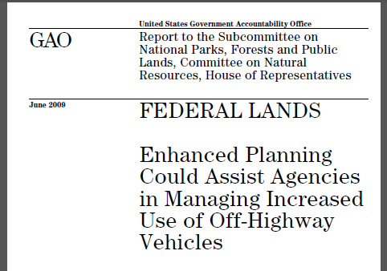
GAO-09-509
Notes:
In 2009, the General Accountability office issued a report of the land management agencies to make recommendations as to how the agencies can better plan for and manage TTM. Much of the progress we have made in recent years towards improving how the Bureau plans for TTM are a direct result of this report. Reference: USFS decided to push the approach of accomplishing TTM on the forests by a certain date. BLM to more of a grass roots approach towards designating systems of routes.

Slide 9
Public Lands Travel Network
Notes:
Too often, this kind of route network can be seen in areas which provide an opportunity the public is seeking, but may not have a designated travel plan. Often referred to as a spaghetti bowl.

Slide 10
Travel and Transportation Management for Managers
National Training Center Course #8300-26
The Basics
What?

Slide 11
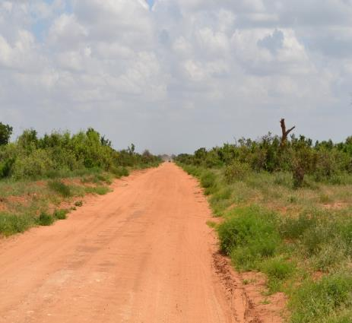
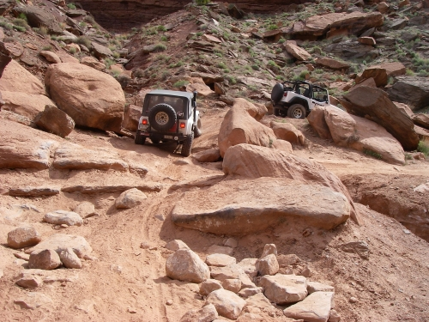
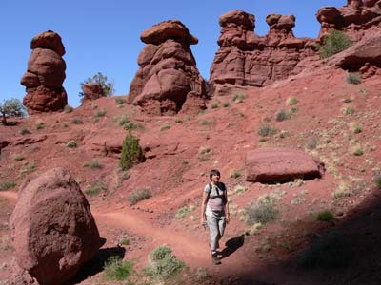
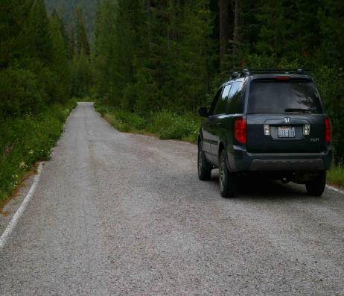
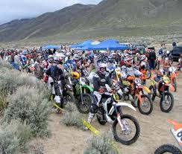
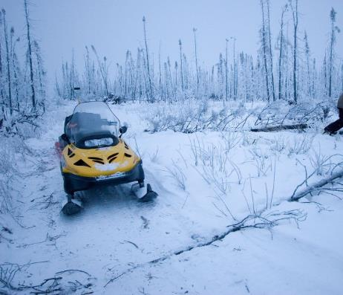
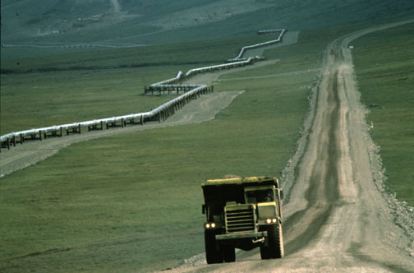
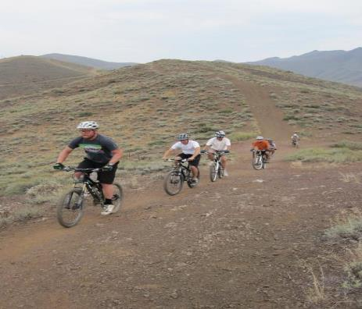
Linear Travel Features - “Routes”
Notes:
Linear travel features and routes are used synonymously. Both terms are a general catch all to capture the entire route network.

Slide 12
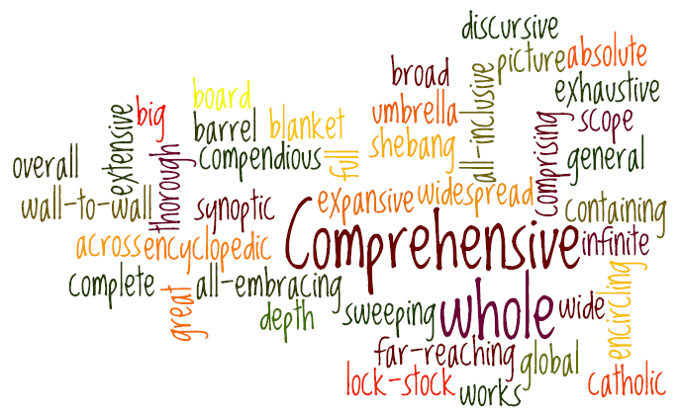
All Users – All Vehicles – All Modes-of-Travel
Notes:
Terminology is one of the most important things we can clarify when talking inside and outside of the agency. Often people think that our terminology is the same as the USFS, or the state or county. Knowing what is and is not an OHV has direct implications on what designations and decisions the BLM makes to manage OHVs. Often times, unnecessary or needlessly harmful decisions are made in land use plans which hamper the ability to effectively manage OHVs or other modes of travel.

Slide 13
Off-Highway Vehicles
https://www.ntc.blm.gov/krc/uploads/971/BLM_OHV_training_FINAL.mp4

Slide 14
Definition of OHV
Definitions established in 43 CFR 8340.05
(a) Off-road vehicle [OHV] means any motorized vehicle capable of, or designed for, travel on or immediately over land, water, or other natural terrain, excluding:
(1) Any nonamphibious registered motorboat;
(2) Any military, fire, emergency, or law enforcement vehicle while being used for emergency purposes;
(3) Any vehicle whose use is expressly authorized by the authorized officer, or otherwise officially approved;
(4) Vehicles in official use; and
(5) Any combat or combat support vehicle when used in times of national defense emergencies.
Notes:
Watch Video and discuss the definition.

Slide 15
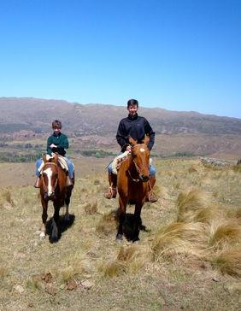
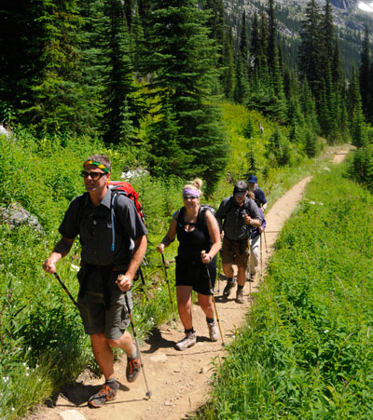
Non-Motorized Modes-of-Transport
Notes:
Modes of travel that are not considered OHV’s. Modes focused around having a certain kind of experience on public lands.

Slide 16
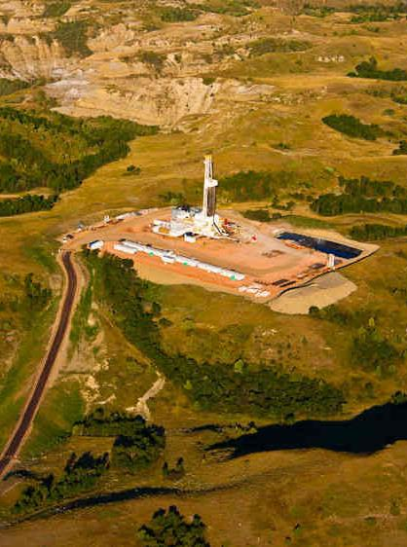
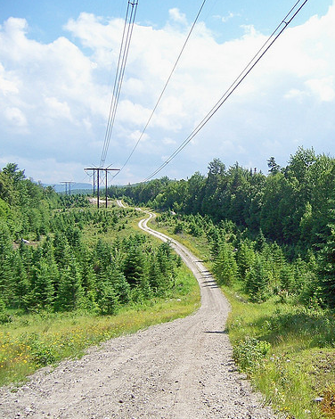
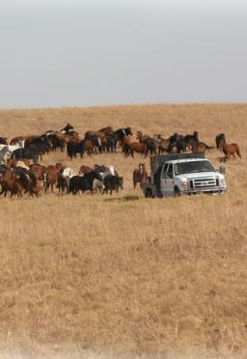
Permitted & Authorized Use
Notes:
Modes focused around access. BLM’s mission is multiple use and sustained yield. Our transportation Systems should reflect this

Slide 17
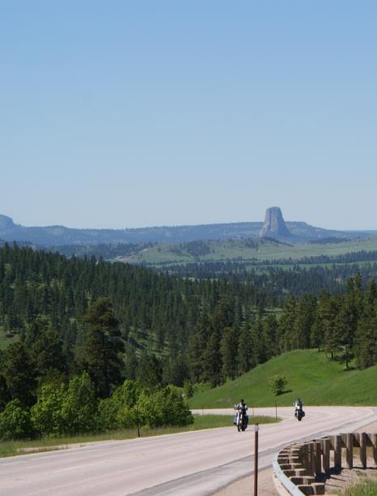
Travel Network & Transportation Systems
Sustainable - Multi-Modal - Comprehensive

Slide 18
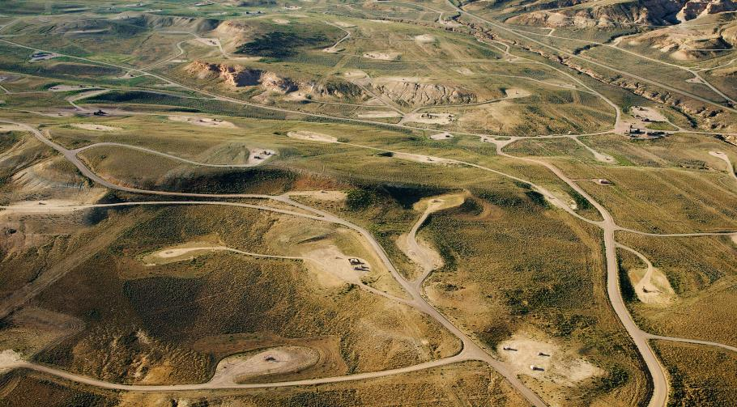
What’s the difference between a Travel Network and Transportation System?
Notes:
Understanding what each is helps will help understand how the three whys of TTM work together in your decision making process.
Travel Network The routes occurring on public lands or within easements granted to the BLM that are recognized, designated, decided upon, or otherwise authorized for use through the planning process or other TTM decisions. These may or may not be part of the transportation system and may or may not be administered by the BLM.
Transportation System The sum of the BLM’s inventory of transportation linear features that have been classified as roads, primitive roads, or trails and are formally recognized and approved as assets, and entered into FAMS.

Slide 19
Managing Comprehensively
TTM
Non-Motorized Trail Decisions
Permitted and Authorized Use
OHV Area Designations
OHV Trails Designations
43 CFR 8342 Designation Criteria
43 CFR 8342 Designation Criteria
43 CFR 8364 / 8365
Closures, Restrictions & Rules
Terms & Conditions / Stipulations
Land Use Allocation
Implementation Decision
Notes:
This is an illustration which outlines the kinds of BLM TTM decisions being made during Land use planning as well as Implementation level planning decisions. It also outlines how to plan for and enforce Non-Motorized decisions.

Slide 20
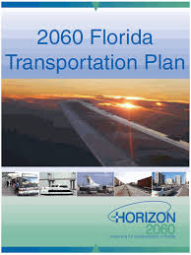
Travel and Transportation Planning
Presents opportunity to review Inventory & Resources
Achieves Site-Specific Impact Analysis
Allows incorporation of Best Management Practices
Results in Defensible Decisions
Aids in Dissemination of Information (User Maps etc.)
Eases Development and Analysis of Future Actions
Notes:
The goal of the “what” is TTM; is to really understand what TTM does for the planning and implementation of all resource decisions. Providing for Access, Connectivity and experience in an active management style will improve the ability to manage all resources more effectively.

Slide 21
Travel and Transportation Management for Managers
National Training Center Course #8300-26
The Basics
How?

Slide 22
Travel and Transportation Management for Managers
National Training Center Course #8300-26
Preparing to Make TTM Decisions
Fundamental Planning Processes
Notes:
Now that we understand “Why” we do TTM and “what” TTM is; Lets now discuss “How” we do TTM. We will discuss the fundamentals of the TTM planning process to help you understand the flexibility and beneficial nature of doing TTM at a manageable planning scale for all resources.

Slide 23
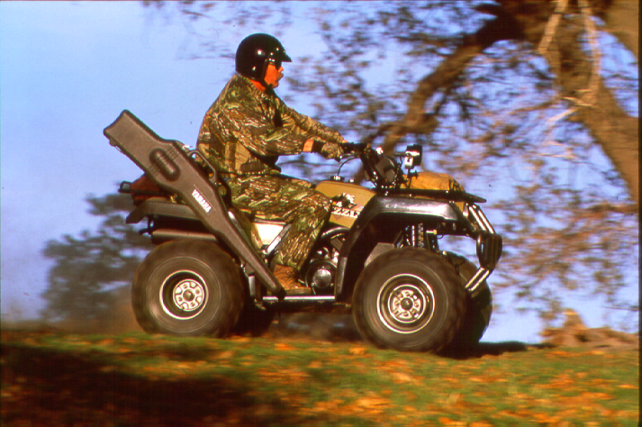
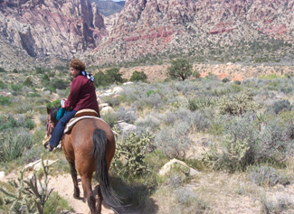
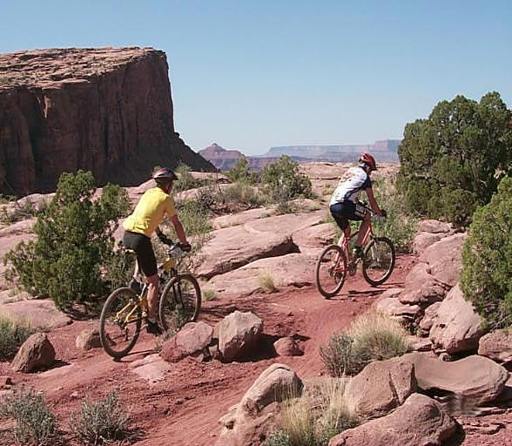
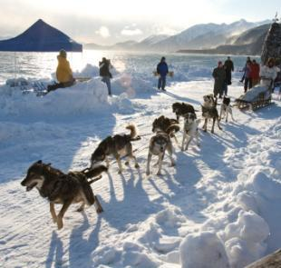
Comprehensive
Notes:
TTM is Multimodal and comprehensive because TTM should provide for transportation needs of all resource programs and assist in meeting the transportation needs of each resource program the Bureau manages on behalf of the American people.

Slide 24
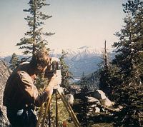
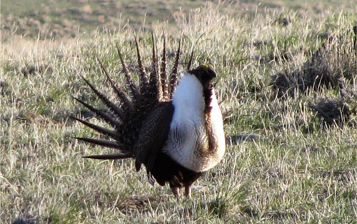
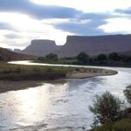
Interdisciplinary
Notes:
If TTM is to benefit all resource programs, then all resource programs need to be involved.

Slide 25
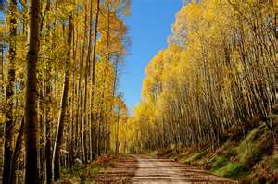
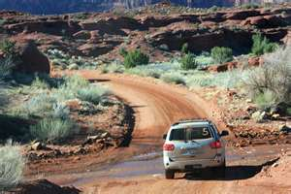
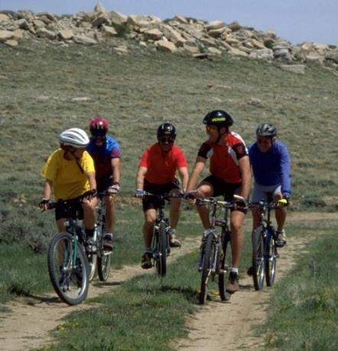
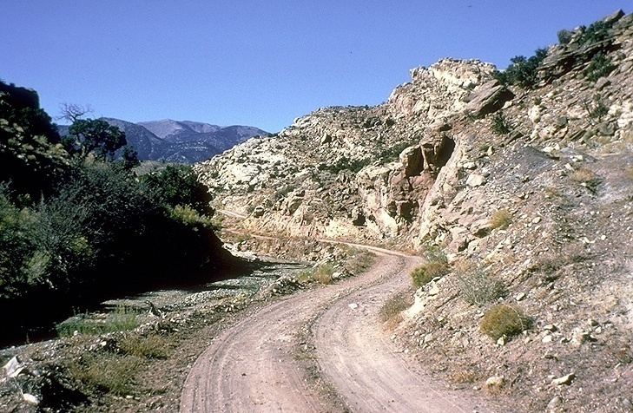
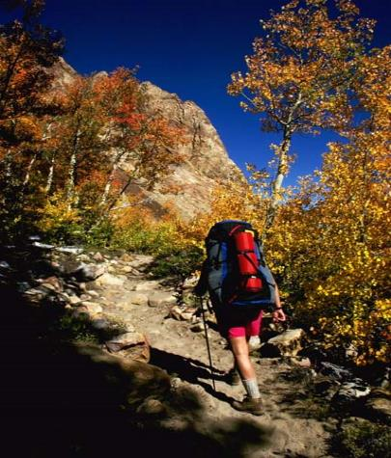
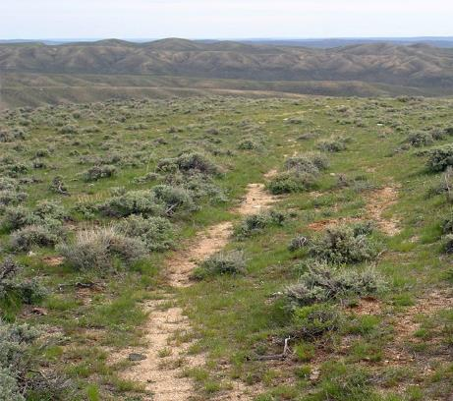
Outcome-Based
Notes:
Managing for identified goals and objectives is a critical component of doing TTM.

Slide 26
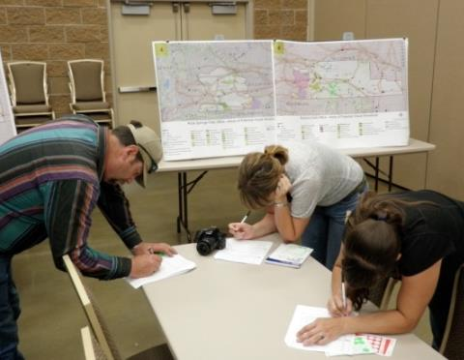
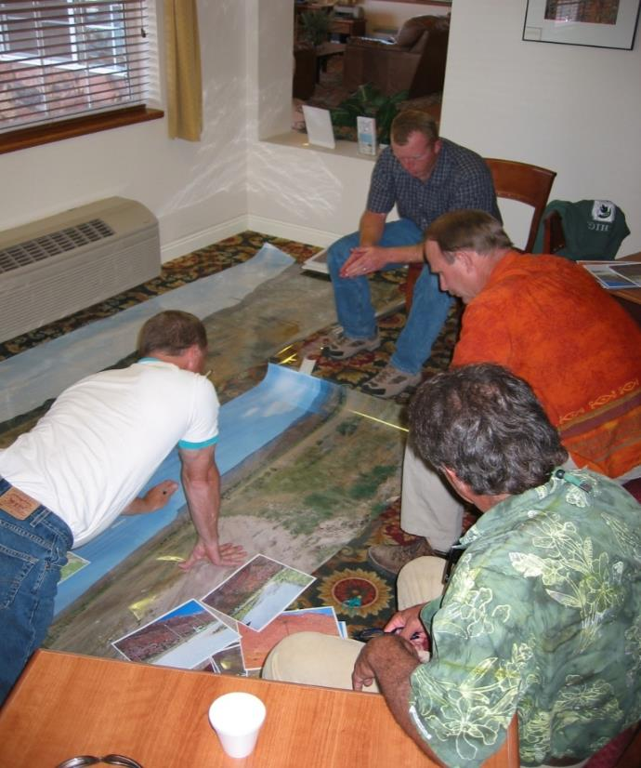
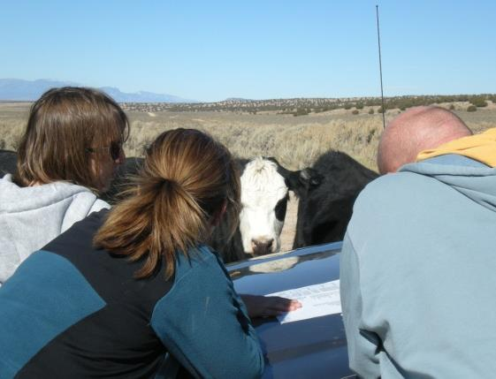
Collaborative
Notes:
Early and often is the key to being effective in TTM.

Slide 27
Communication…
“We all have questions! We want someone up there to answer them.”
- Public Meeting, Manti-La Sal National Forest
Notes:
Watch the first part of the video from a public meeting in Moab Utah. The video has many examples where the group can discuss regarding how to approach public outreach efforts. Discuss the video and see: 1.What went wrong? 2. What could be improved? 3. What should be learned before we get in that position?

Slide 28
Pre-Planning
Identify data requirements
Identify the existing available data
Resource Data
Route Inventory
Identify the data gaps
Identify the issues, concerns and opportunities
Document Pre-Planning
Establish Planning Criteria
Involve leadership so they understand the workload, resources, and funding required!
Notes:
Moving into the beginnings of TTM is helped along greatly by understanding the Pre-Planning process:
Having leadership trained/familiar with Preplanning is critical to provide direction, focus resources and manage time.
This is where a simple communications plan would help determine some of the following things:
Data:
What data exists?
Is the data that exists good enough to be credible to the public?
What kinds of data do we need to collect?
What kind of data will we accept? What kind of data parameters will we communicate to the public to get compatible data?
Issue Identification:
What kinds of resource concerns are you going to have to address and anticipate challenges from?
Who needs to be involved early on in the process? Cooperating agencies, interested parties, etc.
At what time do we reach out for information regarding data, Inventory and Issue identification?
Documentation:
Who will be documenting these efforts and to what standard?
Documenting how you approached pre-planning will not only produce a better product, it will help address any challenges you may get to any phase of the TTM process.
Public outreach tools role in outreach as well as data collection and issue identification. What do you want the tool to do?
Planning Criteria:
Establish this internally via direction in the Handbook, followed by determining what kind of information would we ask the public for that would help us establish planning criteria.
Keeping courts out of this process by doing this well the first time will reduce headaches and reduced flexibility with decision making later.

Slide 29
Resource & Program Data
Driven by planning needs!
Addresses the issues, concerns and opportunities
Includes previous route/area authorizations impacting travel e.g., ROWs, APDs, Sundry Notices, Grazing Permits etc.
Examples
Soils, Water / Watersheds, Vegetation, Air Quality, Wilderness Study / Wilderness Characteristics
Wildlife, Habitat, Critical Habitat
Recreational Uses / Settings / Desired Outcomes
Designated Wilderness, Primitive Areas, Natural Areas
Notes:
What data do we have that we need to consider?
What are we overlooking?
Some of the program data that warrant consideration is sometimes a new thing for your field office. Be patient and help them understand why it is important to do something they may have not done before.

Slide 30
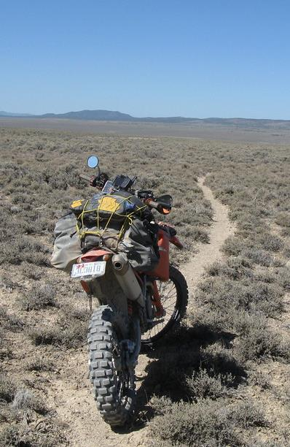
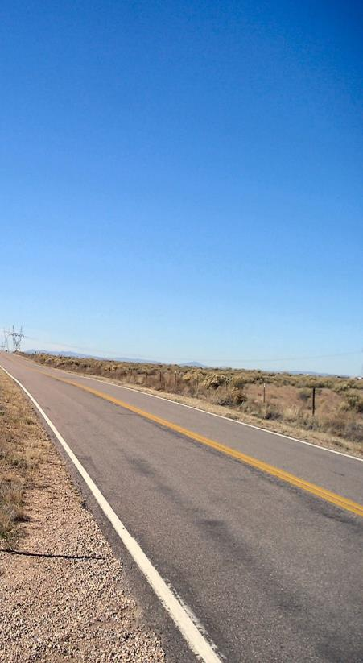
Linear Travel Features ~ “Route” Inventory
Notes:
As a Bureau, we have learned a lot regarding what is good data and what is not good data. Assessing this early on is important to know if you need help collecting or verifying this data. Currently, most of this inventory is being done via contractors.

Slide 31
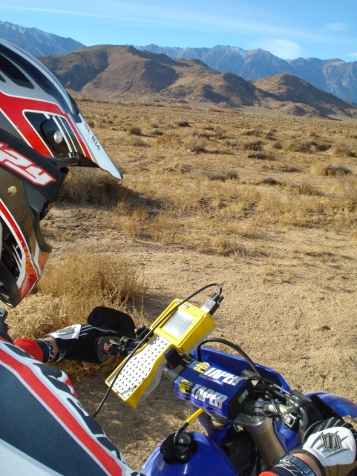
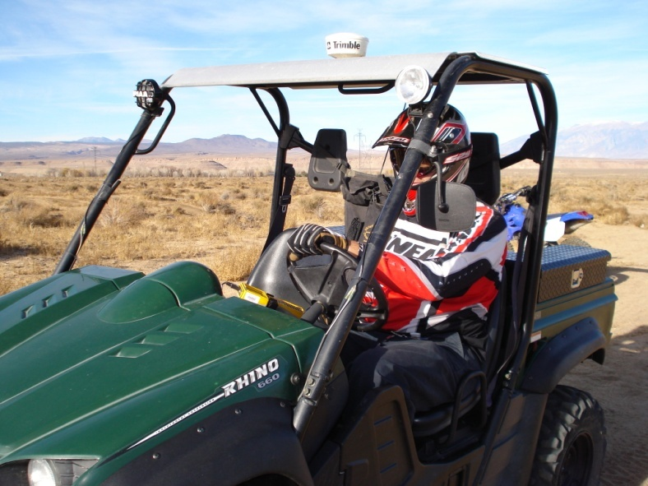
Collecting the Data Manually
Notes:
Things to consider:
Do you have the expertise and the capacity to produce a product that is consistently inventoried and verified?
What are the pros and cons of contracting this work vs. doing this in house?
Verification of the data by the Bureau before using that data is necessary.
Are there other kinds of data that we need to collect? Cultural etc.

Slide 32
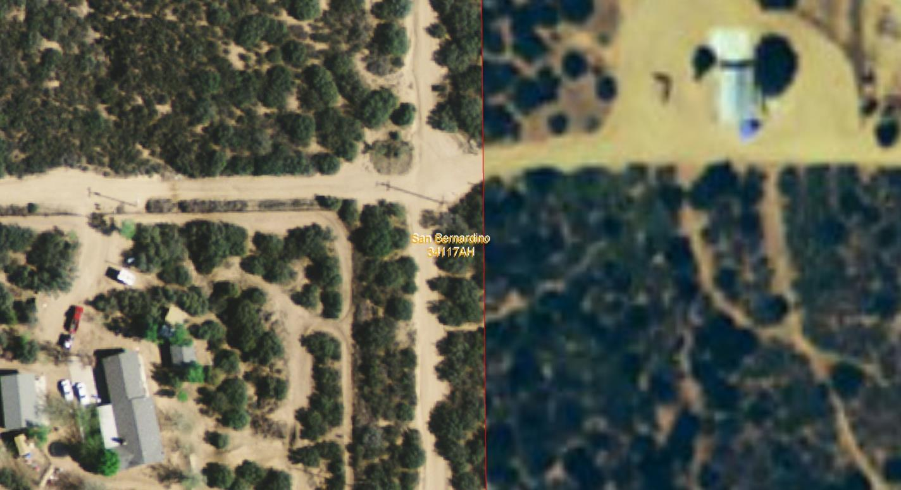
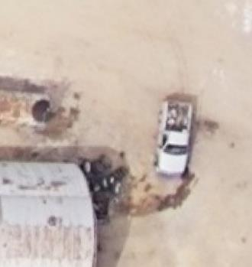
Collecting the Data Digitally
Notes:
Imagery in your planning area: How good is it? How new is it?
Verification of the data by the Bureau before using that data is necessary.

Slide 33
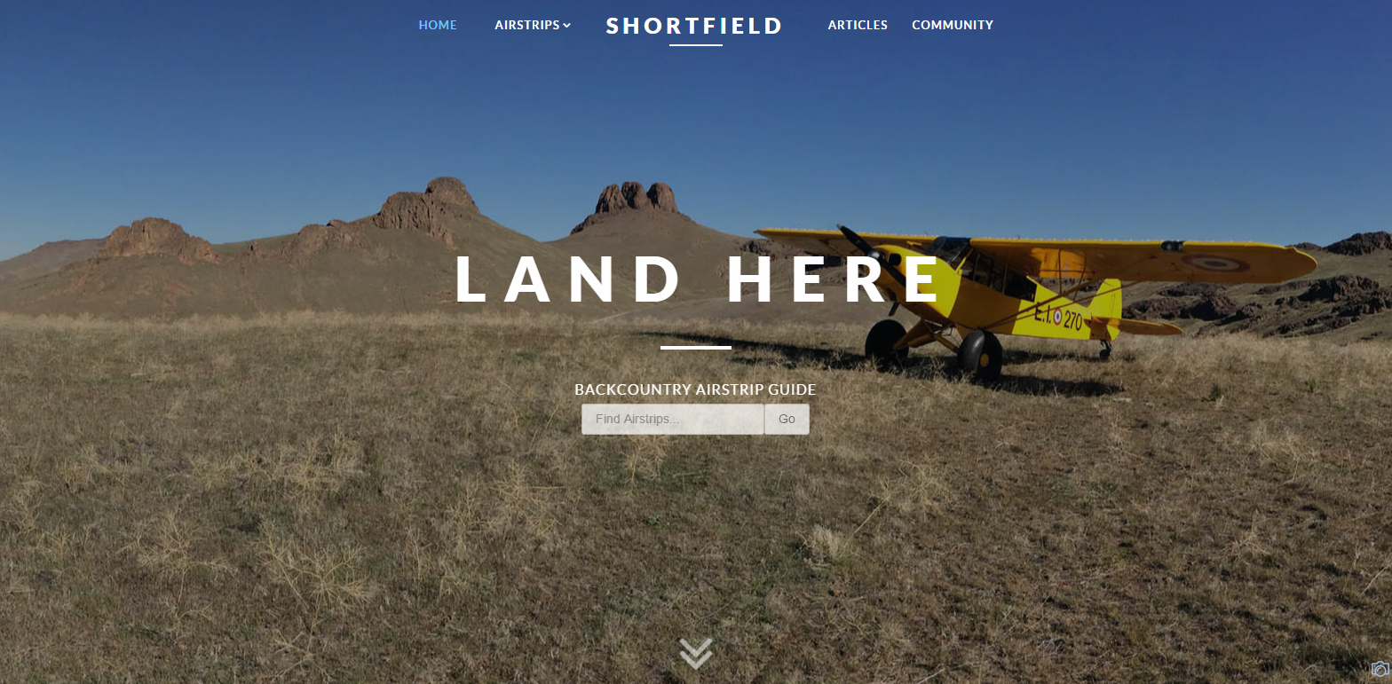
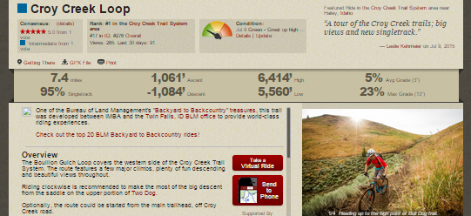
Crowd-sourced Data
Notes:
What kind of data will you accept?
Options: Strava, Google, etc.
What are the pro and cons to using this kind of data?
Verification of the data by the Bureau before using that data is necessary.
Perhaps this data is best used to indicate a need for the field to verify/focus inventory.
Crowd source data is collected by people on the ground who are participating in some ind of activity on public lands. That alone could be useful to consider later in the TTM process.

Slide 34
Ground Transportation Linear Features
Notes:
Required method of storage, national data standard, field office controlled, universally accessible – unit 7 in the larger training.

Slide 35
GTLF “Inventory” Minimums
Route Designation Authority
Observed Mode of Transport
Indicates the general category of transportation observed on the route.
Observed Surface Type
The main surface material of the ground transportation linear feature at the time the observation was made.
Observed Functional Class
This attribute groups routes according to the type of service and amount of traffic they have.
Observed Route Use Class
Describes the observed physical suitability of use of a road in order to aid in safe travel by the public across the BLM road network.
Route Existing Authorization Status
Indicates the existence of an easement, Right-of-Way (ROW), Reciprocal Right-Of-Way (RROW) or similar authorizations.
Route Planning ID
Notes:
These minimums should be baked into all data dictionaries and resulting datasets. The purpose of the GTLF data set is to provide corporate data at the national level which helps the Bureau report and answer TTM questions form inventory through planning, through on the ground implementation/ maintenance.

Slide 36
Route Purpose
Access | Connectivity | Experience

Slide 37
Characterizing Route Use
By the numbers…
Vehicle Counters etc.
RMIS
Federal Highways / State DOT
Field Observation
High
Medium
Low
Notes:
Numbers tell a story and can indicate trends.
Field observation can be helped by numbers but when considering what to consider in the TTM planning process. Stick to High Medium and Low when characterizing use for routes being evaluated and considered for designation across alternatives.

Slide 38
Credible Data?
Is your inventory current?
“How” and “When” was it collected?
What percent has been checked against Aerial Photography?
What percent has been collected by GPS/Ground Truthed?
Is your data stored in a usable format?
GIS data in Ground Transportation Linear Feature (GTLF) layer(s)?
Geo-referenced tables used to store meaningful attributes?
Is the Metadata up-to-date?
Has each route been assigned a unique number?
Has your public process included verification of inventory data?
Has input from the public been verified?
Notes:
Regardless of the inventory method used to collect the data, verification is needed by the agency.
What does Credible mean?
Is it 100% accurate or complete?
How thoroughly is it verified?
The answer is that it needs to pass the red face test with the public and those interested in the BLM’s resulting transportation system.
Think about how involved you want or need the public to be in this process. At some point the Bureau need to say “this is what we are moving forward with”.
What may work for one TMP may require additional efforts in another one. Usually associated with litigation. (Utah and California)

Slide 39
Questions?

Slide 40
Travel and Transportation Management for Managers
National Training Center Course #8300-26
The Big “Decisions”
Land Use Planning for TTM

Slide 41
Decisions, Decisions…
Land Use Planning Level Decisions
Broad-scale [protestable] decisions to direct future management actions and subsequent site-specific implementation decisions.
OHV Area Designations
Open, Closed, Limited – 43 CFR 8342.0-5
BLM Handbook H-8342-1 (Section IV.C – page 11 - 13)
Implementation Decisions
Final [appealable] approval allowing on-the-ground actions to proceed.
Evaluation of Linear Transportation Features (Routes)
Type of Feature (Road, Primitive Road, Trail, Primitive Route or Transportation Linear Disturbances), OHV Trail Designations
Other Limitation/Restrictions e.g., Season of Use, Authorized Users, Type of Vehicle etc.
Implementation Strategy
Sign, Monitoring, Restoration, Outreach, Enforcement Components
Notes:
Provide a brief overview/ review as to the differences.

Slide 42
TTM & Land Use Planning
LUPs provide the overarching guidance for all resources…
Some Resource/Program goals, objectives and allocations directly relate to TTM e.g., provision of access
Others indirectly relate e.g., reduce impacts on air quality from motorized sources
LUPs also include allocations specific to TTM.
OHV Area Designations
Notes:
LUP decisions set the framework for how implementation level decisions such as TTM will be developed to compliment the identified goals and objectives in the RMP.
OHV area designations are the Only OHV decisions you will be making in an RMP. OHV Open, OHV Limited and OHV Closed.
Any OHV Limited specification will be made in a follow up Implementation level plan.
The only acceptable additional language for Limited areas in an RMP is to say that OHV travel in OHV Limited areas will be allowed to occur in a similar manner and degree until TMP’s are developed.

Slide 43
Biological Resource Decisions
Surface-disturbing and disruptive activities would be allowed within 1/2 miles of raptor nest sites with design features which maintain the functionality for the nesting habitat.
Prohibit surface‐disturbing activities within ¼ mile of or within riparian/wetland areas (219,683 acres).
Continue the Bald Ridge Area human presence seasonal closure currently January 1 to April 30 in cooperation with stakeholders.
Notes:
For example: In the longer course, we have the class participate in an activity where they look through Land Use Plans and extract planning goals and objectives which will in turn guide implementation level decisions.

Slide 44
OHV Area Designations

Slide 45
OHV Area Management
The Land Use Planning level decision required by regulation and policy – 43 CFR 8342 & H1601-1
The authorized officer shall designate all public lands as either open, limited, or closed to off-highway vehicles.
This regulation only applies to off-highway vehicles!
Notes:
Only apples to OHV’s as defined by the BLM in the CFR regulations.

Slide 46
OHV Open, Closed & Limited Areas
Open
Closed
Limited

Slide 47
OHV Area Designation Decisions
Decisions must comply with 43 CFR 8342 – Designation of Areas and Trails
All designations shall be based on the protection of the resources of the public lands, the promotion of the safety of all the users of the public lands, and the minimization of conflicts among various uses of the public lands; and in accordance with the following criteria:
(a) Areas and trails shall be located to minimize damage to soil, watershed, vegetation, air, or other resources of the public lands, and to prevent impairment of wilderness suitability.
(b) Areas and trails shall be located to minimize harassment of wildlife or significant disruption of wildlife habitats. Special attention will be given to protect endangered or threatened species and their habitats.
(c) Areas and trails shall be located to minimize conflicts between off-road vehicle use and other existing or proposed recreational uses of the same or neighboring public lands, and to ensure the compatibility of such uses with existing conditions in populated areas, taking into account noise and other factors.
(d) Areas and trails shall not be located in officially designated wilderness areas or primitive areas. Areas and trails shall be located in natural areas only if the authorized officer determines that off-road vehicle use in such locations will not adversely affect their natural, esthetic, scenic, or other values for which such areas are established.
Notes:
These subparts set the basis for determining what resources need to be considered in making OHV area and subsequent OHV implementation level decisions.

Slide 48
Travel Management Areas

Slide 49
What is a Travel Management Area?
TMAs are a planning tool to frame transportation issues and help identify travel networks that address specific uses and resource concerns.
A
B
C
Notes:
No allocations are associated with TMA’s
Can be changed as needed.
Merely a tool to help focus TTM efforts in a given planning area.
Examples of other resources which may influence how TMA’s are determined: Watersheds, County, SRMA, WSA, Wilderness, ACEC

Slide 50
TMAP Data
Travel Management Areas
Off-Highway Vehicle Areas
Notes:
TMAs are tracked in the TMAP system as are OHV areas. Any comments here Dennis?

Slide 51
Questions?

Slide 52
Travel and Transportation Management for Managers
National Training Center Course #8300-26
The “Details”
TTM Implementation Decisions

Slide 53
From Linear Travel Features to Travel Network/Transportation Systems
Notes:
This is where the magic Happens!

Slide 54
Notes:
What are they and what do we want them to become?
Terminology is key to consistent communication during these efforts.

Slide 55
Linear Transportation Features
Road
A linear route declared a road by the owner, managed for use by low-clearance vehicles having four or more wheels, and maintained for regular and continuous use.
BLM Handbook H-8342-1 (Section V.C – page 20)
Notes:
Key for Road is: Maintained for regular and continued use.
Roads have different classes and determining those classes will be part of the process.

Slide 56
Linear Transportation Features
Primitive Road
A linear route managed for use by four-wheel drive or high-clearance vehicles. These routes do not normally meet any BLM road design standards.
BLM Handbook H-8342-1 (Section V.C – page 20)
Notes:
Primitive roads have different types that should be described for each route during TTM efforts.

Slide 57
Linear Transportation Features
Trail
A linear route managed for human-powered, stock, or off-highway vehicle forms of transportation or for historical or heritage values. Trails are not generally managed for use by four-wheel drive or high-clearance vehicles.
BLM Handbook H-8342-1 (Section V.C – page 21)
Notes:
Trails may look a certain way but think about how you would designate “said” linear feature in a TMP. For example, would it be a trail or a primitive road?

Slide 58
Linear Travel Features
Temporary Route
Short-term roads, primitive roads or trails authorized or acquired for the development, construction or staging of a project or event that has a finite lifespan.
BLM Handbook H-8342-1 (Section V.C – page 21 - 22)

Slide 59
Linear Travel Features
Primitive Route
Any motorized/mechanized linear transportation feature located within Wilderness Study Area (WSA) – remains unclassified until Congressional action occurs on WSA.
BLM Handbook H-8342-1 (Section V.C – page 22)
Notes:
This is a term reserved for routes that do not meet the wilderness road definition but which exist on lands the BLM has made a decision to manage for their wilderness character.

Slide 60
Linear Travel Features
Transportation Linear Disturbance
Routes (unauthorized) that are not part of the designated transportation network and usually identified for decommissioning and restoration.
BLM Handbook H-8342-1 (Section V.C – page 22)
Notes:
Utah example of a linear disturbance. Note: this route was still being driven; as people would just go around the fence. Vegetation screening and removing the poles produced a result that allowed the route to no longer be driven.

Slide 61
Route Evaluation Criteria

Slide 62
Route Evaluation Process
Develop route evaluation criteria to…
Identify interfacing resource values
Evaluate route
Develop designation and decision alternatives
Develop minimization options
Identify the route objectives
Document designation process!
Rinse and Repeat… for each route!
Notes:
Just like with Pre Planning, it is important that we document this process. Doing so will answer later question and increase defensibility.

Slide 63
OHV Area Designation Decisions
Decisions must comply with 43 CFR 8342 – Designation of Areas and Trails
All designations shall be based on the protection of the resources of the public lands, the promotion of the safety of all the users of the public lands, and the minimization of conflicts among various uses of the public lands; and in accordance with the following criteria:
(a) Areas and trails shall be located to minimize damage to soil, watershed, vegetation, air, or other resources of the public lands, and to prevent impairment of wilderness suitability.
(b) Areas and trails shall be located to minimize harassment of wildlife or significant disruption of wildlife habitats. Special attention will be given to protect endangered or threatened species and their habitats.
(c) Areas and trails shall be located to minimize conflicts between off-road vehicle use and other existing or proposed recreational uses of the same or neighboring public lands, and to ensure the compatibility of such uses with existing conditions in populated areas, taking into account noise and other factors.
(d) Areas and trails shall not be located in officially designated wilderness areas or primitive areas. Areas and trails shall be located in natural areas only if the authorized officer determines that off-road vehicle use in such locations will not adversely affect their natural, esthetic, scenic, or other values for which such areas are established.
Notes:
Once again, here we look at the Designation criteria.

Slide 64
What does it mean to “Minimize”…
Minimizing impacts by limiting the degree or magnitude of the action and its implementation.
- CEQ 1508 Section 1508.20
Notes:
Minimize does not mean eliminate, nor does it mean to reduce to the smallest possible extent,

Slide 65
Other Evaluation Criteria
43 CFR 8342 Designation Criteria are the minimum items which must be addressed
Other evaluation criteria can evolve from;
Land Use Plan
Issue Development
Scoping

Slide 66
From RMP to Evaluation Criteria
RMP Management Action:
Implement physical and administrative protection measures to stop, limit, or repair damage and vandalism to significant cultural sites.
Related Designation Criteria:
43 CFR 8342.1(a) – minimize damage to “other resources”
Evaluation Criteria:
Proximity of routes to significant cultural sites.
Potential Decisions:
Surface (Cap) site, re-align route, eliminate access, fence resource, etc.
Notes:
Here is a brief example of how evaluation criteria is formulated. Specific to Cutural resources.

Slide 67
From RMP to Evaluation Criteria
RMP Management Action:
No net loss will occur in the quality or quantity of X species habitat.
Related Designation Criteria:
43 CFR 8342.1(b) – Minimize significant disruption of wildlife habitats.
Evaluation Criteria:
Routes within X species habitat (polygon)
Potential Decisions:
Eliminate routes, reduce route width, reduce traffic, prohibit new routes etc.
Notes:
Species X example of development of route valuation criteria.

Slide 68
Evaluation Criteria Informs Decision
Designation Criteria 43 CFR 8342 (a): Soil
RMP Goal/Objective: Protect highly erodible soils (K factor >0.4) on slopes over 20% from surface disturbing activities.
Resource Data & Analysis:
Analyze Route Inventory against a topography (20% slopes) and highly erodible soils.
Designation Criteria 43 CFR 8342 (b): Harassment of Wildlife
RMP Goal/Objective: Protect sensitive raptor nesting sites.
Resource Data & Analysis:
Analyze Route Inventory against “buffered” point data for known raptor nesting location.
Other Criteria
RMP Goal/Objective: Support Oil & Gas Development through reduced conflict with recreational use of public lands.
Resource Data & Analysis:
Analyze Route Inventory against high density O&G development.
Notes:
Together with the Designation Criteria in the CFRs and Larger evaluation criteria extracted from the LUP, public input, issue identification etc.; the resulting decisions reflect a more thoughtful process.

Slide 69
Interfacing Resource Values
Resource values that are on, near, or potentially impacted by a linear feature…

Slide 70
Route Decision that minimize?
Type of Route
Road, Primitive Road, Trail, Temporary Road, Linear Disturbance
Allowable Mode-of-Travel
Motorized, Non-Motorized, Non-Mechanized, OHV Closed
Allowable Users
Administrative Use Only, Permitted/Authorized Users, Street Legal Vehicles Only etc.
Restrictions
Type of Vehicle, Type of Activity/Event etc.
Limitations
Seasonal / Timing, Presence of T&E Species etc.
Everything Else…
Route Objective, Level of Monitoring, Method of Interpretation, Infrastructure, Reroutes, New Routes etc. etc. etc.

Slide 71
- Decision Point -
What is needed in a travel management decision to manage motorized non-OHVs?
Are routes created by a specific authorization available for use by other public land users?
If so, are these routes available to OHV use as governed by 43 CFR 8342? If not, how will use be restricted?

Slide 72
Supplementary Rules
Allows for enforcement of decisions not covered by items in our regulation.
Must be published in the Federal Register.
Proposed Rules
Final Rules
Examples:
Use of bicycles, including mountain bikes, is prohibited for cross country travel within the Blue Ridge TMA.
All mechanized travel is limited to routes identified and designated for their use.
Bicycles are prohibited from using Ridge Way Road.
Notes:
This is something that field offices are needing to consider more and more as we plan in a more comprehensive manner.
There is even still some confusion that supplementary rules need to be developed to enforce OHV decisions in a TMP. This is not true. No supplementary rules are need to enforce OHV decisions because it is already covered under the penalties section of the 8340 regs.

Slide 73
Types of Authorization
Rights-of-Way
APDs / Sundries
Mining Notice/ Plan of Operations
Grazing Authorizations
Special Recreation Permits
Other Misc. Land Use Authorizations
Grandfathered Uses
Other (e.g., Research Permits, Native American Access etc.)
Notes:
Understanding the type of authorization being made is important to determine what kind of regulations need to be followed for related TTM decisions. TTM decisions should compliment the goals and objectives in place for the management of said area.

Slide 74
Revised Statute 2477
RS 2477 was enacted by the United States Congress in 1866 to encourage the settlement of the Western United States by the development of a system of highways.
Its entire text is one sentence: "the right-of-way for the construction of highways across public lands not otherwise reserved for public purposes is hereby granted.“
RS 2477 was repealed in 1976 under the Federal Land Policy and Management Act (FLPMA). The repeal was subject to "valid existing rights.“
The relevant text (Sec. 701. 43 U.S.C. 1701) reads (a) "Nothing in this Act, or in any amendment made by this Act, shall be construed as terminating any valid lease, permit, patent, right-of-way, or other land use right or authorization existing on the date of approval of this Act".^{[1]}
Notes:
Refer to the Manual MS1626 for guidance on how to deal with this Statute during TTM efforts.

Slide 75
Administrative Use…
Notes:
Just because it is allowed (exempt from OHV regulations) doesn’t mean it s always a good idea. Peter got his foot stuck on the pedal trying to drive from the right side of the vehicle. ;)

Slide 76
How does a Route Decision look on paper?
Example:-
Classification | Mode-of-Transport Designation | Restriction(s) | OHV Designation (43 CFR 8342.0-5)
Primitive Road | Motorized | None | Open
Road | Motorized | Street Legal Vehicles Only | Limited
Trail | Motorized | Seasonally Available [dates] | Limited
Temporary Route | Motorized | Authorized Use Only | Closed
Trail | Non-Motorized | Mountain Bike Only | Closed
Trail | Non-Mechanized | Pedestrian Only | Closed
TLD | Transportation Linear Disturbance |  | Closed
Notes:
This is where the classroom would begin to develop a range of designations for individual routes across alternatives using route evaluation forms. We would discuss the data compiled for each route Route Purpose, resource presence, apply evaluation criteria to produce a range of alternatives.

Slide 77
Alternative Formulation
A range of alternative Transportation Networks must be presented and analyzed in the Travel Management Plan.
Concurrent – Range of Alternatives mimics the alternatives main planning document.
Deferred – Range of Alternatives within the pre-established decisions of the planning area.
Alternatives must include a “No Action” alternative
Alternatives must meet Land Use Plan goals and objectives – or amend them
All “open” and all “closed” alternatives are unacceptable

Slide 78
Documenting the Process
The process should be structured to the skills and abilities of the interdisciplinary team;
May be entirely done in GIS
May be done in GIS and an Access Database
May be done in GIS and Paper Evaluation Forms
Notes:
Just make sure you Document the process in enough detail to be defensible.

Slide 79
GIS Recordation
Notes:
Of note: negative declarations must be used. It has been determined by the courts that if the resource, or lack of a resource is not documented, the court will assume it was not considered properly.

Slide 80
Access Database
Notes:
Great way to evaluate routes and develop a range of alternatives. This is also a great way to document the process. Be advised that if a contractor is used; be clear in your statement of work that enough information is supplied in the admin record to answer questions when challenged without needing to continually rely on the contractor for information.

Slide 81
Administrative Record
Notes:
Courtesy of the BLM Solicitors; the following is some advice that was provided at a training in Utah.
Remember that it has been proven by the courts that unless it is documented, it never happened.
I suggest that you share this portion of the training with every field office doing TTM efforts.

Slide 82
Administrative Record
Why is the Administrative Record so Important?
When the “court finds that the agency, in view of the administrative record as a whole, has considered the relevant factors and articulated a rational connection between the facts found and the …decision”, the agency win the challenge
Friends of Endangered Species v. Jantzen, 700 F.2d 976, 982 (9th Cir. 1985)

Slide 83
What is an Admin Record?
Includes all documents and records (44 U.S.C. §3301) created before or available to the decision maker at the time the challenged decision was made...
Includes documents that may support, or not, the final decision.
Includes privileged documents and records.
Includes policy documents as well as reference books and articles

Slide 84
Who Keeps the Admin Record?
The agency is responsible for completing the Admin Record…
For each project a Administrative Record Coordinator should be assigned.
If a decision is challenged the Administrative Record Coordinator must certify to the court that the record is complete.

Slide 85
How is an Admin Record Created?
Being the Admin Record as soon as the project begins…
Use an easy to follow filing system – Index
Educate the ID team and Collaborators about the Admin Record...
Avoid embarrassing, imprudent or unnecessary remarks.
Keep paper records, meeting notes/minutes, electronic records (emails), data, charts, graphs etc.

Slide 86
Admin Record for Route Evaluation
Inventory & Other Resource Metadata
Must include route specific evaluation information…
ID Team members participating in the evaluation of each route
Documentation of interfacing evaluation criteria
Including a negative declaration
Database, Spreadsheet or GIS Data not sufficient – include a conclusion statement/document

Slide 87
Decision Components
Route Selection Criteria
Definitions of Designations and Limitations
Route Designations
Map – GIS Data
Guidelines for Managing and Maintaining the System
Monitoring & Enforcement
Decommissioning & Restoration
Outreach, Education & Signing
Provisions for New Routes/Changes in Uses
Needed Easements & ROWs
Process for Maintaining Plan and Data
Classification in Facility Asset Management System
BLM Handbook H-8342-1 (Section V.H – page 29 - 30)

Slide 88
Monitoring

Slide 89
Monitoring
Establish Factors to Monitor
New Ground Disturbance, Route Dimensions, Condition, Usage etc.
Tailor to resources of concern
Ensure it’s “easy” to monitor
Set “Threshold of Acceptable Change”
Trigger Point for action
Must relate to items being monitored
Provide a rationale for the threshold
Describe course of action…
Notes:
Should be a component of the TMP. Consider the following
Who will be doing the monitoring?
Consider using other examples around the bureau such as the monitoring app developed in Utah.

Slide 90
Enforcement
Notes:
Another component of a TMP
Describe LE’s role in enforcing and implementing the TMP.
Make sure it is clear what regulations apply to a specified TTM decision.

Slide 91
Decommissioning & Restoration
Notes:
Another component of the TMP.
Outline what components of this should be done by the agency vs. what can be done by partners.
Describe a tool box of sorts that help match the appropriate tool to the appropriate decommissioning and restoration situation.
Describe how you will seek to support and fund these efforts.

Slide 92
Outreach & Signing
Notes:
Very important Component of a TMP
Balance signing with monitoring and rehabilitation and enforcement techniques to ensure the public understands where they can and cannot go.
People consume this information in several ways. Consider multiple platforms for communication. Paper, kiosks, Georeferenced maps, partner and commercial maps.
Avoid a sea of signs or a situation where people get lost or confused.
Describe how the sign plan will be implemented over time. 1st couple generations of signs will disappear quickly.

Slide 93
Questions?

