Slide 1
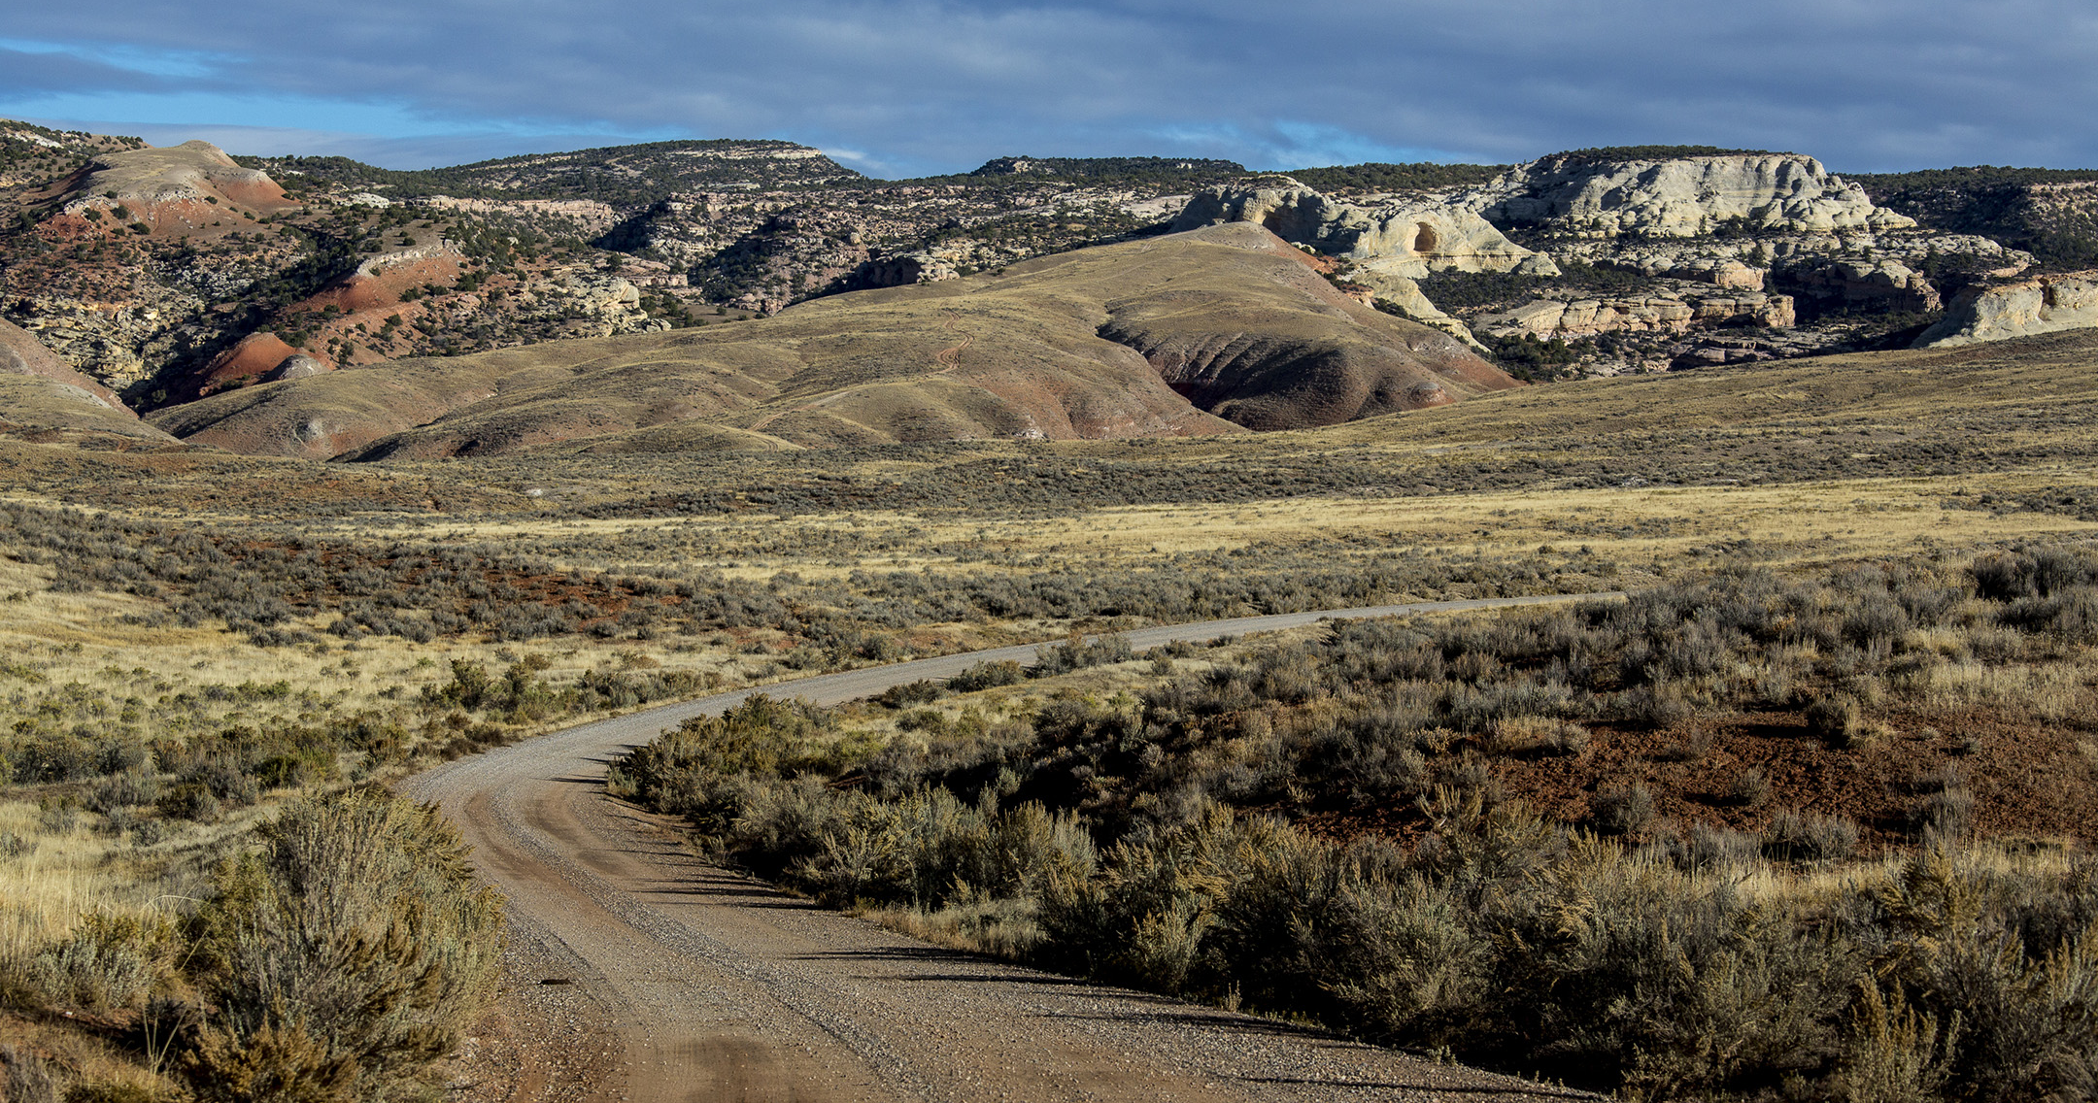
BLM Transportation Program
Rosemarie Spano 202-912-7317 rspano@blm.gov
Supporting Text

Slide 2
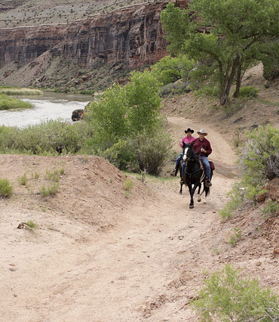
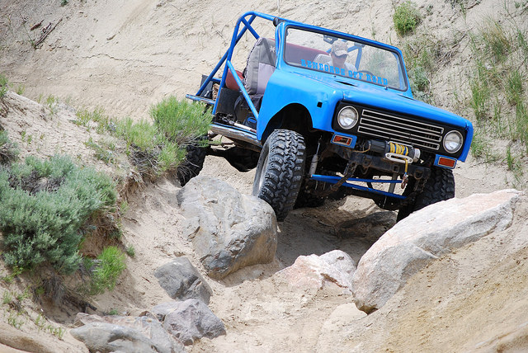
BLM Transportation Assets
45,000 miles roads
30,000 miles primitive roads
15,000 miles trails
891 bridges
654 road bridges (486 NBI)
237 trail bridges
Notes:
These are our transportation assets in our FAMS database.

Slide 3
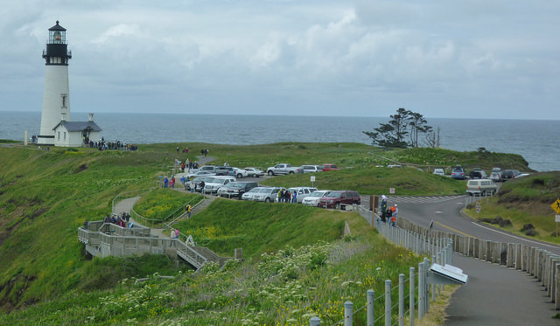
BLM FLTP Inventory
Prioritized our FLTP inventory to roads providing access to high-use recreation sites and federal economic generators as stated in the legislation
1,120 miles roads

Slide 4
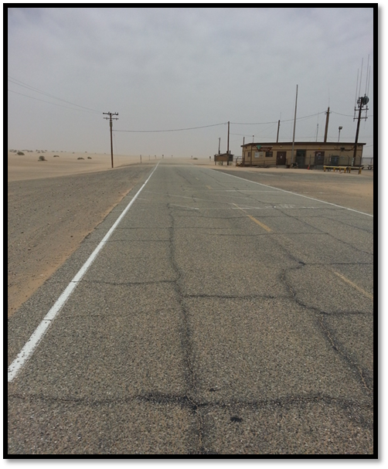
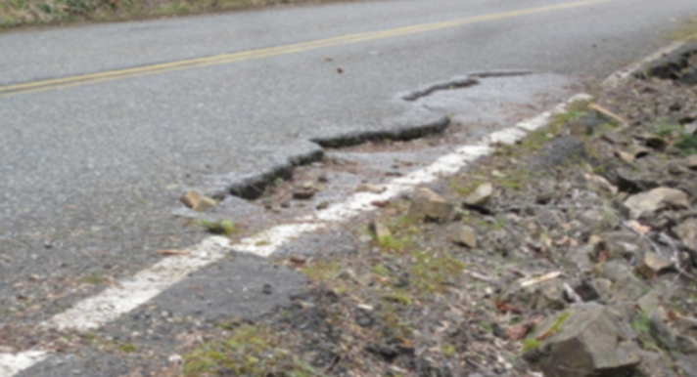
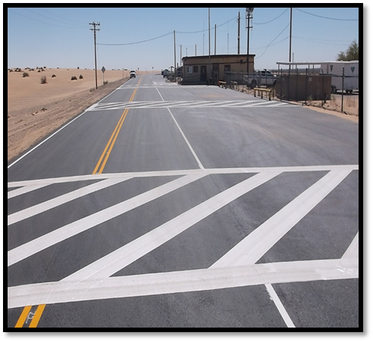
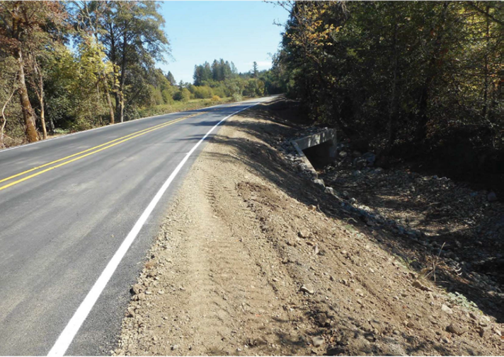
FLTP Accomplishments
$45 million… 104 miles
Safety and Design Improvements:
Widening roads
Guardrail installation
Realignments
Turnout construction
Signage/striping
Surface improvements
Drainage improvements
Notes:
The photos on the left are before and after on Cow Creek BCB in OR and on the right are before and after of Gecko Rd in Southern CA.

Slide 5
BLM Transportation Supporting Secretary Priorities
1. Conserving our Land and Water
Land use planning for public use and access
2. Generating Revenue and Utilizing Our Natural Resources
Ensure energy and economic security for America
Ensure access to mineral resources
Focus timber programs on “healthy forest” lifecycle
Manage grazing resources
3. Expanding Outdoor Recreation Access
Expanding hunting, fishing, and other recreation on DOI
5. Protecting our People and Border
Support securing our southern border
Manage wildland fire to reduce risk and improve resilience
6. Modernizing our Organization and Infrastructure
Prioritize DOI Infrastructure needs and reduce deferred maintenance backlog
Notes:
The Secretary has 6 mission areas containing 21 goals.
I have listed the goals under their respective mission areas to detail how our transportation program supports the Secretaries goals.

Slide 6
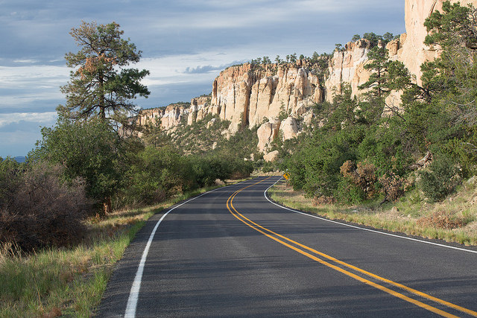
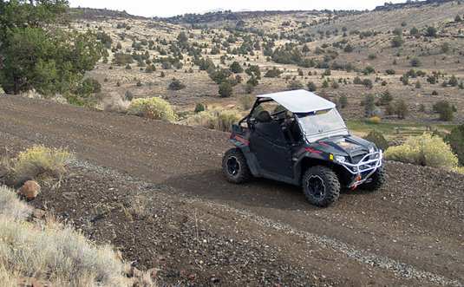
Where do 9420 funds go?
Road condition assessments
NBI bridge inspections
Asset Management
GTLF-FAMS
TTMPs
LRTPs

Slide 7
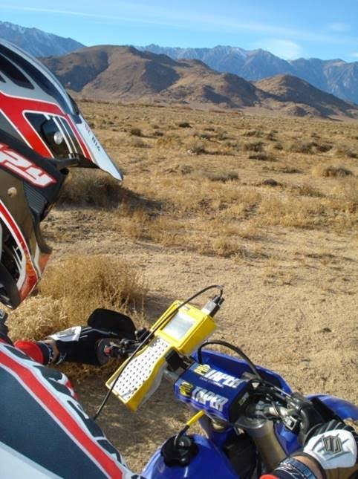
GTLF and FAMS
45,000 miles roads in FAMS
40,000 miles roads in GTLF
Working with the states to get the remaining 5,000 miles of FAMS roads linked to the correct lines in GTLF.
Updating FAMS to include geographic state feature.
Notes:
Last year we worked to merge the data from two separate databases, FAMS our Maximo asset inventory with our GTLF (Ground Transportation Linear Features) which is a GIS platform. This was done manually which was a challenge. Now we are working with out IT for opportunities to automate the communication between these two databases.

Slide 8
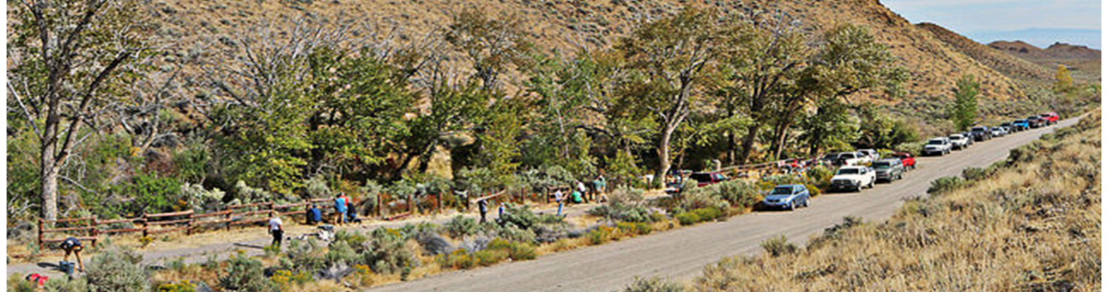
Travel & Transportation Plans
Initiating NLRTP to establish high-level planning goals based on our mission.
AK CLRTP- complete
CA, NM-AZ- on hold
OR-WA CLRTP- complete by end of FY18!

Slide 9
Transportation Challenges
Increasing demands on public lands is increasing congestion within our transportation system.
Increasing usage on our roads by various modes of transportation, including vehicles, OHVs, bicycles, pedestrians, and equestrians is resulting in the need for more multi-modal options.
Unmanaged cross-country travel on BLM has established numerous duplicative routes, increasing the need for TTMPs.
User created routes have evolved into roads which require significant funds to upgrade to engineered roads.
Historically, TTMP have had limited focus on transportation.

