Slide 1
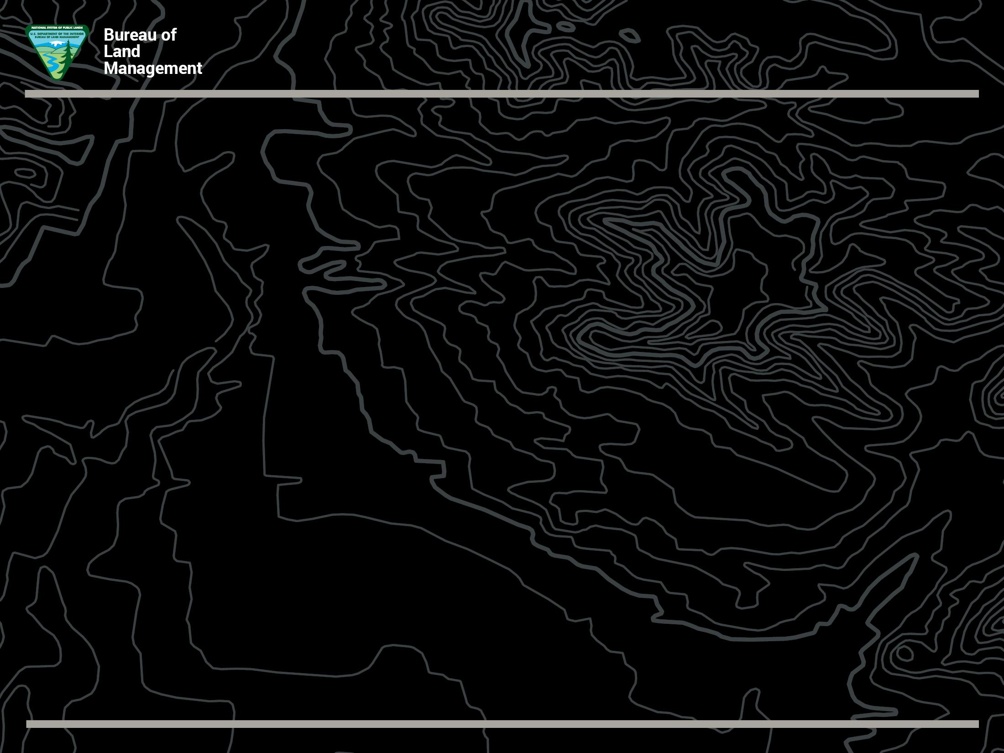
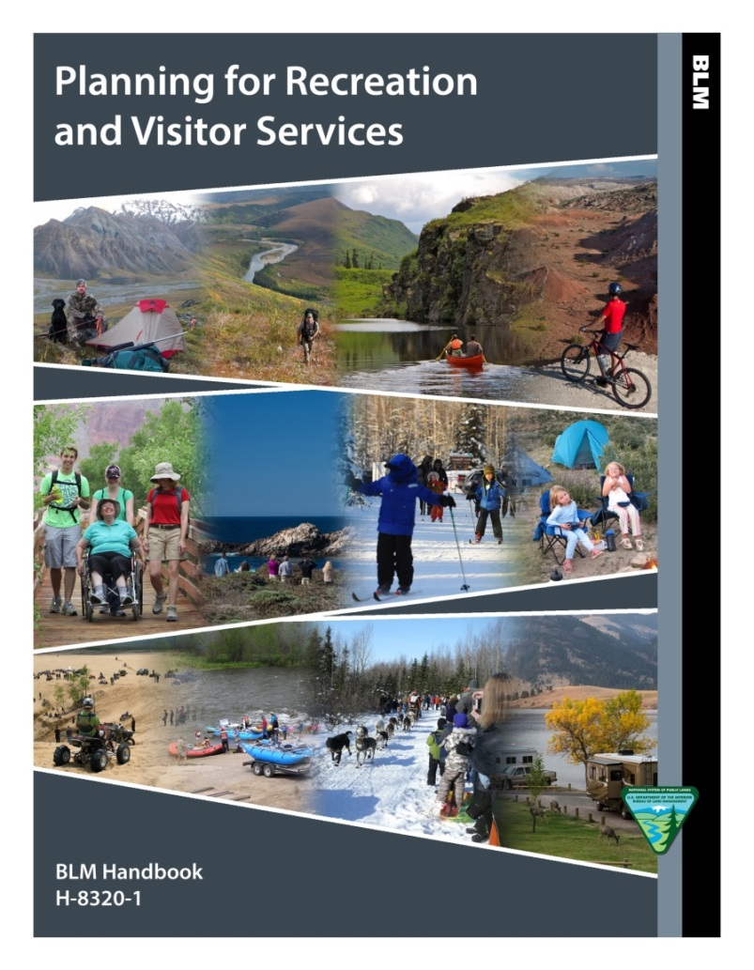
Planning for Recreation
and Visitor Services
June 7, 2018

Slide 2

Bureau of Land Management
Outcomes-Focused Management
Dorothy Morgan
Outdoor Recreation Planner
San Pedro Riparian NCA, AZ
Glenwood Spring Field Office, CO
Carlsbad Field Office, NM
Recreation and Visitor Services
WO-250
June 7, 2018

Slide 3
Part I: OFM overview and history
Part II: Data Collection Update
Part III: The State Lead’s Role
(We need your help!)

Slide 4

August 13th-17th, 2018
Salt Lake City, Utah

Slide 5
Short Course
Your Field Office

Slide 6
Confused?
BBM
OFM
FFA
QVC
???

Slide 7
Doing?
Activity
Feeling,
Thinking?
Experience
Lasting
Effects?
Outcomes

Slide 8

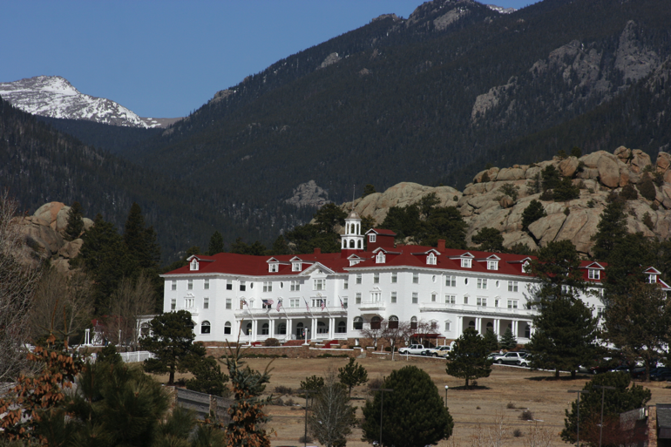
Evolution of Benefits in BLM –
1991 Benefits Workshop, Estes Park CO
“Applying Knowledge About the Benefits of Leisure” Workshop (half practitioners, half social scientists).
Requested pilot projects to initiate benefits research and planning.
BLM – Don Bruns & Grand Junction Manager and staff.

Slide 9
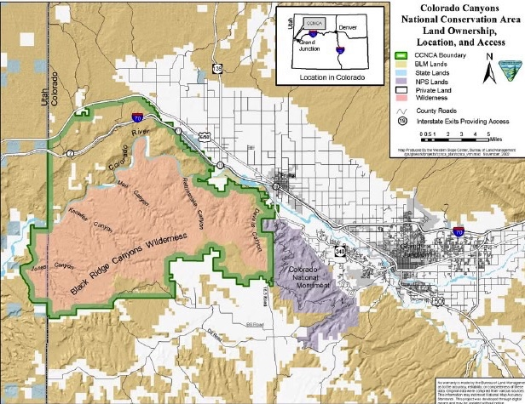
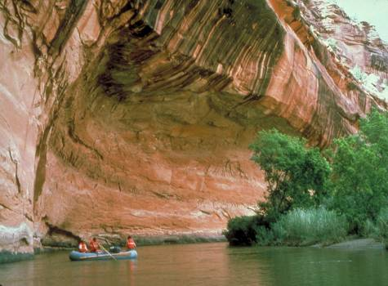
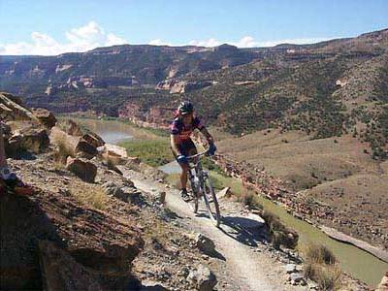
Evolution of Benefits in BLM – First Pilot Project
This first pilot :
Integrated Resource Management Plan of the Ruby Canyons/Black Ridge recreation area, 1998
(now McInnis Canyons NCA).

Slide 10
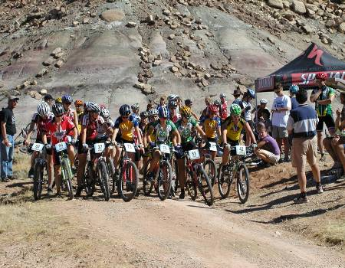
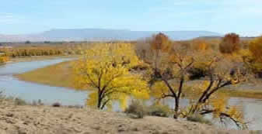
Evolution of Benefits in BLM – First Pilot Project
Personnel:
  Don Bruns (CSO)
  Field Office Staff (Brian Hopkins)
  Bev Driver, U.S. Forest Service’s Rocky Mountain Research Station
  Researchers (Dorothy Anderson, Marty Lee, and Taylor Stein)
Take a ways:
  Began BLM’s experiment with Benefits Based Management
  Resulted in a Resource Mgt. Plan (1998) with benefit based outcomes
  Fueled Driver and Bruns quest to develop a benefits based planning framework.

Slide 11
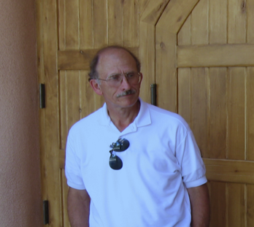
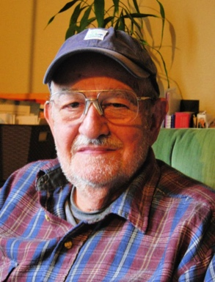
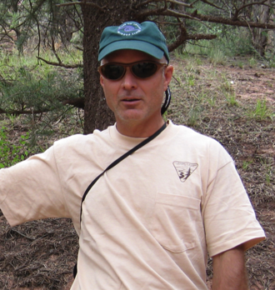
Evolution of Benefits in BLM – 1999-2006
Evolution of Benefits in BLM – First Pilot Project
Don Bruns, Bev Driver and Brian Hopkins worked to conceptually refine the BBM framework and planning process (integrate with LUP).
Late 1990’s and early 2000’s - Benefits Workshops in CO and other western states.
BBM was made policy in BLM on May 5, 2006 IM 2006-060
Revised in 2011

Slide 12

Evolution of Benefits in BLM – 1999-2006
2011 – New Manual
2014 – New Handbook
2015 – New Training
2017 – Standardized OFM Surveys and Focus Groups
2018 – OFM Comment Maps

Slide 13


Partnership with University of Alaska
Collection, Analysis, Centralized Data
Plus…
local colleges and universities near you!
Dr. Peter Fix, Associate Professor of Outdoor Recreation Management
University of Alaska Fairbanks
Dr. Tim Casey, Professor of Political Science Colorado Mesa University

Slide 14
OTHER…
OFM Focus Groups Past & Future
OFM Comments
Future
OFM Surveys
Past & Future
Consistent Data
Efficient Analysis
Centralized OFM Data Base
Notes:
Big picture data collection - comparisons across BLM sites, activities, settings (using standard questions so data can be compared over time).

Slide 15

National meetings & reports
28,000 visitors from
72 sites show
78% of visitors were seeking to improve their heath.
89% were able to attain that outcome.
Society
Outdoor
Recreation
Professionals
Notes:
Coordinate with NTC and interdisciplinary teams working on LUPs in their states to offer the Planning for Recreation and Visitor Services Short Course

Slide 16
Part III: The State Lead’s Role
(We need your help!)
What LUPs are in progress in your state right now?
Are there any areas where we should be collecting data in support of current or upcoming LUPs?
Where could we offer the new Short Course?
Have you invited a member of the Planning for R&VS teaching cadre to your statewide recreation planner meeting?
What issues do you look for when reviewing LUPs?
Notes:
Coordinate with NTC and interdisciplinary teams working on LUPs in their states to offer the Planning for Recreation and Visitor Services Short Course

Slide 17
What are some of the most common mistakes made in LUPs?
LUP Decisions
Vs
Implementation Decisions

Slide 18
Land Use Plan Decisions.
Broad-scale decisions
Guide future land management actions and
Subsequent site-specific implementation decisions.
Two categories:
1. Desired outcomes (goals and objectives)
2. Allowable uses and actions to achieve outcomes.
Proposed land use plan decisions are protestable to the BLM Director but are not reviewable by the Office of Hearings and Appeals.
Implementation Decisions.
BLM’s final approval allowing on-the-ground actions to proceed.
Require site-specific planning and NEPA analysis.
They may be incorporated into implementation plans (activity or project plans) or may exist as stand-alone decisions.
Where implementation decisions are made as part of the land use planning process, they are still subject to the appeals process or other administrative review as prescribed by specific resource program regulations after the BLM resolves the protests to land use plan decisions and makes a decision to adopt or amend the RMP

Slide 19
The BLM may use a single land use planning/NEPA process to make both land use plan and implementation decisions, provided…
both types of decisions are adequately addressed with the appropriate level of NEPA analysis.
Notes:
When describing the protest procedures for proposed RMPs, the BLM must make clear which decisions are land use plan decisions and thus protestable under the planning regulations and which decisions are implementation decisions that are not protestable.
At the decision-making stage, the BLM can separate the two categories of decisions into two decision documents, one adopting the RMP (or amendment) and the other approving the implementation decisions; or the BLM may use a single decision document that adopts the RMP (or amendment) and approves the implementation actions.
If a single decision document is used, the BLM must clearly distinguish the land use plan decisions from the implementation decisions and describe the administrative remedies for both.
Making implementation decisions as part of the land use planning process and analyzing them concurrently with land use plan decisions does not change their administrative remedies or the timing of those remedies.

Slide 20

Streamlining!
Definition:
make (an organization or system) more efficient and effective by employing faster or simpler working methods.
Notes:
However, new streamlining guidance will very likely change this.

Slide 21
Streamlining!
Recommendation:
Make LUP decisions in your LUP.
Include BMPs and Implementation Strategies in your Recreation Appendix.

Slide 22
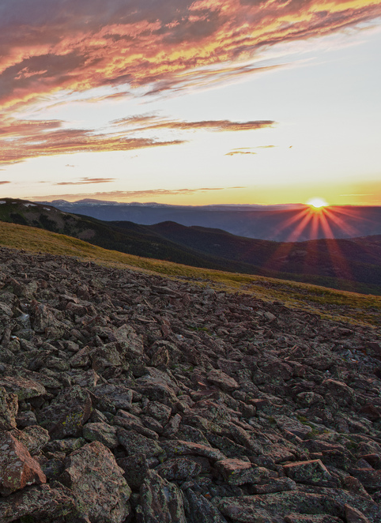
Required LUP Decisions
for R&VS:
Designate recreation management areas (RMAs).
Establish R&VS objectives for each RMA.
Identify LUP-level management actions and allowable uses for each RMA.
Notes:
There are 3 LUP requirements for R&VS:
Designate recreation management areas – 2 types, SRMAs, ERMAs
Establish R&VS objectives for each RMA. – There is more to this than you may think, so we’ll be going over this in more detail.
Identify LUP-level management actions and allowable uses for each RMA. - Many decisions related to R&VS are NOT LUP-level decisions, put these in the Recreation Appendix.

Slide 23
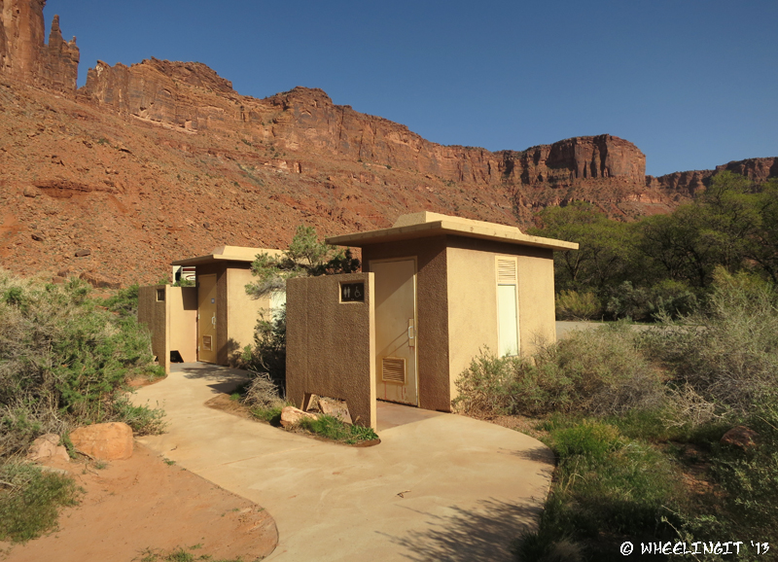
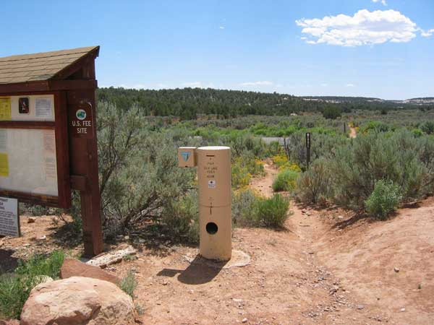
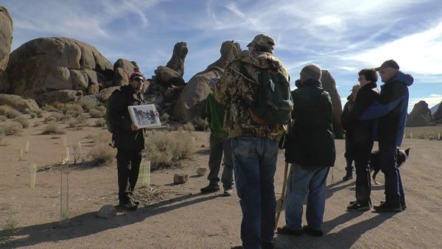
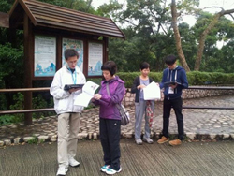
Management
Administration
Information and Education
Monitoring
Notes:
There are four categories of Implementation Decisions
Management
Administration
Information and Education
Monitoring

Slide 24

Implementation Decisions: Management
Commitment of resources
Services
Facilities
Developed sites
Roads and trails
Notes:
Management. Recreation management actions, such as commitment of resources, services to be offered to visitors, and/or the development and provision of facilities (e.g. developed recreation sites, roads and trails).

Slide 25
Implementation Decisions: Administration
Regulatory actions including:
Fiscal accountability systems
Allocation systems
Use restrictions
Partnerships
Business plans
Data management
Permits
Fees
Notes:
Administration includes regulatory actions including:
Allocation systems
Permits
Fees
Use restrictions
Partnership agreements
Business plans
Fiscal accountability systems
Data management protocols

Slide 26
Implementation Decisions: Information and Education
Environmental education
Maps or brochures
Outreach efforts
Websites
Events
Interpretation
Signing
Notes:
Information and Education includes:
Maps or brochures
Websites
Outreach efforts
Events
Interpretation
Environmental education
Signing

Slide 27
Implementation Decisions: Monitoring
Recreation setting characteristics
OFM objectives
Standards and indicators.
Visitor use and use patterns
Resource impacts
Visitor satisfaction
Notes:
Monitoring includes:
- Visitor use and use patterns
- Recreation caused resource impacts
- Visitor satisfaction
Monitoring may measure the effectiveness or attainment of:
- Outcomes-focused objectives
- Recreation setting characteristics
- Standards and indicators.

Slide 28
What’s the problem?
Prohibit bolts on climbing routes in the Soaring Spires ERMA.
Prohibit camping in the Desert Hills SRMA, outside of designated sites.
Close campsites if there is a public
health and safety issue or resource concern.

Slide 29
What’s the problem?
Objective: Manage the Blue Lake SRMA so that visitors report an average 4.0 realization of the targeted experiences and benefit outcome stated in the following table…

Slide 30
What’s the problem?
Activities: Driving OHVs, hiking, horseback riding, picnicking, fishing, wildlife viewing, rock climbing.
Experiences:
Enjoying an escape from crowds and people
Learning outdoor skills; Enjoying getting physical exercise
Testing your endurance; Sensory experiences of a landscape
Benefits:
Restored mind from unwanted stress
Improved outdoor recreation skills
Improved physical fitness and mental health
Increased awareness and protection of natural landscapes.

Slide 31
What’s the problem?
Activities: Trail-based non-motorized recreation activities
Experiences:
Enjoying an escape from crowds and people
Learning outdoor skills; Enjoying getting physical exercise
Testing your endurance; Sensory experiences of a landscape
Benefits:
Restored mind from unwanted stress
Improved outdoor recreation skills
Improved physical fitness and mental health
Increased awareness and protection of natural landscapes.

Slide 32
What’s the problem?
Issue SRPs as a discretionary action as a means to: help meet management objectives, provide opportunities for economic activity, facilitate recreational use of the public lands, direct visitor use,
protect recreational and natural resources, and provide for the health and safety of visitors. Priority would be given to community oriented activities.

Slide 33
What’s the problem?
Work to provide access to public land for hunting, fishing, and other dispersed recreation activities in balance with other resource considerations.

Slide 34
What’s the problem?
Within the Red River SRMA:
Prohibit recreational target shooting on 5,000 acres.
Allow recreational target shooting on 10,000 acres.

Slide 35
Common LUP Issues:
Implementation Decisions
Recreation Goals and Objectives – not enough, or too many.
SRMA and ERMA objectives,
Statements of policy or BMPs / non-decisions.
Formatting by SRMA instead of by LUP decision.
Restrictions on shooting sports (acres, location, analysis, Roundtable)

Slide 36
Why is Planning Important?
WHY???
eBikes?
Rec.gov reservations?
Airbnb SRPs?
Fees?

Slide 37
What can you do?
Take the Planning for R&VS Course
Host the Short Course in Your State
Invite a Planning for R&VS cadre member to your state recreation meetings.
Get ahead of the PLAN!
Mustang Twilight Ride, Nevada.
37
Notes:
Questions?

Slide 38
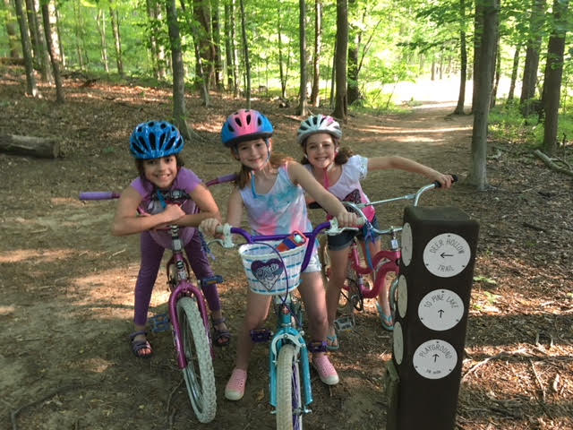
Questions/
Discussion
Mustang Twilight Ride, Nevada.
38
Notes:
Questions?

