Slide 1
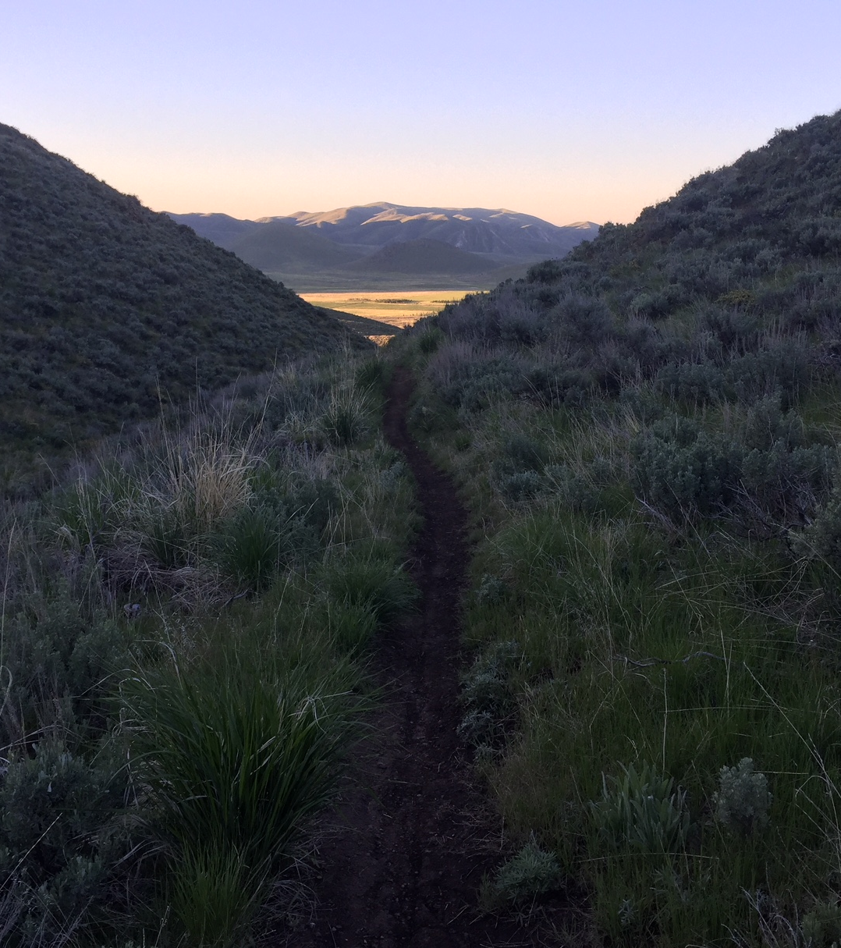
Outcomes Focused Management Framework
Supporting Text
John Kurtz,
Shoshone Field Office Outdoor Recreation Planner

Slide 2
Session Objective – Participants will be valuable resources to field recreation planners when designing/planning and analyzing impacts to any action - including recreation decisions on ebikes, SRPs, making sites reserveable on rec.gov, charging fees etc; as well as actions related to oil and gas, ROWs, TTM, hunting, fishing, shooting sports access and increasing recreation opportunities.

Slide 3
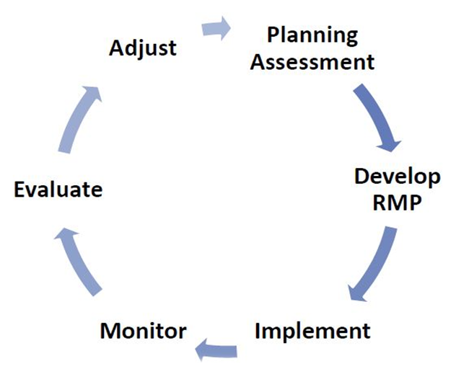
Notes:
Ask:
How much time is spent in these phases of planning at a field office?
Years, decades!
Where do Secretarial orders fall into this cycle? : evaluate and adjust….migration corridors, increase recreation opportunities, take kids outside

Slide 4
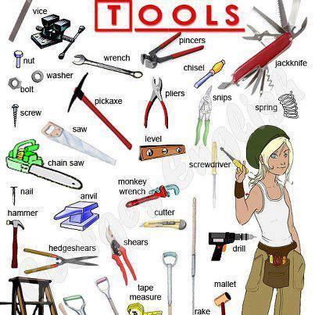
What tools do are at our disposal?
What tool(s) are going to give you the information you need?
Notes:
Using BLM’s recreation planning framework (outcomes focused framework) and recreation setting characteristics to assist with implementation actions and analysis

Slide 5
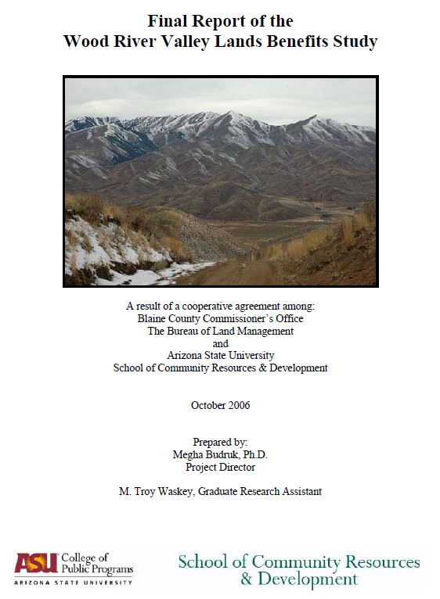
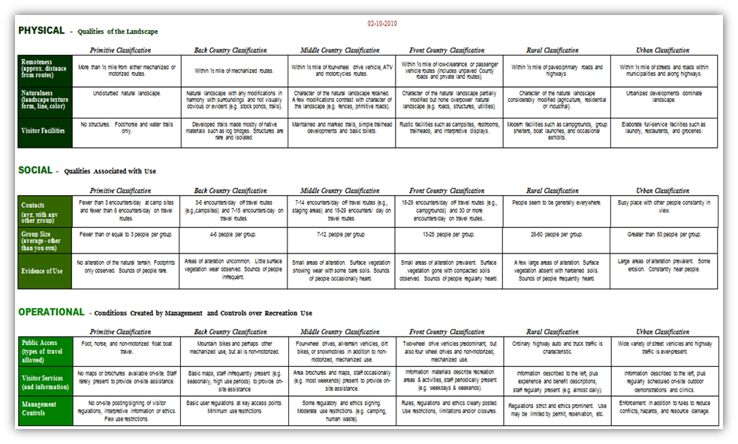
Outcomes Data
Settings Data
Notes:
What tools are available to us during these phases of planning?
Outcomes and RSCs

Slide 6
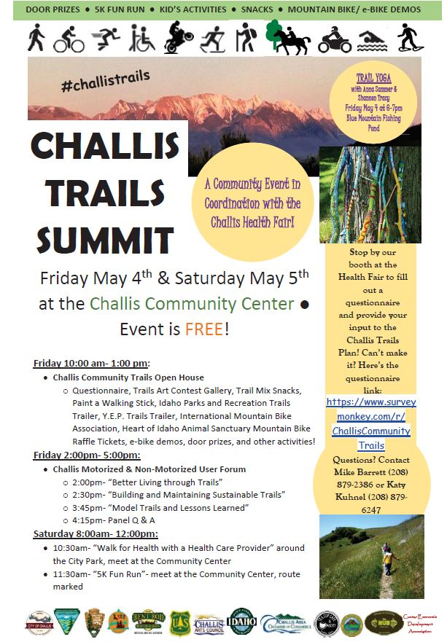
Outcomes Data
Notes:
Latest example/opportunity to collect some OFM data. Challis FO partnered with University of Idaho and the City of Challis to collect some Outcome data.

Slide 7
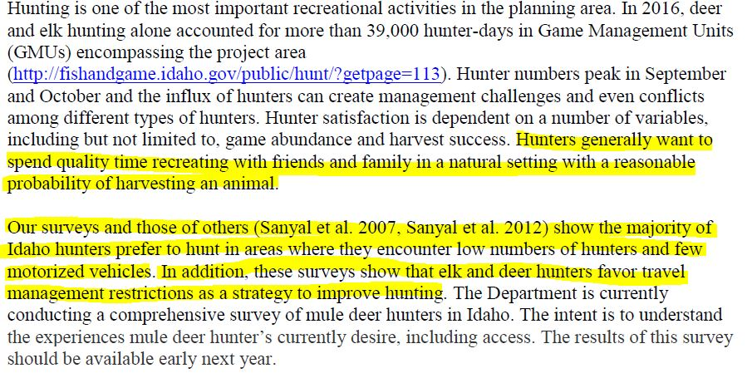
Outcomes
Desired Settings
Notes:
IDFG comment letter on the Wood River Valley TMP.
1st highlight: Identified general recreation experiences and benefits
2nd highlight: Desired Physical setting and Operational setting.

Slide 8
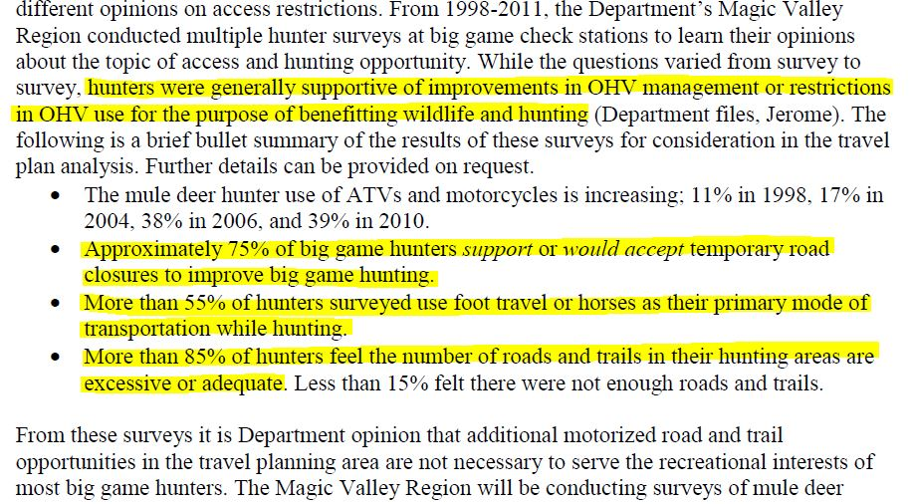
Operational Settings
Activity and Physical Settings
Notes:
1st bullet: IDFG data to support changes to Operational Settings,
2nd and 3rd bullets: more info about the hunting “activity” and desired physical settings.
Discuss how survey’s were conducted…….incorporate OFM survey questions into IDFG survey……….look into these opportunities.
Is there an opportunity to hang out a a game check station and conduct some informal interviews to better understand the activity, experiences, benefits and settings? This is how rec planners increase their professional knowledge and become better subject matter experts.

Slide 9
Secretarial Order 3356, Hunting, Fishing, Recreational Shooting, and Wildlife Conservation Opportunities and Coordination with States, Tribes, and Territories. This section requires the Bureau of Land Management (BLM) to "incorporate analysis of the impacts of Federal land and water management actions on hunting, fishing, and recreational shooting access in planning and decision making.“
Notes:
Based on the previous IDFG requests which alternative best supports their request? AND which alternative best supports SO 3356?
Alt. C : Why...Provides the most acres to support non-motorized hunting opportunities

Slide 10
Notes:
Based on the previous IDFG requests which alternative best supports their request? AND which alternative best supports SO 3356?
Alt. C : Why...Provides the most acres to support non-motorized hunting opportunities

Slide 11
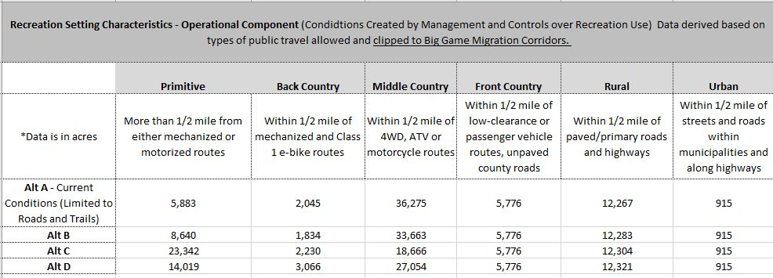
Notes:
This table depicts ORSCs clipped to Big Game Migration corridors.
Which alternative best supports the Secretarial Order 3362?

Slide 12
These data (OFM and Settings) can be used for:
Existing conditions and analysis (EA Chapter 3 & 4)
FONSI (include as a beneficial impact) and
Decision
Notes:
Based on the previous IDFG requests which alternative best supports their request?
Alt. C : Why...Provides the most acres to support non-motorized hunting opportunities.

Slide 13
Take home message, ……….use the tools we have effectively and efficiently no matter what stage of planning you are in!
Notes:
Based on the previous IDFG requests which alternative best supports their request?
Alt. C : Why...Provides the most acres to support non-motorized hunting opportunities AND

Slide 14
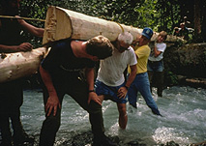
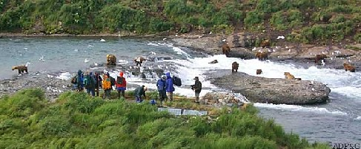
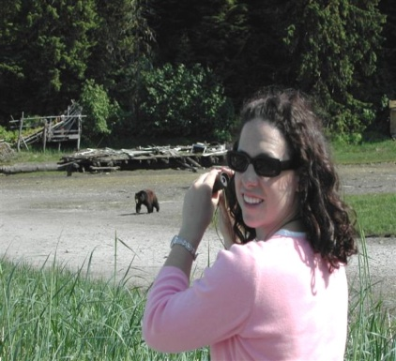
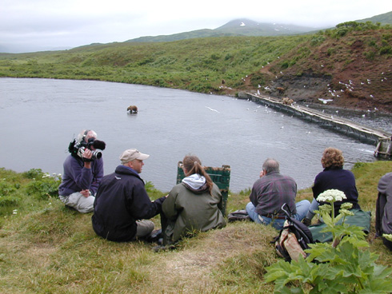
Cubie Wallpaper?
Management,
Administration, Marketing & Monitoring Actions
Recreation Settings
Physical, Social & Administrative
Attributes
Recreation Opportunities
Hiking
Wildlife Viewing
Interpretation Program
Experiences
Enjoying wildlife viewing
Personal Benefits
Improved environmental (wildlife) awareness
Community Benefits
Improved community identify
Environmental Benefits
Increased wildlife stewardship & preservation
Economic Benefits
Increased local economic stability
Physical Setting
Level of:
Remoteness - high
Naturalness - high
Facilities - low
Social Setting
Level of:
Contacts - low
Group Size - small
Evidence of Use - low
Operational Setting
Level of:
Motorized Use - none
Visitor Services – mod.
Mgmt. Controls - high
Management
Management Actions
Trail Building
Signing
Visitor Patrols
Administration
Allowable Uses
Visitor Limits
Budget Duties
Marketing / Education
Naturalist Program
Brochures
Monitoring
LAC
Interact with
Produce
Facilitate
Handbook Page I-2
Notes:
Tools we have help BLM produce recreation opportunities. It is important to learn from our customers about their recreation opportunities (experiences and benefits) so BLM can incorporate supportive management actions, to influence/modify settings which in turn produce quality recreation opportunities.

Slide 15
Cubie Wallpaper?
Notes:
Tools within the R&VS program can and should be used when dealing with issues within whatever quadrant you are in at the moment. For this to happen they must always be at the forefront of your mind.

Slide 16
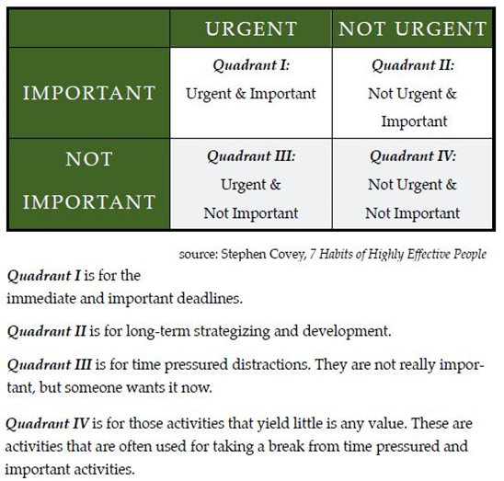
Notes:
Tools within the R&VS program can and should be used when dealing with issues within whatever quadrant you are in at the moment. For this to happen they must always be at the forefront of your mind.

Slide 17
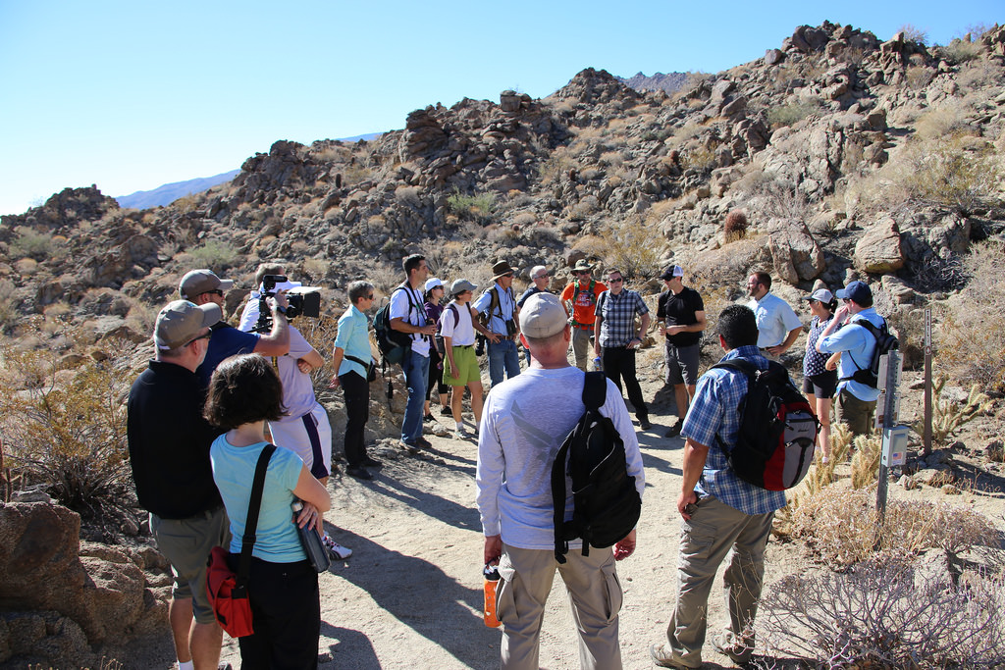
Questions

