Slide 1
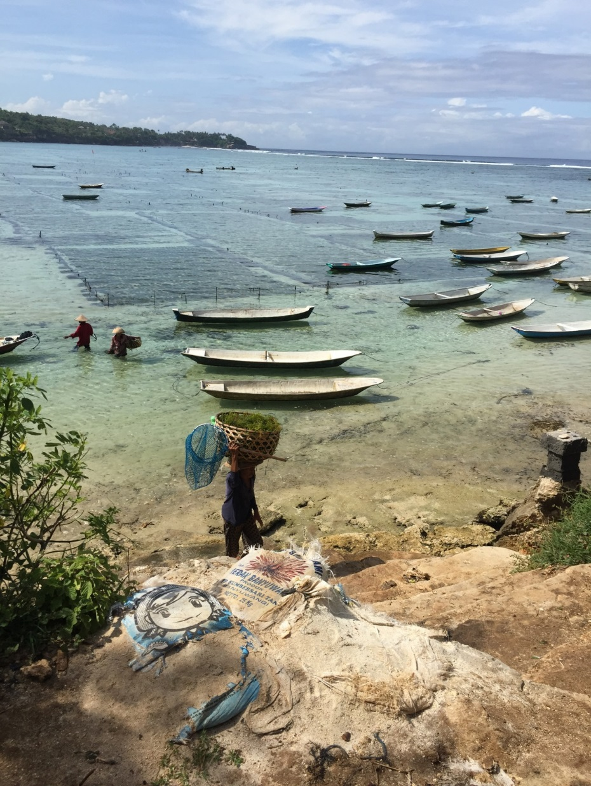
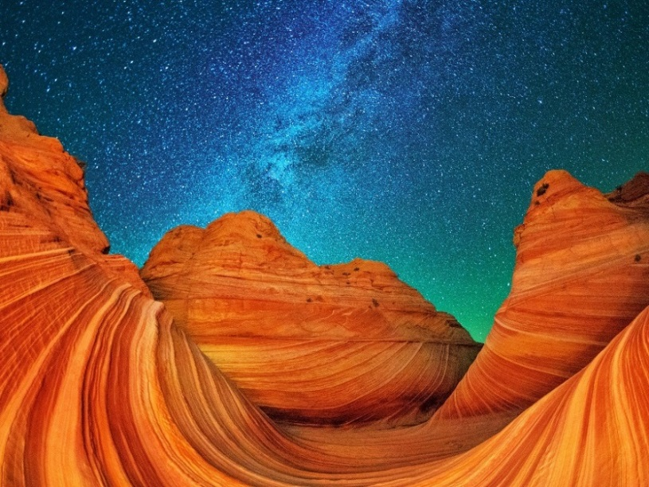
Notes:
.

Slide 2

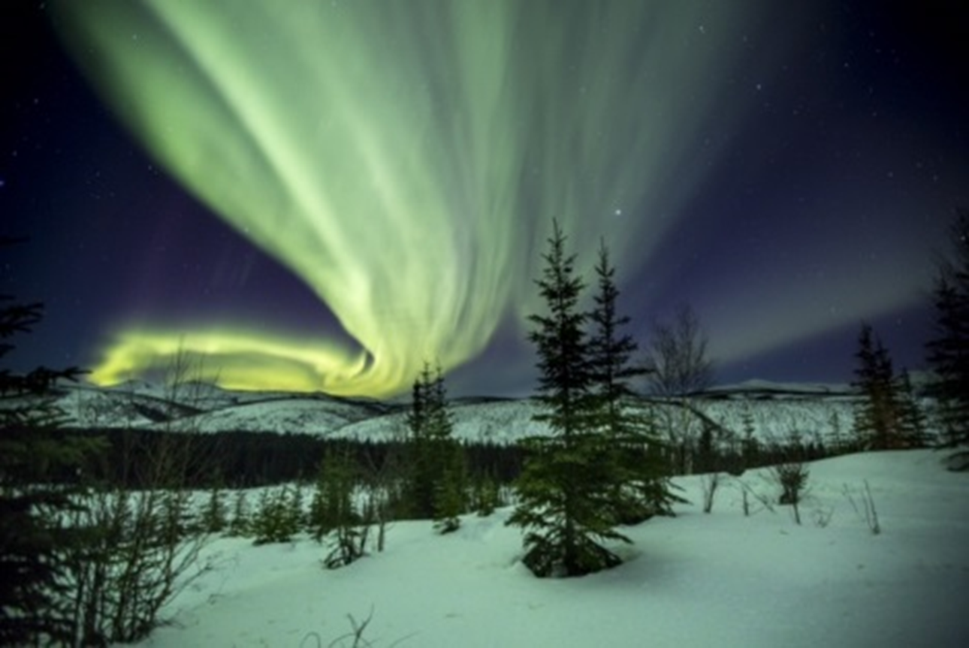
BLM Tourism & Community Service Program
ELT October 2104

Slide 3
MA Outdoor Recreation Planning
Inventoried Northern NM for Wilderness Potential & Participated 5 World Wilderness Congresses
Field Office Program Lead Wilderness, Recreation, OHVs, Forestry
Supervisor Multi-Resource Staff FO
EIS/RMP Manager for El Malpais NCA (BLM & NPS)
Post Graduate UNM Anderson School of Management
Manager Environmental Consultant - 9 years
NM State Lead Lead Wilderness, Recreation, OHV, NLCS
WO 200 - Recreation, Tourism Program Lead , Planning
WO 400- National Program Lead Tourism & Community Assistance
ITAP Indonesia- 2 details
Cultural Heritage Tourism Certification-International Tourism Department GWU
National Geotourism Council
National Lewis & Clark Geotourism Advisory Council

Slide 4
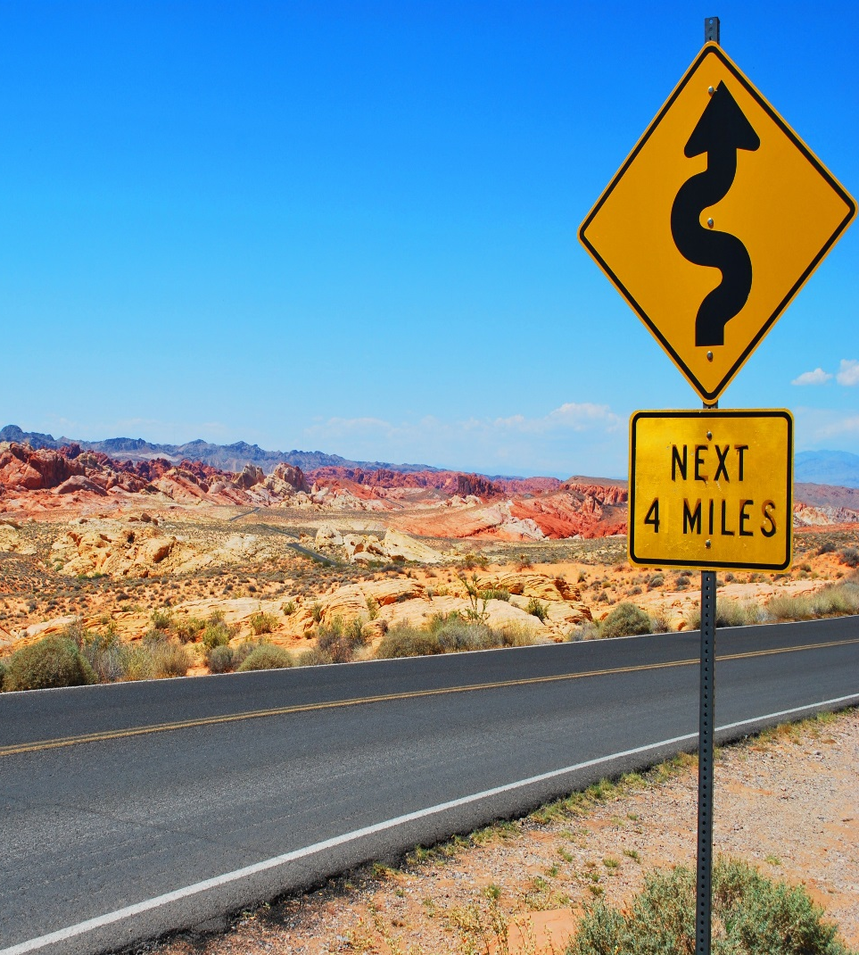
Where is This Going?
What is Travel and Tourism?
The Federal Government’s Role?
The BLM’s Role?
What is the BLM Travel and Tourism Action Plan?
How is this relevant to my work?
Will it help me get things done?
What happens next?

Slide 5

Tourist - one person that travels 50 miles or more from home (one way)

Slide 6

Travel and Tourism Industry
Promotes, advocates, informs, markets and brands
Social Media pros
Project visitor trends and behaviors
Dominated by small business
Measures and records economic, social & cultural benefits
Partner to achieve results
Structured from local to international
Highly Diverse
Strive to create connections between visitor and destination
Rediscovered U.S. Great Outdoors natural and cultural attractions
Notes:
A service Industry

Slide 7
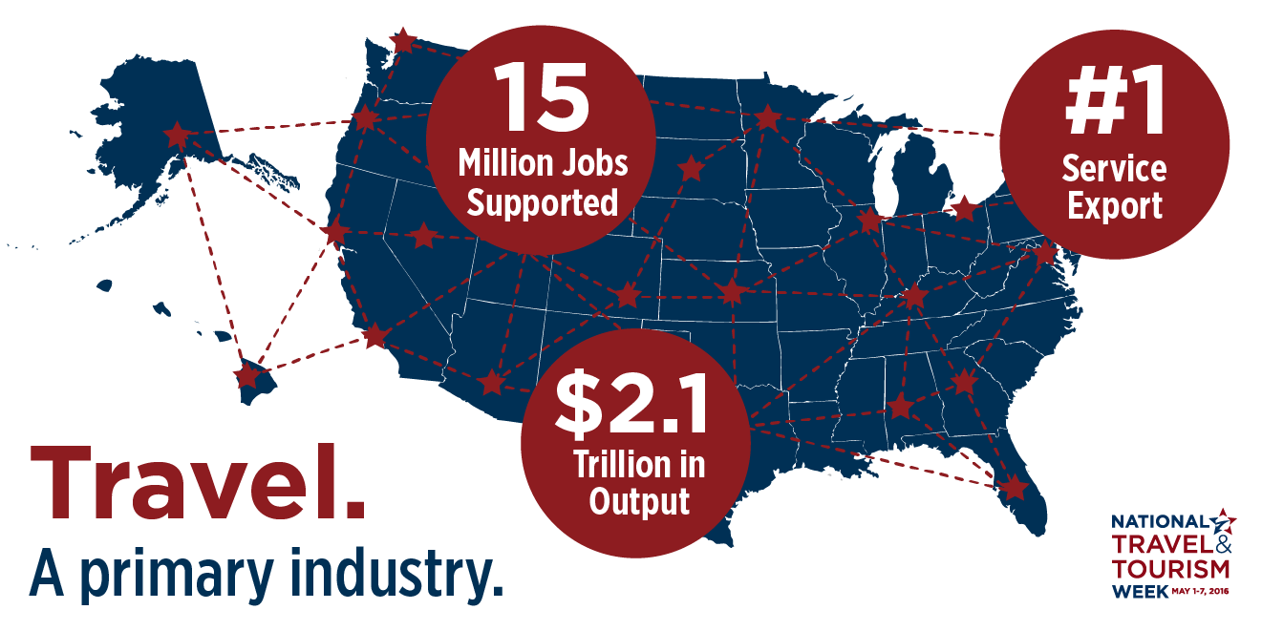
Notes:
Use “Hide-Slide” if you don’t want to use this.

Slide 8
Why Travel & Tourism Matters: 2.7% GDP
State | Spending | Payroll | Jobs | Tax Receipts
Arizona | $16.6 Billion | $4.6 Billion | 160,030 | $2.3 Billion
California | $116 Billion | $27.2 Billion | 909,830 | $ 17.2 Billion
Colorado | $16.7 Billion | $4.1 Billion | 153,060 | $2.9 Billion
Florida | $78.7 Billion | $21.2 Billion | 826,210 | $11.5 Million
Idaho | $4.2 Billion | $549.7 Million | 25,590 | $549.5 Million
New Mexico | $6.6 Billion | $1.2 Billion | 58,480 | $822.9 Million
Nevada | $32.0 Billion | $9.6 Billion | 320,760 | $4.4 Billion
Montana | $4.0 Billion | $594.9 Million | 31,370 | $365.7 Million
Oregon | $9.7 Billion | $ 2.0 Billion | 82,660 | $1.3 Billion
Utah | $7.5 Billion | $2.0 Billion | 75,370 | $1.2 Billion
Washington | $14.5 Billion | $3.1 Billion | $110,470 | 2.2 Billion
 |  |  |  | Domestic and International Visits - 2013
Notes:
BLM States’ travel and tourism economic impact summary
Source: U.S. Travel Assoc.

Slide 9
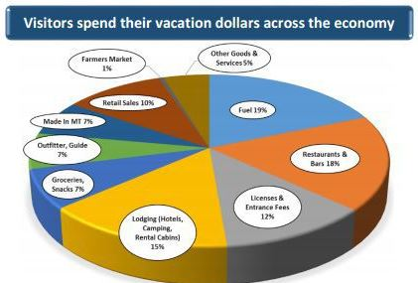
Montana’s Travel Industry
Travel and Recreation by Visitors in 2016
12.3 million visitors
Generated:
52,630 jobs
$4.8 Billion in Outputs
$193.8 Million in Sate & Local Taxes

Slide 10
Direct Spending
Domestic & International
$718.4 Billion in 2017
$2.8 Billion/day
$118.2 Million/hour
$2.0 Million/minute
$32,800/second
Generated 112.3 Billion in Tax Revenue

Slide 11
What Visitors?
ELT October 2104

Slide 12
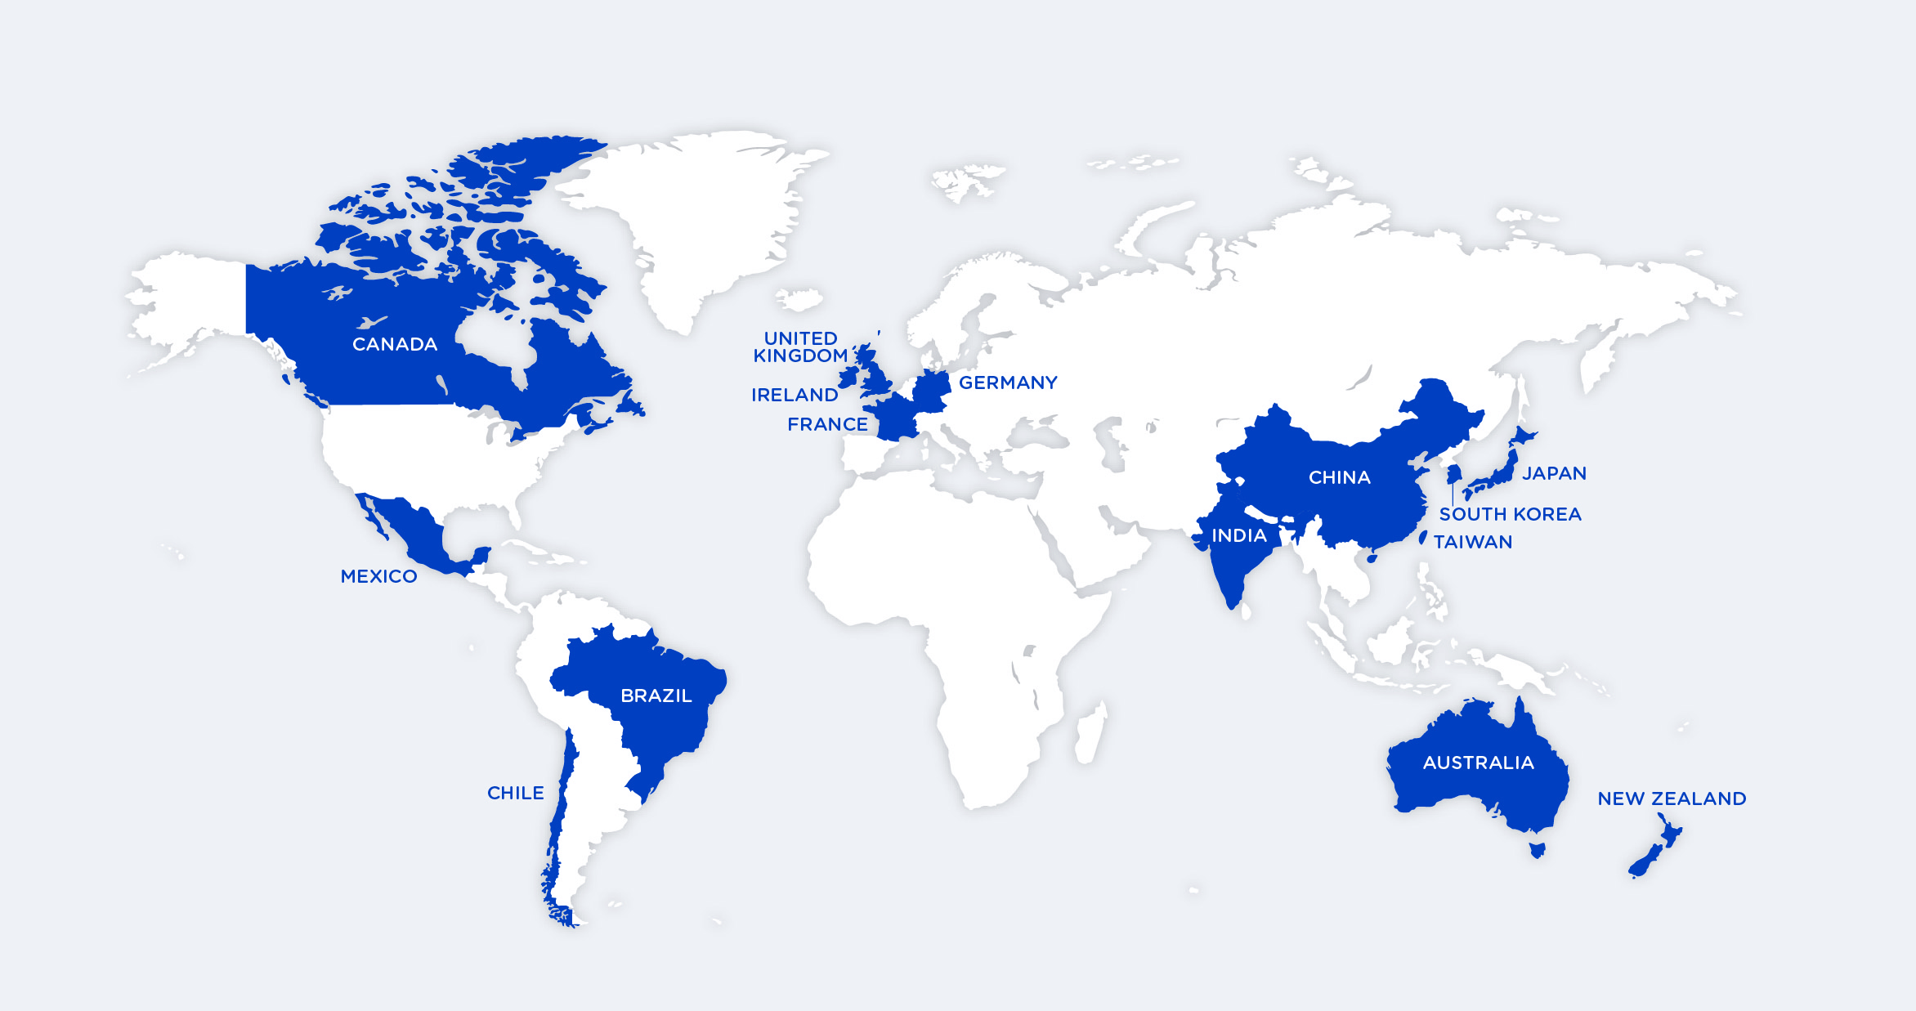
Who’s Coming to Visit?
14 markets that generate 85% of inbound travelers to the USA

Slide 13
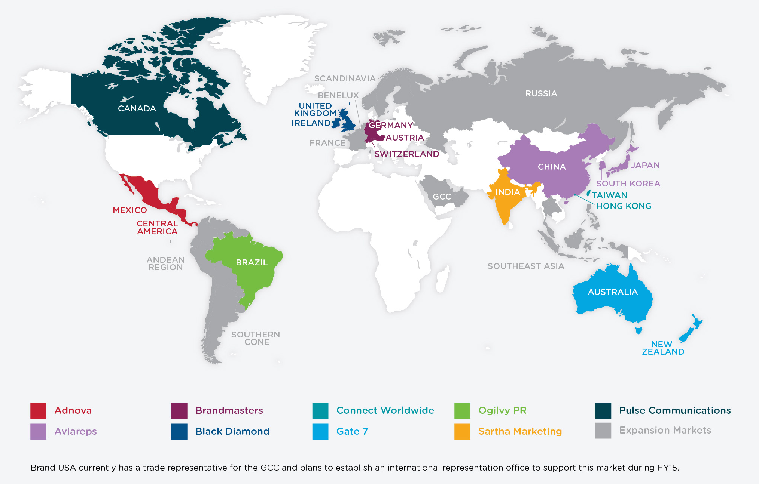
U.S. International Representation:
13 Offices Covering 21 Markets, Expanding to 25 Markets
Notes:
Growth

Slide 14
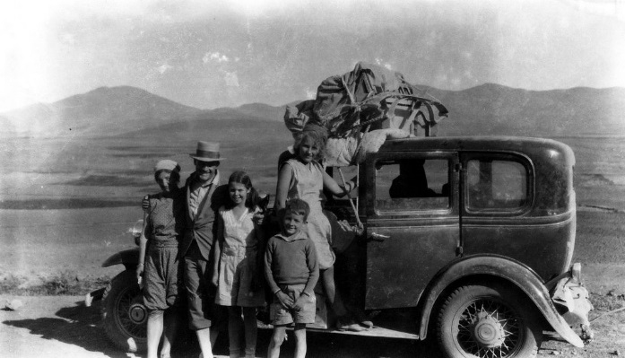
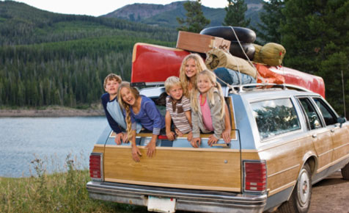

Domestic Travel & Tourism
U.S residents took 1.7 billion leisure trips in 2014
Three 0ut of four domestic trips taken for leisure purposes (78%)
U.S. Road-trips on the rise
Notes:
An American Tradition

Slide 15
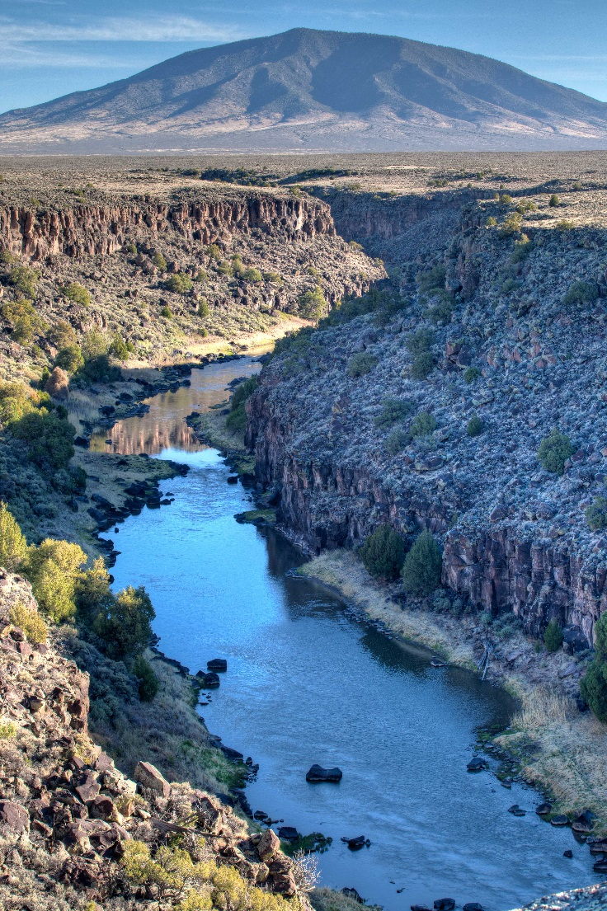
Domestic Travel & Tourism Jobs
Travel and Tourism
One of the top 10 industries in 49 States & DC
Generates 14.8 million jobs
7.9 million jobs direct to travel industry
6.9 million jobs indirect to related industries
Notes:
Site Taos Brewery & Pub 5 min. from RIO Grande and its growth etc.

Slide 16

What do we really know about who’s coming? What they want?
Do we plan………
or do we just react?

Slide 17
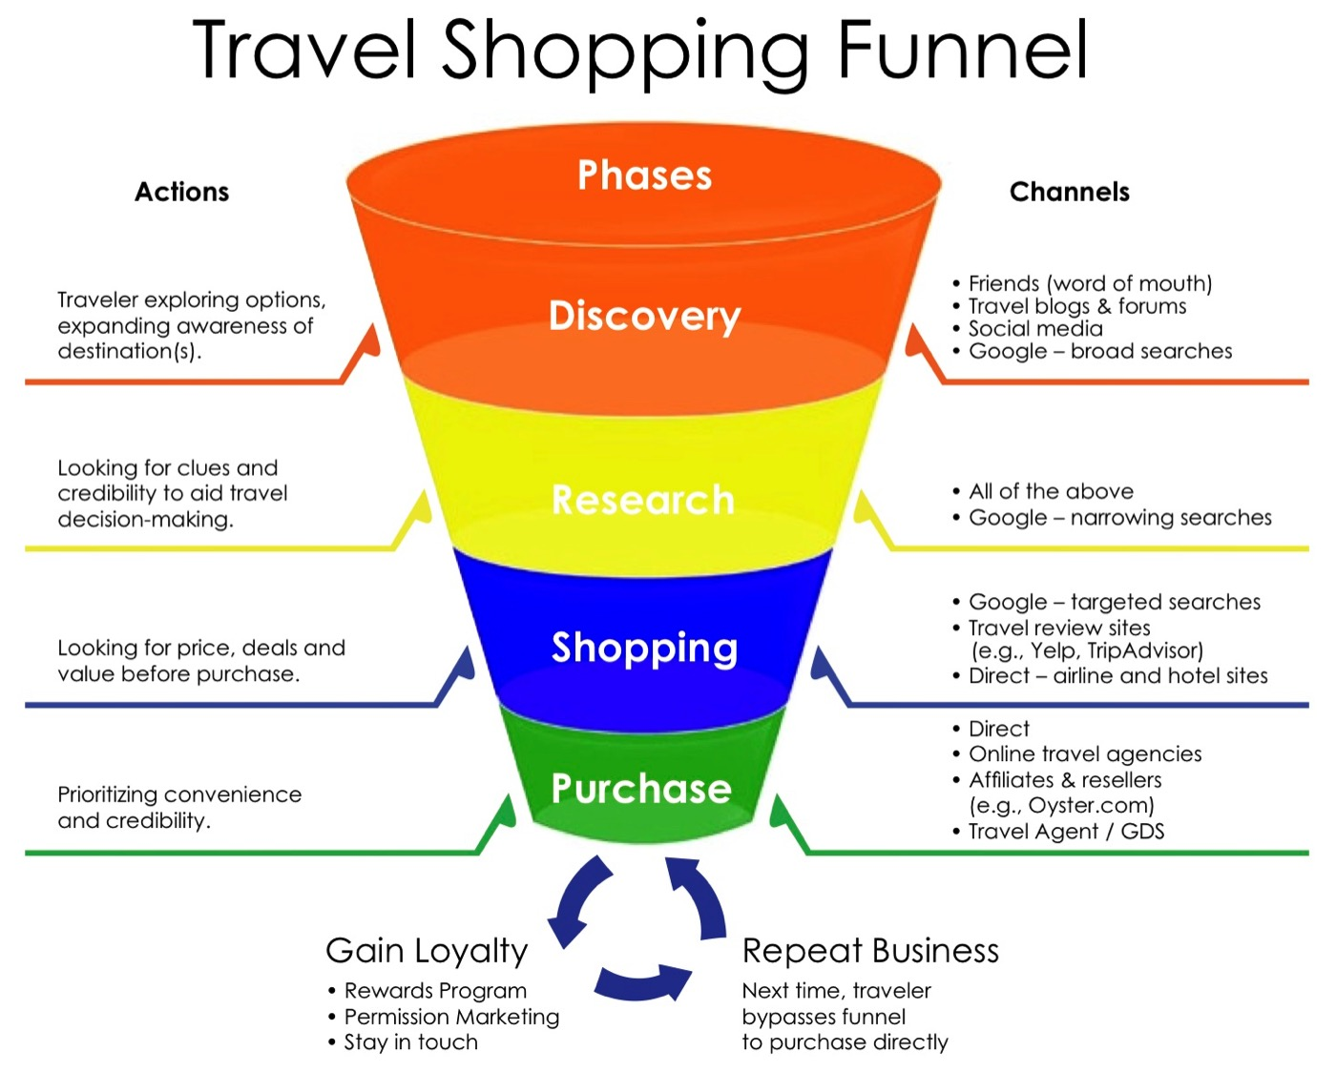
Image 1 source Ulti-Max Travel

Slide 18






















Social Networks Timeline
Courtesy of MediaCom
Launches:
Foursquare
Seina Weibo
WhatsApp
Facebook Launches
Display Ads
Messenger Ads
FB IPO
MySpace Launches
Twitter
IPO
Twitter Launches
FB buys Instagram
2002
2003
2004
2005
2006
2007
2008
2009
2010
2011
2012
2013
2014
2015
2016
Tumblr Launches
Timeline
LinkedIn Launches
Orkut Launches
ello Launch
Peach Launches
Pinterest Launches
Instagram Launches
KakaoTalk Launches
Twitter Ads Launch
WeChat Launches
G+ Launches
Snapchat Launches
2010
2011
Messenger Launches
LinkedIn IPO
Yahoo buys Tumblr
Kik Launches
Social Network Movie
Line Launches

Slide 19
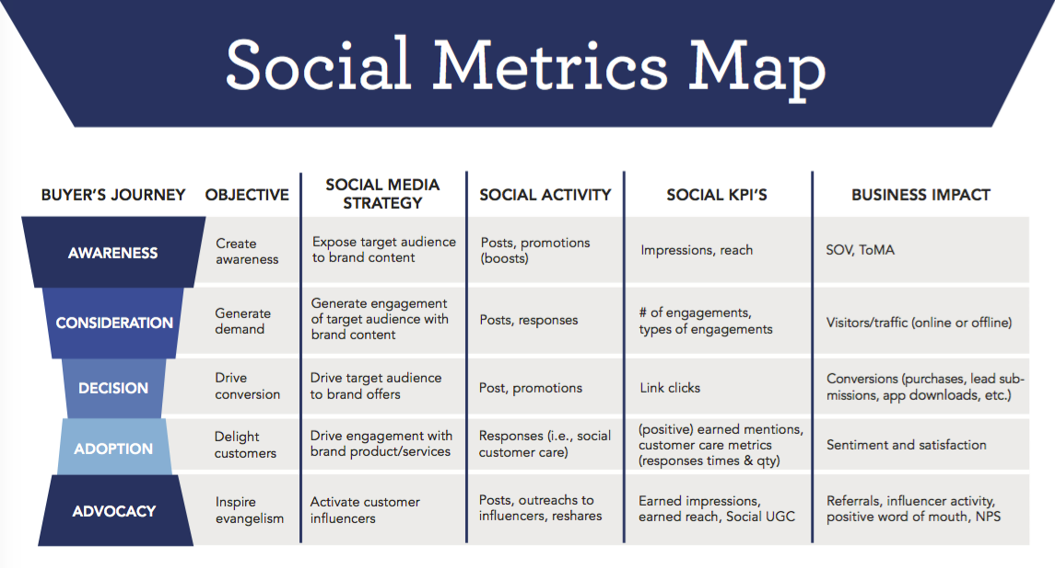
Defining Success
Source Simply Measured

Slide 20
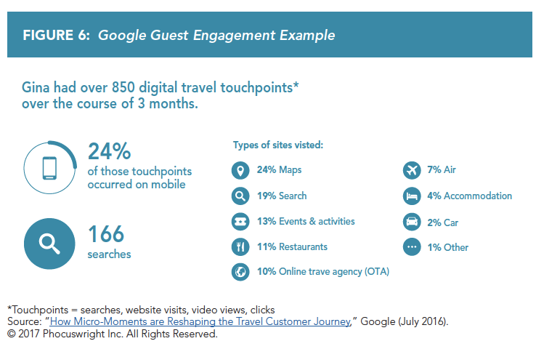
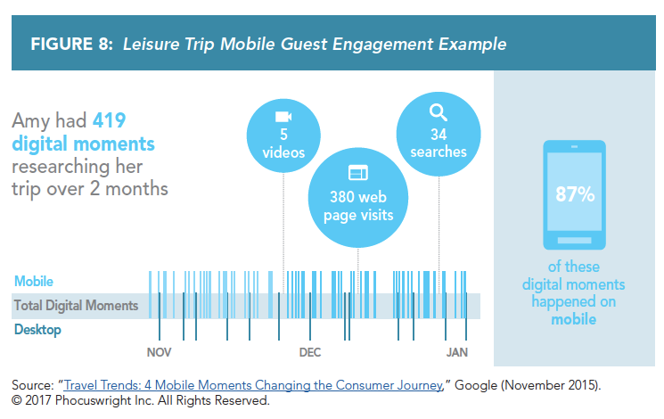

Slide 21
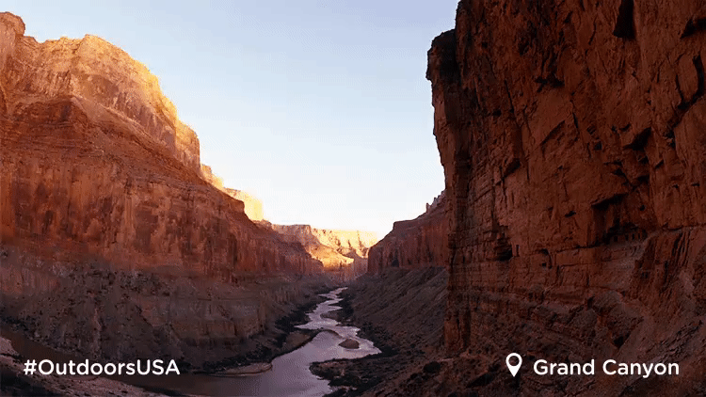
Brand USA Case Study
6-week video campaign
Tactics Employed: A/B testing, retargeting, logo upfront, campaign optimizations
Results:
  28.9 million video views
  6.7 million views (15 seconds or longer)
  12% higher view through rate (phase 1 to phase 2)
  21% higher view through rate (phase 1 to phase 3)

Slide 22
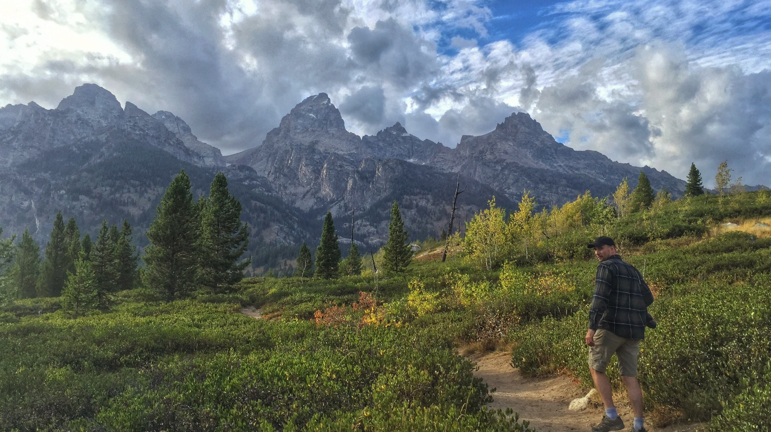
Visuals that transport you

Slide 23
Why a Federal National Travel & Tourism Program?

Slide 24
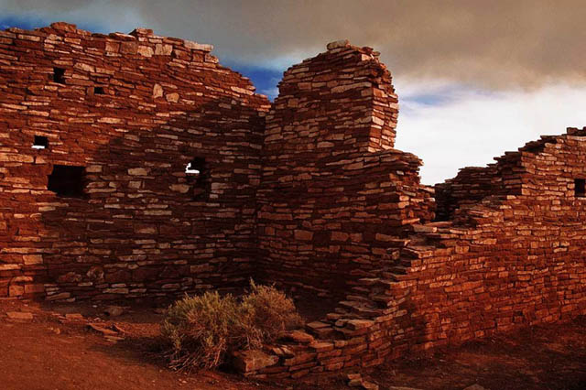
National Travel & Tourism Strategy for the
United States
Executive Order 13497
Created a National Travel & Tourism
Office for the U.S.
Ordered a National Travel & Tourism
Strategy for the U.S.
- Domestic and International Visitors
- Work Across the Federal Government
- Work with Travel &Tourism Industry
Partners
- Federal Agencies Develop Detailed
Action Plans to Implement

Slide 25
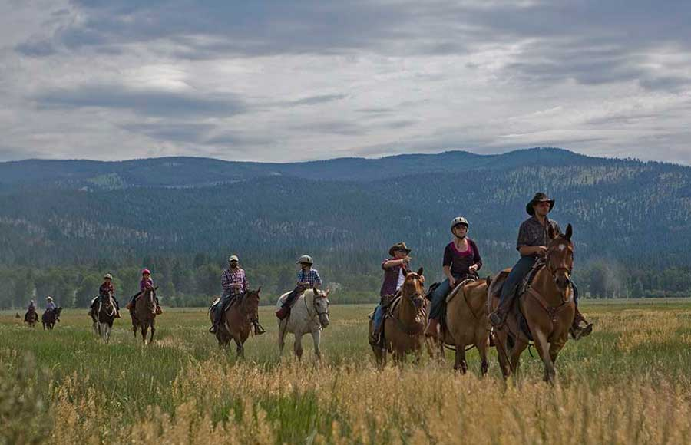
Brand USA
Congress Passes the
Travel Promotion Act
Public Private Partner for
US Government
Market the U.S. to
The world
IPW Partnerships
Notes:
Public Law 111-145

Slide 26
National Travel & Tourism Strategy for the U.S.
Promote domestic & international tourism throughout the U.S.
Increase U.S market share, supporting job creation across the nation
Communicate tourism opportunities in the U.S. to a larger domestic and international audience
Make travel and tourism a Priority
Notes:
National Strategy guides Federal Agencies to implement the following actions
Re-issued and signed by President Trump in 6/17

Slide 27
National Travel & Tourism Strategy for the U.S.
Coordinate efforts among federal agencies, Brand USA
Work with partners in a collaborative effort to meet demand and provide an outstanding American experience
Develop detailed implementation plans
Ensure that government services meet demand and our resources are protected for future generations.”

Slide 28
N A T I V E Act - 2016
Enhance and integrate Native American tourism
Empower Native American communities
Increase coordination and collaboration with Federal tourism assets
Expand heritage and cultural tourism opportunities in the U.S.
Highlights the Special Role of Public Lands.

Slide 29
What is BLM’s Role in Implementing the National Strategy?

Slide 30

BLM’s Challenge: “The National Strategy recognized that the role of government is to create the conditions for growth by ensuring that government services meet demand and our resources are protected for future generations.”
Notes:
Complex relationship, and it’s has to be managed

Slide 31
BLM Tourism & Community Service Program
Support Conservation, Commerce, Community, and Culture through Sustainable Tourism
Managing “new & emerging values” FLPMA
Plan for and manage travel & tourism in partnership with federal, state, tribal and private travel and tourism partners
Provide and enhance visitor settings, visitor experiences and visitor services, while conserving public lands and waters for future generations.

Slide 32
BLM Draft National Travel & Tourism Action Plan
ELT October 2104

Slide 33
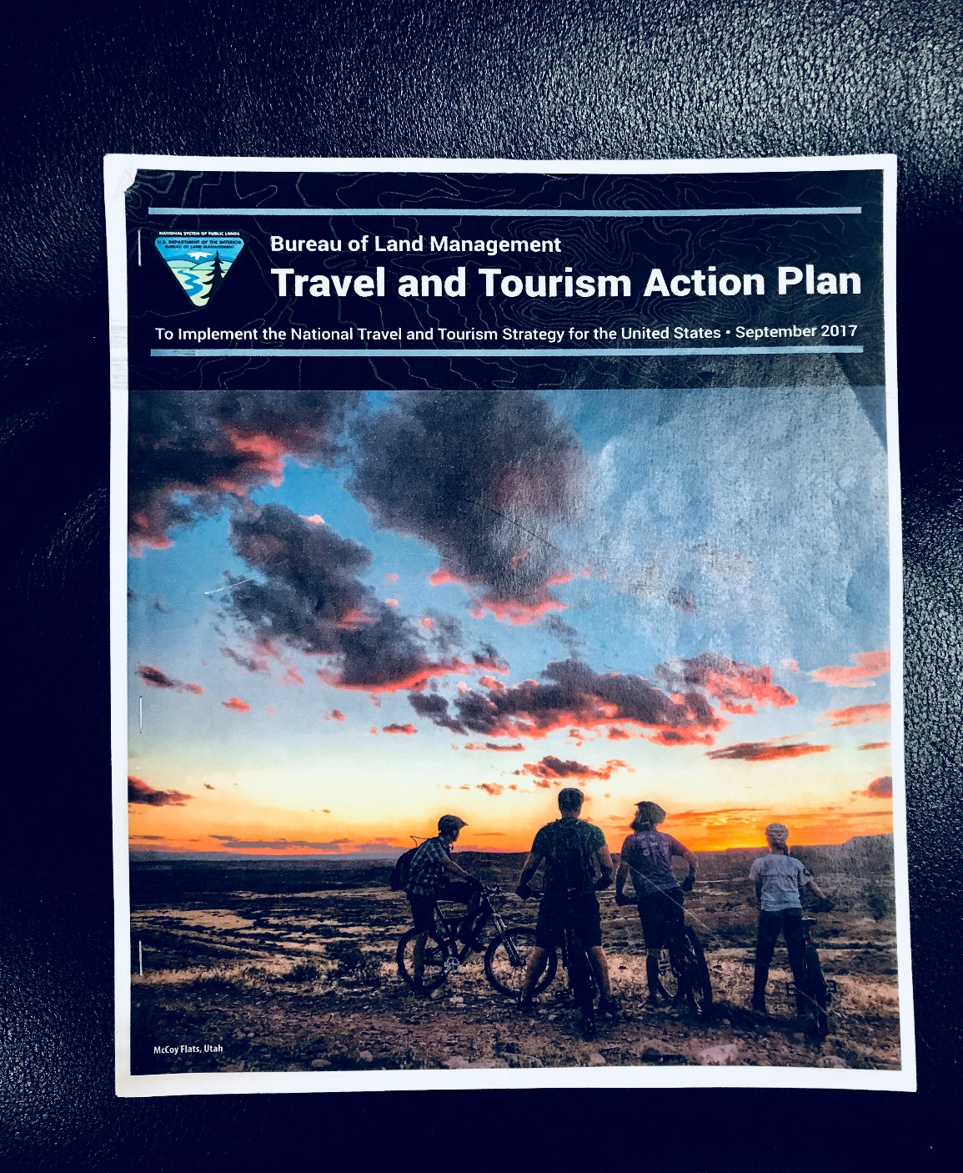

Slide 34

BLM’s Approach
Sustainable Tourism
Tourism that takes full account of its
current and future economic, social,
and environmental impacts,
addressing the needs of visitors,
the industry,
the environment,
And host communities.
Conserve and enhance visitor settings and visitor experiences
Provide outstanding visitor services
Contribute to the economy and communities
Help provide economic, social and cultural benefits for our tourism partners and visitors

Slide 35
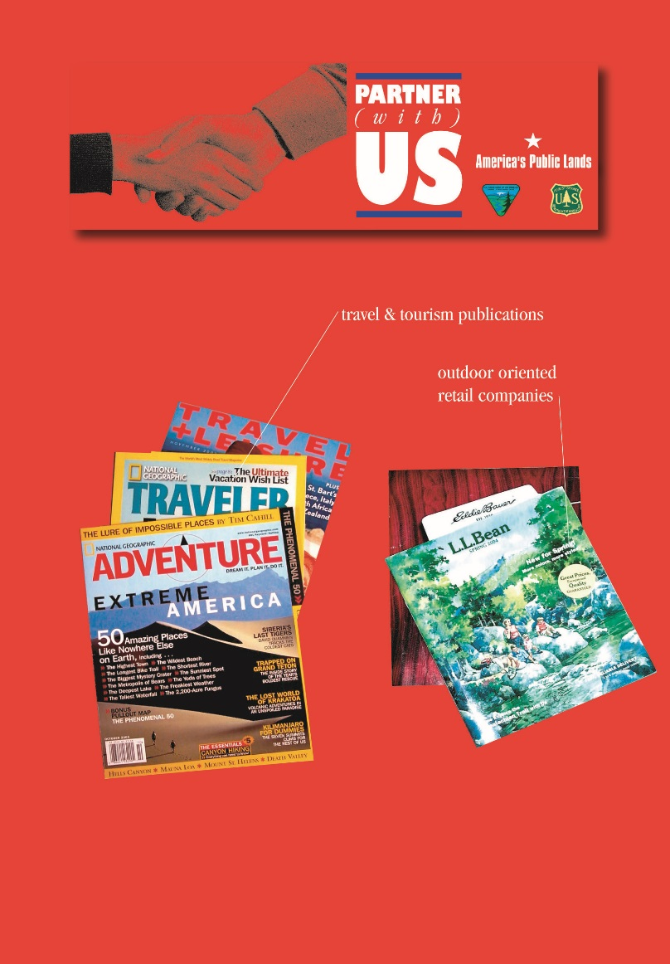
Planning for & Managing Tourism
BLM Manages
Visitor Settings
Visitor Experiences
With BLM’s travel and tourism partners
BLM provides world class service
And an outstanding American visitor
experience
Notes:
Tourism is Ecosystem Service

Slide 36
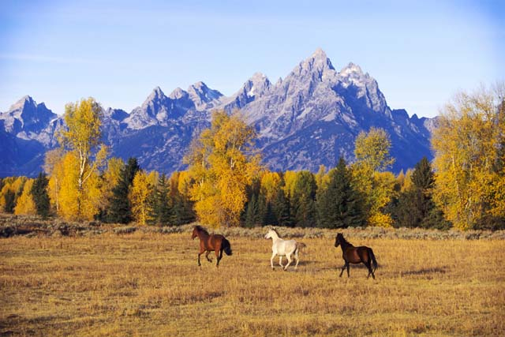
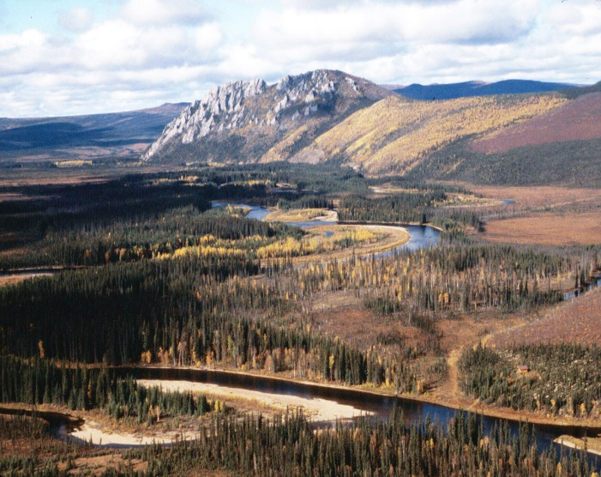
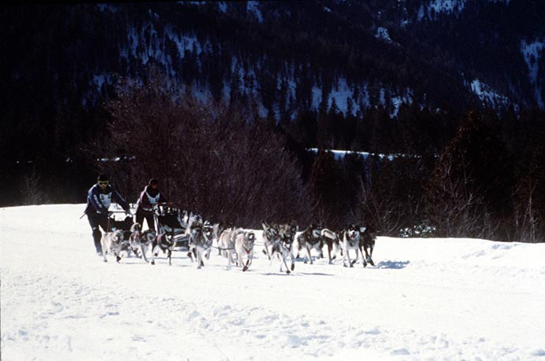
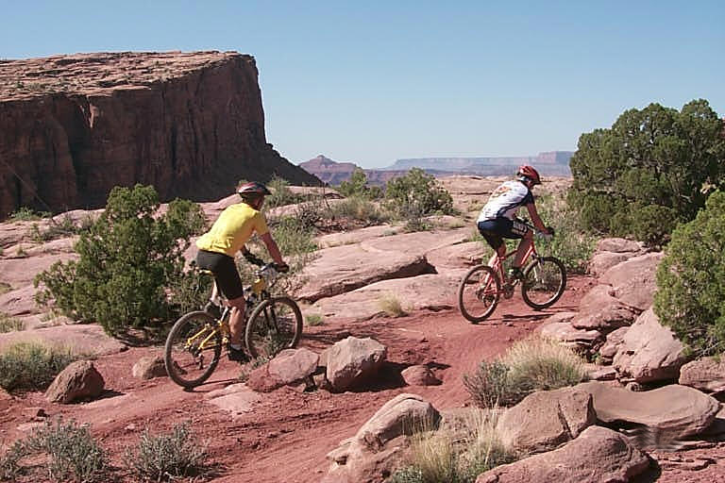
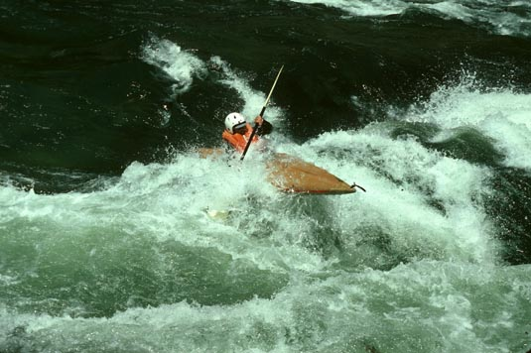
Visitor
Settings
Primitive? Semi-Primitive? Developed? Motorized? Non- motorized?
Notes:
Visitor Settings and landscapes
Can be mapped, measured, allocated and monitored

Slide 37

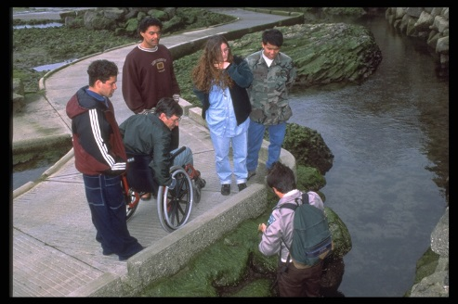
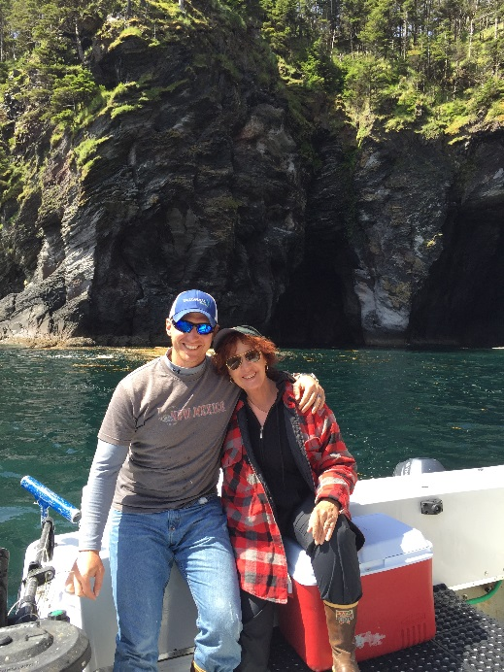

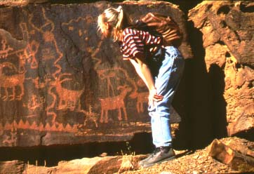
Visitor Experience
Type of activities? Noisy or Quiet? How many people and when? Structured or open?
Notes:
Experiences a management choice what type of use? how many people at what time or season?
motorized
Can be mapped, measured, allocated, monitored

Slide 38
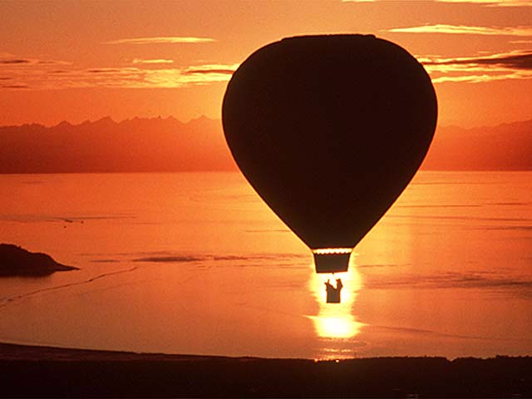
Connect Highly Diverse Visitors to Unique Places
Critical Role of Visitors and Tourism Partners in Conserving and Enhancing Visitor Settings, and Visitor Experiences
Conserve World Class
Visitor Settings & Experiences
Inspire a Personal Connection with “Their Places” = Advocacy
Build Capacity to Manage by Working with
Travel & Tourism Partners

Slide 39
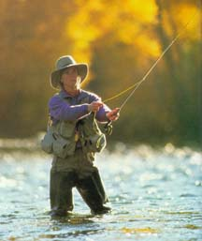
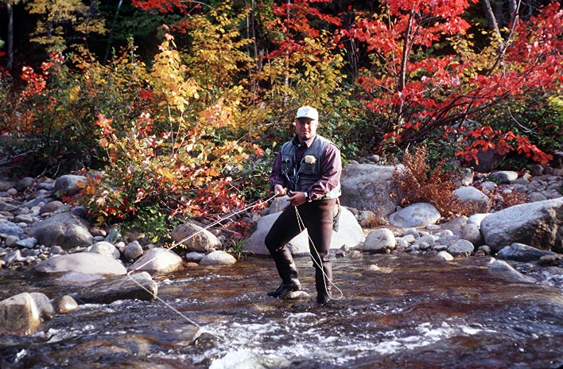
Rio Grande del Norte National Monument
Nick Streit and his father, Taylor, expect the recent designation of El Rio Grande del Norte as a National Monument
to help maintain the Rivers’ integrity for generations to come; continue public access to rivers, streams, canyons and mountain, and help maintain businesses and jobs.
BLM Public Lands Provide the “Hook” for Family’s Fly Fishing Business

Slide 40
Who are BLM’s Key Audiences ?

Slide 41
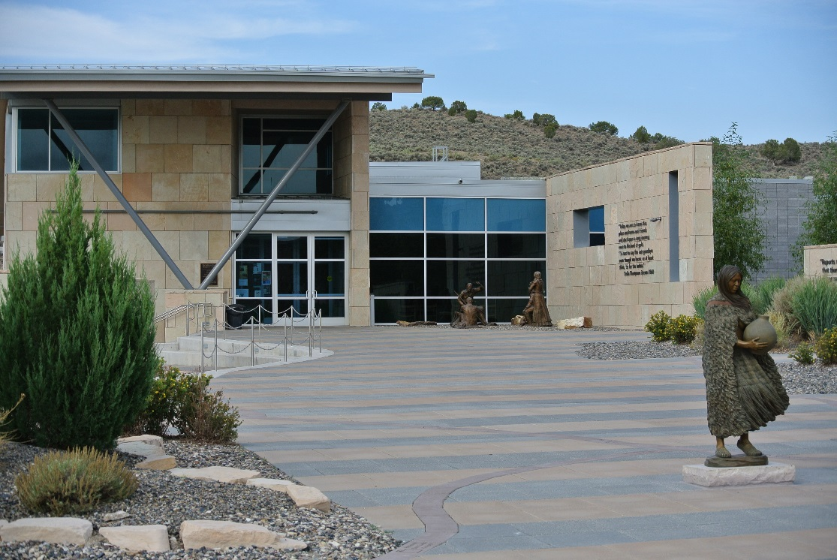
BLM Key Audiences
Internal BLM - All Programs
Federal Travel and Tourism Partners
Travel and Tourism Industry Partners

Slide 42
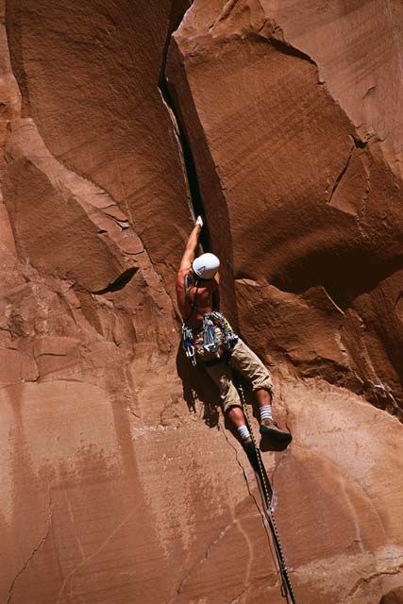
Key Audience: Internal BLM
All BLM Programs
National
State
Local

Slide 43
Key Audience: Internal BLM
All BLM Land and Water Programs
Where ever they influence, or are
influenced by, Travel and Tourism
Recreation
Wildlife
Heritage & Cultural
Education
Interpretation
Volunteers
Range
Minerals

Slide 44
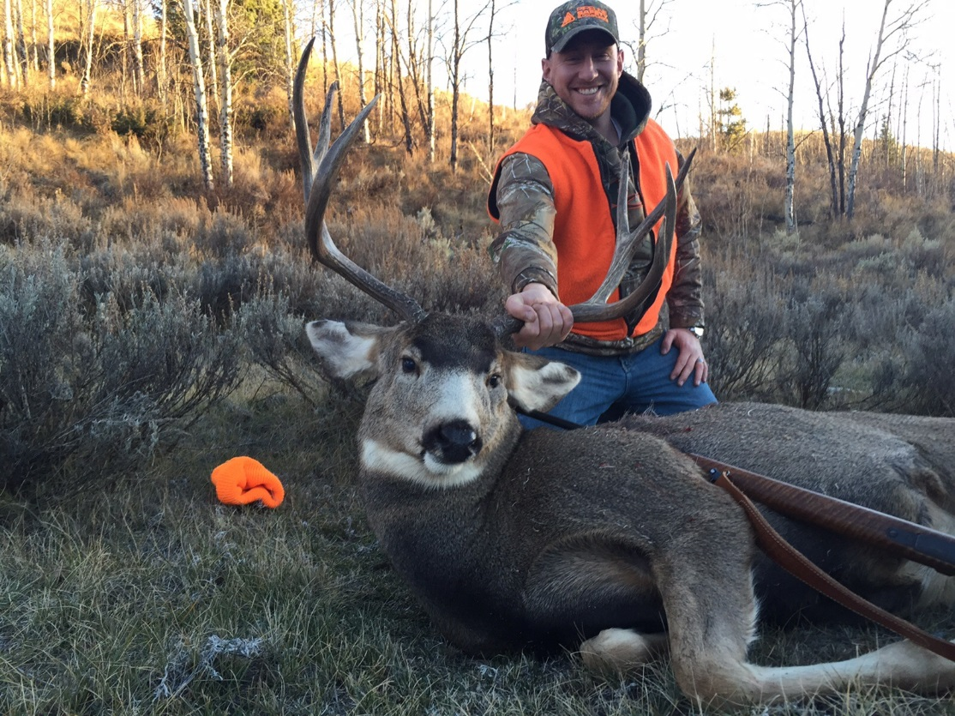
Key Audience: Federal Travel & Tourism Partners
Department of Commerce : National Travel & Tourism Office
Tourism Policy Council
State Department
Department of Transportation
Department of Agriculture: USFS
DOI: FWS, BIA, NPS
US Army Corps of Engineers
Advisory Council
on Historic Preservation
Small Business Administration
Notes:
We will want to share the Final with these Federal Travel and Tourism Partners

Slide 45

Key Audience: Travel & Tourism Industry Partners
Brand USA
U. S. Travel Association
National Tourism Advisory Council
International and Domestic travel and tourism
providers
National Geotourism Council &
local geotourism councils
Notes:
Will want to Share the Final with these Industry Partners-1 of 2 slides
FYI…graphic is something BLM Partnered with to provide, at one time

Slide 46
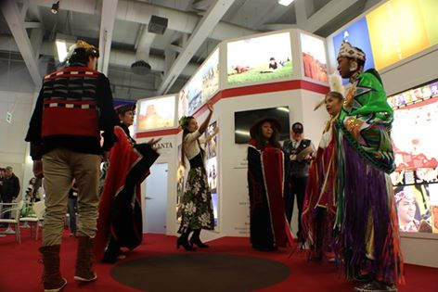
Key Audience: Travel & Tourism Industry Partners
State Tourism Departments
Western States Tourism Policy Council
Southeast Tourism Society
Tribes and the American Indian Alaska Native Tourism Association (AIANTA)
National & local conservation organizations
Communities and CVBs
Individual local businesses
Recreation permittees

Slide 47
How is BLM Structuring Actions?
Promote the United State
Enable and Enhance Travel and Tourism to and within the U.S.
Provide World-Class customer Service and Visitor Experience
Coordinate Across Government
Conduct Research and Measure Results

Slide 48
Programs Processes and Tools We Already Have

Slide 49
Key Partners: Tribes
BLM- AIANTA Letter of Intent

Slide 50
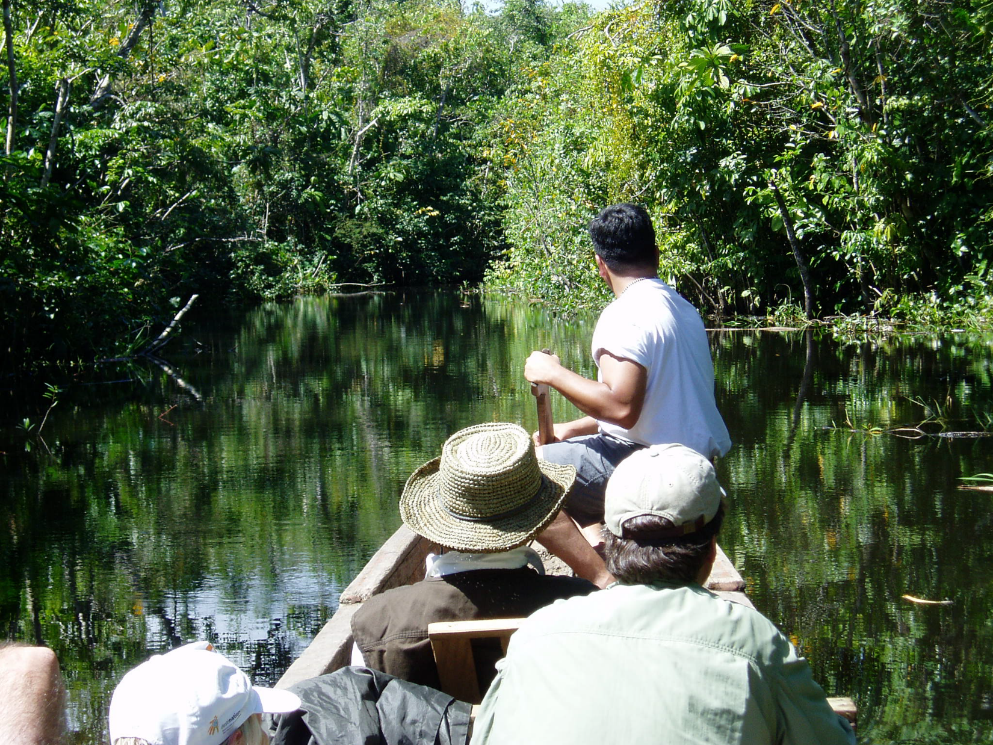
World Wilderness Congress
Geotourism Charter
endorsed Oct. 2005

Slide 51
What Is Next?

Slide 53
Components of Regional Sustainable Tourism
Commerce
Sustainable
Well
Being
Partners
Co-Provide
A Sustainable Future
Conservation
Culture Community

Slide 54

GOALS
ACTIONS

Slide 55
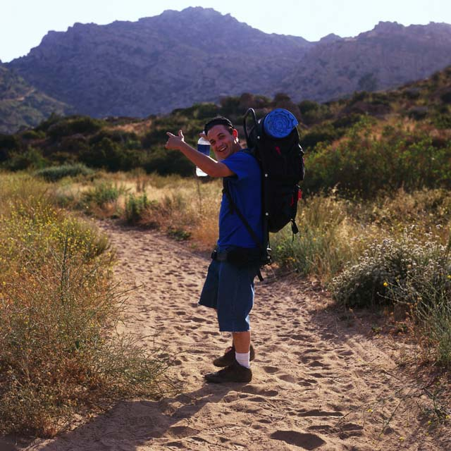
Welcome to the Wild!
EXPLORE YOUR PUBLIC LANDS
DISCOVER THE AUTHENTIC
JOURNEY OFF THE BEATEN PATH
CONNECT WITH FRIENDS
CLEAR YOUR CALENDAR
CHOOSE YOUR PATH-TRAIL-RIVER
FOLLOW YOUR HEART
SAVOR THE MOMENT
SHARE YOUR ADVENTURE
VISIT U.S.

