Slide 2
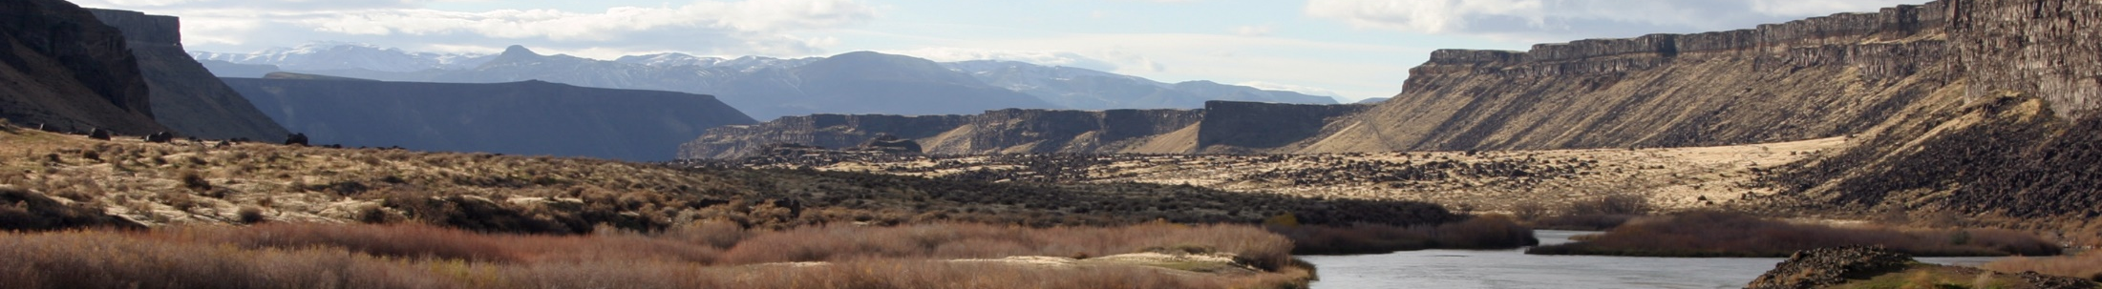


Visual Resource Management
Name
Employer/ Title
Office Location (BLM – Field Office name/ town/state)
What brings you here, your main purpose for registering ?
Your first and second choice for the Thursday team projects
Do you have a:
  Computer
  Photo Shop, or other photo editing software
  Power Point
  Digital camera
  Project Types: Wind – Solar – Recreation Site – Oil & Gas – Vegetation Treatment
June 2019 – Boise, Idaho

Slide 3
Course objective
After attending this course, you will be able to:
  Describe the basic principles and concepts of the VRM system
  Communicate the role of visual resource management in BLM land use planning and project/ activity planning
  Build a foundation of basic skills necessary to implement the VRM program policies and procedures

Slide 4
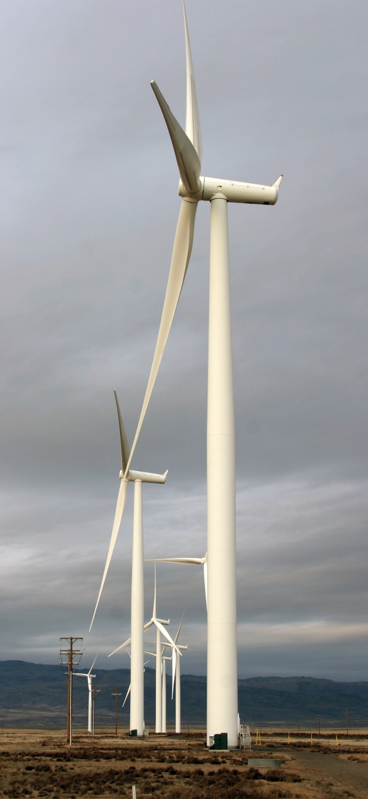
Week’s Agenda
Monday
Unit 1
Intro to VRM
Unit 2
Language of Landscapes
Unit 3
Visual Resource Inventory (VRI)
Field Exercises
(Return ~5:30 PM)
Tuesday
Unit 4
Land Use Planning
Unit 5
Project Planning Essentials
Unit 6
Environmental Factors
(11:15 lunch)
Unit 7
Visual Design Fundamentals
Facilities Field Trip
(Return ~6:00PM)
Wednesday
Unit 8
Visual Simulation
Unit 9
Contrast Rating
Unit 10
NEPA & VRM
Unit 11
Monitoring
Field Exercises
(Return ~5:30 PM)

Slide 5
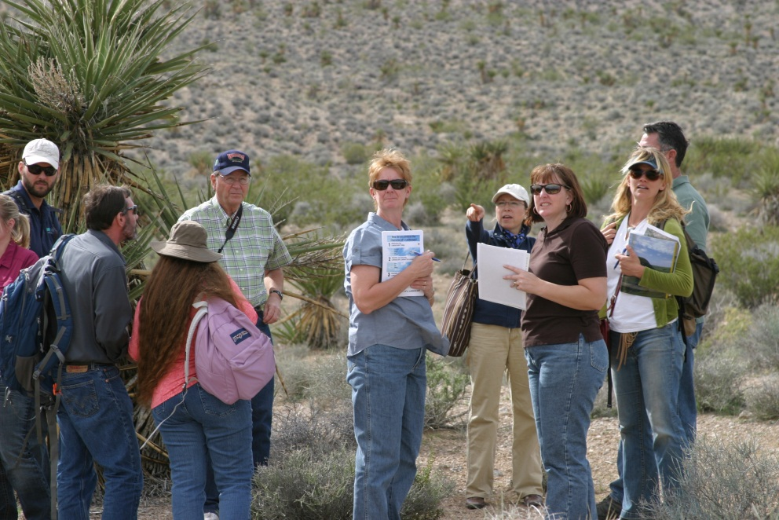
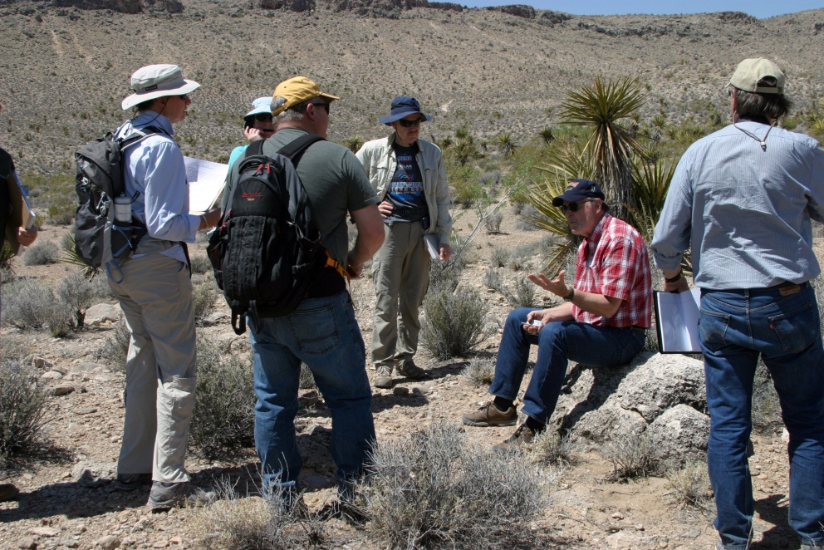
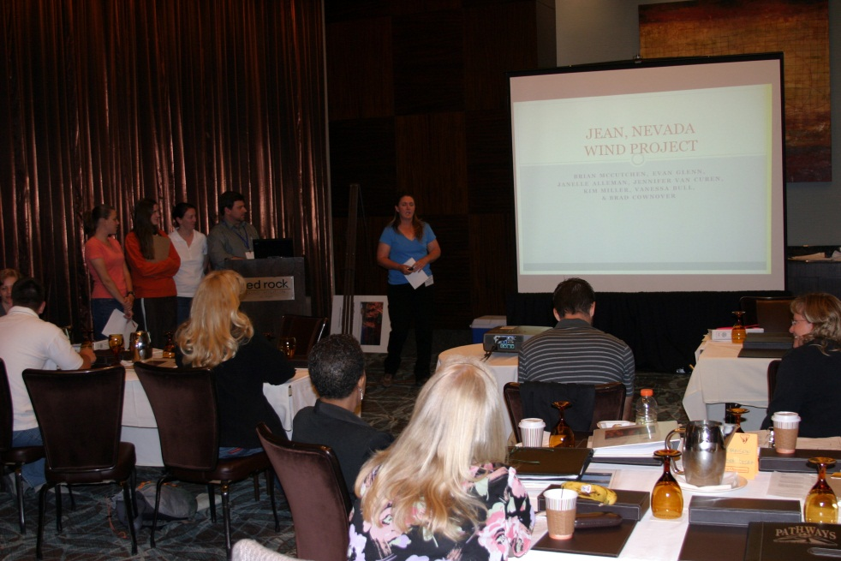
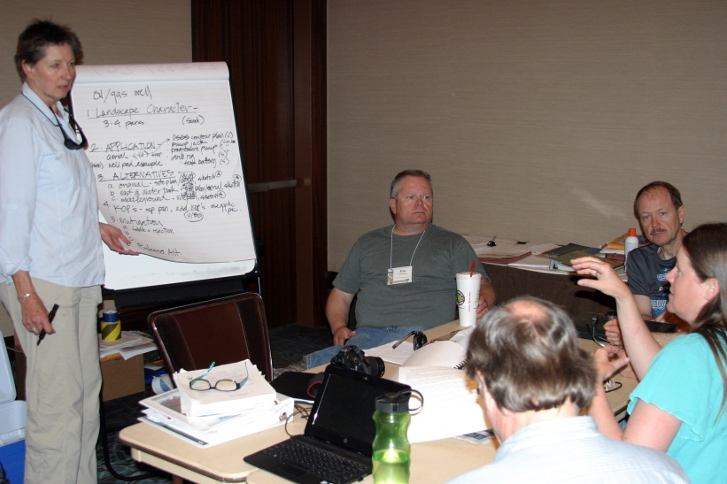
Week’s Agenda
Thursday
  Team Exercises – ALL DAY
Friday
  Team Project Presentations
  Unit 12 - Wrap Up

Slide 6


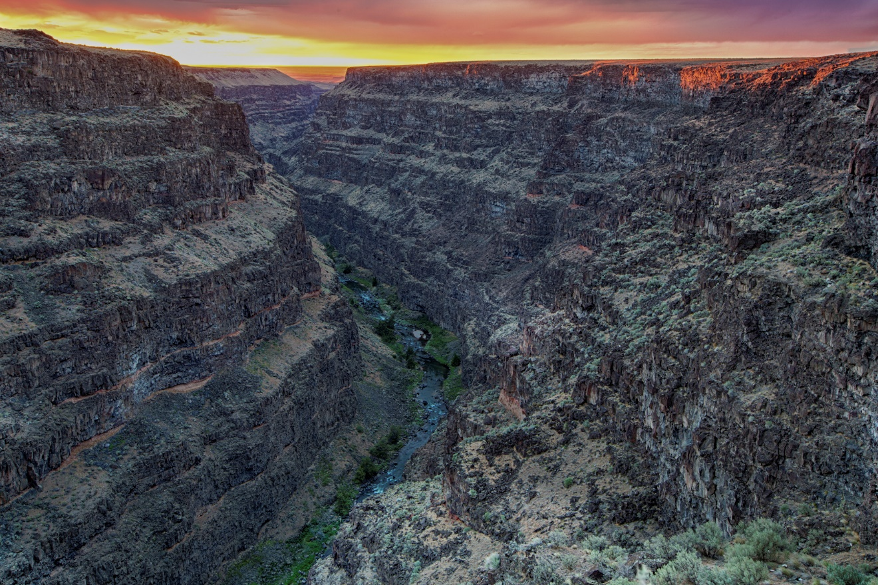
“The beauty of our land is a natural resource.
Its preservation is linked to the inner prosperity of the human spirit.”
President Lyndon B. Johnson, 1965 address to Congress
Bruneau Wild and Scenic River, ID

Slide 7
Introductory Unit Objective
To provide a general overview of the importance of protecting scenic values and the Bureau of Land Management’s Visual Resource Management (VRM) program, including:
  What is VRM
  Why we manage scenery
  How we manage scenery
Notes:
Please share with if you consider visual resources to be an objective resource, or an subjective resource?
Objective – based on facts, subjective – based on opinion.
Objectives are measureable, and observable.
Subjective is based on interpretations, points of view, emotions and judgment.

Slide 8
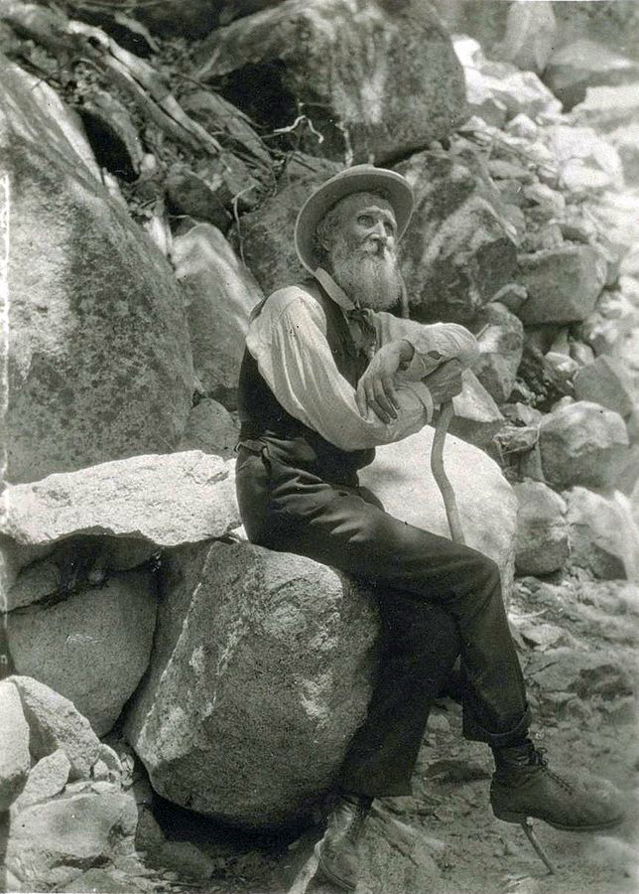
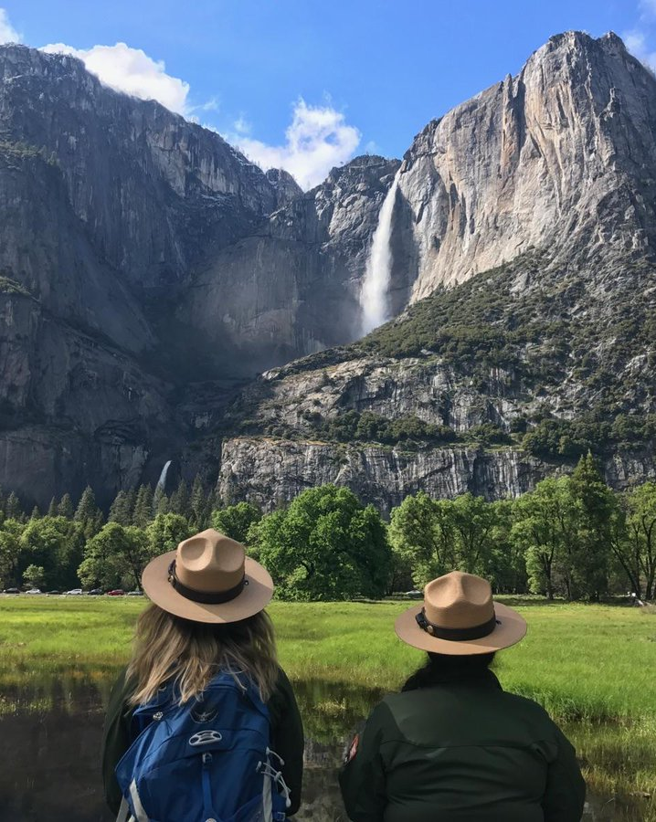
Rising Consciousness of American Scenery
By Francis M. Fritz
By The National Park Service
Notes:
All of us have awareness of the history of Yosemite National Park and John Muir’s role, and his effort to build social awareness for protecting natural areas
– 1855 – first organized tourism of Yosemite, Yosemite Grant 1864
Became a National Park in 1890 and park protection expanded under President Theodore Roosevelt
John Muir’s involvement

Slide 9
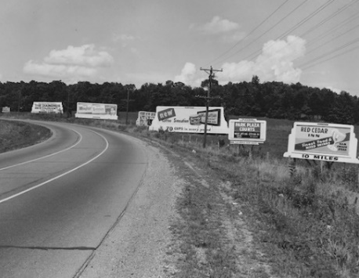
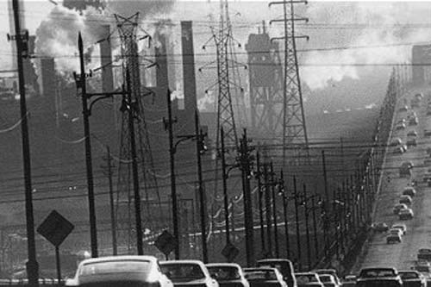
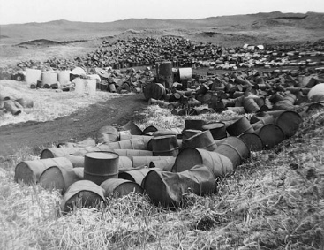
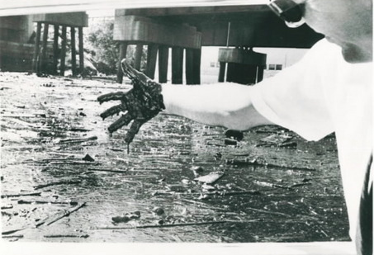
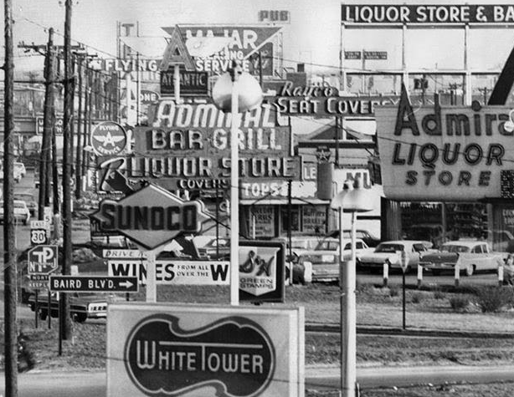
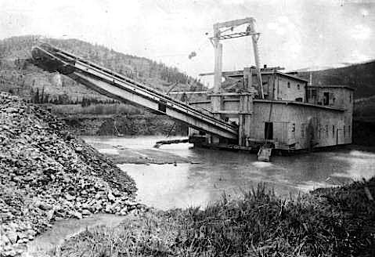
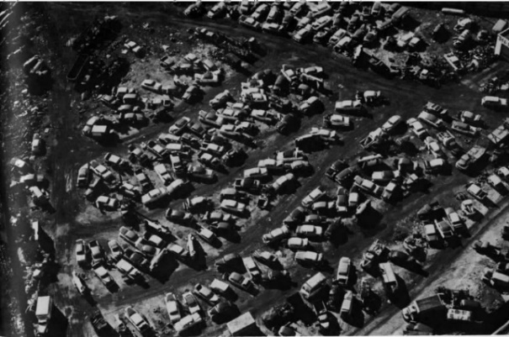
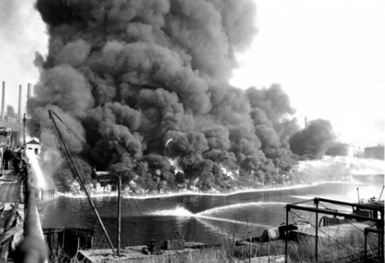
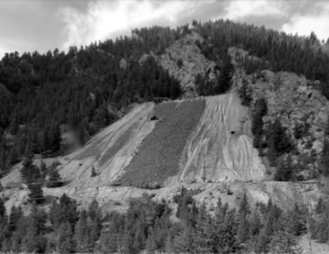
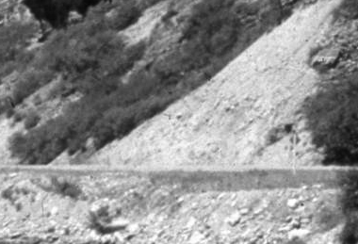
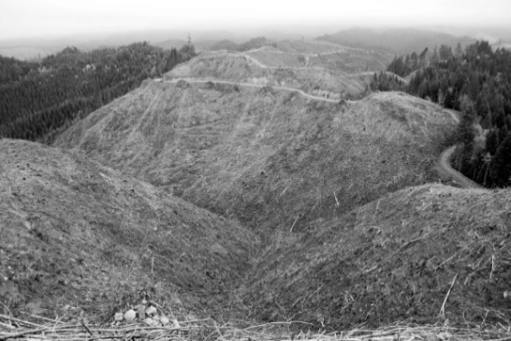
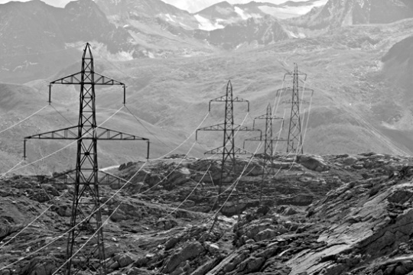
Epidemic Pollution Across U.S.
The condition of the American

Slide 10
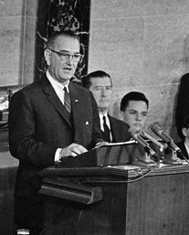
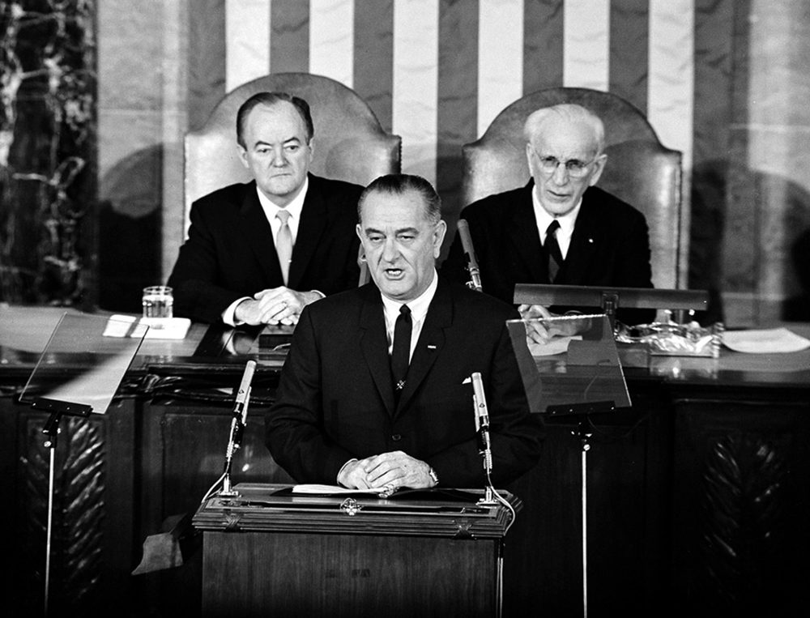
Epidemic Pollution Across U.S.
Congressional Address and the White House Conference on Natural Beauty
“The beauty of our land is a natural resource. Its preservation is linked to the inner prosperity of the human spirit”, and made the commitment to hold a White House Conference on Natural Beauty to meet in mid-May of that year.

Slide 11
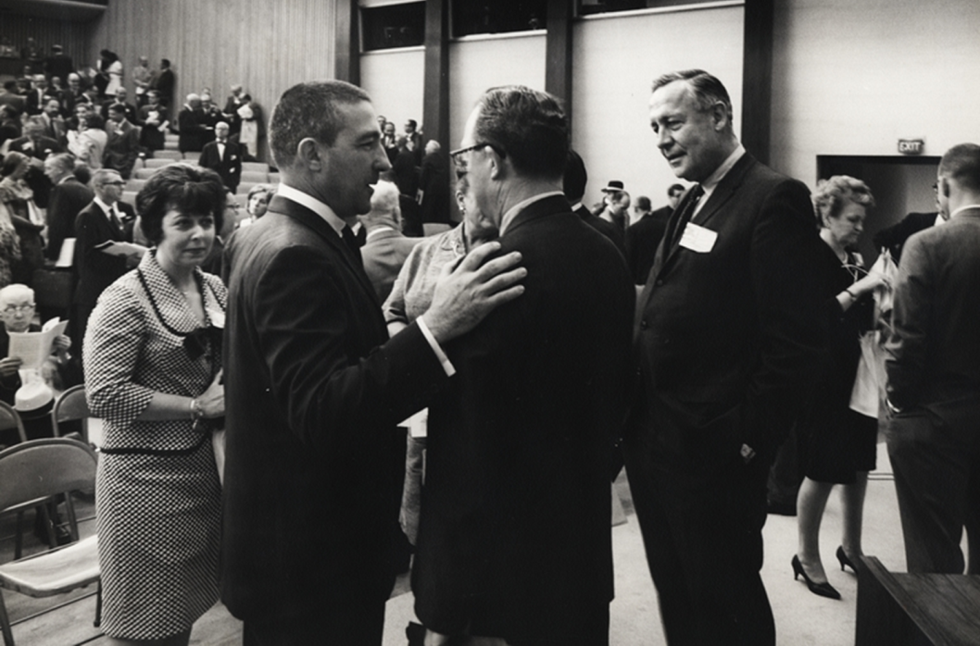
Why
White House Conference on Natural Beauty, May 24, 1965:
  City, rural, and natural
  landscapes
  Pollution: Air, water, litter,
  junkyards, pesticides
  Solid waste management
  Sewage waste management
  Highway beautification
  Electrical transmission lines
  Trails
  Rivers
  Wilderness
  Greenhouse gas emissions (Climate Change)

Slide 12
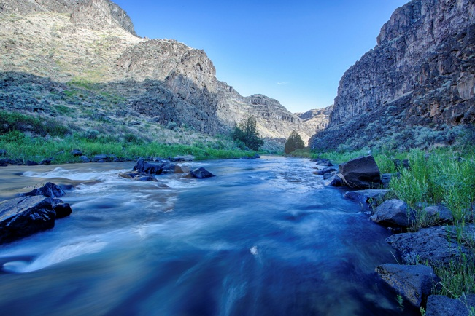
Resulting Legislation
Sampling of Environmental Legislative Acts that followed:
  Highway Beautification Act (HBA), 1965
  Wild and Scenic Rivers Act, 1968
  National Trails System Act, 1968
  National Environmental Policy Act, 1969
  Clean Air Act, 1970
  Clean Water Act, as amended 1972
  Resource Conservation and Recovery Act, 1976
  Surface Mining Control and Reclamation Act, 1977
  National Forest Management Act, 1976
  Federal Land Policy and Management Act, 1976
Notes:
Henry (Scoop) Jackson - chairman of the Committee on Interior and Insular Affairs, which became the Committee on Energy and Natural Resources in 1977. Lisa Murkowski is the current chair.

Slide 13
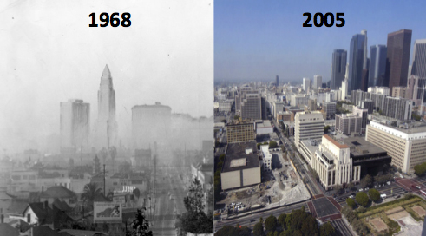
Effects of Legislation

Slide 14
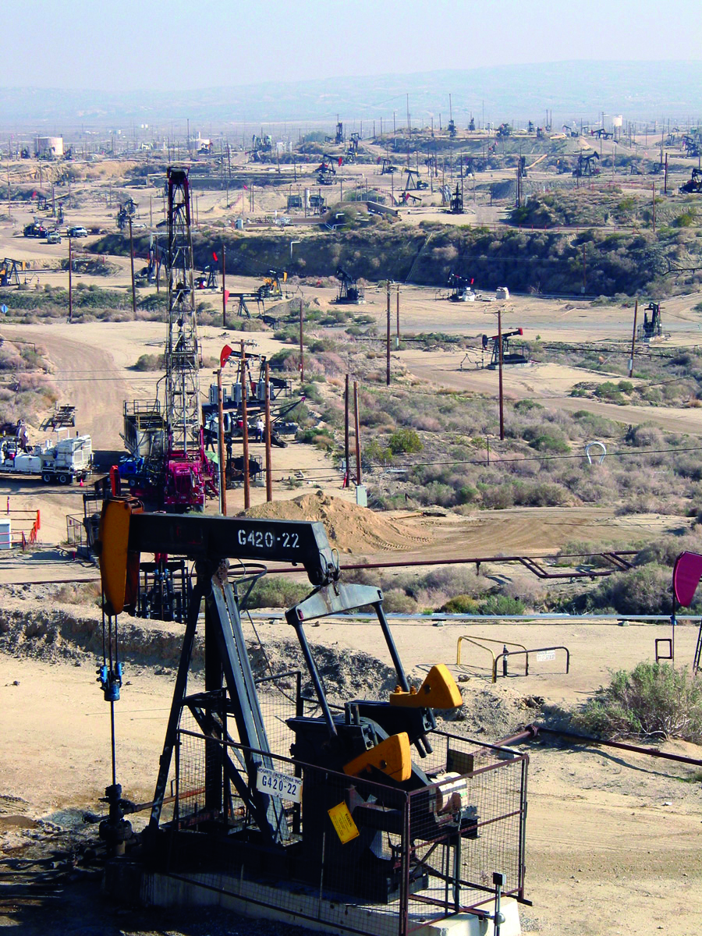
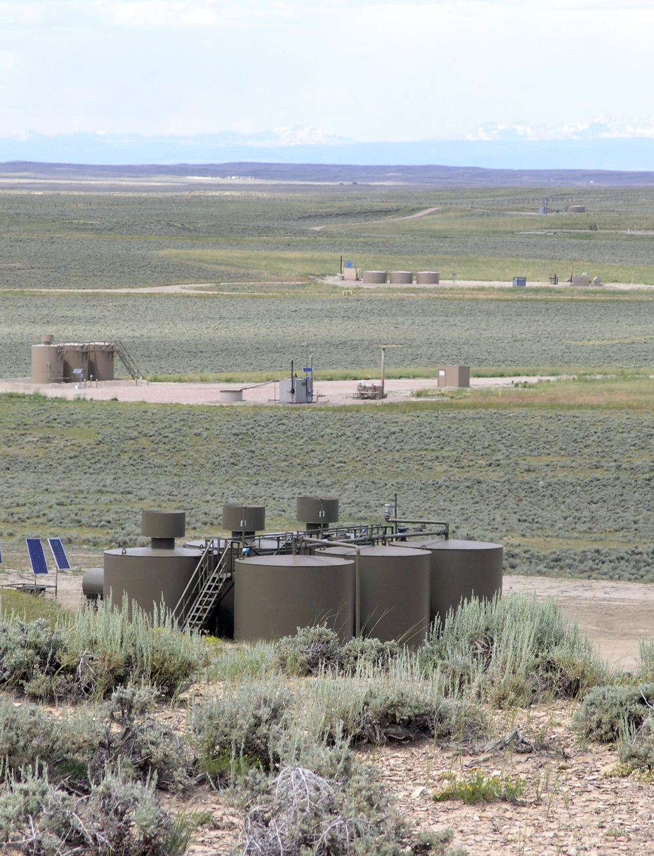
Progress in land use practices

Slide 15
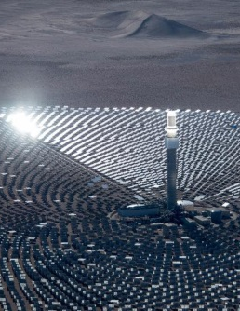
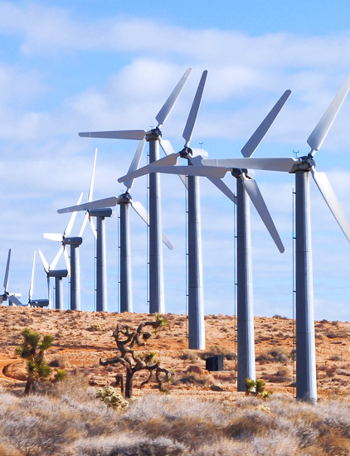
New Challenges in Scale

Slide 16

Legal Authority and Obligation
NEPA directs all federal agencies:
Section 101 (b) requires:
  Measures to be taken to assure aesthetically pleasing surroundings for all Americans.
Section 102 requires:
  Agencies shall use a systematic, interdisciplinary approach to ensure the integrated use of natural and social sciences and the environmental design arts in planning and decision making.
Notes:
Henry (Scoop) Jackson - chairman of the Committee on Interior and Insular Affairs, which became the Committee on Energy and Natural Resources in 1977. Lisa Murkowski is the current chair.

Slide 17
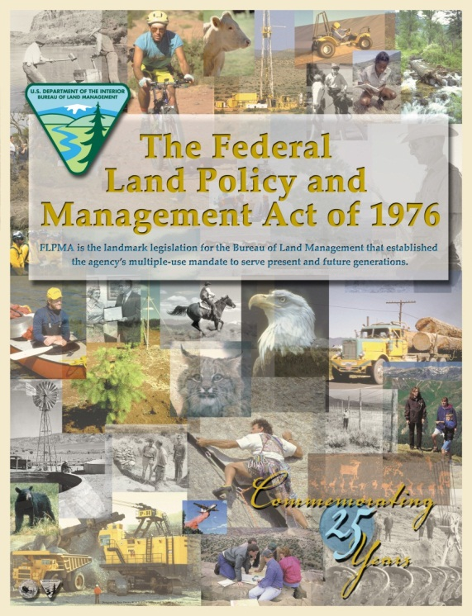
Legal Authority and Obligation
FLPMA mandates the management of scenic value
  FLPMA: “Natural Scenic Values” as a resource to be managed within the multiple use framework
    “…a combination of balanced and diverse resource uses that takes into account the long-term needs of future generations for renewable and non-renewable resources, including…natural scenic…values;” (Sec. 103(c))

Slide 18
Legal Authority and Obligation
FLPMA directs BLM to…
  Sec. 102(8) Manage in a manner that will protect the quality of scenic values and provide for outdoor recreation and human occupancy and use
  Section 201 (a) inventory and maintain on a continuing basis an inventory of all public lands and their resource and other values (including, but not limited to outdoor recreation and scenic values)
Notes:
Scientific, scenic, historical, ecological, environmental, air and atmospheric, water resource, and archeological values; that where appropriate, will preserve certain public lands in their natural condition; that will provide food and habitat for fish and wildlife and domestic animals; and will provide for outdoor recreation and human occupancy and use;

Slide 19
Policy Guidance for Scenic Resources
FLPMA directs BLM to…
  Section 202 (c) Secretary shall – (6) consider the relative scarcity of the values involved
  Concerning the management of use, occupancy and development, take any action necessary to prevent unnecessary or undue degradation of the lands (Sec 302(b))
  Section 505. (a) Requires that each ROW contains terms and conditions to minimize damage to the scenic and aesthetic values.

Slide 20
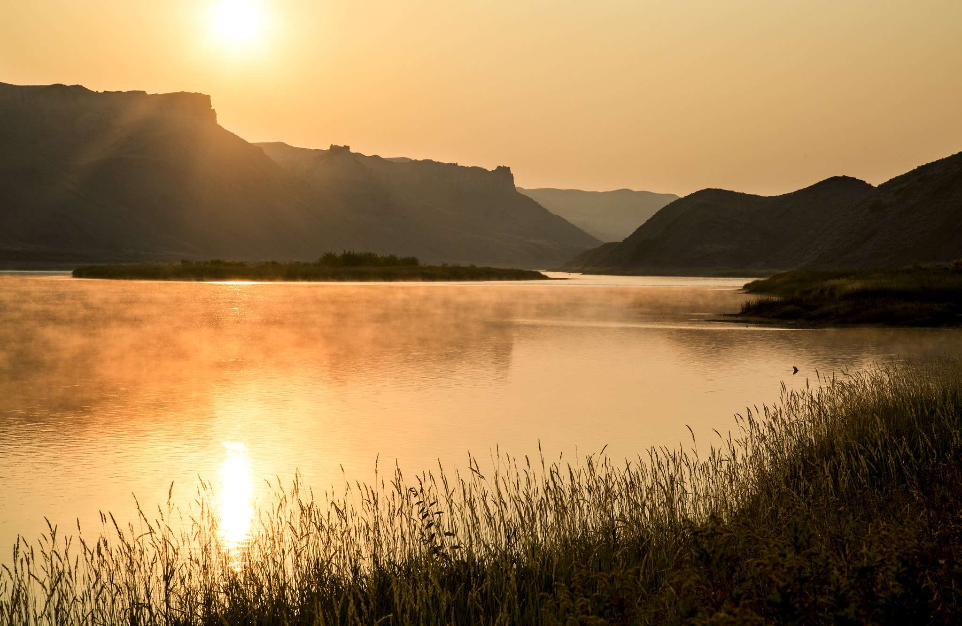
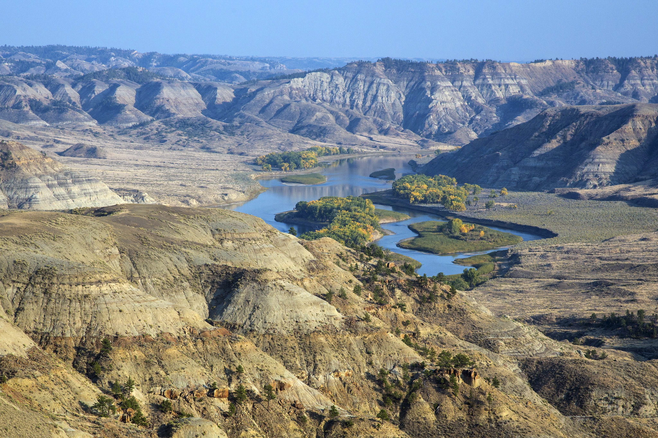
Scenery is a finite public resource…
Upper Missouri Wild and Scenic River, MT
by Bob Wick

Slide 21
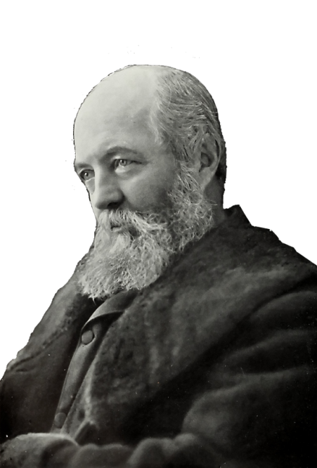
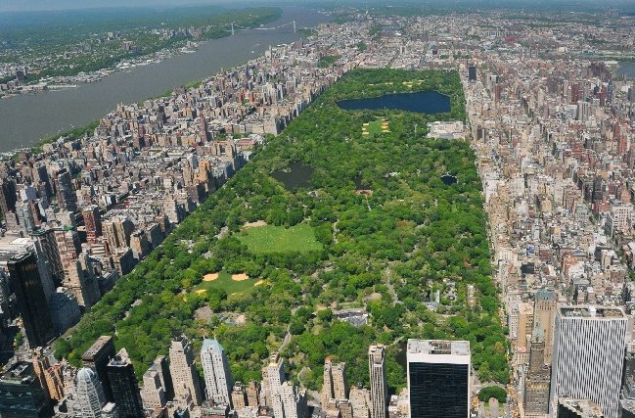
Scenery is a finite public resource…
“It is a scientific fact that the occasional contemplation of natural scenes … is favorable to the health and vigor of (people) and especially to the health and vigor of their intellect...”
Frederick Law Olmsted, 1865
Notes:
Central Park - 1857

Slide 22
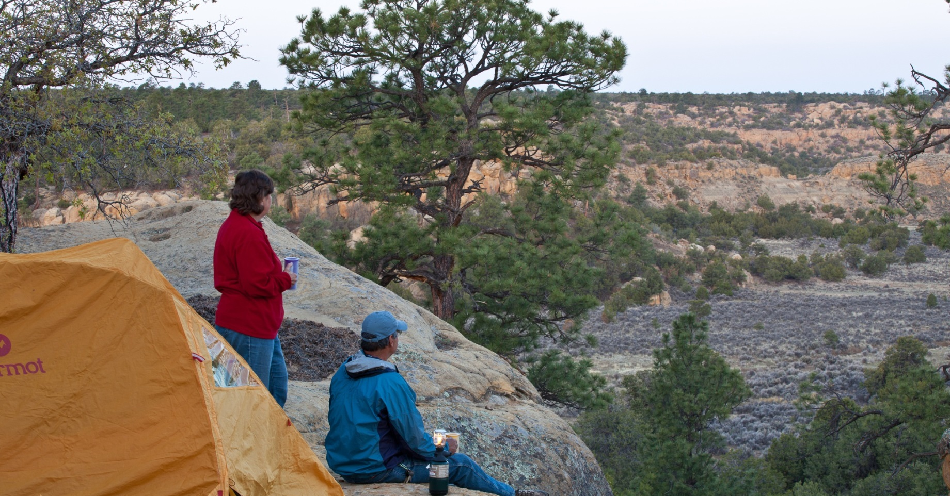
Natural Scenery and Health Benefits
Scenic values of public lands are linked with visual settings that provide for a sense of escape, enjoyment of nature, testing of oneself, and reconnecting with others.
Biophilic Design (The integration of nature into the human living space):
5 minutes of “green exercise” can improve health, mood & self‐esteem (Barton & Pretty, 2010).
Decreased depression (Mind, 2007)
Fewer “ruminative thoughts” (Bratman et al., 2015 )
Better memory performance and attention span (Berman, Jonides, & Kaplan, 2008)
Fewer symptoms of ADHD in children (Faber. Taylor & Kuo, 2009) Similar results to ADHD drug methylphenidate (Ritalin)
Courtesy of Naomi Sachs ASLA, EDAC
Notes:
ENTER THE NOTES FROM ASLA PRESENTATION – BIOPHILIA, BIOPHOLIC DESIGN – THE INTERGATION OF NATURAL ELEMENTS INTO HUMAN LIVING SPACES

Slide 23
Natural Scenery and Health Benefits
Scenic values of public lands are linked with visual settings that provide for a sense of escape, enjoyment of nature, testing of oneself, and reconnecting with others.
Physiological health markers (evidence-base medical research):
Higher amount of “NK cells” – natural cancer-­fighting cells (Li et al., 2007)
Lowered inflammatory cytokines (Mao et al., 2012)
Lowered blood glucose level (Ohtsuka et al., 2008)
Higher immune function (Kuo, 2015)
Stronger bones (Sato et al., 2003; Turner et al., 2002)
Reduced myopia (Rose et al., 2008)
Reduced stress - Lower amounts of adrenaline & cortisol (Li et al., 2008; Park, 2010).
Drs. Prescribing doses of nature Courtesy of Naomi Sachs
Notes:
ENTER THE NOTES FROM ASLA PRESENTATION – BIOPHILIA, BIOPHOLIC DESIGN – THE INTERGATION OF NATURAL ELEMENTS INTO HUMAN LIVING SPACES

Slide 24
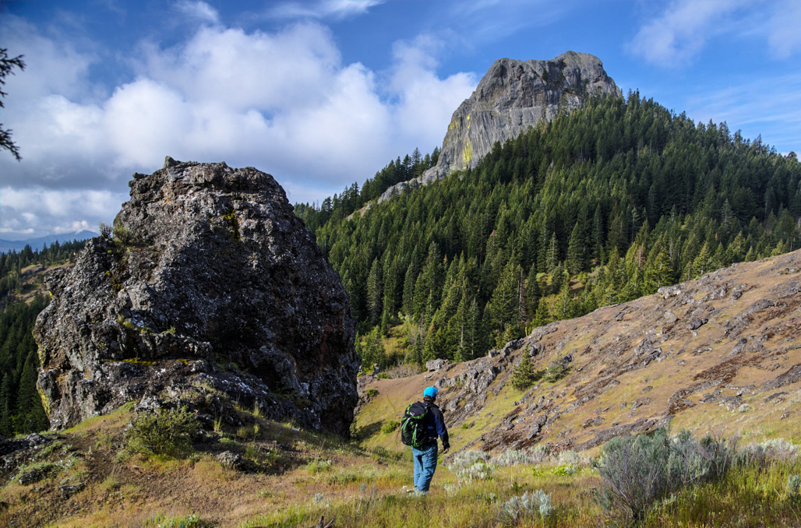
BLM manages lands with scenic value…
Cascade Siskiyou National Monument, OR

Slide 25
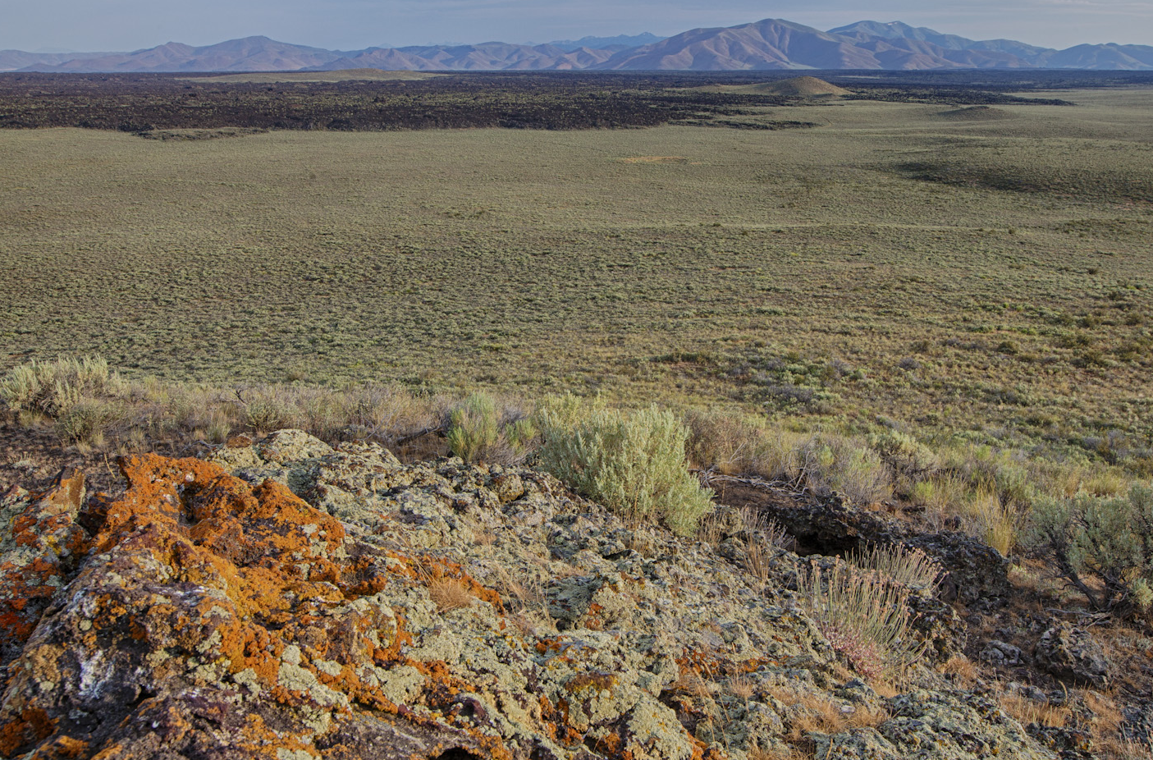
All BLM lands have scenic value…
Photo by Bob Wick
Craters of the Moon National Monument, ID

Slide 26
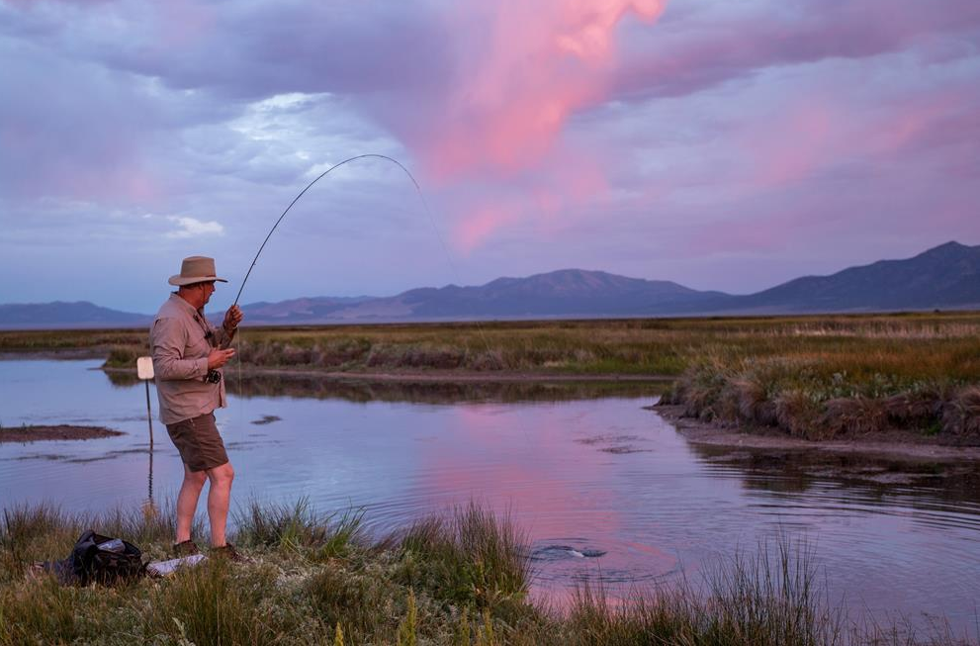
.
BLM land provides scenic escape
Photo by Brady Owen
Pine Forest Range Wilderness Area, NV

Slide 27
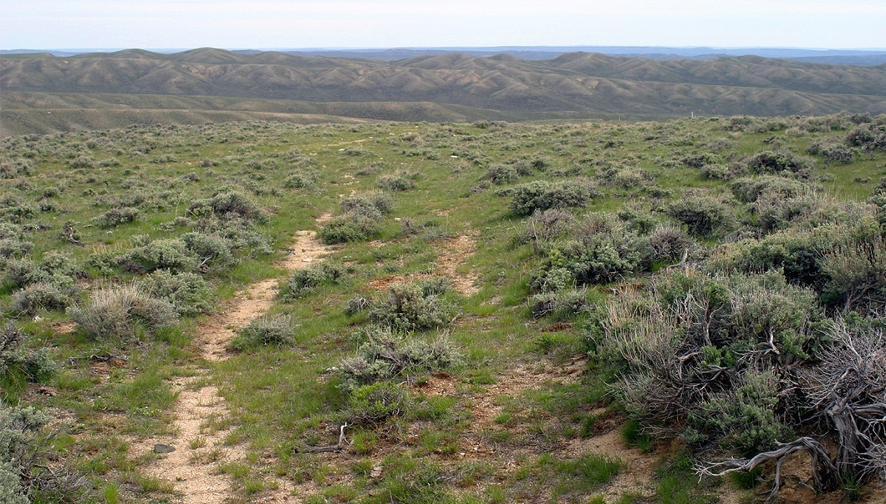
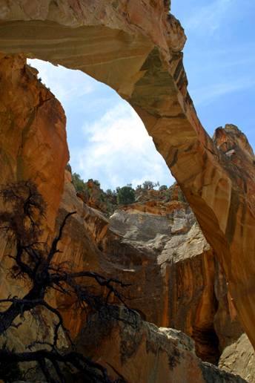
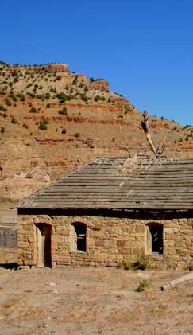
Visual Aspects of Cultural & Historic Sites

Slide 28
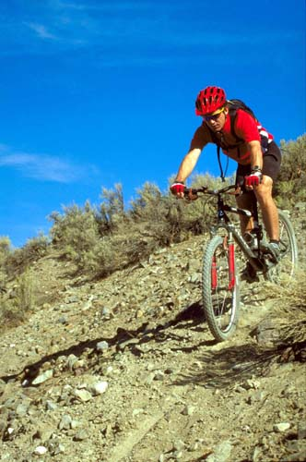
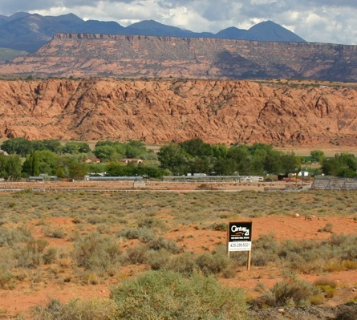
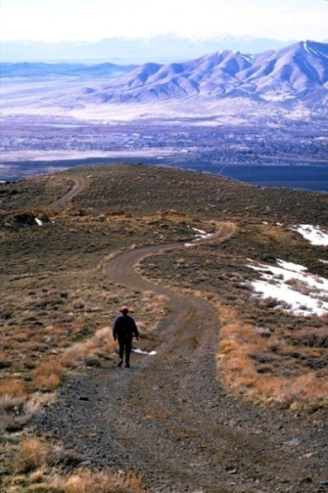
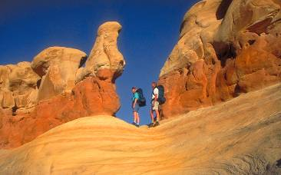
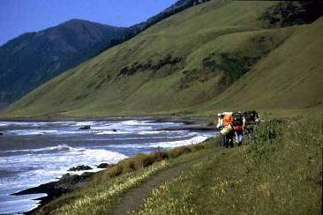
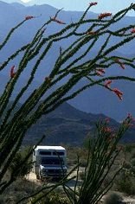
BLM lands are the backyard of many western communities

Slide 29
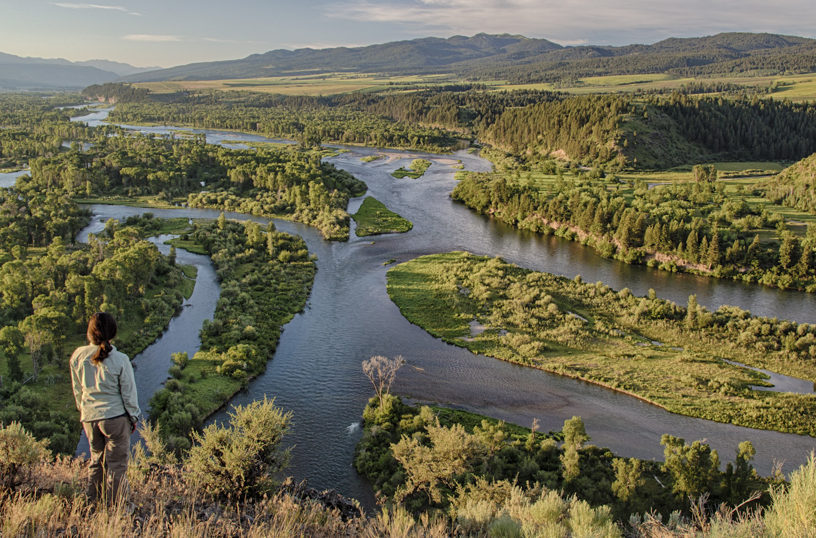
Management Decisions affect Scenic Value
Foresters and wildlife biologists
Range conservationists
Soil scientists
Air specialists
Fire scientists
Botanists
Riparian ecologists
Hydrologists and
aquatic biologists
Water engineers
Lands, realty, energy actions
Outdoor recreation planners
Cultural resource specialists/ archeologists/ historians
by Bob Wick
Notes:
So what makes up the visual resource?
What are its elements in this photo – what do you see, what kind of decisions are we making?
Decisions may change or preserve the natural landscape character

Slide 30
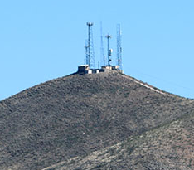







VRM and Multiple Use Management
56 million people live within 30 minutes of BLM administered lands
Land use decisions that add to the landscape’s visual elements:
  Recreation facilities & activities
  Cultural and historic settings
  Renewable energy generation plants
    Solar
    Wind
    Geothermal
  Communication systems
  Metals/minerals/ aggregates mining
  Oil and gas drilling and production
  Coal
  Livestock management facilities (e.g., water tanks/ reservoirs)
Notes:
The BLM is in a fish bowl

Slide 31









A Developing Landscape
Notes:
Many demands for resource and energy development. Selecting the best site within the mosaic of federally managed lands, communities and treasured landscapes -

Slide 32



A Developing Landscape
The decisions we make today as public land managers will be judged today and forward into future generations:
  87% of experiences through sense of sight
  First impressions mold and hold public opinion
  Increasing public sensitivity
  Visible Stewardship
  Legacy for future generations

Slide 33
Overview of VRM Policy
The Visual Resource Management (VRM) System provides an orderly systematic way to observe the public lands and classify existing visual resources. Having this system makes it possible to evaluate effects of change.
1. Inventory
2. Land Use Plan (LUP) VRM Objectives
3. LUP Implementation
4. Monitoring
5. Inventory
Maintenance
  Visual Resource Inventory (VRI)
  Decisions on managing VRI values
  Visual Resource Contrast Rating
  process to safeguard implementation
  Monitoring change to visual resource condition
  Update the Visual Resource Inventory

Slide 34

Policy Guidance for Scenic Resources
BLM Policy: Manual Section 8400: Visual Resource Management (1984)
  Handbook 8410-1 Visual Resource Inventory
  Handbook 8431 Visual Resource Contrast Rating

Slide 35

Overview of VRM Policy
VRM is a collaborative process
And all programs have responsibility

Slide 36



Overview of VRM Policy
Step 1: Visual Resource Inventory
  Establishes a quantified record of the value and condition of the visual resources that exist on the public lands:
    Scenic Quality (A, B, C)
    Public Sensitivity (High, Medium, Low)
    Distance Zones (foreground/ middle-ground, background, seldom seen)

Slide 37


Overview of VRM Policy
Step 2: Planning & Management
  Consider the results of the Inventory with other resource objectives and land use allocations during the RMP process.
  Designate visual resource management objectives through the RMP process

Slide 38



Overview of VRM Policy
Step 3: Implementing VRM decisions in the land use plan:
  Visual Resource Contrast Rating Process helps guide an action’s early project planning toward RMP/VRM objective conformance.
  Discloses impacts to visual resources.
  Targets design elements not meeting a VRM objective.
  Draws attention to alternative design considerations.
  Informs changes to the visual resource inventory values.

Slide 39


Overview of VRM Policy
Step 4: Monitoring:
  Making sure land use authorizations comply with VRM objectives, stipulations, and conditions of approval
  Maintaining a pulse on the visual resource condition over time and tracking the trends
  Land use plan achieves the desired outcomes

Slide 40


Step 5: Update the Visual Resource Inventory
Step 5: VRI Maintenance:
  Changes to the VRI factors
  Track the trends in the Visual Resource condition
  Refresh the Visual Resource Inventory
EcoFlight
Notes:
Check that he VRI is up to date during a project’s 1st onsite meeting

Slide 41

Visible Stewardship of a finite resource
Different viewpoints on what is beautiful

Slide 42

Visible Stewardship of a finite resource
Different approaches to design and many solutions

Slide 43

Visible Stewardship of a finite resource
BLM VRM system is focused on measuring and
minimizing visual contrast

Slide 44



Visible Stewardship of a finite resource
If not carefully designed, activities have the potential to:
  Significantly alter the visual character of the landscape
  Reflect on the BLM’s image
  Effects on visitor experience and community quality of life
  Cause project delays through protest, appeals
  Increase long term costs due to restoration needs

Slide 45


Benefits if carefully designed...

Slide 46


Benefits if carefully designed...

Slide 47

Benefits if carefully designed...

Slide 48

Benefits if carefully designed...

Slide 49




Benefits if carefully designed...

Slide 50
Interior Board of Land Appeals
BLM has the legal obligation to manage for the protection of Scenic Value:
  IBLA Decisions
    144IBLA070 - Utah Decision
    173IBLA313 - Beaver Rim, Lander FO
    174 IBLA 078 - Tom Van Sant, California
    IBLA 2016-74 - Big Burrito Mountain Bike Trail Petition for Stay
Following the BLM’s VRM policies and systematic procedures learned this week will enable the BLM to defend its decisions that affect the visual resource.

Slide 51

Someone is watching

Slide 52

And now Language of Landscapes
“For Centuries Americans have drawn strength and inspiration from the beauty of our country. It would be a neglectful generation indeed, indifferent alike to the judgment of history and the command of principle, which failed to preserve and extend such a heritage for its descendants” (Beauty for America 1965)

