Slide 1
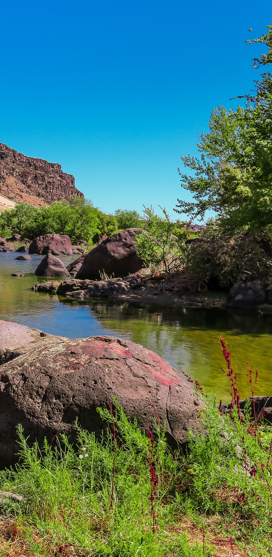
June 2019
Boise, Idaho

Slide 2
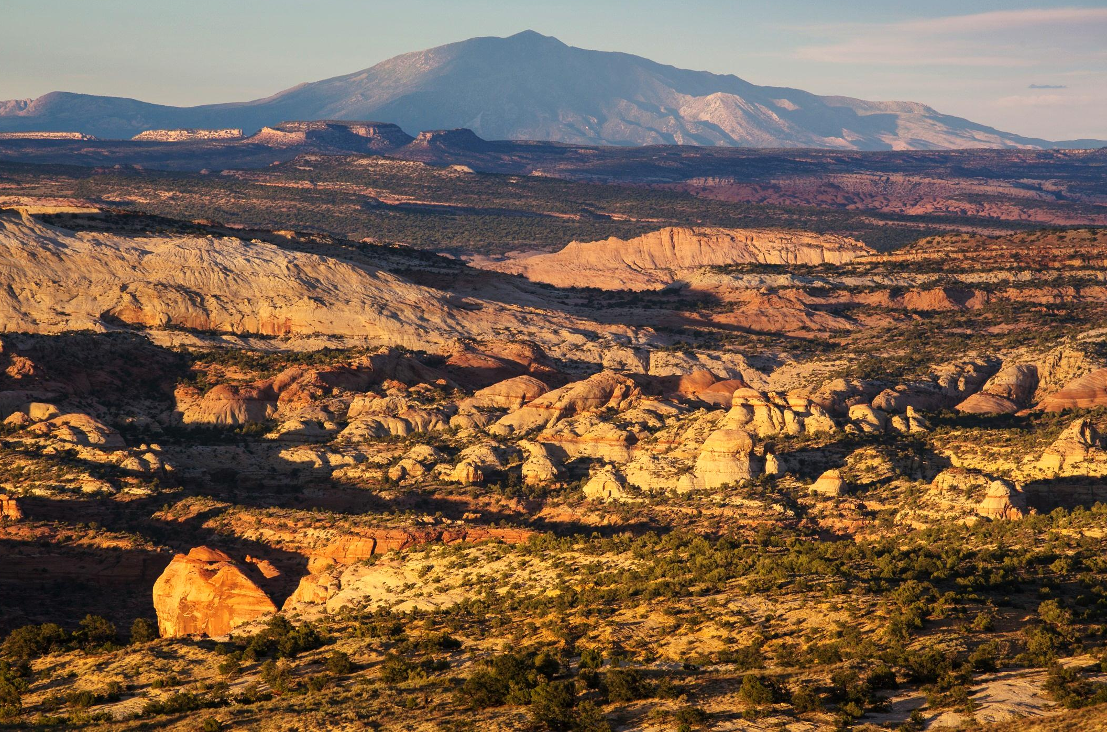
Language of Landscapes

Slide 3
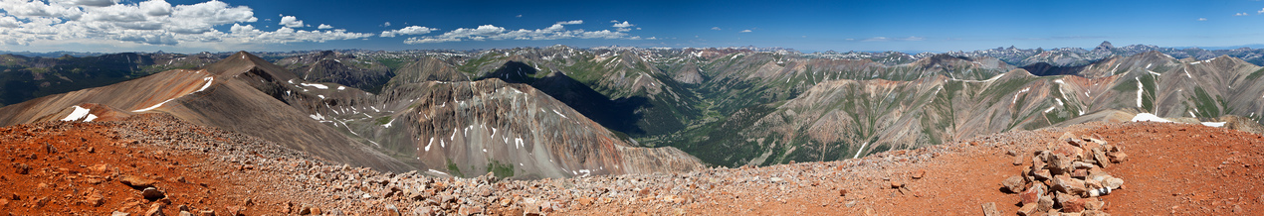
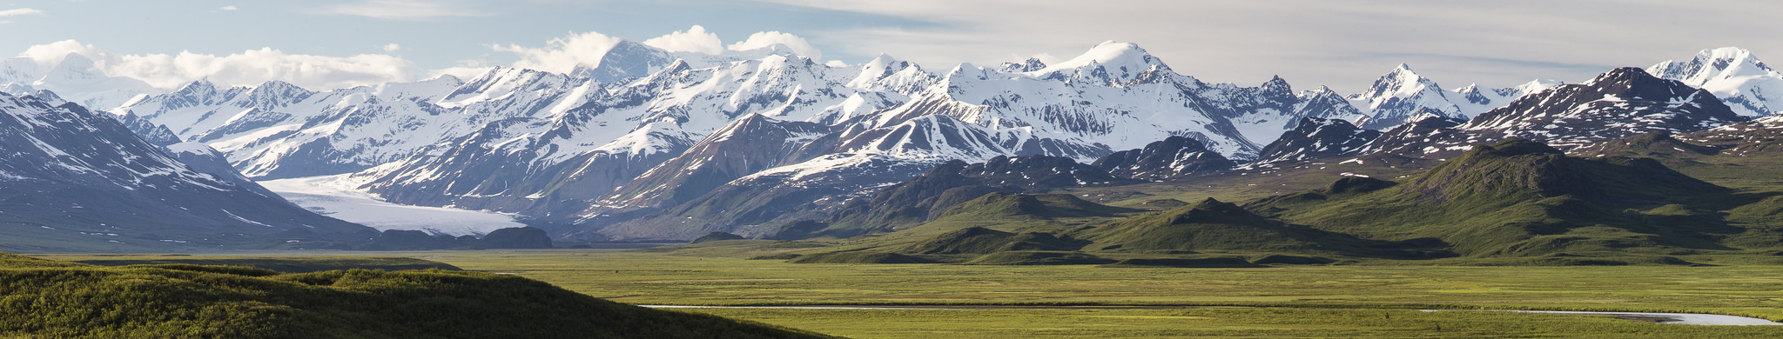
Language of Landscapes
Unit Objective
  By end of lesson, be able to analyze and describe the landscape character of a given scene based on:
  type of landscape
  landscape character elements
  landscape analysis factors

Slide 4
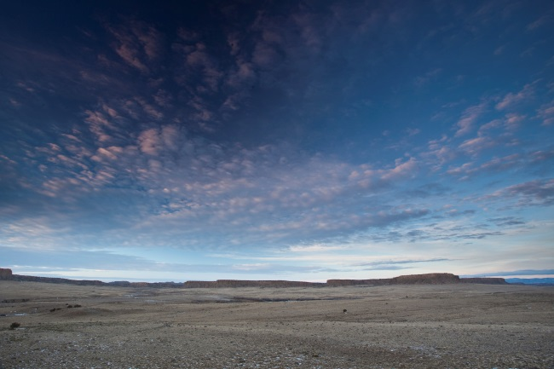
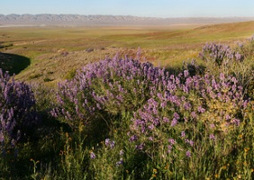
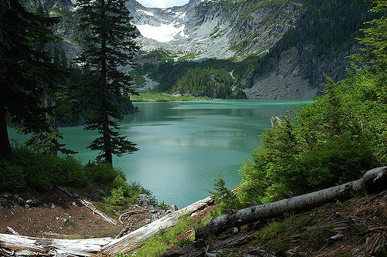
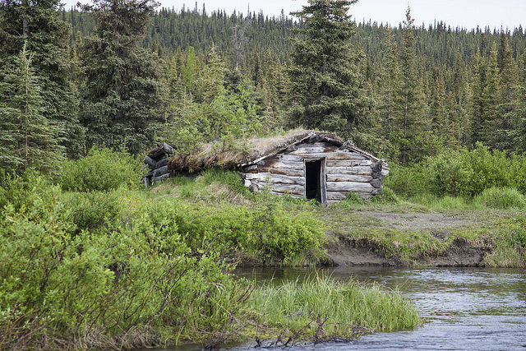
Language of Landscapes
Landscape Character
  The character of a landscape is the overall impression created by its unique combination of visual components (such as land, vegetation, water,
  and structures).

Slide 5
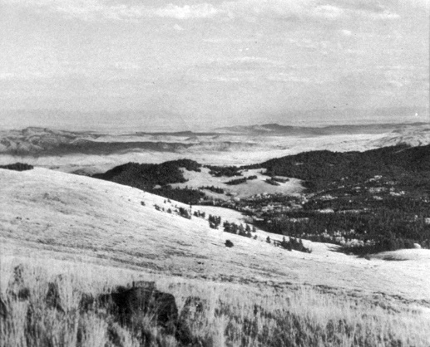
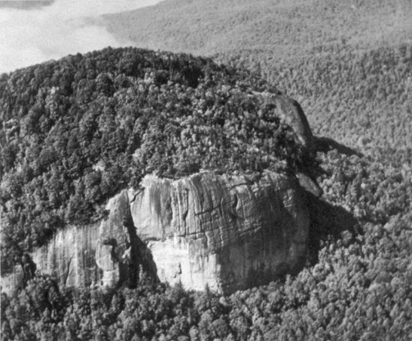
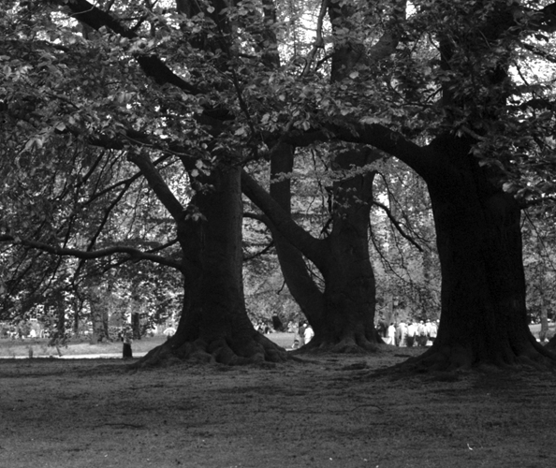
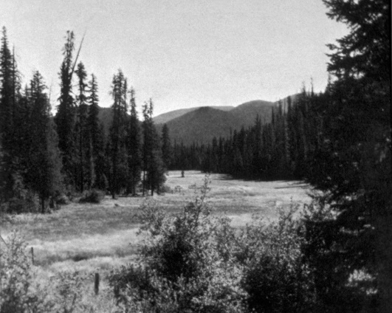
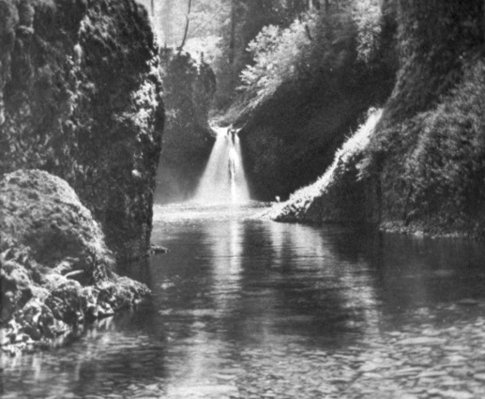
Language of Landscapes
Types of Landscapes
Panoramic
Canopied
Feature
Enclosed
Focal

Slide 6
Language of Landscapes
Types of Landscapes
Panoramic Landscapes
  Unobstructed, wide view of an extensive area
  Little or no sense of boundary
  Open and expansive
  Foreground/middle ground features do not substantially block background
  Sky and foreground occupy much of view

Slide 7
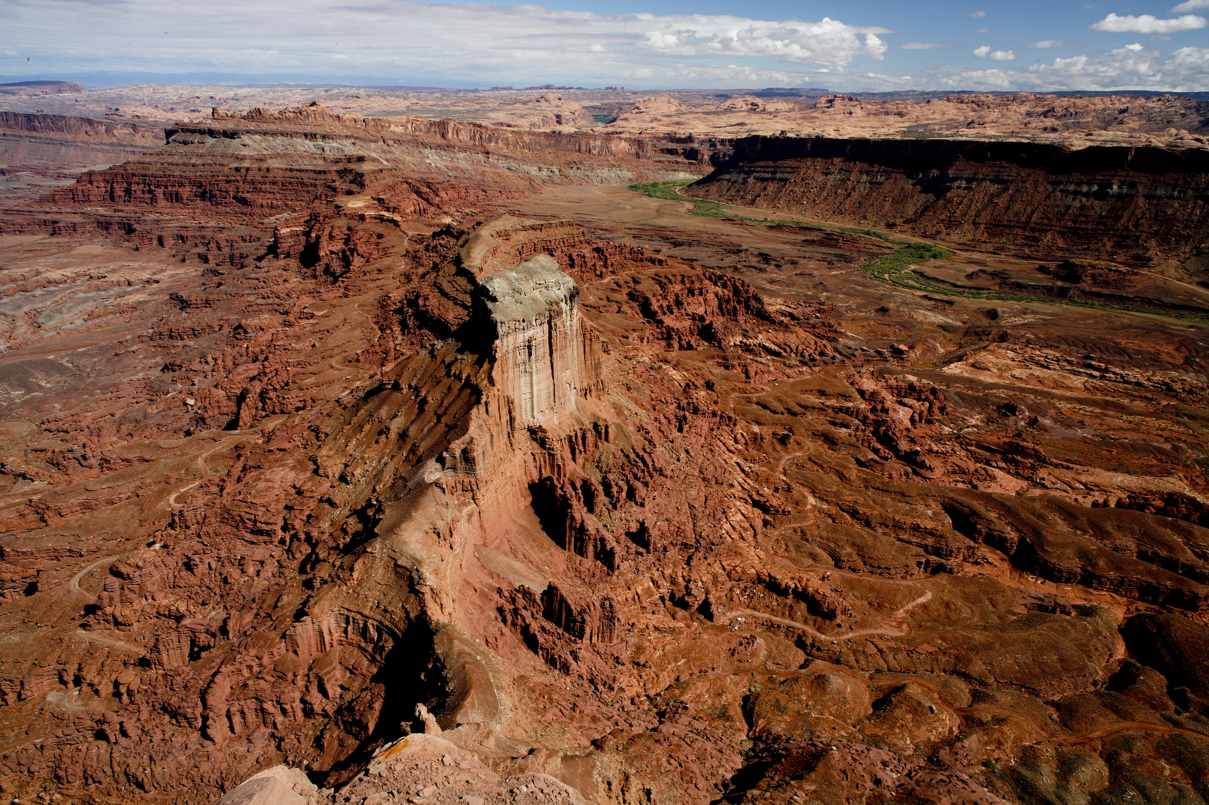
Language of Landscapes
Types of Landscapes
Panoramic

Slide 8
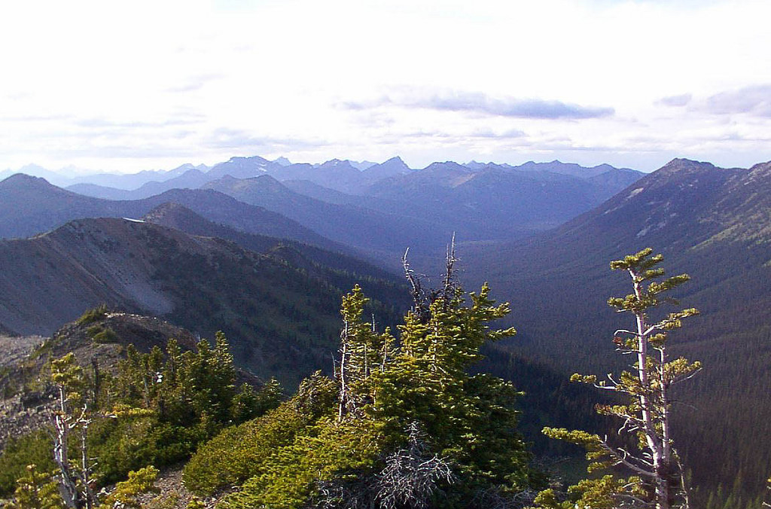
Language of Landscapes
Types of Landscapes
Panoramic

Slide 9
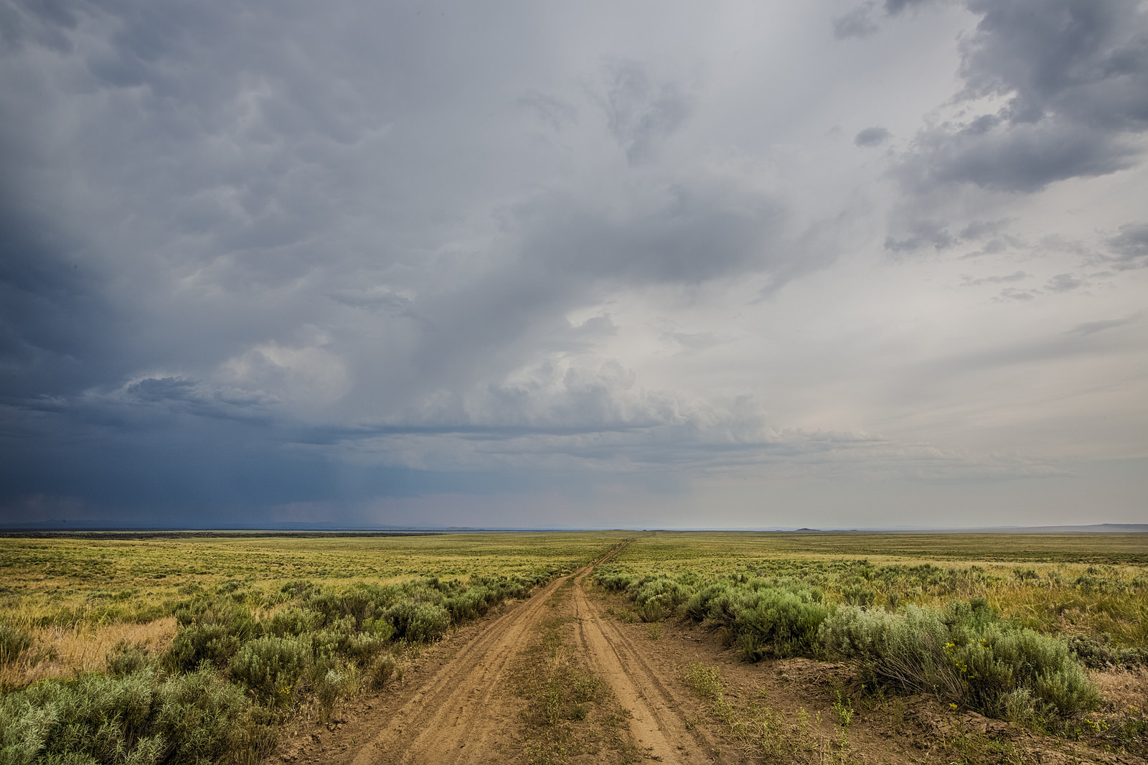
Language of Landscapes
Types of Landscapes
Panoramic

Slide 10
Language of Landscapes
Types of Landscapes
Enclosed Landscapes
  Landscape spaces surrounded by continuous groupings of features.
  Eye is drawn to enclosed portion of landscape.
  An example is a meadow or small lake surrounded by walls of trees or earth forms.
  Modifications within enclosure space may be highly visible.

Slide 11
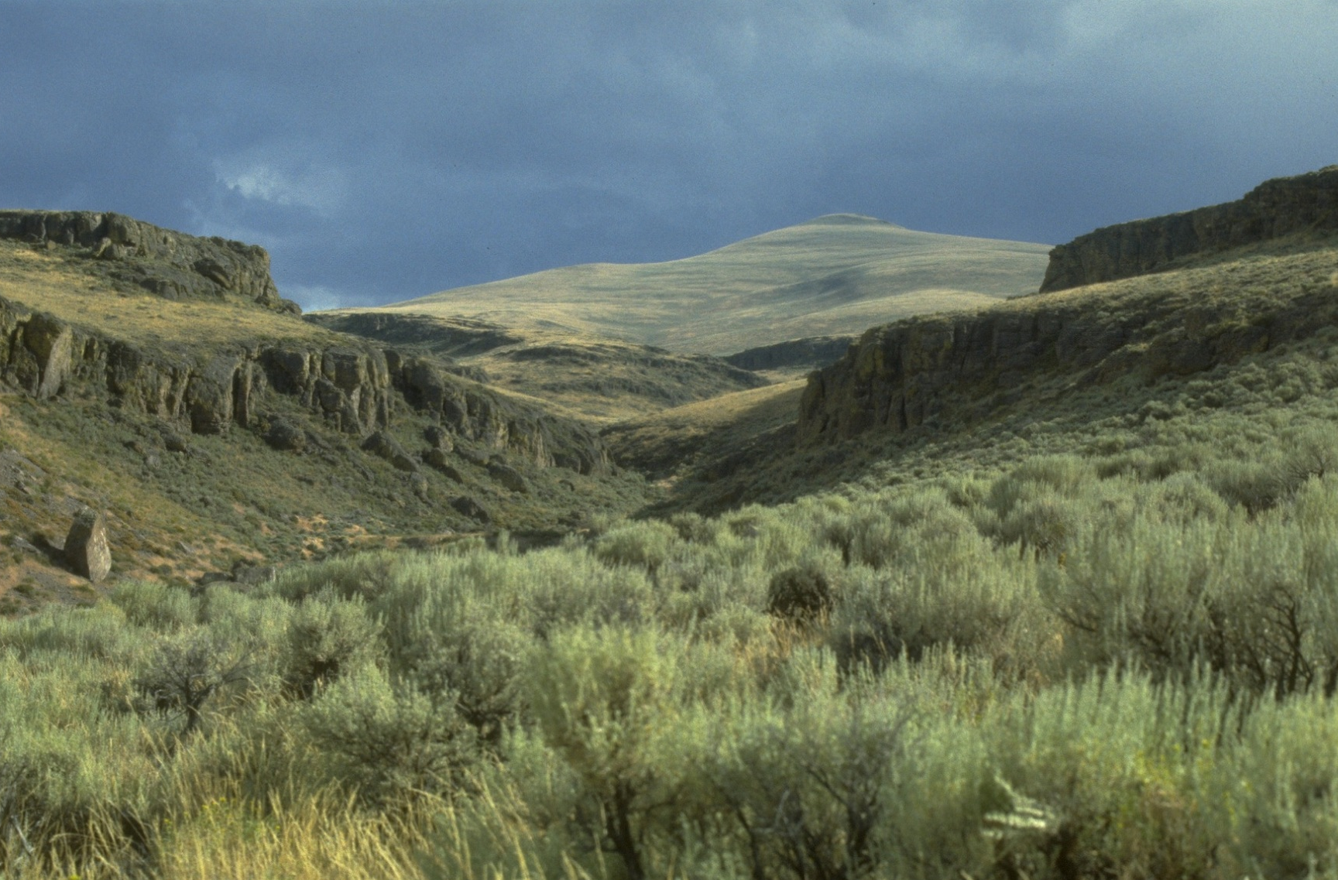
Language of Landscapes
Types of Landscapes
Enclosed

Slide 12
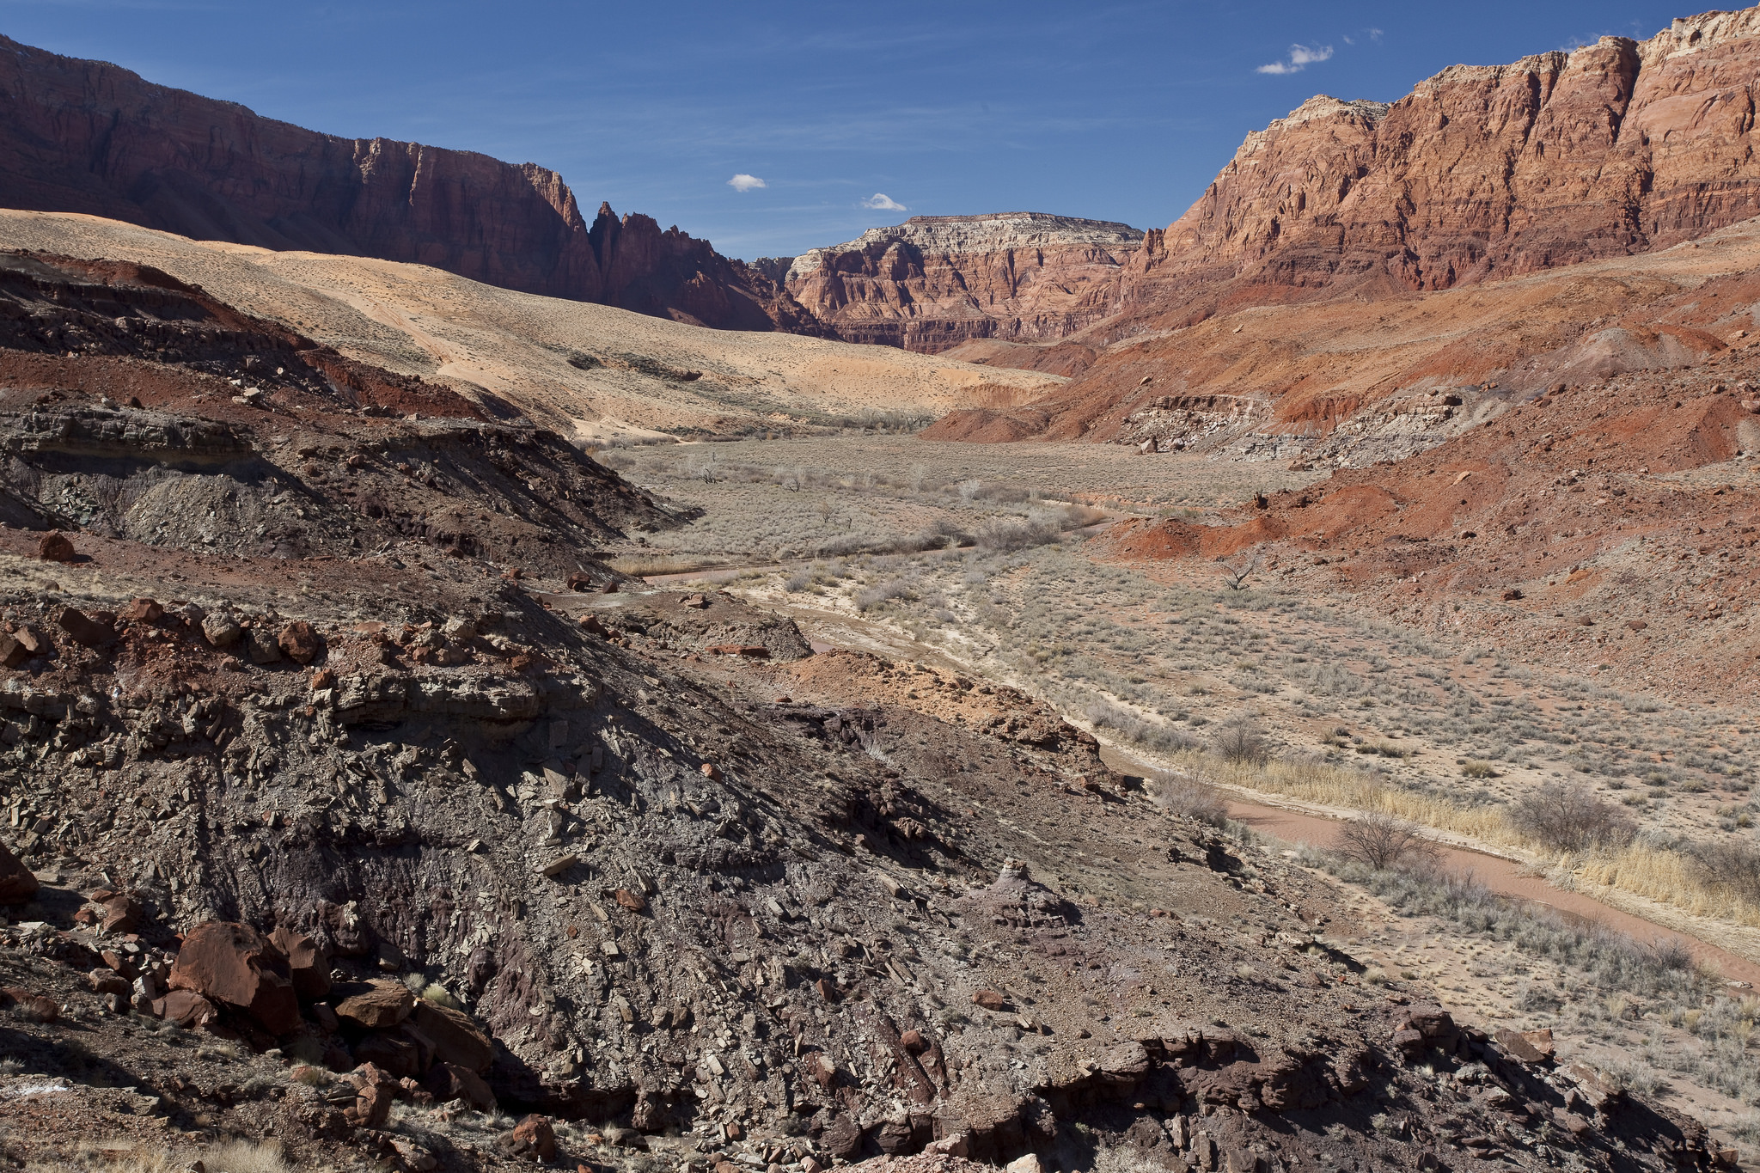
Language of Landscapes
Types of Landscapes
Enclosed

Slide 13
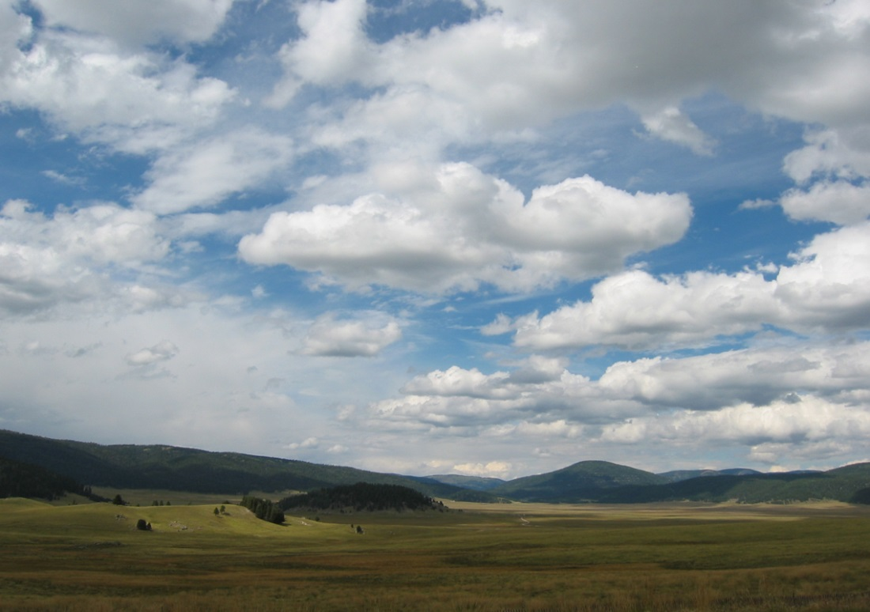
Language of Landscapes
Types of Landscapes
Enclosed

Slide 14
Language of Landscapes
Types of Landscapes
Feature Landscapes
  Dominated by feature or group of feature objects.
  Eye is drawn to feature.
  Typically includes such elements as a prominent landform or waterfall.
  Vulnerable to modification if near feature.

Slide 15
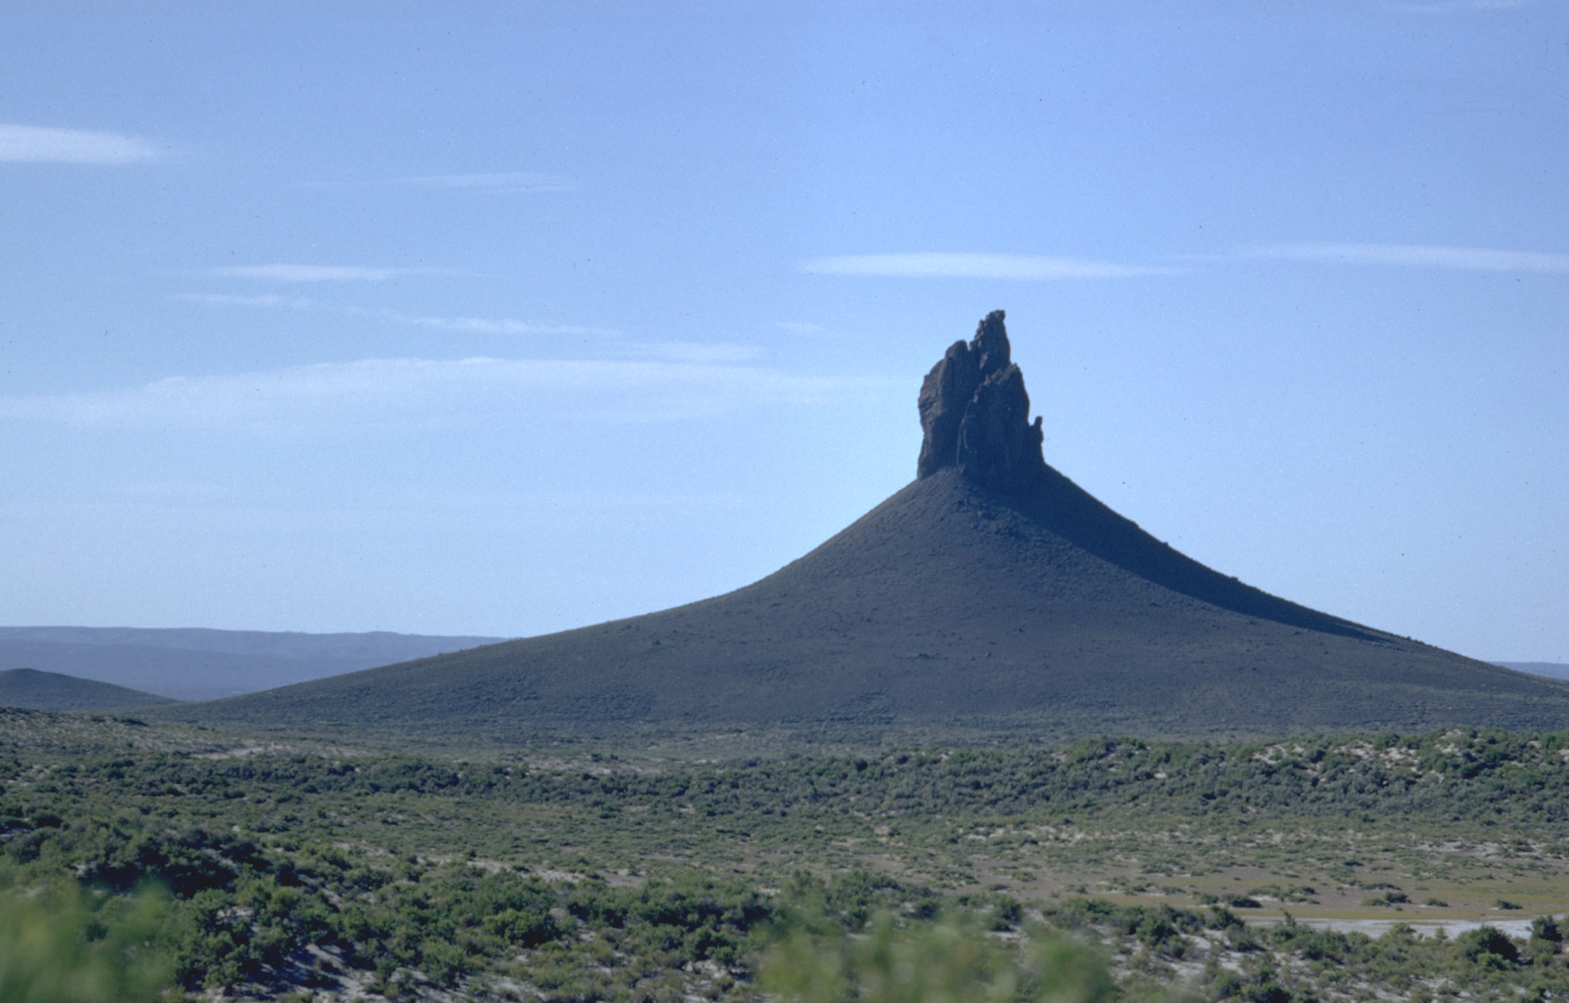
Language of Landscapes
Types of Landscapes
Feature

Slide 16
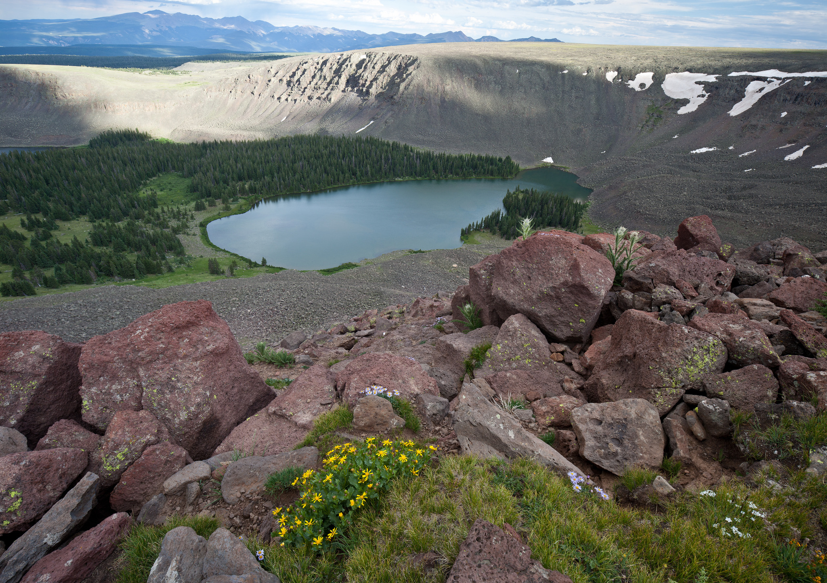
Language of Landscapes
Types of Landscapes
Feature

Slide 17
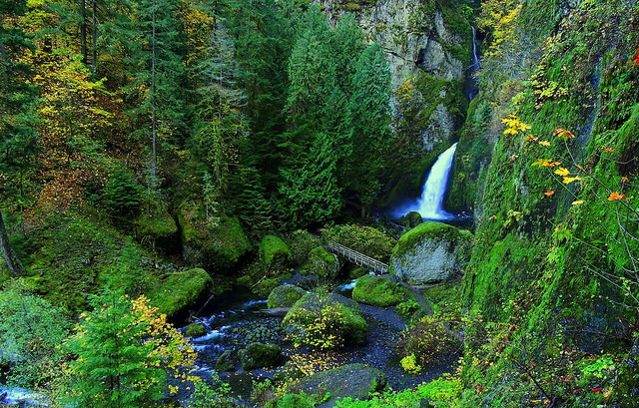
Language of Landscapes
Types of Landscapes
Feature

Slide 18
Language of Landscapes
Types of Landscapes
Focal Landscapes
  Tend to converge upon themselves as distance increases.
  Eye is drawn to focal point.
  Vulnerable to modification if near focal point.

Slide 19
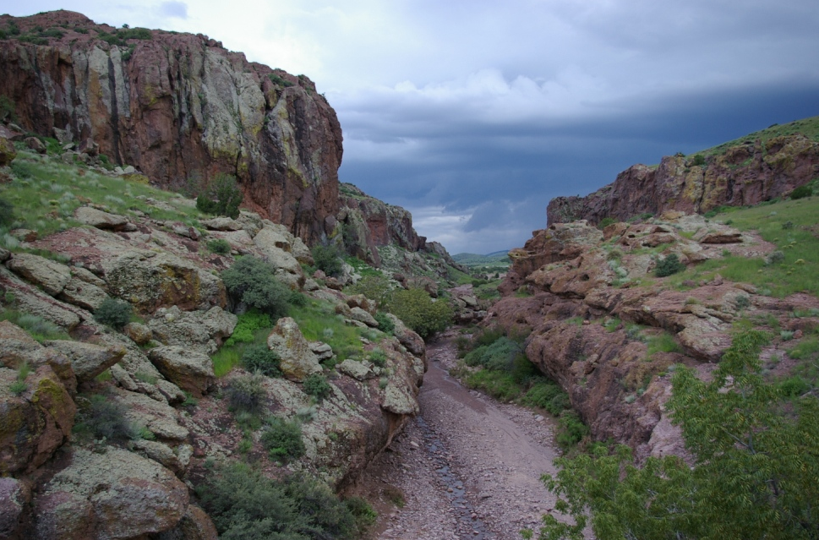
Language of Landscapes
Types of Landscapes
Focal

Slide 20
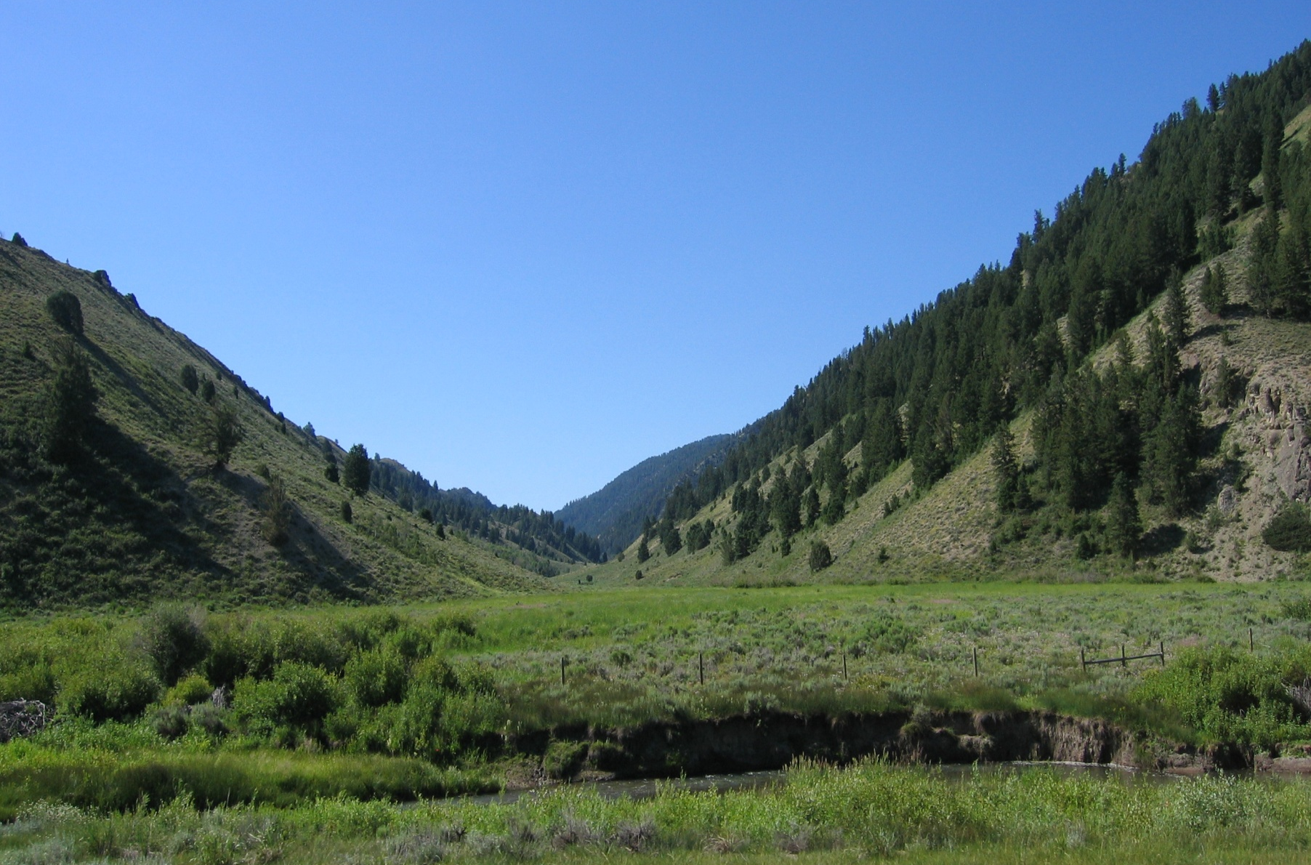
Language of Landscapes
Types of Landscapes
Focal

Slide 21
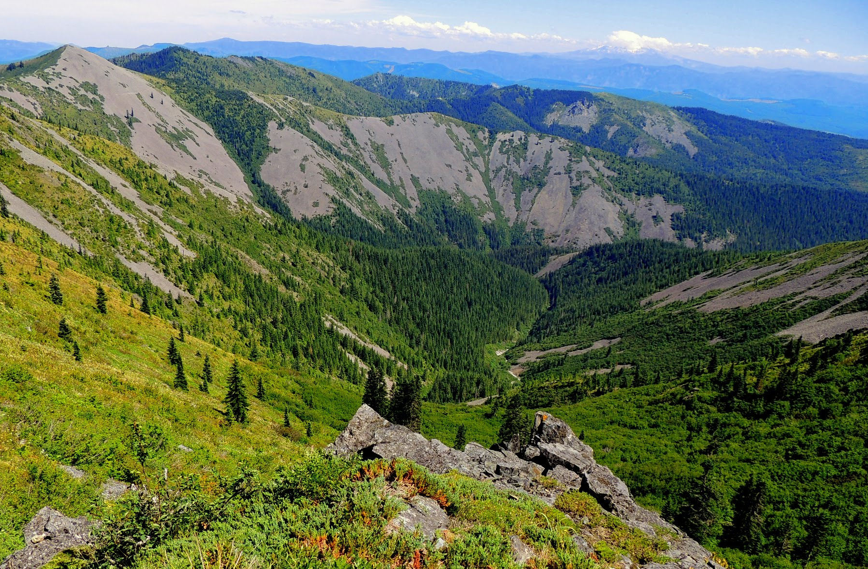
Language of Landscapes
Types of Landscapes
Focal

Slide 22
Language of Landscapes
Types of Landscapes
Canopied Landscapes
  Features overhead create a ceiling or canopy.
  Typically within or at the edge of a forest where branches and foliage are overhead.

Slide 23
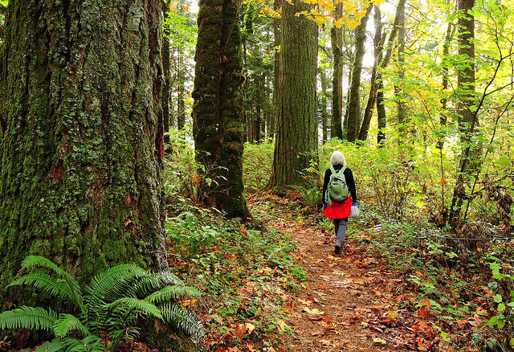
Language of Landscapes
Types of Landscapes
Canopied

Slide 24
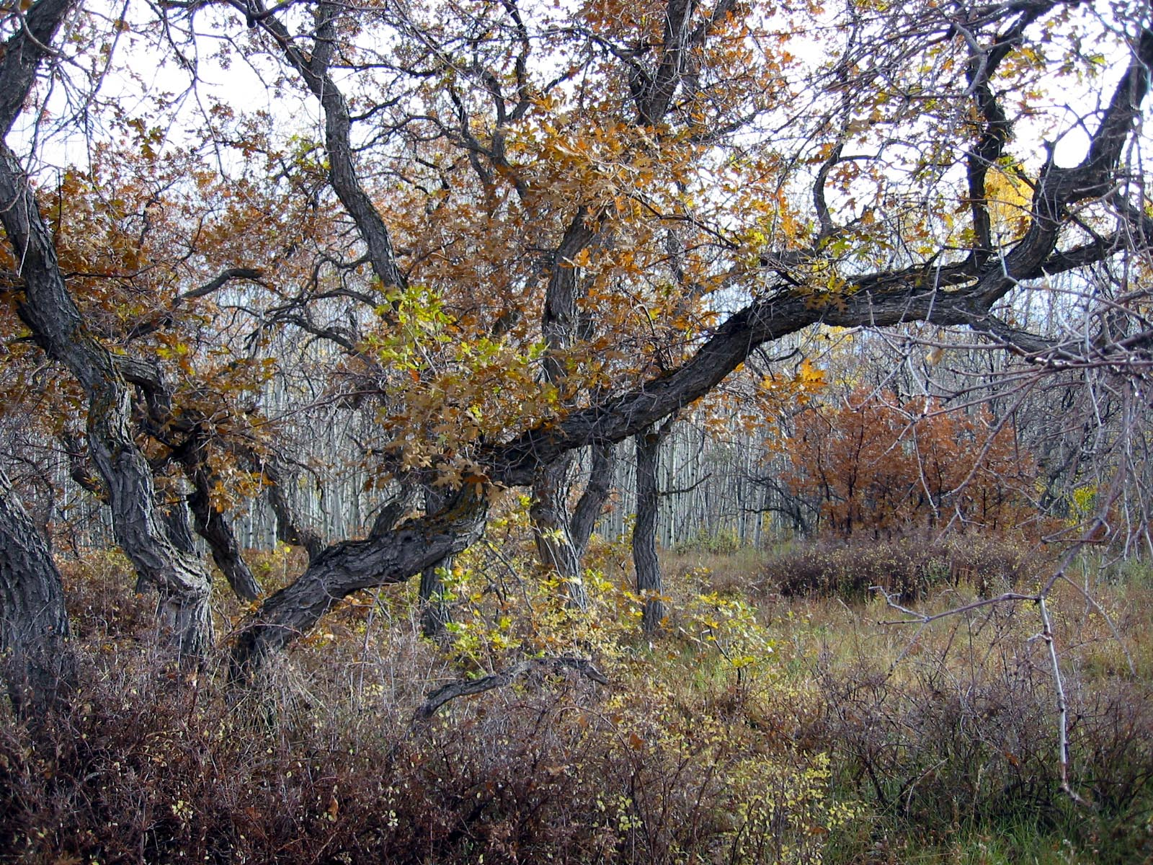
Language of Landscapes
Types of Landscapes
Canopied

Slide 25
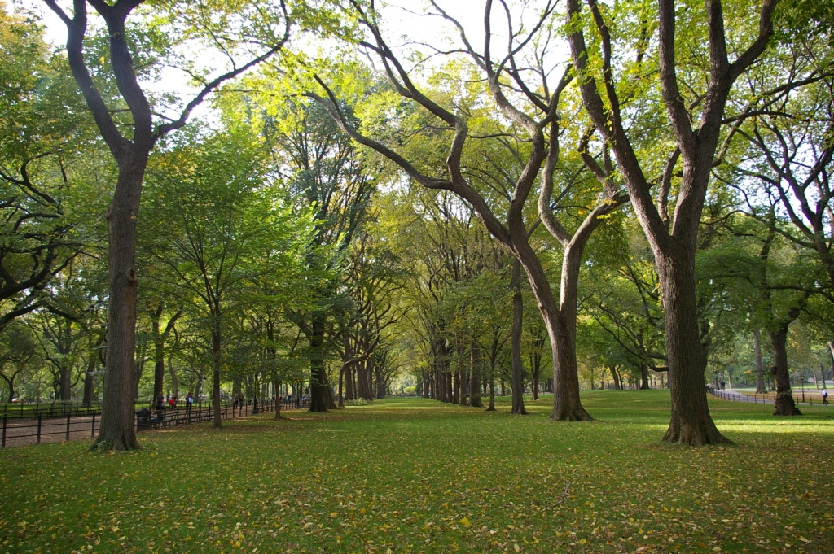
Language of Landscapes
Types of Landscapes
Canopied

Slide 26
Types of Landscapes - EXERCISE A

Slide 27
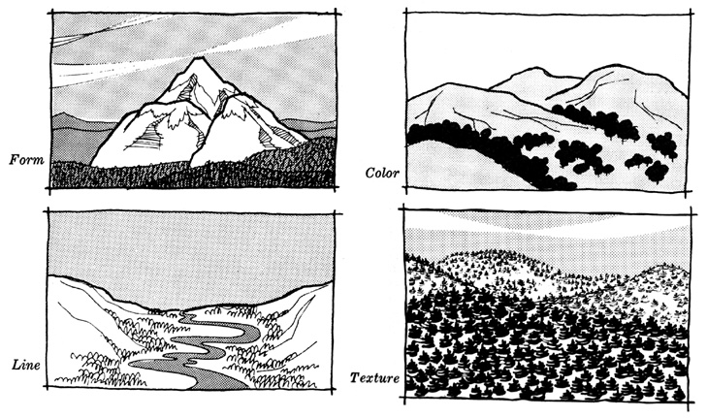
Language of Landscapes
Landscape Character Elements
Form
Color
Texture
Line

Slide 28
Language of Landscapes
Landscape Character Elements
Form
  Mass of an object or a combination of objects that appears unified.
  2-dimensional form = shape
    Shapes are sometimes seen when adjacent areas have a contrast in color or texture.
  3-dimensional form = mass
    Mass is seen when a natural object, landform or manmade structure’s bulk, size and expanse is perceived.
Shape
=
Rectangle
Mass
=
Cube

Slide 29
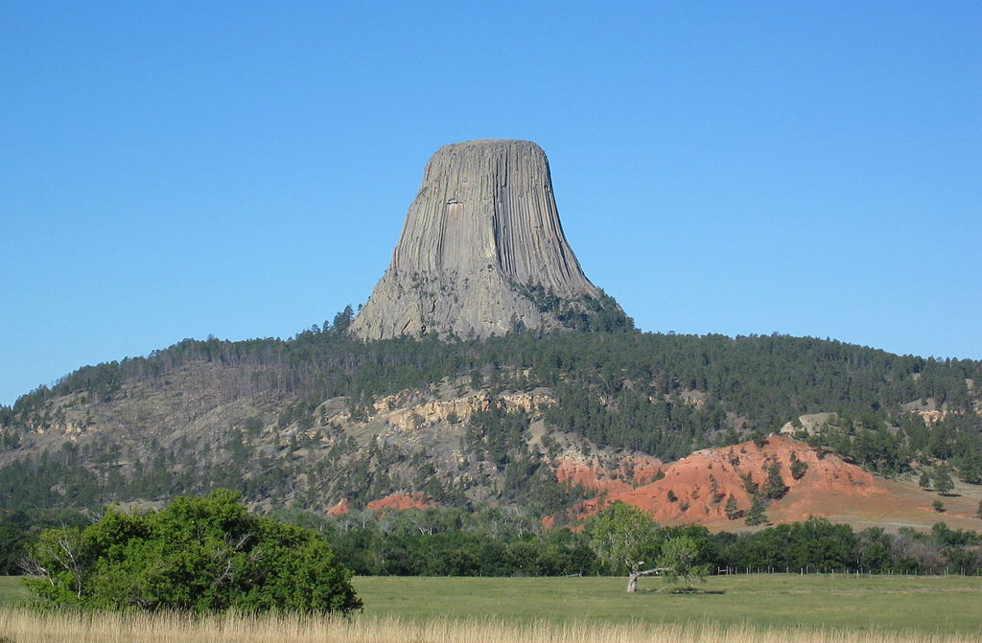
Language of Landscapes
Landscape Character Elements
Form
By Kevstan (Own work) [CC BY-SA 3.0 (http://creativecommons.org/licenses/by-sa/3.0) or GFDL (http://www.gnu.org/copyleft/fdl.html)], via Wikimedia Commons

Slide 30
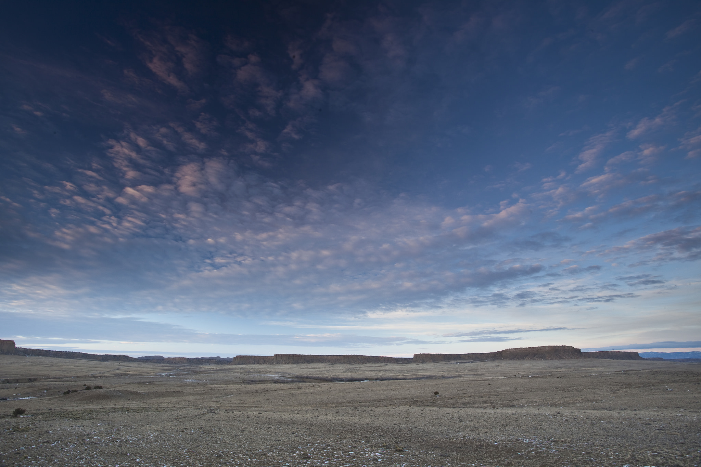
Language of Landscapes
Landscape Character Elements
Form

Slide 31
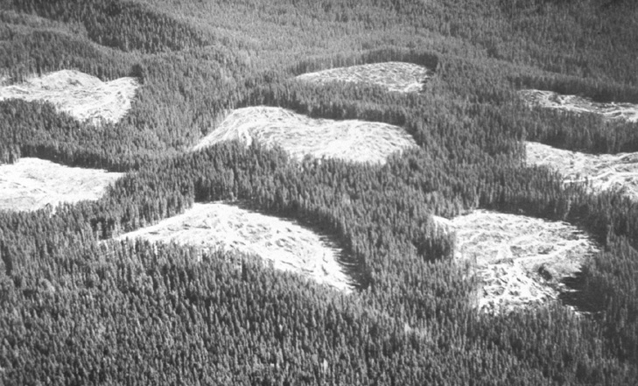
Language of Landscapes
Landscape Character Elements
Form

Slide 32
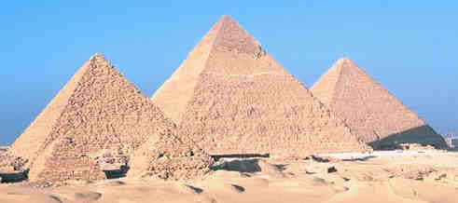
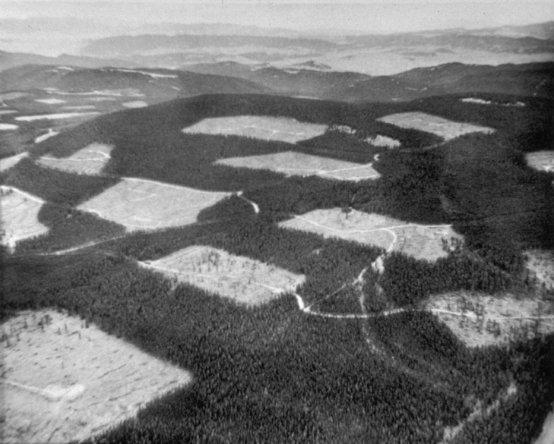
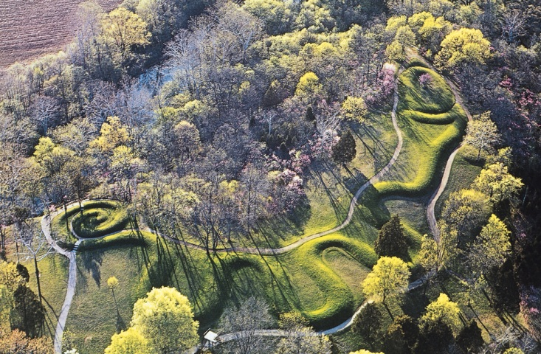
Language of Landscapes
Landscape Character Elements
Form
  Forms that are bold, regular, solid or vertical tend to be dominant.
Pyramids @ Giza
Logging, BLM photo
from Rich Hagan’s file
Serpent Mound, Ohio

Slide 33
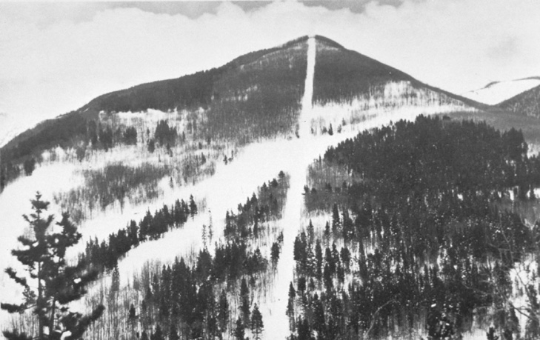
Language of Landscapes
Landscape Character Elements
Line
  Path (real or perceived) that the eye follows in a landscape.
  Perceived in abrupt differences in form, color, or texture, or when objects are aligned in sequence.
  Usually evident as the edge of shapes or masses in the landscape.

Slide 34
Language of Landscapes
Landscape Character Elements
Line
  Types of Line
  Edge
    Boundary between two contrasting areas
    Outline of a two-dimensional shape on the land surface
  Band
    Contrasting linear form with two roughly parallel edges
  Silhouette
    Outline of a mass seen against a backdrop

Slide 35
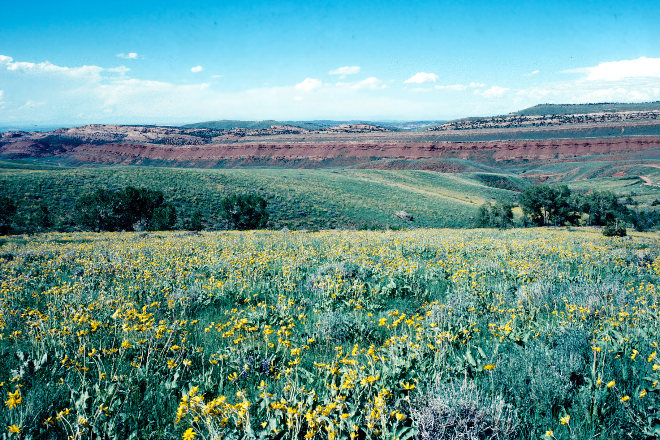
Language of Landscapes
Landscape Character Elements
Line

Slide 36
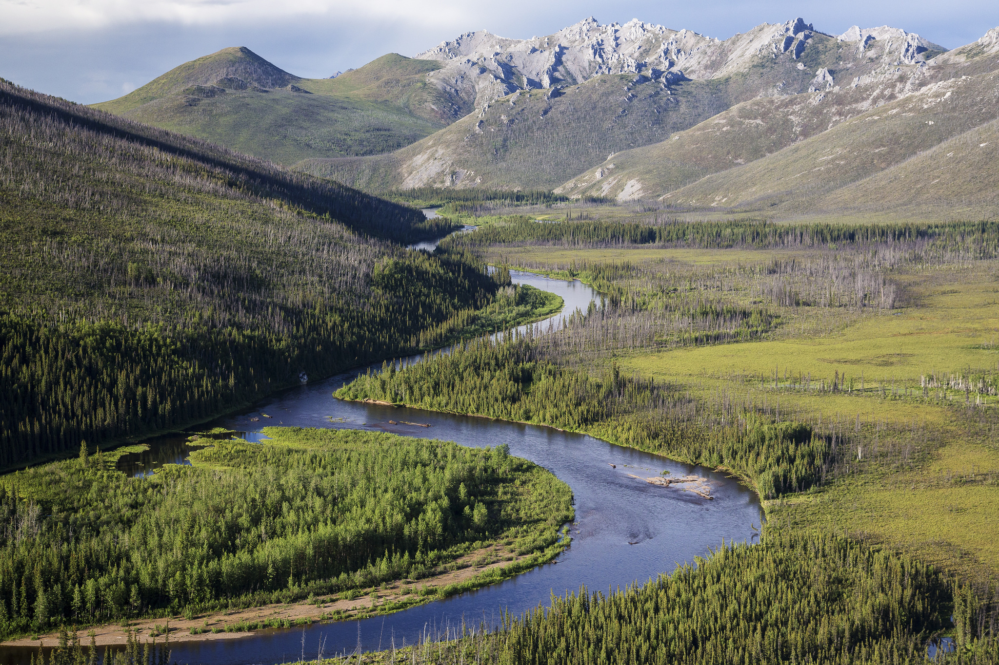
Language of Landscapes
Landscape Character Elements
Line

Slide 37
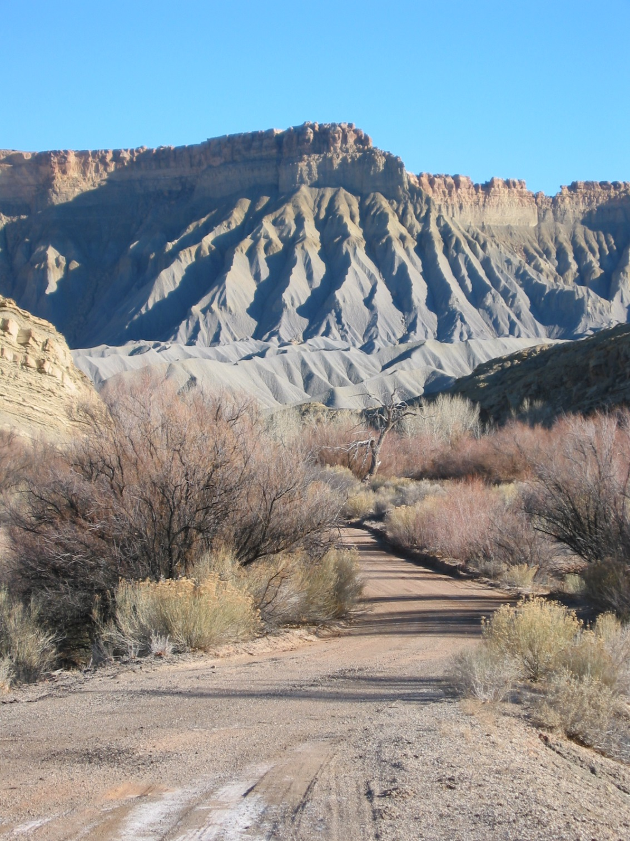
Language of Landscapes
Landscape Character Elements
Line

Slide 38
Language of Landscapes
Landscape Character Elements
Color
  The property of reflecting light of a particular intensity and wavelength to which the eye is sensitive.
  THE major visual property of surfaces.
  Color is what enables us to differentiate objects even though they have identical form, line, and texture.
  Color is processed by the brain before form or motion.
  Light, warm, bright colors typically advance and dominate. Dark, cool, dull colors will typically retreat.

Slide 39
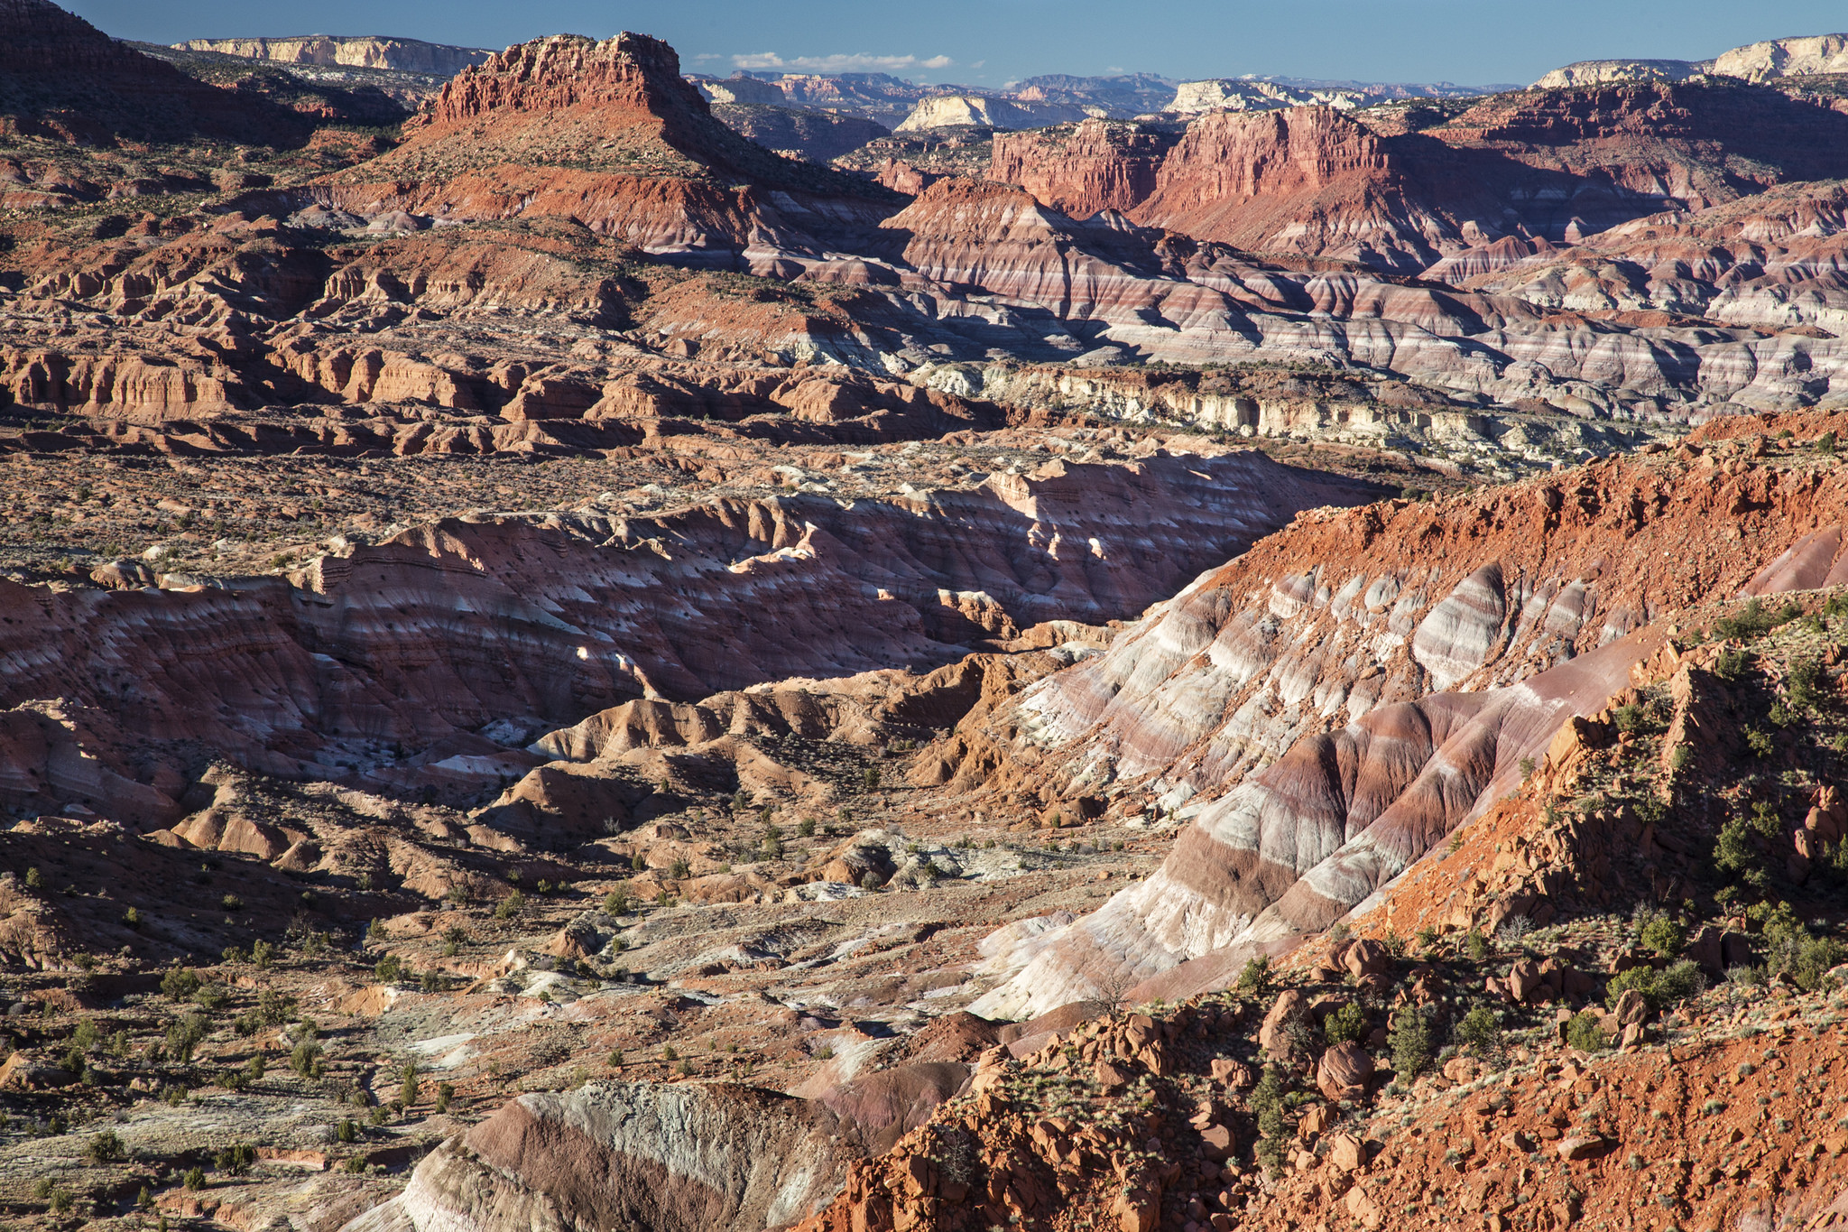
Language of Landscapes
Landscape Character Elements
Color

Slide 40
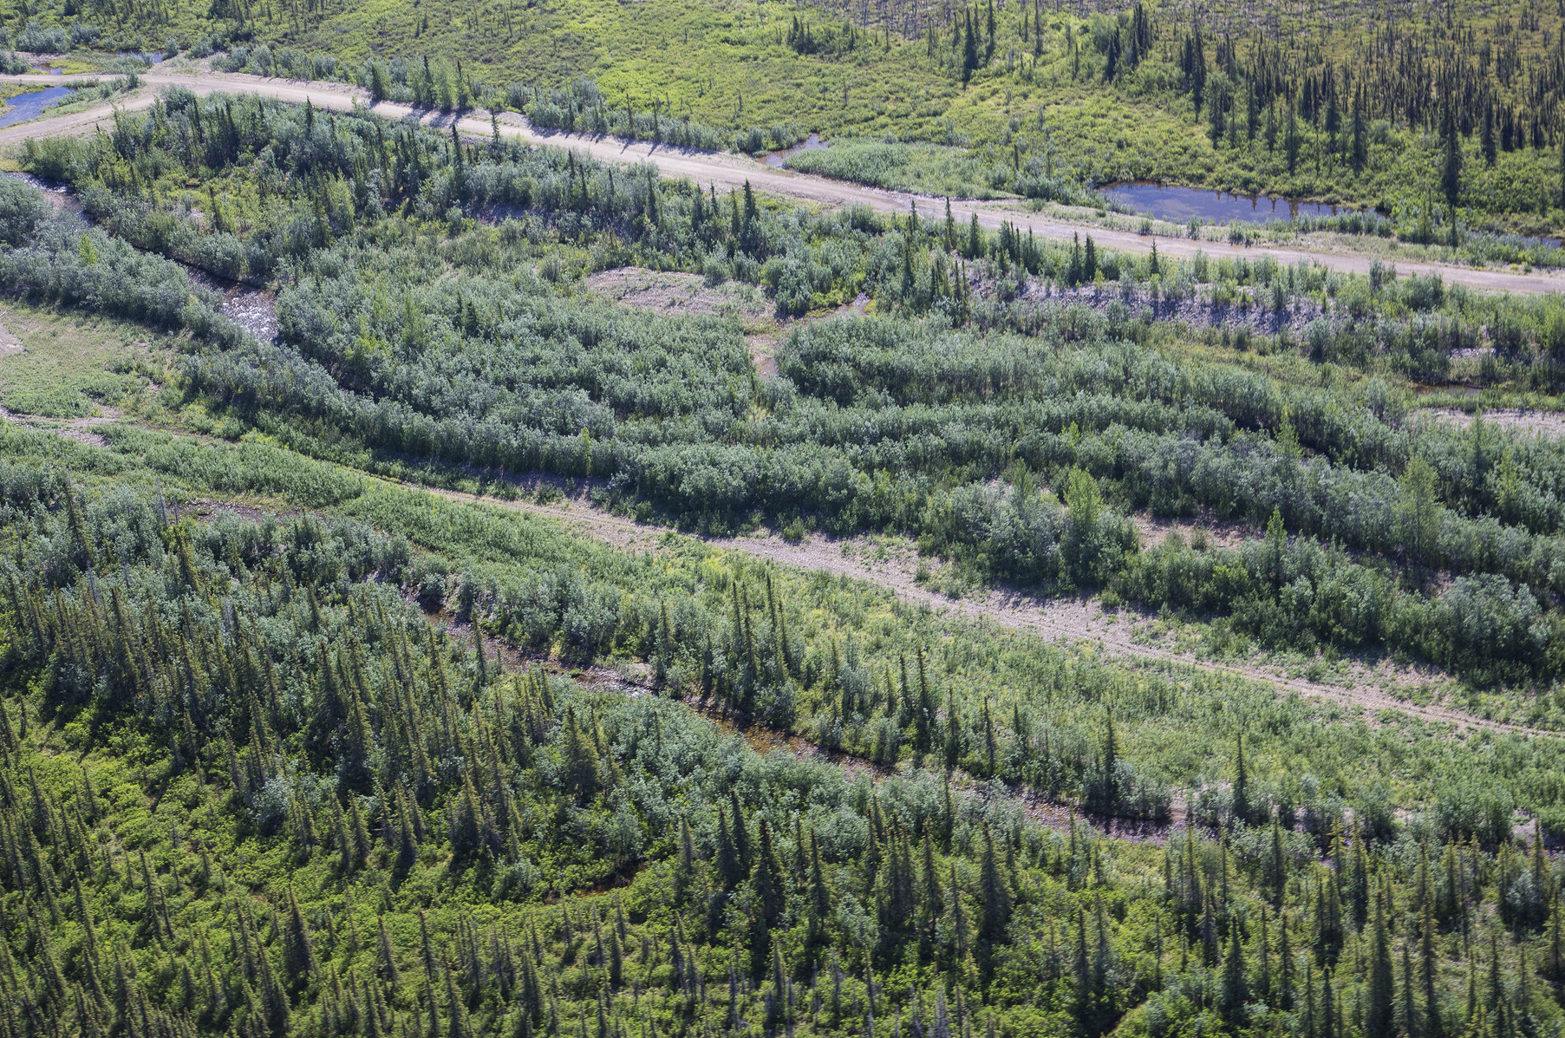
Language of Landscapes
Landscape Character Elements
Color

Slide 41
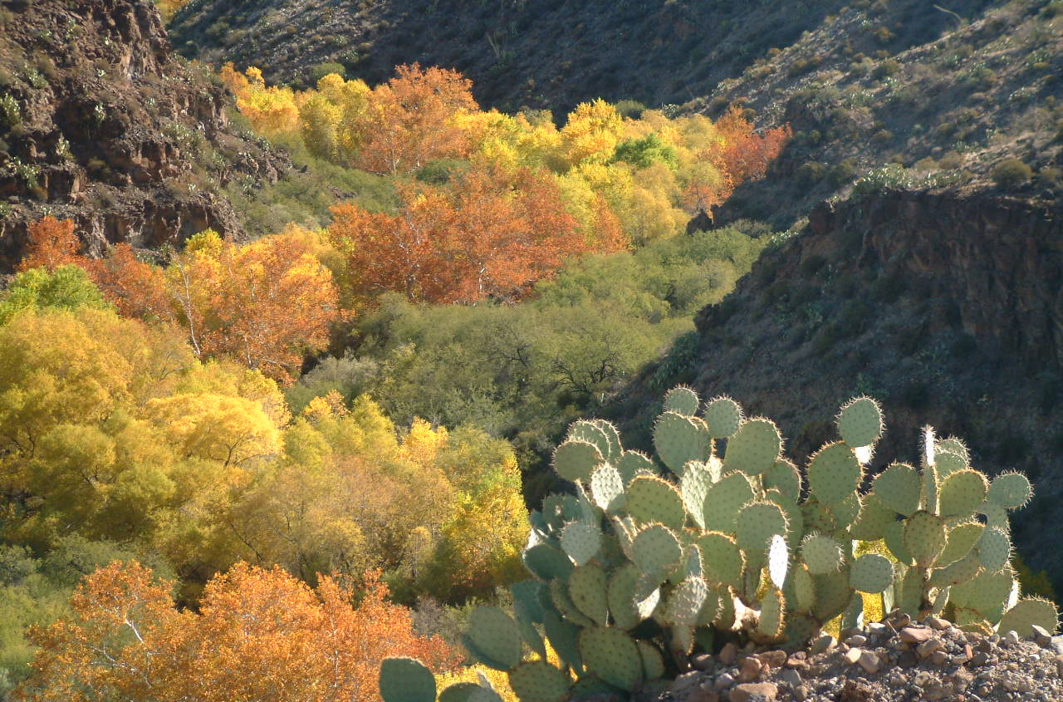
Language of Landscapes
Landscape Character Elements
Color

Slide 42
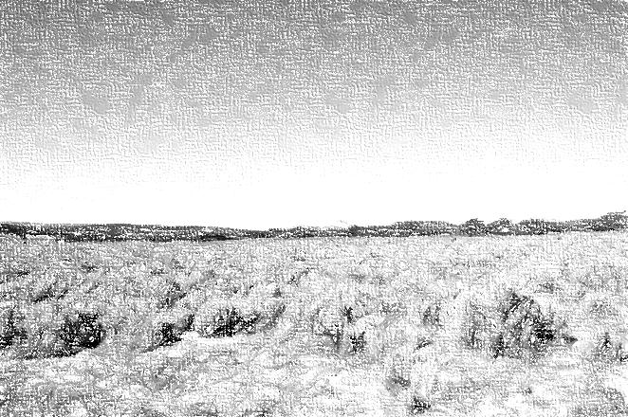
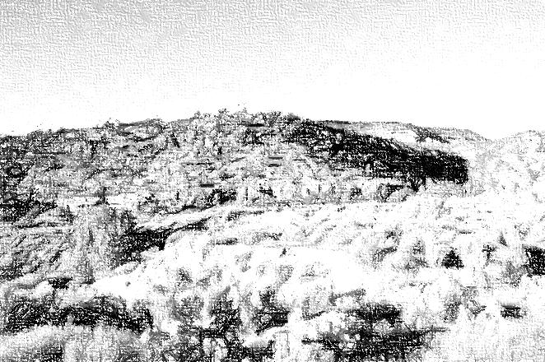
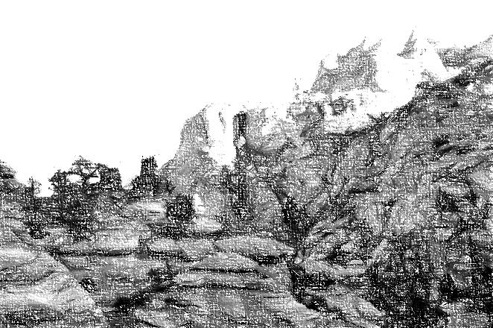
Language of Landscapes
Landscape Character Elements
Texture
  When individual forms or colors combine into a continuous pattern.
  Texture is not seen as discrete objects in the scene.
  Texture dominance diminishes with increasing distance.

Slide 43
Language of Landscapes
Landscape Character Elements
Texture
  Sub-elements of Texture
  Grain
    Relative dimensions of the surface variations.
      Fine, Medium, Coarse
  Density
    Spacing of surface variations.
      Sparse, Medium, Dense
  Regularity
    Degree of recurrence and arrangement of surface variation.
      Uneven/Random, Even/ordered, Gradation

Slide 44
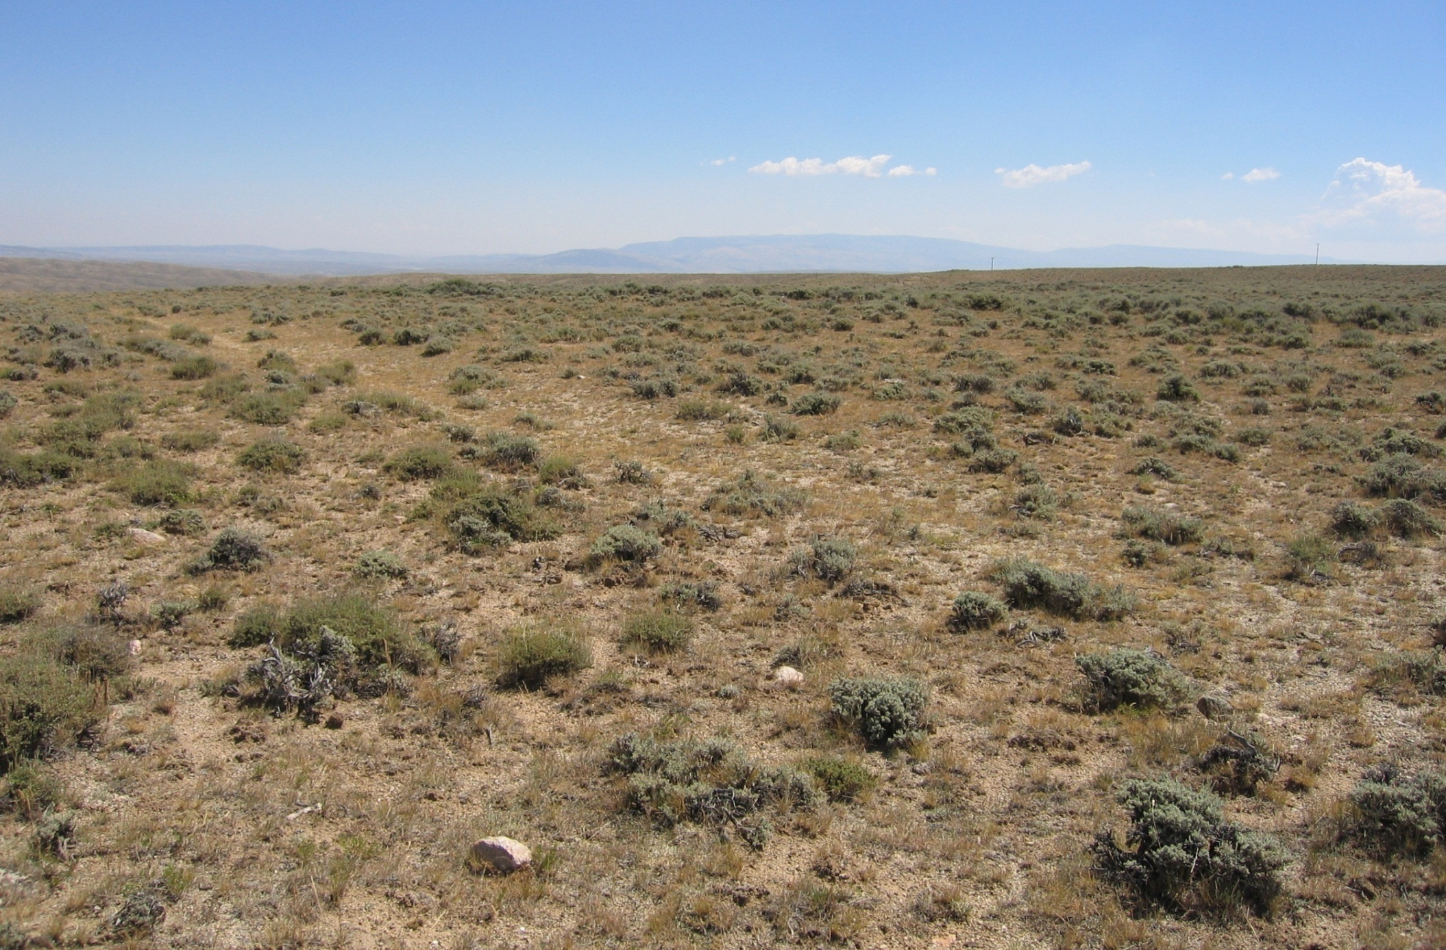
Language of Landscapes
Landscape Character Elements
Texture

Slide 45
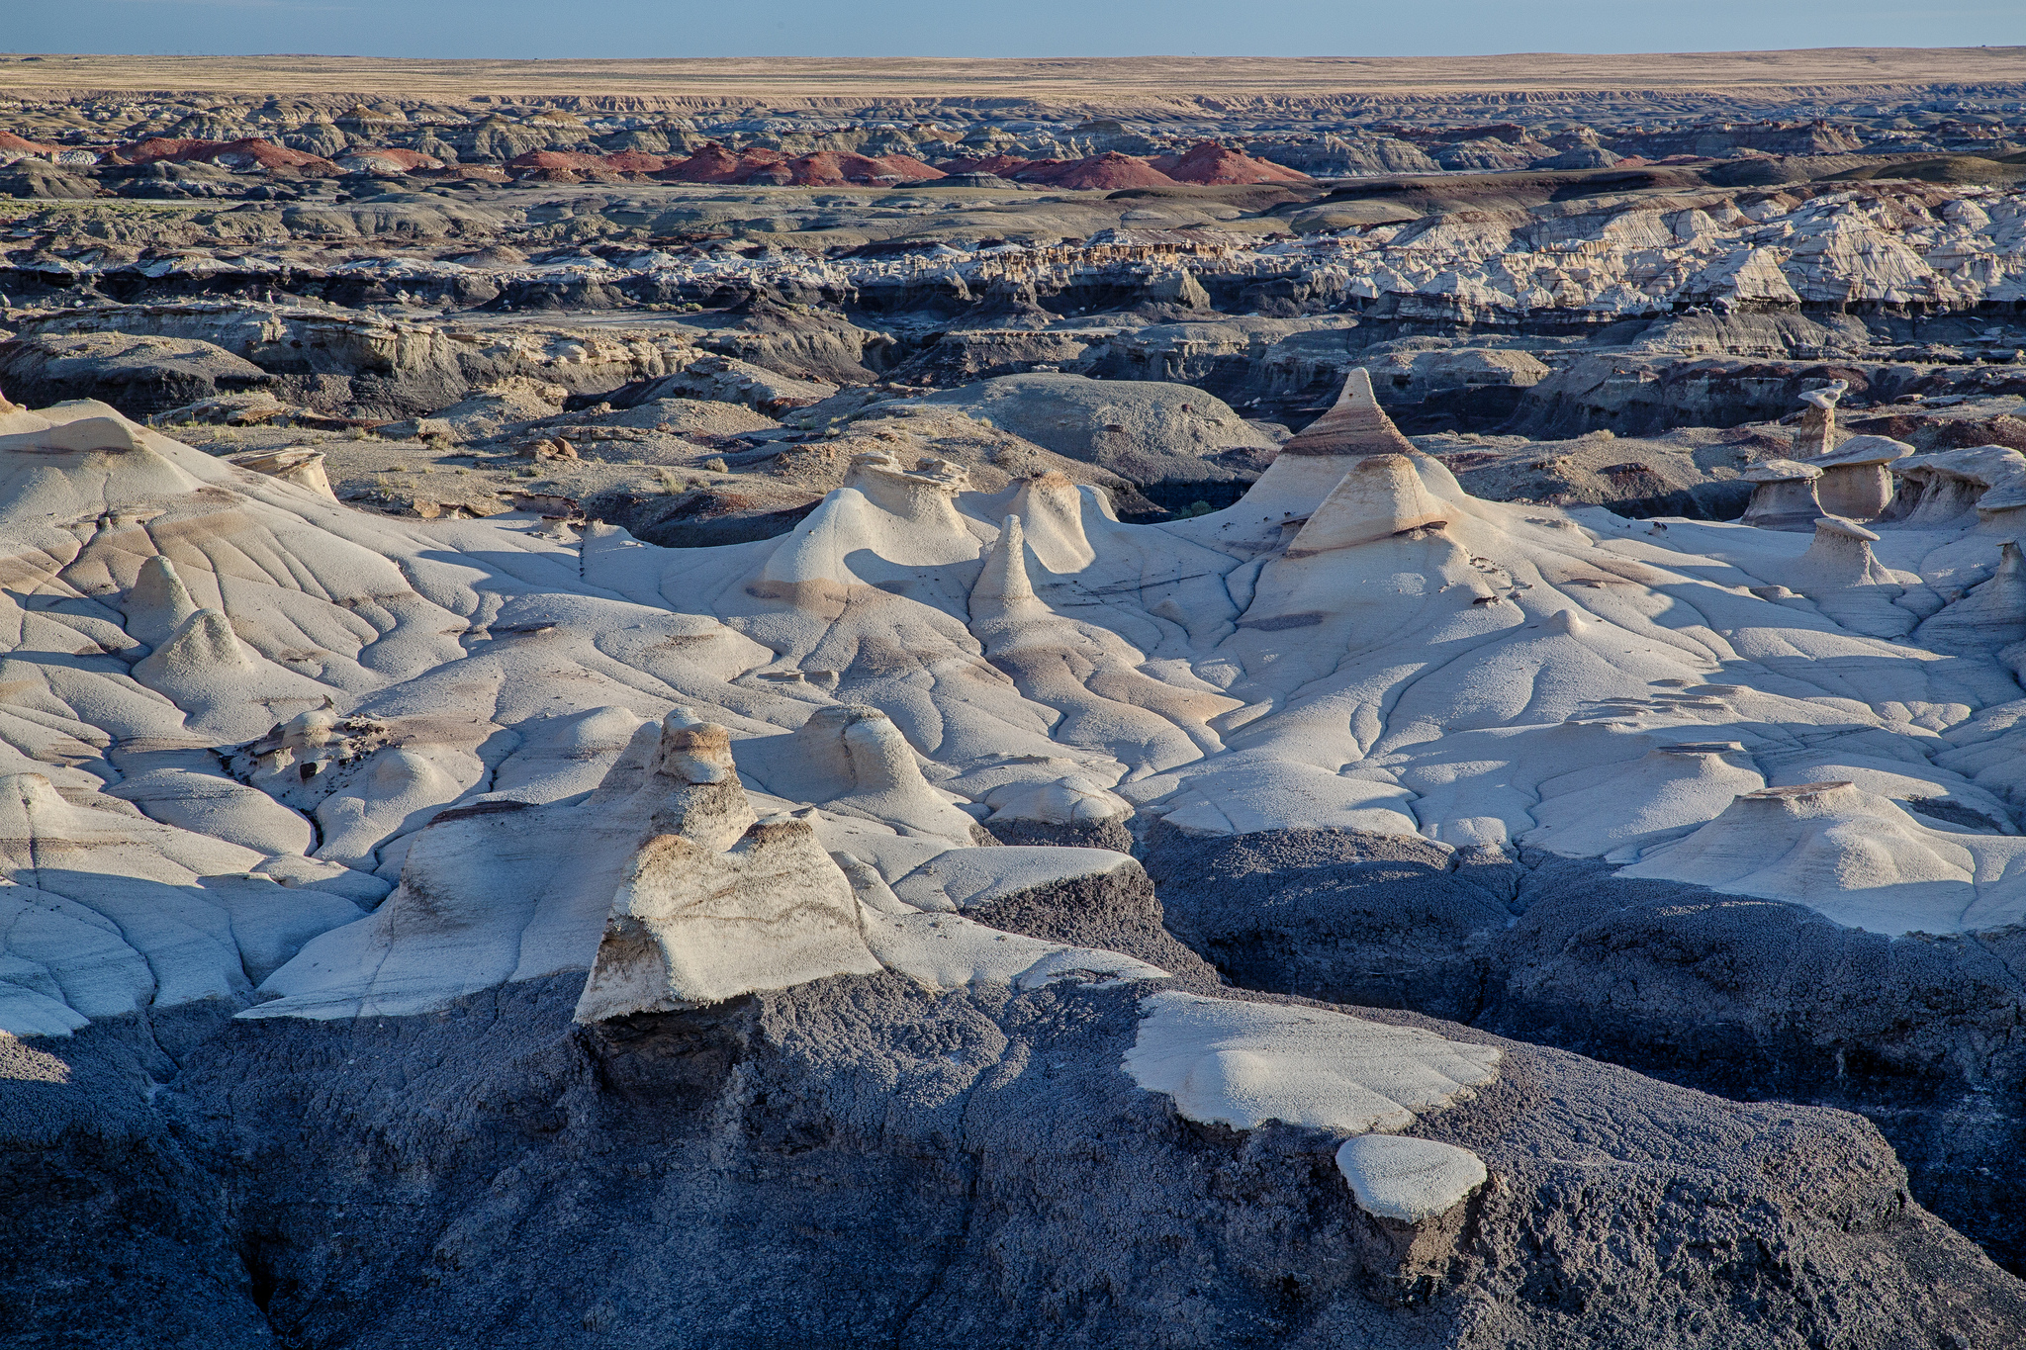
Language of Landscapes
Landscape Character Elements
Texture

Slide 46
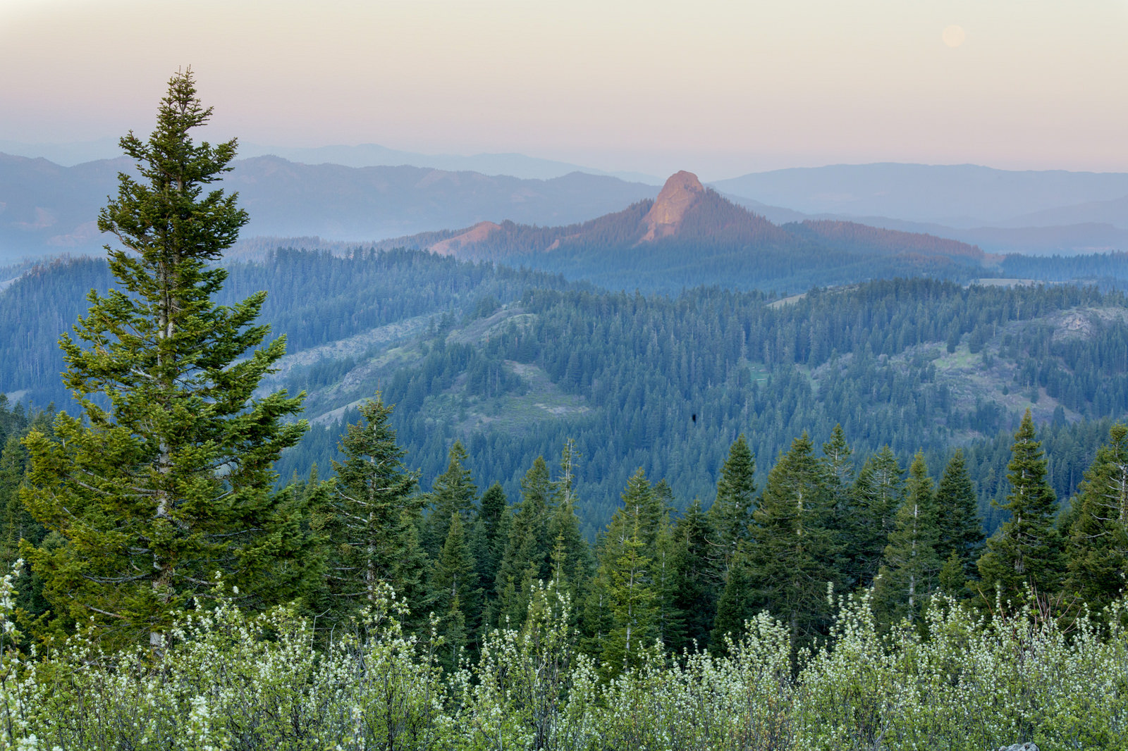
Language of Landscapes
Landscape Character Elements
Texture

Slide 47
Landscape Character Elements - EXERCISE B

Slide 48
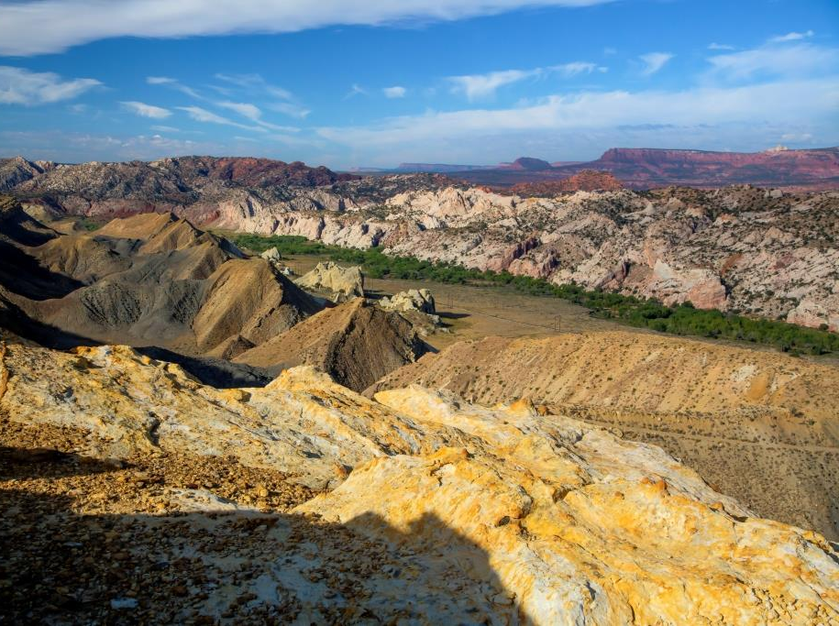
EXERCISE B:
Identify the FORMS, LINES, COLORS, and TEXTURES in this scene.

Slide 49
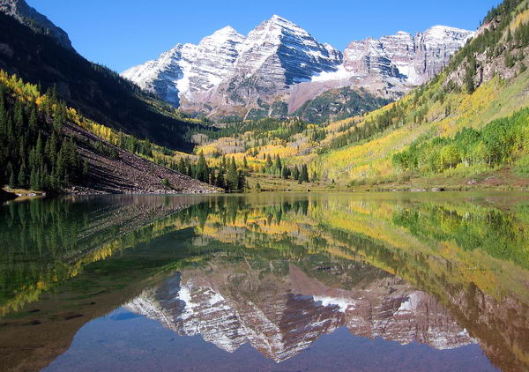

Language of Landscapes
Visual Variety
  Landscapes with abundance and variety in form, line, color and texture, as well as combinations of landscape types, are typically the most interesting and visually appealing.

Slide 50

Language of Landscapes
Language of Landscapes
A

Slide 51

Language of Landscapes
Visual Variety
B
B

Slide 52

Language of Landscapes
Visual Variety
A
A

Slide 53

Language of Landscapes
Language of Landscapes
Visual Variety
B
A
B

Slide 54

Language of Landscapes
Visual Variety
B
A

Slide 55

Language of Landscapes
Visual Variety
B
B

Slide 56
Language of Landscapes
Landscape Analysis Factors
Contrast
Axis
Co-dominance
Sequence
Convergence
Enframement
Scale

Slide 57

Language of Landscapes
Landscape Analysis Factors
Contrast
  Degree to which sharp differences in adjacent objects or areas exist.
  Landscapes or areas of landscapes with great contrast attract the eye more readily than those with little to no contrast.

Slide 58

Language of Landscapes
Landscape Analysis Factors
Contrast

Slide 59

Language of Landscapes
Landscape Analysis Factors
Contrast

Slide 60

Language of Landscapes
Landscape Analysis Factors
Contrast

Slide 61


Language of Landscapes
Landscape Analysis Factors
Sequence
  Succession of landscape elements.
  Systematic repetition of form, line, color, or texture.

Slide 62

Language of Landscapes
Landscape Analysis Factors
Sequence

Slide 63

Language of Landscapes
Landscape Analysis Factors
Sequence

Slide 64

Language of Landscapes
Landscape Analysis Factors
Axis
  A straight line (real or imaginary) passing through a landscape.
  Focuses viewer attention primarily on the terminus and its background.
  A design tool of great forcefulness.

Slide 65

Language of Landscapes
Landscape Analysis Factors
Axis

Slide 66

Language of Landscapes
Landscape Analysis Factors
Axis

Slide 67

Language of Landscapes
Landscape Analysis Factors
Convergence
  Tends to focus attention on one point or small area.
  Point of convergence is highly visible.
  Point of convergence generally becomes focal point within the landscape.

Slide 68

Language of Landscapes
Landscape Analysis Factors
Convergence

Slide 69

Language of Landscapes
Landscape Analysis Factors
Convergence

Slide 70
Language of Landscapes
Landscape Analysis Factors
Co-dominance
  Two or more landscape form features are nearly identical.
  Created co-dominant features often produce a symmetrical composition that does not blend with the characteristic landscape.
  Natural landscapes with co-dominant features added are seldom as visually pleasing as those with a single dominant element.

Slide 71

Language of Landscapes
Landscape Analysis Factors
Co-dominance

Slide 72


Language of Landscapes
Landscape Analysis Factors
Co-dominance

Slide 73

Language of Landscapes
Landscape Analysis Factors
Enframement
  Created when features in the landscape direct the viewer’s attention inward like the frame of a picture.
  Walls of trees or rock cliffs on either side, reflecting waters at the base, and tree canopies overhead serve as forces of enframement.

Slide 74

Language of Landscapes
Landscape Analysis Factors
Enframement

Slide 75

Language of Landscapes
Landscape Analysis Factors
Enframement

Slide 76
Language of Landscapes
Landscape Analysis Factors
Scale
  The proportionate size relationship between an object and its surroundings.
  Relative to the landscape setting, scale determines the object’s dominance in the landscape.
  The size of the space inversely affects an object’s relative scale -- small spaces make objects appear larger.

Slide 77

Language of Landscapes
Landscape Analysis Factors
Scale

Slide 78

Language of Landscapes
Landscape Analysis Factors
Scale

Slide 79
Landscape Analysis Factors - EXERCISE C

Slide 80




EXERCISE C - Match the Analysis Factor to the image that best represents it.
Axis
Co-dominance
Contrast
Convergence
Enframement
Scale
Sequence
A
B
C
D
E
F
G

Slide 81

Language of Landscapes
Change is inevitable,
ugliness is not.
scenicamerica.org
[ Image Caption ]

