Slide 2
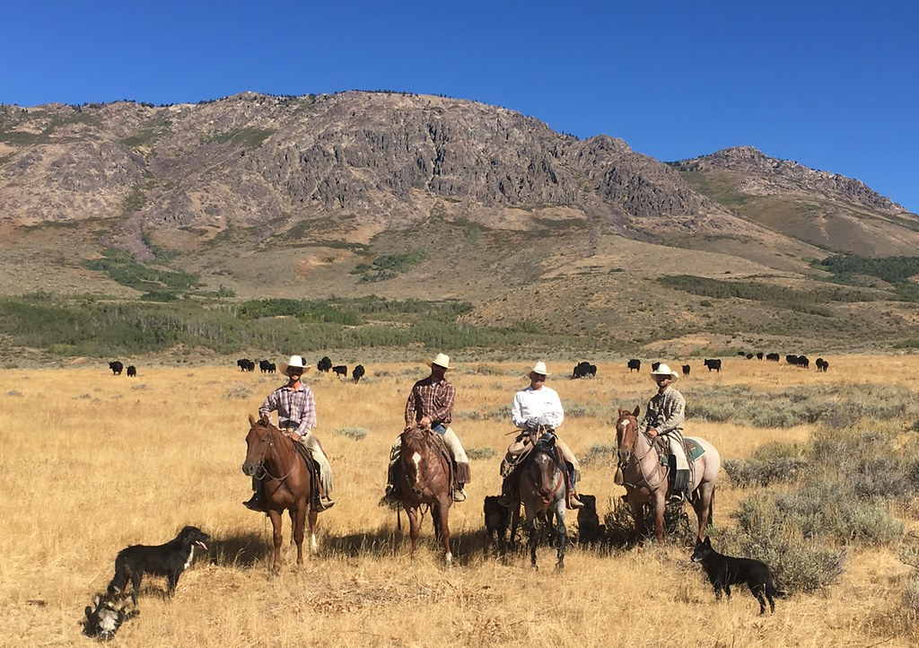
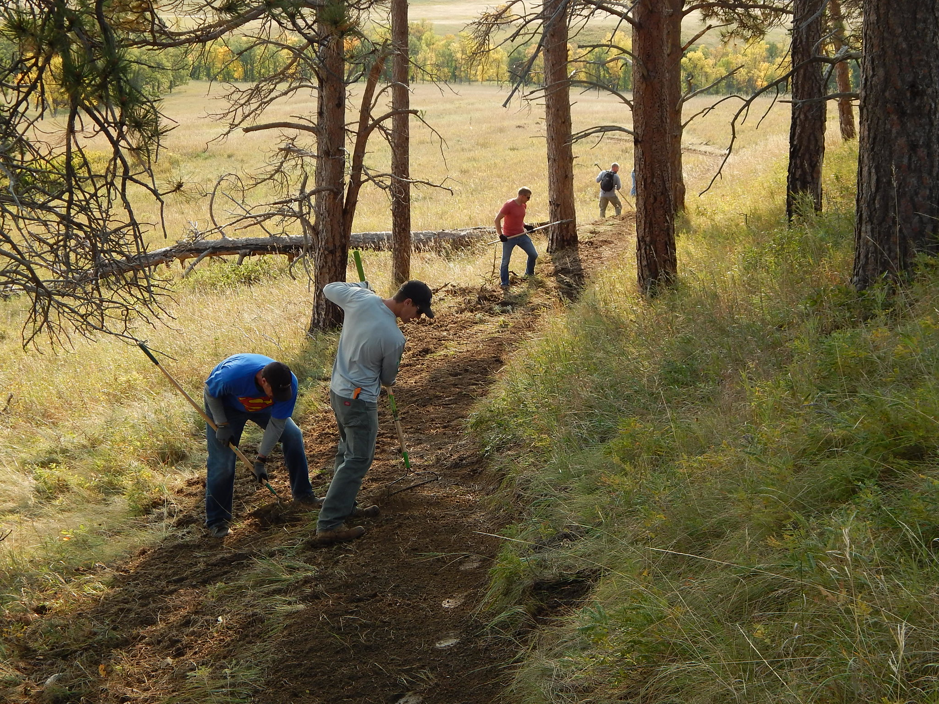

Slide 3
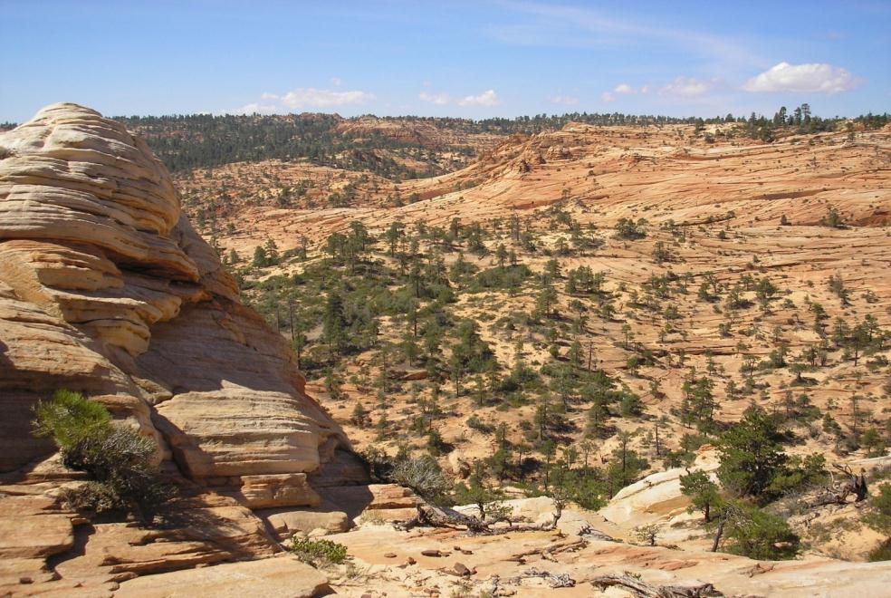
Unit Objective
Understand how to incorporate Visual Resource Inventory information into land use planning decisions.

Slide 4
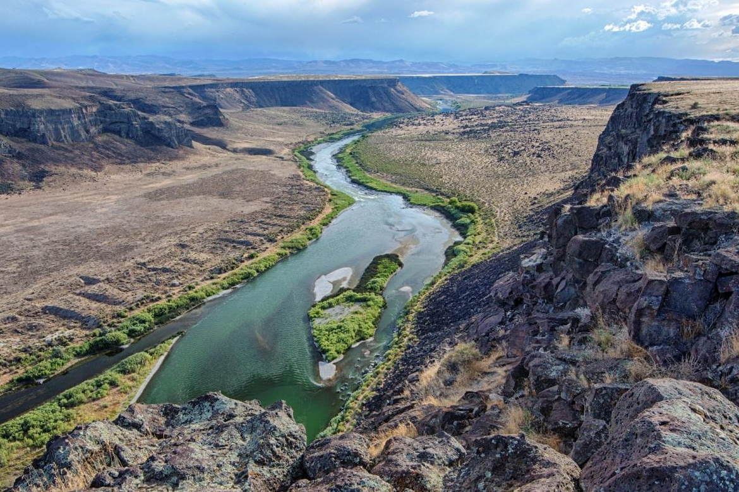
Managing Scenic Values and Viewsheds
Making decisions on managing scenic value . . .

Slide 5
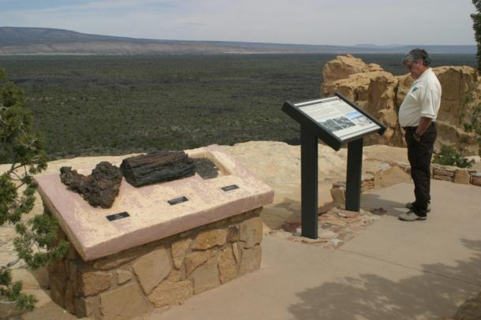
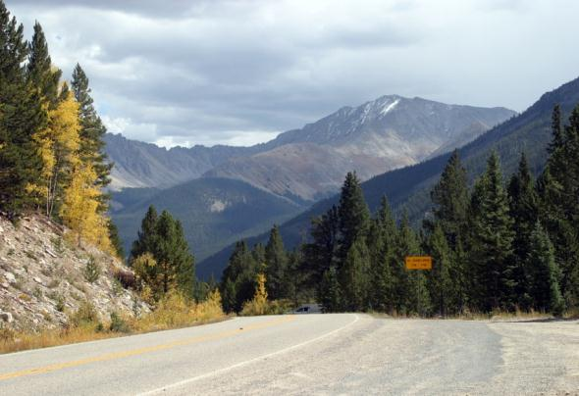
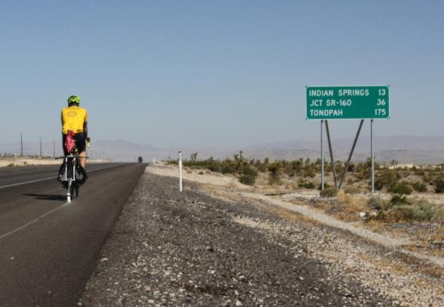
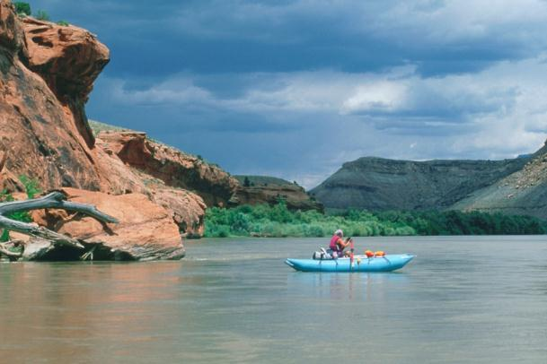
Managing Scenic Values and Viewsheds
. . . where the natural character of public lands is maintained,
. . . in the planning for the human visual experience

Slide 6
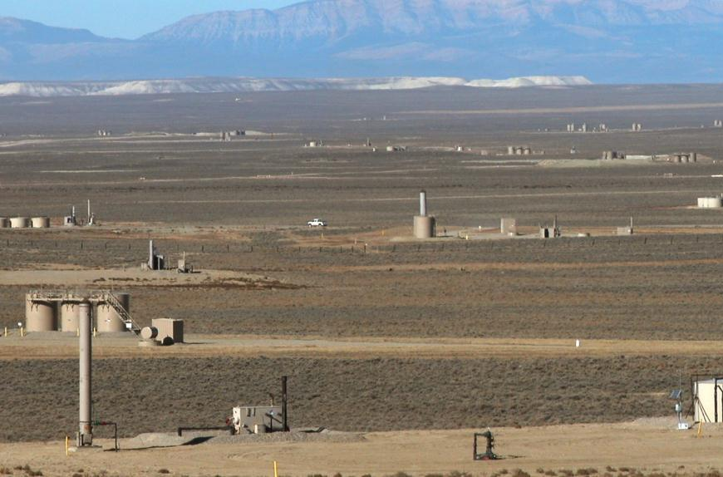
Managing Scenic Values and Viewsheds
or where major character changes are allowed to enable resource development or other land use allocations.

Slide 7
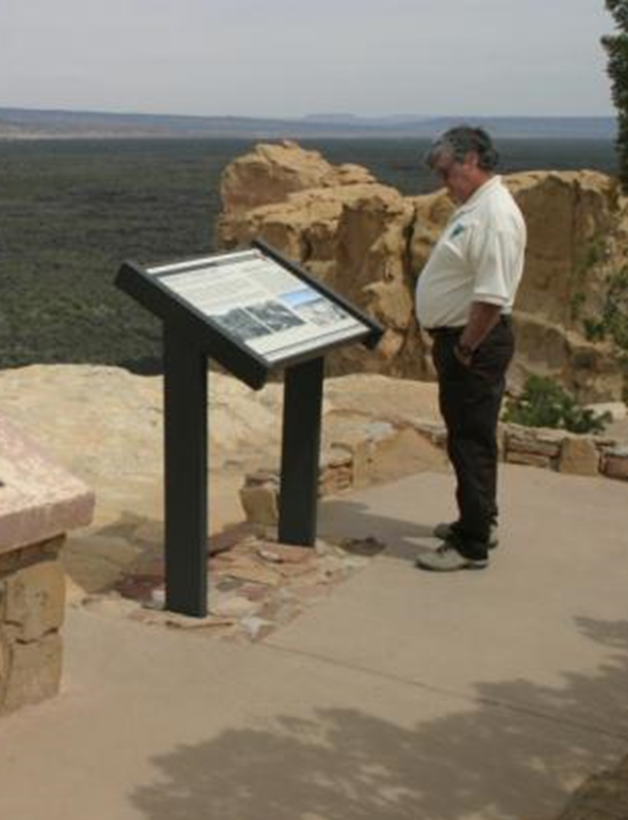
Managing Scenic Values and Viewsheds
These decisions are challenging, should not been taken lightly, and should result from a close examination of facts.
Notes:
Work on this

Slide 8
RMP Planning Policy Directives
Handbook H-8410-1:
Consider visual values throughout the land use planning process and when assigning VRM class objectives
Management decisions in the RMP must reflect the value of visual resources.
VRM Class boundaries are adjusted to reflect the resource allocations decisions made with the RMPs.
Notes:
Start with VRM manual (1984/ 1987) which over time now contradicts the LUP policy (2006). New revision of 8400 in surnaming.

Slide 9
RMP Planning Policy Directives
Land Use Planning Handbook H-1601-1 Appendix C:
Land Use Plan Decisions:
Manage visual resource values in accordance with visual resource management objectives
Designate VRM management classes for all areas of BLM land, based on an inventory of visual resources and management considerations for other land uses.
VRM classes may differ from VRI classes, based on management priorities for land uses.

Slide 10
RMP Planning Policy Directives
Planning Decision Hierarchy: LUP Handbook H-1601-1
Desired Outcomes: goals and objectives of the land use plan
Goals: broad statements of desired conditions
Objectives: specific desired conditions for resources
Allowable Uses (allocations): activities and foreseeable development that are allowed, restricted, or excluded for all or part of the planning area, based on desired future conditions.
Management Actions: (to achieve desired outcomes) actions anticipated to achieve desired outcomes, including actions to maintain, restore, or improve land health.
Notes:
Planning 2.0 – objectives, allowable uses, designations

Slide 11
VRM Class Objectives
Inventory to Management Classes
Directs the management of visual resource factors
The VRM class objectives are binding land use plan decisions
Land use authorizations under the RMP’s implementation must conform to the land use plan VRM Class Objectives.
Notes:
Talking Points
Changes:
Objectives are resource conditions, they describe outcomes not outputs.
Requirement for specific and measurable objectives.
Under planning 2.0 the objectives are the key element that guides future management and drive the resource management plan.

Slide 12
Objectives
Visual Resource Management Classes
A concise statement of desired resource conditions developed to guide progress toward one or more goals.
An objective is:
specific,
Measurable (contrast rating, cumulative effects),
has established time-frames for achievement,
identify standards to mitigate undesirable effects to resource condition,
should provide integrated consideration of resource, environmental, ecological, social, and economic factors.
Notes:
Talking Points
Changes:
Objectives are resource conditions, they describe outcomes not outputs.
Requirement for specific and measurable objectives.
Under planning 2.0 the objectives are the key element that guides future management and drive the resource management plan.

Slide 13
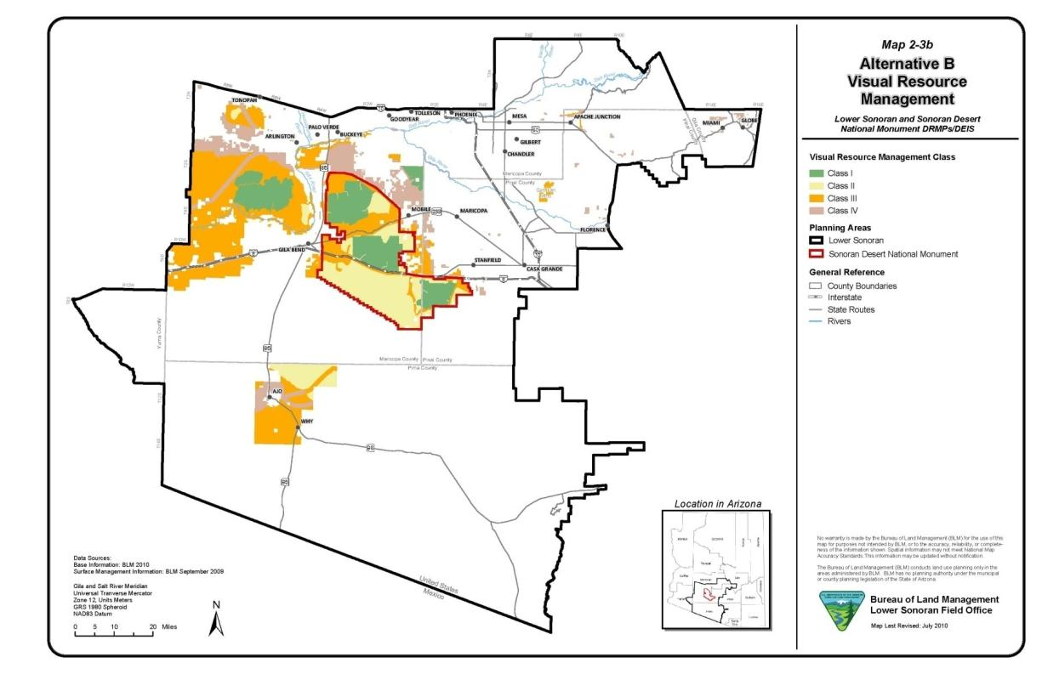
Inventory to Management Classes
VRM Class Objectives – Defined spatially delineated units

Slide 14
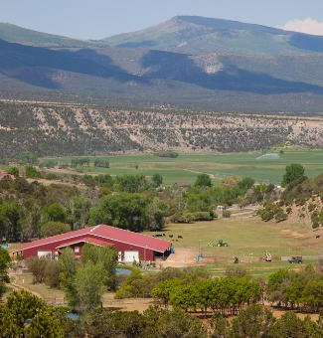
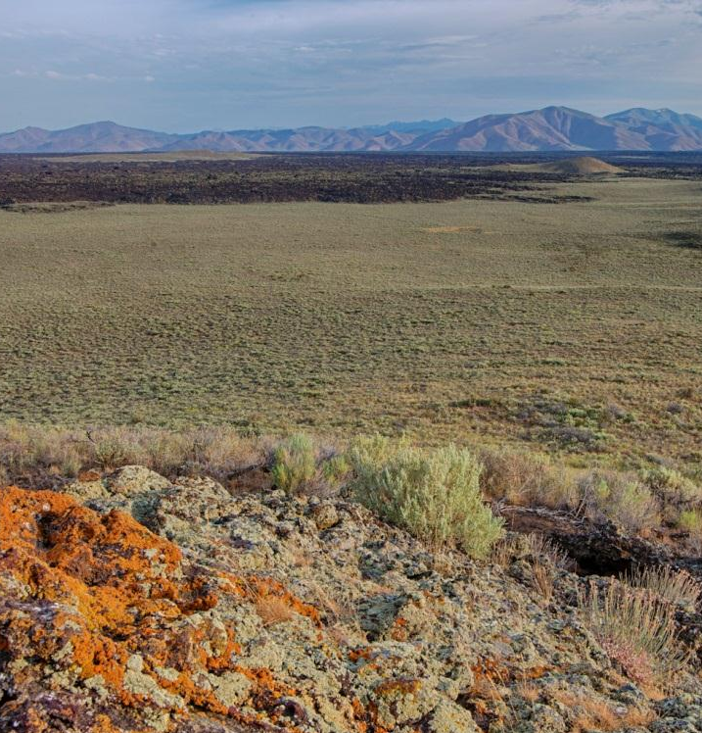
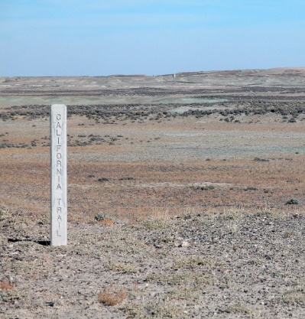
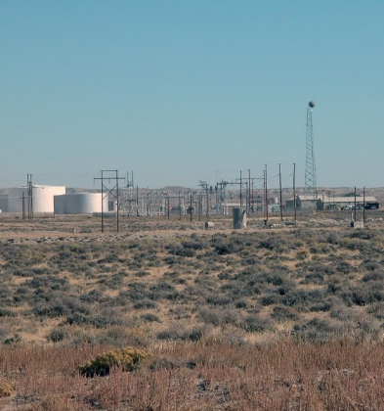
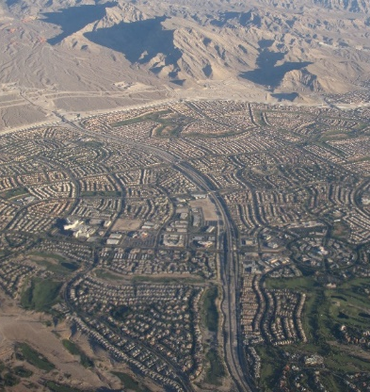
Visual Resource Management Classes
Guides the Protection or Transition of the Characteristic Landscape Manage to protect the quality of…
Describing the landscape character at the larger scale
Decisions on the extent the BLM will allow the landscape to move away from its natural scenic value
Types of Characteristic Landscapes: natural, rural agricultural, rural industrial, rural residential, commercial, urban, suburban, urban, urban industrial.
Natural
Naturalistic
Rural Industrial
Rural Industrial
Suburban
Notes:
Talking Points

Slide 15
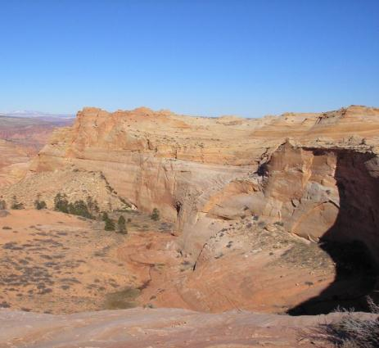
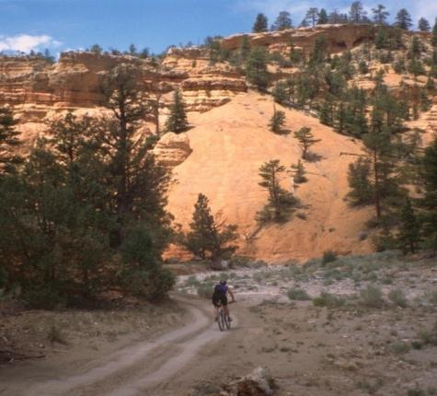
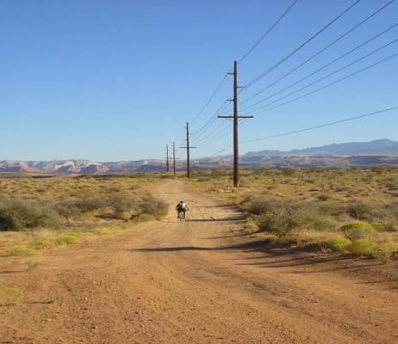
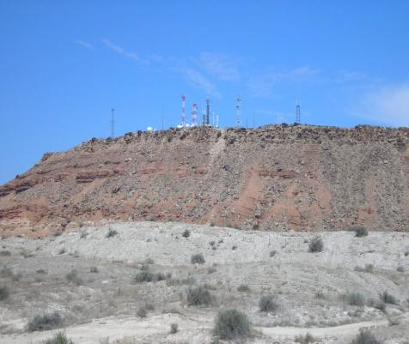
Defining Management Classes

Slide 16
Defining Management Classes – Class I
Class I Objective:
To preserve the existing landscape character.

Slide 17
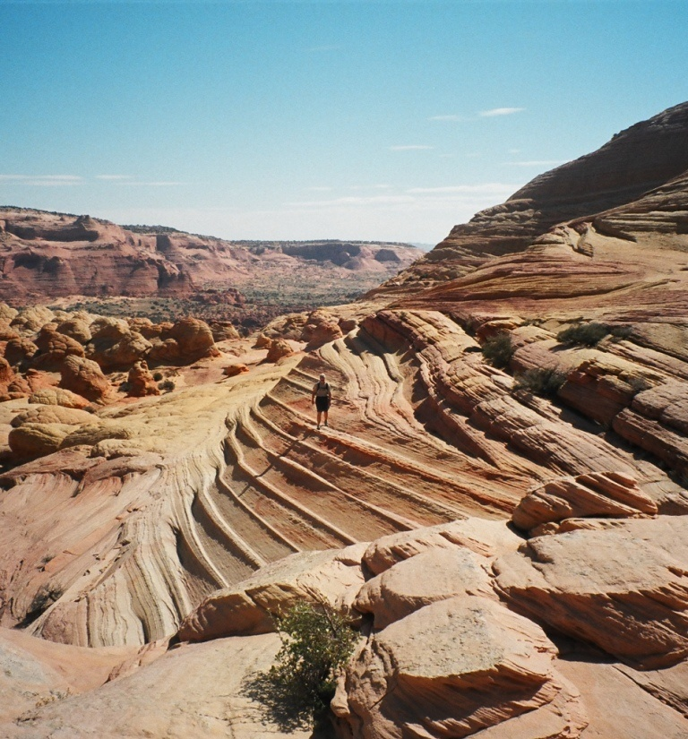
Defining Management Classes – Class I
Level of change to the characteristic landscape should be very low; and must not attract attention.

Slide 18
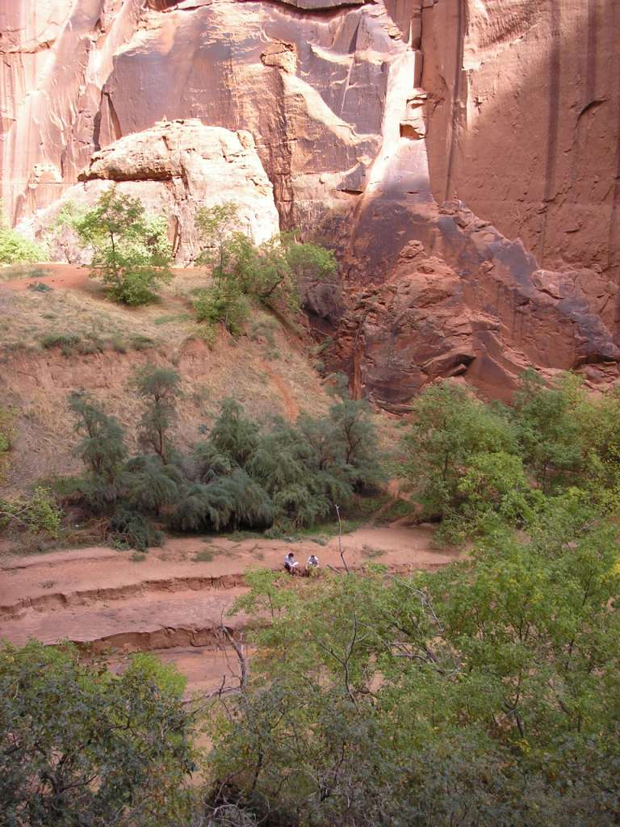
Defining Management Classes – Class I
Provides for natural ecological change
Notes:
Replace with fire example

Slide 19
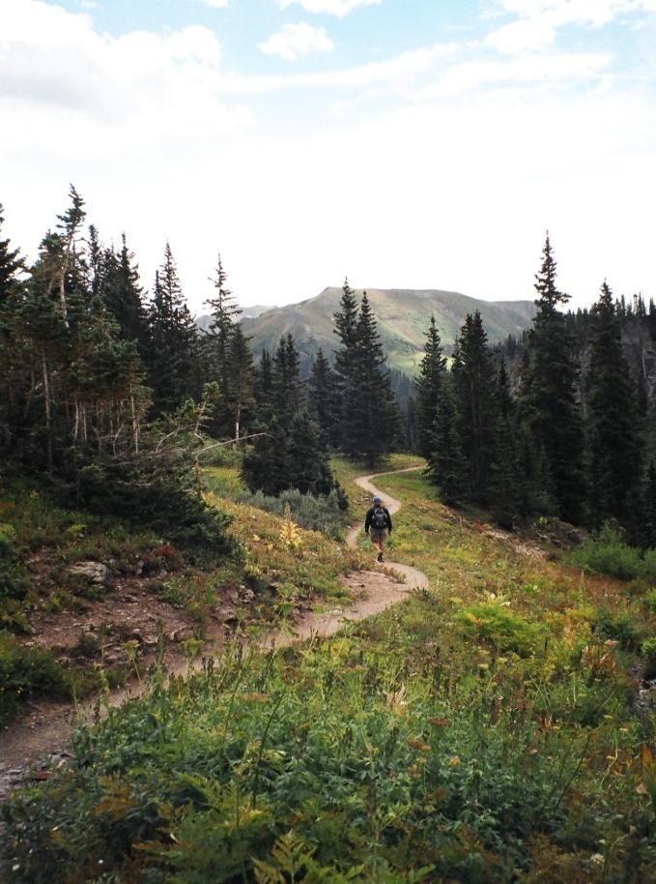
Defining Management Classes – Class I
Provides for limited management activity
Notes:
Replace with fire example

Slide 20
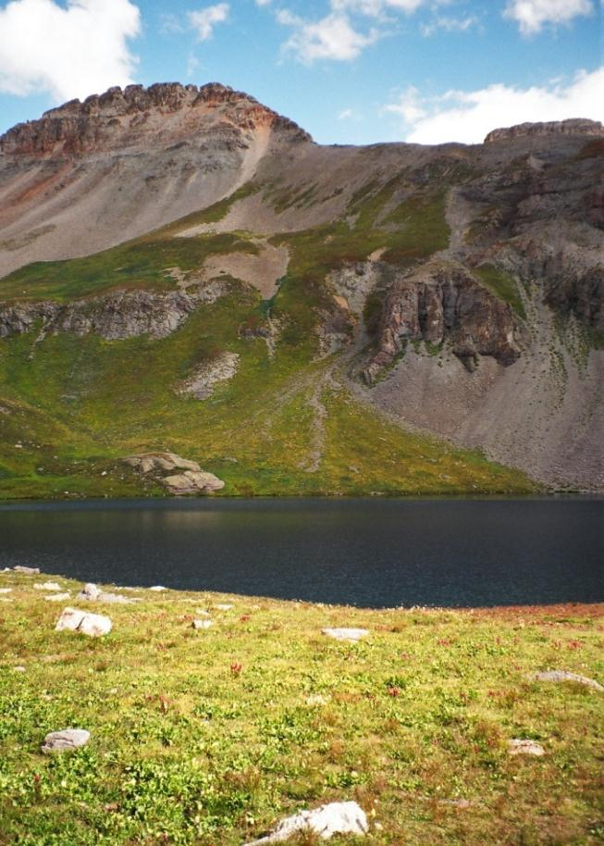
Defining Management Classes – Class I
Examples:
Congressionally driven:
Designated Wilderness
Wilderness Study Areas (WSA)
Potential RMP driven options:
Scenic ACEC
Wild Sections of Wild and Scenic Rivers
National Scenic/ Historic Trails

Slide 21
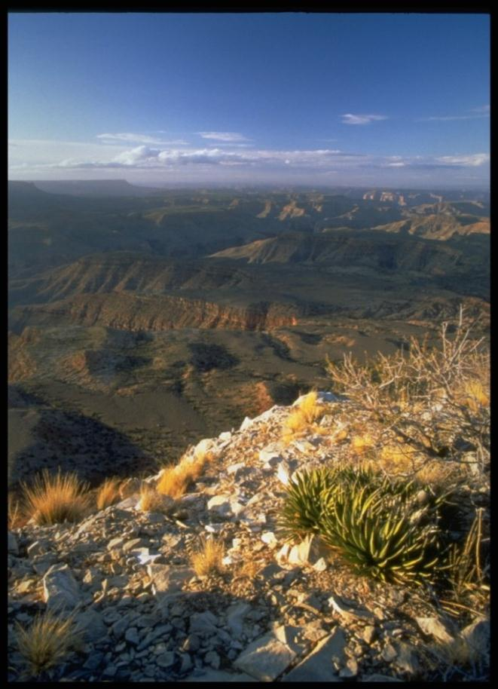
Defining Management Classes – Class II
Class II Objective:
To retain the existing character of the landscape.

Slide 22
Defining Management Classes – Class II
Level of change to the characteristic landscape should be low

Slide 23
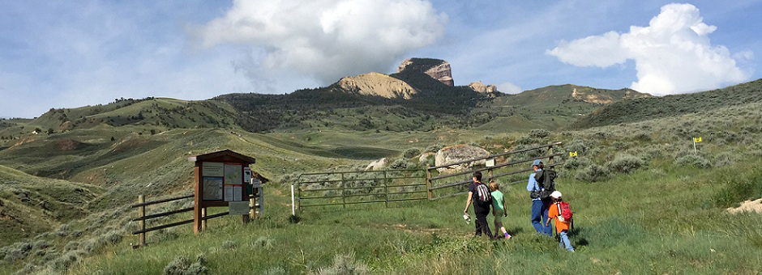
Defining Management Classes – Class II
Changes should repeat the basic elements found in the natural features of the landscape – form, line, color, & texture
Notes:
Get toilet image from the color research file.

Slide 24
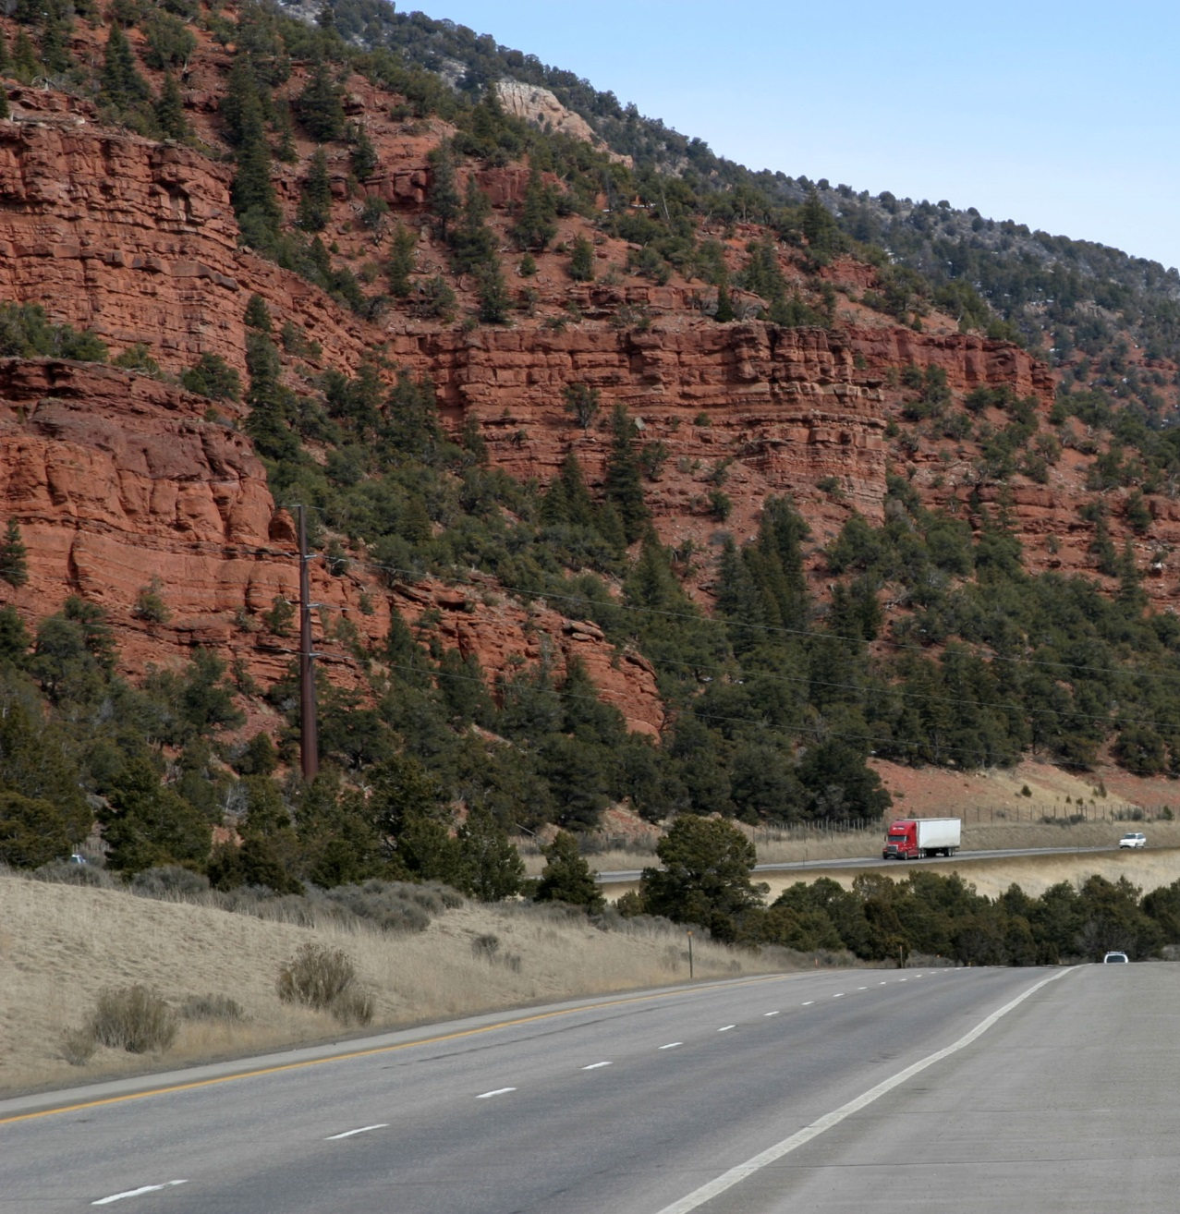
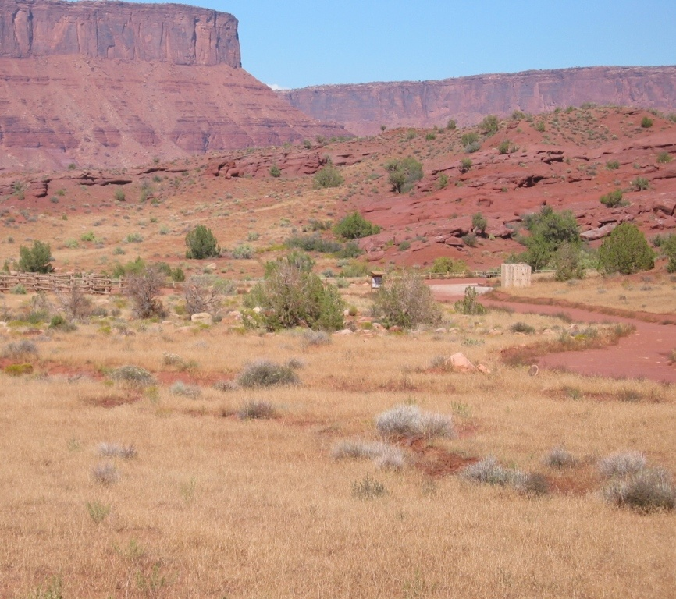
Defining Management Classes – Class II
Management activities may be seen but should not attract attention of the observer

Slide 25
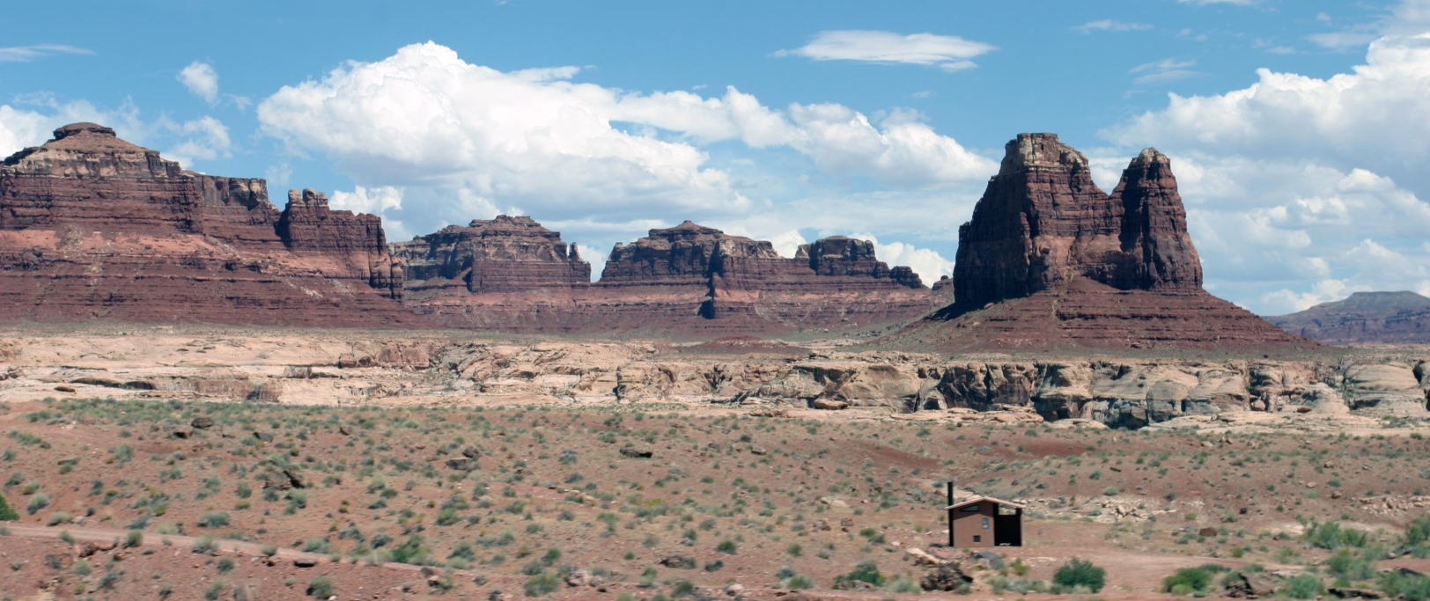
Defining Management Classes – Class III
Class III Objective:
To partially retain the existing character of the landscape
Notes:
Need new image

Slide 26
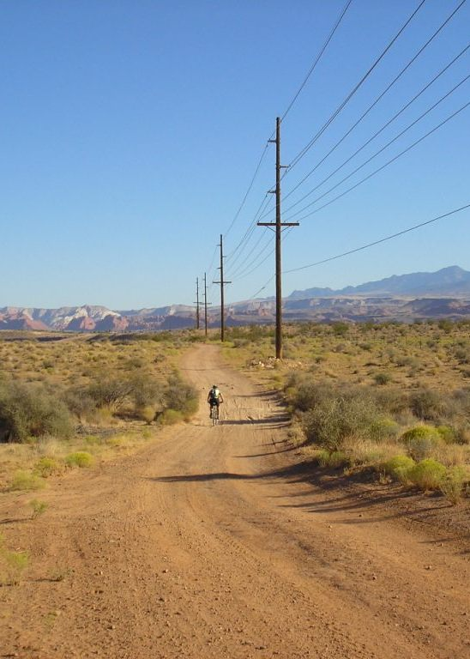
Defining Management Classes – Class III
Level of change to the characteristic landscape can be moderate
Notes:
Need new image – maybe a lattice tower example instead that it less dominating and set back from the road a little further

Slide 27
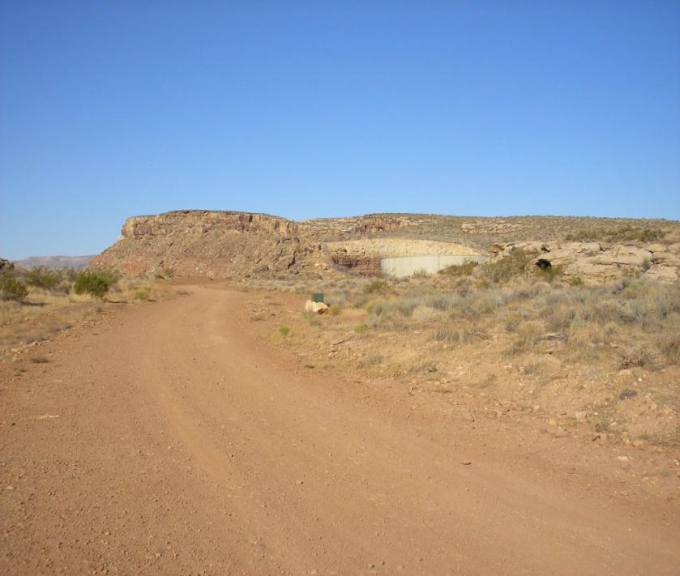
Defining Management Classes – Class III
Management activities may attract attention, but should not dominate the view of the casual observer
Notes:
Need new image – maybe a lattice tower example instead that it less dominating and set back from the road a little further

Slide 28
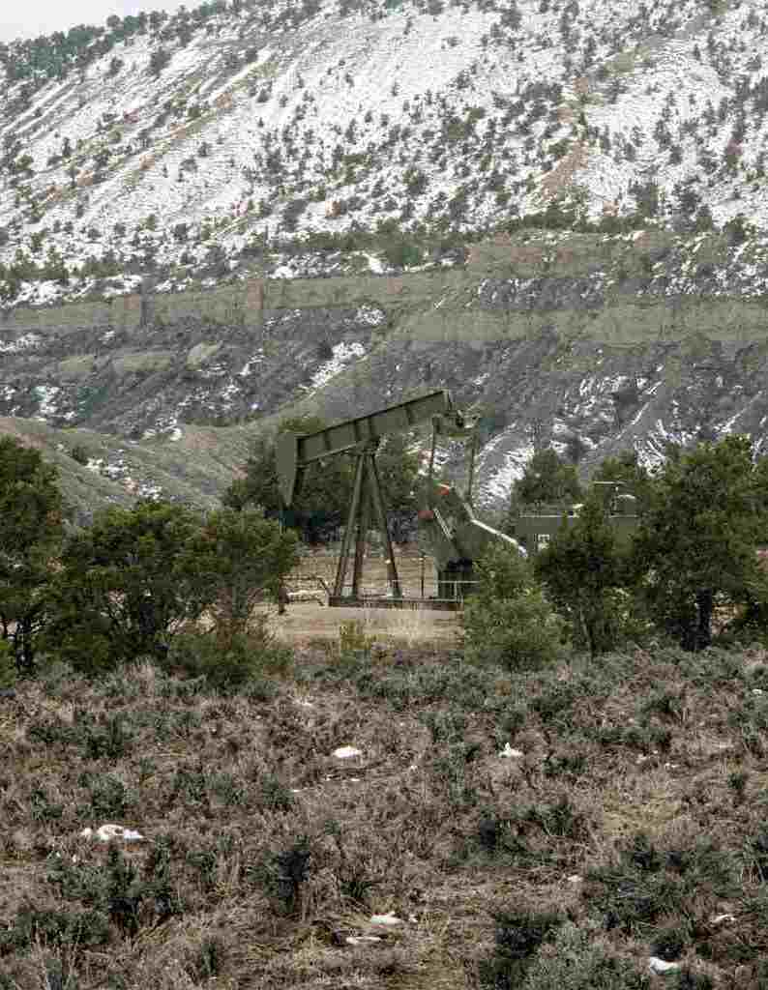
Defining Management Classes – Class III
Change should repeat the basic elements found in the natural landscape – form, line, color, & texture
Notes:
Need new image – maybe a lattice tower example instead that it less dominating and set back from the road a little further

Slide 29
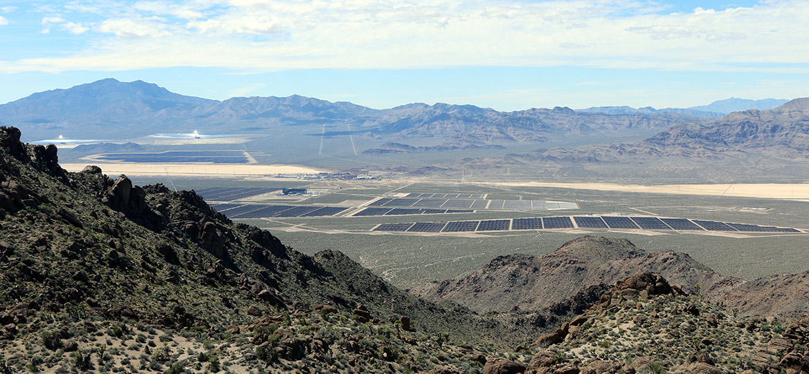
Defining Management Classes – Class IV
Class IV Objective:
To provide for activities that require major modification of the landscape
Notes:
Get updated image from overlook. Add another one looking from the Interstate highway.

Slide 30
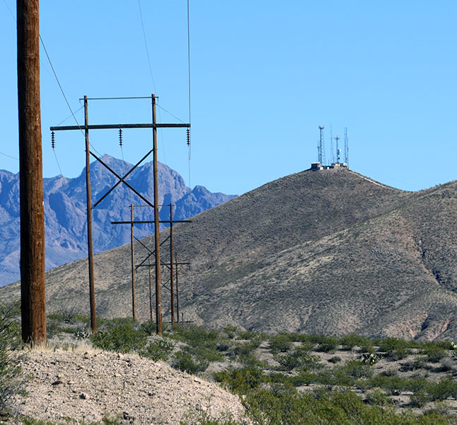
Defining Management Classes – Class IV
Level of change to the landscape can be high
Notes:
Need new image – maybe a lattice tower example instead that it less dominating and set back from the road a little further

Slide 31
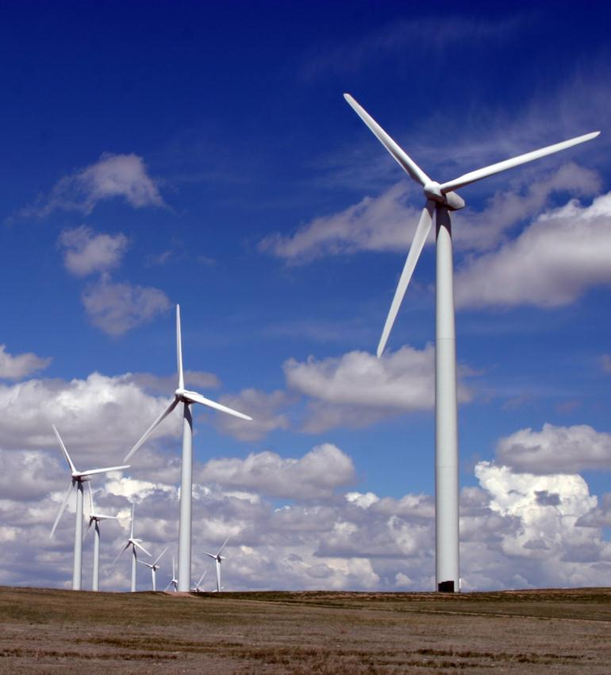
Defining Management Classes – Class IV
Management activities may dominate the view and be the major focus of attention
Notes:
Need new image – maybe a lattice tower example instead that it less dominating and set back from the road a little further

Slide 32
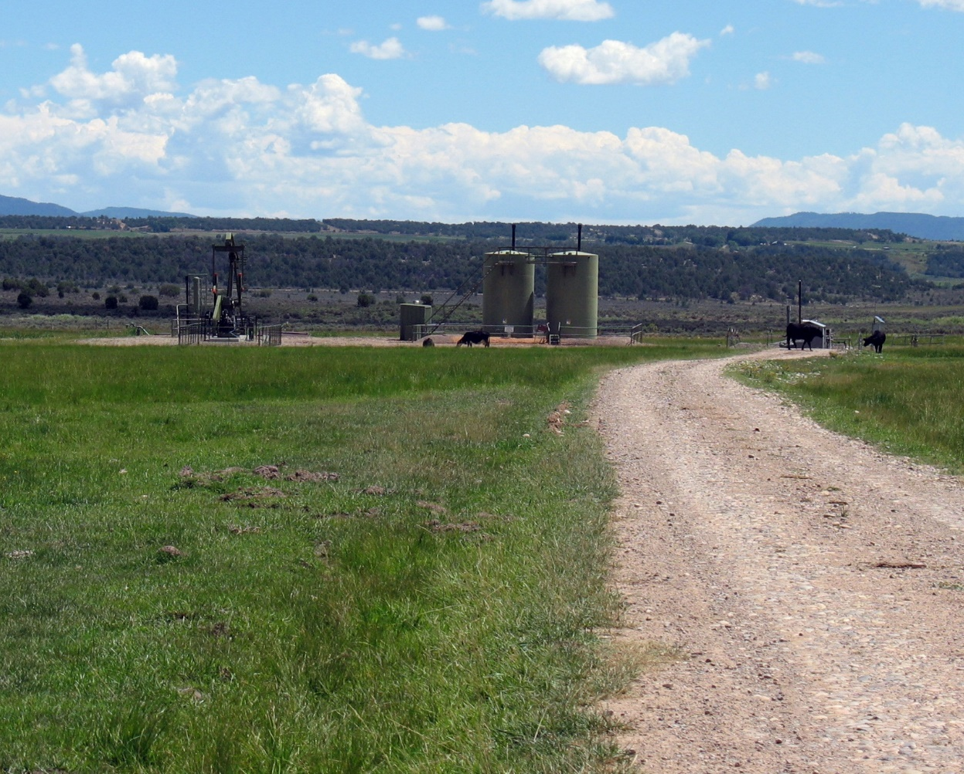
Defining Management Classes – Class IV
Still minimize impacts through location and design by repeating form, line, color, and texture
Notes:
WHERE DO YOU SPEND YOUR TIME
Need new image – maybe a lattice tower example instead that it less dominating and set back from the road a little further

Slide 33
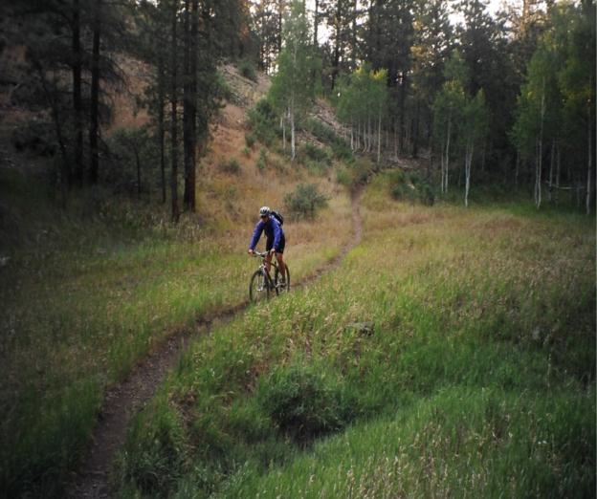
Deciding the Appropriate VRM Class
Selecting the right VRM class objective for the right place.
Notes:
Commensurate – the level of management may not be proportional to the visual resource value
WHERE DO YOU SPEND YOUR TIME?
Most ponder the uses and not consider the visual resource – this is problematic

Slide 34
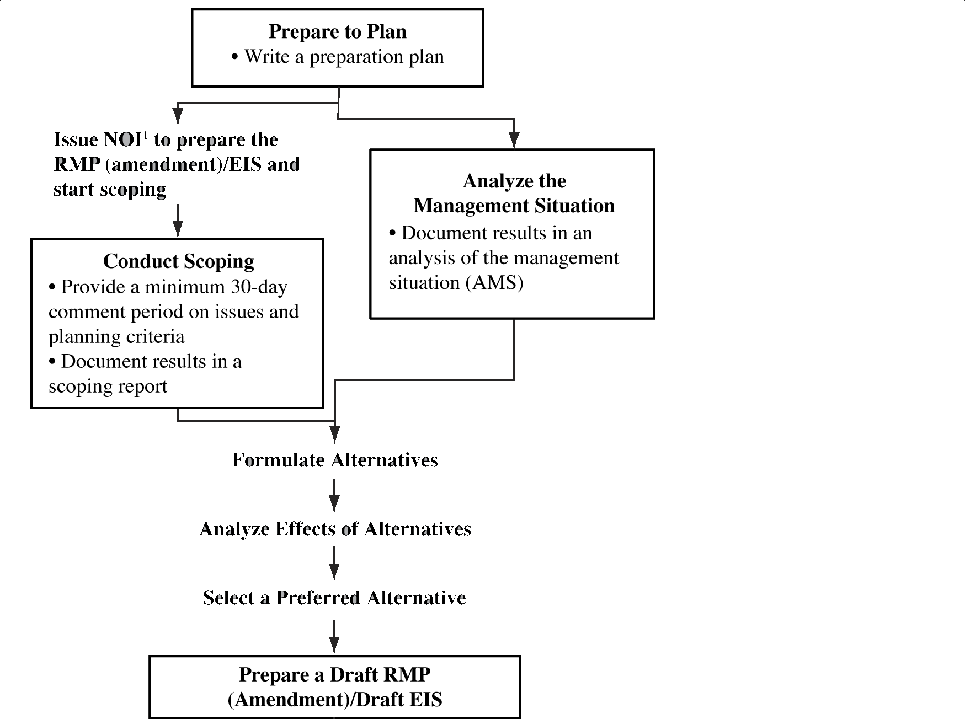
Land Use Planning Process
Notes:
Pathway to selecting the appropriate VRM class objective.
Decisions on VRM class objective an outcome of the BLM’s land use planning process…
I assume most of you are quite familiar with the BLM’s LUP process, but bear with me as I go through the steps….

Slide 35
Land Use Planning Process
Notes:
WHERE DOES THE INVENTORY COME INTO PLAY?

Slide 36
Preparation Plan
Serves as the foundation for the entire land use planning process.
Identify the preliminary issues and list planning questions
Skills needed on the planning team to address the issues
Preliminary opinion on budget requirements
Preliminary planning criteria
Data need and requirements – VRI, other data sets
Basis for the Statement of Work (if using a contractor)
Notes:
This steps helps us pre-ponder the issues the BLM will face when revising the Land Use Plan
Consider breaking the bullet points out into individual slide headings

Slide 37
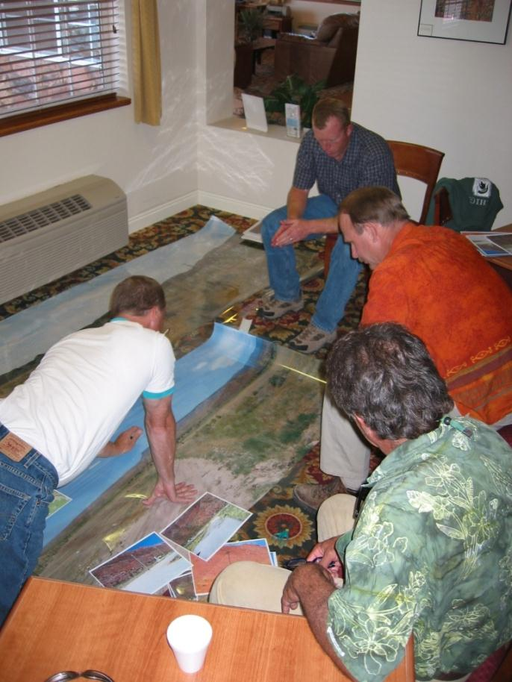
Preparation Plan
Planning Team
Recreation usually represents the values of visual resources on the planning team.
Should others participate with VRM?
Notes:
Outdoor recreation is the customary lead, however, this is changing
Those with a stake in visual resources – who?
Those who participated in the Visual Resource Inventory?
Early networking with programs that manage development permits?

Slide 38
Preparation Plan
VRM Data Needs - Determine status of the visual resource inventory
Is there one?
How old is it?
Do you still have the background support data?
Is it paper (mylar) or electronic?
If electronic then is it updated to current 2012 inventory data standard and entered into the geodatabase?
Notes:
Need new image – maybe a lattice tower example instead that it less dominating and set back from the road a little further

Slide 39
Preparation Plan
VRM Data Needs - Determine status of the visual resource inventory
Is there one? If answer is no – then stop – need a new VRI.
How old is it?
Do you still have the background support data?
Is it paper (mylar) or electronic?
If electronic then is it updated to current 2012 inventory data standard and entered into the geodatabase?
Notes:
Need new image – maybe a lattice tower example instead that it less dominating and set back from the road a little further

Slide 40
Preparation Plan
VRM Data Needs - Determine status of the visual resource inventory
Is there one? If answer is no – then stop – need a new VRI.
How old is it? If more than 10 years old, likely need a new VRI.
Do you still have the background support data?
Is it paper (mylar) or electronic?
If electronic then is it updated to current 2012 inventory data standard and entered into the geodatabase?
Notes:
Need new image – maybe a lattice tower example instead that it less dominating and set back from the road a little further

Slide 41
Preparation Plan
VRM Data Needs - Determine status of the visual resource inventory
Is there one? If answer is no – then stop – need a new VRI.
How old is it? If more than 10 years old, likely need a new VRI.
Do you still have the background support data? If no – then stop – need a new VRI.
Is it paper (mylar) or electronic?
If electronic then is it updated to current 2012 inventory data standard and entered into the geodatabase?
Notes:
Need new image – maybe a lattice tower example instead that it less dominating and set back from the road a little further

Slide 42
Preparation Plan
VRM Data Needs - Determine status of the visual resource inventory
Is there one? If answer is no – then stop – need a new VRI.
How old is it? If more than 10 years old, likely need a new VRI.
Do you still have the background support data? If no – then stop – need a new VRI.
Is it paper (mylar) or electronic? If paper/ mylar – I’ll wager you need a new VRI
If electronic then is it updated to current 2012 inventory data standard and entered into the geodatabase?
Notes:
Need new image – maybe a lattice tower example instead that it less dominating and set back from the road a little further

Slide 43
Preparation Plan
VRM Data Needs - Determine status of the visual resource inventory
Is there one? If answer is no – then stop – need a new VRI.
How old is it? If more than 10 years old, likely need a new VRI.
Do you still have the background support data? If no – then stop – need a new VRI.
Is it paper (mylar) or electronic? If paper/ mylar – I’ll wager you need a new VRI
If electronic then is it updated to current 2012 inventory data standard and entered into the geodatabase? If no – then likely need a new VRI
Notes:
Need new image – maybe a lattice tower example instead that it less dominating and set back from the road a little further

Slide 44
Preparation Plan
If you need to refresh or conduct a new inventory:
Who will do it?
Internal BLM personnel or by a Contractor?
Combination of internal personnel and contractors?
What’s your budget?
Notes:
Need new image – maybe a lattice tower example instead that it less dominating and set back from the road a little further

Slide 45
Preparation Plan: ID preliminary issues
A sampling of VRM planning issues and questions found in various preparation plans:
How can the BLM manage public lands for visual qualities?
What are current and potential conflicts with managing VRM values and how can they be mitigated?
Is the visual resources inventory current?
Where are the different visual resource values within the planning area and to what degree should they be protected?
Are the current visual resource management classes appropriate?
How can VRM classes be managed in a manner consistent with resource and social concerns?
Notes:
Need to work a list into the class as an exercise.

Slide 46
Preparation Plan: ID preliminary issues
Other VRM planning issues and questions to consider:
Where and how should scenic (visual) values be protected and/ or restored within the planning area while accommodating multiple use management and sustained yield?
Were the VRM classes properly implemented under the current RMP?
How much of the planning areas is visually modified (the condition of the visual resource)?
What are the trends in the management of visual resources?
How should scarce visual values be managed?
Where do visual values contribute to positive human outcomes?
Where are viewsheds from adjacent land uses, communities, and land management jurisdictions important?
Where are the development pressures and what are the visual values in these proximities?
Notes:
Need to work a list into the class as an exercise.

Slide 47
Land Use Planning Process
Notes:
Need new image – maybe a lattice tower example instead that it less dominating and set back from the road a little further

Slide 48
Analyze the Management Situation (AMS)
Analysis of the Management Situation (AMS)
H-1601 Appendix F-3
Should describe the current conditions and trends of the resources and the uses/activities in the planning area in sufficient detail to create a framework from which to resolve the planning issues through the development of alternatives.

Slide 49
Analyze the Management Situation (AMS)
Analysis of the Management Situation (AMS)
H-1601 Appendix F-3
Ten Chapters:
Introduction
Area Profile
Current Management Direction
Management Opportunities
Consistency/ Coordination with Other Plans (Fed/State/County/City)
Specific Mandates and Authority
Scoping Report or Summary thereof
List of Prepares
Glossary
References

Slide 50
Analyze the Management Situation (AMS)
Analysis of the Management Situation (AMS)
H-1601 Appendix F-3
Ten Chapters:
Introduction
Area Profile – Sets the stage for the Affected Environment
Current Management Direction
Management Opportunities
Consistency/ Coordination with Other Plans (Fed/State/County/City)
Specific Mandates and Authority
Scoping Report or Summary thereof
List of Prepares
Glossary
References
Notes:
COMPARE THESE CHAPTERS TO THOSE IN ALLYSIA’S AMS

Slide 51
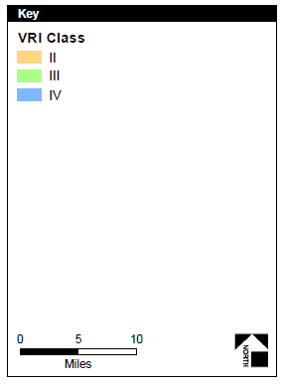
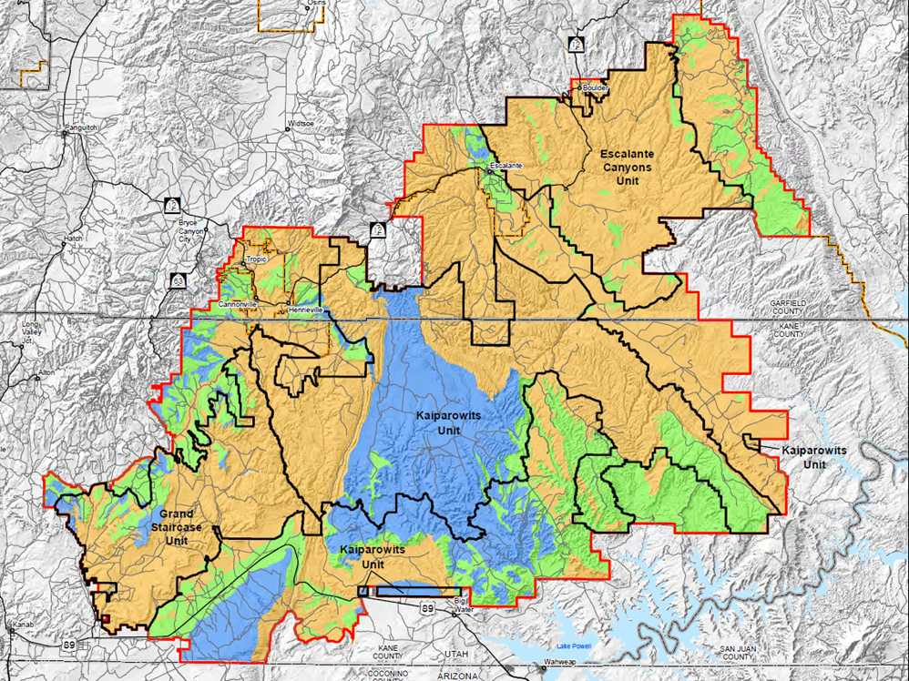
Analyze the Management Situation (AMS)
What is our VRM planning and decision area?

Slide 52
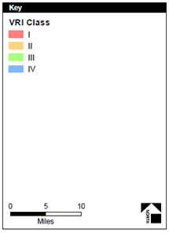
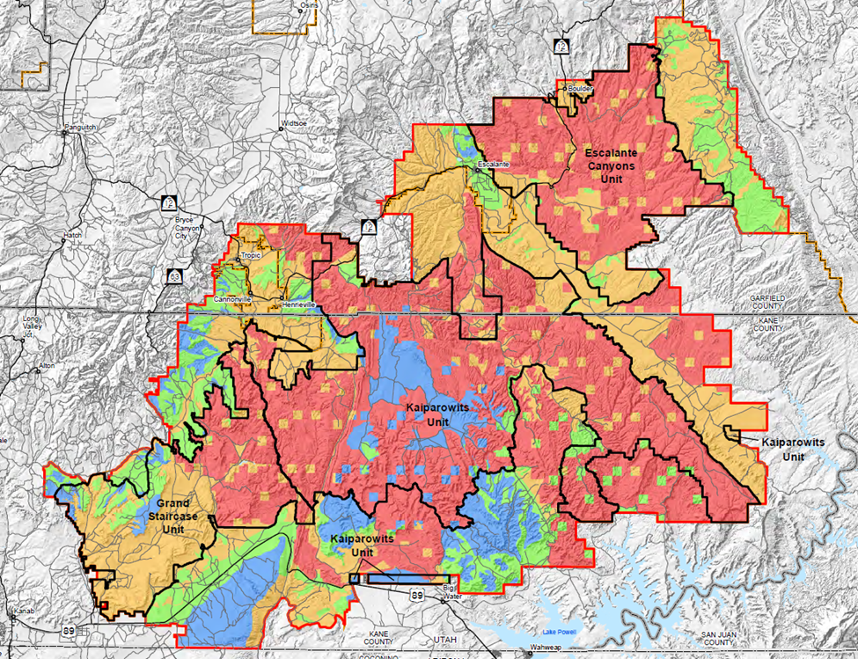
Analyze the Management Situation (AMS)
What is our VRM planning and decision area?

Slide 53
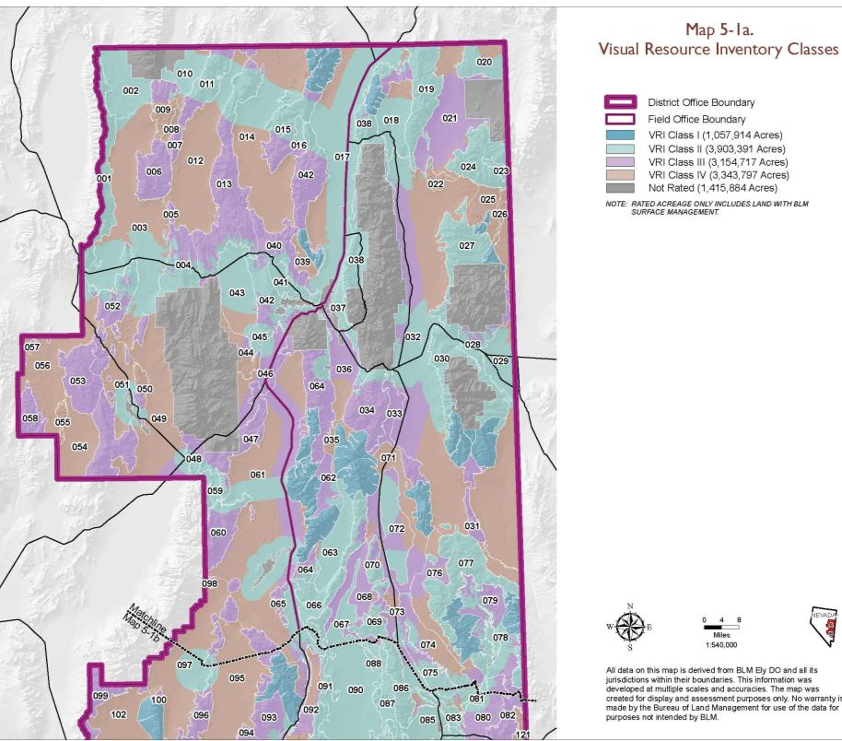
Analyze the Management Situation (AMS)
VRI is the primary source of information
Class I *
Class II
Class III
Class IV
Notes:
Need to know your resource. Don’t limit yourself to VRI Classes alone
REPLACE MATRIX WITH JULIE’S FROM UNIT 3

Slide 54
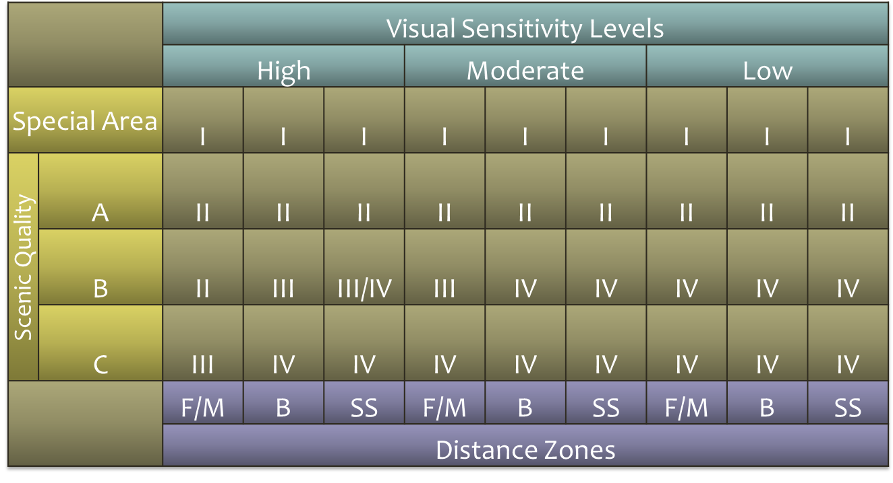
Analyze the Management Situation (AMS)
VRI is the primary source of information - 27 unique relationships between the cross section of the VRI factor values
Class I *
Class II
Class III
Class IV
Notes:
Need to know your resource. Don’t limit yourself to VRI Classes alone
REPLACE MATRIX WITH JULIE’S FROM UNIT 3

Slide 55
Analyze the Management Situation (AMS)
VRI Classes
Class I 7,032,363 (8%)
Class II 18,951,779 (21%)
Class III 23,813,554 (26%)
Class IV 40,826,781 (45%)
Scenic Quality Rating
A 7,332,472 (9%)
B 38,435,868 (48%)
C 34,914,502 (43%)
Sensitivity Level Rating
High 34,674,733 (43%)
Medium 24,698,345 (31%)
Low 20,455,318 (26%)
Distance Zones
FGrnd/MGrnd 55,783,643 (67%)
Background 9,170,500 (11%)
Seldom Seen 18,644,208 (22%)

Slide 56
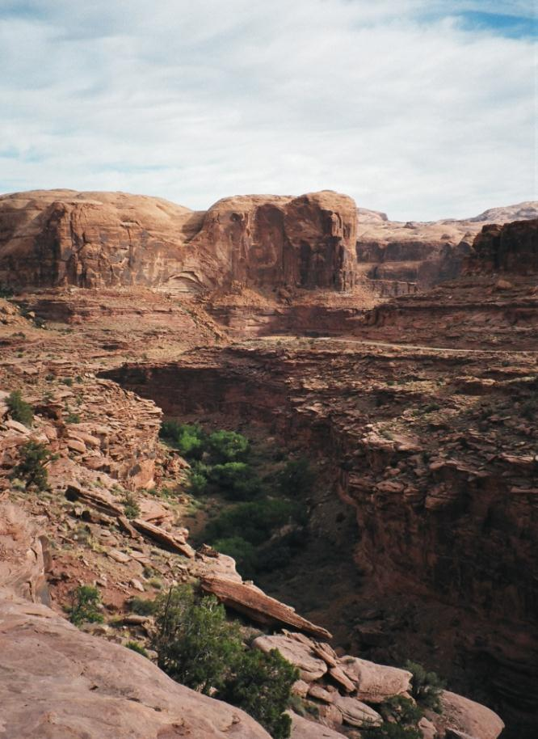
Analyze the Management Situation
Opportunities for Scenic ACEC
Unique/ scarce high quality scenery
If the importance of the setting’s scenery and/ or viewshed supersedes other resource considerations, a Visual ACEC can be considered

Slide 57
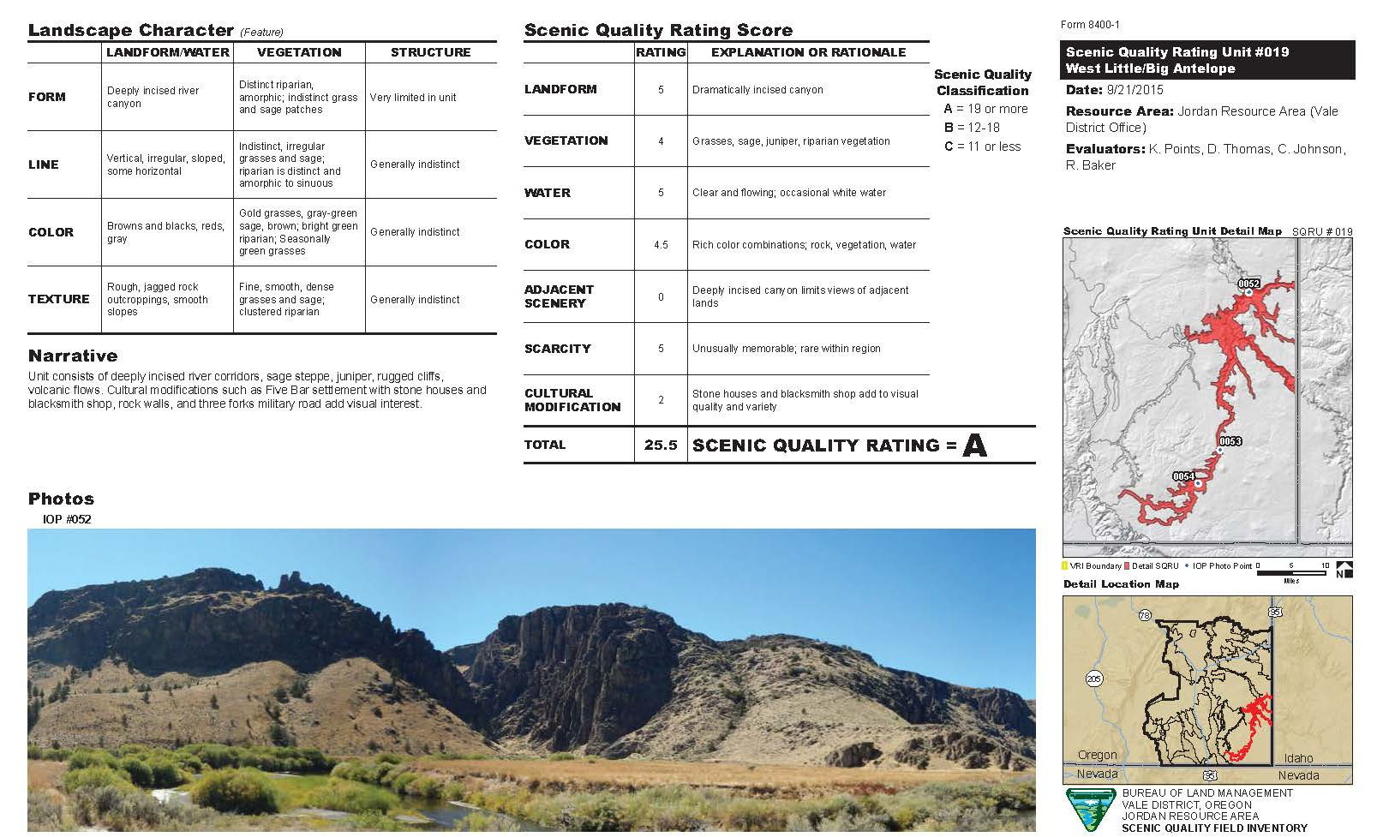
Analyze the Management Situation (AMS)
Analyzing the Existing Management Situation
Understanding the visual resource data
ENTER IN MAPS – JORDAN – High SQRU Score
High sensitivity
ADJACENT SCENERY

Slide 58
Analyze the Management Situation (AMS)
Analyzing the Existing Management Situation
Chapter 2 Area Profile: A.2 Resource-specific information
Indicators: Factors that describe resource condition (e.g., ambient pollutant level)
Current Condition: Location, extent, and current condition of the resource in the planning area.
Trends: Degree and direction of change between the present and some point in the past. Is it moving away or toward the current desired condition based on indicators (stable, declining, improving).
Forecast: Predict changes in the resource condition given the current management and describe the drivers or change agents.
Key Features: geographic location, distribution, areas or types of resource features that should guide land use allocation or management decisions.
Notes:
Indicators: Cultural Modification Score within the SQRU
Current Condition: Where and degree of the Cultural Modifications are located and their relevance to land use and populations (Cult. Mod. Map)
Trends: Are these changes under the current RMP consistent with the VRM class objectives? ID those that are outside the VRM objective, remain unchanged, and those areas that are consistent – reference the scoring adjustment in the SQRU.
Forecast: What’s on the horizon – where are the current applications for development being concentrated and for what type of development, what EO and SO and PEIS works underway e.g. 368 corridors.
Key Features: Where are the high scenic values – WHAT ARE THEY? E.G. SQ-A, High Sensitivity no matter the SQ,- Visibility of landscape.
Compared to resource allocations, special designations, other uses. – Where are the lower SQ areas and have lower levels of sensitivity.
ID the associated uses that benefit from the region’s visual values – Resource uses – example poils and gas – Outdoor Recreation (be specific)

Slide 59
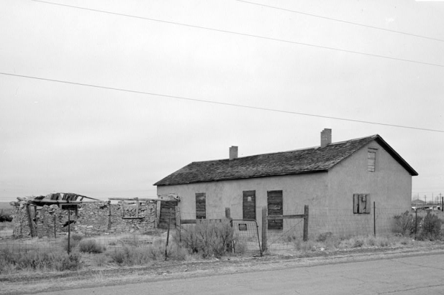
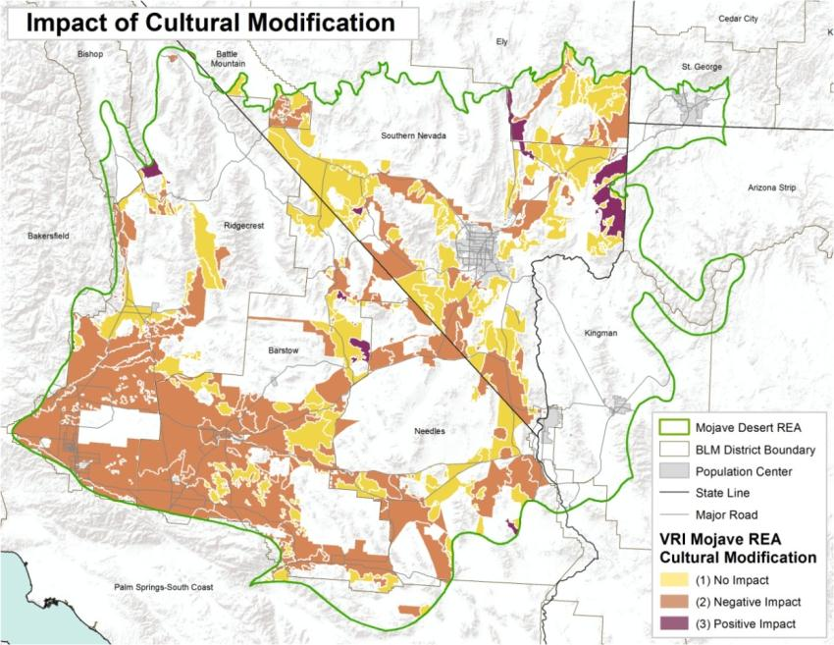
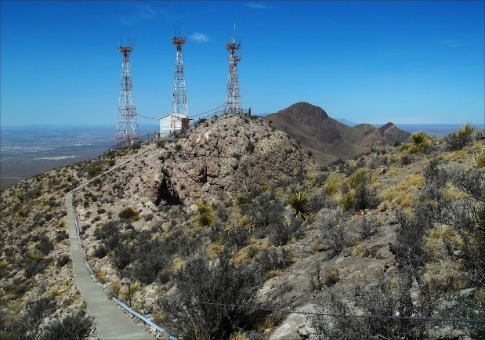
Analyze the Management Situation
Indicator of Condition
Condition of the Visual Resource
Trend of the Visual Resource (stabilized, increasing, decreasing)
Identifying cultural modifications worthy of visual protection not necessarily within areas of high scenic quality.
Delineating areas in need of visual rehabilitation
Notes:
It’s really important to accurately define areas of cultural modifications.

Slide 60
Analyze the Management Situation
Trends in the condition of the Visual Resource
Stable , increasing, decreasing and character of those changes.
Identifying cultural modifications worthy of visual protection not necessarily within areas of high scenic quality.
Delineating areas in need of visual rehabilitation
Notes:
REWORK THIS SLIDE

Slide 61
Analyze the Management Situation (AMS)
Forecasting:
Resource Uses – Orientation to the visual values
Special Designations - Orientation to the visual values
Social & Economic Features - Orientation to the visual values
Notes:
We don’t sell or lease or otherwise “use” Visual Resources. We don’t permit Visual Resources. We issue Special Recreation permits where the uses benefit from and sometimes alter the quality of setting,
We authorize land use development and grant Rights-of-Ways that change the landscape’s character which affects visual resources.
So marry up VRI information up with current uses and foreseeable needs – collaborate with the other program disciplines.

Slide 62
Analyze the Management Situation
Proximity to and enhanced viewshed sensitivities from:
National Monuments and National Conservation designations
Eligible Wild and Scenic Rivers
Wilderness Areas and Wilderness Study Areas
Other special management designations (e.g., National Parks, etc.)

Slide 63
Analyze the Management Situation
Areas of increased levels of recreational use under current plan:
Visually sensitive ACECs
National, State or BLM Backcountry Byways
Trail corridors
Special Recreation Management Areas
Off Road Vehicle areas

Slide 64
Formulate Alternatives
Recreation planning interface
Recreation Settings Characteristics
Outcome Experiences
Notes:
Settings characteristics – match up with the VRI values

Slide 65
Analyze the Management Situation
Forecasting of high potential resource demand:
Rights-of-way (368 Energy Transmission Corridors, roads, communication systems)
Fluid minerals (oil & gas/ CO2),
Solid minerals,
Precious metals,
Renewable energy development

Slide 66
Analyze the Management Situation
Listing areas in the inventory labeled as needing visual restoration

Slide 67
Analyze the Management Situation (AMS)
Analyzing the Existing Management Situation (H-1601 Appendix F)
Chapter 3: Current Management Direction
Relevant plan amendments
Current management decisions
Chapter 4: Management opportunities
Changes in management worthy of consideration
Chapter 5: Consistency and Coordination with other plans
County/ city plans
State plans: wildlife conservation, outdoor recreation plans, etc.
Other Federal agencies
Notes:
Maybe break these apart into their own slides and incorporated images:
Ch 3 – Plan Amendment Doc
Chapter 4 – Think about it
Ch. 5 – Garfield County scenic overlay

Slide 68
Analyze the Management Situation
Identify potential sources of land use conflict:
Consistency with other BLM land use plans
Other federal agencies’ land use plans : National Park Service, US Forest Service, US Fish & Wildlife, etc.
State, County, and Municipal comprehensive master plans

Slide 69
Analyze the Management Situation
Identify potential sources of land use conflict:
State, County, and Municipal comprehensive master plans

Slide 70
Analyze the Management Situation
Acknowledge and address the sensitivity of Adjacent Private Landowners (adjacent land uses in the VRI)

Slide 71
Analyze the Management Situation
AMS Report should cover the following for VRM:
Adherence to the VRM class objectives under current RMP
Distribution of the VRI Classes and inventory factors
Scarcity present within the range of visual values
Condition of the visual resource values
Scenic integrity of the landscape’s intact natural character
Sensitive viewsheds of adjacent land uses
Trends in protection or alteration of the landscape character
Overlay with other data to identify compatibility and conflicts
Concerns/ issues regarding protecting/ modifying the natural landscape character related to other land uses.
Notes:
TURN INTO ON SCREEN EXERCISE

Slide 72
Analyze the Management Situation
Public Scoping and AMS
Opportunity to validate VRI
Share insights developed and other issues and conflicts identified
The public’s take on the insights, issues, and conflicts
Public input on thoughts regarding possible VRM alternatives
Notes:
Need new image – maybe a lattice tower example instead that it less dominating and set back from the road a little further

Slide 73
Analyze the Management Situation
Bringing the AMS information forward into Alternatives:
Generate a report on the finding,
Is the basis for formulating reasonable alternatives
Alternatives must meet the purpose and need
Each alternative needs to have a rationale
Notes:
Need new image – maybe a lattice tower example instead that it less dominating and set back from the road a little further

Slide 74
Land Use Planning Process
Notes:
Need new image – maybe a lattice tower example instead that it less dominating and set back from the road a little further

Slide 75
Formulate Alternatives
VRI Classes to VRM Classes
Classes | Inventory (Pre-planning) VRI Classes |  | Management (Land Use Planning) VRM Classes
I | Special Designation (Congressional or administrative ) |  | Preservation
II | High Visual Values |  | Low levels of change
III | Medium Visual Values |  | Moderate levels of change
IV | Low Visual Values |  | Major levels of change
Notes:
S

Slide 76
Formulate Alternatives
VRI Classes to VRM Classes

Slide 77
Formulate Alternatives
Final decisions on Visual Resource Management Classes may or may not be commensurate with Visual Resource Inventory Classes
Notes:
Commensurate – the level of management may not be proportional to the visual resource value
Relocate to wherever it makes sense

Slide 78
Formulate Alternatives
VRI is the primary source of information to build VRM Class alternatives.
Federal Land Policy and Management Act:
Sec. 202. [43 U.S.C. 1712] (c) In the development and revision of land use plans, the Secretary shall–
(4) rely on the inventory of the public lands, their resources, and other values;
Notes:
Why must the VRI be the primary source of information?
Answer: FLPMA Section

Slide 79
Formulate Alternatives
VRI Classes to VRM Classes
Classes | Inventory (Pre-planning) VRI Classes |  | Management (Land Use Planning) VRM Classes
I | Special Designation (Congressional or administrative ) |  | Preservation
II | High Visual Values |  | Low levels of change
III | Medium Visual Values |  | Moderate levels of change
IV | Low Visual Values |  | Major levels of change
Notes:
Good place to begin

Slide 80
Formulate Alternatives
VRI is the primary source of information to build VRM Class alternatives.
Federal Land Policy and Management Act:
Sec. 202. [43 U.S.C. 1712] (c) In the development and revision of land use plans, the Secretary shall–
(4) rely on the inventory of the public lands, their resources, and other values;
(5) consider present and potential uses of the public lands;
(6) consider the relative scarcity of the values involved
Notes:
Why must the VRI be the primary source of information?
Answer: FLPMA Section

Slide 81
Formulate Alternatives
VRI Classes to VRM Classes
Classes | Inventory (Pre-planning) VRI Classes |  | Management (Land Use Planning) VRM Classes
I | Special Designation (Congressional or administrative ) |  | Preservation
II | High Visual Values |  | Low levels of change
III | Medium Visual Values |  | Moderate levels of change
IV | Low Visual Values |  | Major levels of change

Slide 82
Formulate Alternatives
VRI is the primary source of information to build VRM Class alternatives, but visual values coexist with other resource values and land use allocations.
Other legislative mandates, or other program directives that require, protective visual management of sensitive resource values (designations).
Compatibility between VRM class objectives and land use allocations (e.g., oil and gas, minerals, coal, renewable energy, rights-of-way, etc.).
Prioritizing visual values over other resource values and land use allocations by designating Areas of Critical Environmental Concern (ACEC) based on scenic value and/or VRM Class I.

Slide 83
Formulate Alternatives
Visual Absorption Capability (USFS) – reading the landscape’s visual variety that will visually absorb built facilities

Slide 84
Formulate Alternatives
Common approach:
Current management direction (No Action)
Conservation emphasis
Resource Use – emphasis on constraint reduction
Balanced management – increased conservation balanced against moderate levels of resource use
Notes:
Need new image – maybe a lattice tower example instead that it less dominating and set back from the road a little further

Slide 85
Formulate Alternatives
First, formulate alternative for managing visual resources:
VRI classes and scenic quality/ sensitivity / proximity within distance zones.
Second, identify those lands that lend themselves for higher levels of visual protection:
Wild and Scenic Rivers
National Scenic and Historic Trails
National Monuments and National Conservation Areas
Prioritized views from National Parks within the planning area
New residential areas within the BLM land interface

Slide 86
Formulate Alternatives
Third, identify those lands that lend themselves for lower levels of visual protection:
Fluid minerals,
ROW needs (electrical transmission, communication, etc)
Solid minerals
Livestock grazing
Etc.
Fourth, blending to a refined alternative that resolves conflicts between the uses while managing for the protection of scenic value.

Slide 87
Alternatives Development
Drivers
VRI
Scenic quality
Sensitivity
Distance zones
ACEC Opportunities
Notes:
Enter SQRU 40 – a score of 28

Slide 88
Alternatives Development
Drivers
VRI
Scenic quality
Sensitivity
Distance zones
ACEC Opportunities
Other resources/uses that benefit
Recreational settings and trails (SRMAs)
Cultural/ historic sites
Scenic/historic trails
Wild & Scenic Rivers
Back Country Byway
Special status species
Critical habitat (S.G.)
Other uses that don’t
ROWs
Mineral leasing
Mining
Livestock
Back country byway
Notes:
Enter SQRU 40 – a score of 28

Slide 89
Formulate Alternatives
Visual Absorption Capability (USFS) – reading the landscape’s visual variety that will visually absorb built facilities

Slide 90
.
Formulate Alternatives
Photo by Bob Wick

Slide 91
Formulate Alternatives
Visibility Study/ viewshed modeling

Slide 92
Formulate Alternatives
Visibility Study/ viewshed modeling
VRI Class IV
VRI Class II
VRI Class III

Slide 93
Formulate Alternatives
Rationale behind the VRM class objectives - for the range of alternatives and as carried forward in the ROD.
Need to know the why behind the how
Helps with the plan’s implementation especially for those tasked with implementation without the benefit of being a part of the plan’s development.
Defending the plan decisions against a non-conforming use.

Slide 94
Formulate Alternatives
Basic requirement:
All plans must delineate the standards for protecting scenic resources by designating BLM lands as a Class I, II, III, or IV objective.
Supplemental management protections:
The RMP process allows further standards and management actions for visual resources to be described.
Stipulations, Conditions of Approval, Best Management Practices
Other Management Tools
ROW Exclusion and Avoidance Areas
No Surface Occupancy (NSO)
Controlled Surface Use (CSU)
Notes:
Controlled Surface Use over VRM Class II and VRM Class III? (Class III – based on Visual Absorption Capability)

Slide 95
Formulate Alternatives
What about the inverse? Exemptions?
Exception under VRM Class II stipulation-Alternatives B and C:
The level of change to the landscape should be low; management activities may be seen, but should not attract attention of the casual observer.
Any change to the landscape must repeat the basic elements of form, line, color, and texture found in the predominant natural features of the characteristic landscape.
Also, recognized utility corridors are exempt only for utility projects which would be managed according to VRM III objectives.
Notes:
Recreation as an example
Oil and Gas versus Wind as an example

Slide 96
Land Use Planning Process
Notes:
Need new image – maybe a lattice tower example instead that it less dominating and set back from the road a little further

Slide 97
Analyze Effects of the Alternatives
Chapter 3: Describing the Affected Environment
Description of VRM policy and procedures
Current VRM Classes and changed conditions or circumstances in the planning area
General description of the landscape character
VRI classes and values (Scenic Quality, Sensitivity, Distance Zones) for whole planning area
Visual condition and trends
VRI Class map and VRI values (SQ, SL, DZ) maps and
View-shed values of adjacent lands – public and private

Slide 98
Analyze Effects of the Alternatives
Chapter 4: Environmental Impact Analysis
Each VRM class objective within each alternative shall be evaluated for potential impacts on existing VRI classes and VRI factors (scenic quality, sensitivity, distance zones).
Quantification of potential impacts in accordance with BLM National Environmental Policy Handbook H-1790-1.
Identify and describe the anticipated types of land uses that would potentially alter the VRI factors under plan implementation.

Slide 99
Analyze Effects of the Alternatives
98%
<1%
33%
24%
43%
<1%
65%
25%
10%
Notes:
Discussion on the types of allowable uses and their impact potential in form, line, color, texture, scale

Slide 100
Analyze Effects of the Alternatives
Notes:
Discussion on the types of allowable uses and their impact potential in form, line, color, texture, scale

Slide 101
Analyze Effects of the Alternatives
What are the shifts in VRM Class Designation between the No Action and other alternatives?
“Alternative C is less protective than A, B and D”

Slide 102
Analyze Effects of the Alternatives
What are the shifts in VRM Class Designation between the No Action and other alternatives?
“X acres of VRM Class III will now be managed at VRM Class IV and will affect Scenic Quality B within Fg/Mg Distance Zone with High Sensitivity inventoried as VRI Class II. Under this alternative 17% VRI Class II, 5% of Scenic Quality A…will be managed as VRM Class III…”

Slide 103
Analyze Effects of the Alternatives
Which lands are under higher levels of visual protection and why?
Protection of scenic quality, respecting sensitivity, addressing visibility (distance zones)
Wild and Scenic River backdrops
National Historic Trails – sustaining historic setting
Prioritized viewshed from National Parks within the planning area
Community and residential vistas within the BLM land interface
And quantify – acres, percent of planning area . . .

Slide 104
Analyze Effects of the Alternatives
Which lands are under lesser levels of visual protection and why?
Fluid mineral leasing
Coal leasing
Renewable energy development
Electrical transmission, fluid minerals pipeline, transportation, communications facility rights-of-way
Solid minerals mining

Slide 105
Management Measures (Actions)
Rehabilitation/ Restoration Areas (part of SQRU Cultural Modifications)
Flag areas needing rehab during the inventory and build a list of needs.
Level of rehab will be determined by the visual objectives assigned in the RMP.
Set goals that are achievable.
Work with the other programs in identifying priority areas.
Step down plans
Integrate into the Regional Mitigation strategy

Slide 106
Visual Restoration Management Actions
Abandoned Mine Land:
Undesignated Travel Routes:
Impaired Historic settings (e.g., NSHT):

Slide 107
Other Considerations
Renewable Energy and VRM
West-wide Energy Corridor Programmatic EIS – 368 Energy Transmission Corridors
IOPs
Wind Energy PEIS
15 Amendments
Geothermal PEIS
Comprehensive list of BMPs
Solar PEIS
17 Solar Energy Zones
BMPs

Slide 108
Interim VRM Classes
What do you do when you have no VRM objectives for an area of public land?
Develop interim classes using guidelines from H-8410-1.
A surrogate process to bring non-compliant land use plans into interim compliance with VRM policy.
Interim management classes should reflect existing decisions within the RMP.
A plan amendment is not required unless the project driving the VRM evaluation requires one.
The conclusion of the appropriate interim management should be the result of a NEPA analysis
Is a VRI needed?
Notes:
This should be under project planning

Slide 109
Emerging Issues
Night Sky

Slide 110
Insights based on WO Reviews
What I’m looking for:
Evidence that the VRI was indeed considered in the LUP process:
VRI is the primary source of information when developing alternatives and is properly represented.
Describes an adequate trend analysis
VRM Alternatives cross check with other resource concerns, activities, and allocations.
Impact to VRI factors are adequately disclosed
A rationale is presented for each alternatives VRM Class objective.

Slide 111
Land Use Plan Checklist
Build a robust AMS
VRM Goals, objectives, issues
Inventory – VRI Classes, Scenic Quality, Sensitivity, Distance Zones – Acres and percent area
Description of landscape
Current management classes
How the management of visual values shifts under the alternatives
Impact analysis – VRM Class impact on VRI values
What are the allowable uses within the VRM Class designations creating visual change
Explain why certain VRM Classes were designated – especially when VRM Classes are not commensurate with VRI values

