Slide 2
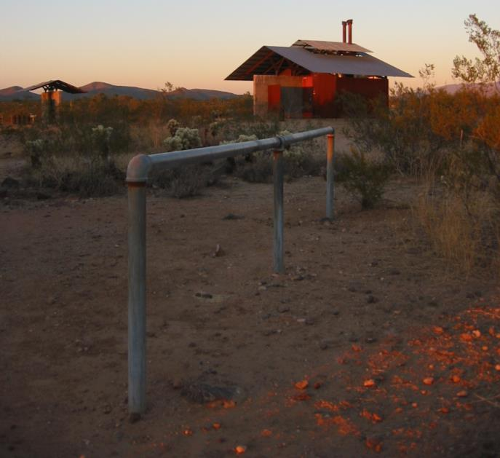
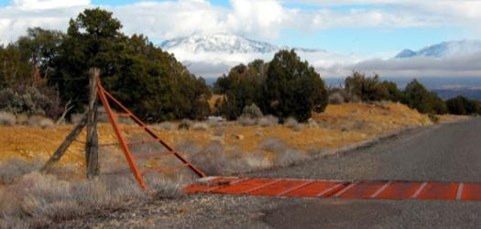
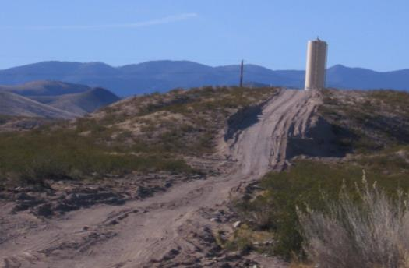
Project Planning Essentials
Notes:
We are now Transitioning from Planning to Implementation

Slide 3
Project Planning Essentials
Unit Objective
Students will:
recognize the need to incorporate visual resources early and throughout all phases of project planning, and
understand the distinctions between Land Use Plan Conformance and NEPA Compliance for project proposals

Slide 4
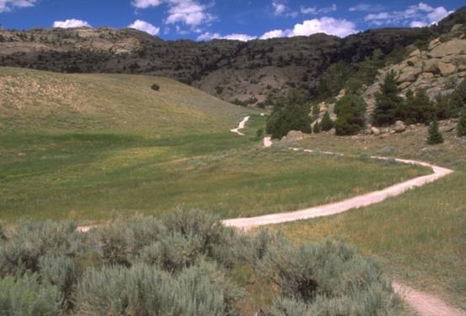
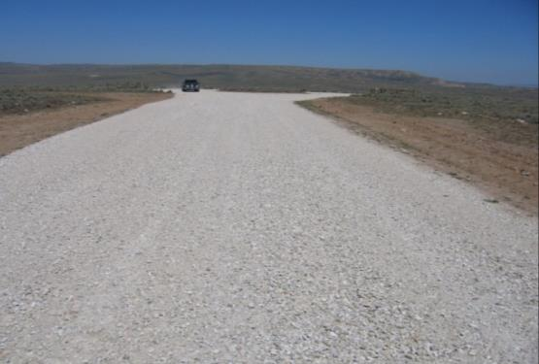
Project Planning Essentials
Incorporation of Visuals in Planning
Better efficiency
Better chance of acceptance
Better projects
Less chance for costly, time delaying court challenges
Avoid/minimize mitigation
Image Caption (if needed)
Image Caption (if needed)
Notes:
Will launch into Key Pts to Remember regarding Project Planning & Analysis:
1st: Incorporating Visual Concepts & Analyses Early and Throughout Project Planning & Analysis
Efficiency: Upfront v Reactive
Incorporating learnings from decades of visual analyses
Acceptance: mutual ownership of ultimate proposal v. defending from change
Better projects: elegant solutions meet the most needs in the simplest way
Court challenges: Acceptance/ownership and Increased defensibility of a minimally impacting project
Post analysis mitigation, and analysis of mitigation itself and disclosure of residual effects avoided

Slide 5
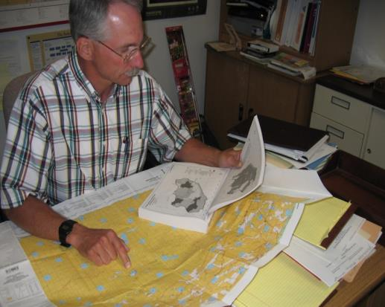
Project Planning Essentials
Understand Existing Constraints
Laws, Regulations, Policy
LUPs, City and County Plans
VRM Management Classes
Activity Plans, including
Travel Management Plans,
Master Plans,
Recreation Area Management Plans
Other resources (T&E, archeology, etc.)
Project plan, design guidance/standards
Existing facilities
Notes:
Understanding Existing Project constraints
1st 4 bullets are Plan Conformance factors, highlighting the breadth of potentially influencing laws, regulations, intergovernmental plans, ordinances, and policies at all levels
PLUS as any BLM implementation-level plans
So consider ALL levels of decision parameters
Don’t forget constraints associated with other resources
Then consider the Project itself – existing design standards?
And factor in existing facilities
Limitations of using
Limitations of adding to or interfering with…

Slide 6
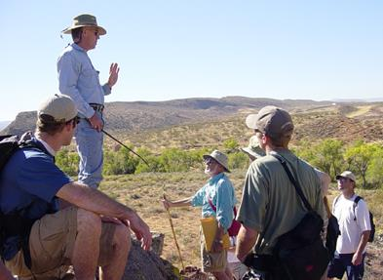
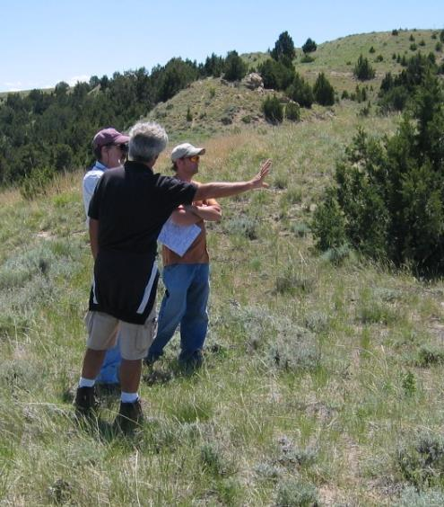
Project Planning Essentials
Team Approach is Best
Minimizing visual impacts is everyone’s job.
Include all of the disciplines that have a significant stake.
Include external stakeholders early on.
Increases the credibility of the recommendations and makes project easier to implement.
Notes:
All disciplines w/ stake: Not only for inclusion & ownership, but also for mutually benefiting solutions
External Stakeholders:
Show-me Tours

Slide 7
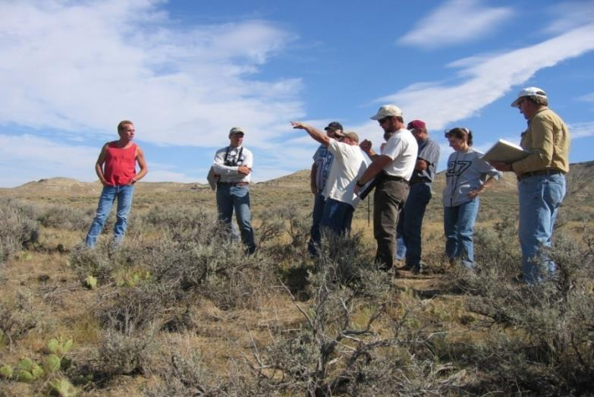
Project Planning Essentials
Field Review is Essential
Proponent and planning team can only meaningfully discuss project on site.
Keeps everyone on the same page.
Misunderstandings can be avoided.
Project parameters can be determined more easily.
Notes:
Visual = Visual
No substitute for the actual, physical, 3-D landscape
[Bullets on the slide]
It’s about people seeing, valuing, and reacting to proposed changes to the Visual Landscape

Slide 8
Project Planning Essentials
Types of Projects
Linear alignments (roads, bridges, transmission corridors, pipelines)
Energy production (oil and gas, wind, solar, geothermal, hydro)
Mineral extraction (mining, gravel operations )
Vertical development (communication sites, radio, cellular)
Vegetative manipulation (fire and fuels, restoration and rehabilitation, timber)
Wildlife and Range (habitat or range improvement, enclosures, water sources)
Recreation and administrative sites (trails, toilets, campgrounds, visitor centers)
Notes:
Consider how Types of Projects influence planning and design, e.g.,
Linear alignments: shortest distance = straight line
Energy production: Scale and Ancillary facilities
Mineral extraction: changes to Landform and Color
Vertical development: Added Dimension? Backdrop? Color, lights?
Veg Manipulation: Color, Texture,, Edge, TIME
Recr & Admin Sites: Scale, Observation Points

Slide 9
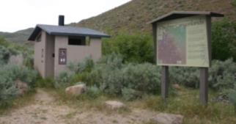
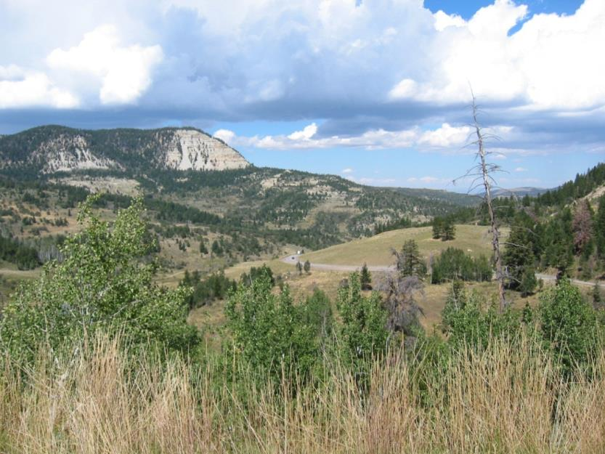
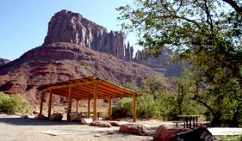
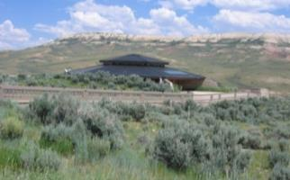
Project Planning Essentials
Don’t Jump to Design Too Soon
Thoughtful and comprehensive planning leads to better design.
Saves time and money if planning leads design.
Notes:
This is the Point that we’ve been emphasizing:
Don’t wait for a complete “final” project proposal
Don’t start design and mitigation before know whether project is allowed at all
Understand the P & N and types of infrastructure needed to achieve them
Then work w/ Team in the field to creatively influence the project design for a smoother analysis and better chance of acceptance.
Brandon will elaborate on Visual Design Fundamentals in Unit 7

Slide 10
Project Planning Essentials
Conformance vs. Compliance
Plan Conformance vs NEPA Compliance
Plan Conformance: Does the project meet VRM Class Objectives?
NEPA Compliance: What are the effects to visual resources and values (VRI) and how can they be avoided, reduced, or mitigated regionally?
Notes:
Our 2nd Unit Obj: Understanding the distinctions betw Plan Conformance & NEPA Compliance
Plan Conformance is a req’mt of FLPMA
Uses VRM Class objectives and decisions held to “arbitrary & capricious” standard
Develop Plans to guide management of Public Lands
NEPA Compliance is obviously a req’mt of NEPA
Uses visual resources and values from VRI and held to “hard look” standard
Analyze proposals and reasonable alternatives
Disclose environmental effects
Consider ways to avoid, reduce, or compensate
So not appropriate to say “will meet VRM objectives, so No Impacts to VRs”
Both analyses use VR concepts & tools covered in Units 6-11
And Allysia will go into detail about Visual Resources in NEPA Analyses in Unit 10
(Handouts?)

Slide 11
Project Planning Essentials
Alternatives to Consider
Formulate alternatives that meet Purpose and Need while mitigating/reducing visual effects
Ensure conformance of each alternative with the RMP’s VRM Class objectives
Consider a “1st impression” of plan conformance
Clear and obvious
Explore ways to further reduce visual effects of otherwise conforming projects
Notes:
When analyzing project proposals:
We Formulate Alternatives: Utilize Options considered in Design Phase. (Disagreements are Alternatives) Any new options?
Each Alternative should meet VRM Class Objective.
Utilize a “1st impression” of plan conformance --- would project clearly & obviously not conform? (e.g., industrial-scale project on VRM Class II in FG-MG view of scenic viewpoint)→location & design
If one alt doesn’t conform, eliminate it or identify is as requiring a Plan Amendment before could be chosen.
Even if Plan-Conforming, legal obligation to further mitigate, if wouldn’t unreasonably hinder project (FLPMA Sec 302(b): prevent unnecessary or undue degradation)

Slide 12
LUP VRM Conformance
Land Use Plan Amendments
What if there is a scenario that wasn’t foreseen or considered?
Three options
Deny
Mitigate
Amend the Plan (only as last resort)
Notes:
If proposal doesn’t conform to the land use plan:
Three Options (list), but need to reverse the tendency to immediately jump to amending the plan.
Subsequent slides discuss how and why to take an extremely cautious approach to amending the plan.

Slide 13
Non-conforming action/ LUP Amendment
Contemplating a land use plan amendment:
An amendment shall be initiated by the need to consider the following criteria (43 CFR 1610.5-5):
New or revised policy.
New data.
A change in circumstances.
Findings from monitoring and evaluation.
A proposed action that may result in a change in scope of resource uses.
A change in the terms, conditions, and decisions of the approved land use plan.
Notes:
Factors from BLM’s Planning Regulations that may require LUP Amendment.
Note that most are responsive to new information or circumstances that come to light over time.
But one is triggered by an actual land use proposal that is outside the scope of our planning decisions for a particular area
(e.g., in our case, not conforming to established VRM objectives).

Slide 14
Non-conforming action/ LUP Amendment
Contemplating a land use plan amendment:
Carefully consider and evaluate before deciding whether to amend the VRM class objectives:
Existing land use plan’s rationale for the current VRM class objective.
If the public benefits associated with the proposed action’s purpose and need outweigh the public benefits associated with the purpose and protection level of the current VRM class objective.
Effects on other resource values and land use plan decisions that may result from modifying the level of visual resource protection.
The need to compensate for any loss of or reduction to visual resource value.
Notes:
Plan Amendment Cautions:
Note our emphasis on “deciding whether to amend,” v “deciding to amend.” It should never be a forgone conclusion.
A primary purpose of land use planning is to “Step Back” from day-to-day decision-making and establish allocations and guidelines, from a holistic perspective, that facilitate subsequent decision making.
So we MUST understand the intent of the original VRM Class (VRM Class II’s were not handed out like candy – a deliberate choice for a specific reason).
And we need to consider the effects on the RMP’s integrity in that area or as a whole.
So we weigh the public benefits (see slide)
And assess the effects on other resource values (remembering that VRM objectives are a mgt tool for the breadth of resources and uses)
If, after all of this analysis of trade-offs, we choose to amend:
Follow RMP-A procedures – it’s an analysis, not a forgone conclusion
Consider and analyze ways to Offset visual losses through Compensation

Slide 15
Non-conforming action/ LUP Amendment
Contemplating a land use plan amendment:
Carefully consider and evaluate before deciding whether to amend the VRM class objectives:
The BLM shall disclose the impacts to visual resources and explain the tradeoffs and benefits of amending the land use plan.
In circumstances in which a land use plan amendment allows a proposed action to move forward, conditions of approval shall include mitigation of adverse visual resource impact and evaluation of the opportunities for compensatory mitigation for recovering lost or reduced value to the VRI factors. (list of restoration areas in LUP)
Notes:
Further elaboration of the proceeding slide (from our updated VRM Manual currently awaiting approval)
Rather than starting from scratch, compensatory mitigation can be facilitated by proactive identification of priority visual restoration areas in the Land Use Planning process.
Regardless of political manipulations of the compensatory mitigation policy, there are still statutory req’mts that support compensatory mitigation when impact avoidance or reduction are not effective (e.g., FLPMA’s emphases on Scenic Values and WSRA mandate to protect and enhance outstandingly remarkable values, which often include scenic resources).

Slide 16
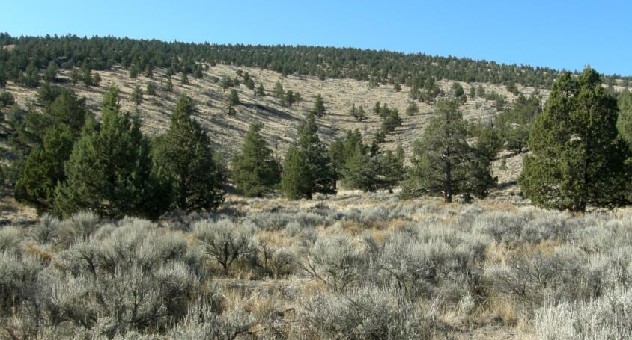
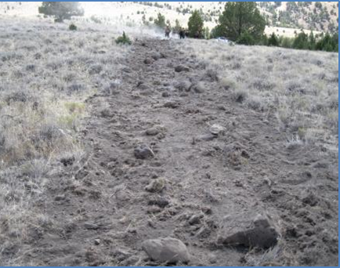
Project Planning Essentials
All Done and Dusted?
Following project design and approval:
Monitor implementation for compliance with design features
Assess over time for effectiveness of design features
Notes:
So you’ve positively influenced the design, you’ve ensured conformance w/ the RMP, you’ve analyzed and avoided, minimized or offset visual effects, and you’ve decided to approve the project.
So you’re all done right?
MONITORING! John McCarty will address further in Unit 11.
These photos are from Compliance & Effectiveness monitoring for two projects…

Slide 17
Project Planning Essentials
Rigorous Post-unit Academic Analysis
It’s Q Time!
Notes:
Time to take the rigorous QUIZ that you must PASS before you can move on to Unit 6.
Give time for quiz, then go thru each question w/ the group as a whole, asking random folks or table groups for their answer
(Note: have Answer Key to work from)

