Slide 2


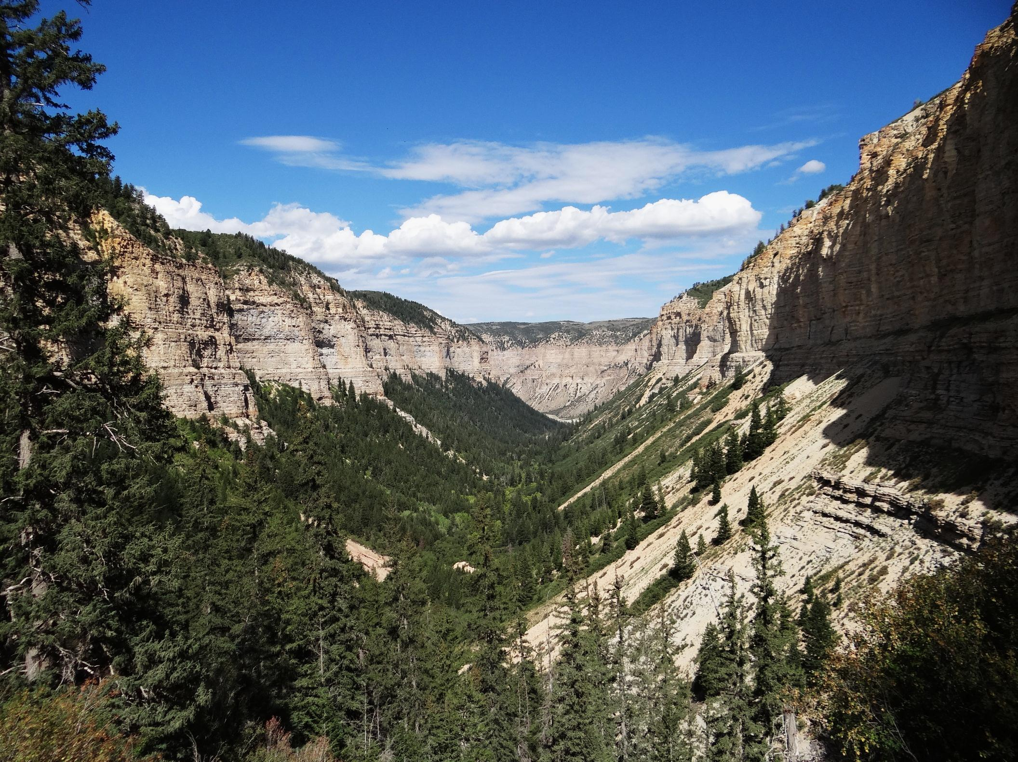
Environmental Factors
Roan Plateau, Colorado
Notes:
Ask the class if they can describe this landscape using “language of landscapes”.

Slide 3
Environmental Factors
Unit Objective
Provide a background
  Factors that that affect the viewer’s perspective of objects
  in the landscape and to
  Be able to use these factors in the planning and design
  process for a given project

Slide 4
Environmental Factors
Key Points to Remember
Environmental factors can help you plan a project to minimize visual impacts
Should be considered when assessing visual impacts
of a proposed project
They are constantly changing
Identify the most critical time or location to judge them

Slide 5
Environmental Factors
Factors
Viewing distance
Angle of observation
Length of time in view
Relative size or scale
Season of use
Light conditions
Recovery time
Spatial relationships
Atmospheric conditions
Motion

Slide 6
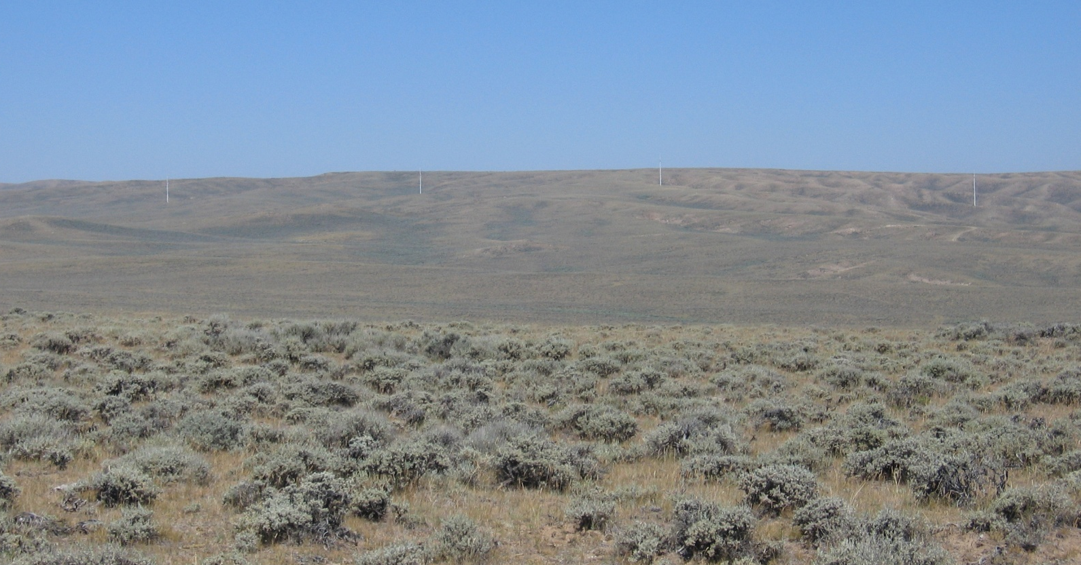
Environmental Factors
1 - Viewing Distance
How far is the viewer from the proposed project?

Slide 7
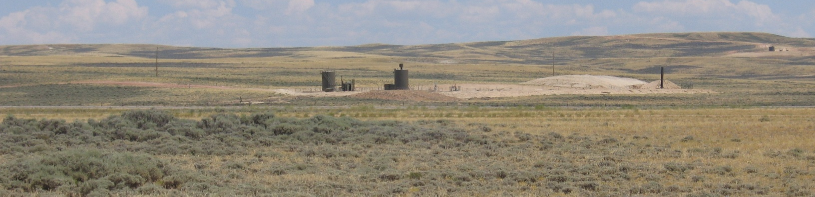
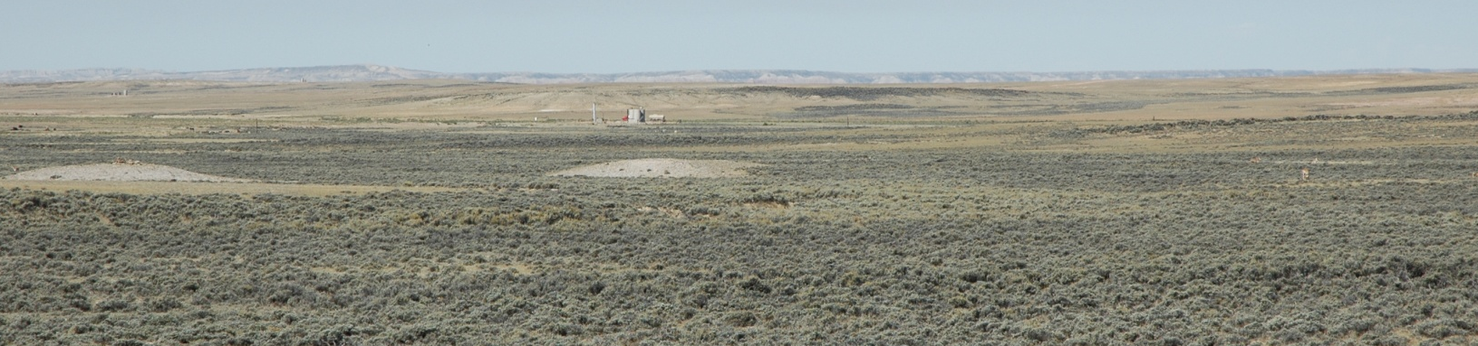
Environmental Factors
1 - Viewing Distance
As viewing distance increases, the project becomes less visually dominant and color value decreases toward uniformity

Slide 8
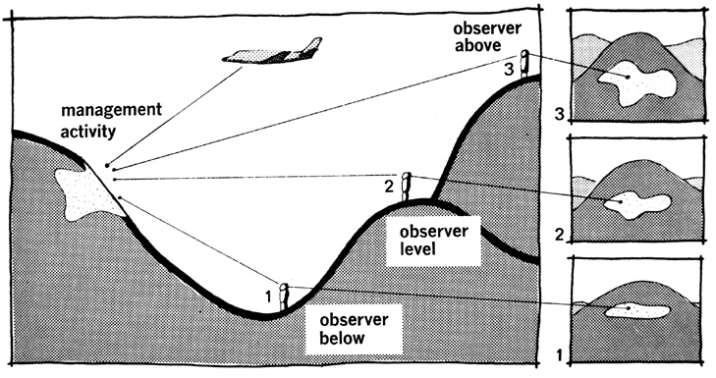
Environmental Factors
2 - Angle of Observation
Are you looking up at the project, looking down at the project, or are you at the same level?
Notes:
Apparent size of a project is directly related to the angle between the viewer’s line-of-sight and the slope upon which the project is located. The visual impact of a project can vary greatly depending on the angle of observation. As this angle nears 90 degrees (vertical and horizontal), the maximum area is viewable.

Slide 9
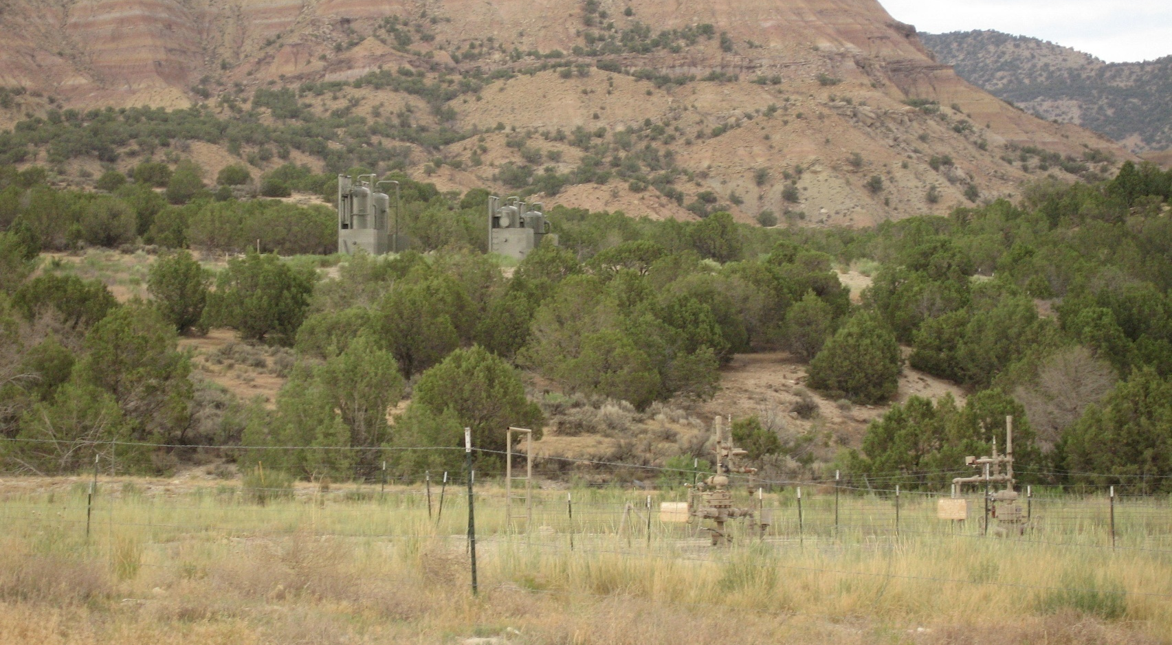
Environmental Factors
2 - Angle of Observation
Observer below – surface disturbance not visible

Slide 10
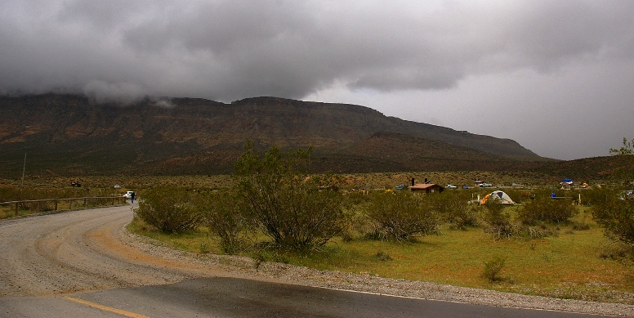
Environmental Factors
2 - Angle of Observation
Observer level – surface disturbance mostly not visible

Slide 11
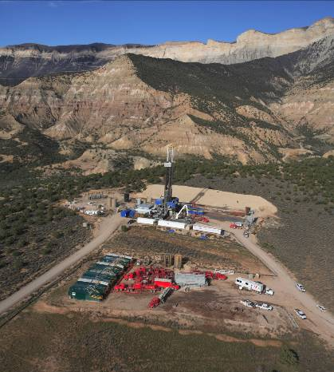
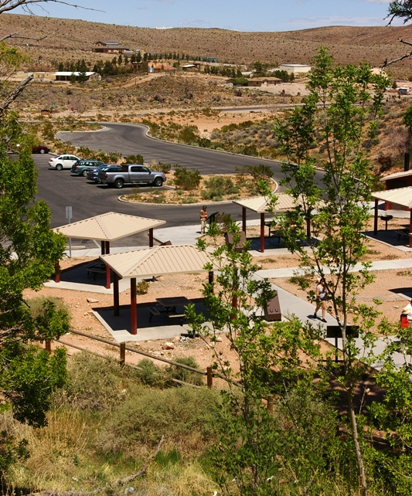
Environmental Factors
2 - Angle of Observation
Observer above – in addition to structures, surface disturbance is visible

Slide 12
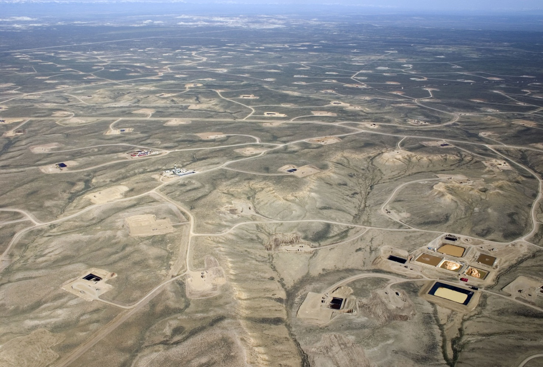
Environmental Factors
2 - Angle of Observation
Observer above – in addition to structures, surface disturbance is visible

Slide 13
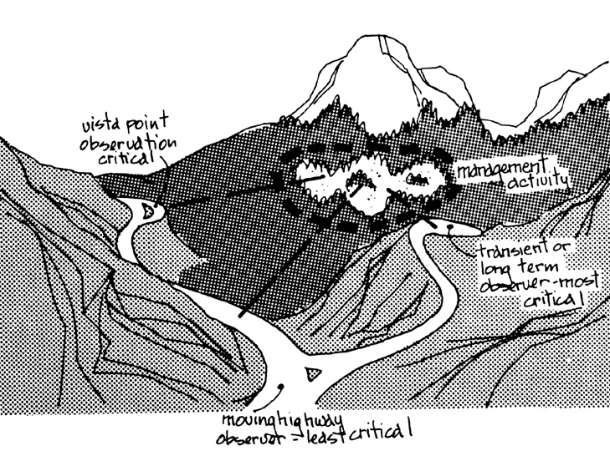
Environmental Factors
3 - Length of Time in View

Slide 14
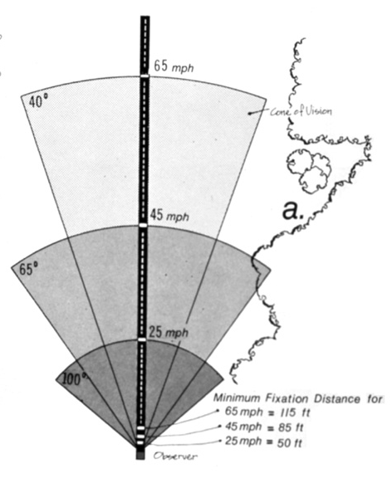
Environmental Factors
3 - Length of Time in View
Three-tenths of a second is needed for the eye to fixate
on an object
Cone of vision decreases as
speed increases along a linear corridor
The slower the travel speed the more likely any contrast created by a project would be noticed

Slide 15
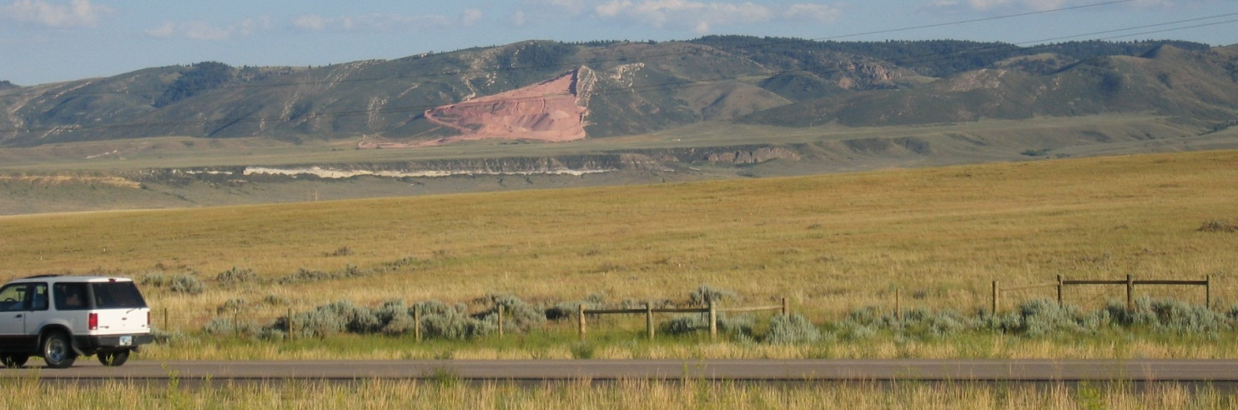
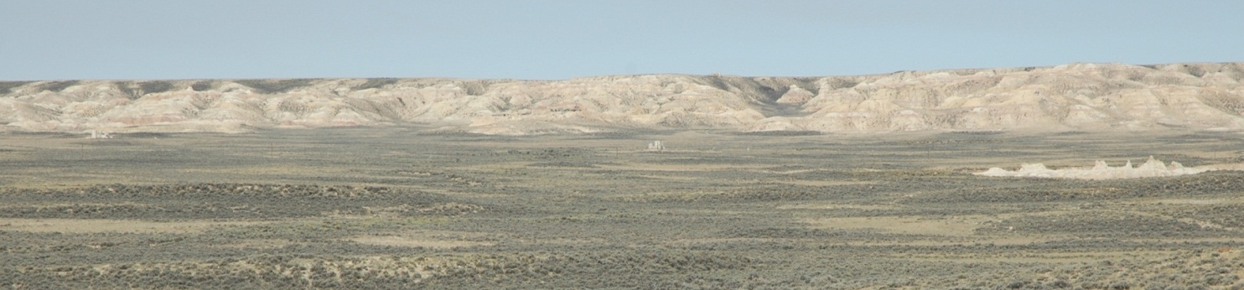
Environmental Factors
4 - Relative Size or Scale
The contrast created by a project is directly related to its size and scale compared to the surrounding landscape in which it is located

Slide 16
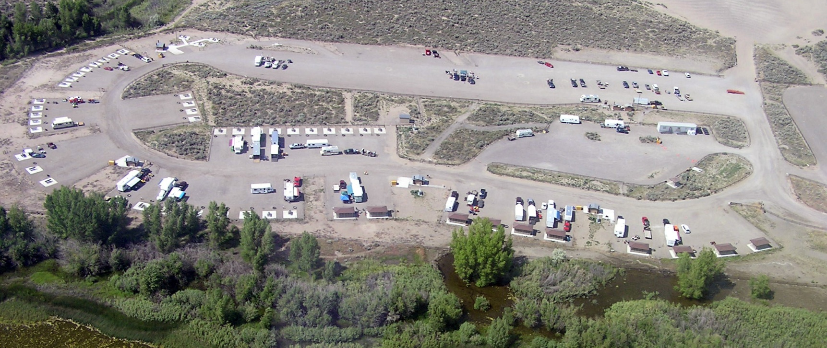
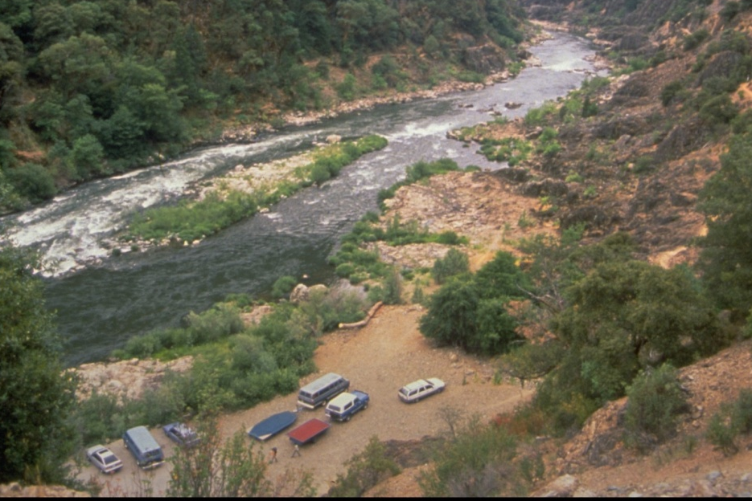
Environmental Factors
4 - Relative Size or Scale

Slide 17
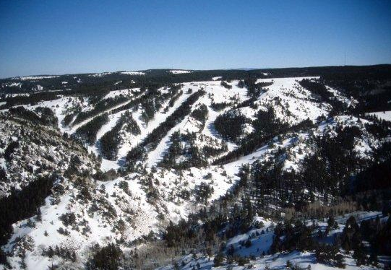
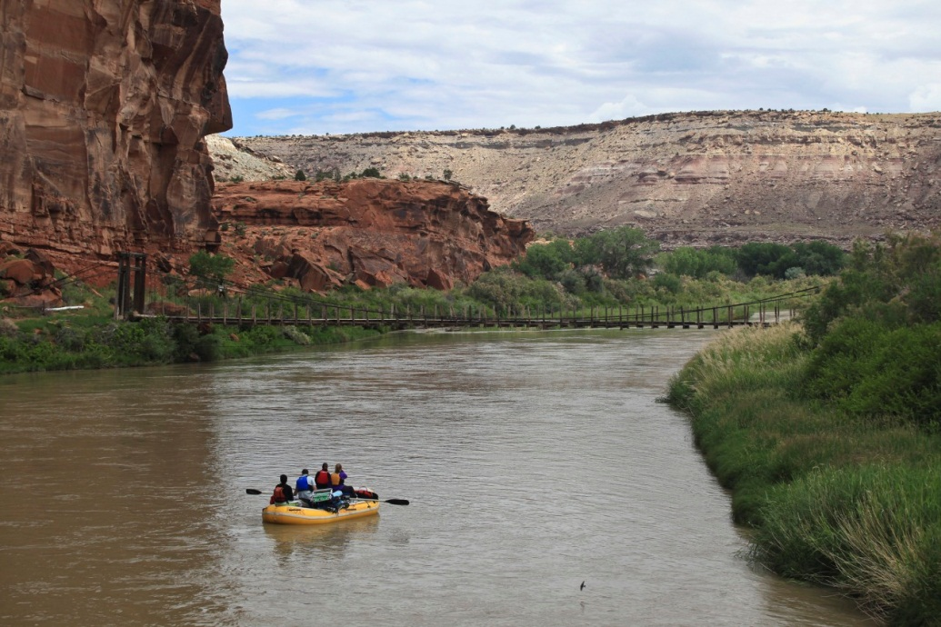
Environmental Factors
5 - Season of Use
Consider the physical conditions that exist during the heaviest or most critical visitor use season
Ski Season
Rafting Season
Notes:
Contrast ratings should consider the physical conditions that exist during the heaviest or most critical visitor use season, such as snow cover and tree defoliation during the winter, leaf color in the fall, and lush vegetation and flowering in the spring.

Slide 18
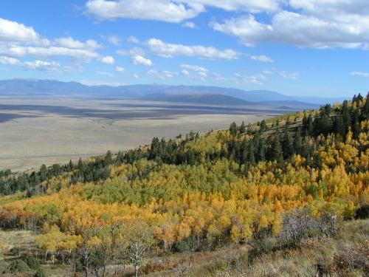
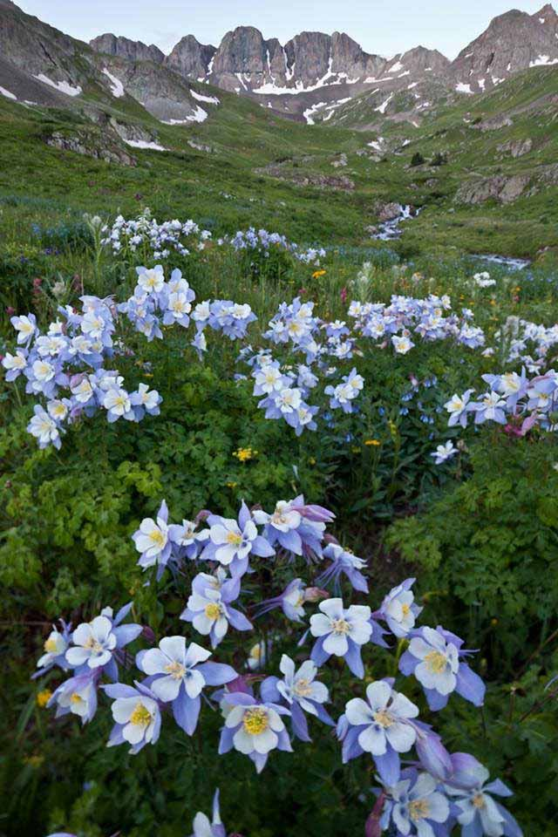
Environmental Factors
5 - Season of Use
Fall Colors and Hunting Season
Wildflower Season

Slide 19
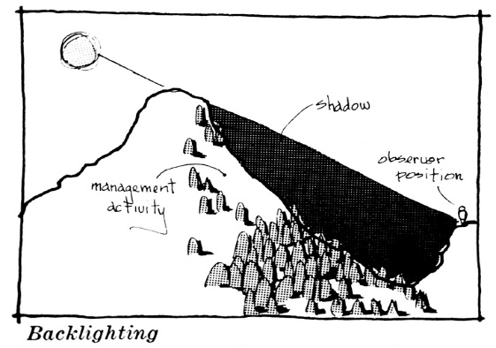
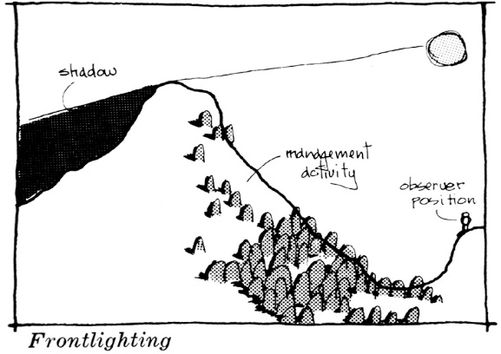
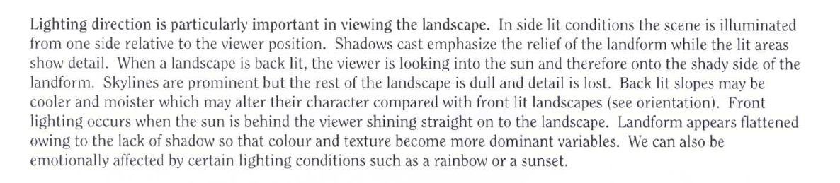
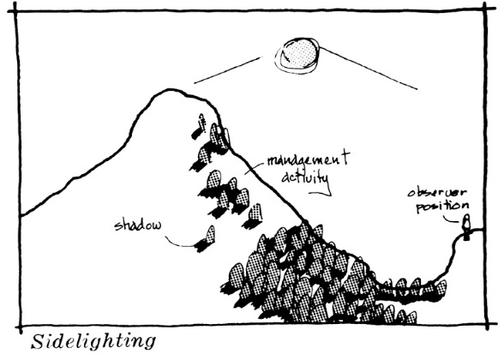
Environmental Factors
6 - Light Conditions
The direction, angle and quality
of light affects the color intensity,
reflection, shadow, form, and
texture
Also, consider time of day and
time of year
Notes:
The amount of contrast can be substantially affected by the light conditions. The direction and angle of lighting can affect color intensity, reflection, shadow, form, texture, and many other visual aspects of the landscape. Light conditions during heavy use periods must be a consideration.

Slide 20
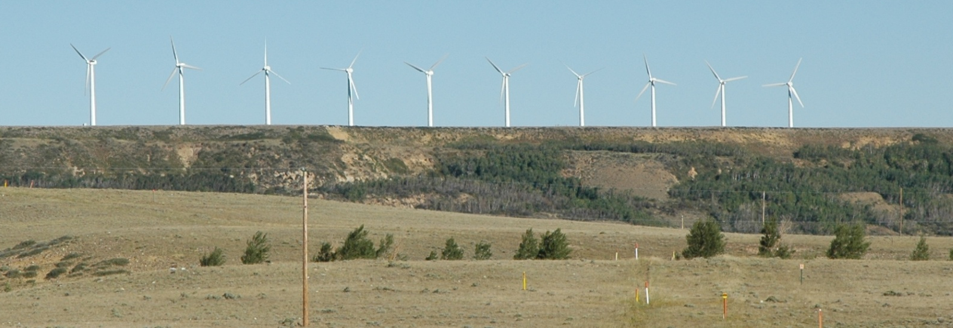
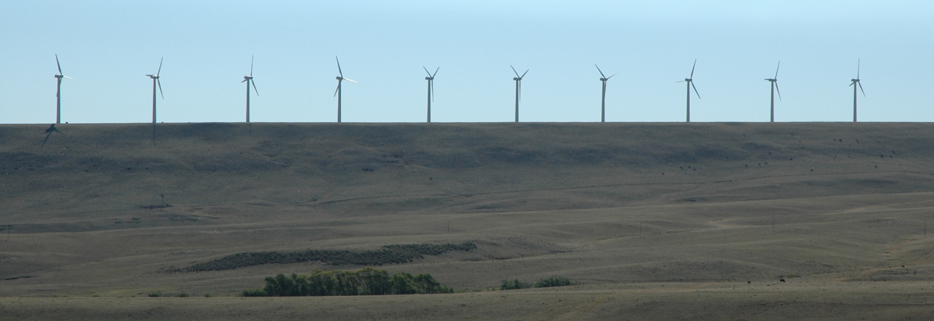
Environmental Factors
6 - Light Conditions
Front Lighting vs. Back Lighting
Front Lighting
Back Lighting
Notes:
Front lighting – when most of the landscape is in full sunlight, it is flattened by lack of shadows.
Back lighting – objects in the landscape become silhouetted or shadows creating visible lines and details are difficult to distinguish.

Slide 21
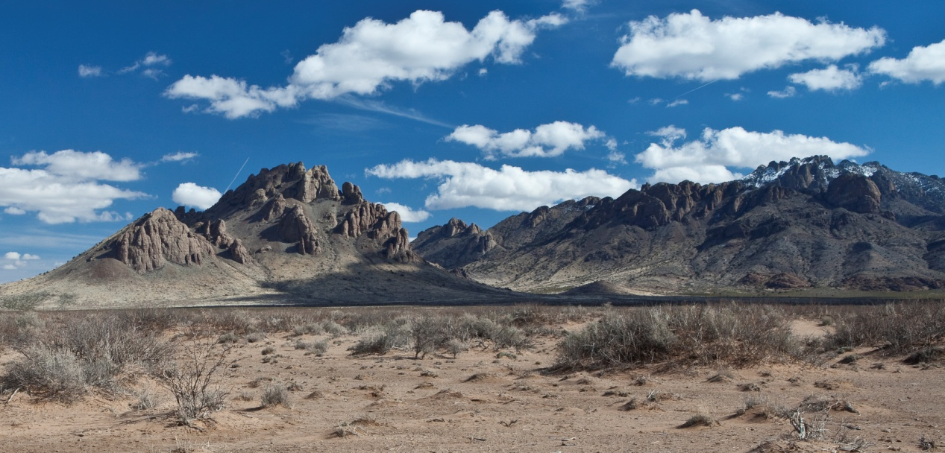
Environmental Factors
6 - Light Conditions
Side lighting causes shadows, creates contrast and accentuating features

Slide 22
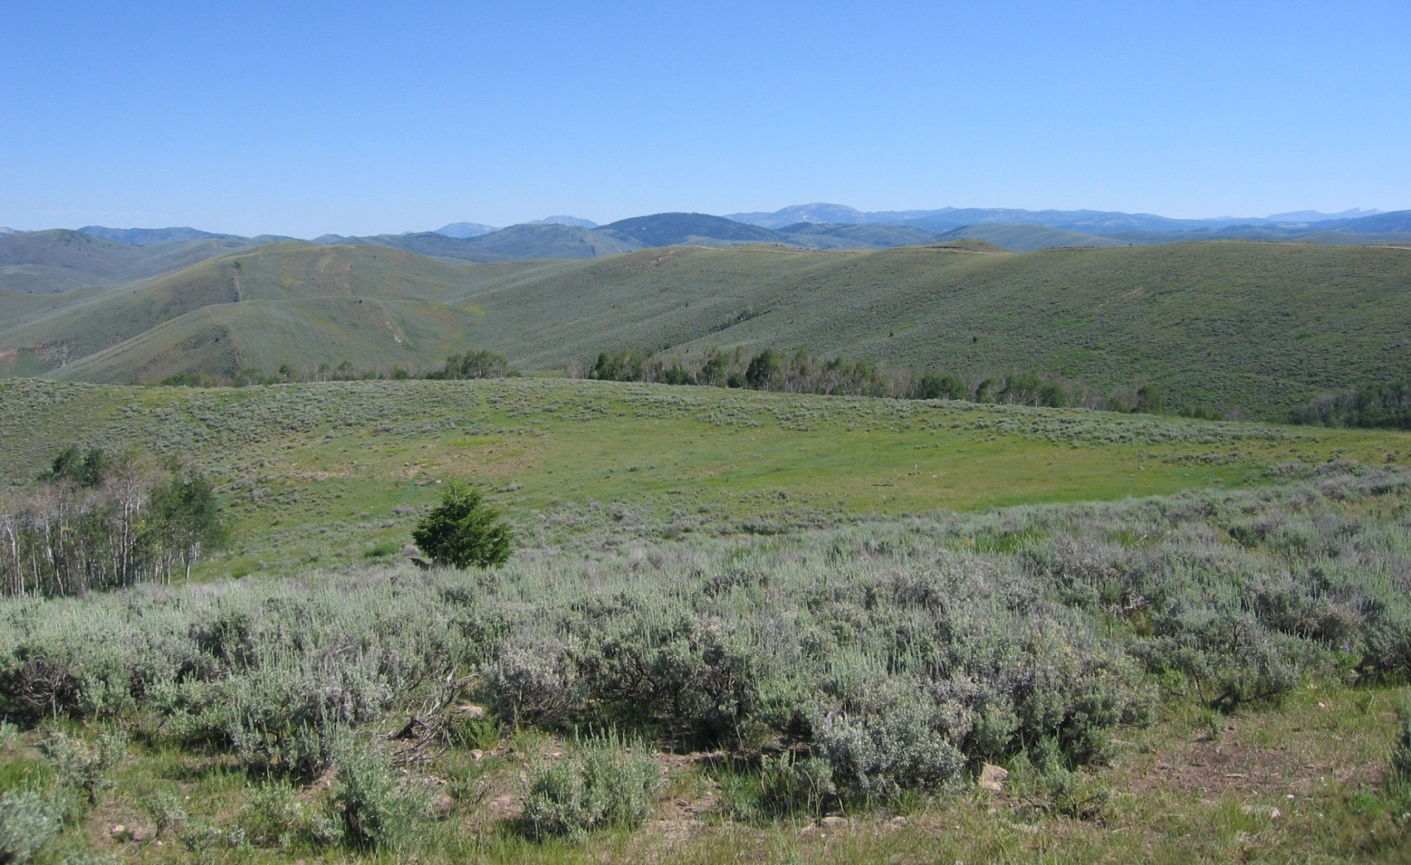
Environmental Factors
7 - Recovery Time
The amount of time successful revegetation/reclamation is expected to take
Notes:
The amount of time required for successful revegetation should be considered. Few projects meet the VRM management objectives during construction activities. Recovery usually takes several years and goes through several phases (e.g. bare ground to grasses, to shrubs, to trees etc.).

Slide 23
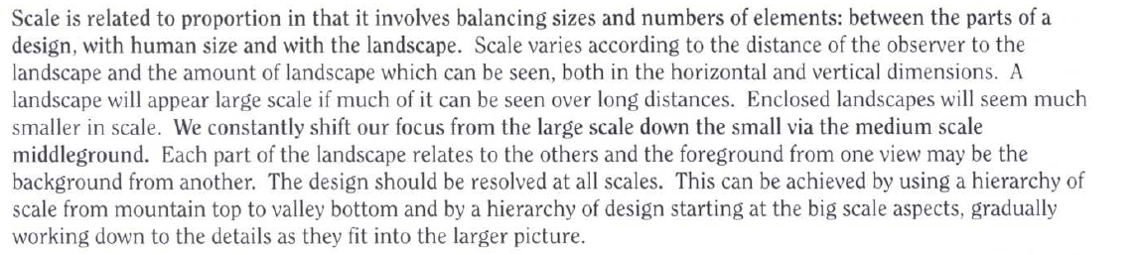
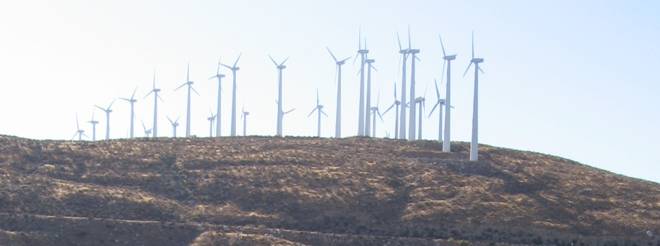
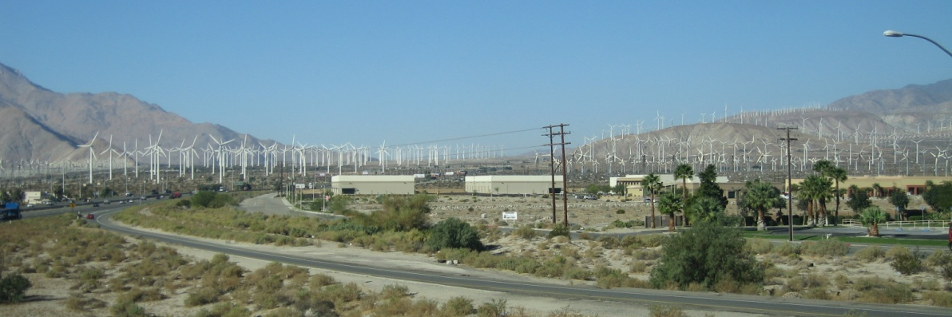
Environmental Factors
8 - Spatial Relationships
Spatial qualities of a landscape are determined by three-dimensional arrangement of objects and voids

Slide 24
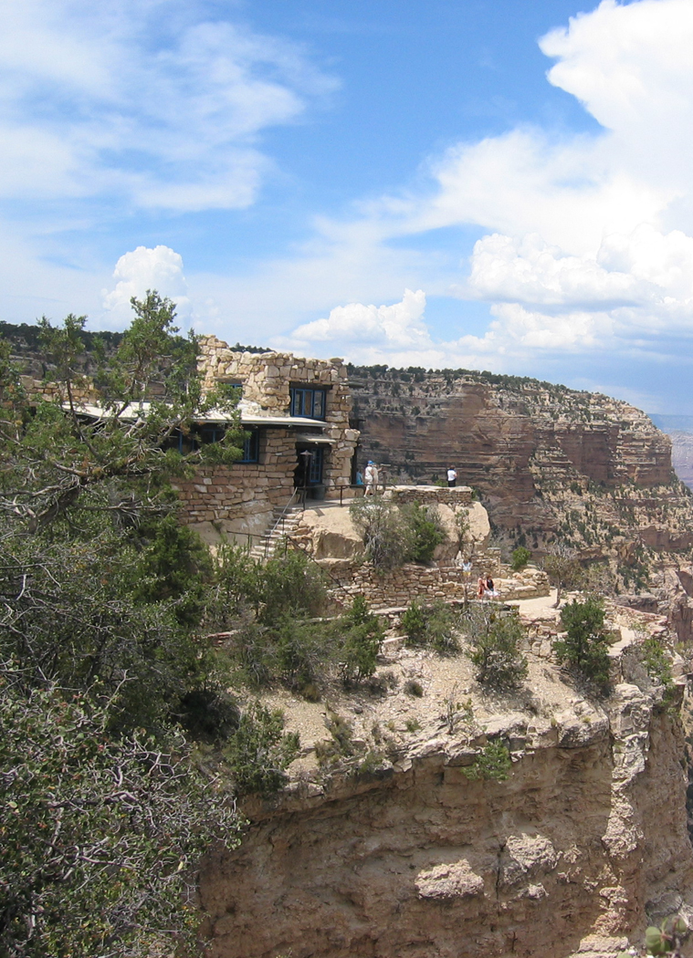
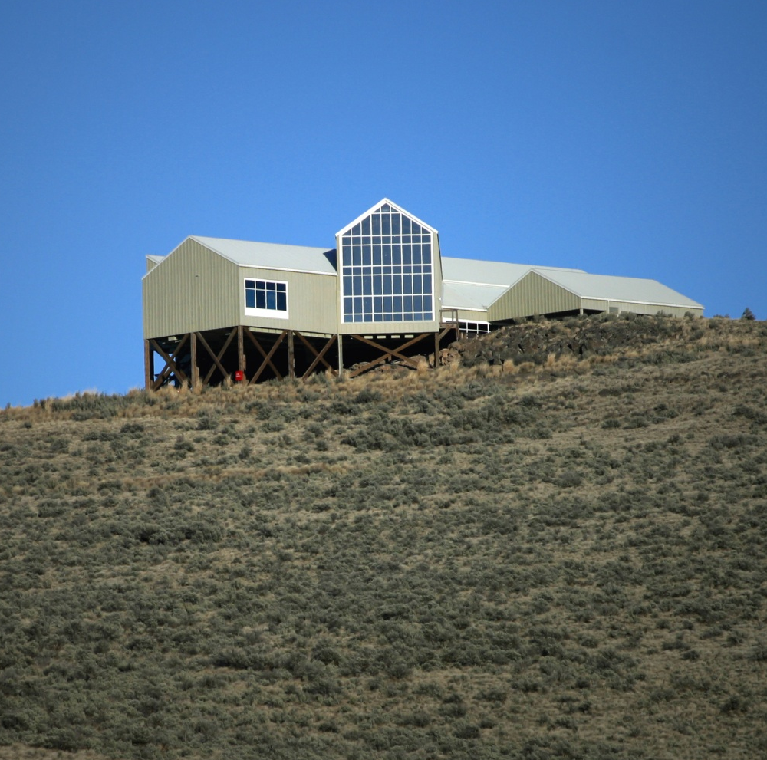
Environmental Factors
8 - Spatial Relationships
Elevated and exposed positions are more prominent than lower obscured positions

Slide 25
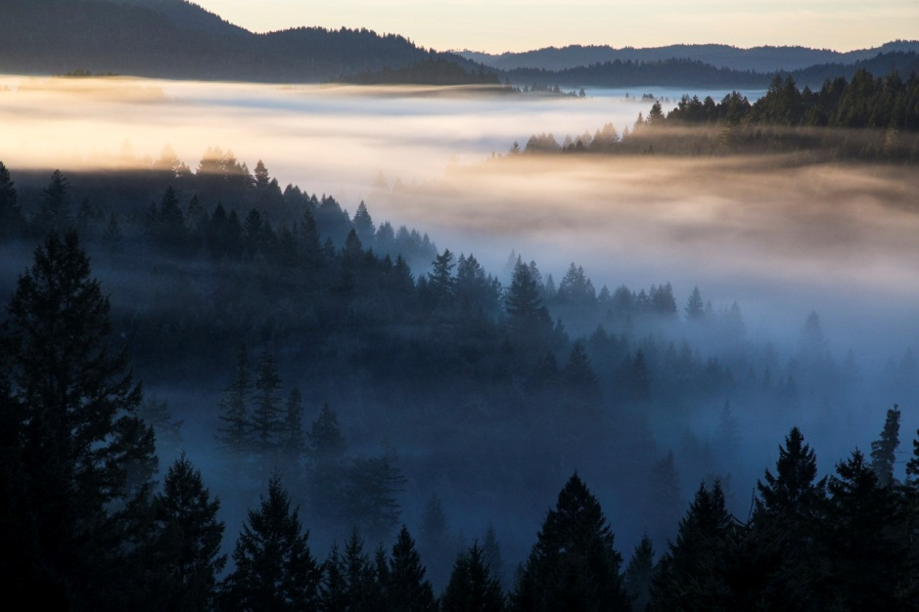
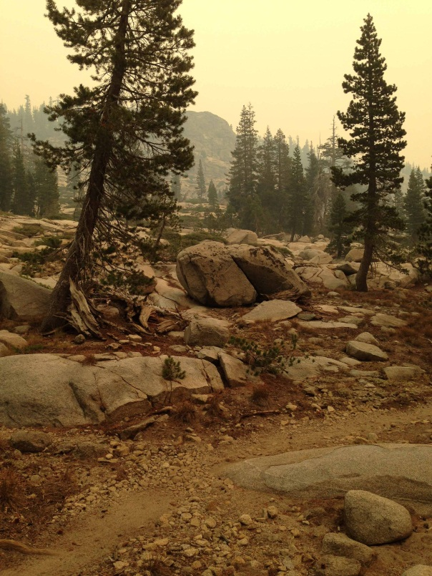
Environmental Factors
9 - Atmospheric Conditions
The ability to analyze form, line, color, and texture is reduced by clouds, fog or smog, precipitation, smoke and dust

Slide 26
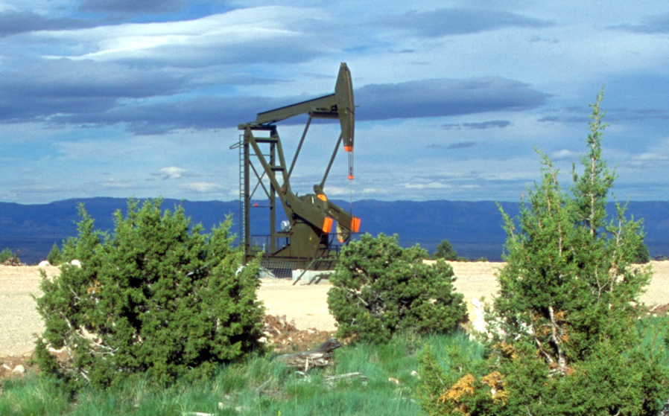
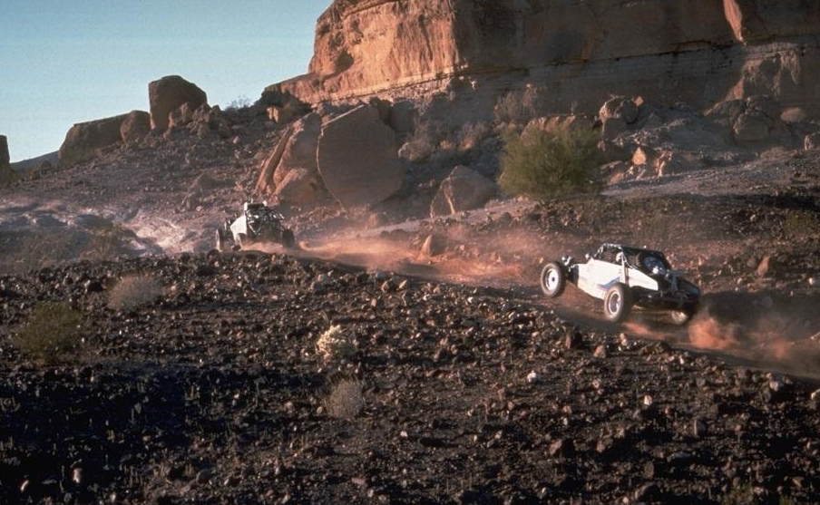
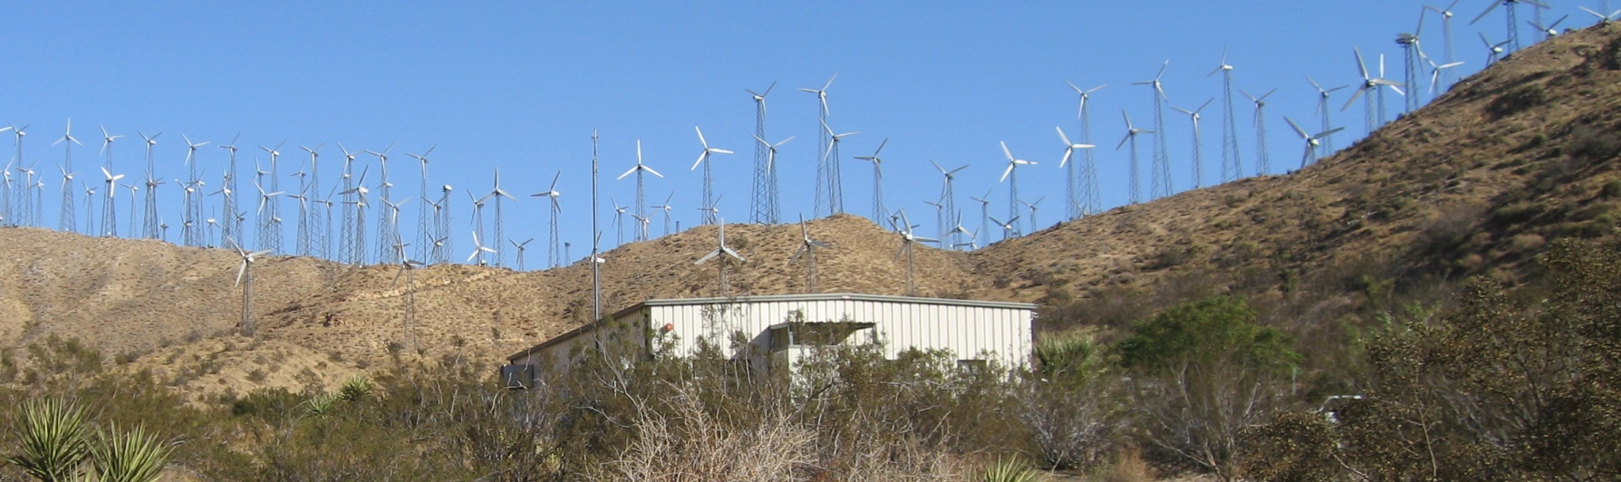
Environmental Factors
10 - Motion
Movement draws attention to a project or activity
Notes:
The eye is attracted to movement in the landscape.

Slide 27
Environmental Factors
Exercise
Your field office is in southern Utah. On the day you
have scheduled for weeks to go into the field to conduct
a contrast rating for a proposed project, the air quality
is especially poor due to fires that kicked up in the area
A couple of days before. What would you do?
  a. Ask one of the fire crew to do the assessment for you since
  b. They are used to looking through smoke and are other anyhow.
  c. Reschedule your field visit and go out once the smoke has
  cleared.
  d. Go on out, take photos, and get the assessment done.
What are three types projects that can add motion:
Who is most likely to notice and be sensitive to a proposed water tank development on the eastern slope of your community:
  a. The truck driver traveling along the bypass around your community.
  b. The homeowner at the base of the slope.
  c. The folks sitting in the stands at the high school football game.
  d. The guy walking his dog along the trail along the ridgeline above the project location.
Motion associated with a project rarely increases its visibility.
  True
  False
A large scale project set in a small scale landscape
would be less visible than a small scale project in a
vast landscape.
  True
  False
BLM typically analyzes the visual impacts of projects from the aerial perspective.
  True
  False
Recovery times for reclamation vary from location
to location.
  True
  False
If a proposed project is to be located along a Scenic Byway that is primarily traveled during the summer, visual impacts should be evaluated in the winter when fewer folks are around, and it’s easier to get parking spaces at the scenic overlooks.
  True
  False
It is best to evaluate the landscape character elements
of a project when the project area is backlit.
  True
  False
As viewing distance increases, the project becomes:
  More visible
  Less visible
  A big eyesore
Observing a project from a superior position allows
you to see less of it.
  True
  False
When assessing the visual impacts of a project, the environmental factors should be considered:
  Always
  Sometimes
  Never
Notes:
The eye is attracted to movement in the landscape.

Slide 28
Environmental Factors
Summary
Why environmental factors are important?
PLANNING
  May help identify potential project locations and facility design
  May help identify alternatives that would have otherwise gone unrealized
ANALYSIS
  Will help in understanding of how a casual observer will experience visual contrast
  Will help in selecting Critical Key Observation Points (KOPs),
  (a subject we will discuss in further detail in another unit)
PLAN CONFORMANCE
  May be the difference between being in conformance with the land use plan or not
Notes:
The eye is attracted to movement in the landscape.

