Slide 2
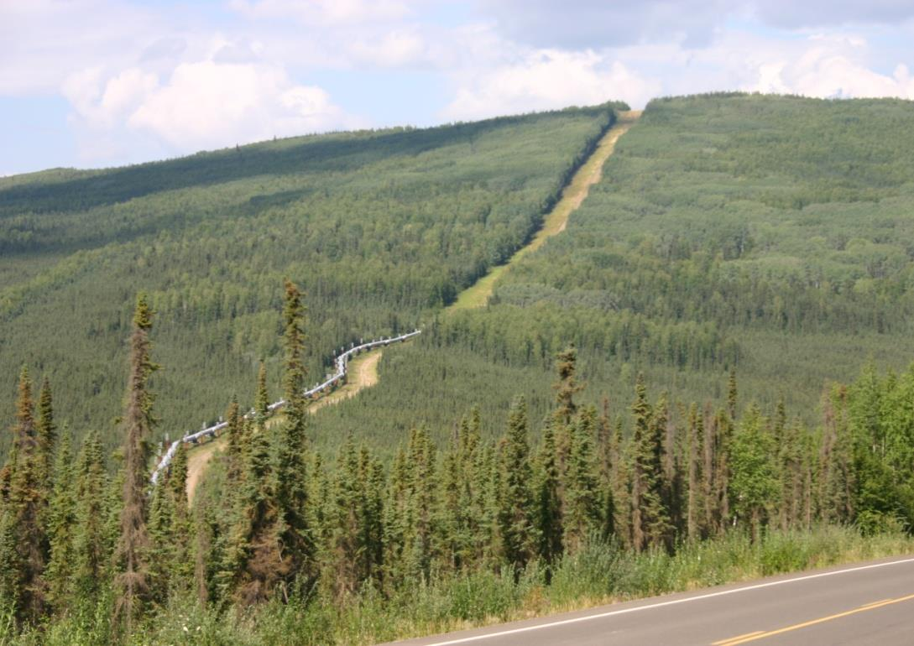
Contrast Rating

Slide 3
Contrast Rating
Unit Objective
Determine the elements of a project that are inconsistent with VRM objectives and recommend measures to improve the visual quality of the project
The VRM System is about minimizing visual contrast
The Contrast Rating process
First, determines whether a proposal conforms to the current Land Use Plan, and
Second, supports the subsequent impact analysis process

Slide 4
Contrast Rating
Process
A systematic process used to analyze potential visual impacts of proposed projects and activities
BLM Handbook 8431-1
The amount of contrast is measured by separating the landscape into major features
Landform/water, vegetation, and structures
Use “language of landscapes” when describing
Then predicting the magnitude of contrast in each of the basic elements
Form, line, color, and texture

Slide 5
Contrast Rating
Process
Quickly reveals elements and features that cause the greatest visual impact
Intended to assist BLM personnel not formally trained in the design arts to apply basic principles of planning and design to prevent or minimize visual impacts
Every attempt should be made to reduce visual impacts even if a project meets VRM objectives for the area

Slide 6
Contrast Rating
Tips
The contrast rating should be completed in the field from the selected KOP(s) and should be completed by an interdisciplinary team
DO NOT fill out forms as a “desk exercise,” it is important to get out on the ground to see the context of the proposed project and its location
The contrast rating should be completed during the time of year and time of day when most people will be viewing the area of development

Slide 7
Contrast Rating
Steps
Work with project proponent early in the project planning process, this will help prevent surprises later!
1 – Obtain a complete project description
2 – Identify VRM objectives from land use plan
3 – Select Key Observation Points (KOPs)
4 – Prepare visual simulations (optional)
5 – Complete contrast rating
Notes:
The following slides address each of these steps in more detail

Slide 8
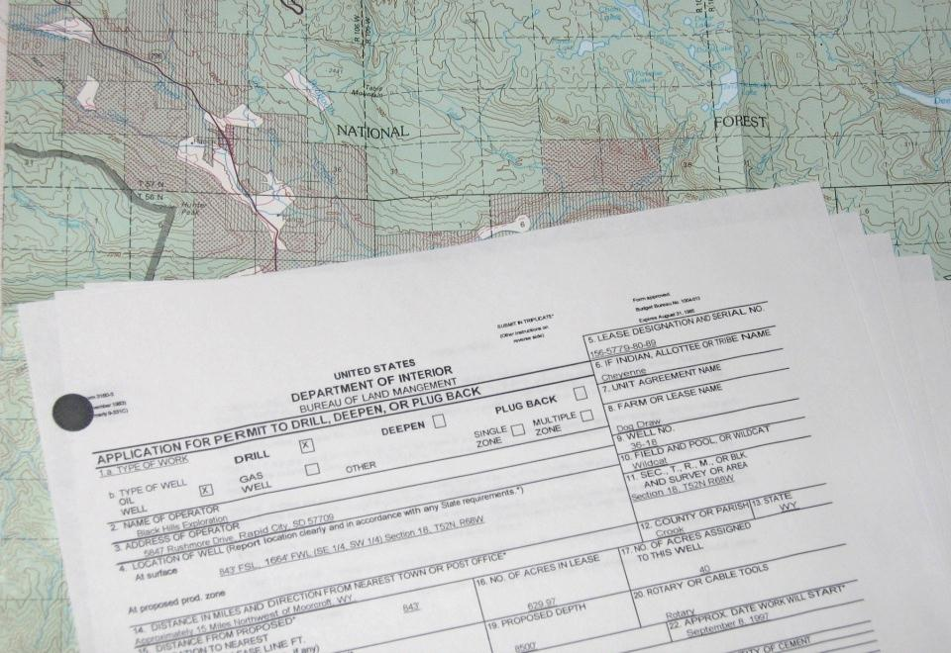
Contrast Rating
Step 1 - Complete Project Description
Emphasize early contact with project proponent
Coach proponent on project design
Project proposal must be comprehensive

Slide 9
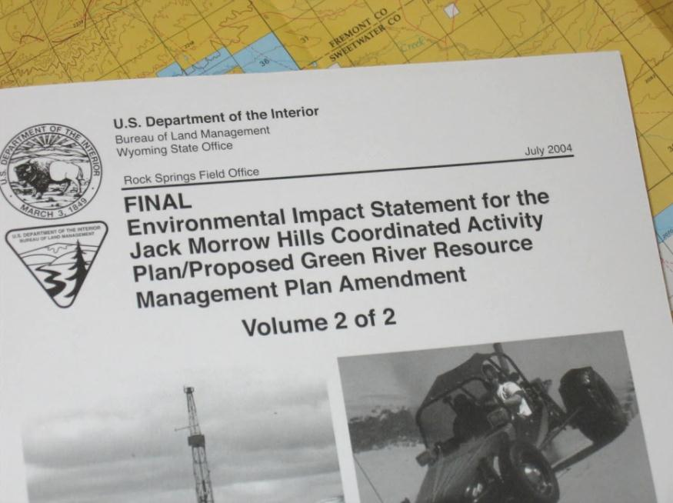
Contrast Rating
Step 2 – VRM Class Objectives
Familiarize yourself with your land use plan
Identify VRM objective
What is the existing management class for the project location
Involve interdisciplinary team
Understand other resource issues
Notes:
VRM Objective: Applies to the “feet” of the project.
Don’t forget the “why” behind the chosen Class (context for impacts)
Involve IDT
Other resource issues: meet multiple needs or solve interrelated issues
e.g., wildlife mitigation for solar project benefiting visuals

Slide 10
Contrast Rating
Step 2 - VRM Class Objectives
OBJECTIVE | Class I | Class II | Class III | Class IV
Management | preserve, manage for natural ecological changes | retain | partially retain | major modification
Change Allowed | very low | low | moderate | high
Visibility | activities should not be visible and must not attract attention | activities may be visible, but must not attract attention | activities may attract attention but should not dominate the view | activities may attract attention, may dominate the view, but are still mitigated
Notes:
Reminder of VRM Class objectives that must be met by any project proposal

Slide 11
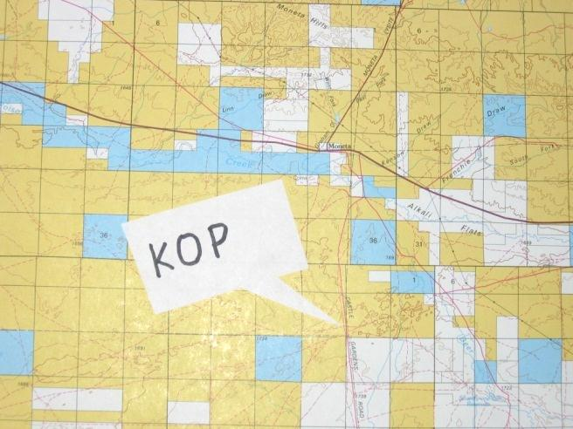
Contrast Rating
Step 3 – Select Key Observation Points
What is a Key Observation Point (KOP)?
A critical viewpoint or place from
which we analyze the visual impact
of a proposed project
Types of KOPs
KOPs should be places from which a proposed project is seen by large numbers of viewers or critical viewers
Where view of proposed project is most revealing
Single Points – trailheads, campgrounds, scenic overlooks, parking lots, subdivisions, and towns
Linear – roads, trails, and rivers

Slide 12
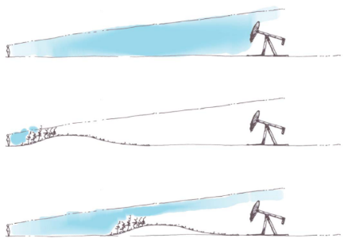
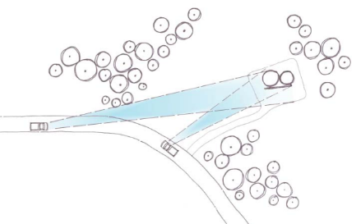
Contrast Rating
Step 3 - Select Key Observation Points
Factors in KOP selection
(Remember the Environmental Factors!)
Angle of observation
Number of viewers
Length of time the project is in view
Relative project size
Season of use
Light Conditions
How many KOPs are needed?
Linear projects should have more than one
Dependent on the size of the project, land use plan direction, locations from where it can be seen

Slide 13
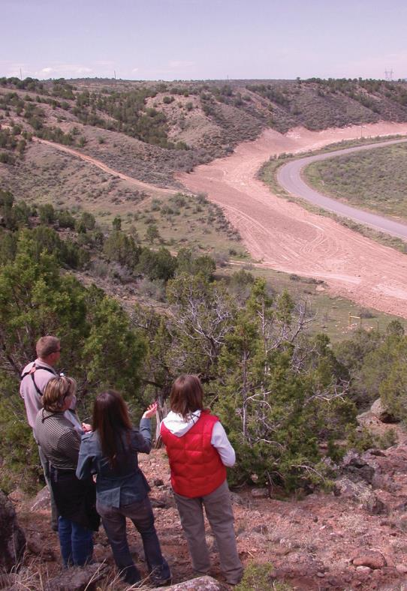
Contrast Rating
Step 3 - Select Key Observation Points
When are KOPs selected?
Early in the project planning
process
Who selects them?
Interdisciplinary team
Input from proponent
Coordination with other agencies
Examples - NPS and USFS
Accuracy is important!
Location can sway results
Notes:
Location accuracy: Selection among possible sites must be unbiased relative to degree of contrast from a particular qualifying KOP.

Slide 14
Contrast Rating
Step 4 – Visual Simulations (Optional)
Complex projects may benefit from visual simulations
Provides visual representation of a project before and after
Highlights impacts and potential mitigation measures
Good way to illustrate impacts in NEPA analysis
Seeing an image of a project is much more powerful than trying to imagine it
Helps eliminate bias
Allows all team members to see the project the same
Helps the proponent, public, and the BLM

Slide 15
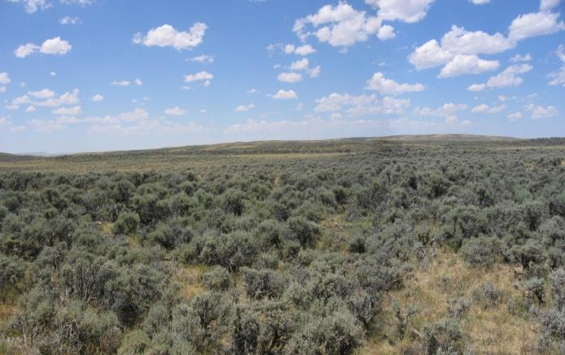
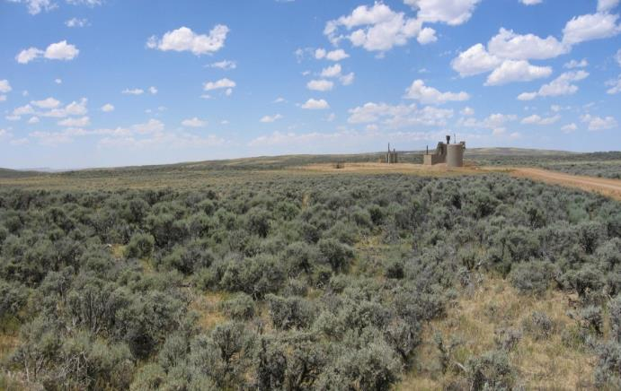
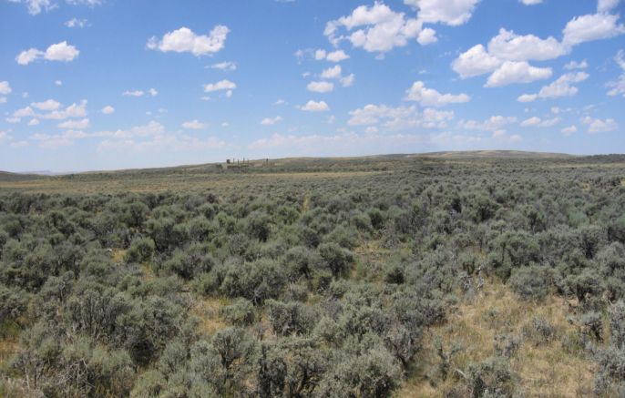
Contrast Rating
Step 4 – Visual Simulations Example
Before – Existing Conditions
“After” Simulation
Mitigated Simulation

Slide 16
Contrast Rating
Step 5 – Complete Contrast Rating
Visual Contrast Rating Worksheet – BLM Form 8400-4
BLM Handbook H-8431-1
Validates Land Use Plan Conformance
Provides documentation for NEPA
Provides a record for future action
Helps defend against appeals
Notes:
Validates plan conformance … or pinpoints where to focus design alterations to meet plan objectives and further minimize impacts.

Slide 17
Contrast Rating
Worksheet

Slide 18
Contrast Rating
Worksheet
Section A
Notes:
The four basic parts of the contrast rating form:
Section A: Project/Site information

Slide 19
Contrast Rating
Worksheet
Section B
Notes:
Section B: Characteristic Landscape Description

Slide 20
Contrast Rating
Worksheet
Section C
Notes:
Section C: Description of the proposed project in similar terms

Slide 21
Contrast Rating
Worksheet
Section D
Notes:
Section D: Actual Contrast Rating

Slide 22
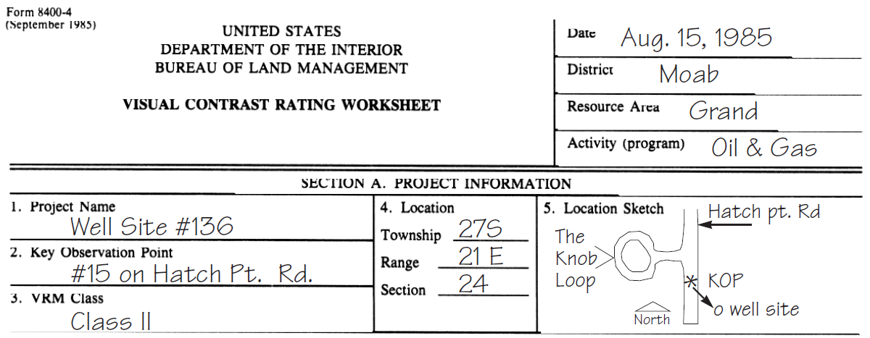
Contrast Rating
Worksheet
Section A
Locates the project and identifies the VRM class
A simple illustration or map identifies the project location and KOP
Notes:
Back to Section A: An example…

Slide 23
Contrast Rating
Worksheet
Sections B and C
It is sometimes difficult to determine which type of feature a project fits under
Landform/Water Features | Vegetative Features | Structural Features
Roads | Timber Harvests | Transmission Lines
Mining | Grazing Systems | Generation Plants
Gravel Pits | Habitat Treatments | Oil & Gas Development
Water Impoundments | Fuel Treatments | Recreation Facilities
 |  | Water Tanks
 |  | Microwave Stations
 |  | Buildings
Notes:
When get into Sections B & C: sometimes difficult to determine…
Here are some examples of where to describe/analyze existing/proposed features.
Can vary a little, but need to be consistent between Sections B & C.

Slide 24
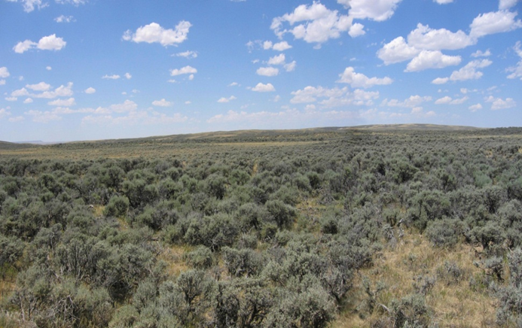
Contrast Rating
Worksheet
Section B
Where the existing characteristic landscape of the project area is described (use “language of landscapes”)
Focus on the area being affected by the project
Notes:
Characteristic Landscape: You’re already familiar w/ this from Scenic Quality exercise, but here you focus on the project and potentially affected area.
Click again for “Before” photo.

Slide 25
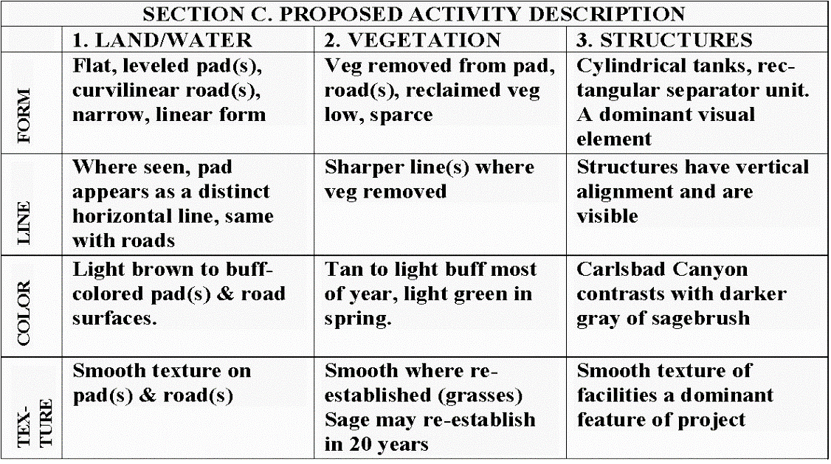
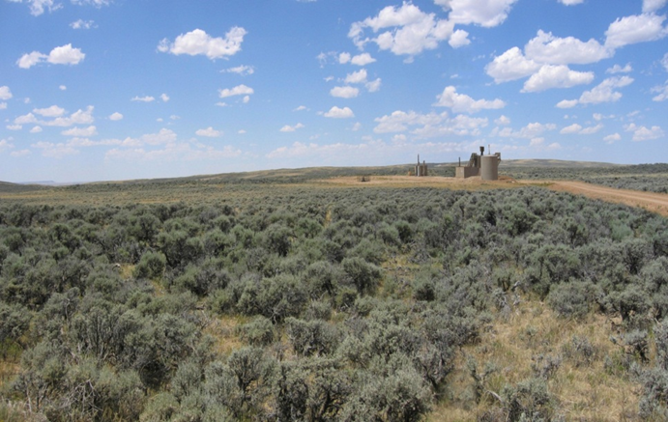
Contrast Rating
Worksheet
Section C
Where the proposed activity’s effects on the characteristic landscape are described
Notes:
Section C: Example of describing the proposed project in similar terms as w/ Sec B
Click again for “After” photo.

Slide 26
Contrast Rating
Worksheet
Section D
Projects may be rated on either a short-term or long-term basis
Short-term is through the first 5 years
Long-term is through the life of the project
If the project has different short-term and long-term effects, two contrast ratings should be completed
X

Slide 27
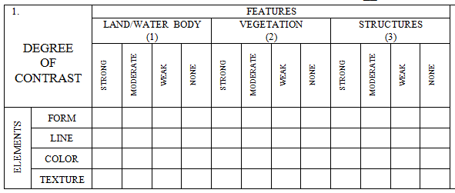
Contrast Rating
Worksheet
Section D
Organized into features (land/water, vegetation, and Structures) and elements (form, line, color, and texture)

Slide 28
Contrast Rating
Worksheet
Section D
Degree of Contrast Criteria:
None – element contrast is not visible or perceived.
Weak – element contrast can be seen but does not attract attention.
Moderate – element contrast begins to attract attention and begins to dominate the landscape
Strong – element contrast attracts attention, will not be overlooked, and is dominate in the landscape
The terms strong, moderate, weak, and none conform to VRM Classes IV, III, II, and I
IV
III
II
I
IV
III
II
I
IV
III
II
I

Slide 29
Contrast Rating
Worksheet
Section D
Degree of Contrast | Criteria | Consistent with………
None | Not visible or perceived | VRM Class I - IV
Weak | Can be seen but does not attract attention | VRM Class II - IV
Moderate | Begins to attract attention and begins to dominate | VRM Class III - IV
Strong | Demands attention and is dominant | VRM Class IV only
IV
III
II
I
IV
III
II
I
IV
III
II
I
Notes:
So any rating of Strong contrast meets only VRM Class IV objectives
While if a project has no more than weak contrast, it would meet VRM Class II, III, & IV objectives, but not Class I objectives.

Slide 30
Contrast Rating
Worksheet
Section D
In this example, the project would meet the VRM Class III objective for form, but only a VRM Class IV objective for line, color, and texture
IV
III
II
I
IV
III
II
I
IV
III
II
I
X
Notes:
(2nd and 3rd clicks highlight Form contrasts and Strong Contrasts, respectively)

Slide 31
Contrast Rating
Worksheet
Section D
This tells you where to focus mitigation efforts in order to reduce the degree of impact, and thus meet the VRM objective
IV
III
II
I
IV
III
II
I
IV
III
II
I
Notes:
2nd click highlights Strong contrasts for instance where need to meet VRM III (no more than Moderate contrast)

Slide 32
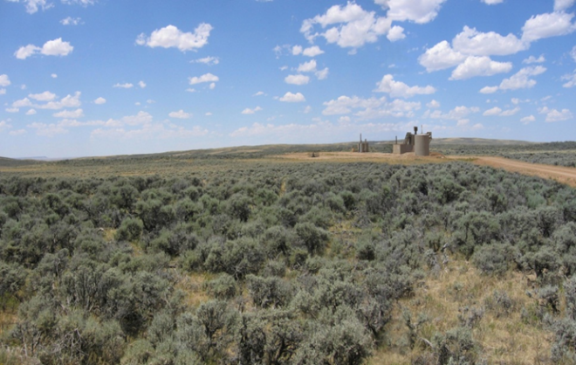
Contrast Rating
Worksheet
Section D (Continued)
Where you can provide further explanation of why a project does or does not meet VRM objectives
As in this example, changes to Land and Vegetation would cause a moderate degree of contrast to the element line, with strong contrast from Structures
The elements line, color & texture for structures are a focus of mitigation efforts
Notes:
Extra space on reverse for Section D comments…
2nd Click for “As Proposed” simulation “for contrast description purposes.”

Slide 33
Contrast Rating
Worksheet
Section D (Continued)
Where you can provide recommended mitigation measures
Proposed
Mitigated
Notes:
Also in Section D on reverse of the contrast rating form: recommended mitigation.
Click again for “As mitigated” simulation.

Slide 34
Contrast Rating
Process (Continued)
Document! Document! Document!
Take pictures
Complete the form
Write short narratives
Prepare visual simulations (optional)
Do whatever you need to do to describe your thought process and final recommendations
Documentation is the only way you or your manager will accurately remember what took place during your analysis
And if challenged, no documentation = didn’t happen

Slide 35
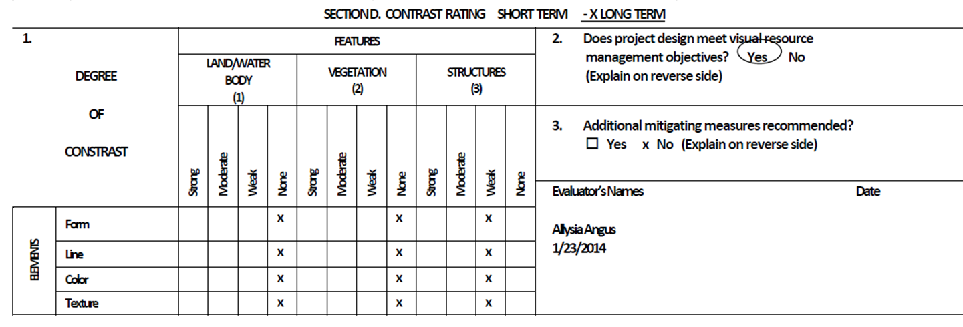
Contrast Rating
Conformance with VRM Objectives
Does project meet VRM Objectives?
YES, if: None = Class I
Weak = Class II
Moderate = Class III
Strong = Class IV

Slide 36
Contrast Rating
Conformance with VRM Objectives
Does project meet VRM Objectives?
NO, what to do?
Redesign project to meet VRM Objectives
Internally initiated – Drop project
Externally initiated – Deny application for project
Amend RMP only as a last resort
Address reasons for the current VRM Class designation
Assess Compensatory Mitigation

Slide 37
Contrast Rating
Process (Continued)
Input information into NEPA document
Enter your findings, along with necessary documentation
Write any necessary stipulations
Be sure all resource stipulations are coordinated and in agreement
Continue to work with the project proponent through all phases of the project (pre-construction, construction, and reclamation) to ensure project is completed as planned and stipulations are being followed!
Patience! It may take years before you see the outcome of all your efforts

Slide 38
Contrast Rating
Example – Habitat Enhancement
1 – Obtain a complete project description
Habitat enhancement project for bighorn sheep
Site was selected for its potential to allow sheep to access suitable habitat
Habitat treatment would include a combination of clear cutting, heavy thinning, and group thinning
Treatment area would be approximately 300 yards wide and would encompass approximately 200 acres
Project design features will be used to minimize the visual impact of the project, including clumping and feathering of the treatment edges to prevent distinct lines, and pruning the lower limbs of the leave trees to maintain portions of intact canopy while still providing sightlines for sheep
Notes:
Example Contrast Rating #1: Habitat enhancement project.

Slide 39
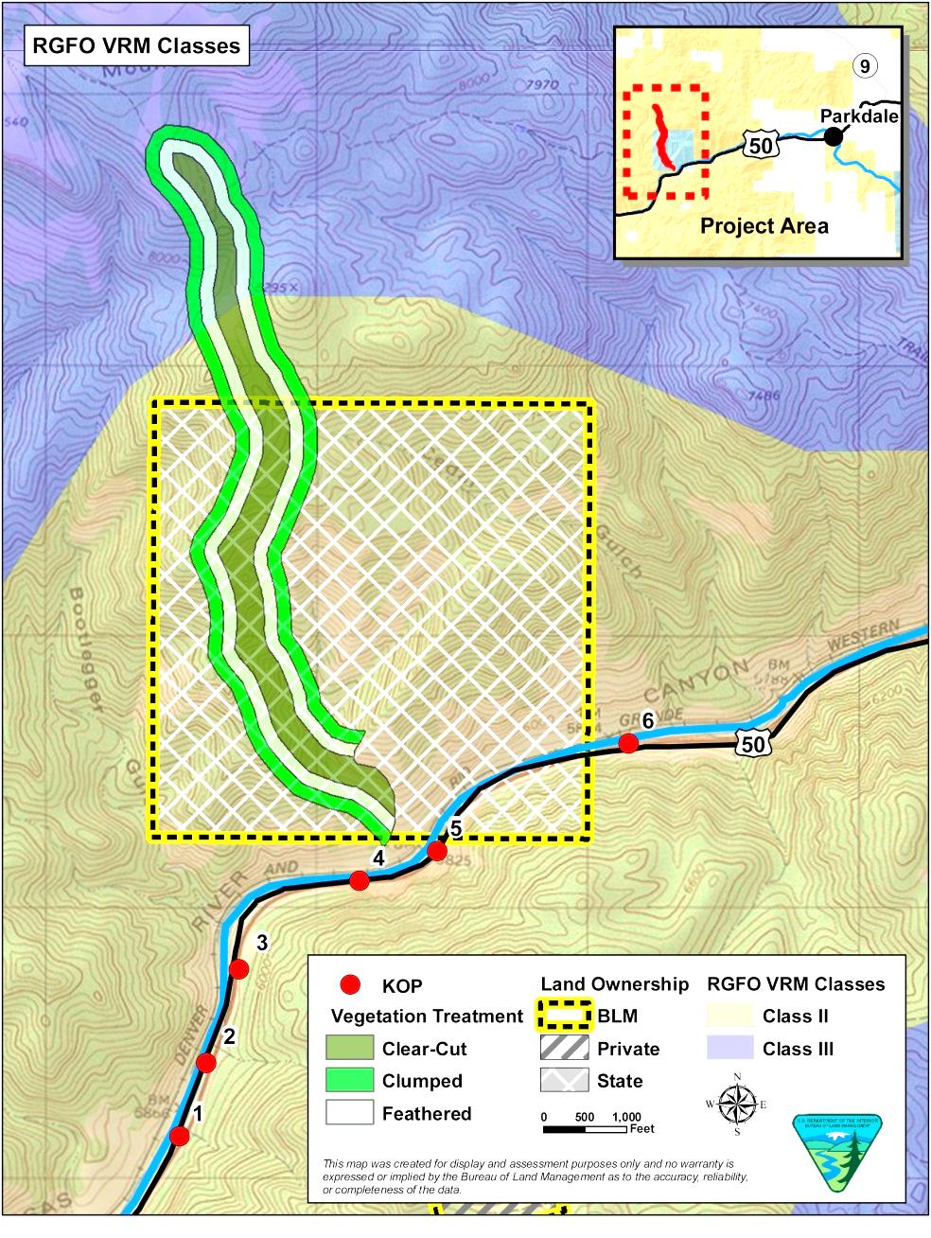
Contrast Rating
Example – Habitat Enhancement
2 – Identify VRM objectives
from land use plan
Class II
Retain landscape character
Change allowed: low
Visible but should not attract
attention
Class III
Partially retain landscape
character
Change allowed: moderate
Can attract attention but
should not dominate view
Notes:
Proposed habitat enhancement corridor extends from State Lands into some VRM Class II on BLM and into VRM Class III.

Slide 40
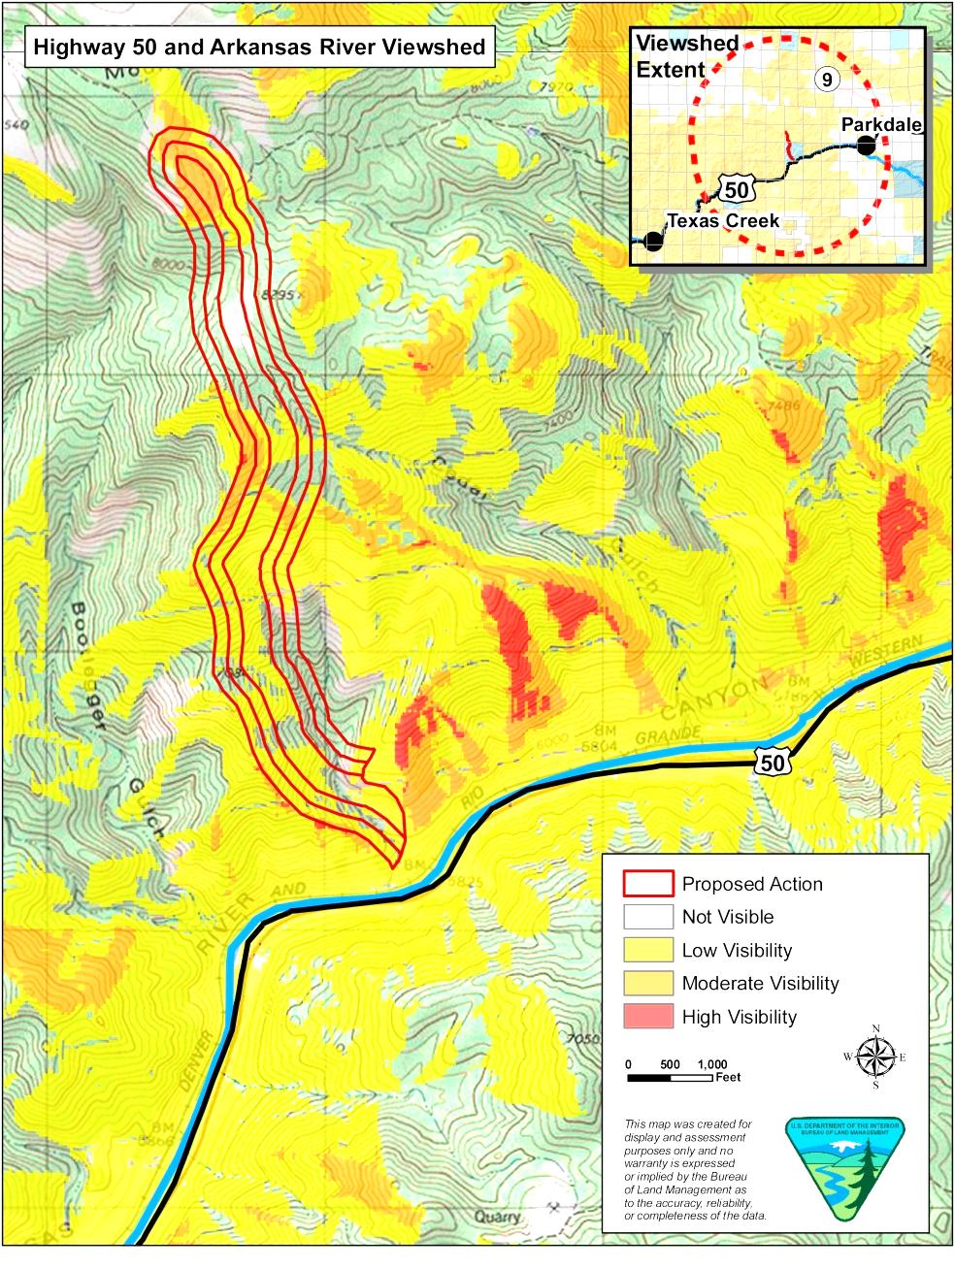
Contrast Rating
Example – Habitat Enhancement
3 – Select Key Observation
Points (KOPs)
Linear feature – State
Highway 50
6 KOPs were selected based
on viewshed analysis and
from environmental factors
(e.g. angle of view, season
of use, duration in view)

Slide 41
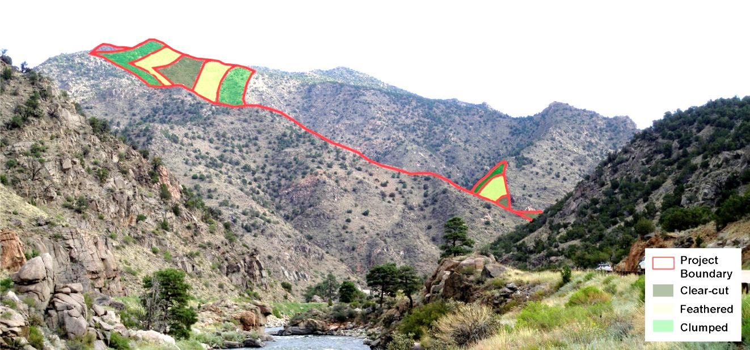
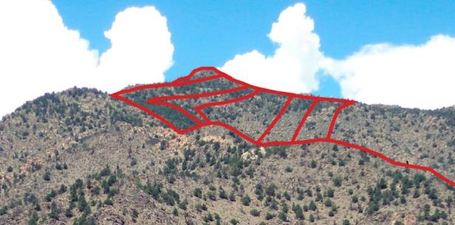
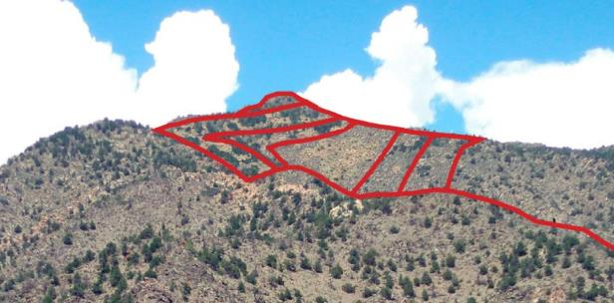
Contrast Rating
Example – Habitat Enhancement
4 – Prepare visual simulations (optional)
KOP 1
Before – Existing Conditions
After Simulation

Slide 42
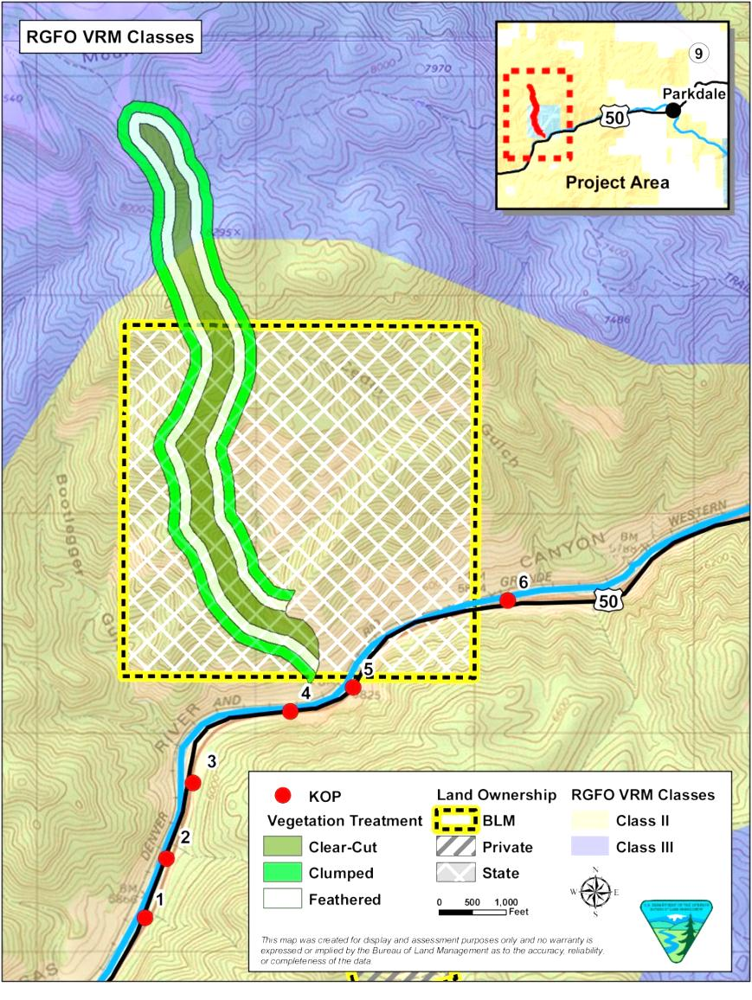
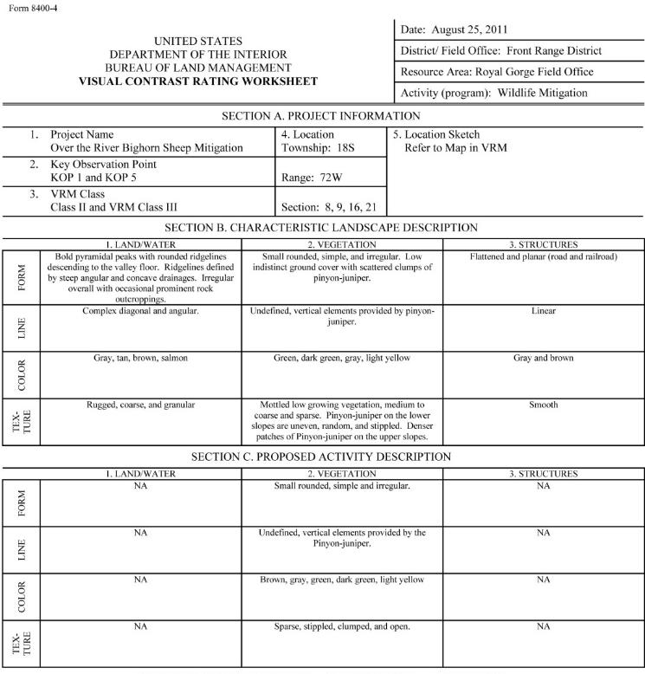
Contrast Rating
Example – Habitat Enhancement
5 – Complete contrast rating

Slide 43
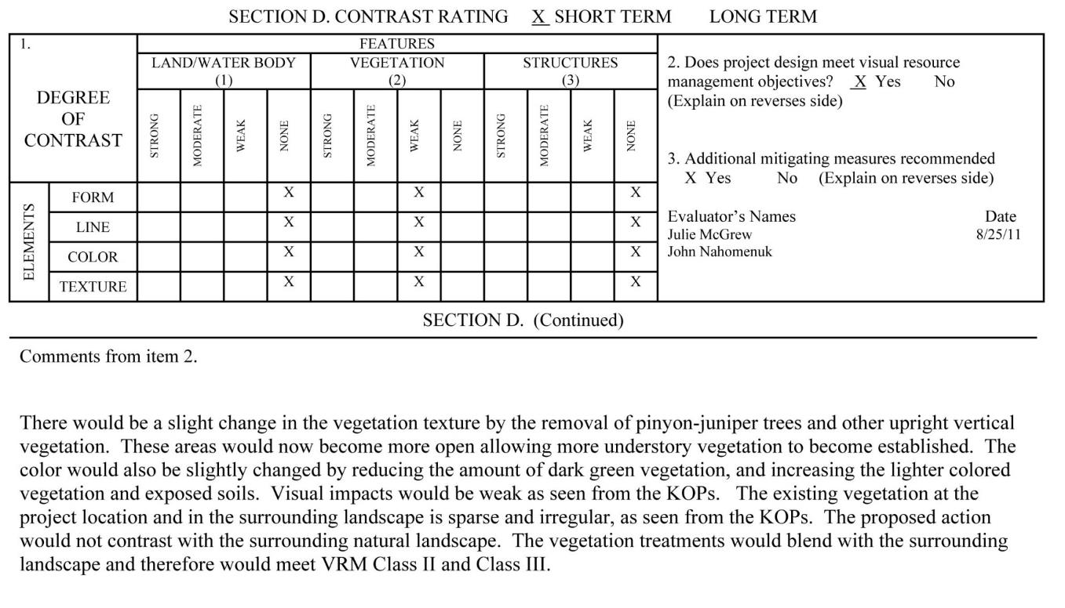
Contrast Rating
Example – Habitat Enhancement
5 – Complete contrast rating

Slide 44
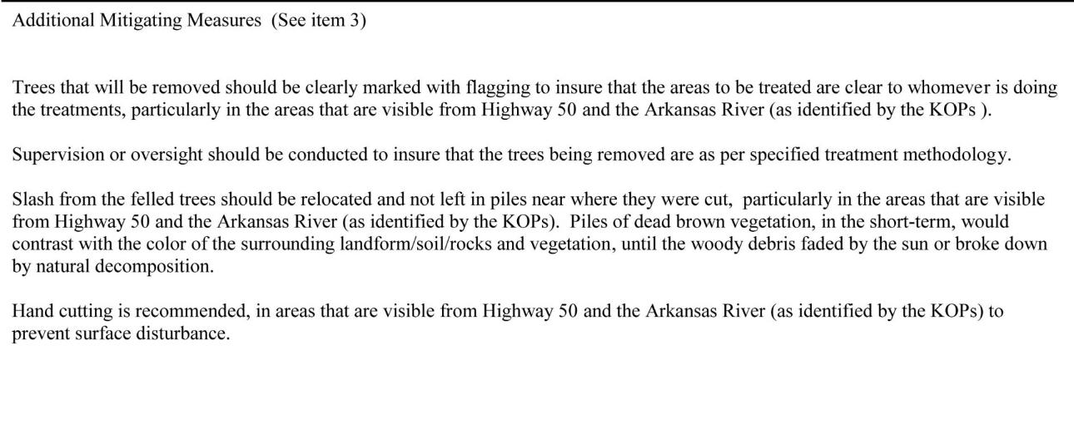
Contrast Rating
Example – Habitat Enhancement
5 – Complete contrast rating

Slide 45
Contrast Rating
Example – New Natural Gas Well Pad
1 – Obtain a complete project description
Proposal to drill 8 new federal wells from a new well pad with new access road on land administered by the BLM
Well pad would have a maximum cut slope of 33.1 feet at the southwest corner and a maximum fill slope of 25.2 feet at the northwestern corner
The road would be approximate 0.4 mile in length and 20-feet in width
The road grade would vary from 5% to 10%
Installation of a temporary pipeline
Construction would involve approximately 7.9 acres of new surface disturbance, which would be reduced to approximately 2.5 acres after interim reclamation
Notes:
Example#2: New Natural Gas Well Pad

Slide 46
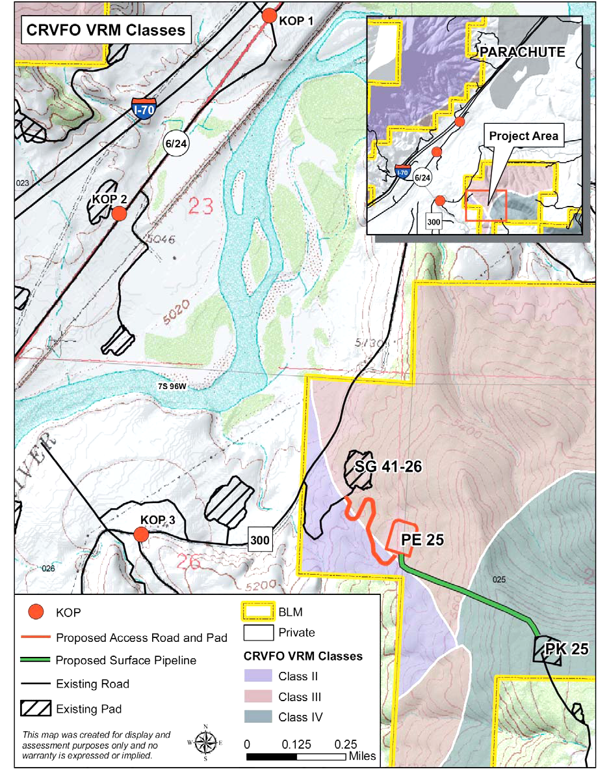
Contrast Rating
Example – New Natural Gas Well Pad
2 – Identify VRM objectives
from land use plan
Class II
Retain landscape character
Change allowed: low
Visible but should not attract
attention
Class III
Partially retain landscape
character
Change allowed: moderate
Can attract attention but
should not dominate view
Notes:
Most of the proposal in VRM Class III
With some road in VRM Class II

Slide 47
Contrast Rating
Example – New Natural Gas Well Pad
2 – Identify VRM objectives
from land use plan
Class IV
Provide for management
activities which require
major modification to the
character of the landscape
Change allowed: high
Activities may attract
attention, may dominate the
view, but is still mitigated
Notes:
And pipeline in Class III & IV to existing well pad.

Slide 48
Contrast Rating
Example – New Natural Gas Well Pad
3 – Select Key Observation
Points (KOPs)
Linear features – State
Highway 6 and County Road
300
3 KOPs were selected based
on field analysis and
from environmental factors
(e.g. angle of view, season
of use, duration in view)

Slide 49
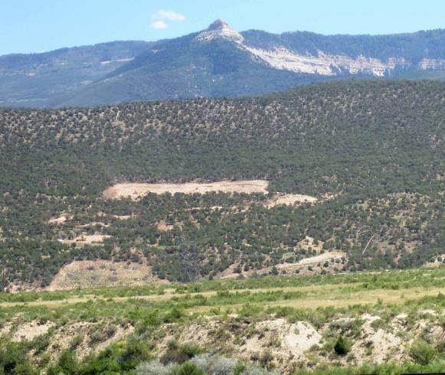
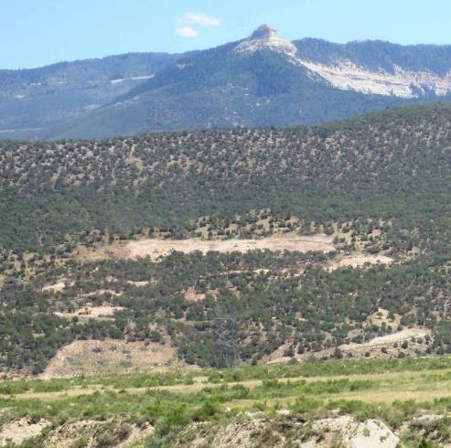
Contrast Rating
Example – New Natural Gas Well Pad
4 – Prepare visual simulations (optional)
KOP 2
Before
Before – Existing Conditions
After
During Construction
Simulation - Mitigated
Notes:
“Interim” mitigation v longer-term restoration (later)

Slide 50
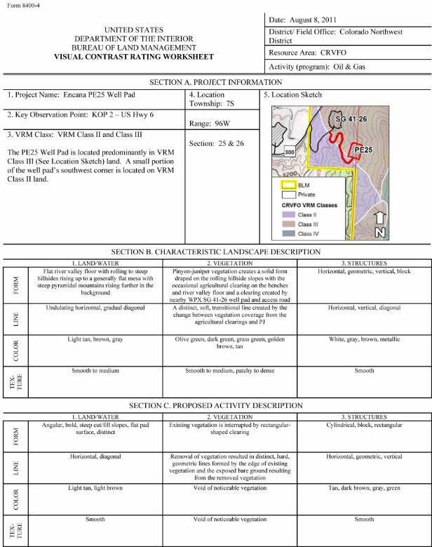
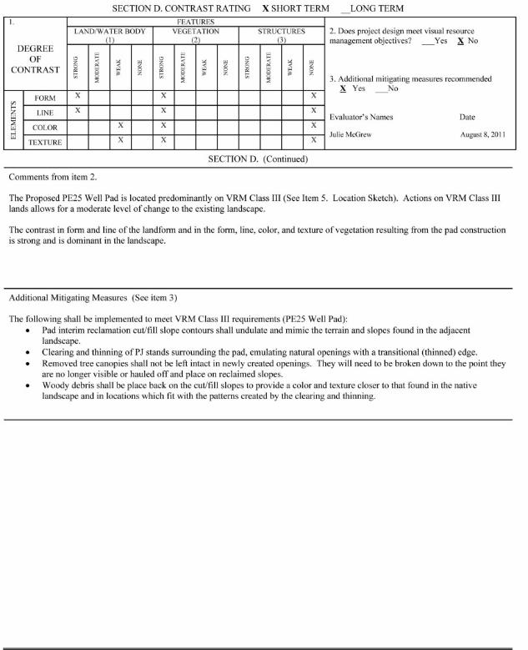
Contrast Rating
Example – New Natural Gas Well Pad
5 – Complete contrast rating

Slide 51
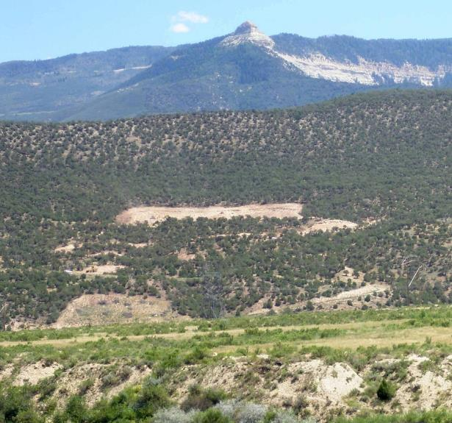
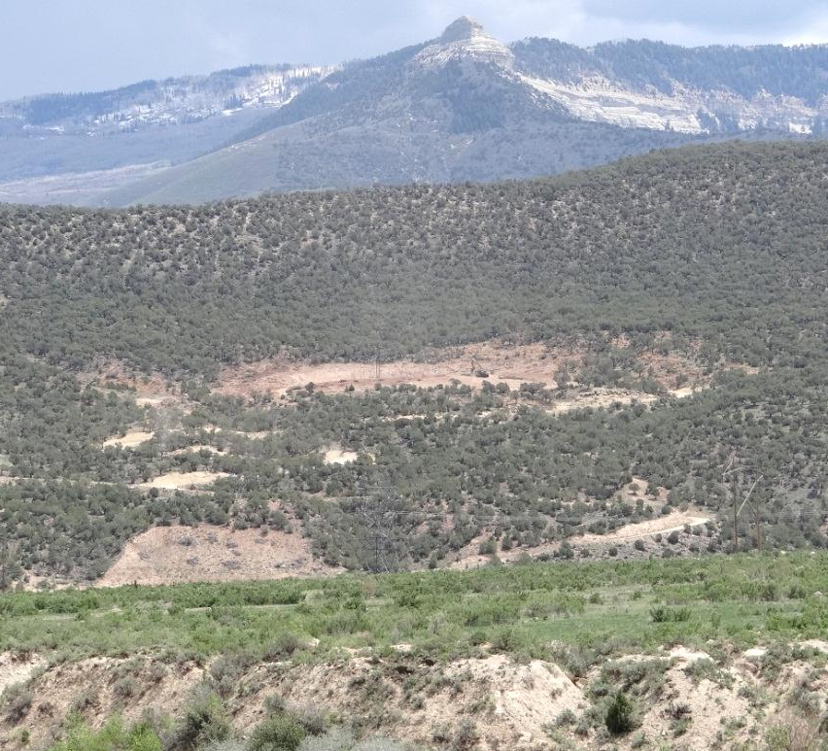
Contrast Rating
Example – New Natural Gas Well Pad
Patience........................
During Construction
Post mitigation
Notes:
It can take years to see the outcome of all the effort, particularly relating to reclamation that meets BLM standards.
So need to allow for typical veg restoration time as reasonable.
Up to 5 yrs to meet VRM Class objectives.

Slide 52
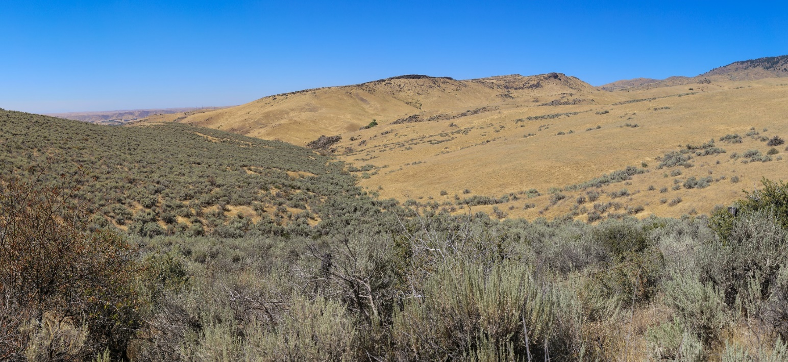
Contrast Rating
Classroom Exercise – Natural Gas Well Pad
Notes:
Unit 9 – Contrast Rating Exercise
A natural gas facility has been proposed in your field office. The project will consist of a 2-acre pad site with eight large-scale tanks, other production facilities, and a perimeter fence. The tanks and other above-ground facilities are proposed to be painted with a tan color similar to the grasses during the dry summer season. The fence will be constructed of galvanized steel panels.
The project will require a significant amount of excavation. The excess materials will be placed on-site for backfill purposes for the pad, and will otherwise be dispersed at the project site. The fill slopes are proposed to be treated with a soil stabilization product that will reduce the potential for erosion, helping to meet the Storm Water Pollution Prevention Plan.
The current VRM classification for the project area is VRM III. The VRI class for the project location is VRI Class III. The VRI sub-factors for the area consist of scenic quality B landscape, a medium level of sensitivity, with the project being located within the foreground-middleground distance zone.
You have been asked by your manager to participate on an Interdisciplinary team (IDT) to determine whether or not the project, as proposed, will conform to the existing VRM Class III objective.
In addition to this determination, you will also determine what mitigation measures the BLM would require to reduce the visual impact of the project.

