Slide 2
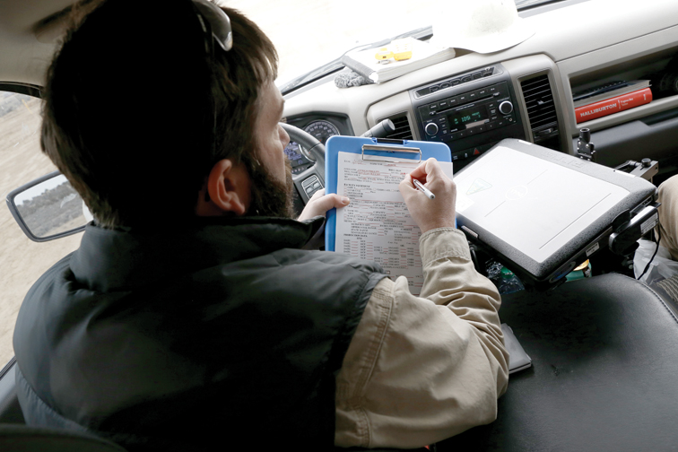
Notes:
This step is so important

Slide 3
Unit Objective
Learn:
The purpose and importance for monitoring
Elements of a monitoring plan
What should be monitored
Methods to consider when developing a monitoring strategy
Possible actions for non-compliance

Slide 4
Monitoring
References
Regulatory & policy requirements:
Visual Resource Management MS 8400: 8400.06.A.7 Policy
H-1790-1 BLM NEPA Handbook: Chapter 10.1 Purposes of and Requirements for Monitoring
NEPA Regulations 40 CFR 1500
Council on Environmental Quality (CEQ) 01/14/2011 Memorandum: Appropriate Use of Mitigation And Monitoring and Clarifying the Appropriate Use of Mitigated Findings of No Significant Impact

Slide 5
Purpose
Monitoring enables the BLM to manage the visual resource values and change to their condition within the planning area, as well as in context of the regional landscape.
Make measured decisions that factor in the mitigation hierarchy:
avoid,
minimize,
rectify,
reduce or eliminate over time, and
compensate for residual impacts
to resources, values, and functions (40 CFR 1508.20).
Notes:
From a NEPA perspective – not monitoring proposed action per se, but the mitigation commitments
BUT for VRM – many of our mitigation is specific to the facilities being constructed. So has a broader sense of application to not only conditions placed on the authorization, but also to conforming design features included in the proposed action.

Slide 6
Authority and Policy
40 CFR 1505.2(c)
“A monitoring and enforcement program shall be adopted and summarized where applicable for any mitigation.”
H-1790-1 NEPA Handbook, Chapter 10.1
“Record of Decision/ Decision Record must delineate the monitoring measures in sufficient detail to constitute an enforceable commitment, or incorporate by reference the portions of the EIS that do so.”
Visual Resource Management Manual Section 8400.06.A.7
“Ensure that project monitoring efforts include timely and thorough compliance evaluations, especially during the construction phase, to ensure that visual management provisions are effectively carried out.”
Notes:
These are the excerpts I pulled to share from those references.

Slide 7
Why we monitor
To confirm:
Compliance – comply with the terms, conditions and mitigation requirements identified in the land use plan and project NEPA decisions. Are we meeting our commitments to the public?
Effectiveness – Are the decisions achieving the intended environmental objectives, and are the predicted environmental effects accurate? Validating that the outcome is as anticipated.
Adaptive management – If decisions are not meeting the purpose and need, nor achieving desired outcomes, then monitoring is used to identify necessary changes.

Slide 8
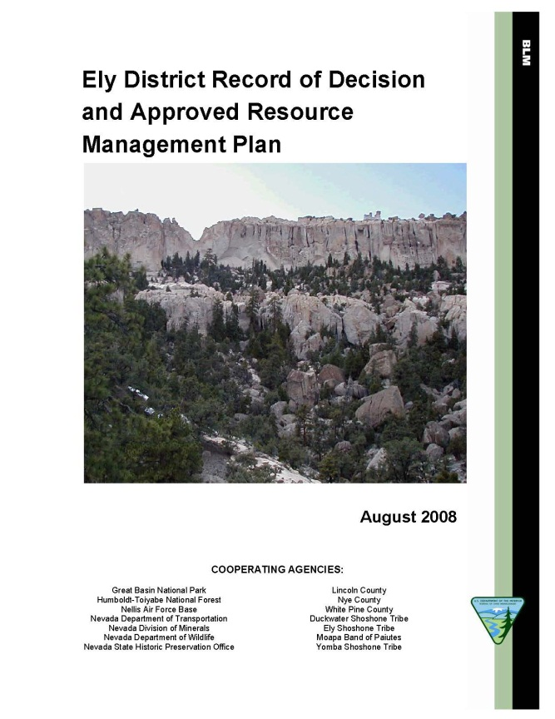
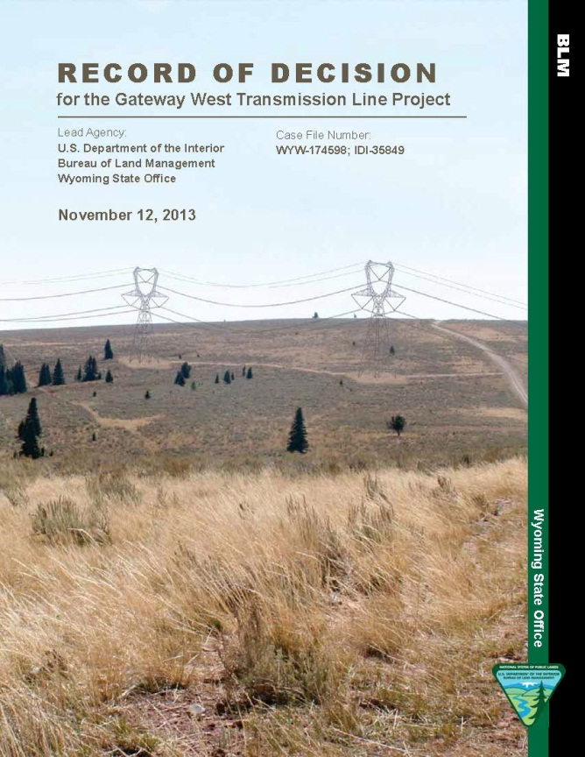
When to Monitor
When does monitoring come into play:
Oversight of project-level land use authorizations
Changes to the Visual Resource Inventory factor values
Adherence to the land use plan (LUP) decisions (VRM Class Objectives)

Slide 9
Project Level
Compliance, effectiveness, and adaptive management of the project design features and mitigation:
while under construction,
while in operation, and
when decommissioned.
Need to have a Monitoring Plan in place:
work with the project manager to make sure the VRM monitoring is addressed in the project’s monitoring plan.

Slide 10
Project Level Monitoring
The VRM Monitoring Plan should:
Set conditions and terms for monitoring, and how and when monitoring occurs.
Clarify measureable performance standards for the applicant and their operators.
Identify how compliance and effectiveness will be quantified and measured.
Outline process for determining and implementing corrective actions when a site is out of compliance or results are ineffective.
Establish a clear understanding of expectations and a road map to successful outcomes.
Notes:
Revegetation example – monitor the seeding for visual adaptation
We want to check the seed tag before seeding to confirm it contains the specified species
What else –
PLS percent (Bulk versus PLS)
Pounds and ounces of each species and percentage of the total mix
4th bullet point - What will the BLM do if a non-compliant seed mix is delivered.

Slide 11
Project Level
Ensure conformance to the VRM objective:
represents the desired future condition under the management of the plan.
If not met, then consideration of compensatory mitigation may come into play. What other issues might be at play?
Change orders when under construction that change the nature of the project.
Need for re-analysis and adjustment of design features and mitigation to meet desired outcome of the project.
What if we find that the project outcome has drifted out of conformance with the VRM Class objective?
Notes:
Part of Monitoring is to also make sure that the Contrast Rating Analysis was correct in that the VRM Objective will be met.
- Last BP- Do we enter into a public process to amend the plan?

Slide 12
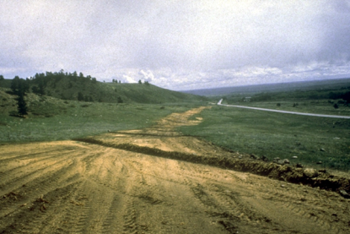
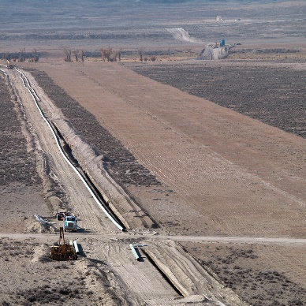
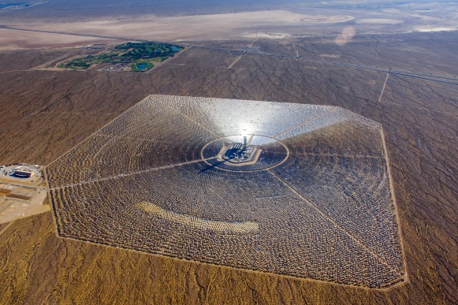
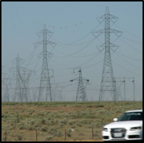
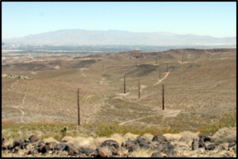
Project Level
Complexity:
Keep the monitoring plan in scale with:
Size of development
Magnitude of impact
Visual sensitivity level
Keep it simple, yet effective.
Small scale
Large scale
Spatial relationship
Large impact
Smaller impact

Slide 13
Project Level
Frequency – Think in terms of project phasing and sequencing:
Document the pre-construction site conditions
After site improvement is staked and limits delineated
Incrementally during construction phases
Construction and installation of VRM:
design features, and
mitigation requirements
Monitor post-construction maintenance of design feature/ mitigation results
Final reclamation construction
After monitoring of final reclamation

Slide 14
Project Level Monitoring
What are some of the methods or tools that can be used?
Develop a photo documentation protocol & maintain a record
Establish monitoring photo points
Compare Visual Impact Analysis simulations to project’s results
Contrast Rating evaluation comparisons
Construction plans compared to as-built results
Assess the magnitude of affected viewshed as being built and after completion
Are there unanticipated impacts? Is there a need to mitigate the unanticipated residual impacts?
Notes:
Establish monitoring photo points
Convenient locations to record progress;
From selected KOPs

Slide 15
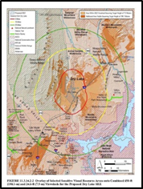
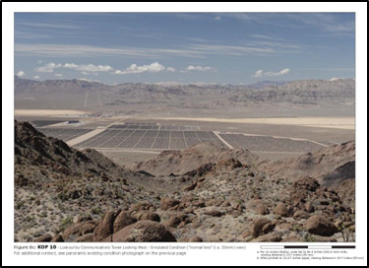
Project Level Monitoring

Slide 16
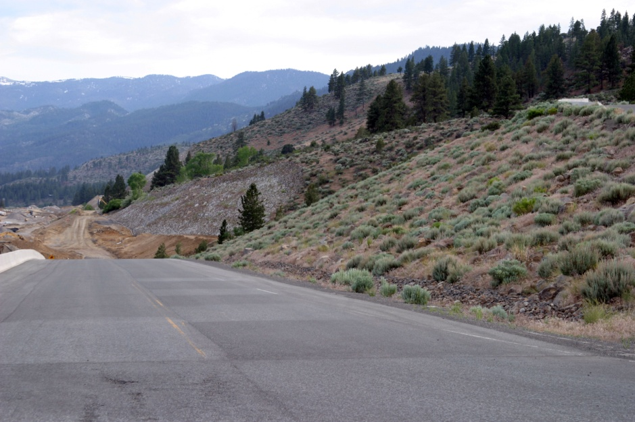
Project Level
Other tools to use?
Construction plans and specifications
Grading plans
Surface preparation
Topsoil specification and testing
Seed mix and germination test
Seeding methods
Mulching

Slide 17
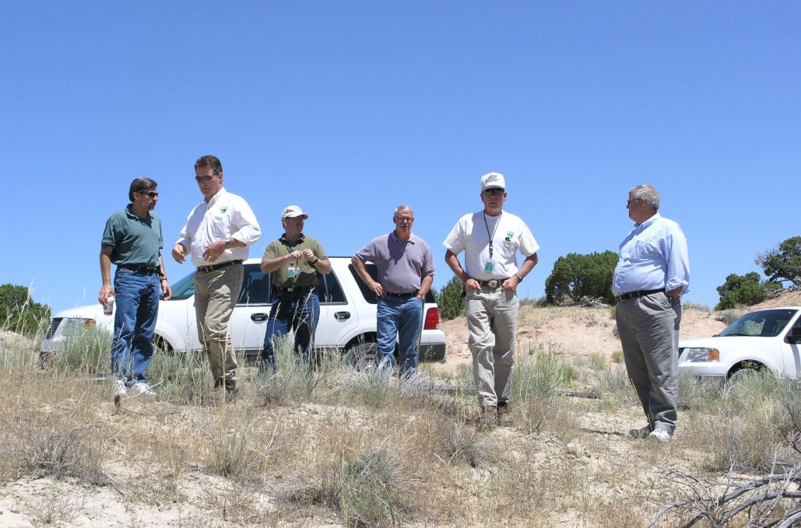
Project Level
Getting it done – You are a member of a community of specialists to consult with in your office that has monitoring responsibility and experience:
Natural resource specialist
Landscape architect
Recreation planner
Engineer
Range conservationist
Wildlife biologist
Botanist
Lands and realty staff
Hydrologist
Foresters

Slide 18
Land Use Plan (LUP) Implementation
Monitoring the Land Use Plan’s Implementation

Slide 19
Land Use Plan (LUP) Implementation
Develop a LUP monitoring plan that would answer the following questions as the LUP is implemented:
Are the visual management decisions being implemented?
Are the conditions of the visual aspects of landscape characte being maintained in accordance with the desired future conditions defined within the LUP?
Is the condition of the visual resource, as described in the inventory (Scenic Quality, Sensitivity, Distance Zone and VRI Classes) changing and what trend is occurring?

Slide 20
Land Use Plan (LUP) Implementation
Is the condition trending toward a decline? Stability? Or improving?
Are more lands being visually altered?
Are the natural scenic qualities of the landscape character:
Being lost?
In balance?
Or are scenic qualities being recovered through enhancement/ restoration?
Is this measureable?
Notes:
Reference back to the Unit 4 LUP

Slide 21
Land Use Plan (LUP) Implementation
Remember – all programs have a responsibility to managing visual resources whether the program alters landscape character through enhancements or new land development - all are participants in the Visual Resource Program.
Tracking the balance between new development and reclamation of decommissioned and/ or inactive land use authorizations.
New authorizations under the lands and realty program
Fluid mineral leasing and development
Healthy Lands – with restored environments
Sage grouse habitat improvements
Abandoned Mine Program - reclamation of inactive mine sites.
Notes:
Communication and tracking system between disciplines and programs

Slide 22
Non-conforming action/ LUP Amendment
What if amending the land use plan?
Is there a warrant for requiring compensatory mitigation?
What other resources will be affected and do they warrant compensatory mitigation?
Opportunities for co-benefits.
Keep in mind that with every facility added to the landscape comes a reduction in value to the visual aspects of the natural landscape.
If we amend the land use plan – then should the proponent be responsible for offsetting the value lost somewhere else with the planning area?
Notes:
SMALL ADDITIONS DO NOT ALTER THE CM SCORE, BUT THE CUMULATIVE EFFECTS OF MANY MAY

Slide 23
Updating the Inventory
When is it the best to update the inventory?
Just before the next RMP revision?
After approved projects are completed?
Before the next proposed action’s NEPA?
Updating the Visual Resource Inventory is an end product of monitoring.
Notes:
.

Slide 24
Summary
What’s the overarching purpose for monitoring? Specifically for visual resources?
When does monitoring comes into play?
What are the three things we’re monitoring on the project?
What are some tools that may play a role in monitoring?
Notes:
Assure that mitigation commitments are met.
To remain aware of the visual resource values and condition within the planning area, as well as in context of the regional landscape.
“visual resource values and change to their condition”
2. Project level and RMP monitoring
3. Compliance, effectiveness, adaptive management, Also Trends in change to scenic quality and how this also affects sensitivity and adjustments to distance zones
4. Contrast ratings, simulations, documentation photo points operator’s construction documents, seed tags

