Slide 1
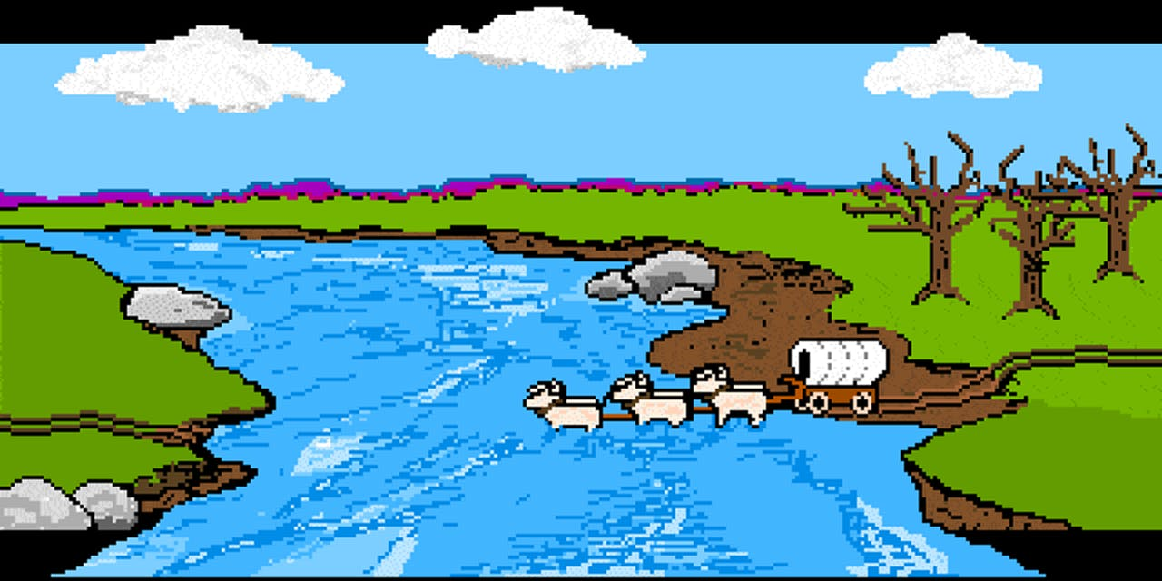
Vegetation Treatment
Christine, Jameson, Dana, Seth, Zack

Slide 2
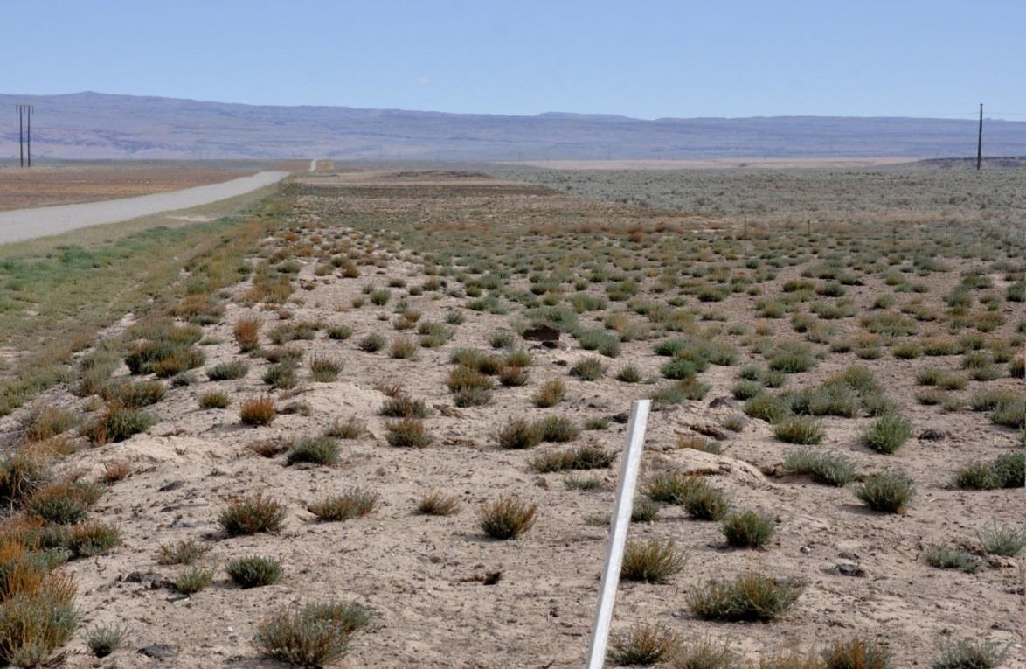
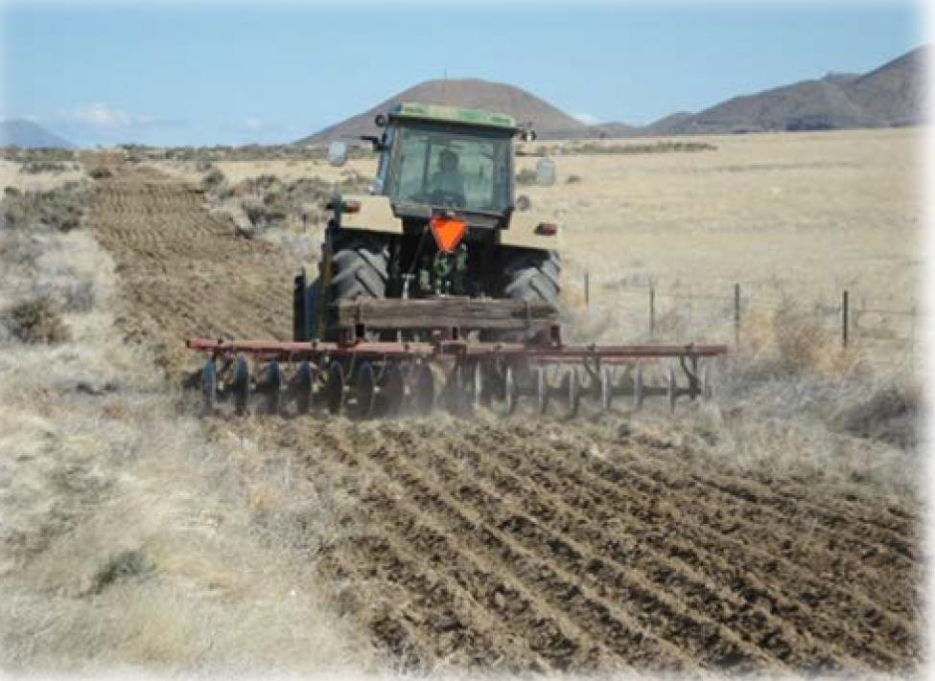
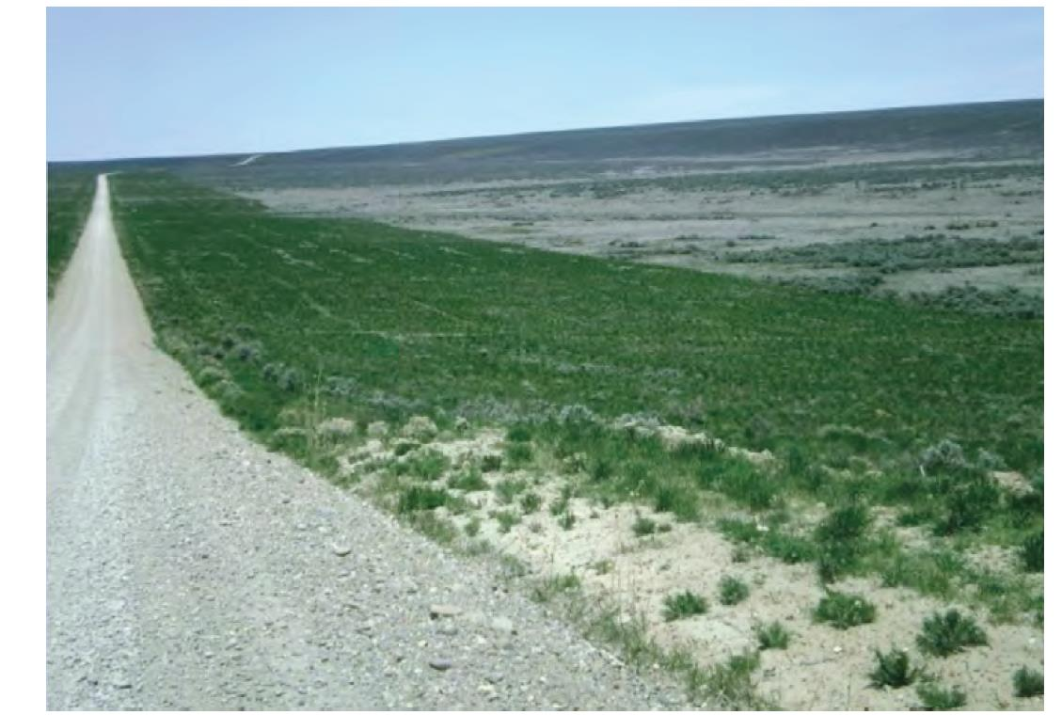
Prostrate Kochia Fuel Breaks

Slide 3
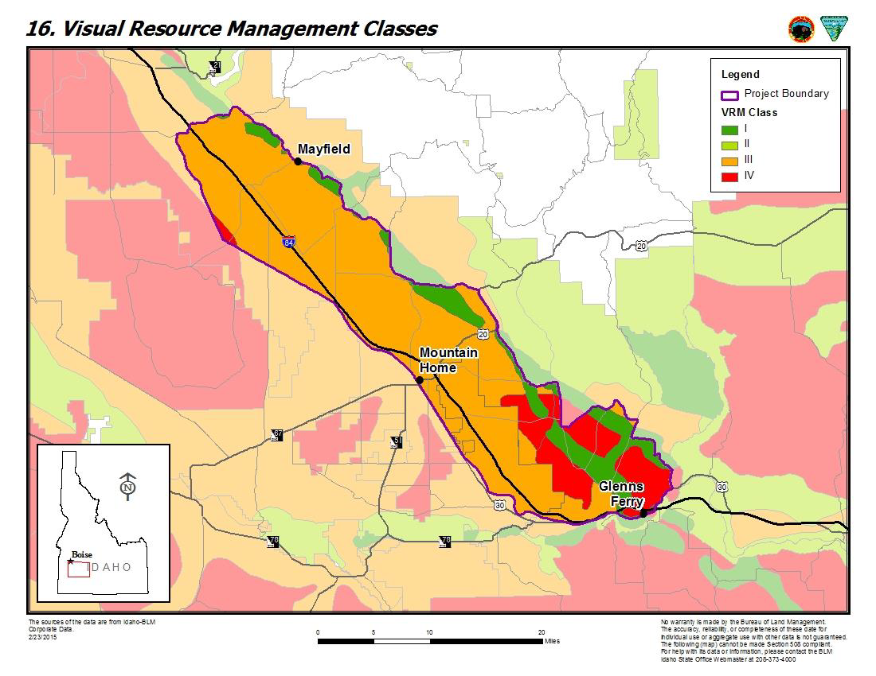
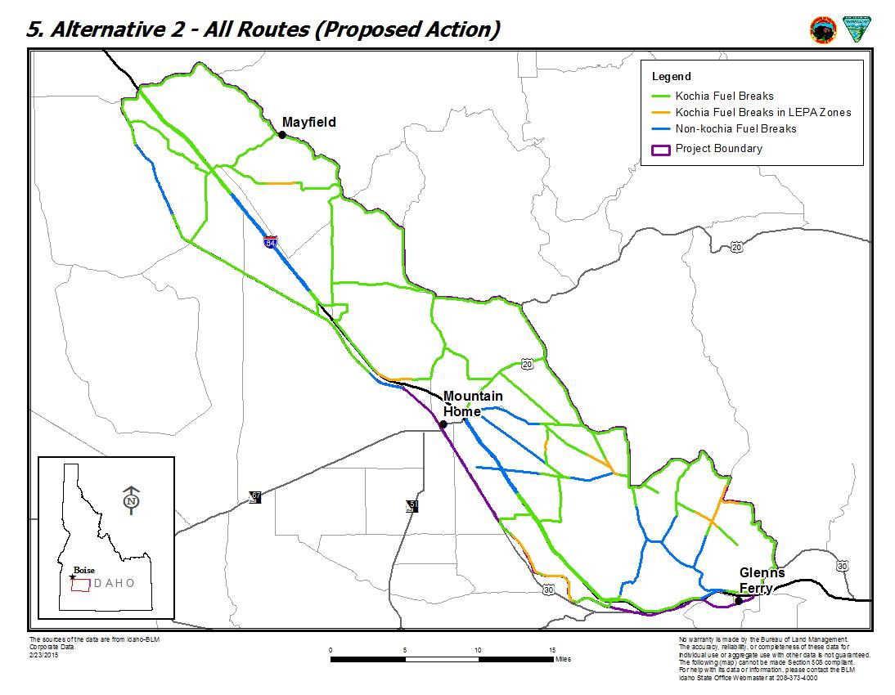
Paradigm Fuel Breaks

Slide 4
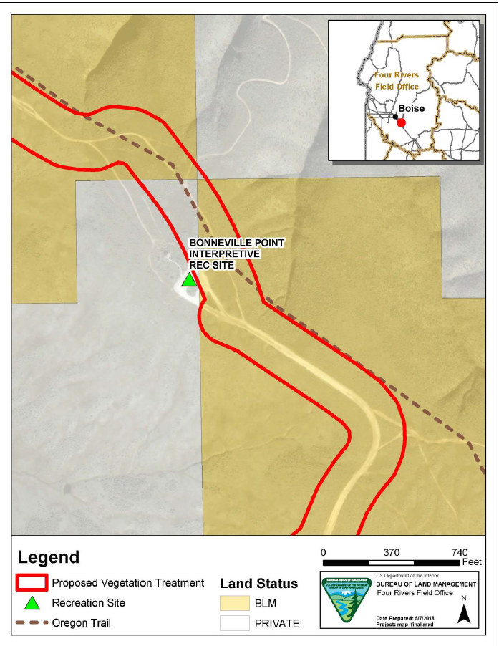
Project Location

Slide 5
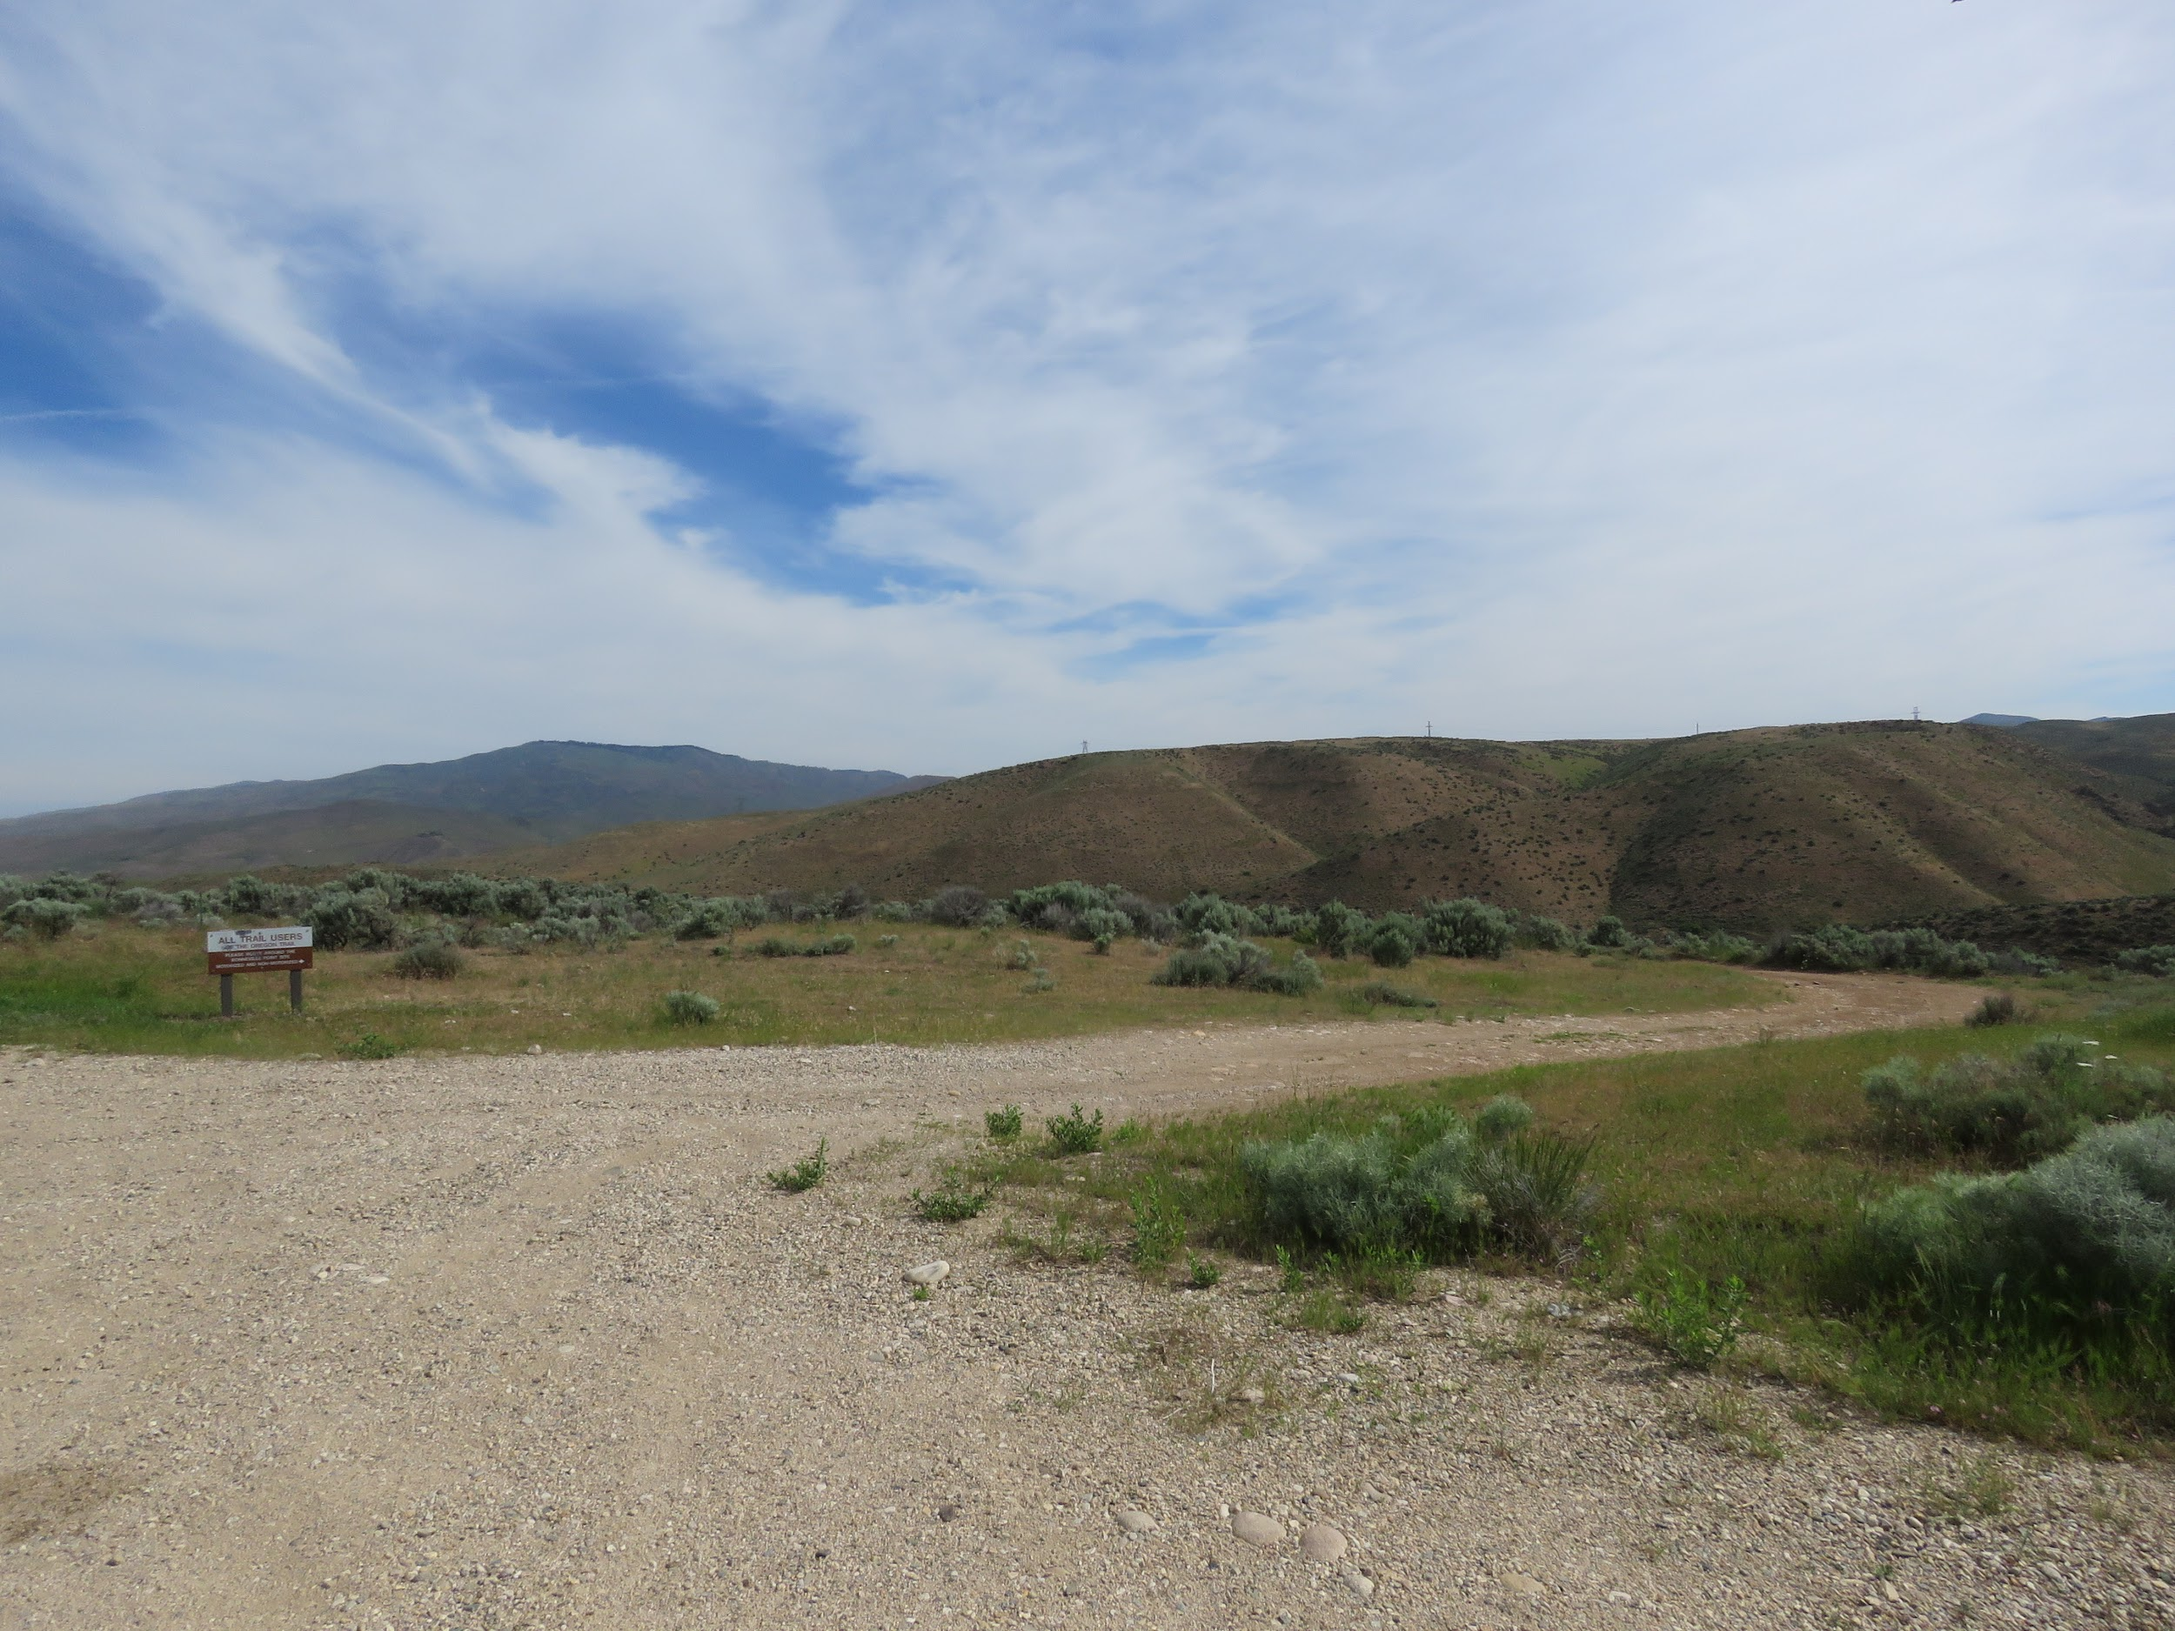
Affected Environment
Scenic Quality
Sensitivity
Distance Zones

Slide 6
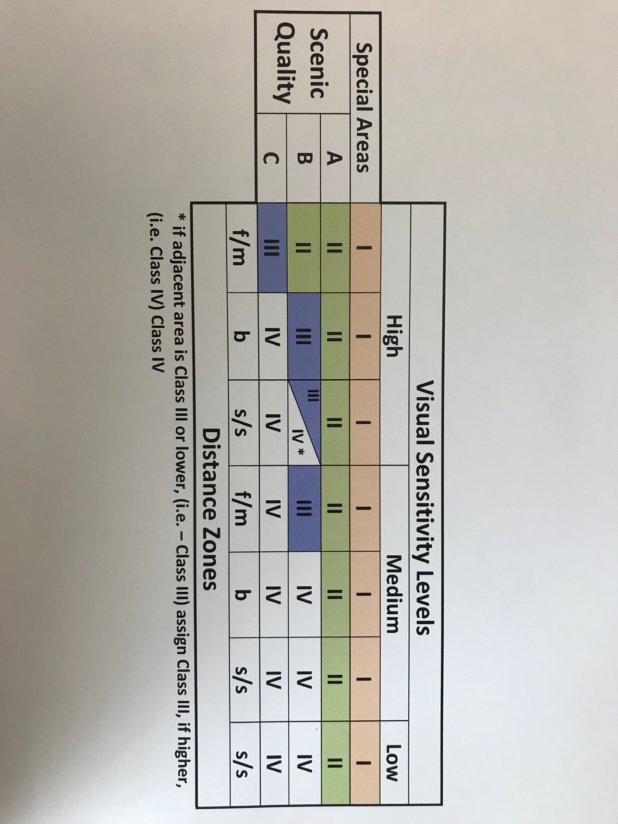
Visual Sensitivity Levels

Slide 7
Landscape Character
Landscape Type
Landscape Character Elements
Landscape Analysis Factors

Slide 8
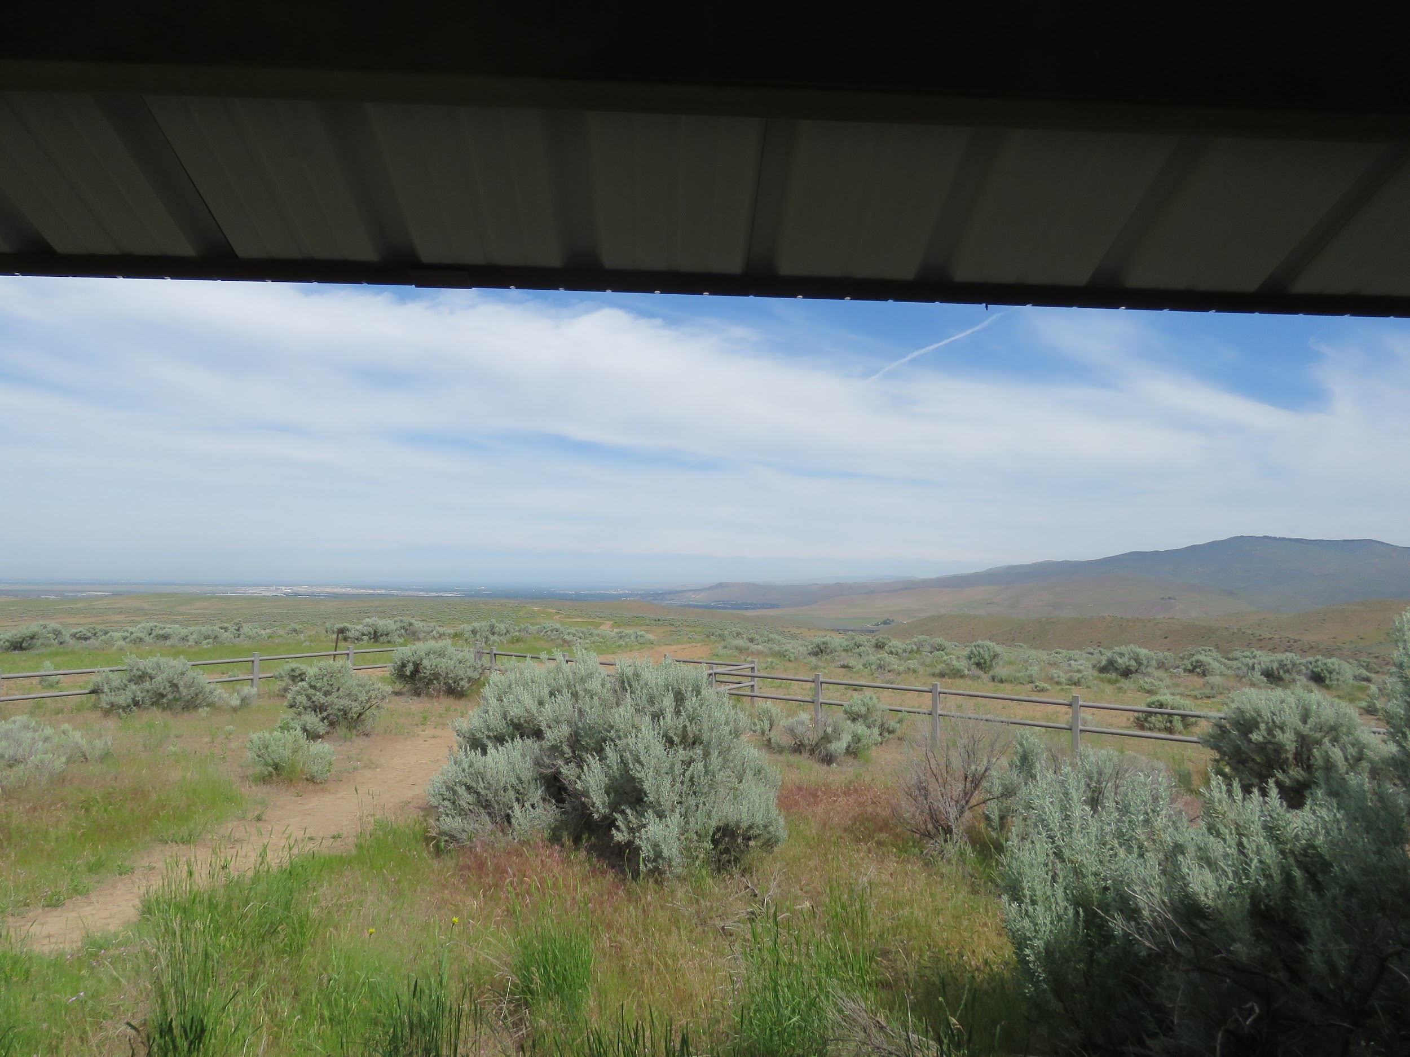
Landscape Analysis Factors
Contrast
Sequence
Axis
Convergence
Co-dominance
Enframent
Scale

Slide 9
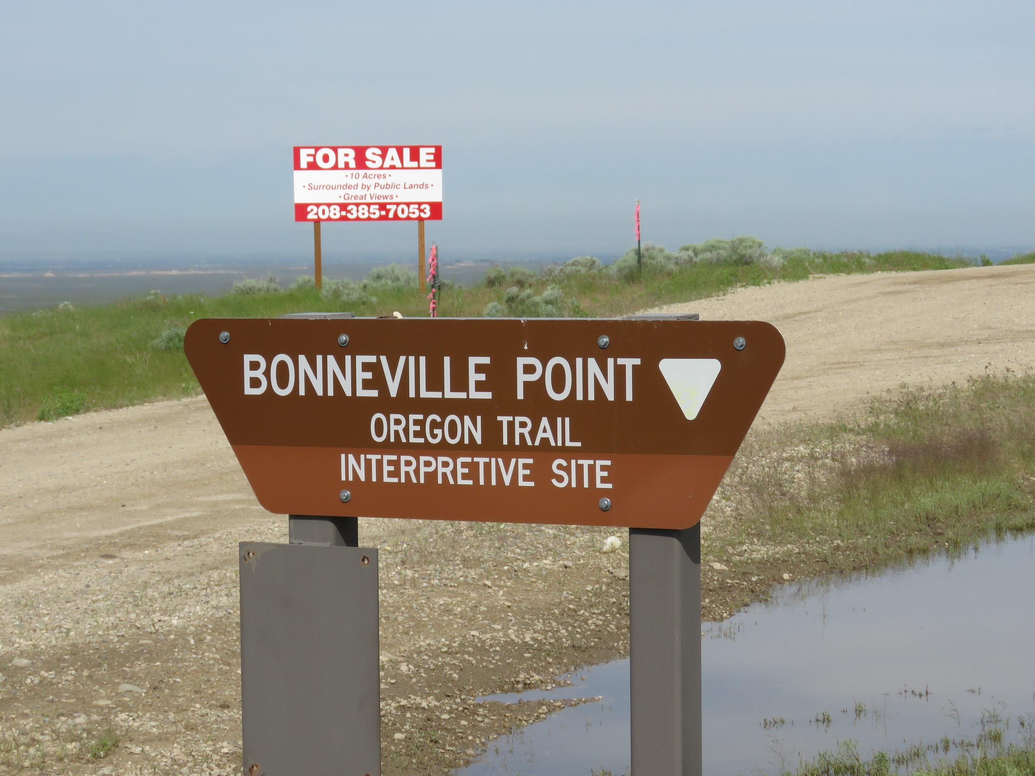
Variable Effects

Slide 10
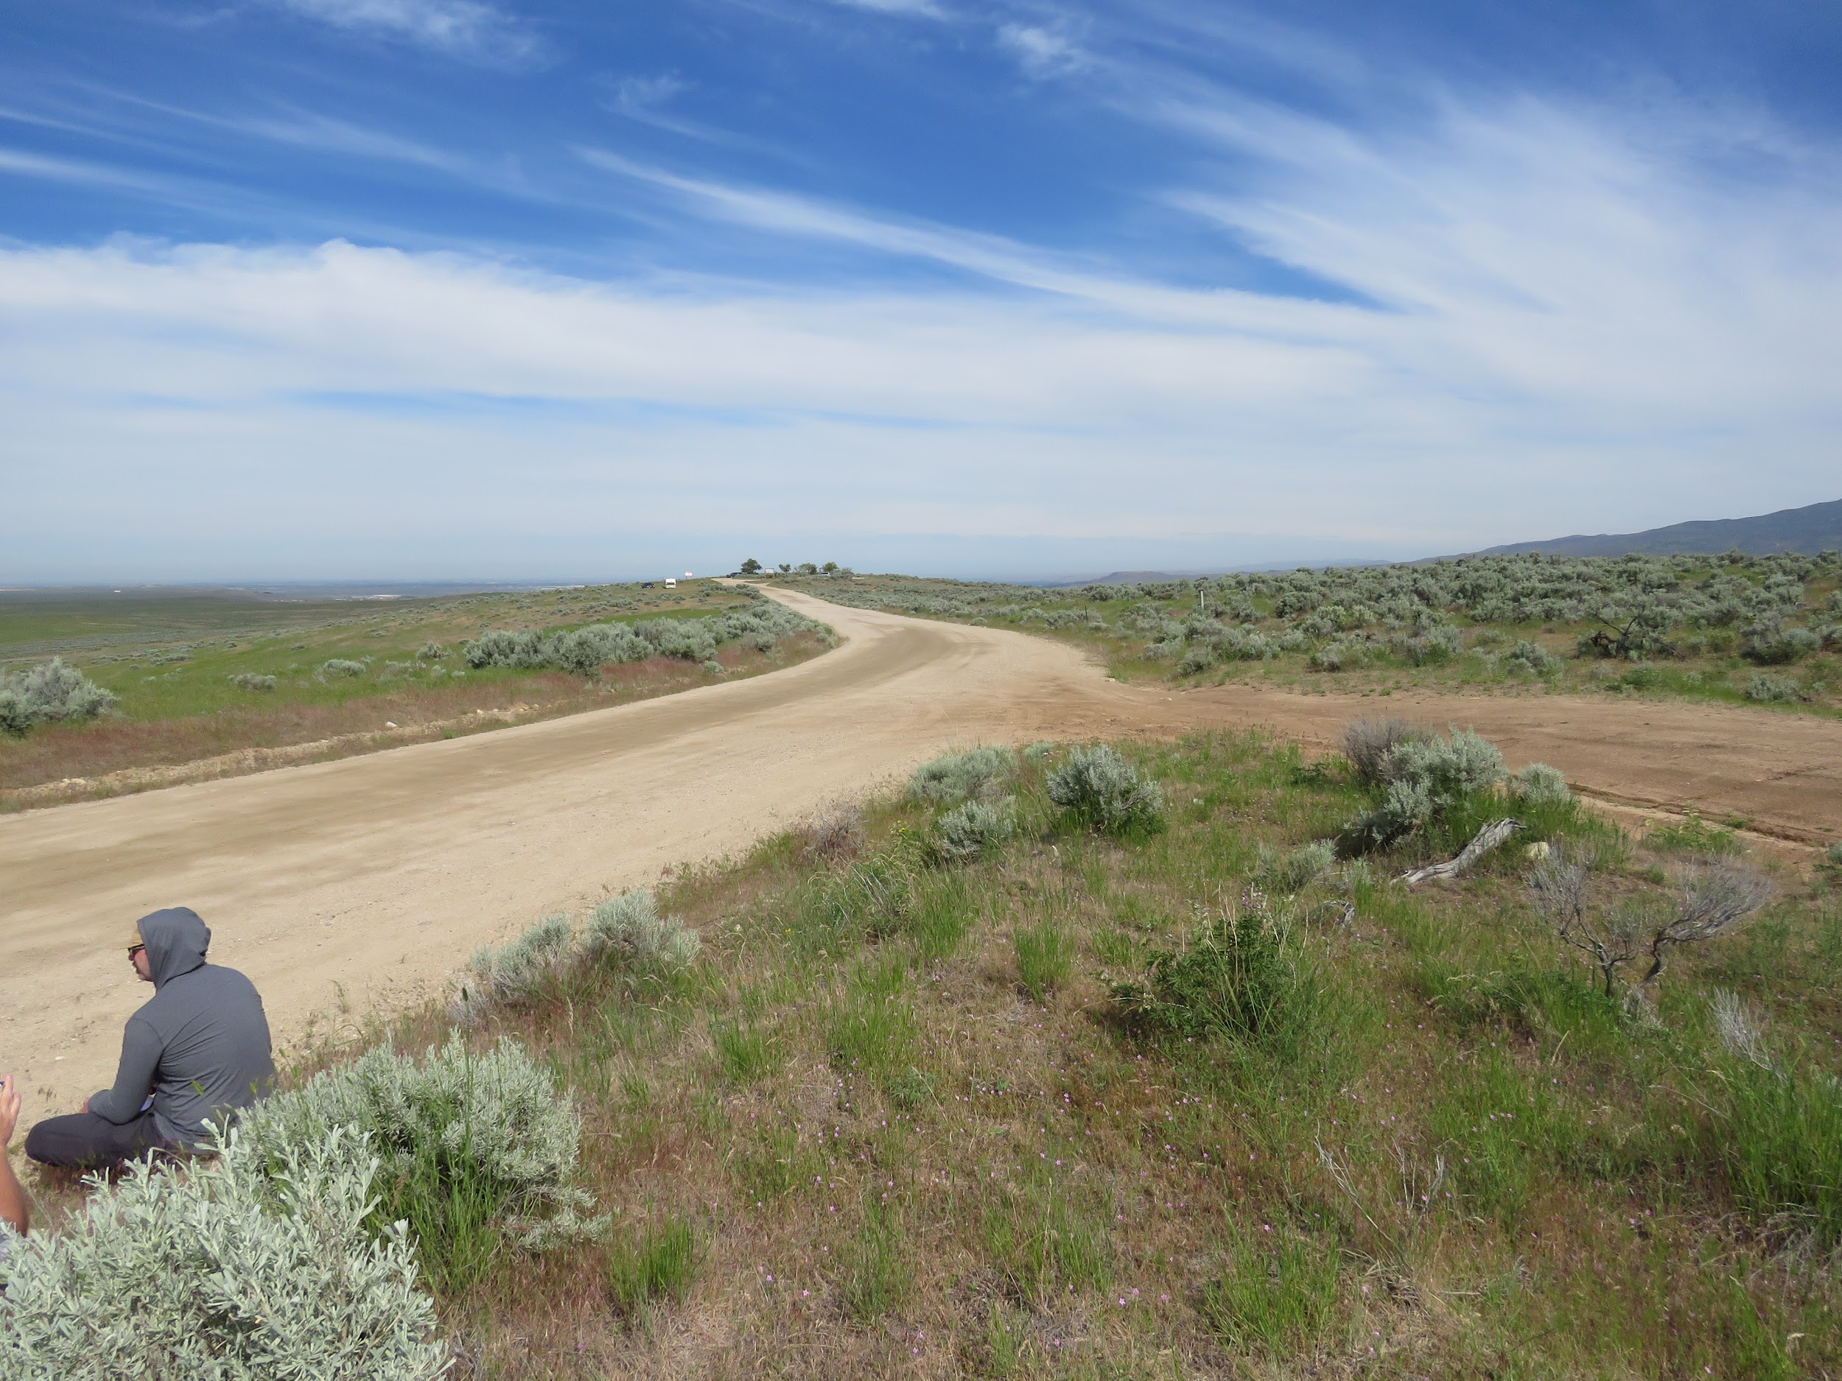
Relative Size or Scale
Recovery Time
Spatial Relationships

Slide 11
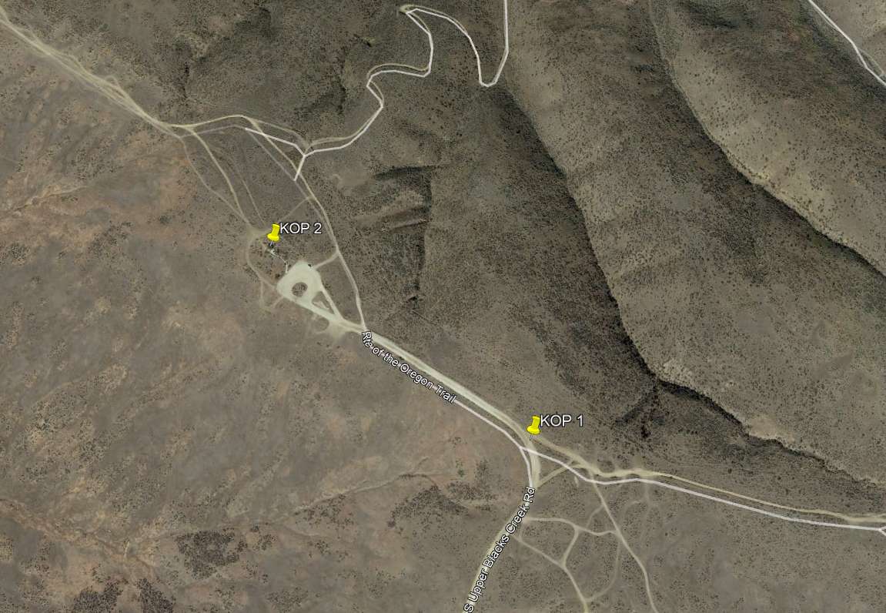
KOP Selection and Location
Notes:
KOPs were selected based on viewer groups in the area and viewer sensitivity. KOP 1 is representative of views of motorists traveling to the Bonneville Point Interpretive Site. KOP 2 is representative of visitors of the Bonneville Point Interpretive Site. Those moving throughout the area (on foot, bike, etc) would likely begin their visit from the gazebo/visitor parking area.

Slide 12
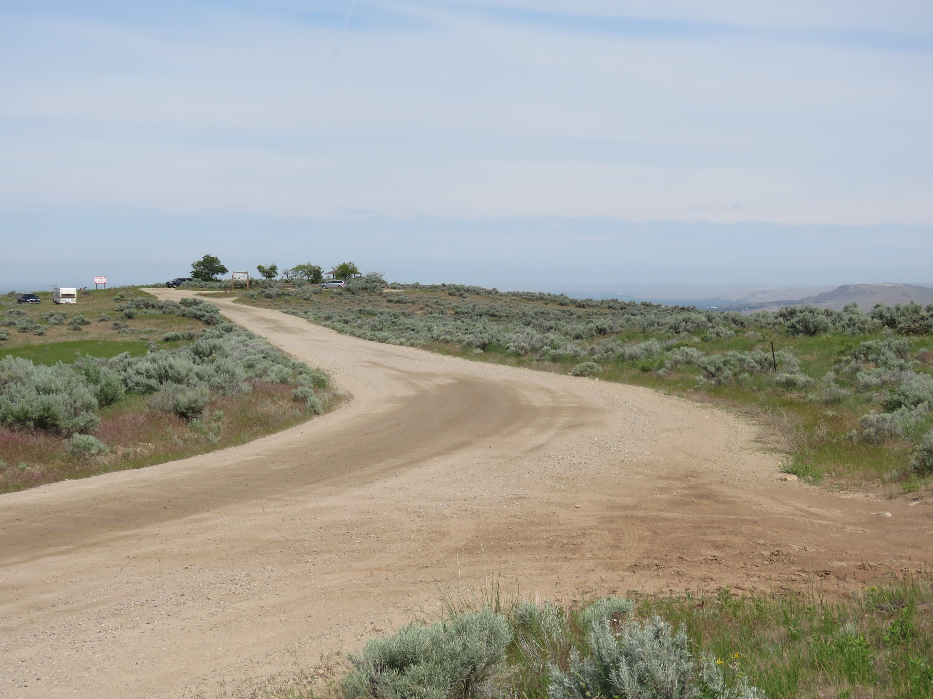
Existing View from KOP 1

Slide 13
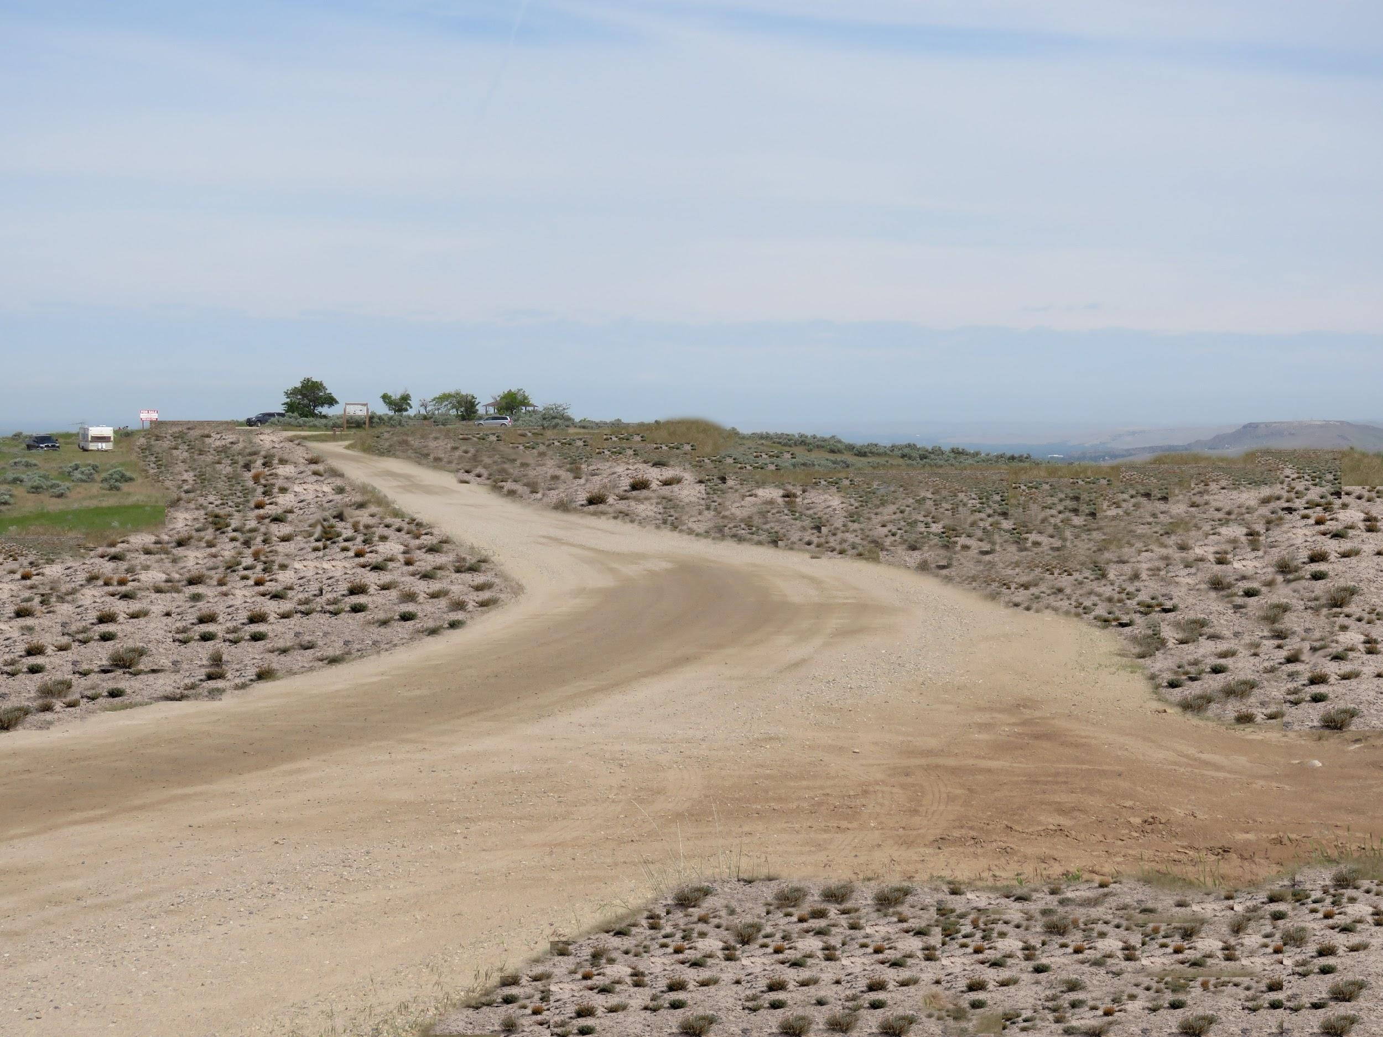
Proposed Project - Visual Simulation KOP 1

Slide 14
Existing View from KOP 2

Slide 15
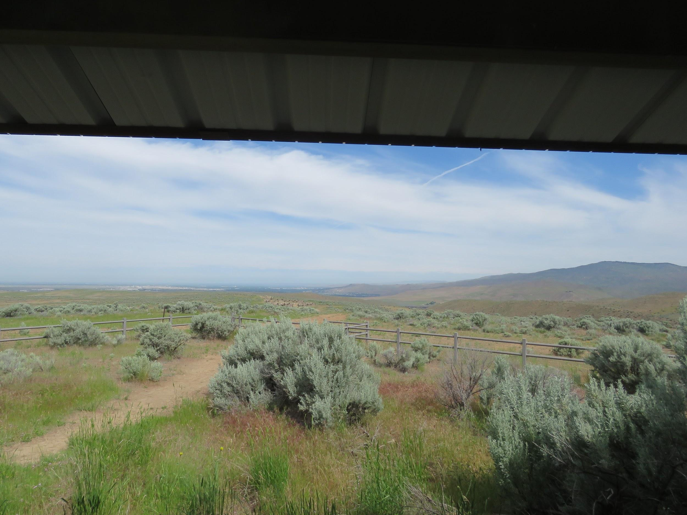
Proposed Project - Visual Simulation KOP 2

Slide 16
Contrast Rating Analysis for Proposed Project
X
X

Slide 17
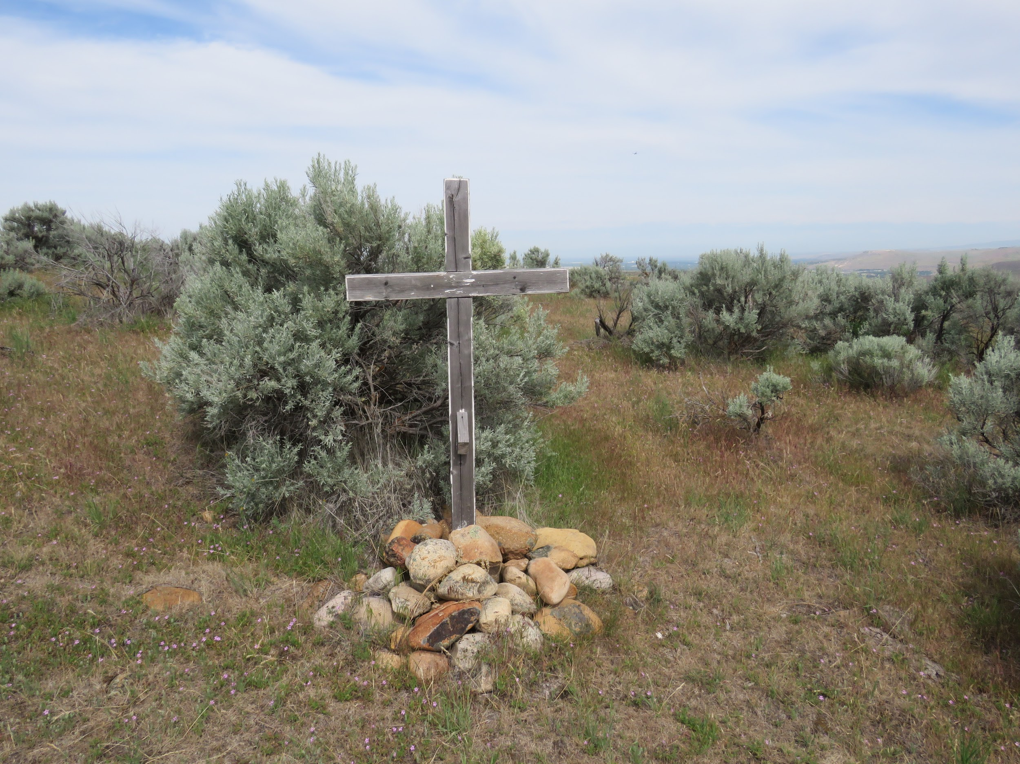
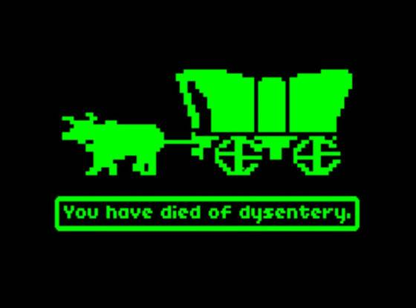
Conclusion
VRM Class I Objectives Met?

Slide 18
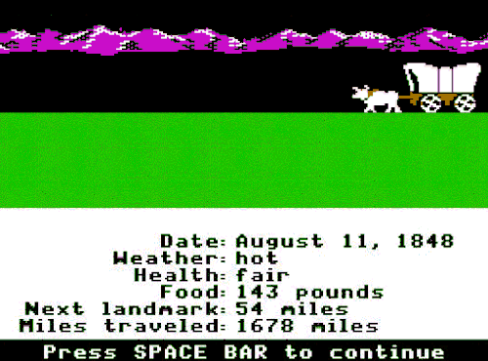
Proposed Mitigation
Hand thinning of dead/dry vegetation and maintain existing vegetation
100-150 feet
Mechanical thinning and mowing with some existing vegetation maintained
75-100 feet
Mechanical thinning and mowing
0-75 feet
Notes:
The fuel modification along the main road shall consist of mechanical thinning and mowing between 0-75 feet from the center line; mechanical thinning and mowing between 75-100 feet from the center line, incorporating a mosaic effect by maintaining some existing vegetation; and hand thinning from 100-150 feet, maintaining existing vegetation and removing dry, dead vegetation. All fuel modification activities directly on and within 25 feet of the historic Oregon Trail byway shall consist of hand thinning only. No surface disturbing activities that would expose bare soil shall be incorporated.

Slide 19
Existing View from KOP 1

Slide 20
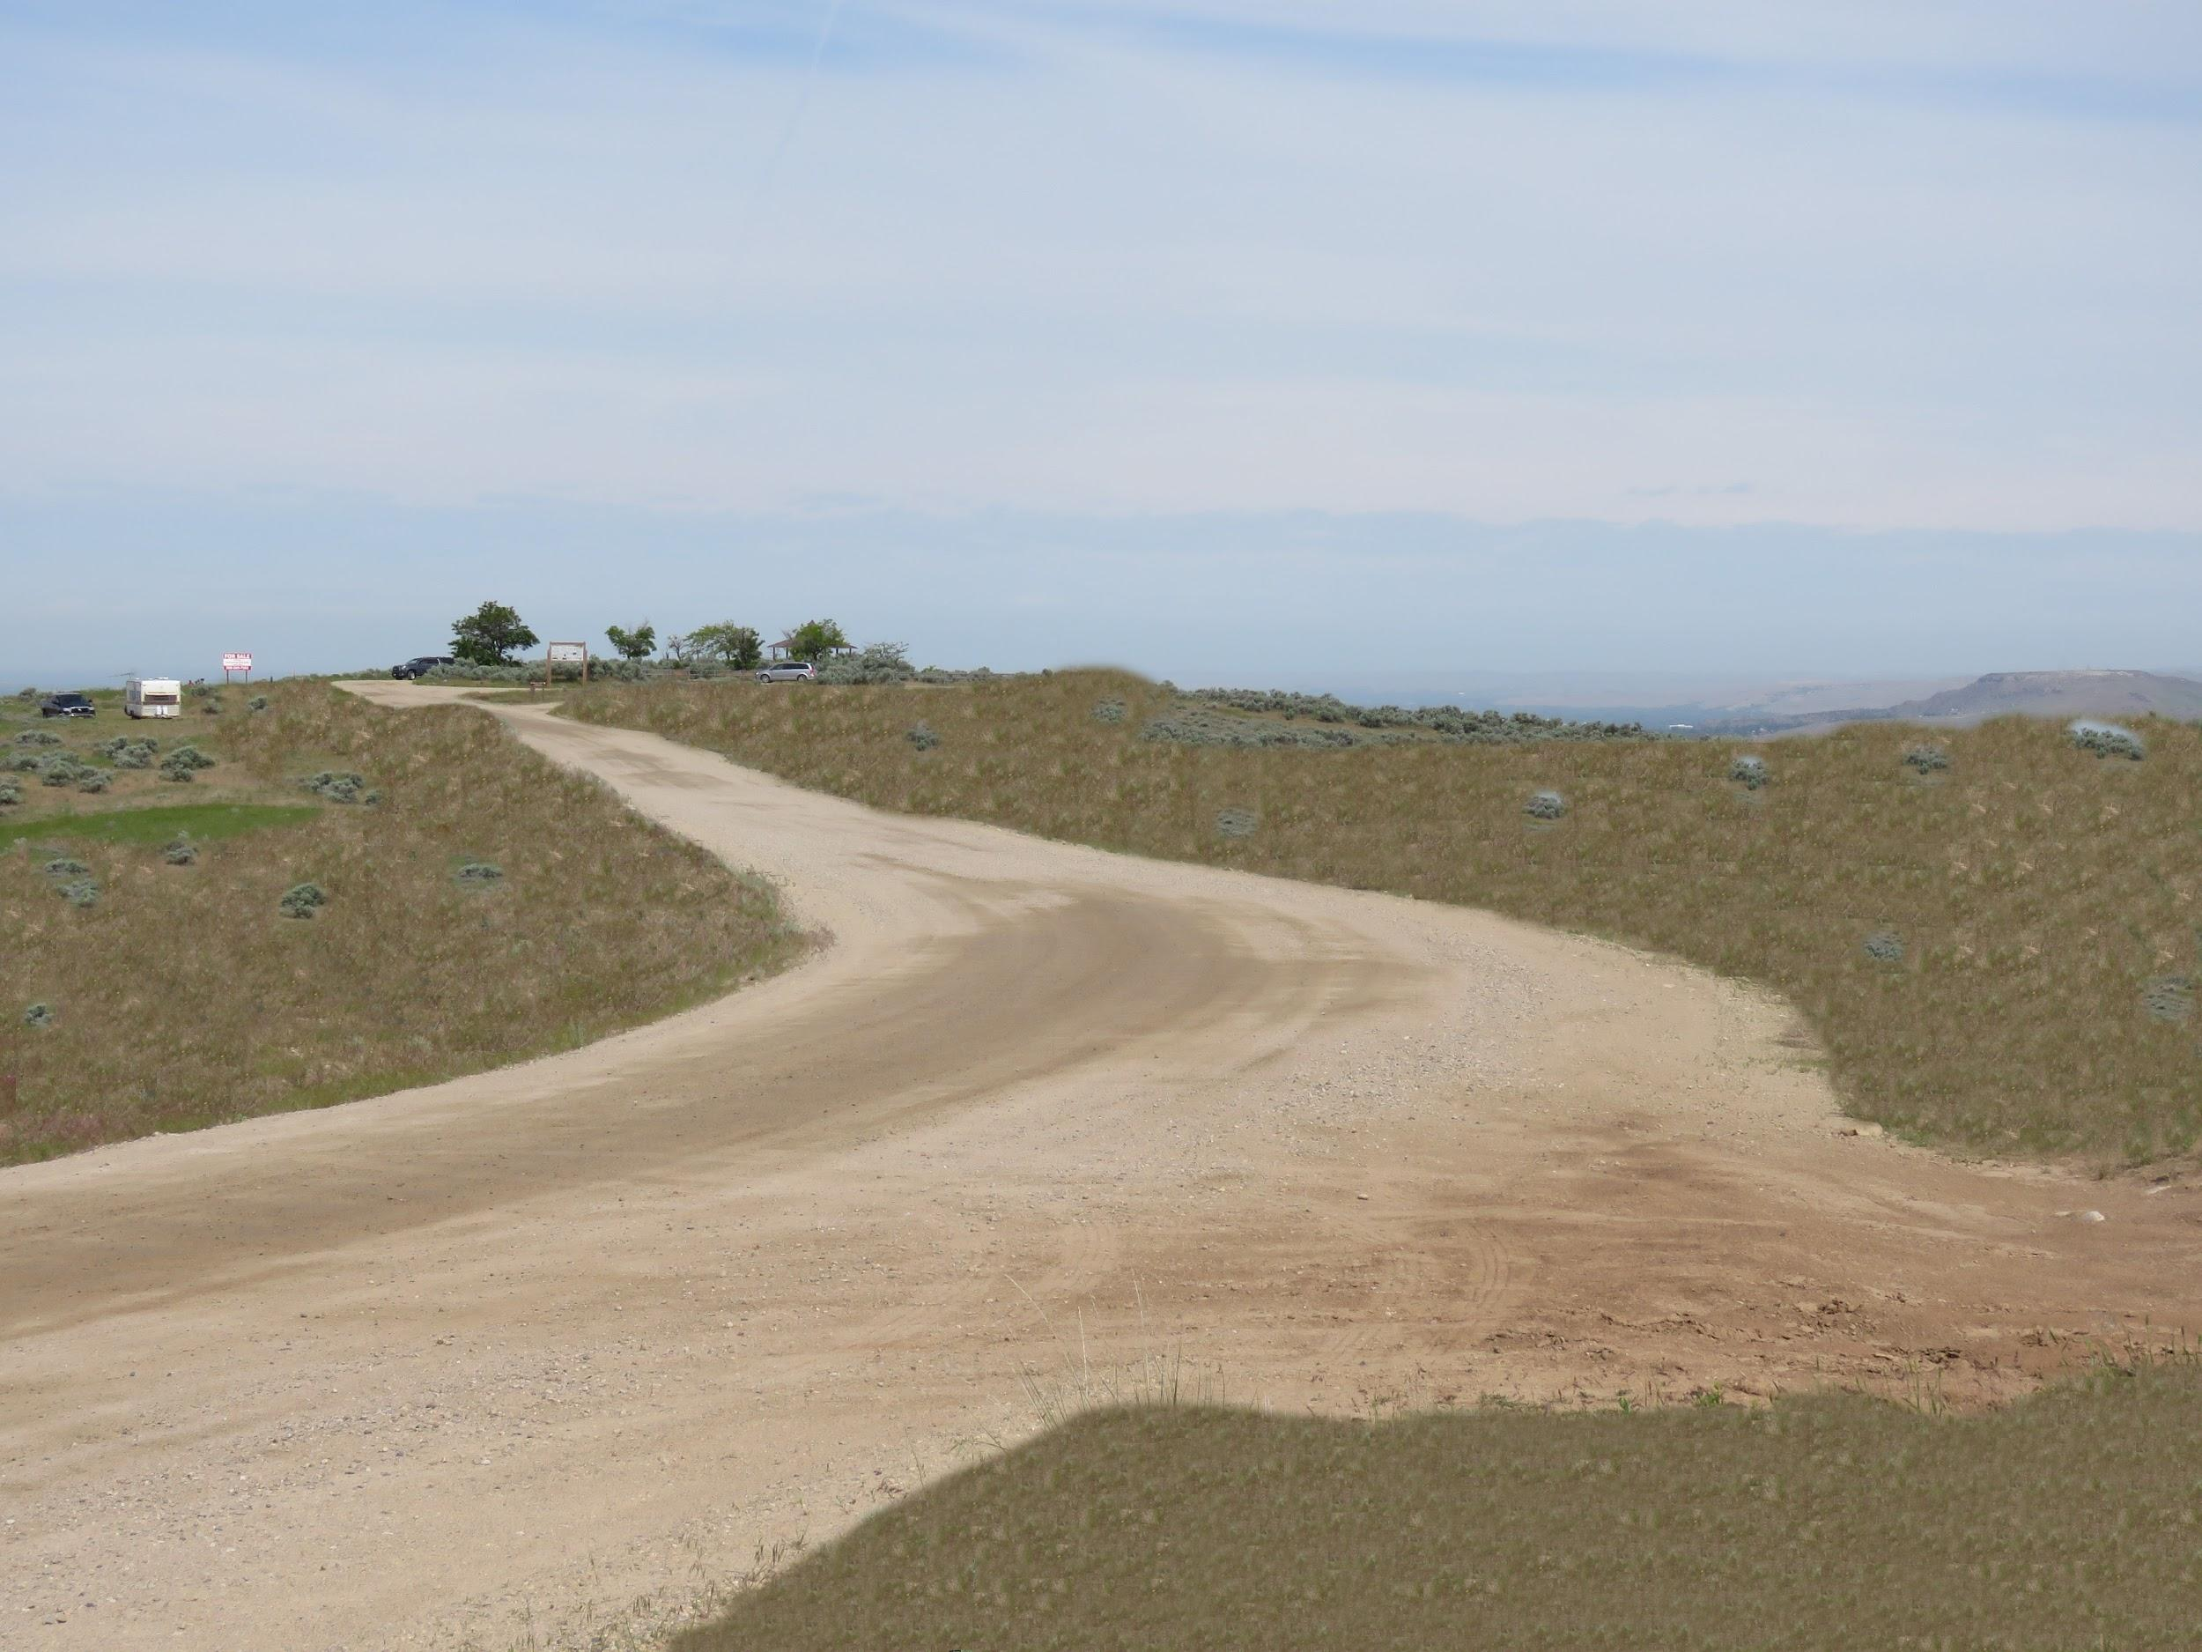
Visual Simulation with Mitigation Incorporated KOP 1

Slide 21
Existing View from KOP 2

Slide 22
Visual Simulation with Mitigation Incorporated KOP 2

Slide 23
Contrast Rating Analysis with Mitigation Incorporated
X
X

Slide 24
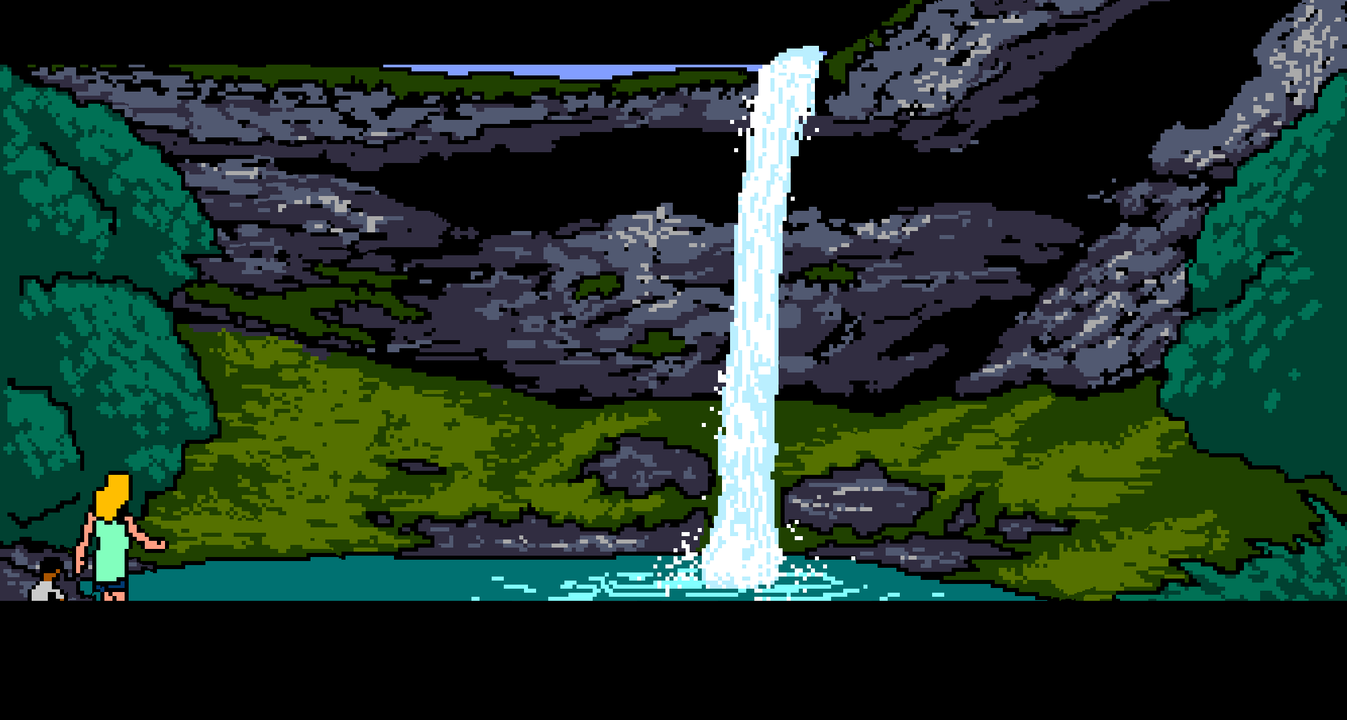
Proposed Fuel Breaks in VRM Class I
Would not conform due to strong contrast in Form, Line, and Color of Vegetation and the presence of bare soil
Recommended Mitigation to eliminate contrast
Accomplished the objectives of the Project while conforming with VRM objectives and preserved the scenic character of important sections of the Oregon National Historic Trail
Questions?

