Slide 2
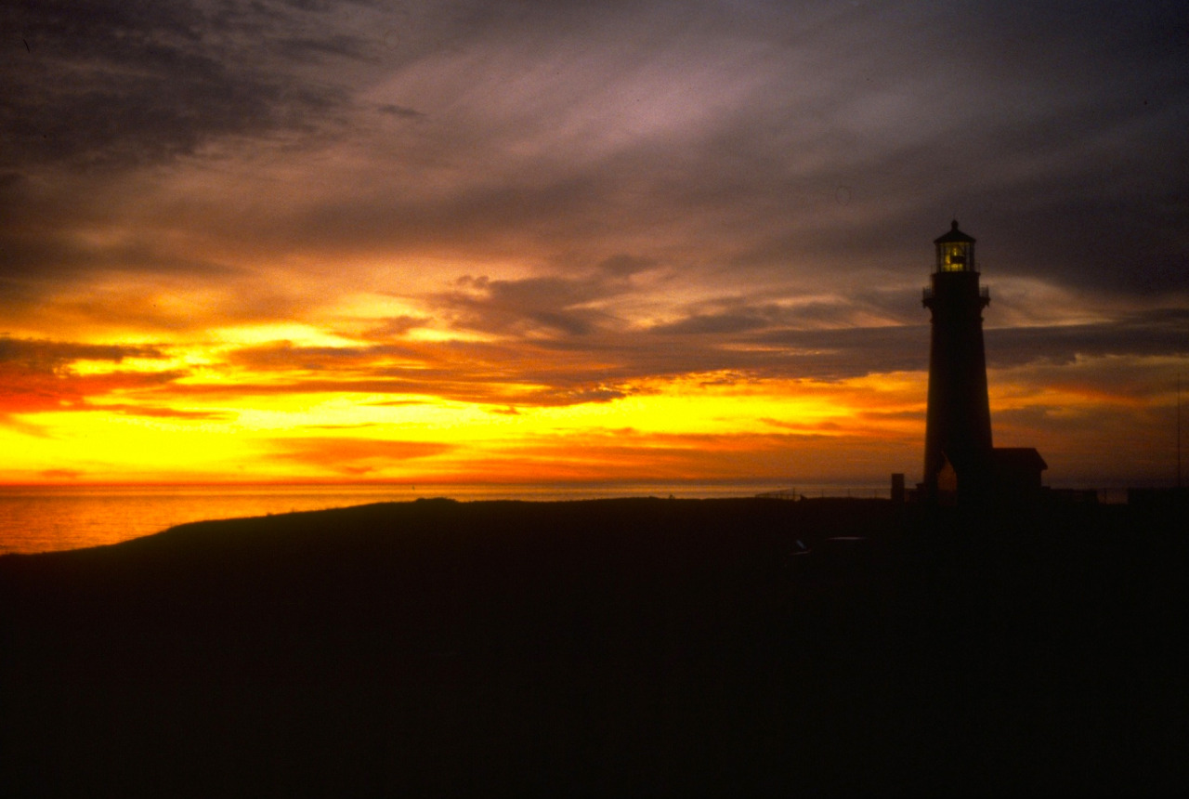

Slide 3
Unit Objective
Review the key learning points of the week
Reflect back on the week’s activities
Answer any remaining questions
And hopefully a chuckle or two

Slide 4
Overall Course Objective
Having participated in the course, you
should be able to:
Describe the basic principles and concepts of VRM
Communicate the role of VRM in land use planning and activity planning within the Bureau.
That you have the foundation to begin hone the skills to:
inventory visual resources,
analyze landscape,
develop mitigations for minimizing contrast.
Notes:
HOPEFULLY COMMUNICATE: Objective process with moments that require PROFESSIONAL JUDGEMENT

Slide 5
Overall Course Objective
Basic Principles
Scenic resources are public resources, which are finite in supply.
BLM has a legal obligation to manage for scenery.
Visual Resource Management (VRM) is our system for scenery management.
VRM is not about obstructing projects, but to make projects better integrated into their setting.

Slide 6
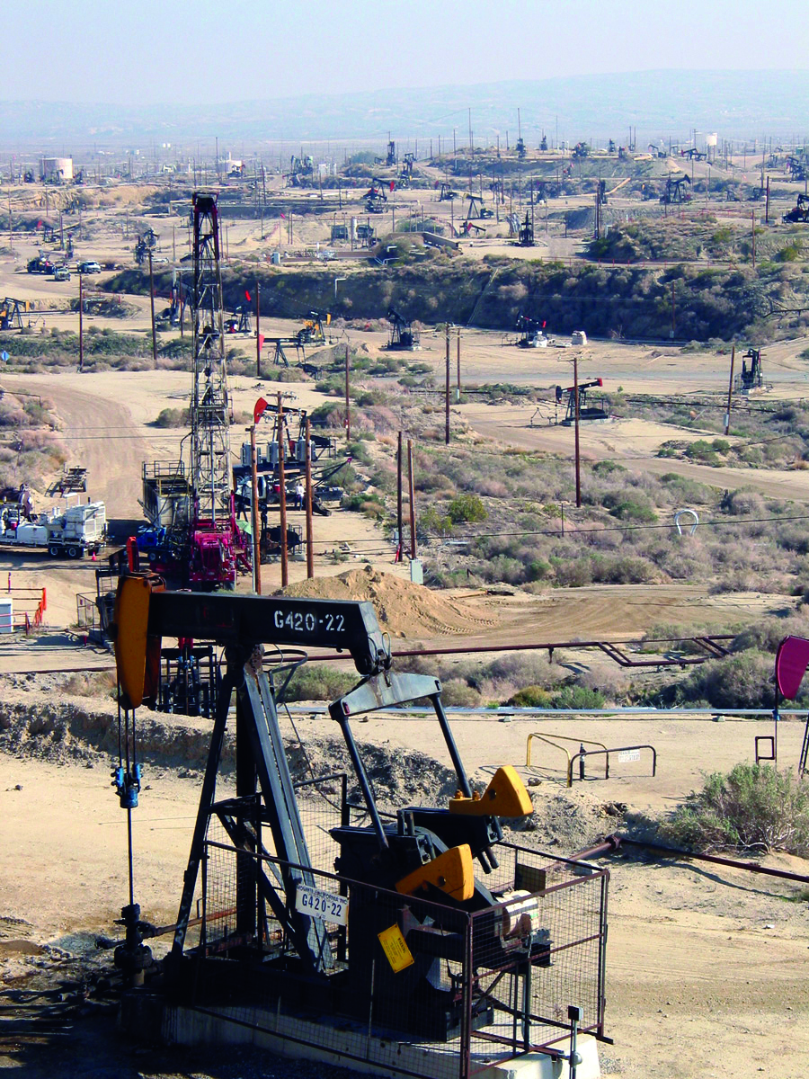
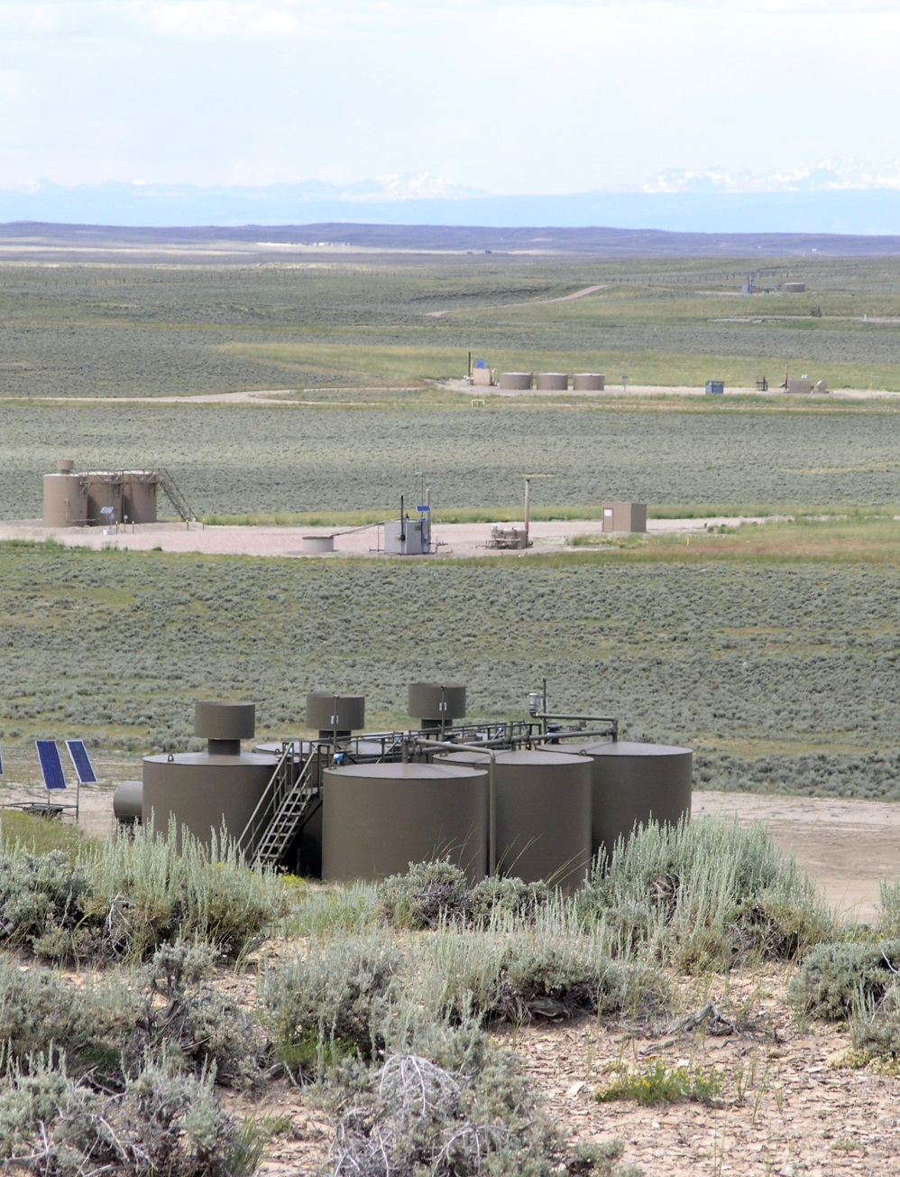
Overall Course Objective
Objectives of the National VRM Program
Manage for protecting the visual resource
Avoid or minimize adverse visual impact
Establish consistency in managing visual resources
Promote an inclusive framework for interaction between VRM and other resource programs
Encourage thoughtful management of visual values with other resources for now and into the future
Ensure management of visual resources in accordance with applicable laws and regulations
Provide adequate information for informed visual resource land use planning, project design, and landscape monitoring

Slide 7
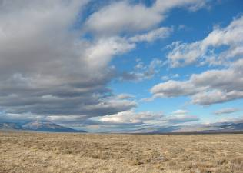
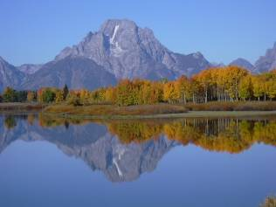
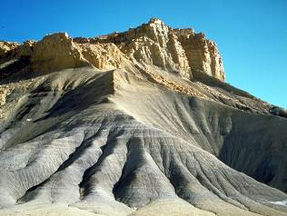
Overall Course Objective
BLM has legal obligation
IBLA Decisions
144IBLA070 - Utah Decision
173IBLA313 - Beaver Rim_Lander FO
174 IBLA 078 -Tom Van Sant – California
IBLA 2016-74 (02/14/2019) Southern Utah Wilderness Alliance
VRM system
Inventory for visual values
Establish Mgt. Classes in the RMP
Evaluate/design activities to meet classes
Monitor project compliance and adherence to the VRM class objectives
Keep the inventory current by updating

Slide 8
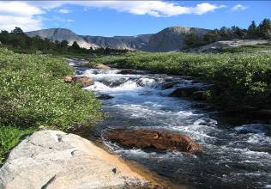
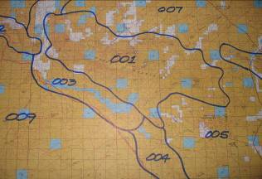
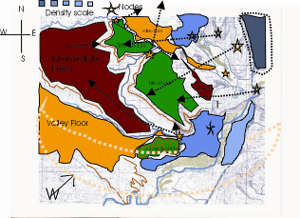
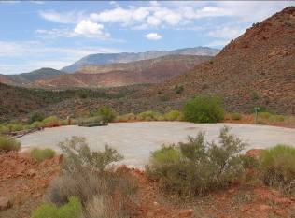
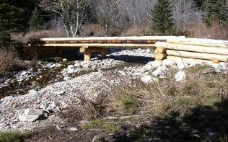
Overall Course Objective
VRM is the “Language for Landscapes”
Types of Landscapes
Elements of Landscape Character
Analysis Factors
Inventory the Visual Resource
Scenic Quality
Sensitivity Levels
Distance Zones
VRI Classes

Slide 9
Overall Course Objective
The VRI in Land Use Planning
Primary source of information
Consideration of other information
Analysis of the Management Situation
Alternatives development/ VRM Class objectives
Analysis of impact on VRI factors
VRM Management Classes I-IV
Going beyond the VRM Classes
Interim VRM Classes
Amending Land Use Plans

Slide 10
Overall Course Objective
Project Level Planning Essentials
VRM Class objective
Site Planning Considerations
Human and Environmental Factors
Observation
Design Fundamentals
Form, Line, Color, Texture AND Scale
Site Selection
Adverse Visual Contrast Reduction

Slide 11
Overall Course Objective
Project Planning, Analysis and Evaluation
Identify VRM Objectives
Project Description
Visual Contrast Rating System
Affected viewshed determination
Key Observation Points (KOP)
Visual simulations
Contrast Rating Form
10 environmental factors
Design modification
Reevaluation
Visualization/ Simulation
Informs the project team
Informs the BLM
Informs the public
Information and verify accuracy

Slide 12
Overall Course Objective
NEPA & VRM
Proposed Action
Alternative
Affected Environment
Environmental Consequences (VRI & settings)
Mitigation – enforceable commitments
Monitoring
Commitment enforcement
Compliance
Effectiveness
Adaptive Management
Land Use Plan – VRM Class objective adherence
Regional Scale Planning & Mitigation Strategy
Enables us to manage visual resources effectively

Slide 13
Summary Questions:
Are Visual Inventory Classes & VRM Management Classes the same thing?
Is VRM
discretionary, a “soft” decision?
do we manage project beauty?
allows visually unmitigated activity within VRM Class IV?
a way to preclude or exclude projects from happening?
Does VRM applies to existing valid mineral rights?
VRM Management Class IV means the area has low visual value?
Are Contrast Rating Evaluations required for all projects?
Who is responsible for VRM?
If the VRM class objective at the KOP is different than where the project is located, which VRM Class objective must be met?
Do we inventory visual resources as a part of a proposed action?

Slide 14
Final Comments
VRM is a Collaborative Process – internally and externally.
Is your Visual Resource Inventory up to date?
Take the time to do comprehensive planning – carefully study VRM/VRI/Allocations compatibility – knowing the industry’s challenges, but capabilities, too.
VRM Class IV should be given as much consideration as VRM II and III.
Plan amendment should be the exception to the rule and not viewed as the easy out. Design your way to conformance rather than amending your way there.

Slide 15
In closing . . .
You are the leaders in VRM - please be assertive stewards of our BLM settings and protecting BLM’s visual values
Share your challenges and successes with us and your fellow students
Encourage customers to use qualified contractors the conduct VRM analysis.
Call upon the instructors and me, if you need assistance
Notes:
Diplomacy versus heavy handedness, KNOW YOUR PROPONENT’S BUSINESS IN ORDER TO MAKE SOUND AND REASONABLE RECOMMENDATIONS
ALSO TO KNOW WHEN YOU’RE BEING BLUFFED.

Slide 16
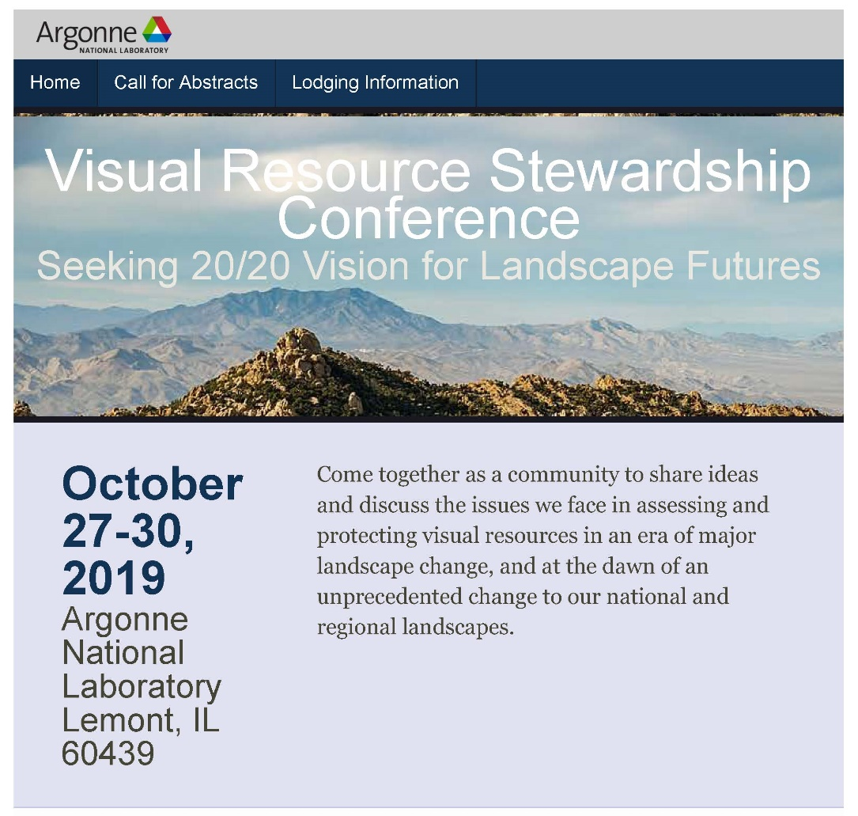
Wrap Up
Other reading
Another Opportunity to Contribute
http://vrconference.evs.anl.gov/

Slide 17
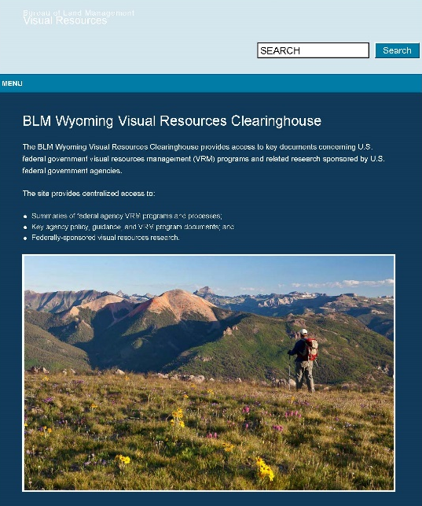
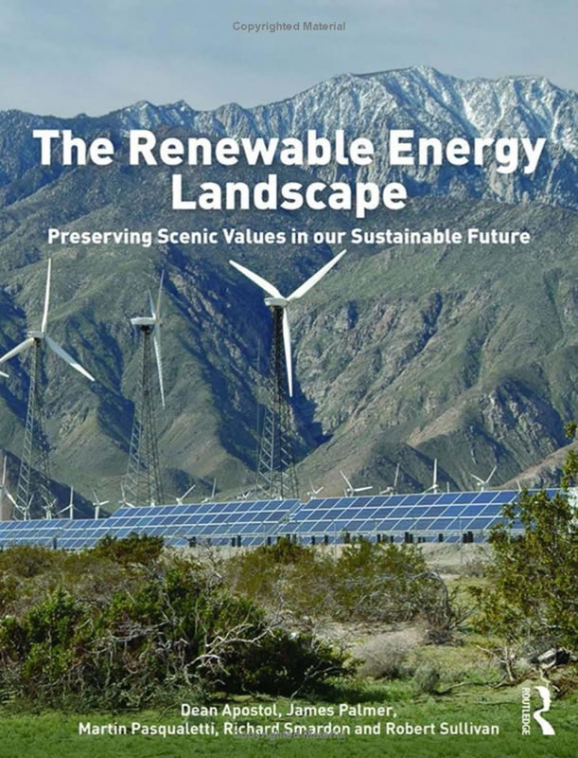
Wrap Up
Other reading
Additional Resources
blmwyomingvisual.anl.gov

Slide 18
Course Sponsors
Tim Gaddis, National Training Center
tgaddis@blm.gov
Andy Tenney, WO250 Division Chief, Recreation and Visitor Services
atenney@blm.gov

Slide 19
Stay in Touch
John McCarty
Washington Office
jhmccart@blm.gov
202.912.7284

