Slide 1
Confined Space

Slide 2
OSHA Confined Space
Definition:
It is large enough to enter and perform work AND,
There is limited or restricted means for entering or exiting the space AND,
It is not designed for continuous employee occupancy .

Slide 3
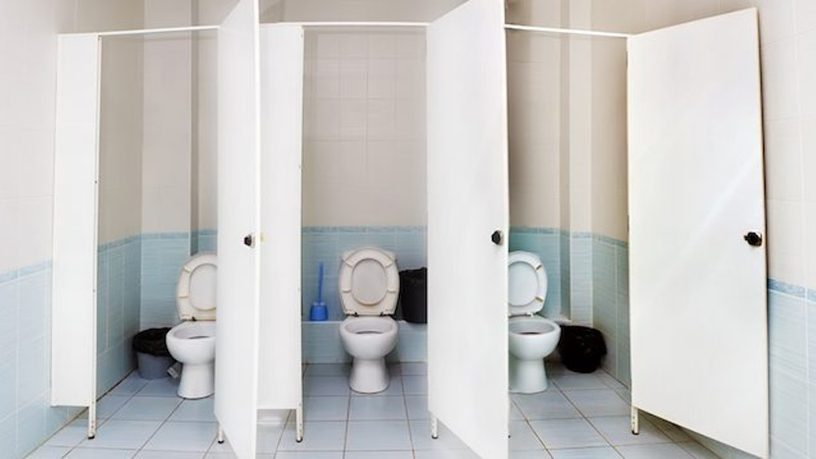
Example:

Slide 4
Permit Required Confined Space (PRCS)
By definition, a permit-required confined space has one or more
of these characteristics:
Contains or has the potential to contain a hazardous atmosphere;
Contains a material with the potential to engulf someone who enters the space;
Has an internal configuration that might cause an entrant to be trapped or asphyxiated by inwardly converging walls or by a floor that slopes downward and tapers to a smaller cross section; and/or
Contains any other recognized serious safety or health hazards.

Slide 5
Contains or has the potential to contain a hazardous atmosphere;
Example:

Slide 6
Contains a material with the potential to engulf someone who enters the space;
Example:

Slide 7
Confined Space…..
Open for
Discussion

