Slide 1
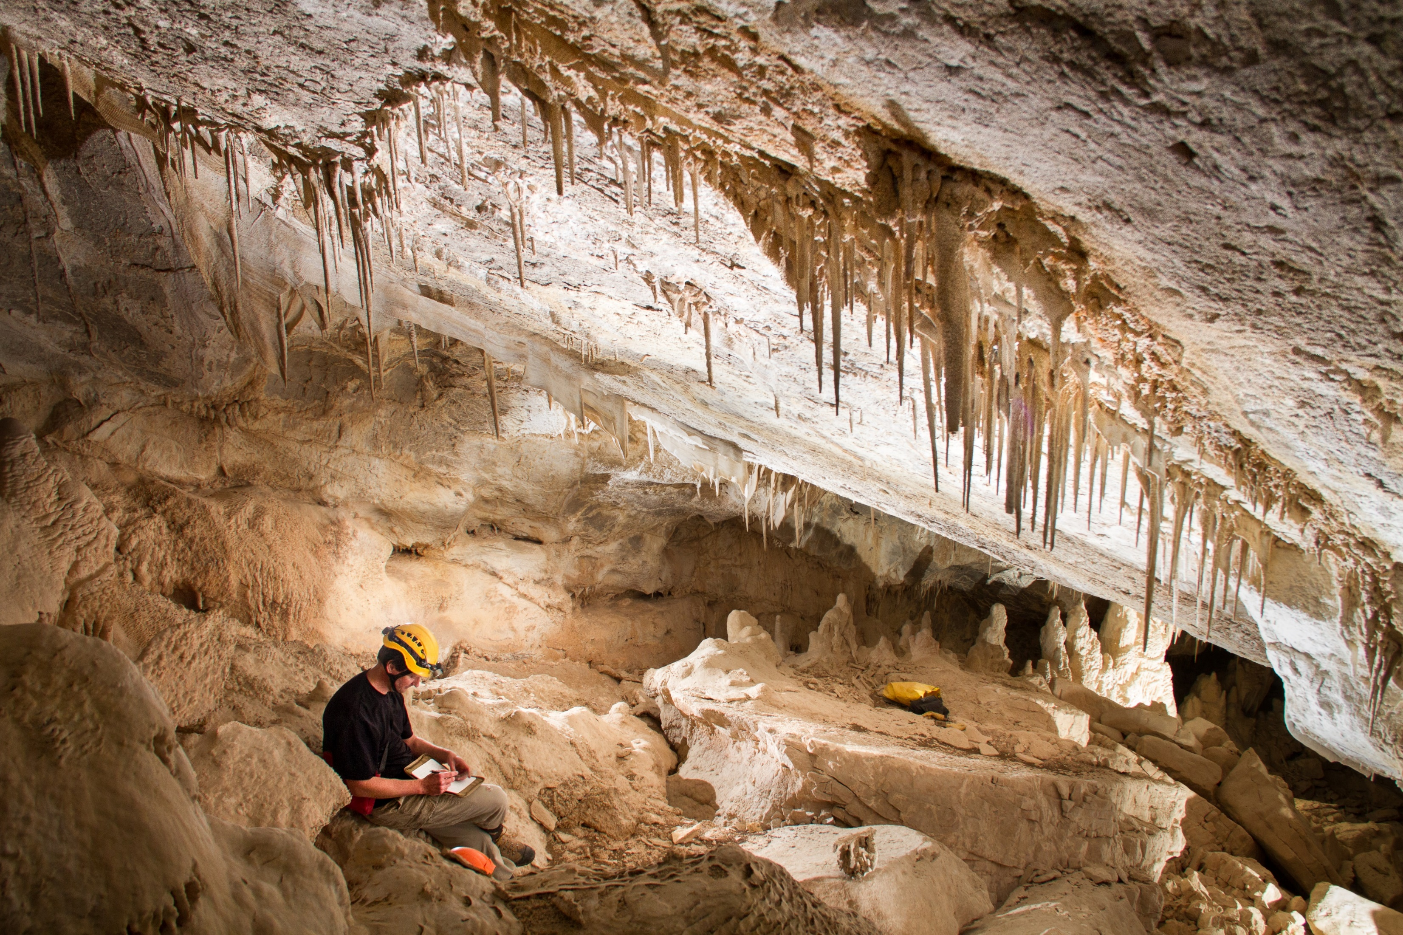
Applications for Cave Surveys
U.S. Department of the Interior Bureau of Land Management
Notes:
Cave found in Canada Dec 2018. Sallacc’s Pit
Entrance is 100 m long and 60 meters wide with a depth of 135 meters.

Slide 2
Why survey a cave?
U.S. Department of the Interior Bureau of Land Management
To measure where it goes (length, depth, direction)
To record what it contains (biology, geology, cave formations, archeology, hydrology)
To understand how it forms (geology, hydrology, structure, chemistry, time)
To aid in its management and science (interactions with human activities and surface morphology)
For planning (tour development, trails, rescues, restoration, science)
To discover more cave passages
Notes:
Why do we survey caves?

Slide 3
How are cave maps created?
U.S. Department of the Interior Bureau of Land Management
Survey (In cave process)
Tape (laser range meter), compass, inclinometer
Plan, Profile and X-section sketches
Inventory
Cartography (After cave process)
Data processing
Drafting the cave map
Incorporating into GIS
Notes:
How are caves surveyed?

Slide 4
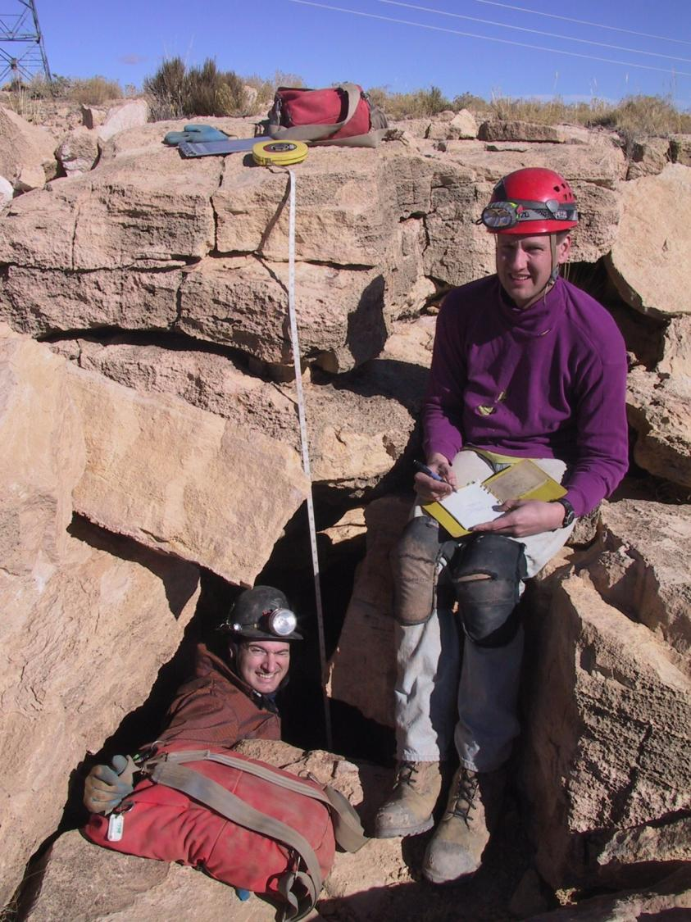
U.S. Department of the Interior Bureau of Land Management
Notes:
Surveying Antelope Cave in the Arizona Strip.

Slide 5
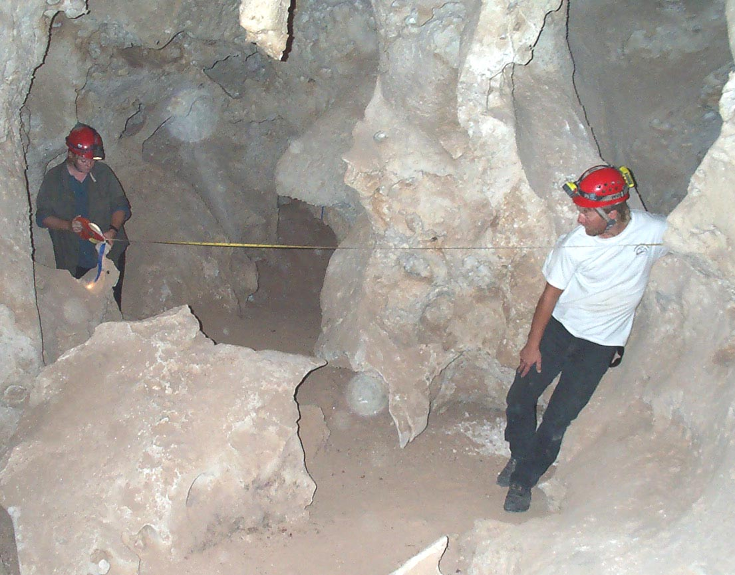
U.S. Department of the Interior Bureau of Land Management

Slide 6
U.S. Department of the Interior Bureau of Land Management
Notes:
Dave Becker takes compass readings while Jon Jasper is collecting data and drafting the sketches

Slide 7
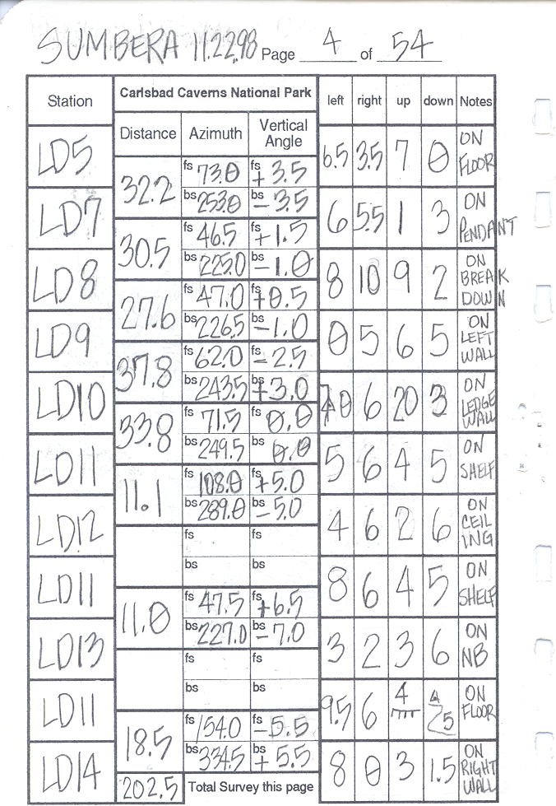
Recording
Data

Slide 8
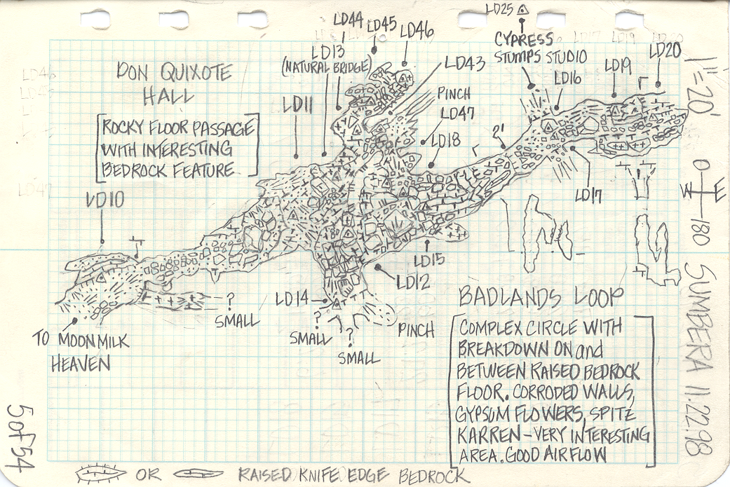
Plan View

Slide 9
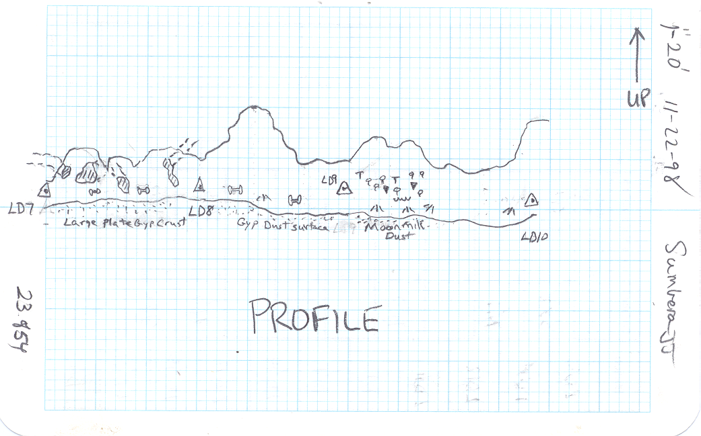
Profile View

Slide 10
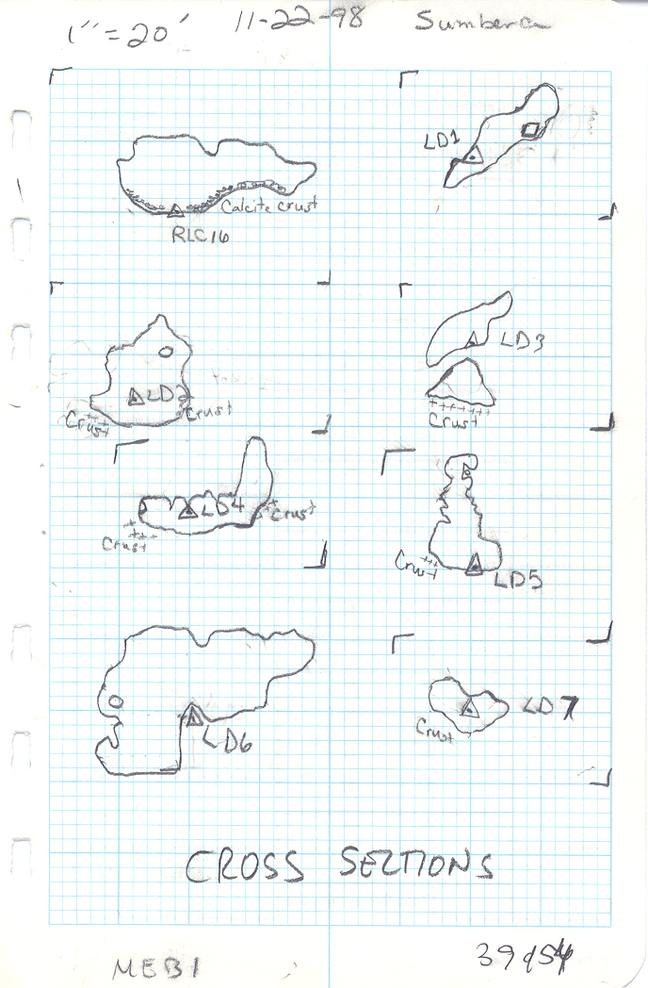
Cross-Sections

Slide 11
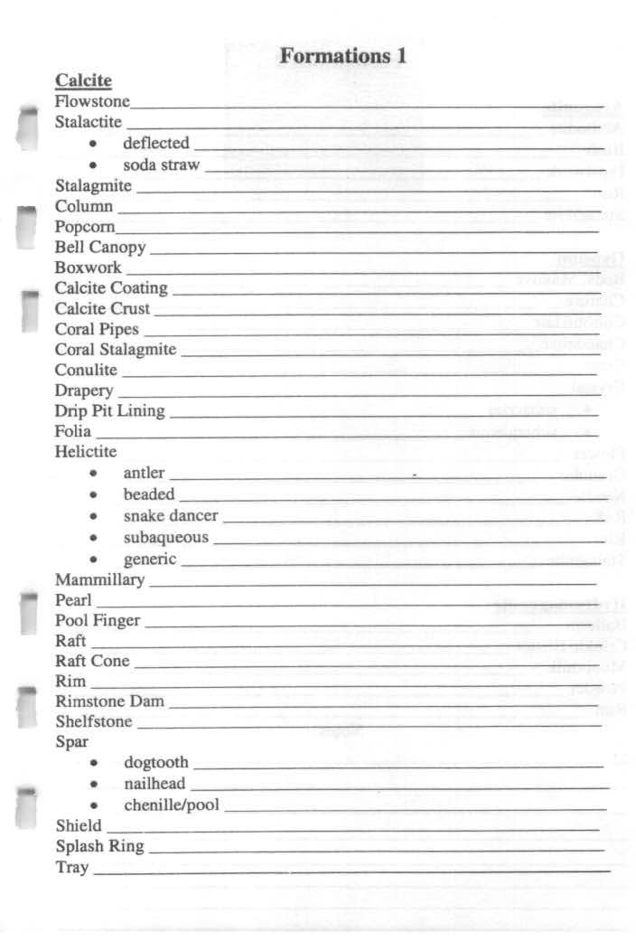
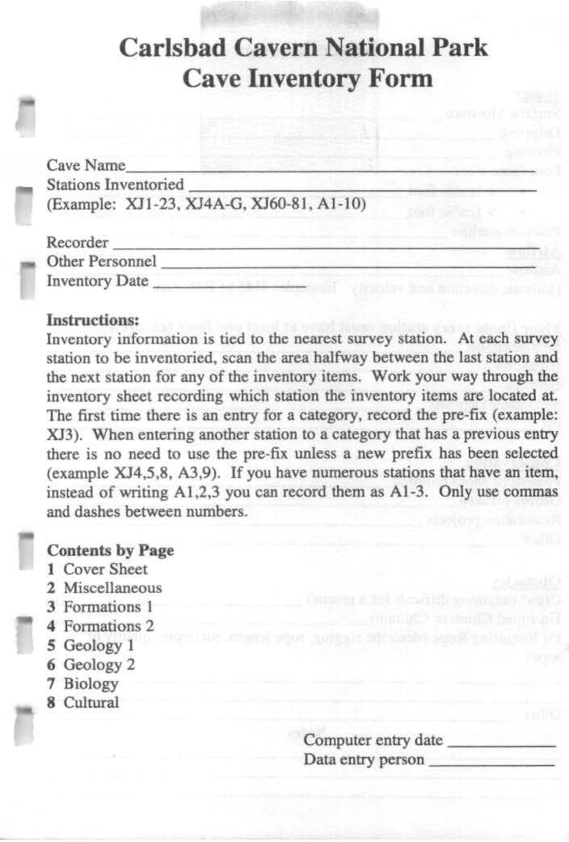
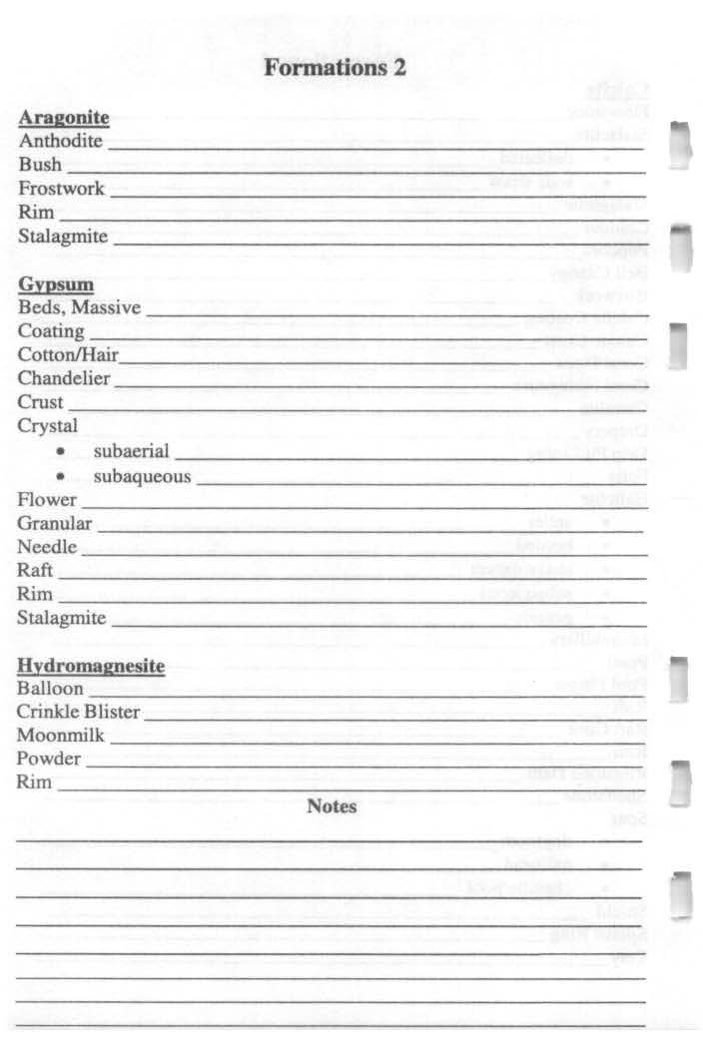
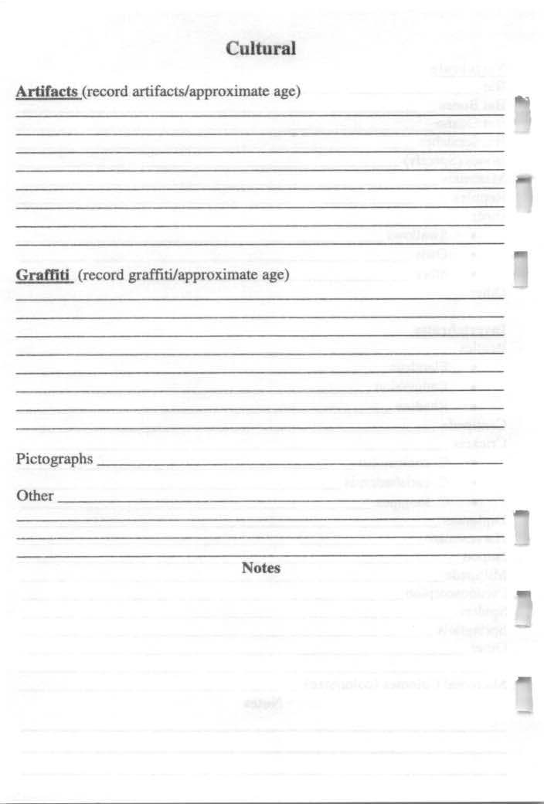
Cave Inventory
U.S. Department of the Interior Bureau of Land Management
Notes:
The cave inventory form used at Carlsbad Caverns. A very detailed form of features for the area. For each feature present list the nearest survey station. The data is then entered into Compass Database feature or entered into Excel spreadsheet. These inventories are often performed but in fluently used.

Slide 12
U.S. Department of the Interior Bureau of Land Management
Notes:
Entering the data into Compass cave survey program with the result plan view lineplot

Slide 13
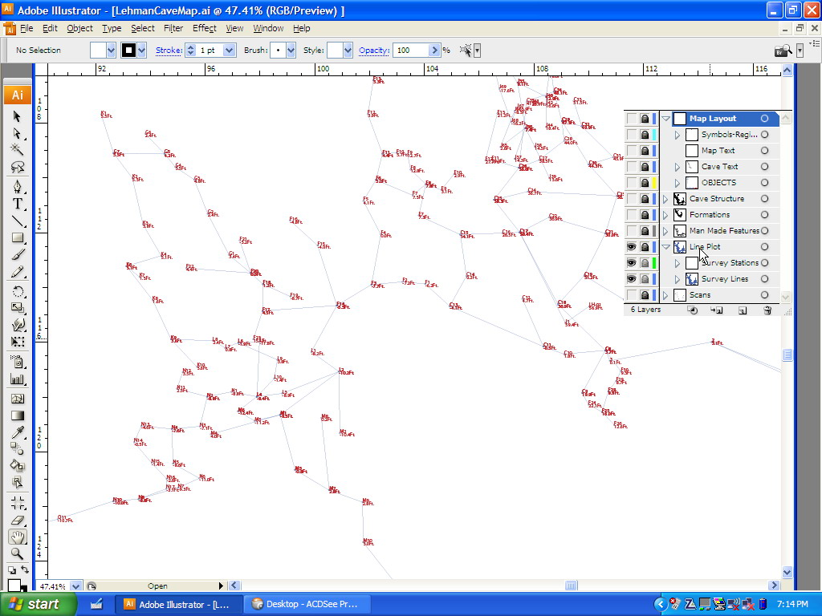
U.S. Department of the Interior Bureau of Land Management
Notes:
Illustrator with imported lineplot. Lineplot was scaled using scale bar imported with the lineplot and the programs rulers (converted to inches not the pixels as shown).

Slide 14
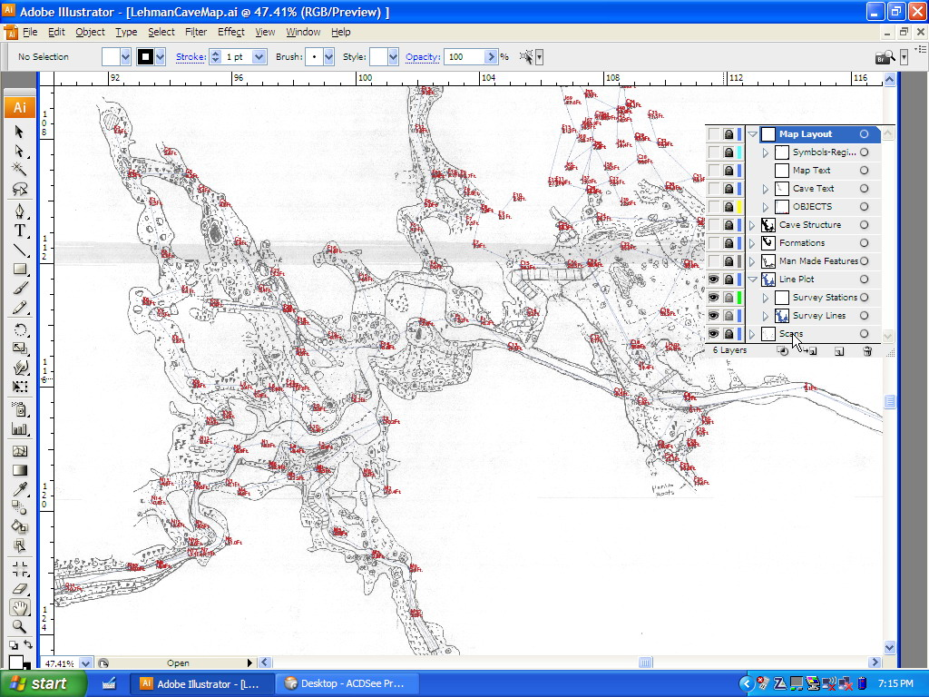
U.S. Department of the Interior Bureau of Land Management
Notes:
Importing and aligning the drafted sketch to the lineplot.

Slide 15
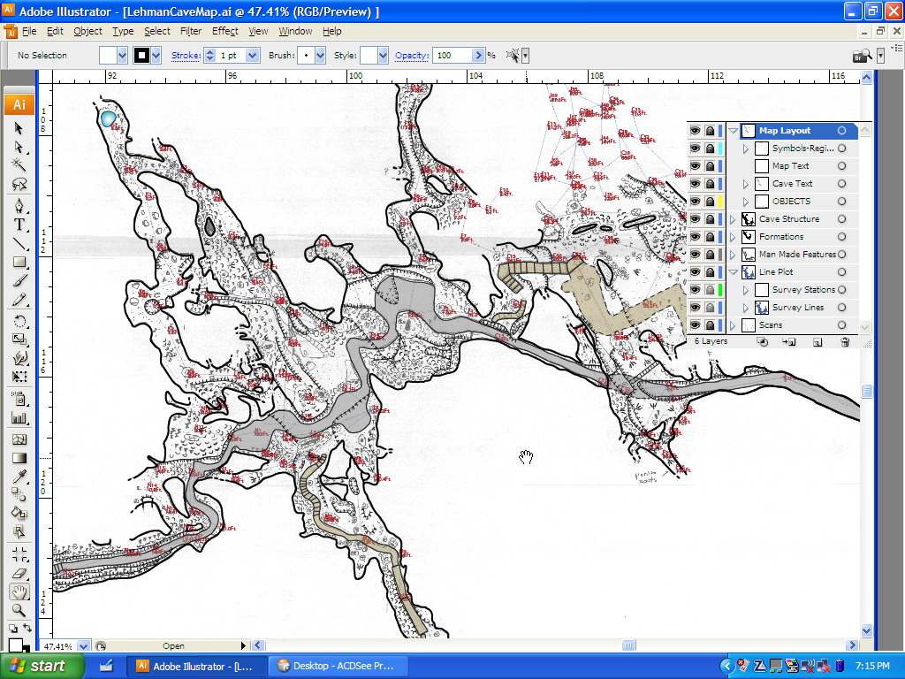
U.S. Department of the Interior Bureau of Land Management
Notes:
Drawing in the features

Slide 16
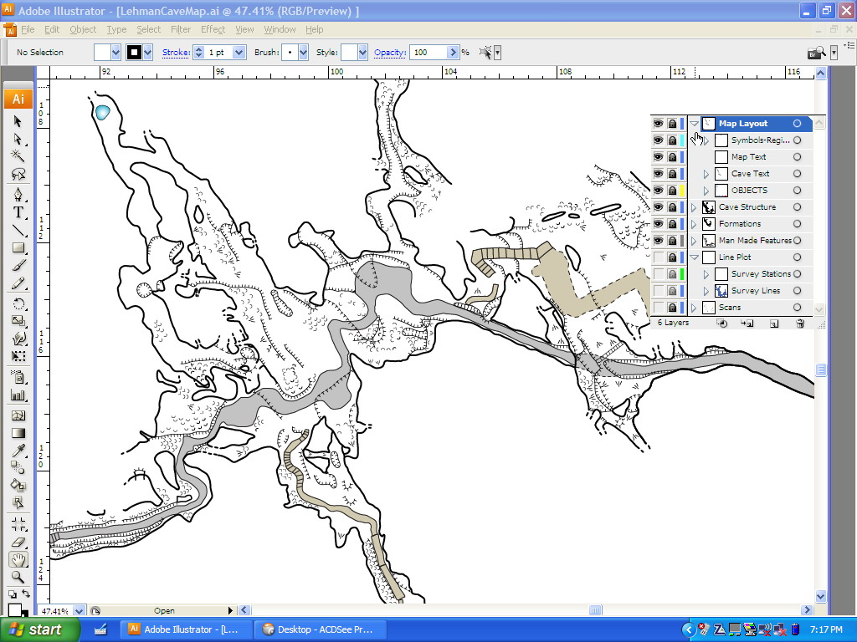
U.S. Department of the Interior Bureau of Land Management
Notes:
The resulting product. Seen with the base lineplot and draft map layer turned off.

Slide 17
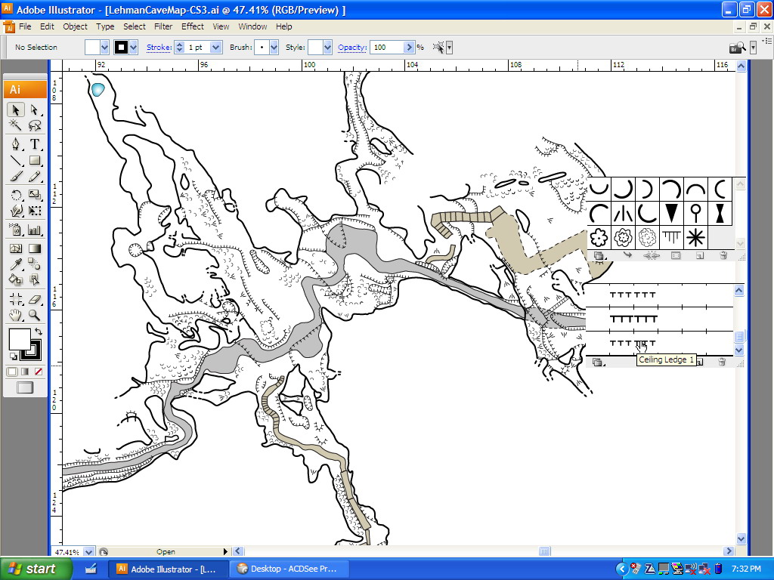
U.S. Department of the Interior Bureau of Land Management
Notes:
Showing the drawing tools that were created: cave symbols and cave-related lines.

Slide 18
How to manage cave surveys
U.S. Department of the Interior Bureau of Land Management
Obtain survey notes and maps from cavers as survey and cartography progresses (original/copies)
Wide range of management involvement in cave cartography
NSS, CRF and other caving organizations
Peer review of survey projects, especially in sensitive caves

Slide 19
U.S. Department of the Interior Bureau of Land Management
Notes:
Now a look at cave maps. Main Drain Cave Map with plan and profile views.

Slide 20
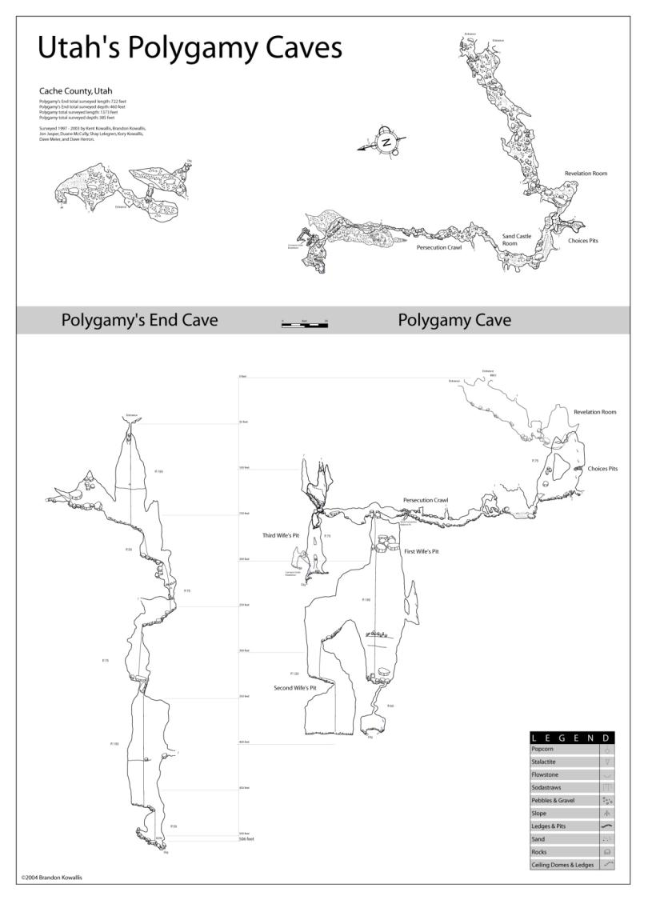
U.S. Department of the Interior Bureau of Land Management
Notes:
Polygamy caves. Two caves shown together on one map to help with exploration pushes.

Slide 21
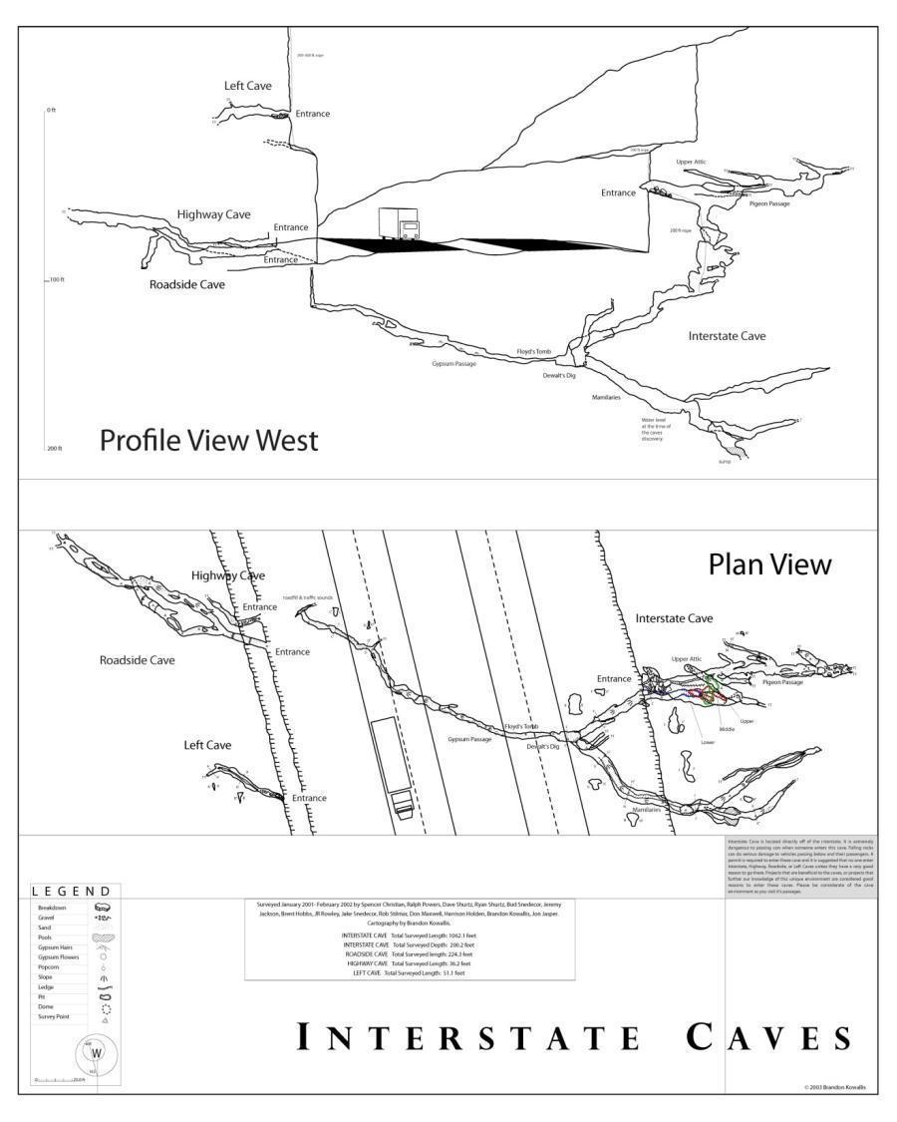
U.S. Department of the Interior Bureau of Land Management
Notes:
Interstate Cave. A cave found when a roadcut intersected it. The map shows how the cave goes underneath the expressway and is associate with the other caves on the other side.

Slide 22
U.S. Department of the Interior Bureau of Land Management
Notes:
Bloomington Cave map with trail marked on it.

Slide 23
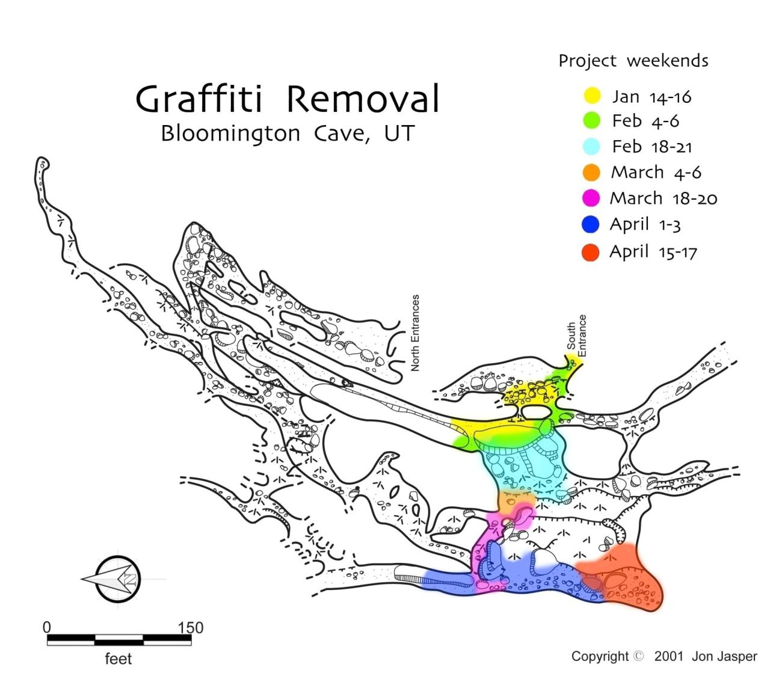
U.S. Department of the Interior Bureau of Land Management
Notes:
A 8.5 by 11 map of Bloomington Cave to show progress of removing graffiti

Slide 24
U.S. Department of the Interior Bureau of Land Management

Slide 25
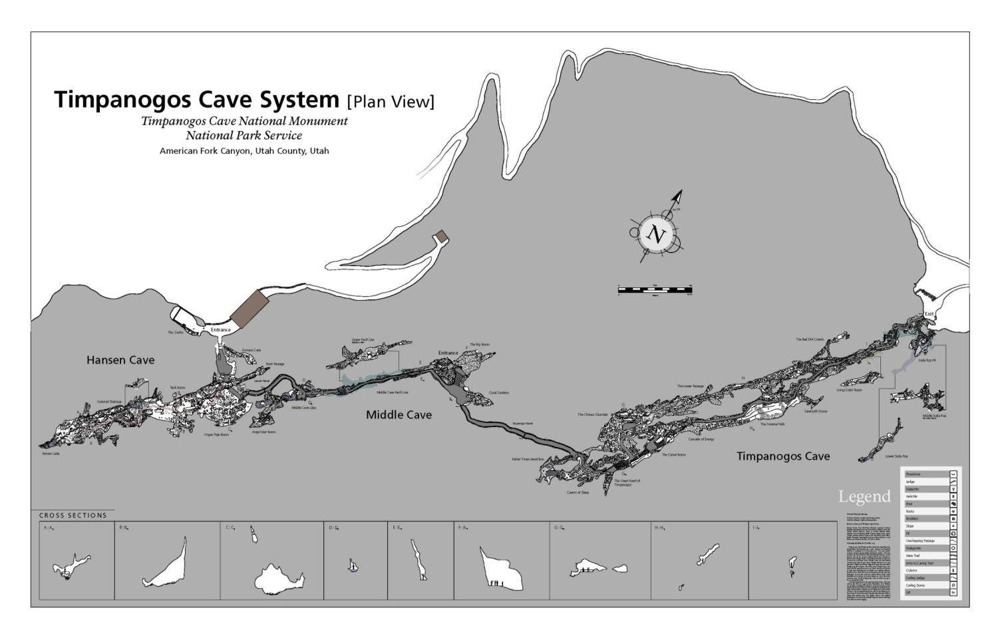
U.S. Department of the Interior Bureau of Land Management
Notes:
Plan view of Timpanogos Cave System

Slide 26
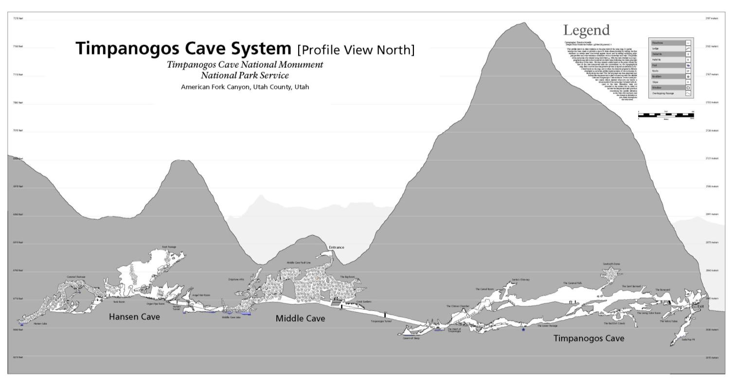
U.S. Department of the Interior Bureau of Land Management
Notes:
Profile view of Timpanogos where the surface is created from a cross-sections data created in GIS. All of the unique formations areas in the caves occur under the deeps parts of the cave.

Slide 27
Interpretative Maps
U.S. Department of the Interior Bureau of Land Management
Notes:
Using layers detail can be removed to create a version for an interpretative display.

Slide 28
U.S. Department of the Interior Bureau of Land Management
For Interpretative Displays
Notes:
The resulting product placed into the Visitor Center at Timpanogos Cave National Monument. This display is about 12 ft long.

Slide 29
U.S. Department of the Interior Bureau of Land Management
Notes:
Then map was then cut up to sections to create a map atlas

Slide 30
U.S. Department of the Interior Bureau of Land Management
Notes:
How the map was divided into pages

Slide 31
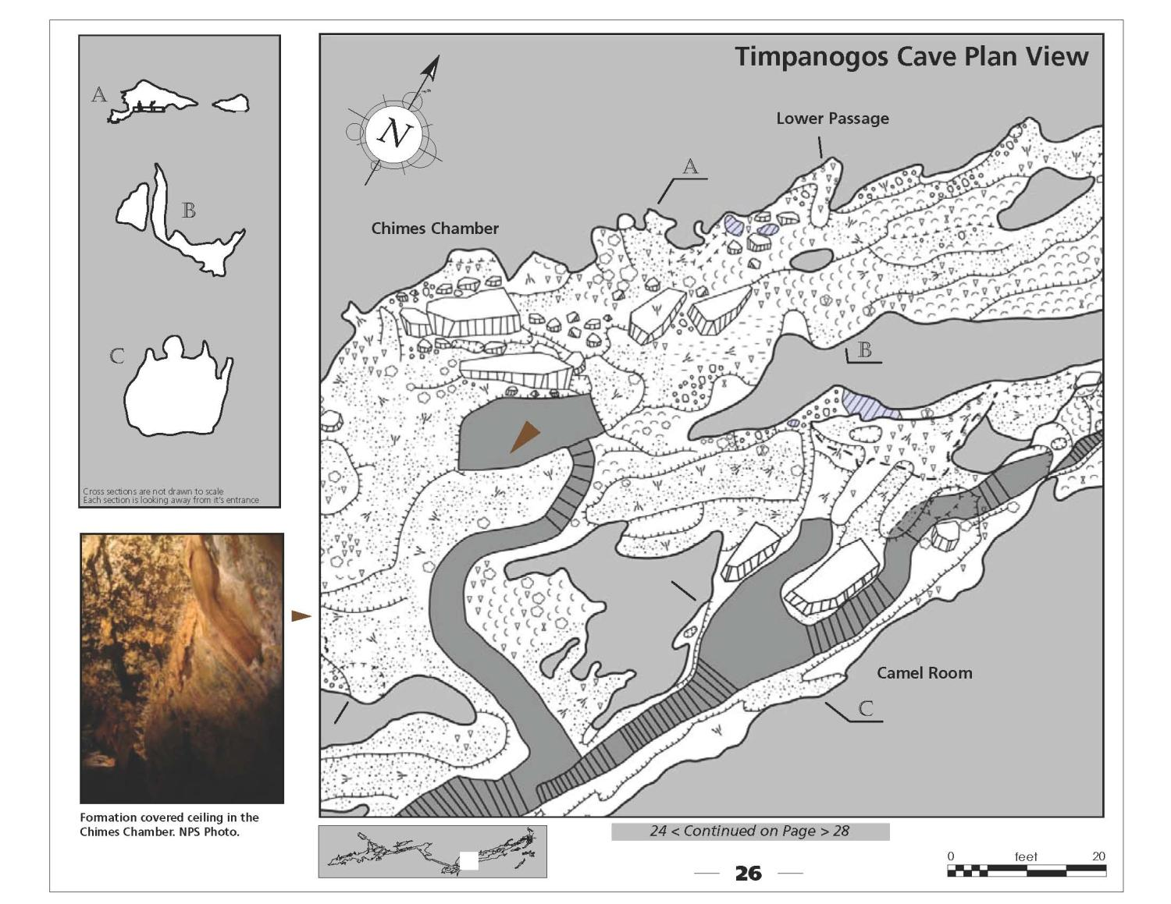
U.S. Department of the Interior Bureau of Land Management
Notes:
Example map page. Each page had cross-sections, representative photos for the mapped area, and location key. This atlas was laminated so that it could be written on with erase markers. Simple way of doing cave inventory while carrying just a small booklet.

Slide 32
Using GIS to incorporate multiple sources of data
U.S. Department of the Interior Bureau of Land Management
Basic topographic overlays
Inventory caves within GIS - ArcPAD
Adding other data sources
Aerial photos
Hydrology
Geology
Land uses
Using 3D visualizations
Using with Avenza
Notes:
Cave data and GIS

Slide 33
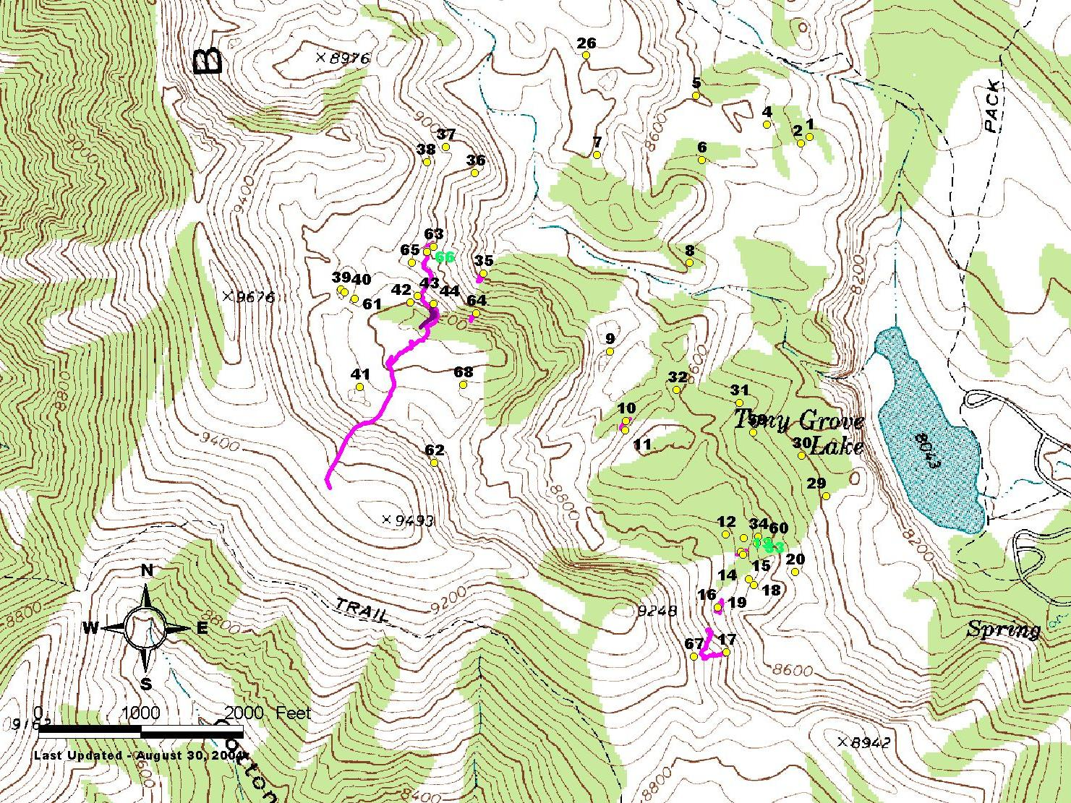
U.S. Department of the Interior Bureau of Land Management
Notes:
Tony Grove map created with GIS

Slide 34
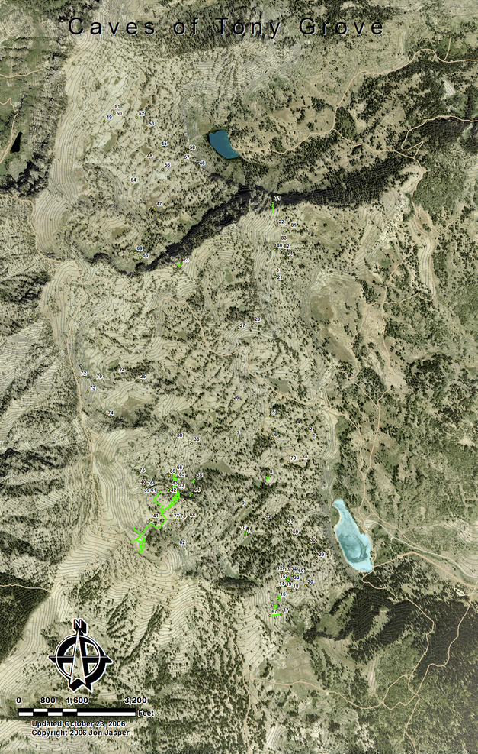
U.S. Department of the Interior Bureau of Land Management
Notes:
Same Tony Grove map with aerial photography, contours lines, cave locations, and cave surveys

Slide 35
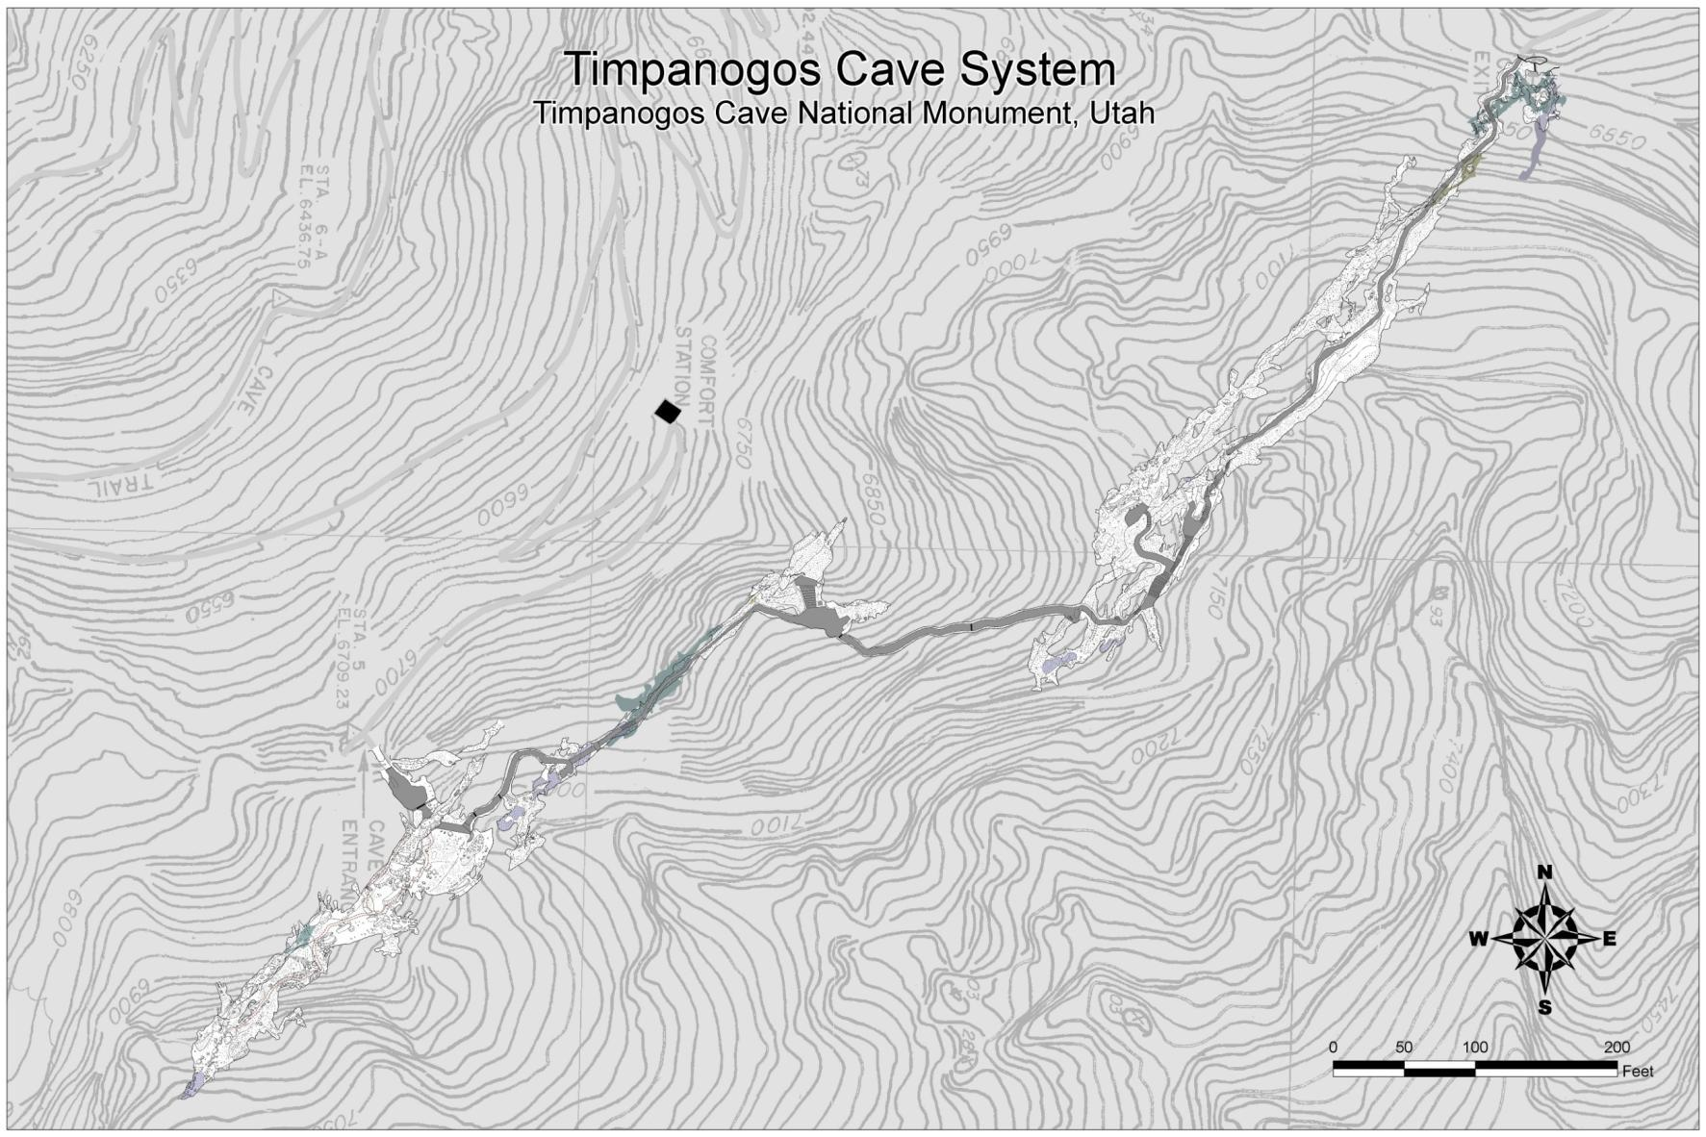
U.S. Department of the Interior Bureau of Land Management
Notes:
Map of Timpanogos Cave with a 10 contour map. Contour map was converted into a Digital Terrain Model (DTM) to accurately create the hillside of the profile view

Slide 36
U.S. Department of the Interior Bureau of Land Management
Notes:
Profile view of Timpanogos where the surface is created from a cross-sections data created in GIS. All of the unique formations areas in the caves occur under the deeps parts of the cave.

Slide 37
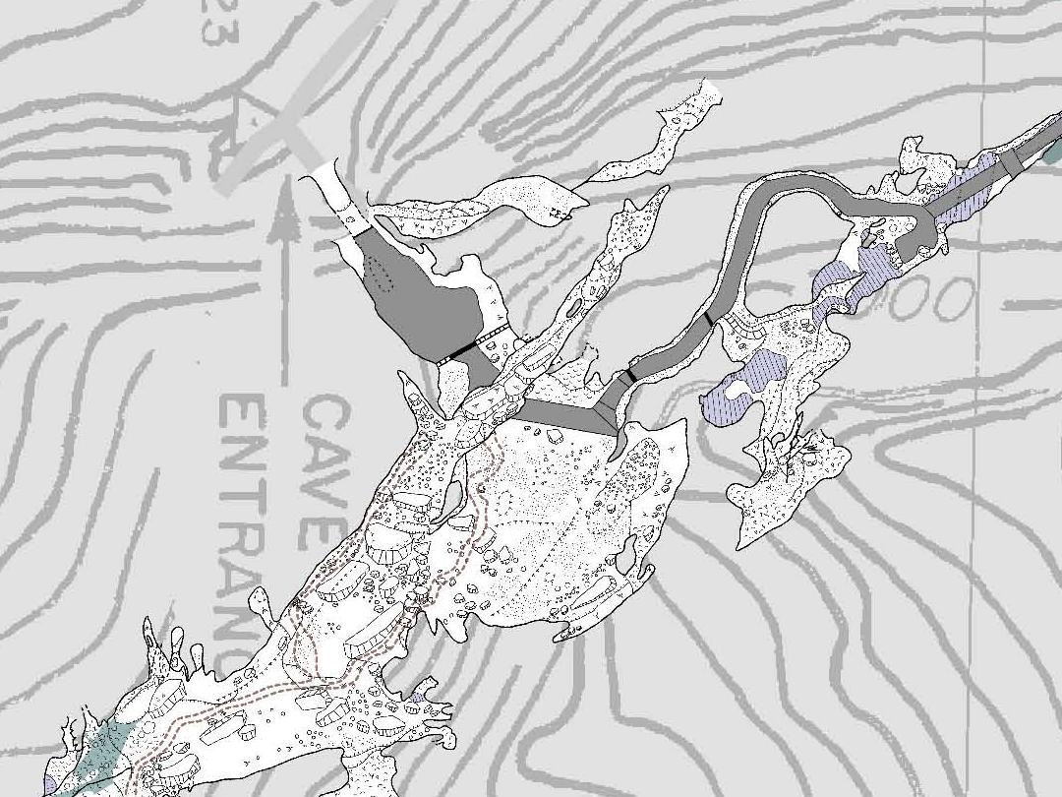
U.S. Department of the Interior Bureau of Land Management
Notes:
Close up to the Hansen Cave Entrance area. Show the detail of the cave map used to inventory cave features.

Slide 38
U.S. Department of the Interior Bureau of Land Management
Notes:
Map tracking the areas cleaned or restored throughout Timpanogos Cave
Using georeferenced map of the Timpanogos Cave, we are keeping track of the cave cleaning and restoration efforts.

Slide 39
Chosa Draw Caves
U.S. Department of the Interior Bureau of Land Management
Parks Ranch – 4.18 miles
Skylight Cave – 0.35 miles
Resurgence Cave – 0.27 miles
Yoda Cave – 0.19 miles
Son of a Gun Cave – 0.16 miles
Skull Cave – 0.04 miles
Cow Cave – 0.03 miles
TOTAL = 5.22 miles

Slide 40
U.S. Department of the Interior Bureau of Land Management
Notes:
With cave surveys added

Slide 41
U.S. Department of the Interior Bureau of Land Management
Notes:
With cave and karst features added

Slide 42
U.S. Department of the Interior Bureau of Land Management
Notes:
With 300 ft and 200 meter buffers around cave passages

Slide 43
U.S. Department of the Interior Bureau of Land Management
Grange Gas Well
Notes:
With 300 ft and 200 meter buffer around cave and karst features.

Slide 44
U.S. Department of the Interior Bureau of Land Management
Grange Gas Well
Notes:
The Oil and Gas leased areas with the Chosa Draw. The inter blue border is the No Surface Occupacy area (NSO) where no surface disturbance is allowed, however can angular drill into. Grange well just drilled in

Slide 45
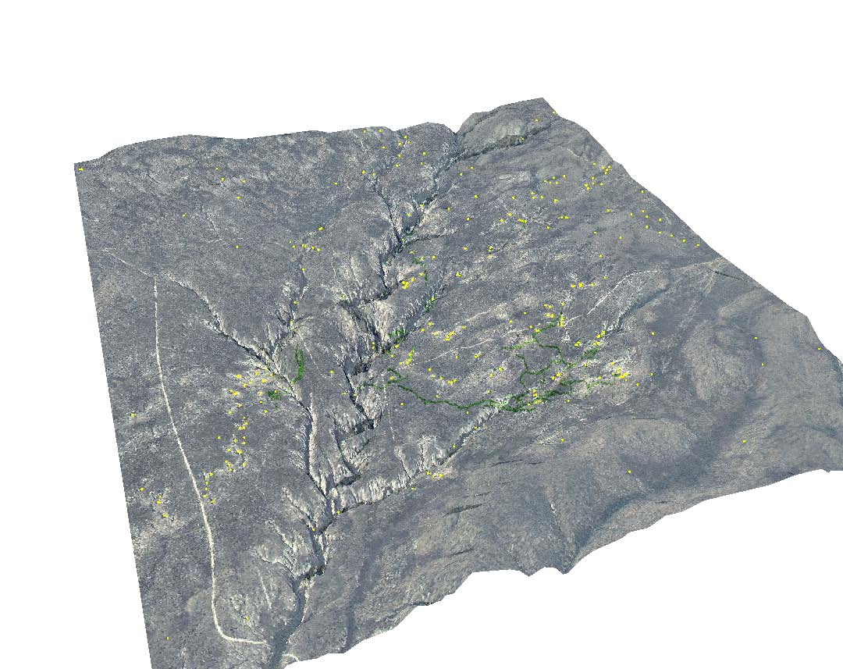
U.S. Department of the Interior Bureau of Land Management
Notes:
3D view showing the Chosa Draw with cave passages and karst features.

Slide 46
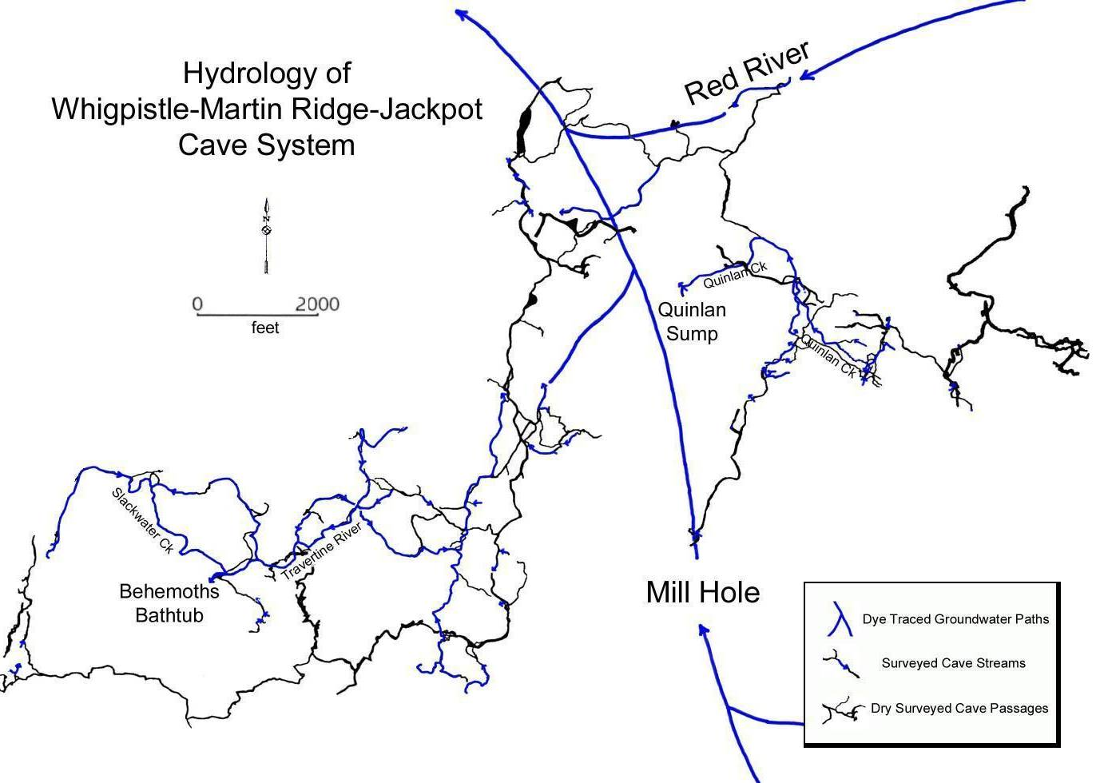
Hydrology
U.S. Department of the Interior Bureau of Land Management
Notes:
Hydrology showing all of the cave stream and flow direction plus regional flow paths. Figures created for my Masters, Geomorphic History of Martin Ridge Cave, KY.

Slide 47
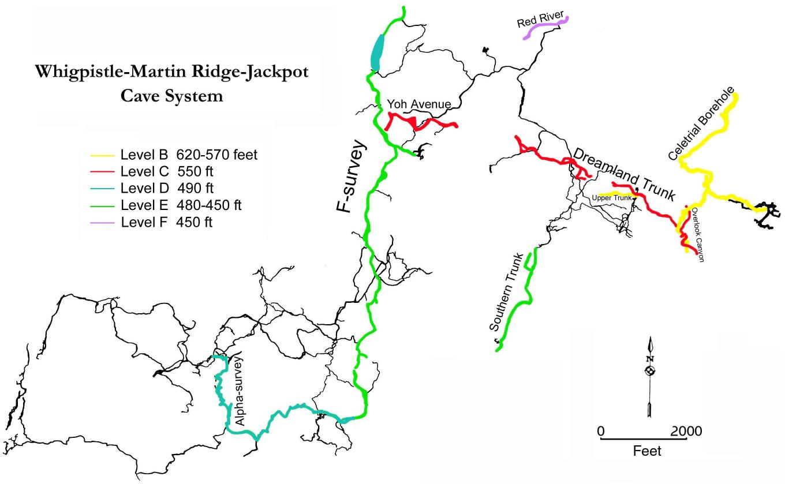
Cave Levels
U.S. Department of the Interior Bureau of Land Management
Notes:
Map showing cave levels. Notice the red passage segmented by downcutting valleys. The middle section was discovered using the cave data. It could have been found while survey if Auriga was used.

Slide 48
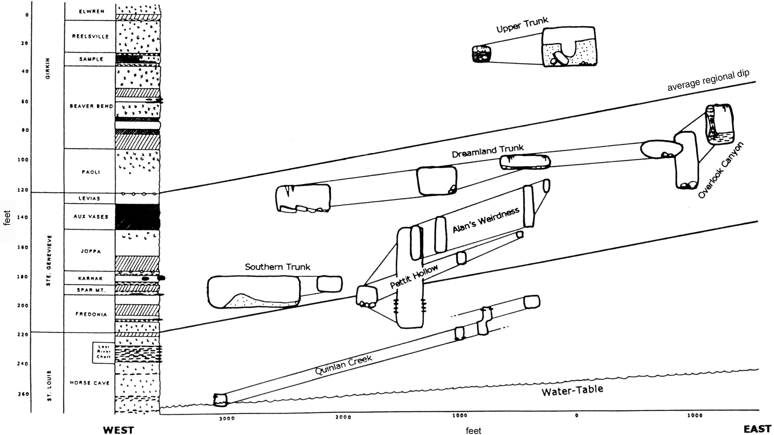
Geology
U.S. Department of the Interior Bureau of Land Management
Notes:
Diagram created with cave data showing how geology and water table relates to passage morphology.

Slide 49
Conclusions
U.S. Department of the Interior Bureau of Land Management
Get in contact with Caver Surveyors and use your imagination
Notes:
My contact information and video tutorials

