Slide 1
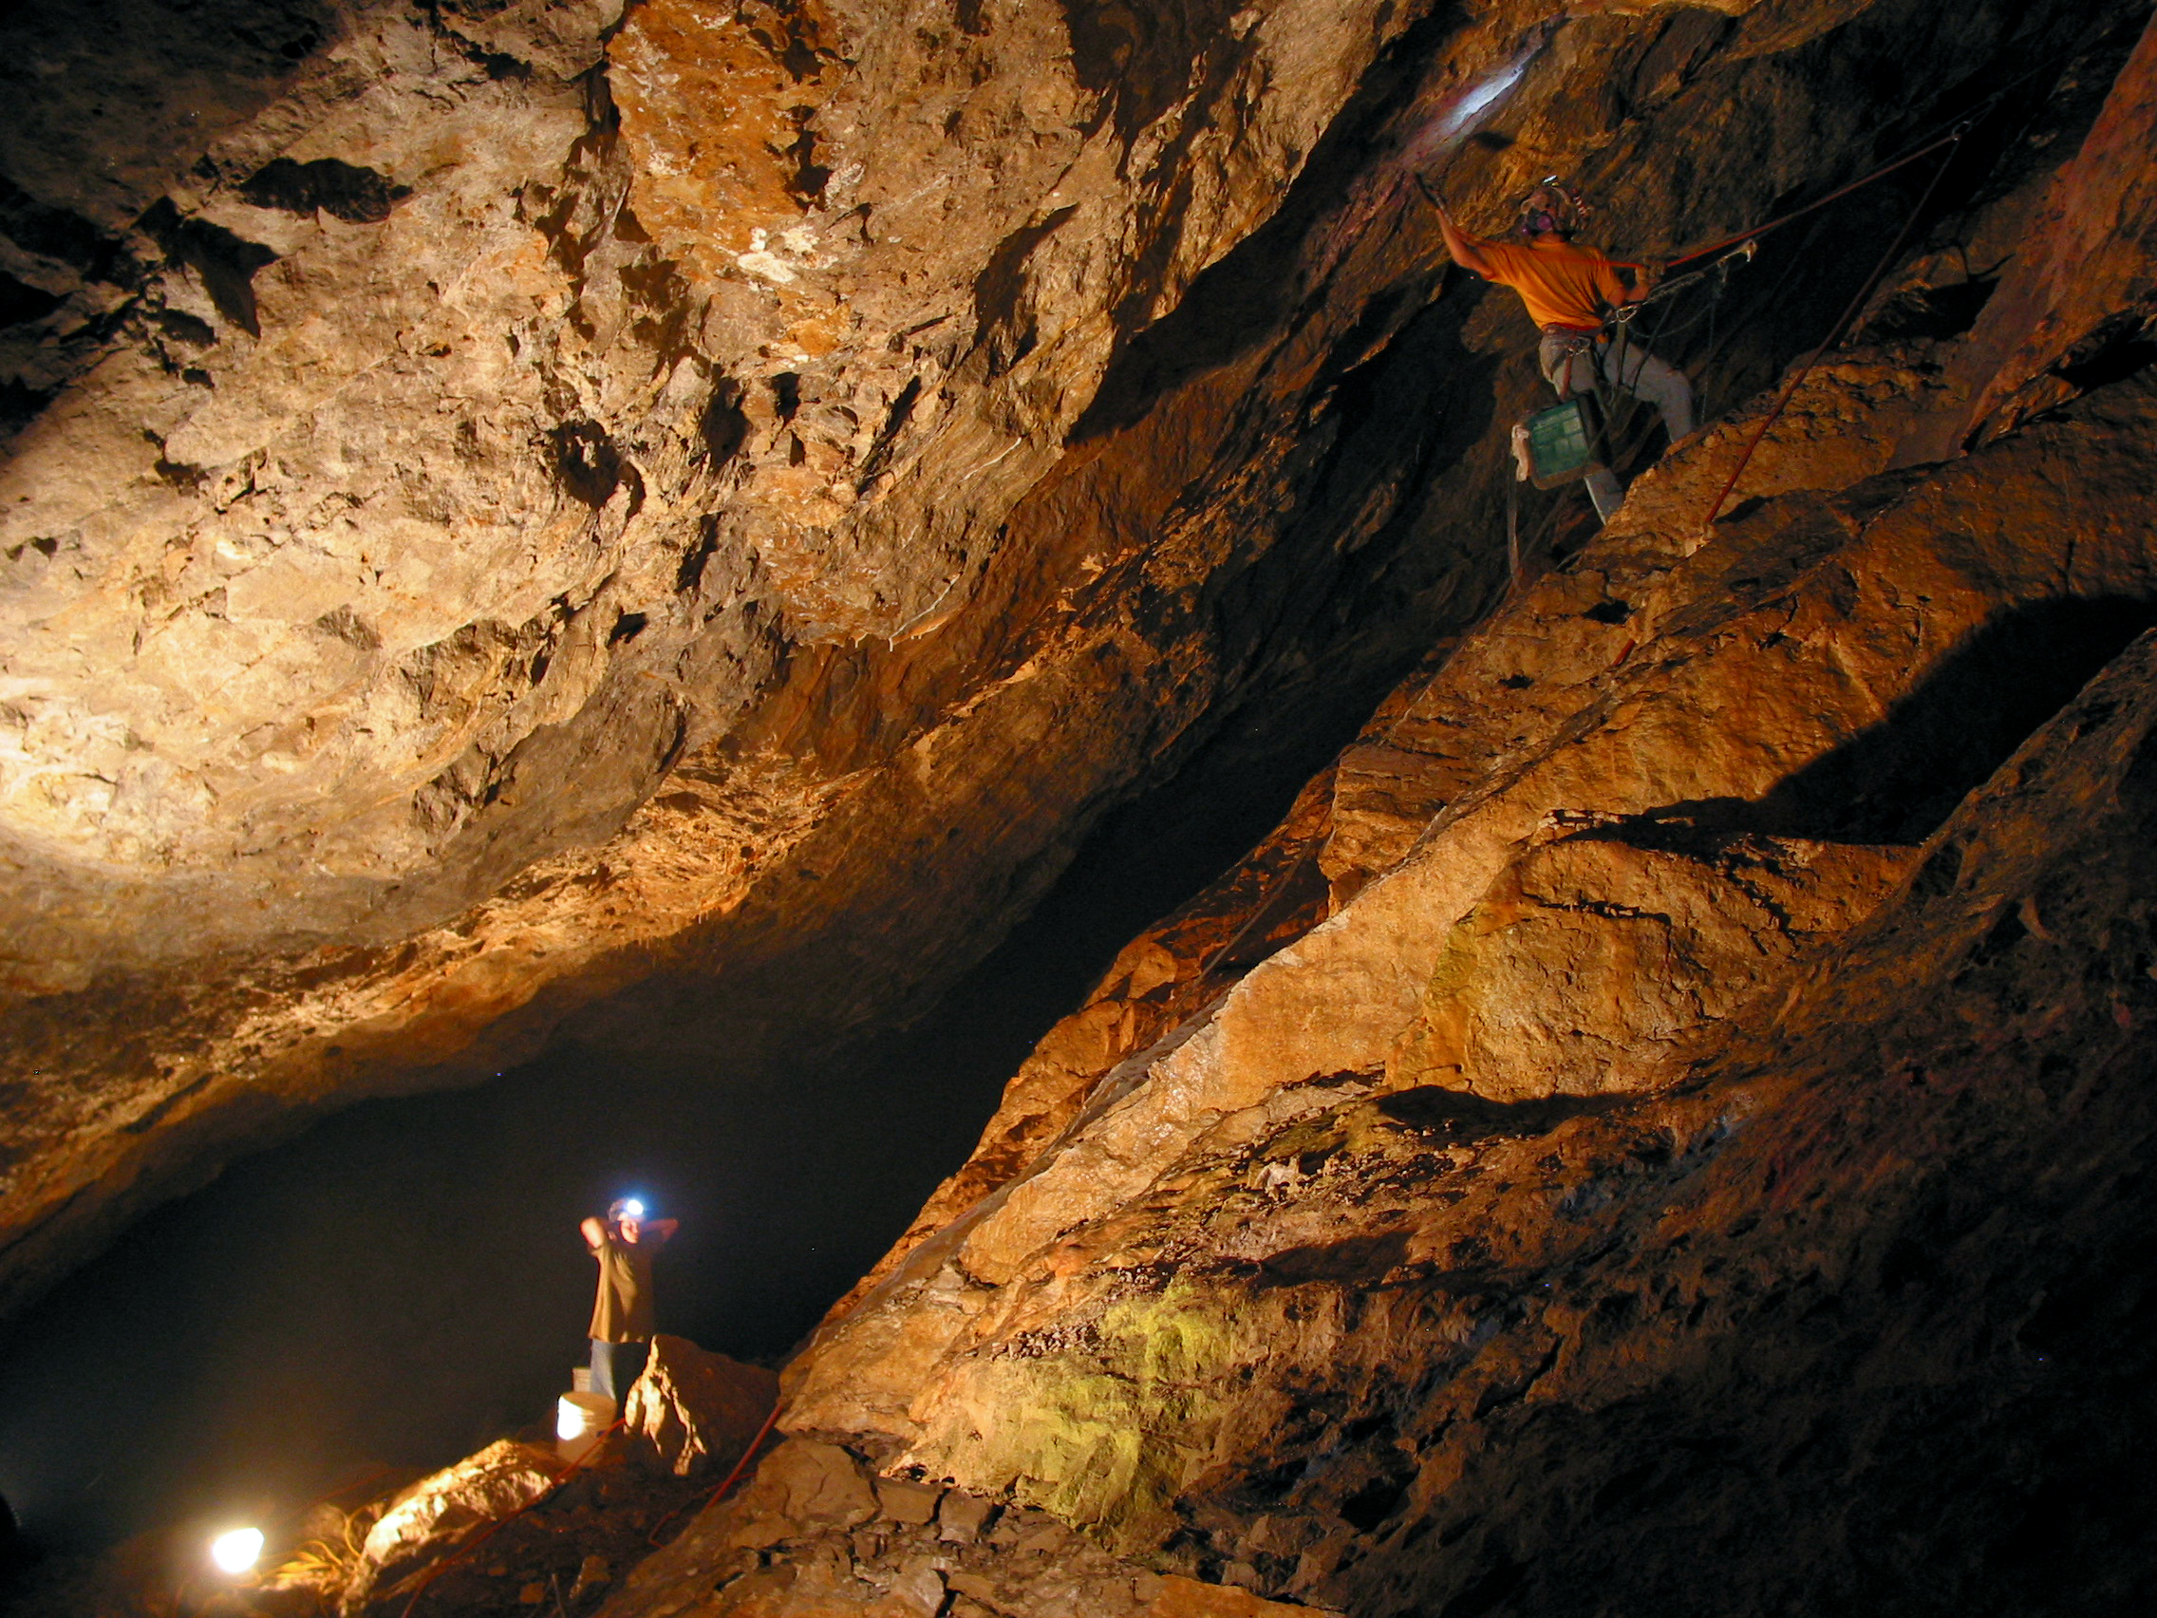
Cave Projects
U.S. Department of the Interior Bureau of Land Management
Notes:
Photo from Bloomington Cave

Slide 2
U.S. Department of the Interior Bureau of Land Management

Slide 3
U.S. Department of the Interior Bureau of Land Management
Gating and creating permitting systems
Removing graffiti
Studying bats
Designing kiosks
Performing carbon dating
Performing biologic inventories
Performing paleologic inventories
Environmental and hydrologic monitoring
Studying visitation
Studying microbes
Studying climate change using speleothems

Slide 4
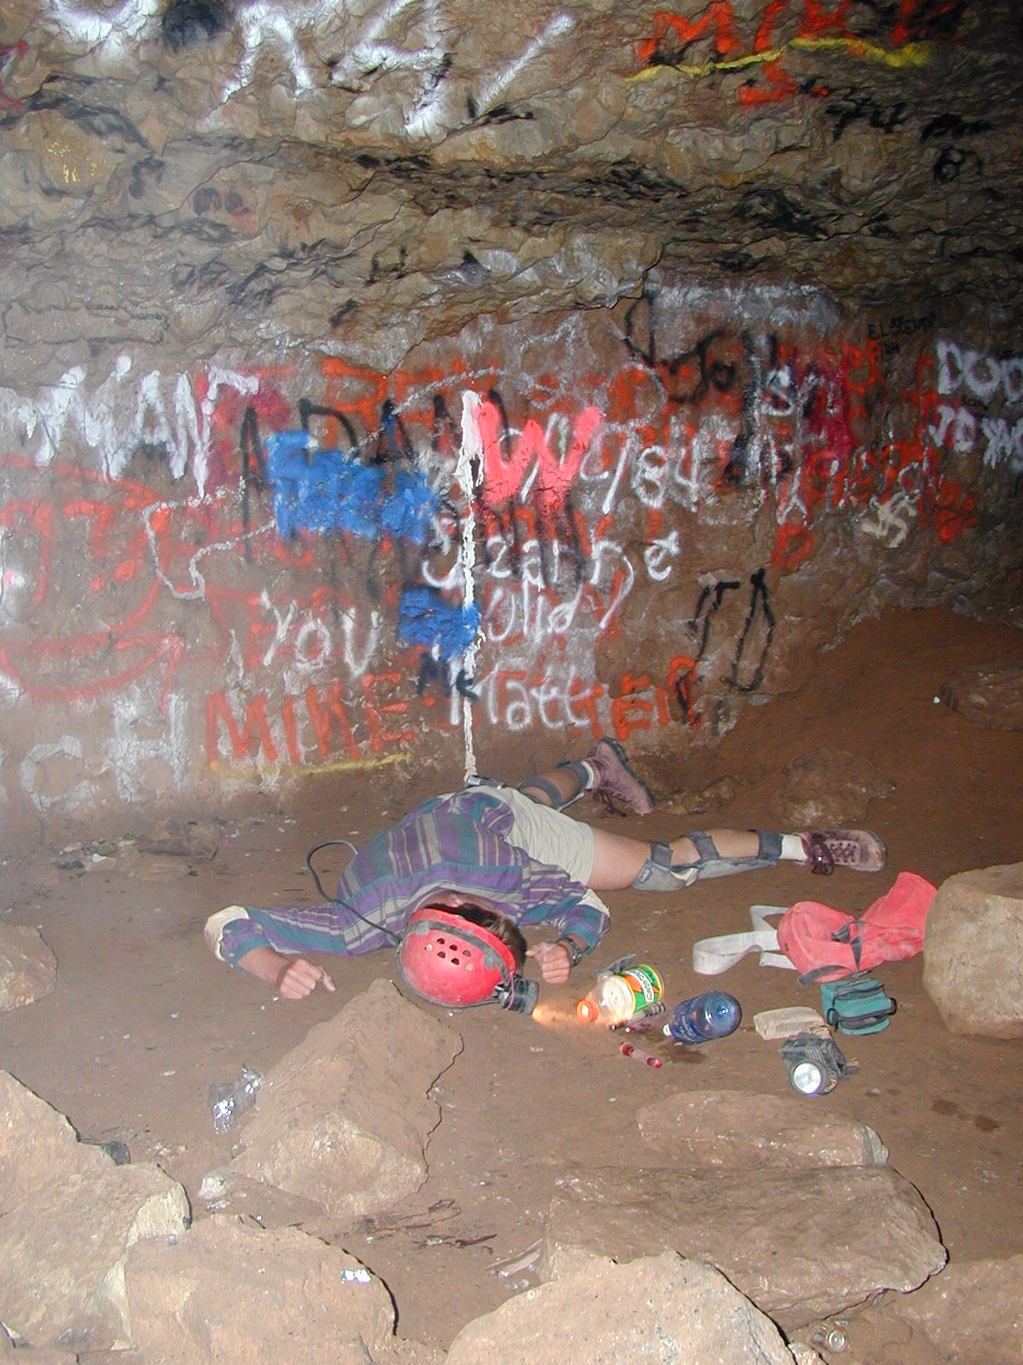
Reenactment of the “good olde days”
U.S. Department of the Interior Bureau of Land Management
Notes:
Reenactment of what we believed went on in Bloomington Cave.

Slide 5
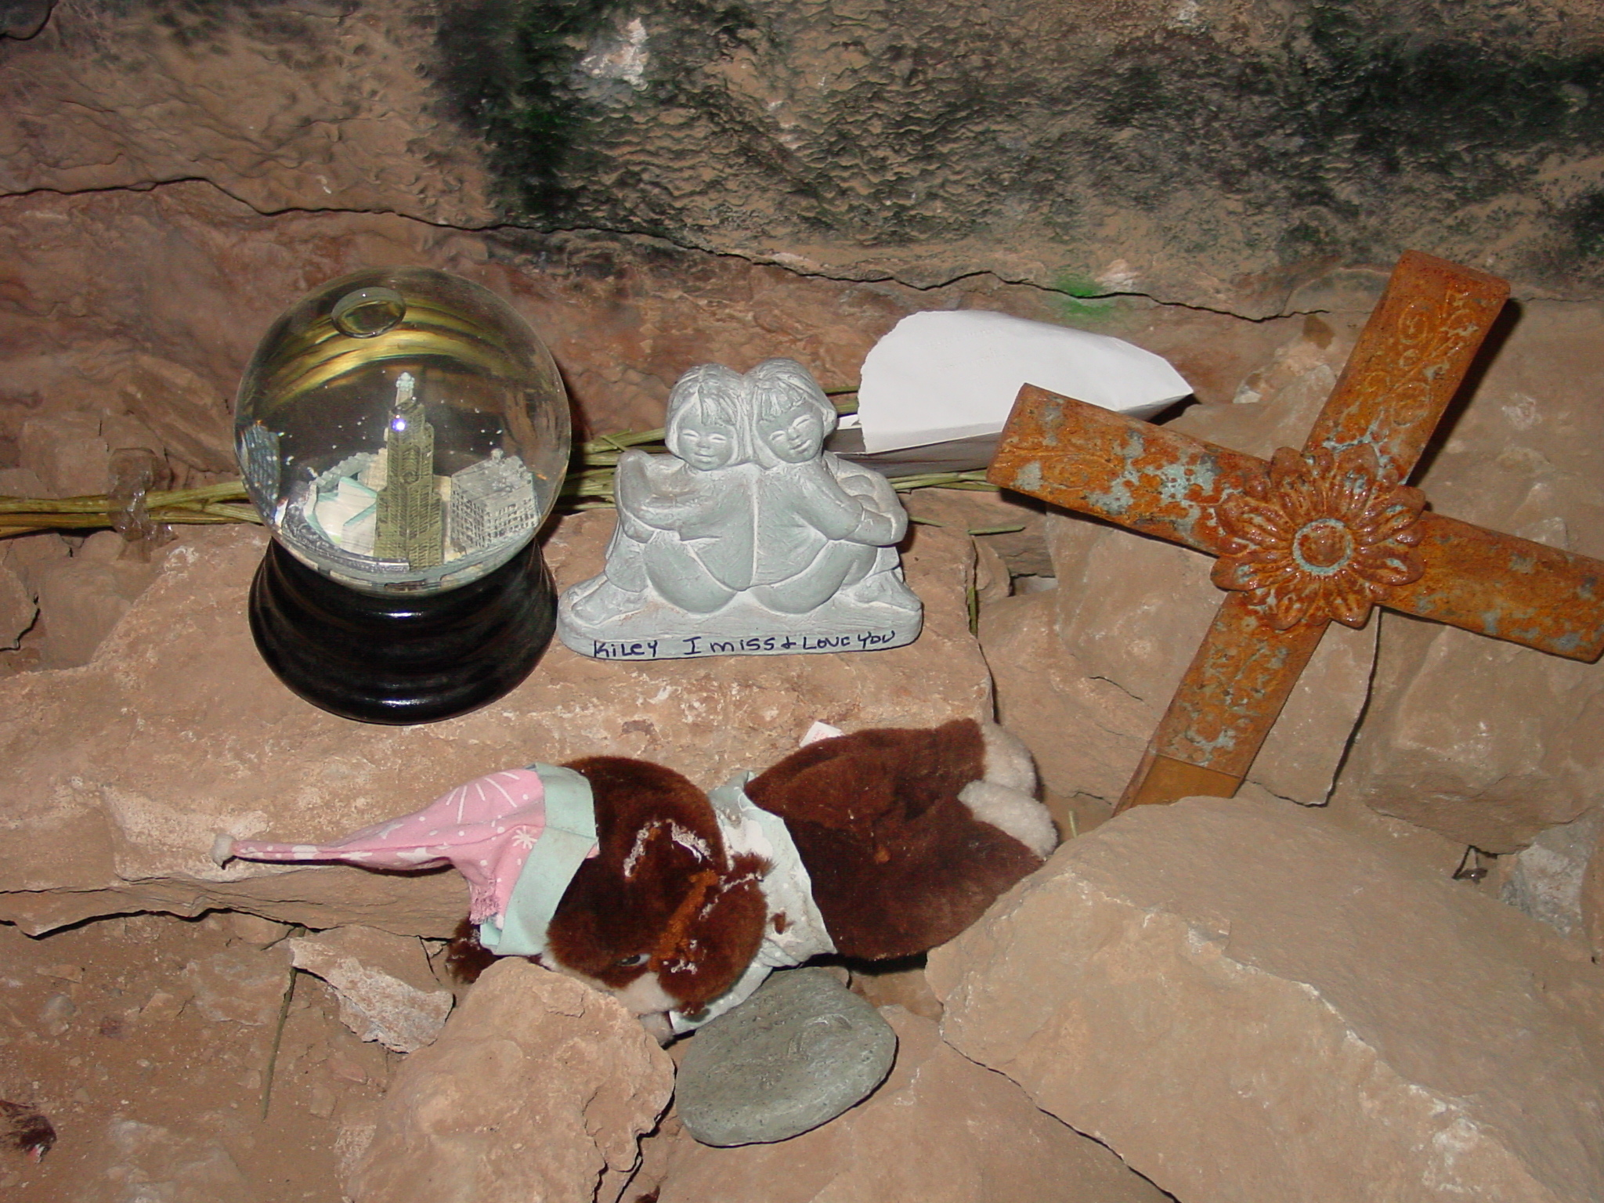
Kiley Shine
U.S. Department of the Interior Bureau of Land Management
Notes:
Death in 2002 December 24

Slide 6
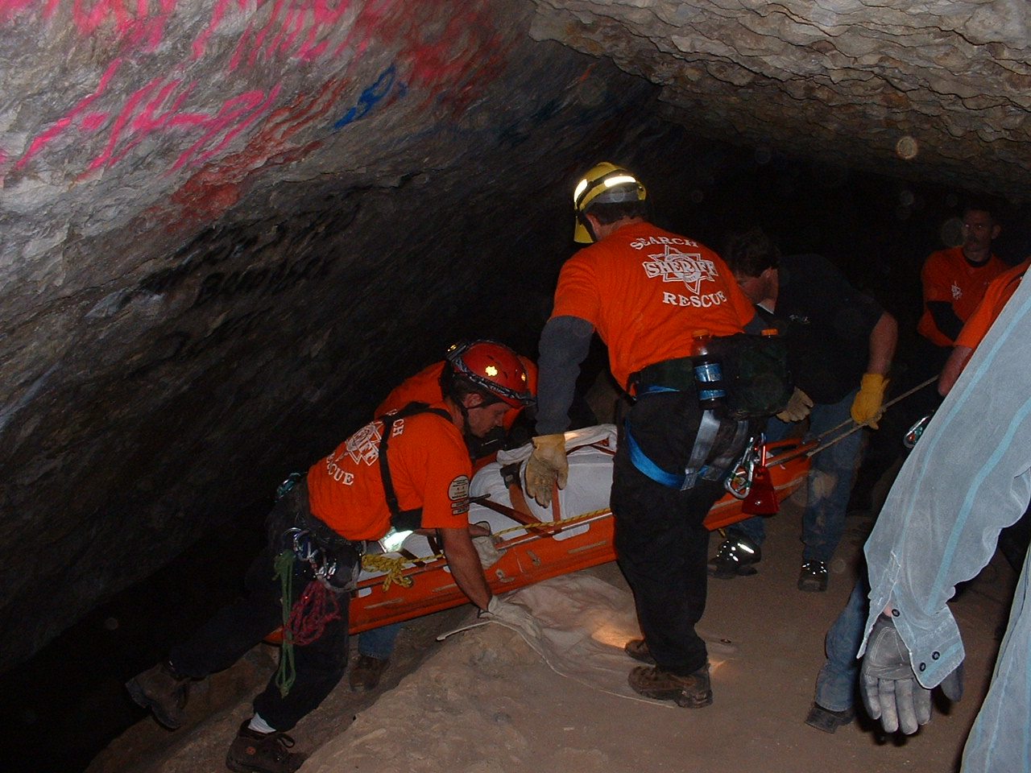
Kiley incident
U.S. Department of the Interior Bureau of Land Management
Notes:
2002 December 24

Slide 7
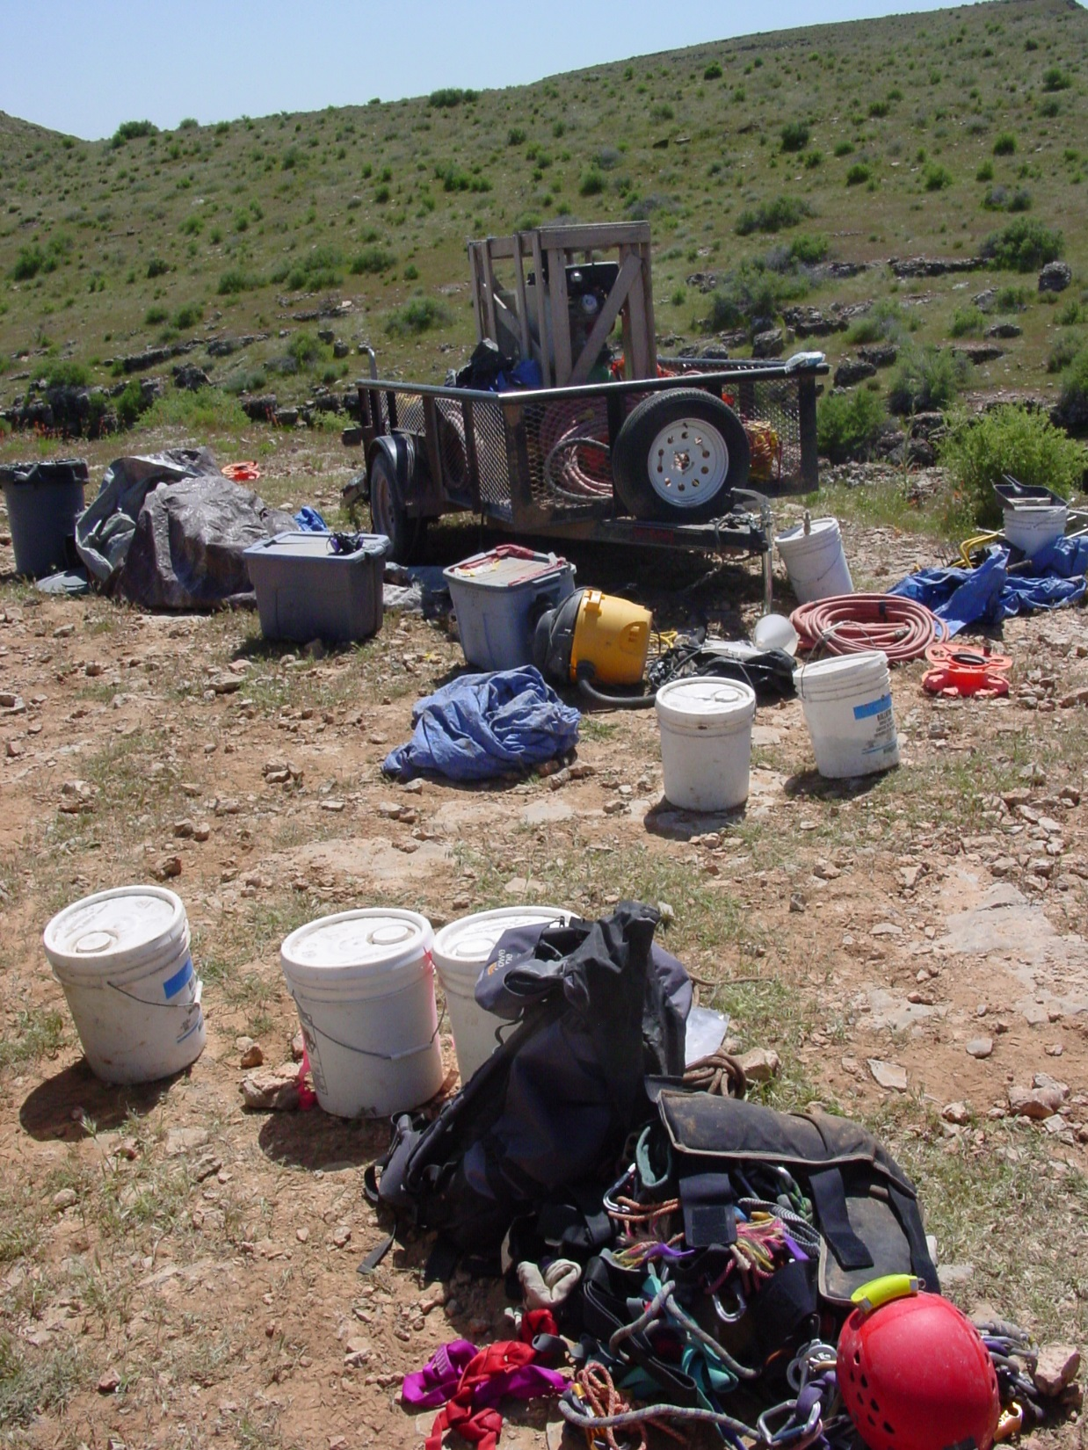
Graffiti removal using sandblasting
U.S. Department of the Interior Bureau of Land Management
Notes:
Air Compressor for sandblasting

Slide 8
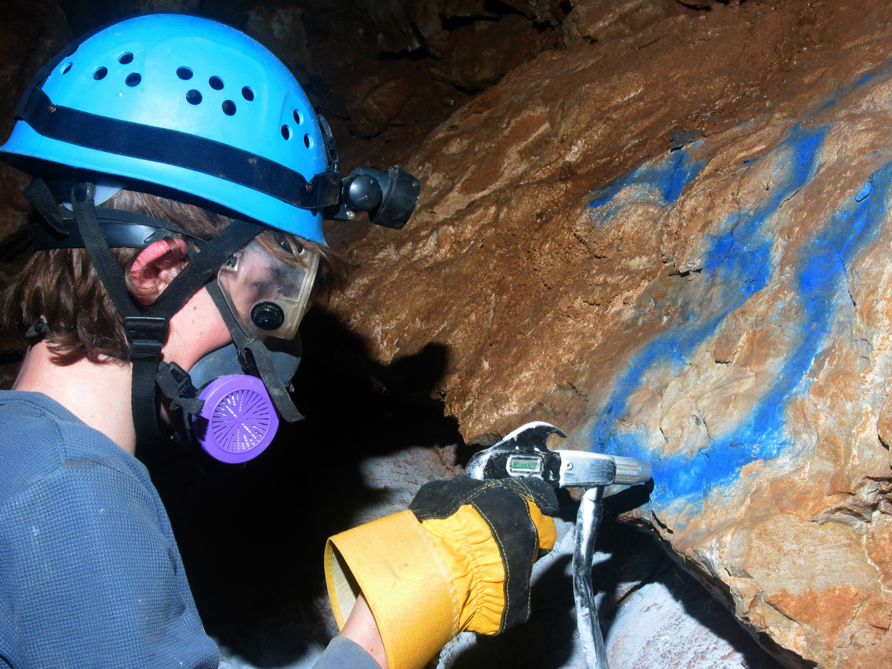
Sandblasting
U.S. Department of the Interior Bureau of Land Management
Notes:
The equipment – gun, gloves, respirator, googles, helmet, and lights

Slide 9
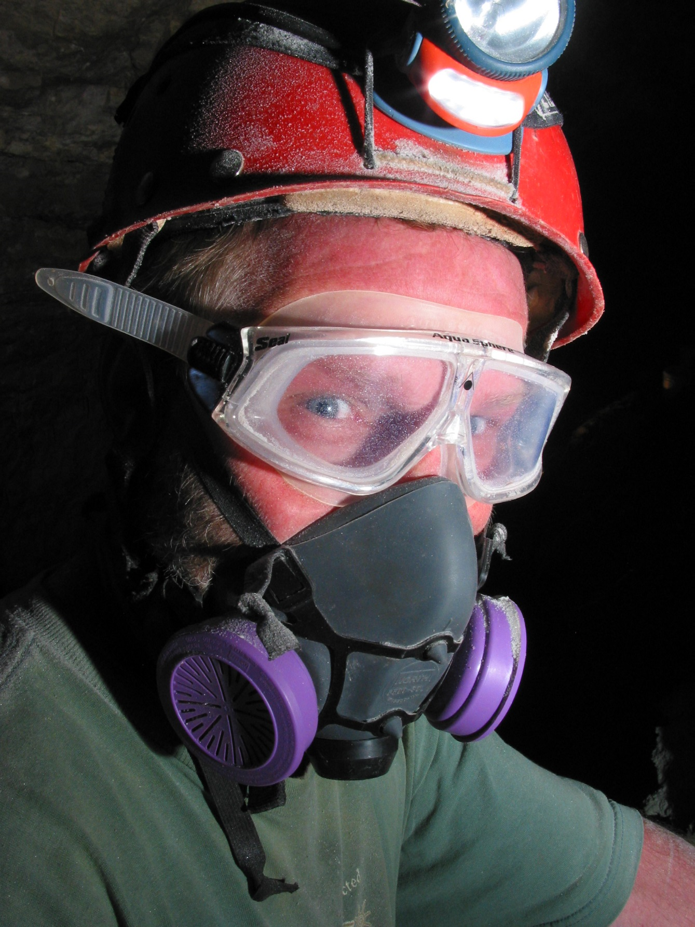
Sandblasting gear
U.S. Department of the Interior Bureau of Land Management
Notes:
The equipment – respirator, googles, helmet, and lights

Slide 10
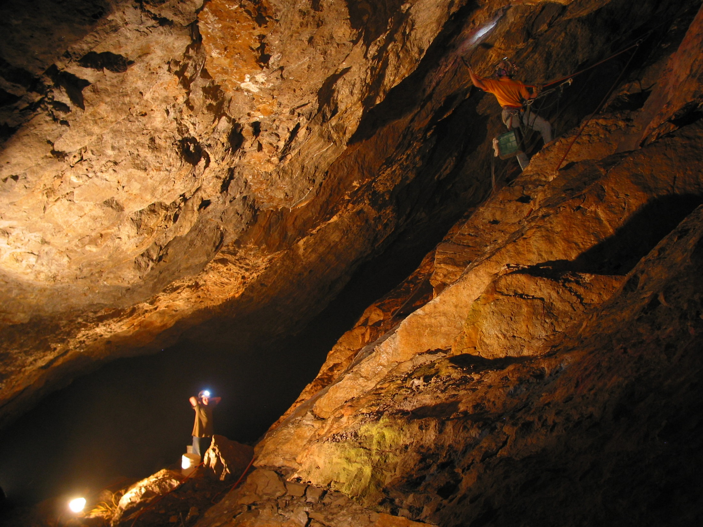
Sandblasting
U.S. Department of the Interior Bureau of Land Management
Notes:
Working in the Big Room

Slide 11
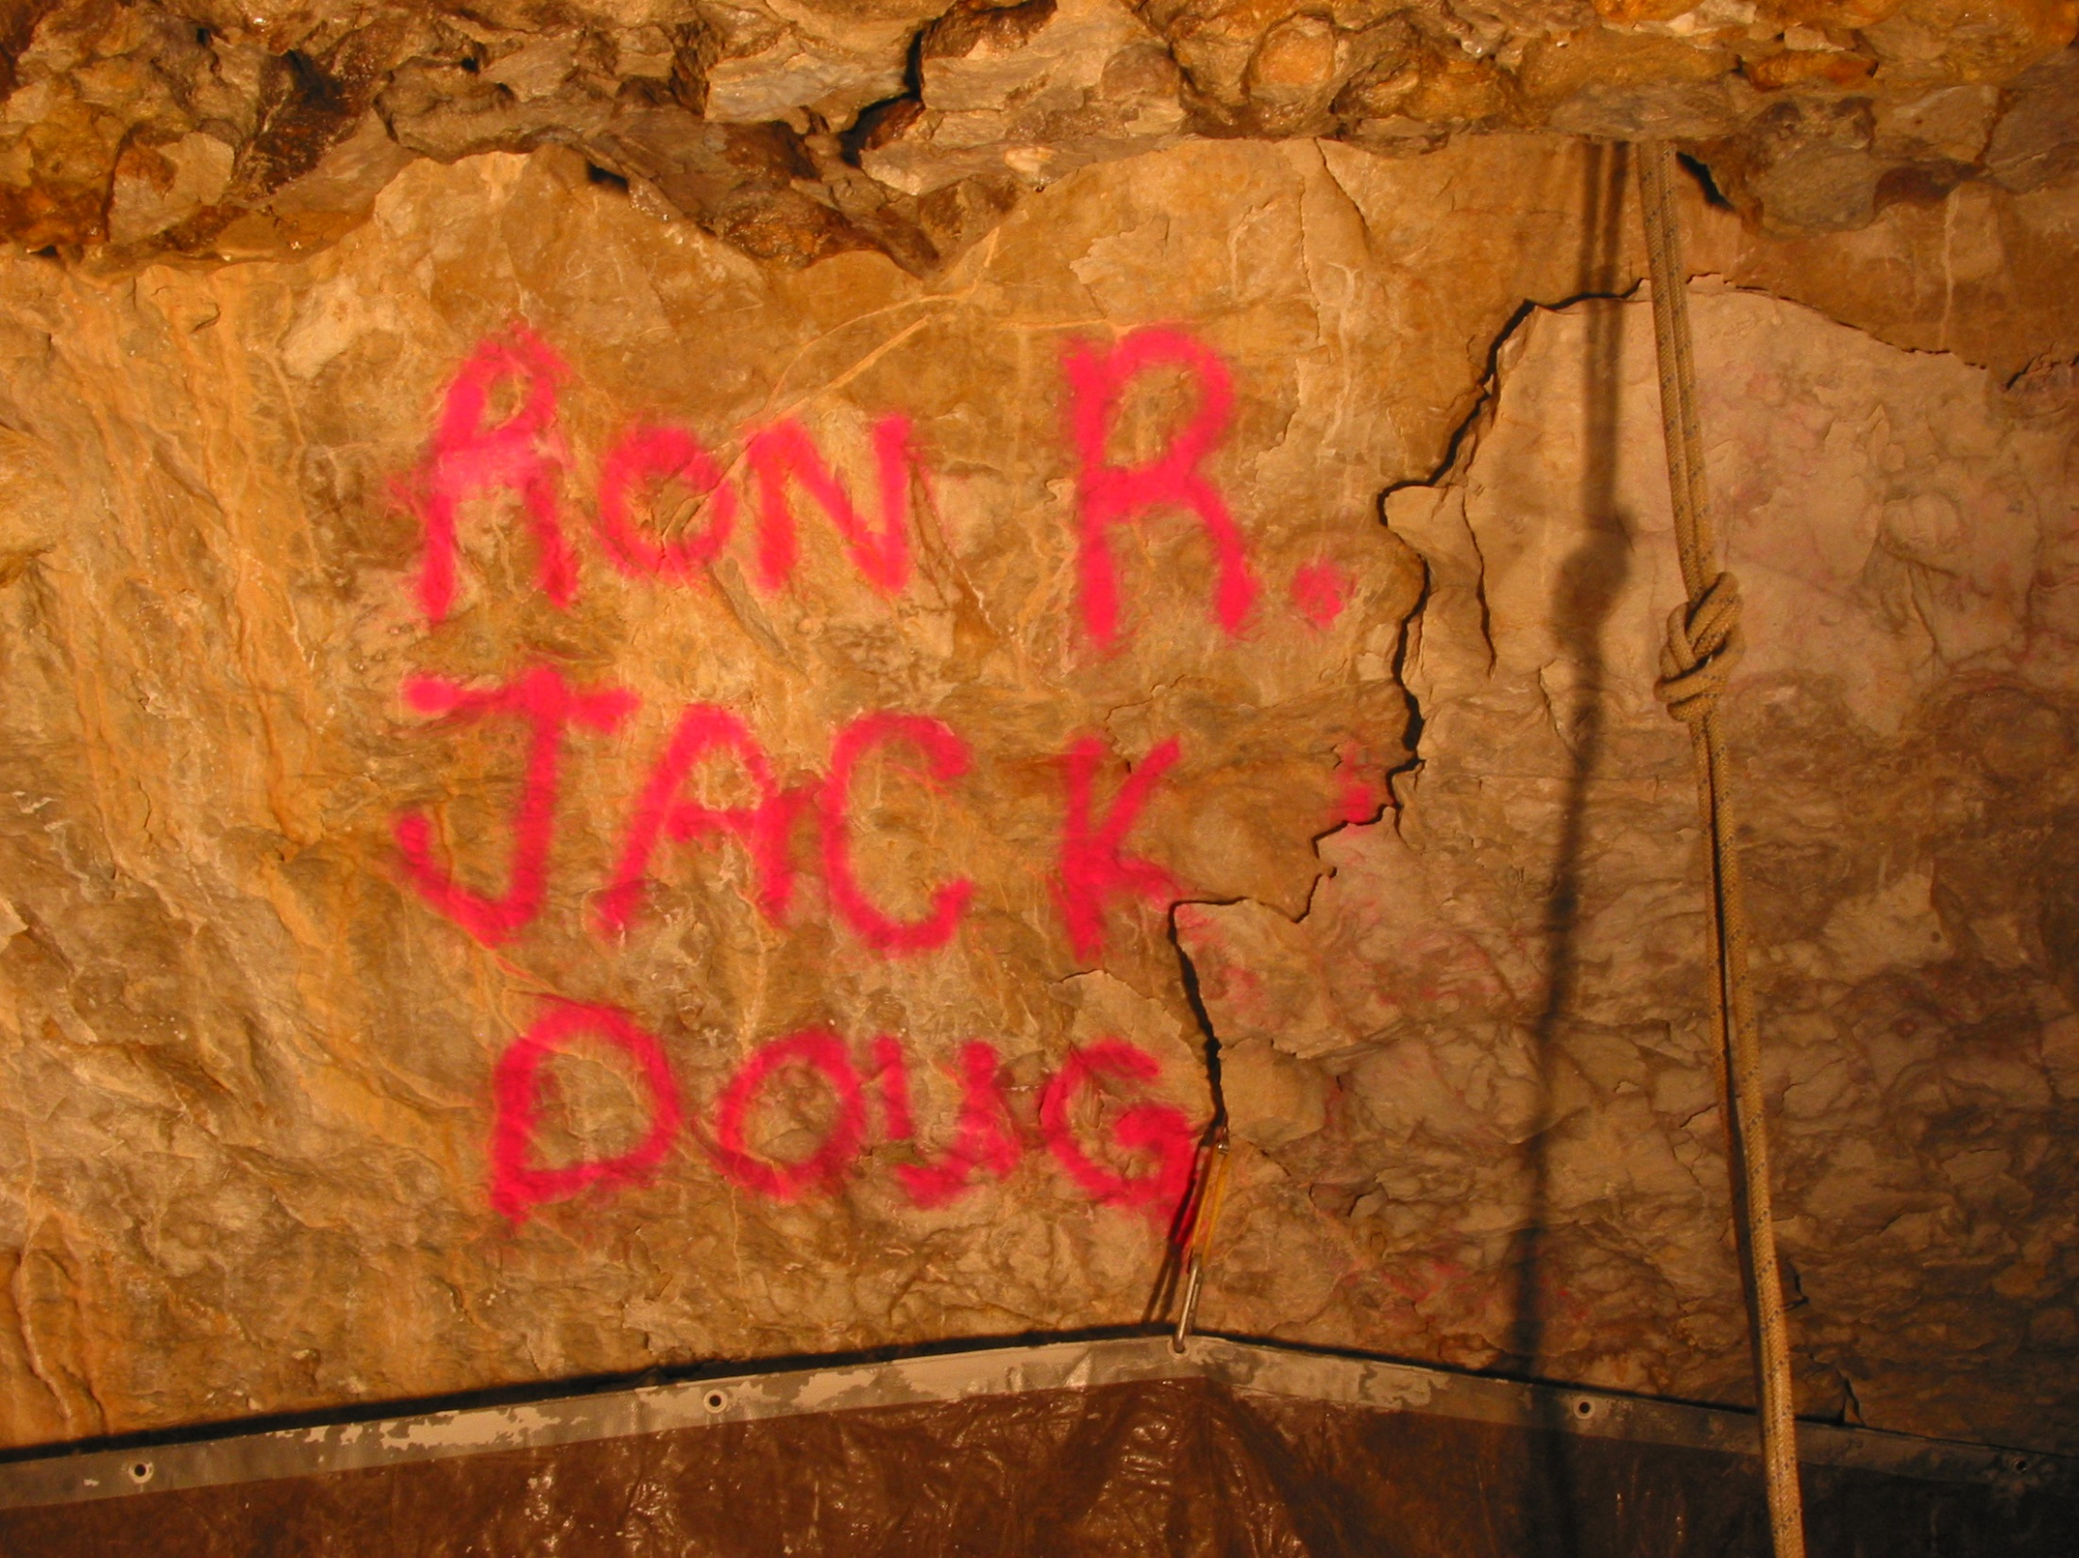
Removing graffiti
U.S. Department of the Interior Bureau of Land Management
Notes:
Before and After

Slide 12
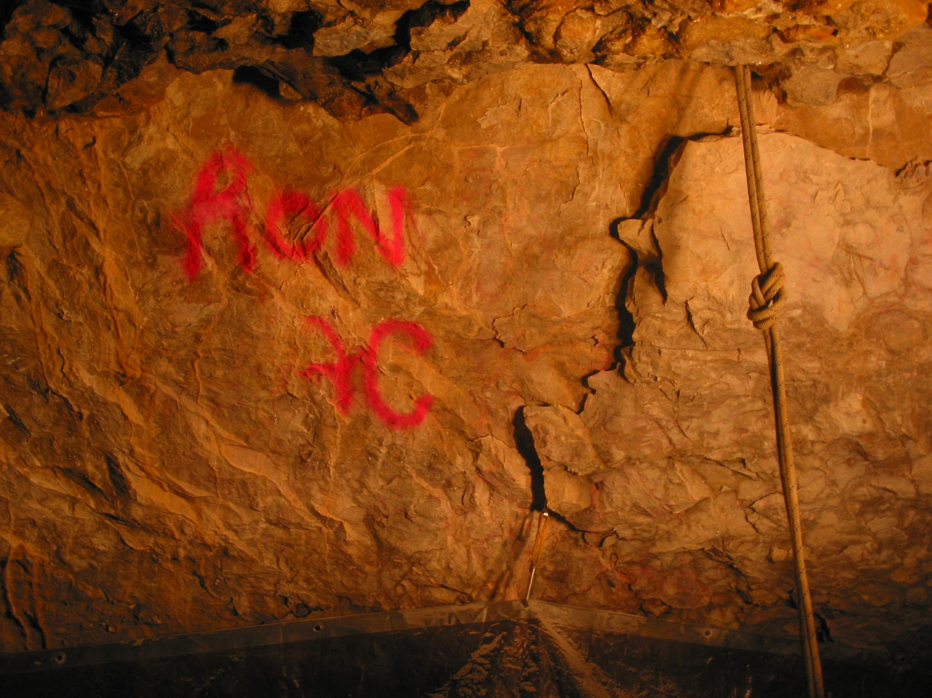
Removing graffiti
U.S. Department of the Interior Bureau of Land Management
Notes:
Before and After

Slide 13
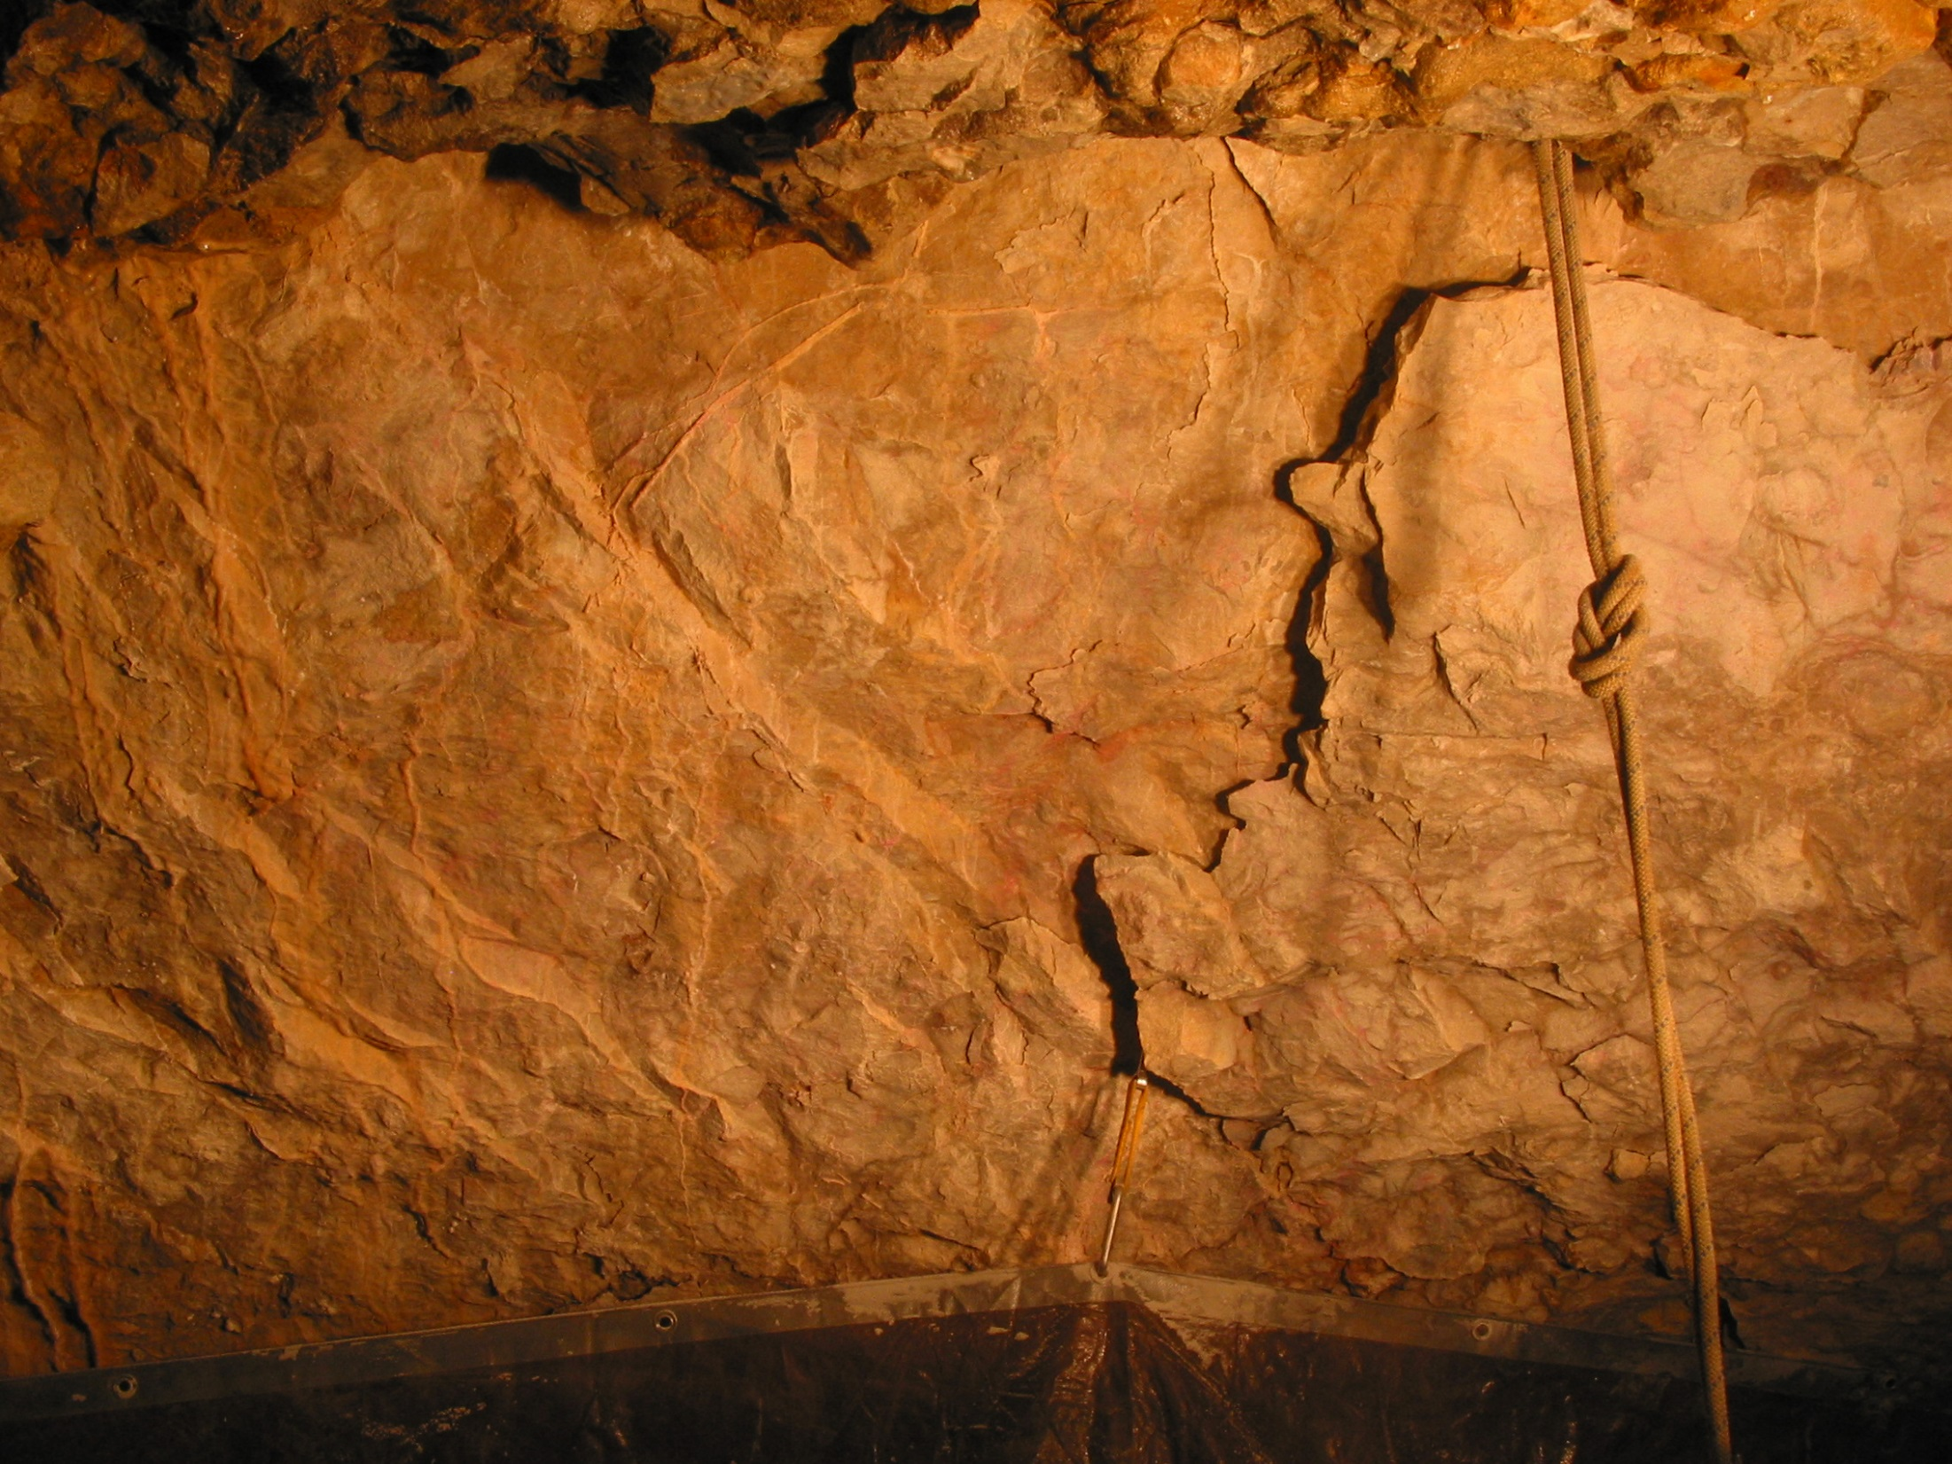
Removing graffiti
U.S. Department of the Interior Bureau of Land Management
Notes:
Before and After

Slide 14
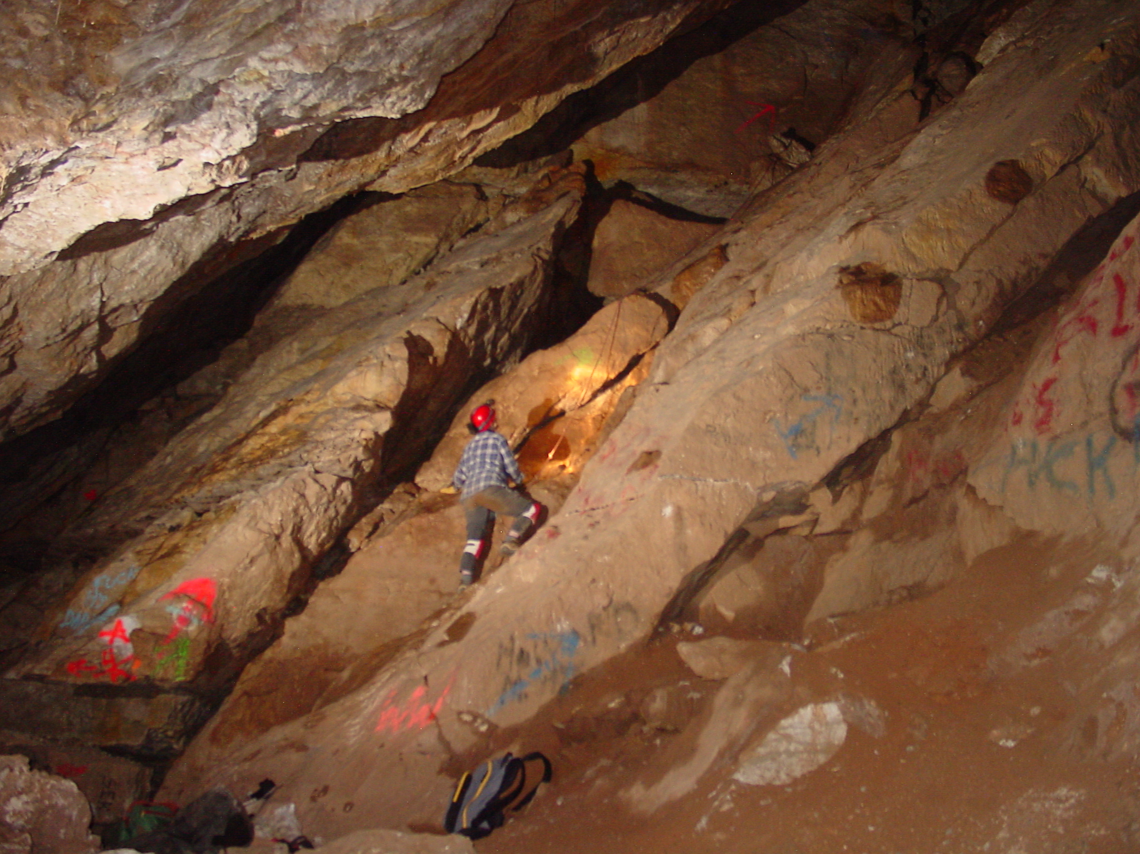
Removing graffiti
U.S. Department of the Interior Bureau of Land Management
Notes:
Before and After

Slide 15
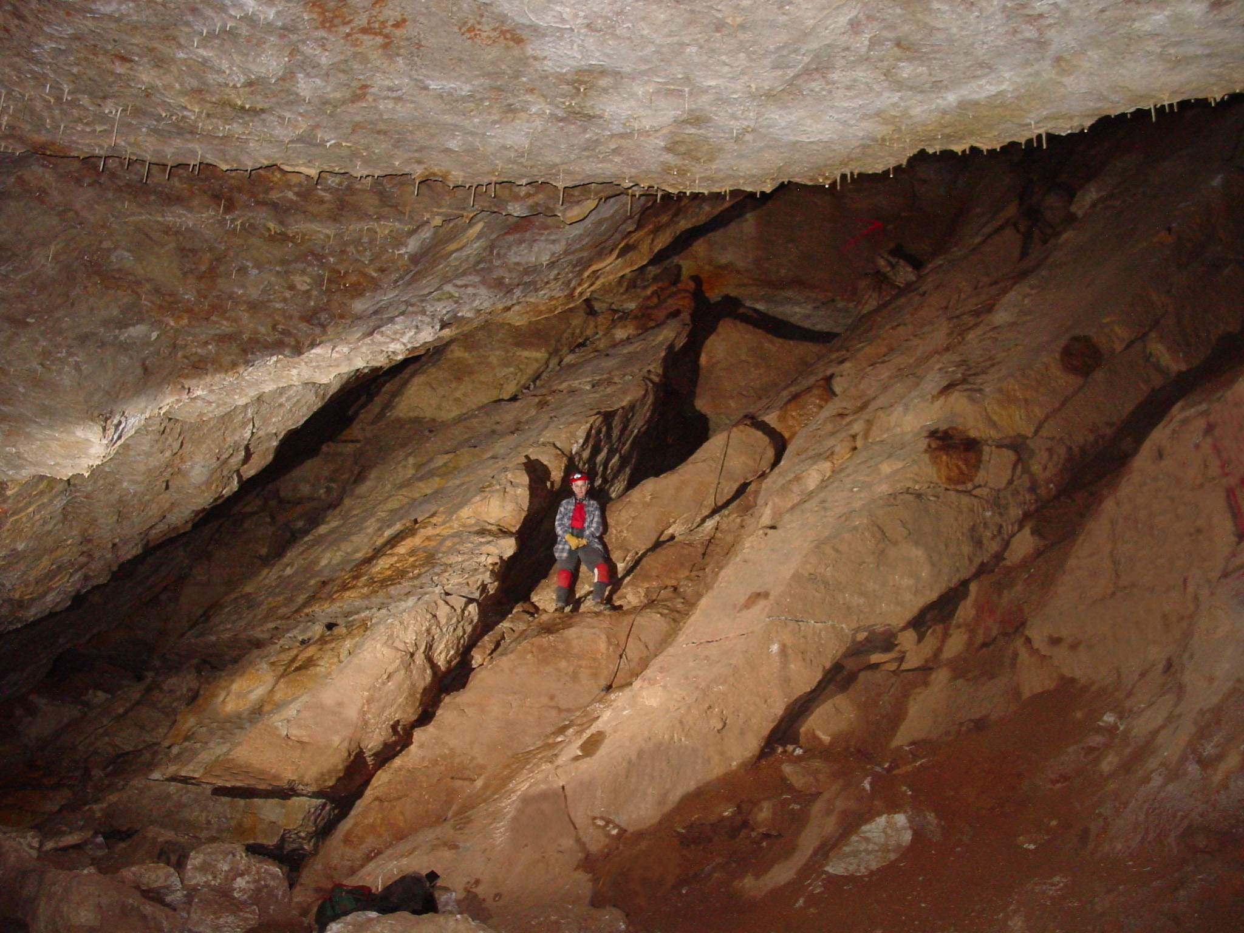
Removing graffiti
U.S. Department of the Interior Bureau of Land Management
Notes:
Before and After

Slide 16
U.S. Department of the Interior Bureau of Land Management
Graffiti Removal Project
BLM Expenses, $2000
50 Volunteers for 1061 hours of donated time in 5 weeks.
Total donated time and expenses, $86,000
Notes:
Project summary

Slide 17
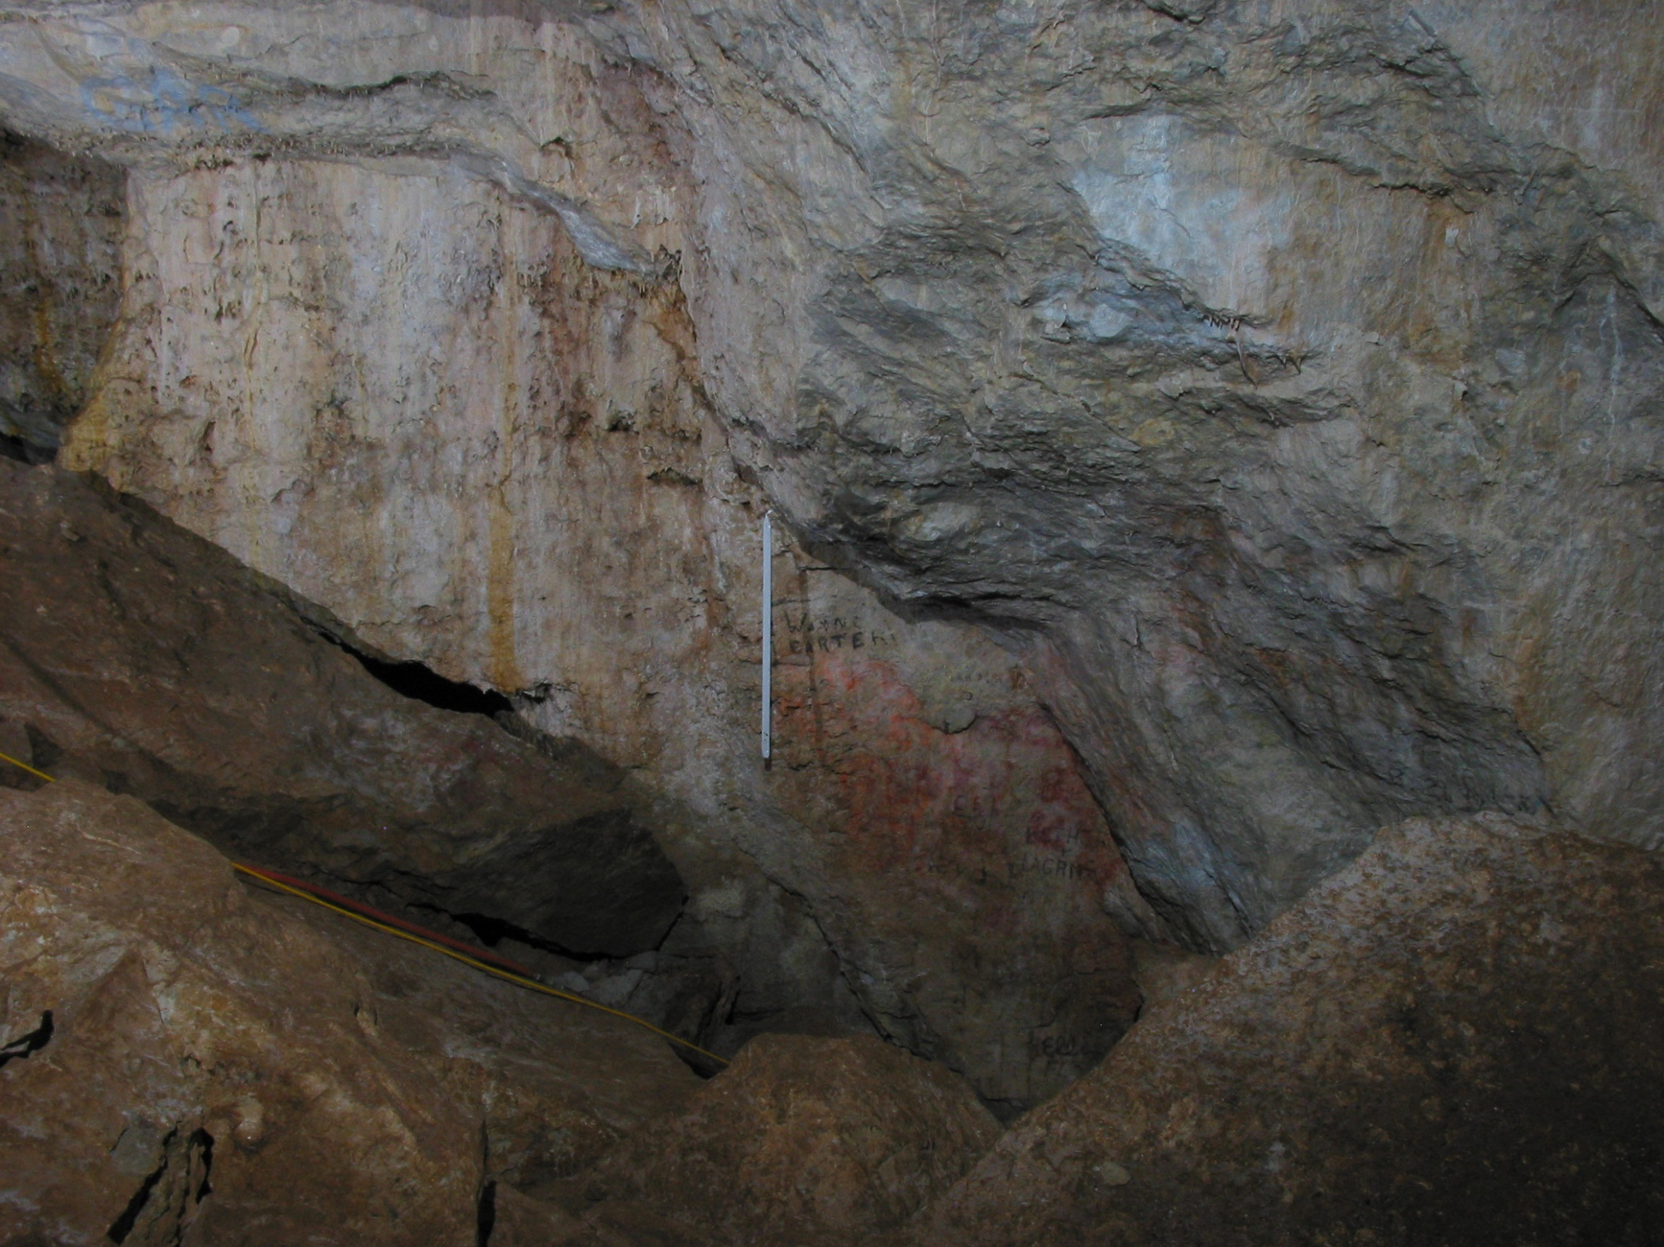
Flagging routes
U.S. Department of the Interior Bureau of Land Management
Notes:
To prevent graffiti and adding string, flagging routes were placed. The hope the farther people went into the cave the more they would appreciate the cave and the more they would help protect the cave.

Slide 18
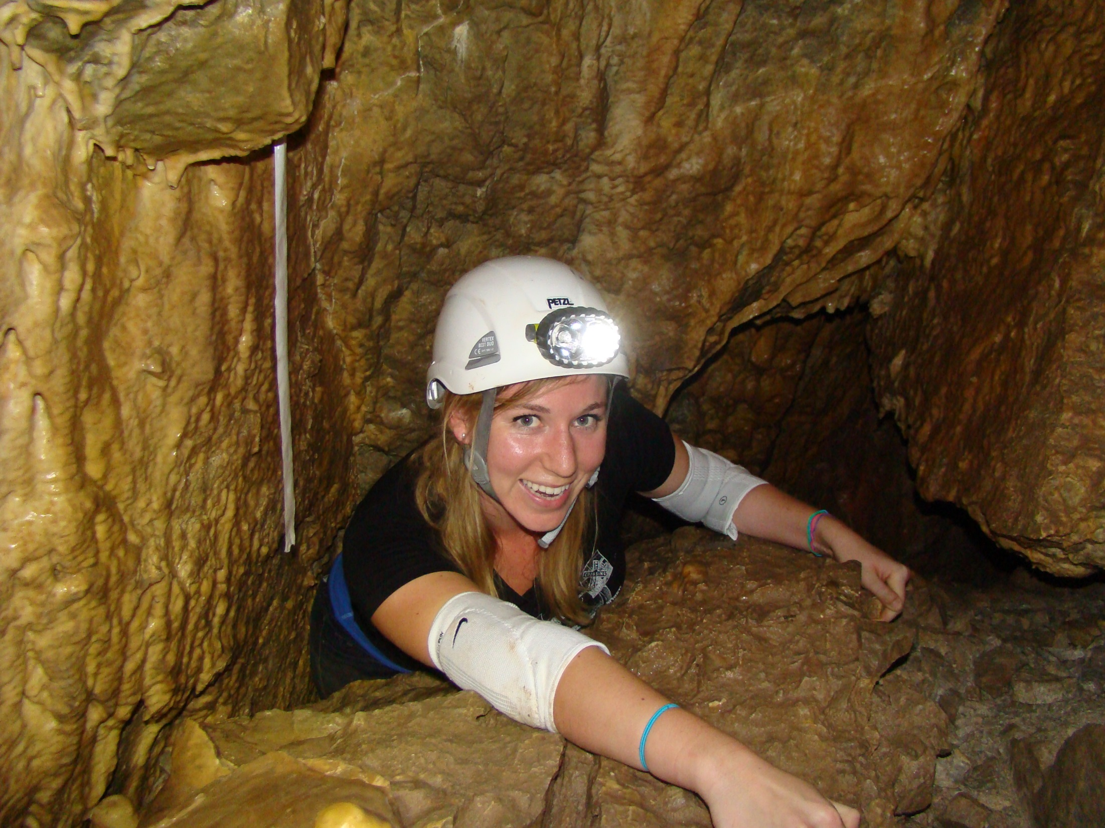
Flagged routes
U.S. Department of the Interior Bureau of Land Management
Notes:
The flags routed the visitors into the safer routes though the cave.

Slide 19
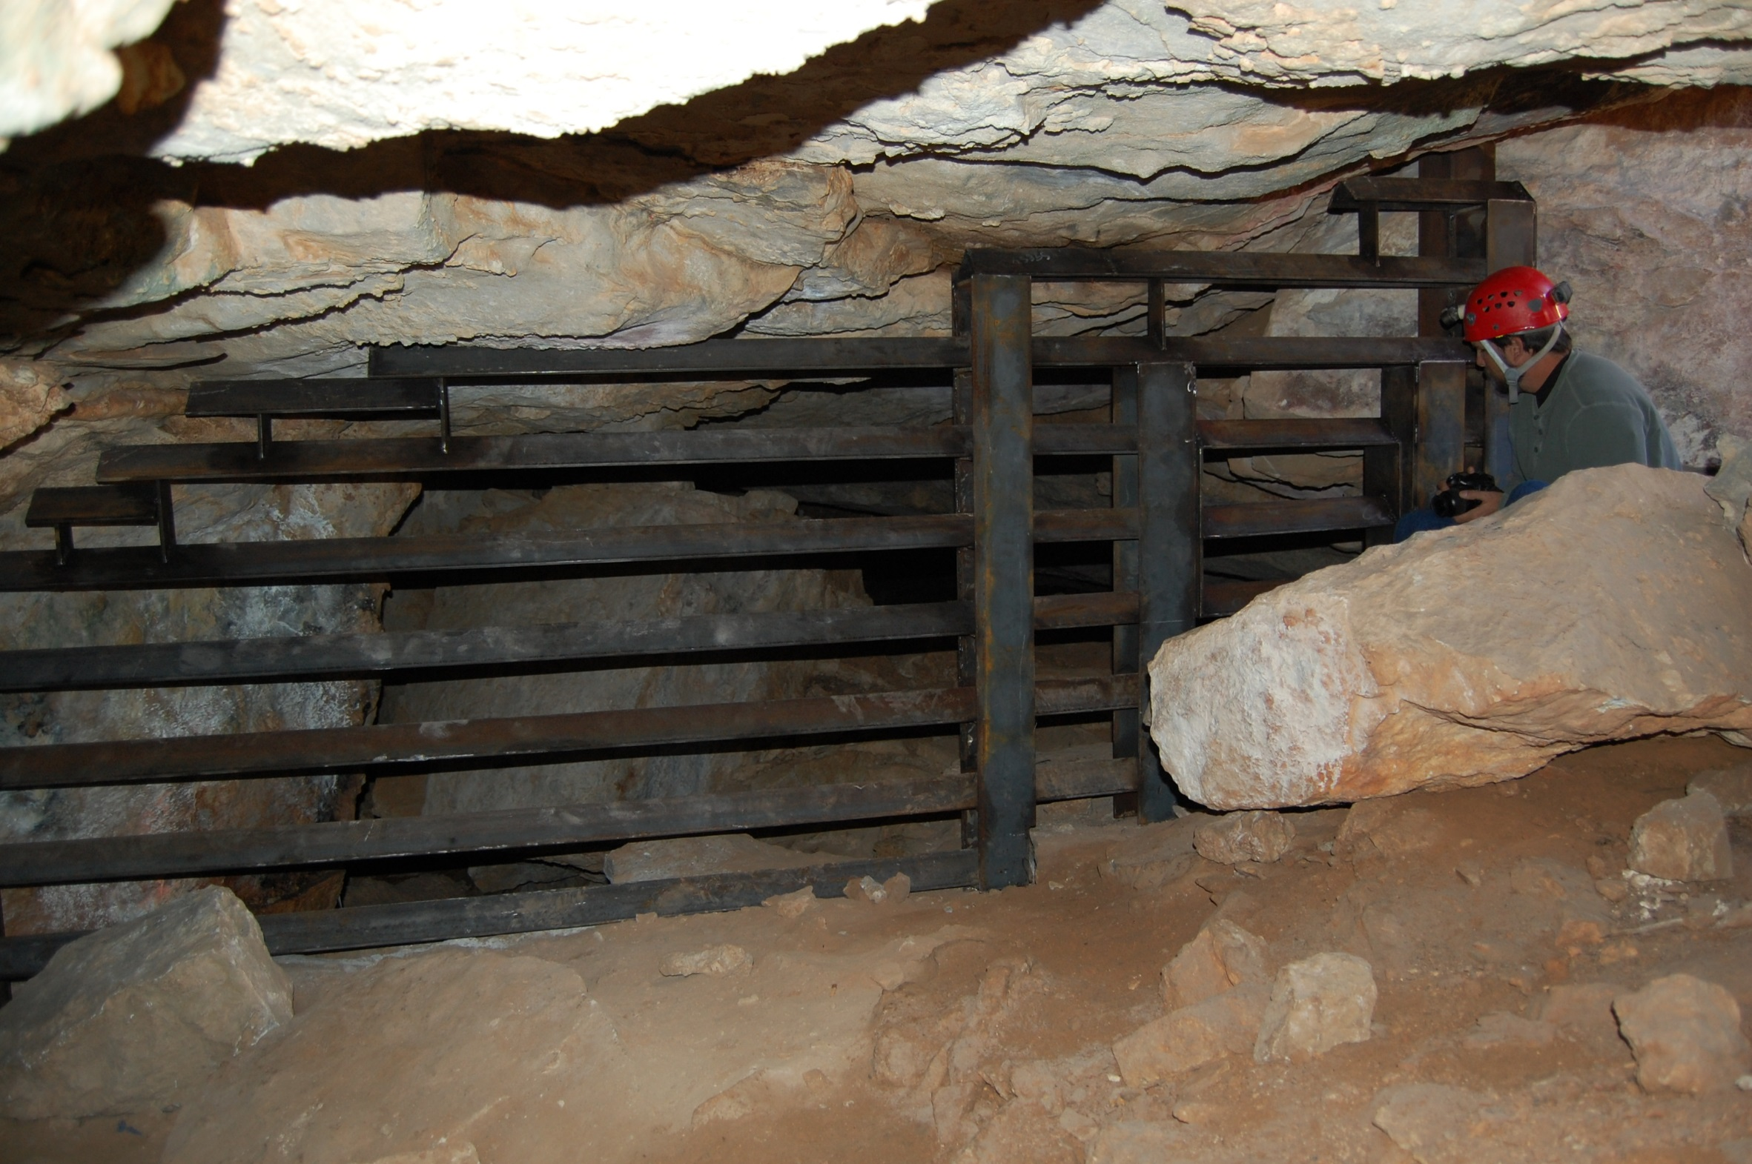
Gate on the South Entrance
U.S. Department of the Interior Bureau of Land Management
Notes:
In spring of 2009, gates were installed. This is the gate on the main South Entrance

Slide 20
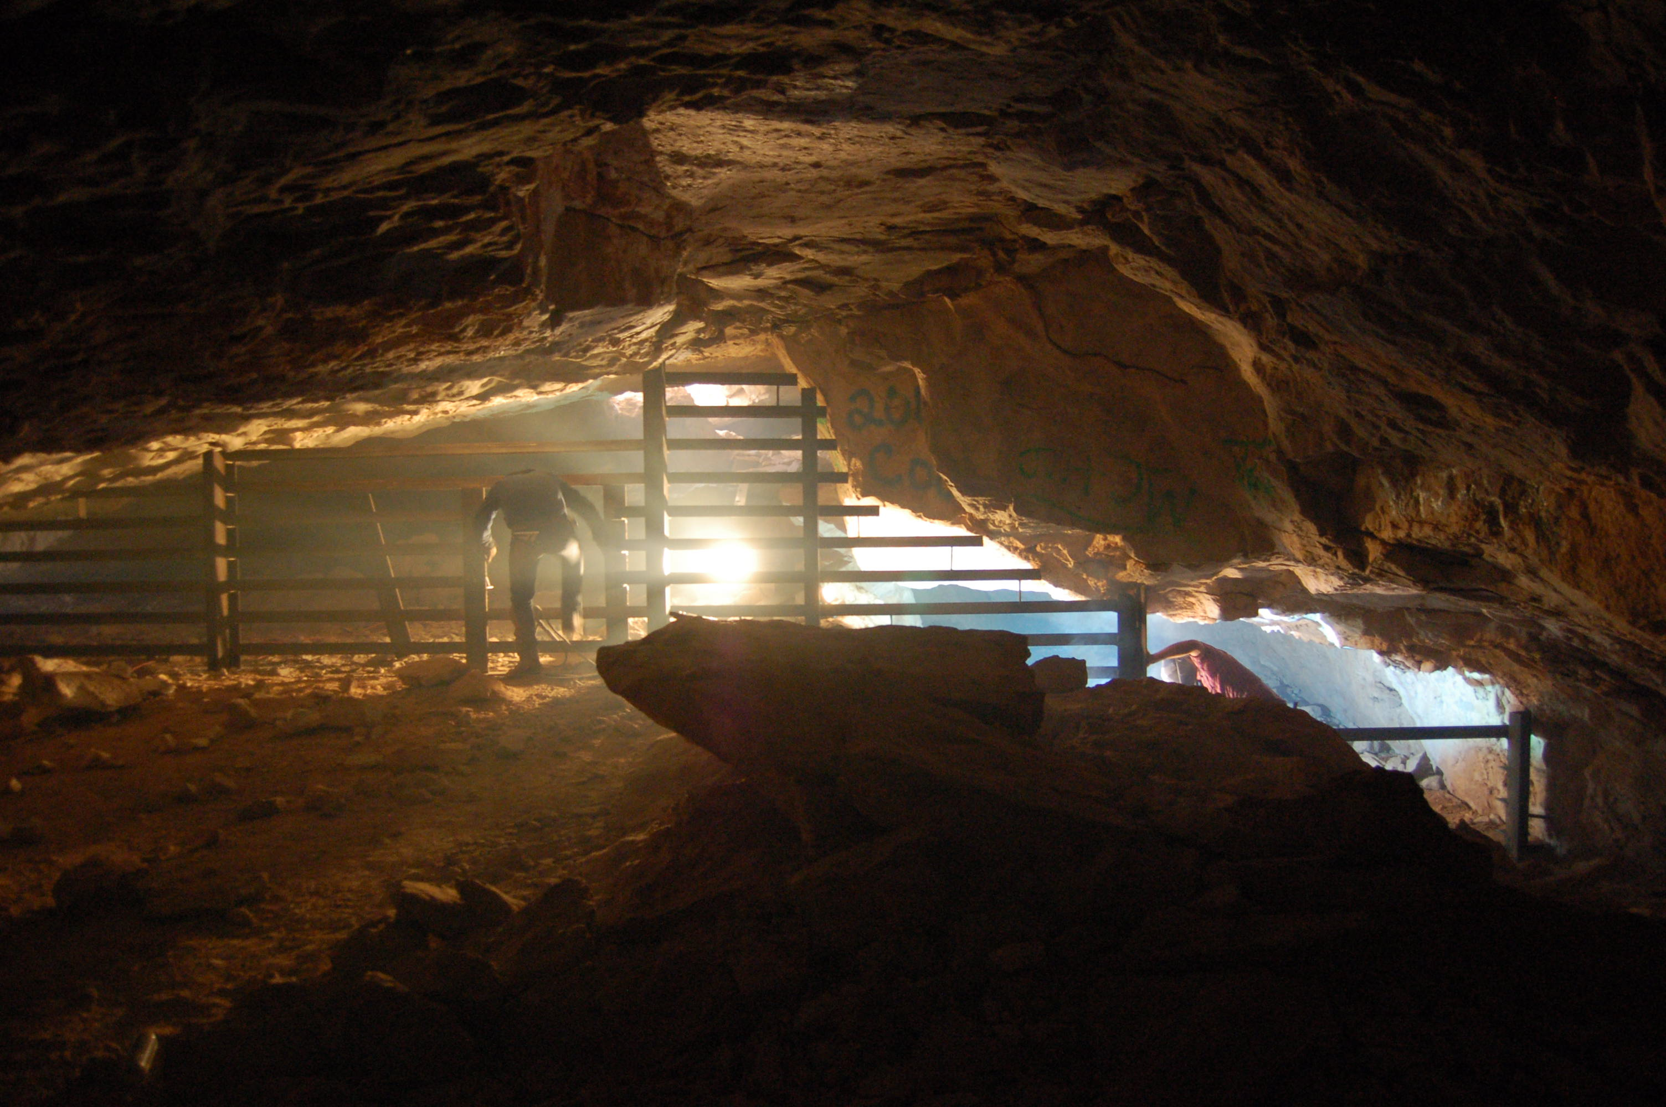
Gate on the North Entrance
U.S. Department of the Interior Bureau of Land Management
Notes:
Gate on the North Entrance

Slide 21
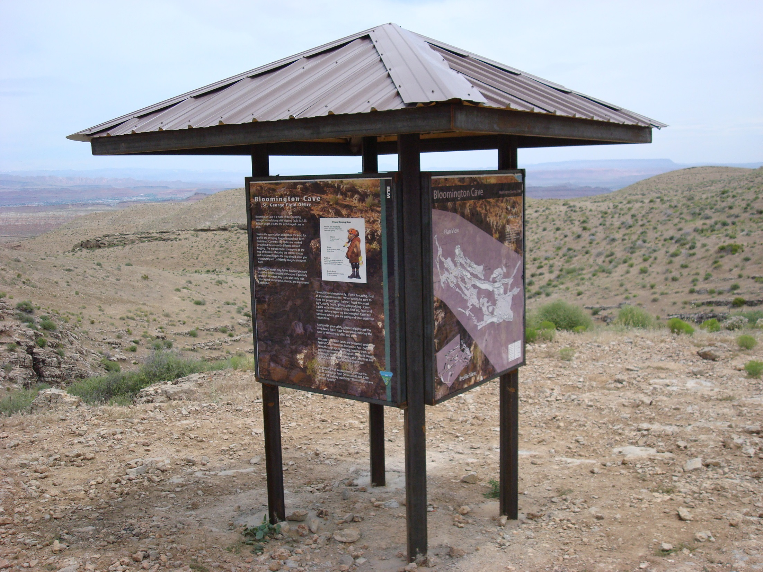
Kiosk
U.S. Department of the Interior Bureau of Land Management
Notes:
Kiosk placed to interpret the cave for permitting and non-permitted visitors

Slide 22
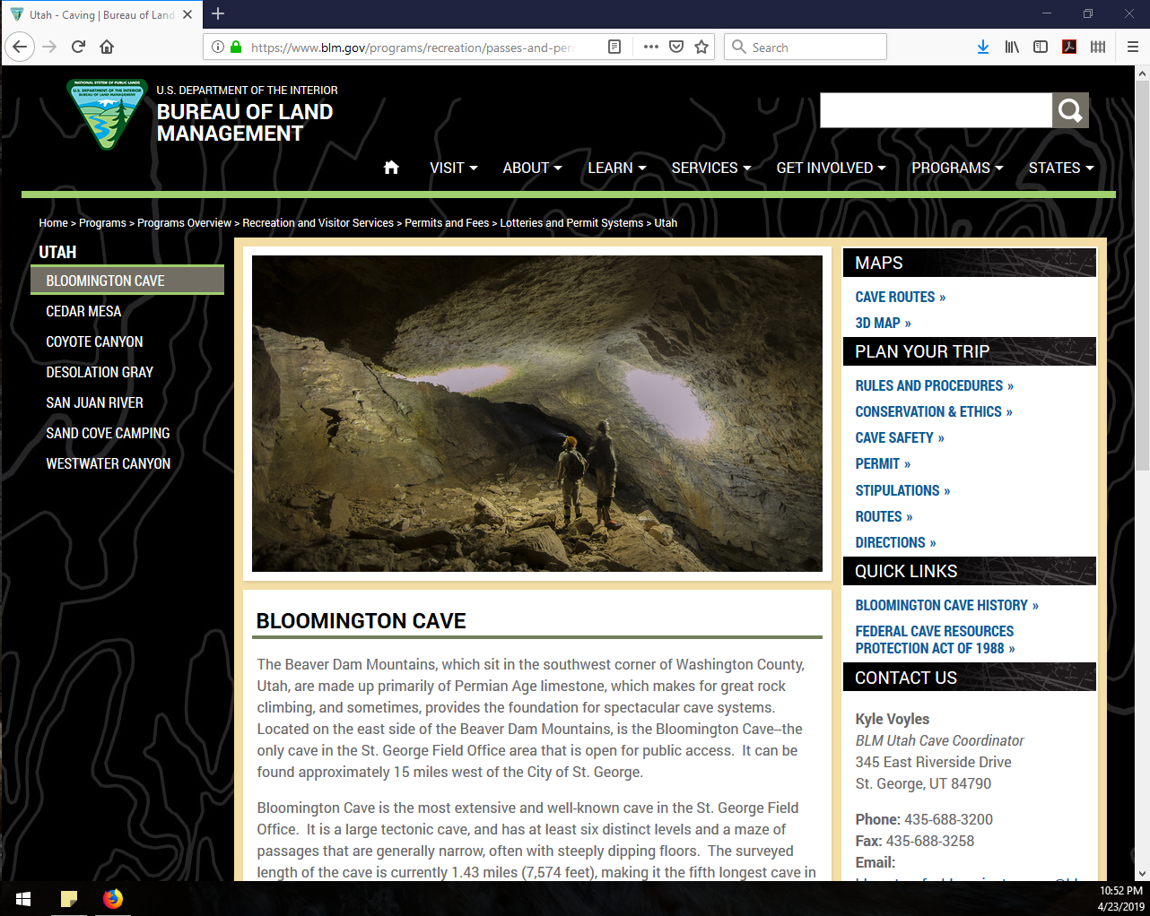
Removing graffiti
Notes:
Management plan was approved allowing access through a free permit. Run through actual website to show resources available – especially permit requirements.

Slide 23
Studying Cave Visitation Trends
U.S. Department of the Interior Bureau of Land Management
Notes:
Studying cave visitation is one of the most basic tools in cave management. It should be as basic as the initial cave survey. However, visitation is often overlooked or ignored. This presentation is meant not to be an instruction of how to study visitation, but rather to encourage and inspire by offering a variety of techniques to study cave visitation.

Slide 24
U.S. Department of the Interior Bureau of Land Management
We don’t manage caves…
We manage the people’s interaction with caves.
Notes:
Don’t fool yourself. We don’t manage caves … we manage the people using the caves.

Slide 25
Why Study Visitation?
U.S. Department of the Interior Bureau of Land Management
Annual Visitation
Visitation Trends (monitoring, closures)
Problem visitation (late night, without permits)
Collecting basic demographics
Develop group size and daily limits
Notes:
There are several reasons to study cave visitation.

Slide 26
Methods of Measuring Visitation
U.S. Department of the Interior Bureau of Land Management
Dataloggers
Permits
Cave Registers
Notes:
And there are several methods and different situtions to measure and collect cave visitation data

Slide 27
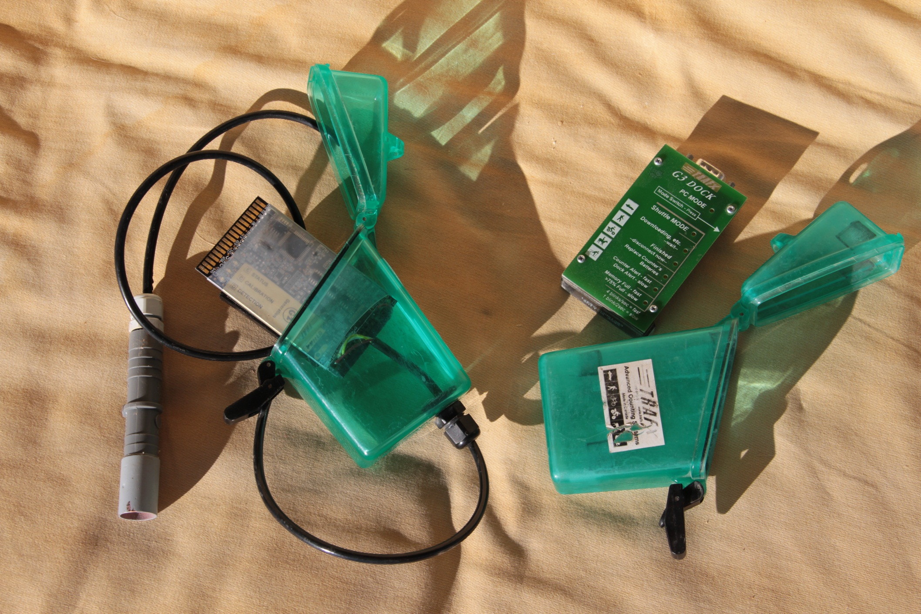
U.S. Department of the Interior Bureau of Land Management
Notes:
This photo show the TRAFx system consisting of a IR sensor and logger (left) and a shuttle and PC connector (right).

Slide 28
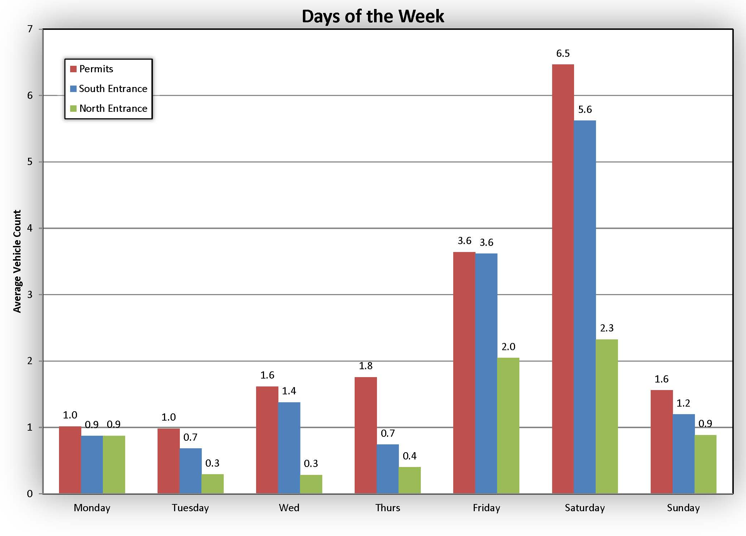
U.S. Department of the Interior Bureau of Land Management
Notes:
This graph shows the visitation by day of the week according to permits and south and north entrance counts using TRAFx counters.

Slide 29
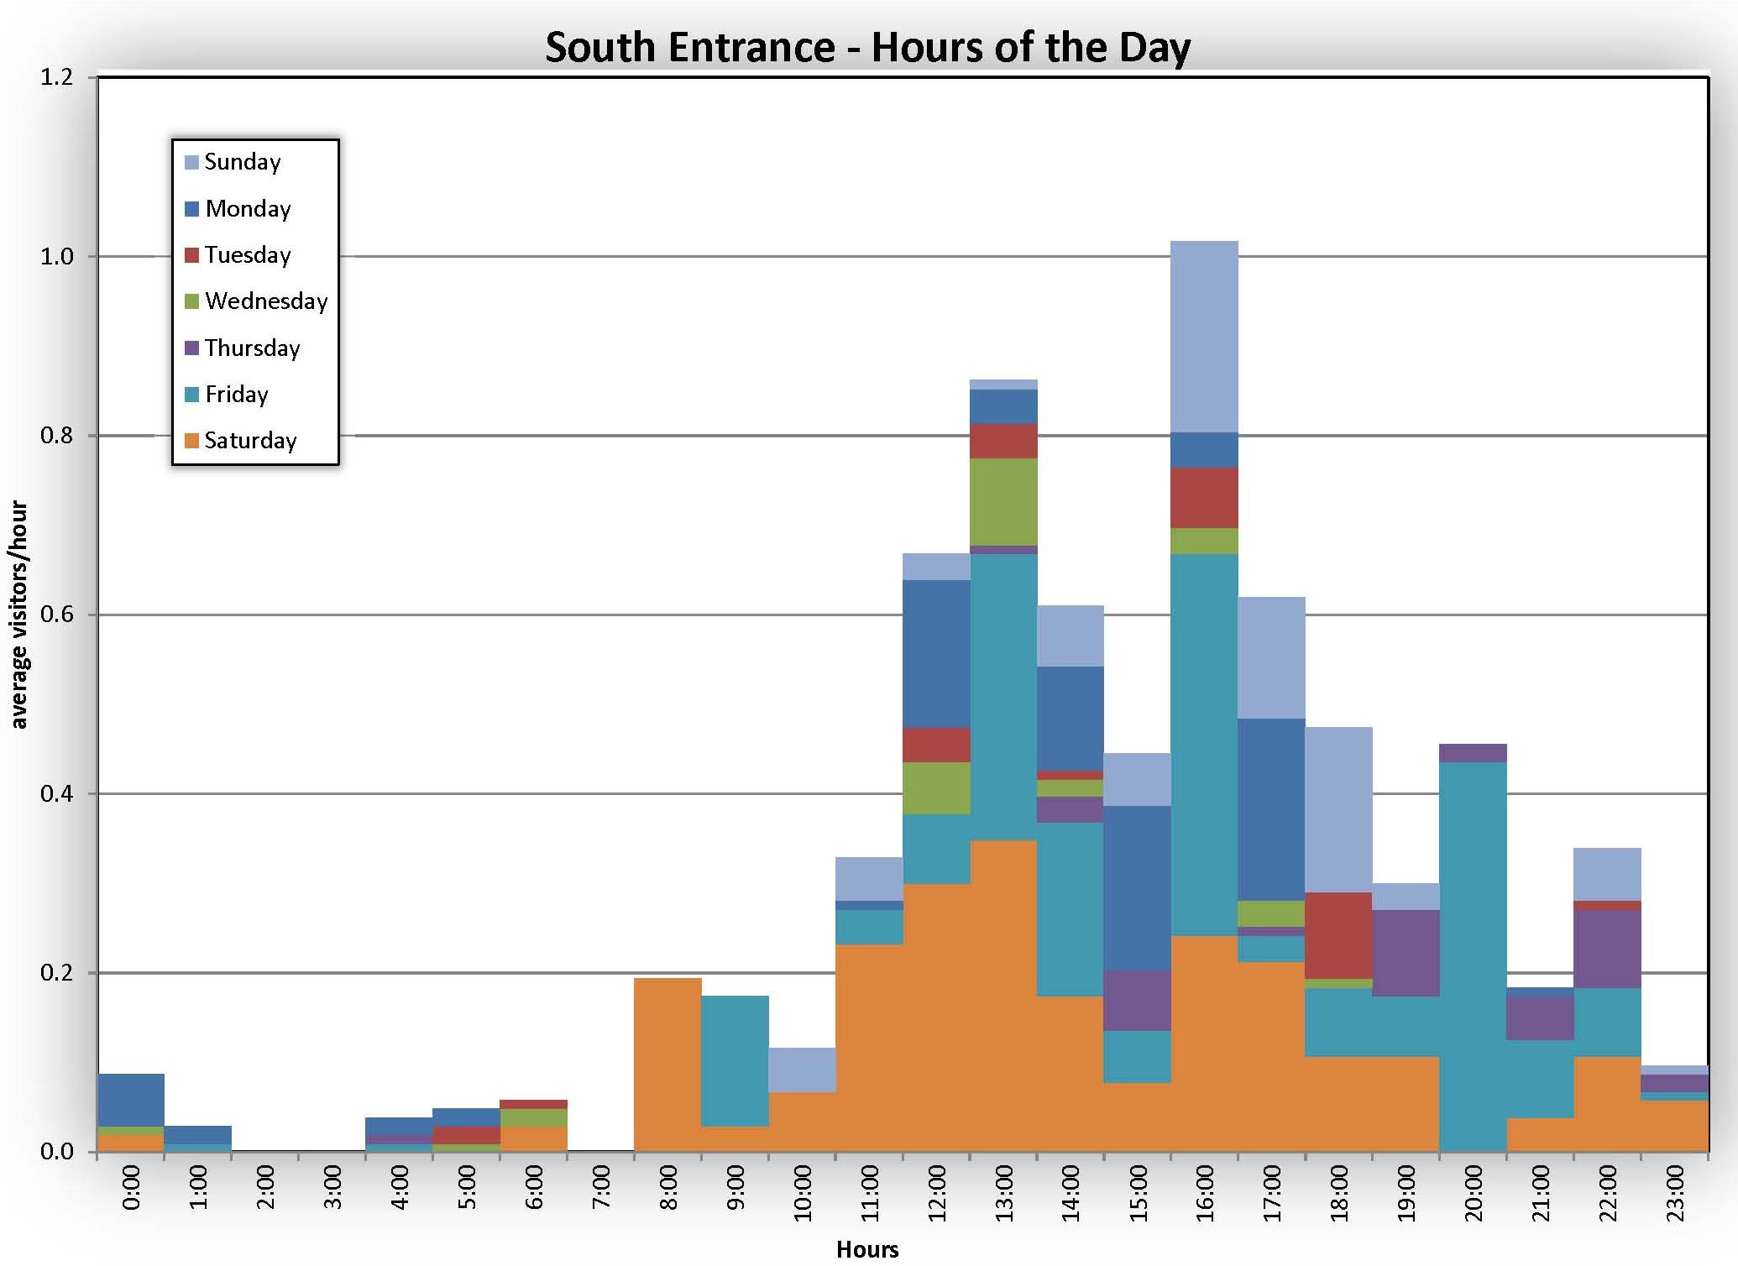
U.S. Department of the Interior Bureau of Land Management
Notes:
A graph using the average hourly visits colored by days of the week for the south entrance to Bloomington Cave. This graph can be used to figure out times for monitoring. It also show the amount mischief nightly use.

Slide 30
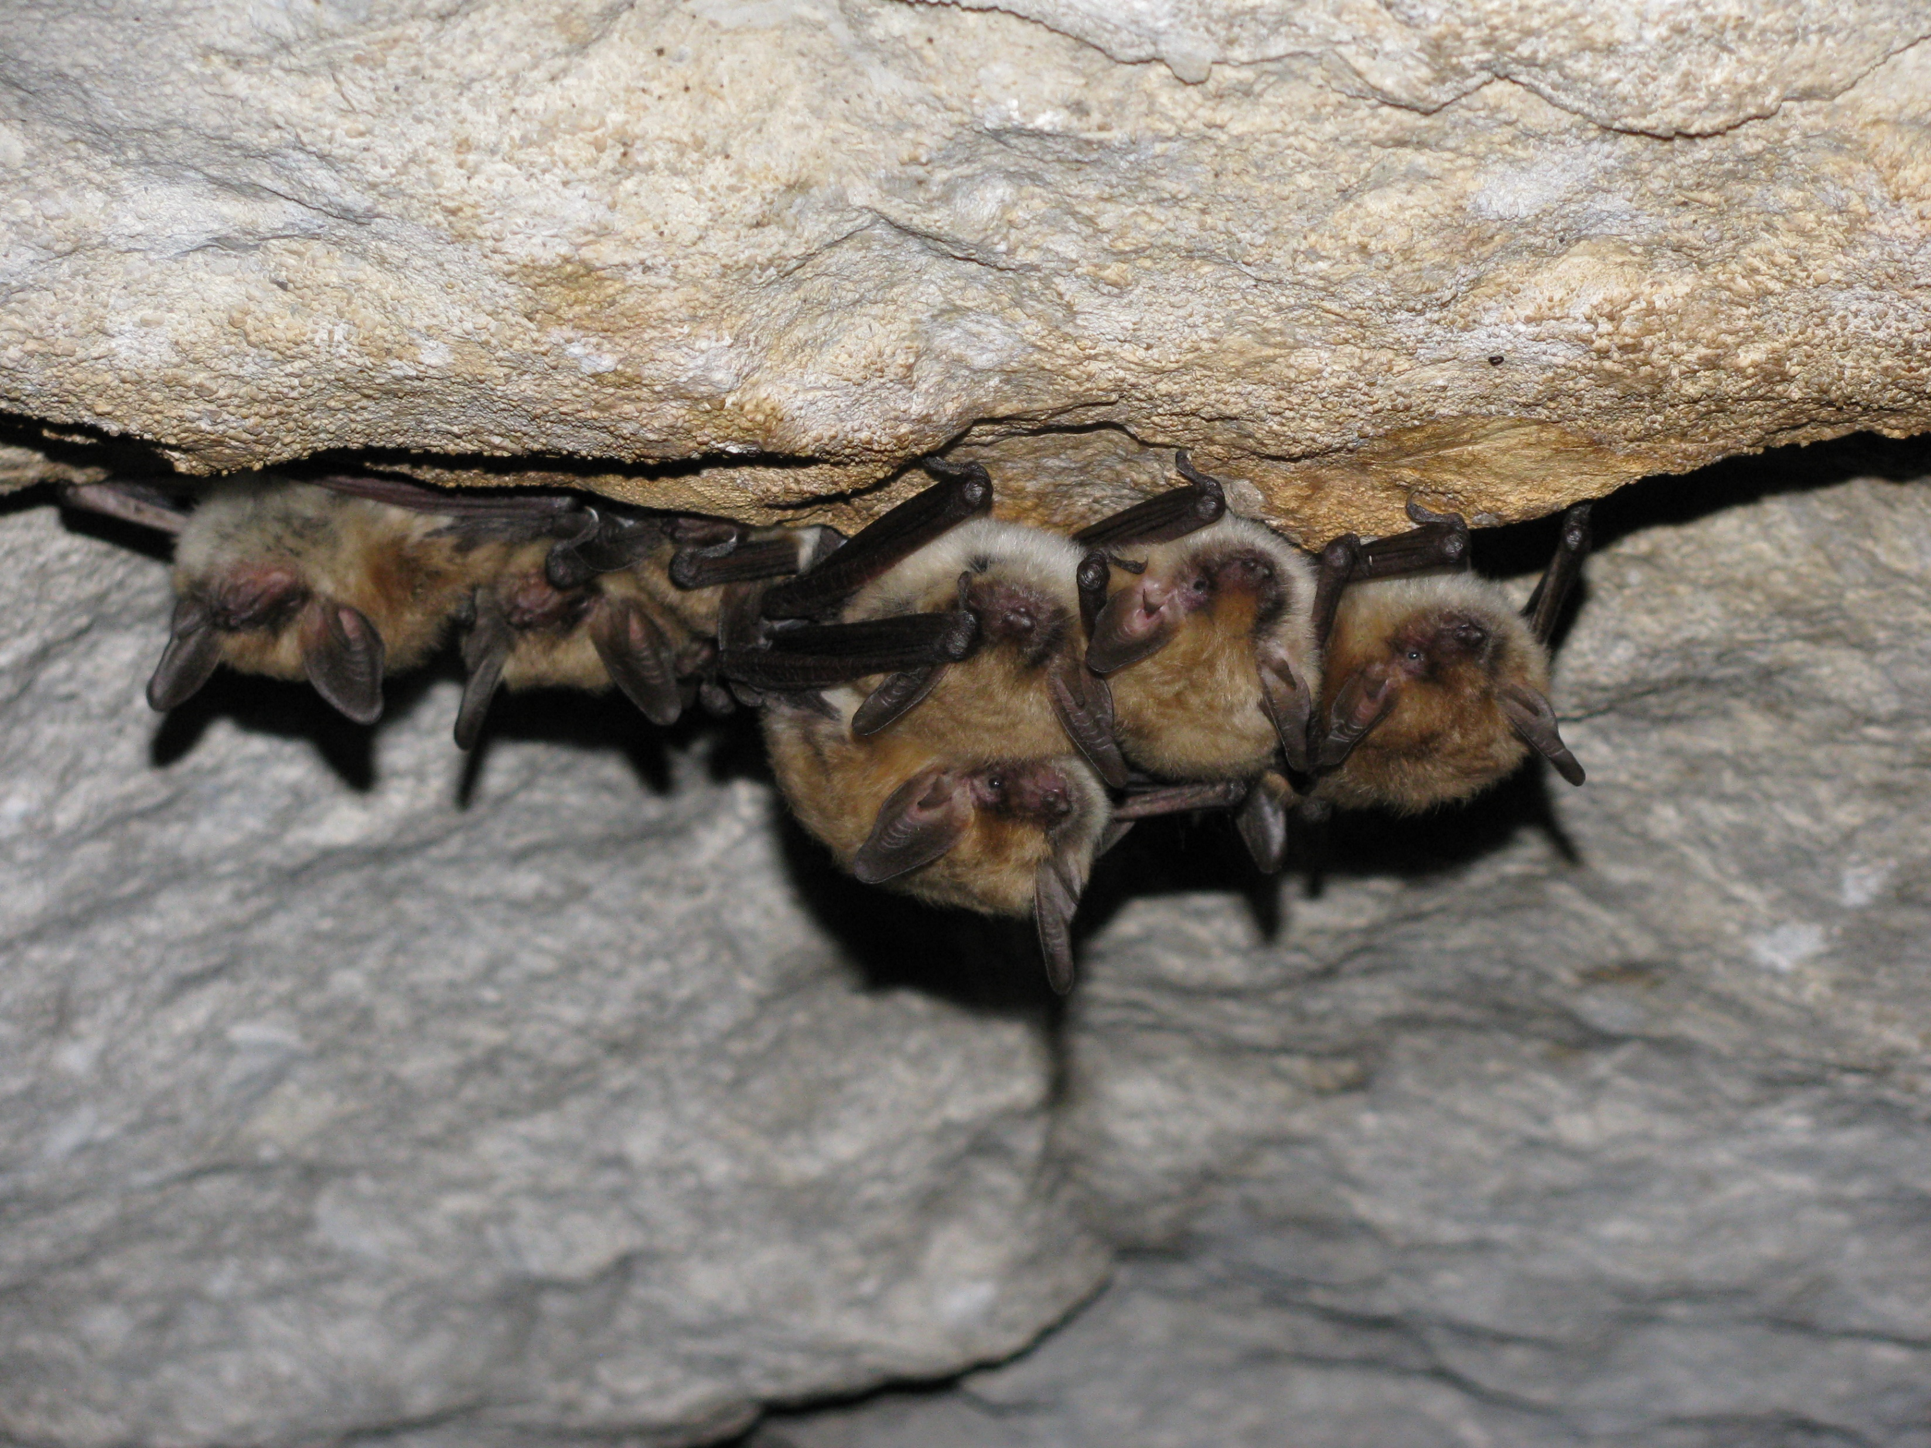
U.S. Department of the Interior Bureau of Land Management
Notes:
A graph using the average hourly visits colored by days of the week for the south entrance to Bloomington Cave. This graph can be used to figure out times for monitoring. It also show the amount mischief nightly use.

Slide 31
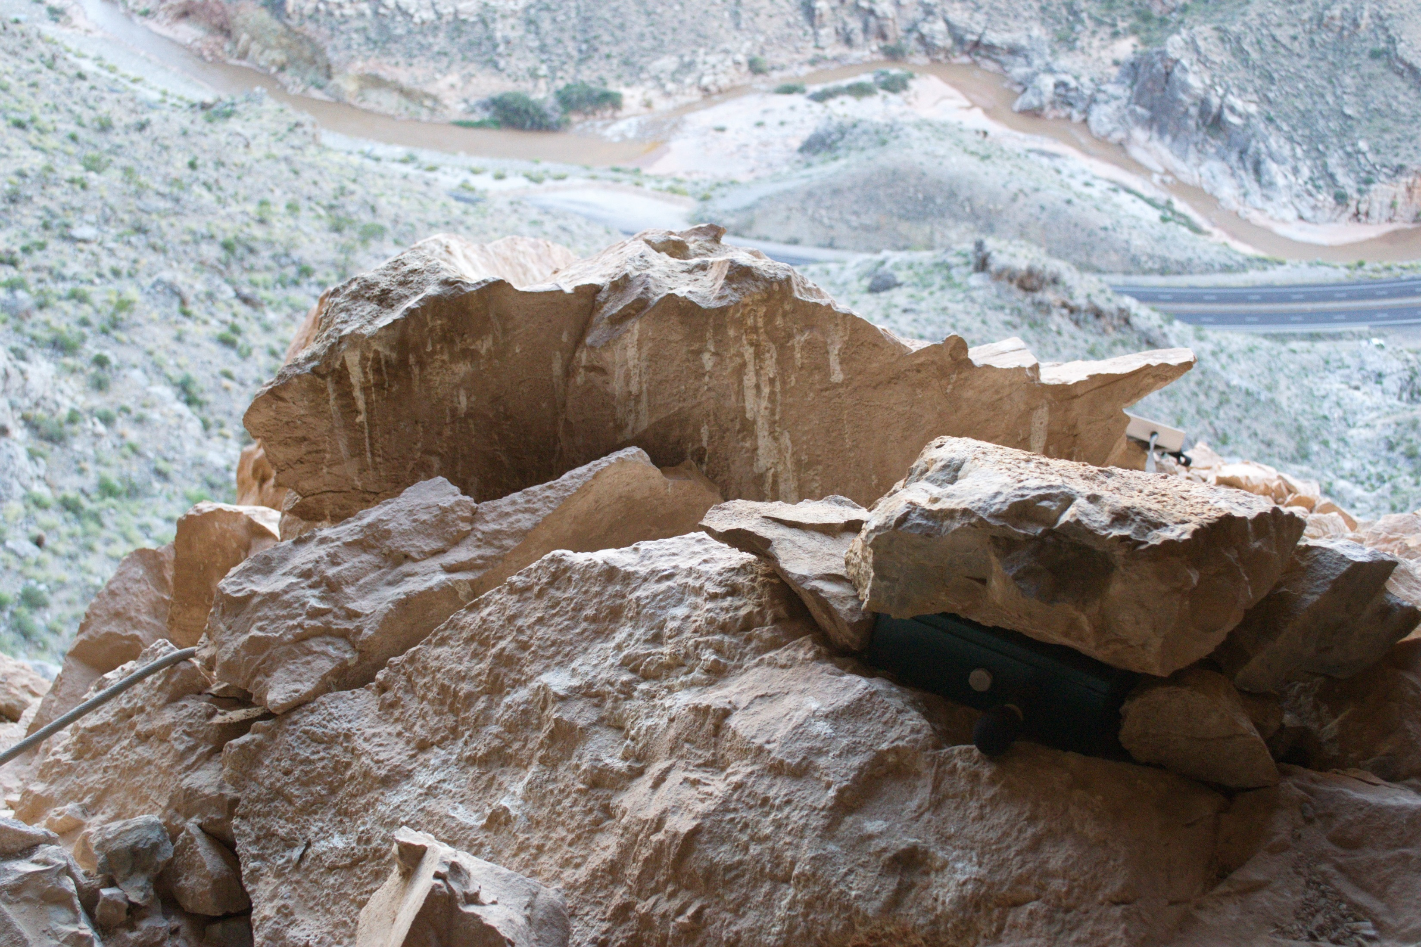
U.S. Department of the Interior Bureau of Land Management
Notes:
A graph using the average hourly visits colored by days of the week for the south entrance to Bloomington Cave. This graph can be used to figure out times for monitoring. It also show the amount mischief nightly use.

Slide 32
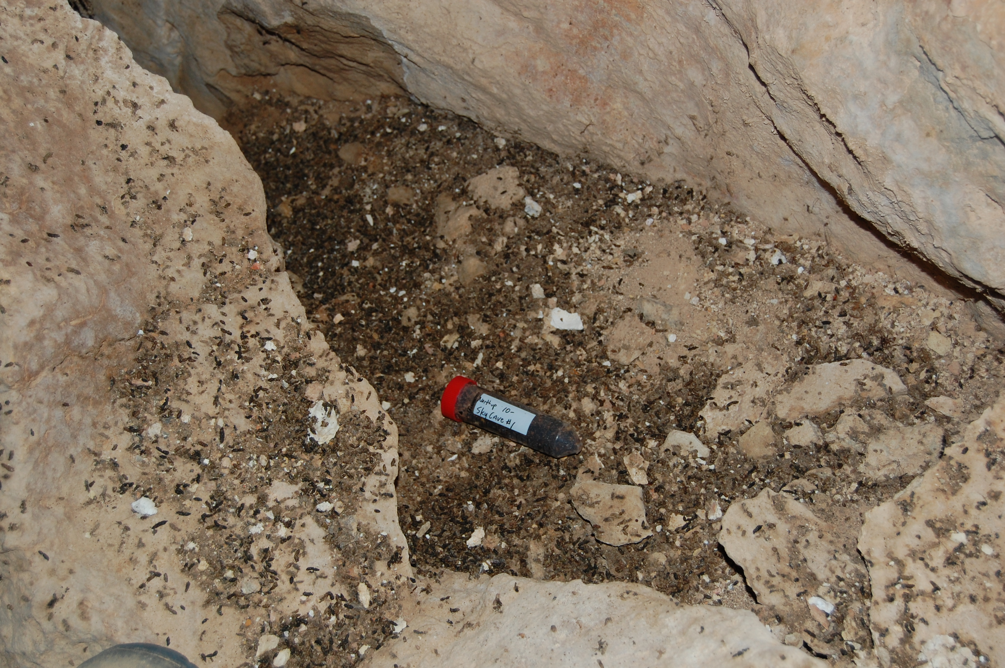
U.S. Department of the Interior Bureau of Land Management
Notes:
A graph using the average hourly visits colored by days of the week for the south entrance to Bloomington Cave. This graph can be used to figure out times for monitoring. It also show the amount mischief nightly use.

