Slide 1

Decon
For HOME, expedition and convention
Level events
Knutt Peterson
Cave and Karst Specialist
BLM, Roswell Field Office

Slide 2
BASICS OF HOT WATER DECON DECON
Read and be familiar with current usfws decontamination procedures
Enter cave with clean deconed gear
EXIT CAVE
FIELD DECON, TRANSITION FROM CONTAMINATED GEAR TO CLEAN STREET CLOTHES
TRANSPORT CONTAMINATED GEAR TO DECON STATION IN SEALED BAG OR CONTAINER
CLEAN MUD OFF OF CAVE GEAR, SEPARATE INTO SUBMERSABLE, AND NON SUBMERSABLE
SUBMERSE GEAR IN 131º H2o for 20 minutes.
Clean non-submersible gear with approved chemical
Remove gear from hot water and dry
Be aware of cross contamination

Slide 3
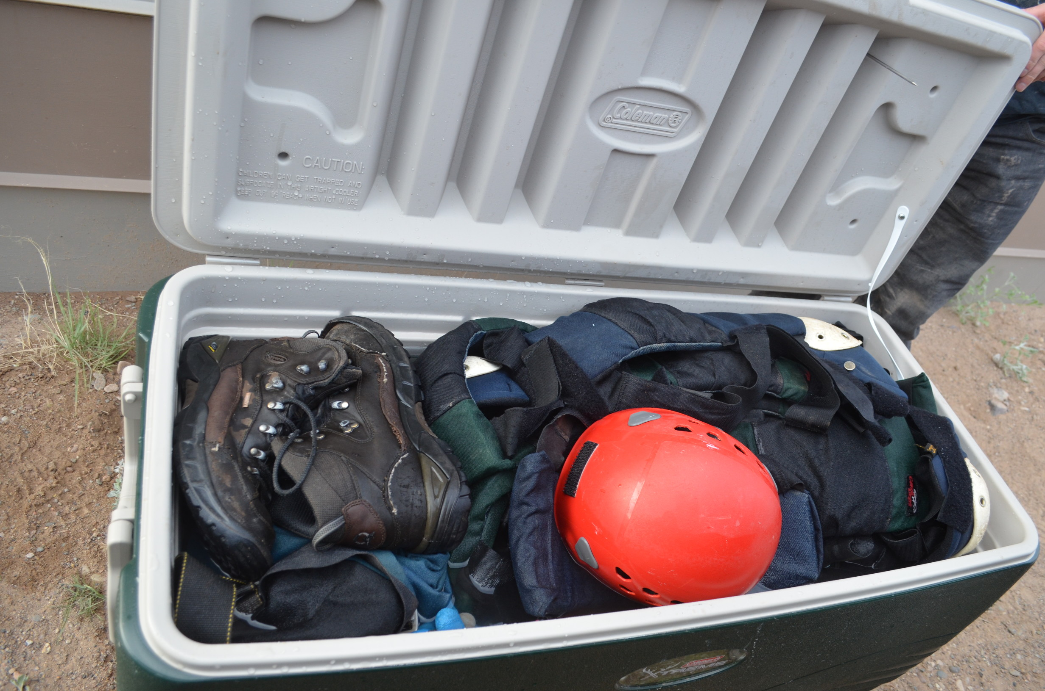
Simple Home decon unit
PRECLEAN GEAR OF MUD, ADD TO COOLER.
FILL LARGE COOLER WITH HOT WATER, AT LEAST 140°F.
ADD A WEIGHT TO KEEP GEAR SUBMERSED.
THERE WILL BE SOME COOLING DURING THE SOAK. AFTER 20 MIN, END TEMP SHOULD BE 131ºF
CLEAN NON-SUBMERSIABLE GEAR WITH APPROPREATE CHEMICAL.
DRY GEAR.

Slide 4
The CONVENTION problem
Need to provide effective decon to 30 to 120 people in 2 to 6hrs
Decon STATION needs to be portable
Decon station needs to be user friendly
Decon station needs to avoid cross contamination
Cost needs to be manageable
System needs to be simple and reliable

Slide 5
History
No Decon <2010
Quaternary ammonia in 55 gallon tubs
122F hot water, generated by military submersible kerosene heater
Non portable Tankless propane water heater, attached to bunkhouse (122F Max)
Portable, Tankless propane water heater, Recirculating system, 131F+ water temps

Slide 6
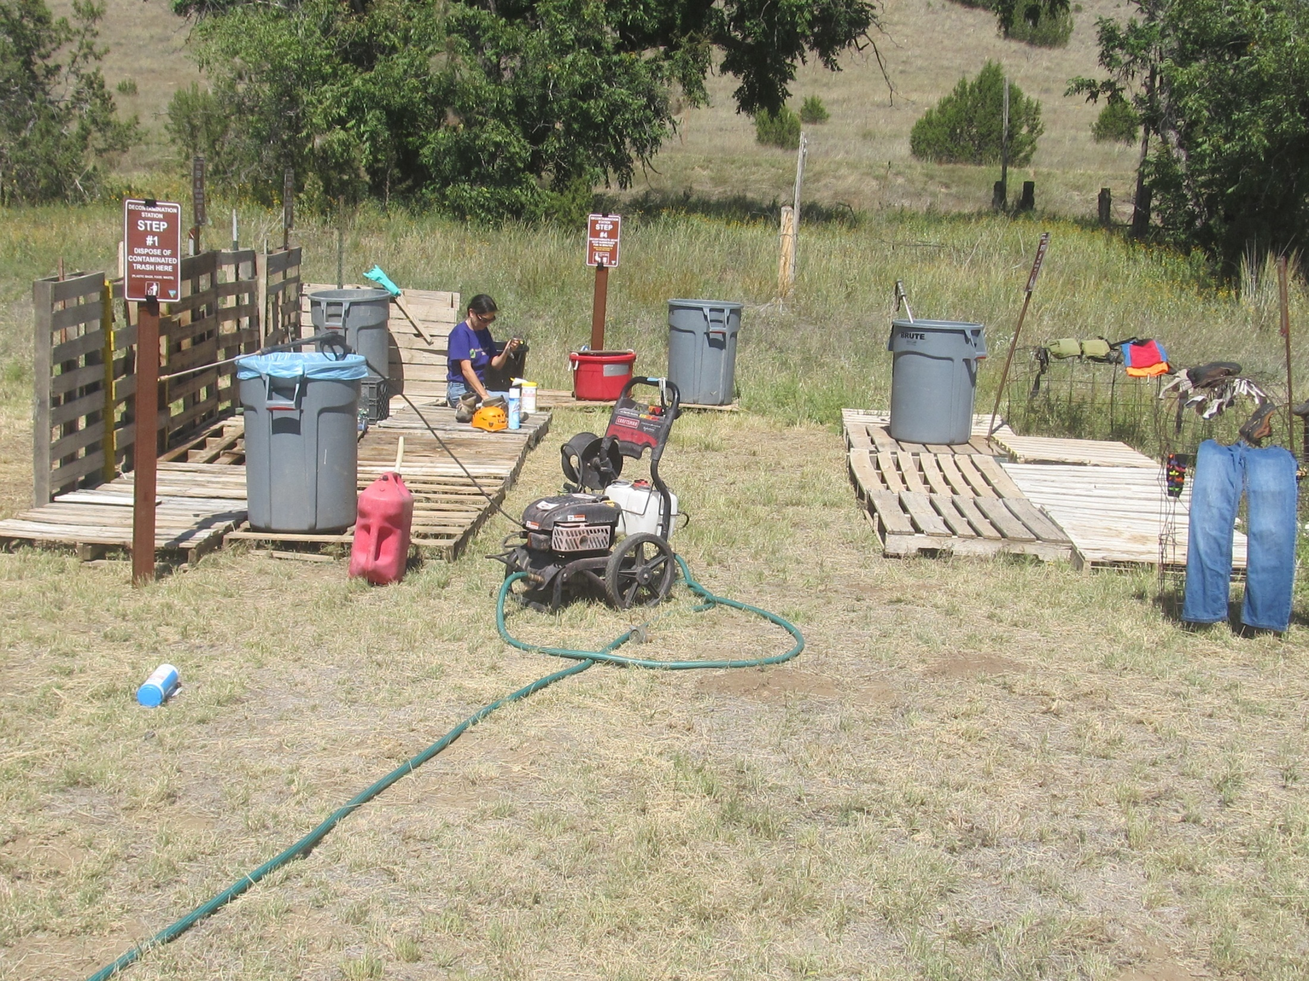
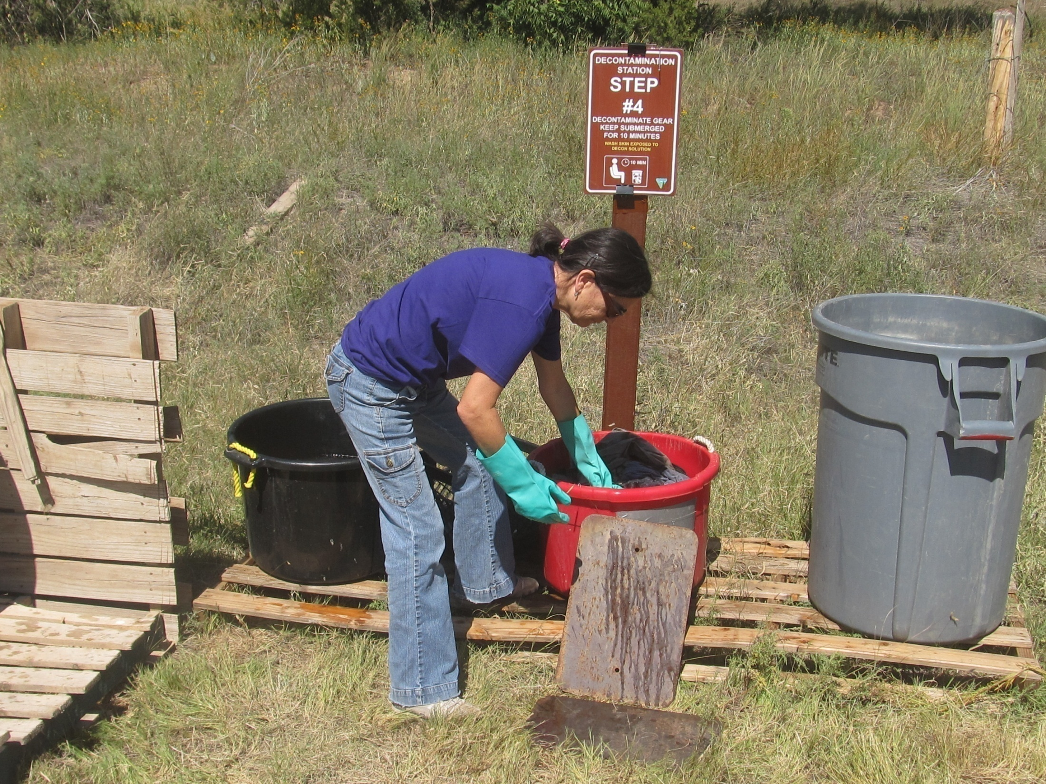
TOXIC
Quat Decon Station
Fumes affecting Cavers

Slide 7
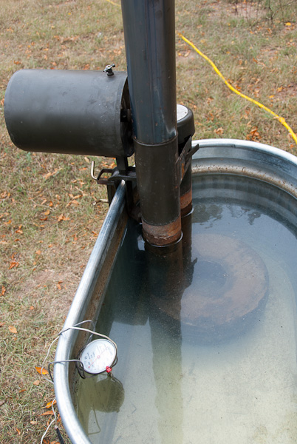
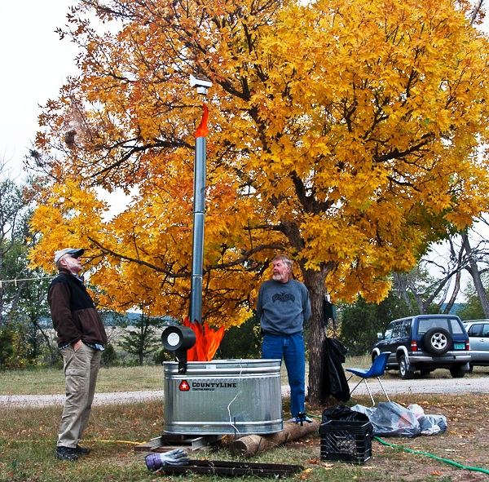
military submersible kerosene heater
DANGEROUS

Slide 8
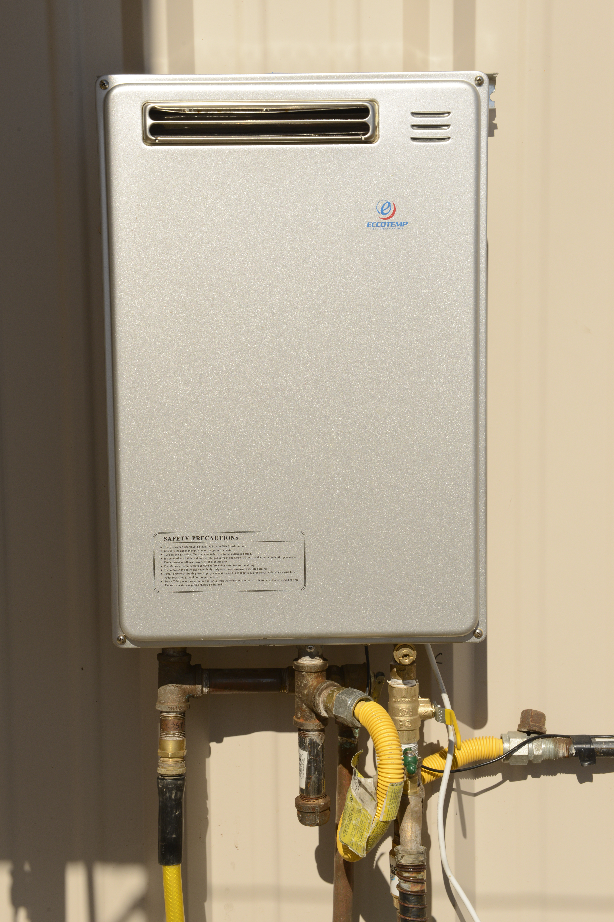
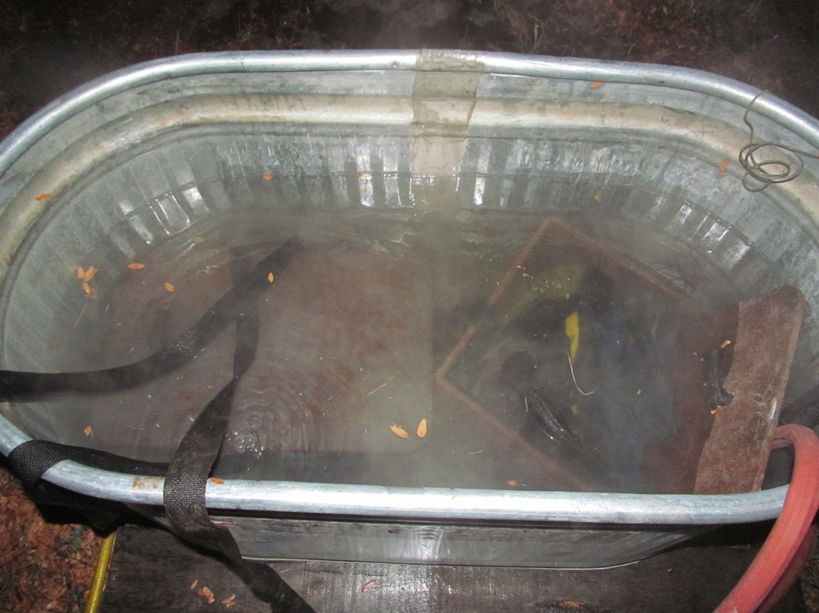
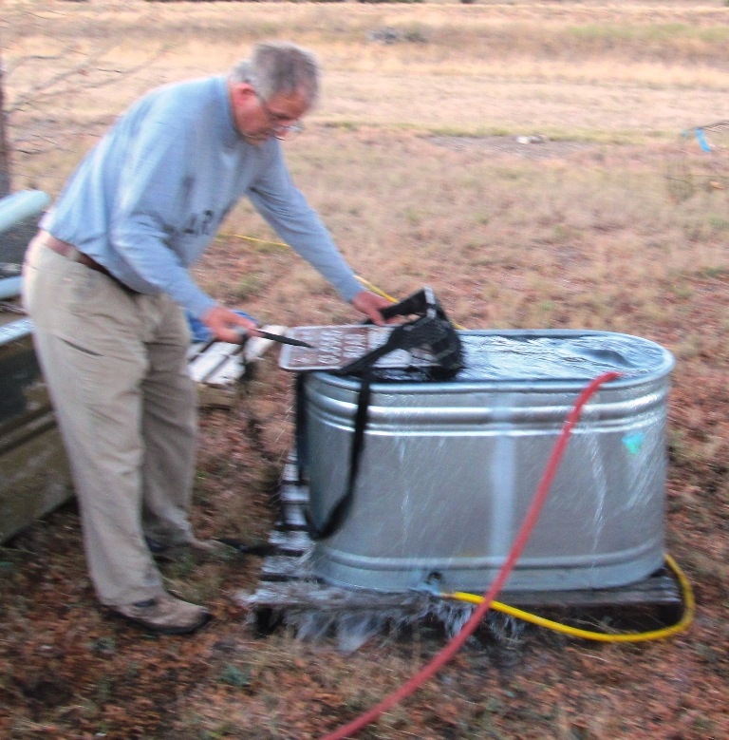
First Tankless water heater (non-portable)
2012 DECON:
50°C / 122°F
Max Temp 130°F

Slide 9
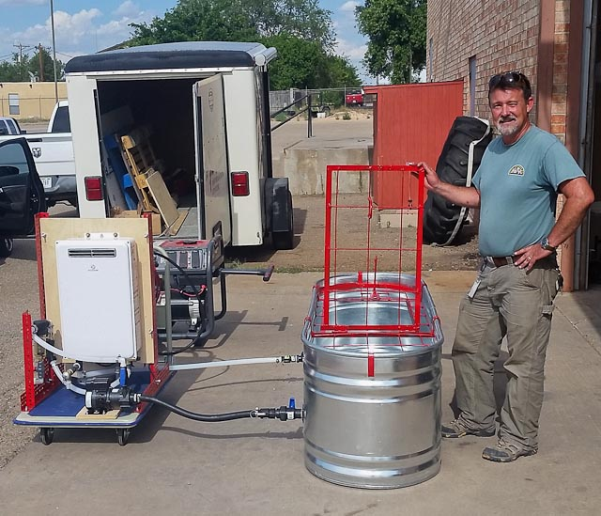
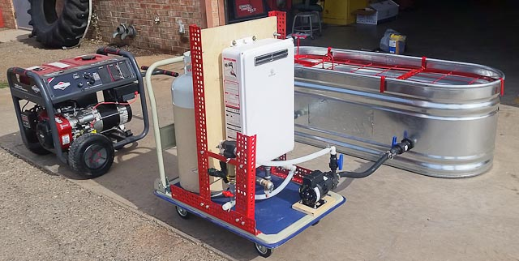
Portable tankless propane water heater
NEW DECON: 55°C / 131°F
Max Temp 155°F

Slide 10
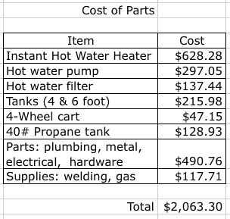
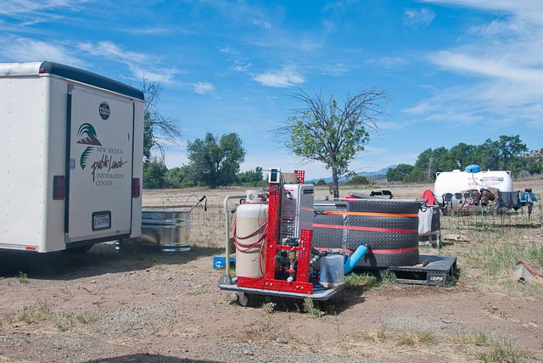
Cost
Additional costs:
2nd 40# propane tank
Hundreds of feet of Hose
Splitters, Pressure Regulator
Drying Racks
Scrub Brushes
Final costs came to ~$2500
RFO Cave Program already owned a trailer, generator, and power washer

Slide 11
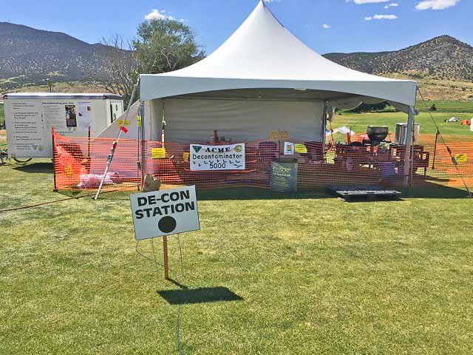
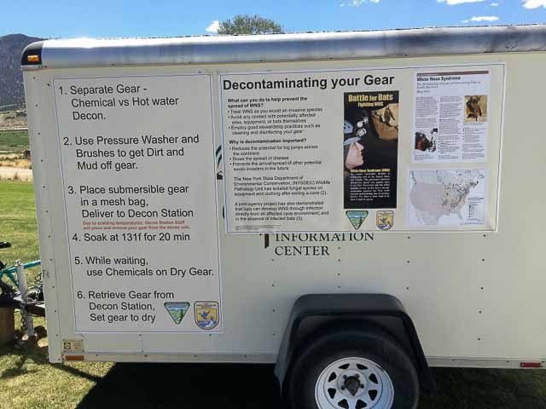
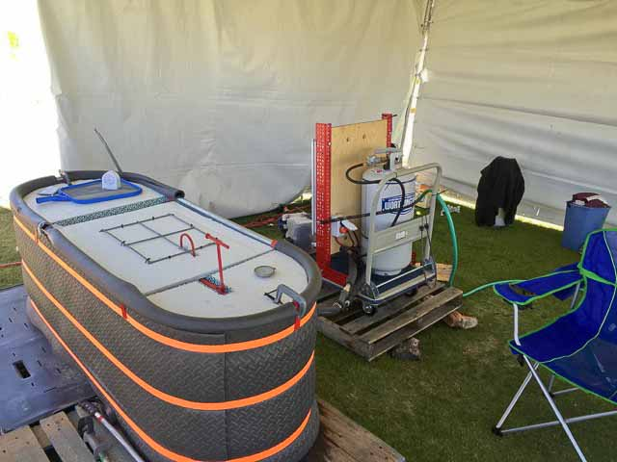
Field Test @ 2016 NSS Convention, ELY NV

Slide 12
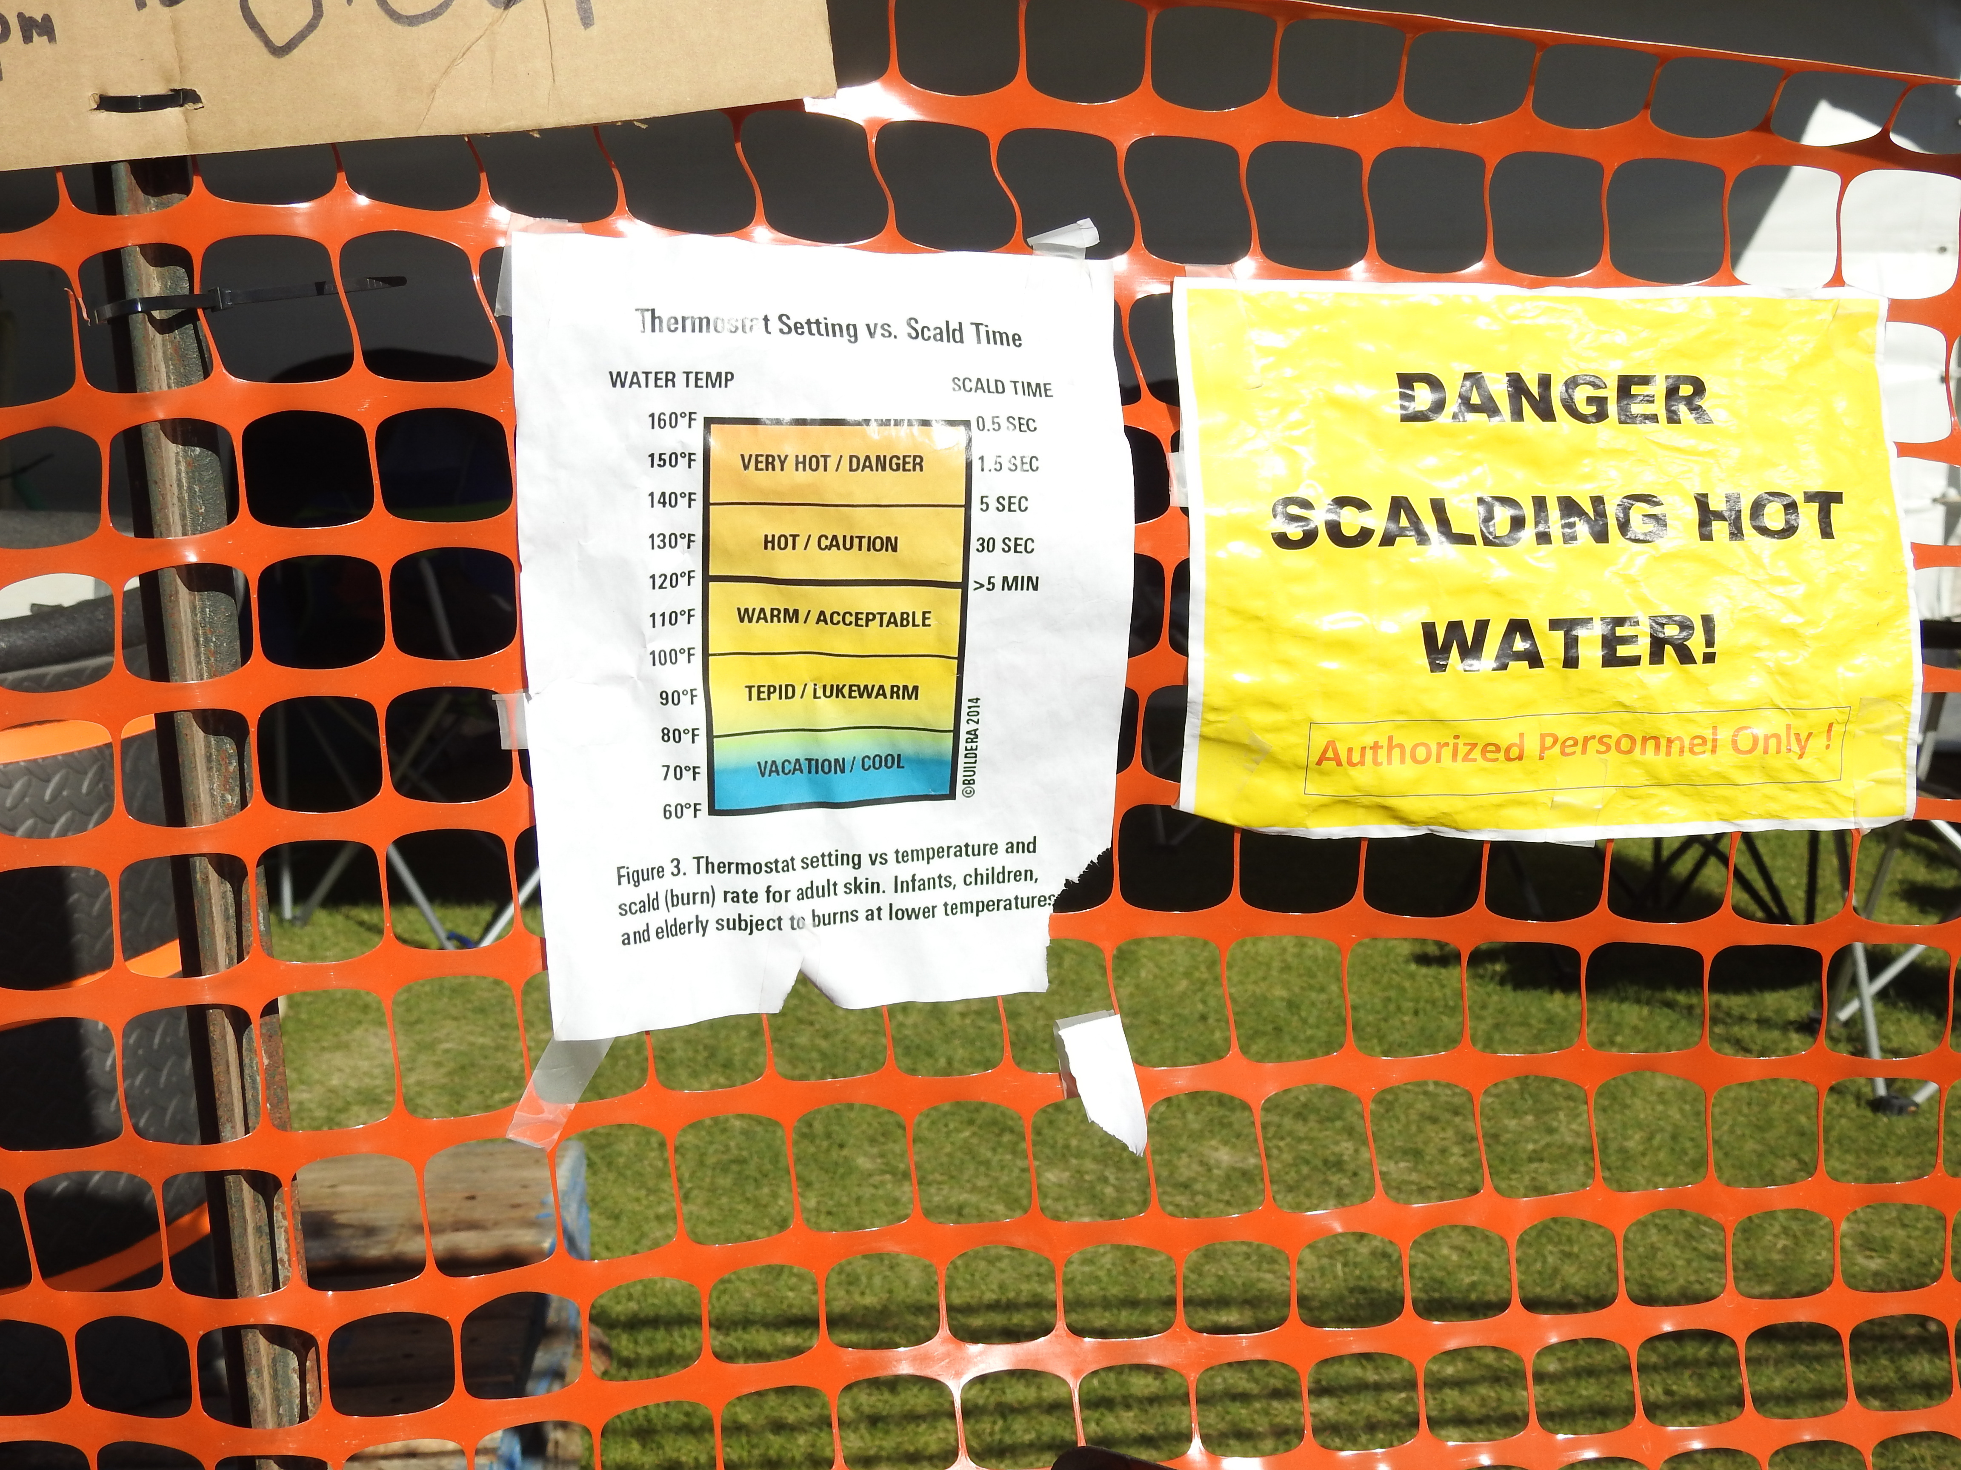
SETUP FOR CONVENTION LEVEL EVENT
PRE CONVENTION WORK:
Have convention inform attendees of current WNS decon expectations
Work with all trip leaders to provide supplies and decon guidance for post trip
CAVE CONDITIONS:
What are the conditions in the caves that will be visited?
Are the caves muddy caves, or just dusty? Or a combination.
EXPECTATIONS:
Decon up to 150 sets of gear per day
DELIVERABLE:
Provide decon for 6 days without fail.
HOURS OF OPERATION:
All day - the first 3 days, then 3pm to 8pm
The convention should provide a 20x20 tent, a water source, electricity, and VOLUNTEERS to help run the station.

Slide 13
User Process
PRE-DECON GEAR AT THE CAVE FOR CONTAINED TRANSPORT TO DECON STATION
BRING BAGGED GEAR TO DECON STATION AND CHECK IN
VOLUNTEER TALKS CAVER THROUGH DECON PROCESS (EDUCATION)
CAVER WASHES MUD AND DUST OFF GEAR
SEPARATES GEAR FOR HOT WATER OR CHEMICAL DECON
GEAR IS BAGGED FOR HOT WATER DECON AND DELIVERED TO DECON UNIT
BAGGED GEAR IS “COOKED” FOR 25 MIN AT 135ºF
CAVER USES CHLOROX WIPES AND OR 70% ALCOHOL TO CLEAN NON-SUBMERSIABLE GEAR AT CHEM STATION
CAVER RETRIEVES DECONED GEAR FROM DECON STATION
CAVER HANGS GEAR TO DRY AT DRYING RACKS OR TAKES BACK TO CAMP

Slide 14
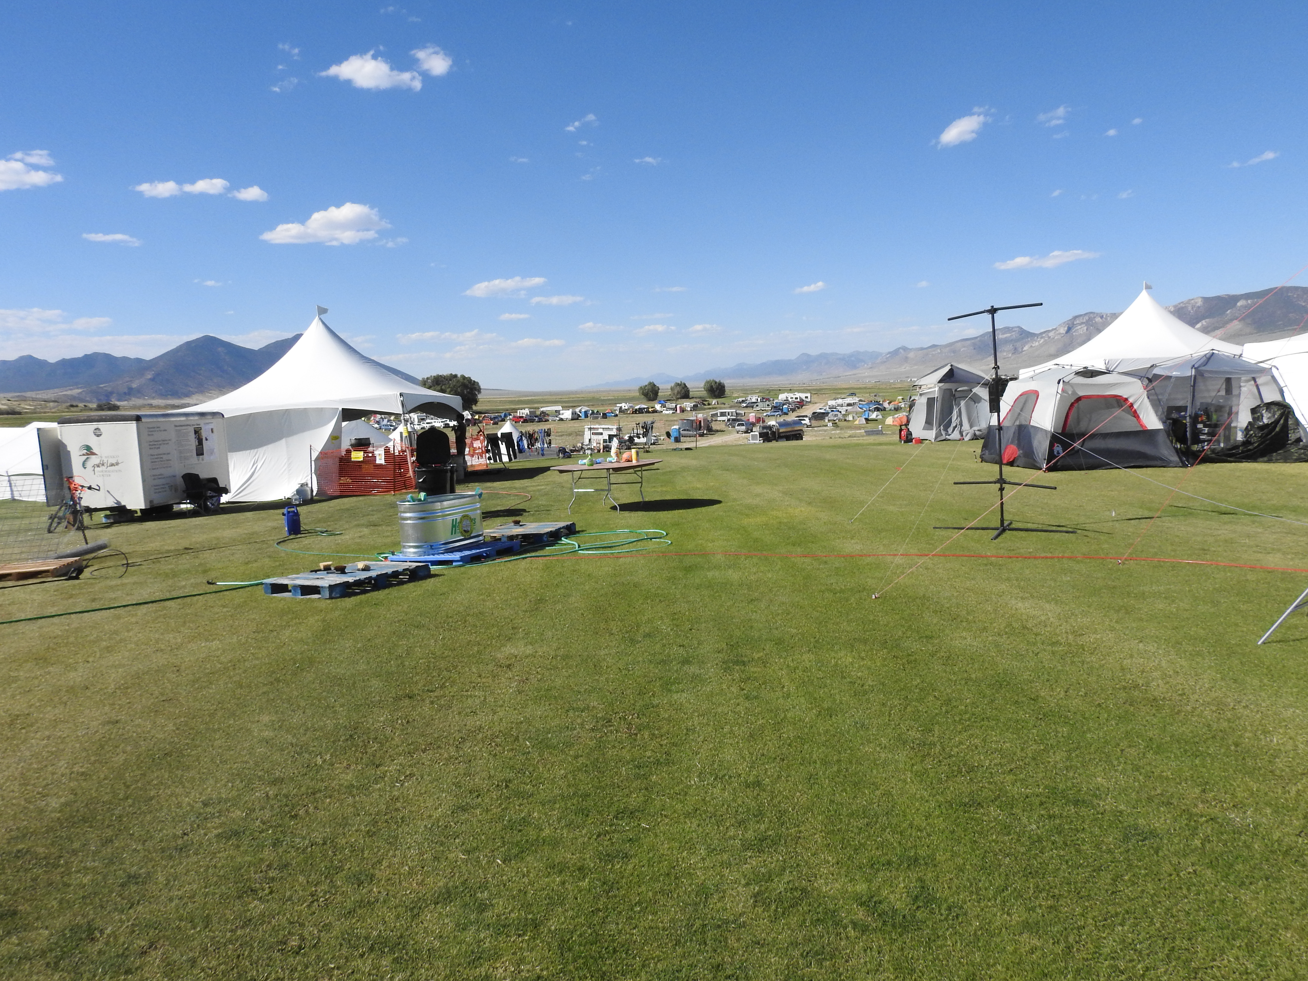
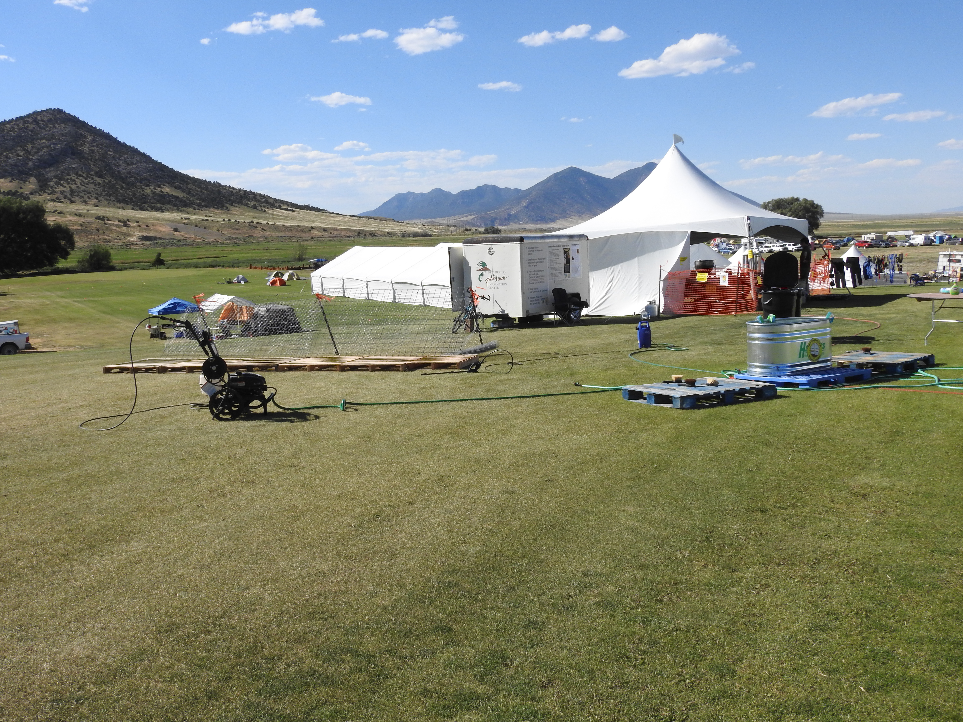
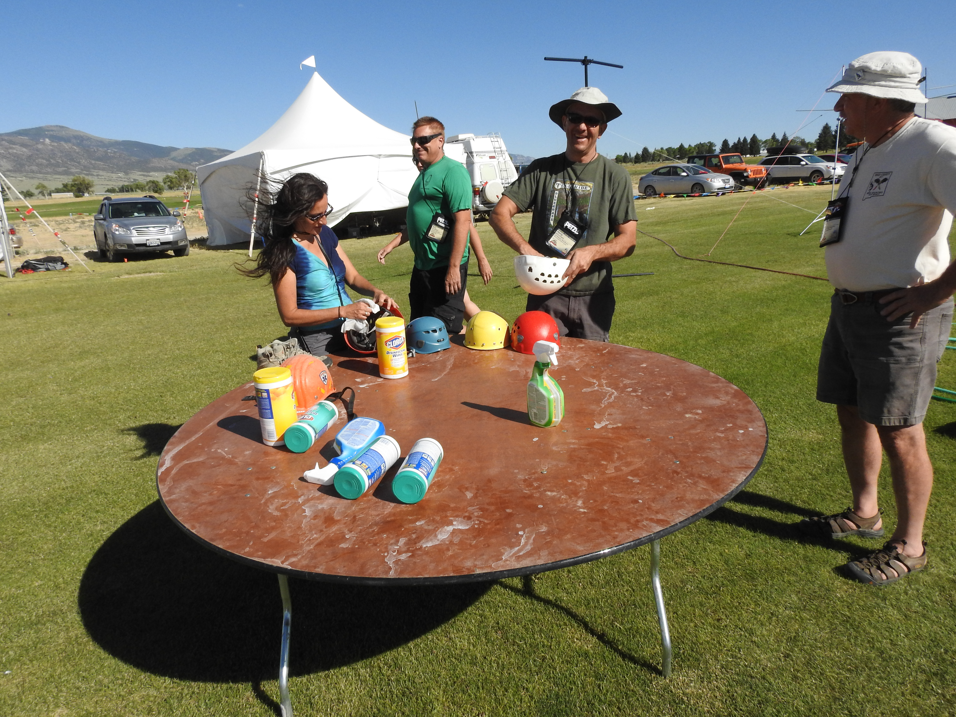
Deposit Gear Here
Chem Station
Dust Station
Mud Station

Slide 15
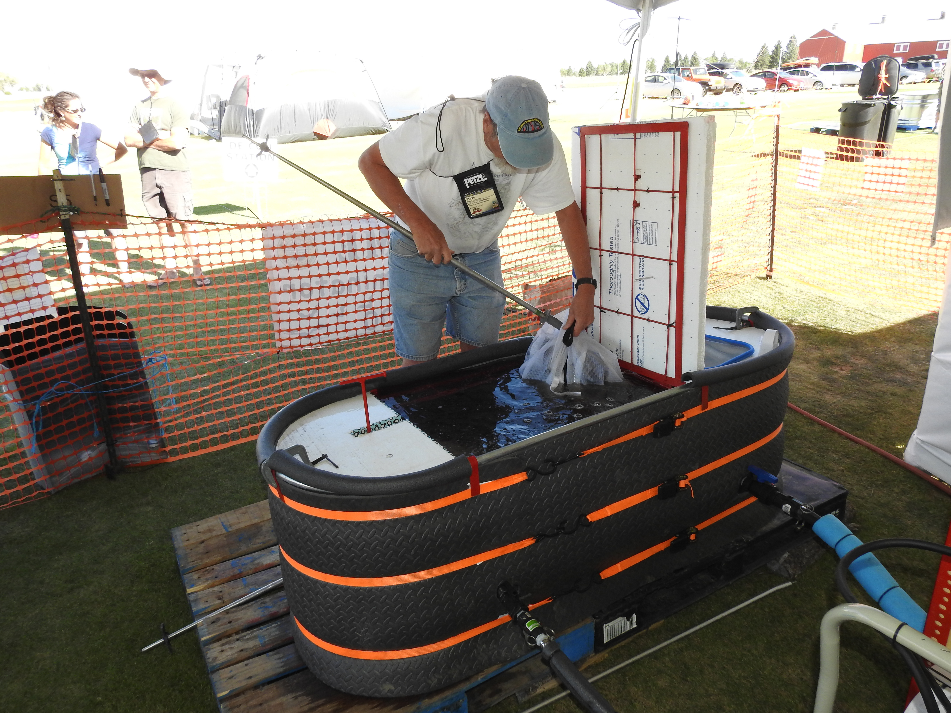
BAGGED GEAR IS “COOKED” FOR 25 MIN AT 135ºF
Gear to be “Cooked” is deposited here by Caver
“Cooked” Gear is deposited outside the fence on a pallet

Slide 16
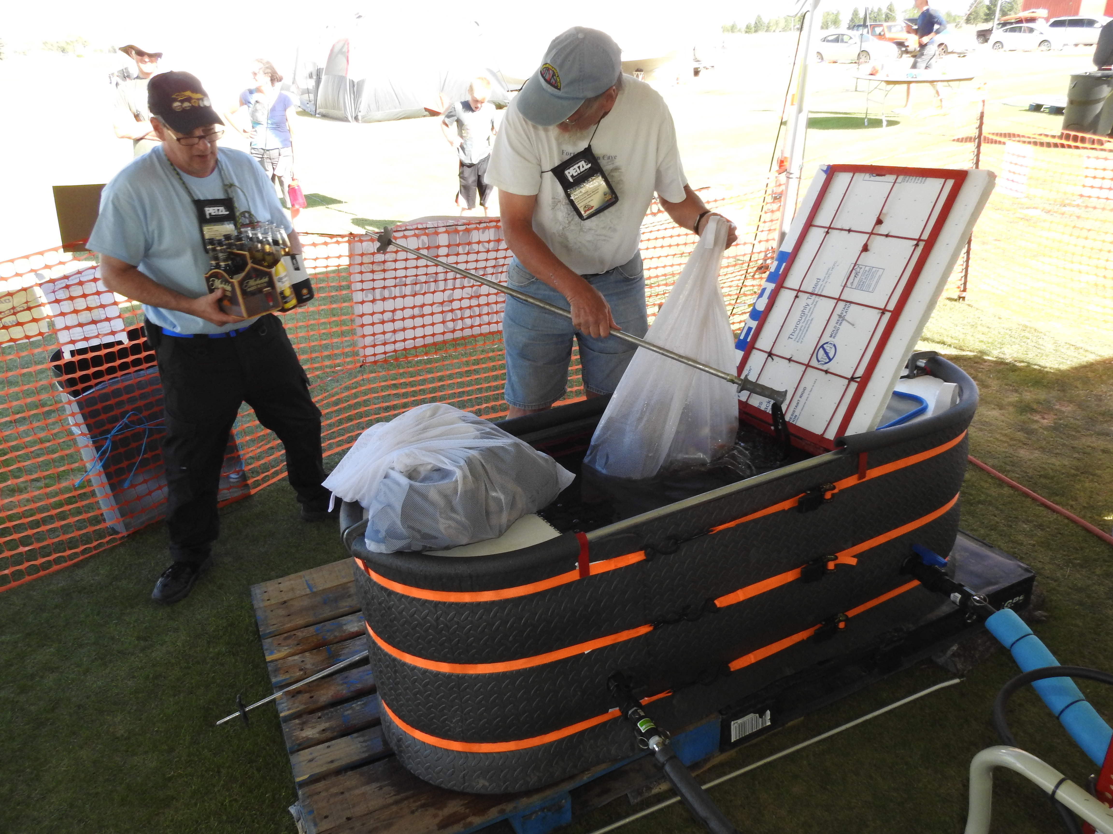
Most cavers are grateful that there is a Decon Station available

Slide 17
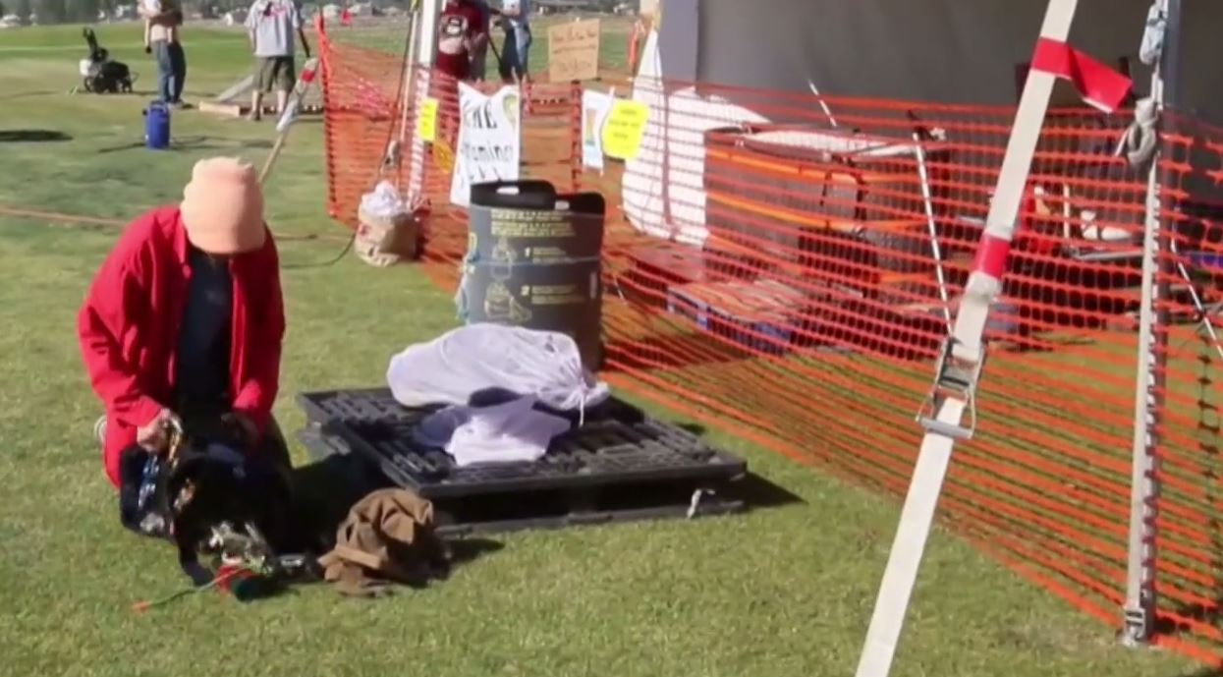
Deconed Gear is deposited on
clean pallet for pickup by Caver

Slide 18
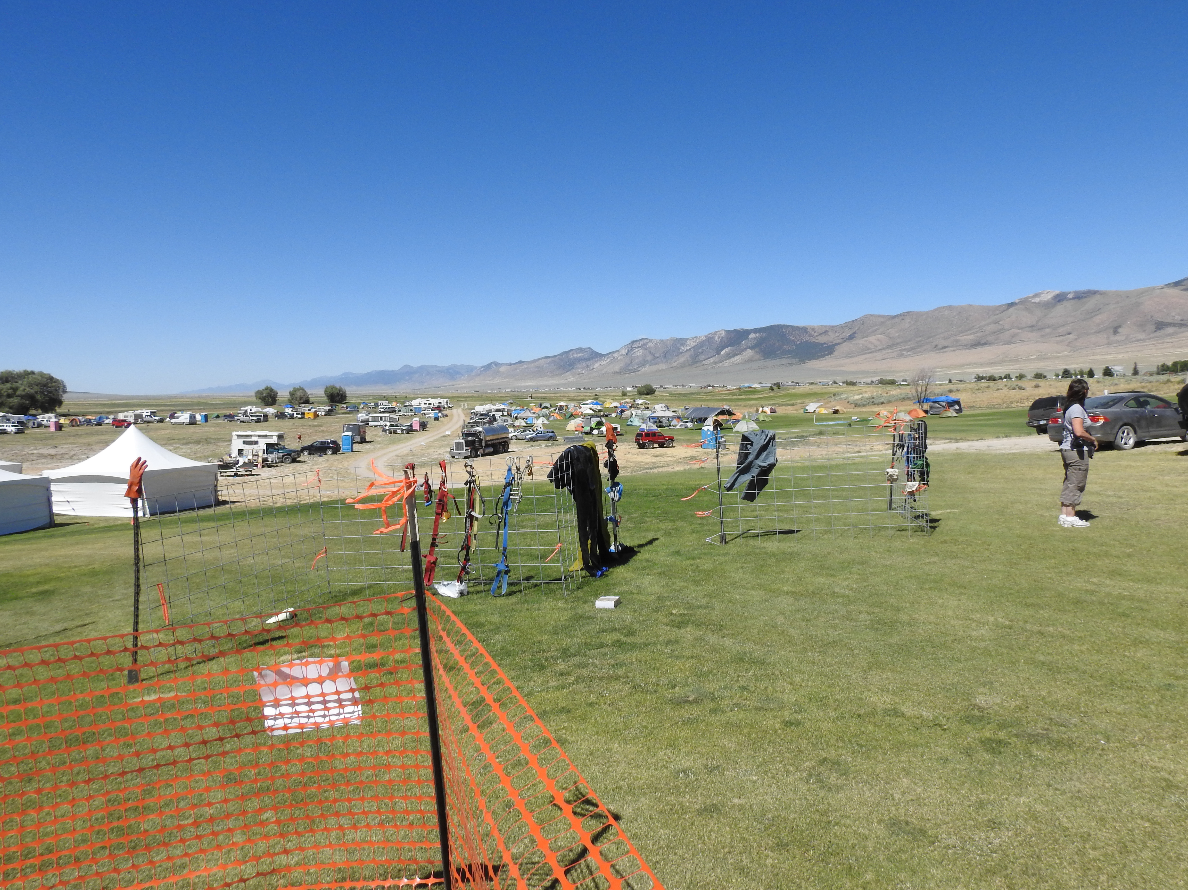
Drying Racks

Slide 19
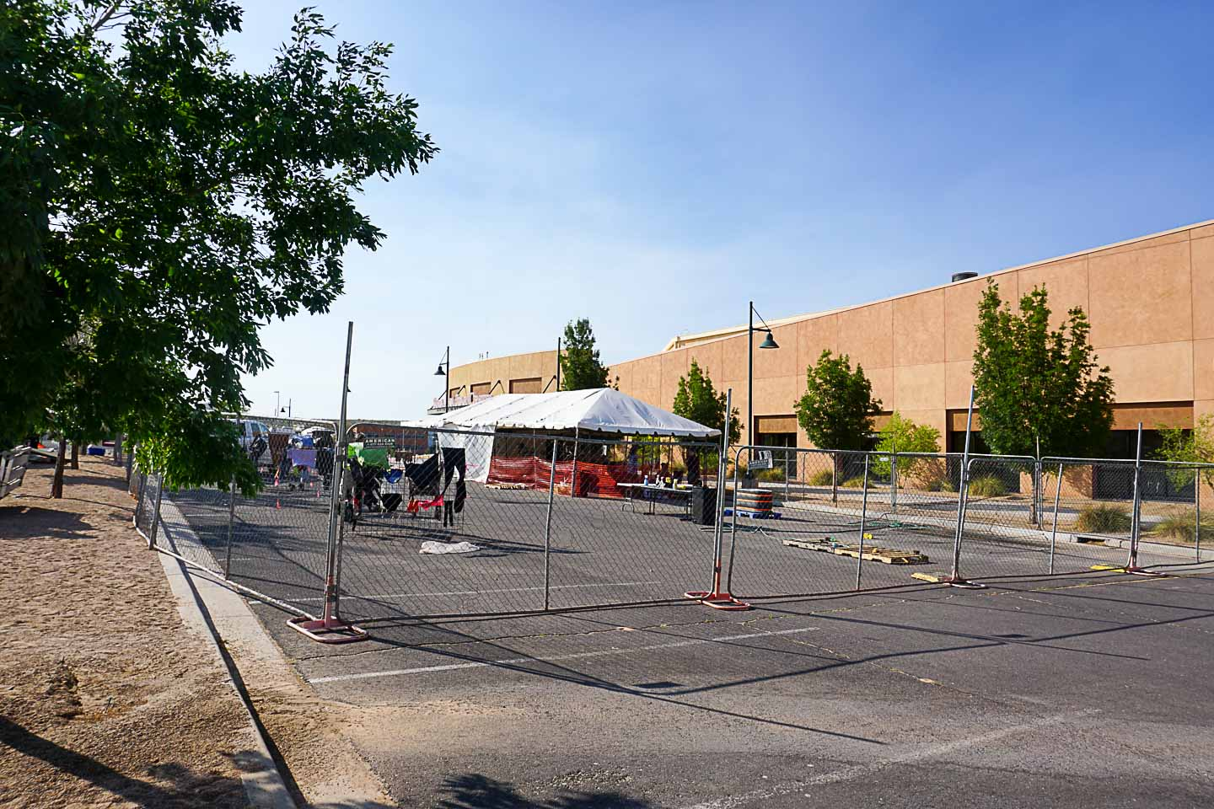
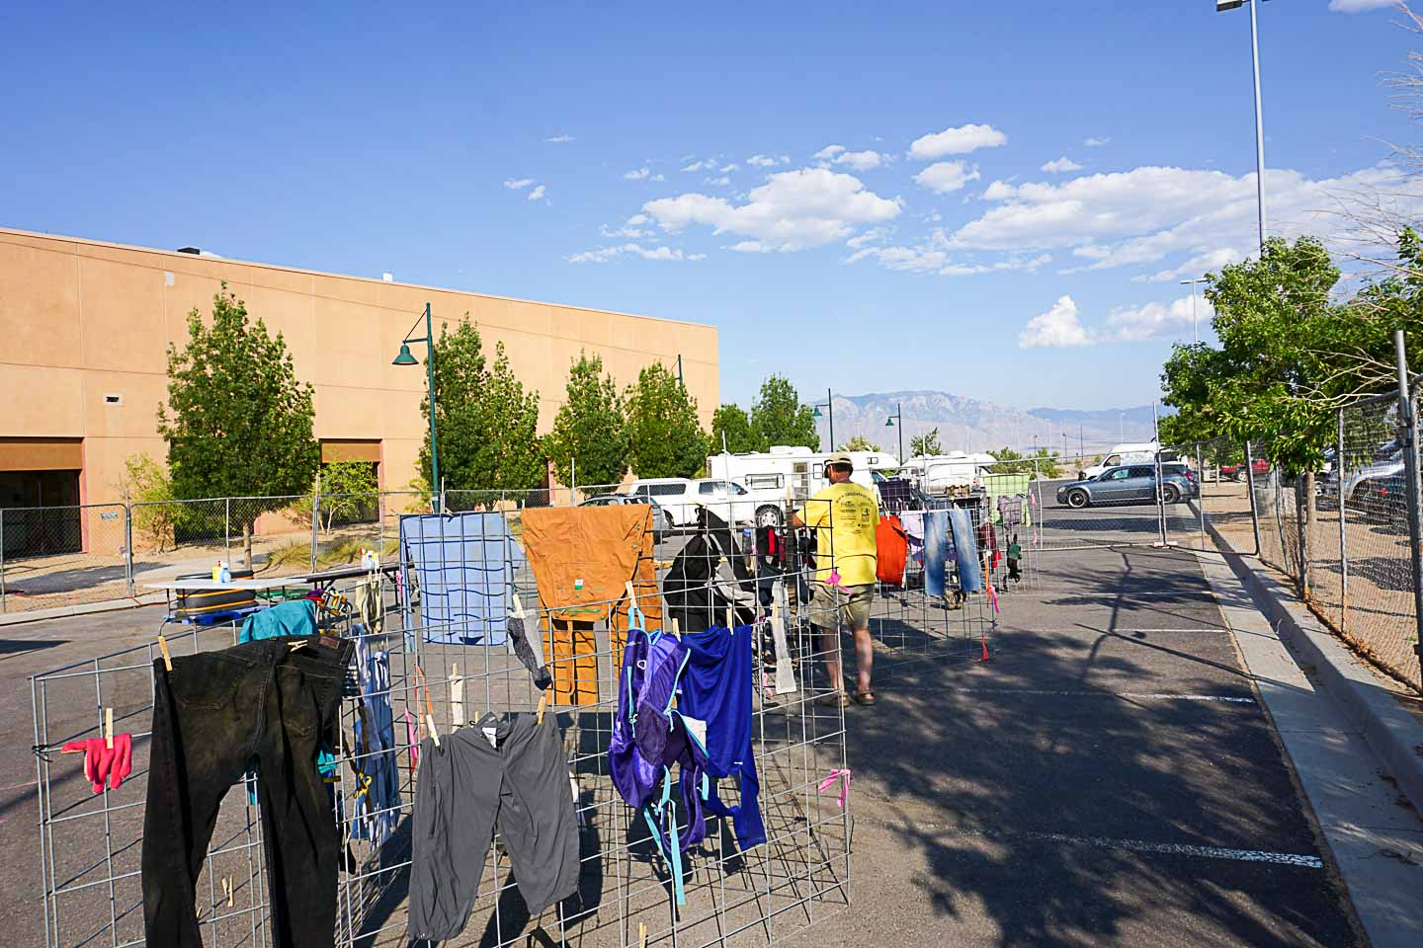
NSS CONVENTIONS
2016 ELY, NV CONVENTION, 1100 ATTENDEES: DECONED 370 SETS OF GEAR
2017 RIO RANCHO, NM CONVENTION - 600 ATTENDEES: DECONED 300 SETS OF GEAR
2018 HELENA, MT. CONVENTION - 1100 ATTENDEES: DECONED 460 SETS OF GEAR
2018 INTERNATIONAL PHOTOGRAPHY SYMPOSIUM
2018 US CAVE RESCUE TRAINING
FT STANTON CAVE EXPEDITIONS ~ 20 TO 60 SETS OF GEAR OVER 9 DAYS

Slide 20
TANKLESS H2O HEATER
SEDIMENT FILTER
PROPANE
PUMP
ELECTRICAL
SOURCE
DECON TANK

Slide 21
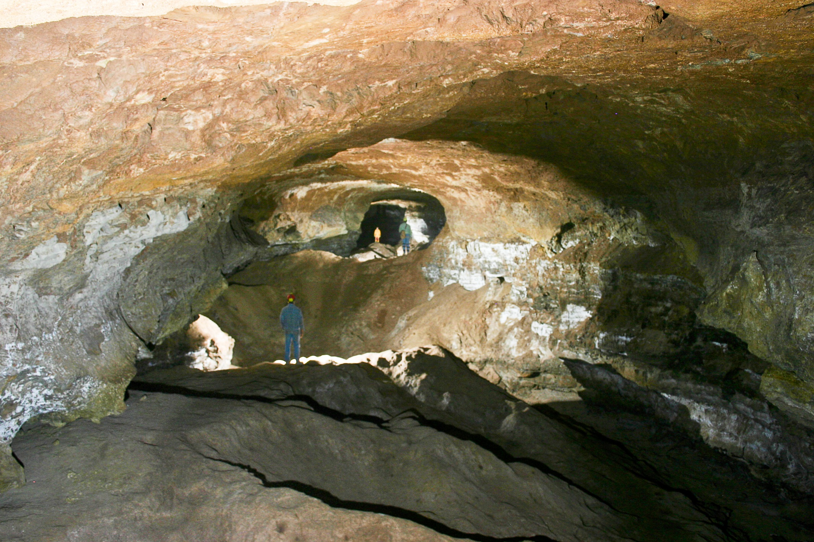
FORT
STANTON
CAVE

Slide 22
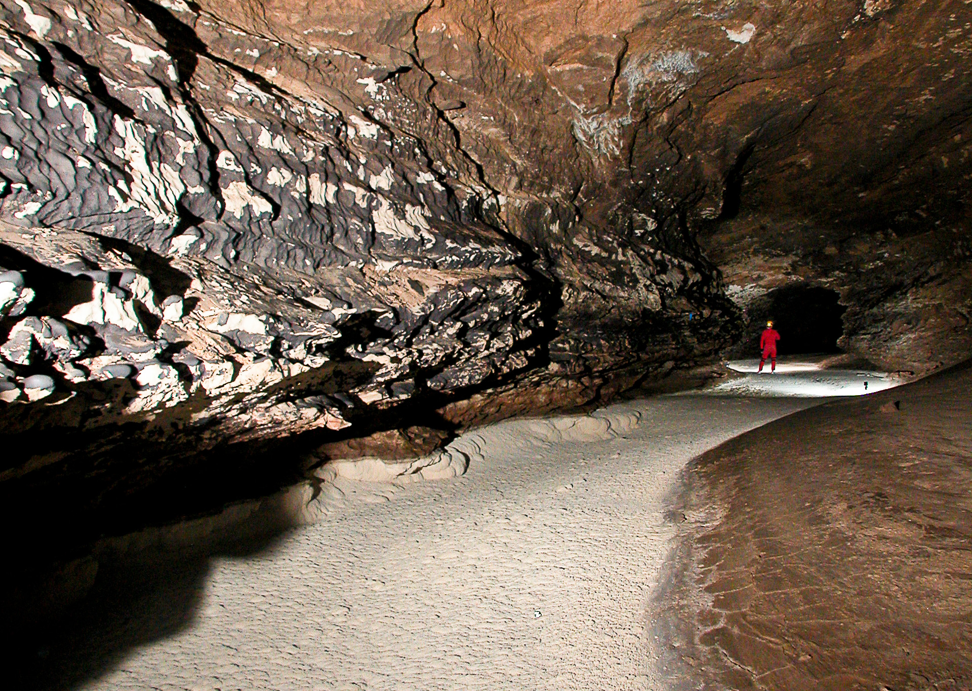
FORT
STANTON
CAVE

Slide 23
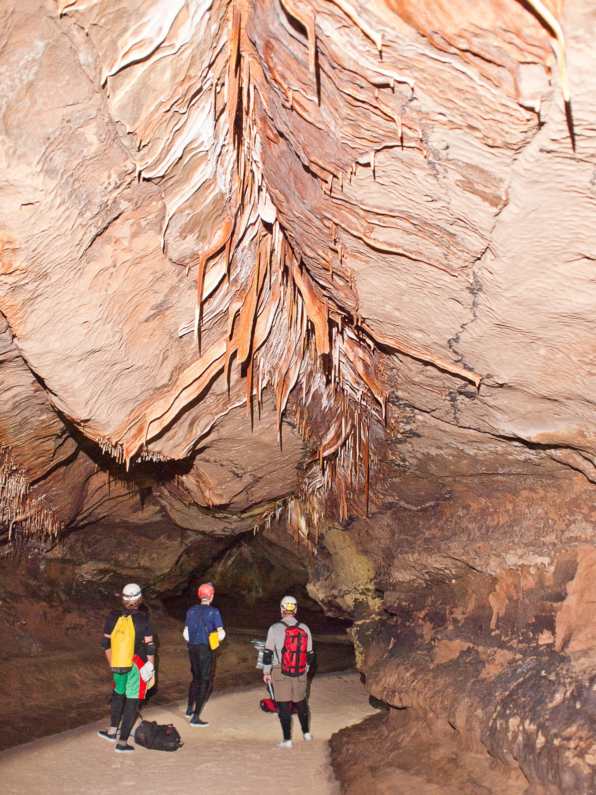
FORT
STANTON
CAVE

Slide 24
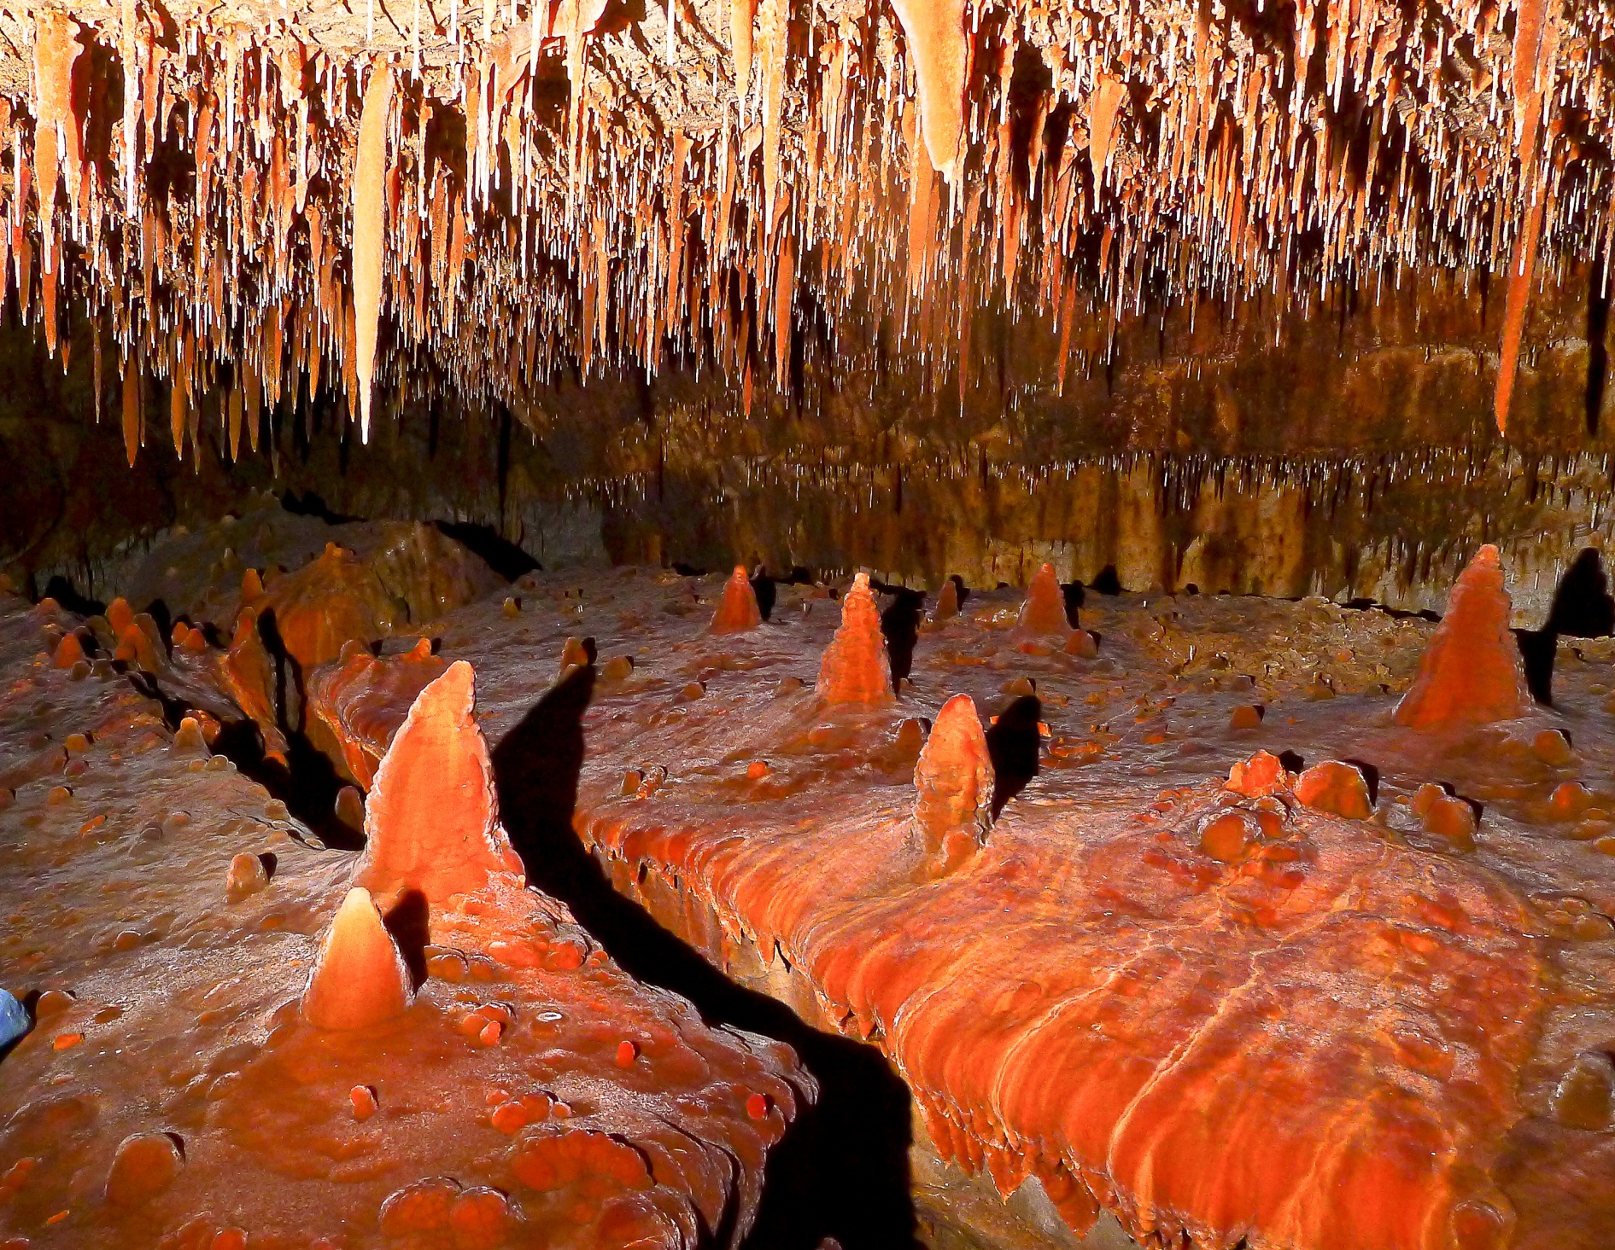
FORT
STANTON
CAVE

