Slide 1
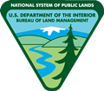
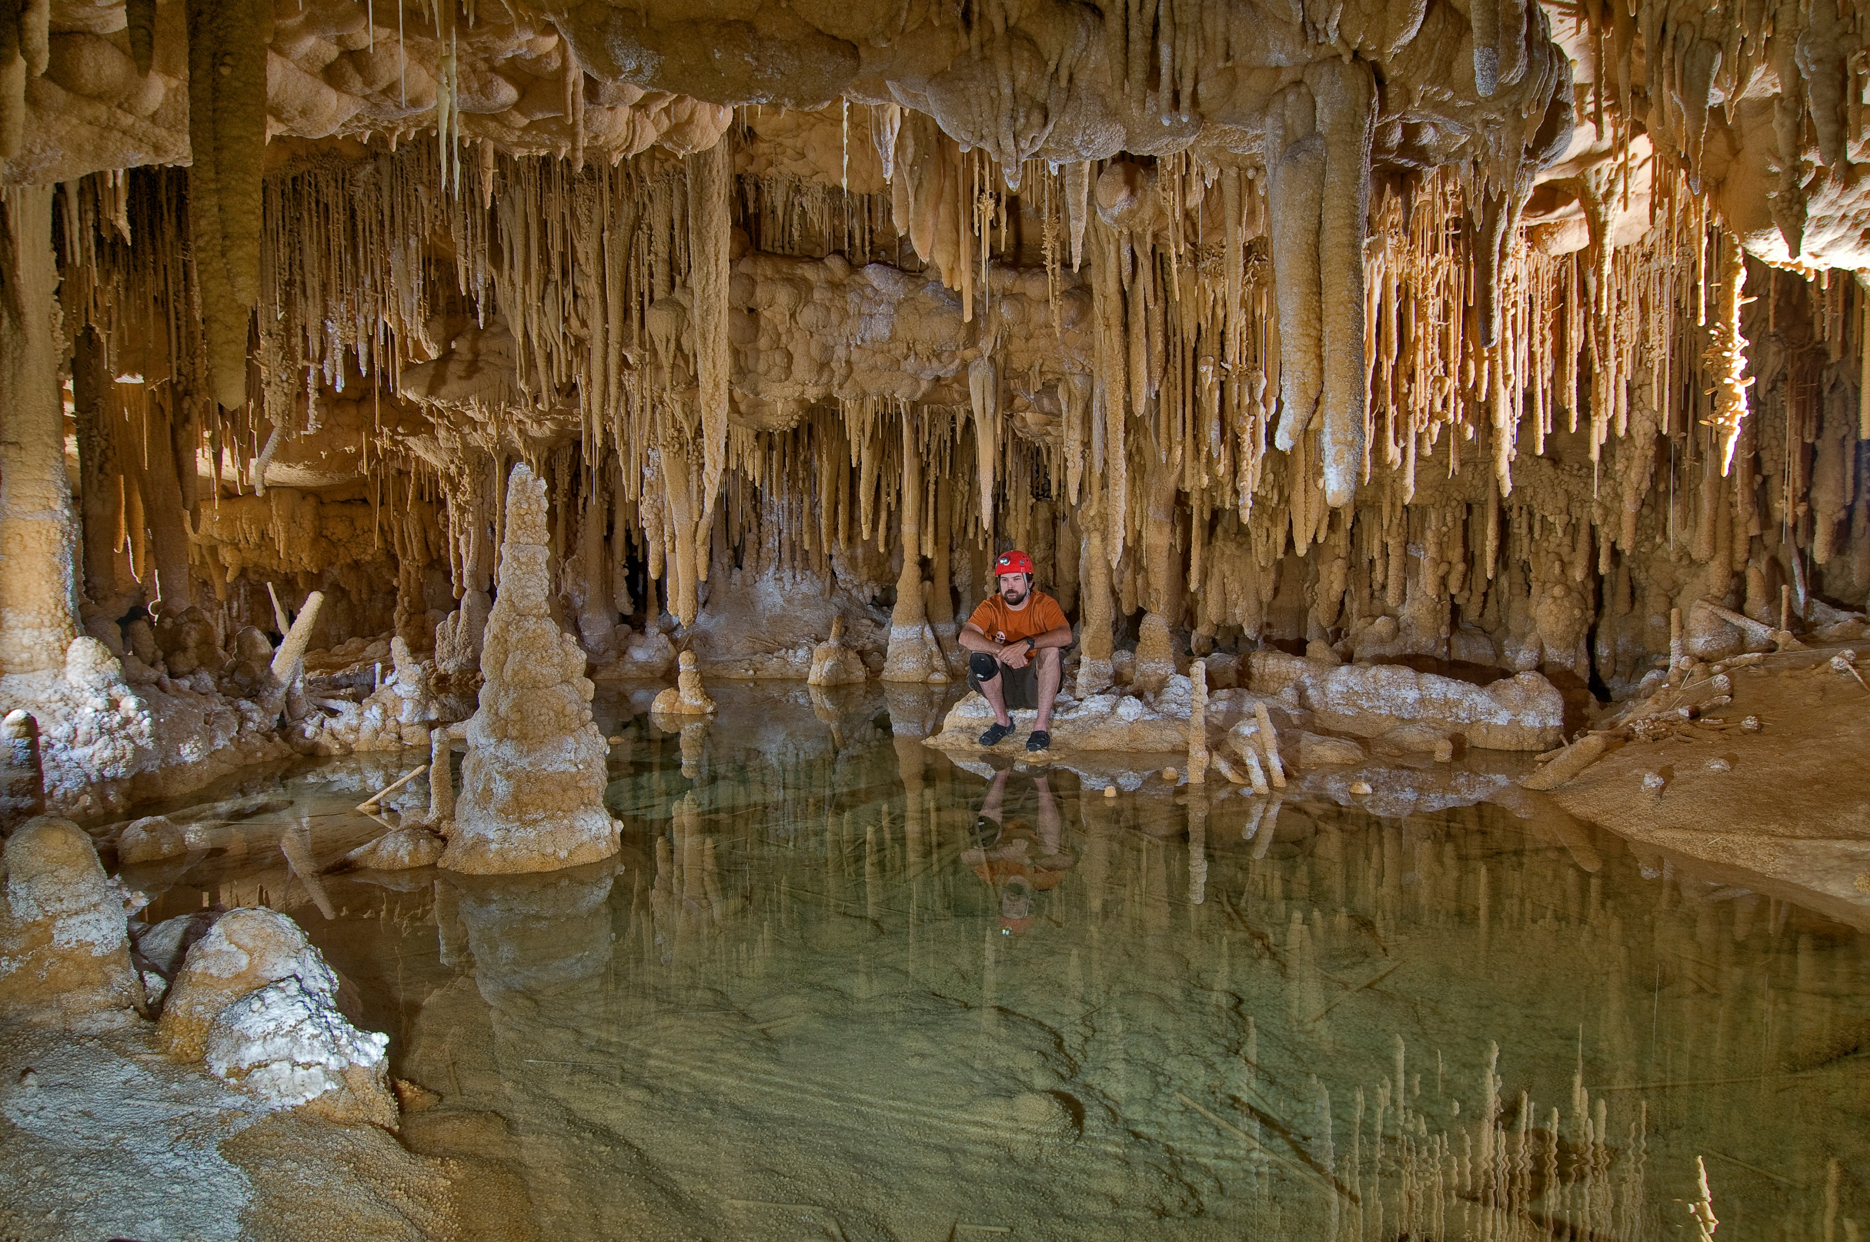
Federal Cave Resources Protection Act of 1988 (FCRPA)
U.S. Department of the Interior Bureau of Land Management
Notes:
Started in 1999 mapping Bloomington Cave with Kyle Voyles. I consider this a great success story.
How many folks have been in a cave? How many have been to a wild cave?

Slide 2
Tiered Relationship
U.S. Department of the Interior Bureau of Land Management
Law
Regulations
Policy
Manual
Land Use Plan
Allocations, Designations, Stipulations
Management Plans
Restrictions
Notes:
What do you know about Bloomington Cave?

Slide 3
Context of Protection in Law
U.S. Department of the Interior Bureau of Land Management
to protect significant caves.
to evaluate significance against clear criteria.
to Foster cooperation and exchange information.
Notes:
What do you know about Bloomington Cave?

Slide 4
Sec 2: Purpose & Policy
U.S. Department of the Interior Bureau of Land Management
Secure , Protect, & Preserve Significant Caves on Federal Lands
Foster cooperation & exchange of information between Government & cave users
Notes:
What do you know about Bloomington Cave?

Slide 5
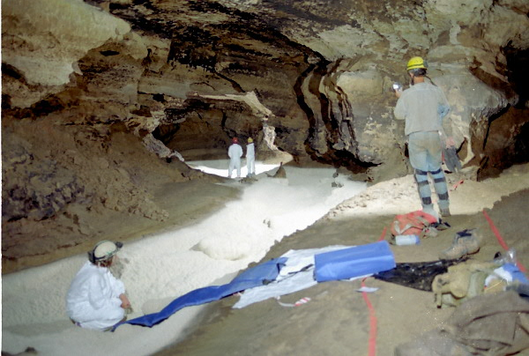
Policy
U.S. Department of the Interior Bureau of Land Management
Federal lands will be managed to protect and maintain significant caves, to the extent practical.
Notes:
What do you know about Bloomington Cave?

Slide 6
Sec. 3 Definitions
U.S. Department of the Interior Bureau of Land Management
Cave : Any naturally occurring void, cavity, recess, or system of interconnected passages beneath the surface of the earth.
Including natural pits, sinkholes, or other feature which is an extension of the entrance.
Notes:
What do you know about Bloomington Cave?

Slide 7
Sec. 3 Definitions
U.S. Department of the Interior Bureau of Land Management
(including any cave resource therein, but not including any vug, mine, tunnel, aqueduct, or other manmade excavation)
Vug – A small cavity in a rock or vein, often with a mineral lining of different composition from that of the surrounding rock.
Origin is from the Cornish vooga meaning “a cave”
Notes:
What do you know about Bloomington Cave?

Slide 8
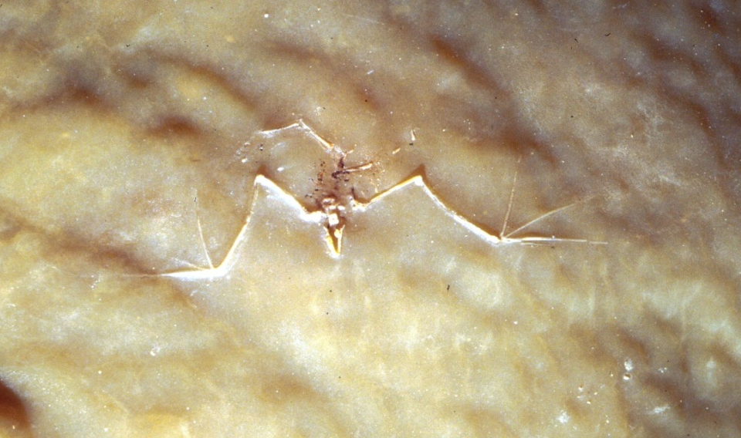
Definitions
U.S. Department of the Interior Bureau of Land Management
Cave Resources - Any material or substance occurring in caves on Federal lands such as; animal life, plant life, Paleontological deposits, sediments, minerals, speleogens, & speleothems.
Notes:
What do you know about Bloomington Cave?

Slide 9
Sec. 4 Management Actions
U.S. Department of the Interior Bureau of Land Management
(A) Regulations:
Develop and issue criteria to identify significant caves
Achieved through inventory and designation
Achieved through land use planning (ACEC, Land use allocations, goal or objective)
Achieved by administrative action (Interim administrative determination of significance)
Notes:
What do you know about Bloomington Cave?

Slide 10
Sec. 4 Management Actions
U.S. Department of the Interior Bureau of Land Management
(B) General
Use restrictions for significant caves
Enter into volunteer management agreements with the scientific and recreational caving community
Notes:
What do you know about Bloomington Cave?

Slide 11
Sec. 4 Management Actions
U.S. Department of the Interior Bureau of Land Management
(C) Planning & Public Participation
Consider caves in any land management planning efforts - NEPA
Foster communication, cooperation, & exchange of information between land managers and the caving community
Notes:
What do you know about Bloomington Cave?

Slide 12
Sec. 7 Prohibited Acts
U.S. Department of the Interior Bureau of Land Management
Destroy, disturb, deface, mar, alter, remove, or harm Cave Resources.
Possess, consume, sell, barter, or exchange Cave Resources.
Counsels, procures, solicits, or employs others to violate the law.
Notes:
What do you know about Bloomington Cave?

Slide 13
Sec. 8 Penalties
U.S. Department of the Interior Bureau of Land Management
Up to $10,000 or 1 year imprisonment
Notes:
What do you know about Bloomington Cave?

