Slide 1
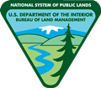
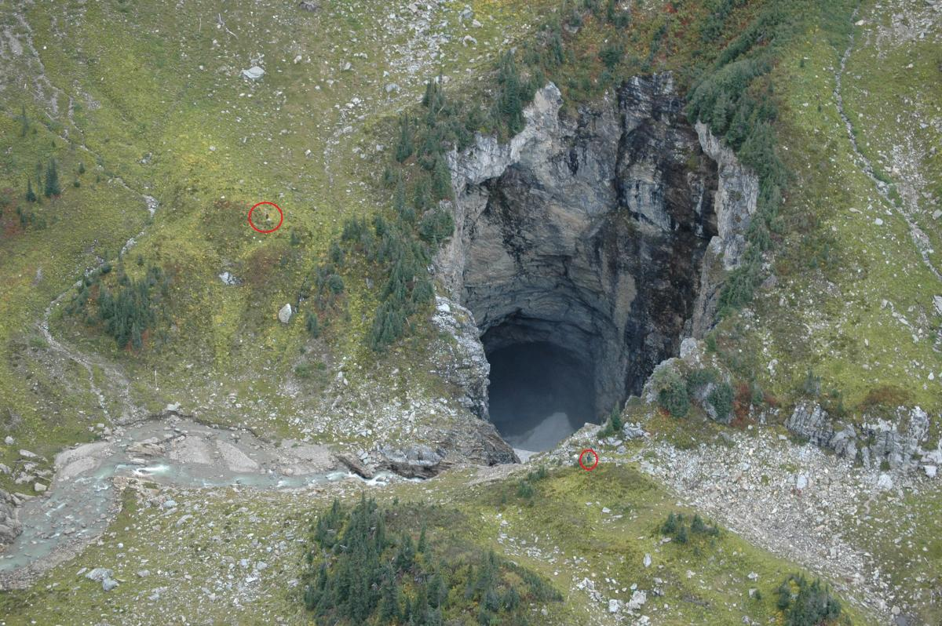
Karst & Cave Reconnaissance
U.S. Department of the Interior Bureau of Land Management
Notes:
Cave found in Canada Dec 2018. Sallacc’s Pit
Entrance is 100 m long and 60 meters wide with a depth of 135 meters.

Slide 2
AKA – How to Find Caves
U.S. Department of the Interior Bureau of Land Management
Notes:
What do you know about Bloomington Cave?

Slide 3
Search the Web
U.S. Department of the Interior Bureau of Land Management
Notes:
What do you know about Bloomington Cave?

Slide 4
Ask cavers
U.S. Department of the Interior Bureau of Land Management
locals
colleges or other specialists
Notes:
Cavers can tell you what to look for: sinkholes, cliff entrances, disappearing streams, blowholes. What geology is best for caves? You don’t have to ask “where are the caves?”
Other specialists could be biologist (bats), fire fighters, OHV/hikers users
Ask about caves, small holes, blowing holes, sinks, disappearing streams, cracks, etc.

Slide 5
Narrow the search by creating maps of your Karst Areas
U.S. Department of the Interior Bureau of Land Management
Notes:
What do you know about Bloomington Cave?

Slide 6
Karst is a landform dominated by features showing drainage through solutional enlarged passages
U.S. Department of the Interior Bureau of Land Management
Notes:
What do you know about Bloomington Cave?

Slide 7
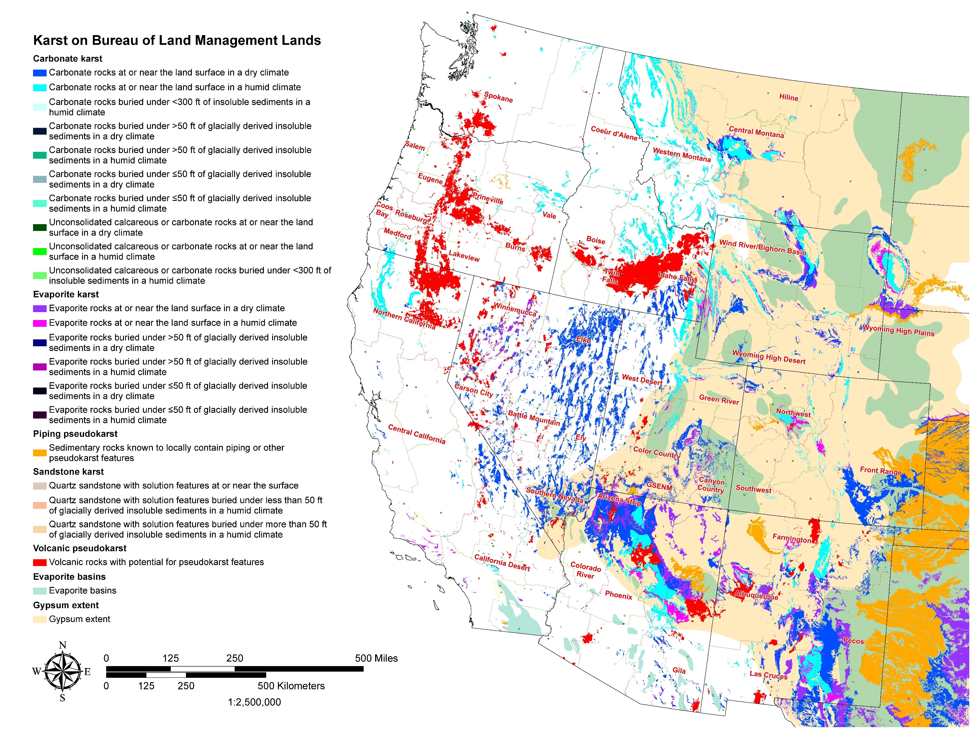
U.S. Department of the Interior Bureau of Land Management
Notes:
What do you know about Bloomington Cave?

Slide 8
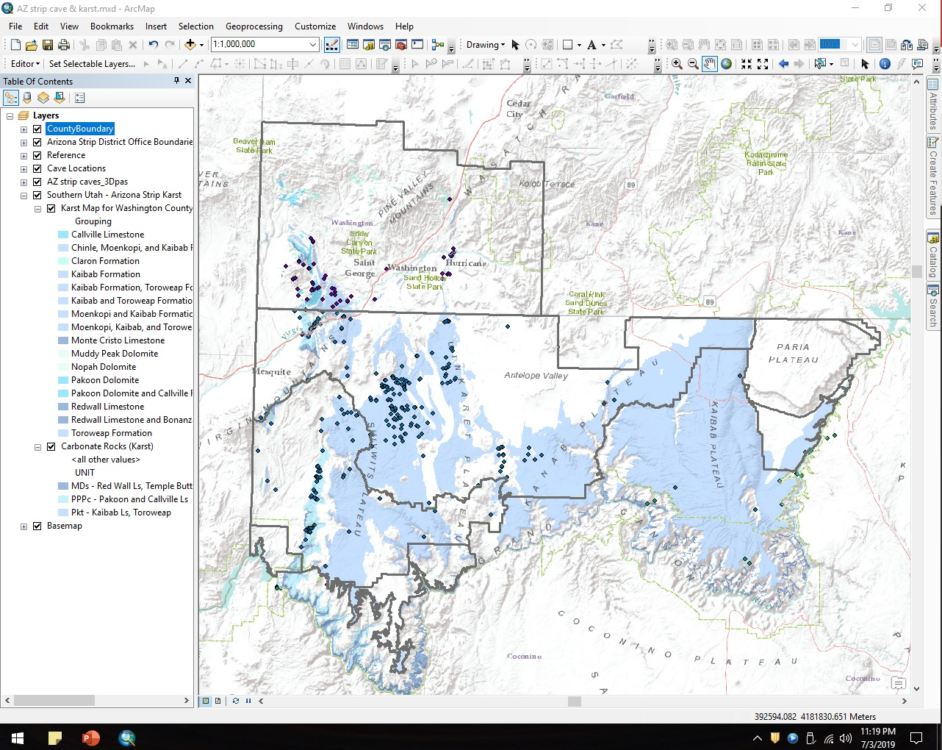
U.S. Department of the Interior Bureau of Land Management
Notes:
What do you know about Bloomington Cave?

Slide 9
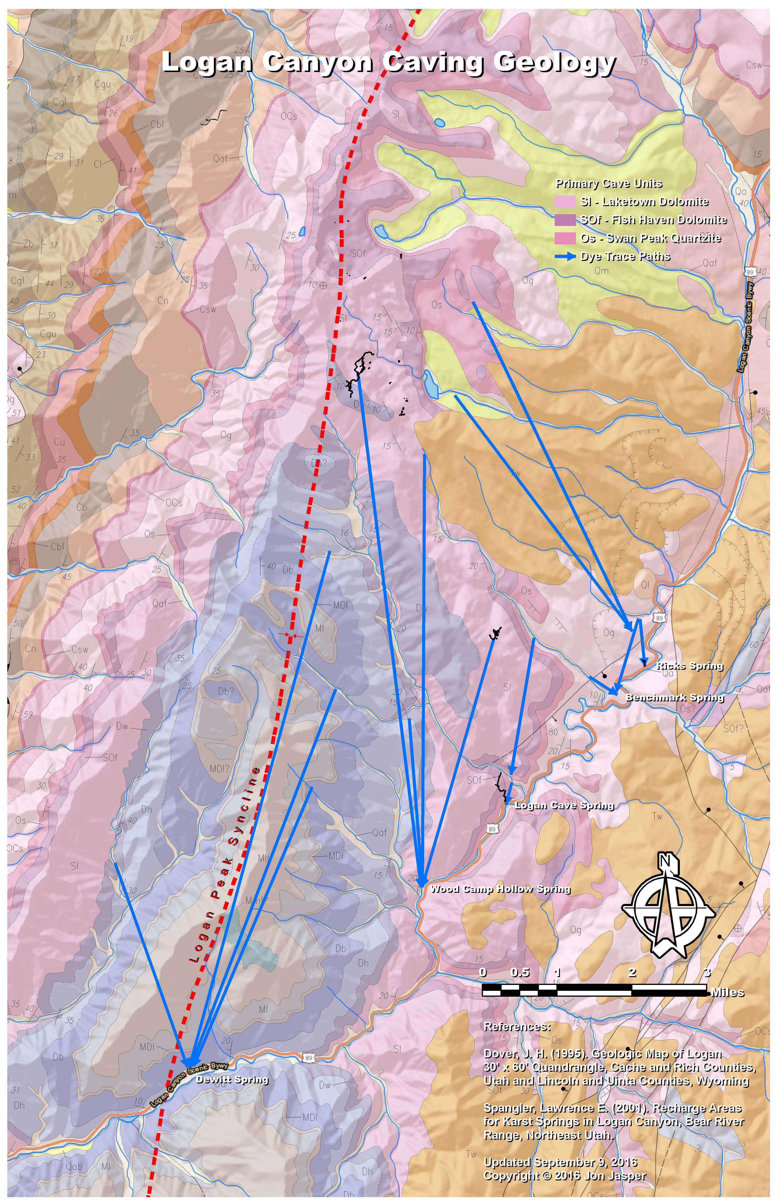
U.S. Department of the Interior Bureau of Land Management
Notes:
What do you know about Bloomington Cave?

Slide 10
Search maps for karst features
U.S. Department of the Interior Bureau of Land Management
Notes:
What do you know about Bloomington Cave?

Slide 11
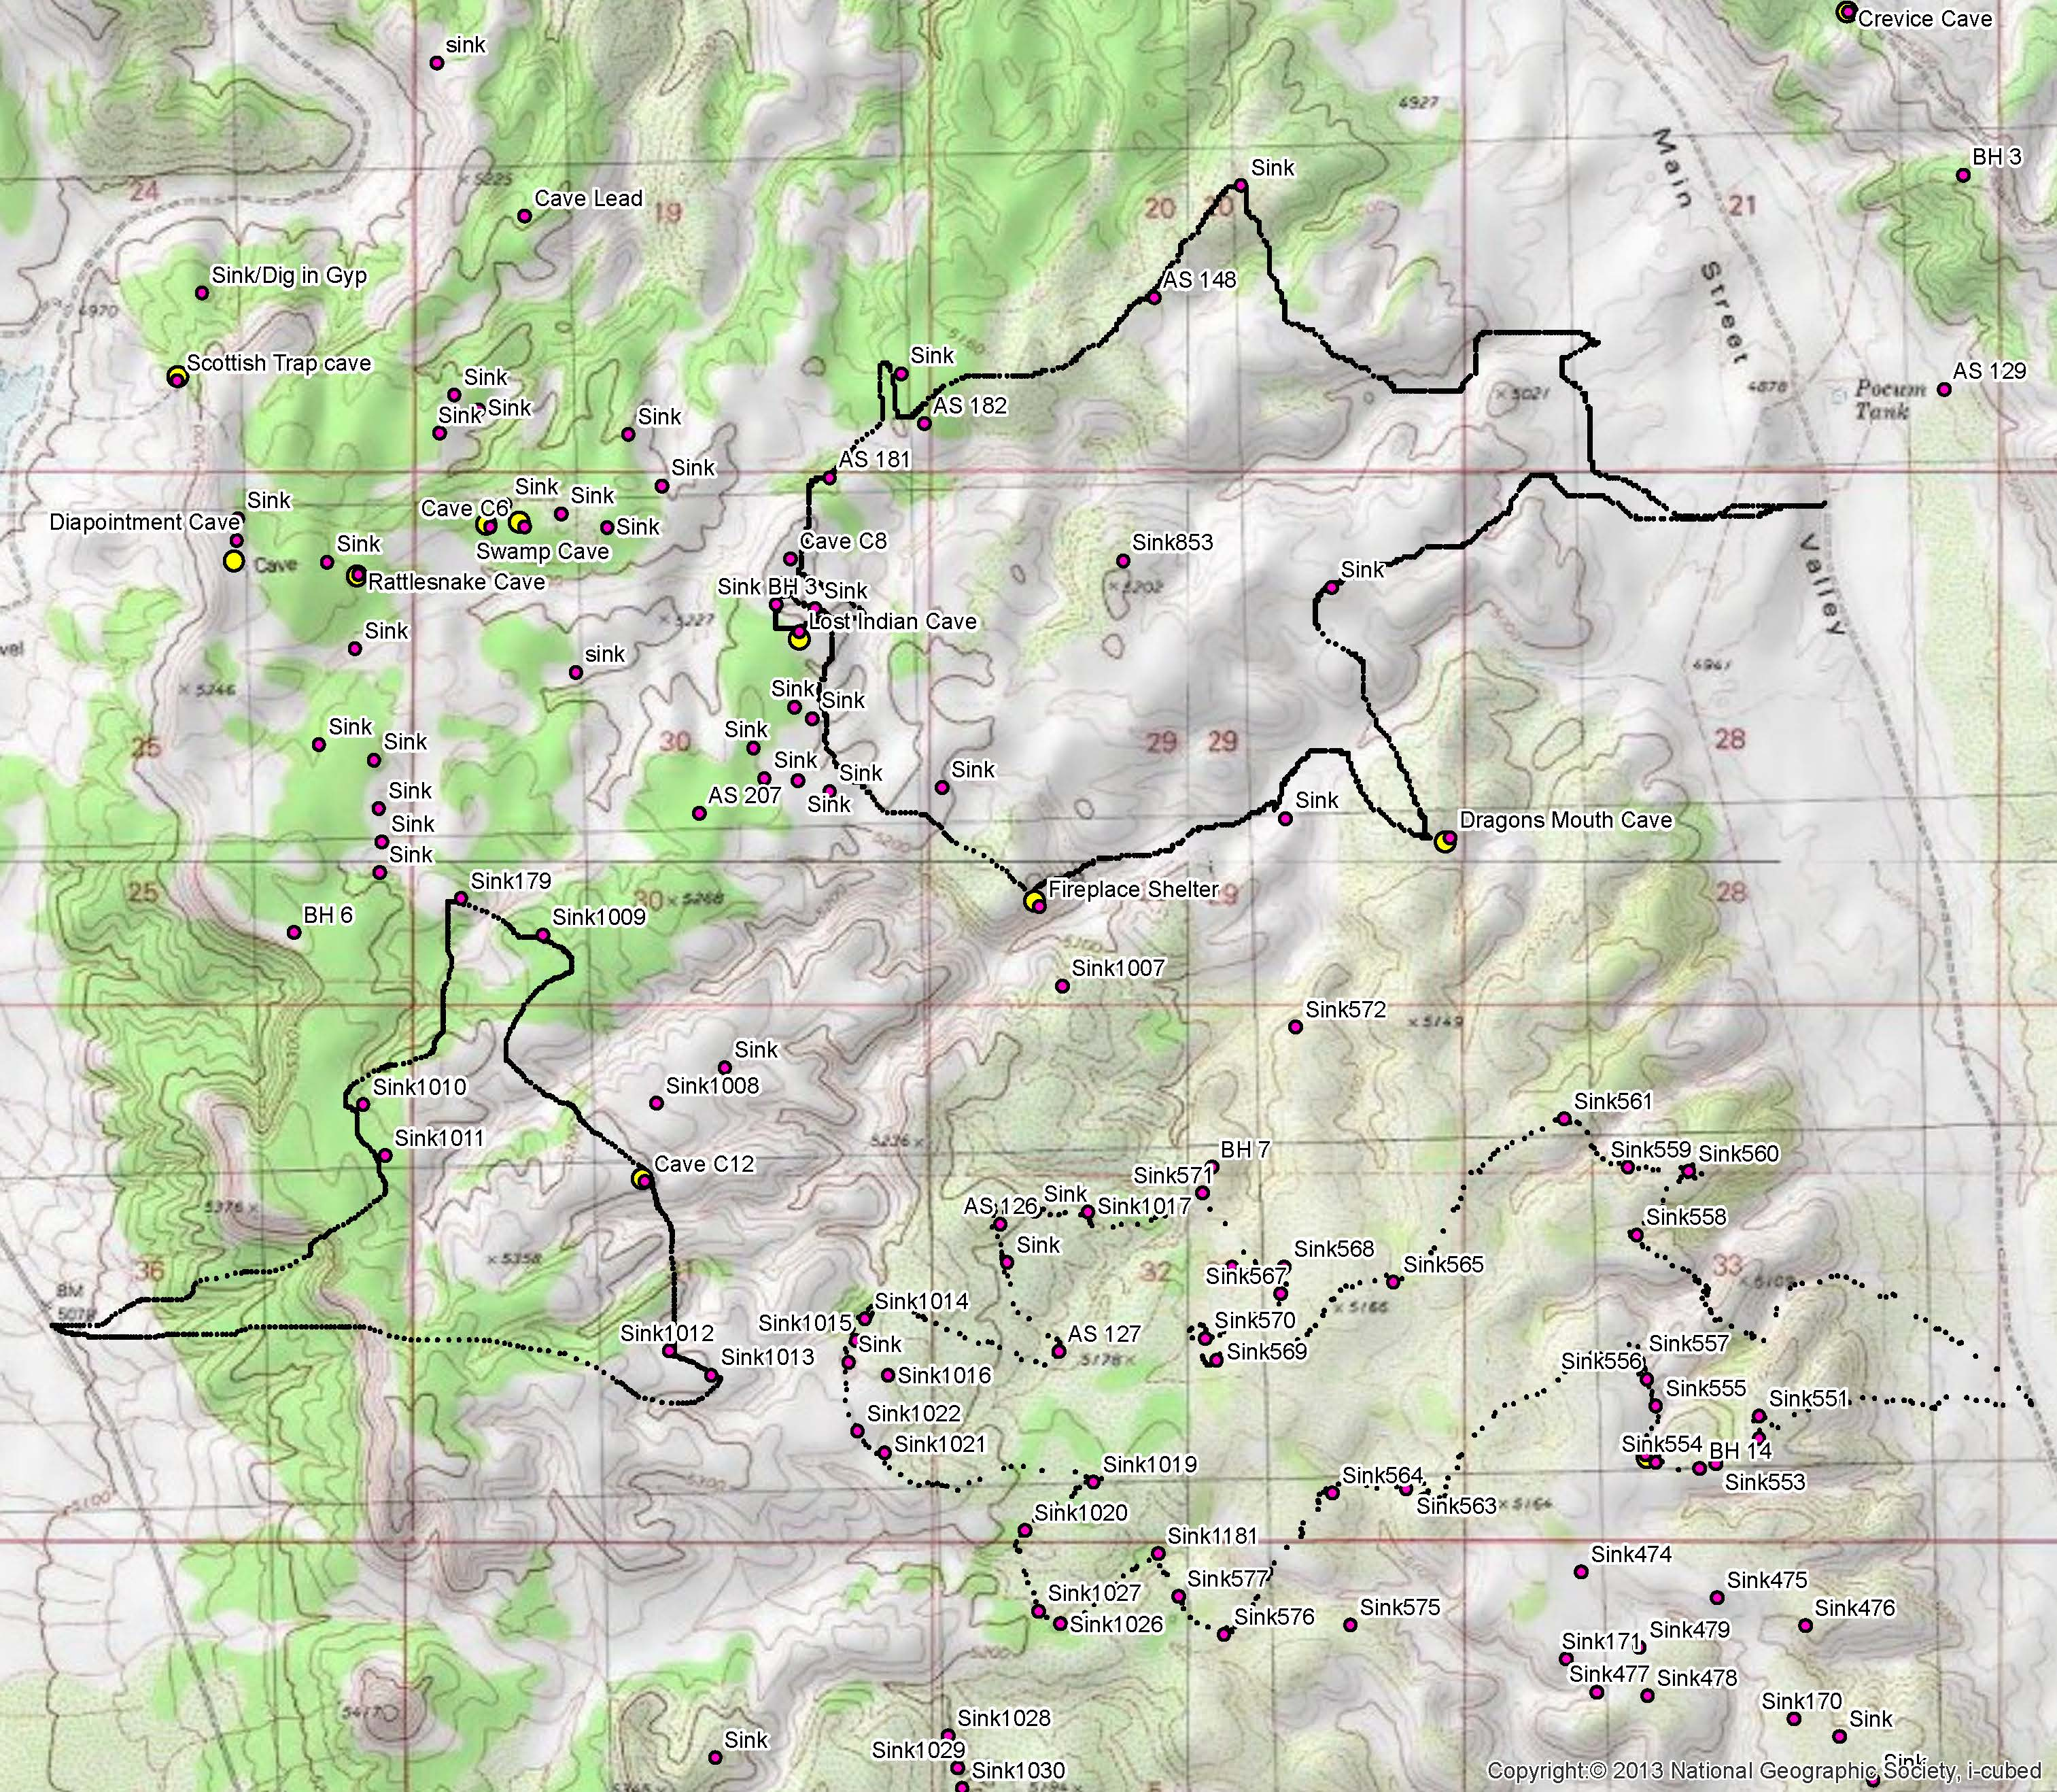
U.S. Department of the Interior Bureau of Land Management
Notes:
What do you know about Bloomington Cave?

Slide 12
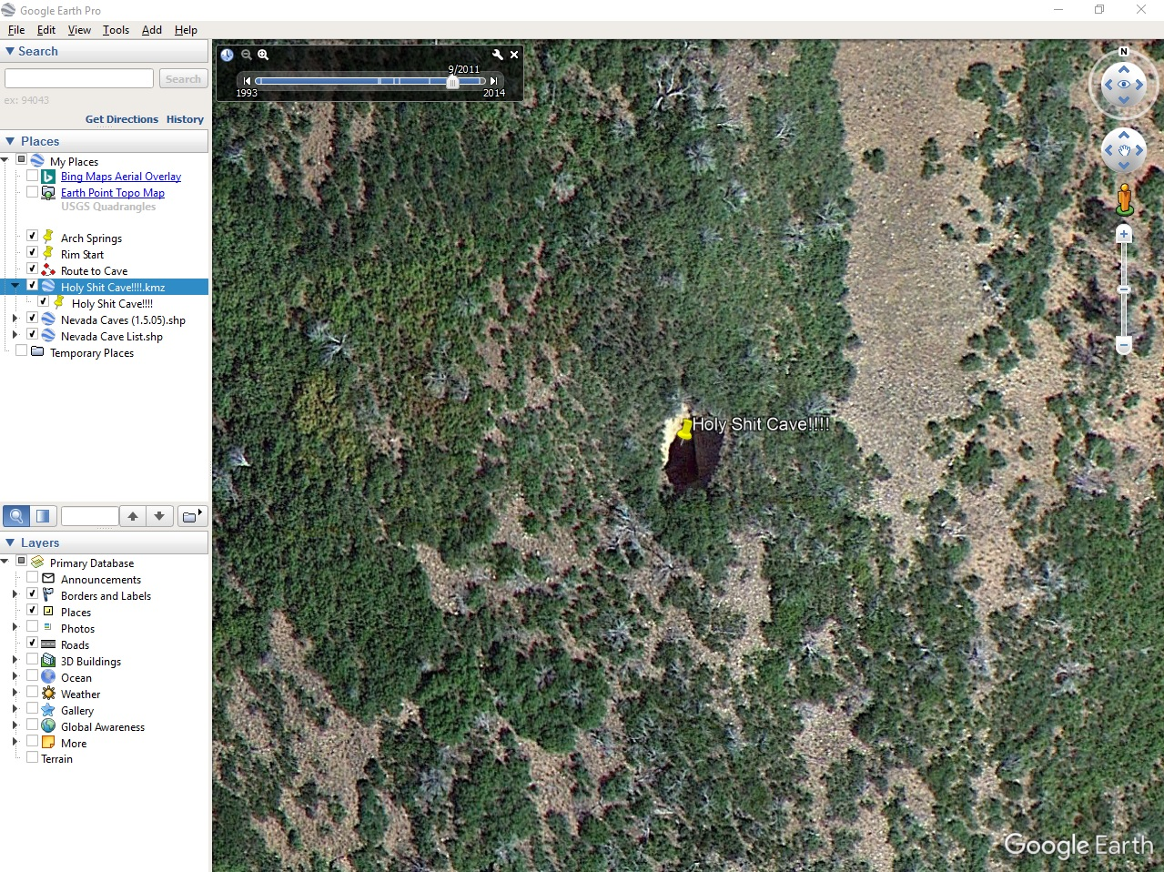
U.S. Department of the Interior Bureau of Land Management
Notes:
What do you know about Bloomington Cave?

Slide 13
Use of spotting scopes
U.S. Department of the Interior Bureau of Land Management
Notes:
What do you know about Bloomington Cave?

Slide 14
Look for trends in existing caves
U.S. Department of the Interior Bureau of Land Management
Geologic units
Faults and folds
Type of entrances – springs, sinkhole, cliffs
Passage trends heading into valleys
Notes:
What do you know about Bloomington Cave?

Slide 15
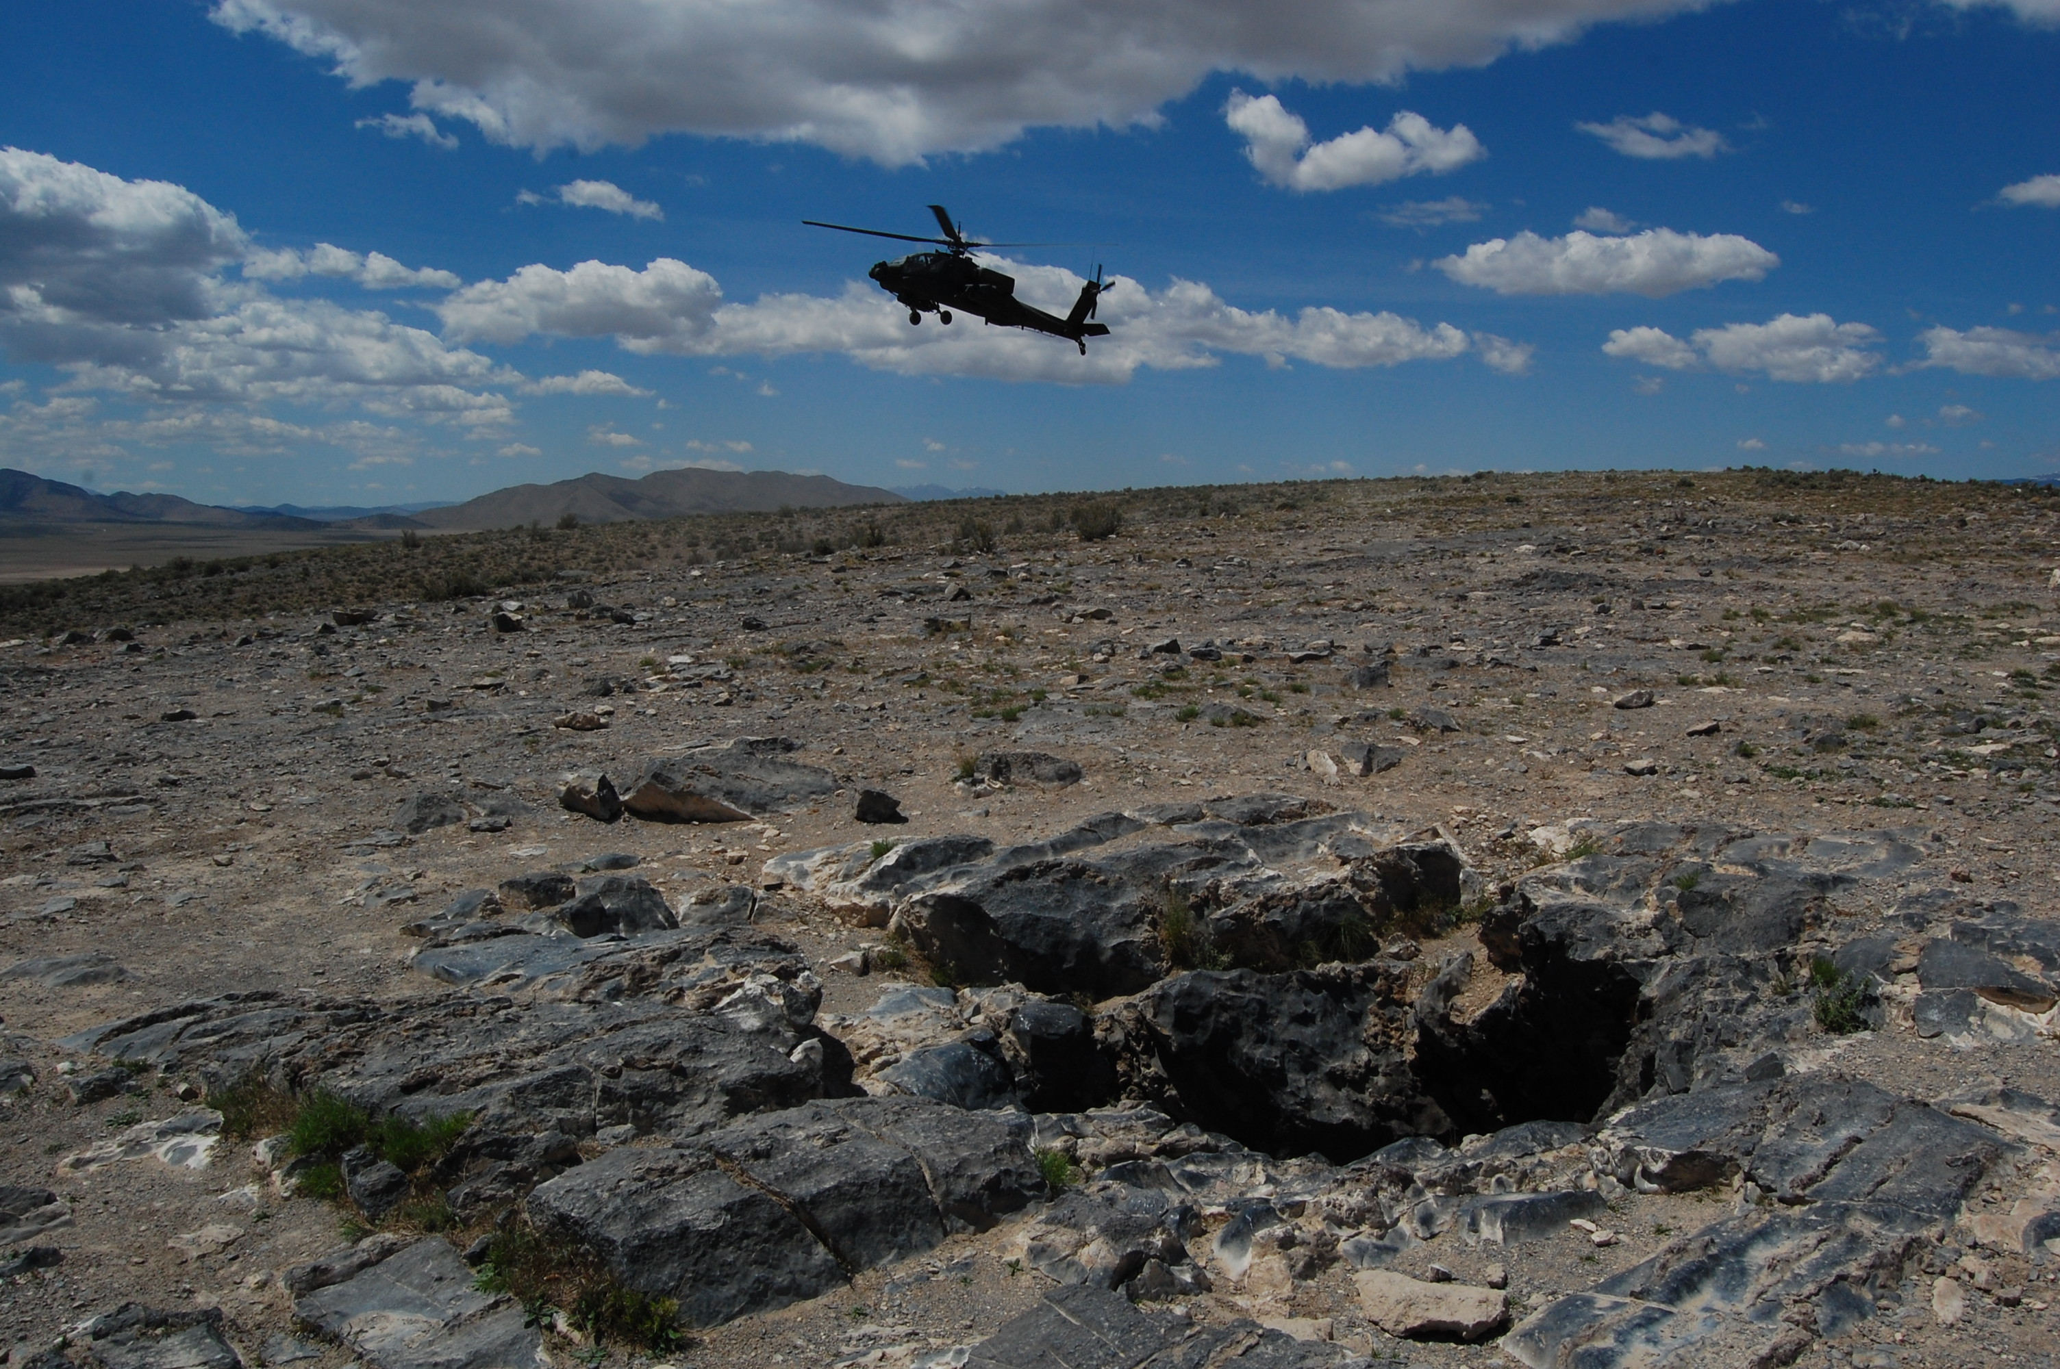
U.S. Department of the Interior Bureau of Land Management
Notes:
What do you know about Bloomington Cave?

Slide 16
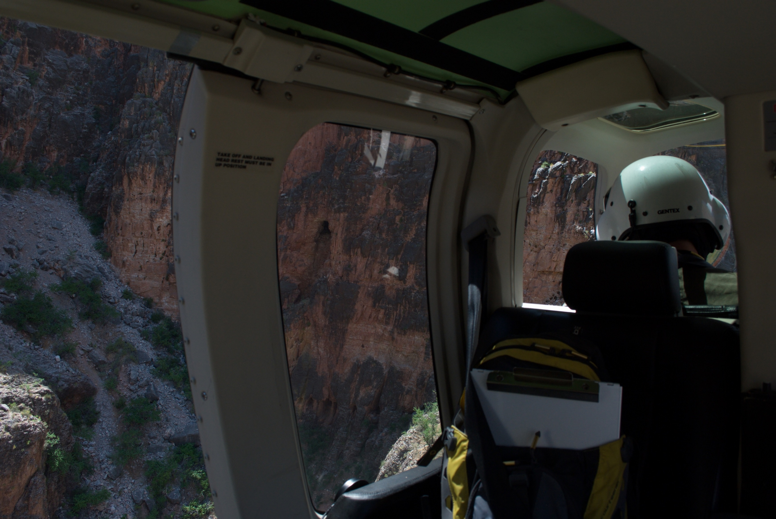
U.S. Department of the Interior Bureau of Land Management
Notes:
What do you know about Bloomington Cave?

Slide 17
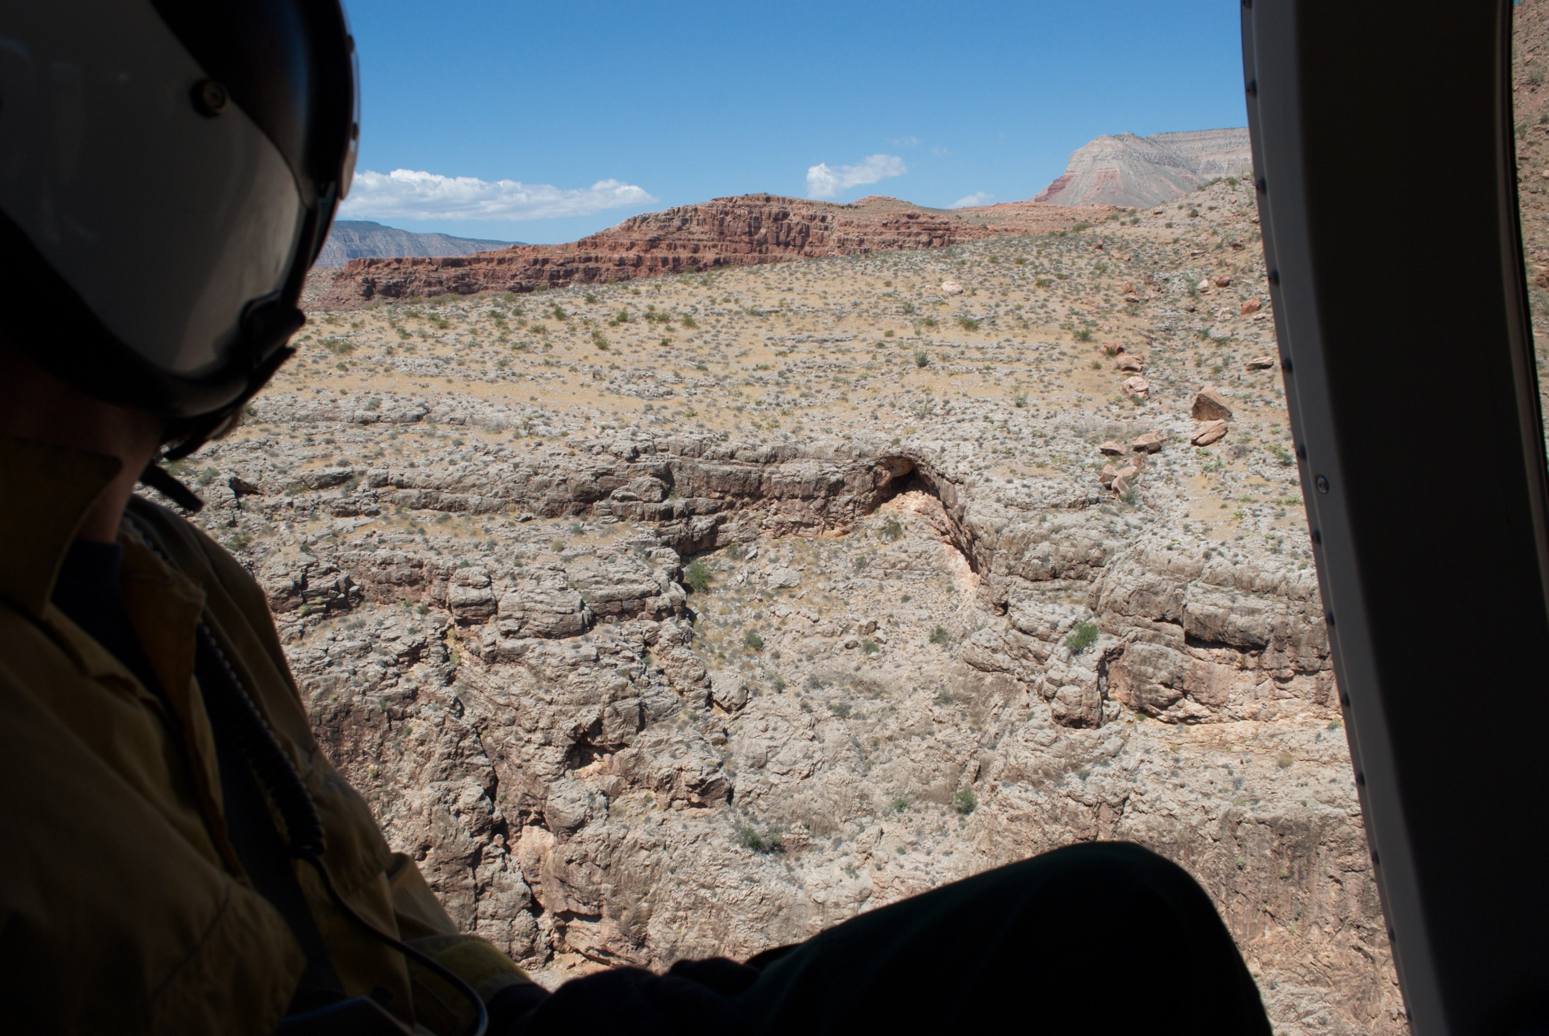
U.S. Department of the Interior Bureau of Land Management
Notes:
What do you know about Bloomington Cave?

Slide 18
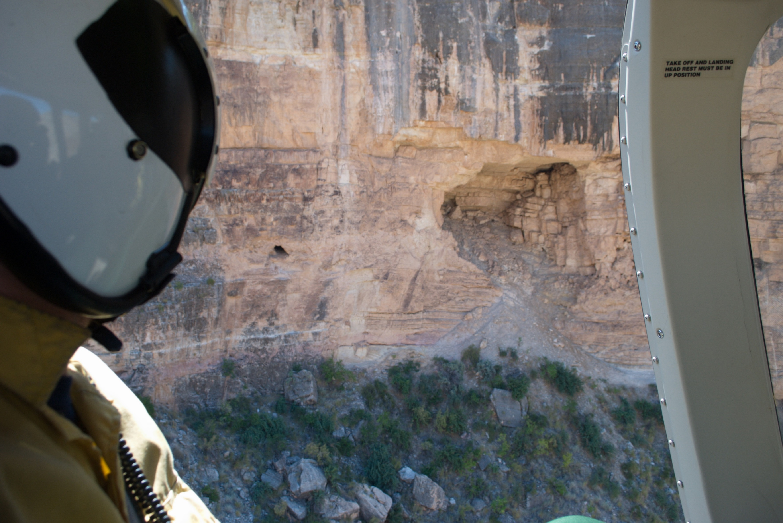
U.S. Department of the Interior Bureau of Land Management
Notes:
What do you know about Bloomington Cave?

Slide 19
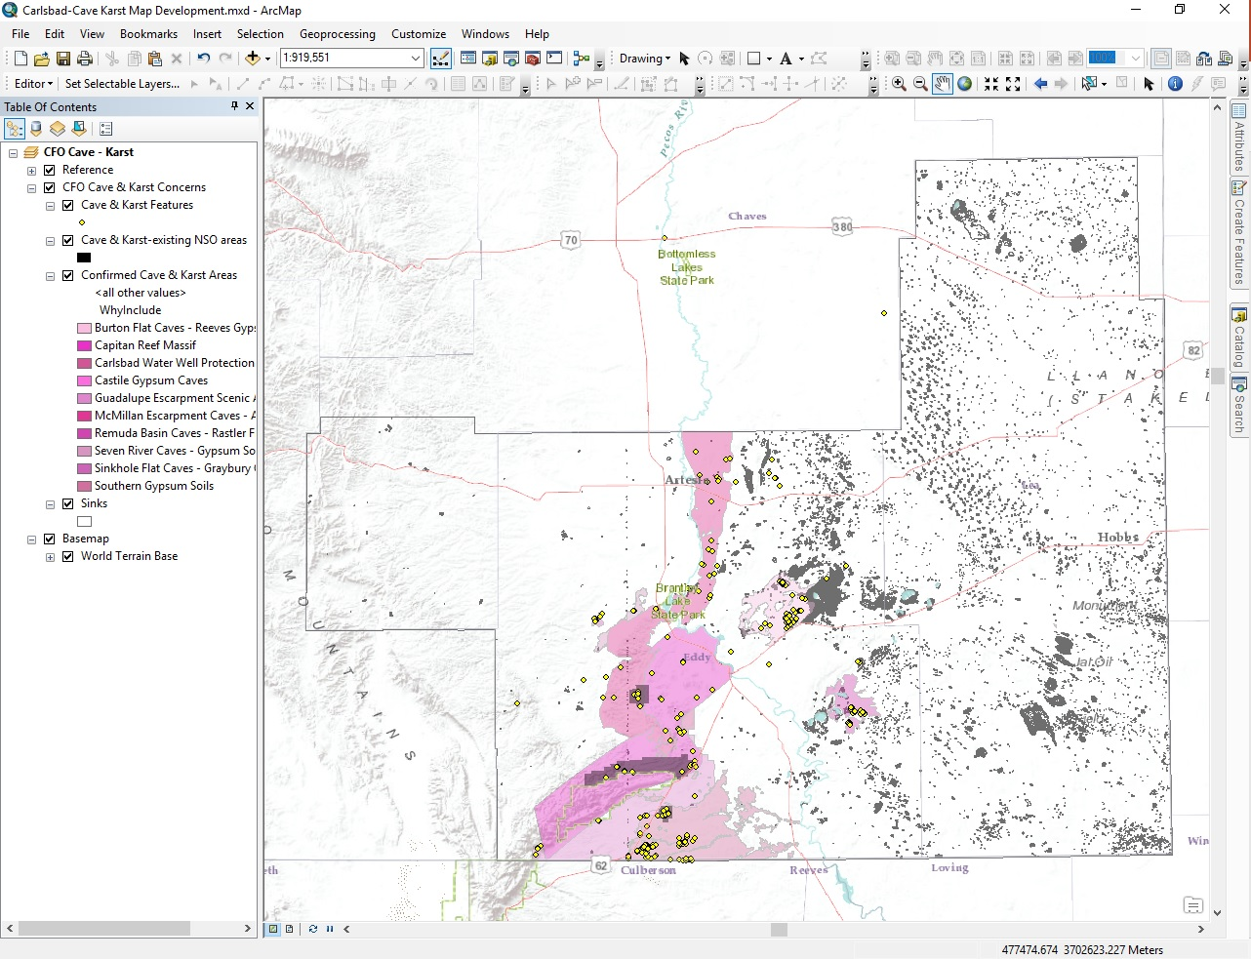
U.S. Department of the Interior Bureau of Land Management
Notes:
What do you know about Bloomington Cave?

Slide 20
GeoPhysical Methods
U.S. Department of the Interior Bureau of Land Management
Notes:
Ground penetrating radar, microgravity, resistivity, magnetic, witching, Lydar

Slide 21
Main way to find caves is to get out on the ground and look
U.S. Department of the Interior Bureau of Land Management
Notes:
What do you know about Bloomington Cave?

