Slide 1
BLM 8380 Manual
Cave & Karst Resources Management Approved October 28, 2008
James Goodbar
Karst Consultant
Silt, Colorado 2019

Slide 2
BLM 8380 Manual
The Manual Sets Policy and Tells you What to Do <<<<<<<<<<>>>>>>>>>>> The Handbook Tells you How to Do It

Slide 3
BLM 8380 Manual
02. Objectives
A. Provide a framework for management.
B. Establish surface & subsurface management practices.
C. Ensure actions requiring approval are consistent with the BLM mission.

Slide 4
BLM 8380 Manual
Objectives
A. Provide a framework to identify, evaluate, manage, monitor and protect cave and karst resources on public lands for the purpose of maintaining their significant values for both present and future uses.

Slide 5
BLM 8380 Manual
Objectives
B. Establish adequate surface and subsurface management practices to ensure the long term protection of Cave and Karst resources.

Slide 6
BLM 8380 Manual
Objectives
C. Ensure that actions related to Cave and Karst resources requiring authorization or approval by the BLM are consistent with the BLM mission of multiple use and sustained yield.

Slide 7
BLM 8380 Manual
03. Authorities
A. Federal Land Policy and Management Act,
B. Federal Cave Resources Protection Act,
C. Cave and Karst Research Institute Act,
D. National Historic Preservation Act,
E. Archaeological Resources Protection Act
F. Antiquities Act
G. Endangered Species Act
H. National Environmental Policy Act (NEPA),
BLM MANUAL 8380
I. Clean Water act
J. Title 43 (CFR), Part 37- Cave Management.

Slide 8
BLM 8380 Manual
04. Responsibility
A. Director
B Assistant Director - Renewable Resources
C. Cave/Karst Resources Senior Specialist
D. State Directors
E. District Managers
F. Field Office Managers

Slide 9
BLM 8380 Manual
06. Policy
A. Identify and Inventory Resources.
B Land Use Planning
a. Management;
b. Marketing
c. Monitoring
d. Administration.
C. Manage to Protect Fragile Resources
D. Volunteers and Partnerships
E. Education and Coordination

Slide 10
BLM 8380 Manual
07. Files & Records Maintenance
A. Maintain Cave & Karst Resource Records.
B. Secure Records - Prevent Unauthorized Access.
C. Report Significant Caves in RMIS
D. Report Gates, Trails, etc. in FAMS

Slide 11
BLM 8380 Manual
08. Relationship to Other Programs
Reduce Conflict
Coordinate

Slide 12
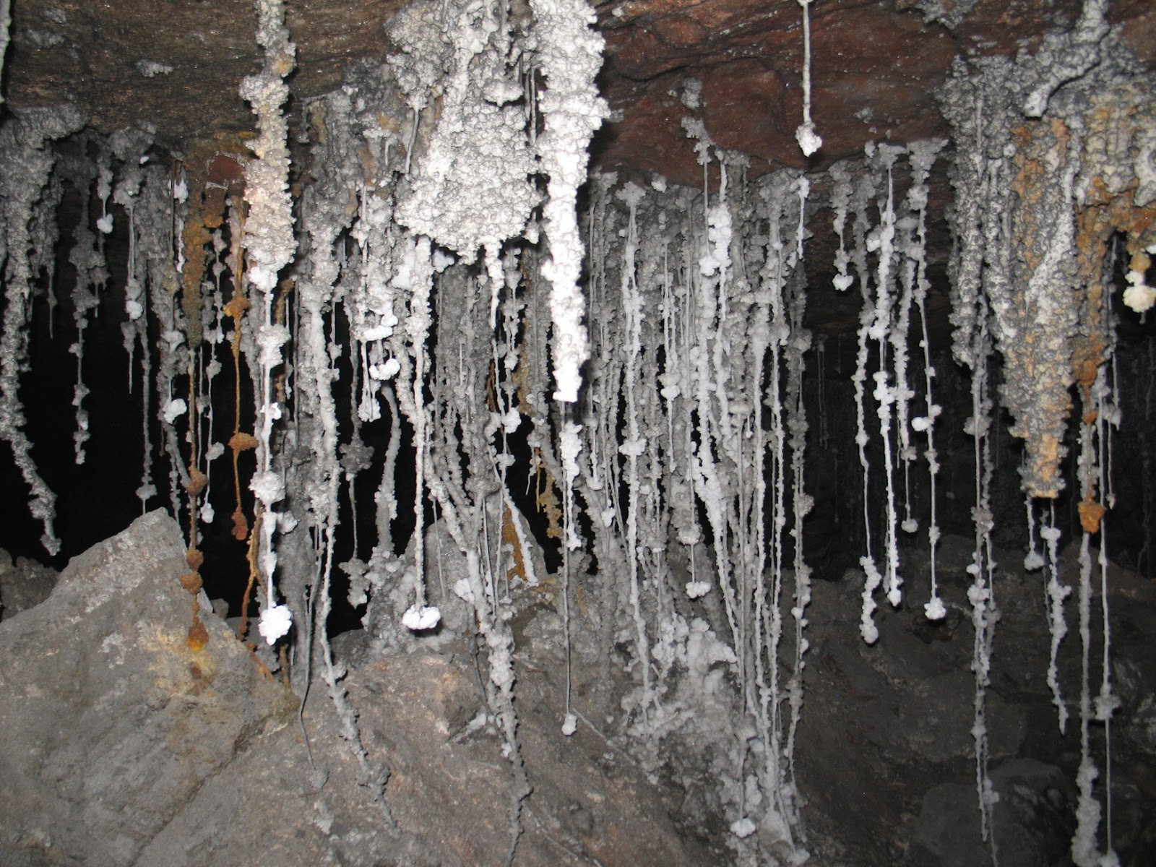
BLM 8380 Manual
09. Definitions

