Slide 1
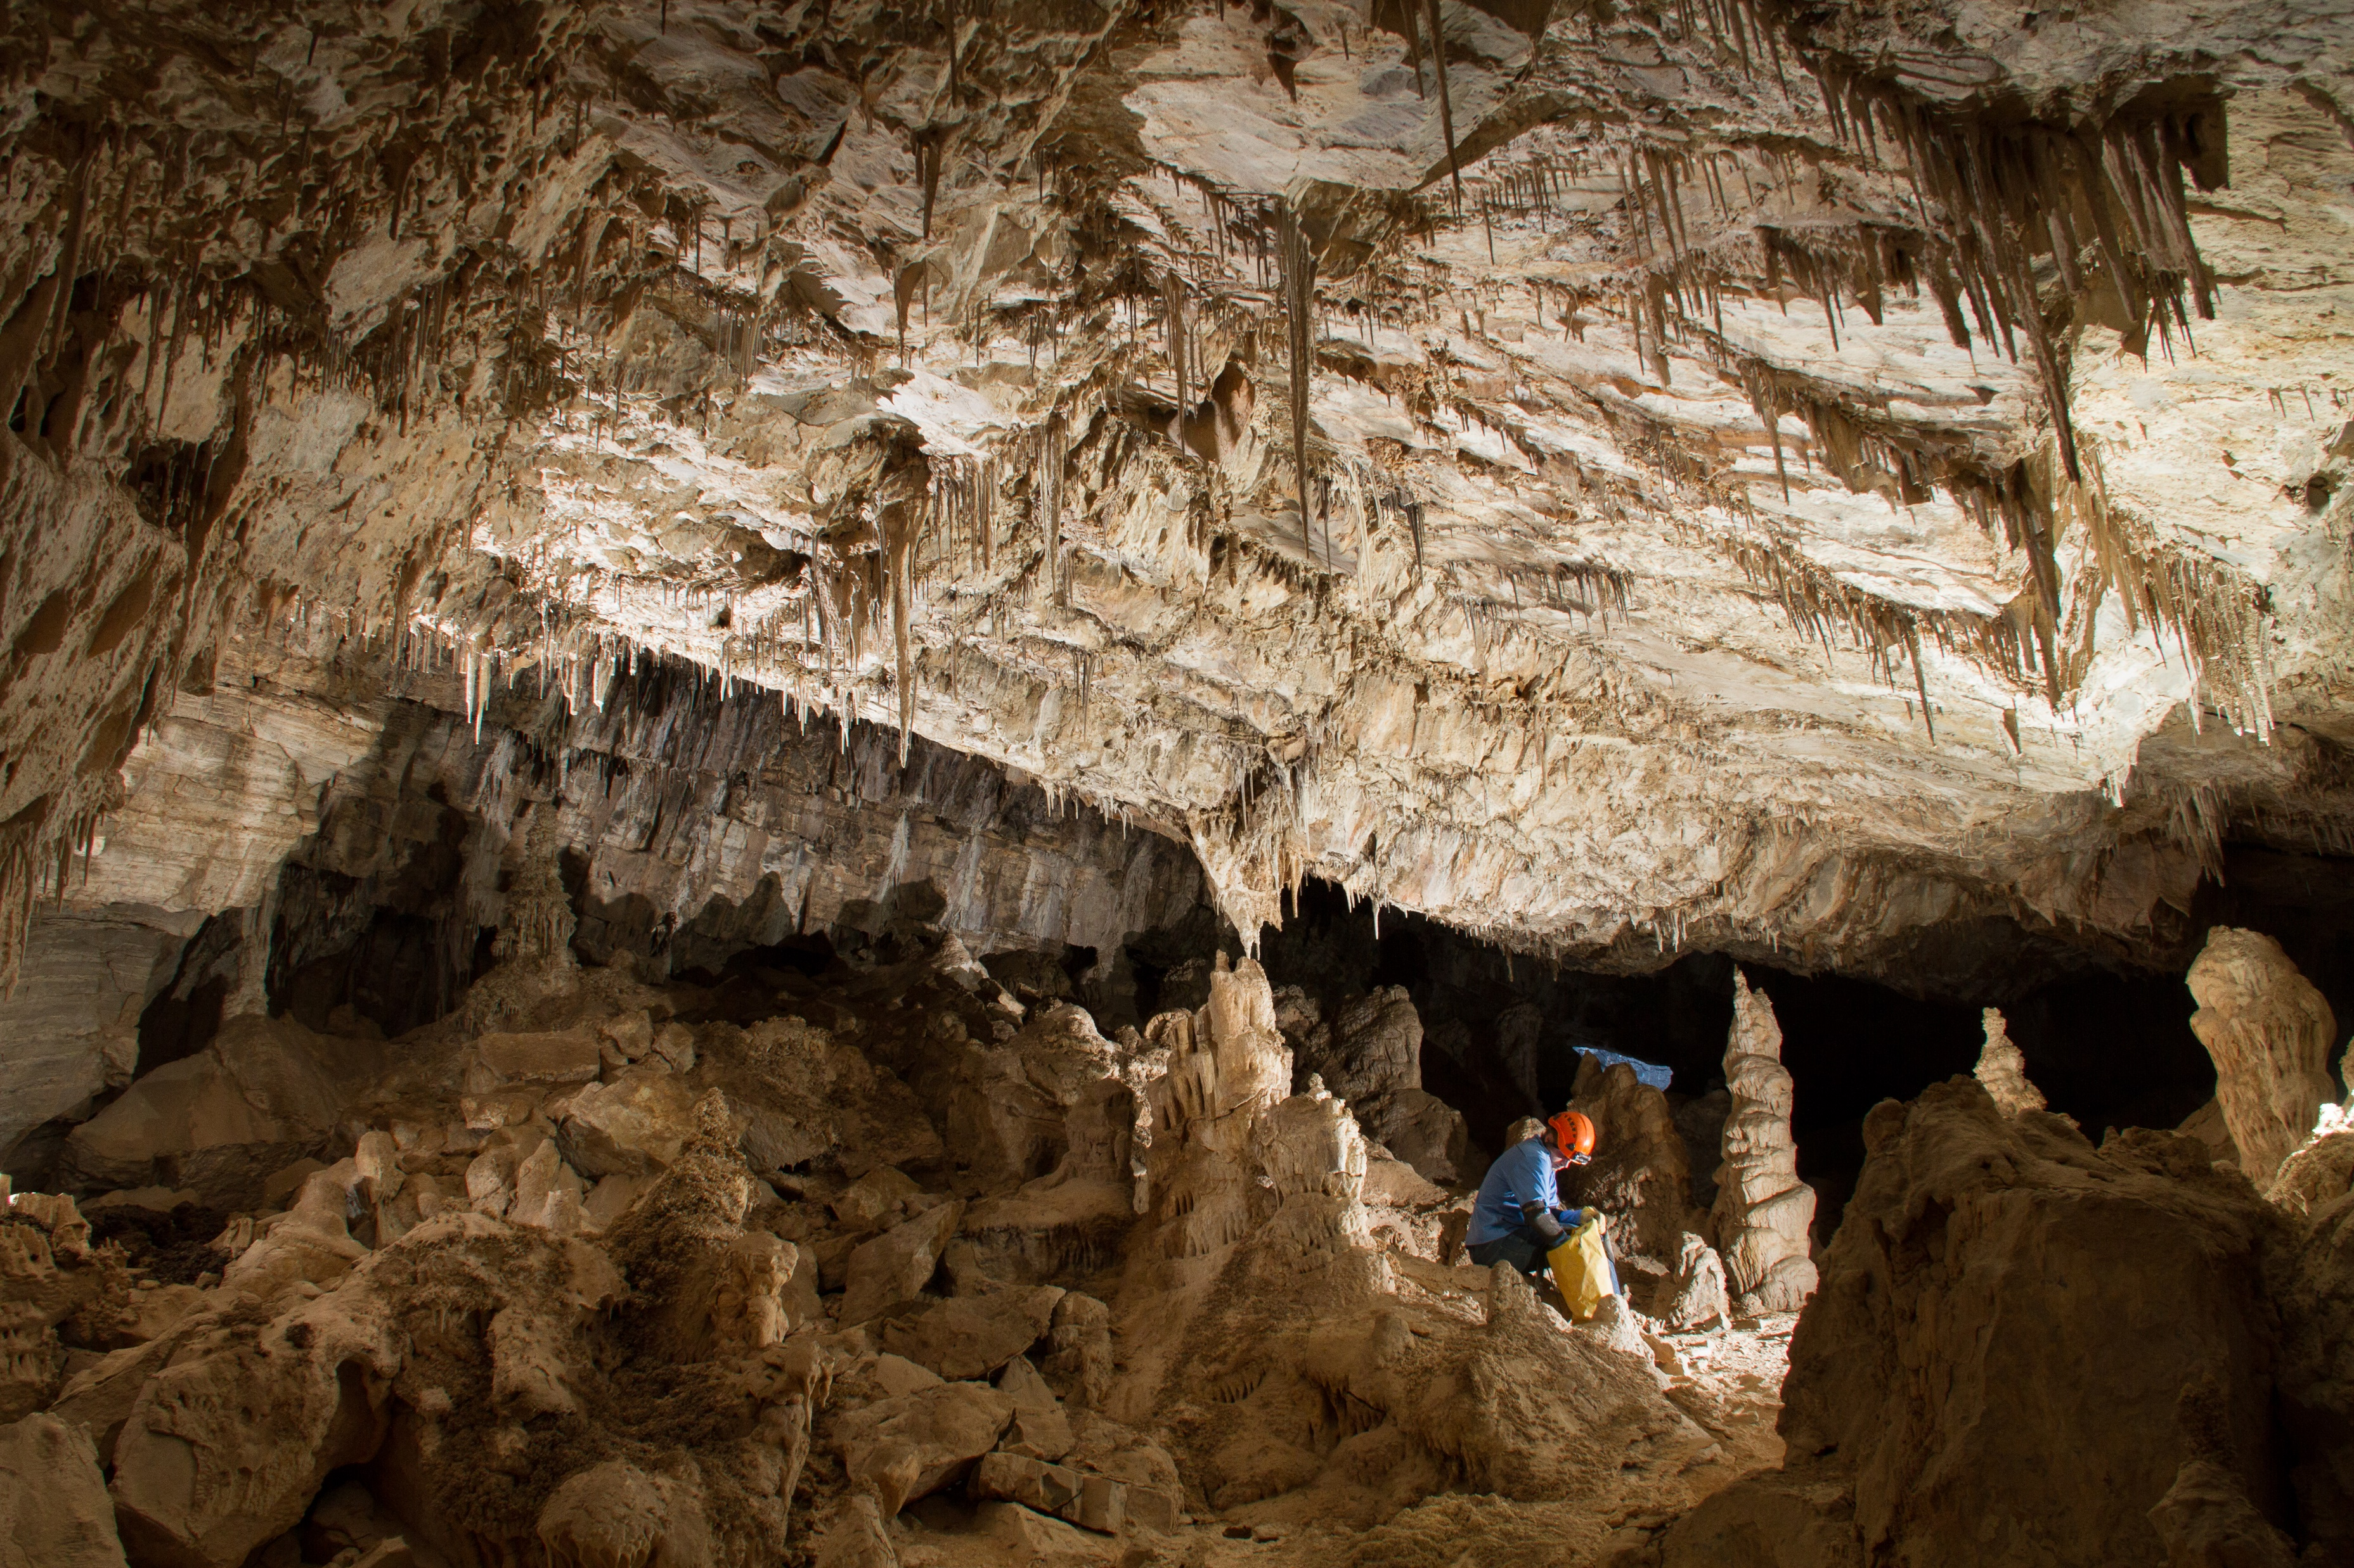
Significant Cave Nominations
U.S. Department of the Interior Bureau of Land Management
Notes:
The first step is in accordance to the Federal Cave Resources Protection Act is listing Significant Caves.

Slide 2
Words of Caution
U.S. Department of the Interior Bureau of Land Management
Need good support from managers
Tread carefully with cavers
Need good data protections in place
Is the listing really needed? Or is it going to create more problems?
Notes:
What do you know about Bloomington Cave?

Slide 3
Two paths for nominations
U.S. Department of the Interior Bureau of Land Management
Internal staff nominations
Nominations from the general public (cavers)
Notes:
What do you know about Bloomington Cave?

Slide 4
Internally
U.S. Department of the Interior Bureau of Land Management
Visit the cave and see if it meets at least one of the significance criteria 43 CFR Part 37
Fill out the Significance Worksheet
Put the cave name(s) and criteria on Significant Cave Designation Form
Have your Field Manager sign the designation form
Notes:
What do you know about Bloomington Cave?

Slide 5
Criteria
U.S. Department of the Interior Bureau of Land Management
Biota
Cultural
Geologic, Mineralogic, Paleontologic
Hydrologic
Recreational
Educational or Scientific
Notes:
What do you know about Bloomington Cave?

Slide 6
U.S. Department of the Interior Bureau of Land Management
Notes:
What do you know about Bloomington Cave?

Slide 7
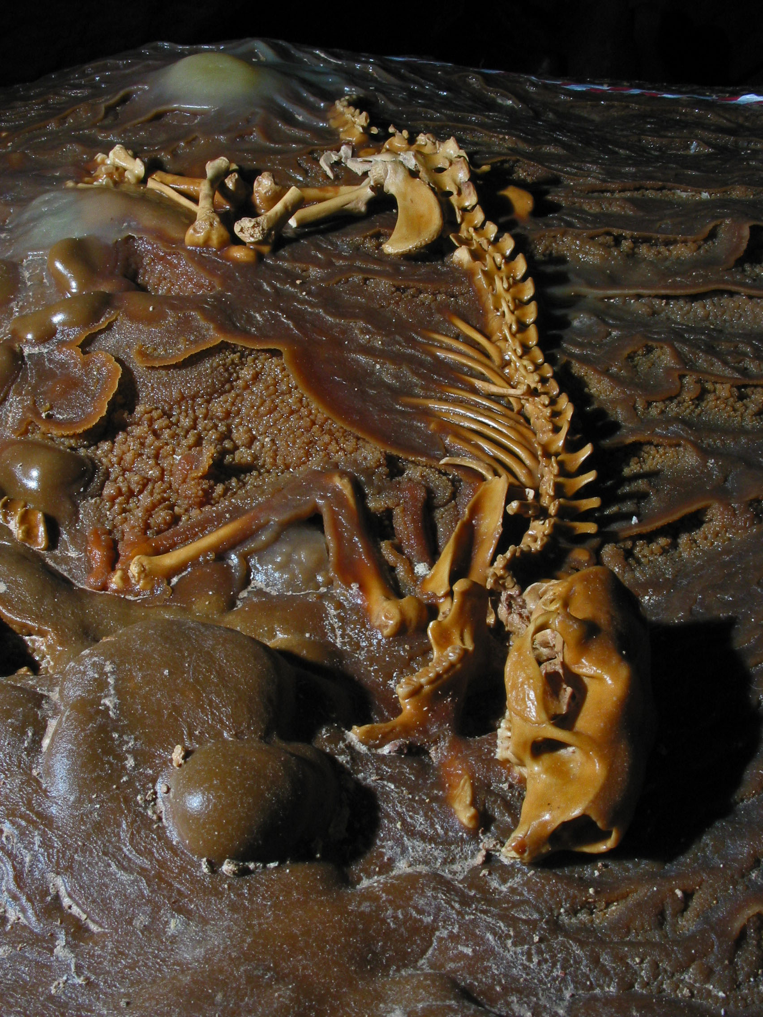
U.S. Department of the Interior Bureau of Land Management
Notes:
What do you know about Bloomington Cave?

Slide 8
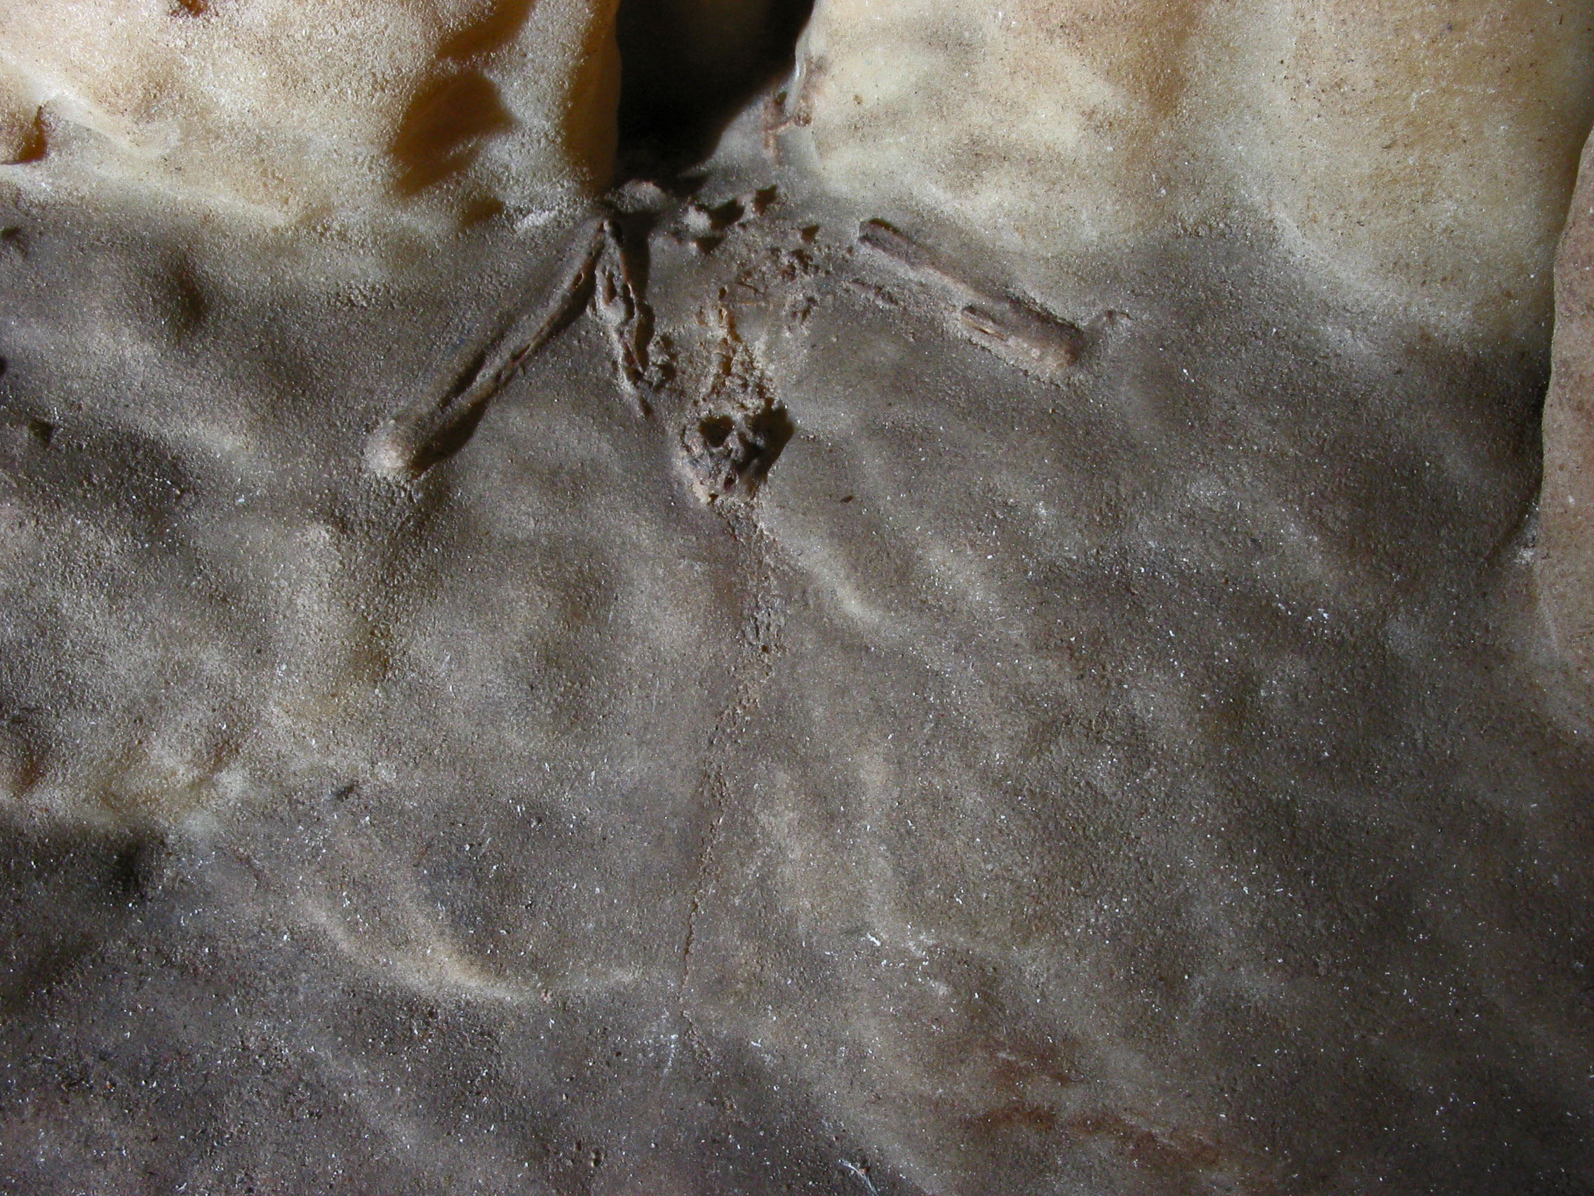
U.S. Department of the Interior Bureau of Land Management
Notes:
What do you know about Bloomington Cave?

Slide 9
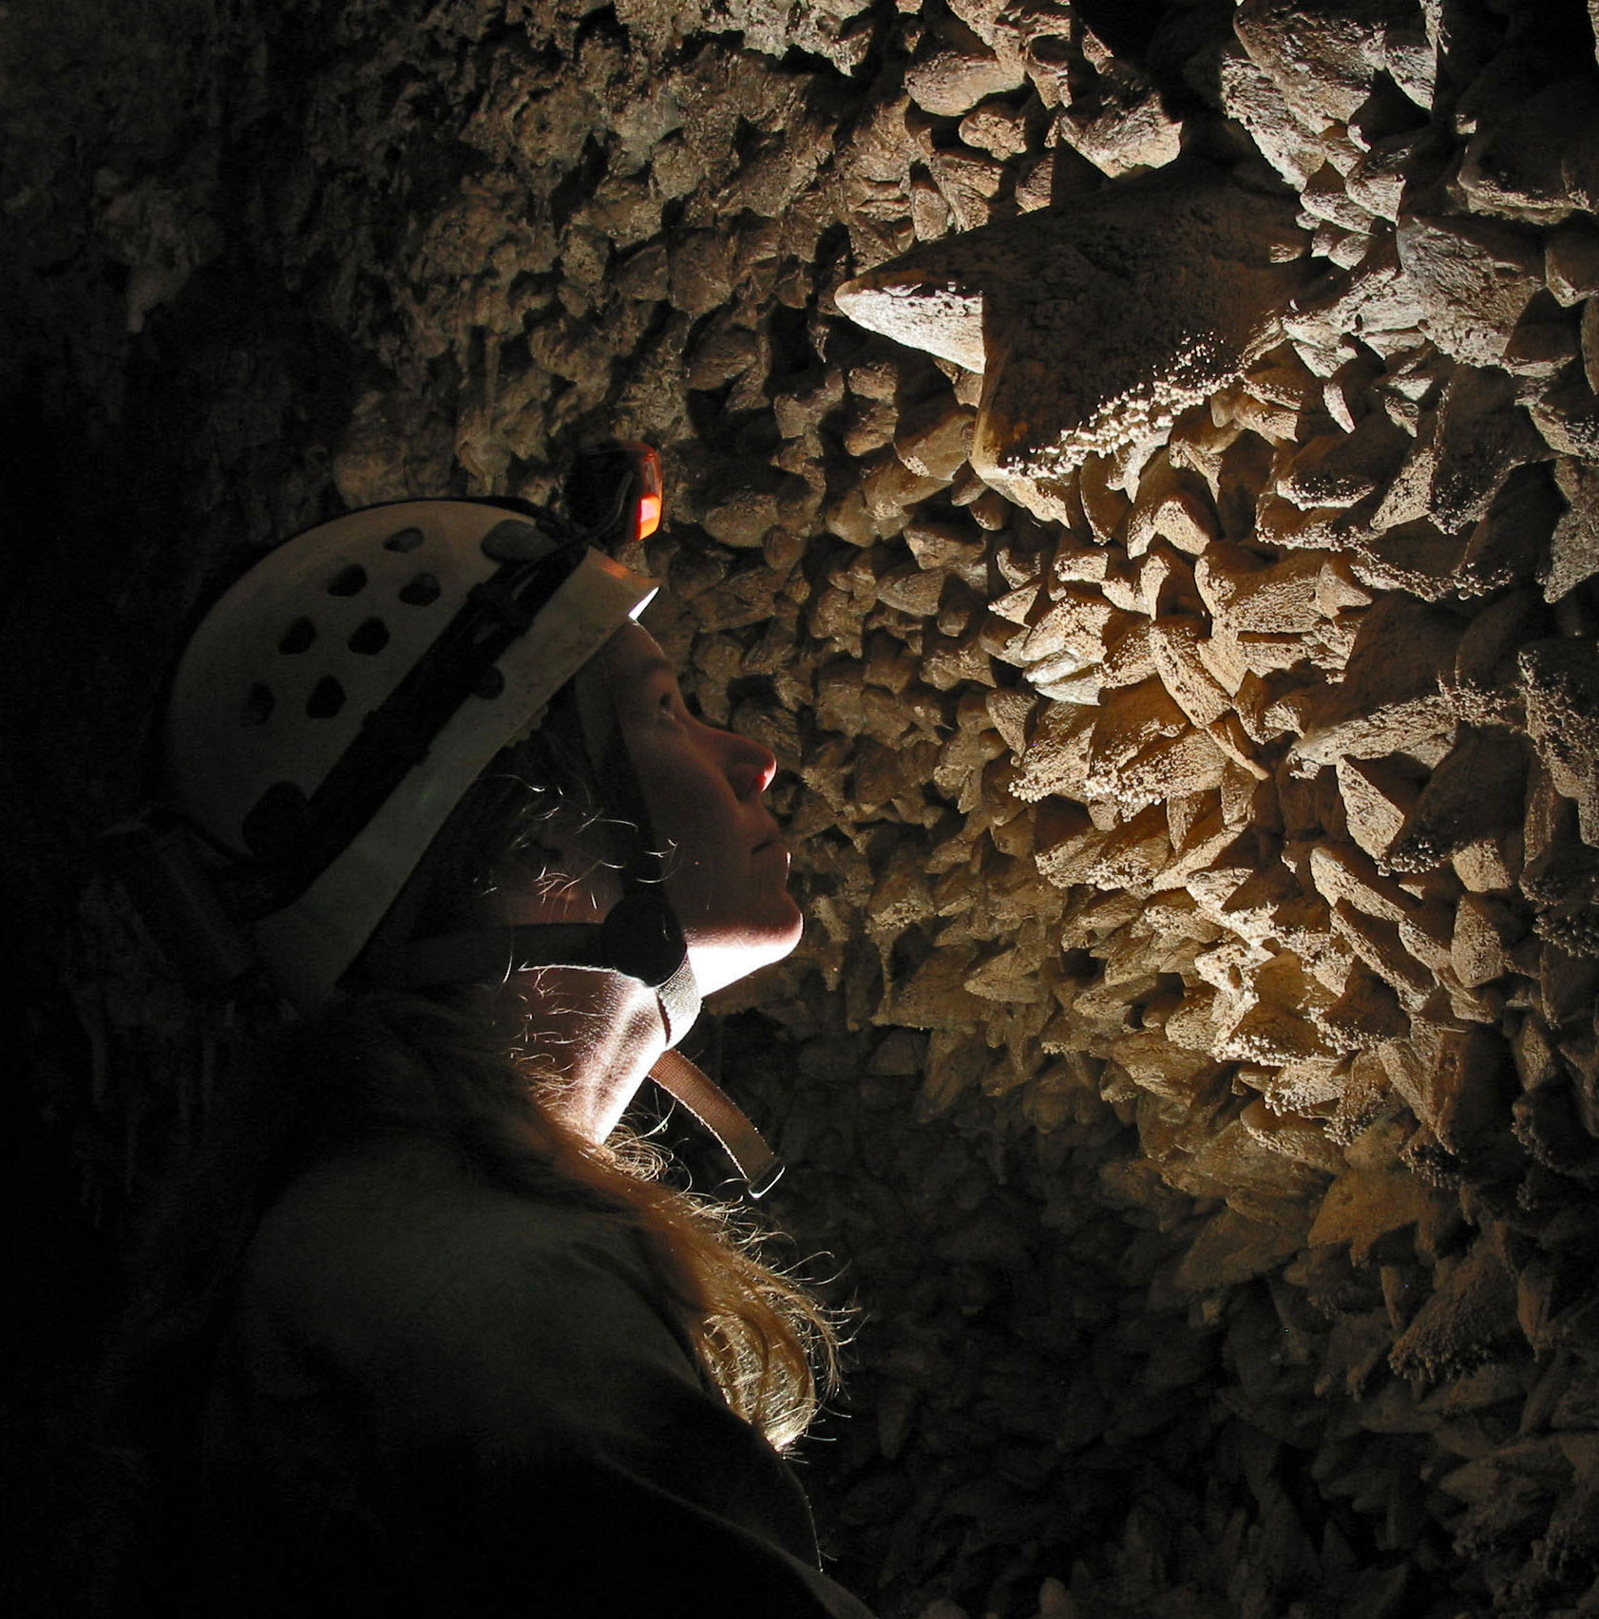
U.S. Department of the Interior Bureau of Land Management
Notes:
What do you know about Bloomington Cave?

Slide 10
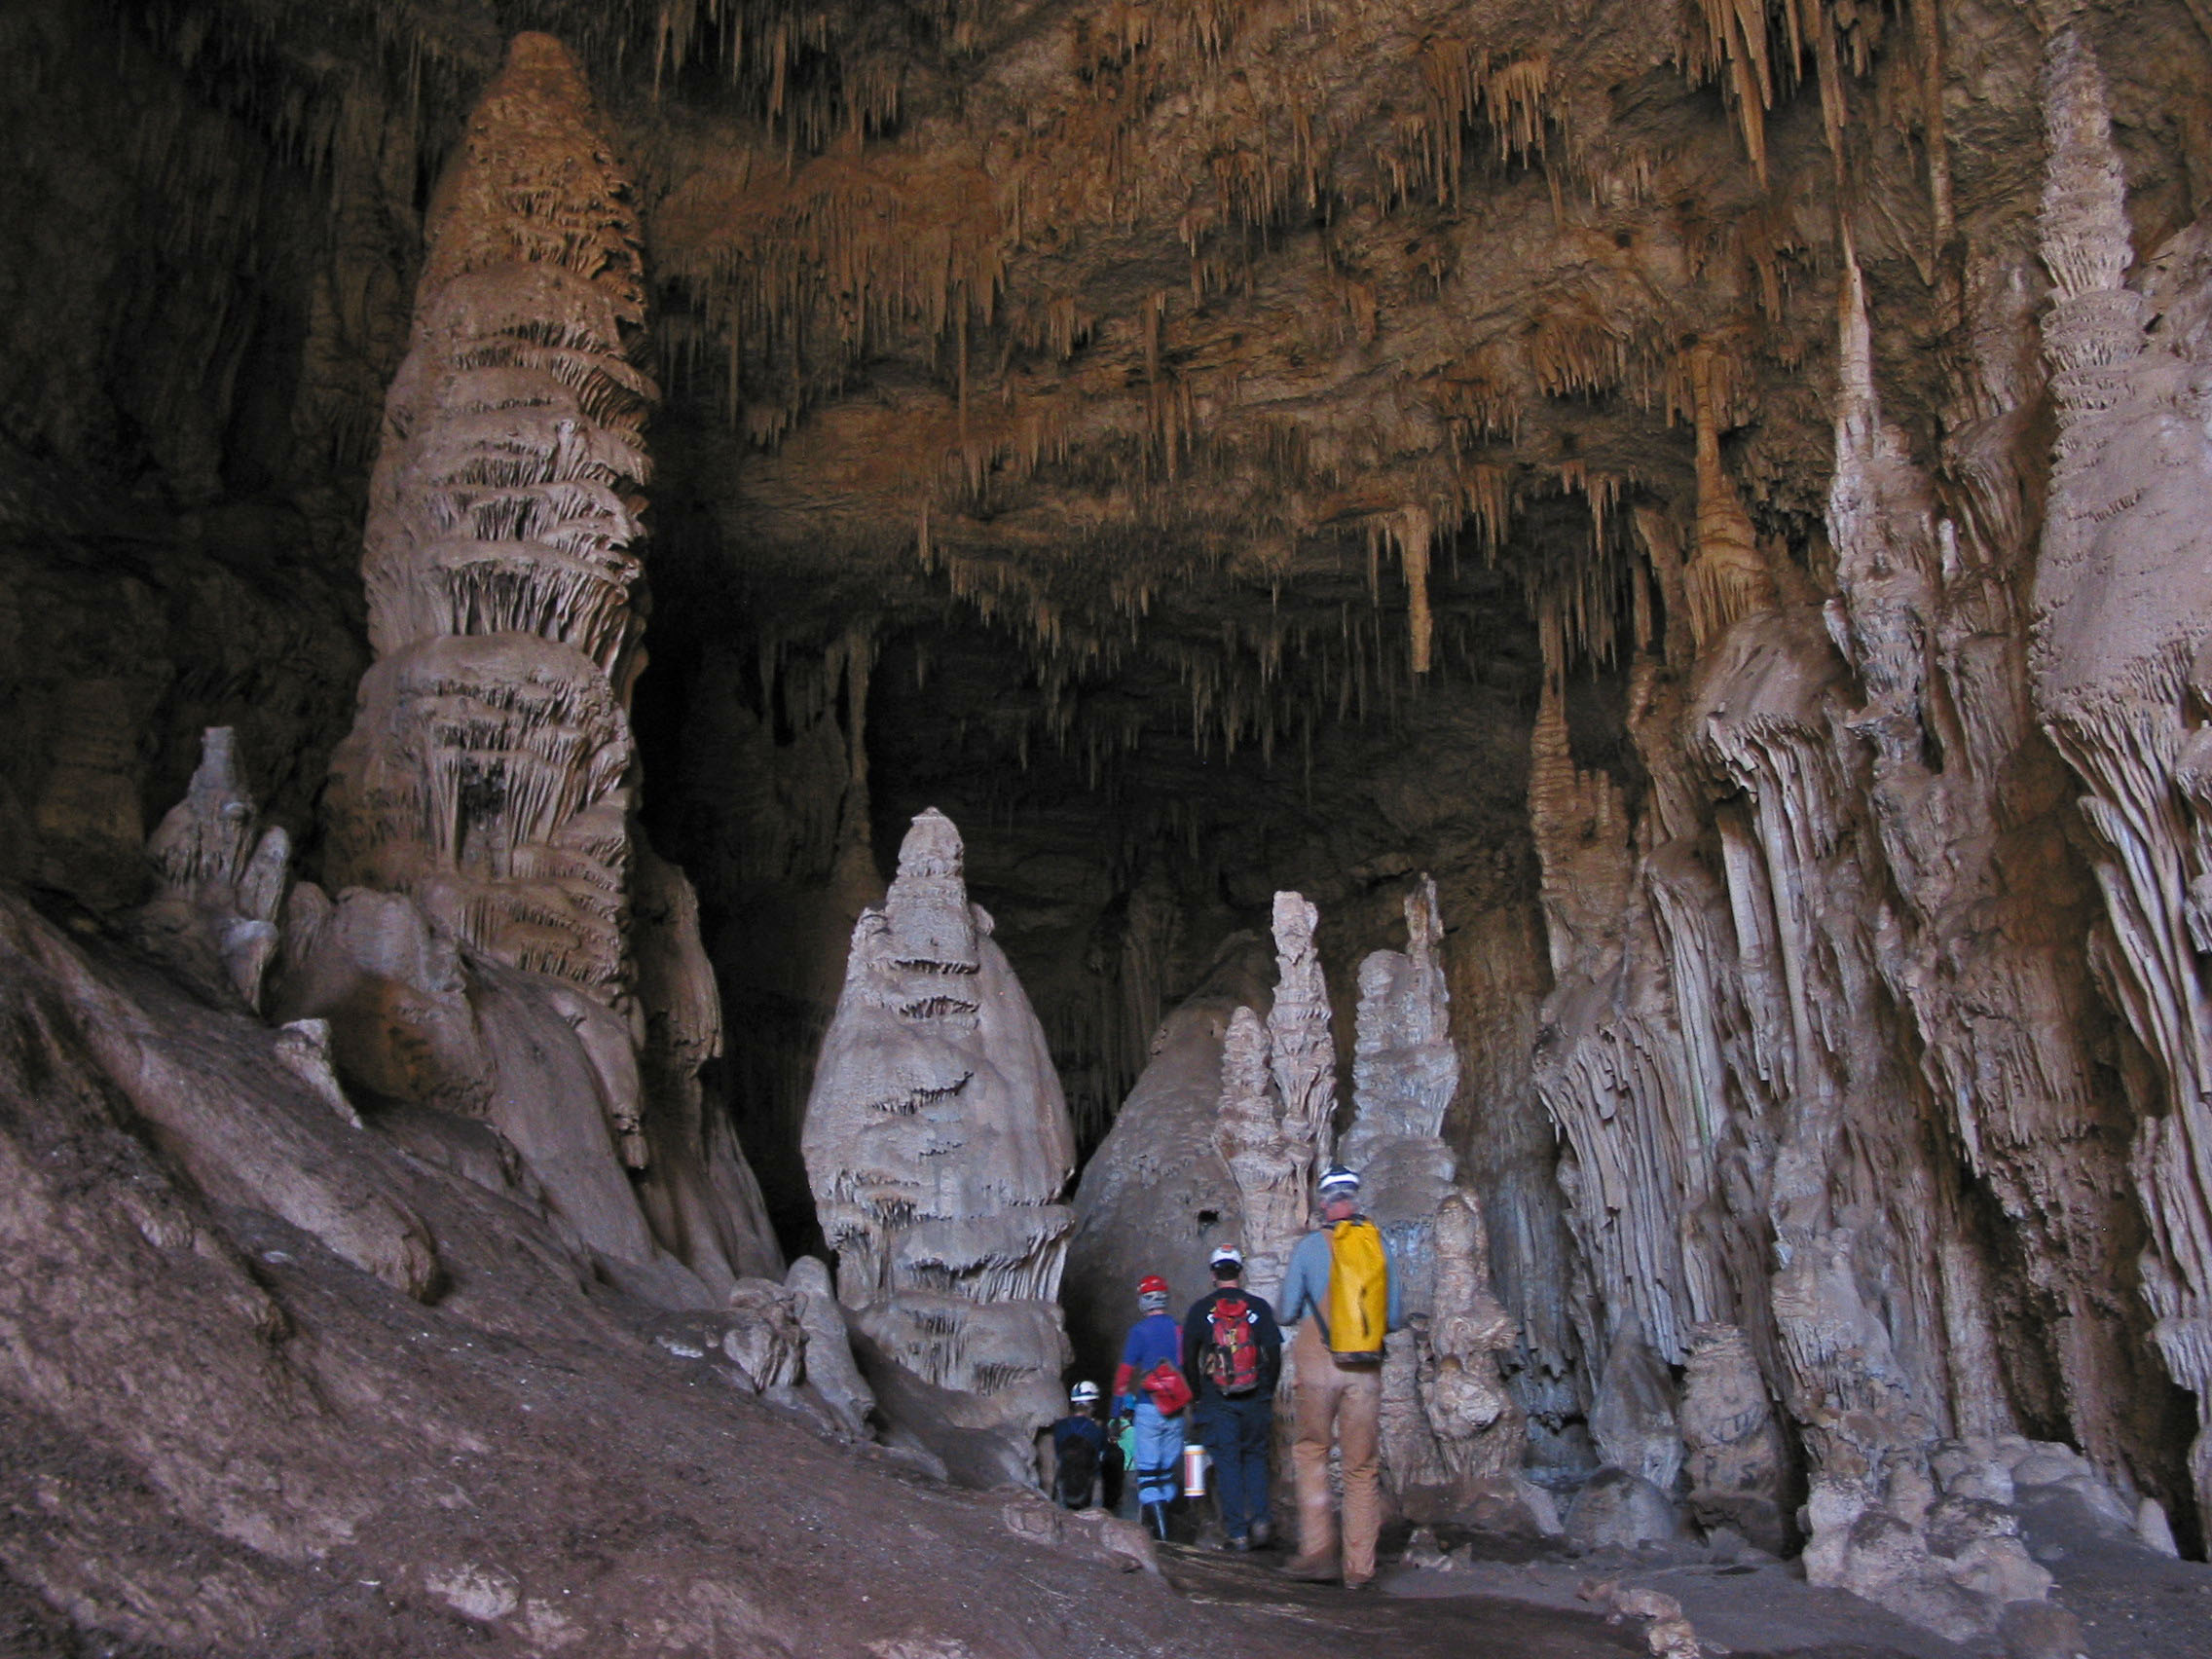
U.S. Department of the Interior Bureau of Land Management
Notes:
What do you know about Bloomington Cave?

Slide 11
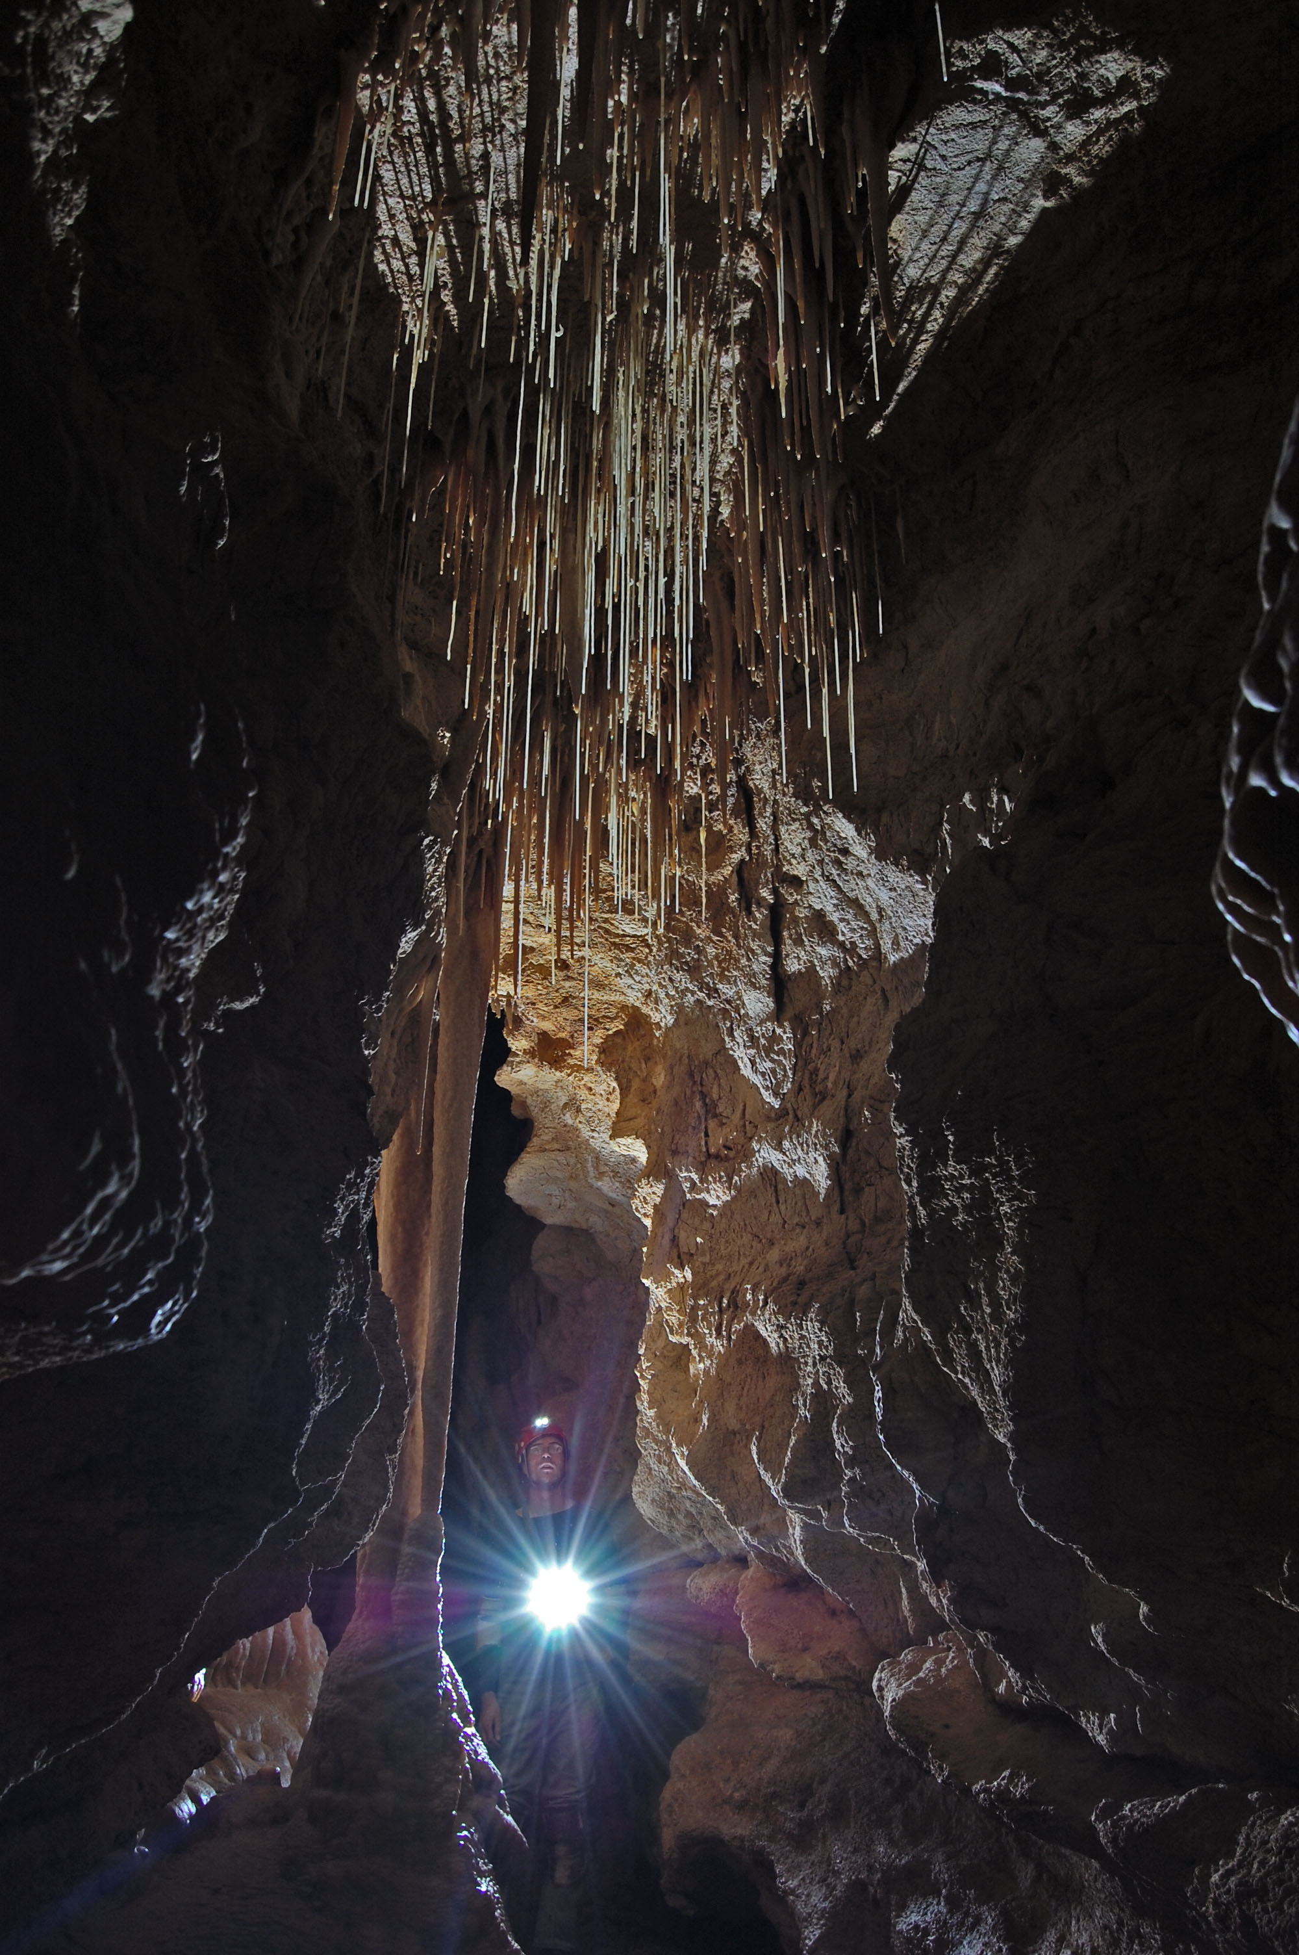
U.S. Department of the Interior Bureau of Land Management
Notes:
What do you know about Bloomington Cave?

Slide 12
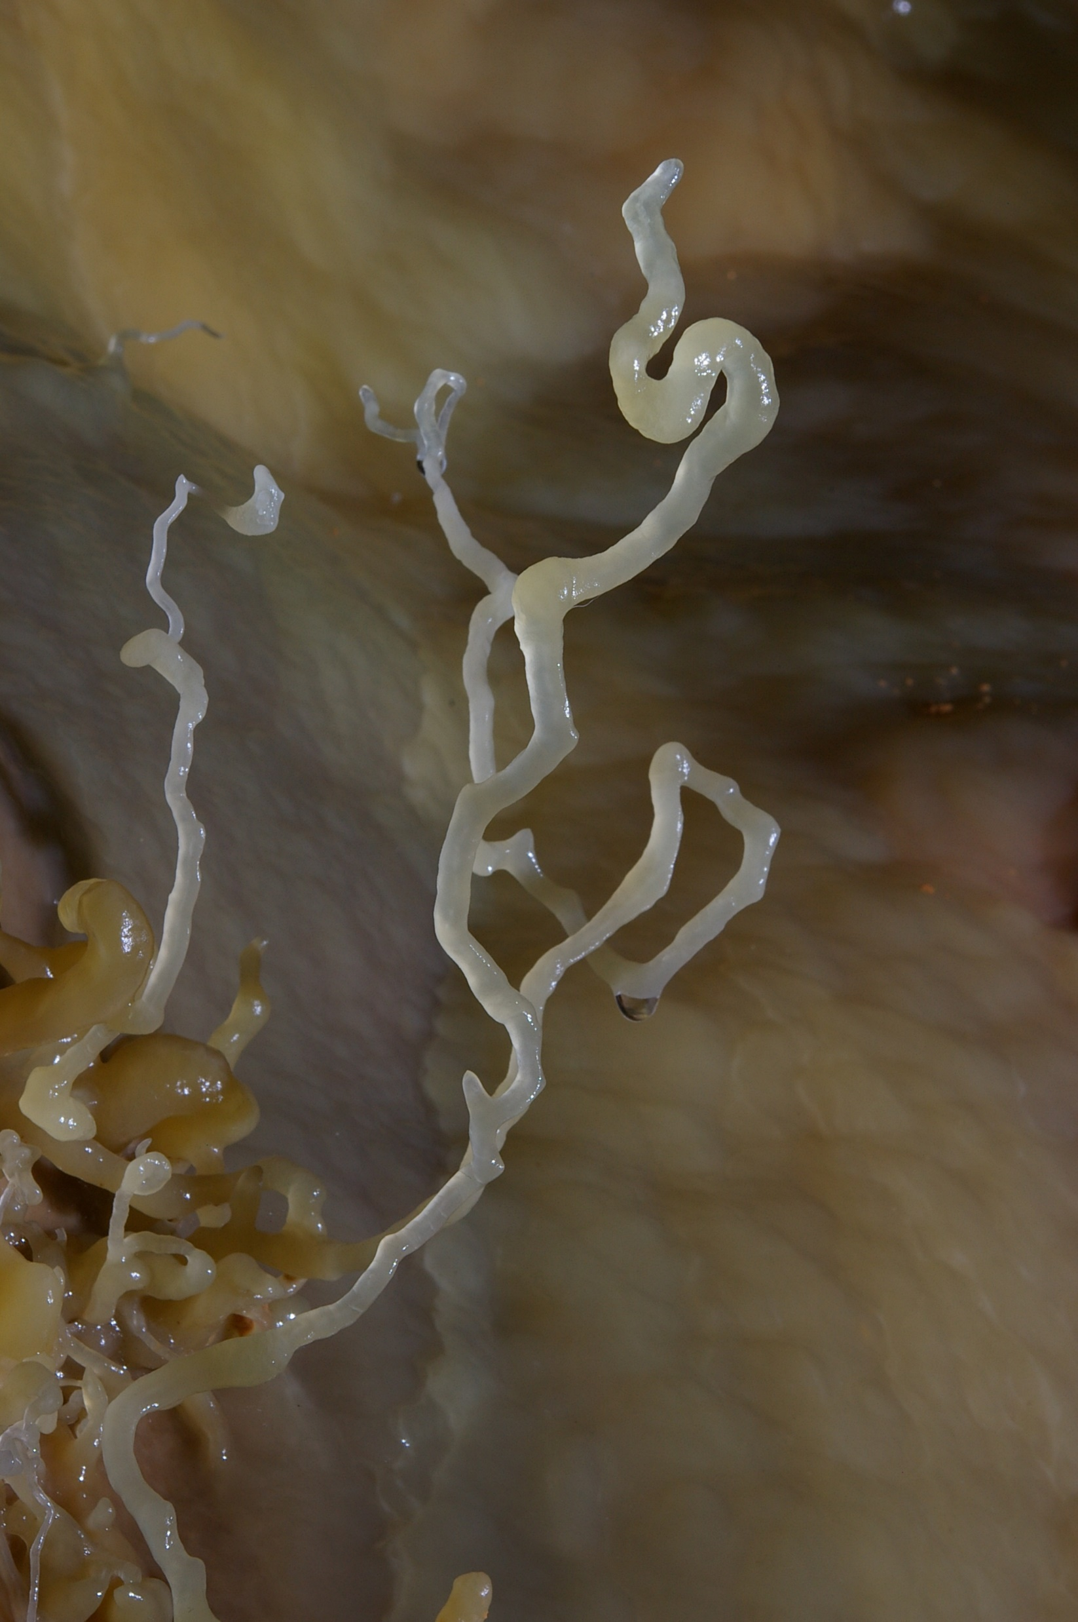
U.S. Department of the Interior Bureau of Land Management
Notes:
What do you know about Bloomington Cave?

Slide 13
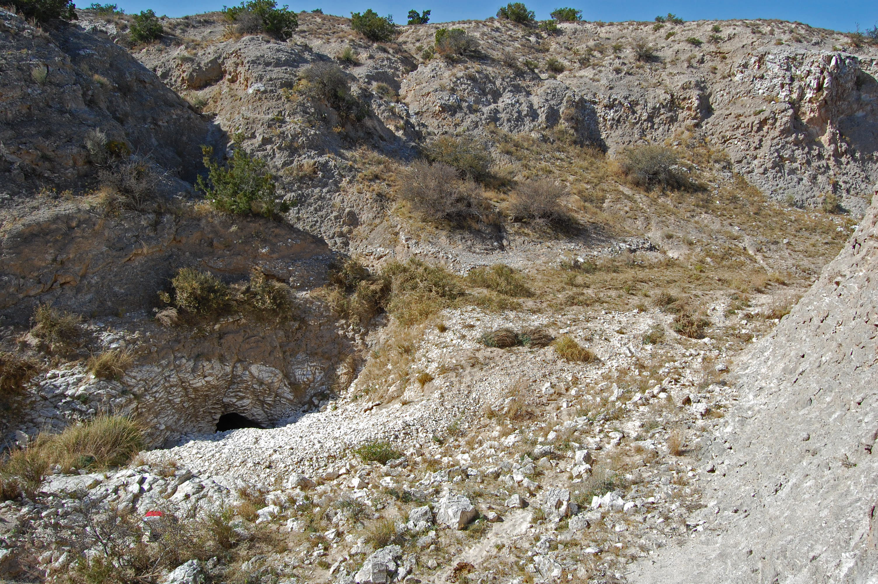
U.S. Department of the Interior Bureau of Land Management
Notes:
What do you know about Bloomington Cave?

Slide 14
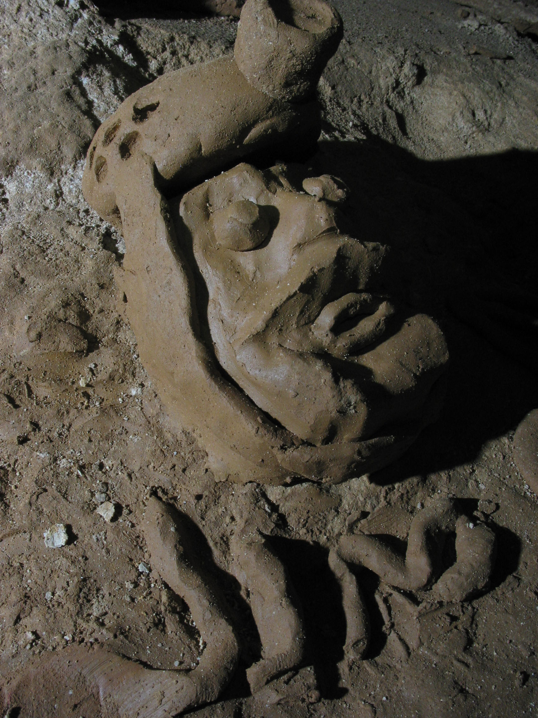
U.S. Department of the Interior Bureau of Land Management
Notes:
What do you know about Bloomington Cave?

Slide 15
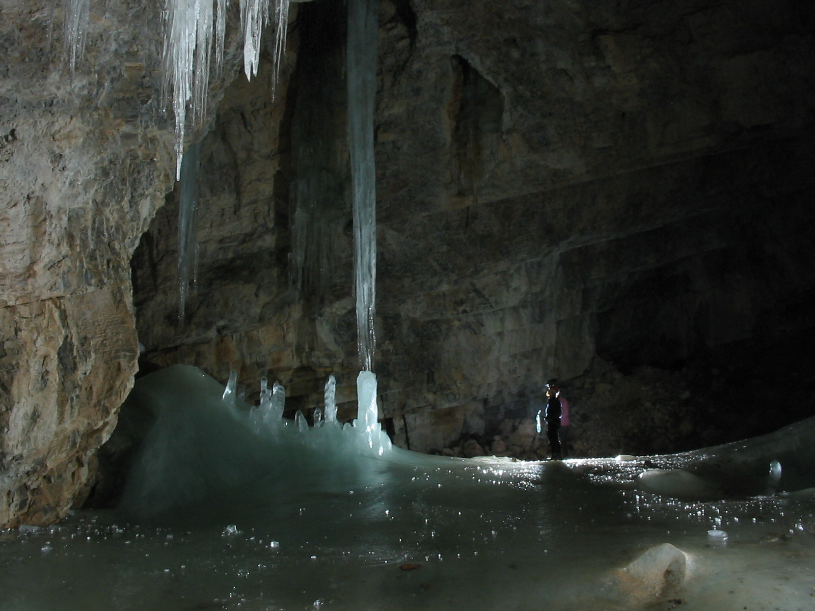
U.S. Department of the Interior Bureau of Land Management
Notes:
What do you know about Bloomington Cave?

Slide 16
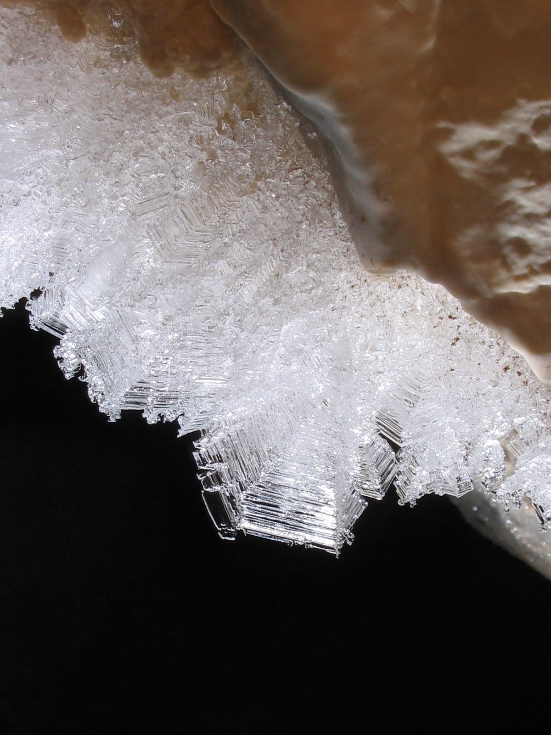
U.S. Department of the Interior Bureau of Land Management
Notes:
What do you know about Bloomington Cave?

Slide 17
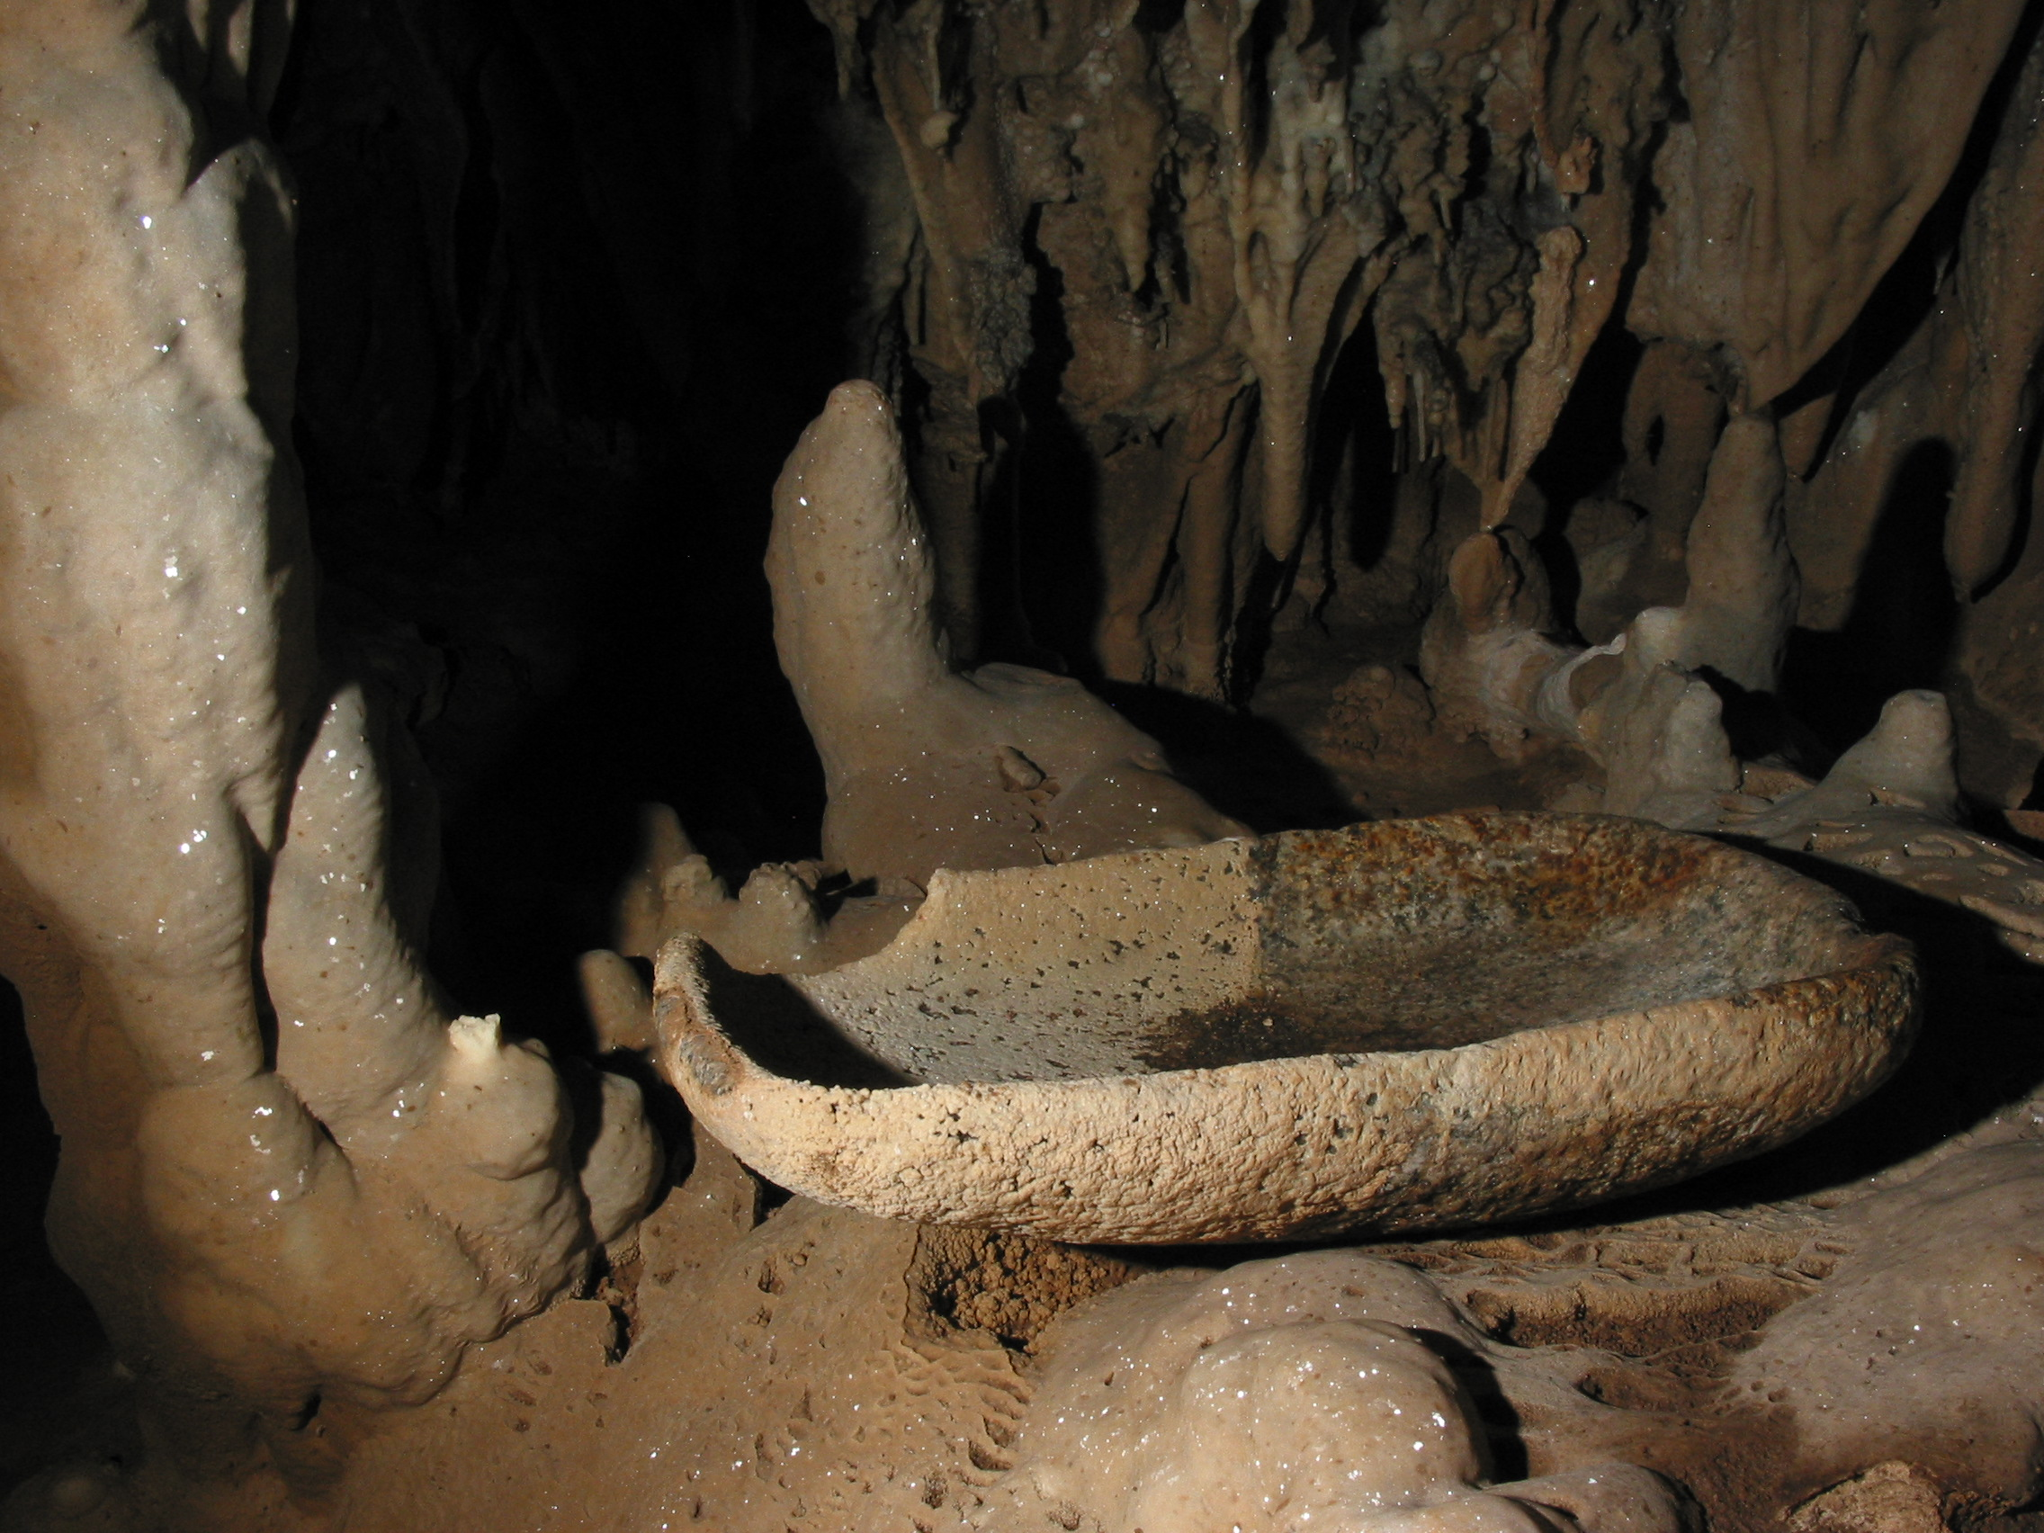
U.S. Department of the Interior Bureau of Land Management
Notes:
What do you know about Bloomington Cave?

Slide 18
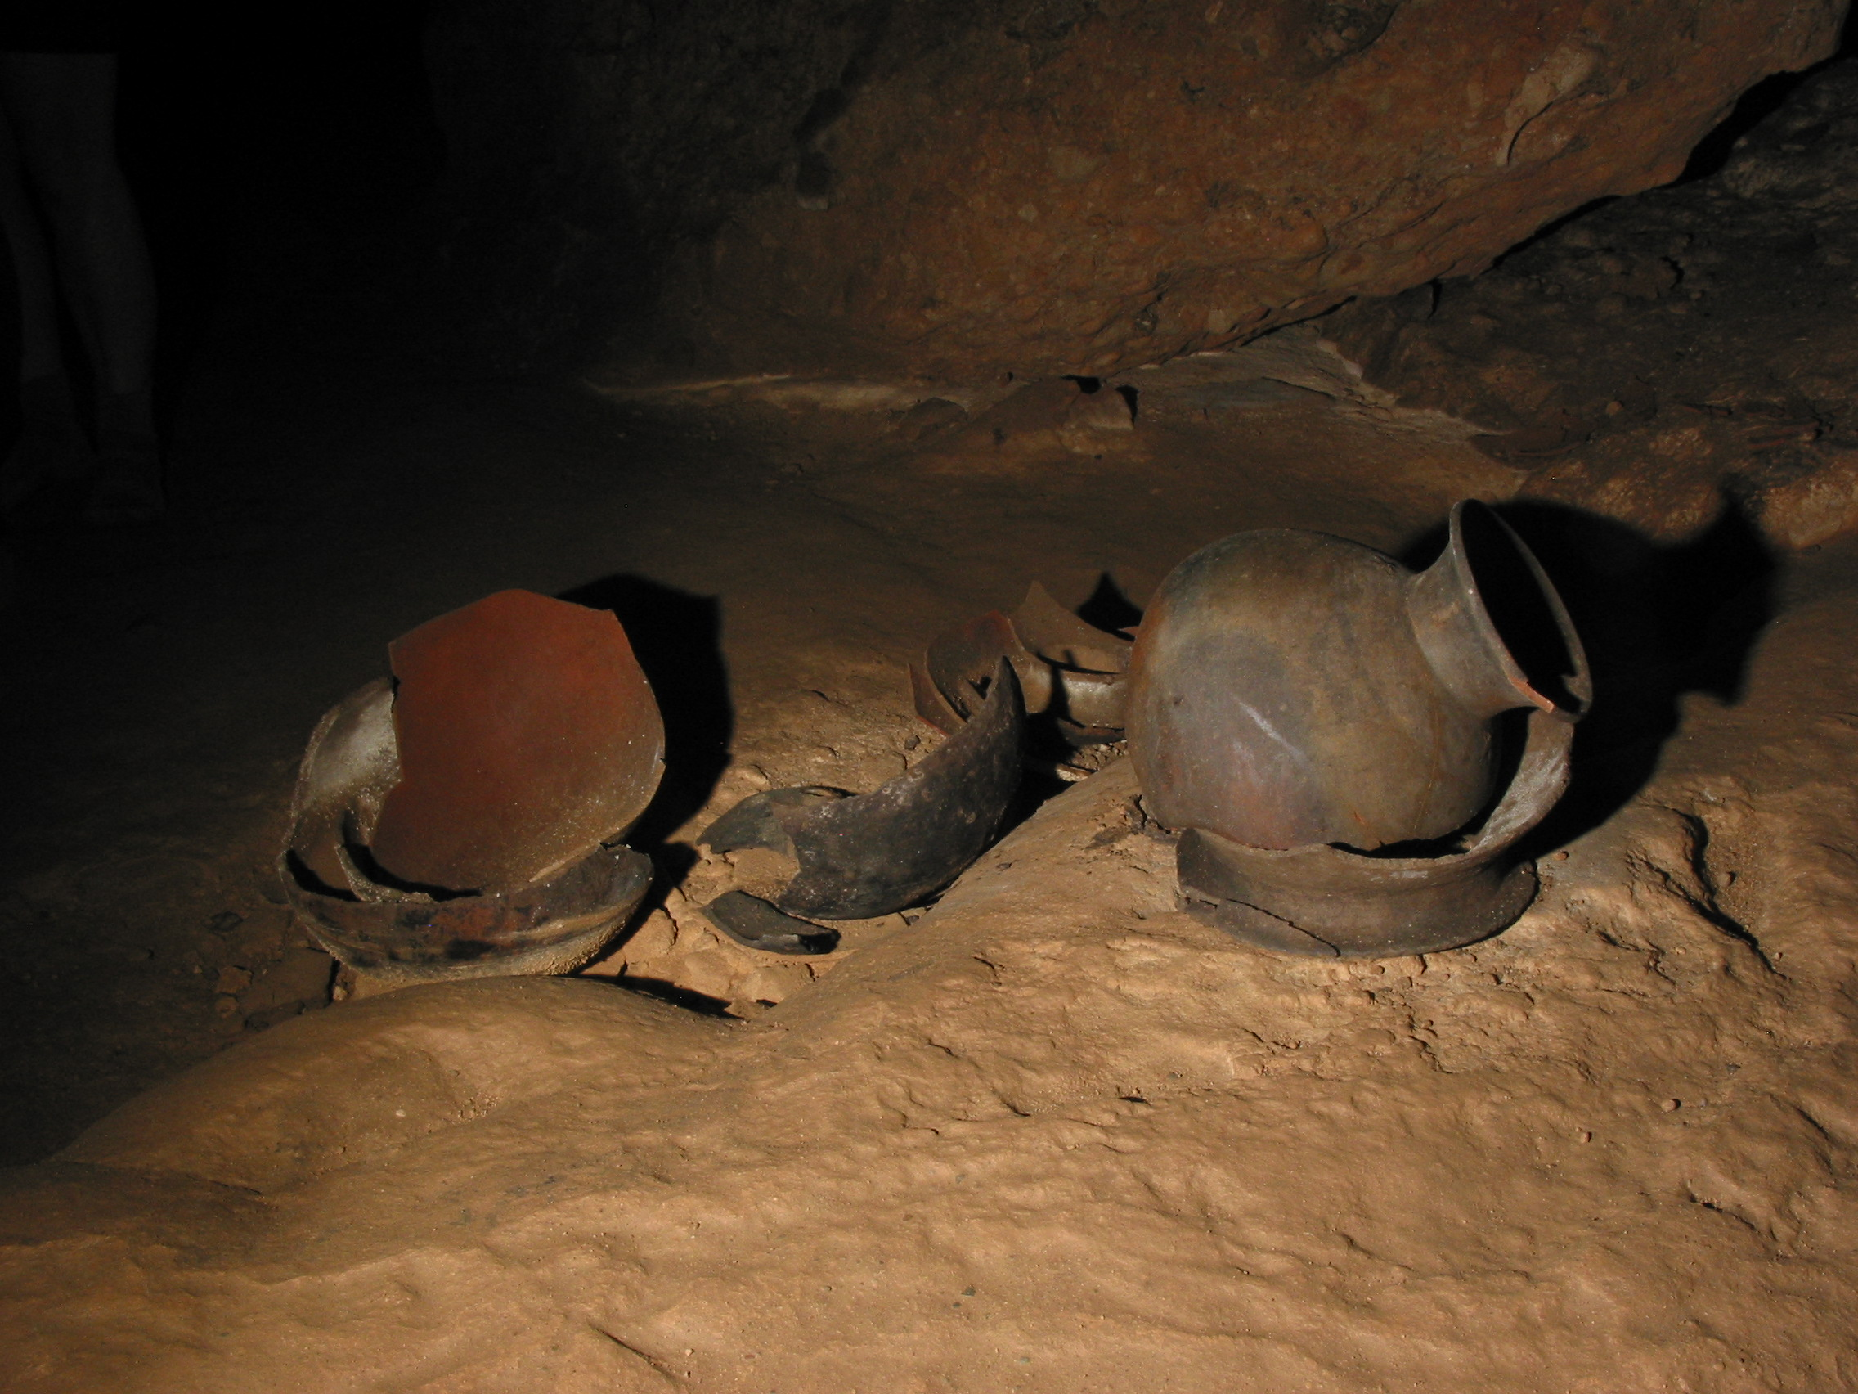
U.S. Department of the Interior Bureau of Land Management
Notes:
What do you know about Bloomington Cave?

Slide 19
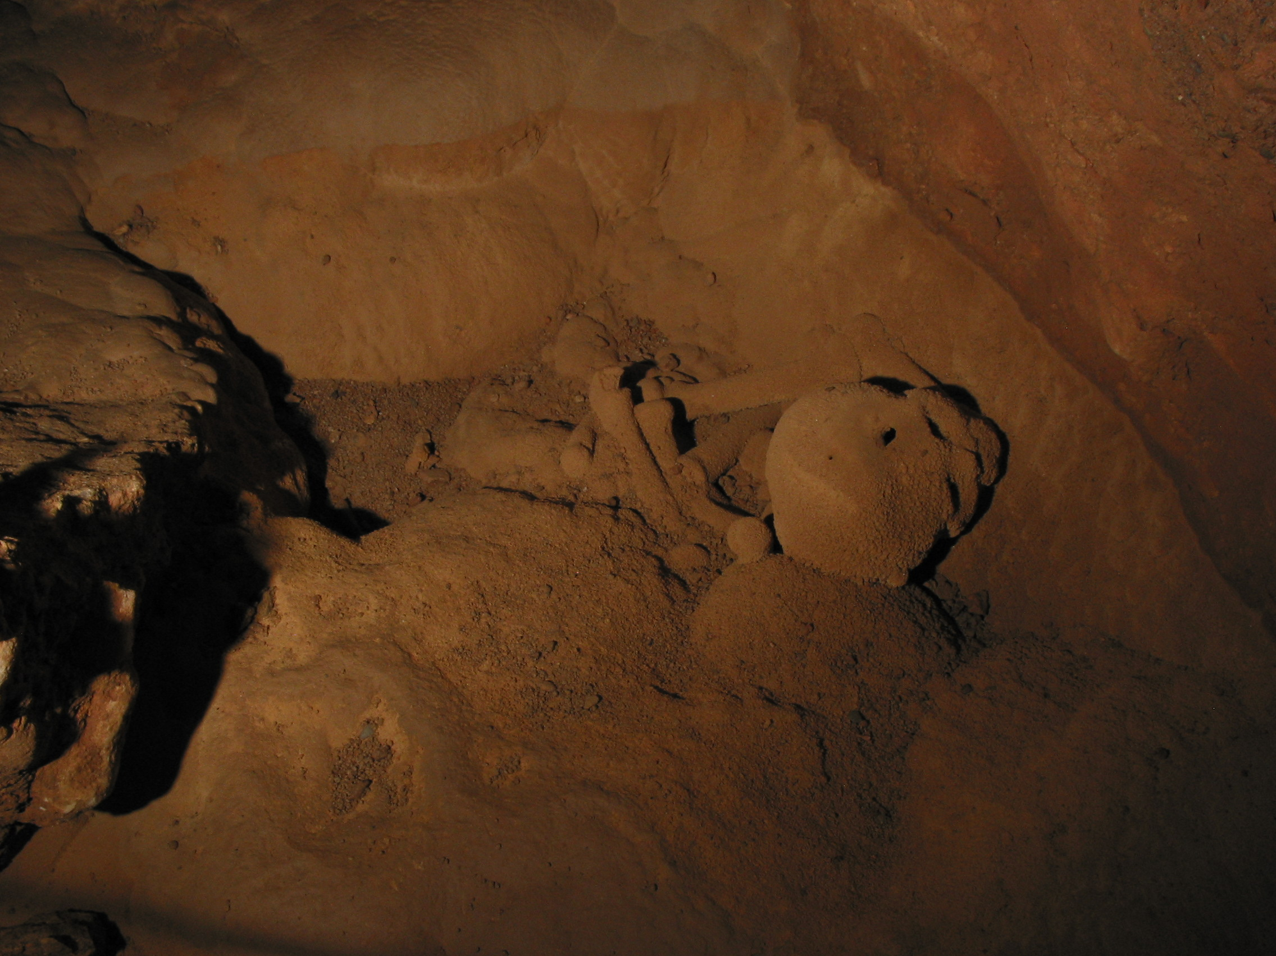
U.S. Department of the Interior Bureau of Land Management
Notes:
What do you know about Bloomington Cave?

Slide 20
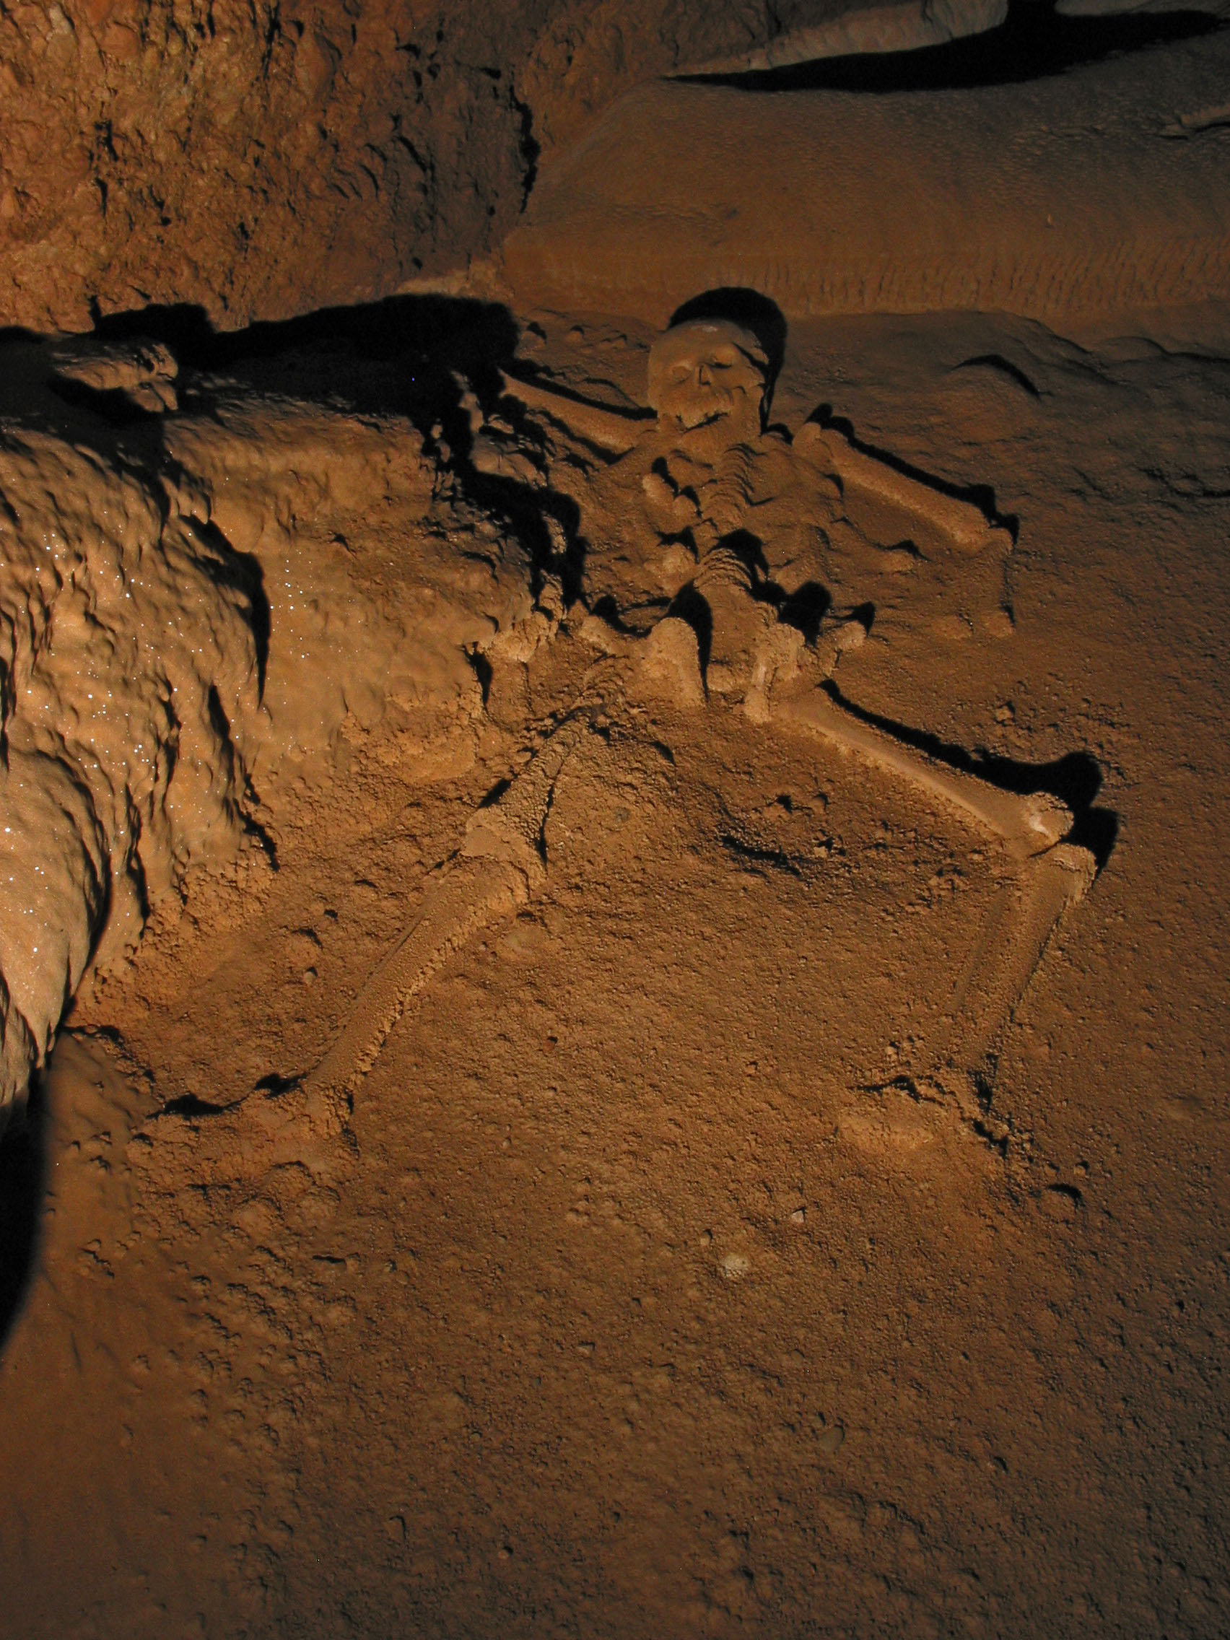
U.S. Department of the Interior Bureau of Land Management
Notes:
What do you know about Bloomington Cave?

Slide 21
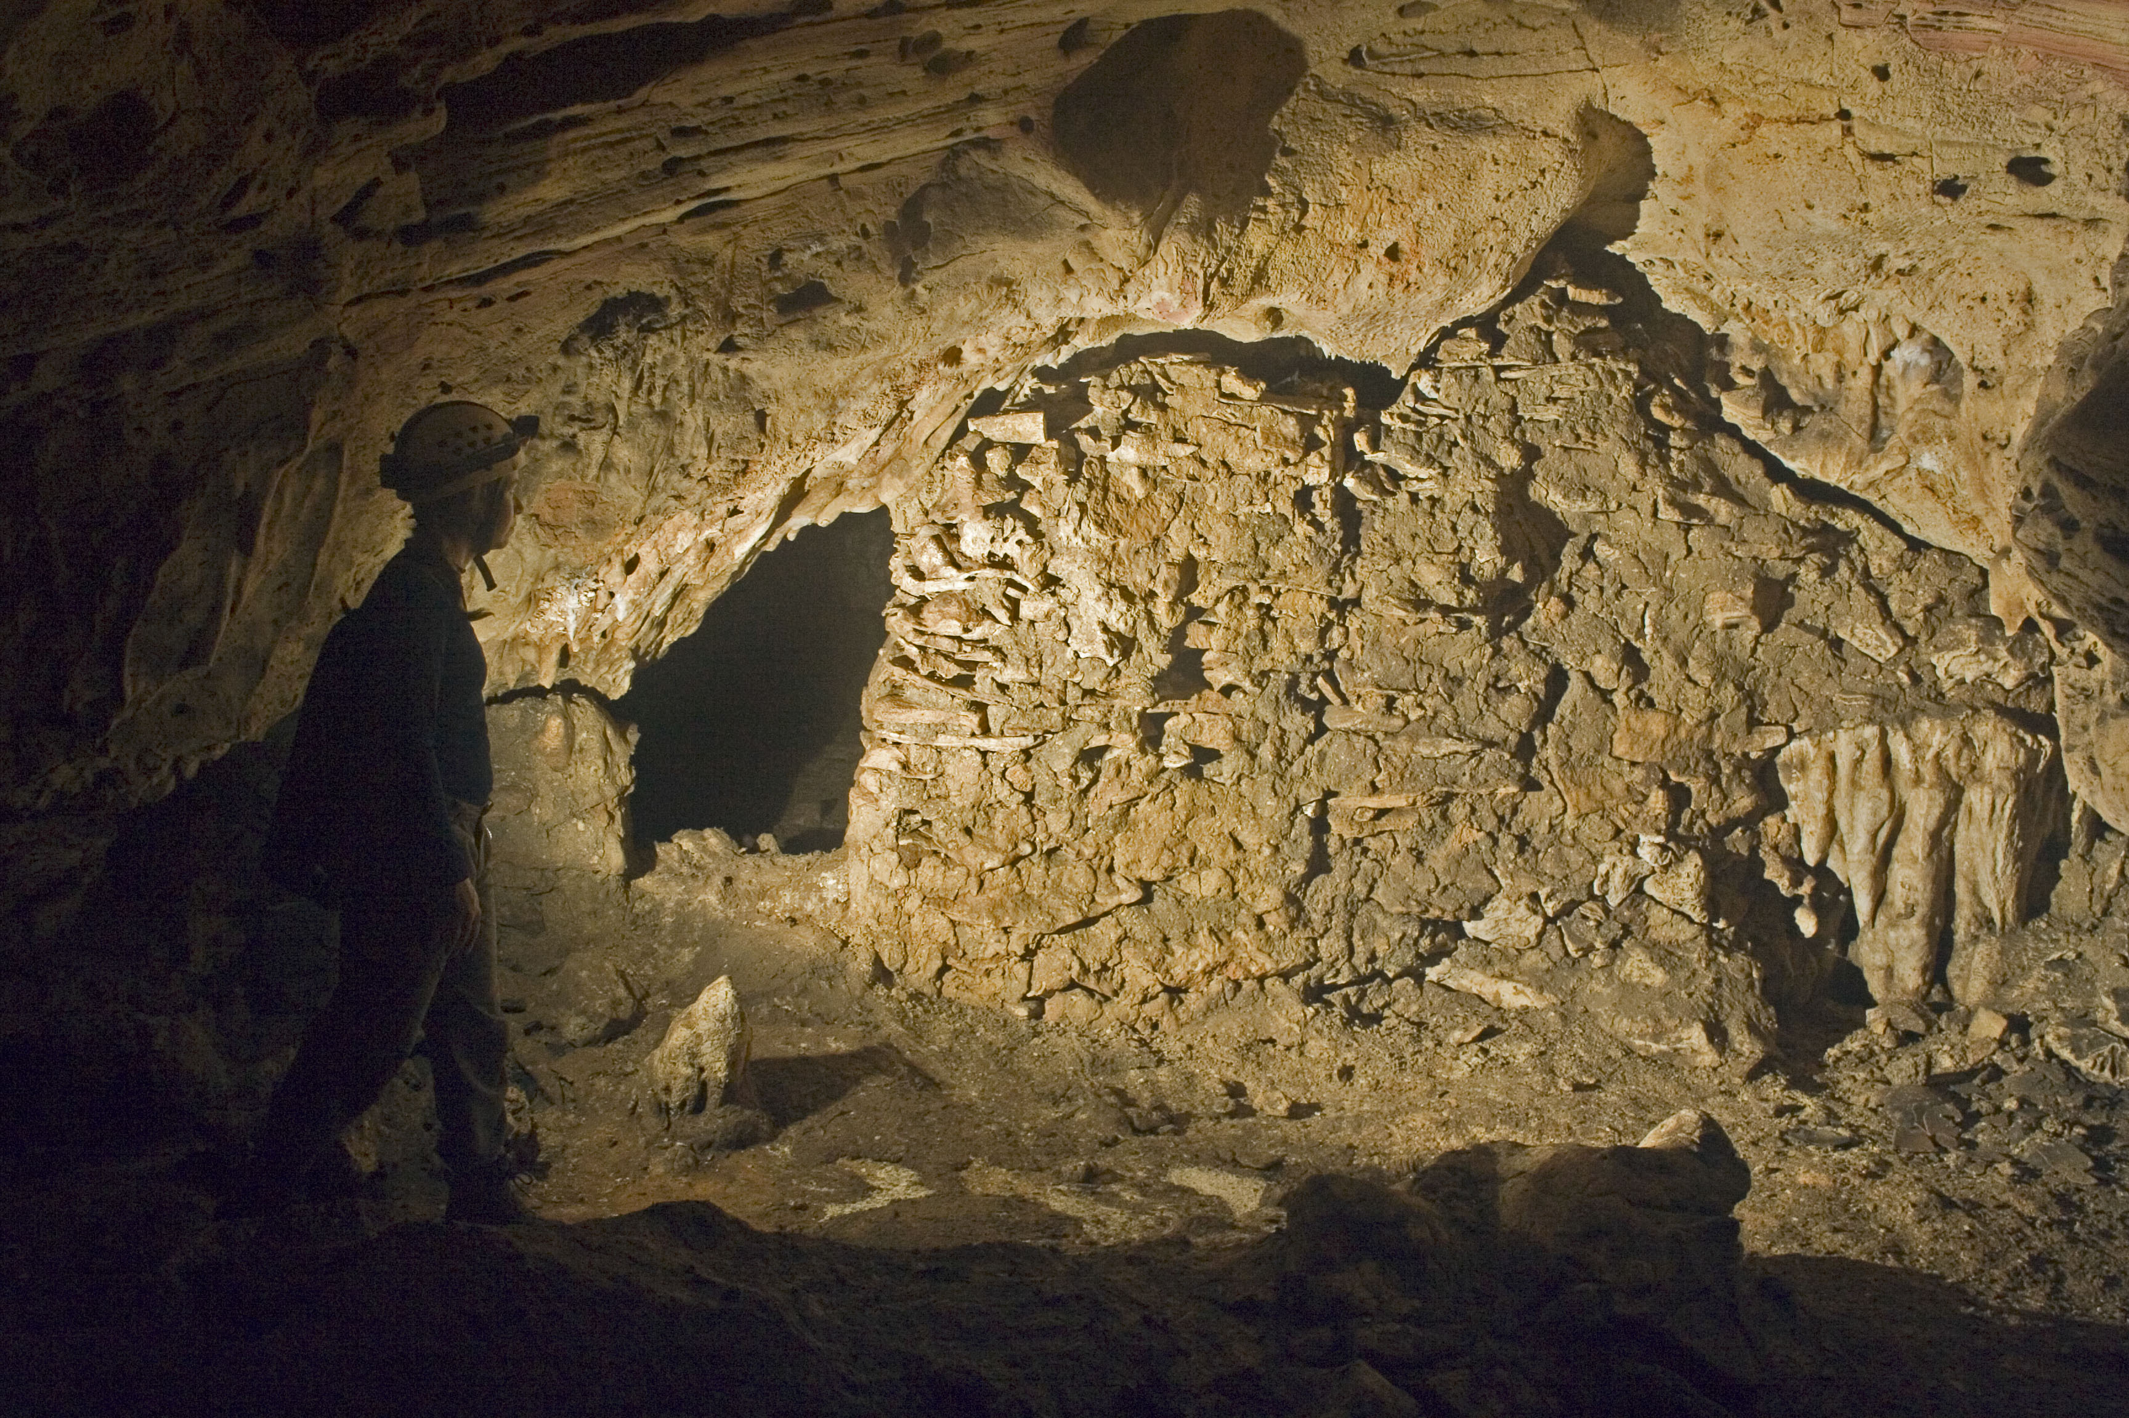
U.S. Department of the Interior Bureau of Land Management
Notes:
What do you know about Bloomington Cave?

Slide 22
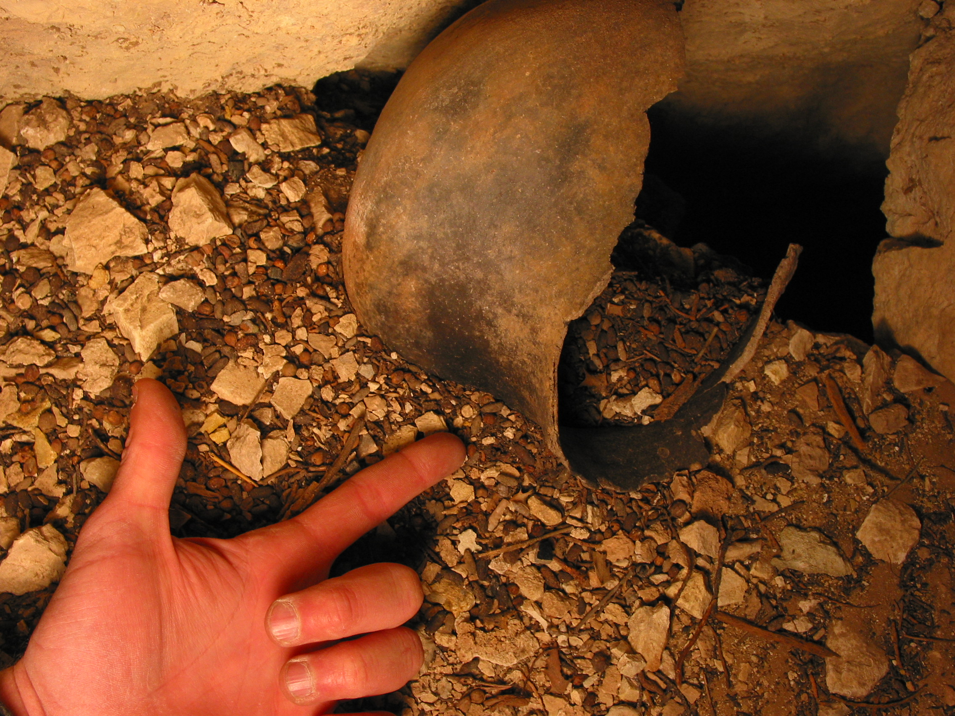
U.S. Department of the Interior Bureau of Land Management
Notes:
What do you know about Bloomington Cave?

Slide 23
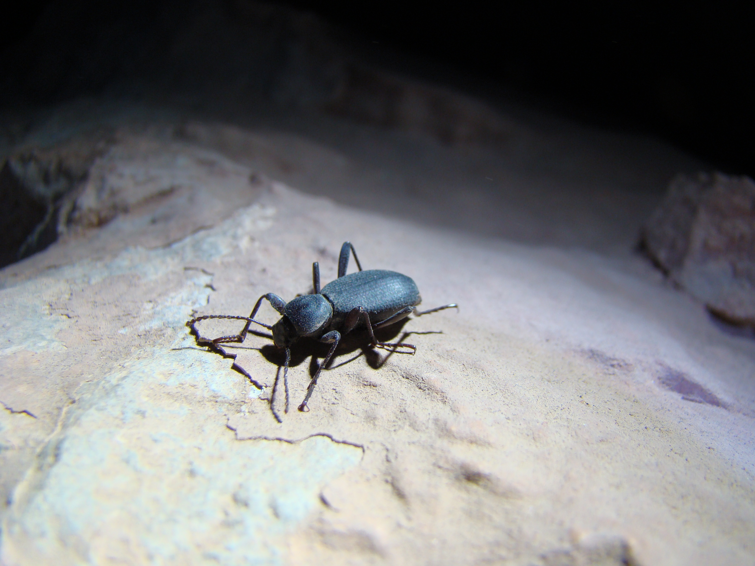
U.S. Department of the Interior Bureau of Land Management
Notes:
What do you know about Bloomington Cave?

Slide 24
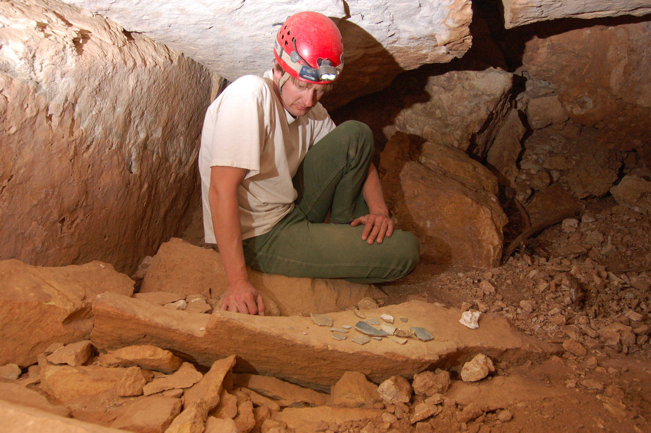
U.S. Department of the Interior Bureau of Land Management
Notes:
What do you know about Bloomington Cave?

Slide 25
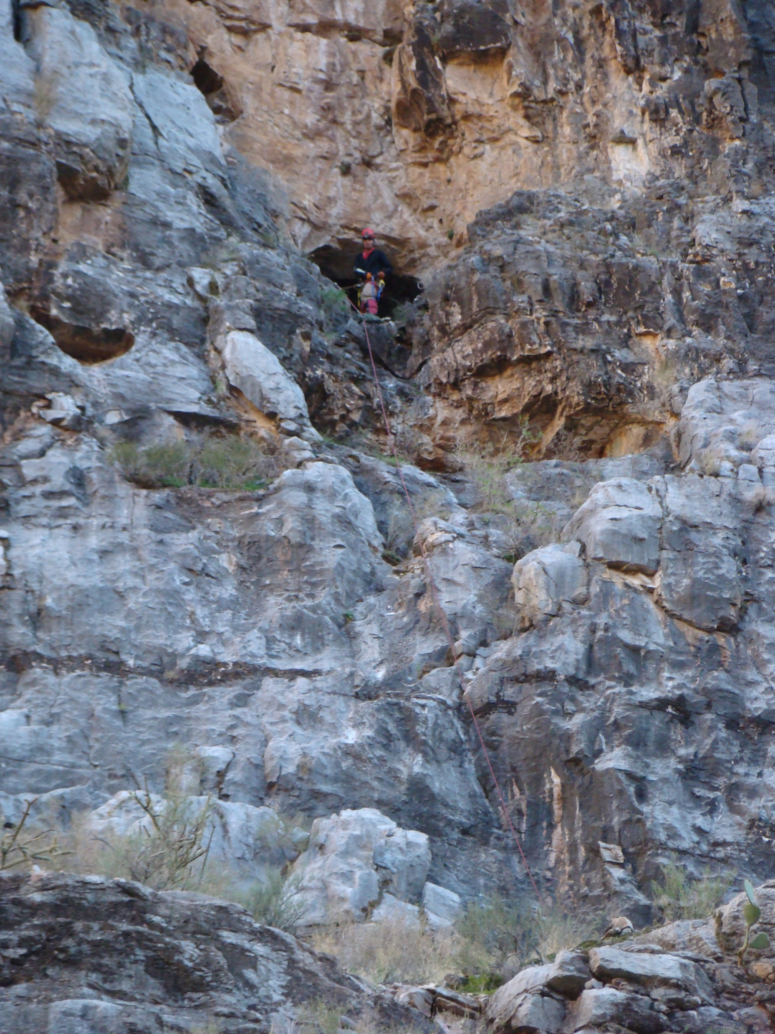
U.S. Department of the Interior Bureau of Land Management
Notes:
What do you know about Bloomington Cave?

Slide 26
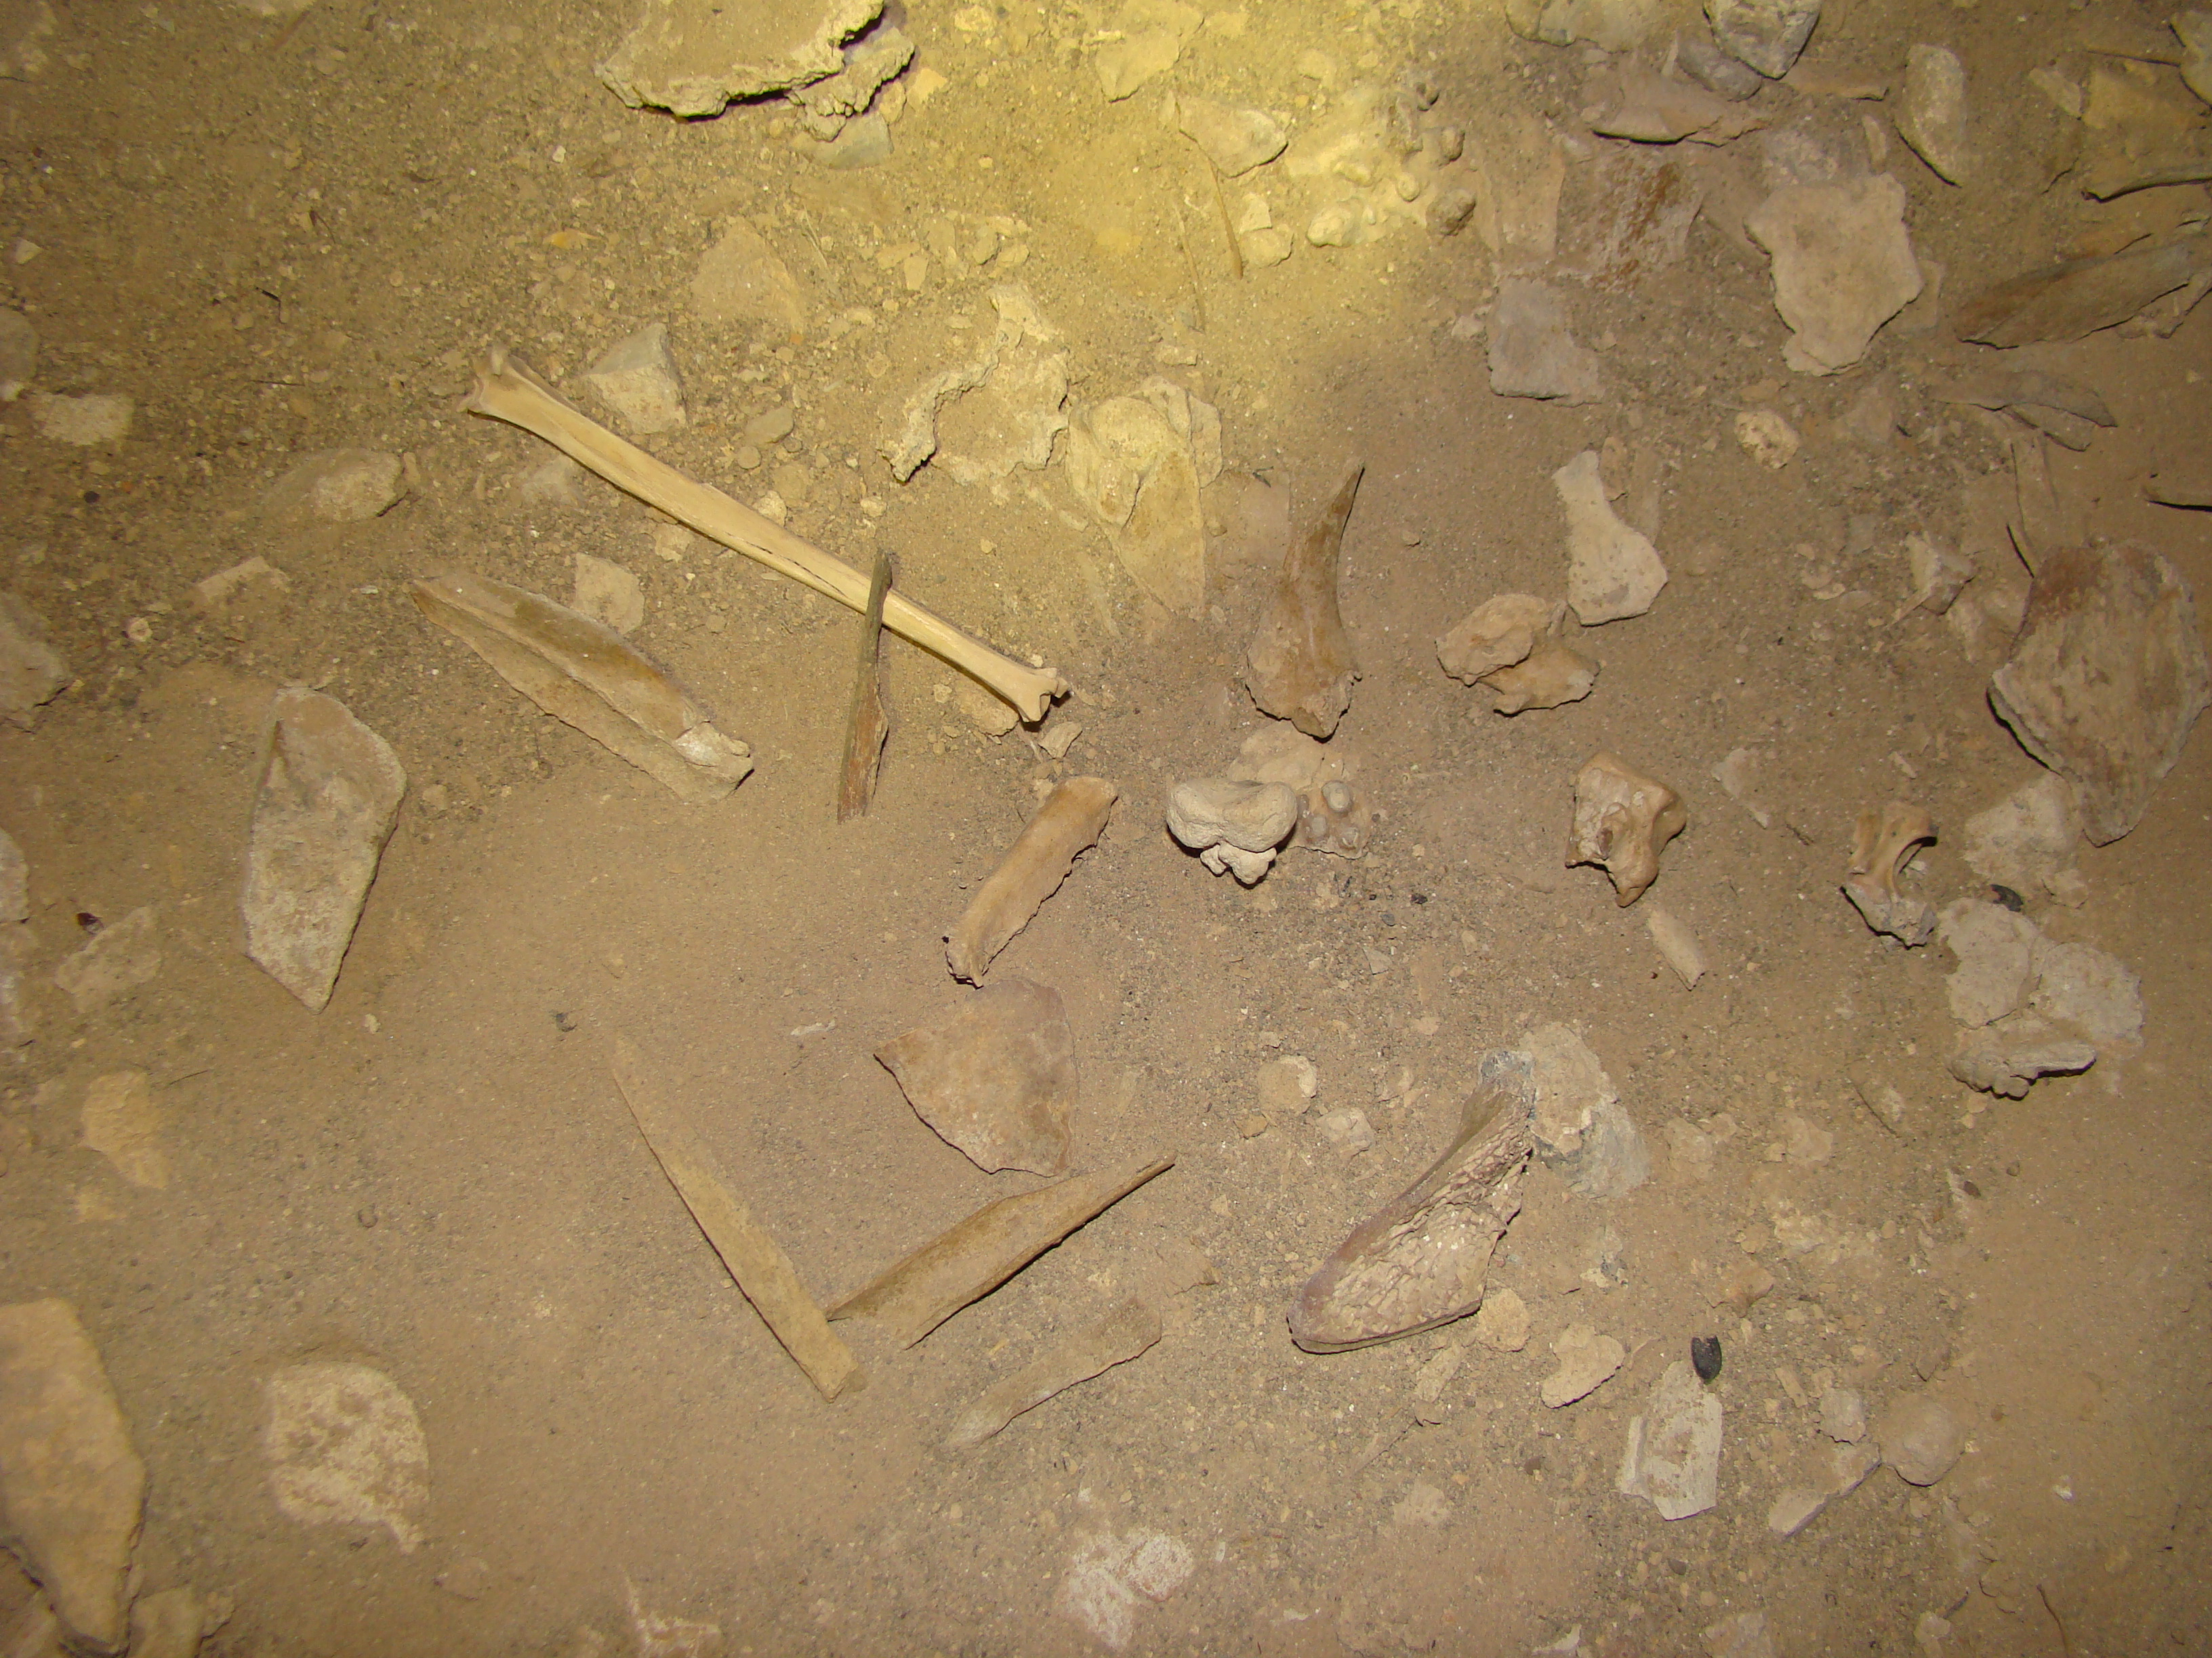
U.S. Department of the Interior Bureau of Land Management
Notes:
What do you know about Bloomington Cave?

Slide 27
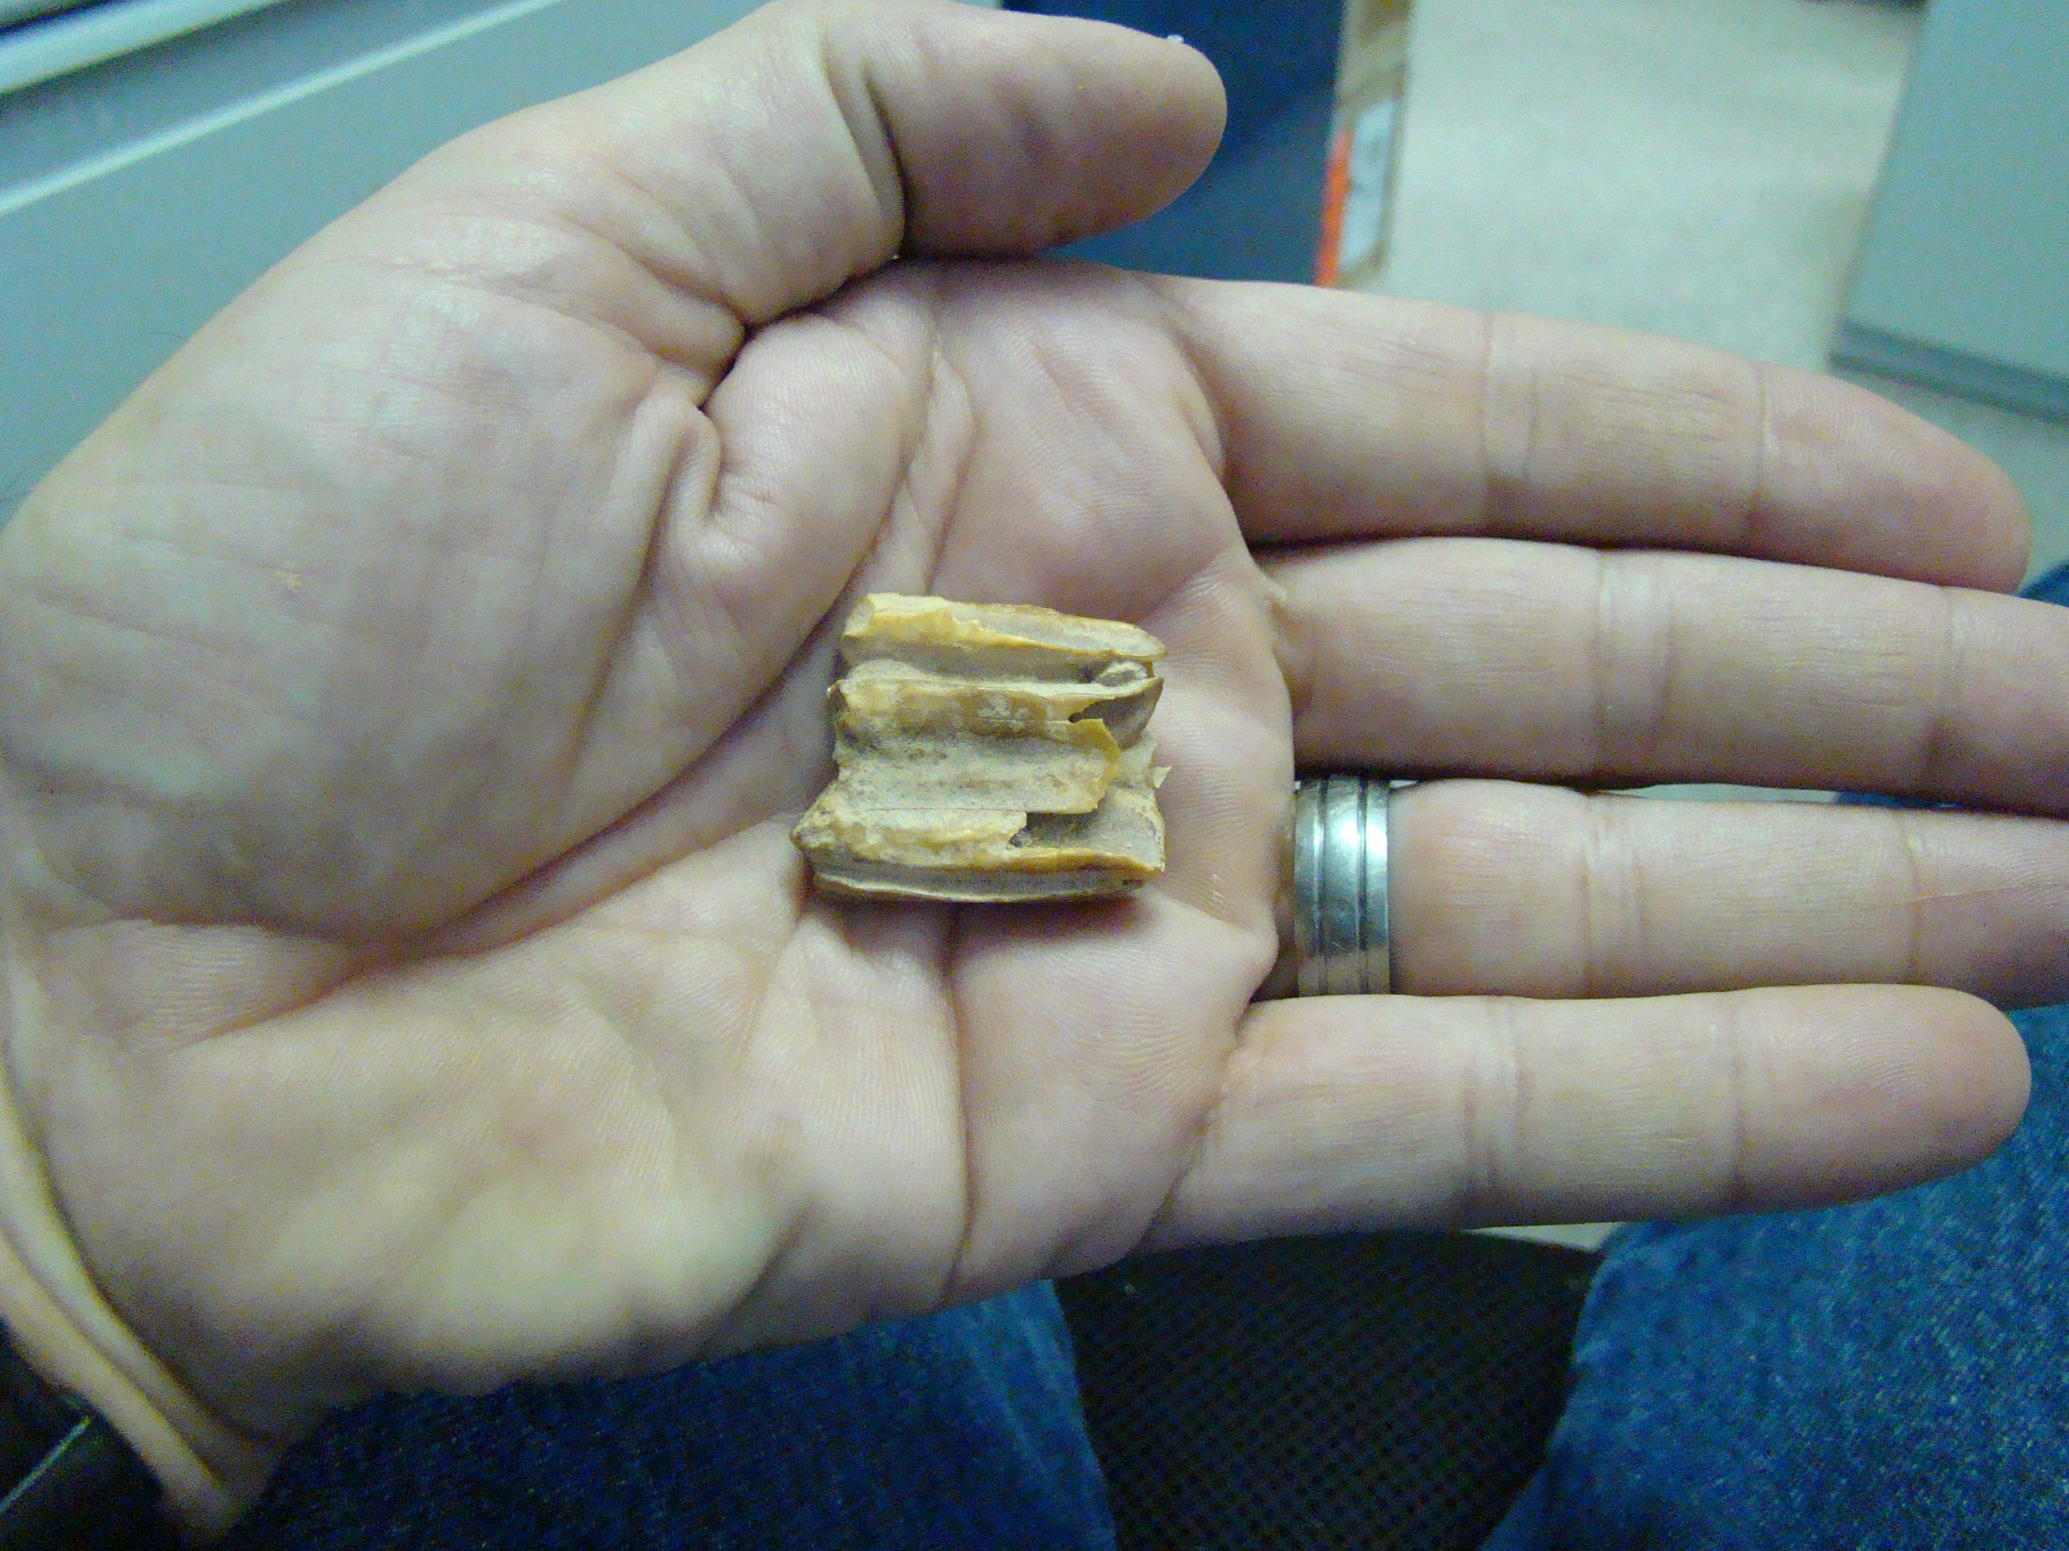
U.S. Department of the Interior Bureau of Land Management
Notes:
Tooth of extinct horse

Slide 28
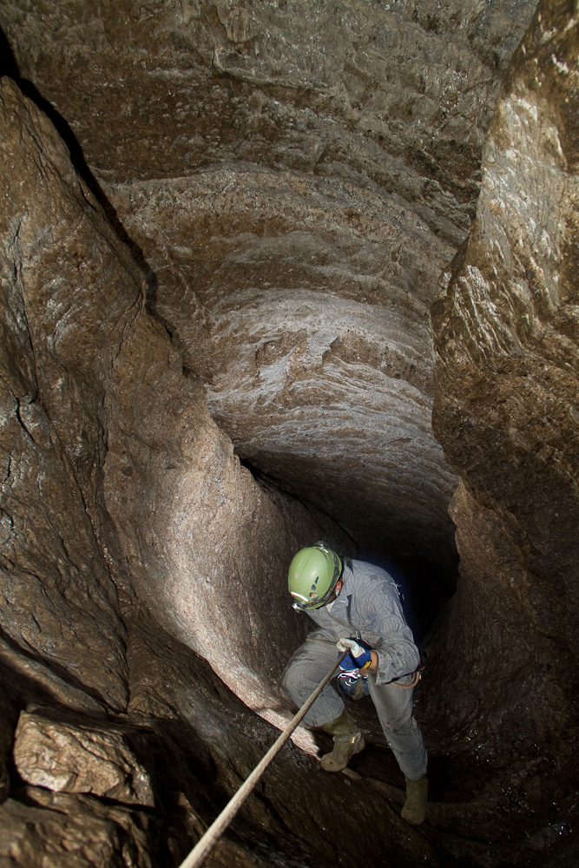
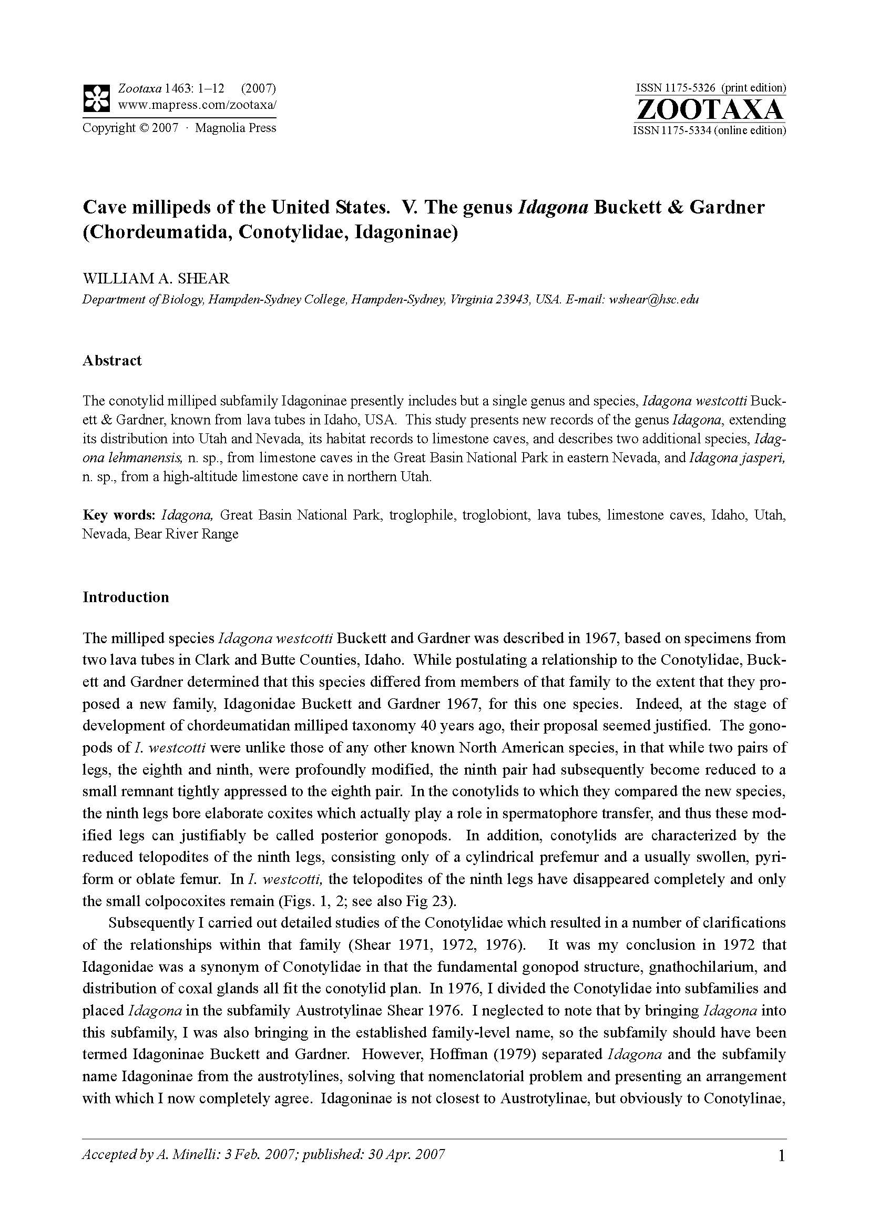
U.S. Department of the Interior Bureau of Land Management
Notes:
What do you know about Bloomington Cave?

Slide 29
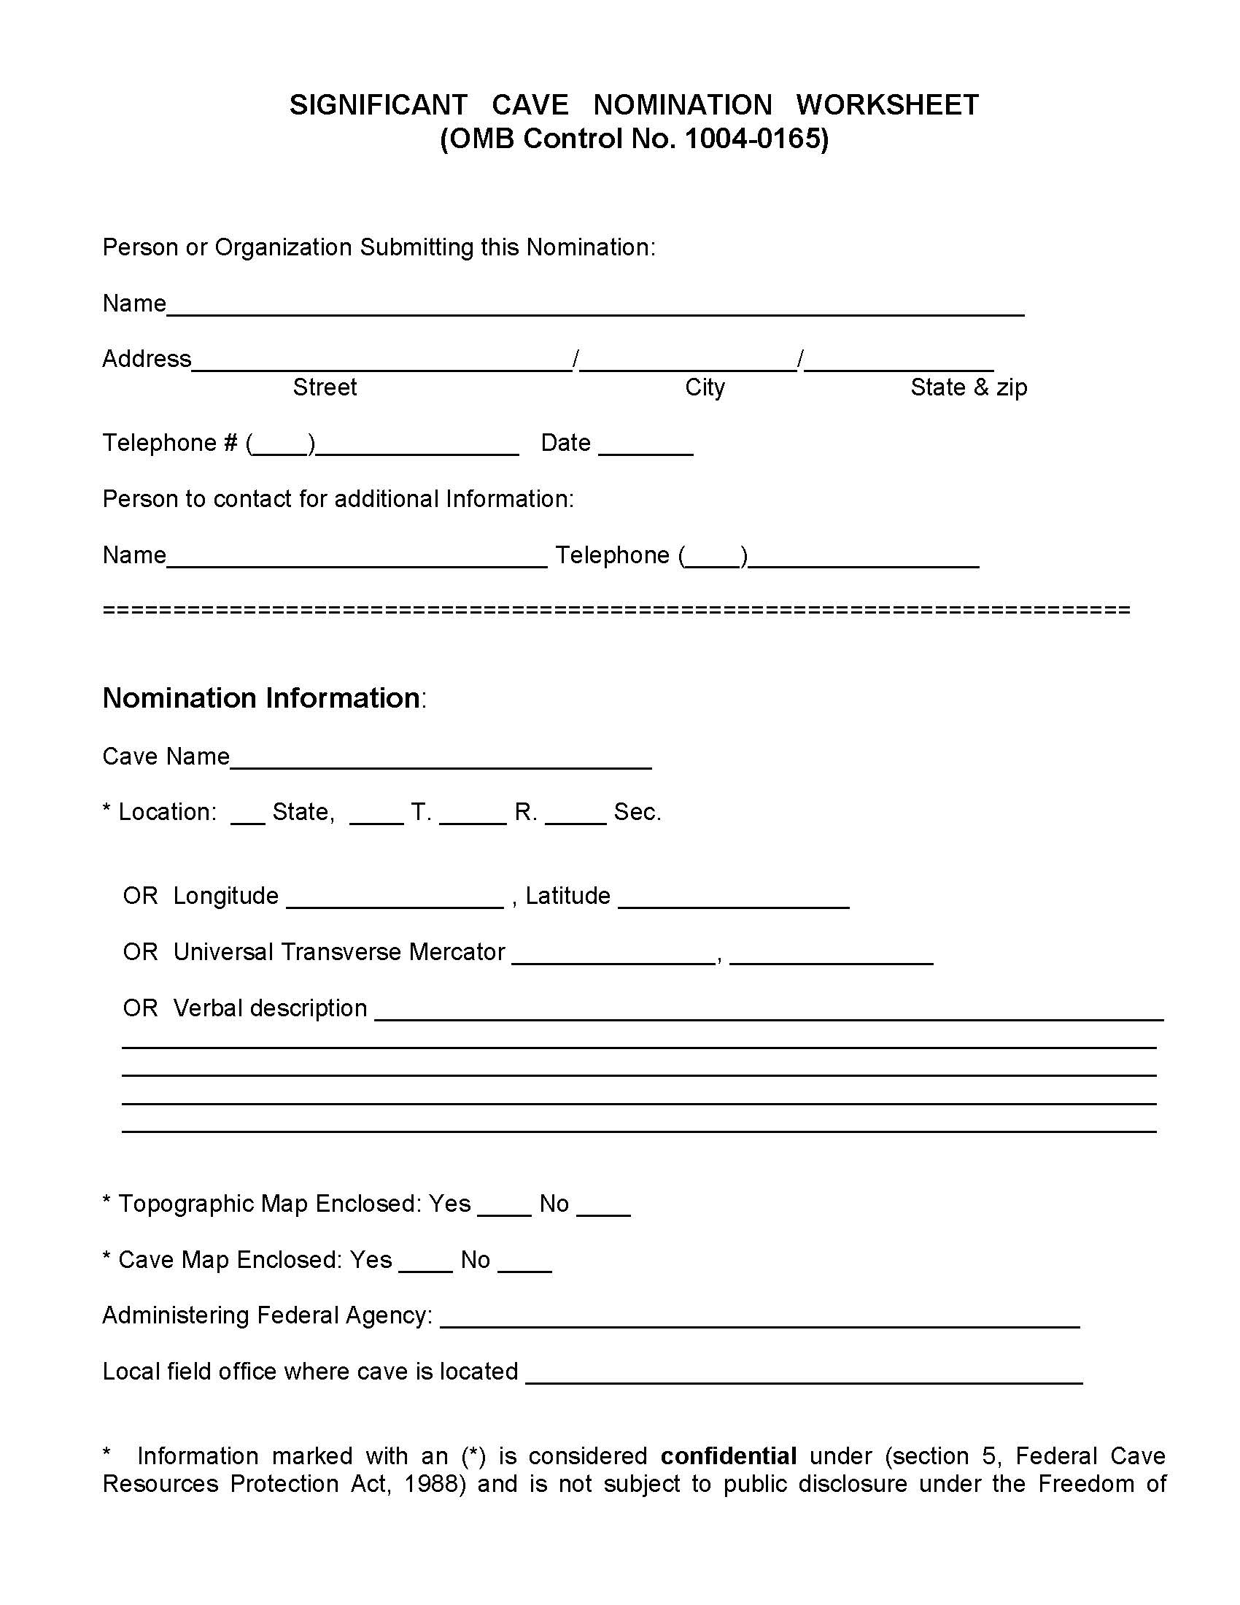
Significance Worksheet
U.S. Department of the Interior Bureau of Land Management
Notes:
What do you know about Bloomington Cave?

Slide 30
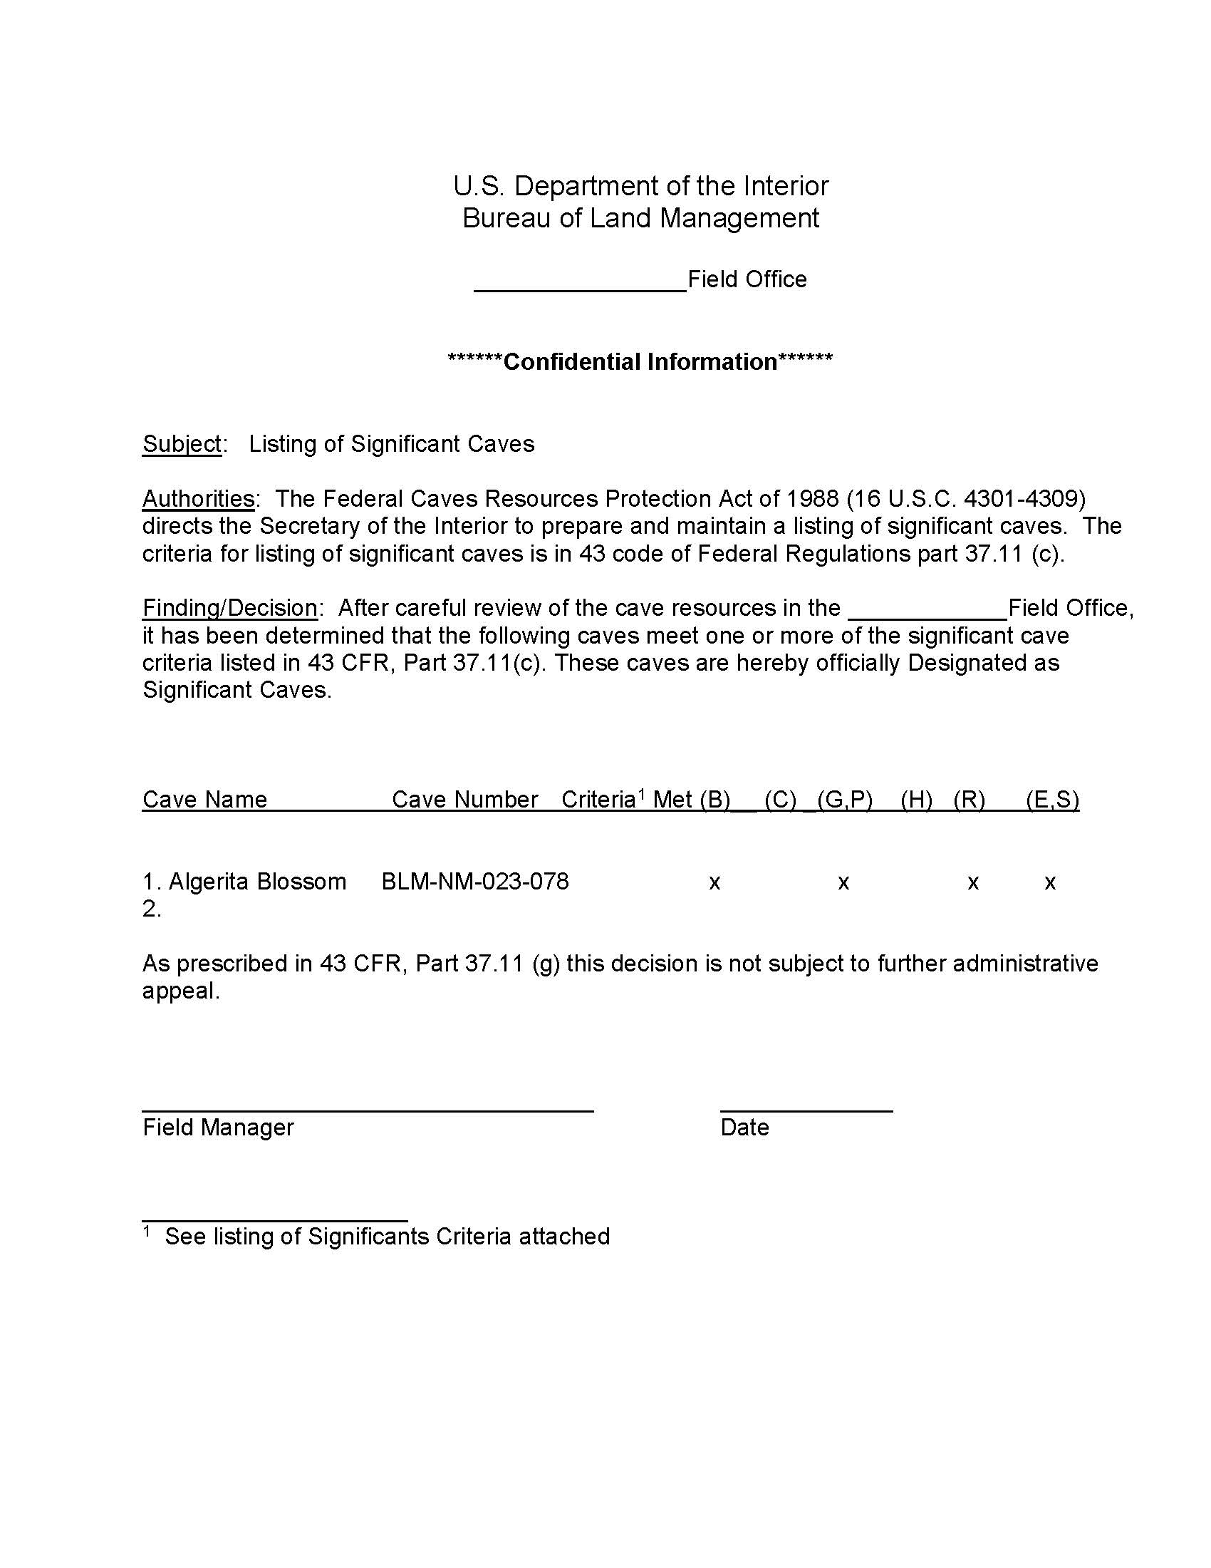
Significant Cave Designation Form
U.S. Department of the Interior Bureau of Land Management
Notes:
What do you know about Bloomington Cave?

Slide 31
RMIS
U.S. Department of the Interior Bureau of Land Management
List the total number significant caves in RMIS
Notes:
What do you know about Bloomington Cave?

Slide 32
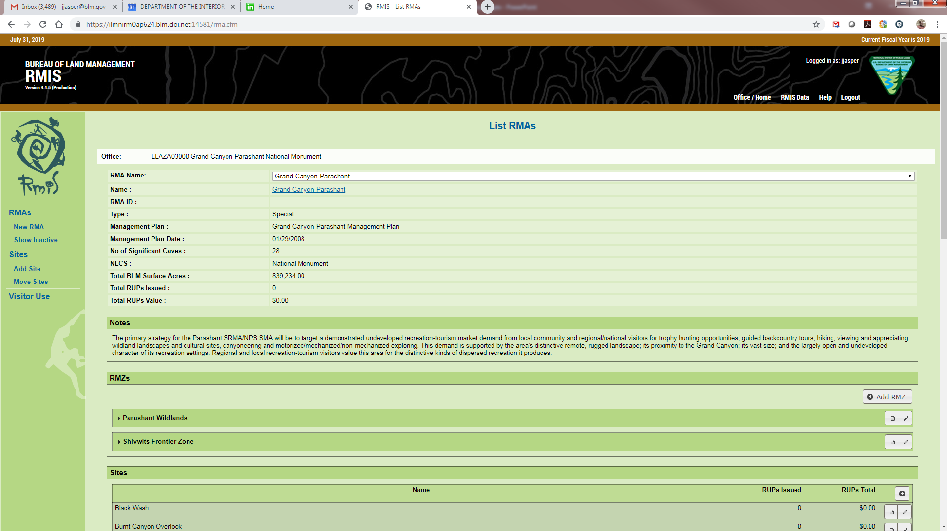
U.S. Department of the Interior Bureau of Land Management
Notes:
Used to be by office; now by RMAs

Slide 33
Nominations from the public
U.S. Department of the Interior Bureau of Land Management
OMB Federal Registry Notice
Good for 3 years
Report at end for Federal Registry Notice
Notes:
What do you know about Bloomington Cave?

Slide 34
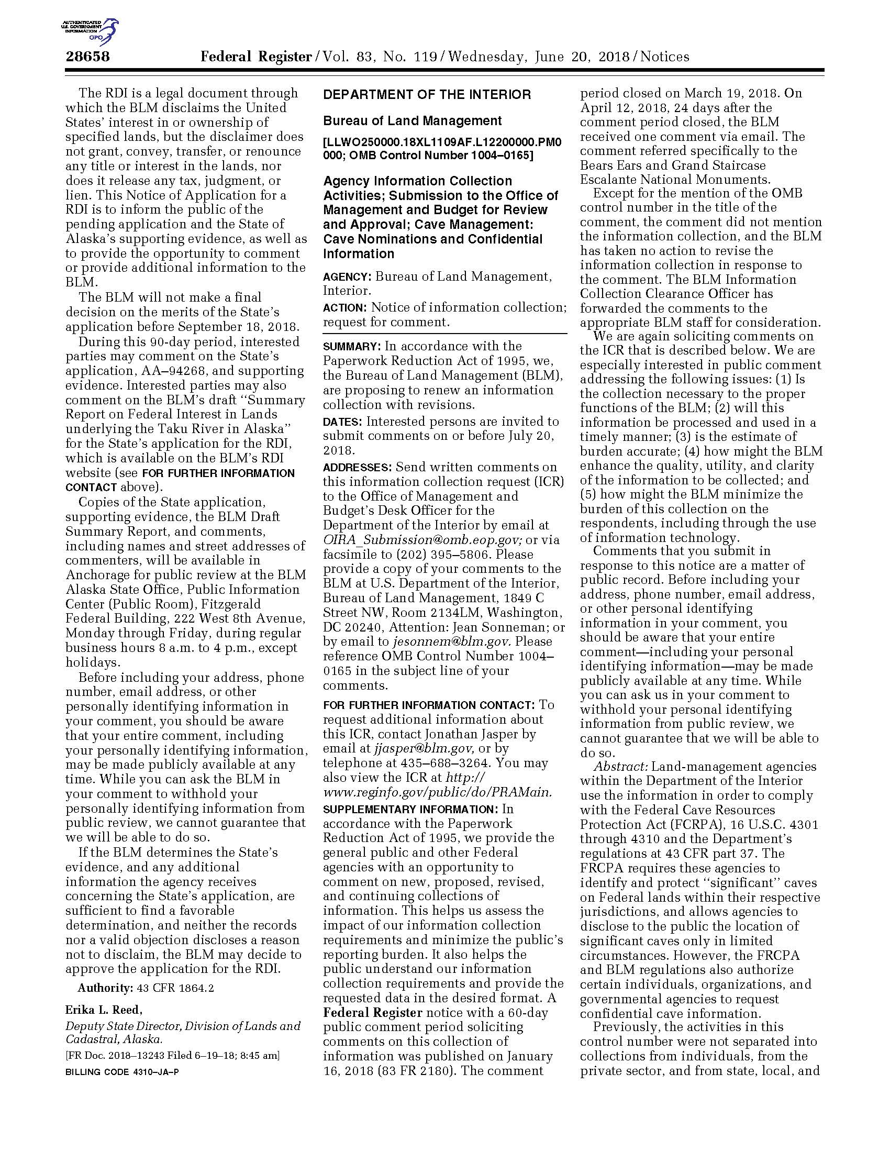
U.S. Department of the Interior Bureau of Land Management
Notes:
What do you know about Bloomington Cave?

Slide 35
Significant Caves
U.S. Department of the Interior Bureau of Land Management
The biggest problem is staffing turnover
Keep files secure, but files in a way they can out live you
Notes:
What do you know about Bloomington Cave?

