Slide 1
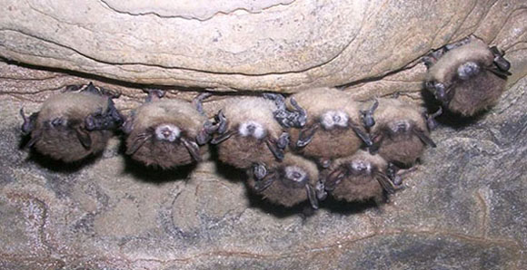
There’s a fungus among us:
White-nose syndrome
White-nose Syndrome in Hailes Cave, Albany County, NY - Photo by N. Heaslip

Slide 2
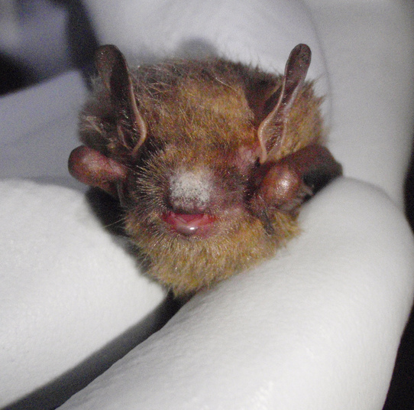
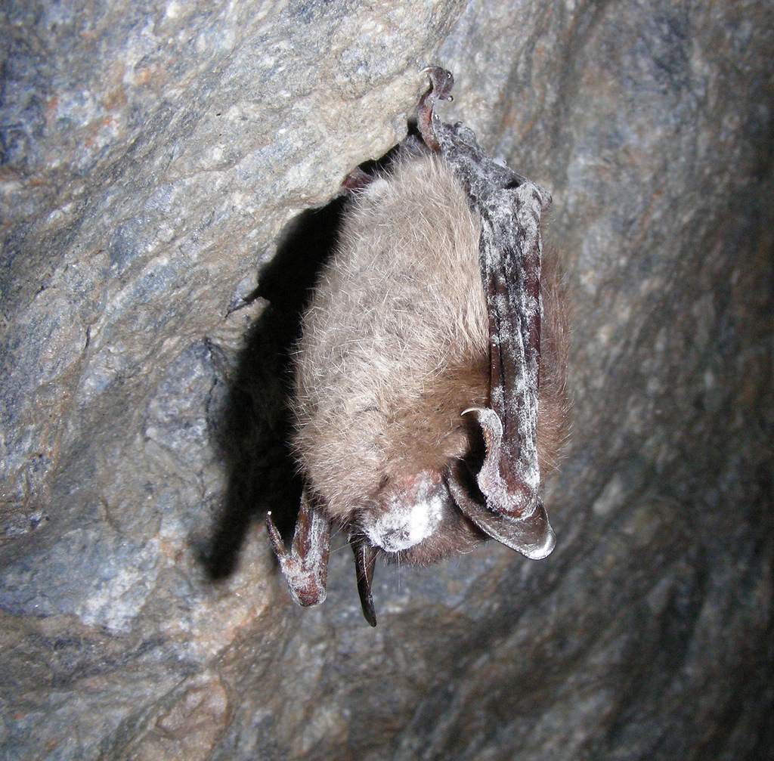
What is White-Nose Syndrome (WNS)?
WNS is a disease caused by a fungus, Pseudogymnoascus destructans (Pd), that affects hibernating bats:
  Unknown to science until it was identified in 2008
  Initially named Geomyces destructans, but reclassified as Pd in 2013
  Grows in cold (39-68° F), dark and damp places
  Attacks the bare skin of bats and causes changes that make them become more active than usual during hibernation (i.e. burn up fat they need to survive the winter)
Tricolored bat from Avery County, North Carolina, with white-nose syndrome. Credit: Gabrielle Graeter/NCWR.
A little brown bat with white-nose syndrome. Credit: Marvin Moriarty/USFWS

Slide 3
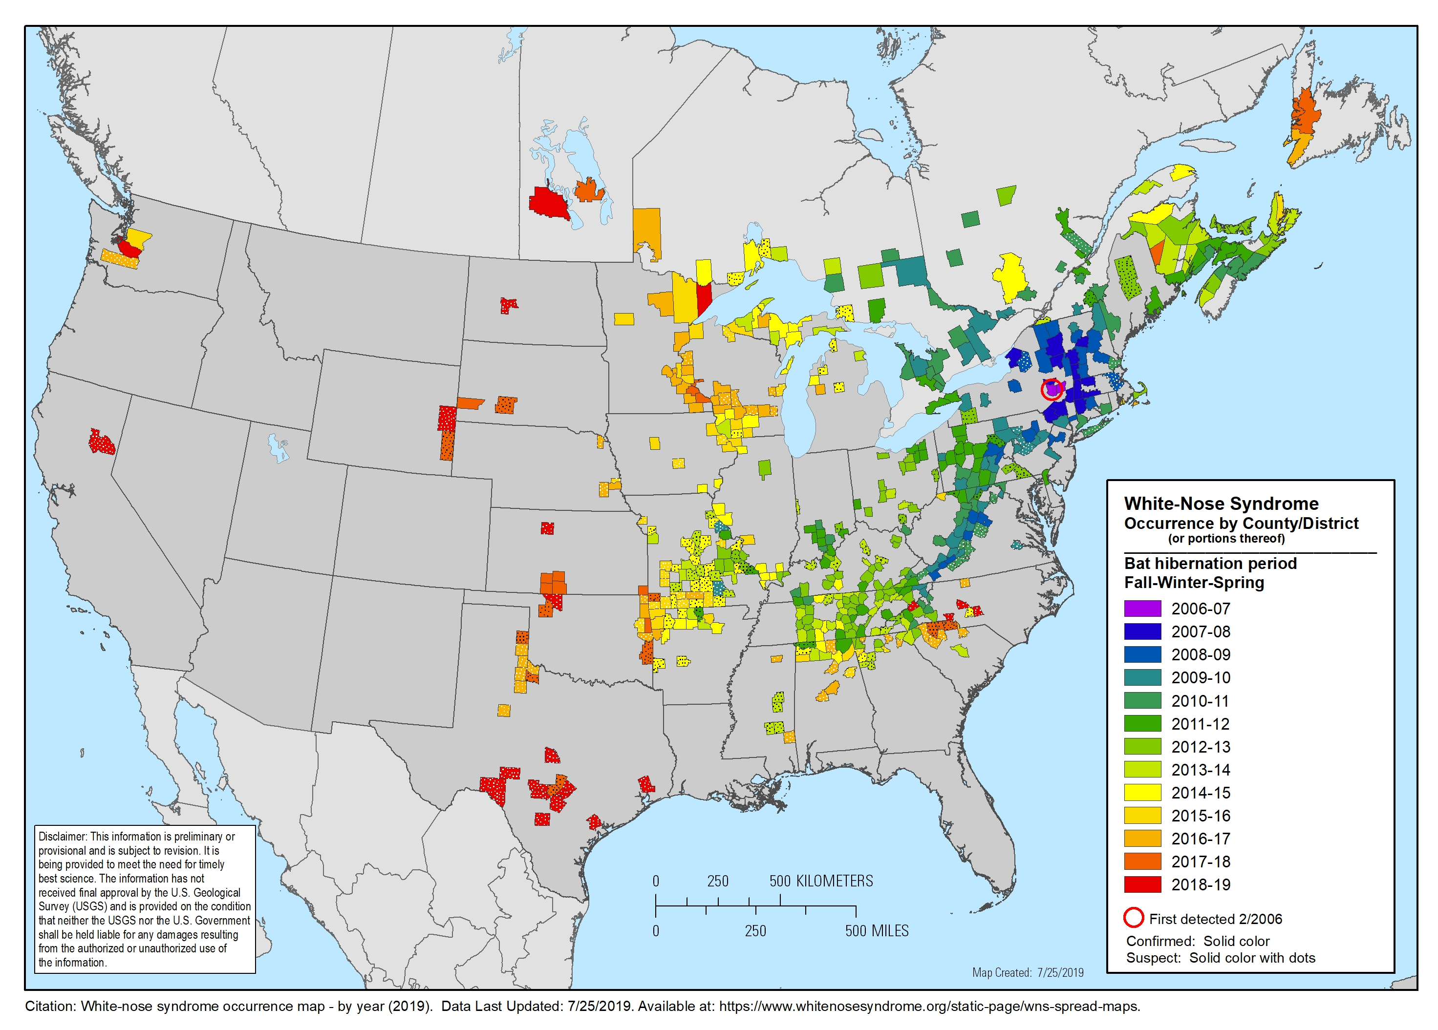
White-nose syndrome through time…
Interactive Map: https://www.whitenosesyndrome.org/spreadmap

Slide 4
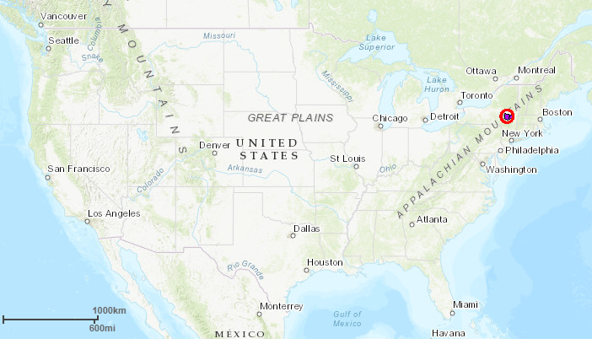
2007: First documented case of WNS, Schoharie County, NY
Interactive Map: https://www.whitenosesyndrome.org/spreadmap

Slide 5
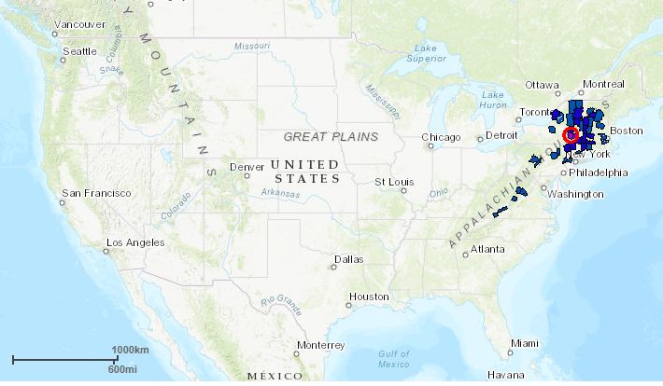
2008-2009: WNS spreads across New York and down the East Coast (extensive cave closures)
Interactive Map: https://www.whitenosesyndrome.org/spreadmap

Slide 6
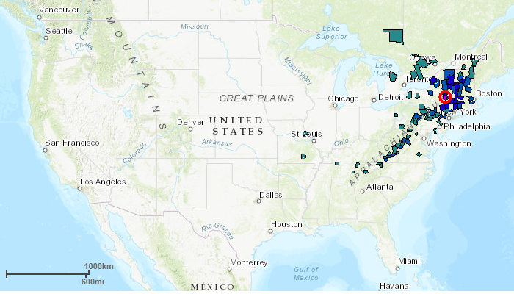
2009-2010: WNS is suspected in Midwest
Interactive Map: https://www.whitenosesyndrome.org/spreadmap

Slide 7
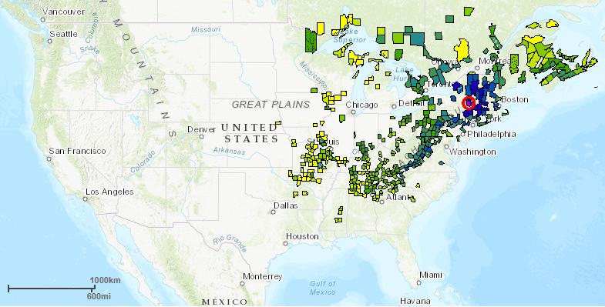
2010-2015: WNS spreads across East Coast, Midwest and Canada
Interactive Map: https://www.whitenosesyndrome.org/spreadmap

Slide 8

2015-2016: WNS is discovered on bat in Washington
Interactive Map: https://www.whitenosesyndrome.org/spreadmap

Slide 9
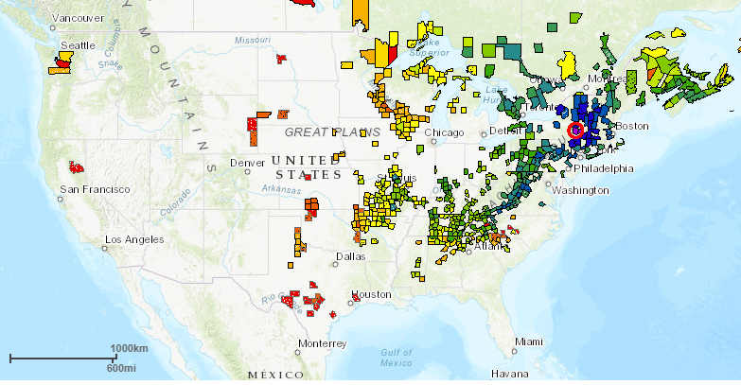
2016-2019: Over half of the lower 48 states are suspected to have WNS
Interactive Map: https://www.whitenosesyndrome.org/spreadmap

Slide 10
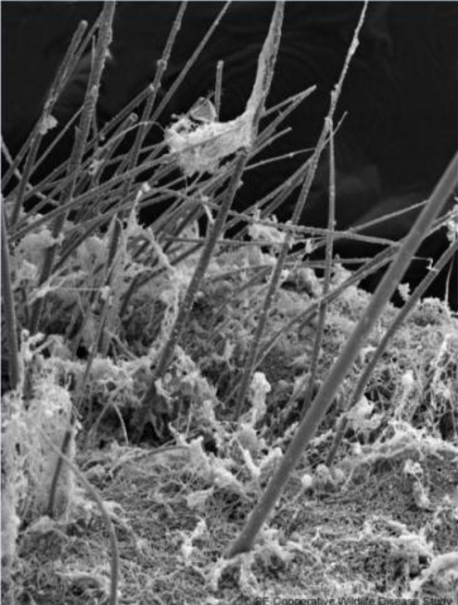
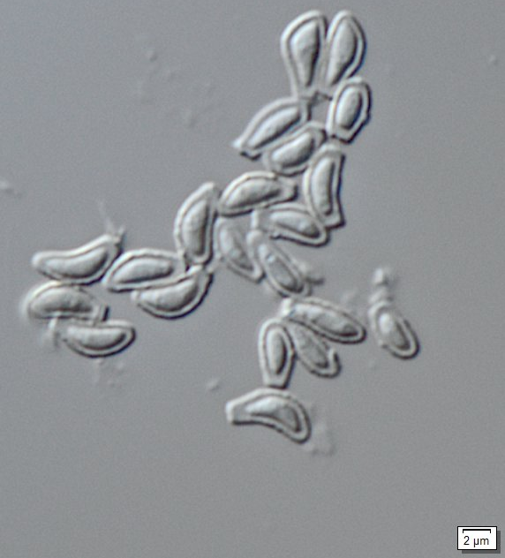
How does WNS spread?
WNS is spread through contact:
  Bat to Bat (main vector)
  Bat and Contaminated Surface
Pd does not need a bat to grow
  Spores can survive in a hibernation area even when bats are gone
  Spores on clothes, shoes and equipment could spread Pd
Not all bats with Pd spores become sick.
Electron microscopy image of Pd. Credit: K. Keel/Southeastern Cooperative Wildlife Disease Study
Differential interference contrast microscopy image of Pd spores. Credit: Barrie E. Overton/Lock Haven University

Slide 11
What bat species are at risk?
Bat species identified with diagnostic symptoms of WNS:
  Big brown bat (Eptesicus fuscus)
  Cave bat (Myotis velifer)
  Eastern small-footed bat (Myotis leibii)
  Gray bat (Myotis grisescens)
  Indiana bat (Myotis sodalist)
  Little brown bat (Myotis lucifugus)
  Long-legged bat (Myotis volans)
  Northern long-eared bat (Myotis septentrionalis)
  Western long-eared bat (Myotis evotis)
  Southeastern bat (Myotis austroriparius)
  Tricolored bat (Perimyotis subflavus)
  Yuma bat (Myotis yumanensis)
Bat species on which Pd has been detected, but no diagnostic sign of WNS has been documented:
  Eastern red bat (Lasiurus borealis)
  Mexican free-tailed bat (Tadarida brasiliensis)
  Rafinesque's big-eared bat (Corynorhinus rafinesquii)
  Silver-haired bat (Lasionycteris noctivagans)
  Townsend's big-eared bat (Corynorhinus townsendii)
  Virginia big-eared bat (Corynorhinus townsendii virginianus
  Ozark big-eared bat (Corynorhinus townsendii ingens)
  Western small-footed bat (Myotis ciliolabrum)
Threatened and Endangered Species

Slide 12
Is there a treatment?
Bats
Currently, there no cure for WNS
Most effect means is to prevent the transfer of spores is decontamination
Ongoing research looking into the effectiveness of different types of treatments including:
  Biological: Stimulate growth of beneficial microorganisms that either attack, or secrete substances that attack, Pd or compete with Pd in other ways to limit its growth.
  Chemical: Apply to either bats or the environment to prevent, control, or eradicate Pd.
  Immunological: Use vaccines to prevent Pd in bats.
  Genetic Manipulation: Reduce symptoms of Pd or alter Pd gene expression.
  Mechanical: Change environmental conditions to prevent, control, or eradicate Pd.
Goal is to break the WNS disease triangle (right) using a single treatment, or combination of treatments, noted above.
WNS
Caves/
Mines
Pd

Slide 13
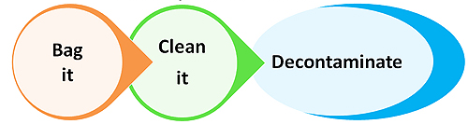
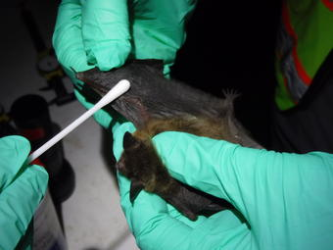
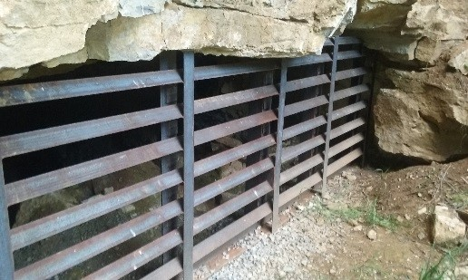
What can we as land managers do to help prevent the spread of WNS?
Only have control over one vector – humans!
  Educational outreach
    Phone/Tailgate briefings
    School visits
  Equipment
    Dedicated gear
    Decontaminate gear
  Monitoring
    Know where bats hibernate
    Pd/WNS sampling trips – Intermediate States
    Bat Counts
  Restrict access to caves
    Permitting system
    Install bat friendly gates
    Closures – Short- and Long-term
Bat swabbing. The swab will be analyzed in the lab for the presence of Pd DNA. (Katrien Werner, USGS)

Slide 14
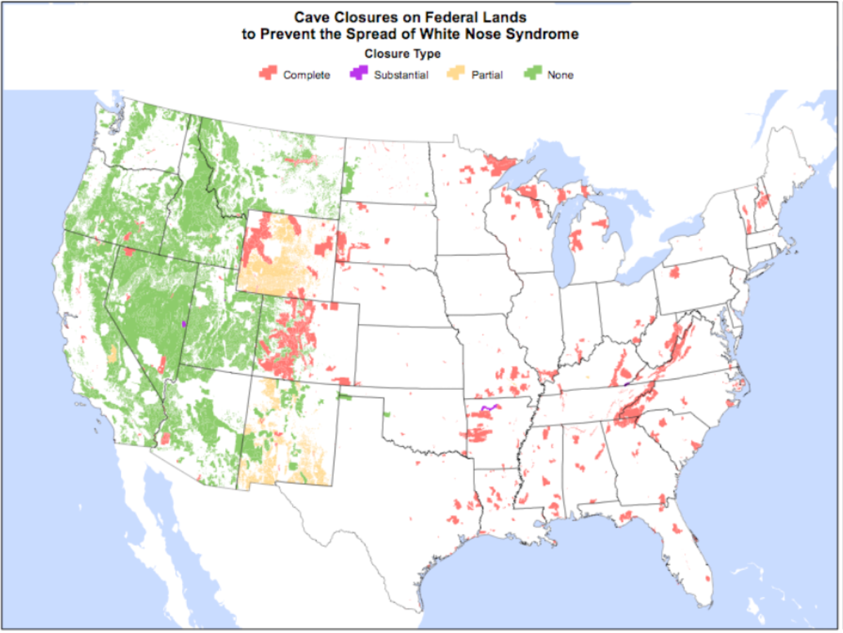
(Center for Biological Diversity, 2011)

Slide 15
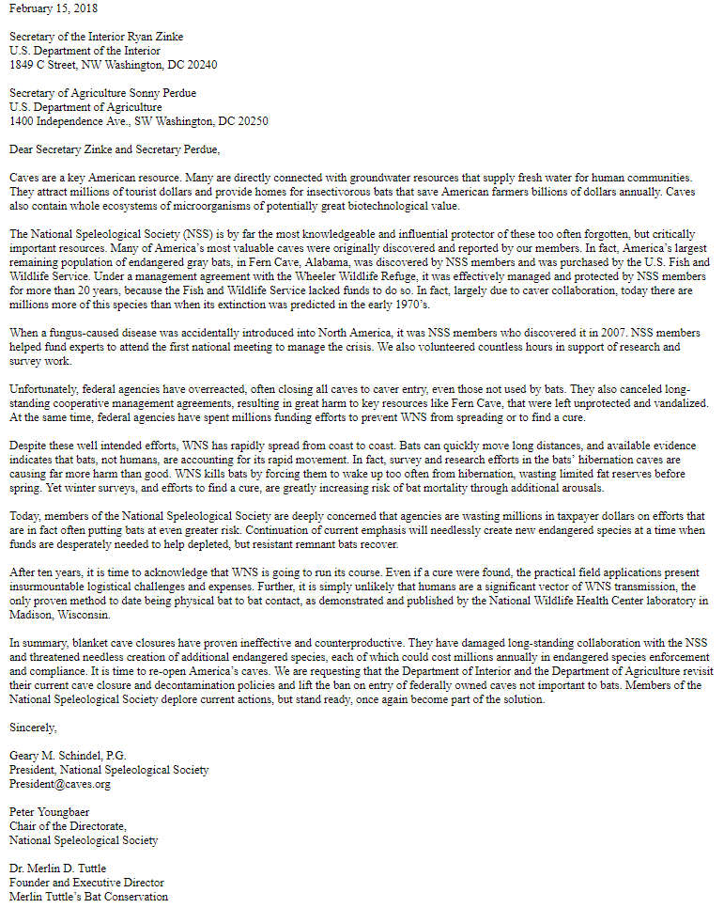
Cave closures and WNS – “NSS Letter to the Feds”
“Unfortunately, federal agencies have overreacted, often closing all caves to caver entry, even those not used by bats. They also canceled long-standing cooperative management agreements, resulting in great harm to key resources like Fern Cave, that were left unprotected and vandalized.”
“In summary, blanket cave closures have proven ineffective and counterproductive. They have damaged long-standing collaboration with the NSS and threatened needless creation of additional endangered species, each of which could cost millions annually in endangered species enforcement and compliance. It is time to re-open America’s caves. We are requesting that the Department of Interior and the Department of Agriculture revisit their current cave closure and decontamination policies and lift the ban on entry of federally owned caves not important to bats. Members of the National Speleological Society deplore current actions, but stand ready, once again become part of the solution.”

Slide 16
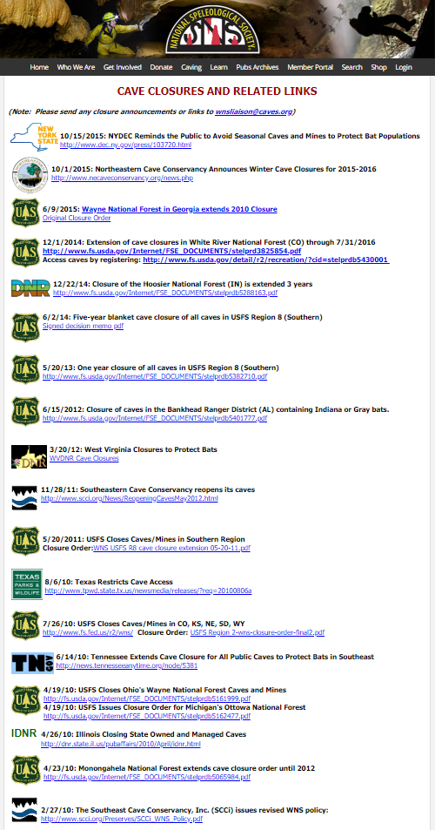
Impacts of Cave Closures
Cave closures have social impacts within the caving community:
Strain on caver-agency relations
  Only keeps the honest, responsible cavers out (~5% of all cave visitors)
Increased vandalism to caves on public lands
Data gaps (withholding of information)
  Visitation
  Monitoring
Small, but not insignificant economic impacts
Cavers feel a sense of loss with closures; a loss of opportunities for natural recreation, stewardship, and science, as well as a loss of a sense of belonging (USDA, 2012).

Slide 17
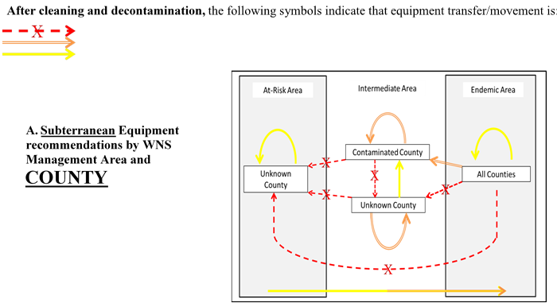
Education and Cooperative Management
“This report suggested a genuine passion and concern for the health of the cave environment among the mainstream caving community.[…] Informed decisions that acknowledge and consider the importance of these public places to the caving community will enhance the acceptance of management policies. Relationships between the agency and the caving community could be enhanced by further engagement with these stakeholders in planning and implementation of stewardship efforts to provide the best management for the caves and bats.” –USDA, 2012

Slide 18
WNS Resources
IM 2010-181: White-nose Syndrome
WNS Decontamination Protocols (09.13.2018)
BLM WNS Interim Response Strategy
White-nose Syndrome Response Team
Bat Conservation International
Merlin Tuttle’s Bat Conservation
USGS Invasive Species Program (White-nose Syndrome)
National Speleological Society
Dept. of Natural Resources/Dept. of Game and Fish Webpages

