Slide 1
Vernal Field Office
August 2019

Slide 2
VRM Overview
Course Objective
After attending this course, you will be able to:
Have a basic understanding of the VRM system and its process
Conduct a visual impact assessment
Incorporate the information into a NEPA document

Slide 3
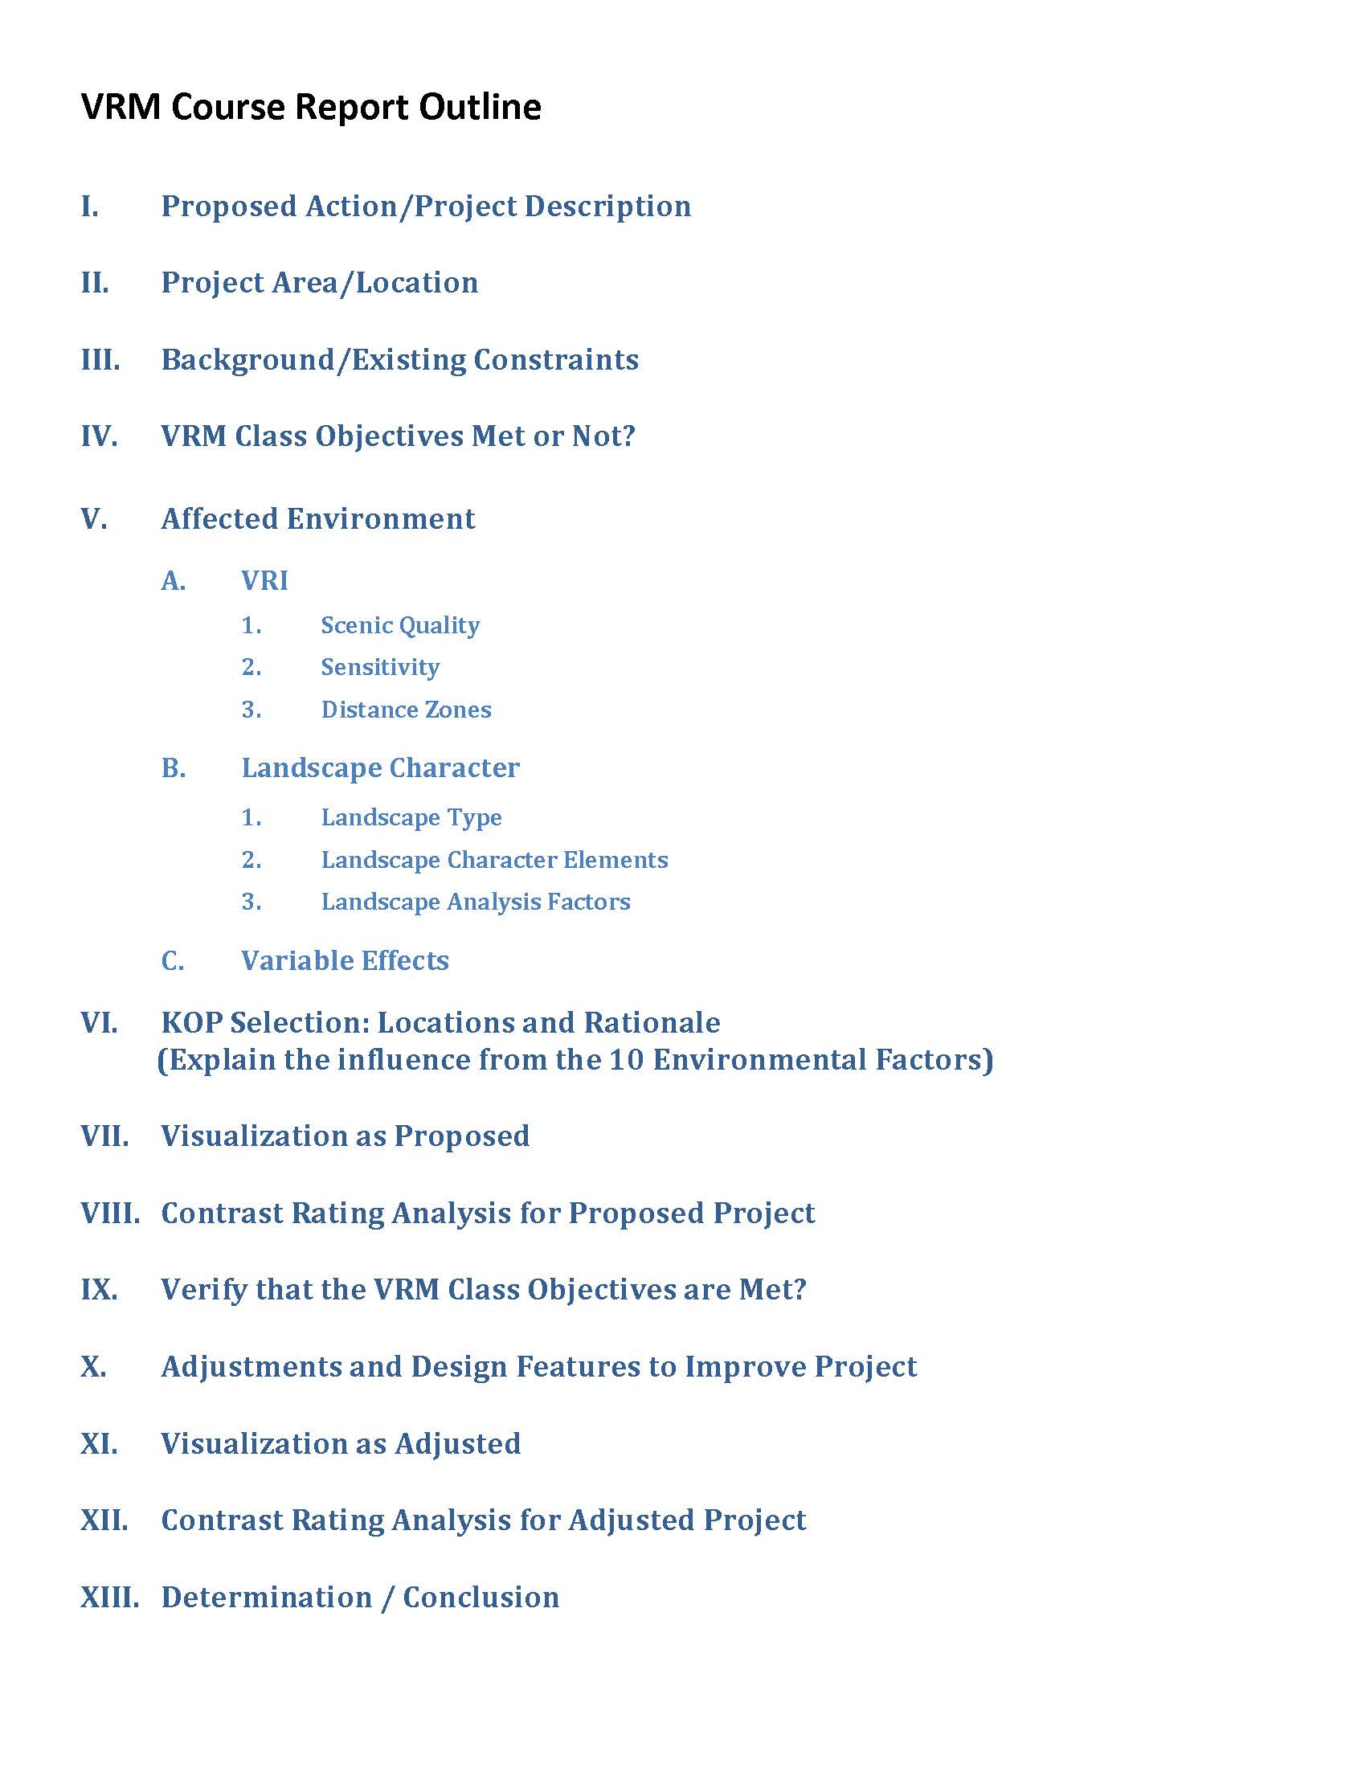
VRM Overview
Goal of the Week
Project Report
Outline:

Slide 4
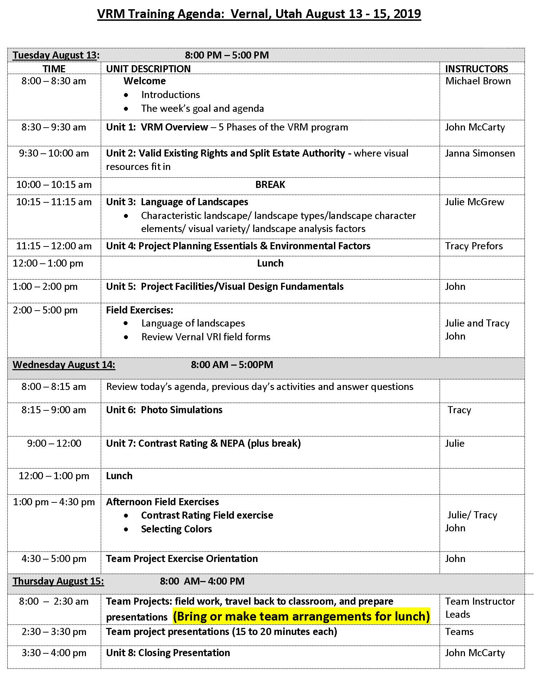
VRM Overview

Slide 5
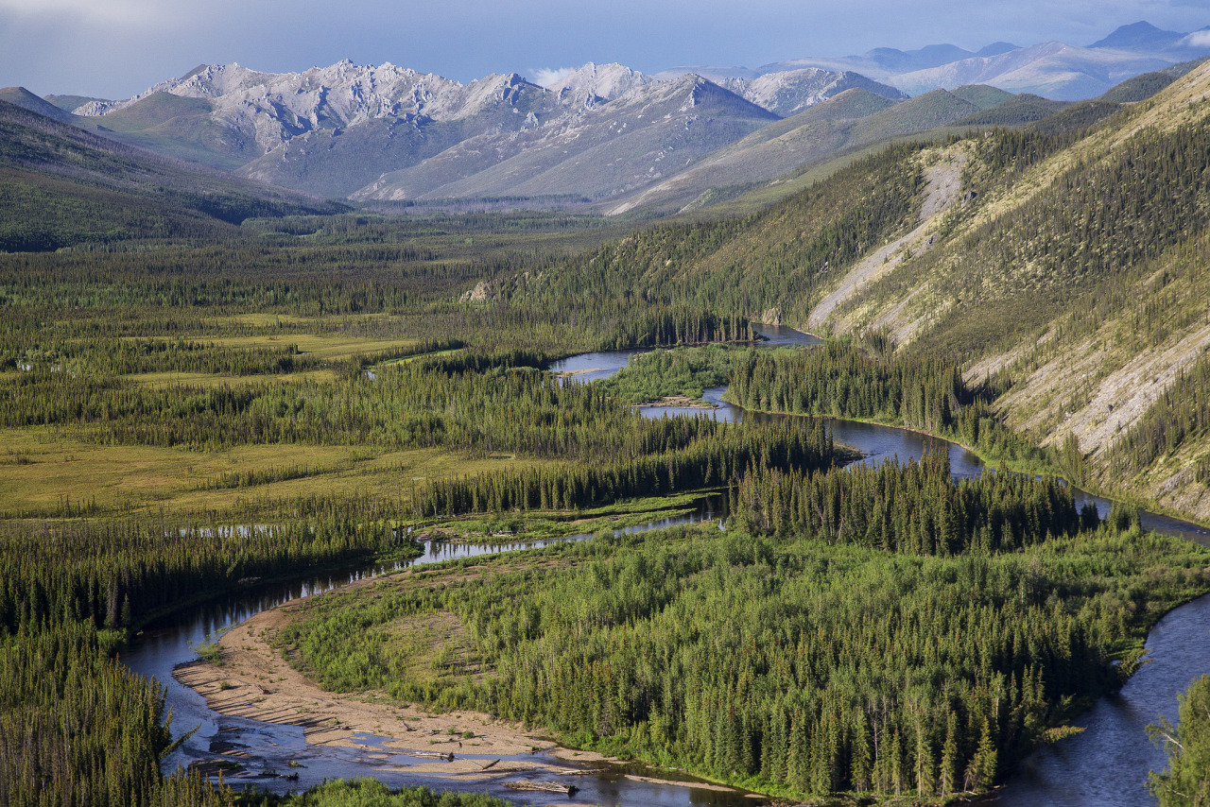
VRM Overview
“The beauty of our land is a natural resource. Its preservation is linked to the inner prosperity of the human spirit.”
President Lyndon B. Johnson, 1965

Slide 6
VRM Overview
Unit Objective
To provide a general overview of the Bureau of Land Management’s Visual Resource Management (VRM) program, including:
Why we inventory and manage visual resources.
What legal authority drives the BLM VRM program.
An overview of the policy and procedures of the VRM Program in place today, with an emphasis on the inventory process.

Slide 7
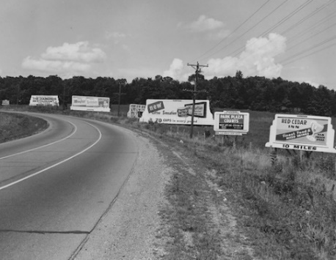
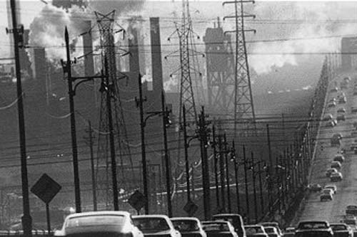
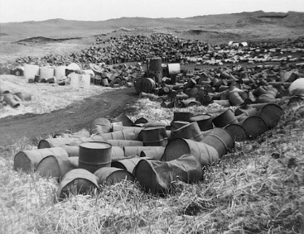
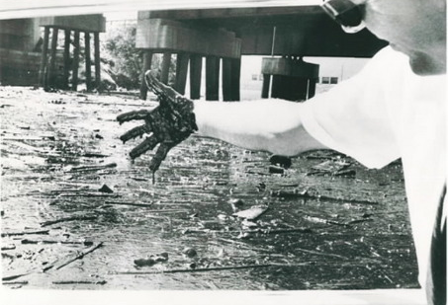
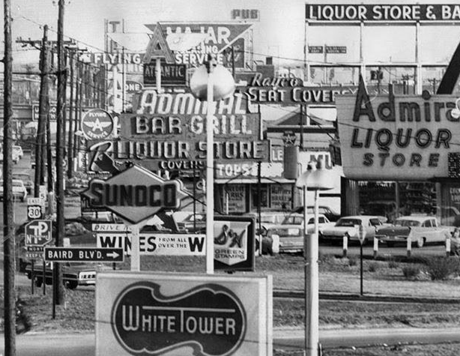
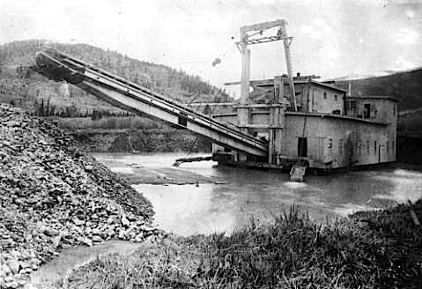
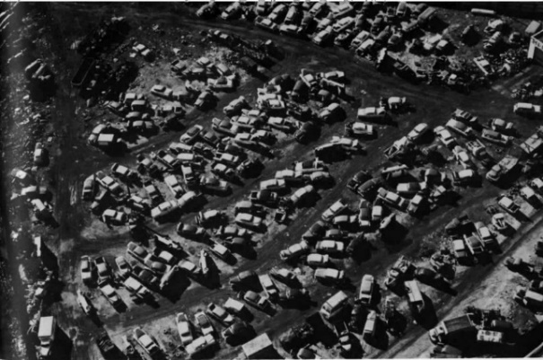
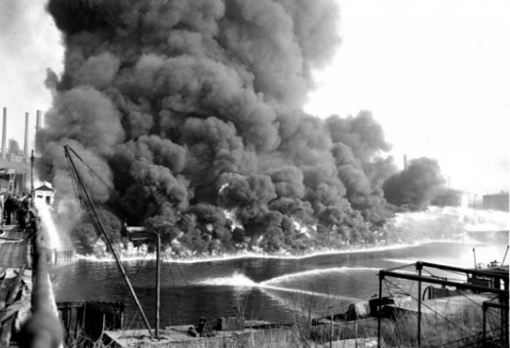
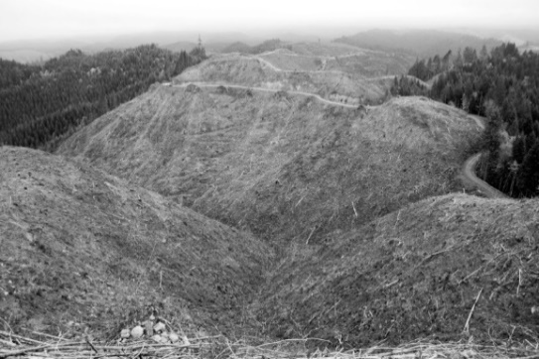
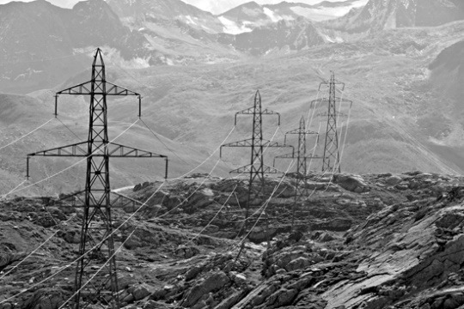
Epidemic Pollution Across U.S.
The condition of the American

Slide 8
Epidemic Pollution Across U.S.
Congressional Address and the White House Conference on Natural Beauty
“The beauty of our land is a natural resource. Its preservation is linked to the inner prosperity of the human spirit”, and made the commitment to hold a White House Conference on Natural Beauty to meet in mid-May of that year.

Slide 9
VRM Overview
Resulting Legislation
Sampling of Environmental Legislative Acts that followed:
Highway Beautification Act (HBA), 1965
Wild and Scenic Rivers Act, 1968
National Trails System Act, 1968
National Environmental Policy Act, 1969
Clean Air Act, 1970
Clean Water Act, as amended 1972
Resource Conservation and Recovery Act, 1976
Surface Mining Control and Reclamation Act, 1977
National Forest Management Act, 1976
Federal Land Policy and Management Act, 1976

Slide 10
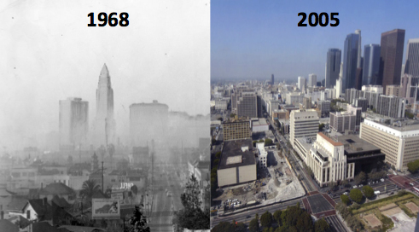
VRM Overview
Results from the Legislation

Slide 11
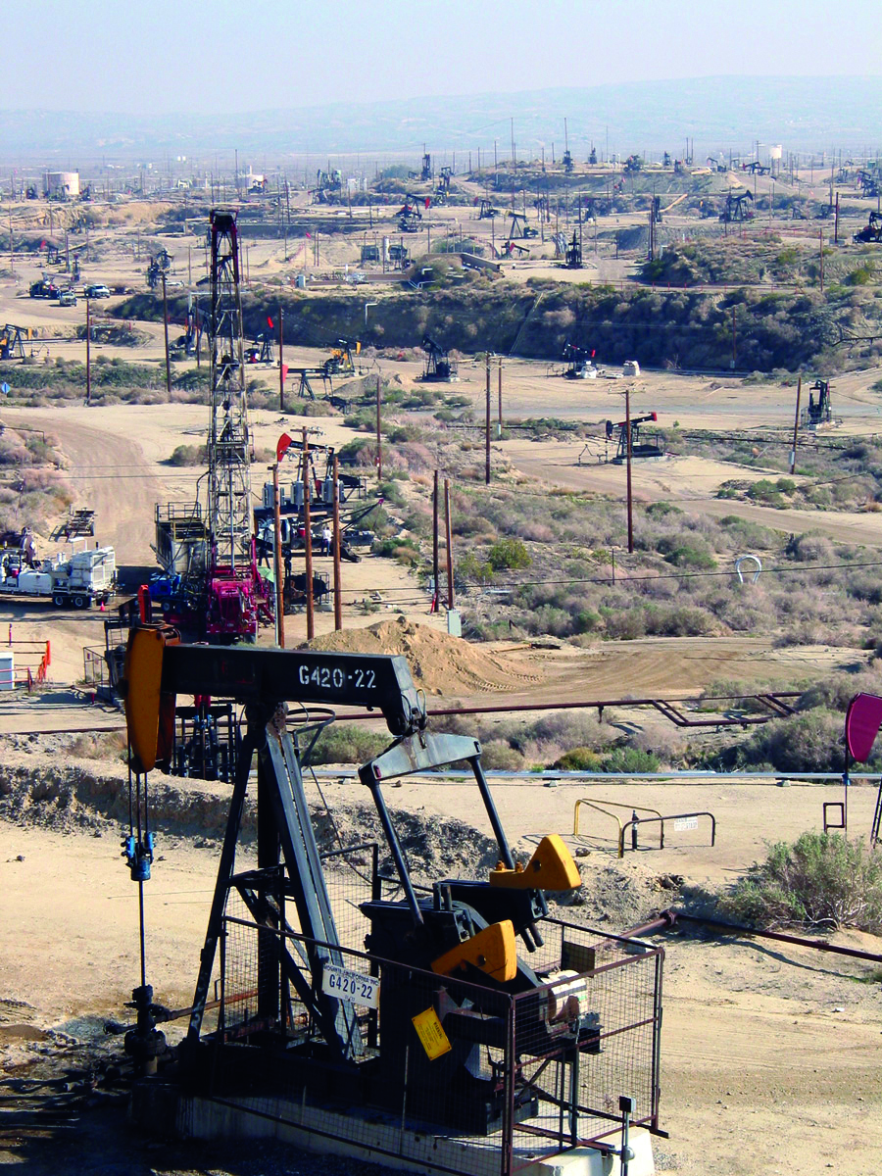
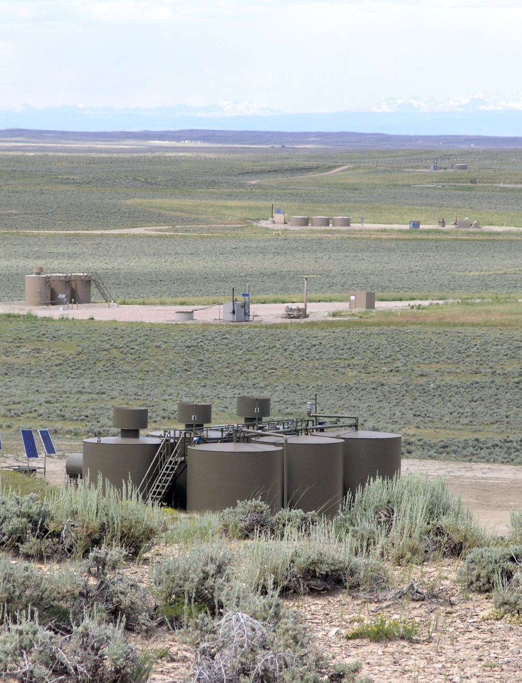
VRM Overview
Results from the Legislation

Slide 12
VRM Overview
Legislative Authorities
NEPA directs all federal agencies:
Section 101 (b) requires:
assure for all Americans safe, healthful, productive, and aesthetically and culturally pleasing surroundings;
Section 102 requires:
Agencies to use a systematic, interdisciplinary approach to ensure the integrated use of natural and social sciences and the environmental design arts in planning and decision making.

Slide 13
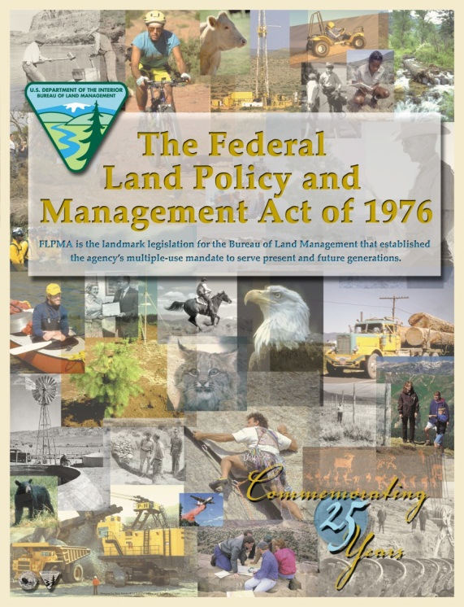
VRM Overview
Legislative Authorities
We are legally bound to manage scenery by FLPMA.
FLPMA: “Natural Scenic Values” as a resource to be managed within the multiple use and sustainable yield framework
“…a combination of balanced and diverse resource uses that takes into account the long-term needs of future generations for renewable and non-renewable resources, including…natural scenic…values;” (Sec. 103(c))

Slide 14
VRM Overview
Legislative Authorities
FLPMA directs BLM to…
Manage in a manner that will protect the quality of scenic values and provide for outdoor recreation and human occupancy and use (Sec. 102(8))
Sec. 201. [43 U.S.C. 1711] (a) The Secretary shall pre-pare and maintain on a continuing basis an inventory of all public lands and their resource and other values (including, but not limited to, outdoor recreation and scenic values),

Slide 15
VRM Overview
Legislative Authorities
FLPMA directs BLM to…
Concerning the management of use, occupancy and development, take any action necessary to prevent unnecessary or undue degradation of the lands (Sec 302(b))

Slide 16
VRM Overview
Legislative Authorities
FLPMA directs BLM to…
SEC. 505. [43 U.S.C. 1765] Each right-of-way shall contain–
(a) terms and conditions which will minimize damage to scenic and esthetic values and fish and wildlife habitat and otherwise protect the environment;

Slide 17
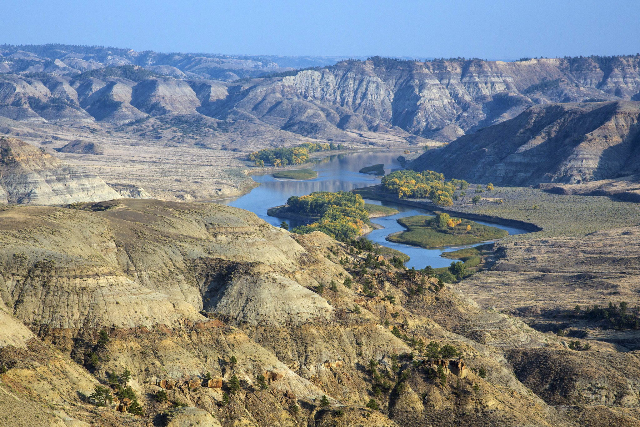
VRM Overview
BLM manages lands with Scenic Value
Upper Missouri Wild and Scenic River, MT
Photo by Bob Wick

Slide 18
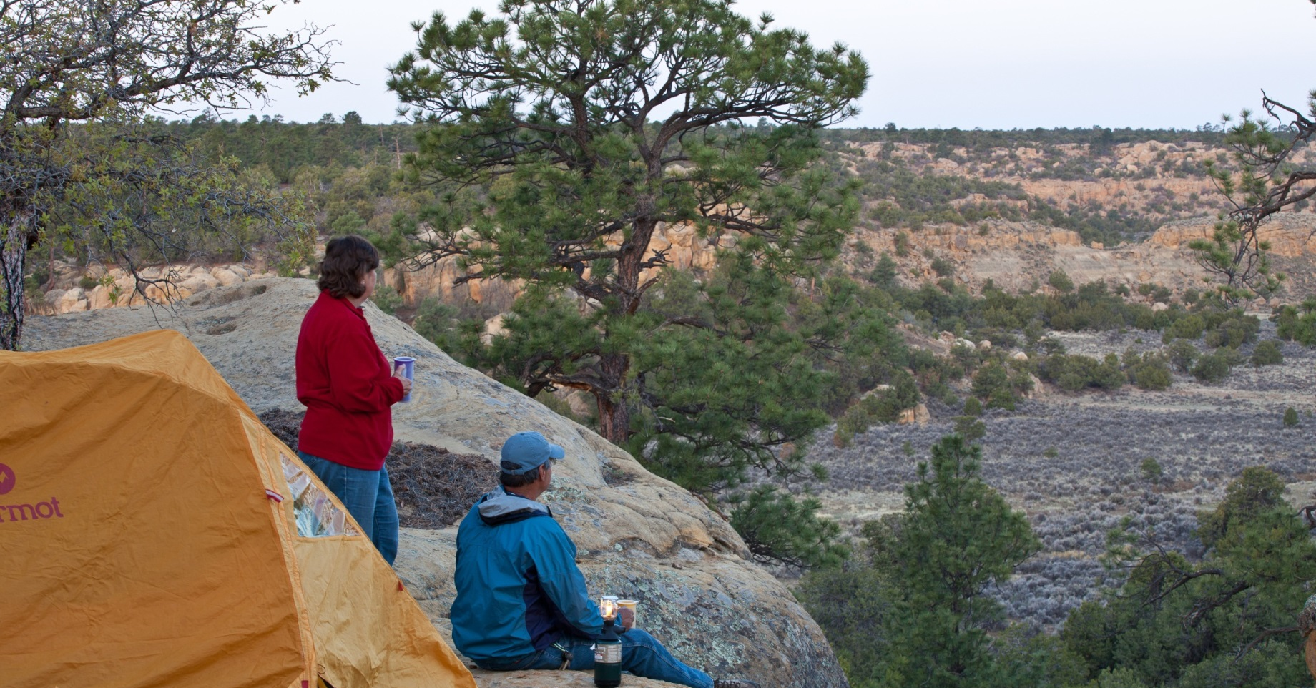
VRM Overview
All BLM lands have scenic value…
Scenic values of public lands are linked with visual settings that provide for a sense of escape, enjoyment of nature, testing of oneself, and reconnecting with others.
Notes:
ENTER THE NOTES FROM ASLA PRESENTATION – BIOPHILIA, BIOPHOLIC DESIGN – THE INTERGATION OF NATURAL ELEMENTS INTO HUMAN LIVING SPACES

Slide 19
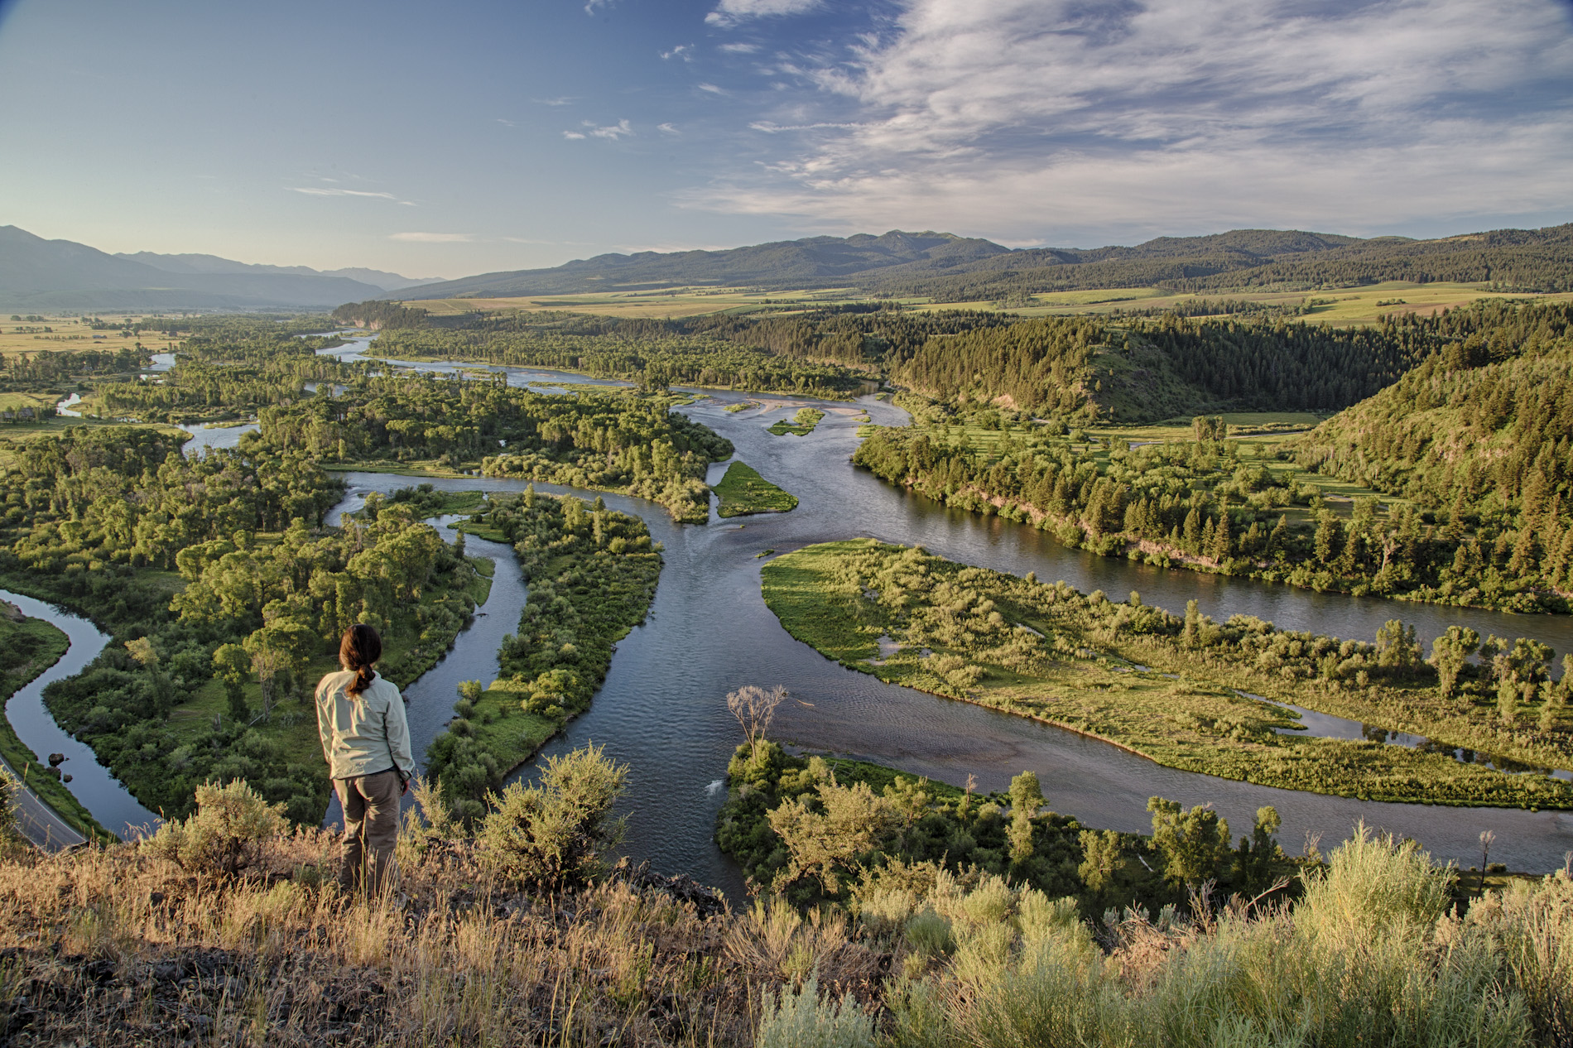
VRM Overview
Scenery is a Finite Resource

Slide 20
VRM Overview
Management Decisions affect its value
Foresters and wildlife biologists
Soil scientists
Air specialists
Fire scientists
Botanists
Range conservationists
Riparian ecologists
Hydrologists and aquatic biologists
Water engineers
Lands, realty, energy actions
Outdoor recreation planners
Cultural resource specialists/ archeologists/ historians
by Bob Wick
Notes:
So what makes up the visual resource?
What are its elements in this photo – what do you see, what kind of decisions are we making?
Decisions may change or preserve the natural landscape character

Slide 21
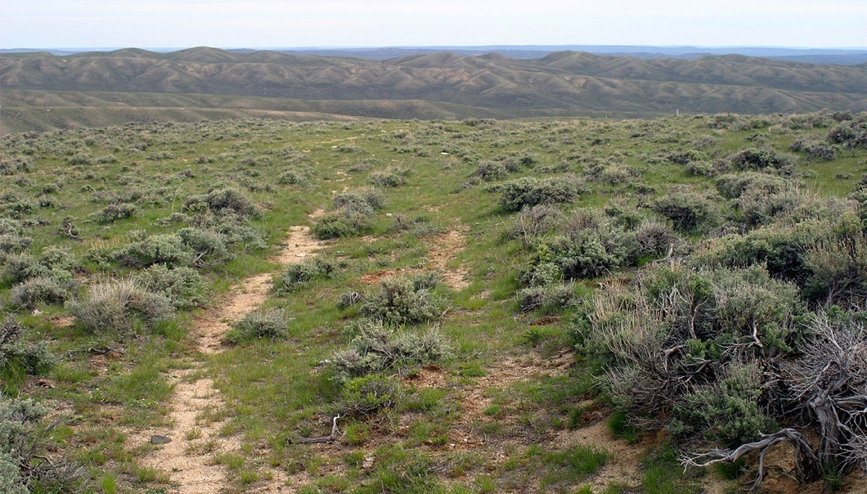
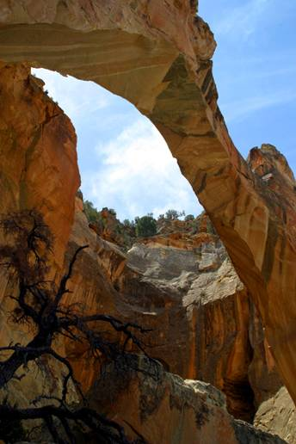
VRM Overview
Visual Aspects of Cultural & Historic Sites

Slide 22
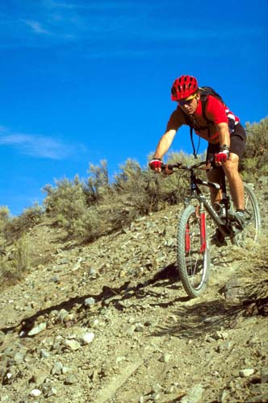
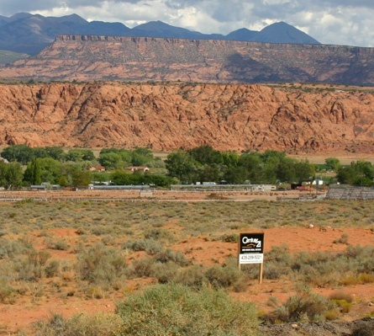
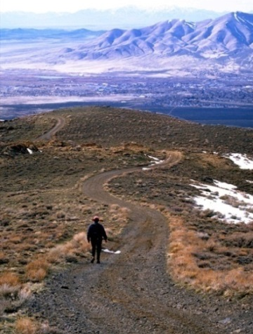
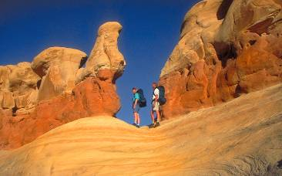
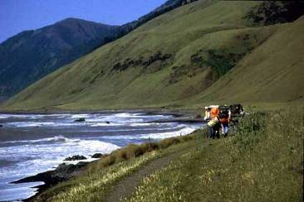
VRM Overview
Wildland and Urban Interface
BLM lands are the backyard of many western communities. 56 million people live within 30 minutes of BLM administered lands.

Slide 23
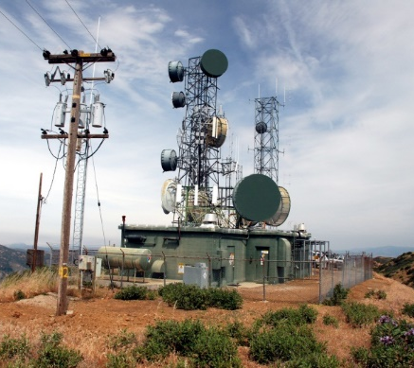
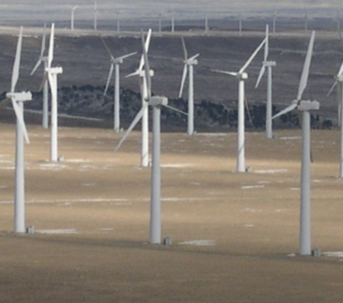
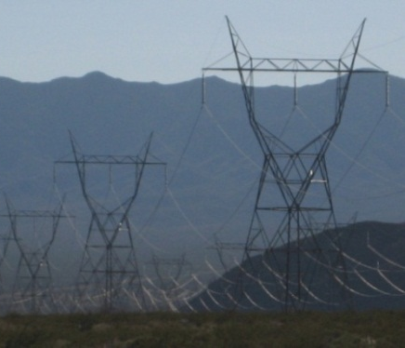
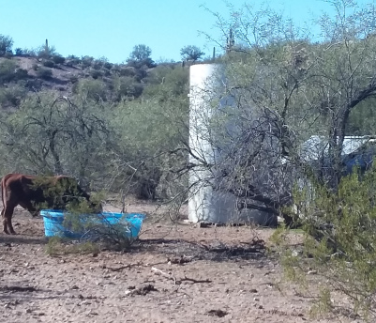
VRM Overview
VRM and Multiple Use Management
56 million people live within 30 minutes of BLM administered lands
Land use decisions that add to the landscape’s visual elements:
Recreation facilities & activities
Cultural and historic settings
Renewable energy generation plants
Solar
Wind
Geothermal
Communication systems
Metals/minerals/ aggregates mining
Oil and gas drilling and production
Coal
Livestock management facilities (e.g., water tanks/ reservoirs)
Notes:
REPLACE PHOTOS ON RIGHT WITH OTHER FACILITIES – A MINE, COM TOWER, STOCK TANK, REC SITE

Slide 24
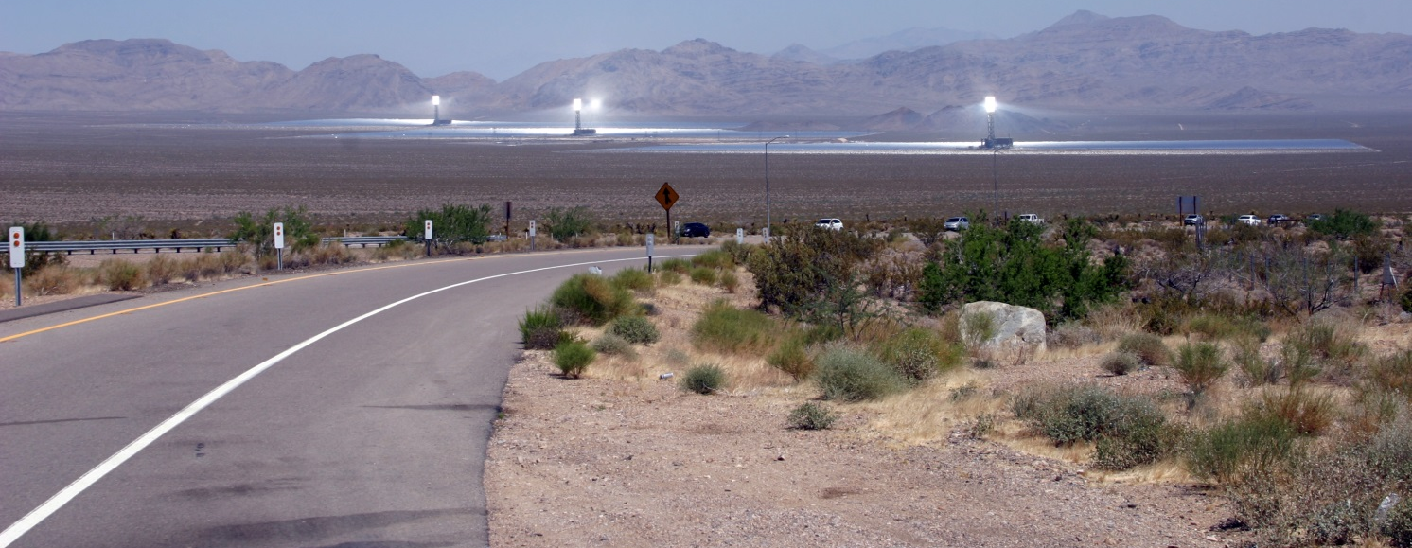
VRM Overview
A Developing Landscape
The decisions we make today as public land managers will be judged today and forward into future generations:
87% of experiences through sense of sight
First impressions mold and hold public opinion
Increasing public sensitivity
Visible Stewardship
Legacy for future generations

Slide 25
Land Use Plan (LUP) Implementation
All programs have a responsibility to the visual environment whether the program alters the landscape through enhancements or new land development - all are participants in the Visual Resource Program.
Tracking the balance between new development and reclamation of decommissioned and/ or inactive land use authorizations.
New authorizations under the lands and realty program
Fluid mineral leasing and development
Healthy Lands – with restored environments
Sage grouse habitat improvements
Abandoned Mine Program - reclamation of inactive mine sites.

Slide 26
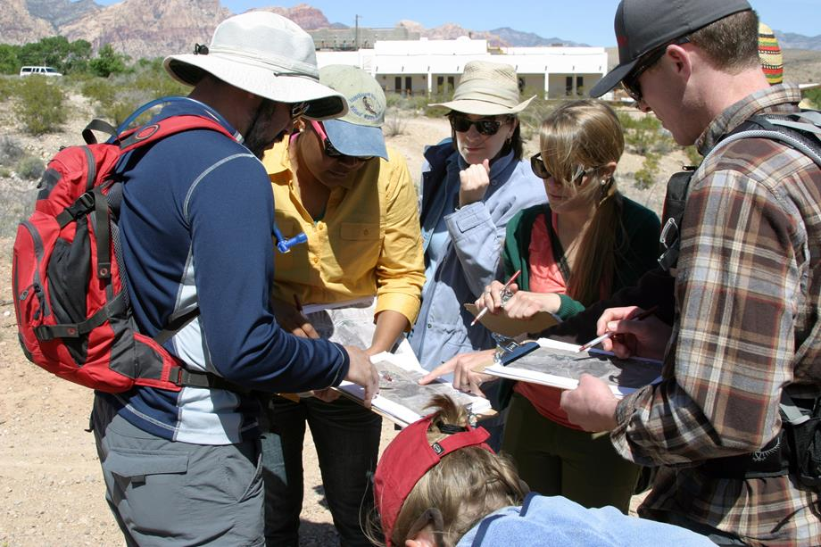
VRM Overview
Overview of VRM Policy & Procedures
VRM is a collaborative process
VRM is the visual composite of all the resources we manage and the uses we authorize

Slide 27
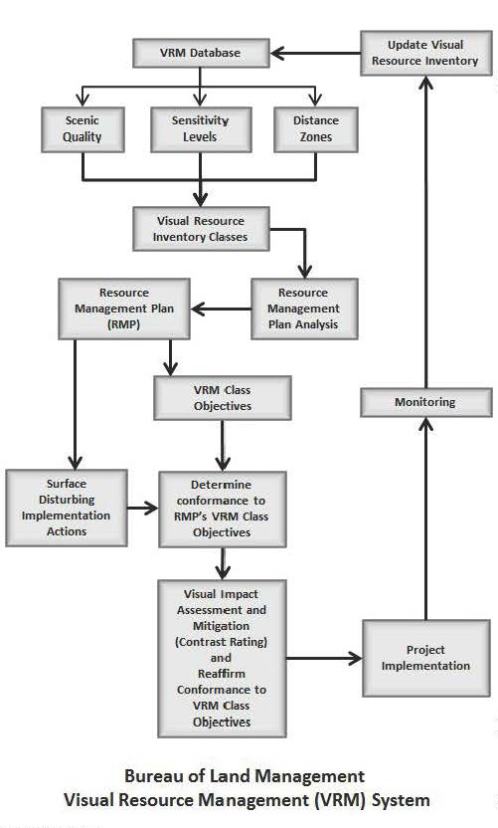
VRM Overview
Overview of VRM Policy & Procedures
The BLM VRM System provides a systematic way to observe the public lands and classify existing visual resources. Having this system makes it possible to evaluate effects of change.
Visual Resource Inventory
Establish Management Objectives
Project planning, RMP VRM Class Conformance, and Visual Resource Contrast Rating process
Visual Resource Monitoring
Updating the Visual resource Inventory

Slide 28
VRM Overview
Overview of VRM Policy & Procedures
Project Report
Outline:

Slide 29
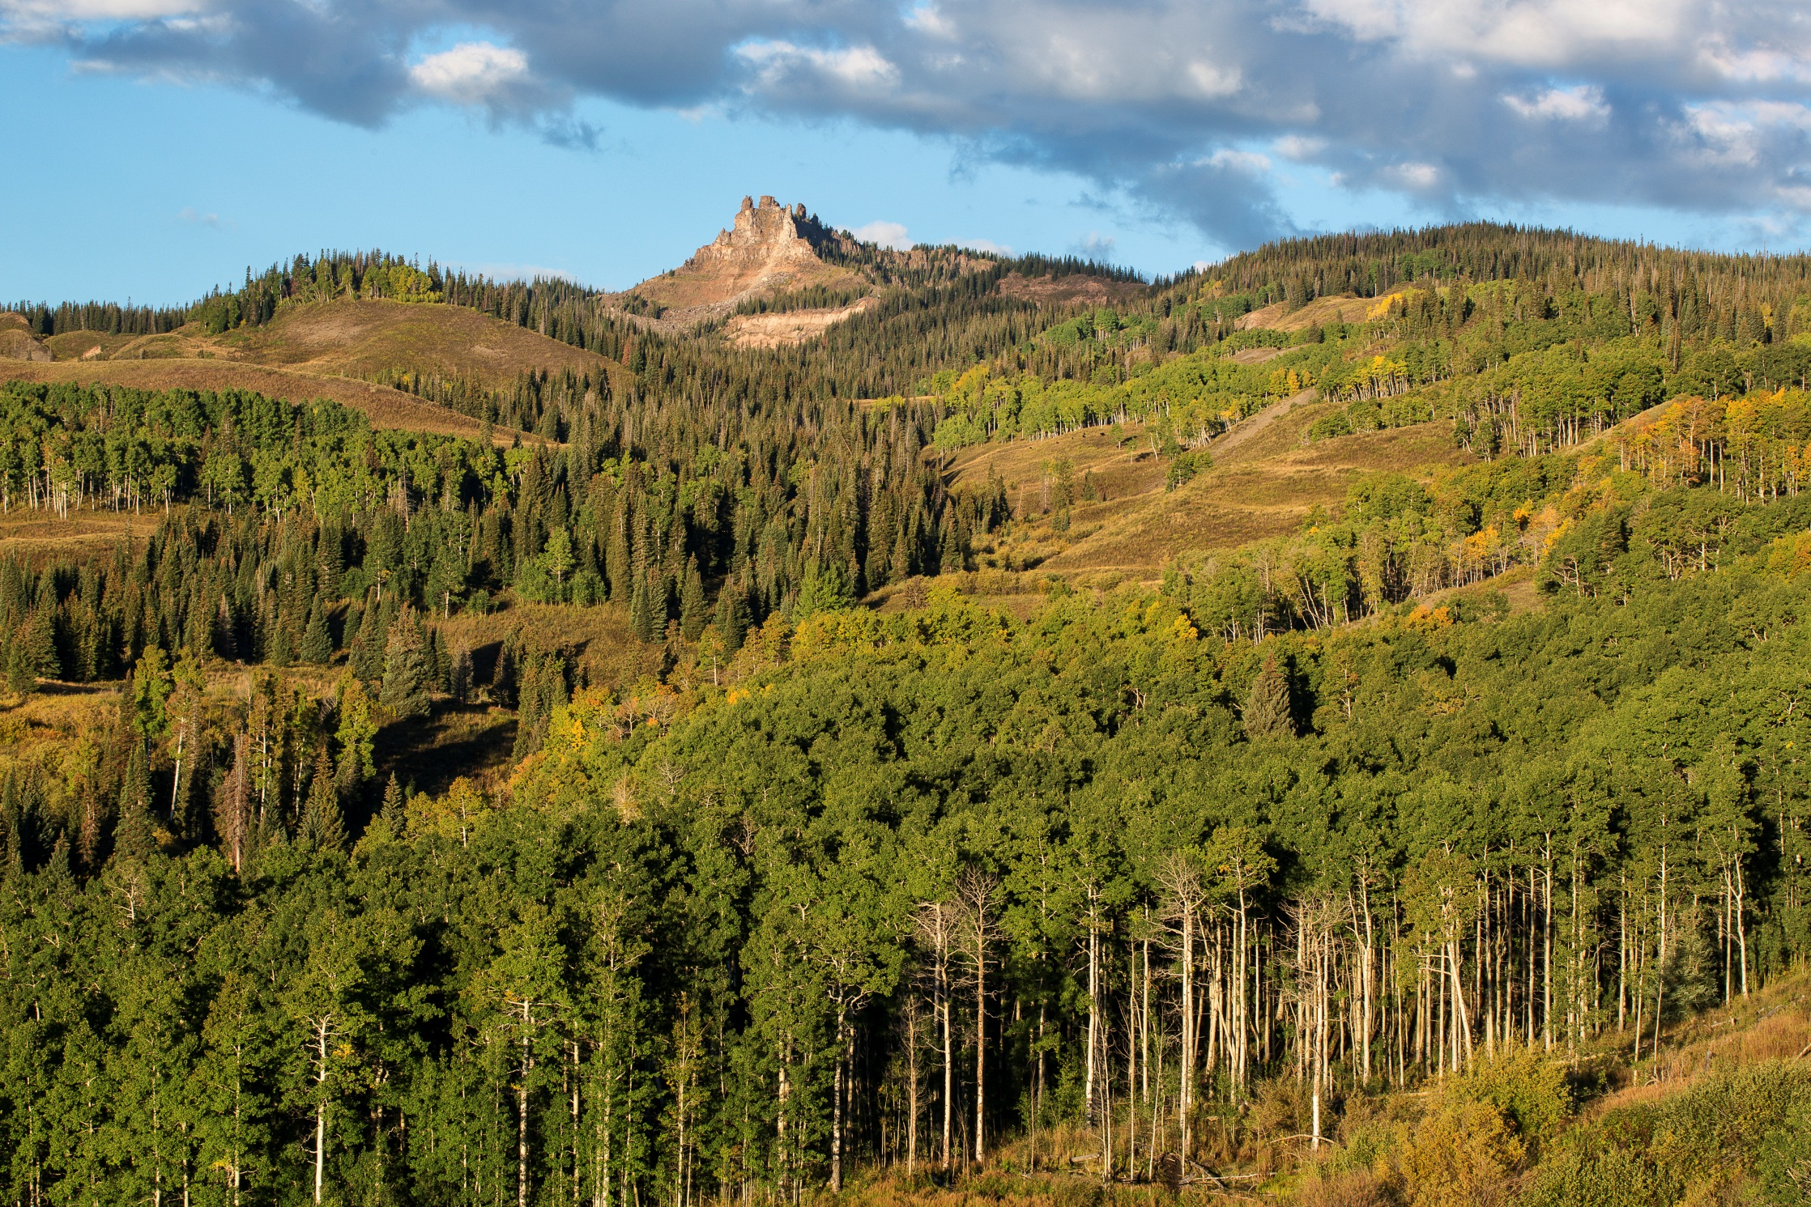
Visual Resource Inventory

Slide 30
Visual Resource Inventory
Inventory to Management Classes
VRI is the product of the inventory process and used for:
land use planning input,
visual impact analysis (project level NEPA), and
when amending the land use plan.
A source for understanding the quality and condition of the visual resource, and how it may change.
It describes the visual aspects of the Affected Environment

Slide 31
Visual Resource Inventory
Philosophy & Process
BLM Visual Resource Inventory (VRI) process is a systematic process that is designed to determine the extent and quality of visual resources in a given area
BLM Manual Handbook 8410-1
Quantitative
Objective
Repeatable
The outcome of the inventory provides the basis for considering visual values in the land use planning process for all BLM-administered lands

Slide 32
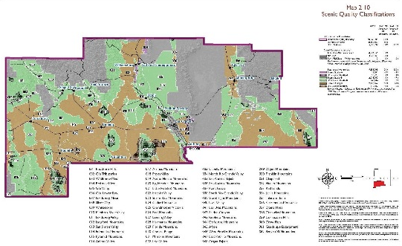
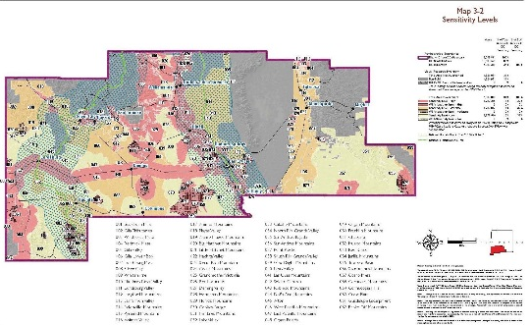
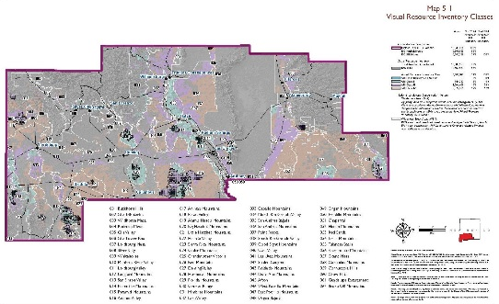
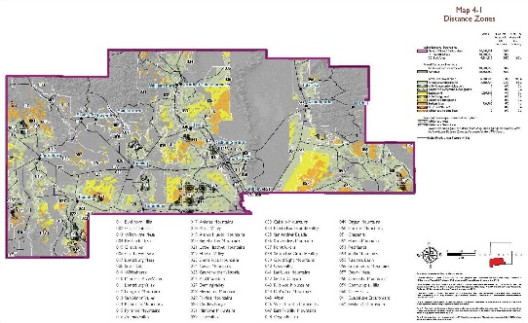
Visual Resource Inventory
Philosophy & Process
Visual Resource Inventory
Scenic Quality Evaluation
Condition - what does it look like
Where and how people view the landscape
Delineation of Distance Zones
VRI Classification
Sensitivity Level Analysis
Importance to the public

Slide 33
Scenic Quality Evaluation
Scenic Quality Rating Units
The planning area is subdivided into scenic quality rating units for rating purposes and are delineated on a basis of:
Similar physiographic characteristics
Similar visual patterns – land form, textures, color, variety etc.
Areas that have similar impacts from man-made modifications
Casper Field Office is located
in which physiographic Province?

Slide 34
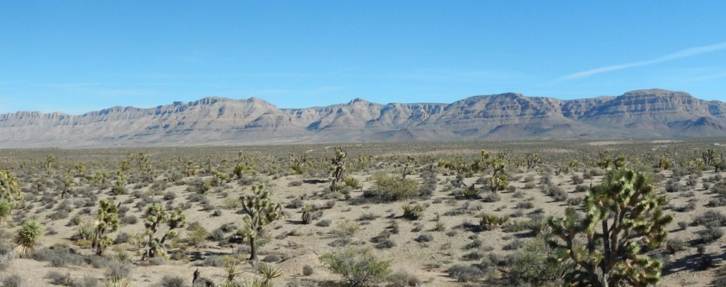
Scenic Quality Evaluation
Step 2 – SQRU Delineation
The planning area is subdivided into scenic quality rating units for rating purposes and are delineated on a basis of:
Similar physiographic characteristics
Similar visual patterns – land form, textures, color, variety etc.
Areas that have similar impacts from man-made modifications
How many SQRU do you see in this image?

Slide 35
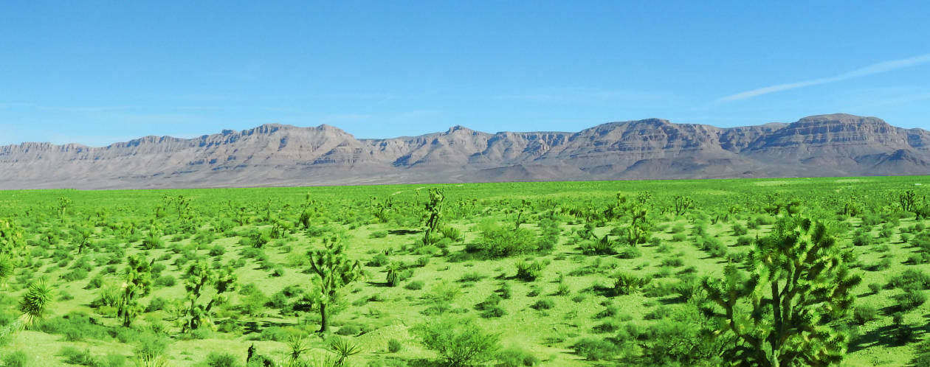
Scenic Quality Evaluation
Step 1 – SQRU Delineation
The planning area is subdivided into scenic quality rating units for rating purposes and are delineated on a basis of:
Similar physiographic characteristics
Similar visual patterns – land form, textures, color, variety etc.
Areas that have similar impacts from man-made modifications
How many SQRU do you see in this image?

Slide 36
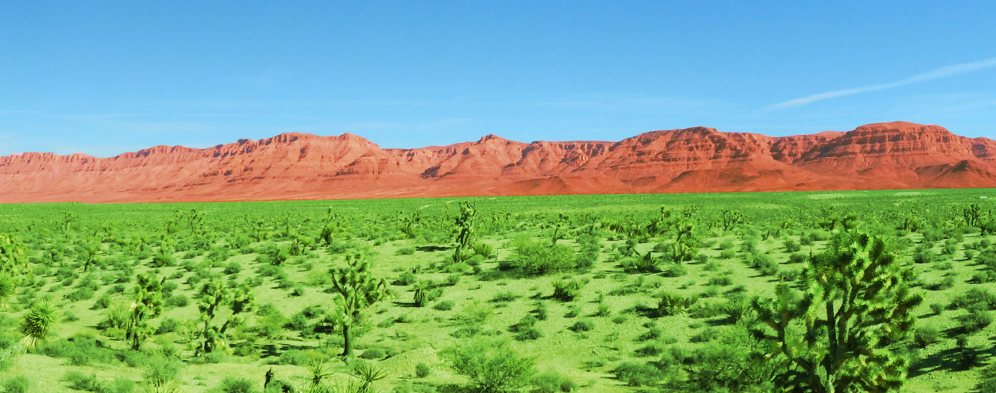
Scenic Quality Evaluation
Step 1 – SQRU Delineation
The planning area is subdivided into scenic quality rating units for rating purposes and are delineated on a basis of:
Similar physiographic characteristics
Similar visual patterns – land form, textures, color, variety etc.
Areas that have similar impacts from man-made modifications
How many SQRU do you see in this image?

Slide 37
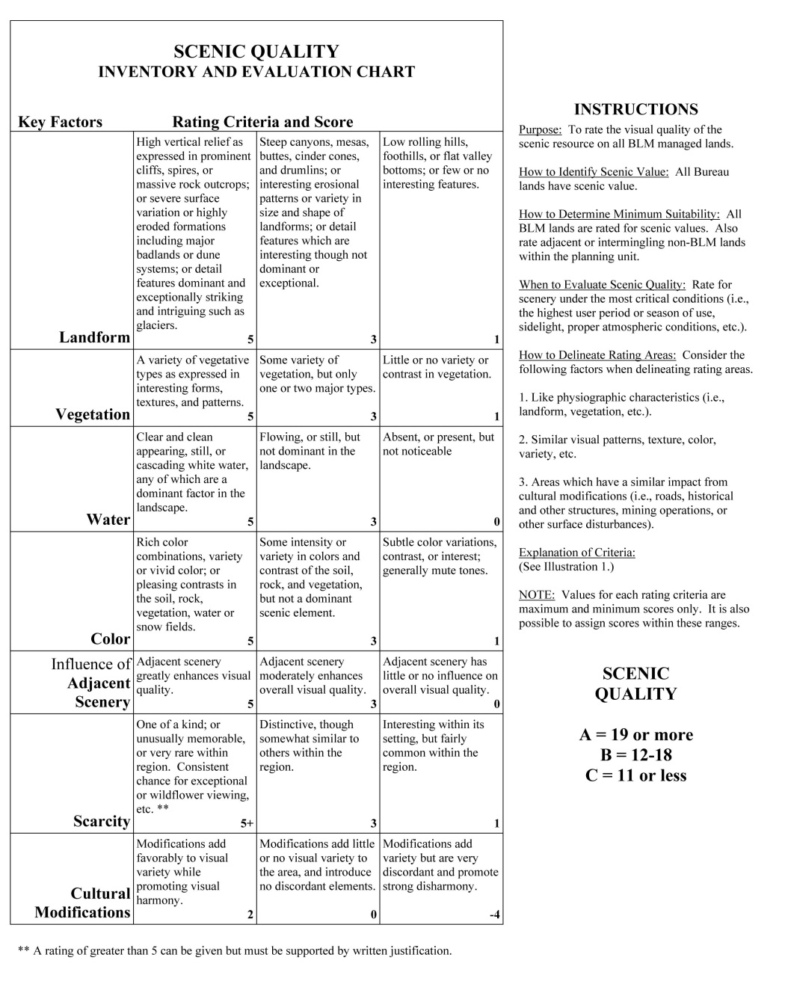
Scenic Quality Evaluation
Step 4 – Evaluate and Score
Score determined using 7 key factors:
Landform
Vegetation
Water
Color
Adjacent Scenery
Scarcity
Cultural Modifications
Notes:
A measure of the visual appeal of a tract of land
All lands have scenic value
Evaluation of scenic quality is done in relationship to the natural landscape on a comparative basis with similar features within the same physiographic province
Lands are given an A, B, C rating based on the apparent scenic quality which is determined by 7 key factors

Slide 38
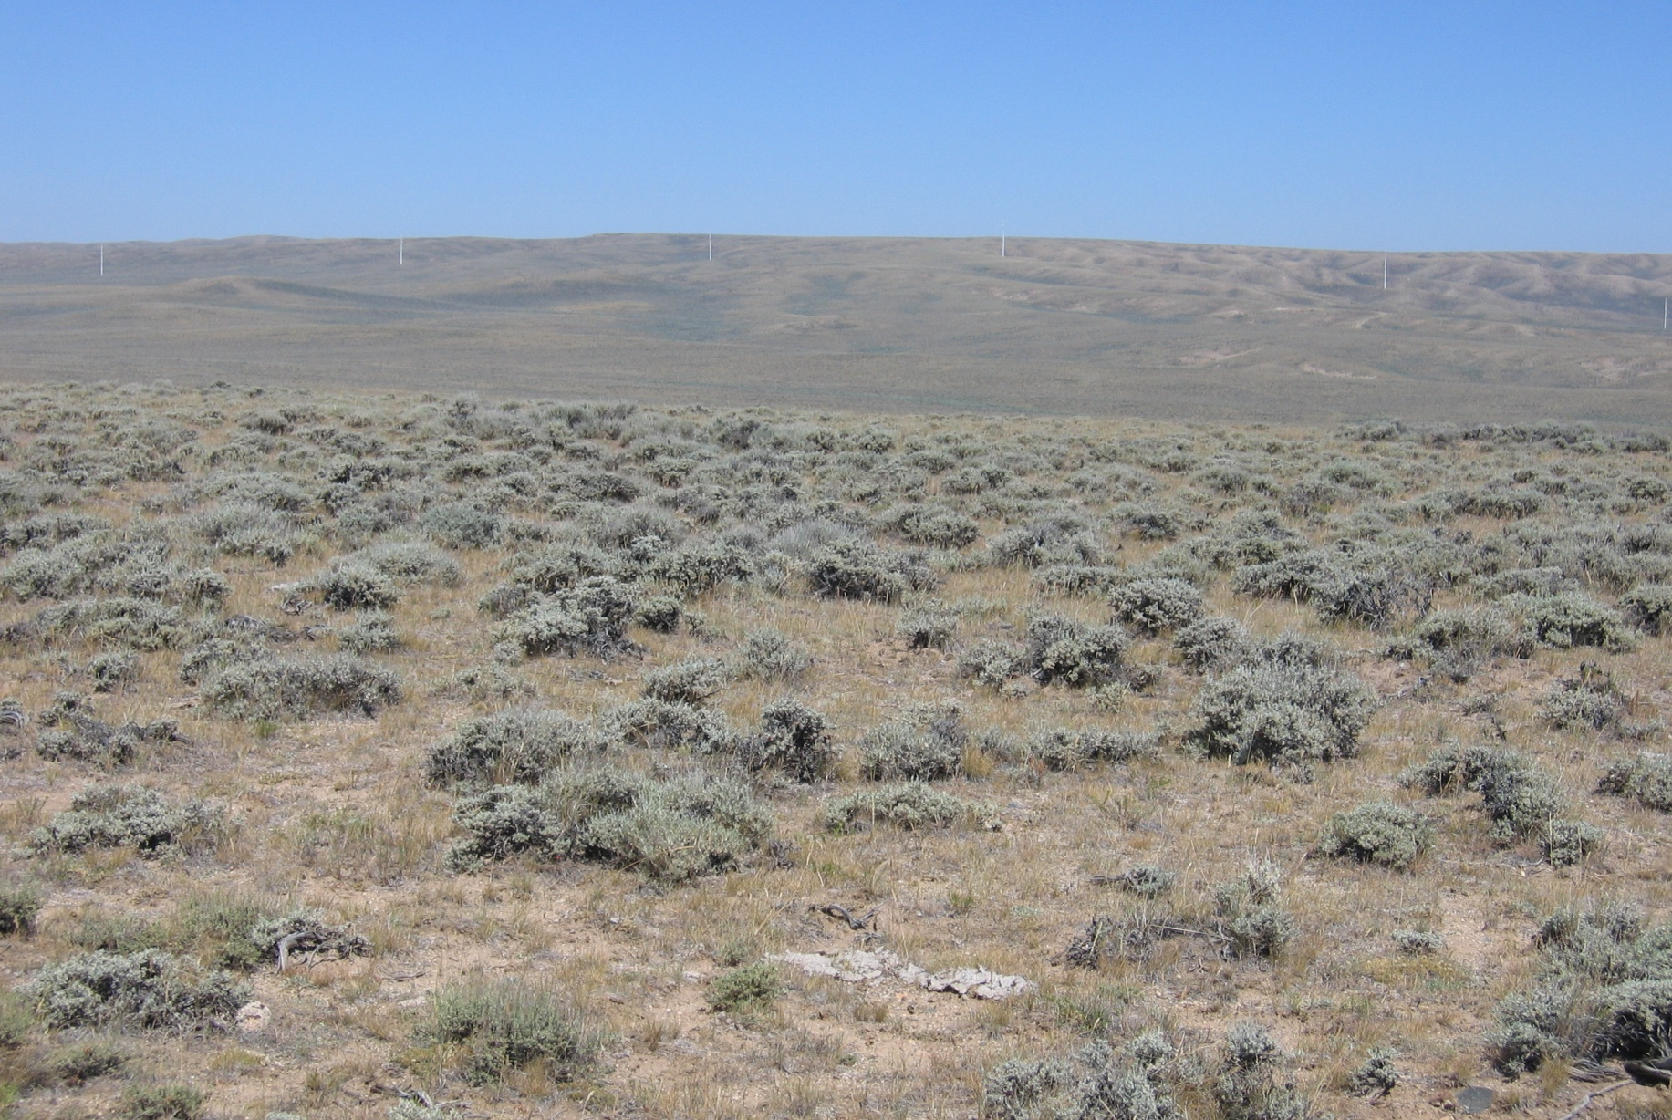
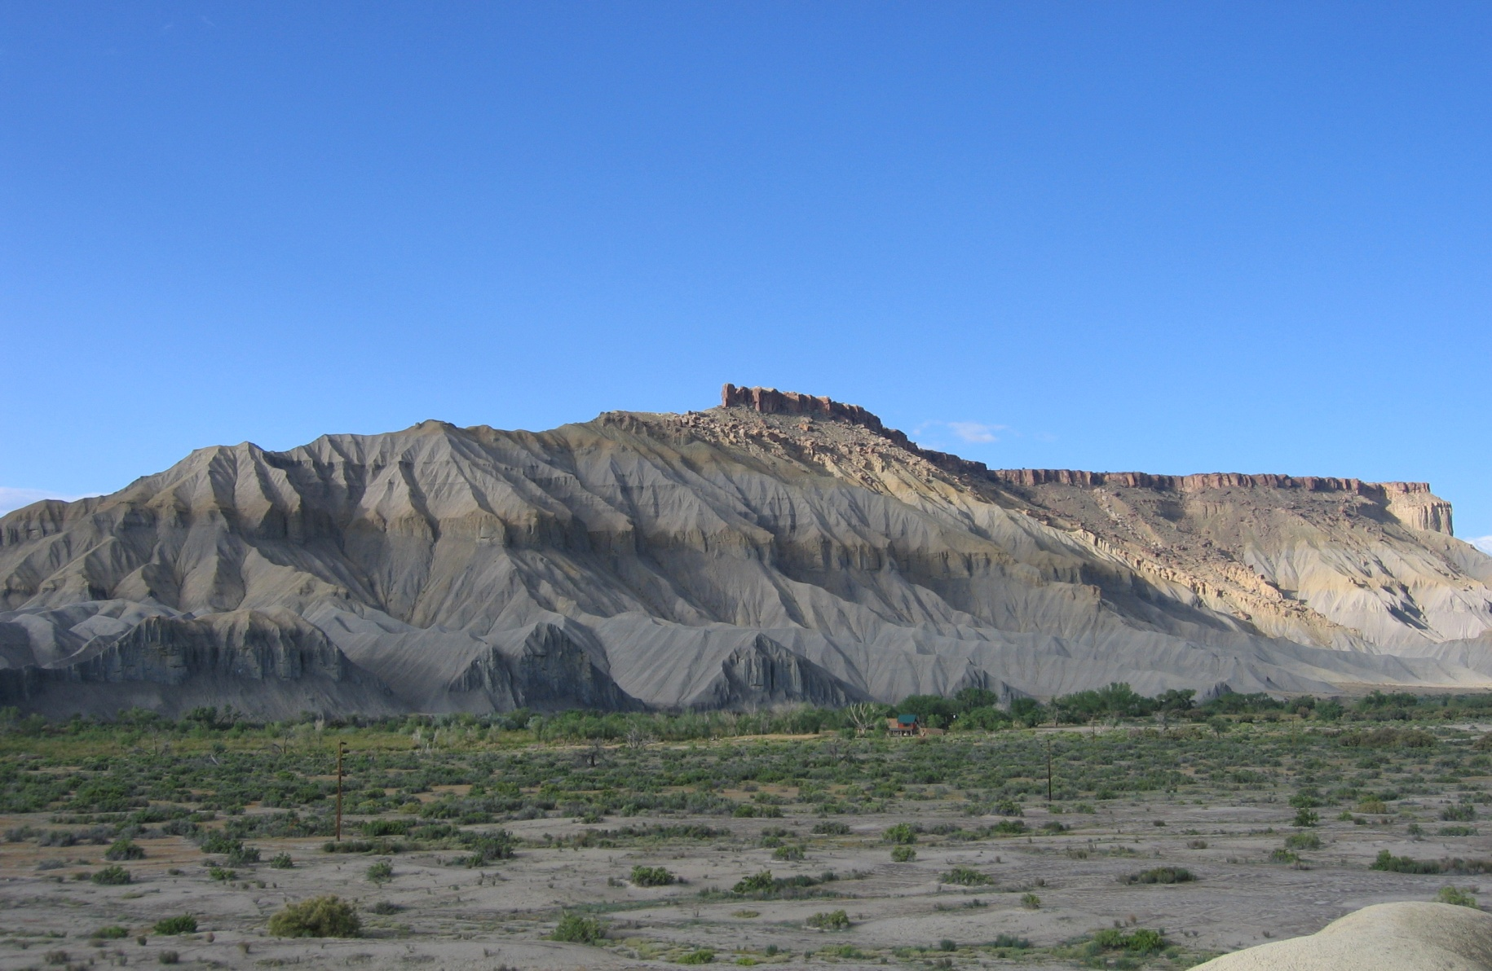
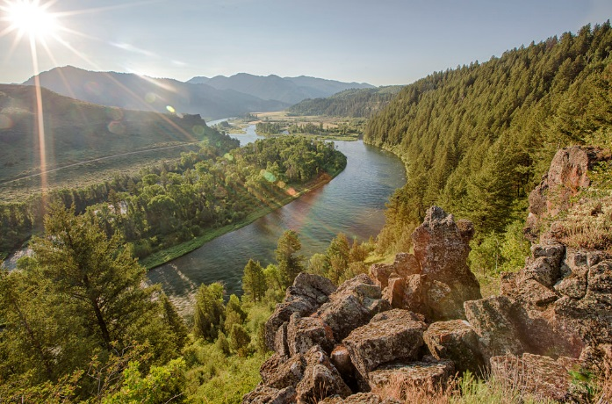
Scenic Quality Evaluation
Step 4 – Evaluate and Score
Scoring the 7 key factors - Example

Slide 39
Scenic Quality Evaluation
Step 4 – Evaluate and Score
Scoring the 7 key factors - Example
Intense variety of color throughout unit
X
Score of 2. Low/Moderate Adjacent Scenery
5
9
2
16

Slide 40
Scenic Quality Evaluation
Scenic Quality distribution
Scenic Quality A
1,336,605,168 /11%
Scenic Quality B
5,505,838,156/ 45%
Scenic Quality C
5,415,759,238/ 44%
Casper Field Office is located
in which physiographic Province?

Slide 41
Scenic Quality Evaluation
Scenic Quality distribution
Scenic Quality A
1,336,605,168 /11%
Scenic Quality B
5,505,838,156/ 45%
Scenic Quality C
5,415,759,238/ 44%
Which SQRU is your project located in and what is the rating?
Casper Field Office is located
in which physiographic Province?

Slide 42
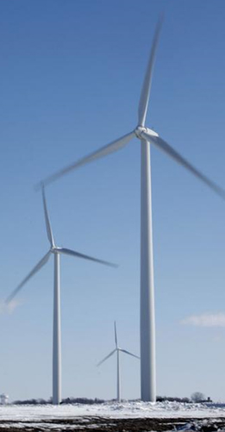
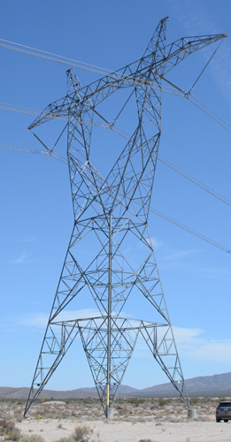
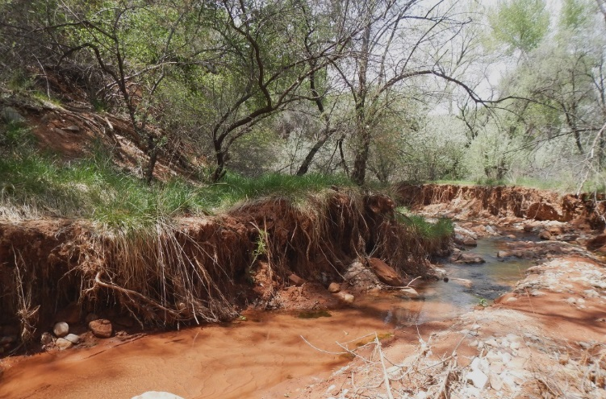
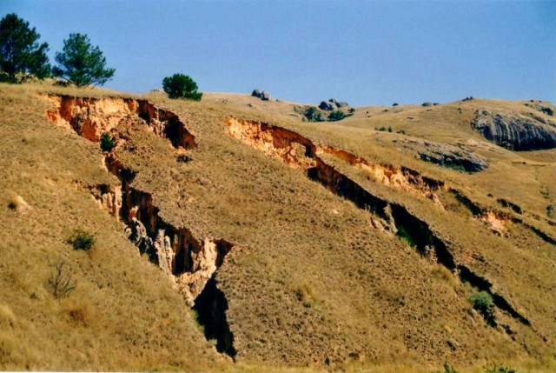
Scenic Quality Evaluation
Cultural Modifications

Slide 43
Scenic Quality Evaluation
Cultural Modifications
Change in Scenic Value
No change: 44%
Reduced value: 55%
Increased value: 1%
Casper Field Office is located
in which physiographic Province?

Slide 44
Scenic Quality Evaluation
What values are changing?
-.5
-1
-1
-1
-1.5
-2
-2
-2
-1
-1
-.5
-.5
-1
Casper Field Office is located
in which physiographic Province?

Slide 45
Scenic Quality Evaluation
Scarcity
-.5
-1
-1
-1
-1.5
-2
-2
-2
-1
-1
-.5
-.5
-1

Slide 46
Visual Resource Inventory
Vernal Field Office VRI
5. Cultural Modifications

Slide 47
Visual Resource Inventory
Vernal Field Office VRI

Slide 48
Sensitivity Analysis

Slide 49
Sensitivity Analysis
Sensitivity Level Analysis
Public lands are assigned one of three possible sensitivity ratings
High Level of Sensitivity
Indicates the public generally has a high CONCERN for retaining existing landscape character, a high INTEREST in potential visual landscape change, and a low TOLERANCE to change
Medium Level of Sensitivity
Indicates the public has a moderate CONCERN for retaining existing landscape character, a moderate INTEREST in potential visual landscape change, and a moderate TOLERANCE to change
Low Level of Sensitivity
Indicates the public has a low CONCERN for retaining existing landscape character; an accompanying low INTEREST in potential visual landscape change, and a high TOLERANCE to change

Slide 50
Sensitivity Analysis
Areas of Sensitivity
High Sensitivity Examples
National monuments
Wilderness/WSAs/outstanding natural areas
Scenic and back country byways
Major transportation corridors
Backdrops to communities
Historic trail corridors
Special management areas where a pristine setting is important
Low Sensitivity Examples
OHV open areas
Mineral or oil and gas development
L

Slide 51
Sensitivity Analysis
Sensitivity Drivers
Factors to consider
Types of users
Amount of use
Public Interest
Adjacent land uses
Special areas
Other considerations
L
Cripple Creek Scenic Byway Overlook
Undisturbed Float Fishing River Banks
Colliding Rivers, Roseburg, OR
Tehachapi Pass, Mojave, CA

Slide 52
Sensitivity Analysis
Evaluation Rating
Sensitivity Level Rating Sheet - BLM Form 8400-6
L
Aug 3, 2015
John Doe
Local, regional, and national populations visit frequently and have a high sensitivity to visual change. Views into and from the unit are highly sensitive due to the multiple trailheads that lead to the Black Ridge Canyons WA.

Slide 53
Sensitivity Analysis
Rating Tables
Explanation and rationale is included in the VRI Report

Slide 54
Sensitivity Analysis
Evaluation Ratings
Explanation and rationale is included in the VRI Report

Slide 55
Sensitivity Analysis
Sensitivity Mapping
Sensitivity Level -
High: 782,301 ac/ 27%
Sensitivity Level –
Medium: 1,312,346 ac/ 46%
Sensitivity Level –
Low: 772,898 ac/ 27%
Which SQRU is your project located in and what is the rating?

Slide 56
Sensitivity Analysis
Sensitivity Mapping

Slide 57
Distance Zone Delineation
Distance Zones Definitions
Landscapes are subdivided into 3 distance zones based on relative visibility from travel routes or observation points
H8410 defines Distance Zones as:
Foreground/Middle-ground
0 – 5 miles
management activities can be viewed in detail
Background
5 – 15 miles
Large vegetation is visible, becoming patterns of light and dark
Seldom Seen
>15 miles or blocked view

Slide 58
Distance Zone Delineation
Select Viewing Platforms
Viewing platforms are popular ‘travel routes’ or ‘observation points’ where the general public are commonly present

Slide 59
Distance Zone Delineation
Select Viewing Platforms
Viewing platforms are popular ‘travel routes’ or ‘observation points’ where the general public are commonly present.

Slide 60
Distance Zone Delineation
Distance Zone Mapping
Create polygons for ‘unseen’ areas (Blue).
These polygons become the Seldom Seen distance zone
H 8410-1, IIV. A(3)
Foreground/ Middle-ground
3,100,673 ac/ 57%
Background
1,053,438 ac/ 20%
Seldom Seem
1,265,690 ac/ 23%

Slide 61
Distance Zone Delineation
Distance Zone Mapping
Which Distance Zone is your project located in and what is the rating?
Foreground/ Middle-ground
3,100,673 ac/ 57%
Background
1,053,438 ac/ 20%
Seldom Seem
1,265,690 ac/ 23%

Slide 62
Distance Zone Delineation
Distance Zone Mapping
Create polygons for ‘unseen’ areas (Blue).
These polygons become the Seldom Seen distance zone
H 8410-1, IIV. A(3)

Slide 63
Visual Resource Inventory
VRI Class Definitions
The VRI Class offers a quick understanding of an area’s overall visual value yet does not replace the need to understand the 3 underlying factors and their ratings
The VRI Class is different than the VRM Class
VRI Class 1: NOT BASED ON INVENTORY – Assigned to areas where a congressional decision has been made previously to maintain a natural landscape. These areas reflect a management decision, not based on inventory (such as wilderness areas).
VRI Class 2: High overall visual value based on inventory
VRI Class 3: Moderate overall visual value based on inventory
VRI Class 4: Low overall visual value based on inventory

Slide 64
Scenic Quality Evaluation
Step 1 – Identify the Basis of Comparison
Scenic Quality A: 1,336,605,168 /11%
Scenic Quality B : 5,505,838,156/ 45%
Scenic Quality C : 5,415,759,238/ 44%
Sensitivity Level High: 782,301 ac/ 27%
Sensitivity Level Medium 1,312,346 ac/ 46%
Sensitivity Level Low 772,898 ac/ 27%
Foreground/ Mid-ground: 3,100,673 ac/ 57%
Background: 1,053,438 ac/ 20%
Seldom Seem: 1,265,690 ac/ 23%

Slide 65
Visual Resource Inventory
VRI Class Determination Table
How are VRI classes determined?

Slide 66
Visual Resource Inventory
VRI Class Definitions
VRI Class I
56,590 ac / 2%
VRI Class II
524,772ac / 22%
VRI Class III
767,701/ 32%
VRI Class IV
1,081,231/ 44%

Slide 67
Visual Resource Inventory
Summary
Methodology is the same across all BLM field offices
One inventory serves the planning area and serves as a basis for NEPA analysis for comparing the existing condition (affected environment) to a proposed condition in order to identify how the change would affect scenic quality (environmental consequences)
Allows analysis to determine scarcity levels of a particular visual value
Provides basis to consider visual values in the land use planning process

Slide 68
Land Use Plan (LUP) Implementation
Is the condition trending toward a decline? Stability? Or improving?
Are more lands being visually altered?
Are the natural scenic qualities of the landscape character:
Being lost?
In balance?
Or are scenic qualities being recovered through enhancement/ restoration?
Is this measureable? Explain.

Slide 69
Visual Resource Management
From Inventory to Management Classes
VRM is the product of planning and used to retain or achieve the desired visual character
VRM class alternatives based on the visual resource inventory factors and their values
Visual values are weighed along with other resource considerations (multiple uses)
A range of alternatives are prepared with goals, objectives, allowable uses, and management actions

Slide 70
VRM Overview
Land Use Planning & Policy
The VRM Classes establish limits of allowable change to the natural landscape character.
VRM Class I
Preserve the existing visual character of the landscape (must not attract attention)
VRM Class II
Retain the existing visual character of the landscape (should not attract attention)
VRM Class III
Partially Retain the existing character of the landscape (may attract attention but not dominate)
VRM Class IV
Provides for Major Modification of the existing character of the landscape (may attract and dominate attention)
Notes:
Reference the VRM Class Handout

Slide 71
Visual Resource Management
Land Use Planning & VRM Classes
VRM Class I: 57,776 (3%)
VRM Class II: 259,734 (15%)
VRM Class III: 759,977 (44%)
VRM Class IV: 642,450 (38%)
1,719,937

Slide 72
Visual Resource Management
VRM Class Decisions on VRI Values
VRI/ VRM Class I
2%/ 3%
VRI/ VRM Class II
22%/ 15%
VRI/ VRM Class III
32%/ 44%
VRI Class IV
44%/ 38%

Slide 73
Visual Resource Management
VRM Class Decisions on VRI Values
VRI/ VRM Class I
2%/ 3%
VRI/ VRM Class II
22%/ 15%
VRI/ VRM Class III
32%/ 44%
VRI Class IV
44%/ 38%

Slide 74
VRM Overview
Visible Stewardship of a finite resource
If not carefully designed, activities have the potential to:
Significantly alter the visual character of the landscape
Reflect on the BLM’s image
Effects on visitor experience and community quality of life
Cause project delays through protest, appeals
Increase long term costs due to restoration needs

Slide 75
VRM Overview
Visible Stewardship of a finite resource
Different approaches to design and many solutions

Slide 76
VRM Overview
Benefits if carefully designed...

Slide 77
VRM Overview
Benefits if carefully designed...

Slide 78
VRM Overview
Benefits if carefully designed...

Slide 79
VRM Overview
Conclusion
“What a citizen sees every day is his (her) America. If it is attractive it adds to the quality of his (her) life. If it is ugly it can degrade his (her) existence.” President Lyndon B. Johnson, 1965

