Slide 2
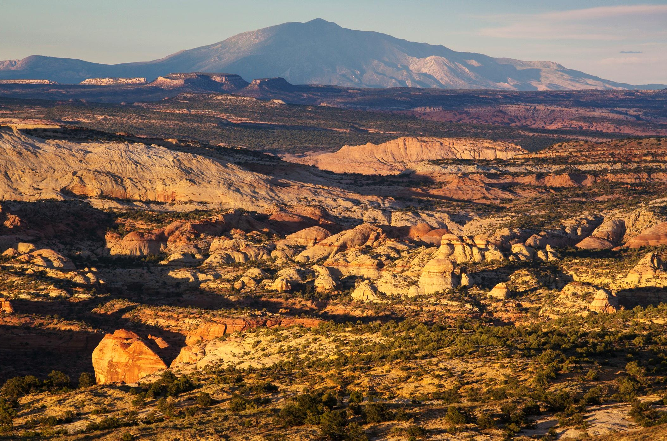
Language of Landscapes

Slide 3
Language of Landscapes
Unit Objective
Analyze and describe the landscape character of a given scene.

Slide 4
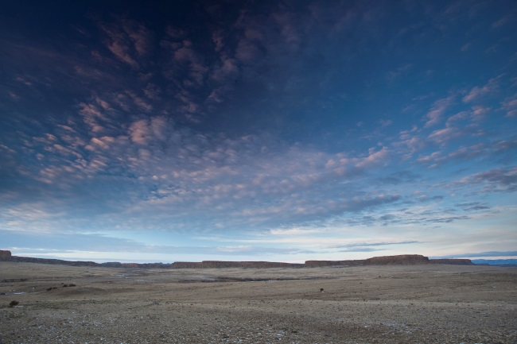
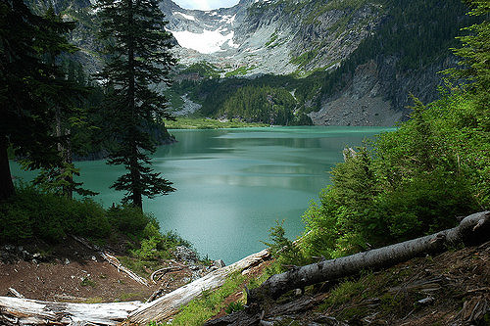
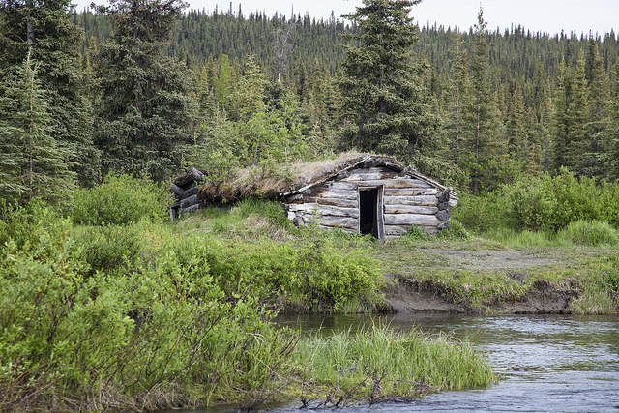
Language of Landscapes
Landscape Character
The character of a landscape is the overall impression created by its unique combination of visual components (such as land, vegetation, water, and structures).

Slide 5
Language of Landscapes
Landscape Character

Slide 6
Language of Landscapes
1 – Types of Landscapes

Slide 7
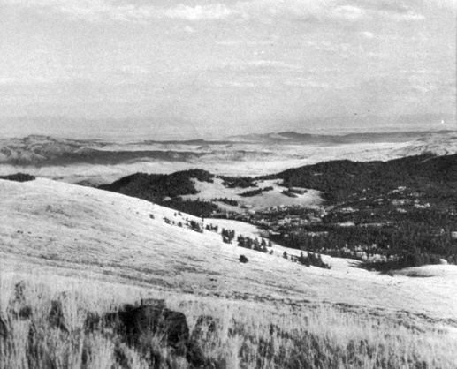
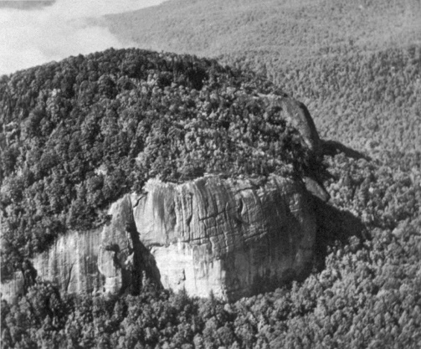
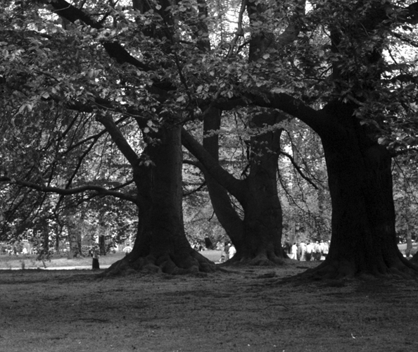
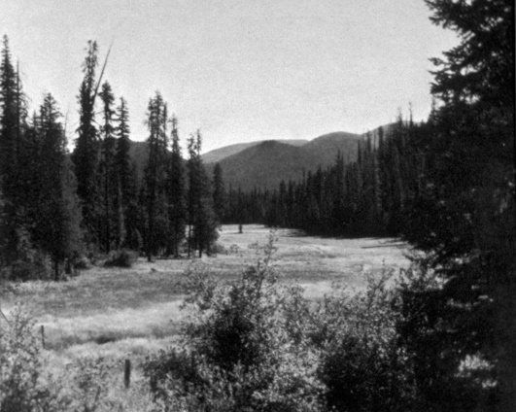
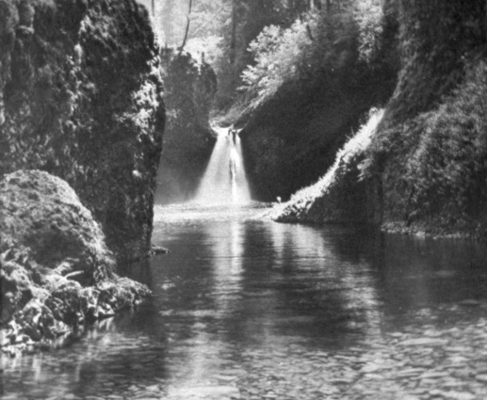
Language of Landscapes
1 - Types of Landscapes
Panoramic
Canopied
Feature
Enclosed
Focal

Slide 8
Language of Landscapes
1 - Types of Landscapes
Panoramic Landscapes
Unobstructed, wide view of an extensive area
Little or no sense of boundary
Open and expansive
Foreground/middle ground features do not substantially block background
Sky and foreground occupy much of view

Slide 9
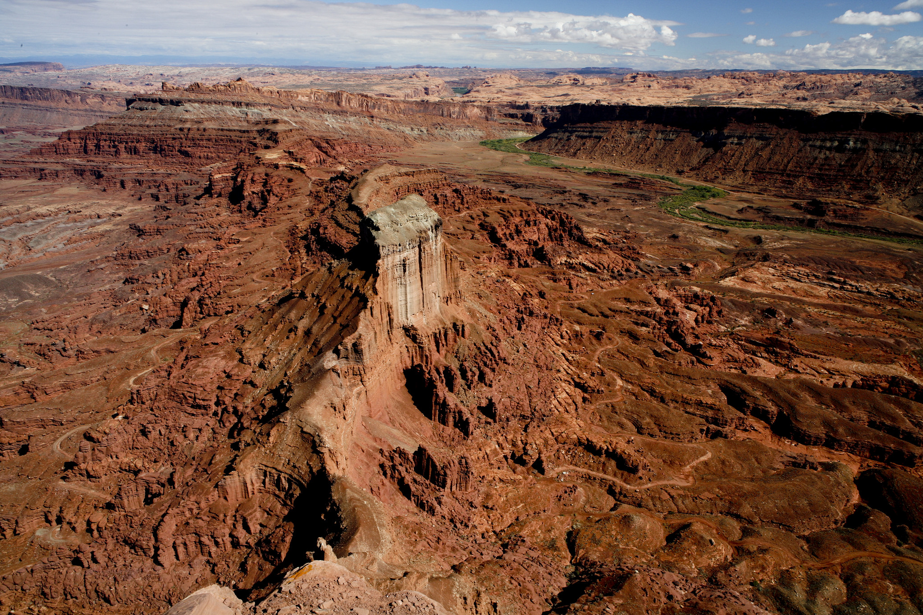
Language of Landscapes
1 - Types of Landscapes
Panoramic

Slide 10
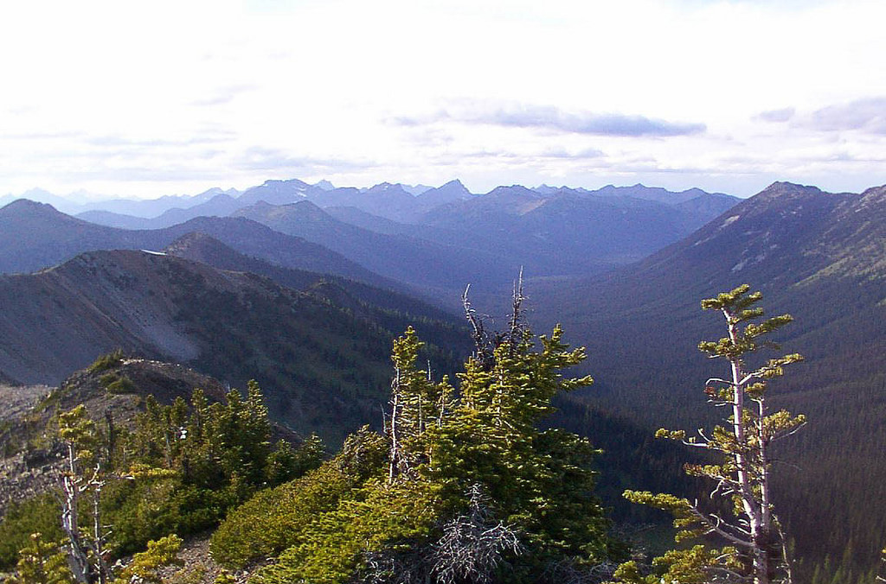
Language of Landscapes
1 - Types of Landscapes
Panoramic

Slide 11
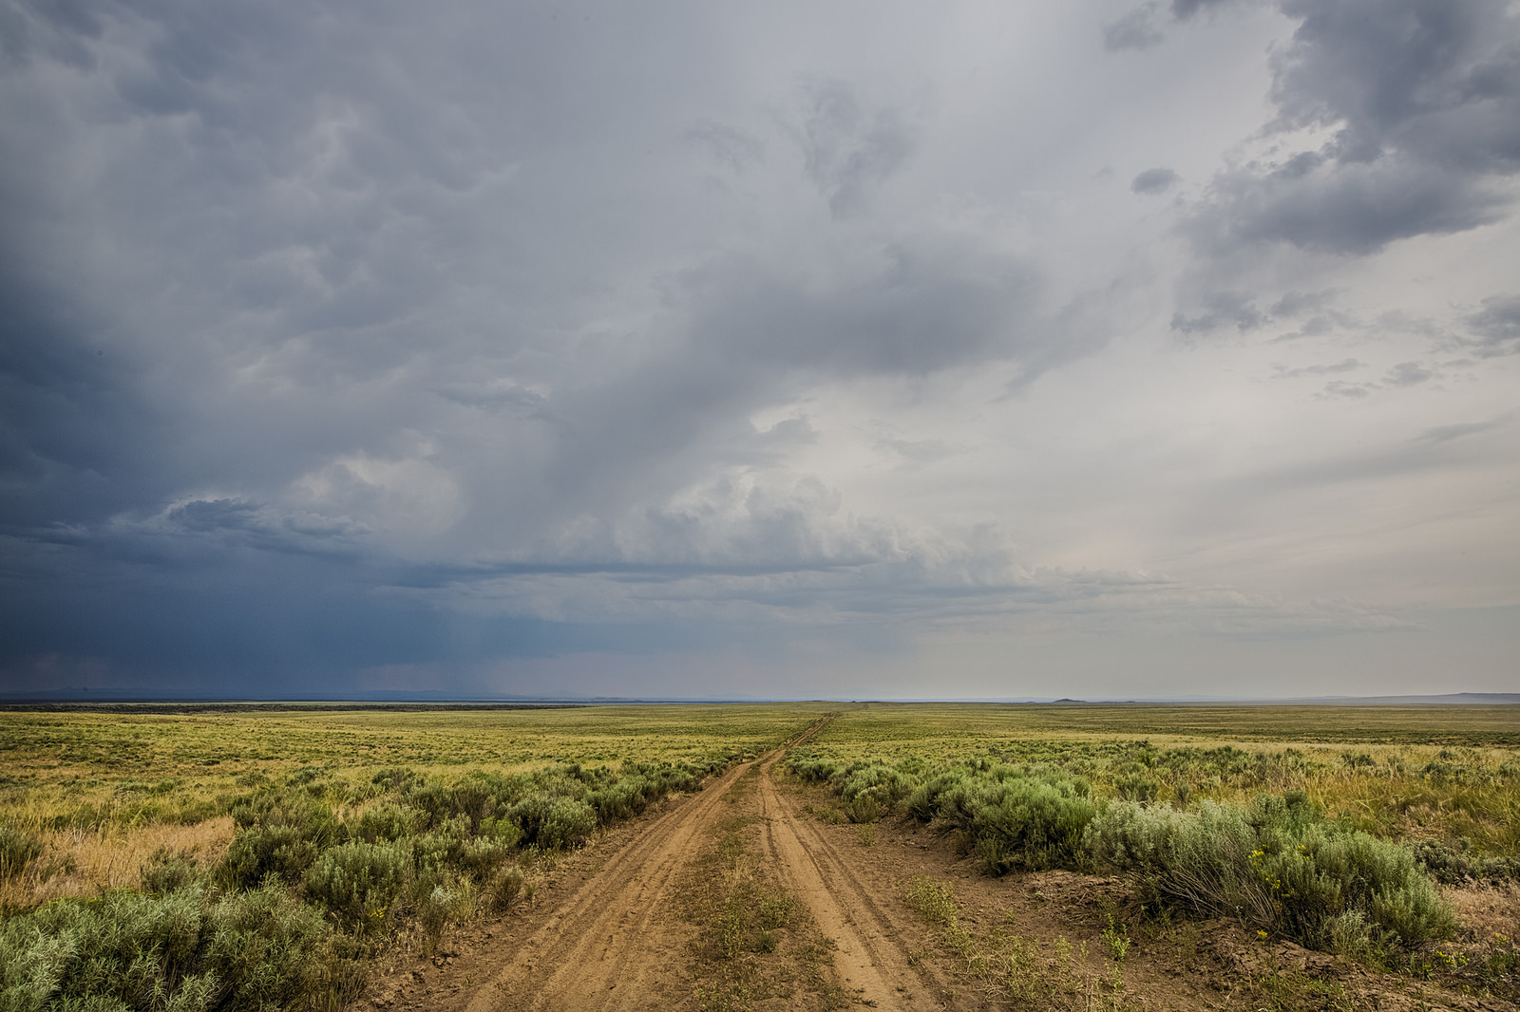
Language of Landscapes
1 - Types of Landscapes
Panoramic

Slide 12
Language of Landscapes
1 - Types of Landscapes
Enclosed Landscapes
Landscape spaces surrounded by continuous groupings of features.
Eye is drawn to enclosed portion of landscape.
An example is a meadow or small lake surrounded by walls of trees or earth forms.
Modifications within enclosure space may be highly visible.

Slide 13
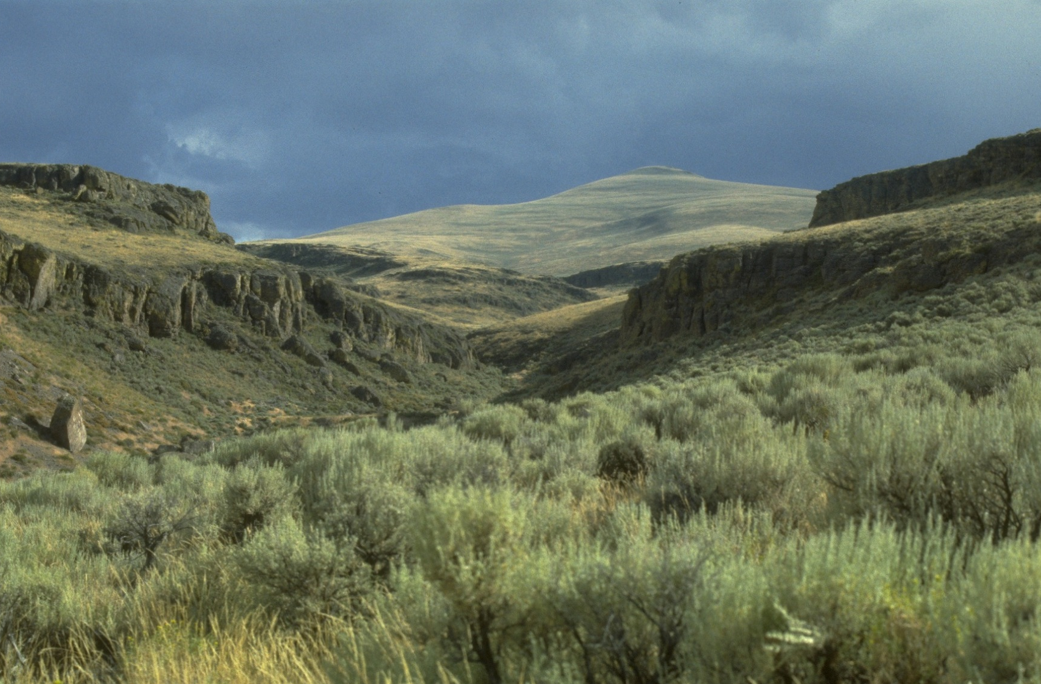
Language of Landscapes
1 - Types of Landscapes
Enclosed

Slide 14
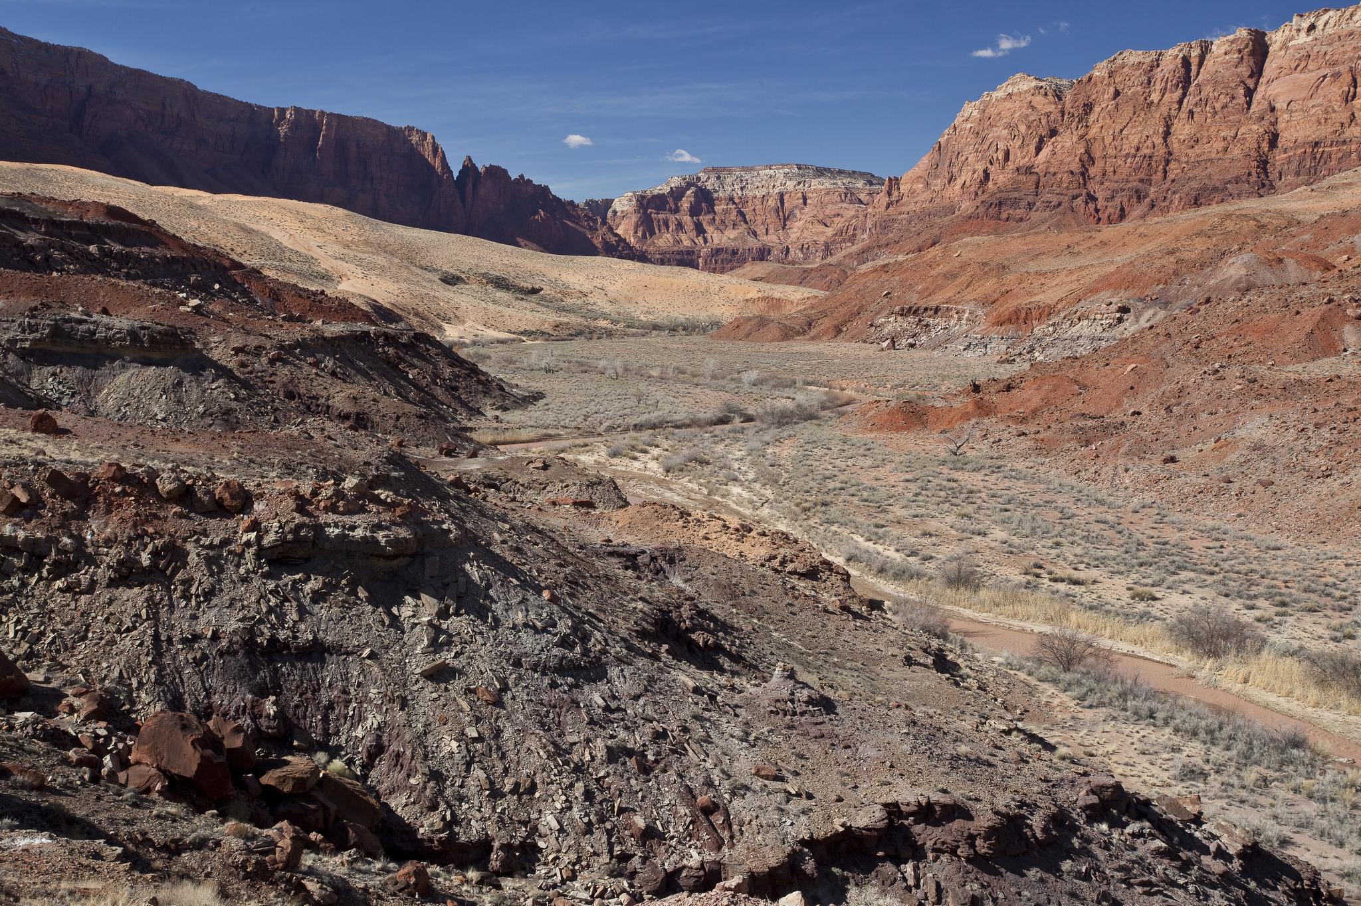
Language of Landscapes
1 - Types of Landscapes
Enclosed

Slide 15
Language of Landscapes
1 - Types of Landscapes
Enclosed

Slide 16
Language of Landscapes
1 - Types of Landscapes
Feature Landscapes
Dominated by feature or group of feature objects.
Eye is drawn to feature.
Typically includes such elements as a prominent landform or waterfall.
Vulnerable to modification if near feature.

Slide 17
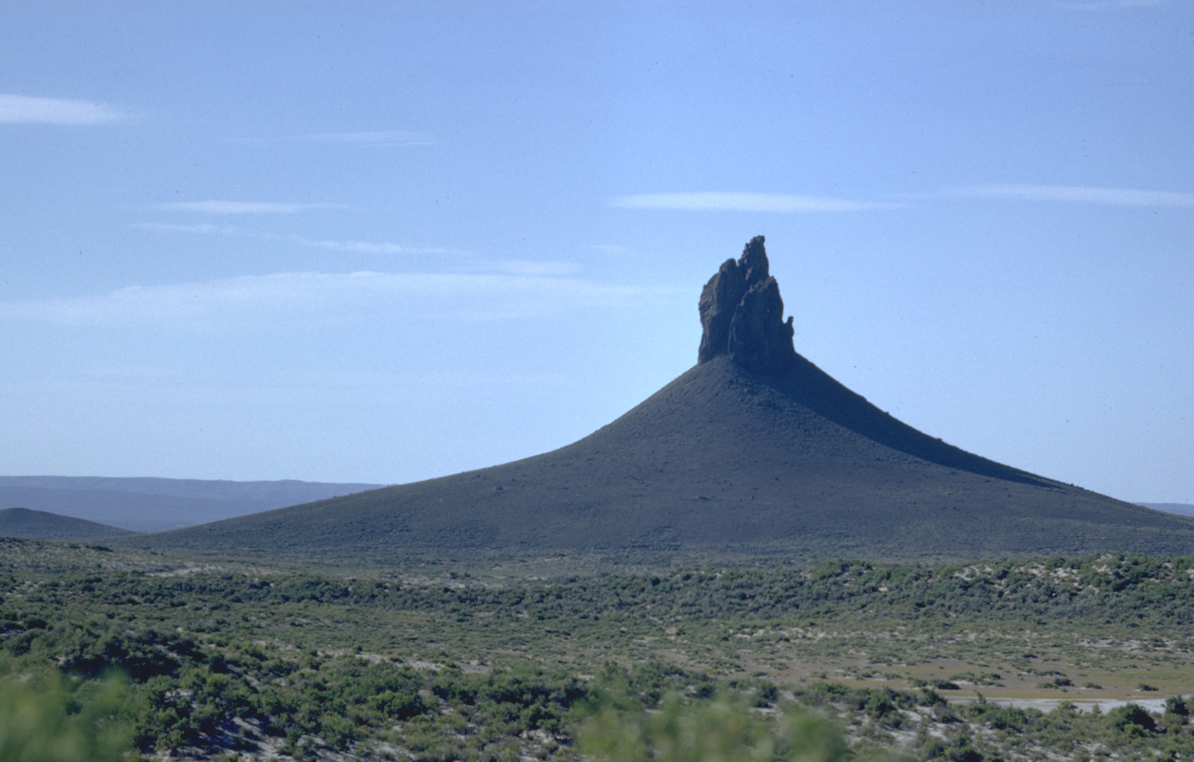
Language of Landscapes
1 - Types of Landscapes
Feature

Slide 18
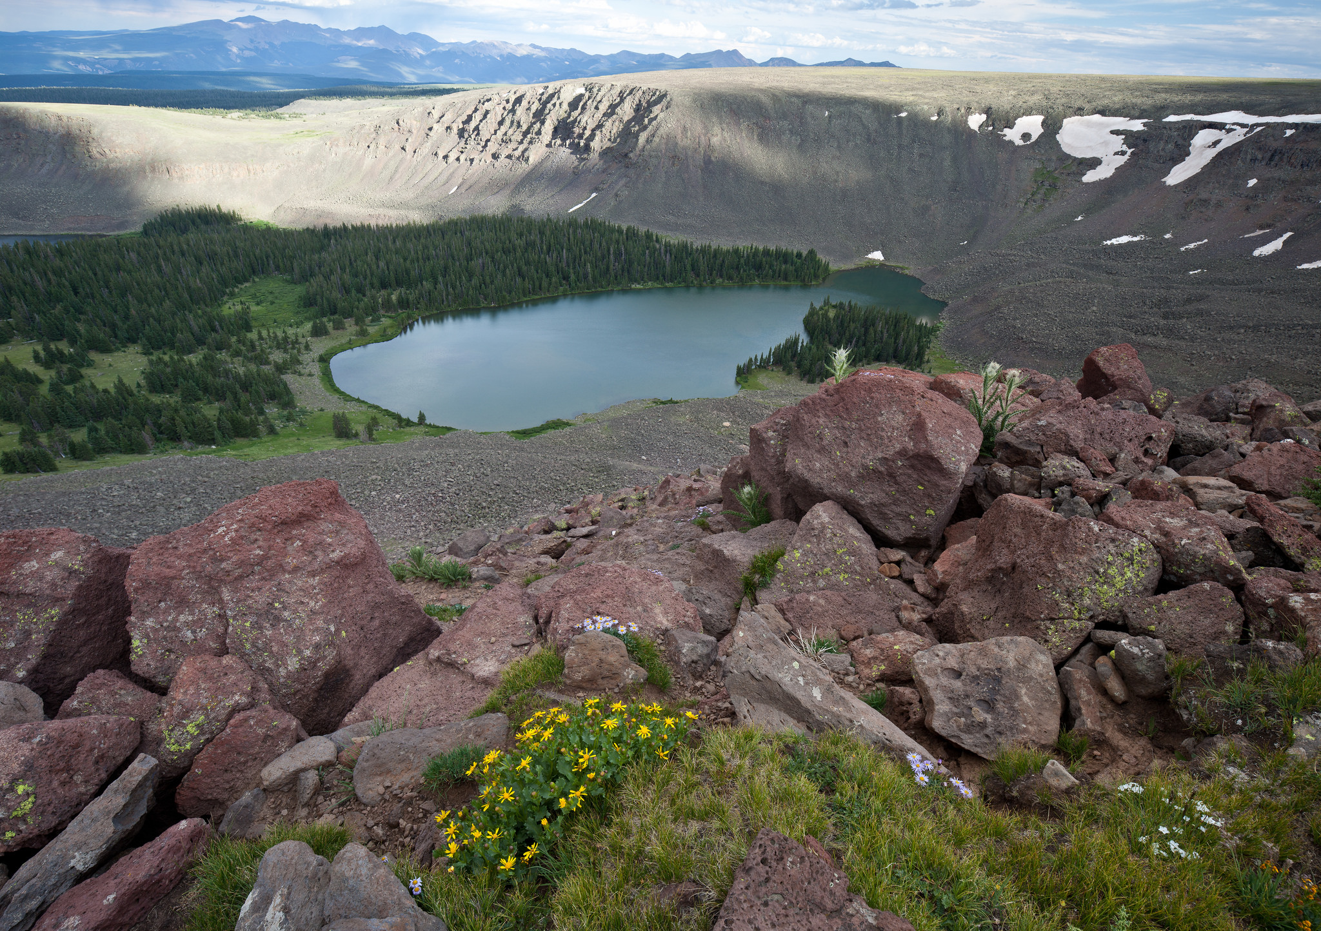
Language of Landscapes
1 - Types of Landscapes
Feature

Slide 19
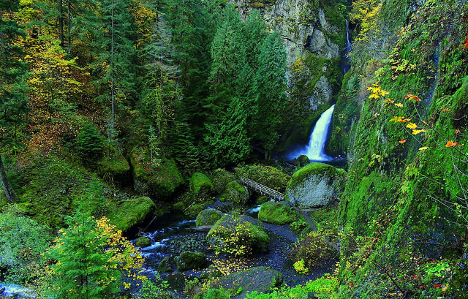
Language of Landscapes
1 - Types of Landscapes
Feature

Slide 20
Language of Landscapes
1 - Types of Landscapes
Focal Landscapes
Tend to converge upon themselves as distance increases.
Eye is drawn to focal point.
Vulnerable to modification if near focal point.

Slide 21
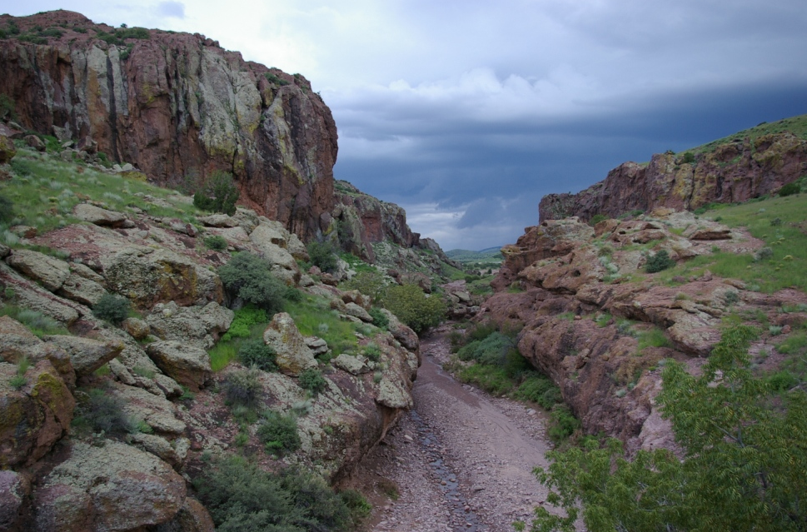
Language of Landscapes
1 - Types of Landscapes
Focal

Slide 22
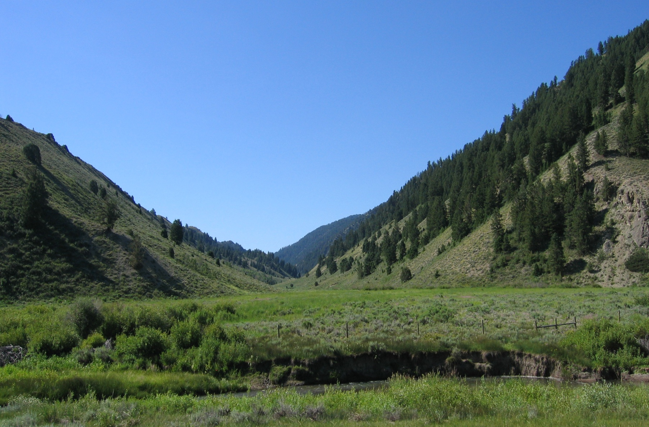
Language of Landscapes
1 - Types of Landscapes
Focal

Slide 23
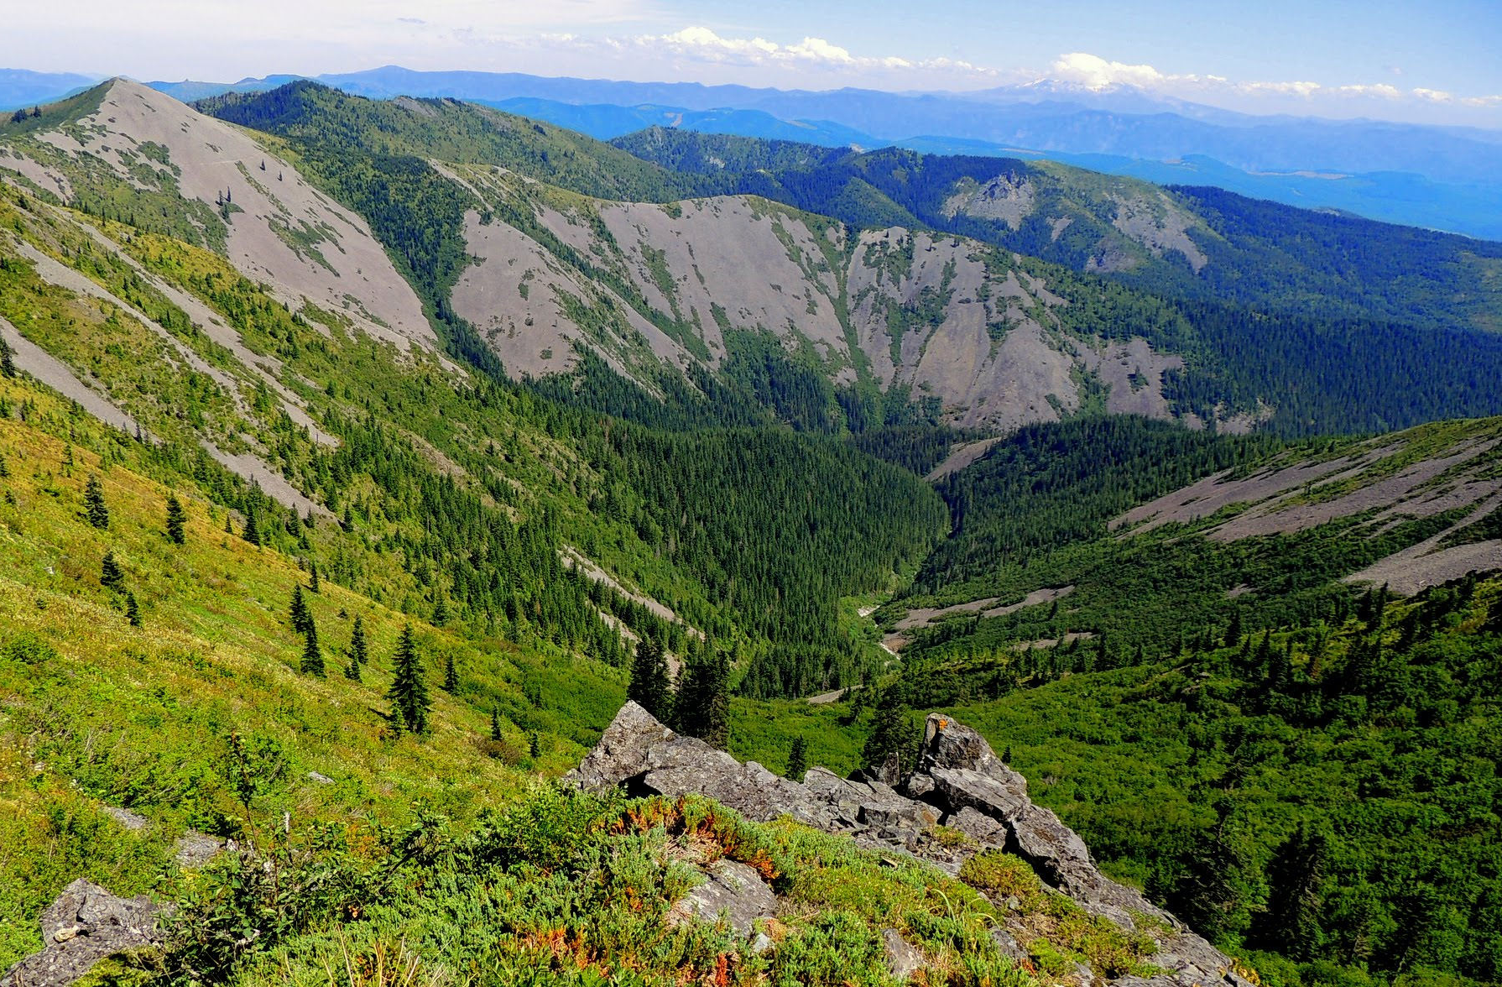
Language of Landscapes
1 - Types of Landscapes
Focal

Slide 24
Language of Landscapes
1 - Types of Landscapes
Canopied Landscapes
Features overhead create a ceiling or canopy.
Typically within or at the edge of a forest where branches and foliage are overhead.

Slide 25
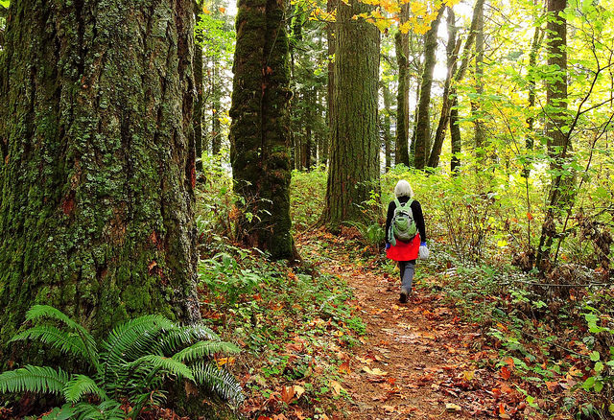
Language of Landscapes
1 - Types of Landscapes
Canopied

Slide 26
Language of Landscapes
1 - Types of Landscapes
Canopied

Slide 27
Language of Landscapes
1 - Types of Landscapes
Canopied

Slide 28
Language of Landscapes
2 - Landscape Character Elements

Slide 29
Language of Landscapes
2 - Landscape Character Elements
Form
Color
Texture
Line

Slide 30
Language of Landscapes
2 - Landscape Character Elements
Form
Mass of an object or a combination of objects that appears unified.
2-dimensional form = shape
Shapes are sometimes seen when adjacent areas have a contrast in color or texture.
3-dimensional form = mass
Mass is seen when a natural object, landform or manmade structure’s bulk, size and expanse is perceived.
Shape
=
Rectangle
Mass
=
Cube

Slide 31
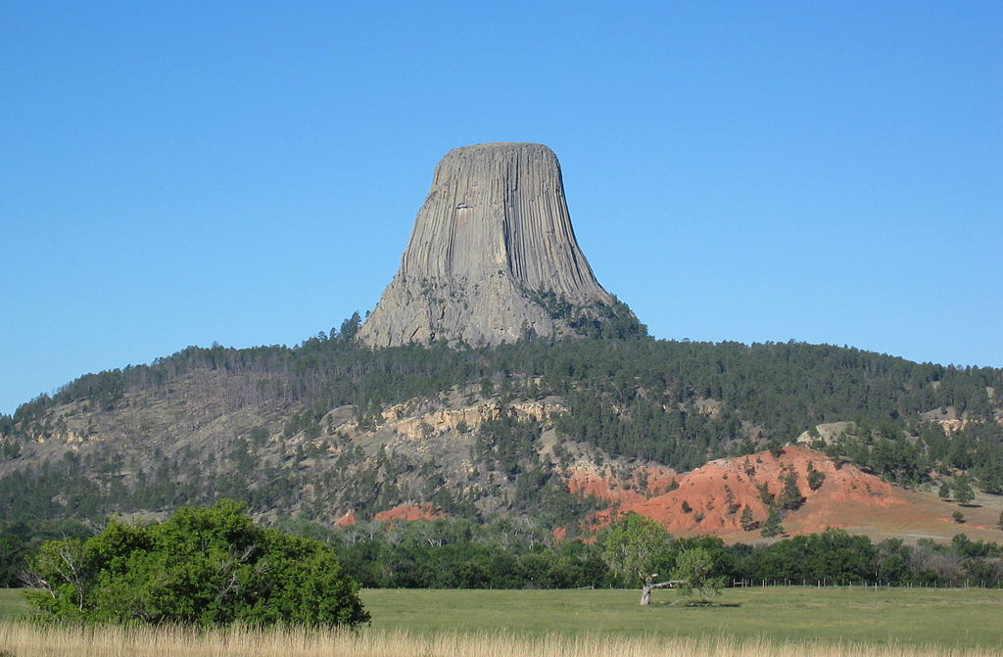
Language of Landscapes
2 - Landscape Character Elements
Form
By Kevstan (Own work) [CC BY-SA 3.0 (http://creativecommons.org/licenses/by-sa/3.0) or GFDL (http://www.gnu.org/copyleft/fdl.html)], via Wikimedia Commons

Slide 32
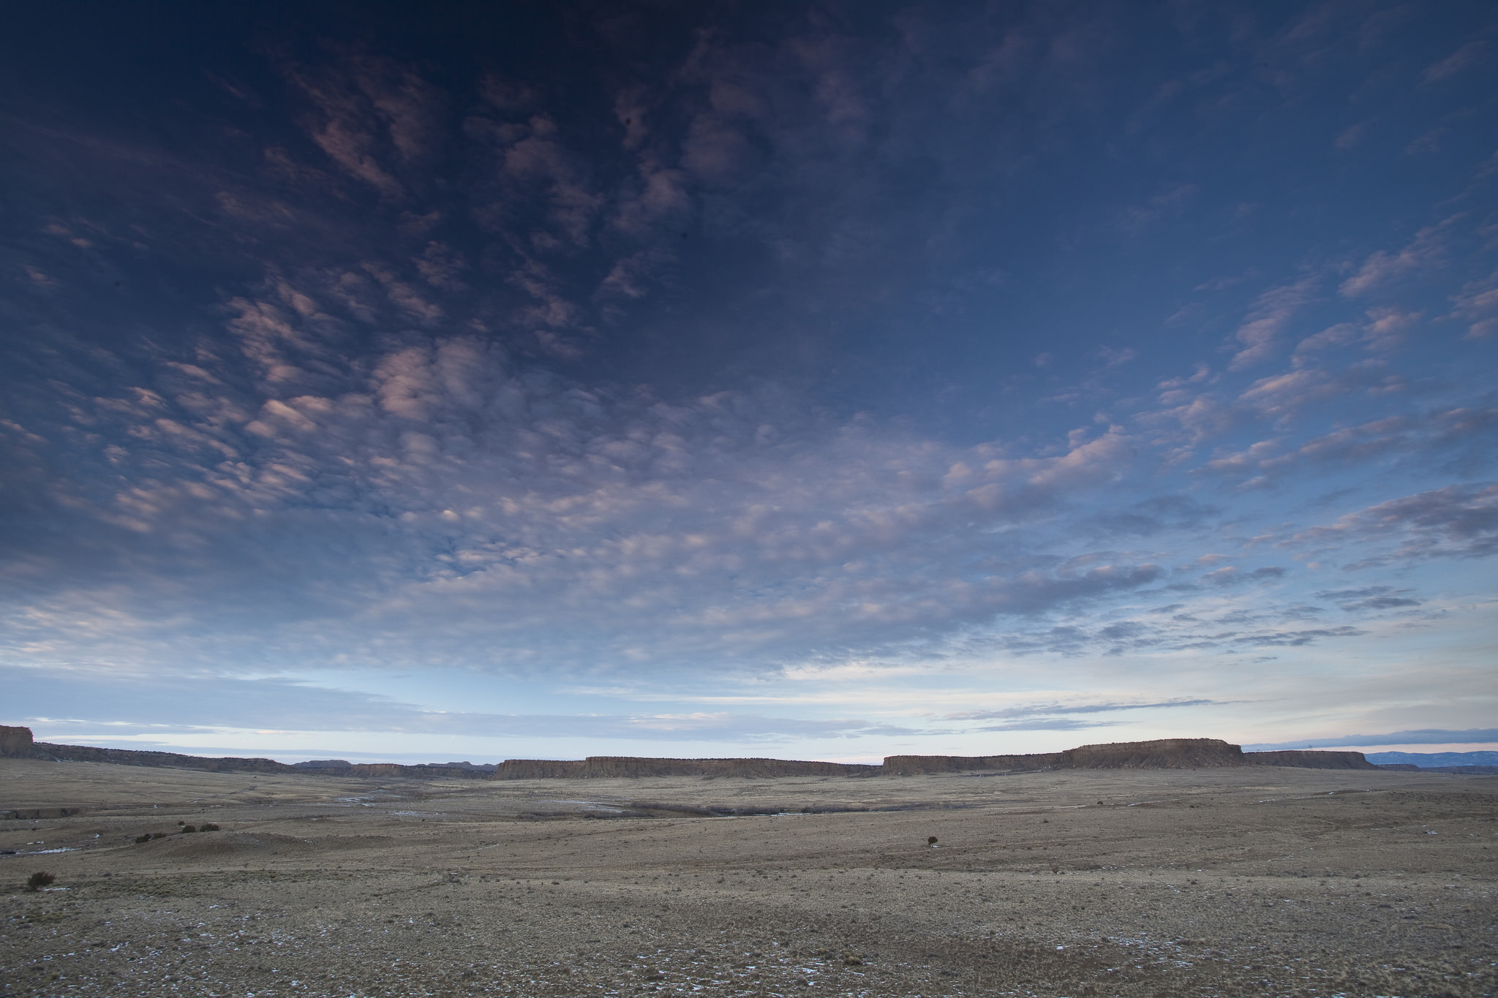
Language of Landscapes
2 - Landscape Character Elements
Form

Slide 33
Language of Landscapes
2 - Landscape Character Elements
Form

Slide 34
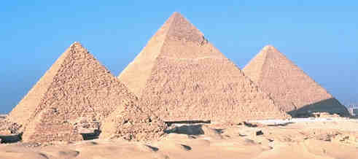
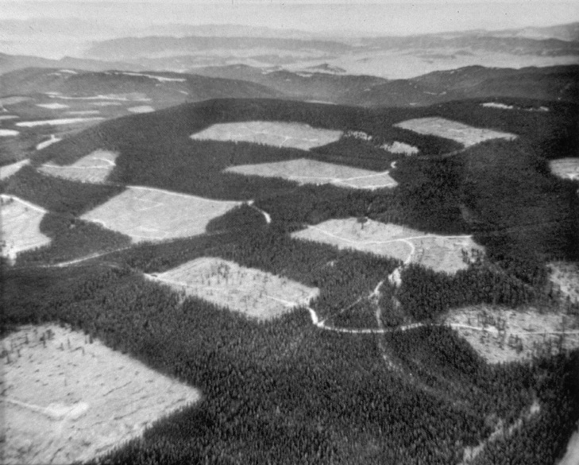
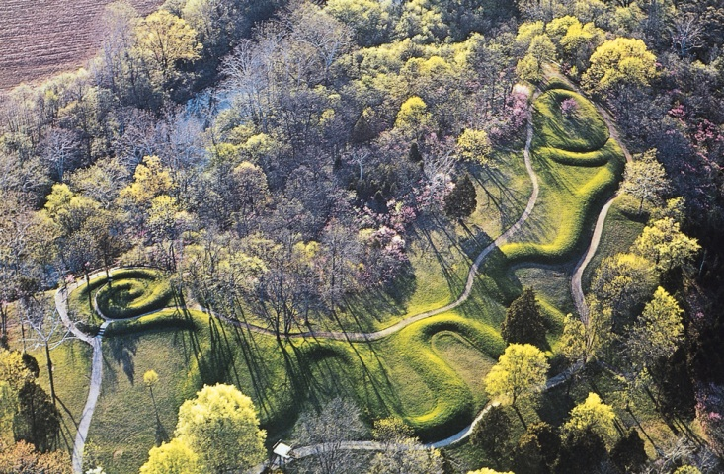
Language of Landscapes
2 - Landscape Character Elements
Form
Forms that are bold, regular, solid or vertical tend to be dominant.
Pyramids @ Giza
Logging, BLM photo
from Rich Hagan’s file
Serpent Mound, Ohio

Slide 35
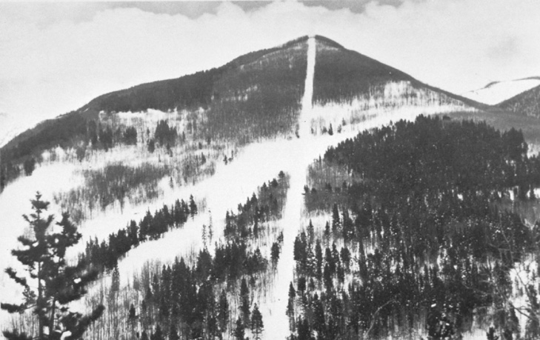
Language of Landscapes
2 - Landscape Character Elements
Line
Path (real or perceived) that the eye follows in a landscape.
Perceived in abrupt differences in form, color, or texture, or when objects are aligned in sequence.
Usually evident as the edge of shapes or masses in the landscape.

Slide 36
Language of Landscapes
2 - Landscape Character Elements
Line
Types of Line
Edge
Boundary between two contrasting areas
Outline of a two-dimensional shape on the land surface
Band
Contrasting linear form with two roughly parallel edges
Silhouette
Outline of a mass seen against a backdrop

Slide 37
Language of Landscapes
2 - Landscape Character Elements
Line

Slide 38
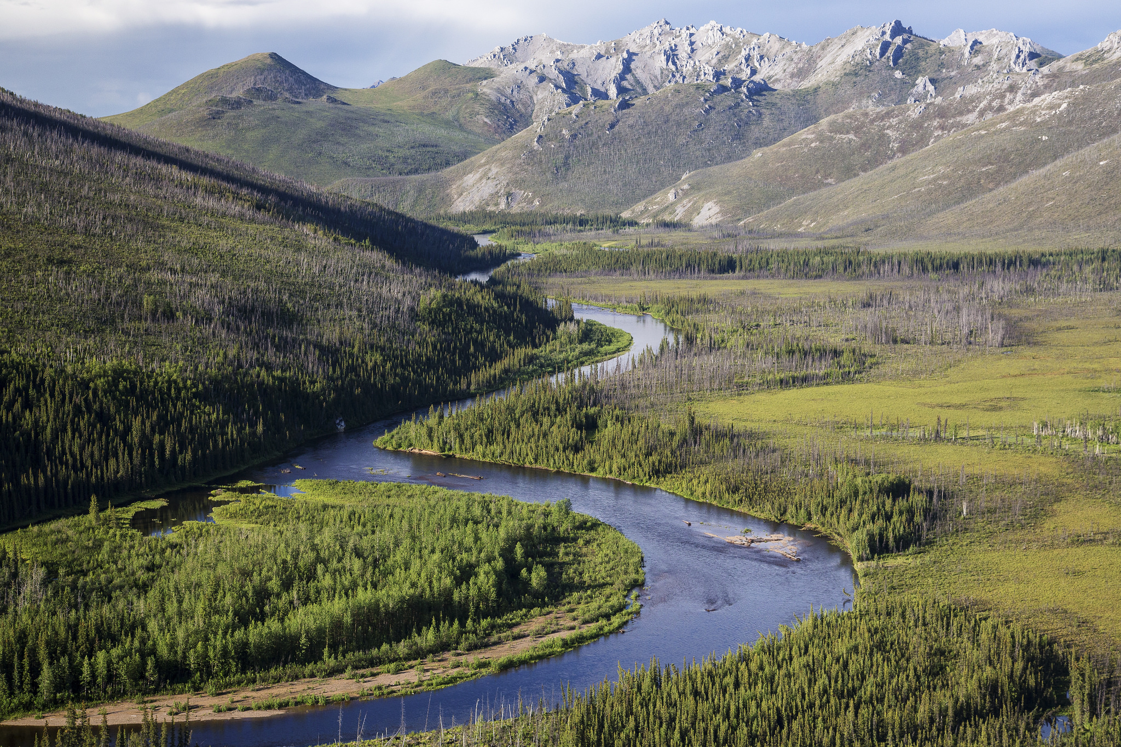
Language of Landscapes
2 - Landscape Character Elements
Line

Slide 39
Language of Landscapes
2 - Landscape Character Elements
Line

Slide 40
Language of Landscapes
2 - Landscape Character Elements
Color
The property of reflecting light of a particular intensity and wavelength to which the eye is sensitive.
THE major visual property of surfaces.
Color is what enables us to differentiate objects even though they have identical form, line, and texture.
Color is processed by the brain before form or motion.
Light, warm, bright colors typically advance and dominate. Dark, cool, dull colors will typically retreat.

Slide 41
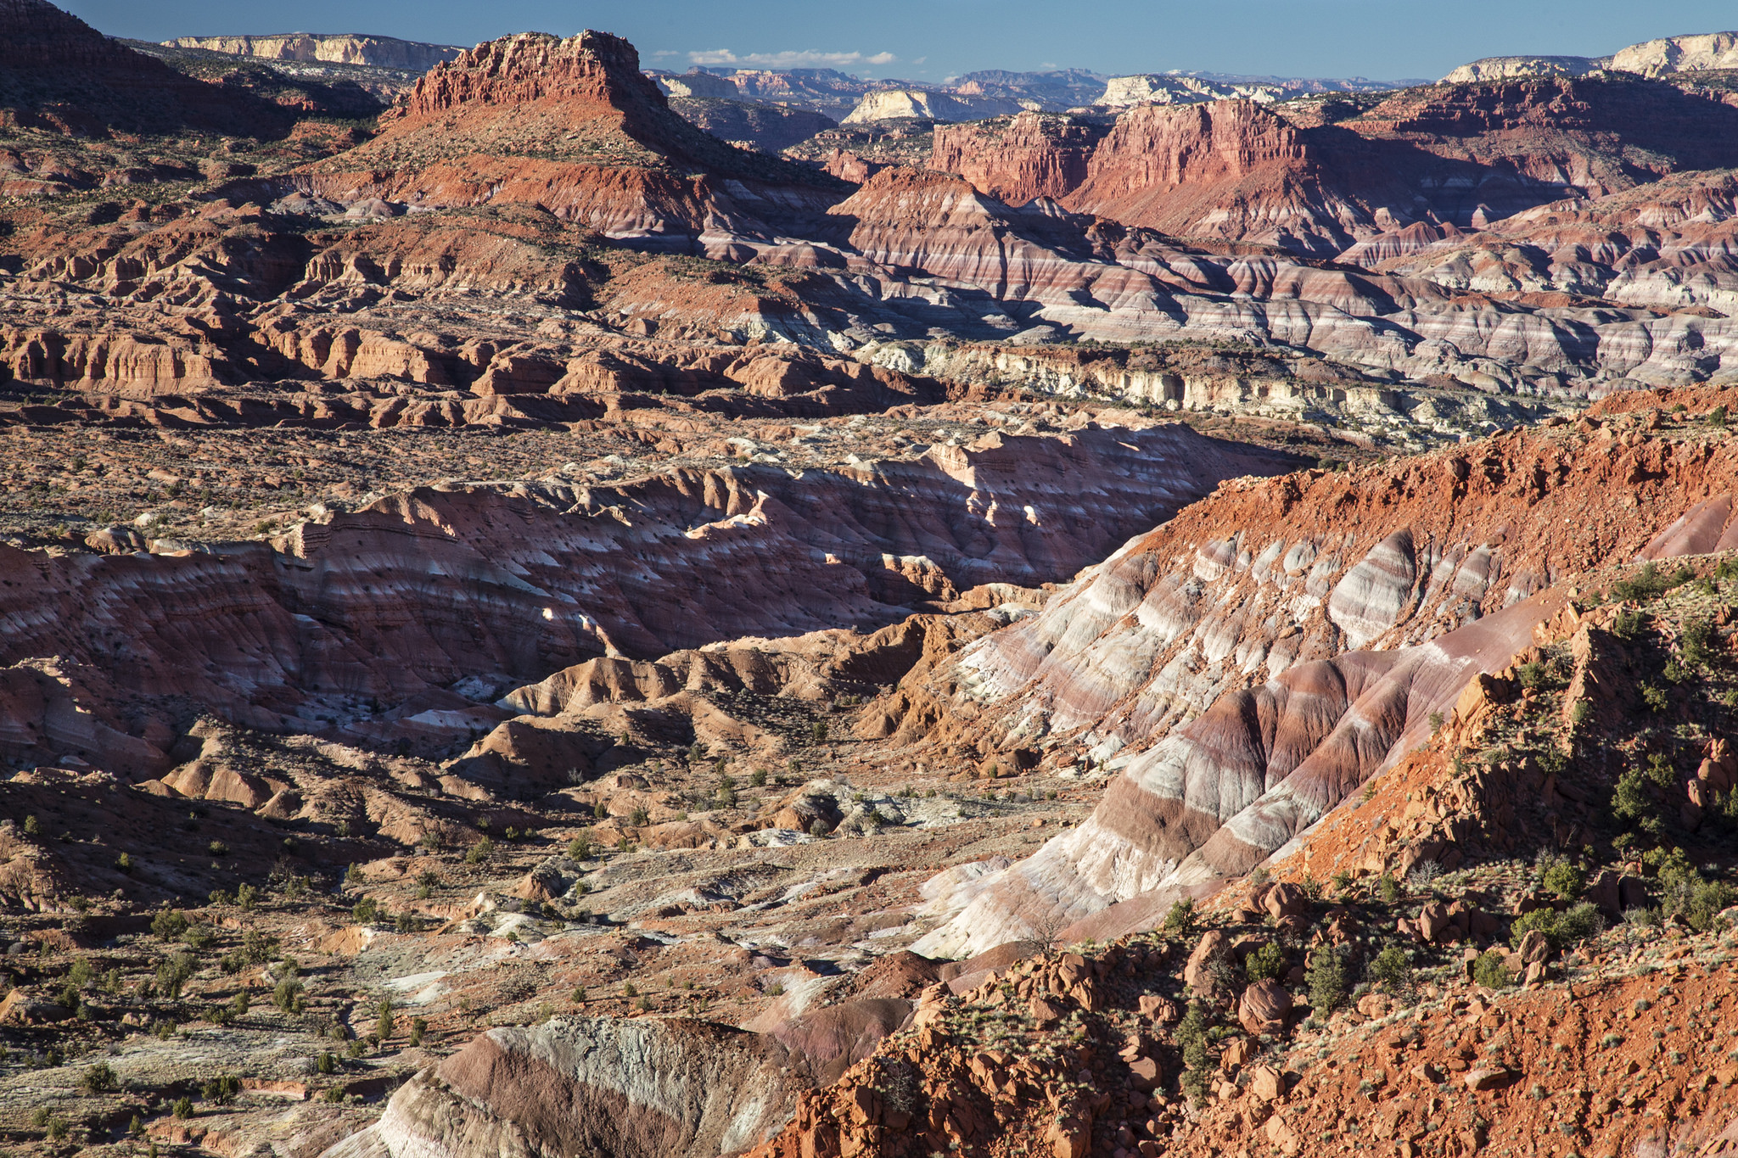
Language of Landscapes
2 - Landscape Character Elements
Color

Slide 42
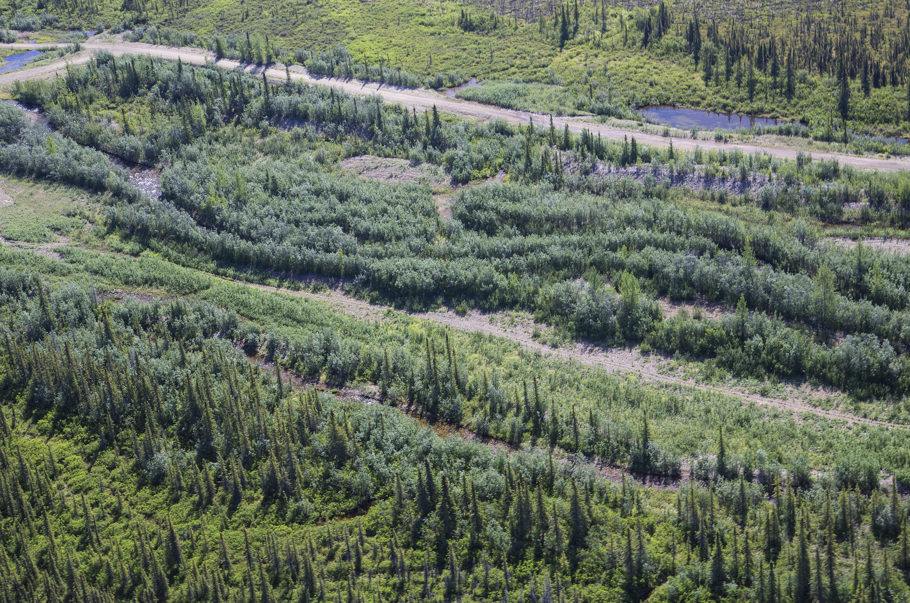
Language of Landscapes
2 - Landscape Character Elements
Color

Slide 43
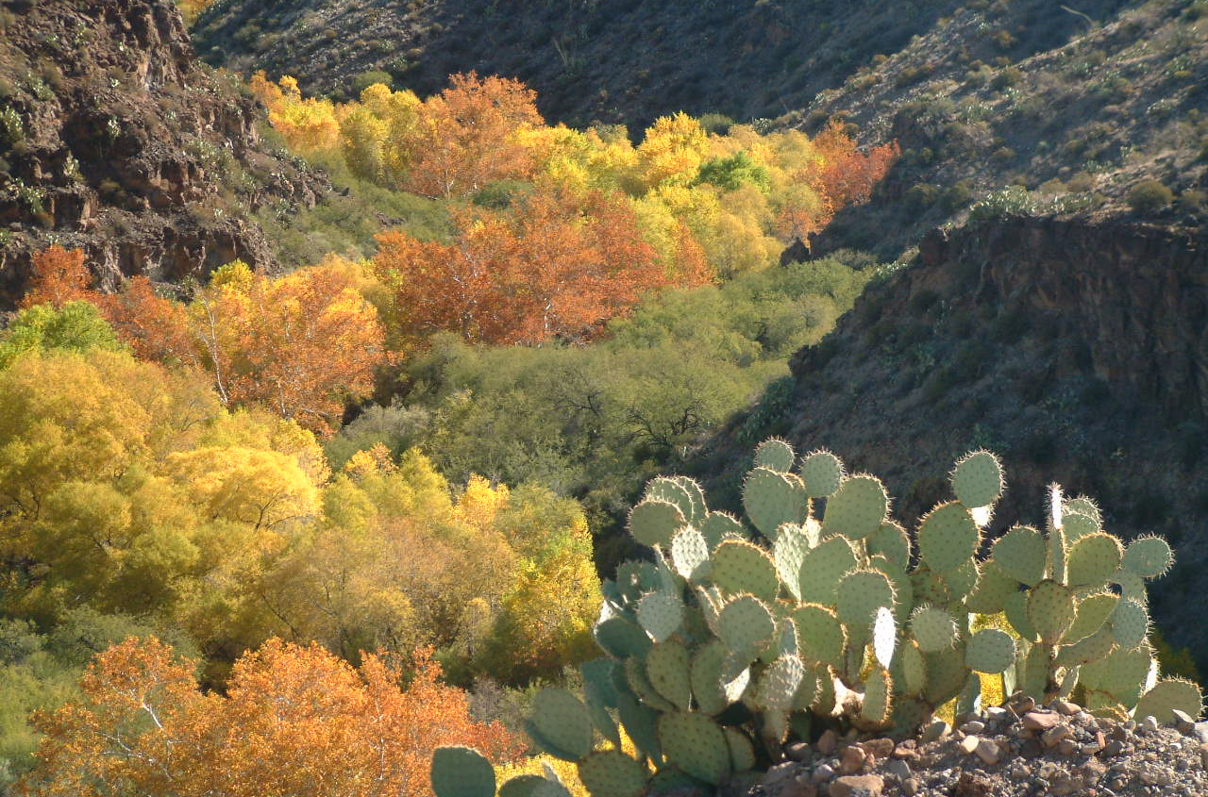
Language of Landscapes
2 - Landscape Character Elements
Color

Slide 44
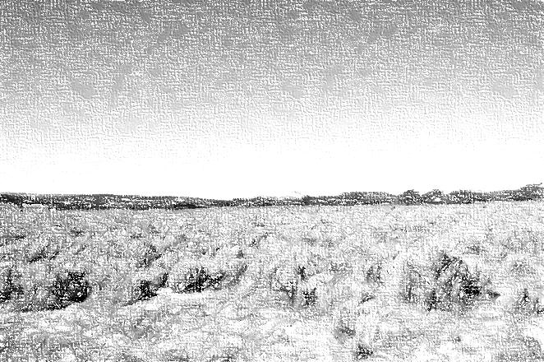
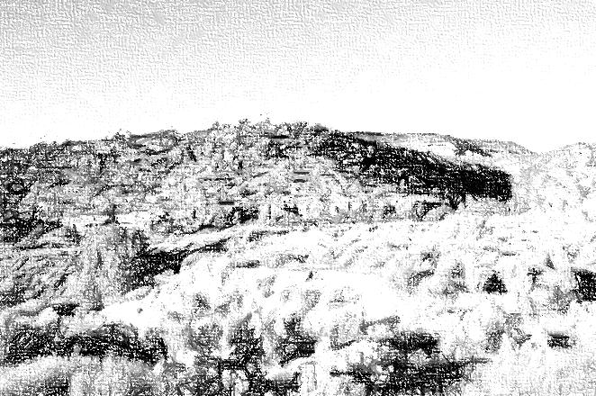
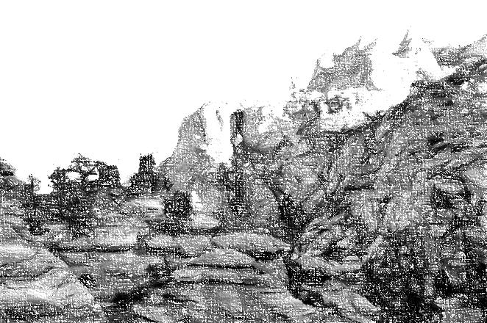
Language of Landscapes
2 - Landscape Character Elements
Texture
When individual forms or colors combine into a continuous pattern.
Texture is not seen as discrete objects in the scene.
Texture dominance diminishes with increasing distance.

Slide 45
Language of Landscapes
2 - Landscape Character Elements
Texture
Sub-elements of Texture
Grain
Relative dimensions of the surface variations.
Fine, Medium, Coarse
Density
Spacing of surface variations.
Sparse, Medium, Dense
Regularity
Degree of recurrence and arrangement of surface variation.
Uneven/Random, Even/ordered, Gradation

Slide 46
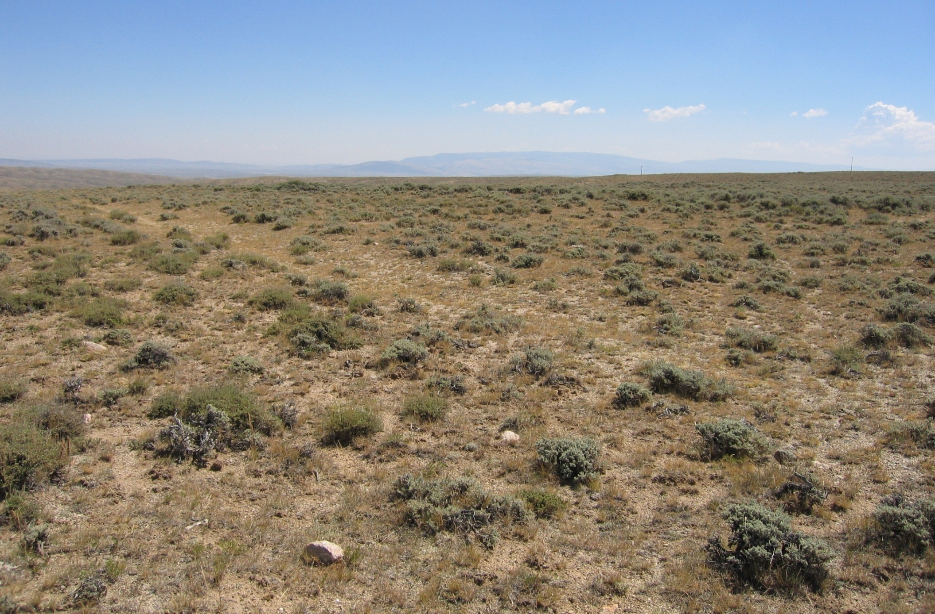
Language of Landscapes
2 - Landscape Character Elements
Texture

Slide 47
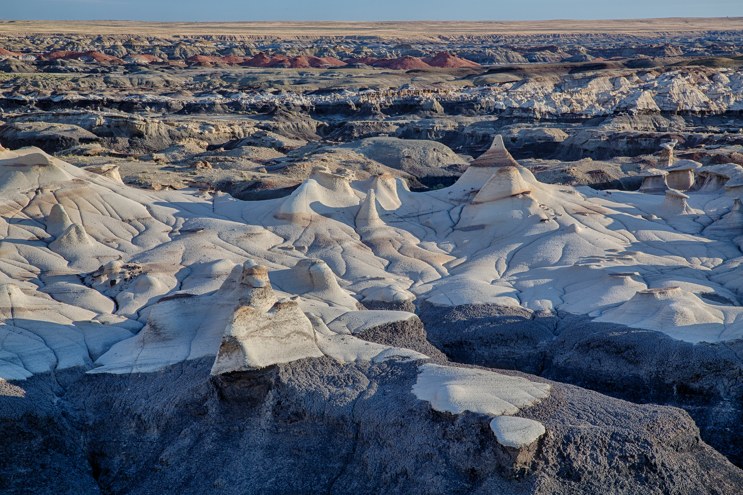
Language of Landscapes
2 - Landscape Character Elements
Texture

Slide 48
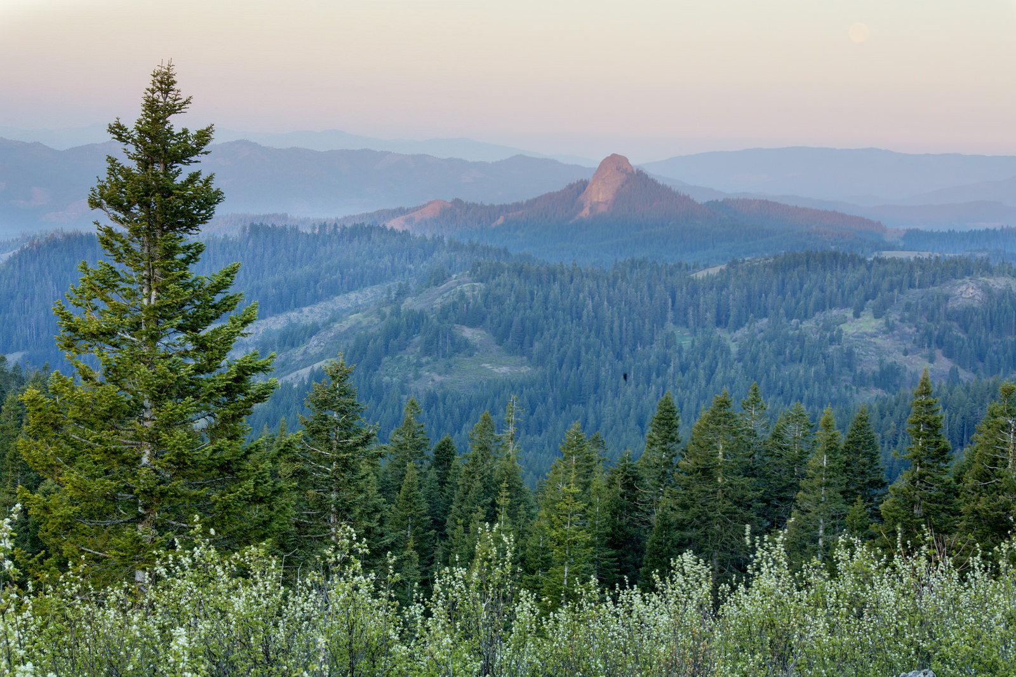
Language of Landscapes
2 - Landscape Character Elements
Texture

Slide 49
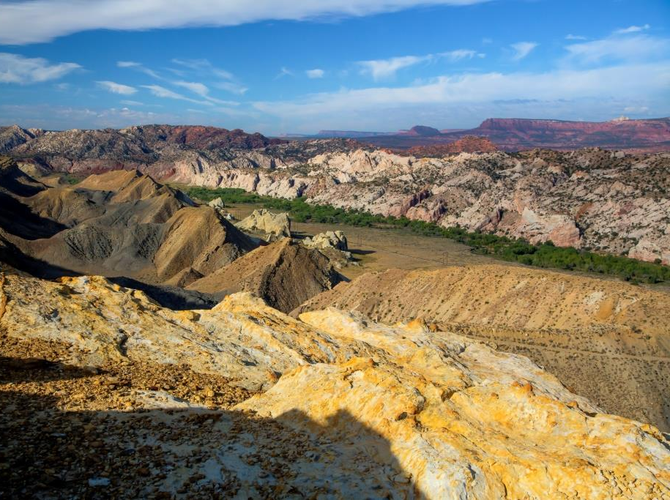
EXERCISE A:
Identify the FORMS, LINES, COLORS, and TEXTURES in this scene.

Slide 50
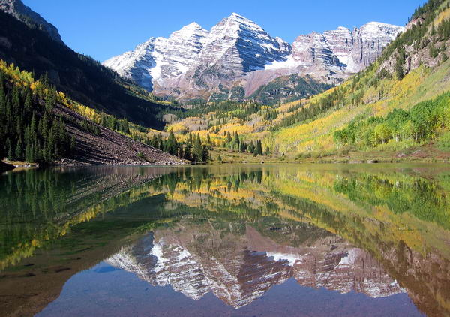
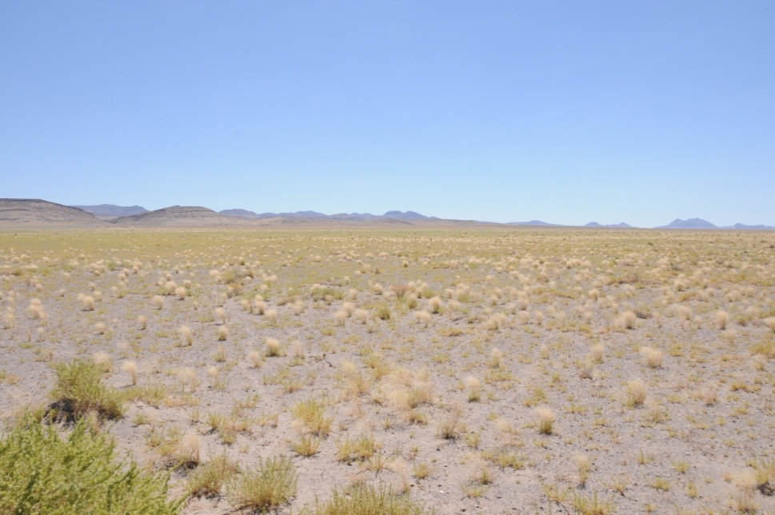
Language of Landscapes
Visual Variety
Landscapes with abundance and variety in form, line, color and texture, as well as combinations of landscape types, are typically the most interesting and visually appealing.

Slide 51
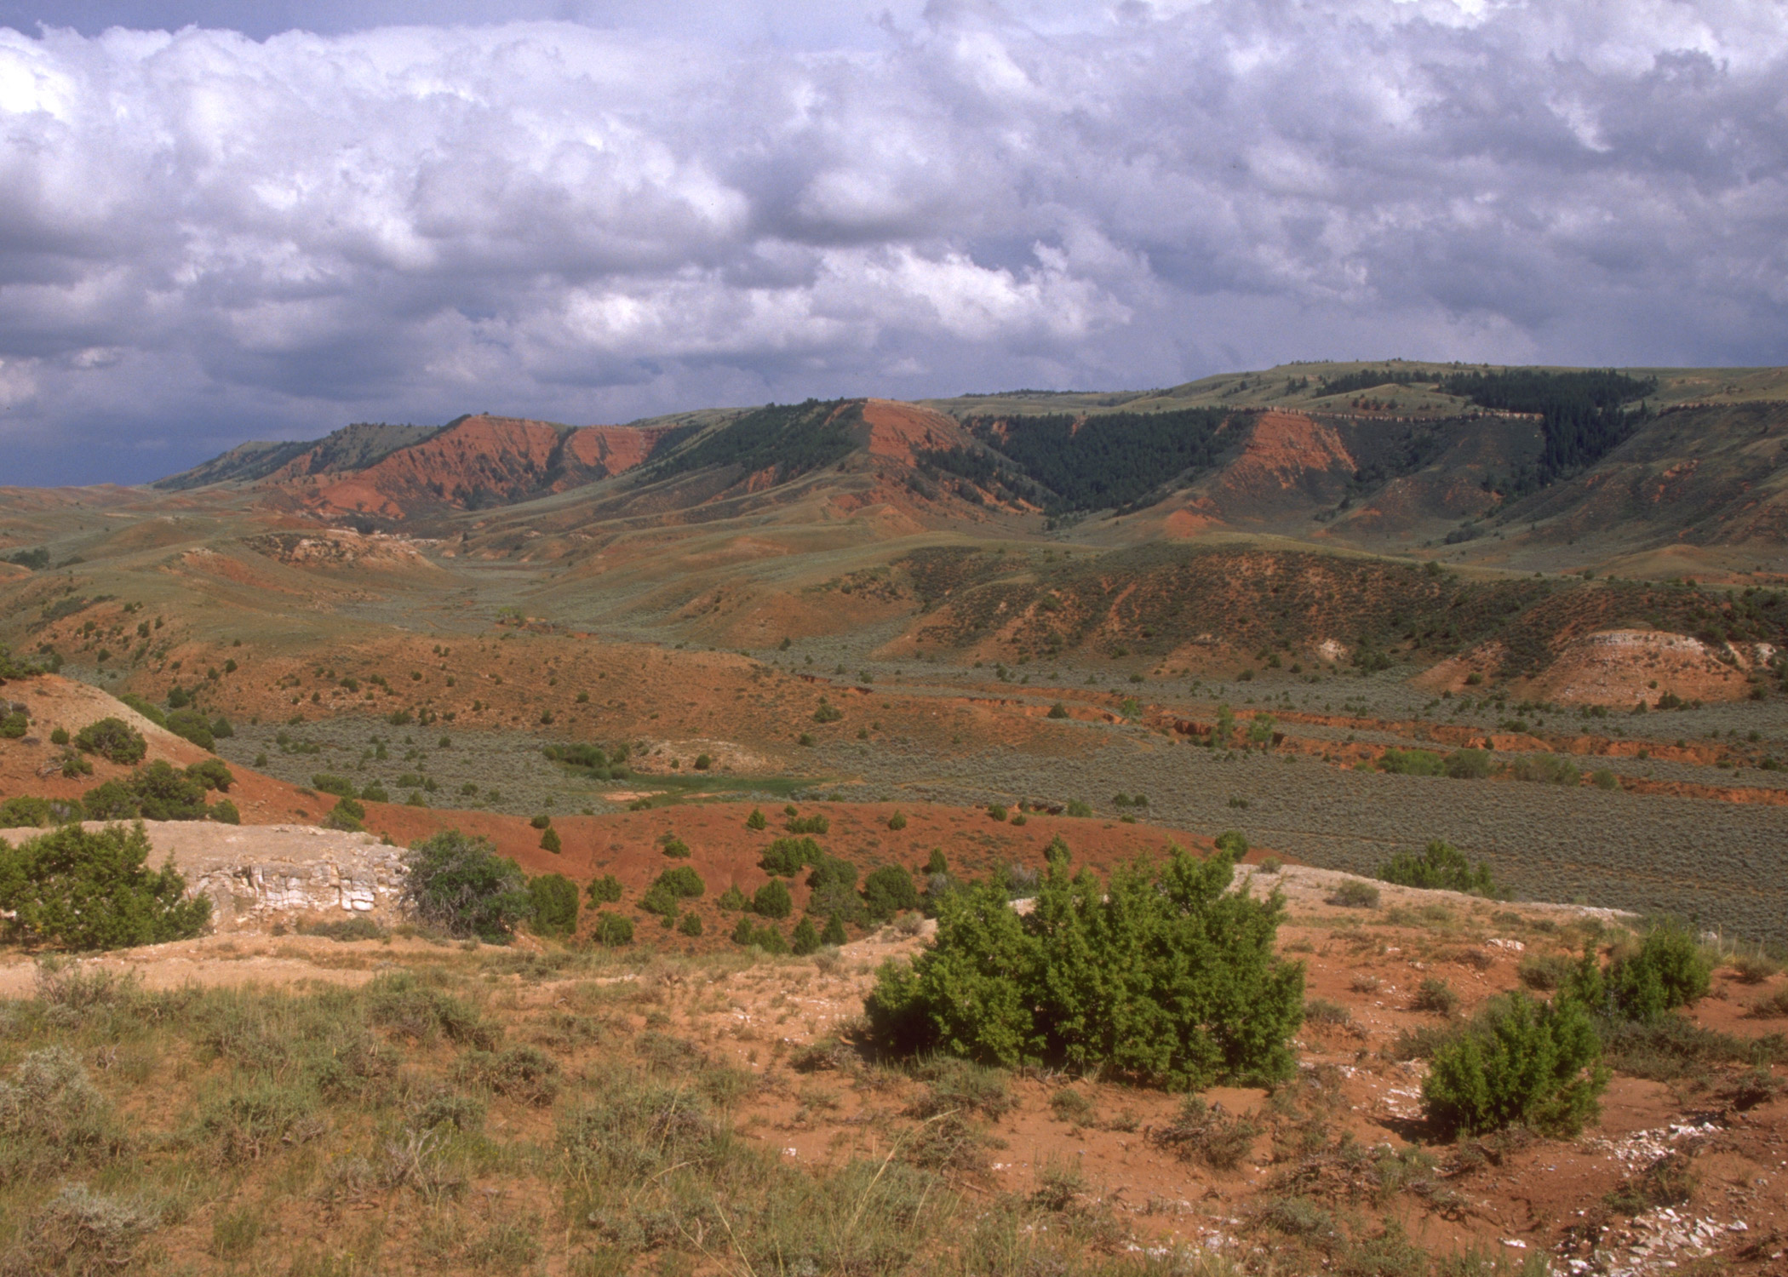
Language of Landscapes
Visual Variety
A

Slide 52
Language of Landscapes
Visual Variety
B
B

Slide 53
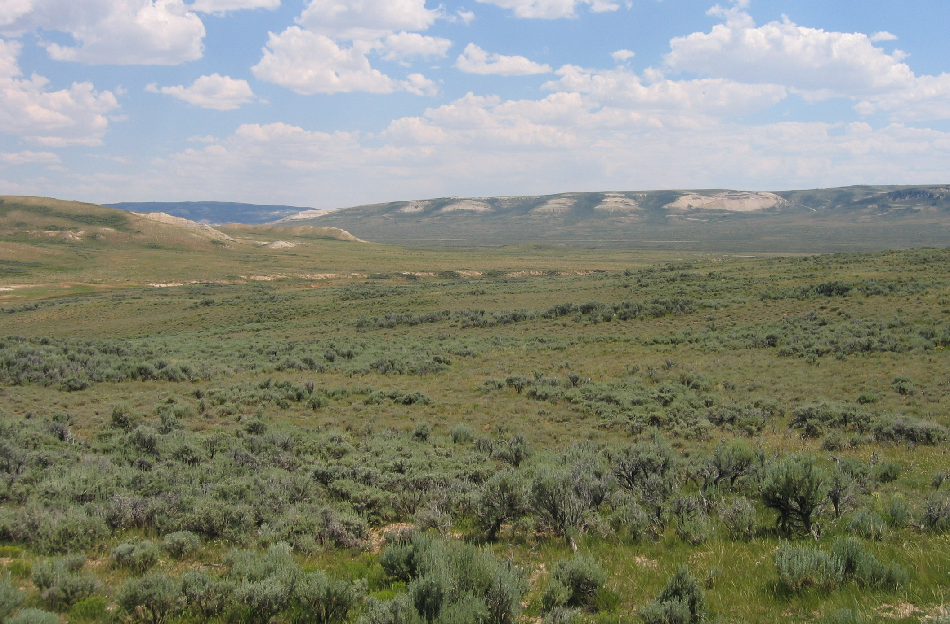
Language of Landscapes
Visual Variety
A
A

Slide 54
Language of Landscapes
Language of Landscapes
Visual Variety
B
A
B

Slide 55
Language of Landscapes
Visual Variety
B
A

Slide 56
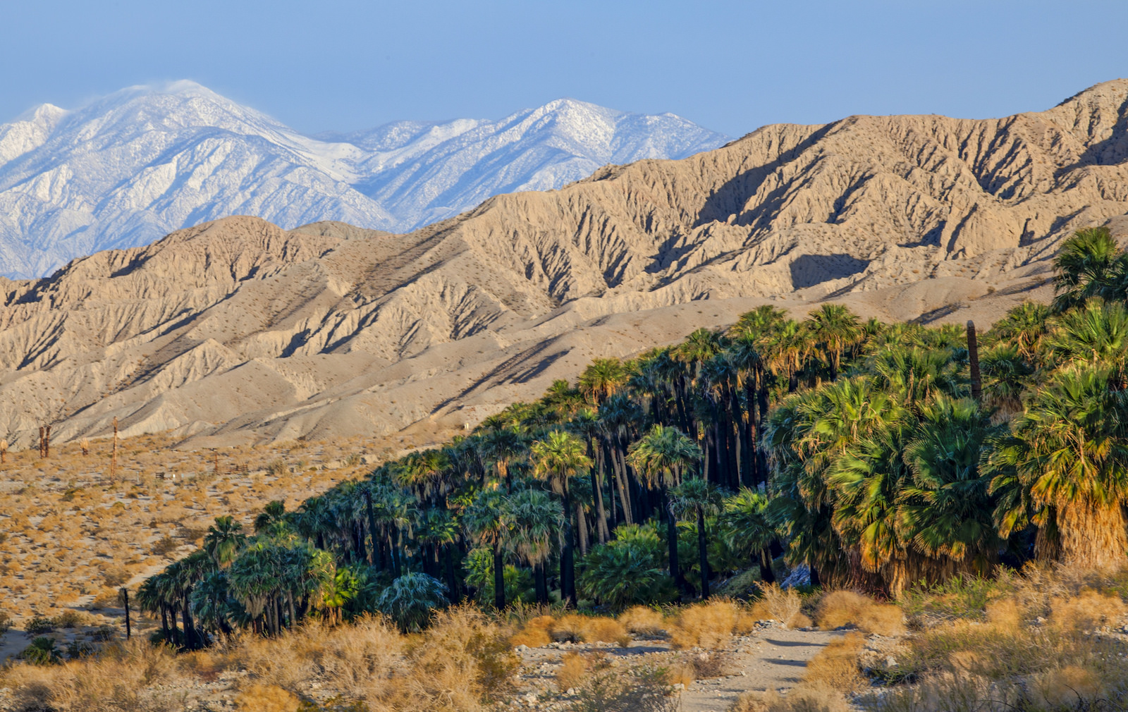
Language of Landscapes
Visual Variety
B
B

Slide 57
Language of Landscapes
3 - Landscape Analysis Factors

Slide 58
Language of Landscapes
3 - Landscape Analysis Factors
Contrast
Axis
Co-dominance
Sequence
Convergence
Enframement
Scale

Slide 59
Language of Landscapes
3 - Landscape Analysis Factors
Contrast
Degree to which sharp differences in adjacent objects or areas exist.
Landscapes or areas of landscapes with great contrast attract the eye more readily than those with little to no contrast.

Slide 60
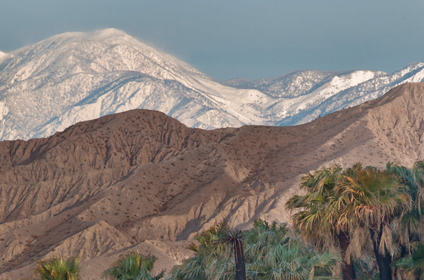
Language of Landscapes
3 - Landscape Analysis Factors
Contrast

Slide 61
Language of Landscapes
3 - Landscape Analysis Factors
Contrast

Slide 62
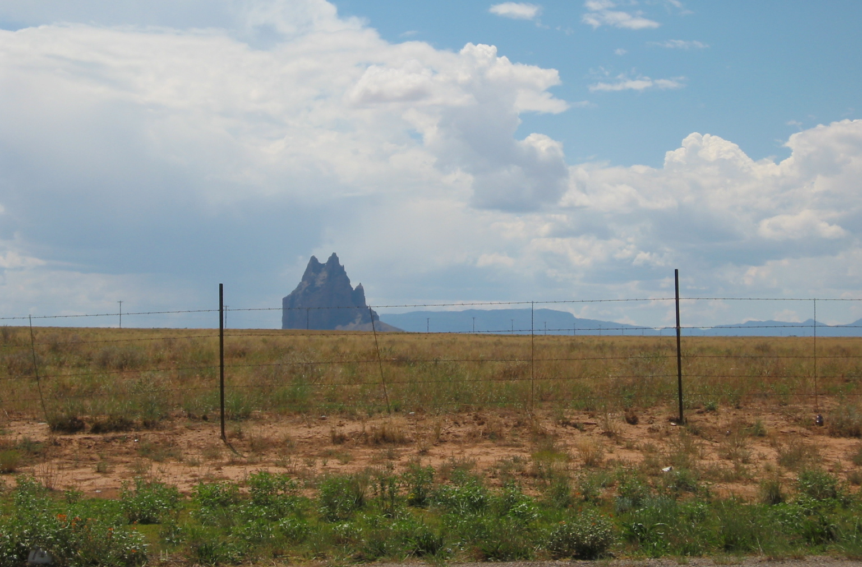
Language of Landscapes
3 - Landscape Analysis Factors
Contrast

Slide 63
Language of Landscapes
3 - Landscape Analysis Factors
Sequence
Succession of landscape elements.
Systematic repetition of form, line, color, or texture.

Slide 64
Language of Landscapes
3 - Landscape Analysis Factors
Sequence

Slide 65
Language of Landscapes
3 - Landscape Analysis Factors
Sequence

Slide 66
Language of Landscapes
3 - Landscape Analysis Factors
Axis
A straight line (real or imaginary) passing through a landscape.
Focuses viewer attention primarily on the terminus and its background.
A design tool of great forcefulness.

Slide 67
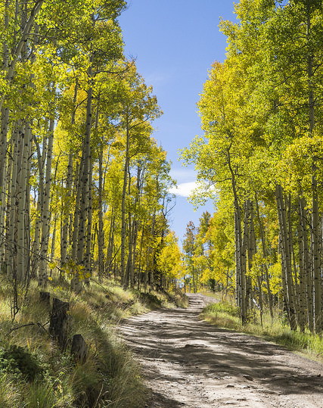
Language of Landscapes
3 - Landscape Analysis Factors
Axis

Slide 68
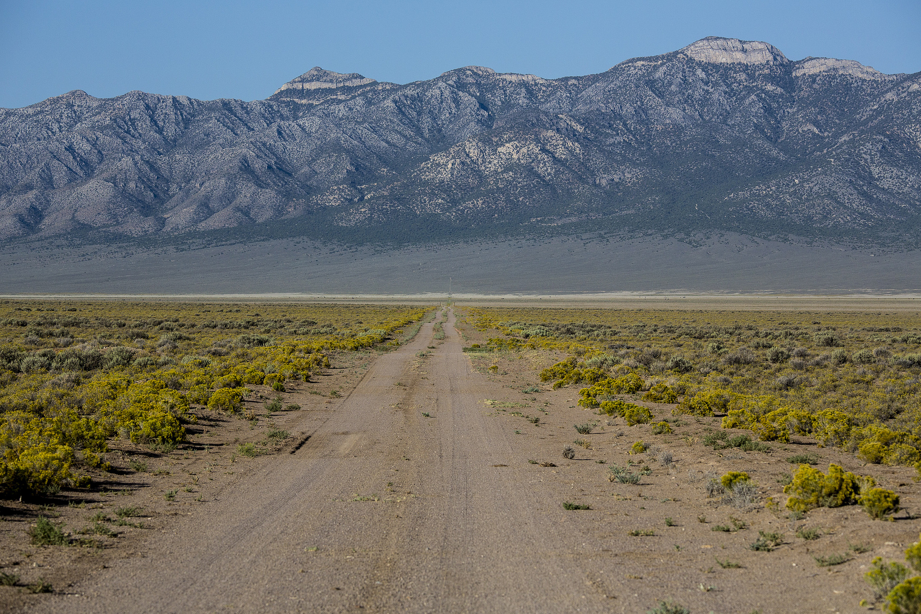
Language of Landscapes
3 - Landscape Analysis Factors
Axis

Slide 69
Language of Landscapes
3 - Landscape Analysis Factors
Convergence
Tends to focus attention on one point or small area.
Point of convergence is highly visible.
Point of convergence generally becomes focal point within the landscape.

Slide 70
Language of Landscapes
3 - Landscape Analysis Factors
Convergence

Slide 71
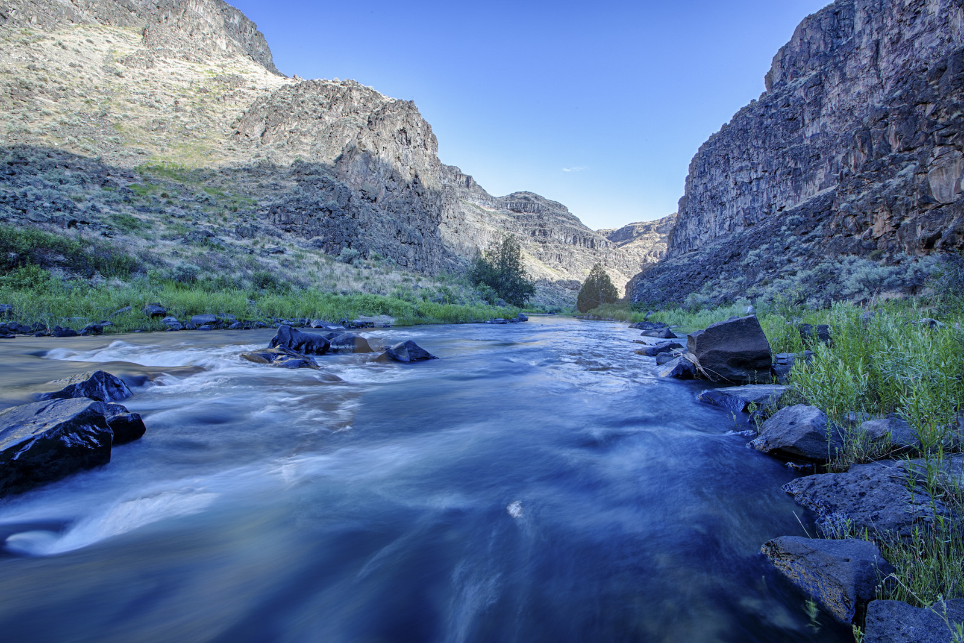
Language of Landscapes
3 - Landscape Analysis Factors
Convergence

Slide 72
Language of Landscapes
3 - Landscape Analysis Factors
Co-dominance
Two or more landscape form features are nearly identical.
Created co-dominant features often produce a symmetrical composition that does not blend with the characteristic landscape.
Natural landscapes with co-dominant features added are seldom as visually pleasing as those with a single dominant element.

Slide 73
Language of Landscapes
3 - Landscape Analysis Factors
Co-dominance

Slide 74
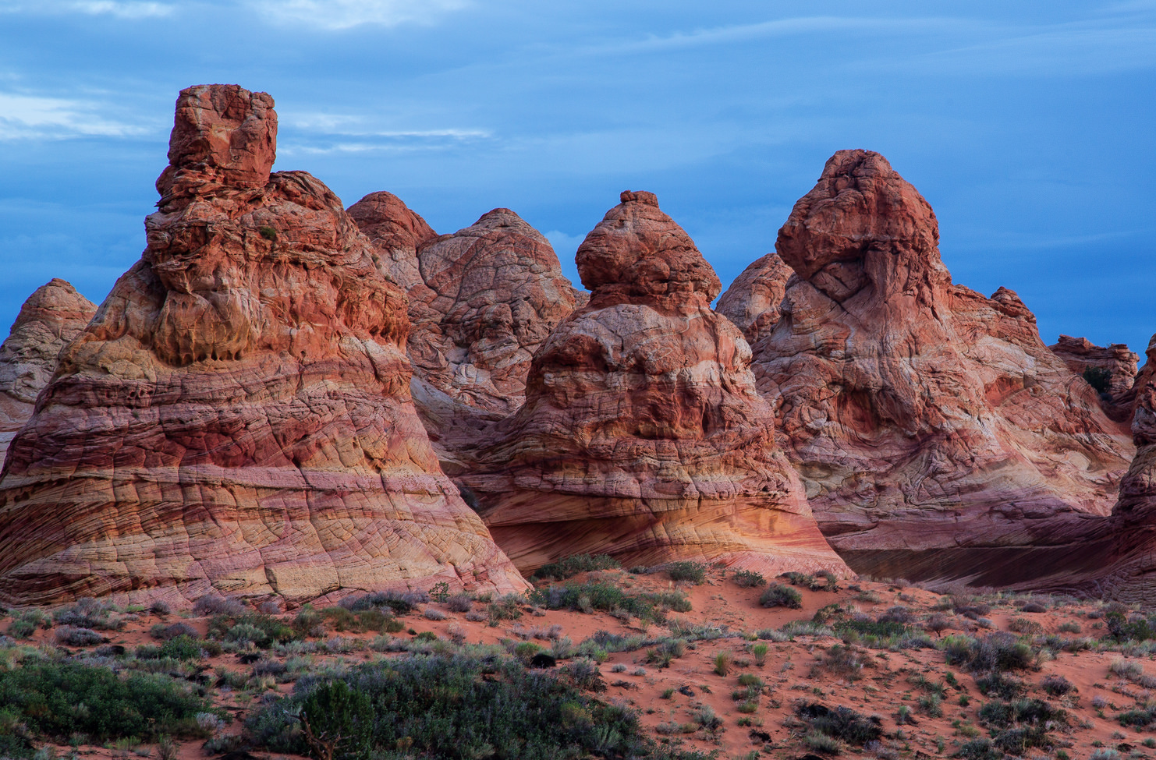
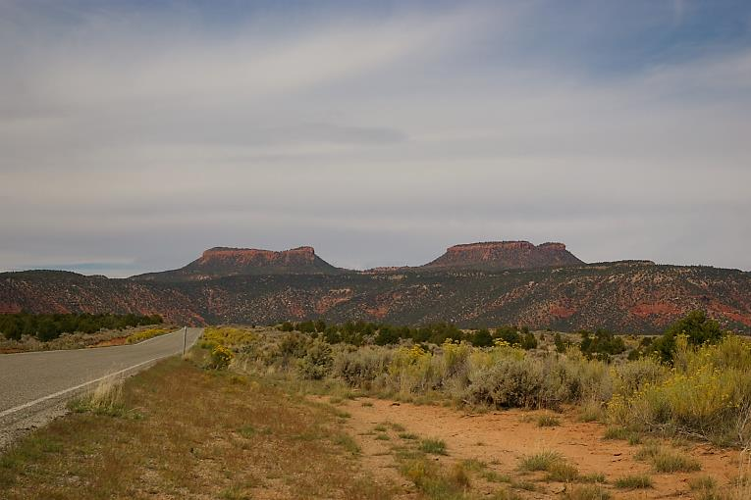
Language of Landscapes
3 - Landscape Analysis Factors
Co-dominance

Slide 75
Language of Landscapes
3 - Landscape Analysis Factors
Enframement
Created when features in the landscape direct the viewer’s attention inward like the frame of a picture.
Walls of trees or rock cliffs on either side, reflecting waters at the base, and tree canopies overhead serve as forces of enframement.

Slide 76
Language of Landscapes
3 - Landscape Analysis Factors
Enframement

Slide 77
Language of Landscapes
3 - Landscape Analysis Factors
Enframement

Slide 78
Language of Landscapes
3 - Landscape Analysis Factors
Scale
The proportionate size relationship between an object and its surroundings.
Relative to the landscape setting, scale determines the object’s dominance in the landscape.
The size of the space inversely affects an object’s relative scale -- small spaces make objects appear larger.

Slide 79
Language of Landscapes
3 - Landscape Analysis Factors
Scale

Slide 80
Language of Landscapes
3 - Landscape Analysis Factors
Scale

Slide 81
EXERCISE B - Match the Analysis Factor to the image that best represents it.
Axis
Co-dominance
Contrast
Convergence
Enframement
Scale
Sequence
A
B
C
D
E
F
G

Slide 82
Language of Landscapes
Change is inevitable,
ugliness is not.
scenicamerica.org
[ Image Caption ]

