Slide 1
Vernal Field Office
August 2019

Slide 2
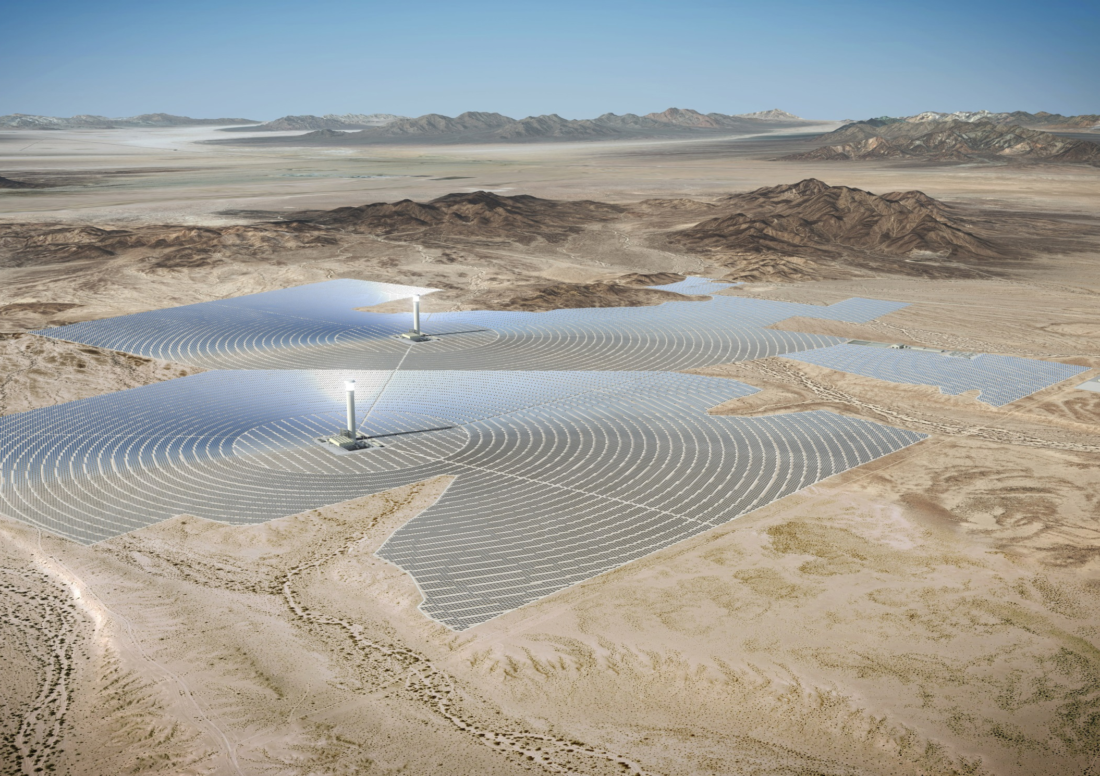
Visual Simulations
Rio Mesa Solar Generating Facility (Riverside County, CA)

Slide 3
Unit Objectives
To define the value of visual simulation as it relates to BLM projects, and to provide a baseline for what criteria should be met with visual simulations produced for use by the BLM.
?

Slide 4
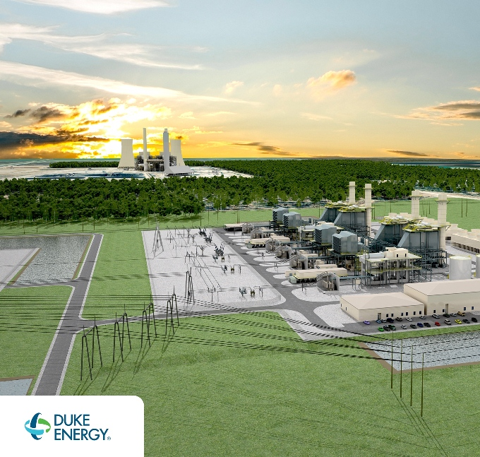
Value of visual simulation
Visual simulation uses such as:
Geospatial – land use planning
Project planning and decision making
Affects analysis and evaluation
Visual simulation technology:
Computer generated techniques
2D image editing
3D modeling & rendering

Slide 5
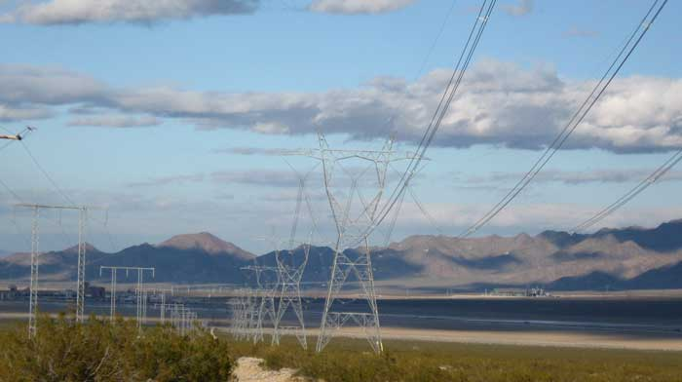
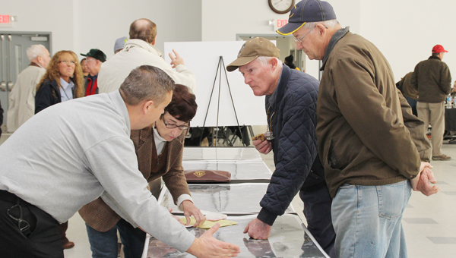
Value of Visual Simulation
How can visual simulations be utilized?
Environmental consequences
Visual Resource Management (contrast ratings)
Alternative Studies
Negotiations with project proponent
Engage the public
Internal communication
Landscape level planning
Land Use Plan and Activity

Slide 6
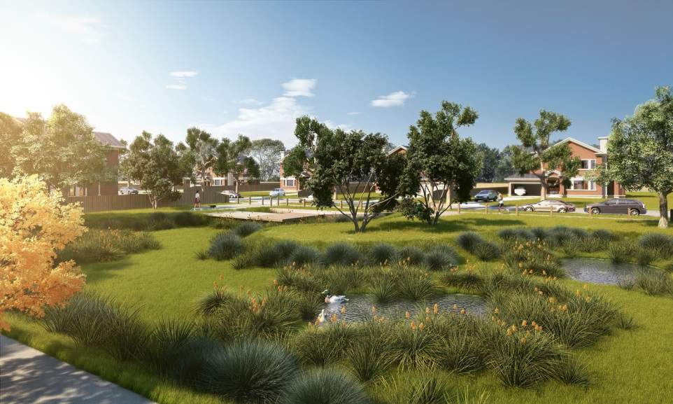
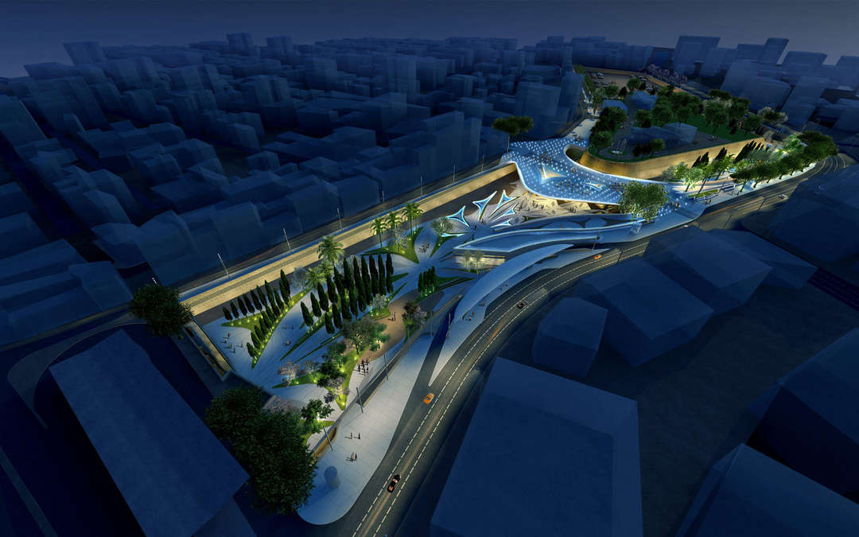
Why is Visual Simulation a Useful Tool?
Why is there a need for 3-D / perspective visual simulation?
Many people have difficulty interpreting 2D plans and drawings (aerial plan drawings and front or side elevations).
visual simulations help provide a tool to inform designers, decision makers, and the general public.
www.cgarchitect.com
www.architizer.com

Slide 7
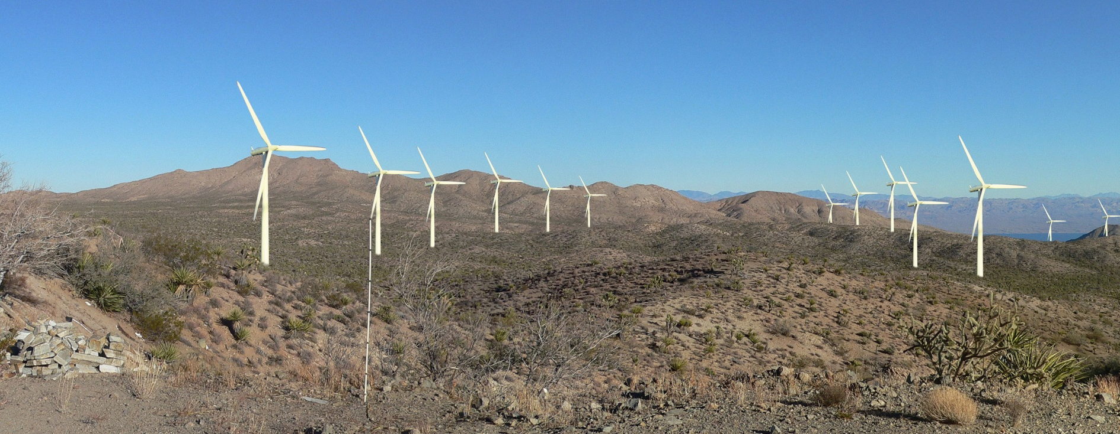
What is Visual Simulation?
For the BLM VRM Program…
The use of illustrations, photographs, and computer generated images designed to communicate the visible changes to the environment as a result of management activities or decisions.

Slide 8
Visual Simulation / Rendering Software
Raster-based (pixel) 2D
Photo editing and manipulation software (Photoshop, etc.).
Operates with raster technology.
Raster is the same type of technology that digital cameras utilize (megapixels).
CAD Based (vector) 2D + 3D
Computer-aided drafting applications utilize vector technology which are point and line based (AutoCAD, Rhino3D, etc.).
CAD applications operate on a coordinate system, utilizing the x, y, and z coordinates.

Slide 9
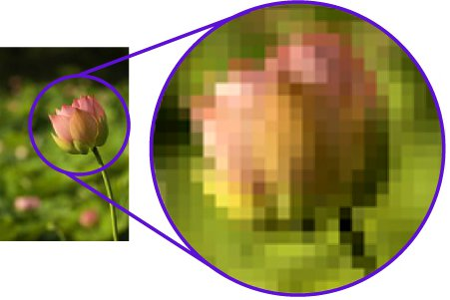
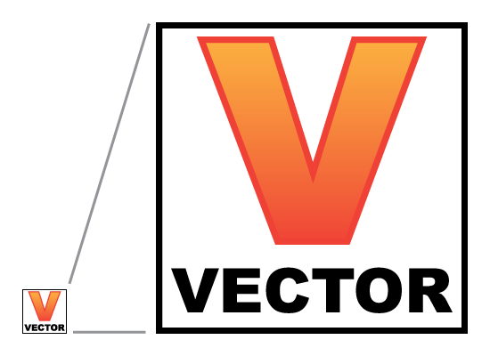
2D Visual Simulation Rendering
Basics of 2D visual simulation
Raster technology vs.
Vector technology

Slide 10
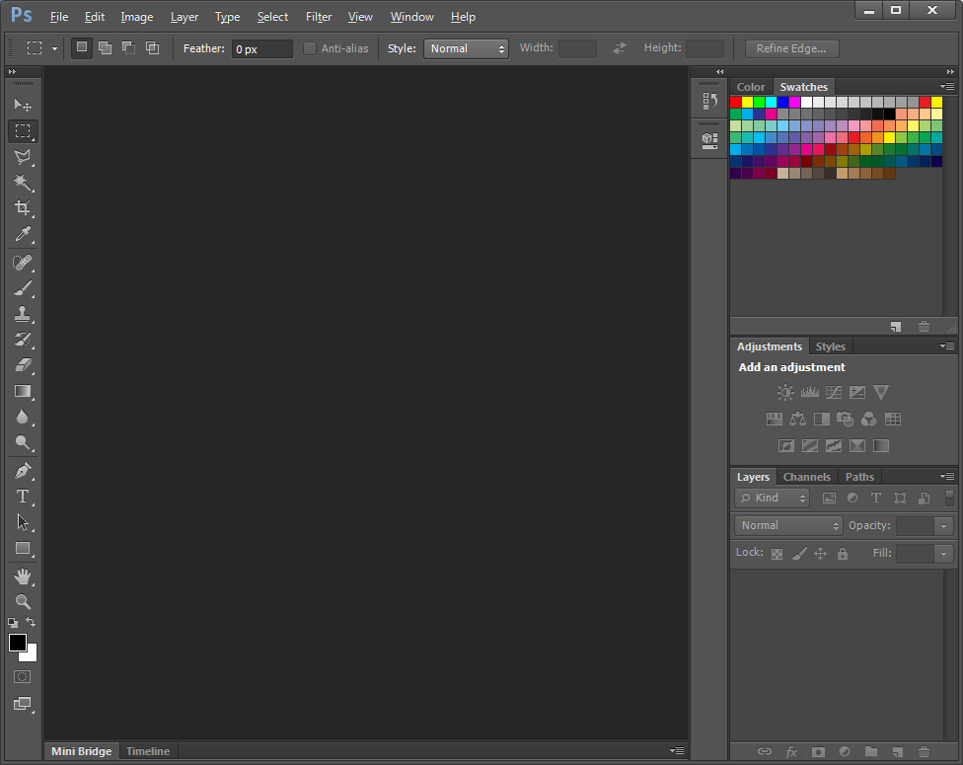
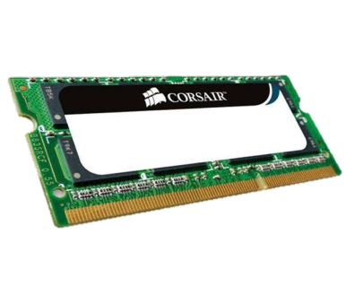
System Requirements
Image Editing
Process
Input: (photographs, digital scans, etc.)
Edit: (software)
Export (print, save digitally)
System Requirements
Hardware: (CPU, memory, storage space, etc.)
Considerations
Source imagery
Ultimate Application

Slide 11
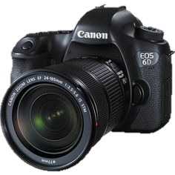
Photography Basics
DSLR (digital single-lens reflex) camera optimal for visual simulations.
Point & shoot cameras can be used, but it is difficult to capture the scene as the human eye does.
Don’t skimp on the number of images taken. Easy to capture, easy to delete.
vs

Slide 12
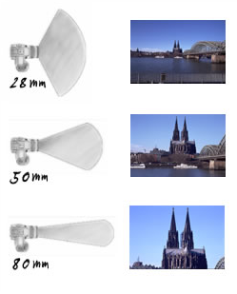
Photography Basics
Proper zoom, orientation, frequency, lighting, resolution, color balance, etc. are critical for an accurate visual simulation to be created.

Slide 13
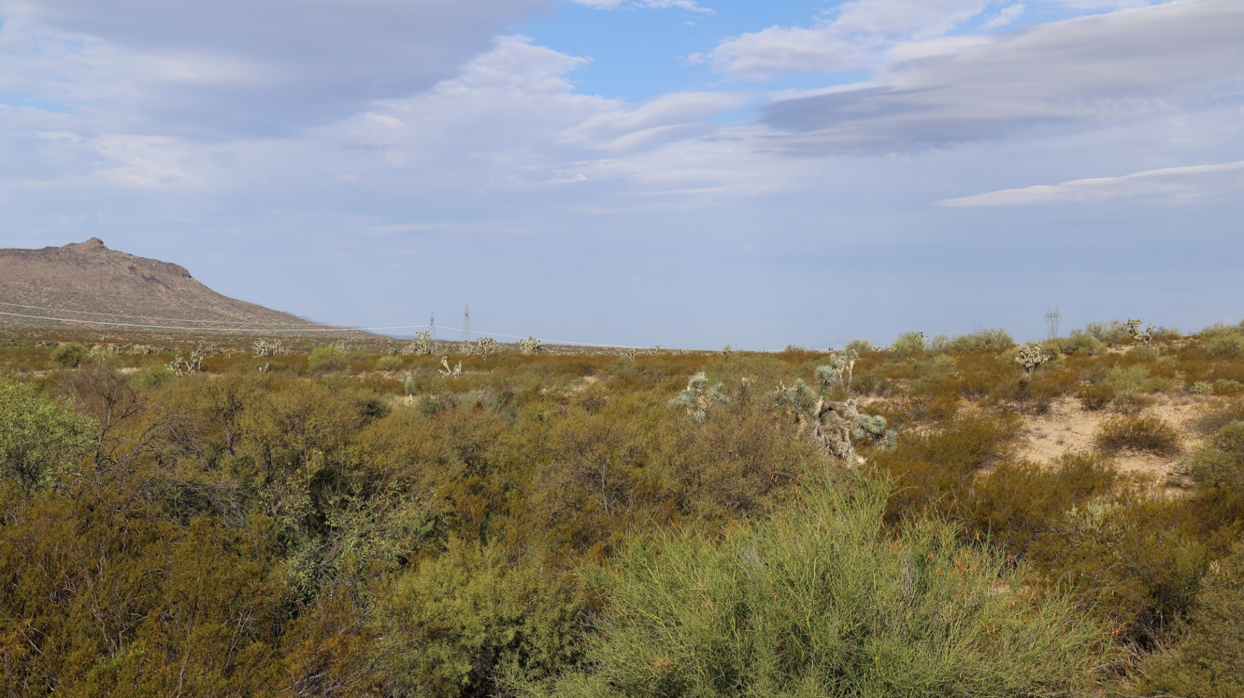
Photography Basics

Slide 14
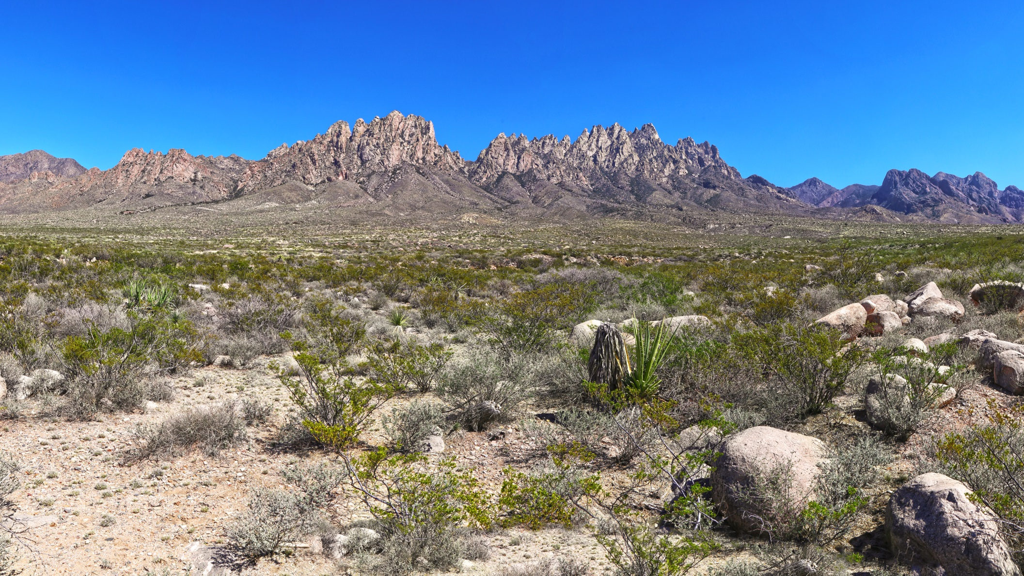
Photography Basics

Slide 15
Photography Basics

Slide 16
Photography Basics

Slide 17
Photography Basics

Slide 18
Photography Basics

Slide 19
Photography Basics

Slide 20
Photography Basics

Slide 21
Photography Basics

Slide 22
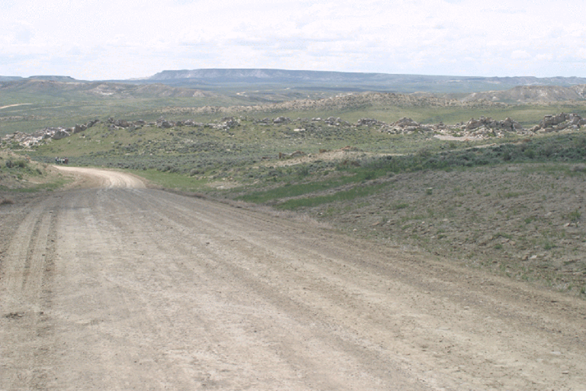
Developing 2D Visual Simulation
Existing site for proposed development
Notes:
Avenue of the Rocks – Oregon/Pony/Mormon Trail outside of Casper. The road is the trail.

Slide 23
Developing 2D Visual Simulation
Example of proposed development
Notes:
Avenue of the Rocks – Oregon/Pony/Mormon Trail outside of Casper. The road is the trail.
Existing oil & gas well (is in operation… just a little dated)

Slide 24
Developing 2D Visual Simulation
Cropping the example into the existing site
Notes:
Avenue of the Rocks – Oregon/Pony/Mormon Trail outside of Casper. The road is the trail.
Existing oil & gas well (is in operation… just a little dated)

Slide 25
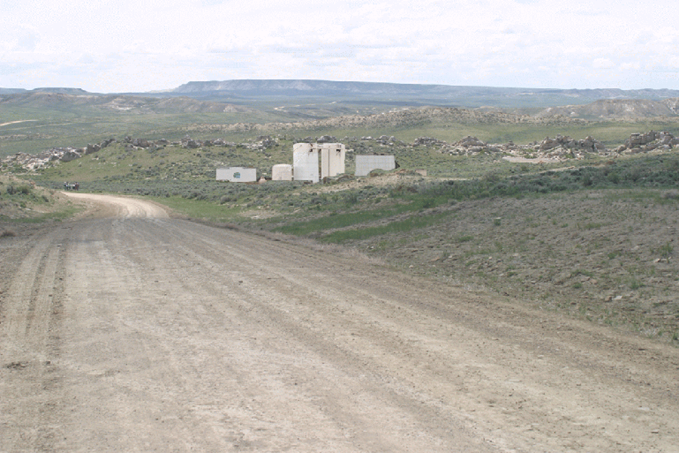
Developing 2D Visual Simulation
Final conceptual rendering (visual simulation)
Notes:
Avenue of the Rocks – Oregon/Pony/Mormon Trail outside of Casper. The road is the trail.
Existing oil & gas well (is in operation… just a little dated)

Slide 26
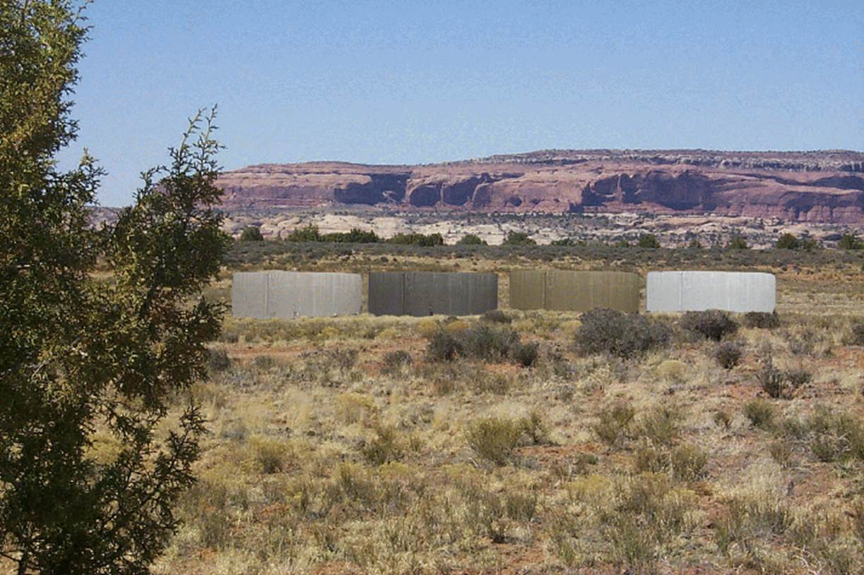
Developing 2D Visual Simulation
Notes:
Moab – Hwy 313 on the way to Dead Horse Point (Big Flat).
These examples are more intended for internal BLM use.

Slide 27
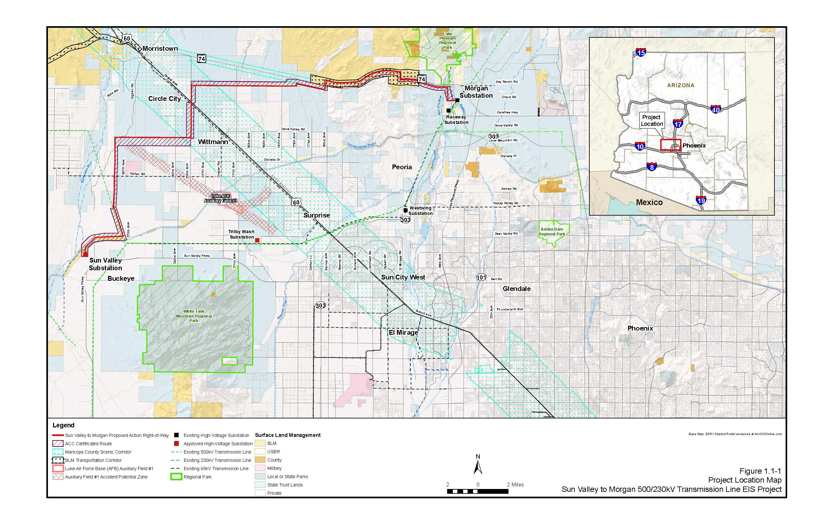
2D Visual Simulation Example

Slide 28
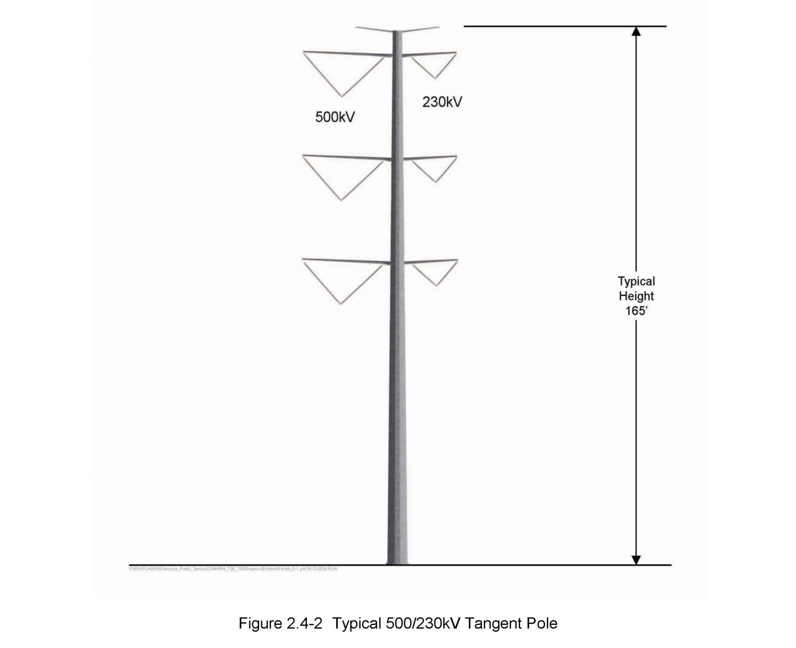
2D Visual Simulation Example

Slide 29
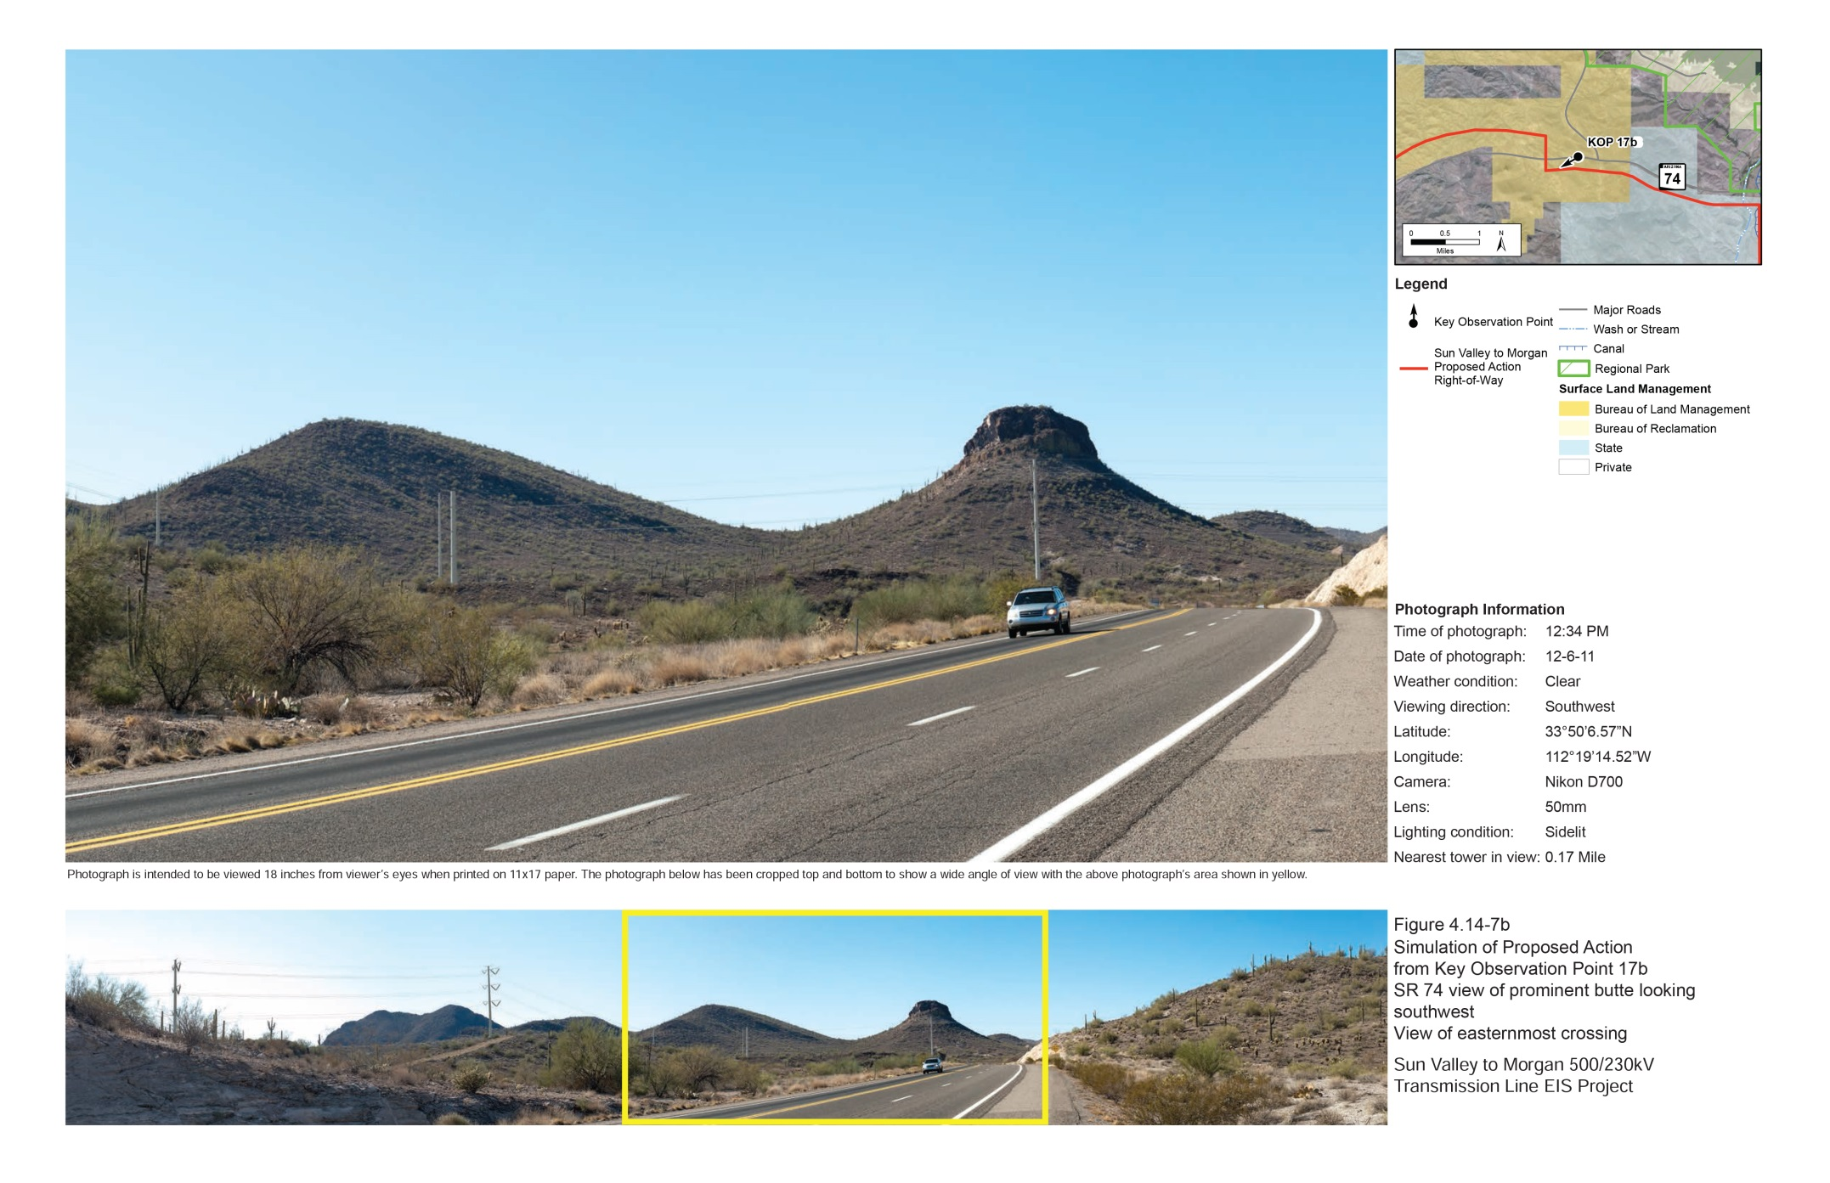
2D Visual Simulation Example

Slide 30
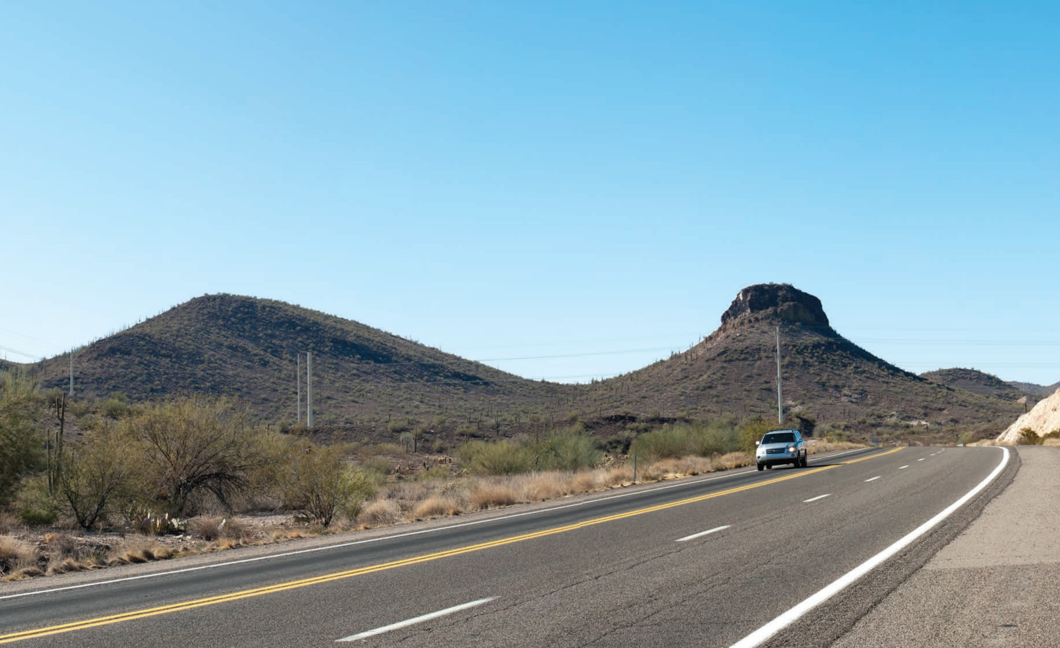
2D Visual Simulation Example
Standard galvanized simulation

Slide 31
2D Visual Simulation Example
Color treated (shale green) simulation

Slide 32
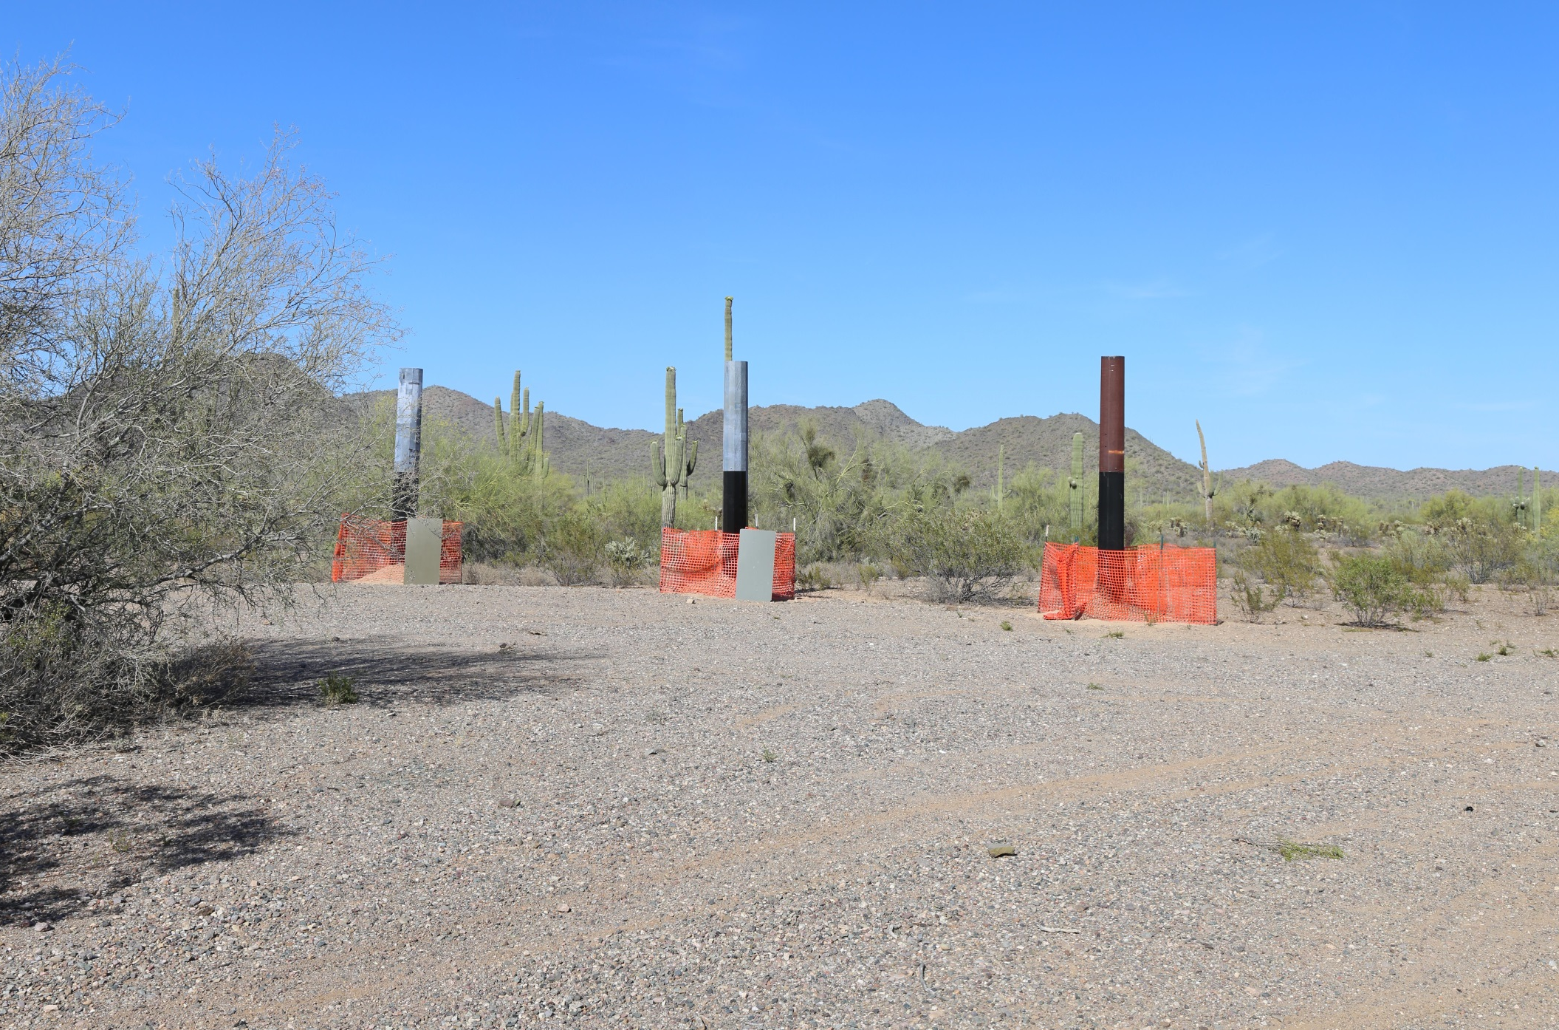
2D Visual Simulation Example

Slide 33
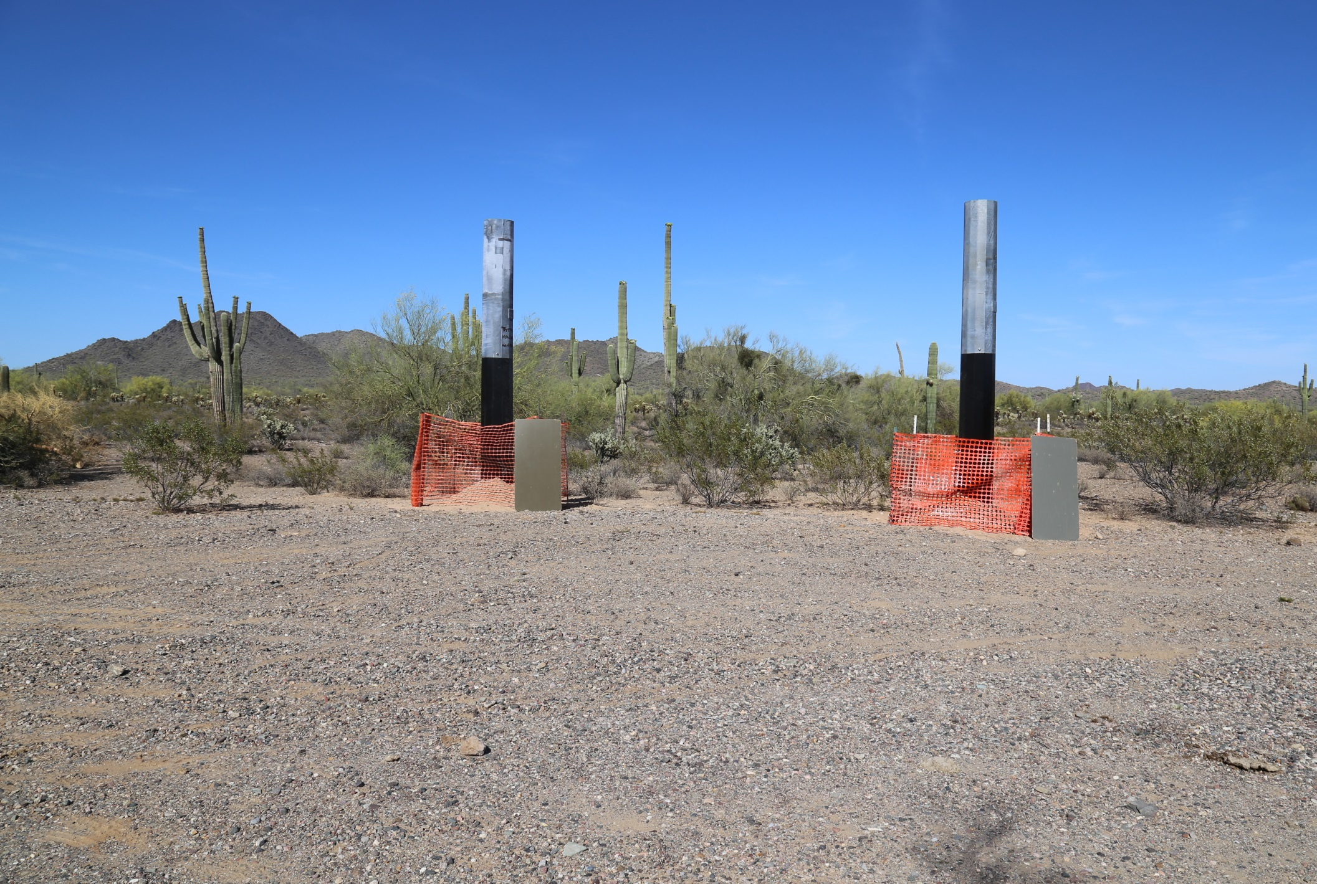
2D Visual Simulation Example

Slide 34
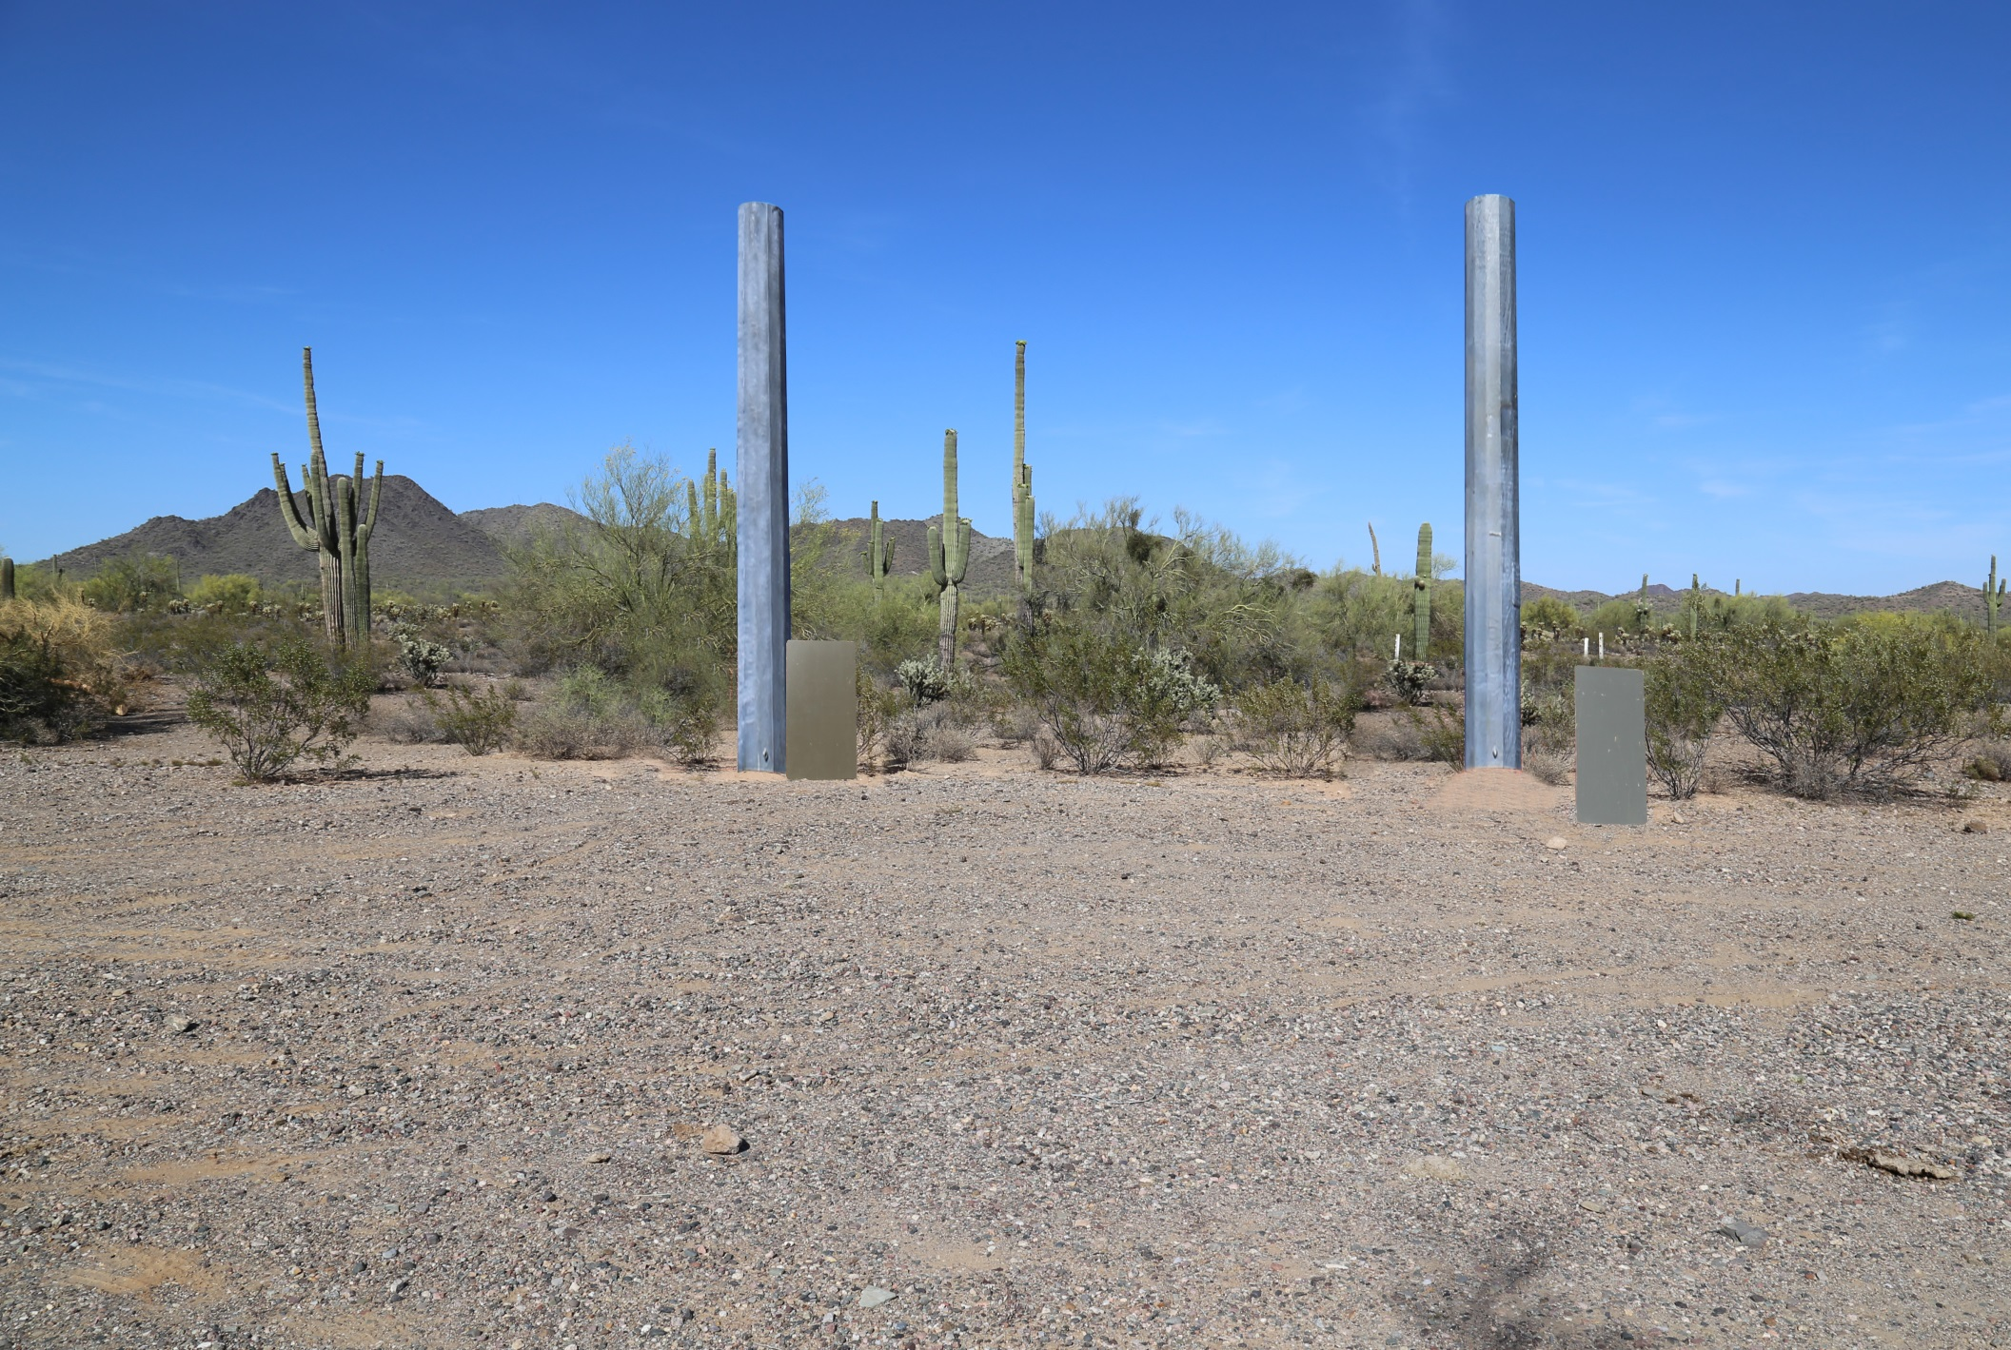
2D Visual Simulation Example

Slide 35
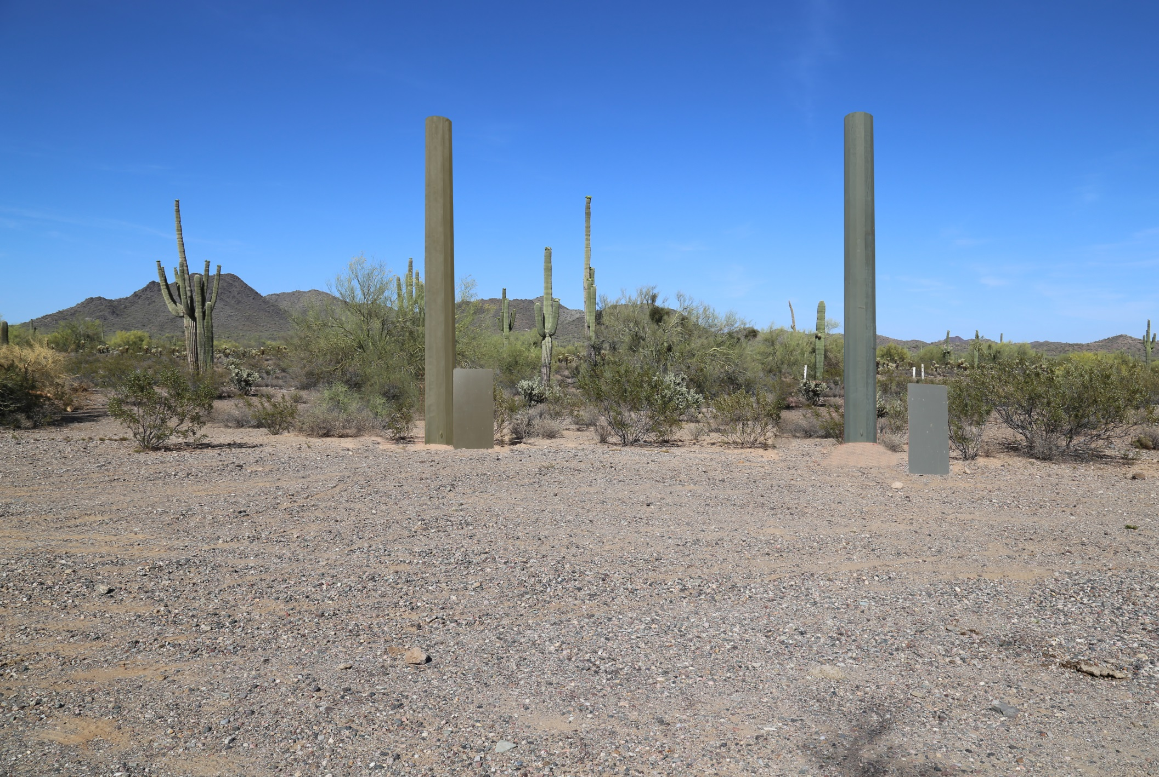
2D Visual Simulation Example

Slide 36
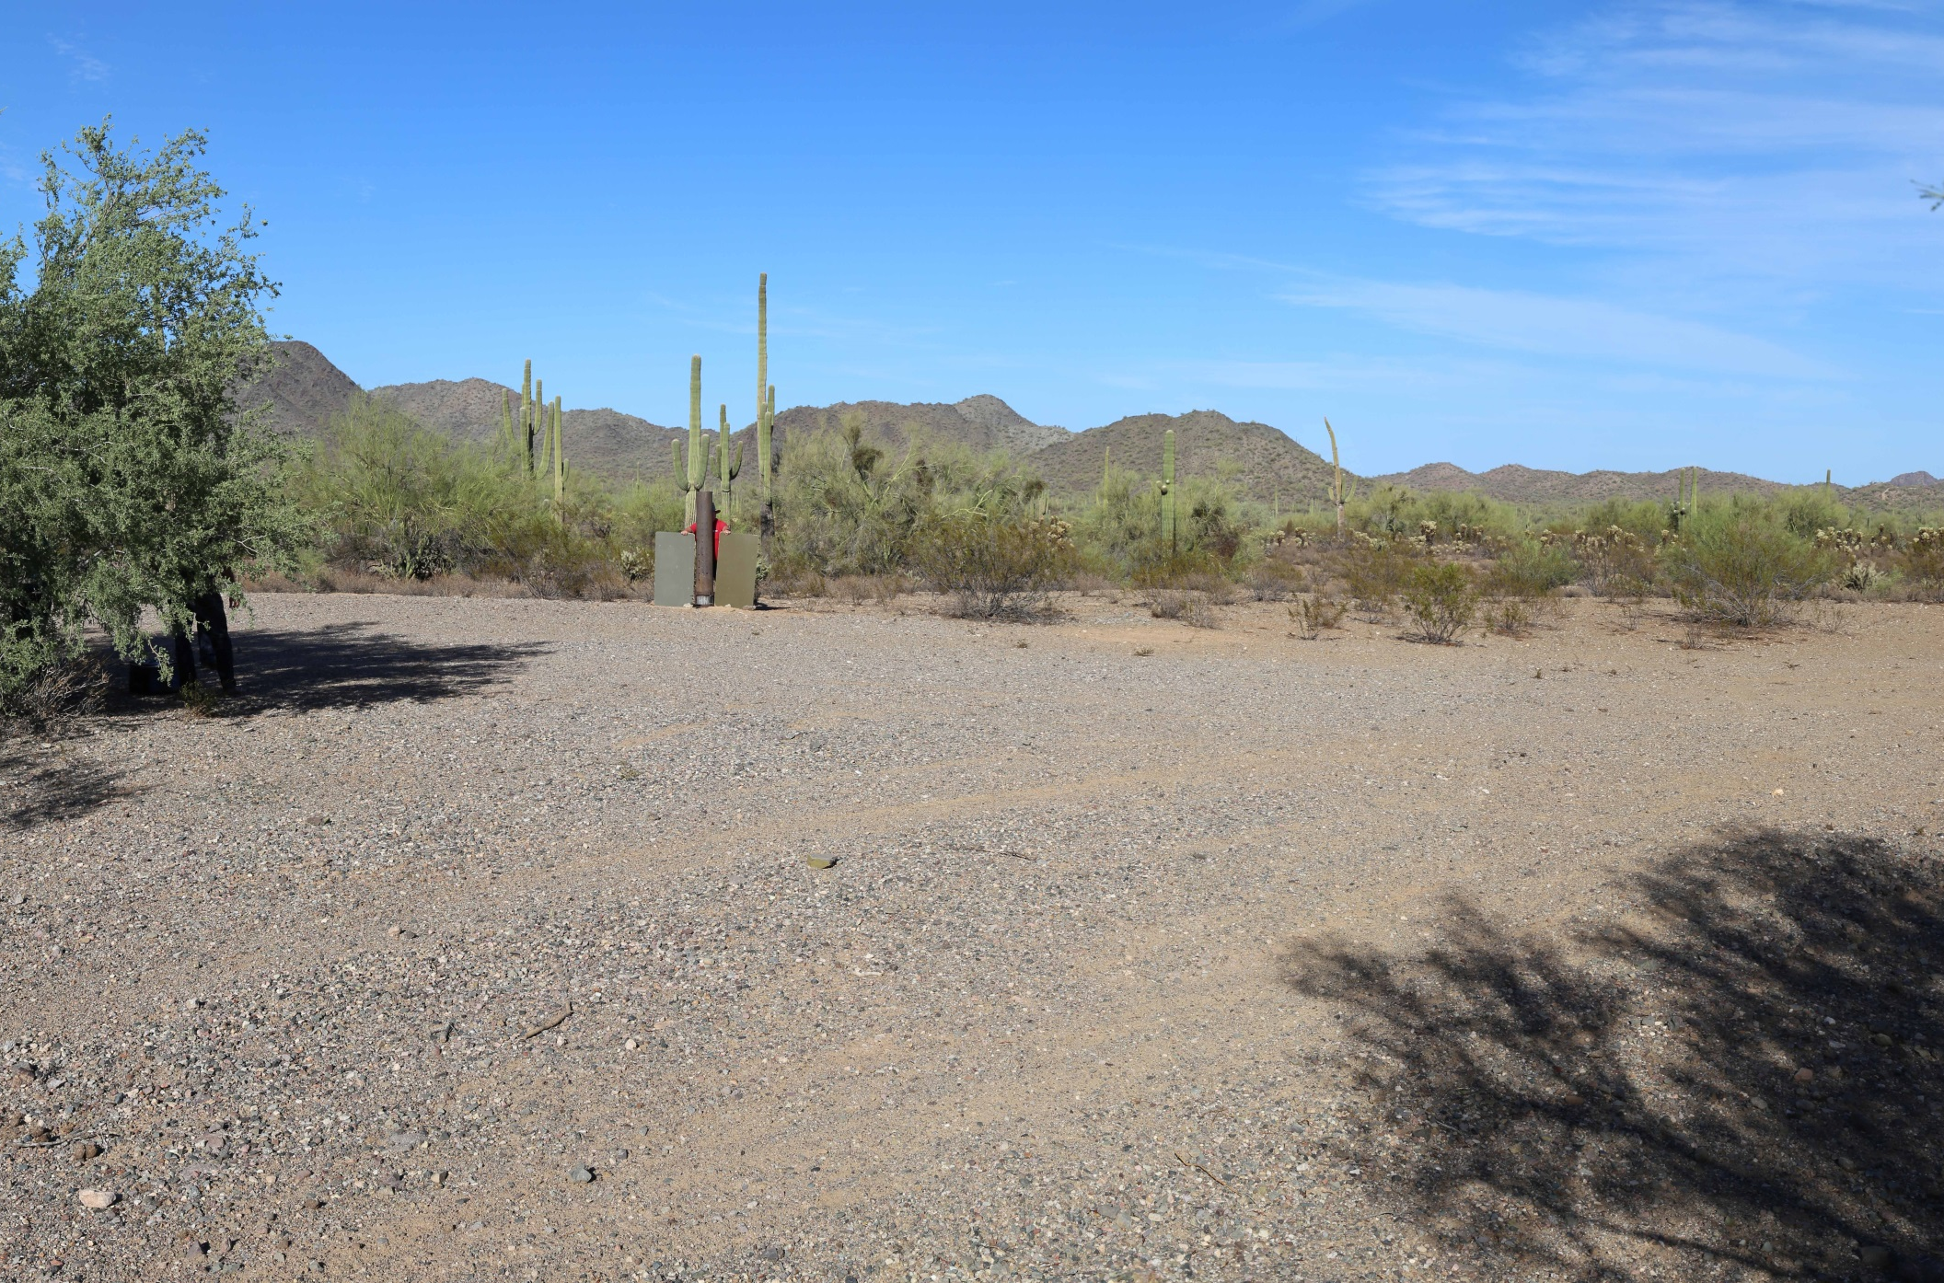
2D Visual Simulation Example

Slide 37
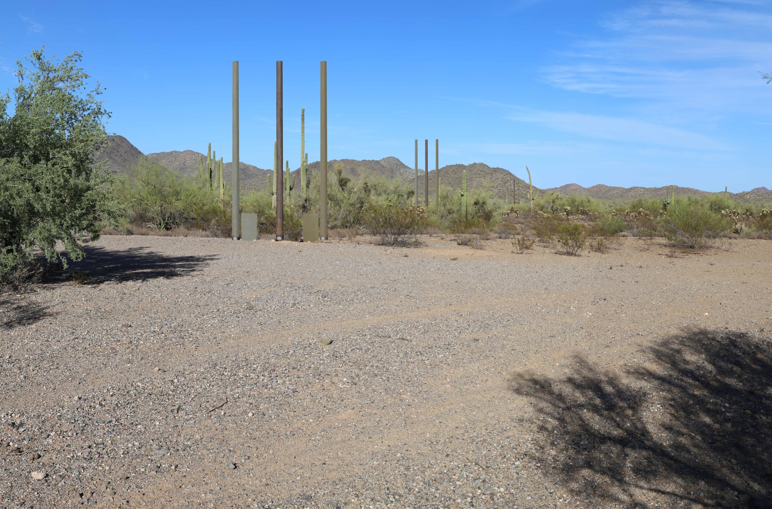
2D Visual Simulation Example

Slide 38
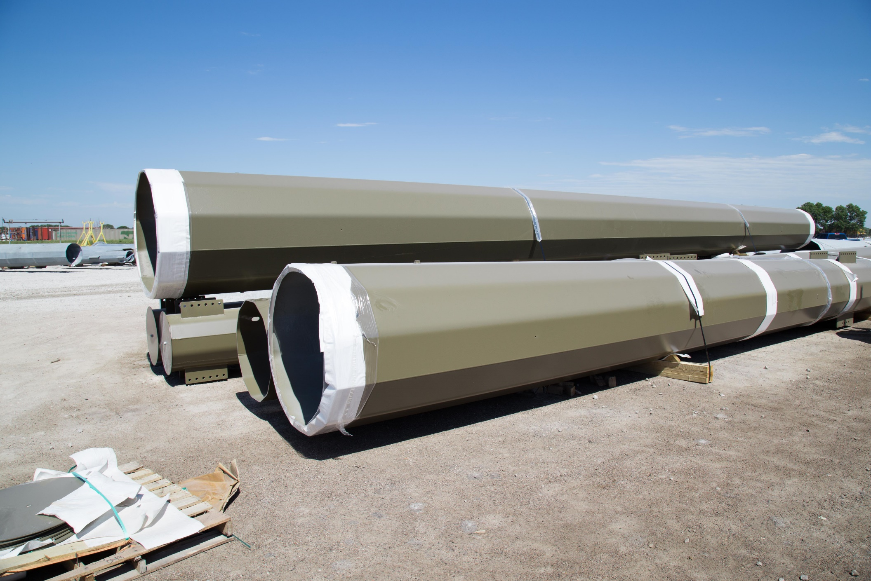
2D Visual Simulation Example

Slide 39
Oil & Gas Simulation Example

Slide 40
Oil & Gas Simulation Example

Slide 41
Oil & Gas Simulation Example

Slide 42
Oil & Gas Simulation Example

Slide 43
Oil & Gas Simulation Example

Slide 44
Oil & Gas Simulation Example

Slide 45
Oil & Gas Simulation Example

Slide 46
Oil & Gas Simulation Example

Slide 47
Oil & Gas Simulation Example

Slide 48
2D Visual Simulation Example
Existing Condition
Forest Density Reduction Conceptual Rendering

Slide 49
2D Visual Simulation Example

Slide 50
2D Visual Simulation Example

Slide 51
2D Visual Simulation Example
Notes:
Software package – Visual Nature Studio. This is a simulation, not an image.

Slide 52
2D Visual Simulation Summary
Benefits:
Quick method to visualizing a desired condition
Can be easily manipulated to generate different options
Can be completed with a basic set of tools (digital camera, internet image, software)
Challenges:
Depending on skill level, these can be labor intensive
2D (raster-based) rendering. This limits the ability to maneuver to different zoom levels, angles, etc.
Scale can be very difficult to render accurately

Slide 53
3D Visual Simulation Rendering
3D rendering as used in most BLM visual simulations to date has proven to become the most efficient and reliable method for producing accurate, realistic, and defensible visual simulations
Common Tools
SketchUp
Google Earth
World Construction Set (WCS) / Visual Nature Studio (VNS)
System Requirements
Considerations
Skill level vs. time
Library of elements

Slide 54
Value of 3D Visual Simulation
Maneuverability
Once modeling elements are created, it is a relatively simple process to view a project from different angles and perspectives (such as different KOPs)
Accuracy
Because modeling elements are drafted in vector based programs, they are highly accurate, often to within inches
Technology
As technology continues to evolve, 3D visual simulation will continue to become more realistic; integrating motion, sound, and live interactivity

Slide 55
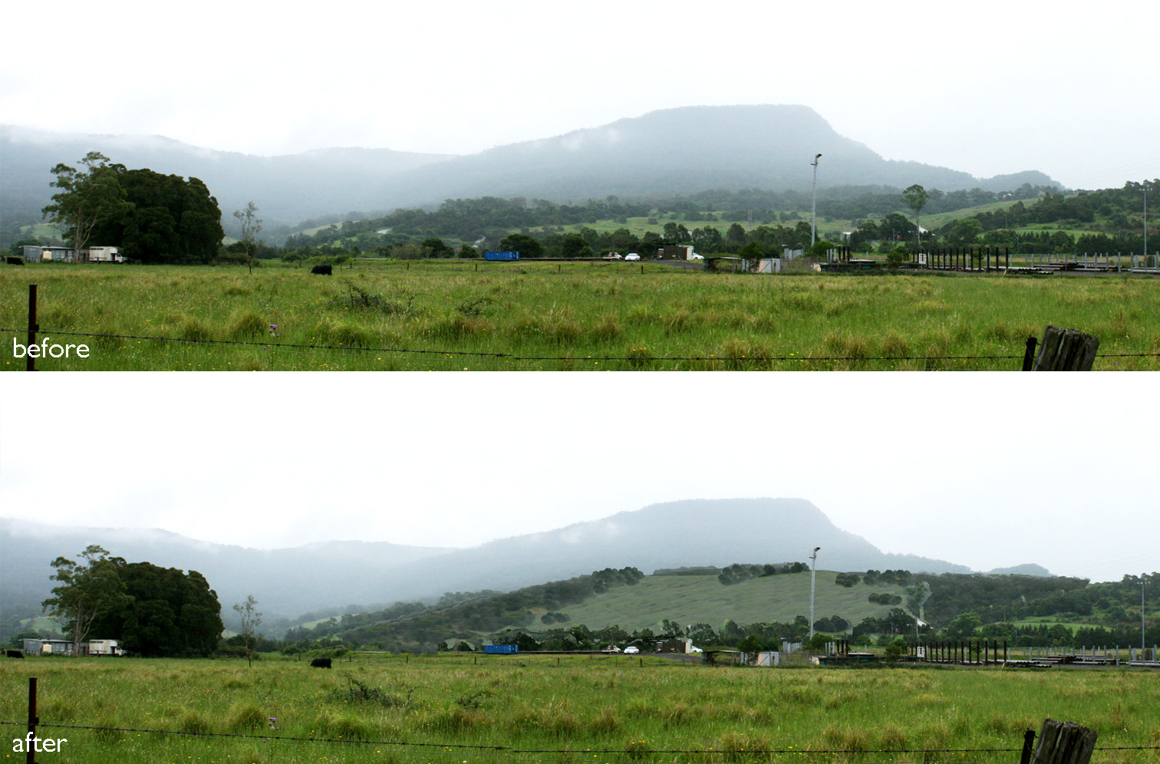
3D Visual Simulation Rendering
Proposed landfill reclamation rendering
Notes:
Visual simulations were prepared using 3D data of the proposed landform to illustrate the potential visibility of the landfill expansion in relation to a number of nearby residential properties. Mitigation measures to address any potential visual impacts that may occur. These included screen planting along the boundary of the landfill site, as well as rehabilitation to be carried out progressively as each stage of the landfill is completed.
www.corkeryconsulting.com

Slide 56
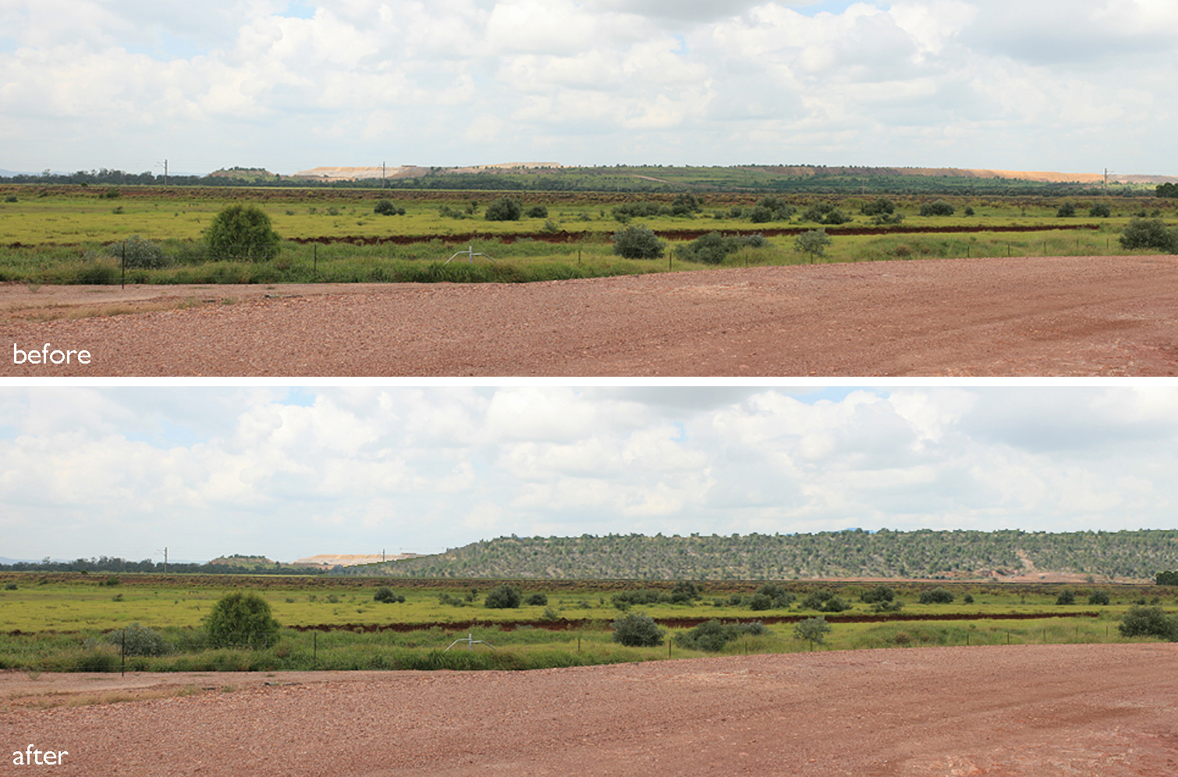
3D Visual Simulation Rendering
Coal mine reclamation rendering
Notes:
The Visual Assessment addressed all of the above ground components of the proposed mining operations including vegetation clearing, construction of haul roads, spoil dump landforms together with associated remediation works. The potential visual impacts during the period of mining operations as well as the long term post-mining situation were assessed
The Visual Assessment involved mapping of the visual catchment of the proposed above ground works to identify areas from which they may be visible. Key viewing situations were then identified within the visual catchment including public roads and homesteads. The potential visual impact on viewers at each of the key view situations was assessed by use of a matrix that combines the Magnitude of Visibility with the level of Sensitivity of the category of viewer.
www.corkeryconsulting.com

Slide 57
Reviewing Visual Simulations
While many of you have or will develop visual simulations throughout your career, some of you may not. But that doesn’t mean you won’t be able to keenly assess the accuracy and validity of visual simulations
General criteria to look for in visual simulations:
Image clarity
Accurate scale (project elements appear to be inserted in a realistic scale)
No unusual elements (floating towers, etc.)
Would you generally understand what is being represented as a member of the general public?

Slide 58
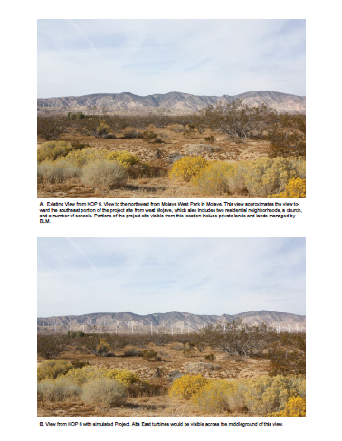
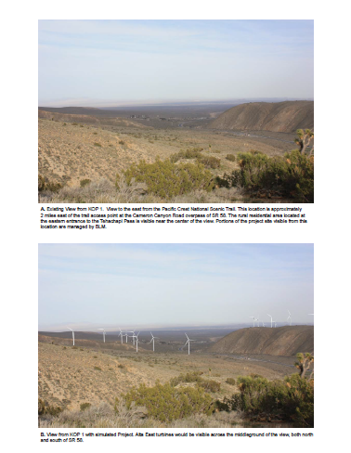
Visual Simulation Examples

Slide 59
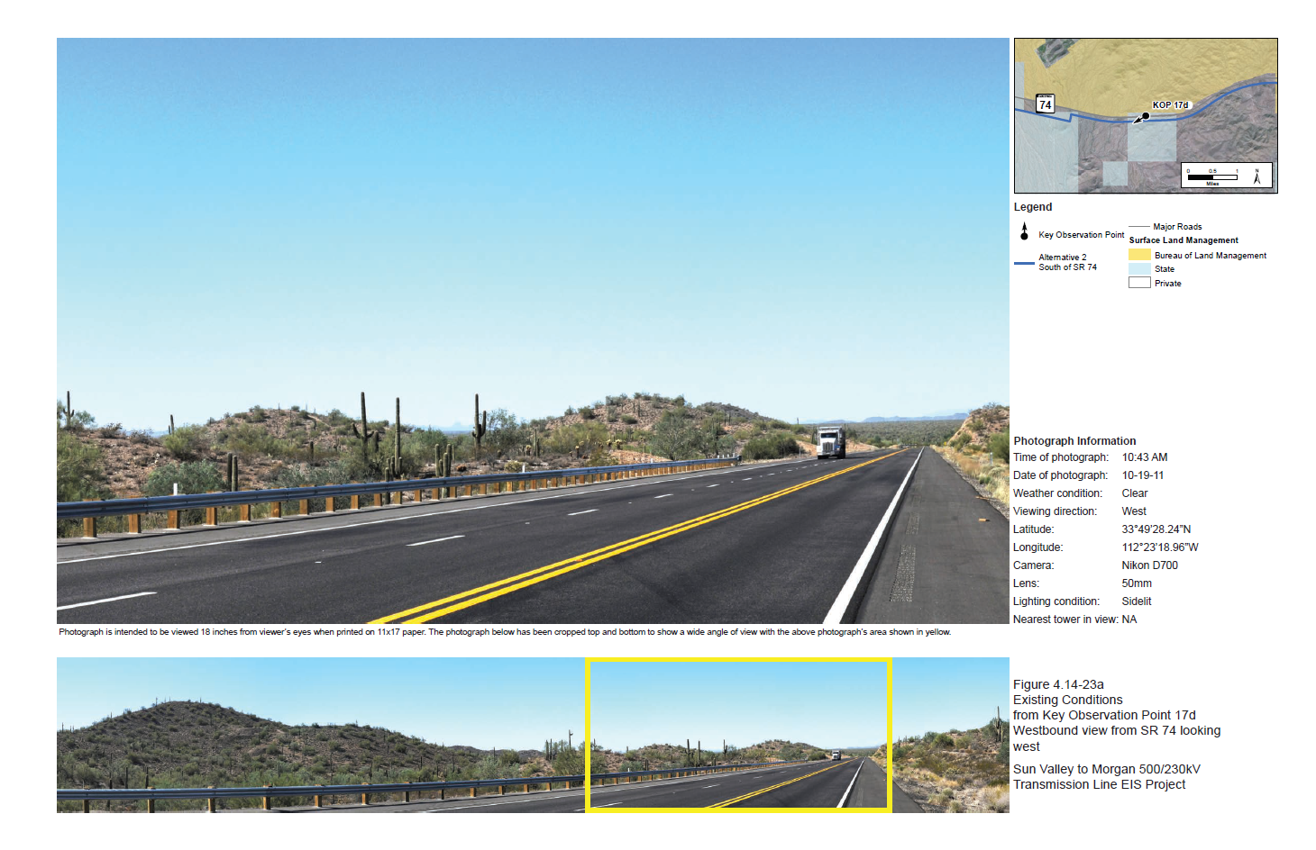
Visual Simulation Examples

Slide 60
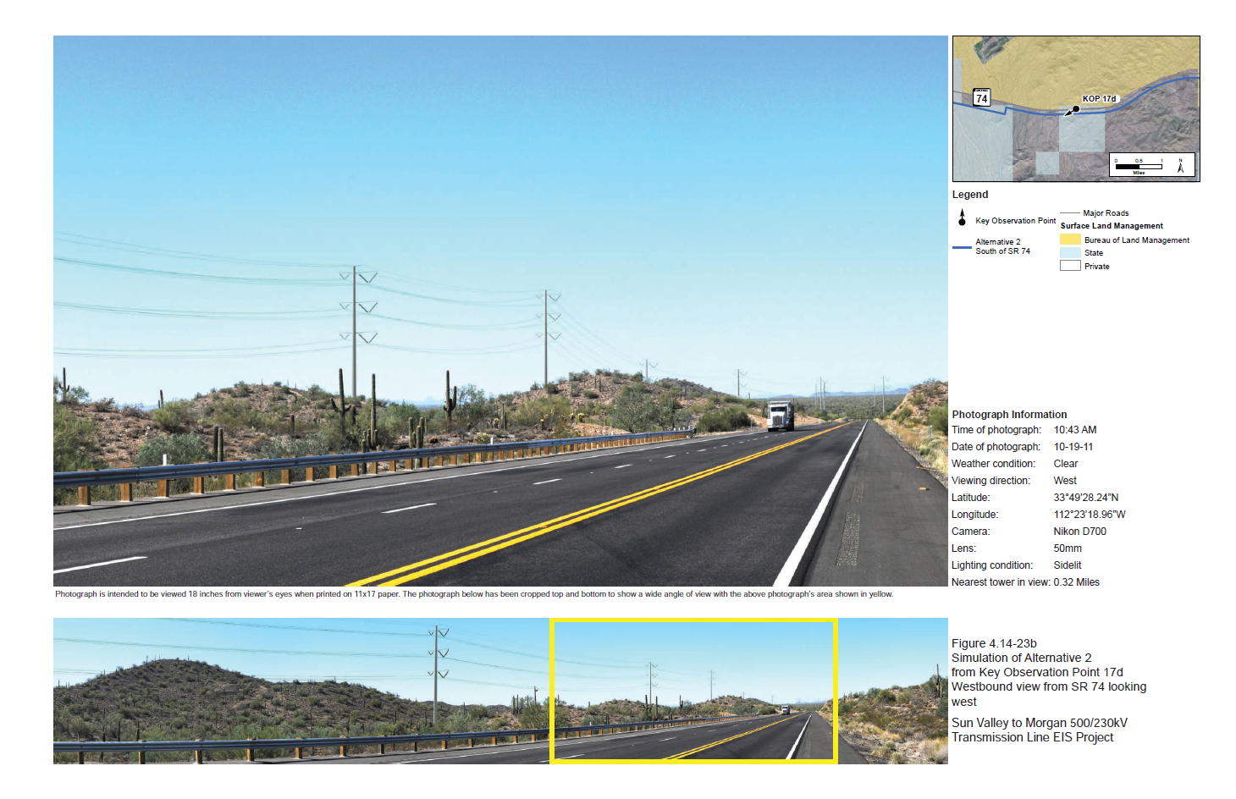
Visual Simulation Examples
Notes:
Angle of the image taken is also important. Perspective should be mostly parallel with a roadway, not perpendicular

Slide 61
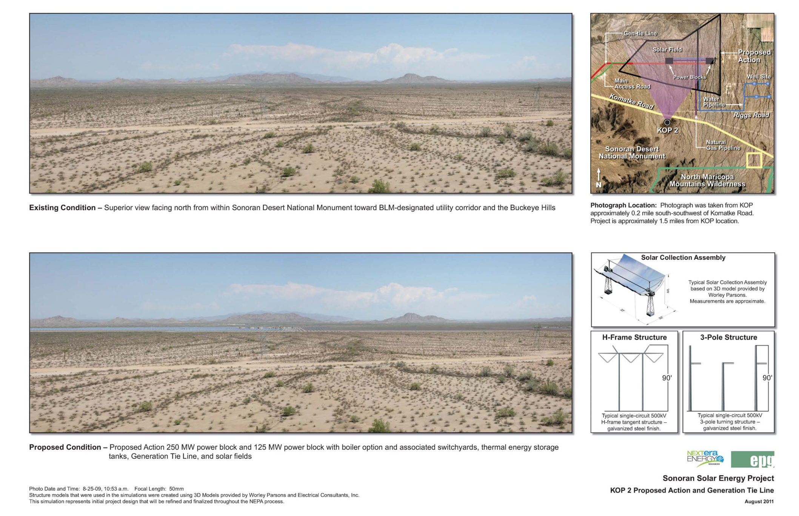
Visual Simulation Examples

Slide 62
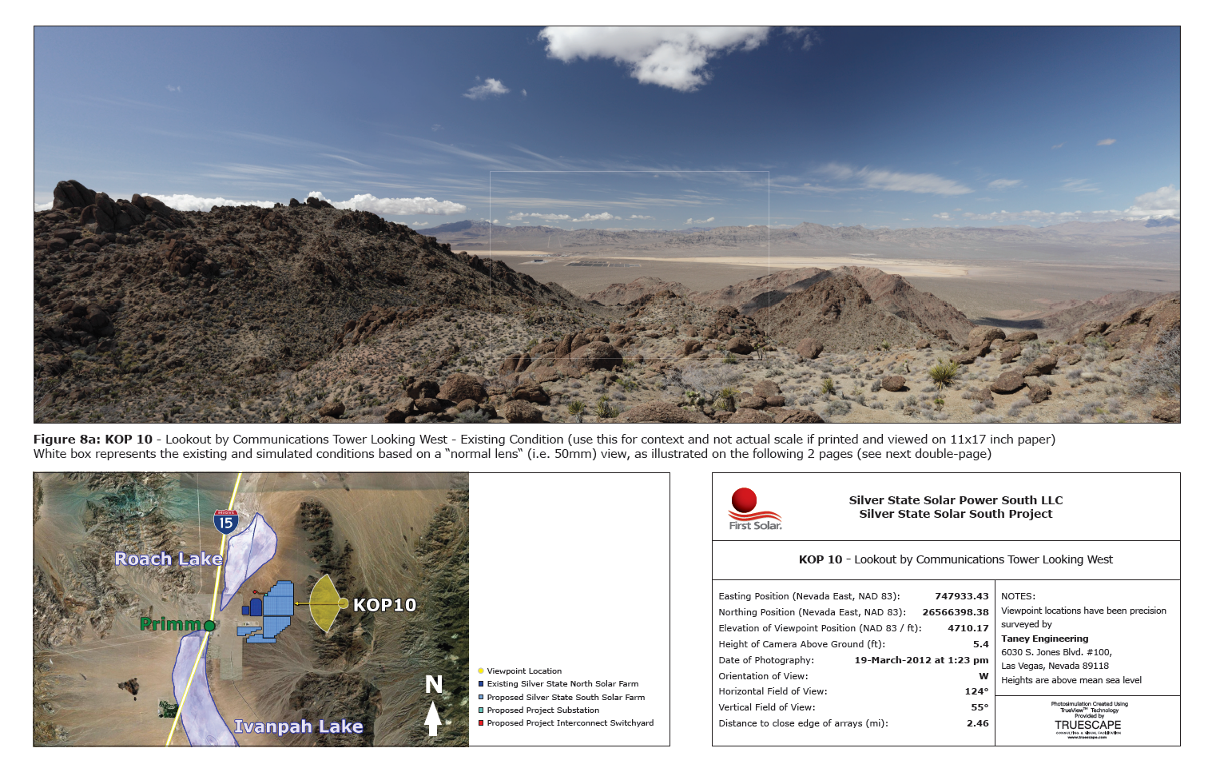
Visual Simulation Examples

Slide 63
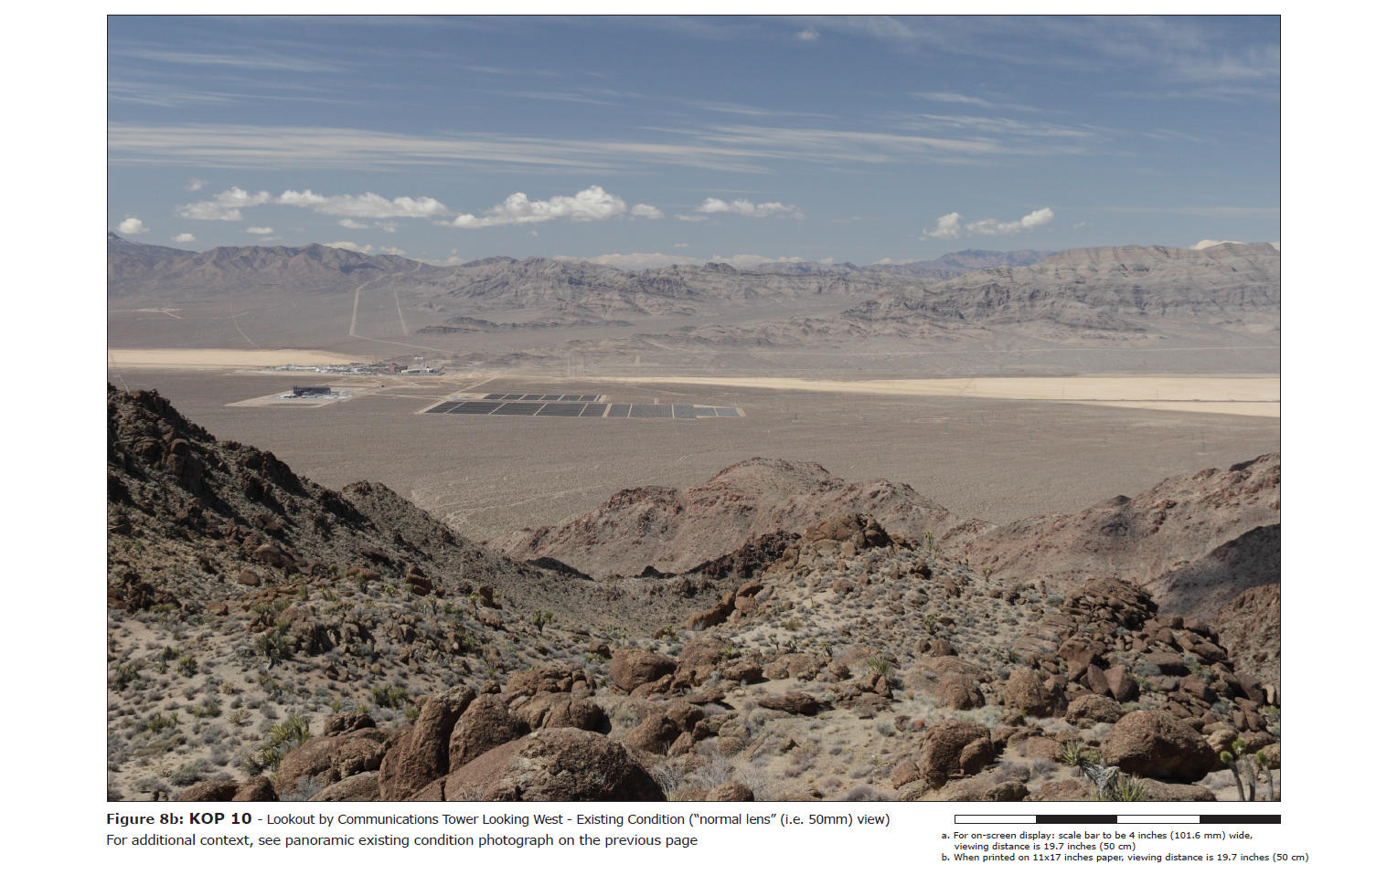
Visual Simulation Examples
Notes:
For on-screen display: scale bar to be 4 inches, viewing distance is 19.7 inches.
When printed on 11x17 inch paper, viewing distance is 19.7 inches.

Slide 64
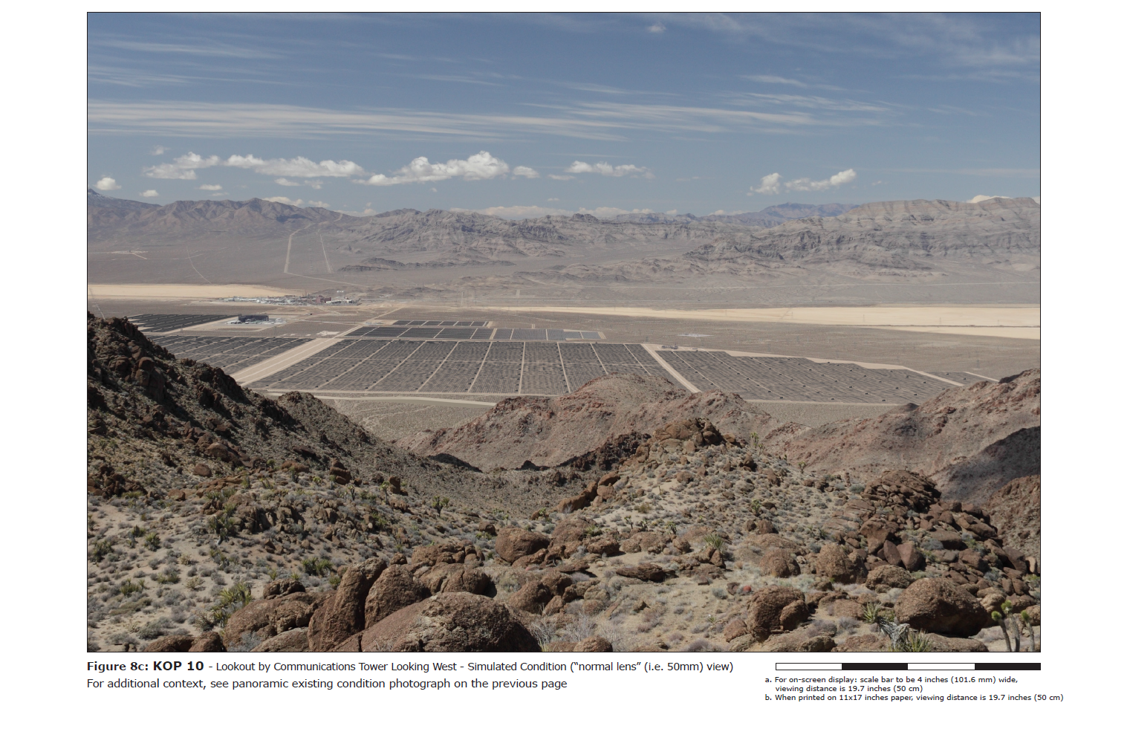
Visual Simulation Examples
Notes:
For on-screen display: scale bar to be 4 inches, viewing distance is 19.7 inches.
When printed on 11x17 inch paper, viewing distance is 19.7 inches.

Slide 65
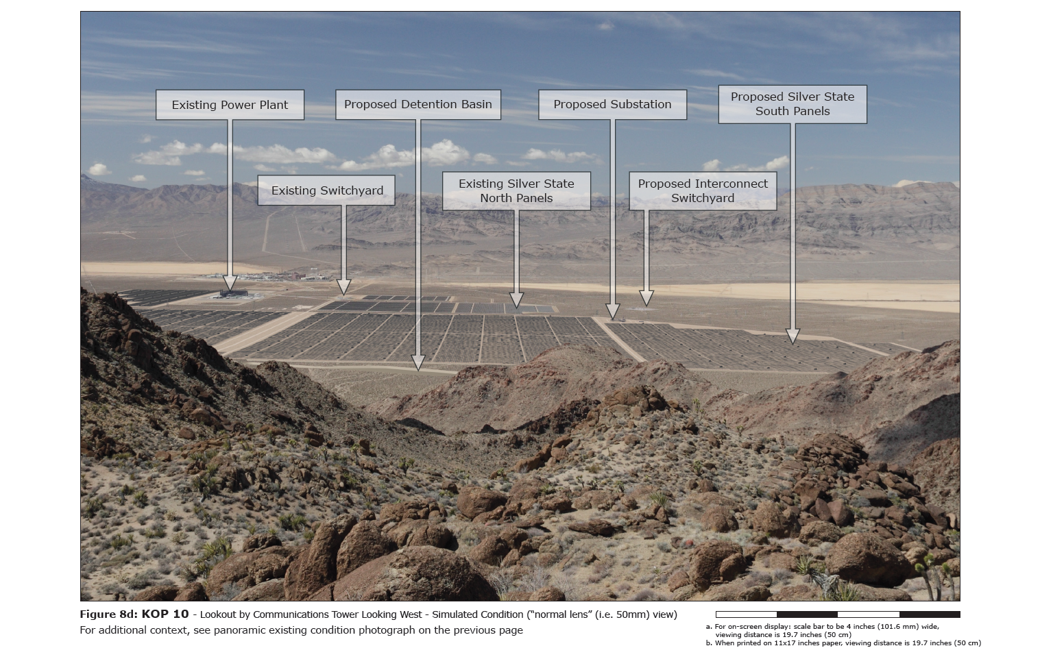
Visual Simulation Examples
Notes:
For on-screen display: scale bar to be 4 inches, viewing distance is 19.7 inches.
When printed on 11x17 inch paper, viewing distance is 19.7 inches.

Slide 66
Visual Simulation Template Example
Existing Image
Visual Simulation

Slide 67
Conclusion
Takeaways…
Many different tools
Many different techniques
Understand end results
Client needs vs. cost vs. time
Scale
Context
Bottom line…
Utilizing visual simulation technology is a powerful tool to aid in BLM analysis and decision-making process
As technology continues to advance, we need to collaborate with agency staff and contractors to continue to improve the visual simulations that are produced for BLM projects

