Slide 2
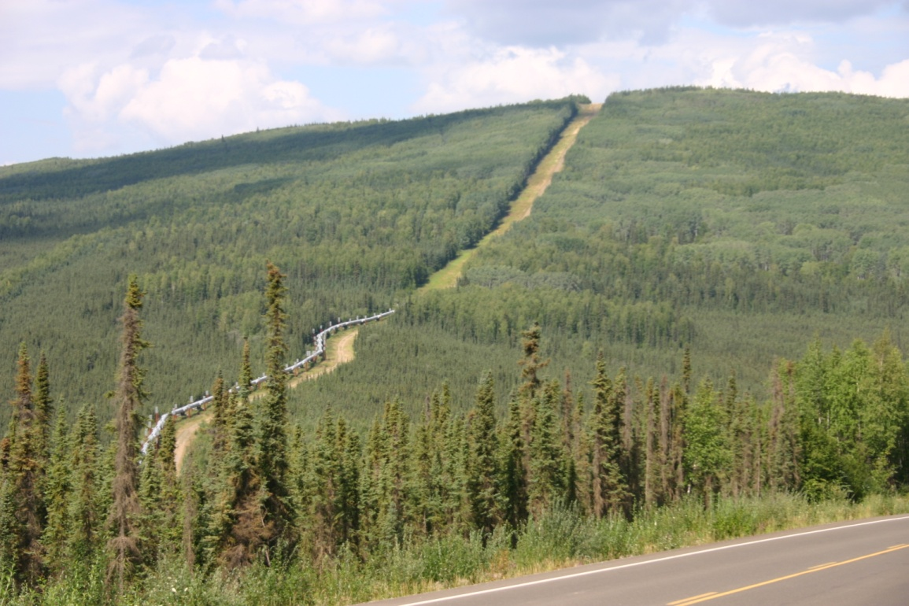
Contrast Rating

Slide 3
Contrast Rating
Unit Objective
Determine the elements of a project that are inconsistent with VRM objectives and recommend measures to improve the visual quality of the project
The VRM System is about minimizing visual contrast
The Contrast Rating process
First, determines whether a proposal conforms to the current Land Use Plan, and
Second, supports the subsequent impact analysis process

Slide 4
Contrast Rating
Process
A systematic process used to analyze potential visual impacts of proposed projects and activities
BLM Handbook 8431-1
The amount of contrast is measured by separating the landscape into major features
Landform/water, vegetation, and structures
Use “language of landscapes” when describing
Then predicting the magnitude of contrast in each of the basic elements
Form, line, color, and texture

Slide 5
Contrast Rating
Process
Quickly reveals elements and features that cause the greatest visual impact
Intended to assist BLM personnel not formally trained in the design arts to apply basic principles of planning and design to prevent or minimize visual impacts
Every attempt should be made to reduce visual impacts even if a project meets VRM objectives for the area

Slide 6
Contrast Rating
Tips
The contrast rating should be completed in the field from the selected KOP(s) and should be completed by an interdisciplinary team
Do not fill out forms as a “desk exercise,” it is important to get out on the ground to see the context of the proposed project and its location
The contrast rating should be completed during the time of year and time of day when most people will be viewing the area of development

Slide 7
Contrast Rating
Steps
Work with project proponent early in the project planning process, this will help prevent surprises later!
1 – Obtain a complete project description
2 – Identify VRM objectives from land use plan
3 – Select Key Observation Points (KOPs)
4 – Prepare visual simulations (optional)
5 – Complete contrast rating

Slide 8
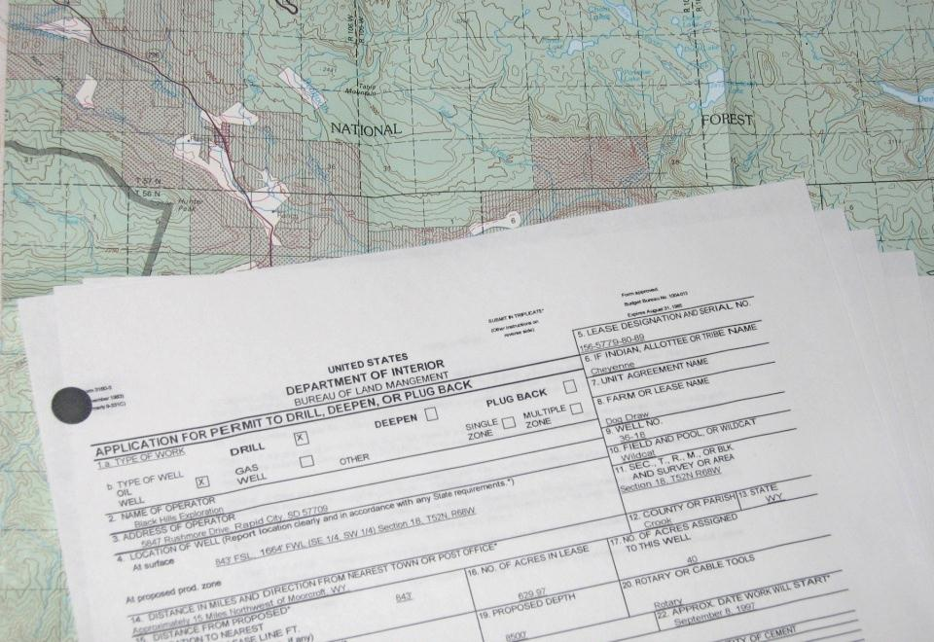
Contrast Rating
Step 1 – Project Description
Obtain a complete project description
Emphasize early contact with project proponent
Coach proponent on project design
Project proposal must be comprehensive (who, what, when, where, and why)
Details are important

Slide 9
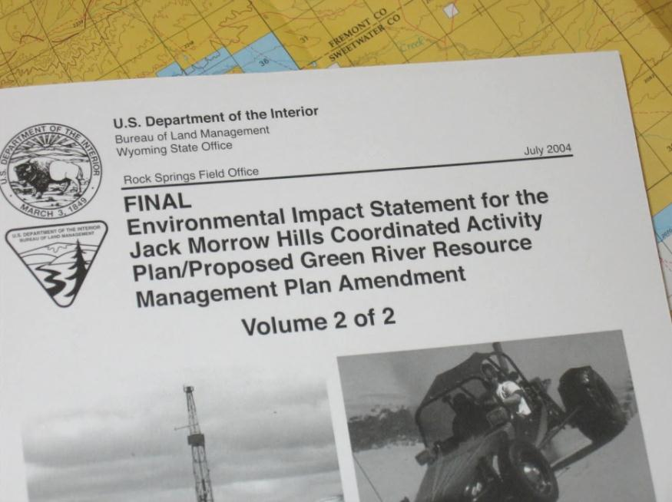
Contrast Rating
Step 2 – VRM Class Objectives
Identify VRM objectives from the land use plan
Familiarize yourself with your land use plan
Identify VRM objective
What is the existing management class for the project location and why?
Involve interdisciplinary team
Understand other resource issues

Slide 10
Contrast Rating
Step 2 – VRM Class Objectives
OBJECTIVE | Class I | Class II | Class III | Class IV
Management | preserve, manage for natural ecological changes | retain | partially retain | major modification
Change Allowed | very low | low | moderate | high
Visibility | activities should not be visible and must not attract attention | activities may be visible, but must not attract attention | activities may attract attention but should not dominate the view | activities may attract attention, may dominate the view, but are still mitigated

Slide 11
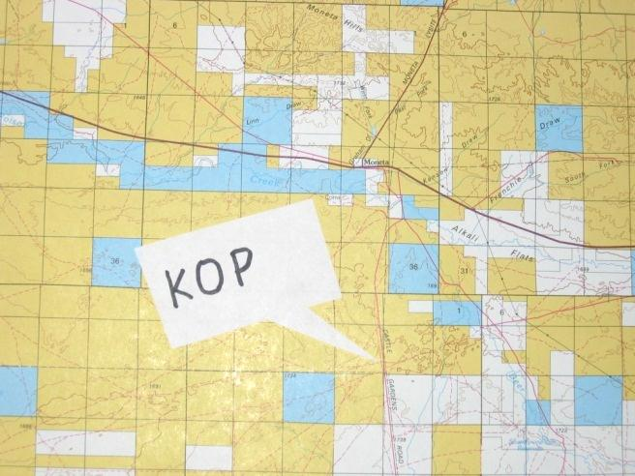
Contrast Rating
Step 3 - KOPs
Select Key Observation Points (KOPs)
What is a KOP?
A critical viewpoint or place from
which we analyze the visual impact
of a proposed project
Types of KOPs
KOPs should be places from which a proposed project is seen by large numbers of viewers or critical viewers
Where view of proposed project is most revealing
Single Points – trailheads, campgrounds, scenic overlooks, parking lots, subdivisions, and towns
Linear – roads, trails, and rivers

Slide 12
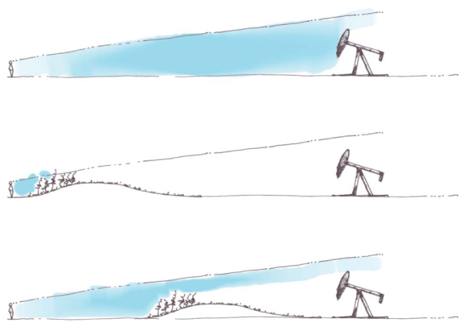
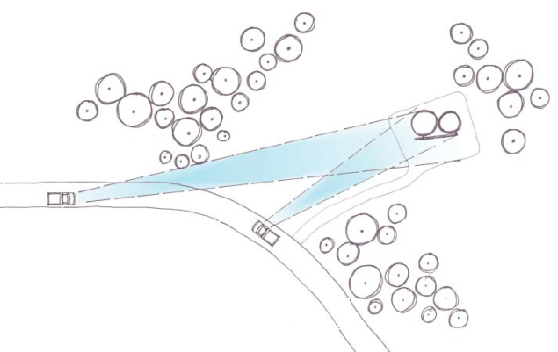
Contrast Rating
Step 3 - KOPs
Factors in KOP selection
Remember the Environmental Factors!
Angle of observation
Number of viewers
Length of time the project is in view
Relative project size
Season of use
Light Conditions
How many KOPs are needed?
Linear projects should have more than one
Dependent on the size of the project, land use plan direction, locations from where it can be seen

Slide 13
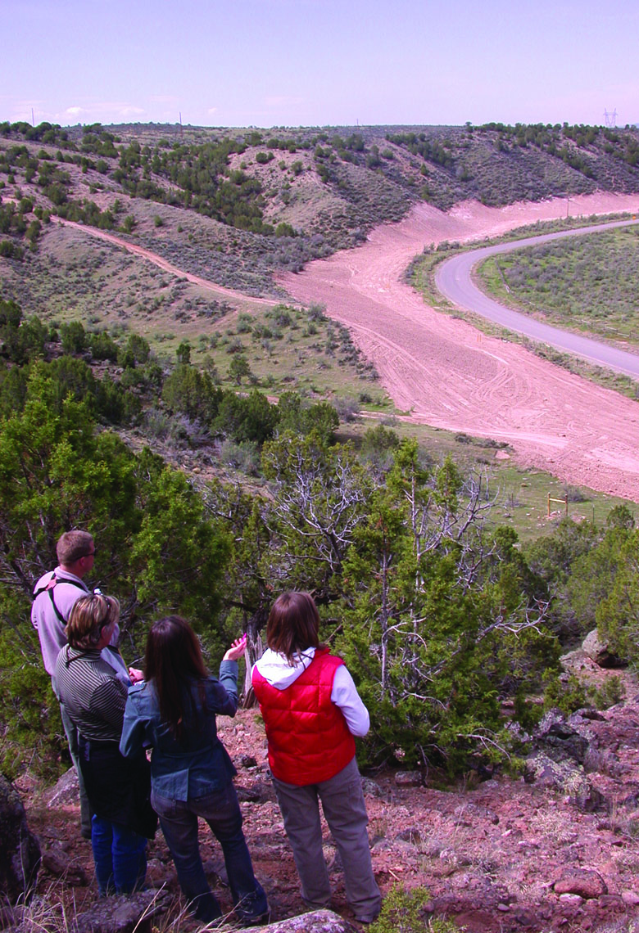
Contrast Rating
Step 3 - KOPs
When are KOPs selected?
Early in the project planning
process
Who selects them?
Interdisciplinary team
Input from proponent
Coordination with other agencies
Examples - NPS and USFS
Accuracy is important!
Location can sway results

Slide 14
Contrast Rating
Step 4 – Visual Simulation(s)
Prepare visual simulations (optional)
Larger, complex projects may benefit from visual simulations
Provides visual representation of a project before and after
Highlights impacts and potential mitigation measures
Good way to illustrate impacts in NEPA analysis
Seeing an image of a project is much more powerful than trying to imagine it
Helps eliminate bias
Allows all team members to see the project the same
Helps the proponent, public, and the BLM

Slide 15
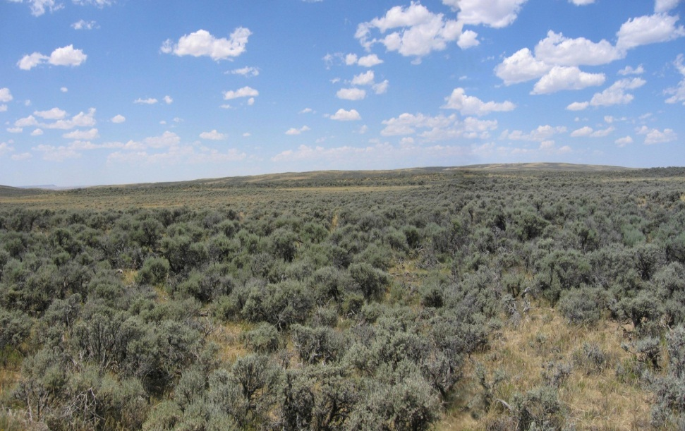
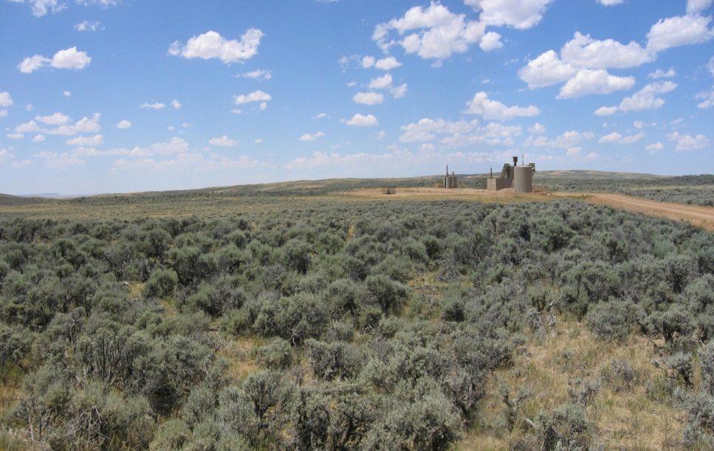
Contrast Rating
Step 4 – Visual Simulation Example
Before – Existing Conditions
After - Simulation
Mitigated Simulation

Slide 16
Contrast Rating
Step 5 – Contrast Rating
Complete Contrast Rating
Visual Contrast Rating Worksheet – BLM Form 8400-4
See BLM Handbook H-8431-1
Validates Land Use Plan Conformance
Provides documentation for NEPA
Provides a record for future action
Helps defend against appeals

Slide 17
Contrast Rating
Step 5 – Contrast Rating Worksheet
Use separate sheets for multiple KOPs

Slide 18
Contrast Rating
Worksheet
Section A

Slide 19
Contrast Rating
Worksheet
Section B

Slide 20
Contrast Rating
Worksheet
Section C

Slide 21
Contrast Rating
Worksheet
Section D

Slide 22
Contrast Rating
Step 5 – Contrast Rating Worksheet
Section A
Locates the project and identifies the VRM class
A simple illustration or map identifies the project location and KOP

Slide 23
Contrast Rating
Step 5 – Contrast Rating Worksheet
Section B
Where the existing characteristic landscape of the project area is described (use “language of landscapes”)
Focus on the area being affected by the project

Slide 24
Contrast Rating
Step 5 – Contrast Rating Worksheet
Section C
Determine the type of feature a project fits under
A project might fit under more than one
Landform/Water Features | Vegetative Features | Structural Features
Roads | Timber Harvests | Transmission Lines
Mining | Grazing Systems | Generation Plants
Gravel Pits | Habitat Treatments | Oil & Gas Development
Water Impoundments | Fuel Treatments | Recreation Facilities
 |  | Water Tanks
 |  | Microwave Stations
 |  | Buildings

Slide 25
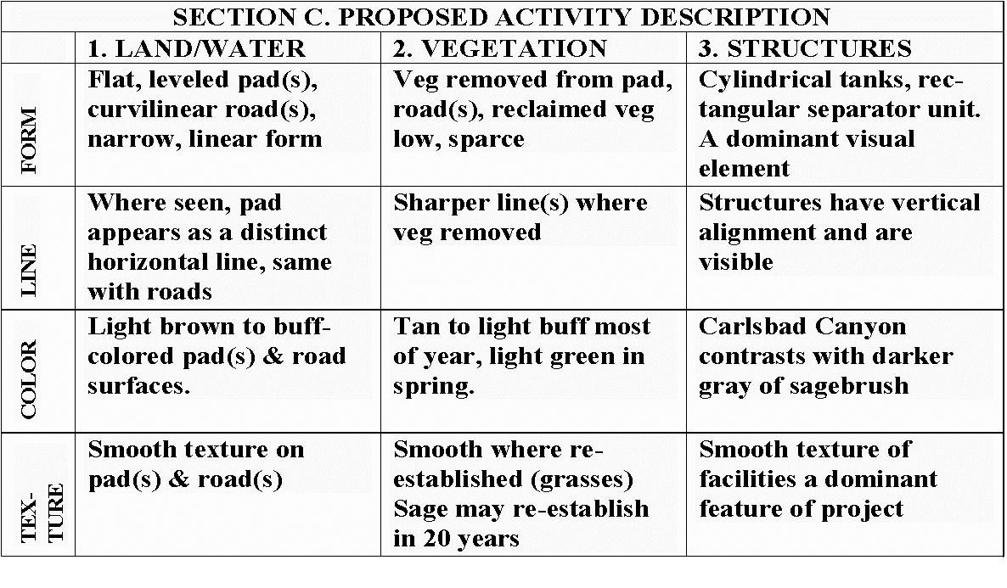
Contrast Rating
Step 5 – Contrast Rating Worksheet
Section C
Where the proposed activity’s effects on the characteristic landscape are described

Slide 26
Contrast Rating
Step 5 – Contrast Rating Worksheet
Section D
Projects may be rated on either a short-term or long-term basis
Short-term is through the first 5 years
Long-term is through the life of the project
If the project has different short-term and long-term effects, two contrast ratings should be completed
X

Slide 27
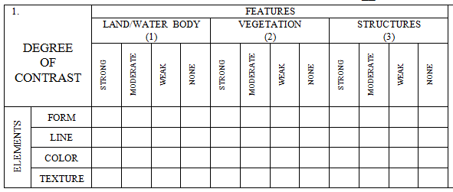
Contrast Rating
Step 5 – Contrast Rating Worksheet
Section D
Organized into features (land/water, vegetation, and Structures) and elements (form, line, color, and texture)

Slide 28
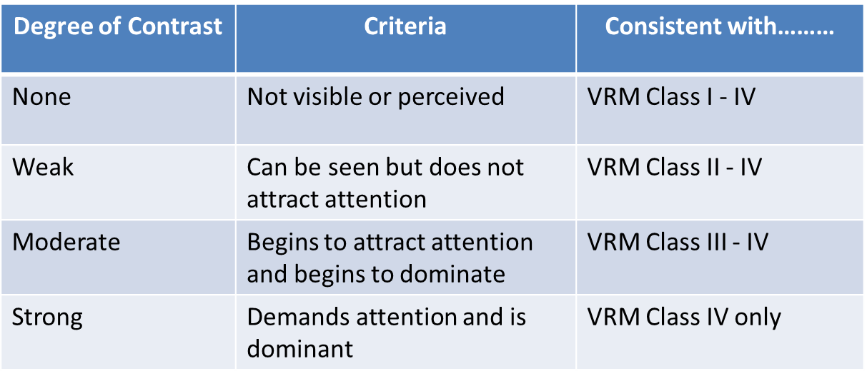
Contrast Rating
Step 5 – Contrast Rating Worksheet
Section D
IV
III
II
I
IV
III
II
I
IV
III
II
I

Slide 29
Contrast Rating
Step 5 – Contrast Rating Worksheet
Section D
Example – if a project demands attention and is dominate, it creates a strong degree of contrast. It would conform to the class IV objective ONLY and would not conform to class I, II, or III objectives
IV
III
II
I
IV
III
II
I
IV
III
II
I
x
x
x
x
x
x
x
x
x
x
x
x

Slide 30
Contrast Rating
Step 5 – Contrast Rating Worksheet
Section D
Example – if a project can be seen but does not attract attention, it creates a weak degree of contrast. It would meet Class II, III, and IV objectives
It would not meet the Class I objective
IV
III
II
I
IV
III
II
I
IV
III
II
I
x
x
x
x
x
x
x
x
x
x
x
x

Slide 31
Contrast Rating
Step 5 – Contrast Rating Worksheet
Section D
In this example, a project is proposed in VRM Class III
The project would meet VRM Class III for all features and elements - except structures where there is strong contrast in line, color, and texture
IV
III
II
I
IV
III
II
I
IV
III
II
I
X

Slide 32
Contrast Rating
Step 5 – Contrast Rating Worksheet
Section D
This tells you where to focus mitigation efforts in order to reduce the degree of impact, and thus meet the VRM objective
Additional mitigation measures would be recommended for the structure’s elements of line, color, and texture
IV
III
II
I
IV
III
II
I
IV
III
II
I
X

Slide 33
Contrast Rating
Step 5 – Contrast Rating Worksheet
Section D (Continued)
Where you can provide further explanation of why a project does or does not meet VRM objectives
As in this example, changes to land and vegetation would cause a moderate degree of contrast to the element line
The element line is a focus for mitigation efforts for this project

Slide 34
Contrast Rating
Step 5 – Contrast Rating Worksheet
Section D (Continued)
Where you can provide recommended mitigation measures

Slide 35
Contrast Rating
Step 5 – Contrast Rating Worksheet
Conformance with VRM Objectives
Does project meet VRM Objectives?
NO, what to do?
Redesign project to meet VRM Objectives
Internally initiated – Drop project
Externally initiated – Deny application for project
Amend RMP only as a last resort
Address reasons for the current VRM Class designation
Assess offsite mitigation

Slide 36
Contrast Rating
Process (Continued)
Document!
Take pictures
Complete the form
Write short narratives
Prepare visual simulations (optional)
Do whatever you need to do to describe your thought process and final recommendations
Documentation is the only way you or your manager will accurately remember what took place during your analysis
And if challenged, no documentation = didn’t happen

Slide 37
Contrast Rating
Process (Continued)
Input information into NEPA document
Enter your findings, along with necessary documentation
Write any necessary stipulations
Be sure all resource stipulations are coordinated and in agreement
Continue to work with the project proponent through all phases of the project (pre-construction, construction, and reclamation) to ensure project is completed as planned and stipulations are being followed!
Patience! It may take years before you see the outcome of all your efforts

Slide 38
Contrast Rating
Example – New Natural Gas Well Pad
1 – Obtain a complete project description
Proposal to drill 8 new federal wells from a new well pad with new access road on land administered by the BLM
Well pad would have a maximum cut slope of 33.1 feet at the southwest corner and a maximum fill slope of 25.2 feet at the northwestern corner
The road would be approximate 0.4 mile in length and 20-feet in width
The road grade would vary from 5% to 10%
Installation of a temporary pipeline
Construction would involve approximately 7.9 acres of new surface disturbance, which would be reduced to approximately 2.5 acres after interim reclamation

Slide 39
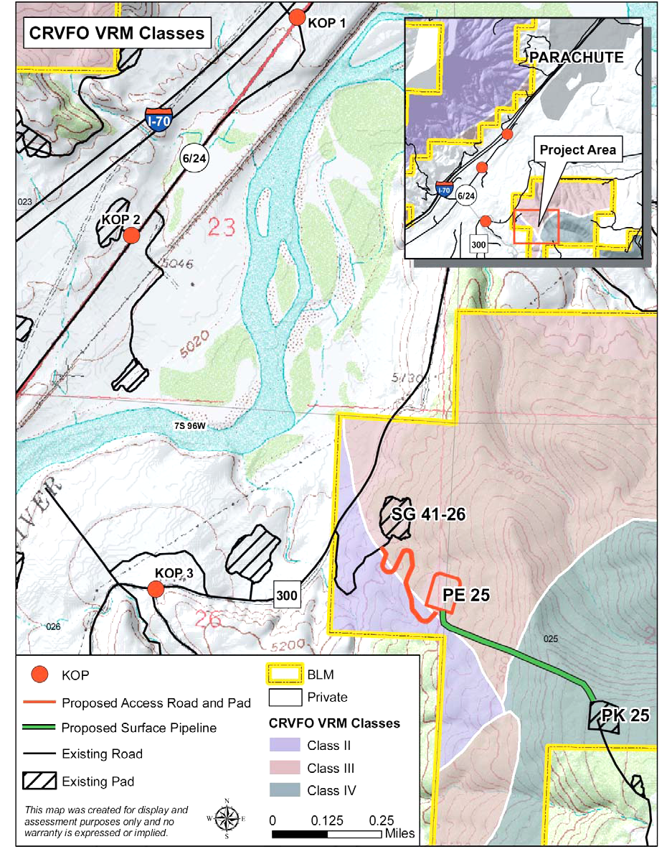
Contrast Rating
Example – New Natural Gas Well Pad
2 – Identify VRM objectives
from land use plan
Class II
Retain landscape character
Change allowed: low
Visible but should not attract
attention
Class III
Partially retain landscape
character
Change allowed: moderate
Can attract attention but
should not dominate view

Slide 40
Contrast Rating
Example – New Natural Gas Well Pad
2 – Identify VRM objectives
from land use plan
Class IV
Provide for management
activities which require
major modification to the
character of the landscape
Change allowed: high
Activities may attract
attention, may dominate the
view, but is still mitigated

Slide 41
Contrast Rating
Example – New Natural Gas Well Pad
3 – Select Key Observation
Points (KOPs)
Linear features – State
Highway 6 and County Road
300
3 KOPs were selected based
on field analysis and
from environmental factors
(e.g. angle of view, season
of use, duration in view)

Slide 42
Contrast Rating
Example – New Natural Gas Well Pad
4 – Prepare visual simulations (optional)
KOP 2
Before
Before – Existing Conditions
During Construction
Simulation - Mitigated

Slide 43
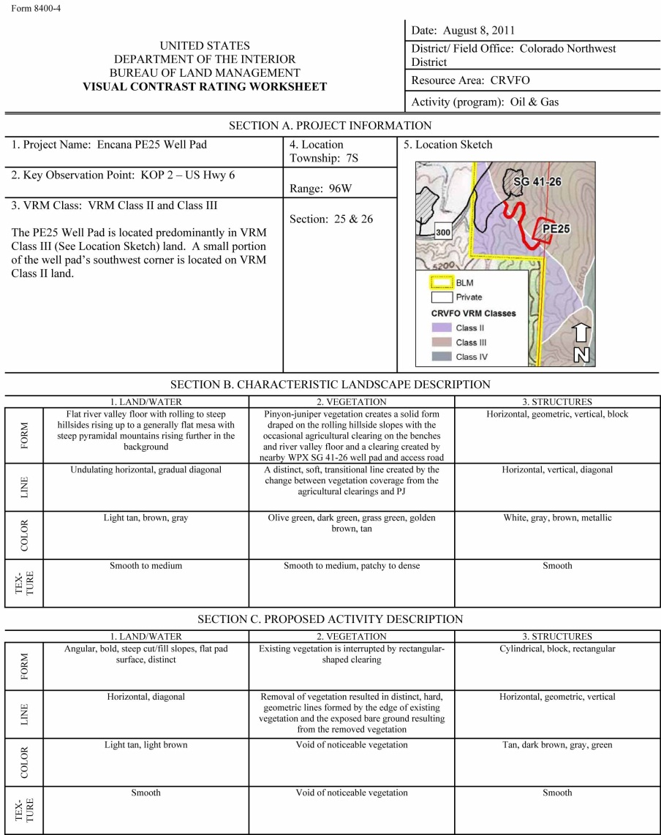
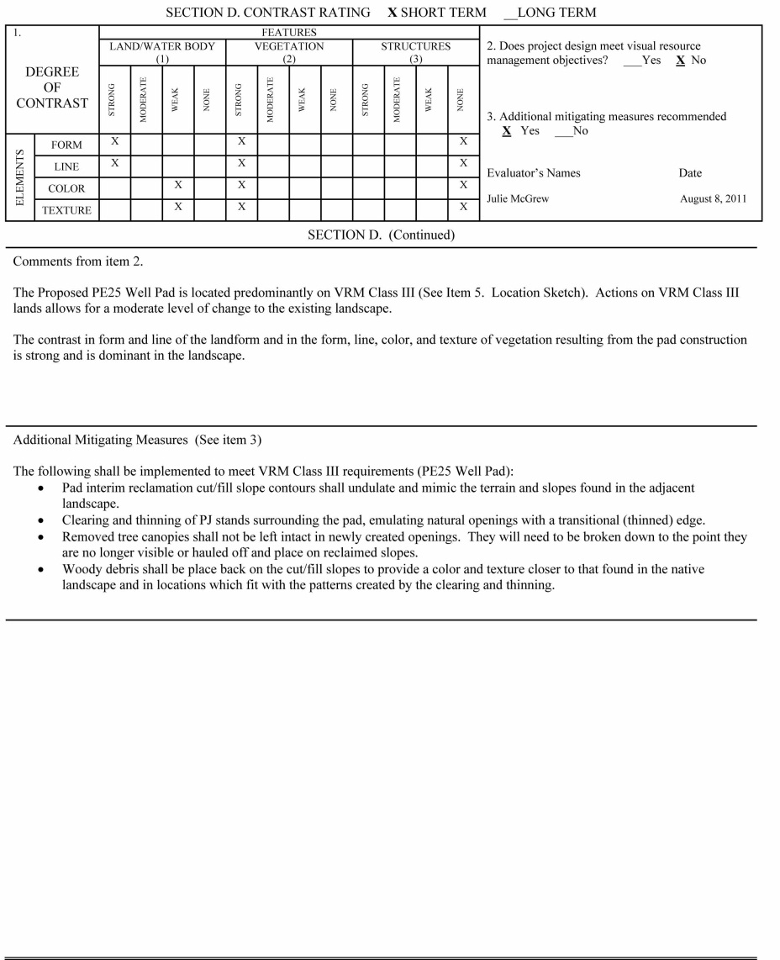
Contrast Rating
Example – New Natural Gas Well Pad
5 – Complete contrast rating

Slide 44
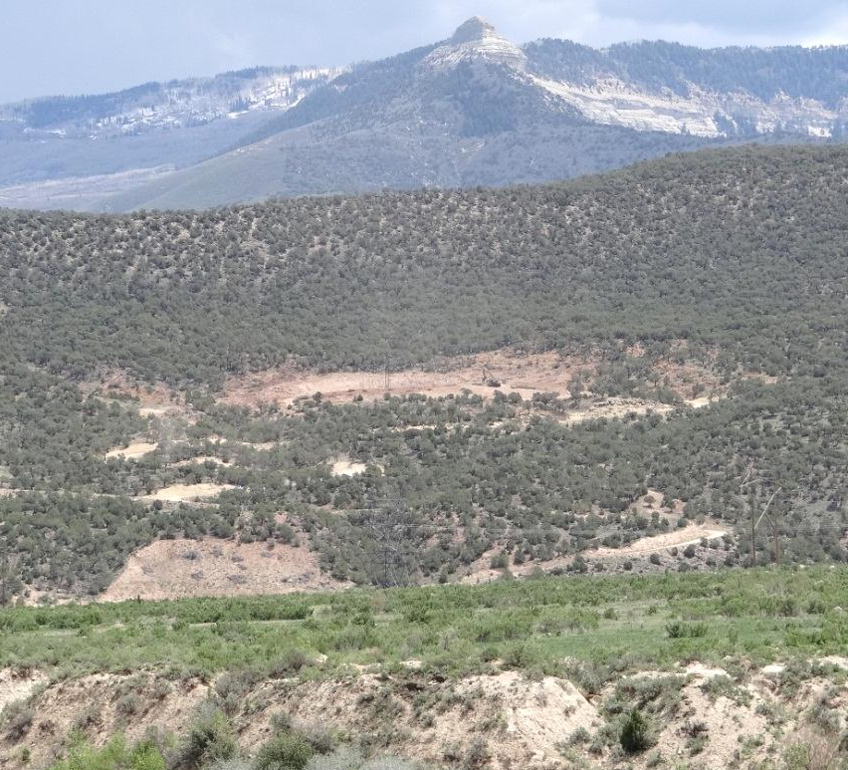
Contrast Rating
Example – New Natural Gas Well Pad
Patience........................
During Construction
Post mitigation
Notes:
It can take years to see the outcome of all the effort, particularly relating to reclamation that meets BLM standards.

Slide 45
Contrast Rating
Class Exercise # 1
Notes:
It can take years to see the outcome of all the effort, particularly relating to reclamation that meets BLM standards.

Slide 46
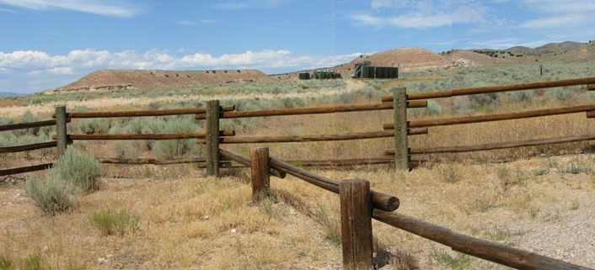
Contrast Rating
Class Exercise
Before – Existing Condition
After - Simulation
Notes:
It can take years to see the outcome of all the effort, particularly relating to reclamation that meets BLM standards.

Slide 47
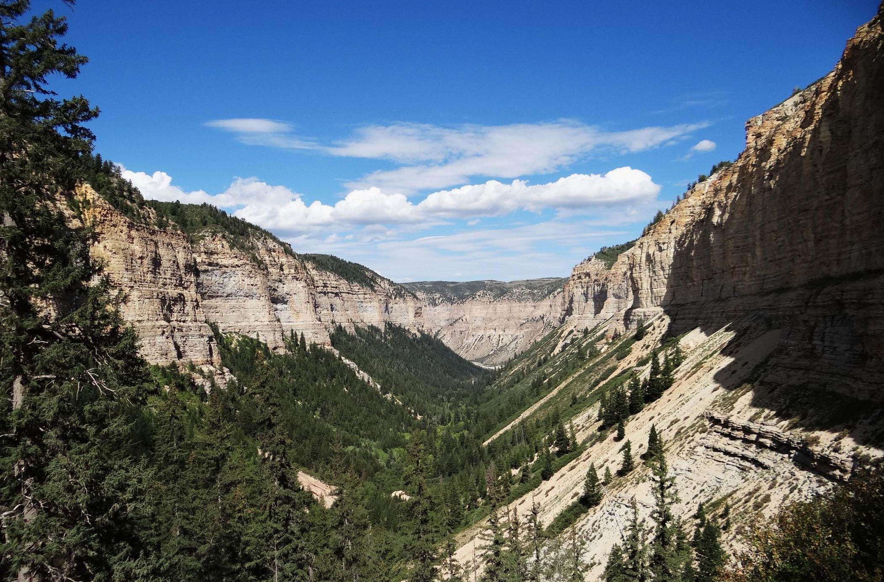
NEPA
Notes:
It can take years to see the outcome of all the effort, particularly relating to reclamation that meets BLM standards.

Slide 48
NEPA
National Environmental Policy Act
Signed into law on January 1, 1970
Landmark environmental policy
Encourages environmental protection and informed decision-making

Slide 49
NEPA
Types of NEPA Documents
Determination of NEPA Adequacy (DNA)
Proposed Action is adequately analyzed in existing NEPA document(s)
Categorical Exclusion (CX)
Proposed Action predetermined to NOT have significant effect on the quality of the human environment (individually or cumulatively)
Statutory, Departmental, or BLM categorically excluded
Lacks extraordinary circumstances (ex. T&E, WA/WSA, wetlands, etc.)
Environmental Assessment (EA)
Used to determine IF Proposed Action would have significant effects
Environmental Impact Statement (EIS)
Proposed Action WOULD result in significant effects

Slide 50
NEPA
Types of NEPA Efforts
Prepared by BLM specialists:
Internal – rec site, range improvement, fuels reduction
External – single pad oil & gas well, communication site
Prepared by others but reviewed by BLM specialists:
Land Use Plan revisions
ROW for utility-scale renewable energy development
ROW for transmission line / natural gas line

Slide 51
NEPA
Sources for Visual Documentation
Project Proponent
Resource Management Plan
Knowledge from Resource Specialists
Visual Resource Inventory
Field Review of Project Proposal
Completed Contrast Rating Form
Input from Affected Landowners
Associated Consulting Firms
Input From the General Public
Similar Projects (including images) / Visualizations

Slide 52
NEPA
NEPA Document - Chapter 1
Introduction
Background
Project location
Purpose and Need
Plan Conformance
What is the VRM Class where project is proposed?
Is project allowable per RMP guidance?
Can it meet VRM objectives?

Slide 53
NEPA
NEPA Document – Chapter 1 Continued
Scoping: Issue identification
Internally generated (IDT Checklist)
Externally generated (public scoping)
What are visual concerns related to the proposed project?
Entire resources are NOT issues
Issues drive design features and alternative development
EXAMPLE LANGUAGE:
Will the proposed site developments create visually contrasting impacts that alter the landscape character?

Slide 54
NEPA
NEPA Document – Chapter 1 Continued
Scoping: Issue identification
Example: How would constructing, operating and maintaining a 159 turbine wind energy facility alter the landscape character?

Slide 55
NEPA
NEPA Document – Chapter 1 Continued
Interdisciplinary team checklist

Slide 56
NEPA
NEPA Document – Chapter 2
Proposed Action & Alternatives
Alternative development
Develop alternatives that meet VRM objectives
What would it take for project to conform?
Forces early consideration of visual design solutions when preparing alternatives
Establishes a range of design features and/or mitigation measures
Allows for better evaluation of trade-offs and benefits
Allows for informed decision making

Slide 57
NEPA
NEPA Document – Chapter 2 Continued
Alternatives Content
Complete project descriptions for each alternative
Who, what, when, where, how, and why
Photos of similar projects or visualizations can be very helpful

Slide 58
NEPA
NEPA Document – Chapter 2 Continued
Alternative B: BLM would develop a parking area adjacent to Dance Hall Rock Historic Site on the east side of the Hole in the Rock Road. Development would occur in a previously undisturbed area and include the following:
constructing parking for approximately 12 vehicles including two oversize ones
installing a vault toilet
constructing a 500-foot entrance road for ingress and egress to the parking area
installing interpretive panels
installing site signage
constructing a 500-foot trail from the parking area to the edge of Dance Hall Rock
Improvements would include hardening the parking area and road surface with road base. Equipment that would be used to develop this project would likely include hand tools, dump trucks, front end loaders, road graders and a tractor trailer with crane to install the vault toilet. The earliest the project would be implemented is Fall 2014. Implementation and completion of the project is estimated to be one month from when construction starts.
Design criteria to meet built environment image guidelines and other guidance would include the following:
Natural or natural-appearing materials would be used. These could include concrete, natural stone, gravels or fines, rusted or painted metal, and/or wood. No shiny, reflective materials would be used.
Natural palette colors would include grays, reds, salmons, rusts, browns, and buffs. No bright colors such as whites or yellows would be used.

Slide 59
NEPA
NEPA Document – Chapter 3
Affected Environment
Describe Characteristic Landscape
Use VRI
Use Section B of the Contrast Rating Form(s)

Slide 60
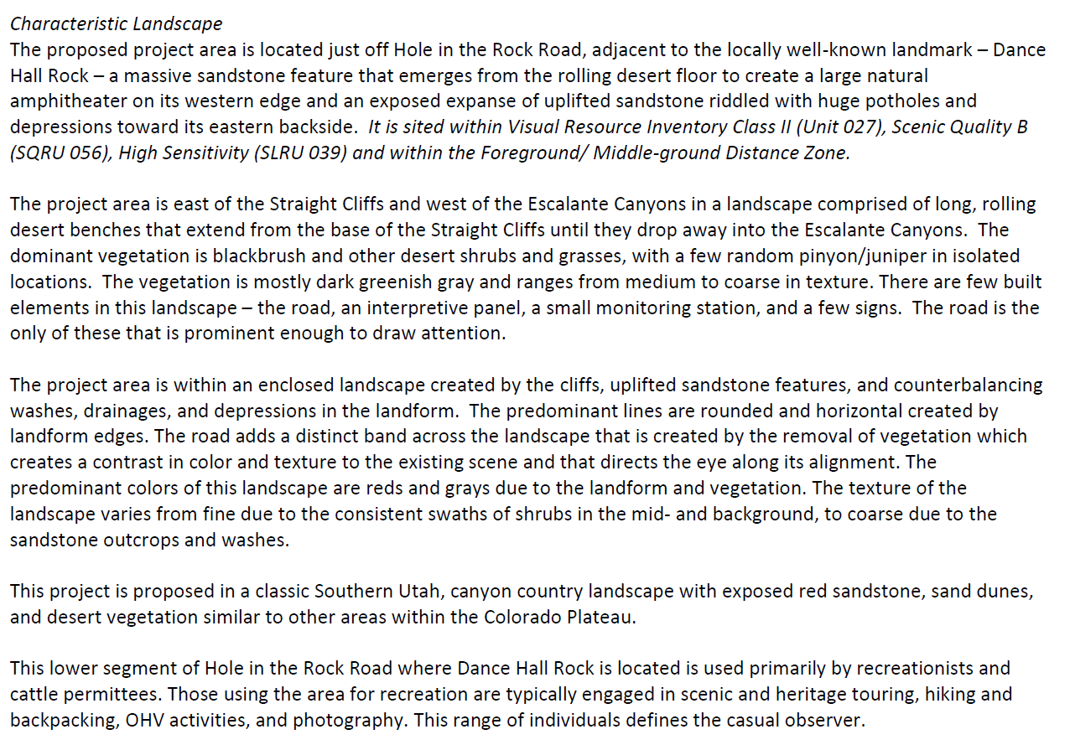
NEPA
NEPA Document – Chapter 3 Continued
Affected Environment
VRM Objectives

Slide 61
NEPA
NEPA Document - Chapter 3 Continued
Affected Environment Continued
Describe the casual observer(s)
Explain VRM Class Objectives

Slide 62
NEPA
NEPA Document – Chapter 4
Environmental Effects
Need to be quantified / qualified
Determine conformance with VRM objectives
A statement like: “The project would (or would not) impact visual resources is NOT sufficient.”
The Environmental Impact is the amount of contrast the project causes to the existing landscape.
Identify the KOP(s) and why selected.
Explain influence of any Environmental Factors.
Refer to Sections C and D on the Contrast Rating Form.
Describe the nature of the impact - use terms WEAK, MODERATE, STRONG - and include language from narrative on back of Contrast Rating Form.

Slide 63
NEPA
NEPA Document – Chapter 4 Continued
Environmental Effects
SECTION C. PROPOSED ACTIVITY DESCRIPTION
 | 1. LAND/WATER | 2. VEGETATION | 3. STRUCTURES
FORM | Same . | Same. | Boxy forms associated with toilet and automobiles. Curving swatch of new entrance road and irregular horizontal form parking area.
LINE | Same. | Same. | Horizontal, vertical, curving band.
COLOR | Same. | Same. | Reds and salmons, grays, browns and tans, earth-tones – multi-color intermittently when autos are parked on site.
TEX- TURE | Same. | Same. | Smooth to medium.

Slide 64
NEPA
NEPA Document – Chapter 4 Continued
Environmental Effects
Section D, continued (from back of Contrast Rating Form)
For Alternative B as viewed from KOP 2 has the development located in a depression where the landform rolls away and down from this viewing angle, thus partially screening the features associated with it. The casual observer would see the upper portions of the vault toilet, portions of the intermittently-parked vehicles and possibly some portions of the other site features. The toilet and other features would be of colors and textures to blend with the natural landscape character. The automobiles of all colors would be the most noticeable items but would be parked

Slide 65
NEPA
NEPA Document – Chapter 4
BLM’s Visual Resource Management program includes a standardized system to review lands actions for resource management plan conformance. Visual contrast rating worksheets are completed to determine if a project conforms to the resource management plan. In order to evaluate the environmental consequences of the alternatives for this proposed project, three key observations points (KOPs) were established as part of completing the contrast rating analysis.
KOP #1 was along Hole in the Rock Road looking south toward the sites; KOP#2 was also along Hole in the Rock Road but looking north toward the sites; and KOP#3 was on the floor of Dance Hall Rock looking outward across the landscape. The visibility of the alternatives from these KOPs is detailed in the table below.
Comparison of Visibility by Alternative from Key Observation Points
Hole in the Rock Road closely follows the path of the Mormon San Juan Mission expedition route, is a State Scenic Backway, and provides access to many popular recreation destinations in GSENM and Glen Canyon National Recreation Area for thousands of visitors annually, hence the justification for selecting two KOPs along it from both travel directions. The third KOP, on the Dance Hall Rock amphitheater floor looking outward, was selected per feedback from public scoping from those concerned about the preservation of the views from inside the historic site outward.
4 - Environmental Effects Continued
 | KOP#1 | KOP#2 | KOP#3
Alt A: No Action | Not Visible | Minimally Visible | Fully Visible
Alt B: Existing Disturbance Area | Not Visible | Partially Visible | Fully Visible
Alt C: New Disturbance Area | Partially Visible | Fully Visible | Not Visible

Slide 66
NEPA
NEPA Document – Chapter 4
BLM’s Visual Resource Management program includes a standardized system to review lands actions for resource management plan conformance. Visual contrast rating worksheets are completed to determine if a project conforms to the resource management plan. In order to evaluate the environmental consequences of the alternatives for this proposed project, three key observations points (KOPs) were established as part of completing the contrast rating analysis.
KOP #1 was along Hole in the Rock Road looking south toward the sites; KOP#2 was also along Hole in the Rock Road but looking north toward the sites; and KOP#3 was on the floor of Dance Hall Rock looking outward across the landscape. The visibility of the alternatives from these KOPs is detailed in the table below.
Comparison of Visibility by Alternative from Key Observation Points
Hole in the Rock Road closely follows the path of the Mormon San Juan Mission expedition route, is a State Scenic Backway, and provides access to many popular recreation destinations in GSENM and Glen Canyon National Recreation Area for thousands of visitors annually, hence the justification for selecting two KOPs along it from both travel directions. The third KOP, on the Dance Hall Rock amphitheater floor looking outward, was selected per feedback from public scoping from those concerned about the preservation of the views from inside the historic site outward.
4 - Environmental Effects Continued
 | KOP#1 | KOP#2 | KOP#3
Alt A: No Action | Not Visible | Minimally Visible | Fully Visible
Alt B: Existing Disturbance Area | Not Visible | Partially Visible | Fully Visible
Alt C: New Disturbance Area | Partially Visible | Fully Visible | Not Visible

Slide 67
NEPA
NEPA Document – Chapter 4
The potential project locations are within close proximity to Hole in the Rock Road, contributing to their visibility. Visitors travel in this area year round though peak visitation is in the spring and fall months. For those travelling the road in either direction, the length of time the sites would be in view is less than a minute, but for those spending time at the site, Alternative B would be visible as long as their visit lasts. The massiveness of Dance Hall Rock would dwarf the site improvements in terms of scale.
Alternative B
During construction, temporary visual impacts would result from the visibility of construction equipment and site work. Post-construction, the contrast created by the site improvements would be negligible in regards to the changes in vegetation. Weak landform contrast would be created in line and form by the delineation of the parking area and the structures (i.e. toilet, signs, etc.) due to adding blocky, randomly-spaced elements with vertical, horizontal, and diagonal lines into the landscape. Additionally, the vehicles that park to use the area would be visible and would create minor visual contrast, though they would be transitory.
In order to minimize the visibility of the site development for those travelling along Hole in the Rock Road, it would be sited in a depression surrounded by landforms. The toilet and other fixtures would be constructed of materials that blend with the natural environment minimizing the color and textural contrast they would create.

Slide 68
NEPA
NEPA Document – Chapter 4 Continued
Environmental Effects
Cumulative Effects
Impact on the environment which results from incremental effect of past, present, and reasonably foreseeable future actions (no matter who undertakes them)
Determine Cumulative Impact Area
Assess quantitatively if possible

Slide 69
NEPA
NEPA Document – Chapter 4 Continued
Environmental Effects Continued
Cumulative Impact Area (CIA)
Visual Resources - The cumulative impact area of analysis for Visual Resources is the viewshed along Hole in the Rock Road.
Cumulative Impact Analysis
The cumulative impacts to visual resources from past, present, and reasonably foreseeable actions include establishment of livestock grazing management facilities (corrals, fences, water developments, storage buildings, etc.), recreational facilities (trailheads, day use areas, etc.), general recreational use, and road construction and maintenance activities. The action alternatives would not contribute to a measureable increase in impacts to visual resources as they would be constructed to blend with the landscape, be screened from view to the extent practicable, and the Dance Hall Rock location is already an attraction visited by the general public on a regular basis. Additionally, the Hole in the Rock Road runs for more than 60 miles from north to south through a viewshed that encompasses a landscape of 100,000s of acres. This development would be visible only when in near proximity to the site and is small in scale within this grand scale landscape.

Slide 70
NEPA
NEPA Document – Chapter 4 Continued
Environmental Effects
Does project meet VRM Objectives?
YES, if:
None = Class I
Weak = Class II
Moderate = Class III
Strong = Class IV

Slide 71
NEPA
NEPA Document – Chapter 4 Continued
Environmental Effects
Alternative B
By constructing the project according to the outlined design criteria and implementation measures, the minor changes to the existing character of the landscape would be appropriate to meet the visual resource management objectives of the area.

Slide 72
NEPA
NEPA Document – Chapter 4 Continued
Environmental Effects
Alternative B
By constructing the project according to the outlined design criteria and implementation measures, the minor changes to the existing character of the landscape would be appropriate to meet the visual resource management objectives of the area.

Slide 73
NEPA
NEPA Document – Chapter 4 Continued
Environmental Effects
Does project meet VRM Objectives?
NO, what to do?
Redesign project to meet VRM Objectives
Internal – Drop project
External - Deny application for project
Amend RMP
List of preparers
Agencies consulted

Slide 74
NEPA
NEPA Document – Chapter 5
References
Bureau of Land Management (BLM). 1986. BLM Manual Handbook 8410-1-Visual Resource Inventory
Bureau of Land Management (BLM). 1986. BLM Manual Handbook 8431-1-Visual Resource Contrast Rating

Slide 75
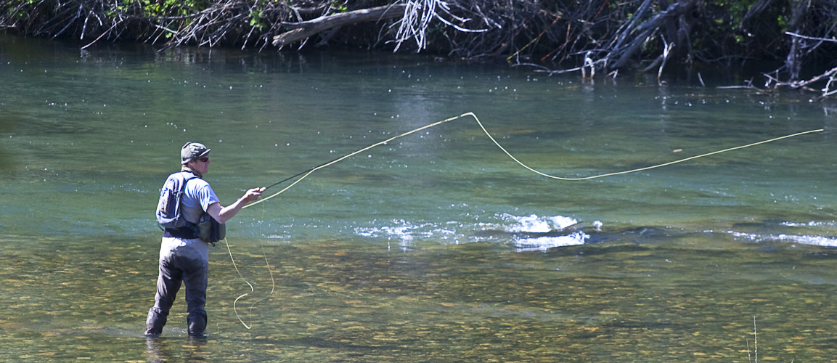
NEPA
Are we done once NEPA is completed?
Is it time to go fishing?

Slide 76
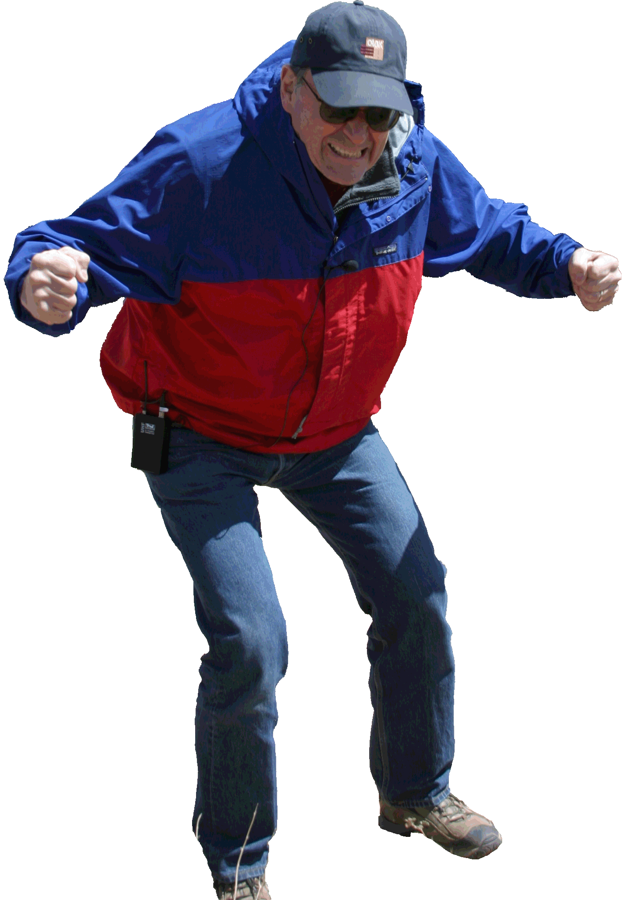
NEPA
NO?!!
Sooooo, What’s next?

Slide 77
NEPA
Build it and check to see if you did okay………….
AKA - Monitoring

