Slide 1
Planning for Recreation & Visitor Services

Slide 2
Module 2 – LUP part 1
Land Use Planning Process
Part 1
Kalem Lenard
Assistant Field Manager, Royal Gorge Field Office
jlenard@blm.gov
719-269-8538
Notes:
We are covering the LUP Process in 2 parts.

Slide 3
Module 2 – LUP part 1
Objectives
What is a Land Use Plan (LUP)?
Land Use Planning – law, regulation, policy
Overview of the BLM’s Land Use Planning process
LUP Checklist for RVS (Appendix 1, A1-1)

Slide 4
Module 2 – LUP part 1
What is a Land Use Plan?
Resource Management Plan (RMP) – revision, or amendment
Monument Plan
National Conservation Area Plan
Others
Notes:
Land use plans and planning decisions are the basis for every on-the-ground action the BLM undertakes .
All future NEPA actions must be consistent with the LUP, otherwise a LUP amendment is necessary.

Slide 5
Module 2 – LUP part 1
Law, regulation and policy
Land-Use Plans are required by the Federal Land Policy and Management Act of 1976 (FLPMA)
“the national interest will be best realized if the public lands and their resources are periodically and systematically inventoried and their present and future use is projected through a land use planning process coordinated with other Federal and State planning efforts;”
Land Use Plans shall…
use and observe the principles of multiple use and sustained yield
use a systematic interdisciplinary approach to achieve integrated consideration of physical, biological, economic, and other sciences;
consider present and potential uses of the public lands;
weigh long-term benefits to the public against short-term benefits;
Notes:
This isn’t an exhaustive list out of FLPMA but does provide good context for what the Act directs land-use plans to include and contemplate.

Slide 6
Module 2 – LUP part 1
Law, regulation and policy
43 Code of Federal Regulations (CFR) 1600
“The objective of resource management planning is to maximize resource values for the public through a rational, consistently applied set of regulations and procedures which promote the concept of multiple use management and ensure participation by the public, state and local governments, Indian tribes and appropriate Federal agencies.”
“Resource management plans are designed to guide and control future management actions and the development of subsequent, more detailed and limited scope plans for resources and uses.”
Notes:
Do any of these concepts seem familiar? Public participation, coordination with state and local governments.

Slide 7
Module 2 – LUP part 1
Law, regulation and policy
H-1601-1 — Land Use Planning Handbook
Provides supplemental guidance to employees for implementing the BLM land use planning requirements established under FLPMA
Appendix C provides resource-specific guidance for land use plan decisions and implementation decisions.
H-8320-1 – Planning For Recreation and Visitor Services
Provides planning guidance at the land-use plan and implementation level for recreation and visitor services.
Notes:
Please note that Appendix C has been updated for recreation. These can be found in the handbook. The 1601 handbook likely contains the old recreation language.

Slide 8
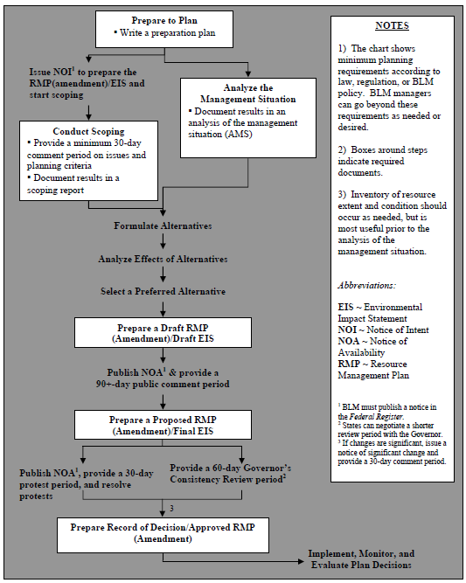
Module 2 – LUP part 1
Overview of the Land Use Planning Process
Notes:
Through the course we will be referring to this handout to indicate where the different “parts” of the recreation planning process get inserted in the LUP process.
The BLM is currently in the process of revising the Planning Regulations in the CFR including streamlining the process. Be sure to get up-to-date information when you start working on your plan so you understand how the changes may affect the recreation program.

Slide 9
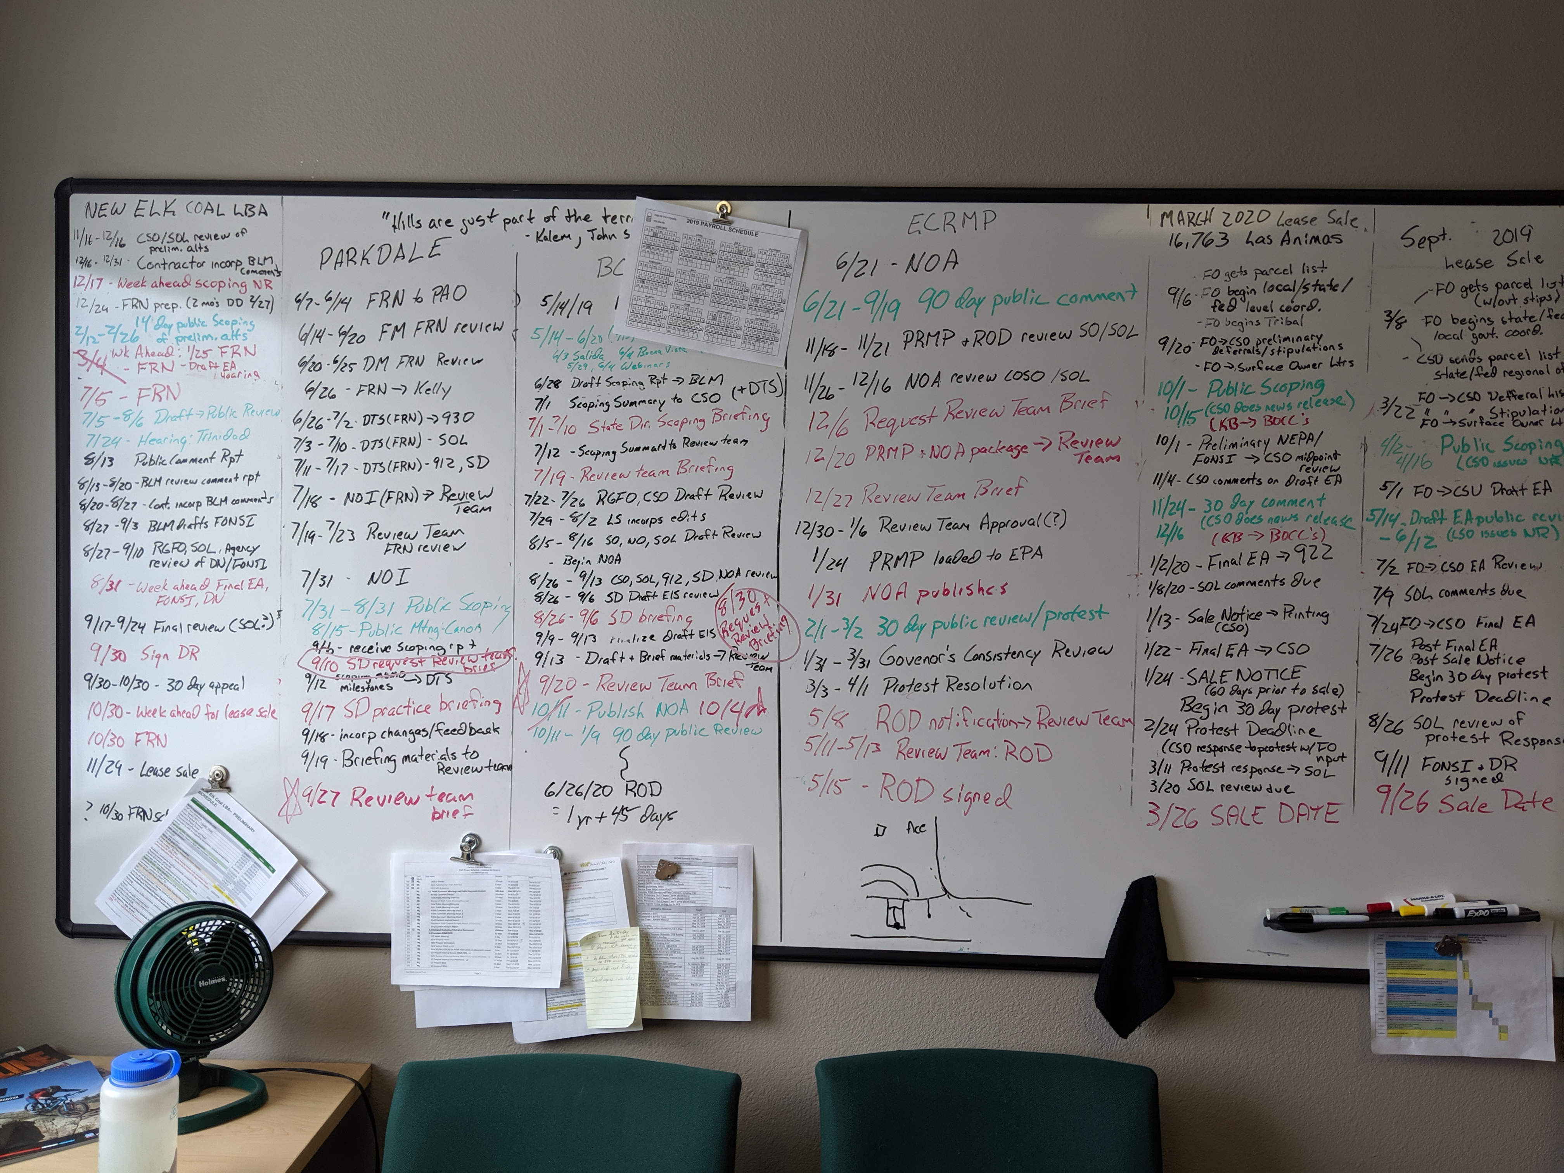
Module 2 – LUP part 1
Overview of the Land Use Planning Process
Notes:
And this is what that same process looks like in the eyes of a project manager. Staying on schedule is incredibly important to meet the timeframes established through NEPA streamlining efforts. There are a bunch of other sub-steps within each of the major milestones.

Slide 10
Module 2 – LUP part 1
LUP Checklist for RVS (Appendix 1, A1-1)
Preparing for a Planning Effort
Scoping
Analysis of the Management Situation (AMS)
Draft RMP
Alternative descriptions and comparison tables
Affected environment
Environmental Consequences
Consultation and Coordination
Proposed RMP/Final EIS
Record of Decision (ROD)/approved LUP
Notes:
All of this information can be found in the Handbook under Appendix A. This is a good reference that outlines each of the land-use planning steps and what you should be thinking about the R&VS.
Recommend the students put a sticky flag on this page so it’s easy to find when they need it.
MOVED THIS SLIDE TO BEFORE THE FLOW CHART AS AN INTO AND FOR STUDENTS TO FOLLOW ALONG.

Slide 11
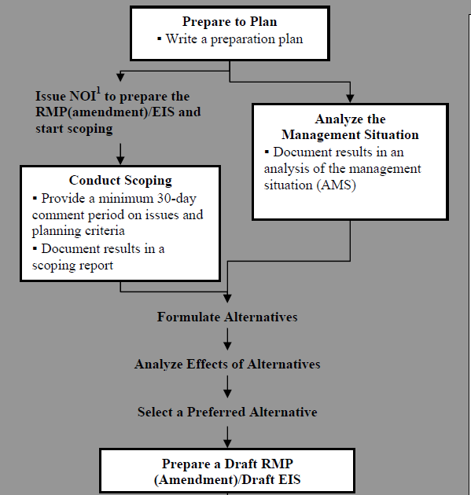
Module 2 – LUP part 1, pg A1-1
Preparation Plan:
- Interdisciplinary team typically involved.
Identifies:
- Preliminary issues to be addressed
- Skills needed
- Preliminary budget
- Preliminary planning criteria
- Data available and needed
Notes:
The preparation plan is more than merely a vehicle to secure planning funds.
A properly prepared preparation plan provides the foundation for the entire planning process by identifying the preliminary issues to be addressed, the skills needed to address them, a preliminary budget that can be used for the cost estimate, preliminary planning criteria, and data and metadata available and needed.
If the plan is to be contracted, the preparation plan also forms the basis for the statement of work.
Offices should use a full interdisciplinary team to develop a realistic preparation plan.
Recreation planners need to be thinking about data and inventory needs and timeframes to accomplish this.

Slide 12
Module 2 – LUP part 1, pg A1-3
Analysis of Management Situation (AMS):
- Each resource has a section
Identifies:
- Conditions of resources
- How resources are currently being managed (current RMP)
- Trends
- Future management opportunities
Used for writing the Affected Environment
Notes:
For recreation planners the AMS could include information such as visitor use data and types and number of SRPs. Look to studies and other planning efforts such as Statewide Comprehensive Outdoor Recreation Plans (SCORP) for trend data.
The AMS is used for the writing the affected environment so do a good job to save time later down the road.

Slide 13
Module 2 – LUP part 1, pg A1-2
Scoping
Officially starts the clock on the RMP in conjunction with the NOI
A scoping report is developed to help identify issues to formulate alternatives.
Notes:
Other information gathering efforts may also occur pre NOI such as community envisioning.

Slide 14
Module 2 – LUP part 1
Group Discussion
Are you currently in a LUP process, or about to start one?
What have been your challenges?
How are the streamlining timelines affecting your process?
Other?

