Slide 1
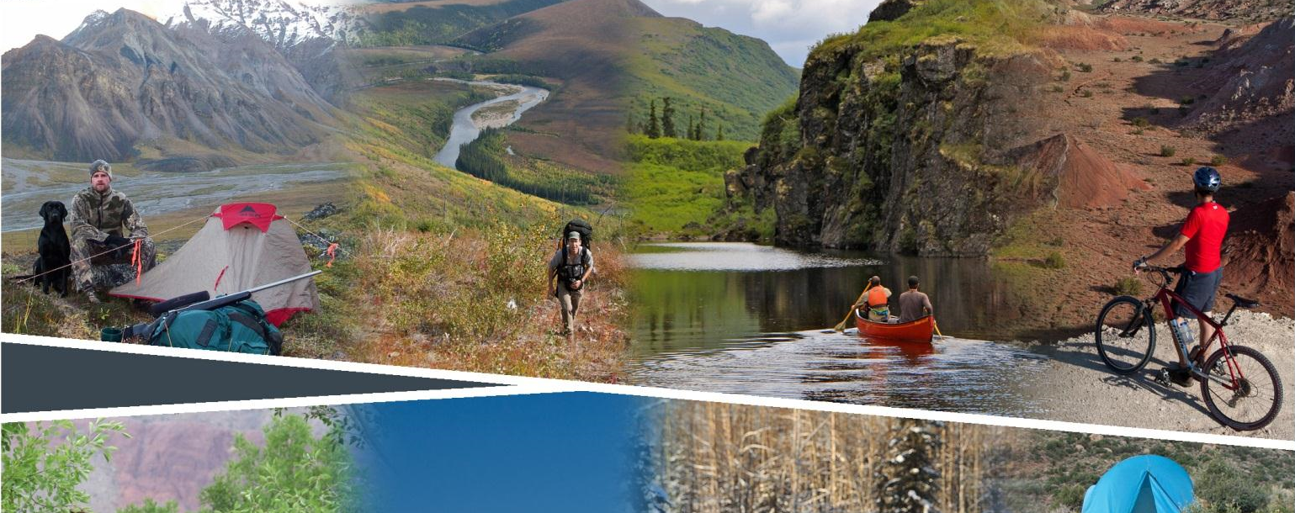
Planning for Recreation & Visitor Services

Slide 2
Module 3 – LUP Decisions for RVS
Required LUP Decisions for RVS
Dorothy Morgan, Outdoor Recreation Planner
WO-430 Division of Recreation and Visitor Services
dmorgan@blm.gov
202-912-7412

Slide 3
Module 3 – LUP Decisions for RVS, pg I-6
Objectives
What are the 3 required LUP Decisions for RVS?
What is the difference between SRMAs, ERMAs and undesignated lands?
What kind of objectives are required for each?
What LUP decisions must be made for the RVS, and other programs?
What is the difference between LUP decisions and Implementation decisions?

Slide 4
Module 3 – LUP Decisions for RVS, pg I-7
The 3 Required LUP Decisions for RVS:
Designate Recreation Management Areas (RMAs)
Establish R&VS Objectives for each RMA
Identify LUP-level Management Actions and Allowable Use Decisions for each RMA

Slide 5
Module 3 – LUP Decisions for RVS, pg I-7-0
Special Recreation Management Area | Extensive Recreation Management Area
Definition: Recreation opportunities or recreation setting characteristics (RSCs) unique, important or distinctive | Definition: Specific management required to address recreation use, demand or R&VS program investments
Management Focus: Protect/enhance targeted activities, experiences, benefits, and desired RSCs. | Management Focus: Support the principal recreation activities and the associated qualities and conditions, commensurate with other resources or resource uses.
Requirements: Outcomes-focused objectives, protect the desired RSCs, and constrain non-compatible uses. | Requirements: Objectives which define the recreation activities & the area’s associated qualities and conditions.
Keywords. Unique, Important or Distinctive Priority Protect and Enhance | Keywords. Specific R&VS Mgmt Required Commensurate Support and Sustain
Notes:
What is the difference between SRMAs & ERMAs?

Slide 6
Module 3 – LUP Decisions for RVS, pg I-9
Management Focus. Recreation is not emphasized however recreation activities do occur. Allow recreation uses that are not in conflict with the primary uses. Managed to meet basic R&VS and resource stewardship needs.
Requirements. Identify decisions to address basic R&VS and resource stewardship needs: Visitor health and safety. Use and user conflicts. Address the type(s), activities and locations where special recreation permits would not be issued. Mitigation of recreation impacts on cultural and natural resources.
Lands not Designated

Slide 7
Module 3 – LUP Decisions for RVS, pg I-7
Objectives for RMAs
SRMA | ERMA
Outcome-focused objectives define the specific recreation opportunities: Activities Experiences Benefits (derived from those experiences) | Objectives define the: Activities Qualities and conditions which support the activities

Slide 8
Module 3 – LUP Decisions for RVS, pg I-8-9
LUP Decisions within RVS Program
SRMA | ERMA
Identify R&VS decisions necessary to: Sustain or enhance recreation objectives. Maintain or enhance desired RSCs. | Identify R&VS decisions necessary to: Facilitate participation in identified activities. Maintain particular RSCs.
Restrict uses and activities detrimental to achieving objectives.
Address visitor health and safety, resource protection, and use and user conflicts.
Type(s), activities and locations where SRPs would not be issued.
Mitigation of recreation impacts on cultural and natural resources.
Notes:
The differences are subtle but important.
Ask the class to identify the differences.
Ask for examples.
Be cautious with any LUP decisions – changing them requires a LUP amendment which can be very difficult and time consuming.
Err on the side of caution, and flexibly by separately identifying “implementation decisions” or “implementation guidance” in the Recreation Appendix.

Slide 9
Module 3 – LUP Decisions for RVS, pg I-8-9
LUP Decisions within other programs
Establish terms, conditions or restrictions for other resource uses necessary to achieve the RMA objective(s).
Examples:
Stipulations on mineral or other development
ROW avoidance or exclusion
OHV designations
Areas available for livestock grazing
Visual Resource Management (VRM) classes

Slide 10
Module 3 – LUP Decisions for RVS, pg I-10
Implementation Decisions/Guidance
Anything that fits in one of these categories should NOT be a LUP Decision. (Identify it in the Recreation Appendix instead.)
Management (facilities, roads, trails)
Administration (permits, fees, recreation use restrictions)
Information & Education (maps, brochures, interpretation)
Monitoring (visitor use, resource impact, attainment of objectives)
Notes:
A high percentage of what we do in RVS falls under implementation.
More details on this later in the course. But important to keep in mind as we work through the exercises.

Slide 11
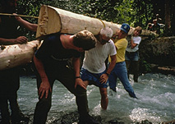
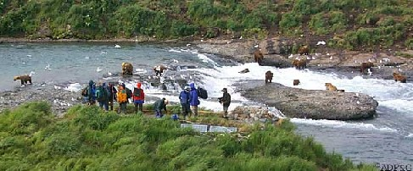
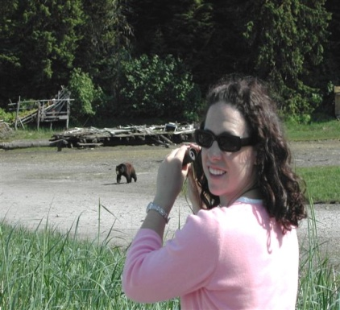
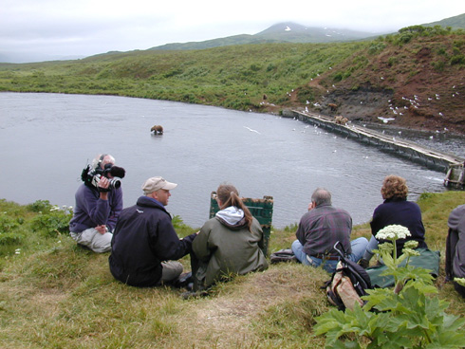
Module 1 – OFM Framework
Management,
Administration, Marketing & Monitoring Actions
Recreation Settings
Physical, Social & Administrative
Attributes
Recreation Activity Opportunities
Hiking
Wildlife Viewing
Experiences
Enjoying wildlife viewing
Personal Benefits
Improved environmental (wildlife) awareness
Community Benefits
Improved community identify
Environmental Benefits
Increased wildlife stewardship & preservation
Economic Benefits
Increased local economic stability
Management
Management Actions
Trail Building
Signing
Visitor Patrols
Administration
Allowable Uses
Visitor Limits
Budget Duties
Information/ Education
Naturalist Program
Brochures
Monitoring
LAC
Physical Setting
Level of:
Remoteness - high
Naturalness - high
Facilities - low
Social Setting
Level of:
Contacts - low
Group Size - small
Evidence of Use - low
Operational Setting
Level of:
Motorized Use - none
Visitor Services – mod.
Mgmt. Controls – high
Interact with
Produce
Facilitate
Notes:
Where do the LUP and Implementation decisions fit into the framework?
The “blue box” is what the manager does – through LUP and implementation decisions.
These affect the setting, which produces the activity opportunity which facilitates the outcomes!

Slide 12
Module 3 – LUP Decisions for RVS
Required LUP Decisions for RVS
Notes:
What boxes do the LUP decisions fit in?
What do we need to do before we make those decisions?

Slide 13
Module 1 – OFM Framework
Questions?
Notes:
Class discussion – ask for examples of each.

