Slide 1
Planning for Recreation & Visitor Services

Slide 2
Module 4 – Evaluating RMAs (pg I-34)
Evaluating Recreation Management Areas (RMAs)
Kimberly Leitzinger
Outdoor Recreation Planner
Colorado River Valley Field Office
kleitzinger@blm.gov
(970) 876-9075

Slide 3
Module 4 – Evaluating RMAs (pg I-34)
Objectives
Where does this step fit in the LUP process?
How do you determine eligibility?
How do you determine manageability?
How do you determine the RMA type?

Slide 4
Module 4 – Evaluating RMAs (pg I-34)
LUP Process
Consider an area’s eligibility and manageability before:
discussing it in the analysis of the management situation (AMS) or
proposing it for designation in the in the LUP (range of alternatives)

Slide 5
Module 4 – Evaluating RMAs (pg I-34)
Step 1 – Eligibility Factors
a. Demand for recreation opportunities.
b. Existing recreation use.
c. Supply of Recreation Setting Characteristics (RSCs).
d. The unique value, importance, and/or distinctiveness of RSCs, especially compared to other areas used for recreation.
e. Existing or needed R&VS program investments and infrastructure.

Slide 6
Module 4 – Evaluating RMAs (pg I-35)
Step 2 –Manageability Considerations
a. Capability to manage recreation resources and uses.
b. The amount of certainty that proposed or competing land uses or other resource values do not preclude providing the desired recreation opportunities or protecting the RSCs.
c. Ability to establish interdisciplinary management actions and allowable uses to support desired recreation opportunities.

Slide 7
Module 4 – Evaluating RMAs (pg I-35)
Step 2 –Manageability Considerations
d. Necessary recreation management actions and allowable uses that will be needed to:
(1) Support and facilitate targeted recreation opportunities.
(2) Maintain or enhance RSCs.
(3) Mitigate recreation impacts to cultural and natural resources.
(4) Address use and user conflicts.
(5) Gain public support for managing specific recreation opportunities.
(6) Involve existing and/or potential partners/volunteers to help the BLM manage specific recreation opportunities and RSCs on a sustained long-term basis.

Slide 8
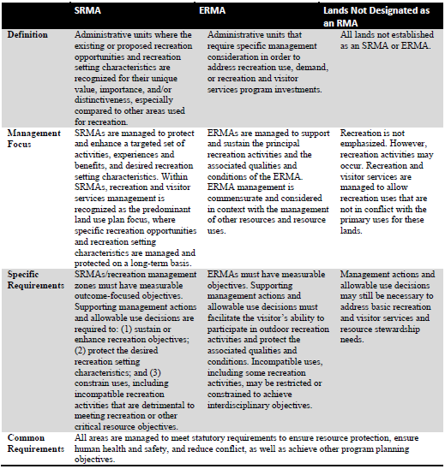
Module 4 – Evaluating RMAs (pg I-36)
Step 3 –Determine the RMA Type
See pg I-36, Figure 16 – Recreation Management Area Comparison Table

Slide 9
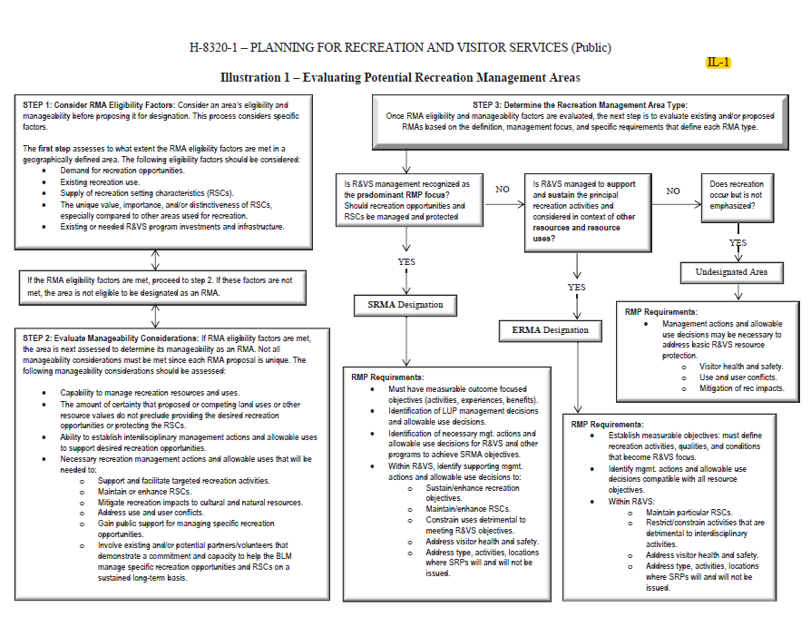
Module 4 – Evaluating RMAs (pg IL-1)
See also Illustration 1, pg IL-1

Slide 10
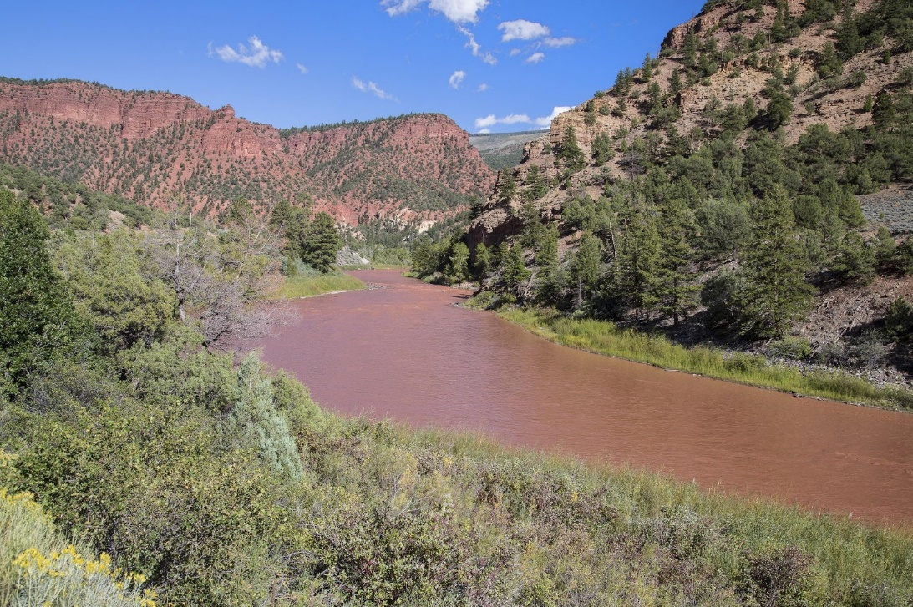
Module 4 – Evaluating RMAs
Colorado River Valley Field Office (previously known as Glenwood Springs Field Office) Case Study Information:
The 1984 Glenwood Springs RMP, along with subsequent amendments, has served as an effective guide for management of BLM-administered public lands within the planning area.

Slide 11
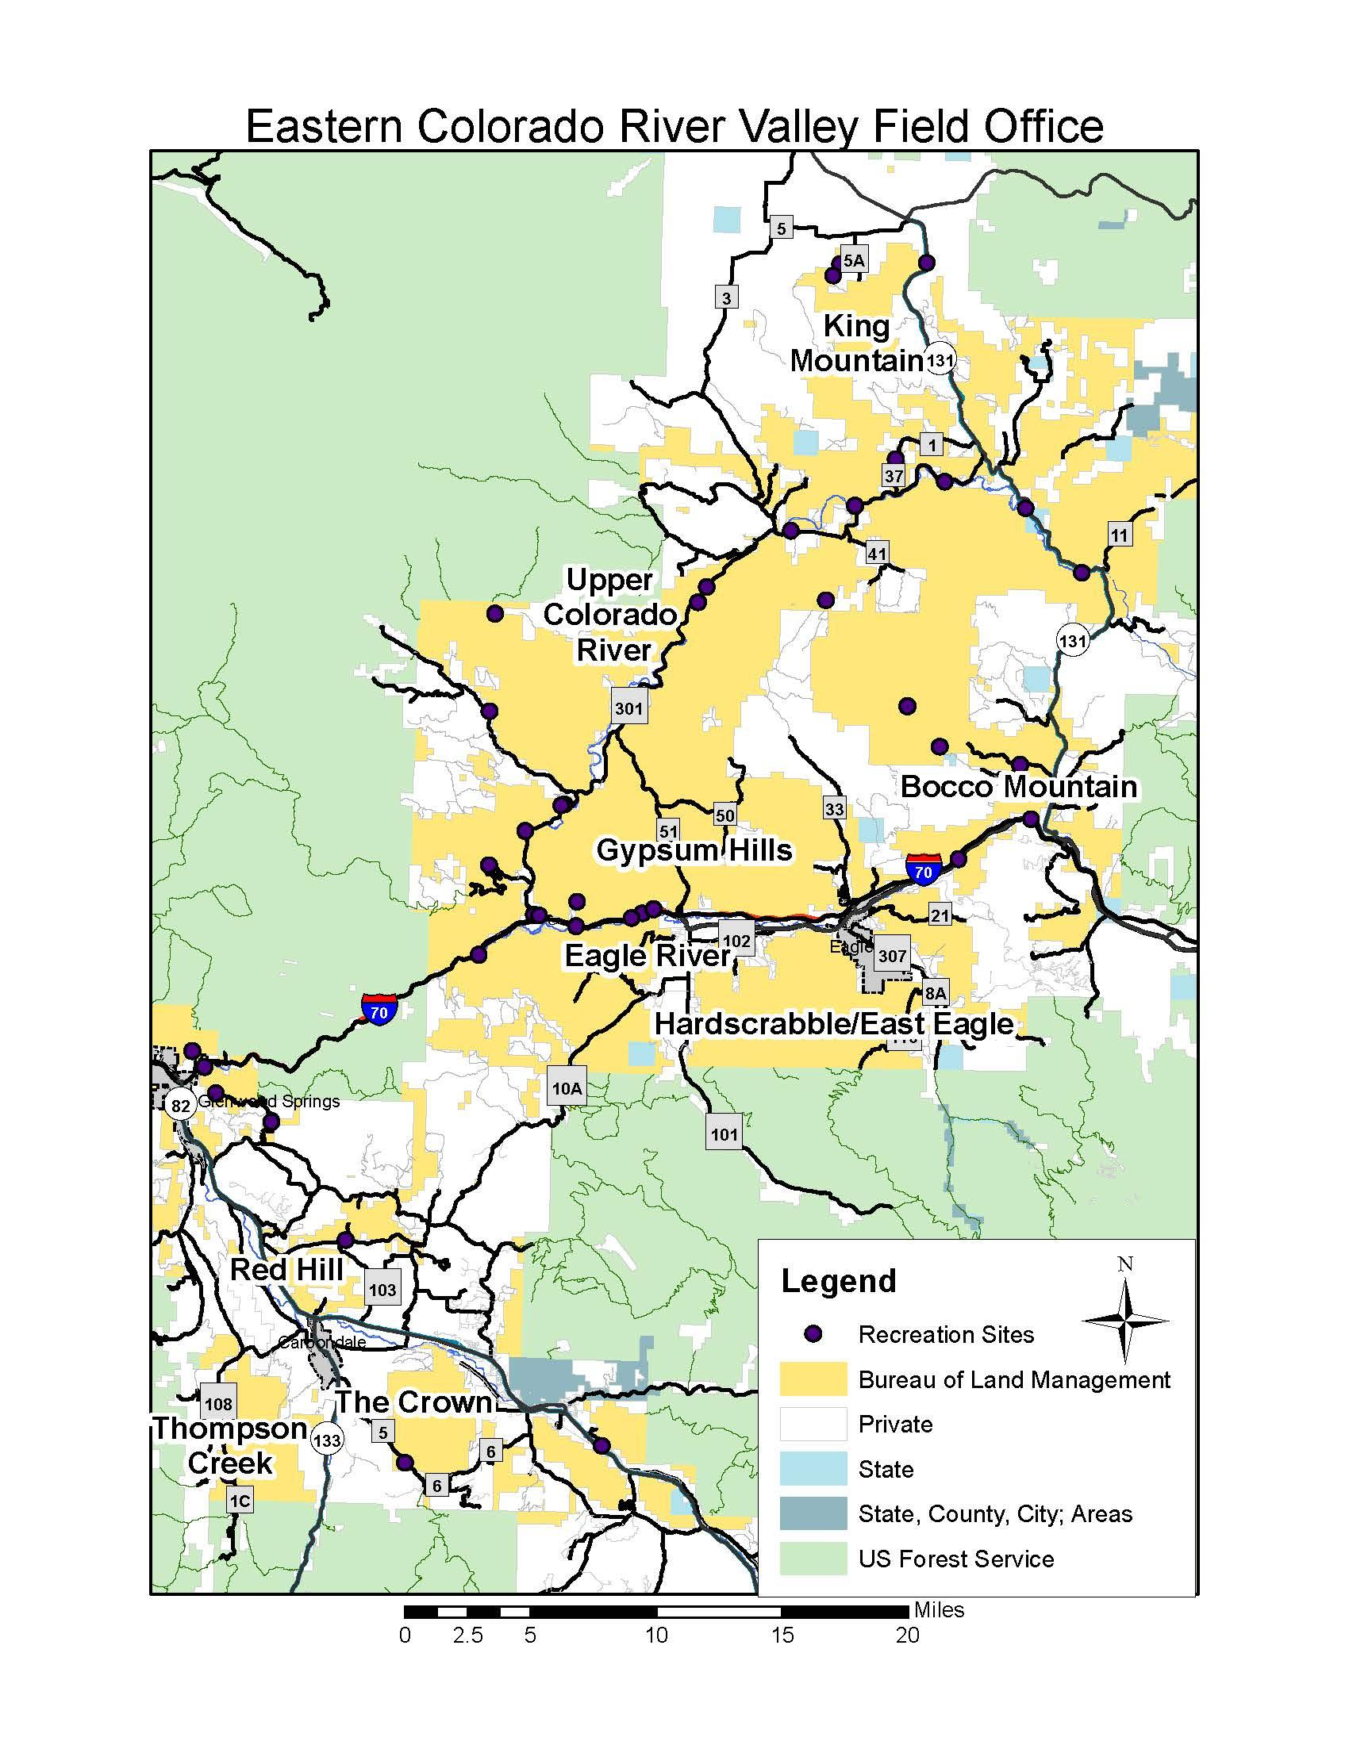
Module 4 – Evaluating RMAs

Slide 12
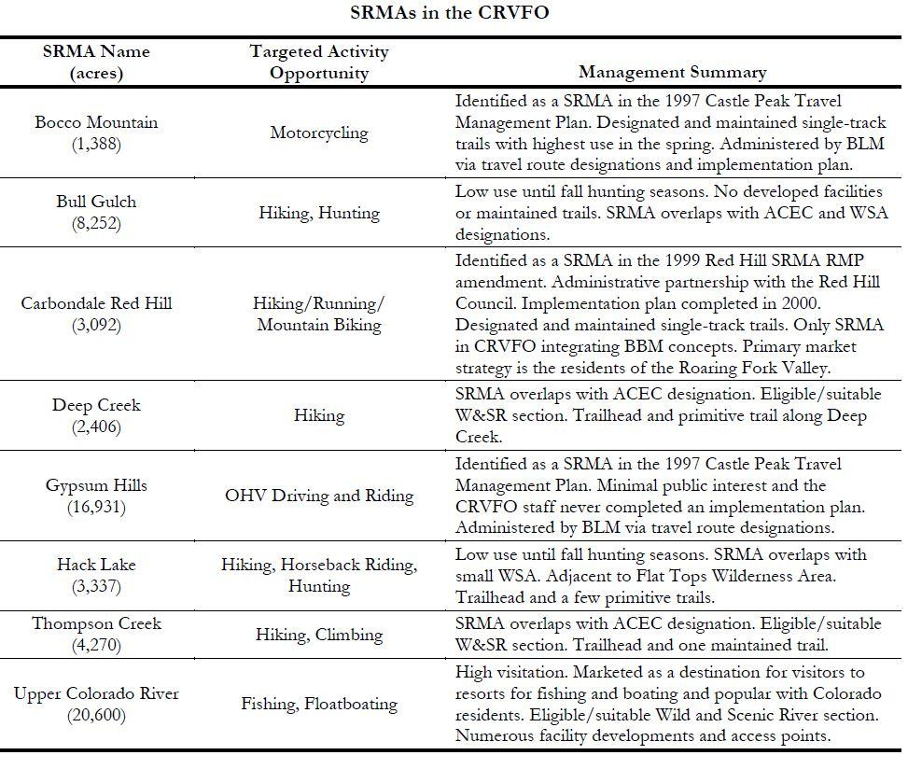
Module 4 – Evaluating RMAs
Bull Gulch, Deep Creek and Hack Lake were determined not to manage for recreation moving forward due to other management priorities.

Slide 13
Module 4 – Evaluating RMAs
Group Exercise
Consider potential RMAs.
List what makes the area eligible.
List what makes the area manageable.
Consider potential RMA type (SRMA or ERMA?)
Document supporting information on the RMA template.
Describe any potential resource or resource use conflict.
Helpful tools:
Pg I-34 Evaluating Potential RMAs (table)
Pg IL-1 Evaluating Potential RMAs (flow chart)

