Slide 1
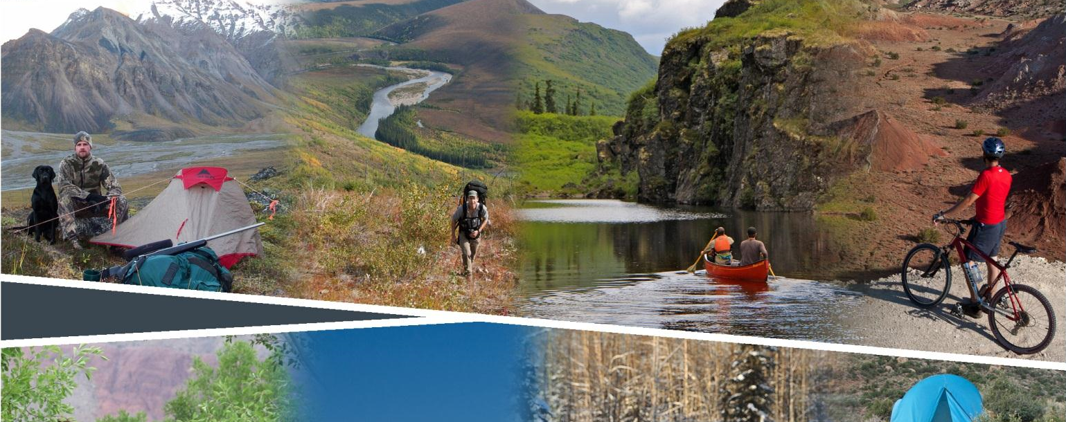
Planning for Recreation & Visitor Services

Slide 2
Module 5 – Data and Data Collection pg I-14
Data and Data Collection
Jared Oakleaf
Wyoming
Outdoor Recreation Planner, Lander Field Office
joakleaf@blm.gov
307-332-8407

Slide 3
Module 5 – Data and Data Collection pg I-14
Objectives
How is data used in the OFM framework?
What kind of data is needed?
Where is it collected?
How it is collected?
Case study – Colorado River Valley Visitor Study
Exercise

Slide 4
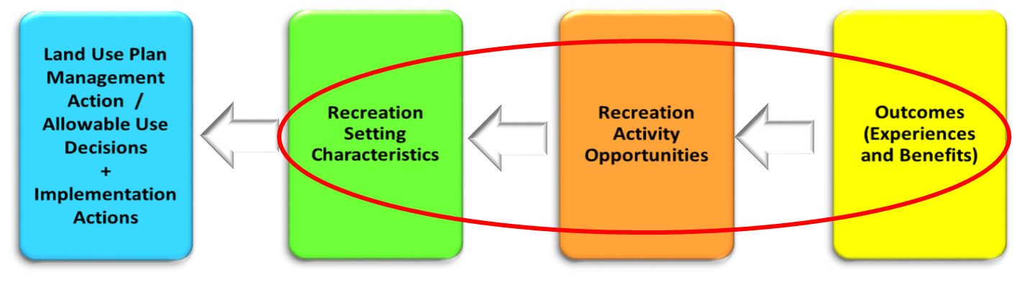
Module 5 – Data and Data Collection pg I-14
How is data used in the OFM framework?

Slide 5
Module 5 – Data and Data Collection pg I-14
Informal Discussions
What kind of data is needed?
Focus Groups
Scoping
Surveys
Other
Activities, Experiences, Benefits
RSCs
SRMA Objective

Slide 6
Module 5 – Data and Data Collection pg I-14
Where is it collected?
Focus on existing or potential RMAs
  Activities/ Opportunities
  Settings - What makes area:
  Unique
  Important
  Distinctiveness
  Experiences
  Benefits
    Personal/Individual
    Social/Community
    Economic
    Environmental
Notes:
Activities, experiences & benefits form the Recreation Objective.
Information on the settings form the “Desired Recreation Setting Characteristics.”
Collect data spatially, needs to be tied to existing or potential RMAs.
Determine zones and access points to collect data from.
These areas may become recreation management zones if the activities, experiences and outcomes of the visitors and/or communities are different (i.e. different objectives.)

Slide 7
Module 5 – Data and Data Collection pg I-14
Where is it collected?
Focus on existing or potential RMAs
Vicinity Map for Glenwood Springs Field Office
Survey Zones

Slide 8
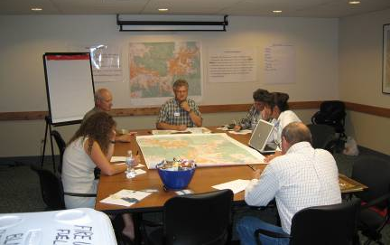
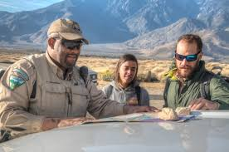
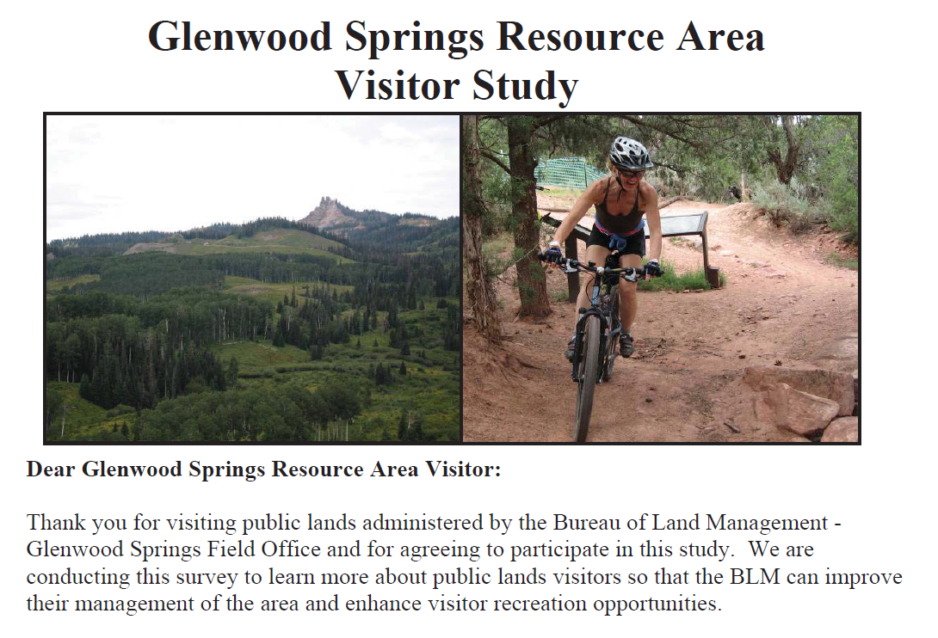
Module 5 – Data and Data Collection pg I-14
How is it collected?
Surveys
(IL-12, example)
Focus Groups
(IL-2, Small group
discussion)
Informal discussion/ contacts in field.

Slide 9
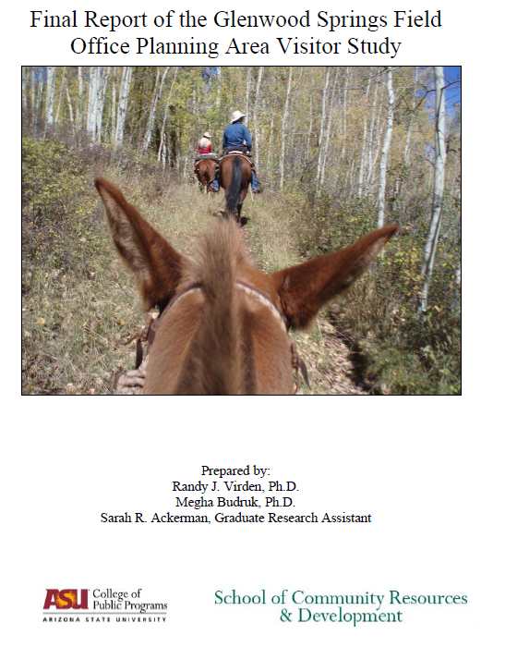
Module 5 – Data and Data Collection pg I-14
Case Study –
Glenwood Springs/ Colorado River Valley
Field Office
Notes:
Discuss methodology, results, how it influenced the plan, etc.

Slide 10
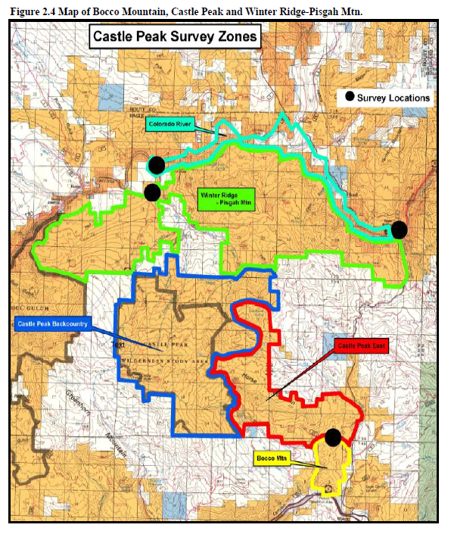
Module 5 – Data and Data Collection pg I-14
Case Study –
Glenwood Springs/ Colorado River Valley
Field Office
Notes:
Discuss methodology, results, how it influenced the plan, etc.

Slide 11
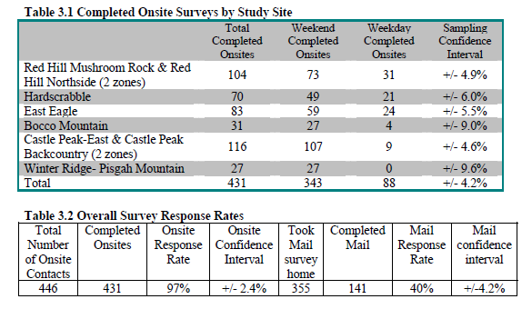
Module 5 – Data and Data Collection pg I-14
Notes:
Over view of Survey.

Slide 12
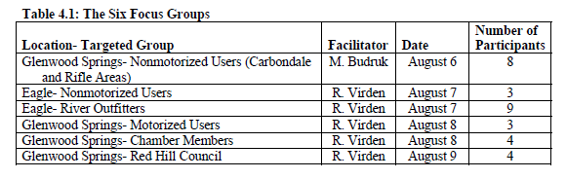
Module 5 – Data and Data Collection pg I-14
Notes:
Over view of Focus Groups.

Slide 13
Module 5 – Data and Data Collection
Data and Data Collection – Questions?
How is data used in the OFM framework?
What kind of data is needed?
Where is it collected?
How it is collected?
Case study – Colorado River Valley Visitor Study

Slide 14
Module 5 – Data and Data Collection
Exercise
Imagine you are a visitor to the Glenwood Springs Field Office in 2005.
Fill out the Visitor Survey.
Then – discuss as a group.

