Slide 1
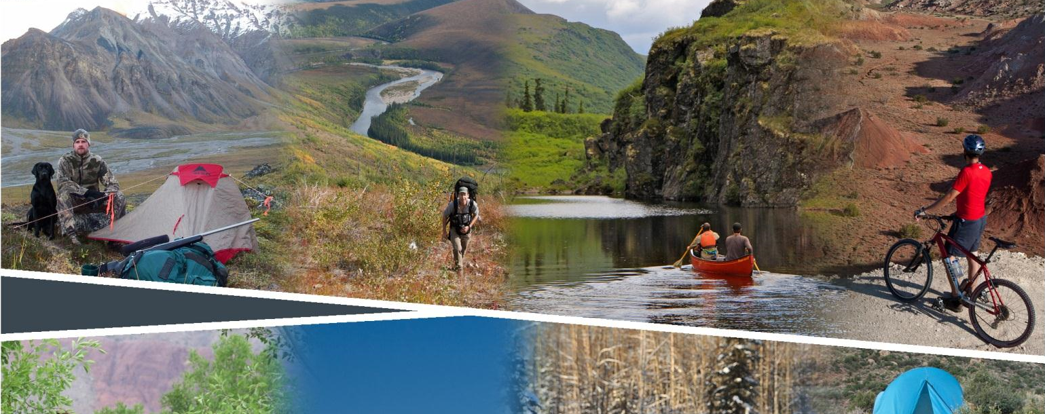
Planning for Recreation & Visitor Services

Slide 2
Module 6–Existing Settings, pg I-23
Existing
Recreation Setting Characteristics
Jared Oakleaf
Outdoor Recreation Planner
BLM Lander Field Office
307-332-8408
joakleaf@blm.gov

Slide 3
Module 6–Existing Settings, pg I-23
Objectives
What are Recreation Settings Characteristics (RSCs)?
How are RSCs useful and how can they be displayed?
Where do they fit in the LUP process?

Slide 4
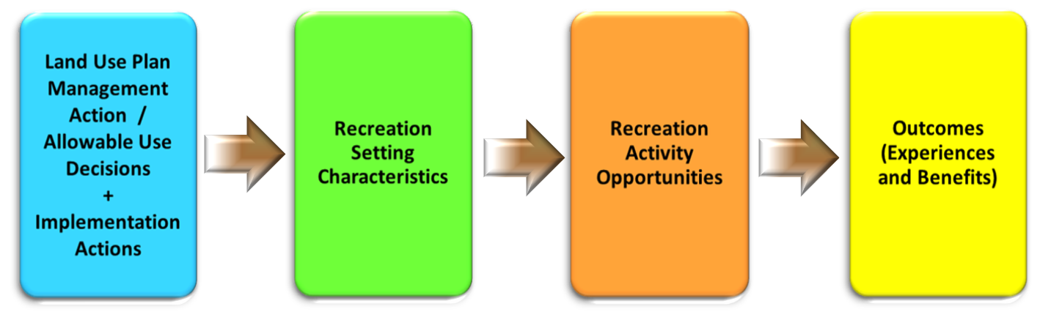
Module 6–Existing Settings, pg I-23
Existing Recreation Setting Characteristics
(RSCs)

Slide 5
Module 6–Existing Settings, pg I-24
Spectrum of Characteristics

Slide 6
Module 6–Existing Settings, pg I-25
What are RSCs?
Notes:
RSCs are a continuum of classes characterized by three components—physical, social, and operational qualities and conditions of the area. Each component is further defined by characteristics such as remoteness, group size, and types of access. This provides a comprehensive way to describe a geographic location’s recreational qualities and conditions.

Slide 7
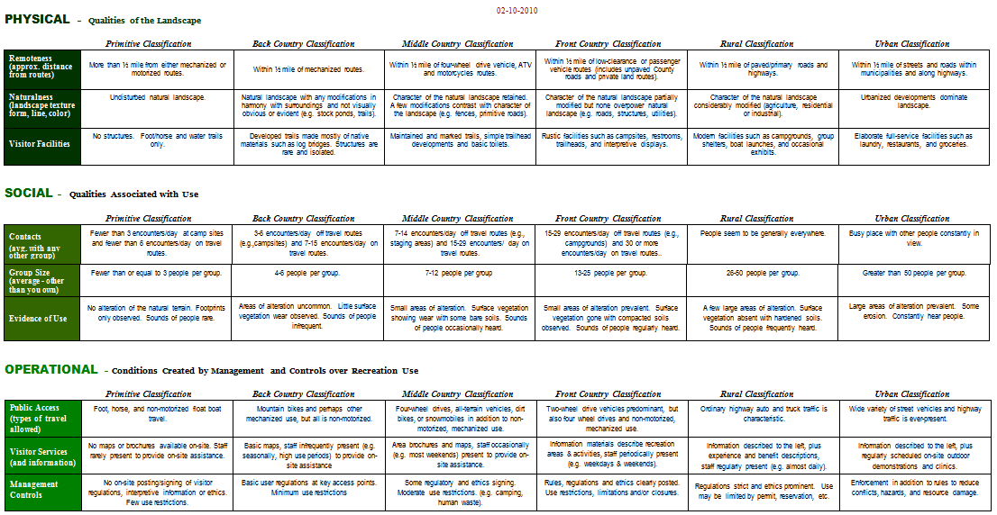
Module 6–Existing Settings, pg Appendices A3-1
Recreation Setting Characteristics Matrix
Notes:
RSCs are a continuum of classes characterized by three components—physical, social, and operational qualities and conditions of the area. Each component is further defined by characteristics such as remoteness, group size, and types of access. This provides a comprehensive way to describe a geographic location’s recreational qualities and conditions.

Slide 8
Module 6–Existing Settings, pg I-27
Help describe areas using:
Narrative Format
(Qualitative inventory)
Notes:
The narrative format (see pg I-27 [Figure 10) is useful for describing RSCs without engaging in an extensive mapping exercise. This can be useful in the analysis of the management situation or in planning documents that include many RMA alternatives. The narratives can describe the RSCs for existing or proposed RMAs. RSC data for existing or proposed RMAs can be acquired from: existing management plans, travel designations, existing GIS information from other resource programs, staff observations, monitoring data, and professional judgment.
Describe an area using a narrative format, using the RSC matrix for support.

Slide 9
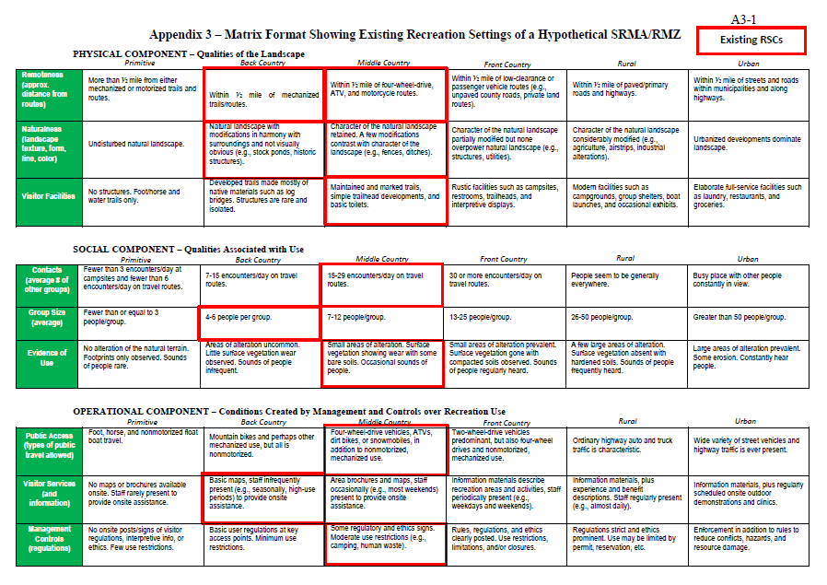
Module 6–Existing Settings, pg I-28
Help describe areas using:
Matrix Format
(Qualitative Inventory)
Notes:
The matrix format provides a description of individual RSCs and can be used as a visual tool to display RSCs on documents for public/staff discussions (see Figure 11). The classes of each RSC can be highlighted to visually show the supply of existing recreation settings (see Appendix 3). The matrix format can be used in lieu of RSCs narratives, or it can be used to complement maps displaying RSCs. The advantage of using the matrix format is that it can concisely display both existing and desired RSCs in the same graphic (see Figure 24).

Slide 10
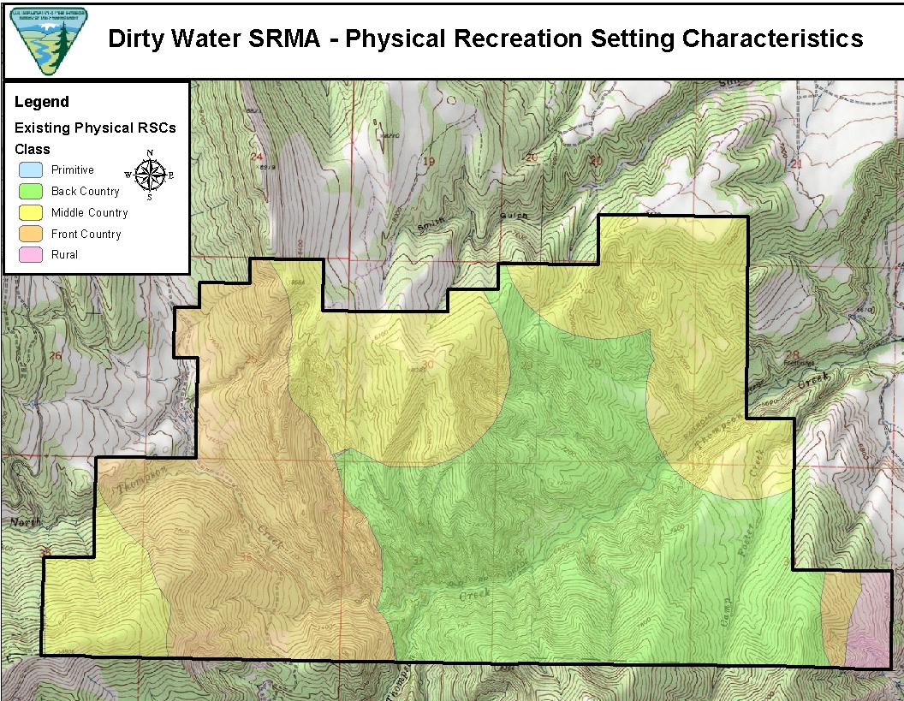
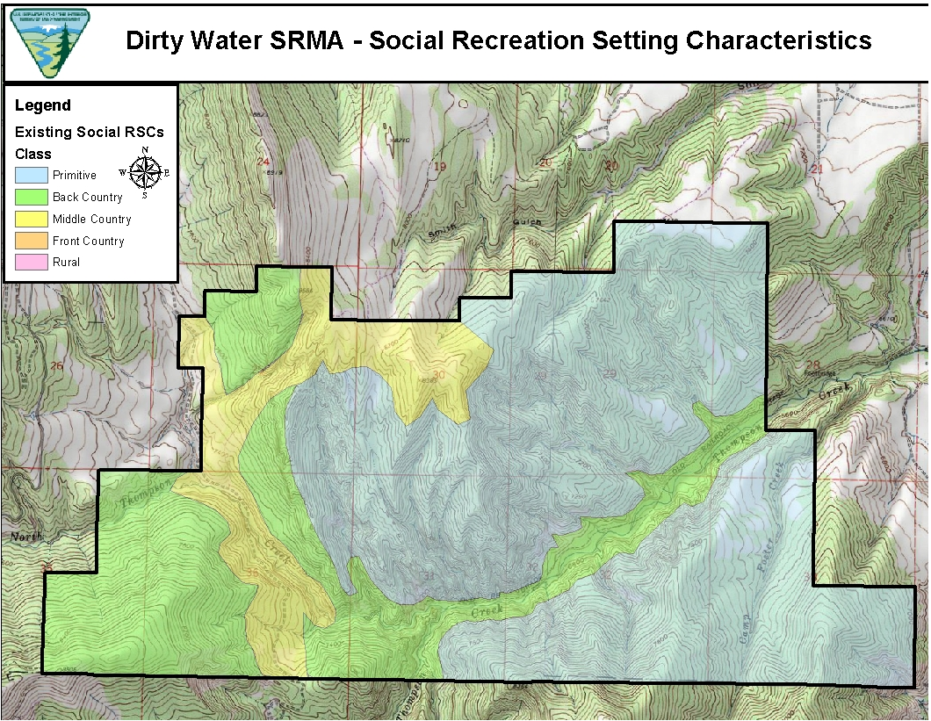
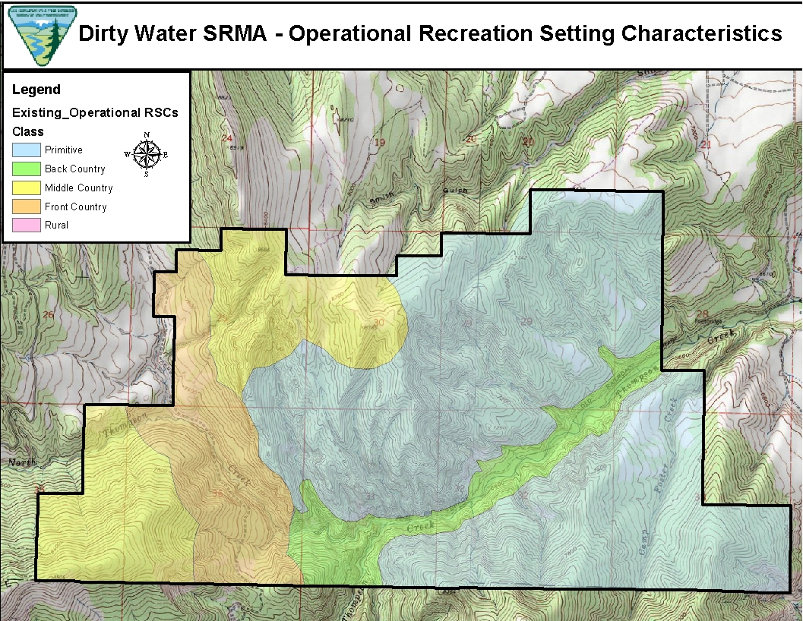
Module 6–Existing Settings, pg I-29
Help describe areas using:
Map Format
(Qualitative Inventory)
Notes:
Mapping is the preferred format for displaying RSCs (see Figures 12, 13, and 14). Mapping spatially displays physical, social, and operational recreation setting components and provides data for quantitative analysis. RSC maps may be developed for existing and proposed SRMAs, all RMAs, or the entire planning area. Mapping the entire planning area can offer useful data to support other LUP decisions, such as identifying BLM lands managed to protect wilderness characteristics or travel designations. Use geographic information system (GIS) data along with the RSC narrative and/or the RSC matrix to help construct maps.

Slide 11
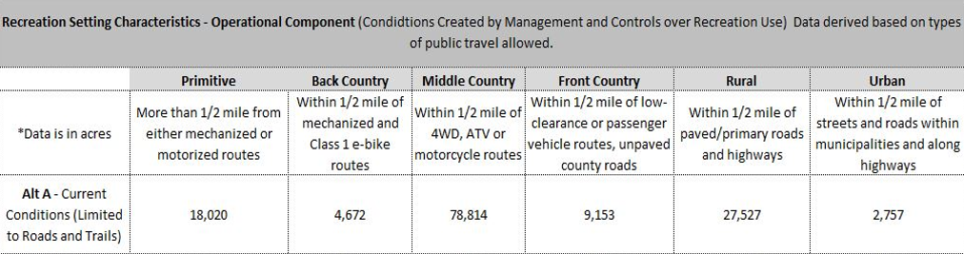
Module 6–Existing Settings
Quantitative Inventory
Notes:
Inventory: Once in GIS, acres of each component can be determined. This data can help with analysis. This level of analysis is mostly done during implementation planning because of the specificity. Most LUPs do not and probably should not get into this level of specificity.

Slide 12
Module 6–Existing Settings
Field Trip Exercise
Each group will be assigned a zone to inventory.
Draw a red box around the RSCs observed for the physical, social and operational setting
Remember – each zone is likely to have RSCs in more than one category!

Slide 13
Module 6–Existing Settings
Discussion for after field trip
Discuss your results with the class.
Compare your matrix with the other groups.
Compare you results with the following Existing RSCs from the CRV LUP.

Slide 14
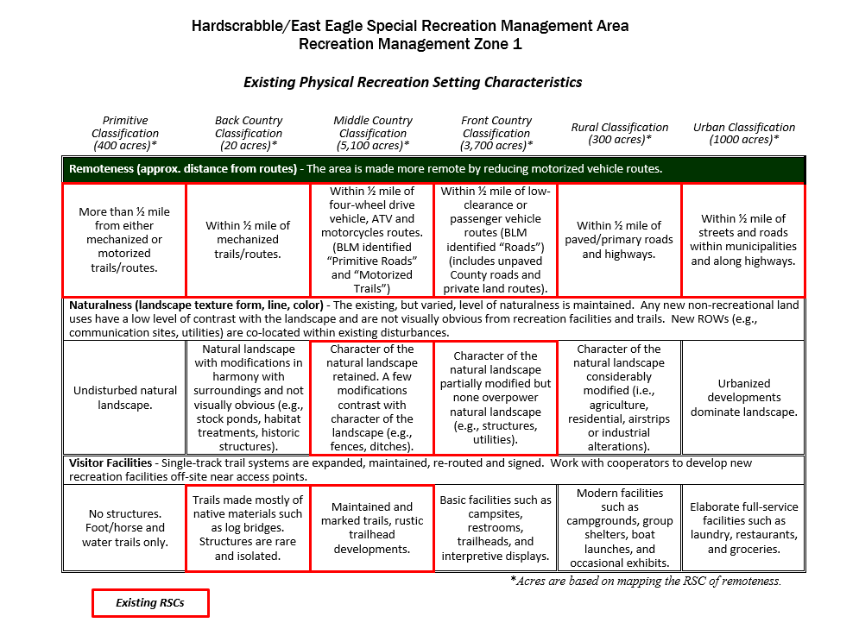
Module 6–Existing Settings

Slide 15
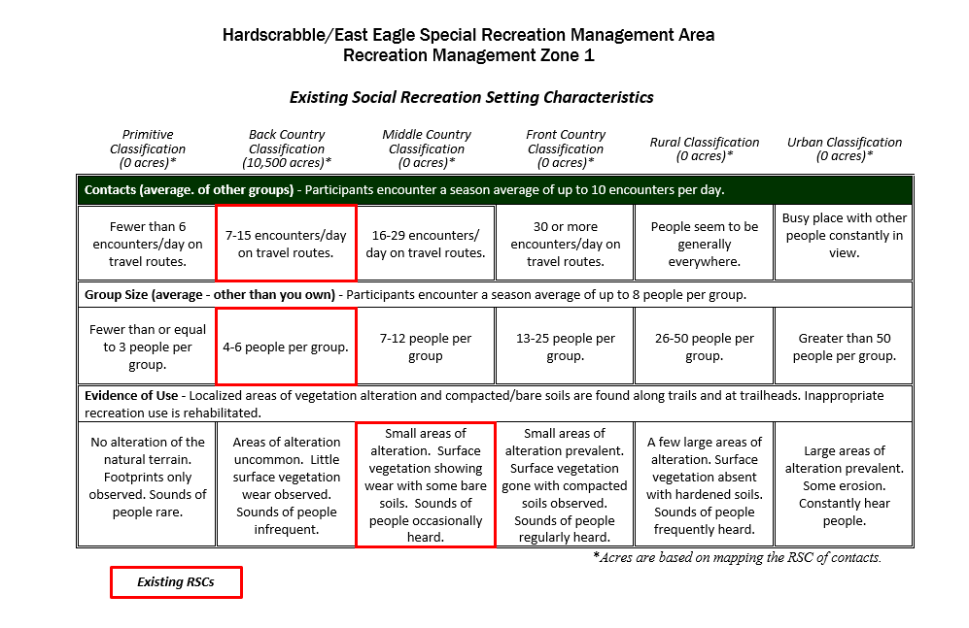
Module 6–Existing Settings

Slide 16
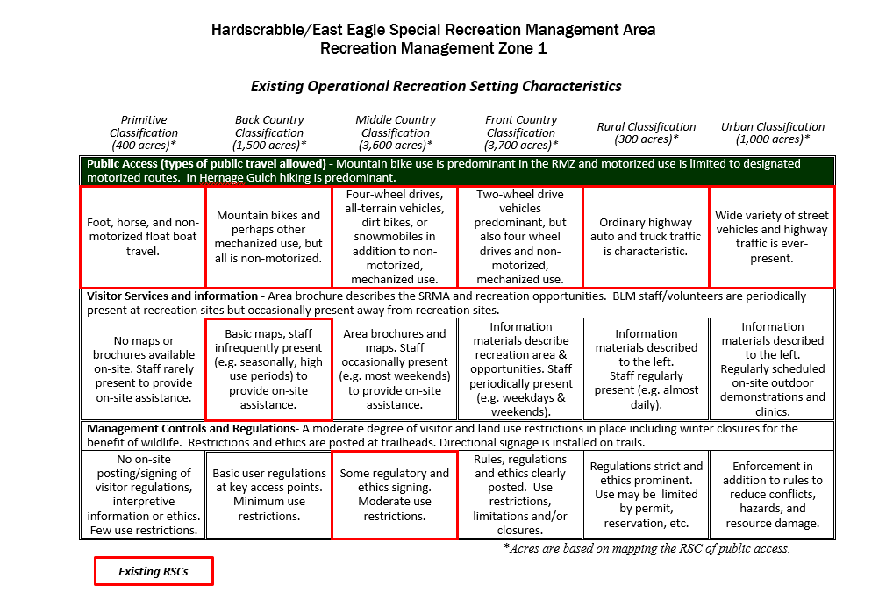
Module 6–Existing Settings

Slide 17
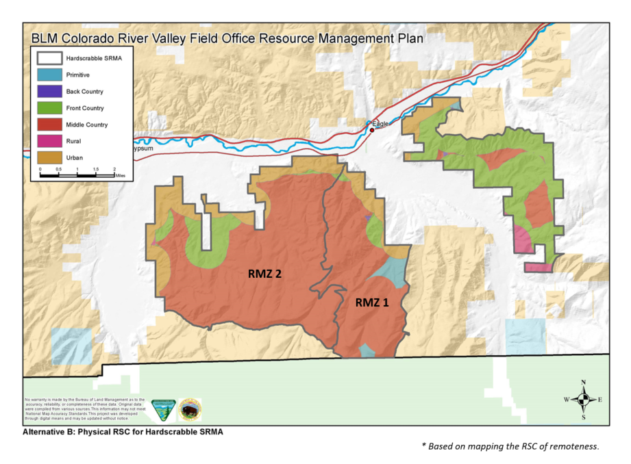
Module 6–Existing Settings

