Slide 1
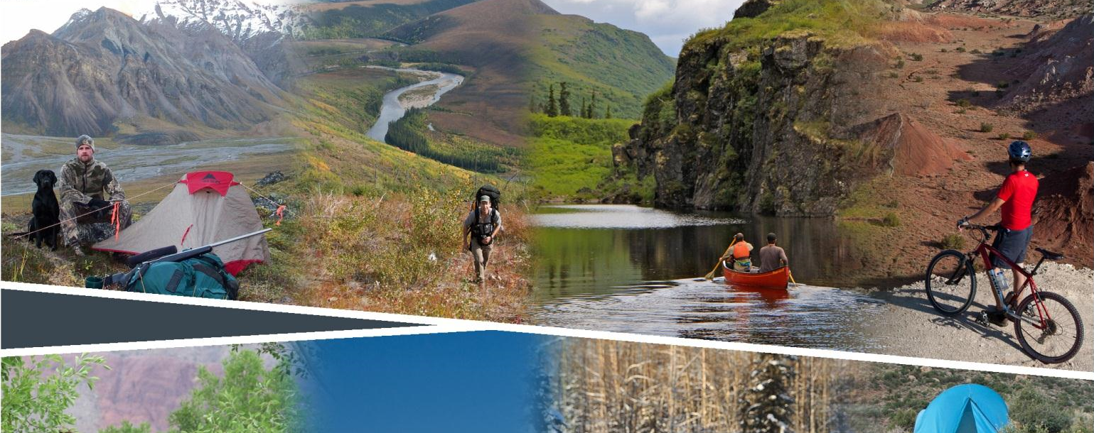
Planning for Recreation & Visitor Services

Slide 2
Module 7 – Writing Objectives
Writing Objectives
Kalem Lenard
Assistant Field Manager, Royal Gorge Field Office
jlenard@blm.gov
719-269-8538

Slide 3

Module 7 – Writing Objectives
Writing Objectives

Slide 4
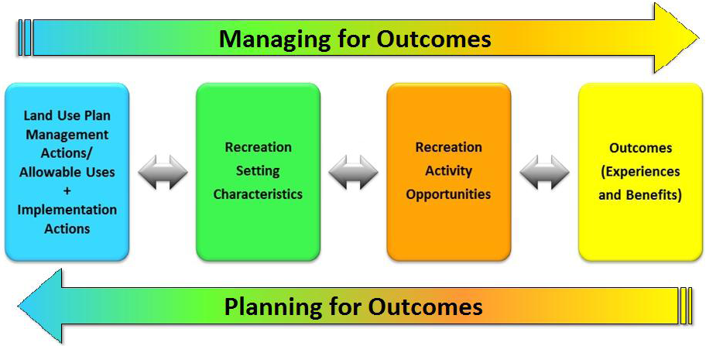
Module 01 – Writing Objectives
Notes:
When writing objectives, use data on visitor activities, experiences and benefits.

Slide 5
Module 7 – Writing Objectives
Objectives
Goals – General Recreation section.
SRMA Objectives – Outcomes-Focused Objectives.
ERMA Objectives – Activities, qualities and conditions.
Undesignated Lands – Safety, user conflict, resource protection.

Slide 6
Module 7 – Writing Objectives
Recreation Goals
Goals are for the general recreation section ONLY.
Think about the future of the planning area, be broad and general.
Avoid focusing on management activities of the recreation program and staff.
Consider including departmental recreation goals, strategic plans, LUP planning themes, purpose and need of the planning process.
Goals should be realistic and attainable.
R&VS goals should be consistent with other program goals.
Over the life of the LUP, what will be the general results or outcomes of the recreation program?
Notes:
Big Picture “WHY?”
Goals are important, but can be broad and general.
FUTURE – how do describe the future in the context of recreation?
What do we mean by management activities? (maintain facilities, provide information, provide access…)

Slide 7
Module 7 – Writing Objectives
Recreation Goals – Example
The recreation program will produce a diversity of quality recreational opportunities that add to the recreation participant’s quality of life, benefit local communities and contribute to regional economies while maintaining public land health.

Slide 8
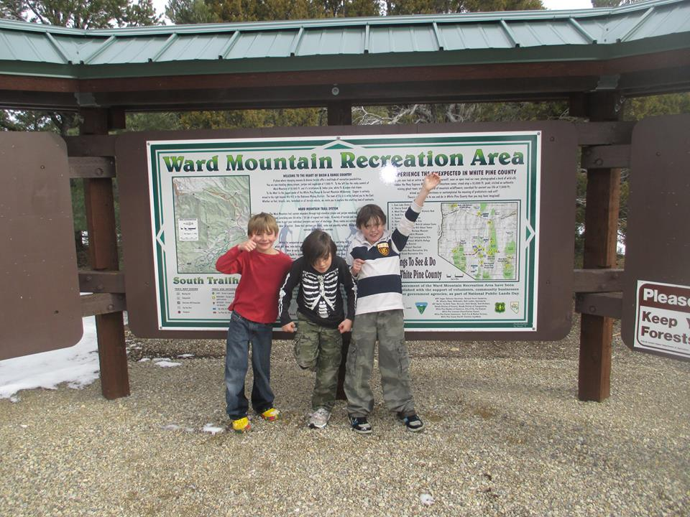
Module 7 – Writing Objectives
SRMA Objectives

Slide 9
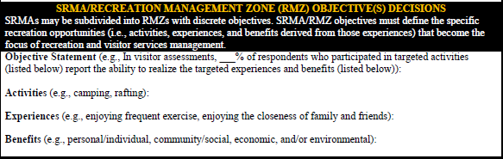

Module 7 – Writing Objectives
Activities: Hiking
Experiences: Enjoying canyon-country aesthetics
Enjoying a closer relationship with the natural world
Benefits: Greater environmental awareness and sensitivity
Improved stewardship/preservation
Identify...
Enjoying 1) canyon-country aesthetics & 2) a closer relationship with the natural world.
Greater environmental awareness & sensitivity
Improved stewardship/
preservation

Slide 10
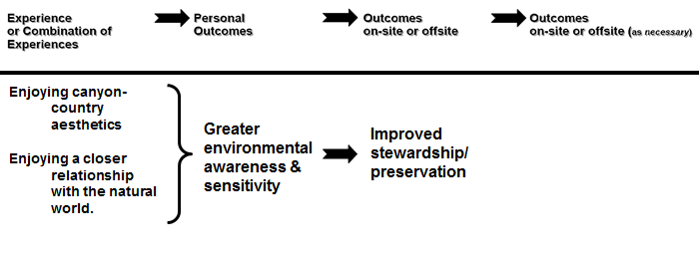
Module 7 – Writing Objectives
Identify...
Enjoying 1) canyon-country aesthetics & 2) a closer relationship with the natural world.
Greater environmental awareness & sensitivity
Improved stewardship/
preservation

Slide 11
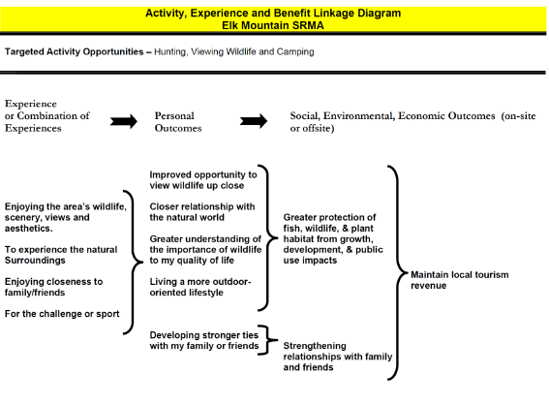
Module 7 – Writing Objectives, pg II-2
Linkages between activities, experiences, and benefits should be graphically diagramed to document their relationship.
Retain the documentation for the EIS/EA administrative record.

Slide 12
Module 7 – Writing Objectives
SRMA Objectives (OFM)
Outcomes-focused recreation objectives for an SRMA identify:
The specific set of recreation activities to be emphasized.
The specific outcomes (experiences and benefits) to be realized.
NOT
Management Actions
Or Implementation Actions!
Notes:
The objectives are based on data available through scoping, visitor studies, etc.
Save your management actions for later!

Slide 13
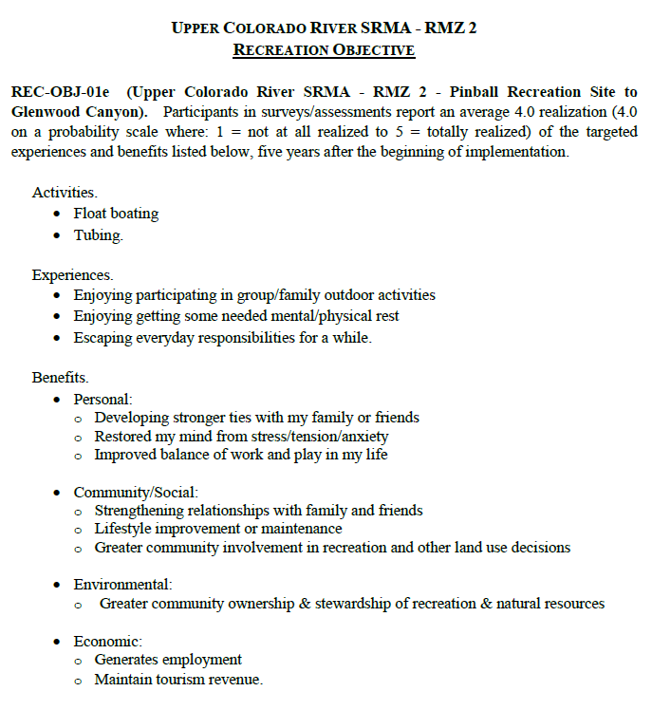

Module 7 – Writing Objectives
SRMA Objectives (OFM) - example

Slide 14
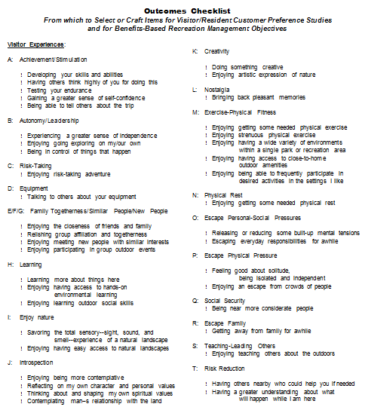
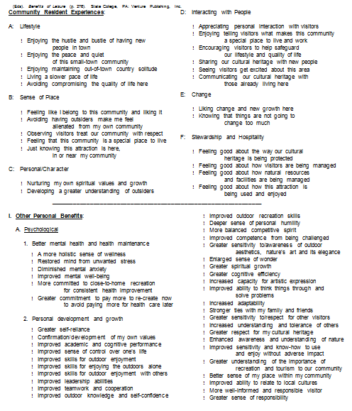
Module 7 – Writing Objectives
Experience and Benefit Checklist (Appendix 2)
Use as a guide, not a shopping list).

Slide 15
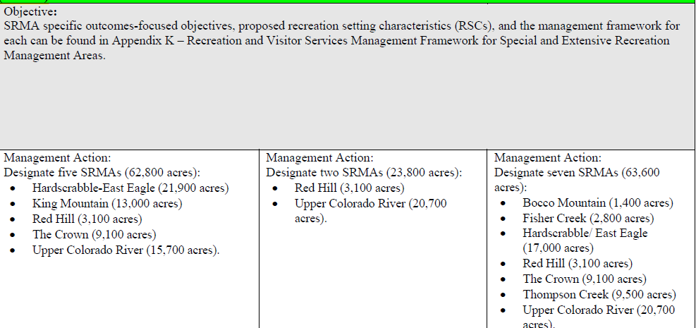
Module 7 – Writing Objectives
Abbreviated objective in Chapter 2 (Range of Alternatives) refers to the Recreation Appendix

Slide 16
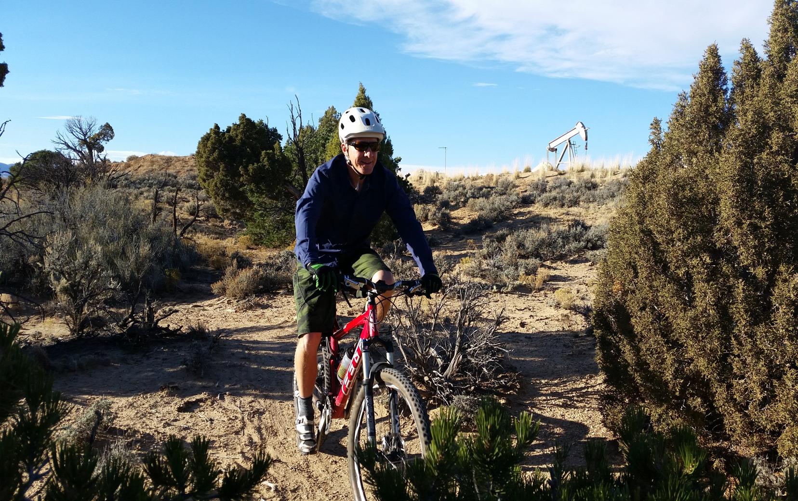
Module 7 – Writing Objectives
ERMA Objectives

Slide 17

Module 7 – Writing Objectives
ERMA Objectives
Objectives for an ERMA define…
the recreation activities and
associated qualities and conditions
… that will become the management focus for R&VS
Unlike SRMA objectives, ERMA
objectives do not typically describe
a set of outcomes to be targeted….?

Slide 18
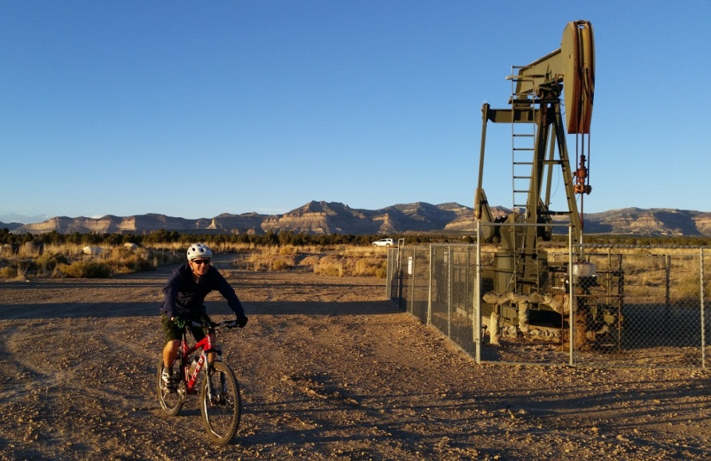
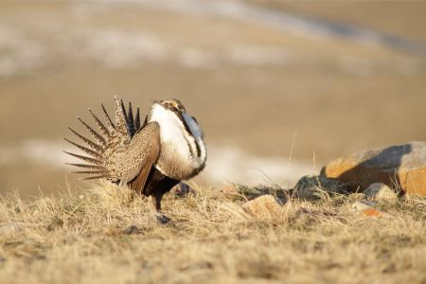
Module 7 – Writing Objectives
Because…
Conflicting resources
Or resource uses…
18
Notes:
Recreation managers may not autonomously manage the area's physical, social, and operational components to a degree necessary to facilitate attainment of a targeted set of outcomes, and recreation opportunities may be constrained by decisions to benefit other resources.

Slide 19
Module 7 – Writing Objectives
ERMA Objectives
Refer to the interdisciplinary state of the area with regard to …
appearance
administrative /managerial working order
the general environment
… that becomes the focus of recreation and visitor services management

Slide 20
Module 7 – Writing Objectives
ERMA Quality and Conditions Examples:
Maintaining particular RSCs
Improved visitor health and safety
Improved resource protection
Reduced use and user conflicts
Future condition of recreation infrastructure
Description of visitor services
Cooperation with community partners
Landscape conditions (e.g. open space)

Slide 21
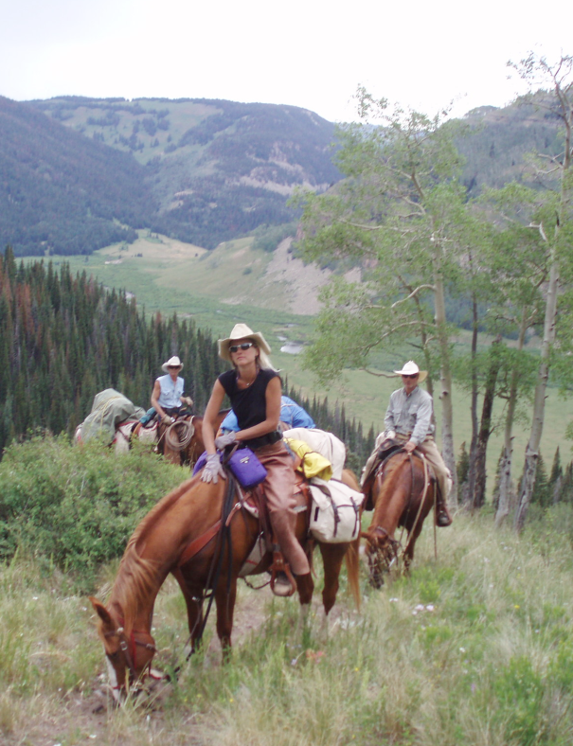
Module 7 – Writing Objectives
ERMA Objective Examples –
Through the life of the RMP in the Thompson Creek ERMA, the R&VS focus maintains the existing naturally-appearing landscape that supports participation in horseback riding and hunting while commensurately protecting wilderness characteristics and supplemental values.
Through the life of the RMP in the Barrel Springs ERMA manage recreation to ensure a balance between protecting off-highway vehicle recreation activities and settings with other resource uses. In this area, consider the following resource uses: fluid mineral leasing, livestock grazing, and lands and realty.

Slide 22
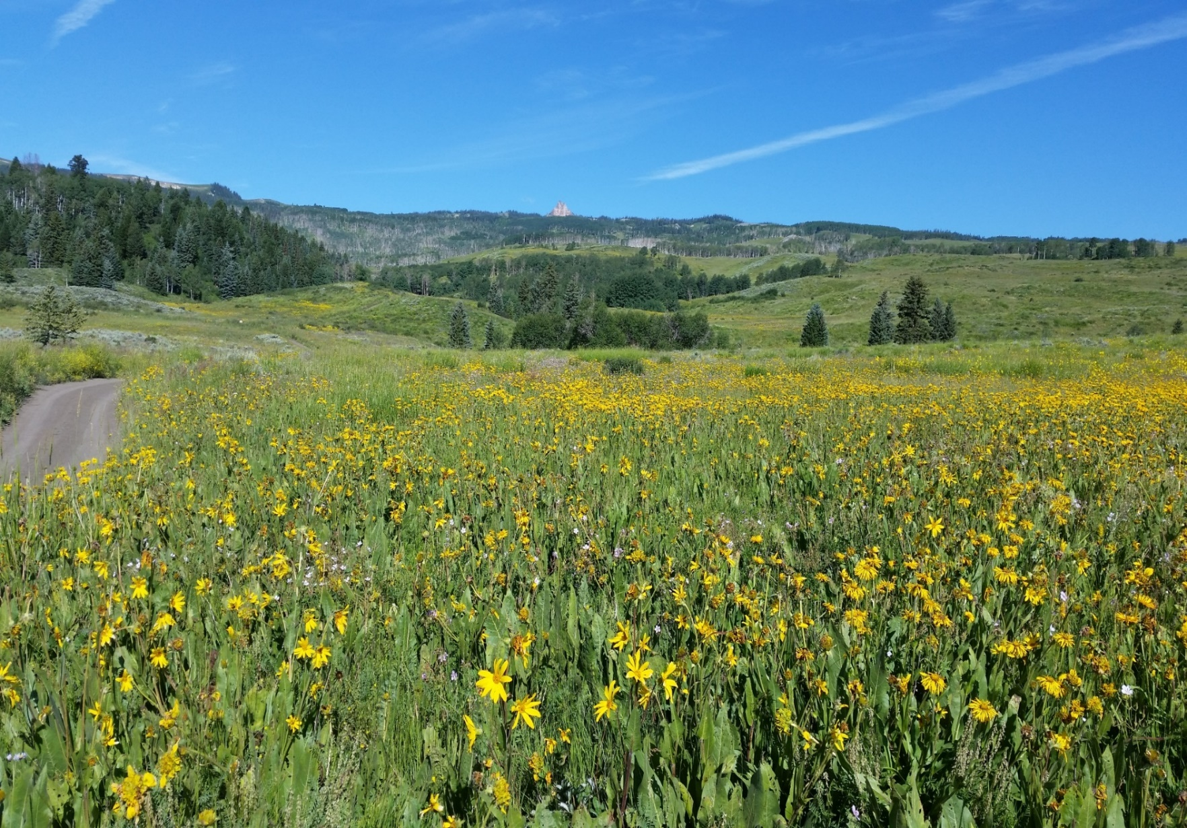
Module 7 – Writing Objectives
Objectives for undesignated lands

Slide 23
Module 7 – Writing Objectives
Objectives for undesignated lands
Recreation is not emphasized, however recreation activities may require management direction to address basic R&VS and resource stewardship needs.
R&VS objectives focus on:
resource protection
human health and safety
use or user conflicts

Slide 24
Module 7 – Writing Objectives
Group exercise:
Develop an objective for each of the following:
SRMA (see pg II-4)
Diagram the “linkage” for SRMA (pg II-2)
ERMA (see pg II-5)
Undesignated lands (see pg II-6)

