Slide 1
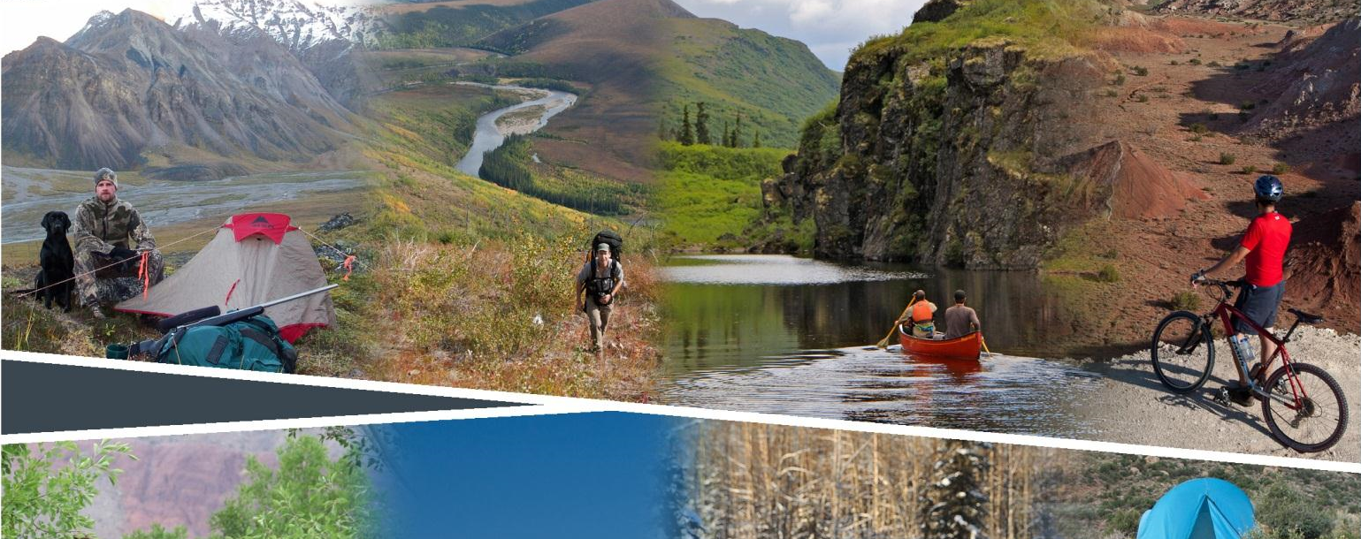
Planning for Recreation & Visitor Services

Slide 2
Module 8–Desired Settings, pg II-6
Desired
Recreation Setting Characteristics
Jared Oakleaf
Outdoor Recreation Planner
BLM Lander Field Office
307-332-8407
joakleaf@blm.gov
Notes:
Remind the class that Mod

Slide 3
Module 8 – Desired Settings, pg II-6
Objectives
Learn how to determine desired settings
Learn how to display desired settings
How desired settings are incorporated into the LUP process
Notes:
This module will show how we go from the existing setting to desired setting from data generated from focus groups or surveys. It will then show ways to display the desired settings related to the activities, experiences and benefits.

Slide 4
Module 8 – Desired Settings, pg II-6
Existing Recreation Setting Characteristics
(RSCs)
Notes:
This module will show how we go from the existing setting to desired setting from data generated from focus groups or surveys. It will then show ways to display the desired settings related to the activities, experiences and benefits.

Slide 5
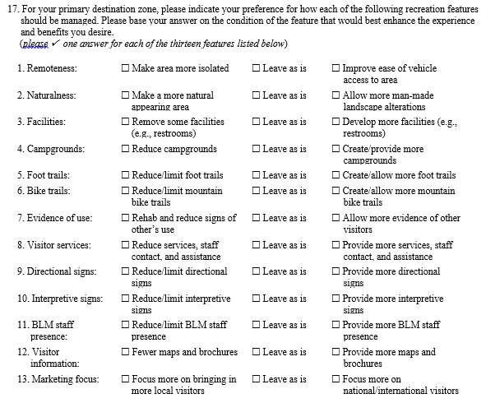
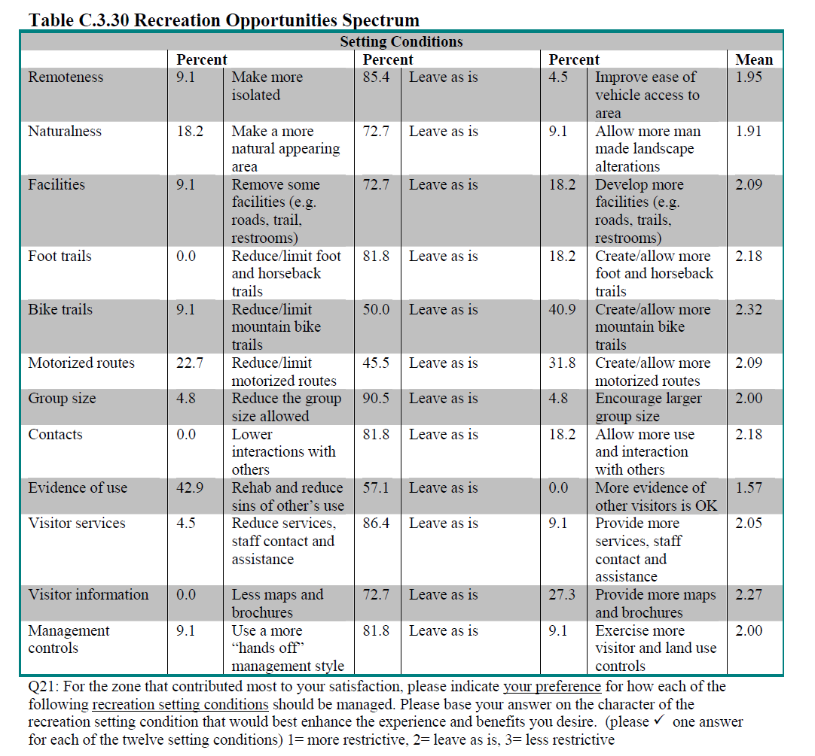
Module 8 – Desired Settings
How do we determine the Desired RSCs?
See page 182, Visitor Study handout.
Notes:
Sample question from the R&VS questionnaire and results. Results of this information will help guide the ORP in determining the differences there are between existing and desired settings.
RSC characteristics were asked in the questionnaire, Remoteness, Naturalness, Evidence of use, etc.

Slide 6
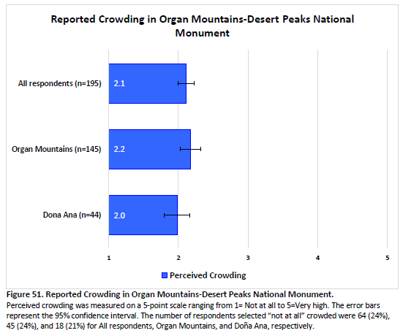
Module 8 – Desired Settings
How do we determine the Desired RSCs?
Notes:
Example from Organ Mountains – Desert Peaks National Monument visitor study.

Slide 7
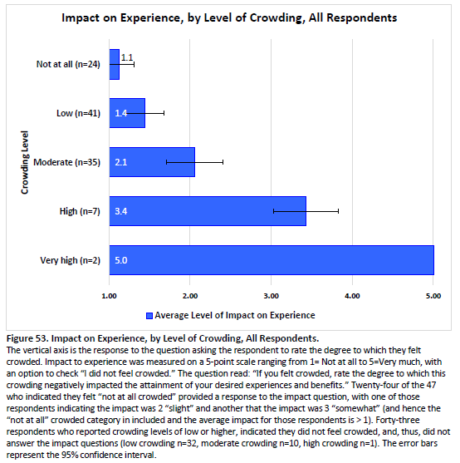
Module 8 – Desired Settings, pg II-6
How do we determine the Desired RSCs?
Notes:
Example from Organ Mountains – Desert Peaks National Monument visitor study showing to what degree crowding negatively impacted the visitor’s experience and attainment of benefits.

Slide 8
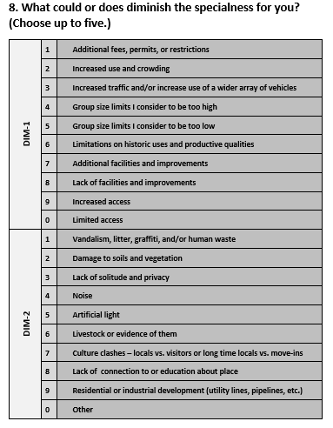
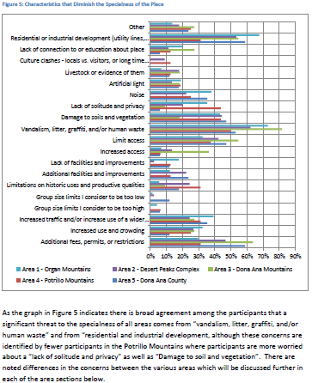
Module 8 – Desired Settings
How do we determine the Desired RSCs?
Notes:
Sample question from the R&VS focus group and results. Results of this information will help guide the ORP in determining the differences there are between existing and desired settings. This question also helps provide some insight as to what interdisciplinary management actions, allowable uses, BMPs and implementation actions could be considered to help support the RMA objective.
Physical, Social and Operational questions.

Slide 9
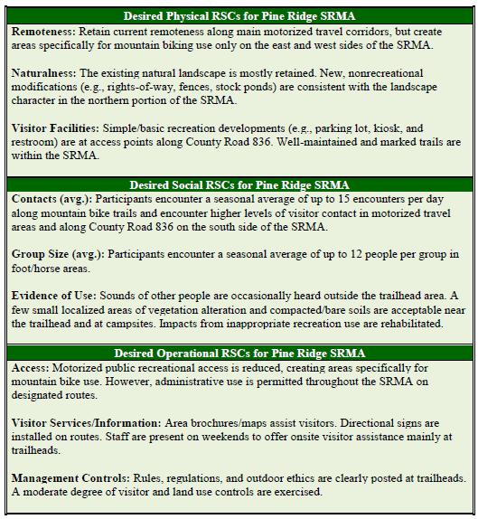
Module 8 – Desired Settings, pg II-9
Desired Recreation Setting Characteristics in a Narrative
Notes:
At a minimum, the LUP must describe the desired physical, social, and operational RSCs for SRMAs in a narrative format (see Figure 23 for an example). The desired RSCs should be realistic, achievable, and sustainable over time.
It is important to remember that when gathering data, focus groups or surveys, the public may have requested some shifts be made to the settings. The recreation planner understands the relationship between settings and outcomes and documents those changes that need to occur to help facilitate the RMA objective, i.e. desired outcomes.
The main point is to review and explain that it's similar to the mapping/narrative/matrix options of the existing settings, BUT based on input from visitors and communities and the influence of interdisciplinary LUP decisions.

Slide 10
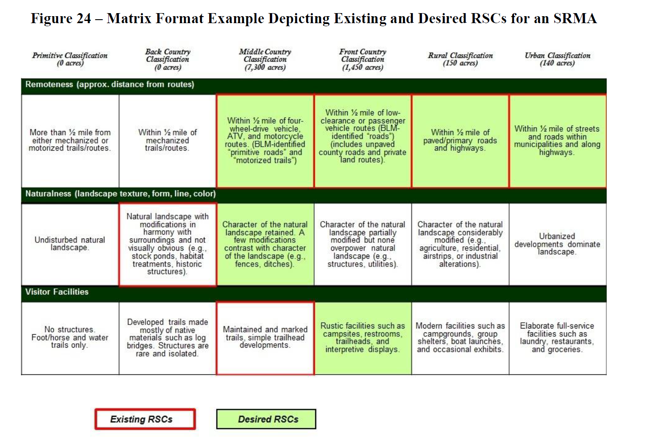
Module 8 – Desired Settings, pg II-10
Desired
Recreation Setting Characteristics in a Matrix
Notes:
The matrix format can clearly display both existing and desired RSCs. In the matrix format, this can result in different classes being highlighted for each individual RSC. For example, Figure 24 displays four remoteness classes (i.e., middle country, front country, rural, and urban) as the existing and desired recreation settings within the SRMA. But when it comes to managing visitor facilities, the desired class is a front country recreation setting class, not the existing middle country class. To achieve this RSC change in visitor facilities, the trailhead facilities are anticipated to be improved from simple trailhead developments (i.e., middle country class) to modest but rustic recreation sites with campsites and restrooms (i.e., front country class).
In summary, managing RSCs under an outcomes-focused framework means planning for each RSC individually and not trying to manage the RSCs within each recreation setting component (i.e., physical, social, and operational) under the same recreation setting class.

Slide 11
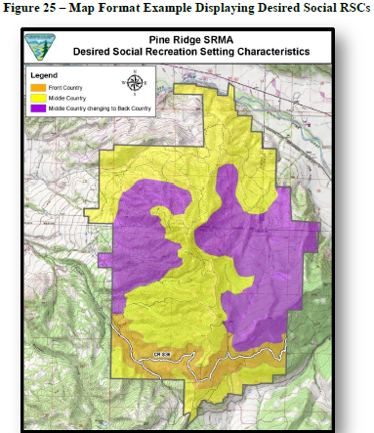
Module 8 – Desired Settings, II-11
Desired Recreation Setting Characteristics on Maps
Notes:
Mapping RSCs
Graphically support both the narrative and matrix formats along with supporting quantitative analysis. See Figure 25 for an example of a map displaying desired RSCs.

Slide 12
Module 8 – Desired Settings
Existing
and
Desired
Notes:
Question:
Will changing the setting from existing to setting change the experiences and benefits? This can be addressed in the analysis section of the LUP.
(In theory, yes. But it depends on the visitor – which is why we base our objectives and monitoring on the visitor reported experiences and benefits, NOT the setting it’s self!)
Reminder that Settings are NOT LUP decisions but they help support other interdisciplinary management actions and allowable uses, Module 9. The next step is to show how those desired settings can be translated into interdisciplinary actions and allowable uses.

Slide 13
Module 8 – Desired Settings, pg II-6
Questions?
Learn how to determine desired settings
Learn how to display desired settings
How desired settings are incorporated into the LUP process

Slide 14
Module 8 – Desired Settings, pg II-6
Exercise
Use data from:
GSFO Visitor Study Report
The objectives you developed in Module 7
Determine the Desired Recreation Settings
Highlight the desired RSCs on the matrix you used on the field trip.

