Slide 1
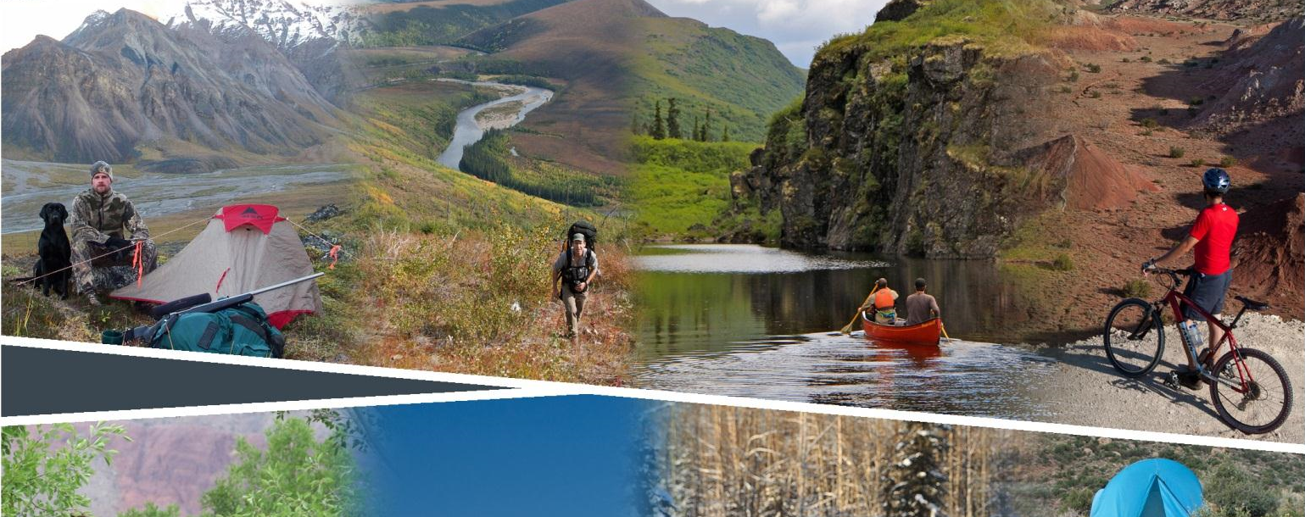
Planning for Recreation & Visitor Services

Slide 2
Module 9 – Interdisciplinary LUP Decisios
Interdisciplinary LUP Decisions
Kalem Lenard
Assistant Field Manager, Royal Gorge Field Office
jlenard@blm.gov
719-269-8538

Slide 3
Module 9 – Interdisciplinary LUP Decisions pg II-12 to II-16
Objectives
Identify management actions and allowable use decisions to support recreation goals and objectives.
Distinguish land use plan (LUP) decisions from implementation decisions and from best management practices (BMP).
Distinguish actions/decisions for the R&VS program and actions/decisions for other programs.

Slide 4
Module 9 – Interdisciplinary LUP Decisions
Notes:
Where do interdisciplinary LUP decisions fall within the framework?
pages II-12 to II-16 in the handbook
Now that the RMA objectives have been established it is necessary to identify management actions and allowable uses needed to achieve them and the desired or particular RSCs. Within the R&VS program and other programs, supporting management actions and allowable use decisions are selected in terms of their ability to help achieve the recreation objectives, maintain or enhance RSCs or guide recreation implementation.
Review the production process
It is very important to distinguish between LUP, implementation, and BMP decisions. Actions applied to the R&VS program could come from other programs (e.g., timing limitations, climbing closure)
Now we need to determine how best to produce the outcomes and recreation opportunities and achieve the desired RSCs by identifying supporting land use plan management actions and allowable uses.
After establishing objectives and identifying desired RSCs, identify management actions and allowable uses for each alternative needed to achieve them. They are needed to achieve program objectives or constrain incompatible activities.
Interdisciplinary management actions and allowable uses associated with the RMA help support the desired settings which in turn helps achieve the RMA objective. They are a way of translating what the publics desires into BLM LUP decisions.

Slide 5
Module 9 – Interdisciplinary LUP Decisions pg II-12 to II-16
LUP Decisions
Recreation and Visitor Services
LUP decisions must be necessary in order to :
Sustain or enhance recreation objectives.
Maintain or enhance the desired physical, social, and operational RSCs.
Address visitor health and safety, resource protection, and use and user conflicts.

Slide 6
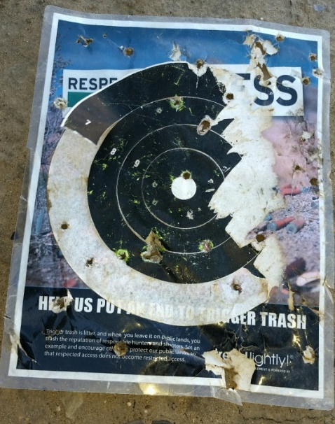
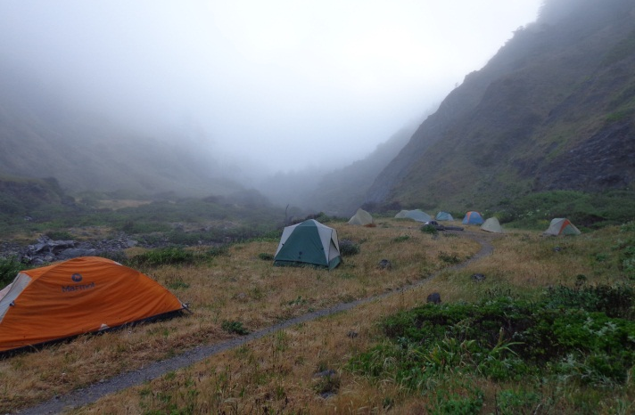
Module 9 – Interdisciplinary LUP Decisions pg II-12 to II-16
Examples
Areas closed to target shooting (follow procedures in Dingell Act).
Area-wide camping limitations.
Types, activities and locations where SRPs would NOT be issued.
Notes:
Each LUP decision should be fully analyzed in the LUP/EIS, including discussion of how these actions are necessary to support objectives, maintain or enhance settings, or address visitor health and safety, resource protection, or use and user conflicts.
Note regarding SRPs – it’s recommended to state only where SRPs would NOT be issued, because SRPs are always a discretionary decision and it could be argued that you must issue an SRP, even if other factors deem it inappropriate or not possible (new resource conflicts, staffing issues etc.)

Slide 7
Module 9 – Interdisciplinary LUP Decisions pg II-12 to II-16
LUP Decisions
Other Programs - examples
Fuels – restrictions on fuels treatments
Forestry – Closed to timber harvest, firewood cutting and special forest products
Lands and Realty – ROW avoidance areas applied to an RMA
VRM – Classify as VRM II
CTTM – Classify as limited to designated routes for mountain bikes
Fluid Mineral Leasing – Apply an NSO stipulation which prohibits surface use, occupancy and surface-disturbing activities.
Notes:
Maintaining or enhancing “desired” or “particular” settings requires looking at what has the potential to impact those settings, what’s the threat? Then determine how that can be addressed through other programs LUP decisions.
Like the LUP decisions for RVS, each decision should be fully analyzed in the LUP/EIS, including a discussion of how these actions are necessary to:
Support objectives,
Maintain or enhance settings, or
Address visitor health and safety, resource protection, or use and user conflicts.
Land-Use Plan decisions for other programs can be found in Appendix C of the 1601 Handbook.

Slide 8
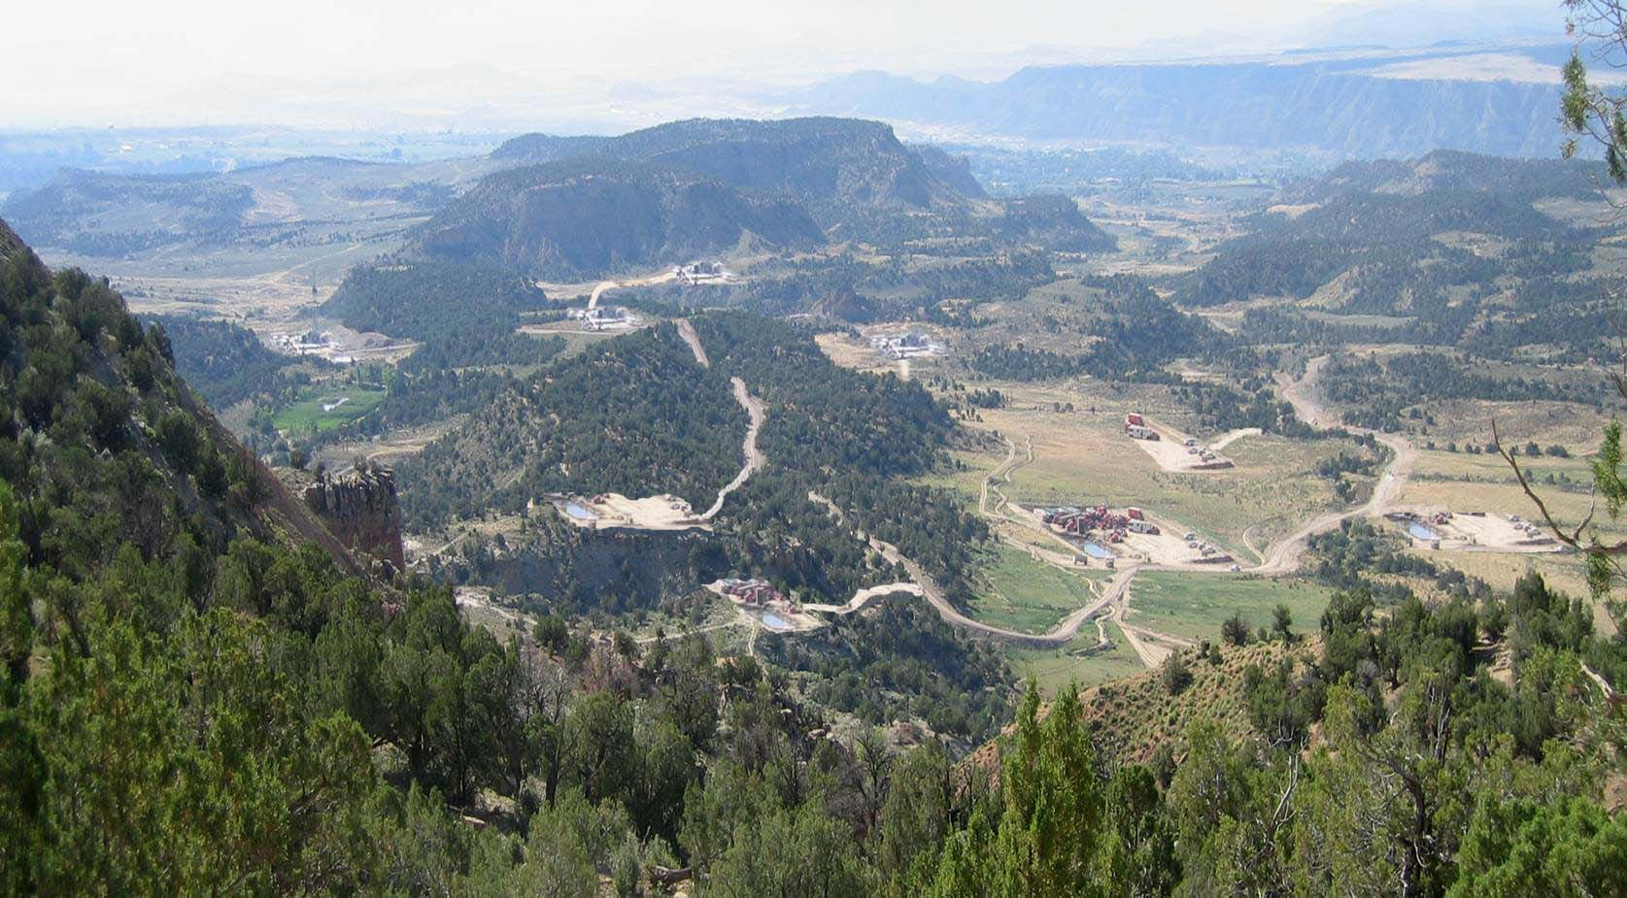
Module 9 – Interdisciplinary LUP Decisions pg II-12 to II-16
Example
No management actions
Notes:
Example. This photo represents an area that did not have any LUP decision to protect the setting and these disturbances happened over time. Could these impacts have an impact on activities or outcomes?
People may ask, how did we get here? Incremental decisions over time, cumulative impacts.

Slide 9
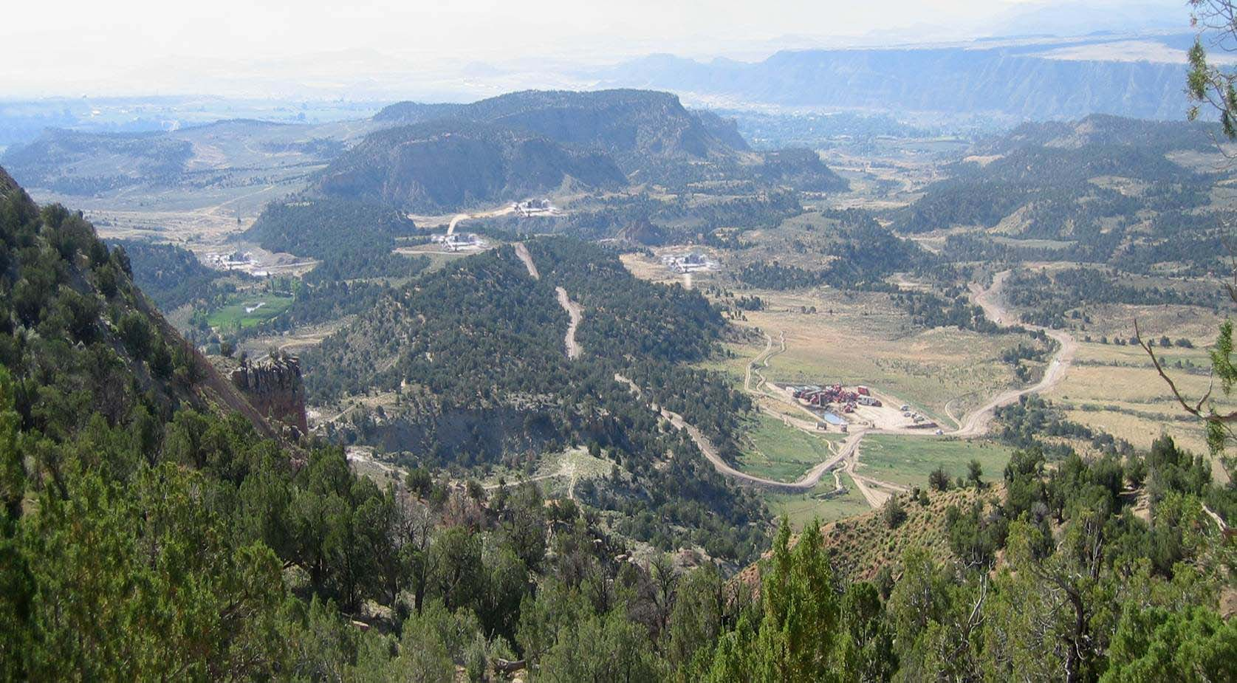
Module 9 – Interdisciplinary LUP Decisions pg II-12 to II-16
Example
Apply a CSU to protect some trailheads
Notes:
A Controlled Surface Use (CSU) stipulation would have allowed the recreation program to move some of the facilities away from the access points

Slide 10
Module 9 – Interdisciplinary LUP Decisions pg II-12 to II-16
Example
Apply VRM II to sensitive view sheds
Notes:
If VRM II had been applied in the LUP, the view shed would have been better protected

Slide 11
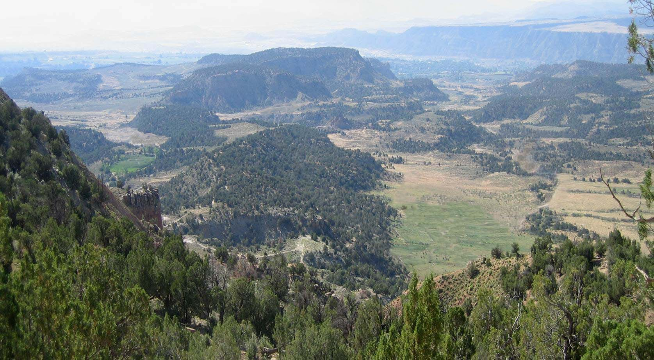
Module 9 – Interdisciplinary LUP Decisions pg II-12 to II-16
Example
NSO stipulation for surface disturbing activities
Notes:
An NSO stipulation could have prevented the surface disturbing activities that would have a negative impact on recreation values. Now we can see how selecting appropriate LUP level decisions can protect the setting and help produce the recreation activities and facilitate the desired outcomes.

Slide 12
Module 7 – Interdisciplinary LUP Decisions, pg II-13
Rationale for establishing management actions or allowable use decisions | SRMA | ERMA | Lands not designated
Facilitate targeted recreation opportunities (activities, experiences and benefits) | X
Facilitate visitor participation in principal recreation activities |  | X
Maintain or enhance desired RSCs | X
Maintain particular RSCs |  | X
Visitor health and safety, Resource Protection, Use/User Conflicts | X | X | X
SRPs (types, activities and locations) | X | X | X
Limit incompatible recreation activities | X | X | X
Identify terms, conditions or special considerations | X | X | X
Mitigation of recreational impacts on cultural and/or natural resources | X | X | X
Protect developed recreation sites | X | X | X
Any RMA designation without supporting LUP decisions will be unsuccessful
Notes:
Quote: May not be able to tell you how to succeed however I can tell you how to fail, that is trying to please everybody.
Specifically related to lands not designated, identify/disclose specific issues that will/could result in a management action and/or allowable use to resolve the issue. No reason to propose a solution to a problem that doesn’t exist.

Slide 13
Module 7 – Interdisciplinary LUP Decisions pg II-14
Implementation Decisions
Decisions that take site-specific action to achieve land use plan decisions.
Usually made in a more site-specific plan (RAMP) tiered from the LUP.
More detailed level of analysis required.
Administrative remedies (protest vs appeal).
Best to put IMPLEMENTATION GUIDANCE or BEST MANAGEMENT PRACTICES TO GUIDE IMPLEMENTATION in Recreation Appendix!
Notes:
Due to streamlining time and page limits, it’s more important than ever to keep implementation decisions out of the LUP. Instead, develop a Recreation Appendix, or begin development of a Recreation Area Management Plan (RAMP).

Slide 14
Module 7 – Interdisciplinary LUP Decisions pg II-12 to II-16
Best Management Practices (BMPs)
BMPs are state-of-the-art mitigation measures that will guide management, administration, information and education, and monitoring for future implementation level decisions.
BMPs avoid, minimize, reduce, rectify, or compensate for adverse environmental or social impacts of land use activities.
Examples of BMPs for the R&VS program include:
Reroute trails that cause natural or cultural resource damage or trespass on private property.
Grant administrative use authorization for motorized travel on a case-by-case basis.
Create an SRMA brochure to address use and user conflicts.
Notes:
These are not LUP or Implementation decisions but do guide future management, they are not required as part of a LUP but may be include a BMP appendix. It is important to be able to identify them because they are frequently brought up during the LUP process.
Help to capture partners and cooperators concerns with out making a decision.
Show project proponents examples of commonly used practices to reduce impacts of land use activities on desired RSCs or recreation opportunities.
often included in LUPs, but they are not LUP or implementation decisions
Could be developed once a specific proposal is being evaluated through the environmental analysis process.
Ask the class for examples of BMPs that would help achieve guide future implementation level decisions.

Slide 15
Module 7 – Interdisciplinary LUP Decisions pg II-12 to II-16
Exercise
What management actions should be considered to maintain or enhance the setting of the proposed SRMA, and support the recreation objectives.
Include:
Interdisciplinary LUP decisions
Implementation actions
Best management practices
Use Handout - Illustration 4 (IL-20)
Notes:
Discussion. Look at the handout and/or Illustration 4 (IL-20) – Actions to maintain or enhance recreation setting characteristics OR address an issue.

