Slide 1
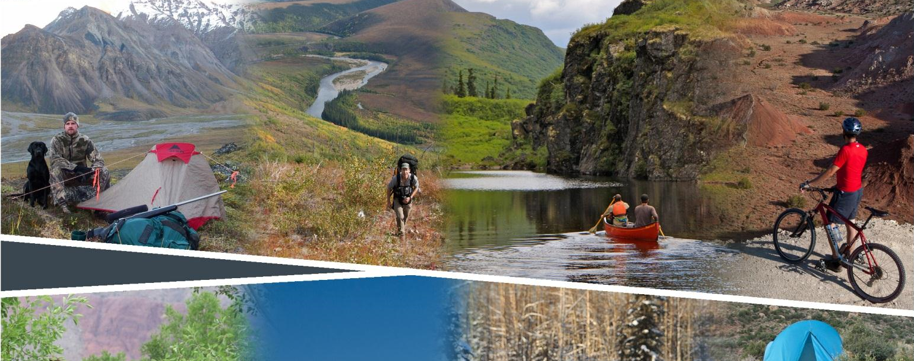
Planning for Recreation & Visitor Services

Slide 2
Module 10 – LUP part 2
Land Use Planning Process
Part 2
Kalem Lenard
Assistant Field Manager
Royal Gorge Field Office
719-269-8538
jlenard@blm.gov

Slide 3
Module 10 – LUP part 2
Objectives
Learn ways to develop LUP alternatives
Understand describing the Affected Environment
Learn ways to disclose Environmental Consequences

Slide 4
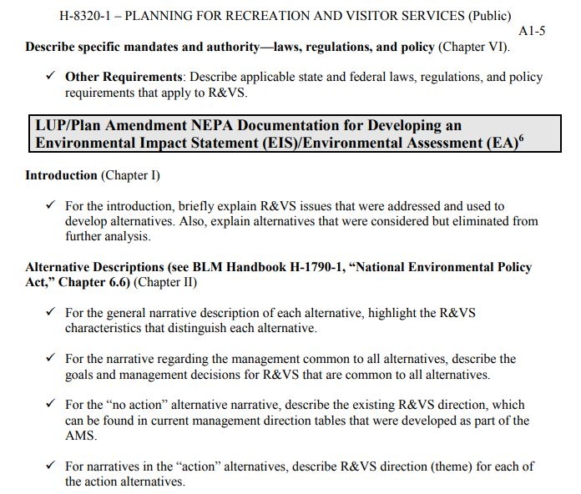
Module 10 LUP Part 2, Appendix AI-5
Notes:
Handbook Appendix AI-5.
Good reminder to keep referencing the Land Use Planning Checklist for Recreation and Visitor Services.

Slide 5
Module 10 – LUP part 2
Issue - Driven NEPA
Alternatives should be developed based on issues or conflicts:
Recreation demand
Resource use
Resource protection
Conflicts between different recreational use
Notes:
DO NOT make a “goldilocks” range of alternative just for the sake of having a “range.”
Within the RVS program, your alternatives must be driven by some issues – resource, resources use, or conflicts between different recreational use (OHV vs Mt bike for example).
Your NEPA lead might want you have the “too hot, too cold, just right” alternatives, but recreation rarely fits neatly into these broad categories. Instead consider what is best for the recreation program, visitors and local communities. Then adjust the ideal alternative as needed based on conflicts and issues.

Slide 6
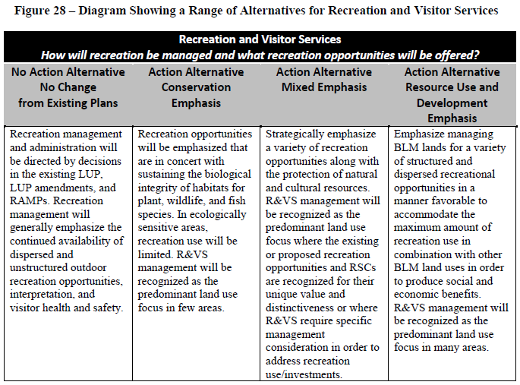
Module 10 – LUP part 2, pg III-2
LUP
Chapter 2 - Alternatives
Notes:
- Common range from No action – conservation – balanced/mixed – use & development
A different suite of potential planning decisions:
Desired outcomes
Management actions
Allowable uses
Individual R&VS decisions may be common to multiple or even all alternatives.
All proposed LUP decisions within each alternative must be compatible, but may vary across alternatives.

Slide 7
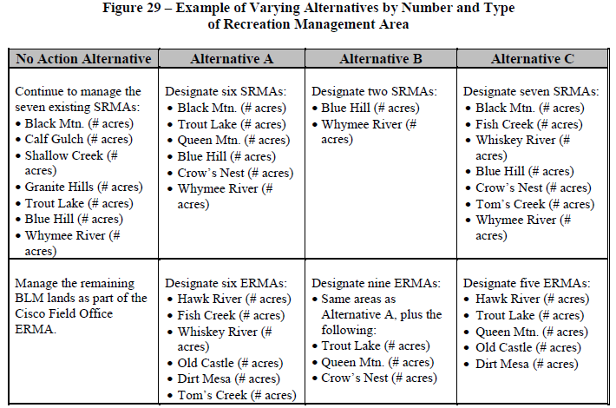
Module 10 – LUP part 2, pg III-3
LUP
Chapter 2 - Alternatives
Notes:
Varying the number, type, size, and management of RMAs has the greatest impact on the range of alternatives.
The same area can be proposed as an SRMA in one alternative, an ERMA in another alternative, and an undesignated area in a third alternative. Alternatives may also vary by changing the RMA objective or changing supporting management actions and allowable uses.
An example of alternatives in which the number and types of RMAs vary can be found in Figure 29 in the Handbook.

Slide 8
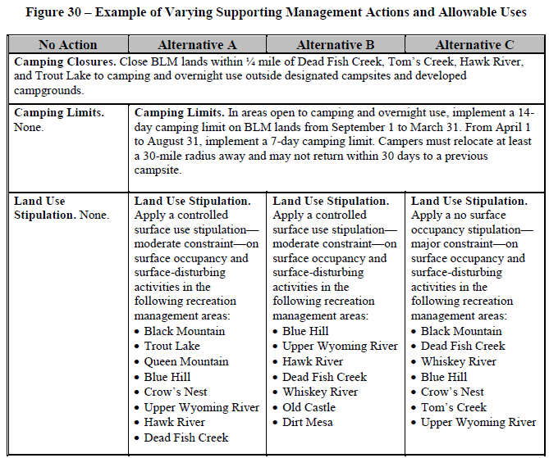
Module 10 – LUP part 2, pg III-4
LUP
Chapter 2 - Alternatives
Notes:
Alternative example of varying supporting management actions and allowable uses can be found in Figure 30.
In this example, the camping closures are common across all four alternatives. Camping limits are common to all action alternatives (Alternatives A, B, and C).
Land use stipulations vary across the alternatives, from no stipulations on surface occupancy and surface-disturbing activities, to a controlled surface use stipulation, to a no surface occupancy stipulation.

Slide 9
Module 10 – LUP part 2, pg III-4
Chapter 3 – Affected Environment
Present condition
Supply and demand
Recreational Setting Characteristics (RSCs): Physical, Social, Operational
Pertinent recreation management, administration, information, monitoring
Notes:
Describing the affected environment provides the basis for identifying and interpreting potential impacts.
Discuss the existing management, conditions, issues, and trends.
Be concise and limit the description to what is needed to understand the issues, environmental consequences, and goals and objectives.
Most of this information will come from the analysis of the management situation.
1. Describe the present condition of the affected resources within the identified geographic scope, and provide a baseline for the cumulative effects analysis.
2. Describe applicable supply and demand information (e.g., user preferences; demand for particular recreation activities, recreation settings, experiences or benefits).
3. Describe the physical, social, and operational RSC conditions.
4. Explain pertinent recreation management, administration, information, and monitoring direction (e.g., type, volume, and location of recreation use; recreation management plans; existing closures and restrictions; existing infrastructure; types and volume of SRPs; fee program; tourism; and partnerships).

Slide 10
Module 10 – LUP part 2, pg III-6
Chapter 4 – Environmental Consequences
Analyzing Environmental Effects
Predicts the degree to which a resource or use will be affected
Demonstrate that the BLM took a “hard look” at the impacts
Commensurate with the importance of the impact
Notes:
Lots of info in Handbook!
The effects analysis predicts the degree to which a resource or resource use will be affected by the proposed actions of each alternative.
A “hard look” is defined as a reasoned analysis containing quantitative or detailed qualitative information.
Data and analyses must be commensurate with the importance of the impact; less important material may be summarized, consolidated, or simply referenced.

Slide 11
Module 10 – LUP part 2, pg III-4
Chapter 4 – Environmental Consequences
Analyzing Environmental Effects
Analysis must include both:
Impacts of other proposed resources/resource uses on recreation.
Impacts of the proposed recreation uses on the existing recreation opportunities and other resources or resource uses.
Proposed Recreation
Existing Recreation
Resource Protection
Resource Use
Impacts
Notes:
Several examples and information in the Handbook!
Data and analyses must be commensurate with the importance of the impact; less important material may be summarized, consolidated, or simply referenced.
Effects analysis discloses the tradeoffs associated with each alternative. Opportunity costs! Disclose the tradeoffs associated with each alternative.

Slide 12
Module 10 – LUP part 2, pg III-6
Chapter 4 – Environmental Consequences
Analyzing Environmental Effects
Qualitatively discuss: Outcomes data.
Quantitatively estimate: RMAs (acres and overall numbers), numbers of visitors per RMA recreation opportunities are provided, RSCs acres.
Consequences of other proposed LUP decisions on R&VS.
In the absence of quantitative data, use professional judgment to qualitatively analyze the impacts of each alternative.
Notes:
Lots of info in Handbook!
The effects analysis predicts the degree to which a resource or resource use will be affected by the proposed actions of each alternative.
A “hard look” is defined as a reasoned analysis containing quantitative or detailed qualitative information.
Data and analyses must be commensurate with the importance of the impact; less important material may be summarized, consolidated, or simply referenced.

Slide 13
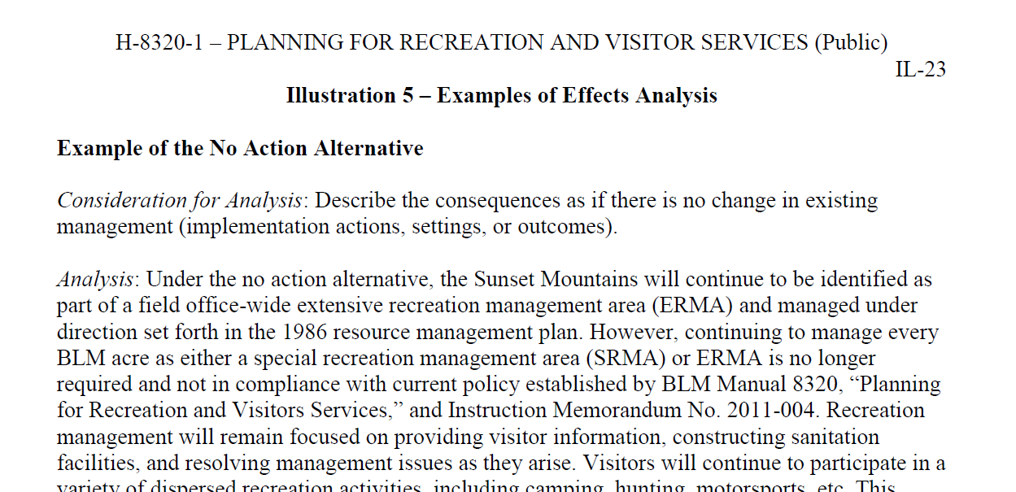
Module 10 – LUP part 2, Illustration 5, pg IL-23
Chapter 4 –Environmental Consequences
Notes:
The Handbook has an excellent example of Effects Analysis.

Slide 14
Module 10 – LUP part 2, pg III-4
Chapter 4 – Environmental Consequences
Analyzing Environmental Effects – Group discussion
Provide a real world example of each:
Impacts of resource protection on proposed recreation
Impact of resource use on proposed recreation
Impact of proposed recreation on existing recreation

Slide 15
Module 10 – LUP part 2
Group Exercise
Develop a range of alternatives based on issues or other competing resources or resources uses within your proposed SRMA and/or ERMA.

