Slide 1
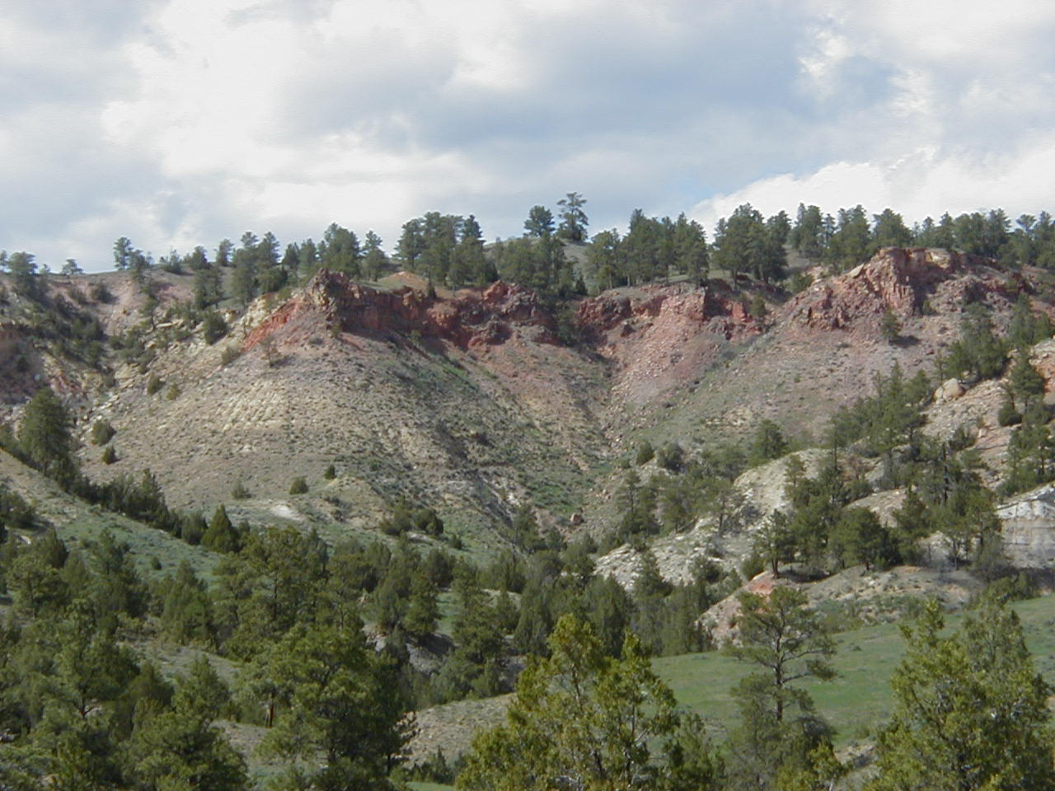

Slide 2
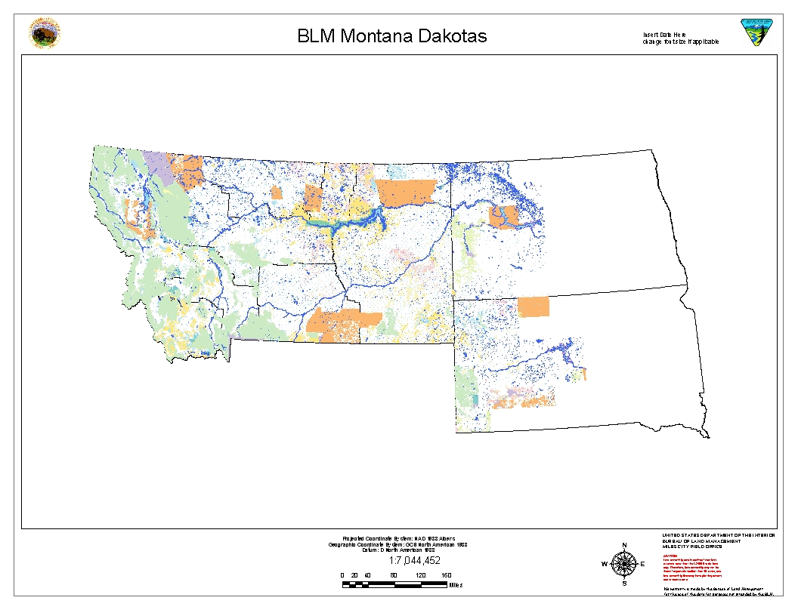

Slide 3
Miles City Field Office (Montana)
2.7 million surface acres - 12.4 million acres of subsurface mineral estate.
North Dakota Field Office
58,000 acres of public land - 4.1 million acres of mineral estate.
South Dakota Field Office
274,000 surface acres - 1.5 million acres of subsurface mineral estate.

Slide 4
Montana Activity
Bayswater Uranium Corporation acquired uranium properties and historical database. At least three prospects – possibly more. In early 2008 proposed a drilling program on private lands. In Spring of 2008 announced prospects would not be drilled this year.

Slide 5
North Dakota Activity
Formation Resources Incorporated (Formation) has submitted nine prospecting applications to BLM to prospect for uranium on approximately 17,611 acres of National Forest System (NFS – (acquired lands)) and private lands. The permits are for hand sampling with possible drilling to follow.

Slide 6
South Dakota Uranium Activity
Powertech is in the process of permitting their Dewey-Burdock Property which contains an inferred 7.6 million tons U3O8. About 120 acres of BLM is in permit area. Meetings with Powertech to discuss permit needs/issues will be held soon.

Slide 7
Mining Claims Montana – 576 North Dakota – 0 (Acquired – Leasable) South Dakota - 556

