Slide 1
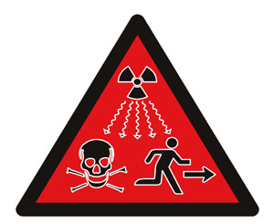
URANIUM and ABANDONED MINE LANDS
George Stone
Senior AML Specialist
Division of Environmental Quality and Protection
August 13, 2008

Slide 2
Topics
Scope of Uranium AMLs
Issues
Funding
Partnerships & Coordination
Information Sources

Slide 3
Information from EPA – TENORM Program
Technologically Enhanced Naturally Occurring Radioactive Materials From Uranium Mining
  Volume 1: Mining and Reclamation Background
  Volume 2: Investigation of Potential Health, Geographic, and Environmental Issues of Abandoned Uranium Mines
  Uranium Database Location Compilation
  All available on EPA’s TENORM website

Slide 4
Inventories
No single comprehensive inventory
Most based on historic MAS/MILS records
  Supplemented by field validation to varying degrees
GAO estimates (2008)
  161,000 hardrock AML sites in western states
  332,000 features that may pose physical safety hazards
  33,000 sites that have degraded the environment.

Slide 5
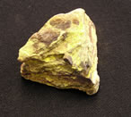
EPA Estimates from Existing Data
15,000 mine locations with uranium occurrence
Mostly in AZ, CO, NM, UT, WY
75% on federal and tribal lands
Mostly conventional open pit and underground mines
Two Superfund NPL sites
(OR, WA)
Source: EPA Uranium Database Location Compilation
Notes:
EPA: The uranium mining industry began in the U.S. in the 1940s primarily to produce uranium for weapons and later for nuclear fuel. Although there are about 4,000 mines with documented production, EPA, with information provided by other federal, state, and tribal agencies, has identified 15,000 mine locations with uranium occurrence in 14 western states. Most of those locations are found in Colorado, Utah, New Mexico, Arizona, and Wyoming, with about 75% of those on federal and tribal lands. The majority of these sites were conventional (open pit and underground) mines.

Slide 6
General Observations
Most uranium AML sites:
  Small to medium in size
  Do not pose significant radiation exposure risks to the casual visitor or short-term occupant
  Should not require special remediation measures solely due to radiation
  Non-radioactive materials, typical safety hazards may pose greater impacts
Source: EPA TENORM

Slide 7
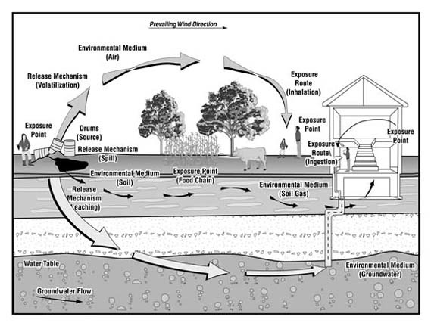
Issues
In addition to typical AML-Hazmat concerns…
Exposure pathways
  Ingestion and Inhalation
  Direct and Indirect
Radiation exposure
  Groundwater
  Uranium in waste rock piles and mill tailings
  Off-site contamination, e.g. water
Flora and fauna impacts
Sources: EPA TENORM & ATSDR

Slide 8

Factors Potentially Increasing Risks
Rapid population growth and sprawl in the West
Concentration of multiple AML sites
Recreation activities
  OHV users often visit AML sites
  Site visits
    Prolonged or extensive site visits
    Visits involving underground mines where mechanical ventilation has ceased
Use of mine waste material as building materials
Home sites constructed on AML sites

Slide 9
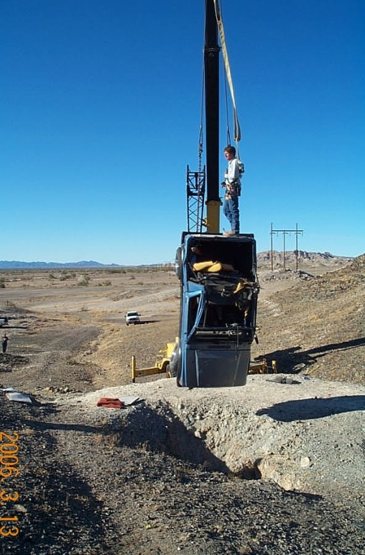
Broader Objectives Drive AML Programs
Remediate AMLs as part of:
Clean Water – Watershed Approach
Recreation & Visitor Safety
Reducing Environmental Disposal Liabilities on agency financial reports

Slide 10
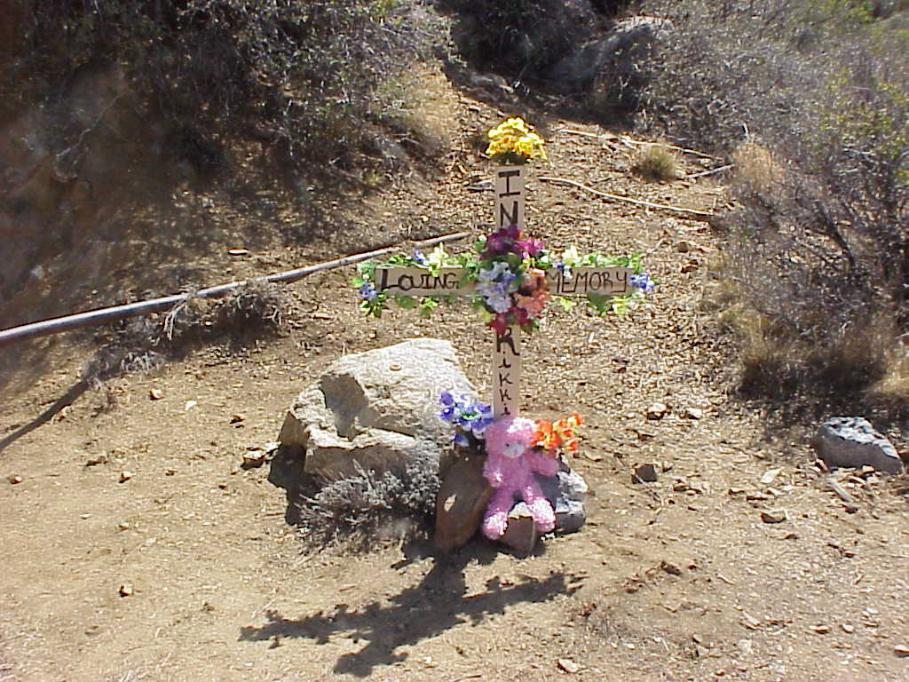
Site Prioritization
Existing AML-Hazmat programs focus on uranium indirectly
  Coal
  Hardrock
Most funding is tied to
  Clean Water
  Hazmat
  Physical Safety
Mixed-ownership is common
Coordination with mining claimants

Slide 11
Site Prioritization
In addition to hardrock AML criteria:
Depth to Groundwater and Annual Precipitation
Frequency of Use
Presence and Concentrations of Contaminants in Soils, Water, and Sediments
Density of Mines
Level of Acceptable Radiation Exposure Risk
Source: EPA TENORM
Notes:
There are a number of items that could be considered when trying to prioritize the mines to be remediated.
Depth to Groundwater and Annual Precipitation
Frequency of Use
Presence and Concentrations of Contaminants in Soils, Water, and Sediments
Density of Mines
Level of Acceptable Risk Sites which get frequent visitation may approach the upper end of the cancer risk range, while other sites would be at the lower end of the risk range. Residential exposure to uranium mine wastes, if it were to occur, would most likely be at the high end of risk range or even above.

Slide 12

Funding
“Polluter Pays” Principle
aka/CERCLA Cost Avoidance/Cost Recovery
  Sites mined primarily for uranium tend to be more recent
  Increased likelihood to identify financially viable responsible parties
  Most AML “Clean Water” and Hazmat funding sources require PRP searches and application of Cost Avoidance/Cost Recovery

Slide 13
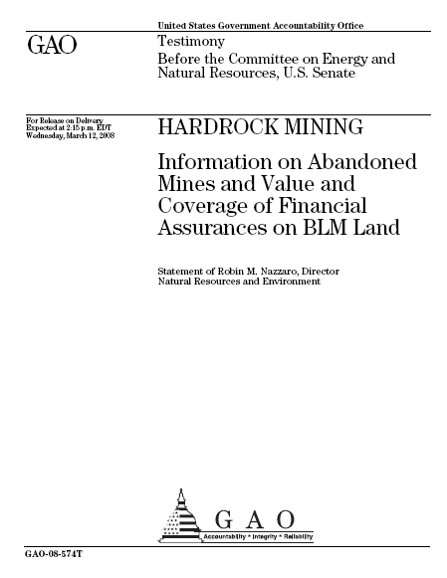
Expenditures
FYs 1998 - 2007
EPA $2.200 billion
BLM/FS $0.259 billion
OSM $0.198 billion
Notes:
Between fiscal years 1998 and 2007, BLM, the Forest Service, EPA, and OSM spent at least $2.6 billion (in 2008 constant dollars) to reclaim abandoned hardrock mines. BLM and the Forest Service have reclaimed abandoned hardrock mine sites on the lands they manage; EPA funds the cleanup of these sites, primarily on nonfederal lands through its Superfund program; and OSM provides some grants to states and Indian tribes to clean up these sites on their lands. Of the four agencies, EPA has spent the most—about $2.2 billion (in 2008 constant dollars) for mine cleanups. BLM and the Forest Service spent about $259 million (in 2008 constant dollars), and OSM awarded grants totaling about $198 million (in 2008 constant dollars) to support the cleanup of abandoned hardrock mines.
Over the last 10 years, estimates of the number of abandoned hardrock mining sites in the 12 western states and Alaska have varied widely, in part because there is no generally accepted definition for a hardrock mine site. Using a consistent definition that GAO provided, 12 western states and Alaska provided estimates of abandoned hardrock mine sites. On the basis of these data, GAO estimated a total of at least 161,000 such sites in these states with at least 332,000 features that may pose physical safety hazards and at least 33,000 sites that have degraded the environment.

Slide 14
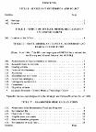
SMCRA States
Western SMCRA States
  Alaska
  Colorado
  Montana*
  New Mexico
  North Dakota
  Utah
  Wyoming*
SMCRA Tribes
  Crow
  Hopi
  Navajo
Congressional action 12/06
Fee extended through 9/30/2021, though at lower rates
Sets $3 million for minimum program
Phase-in of increased grants
  WY: $80 – $100 million
Issues: use of funds for non-coal projects
* Certified
Source: OSM

Slide 15
Existing Federal AML programs
Uranium generally falls within hardrock AML programs
USDA, USDOI, EPA, COE
  Collectively appropriated ≈$80-90 million annually for hardrock AML remediation
EPA Clean Water grants
EPA Brownfields “Mine-Scarred Lands”

Slide 16
Future Funding?
Increased Congressional interest
  House passed Mining Law Reform
  Senate held hearings
  Further action in 2008 doubtful
Focus of audit agencies
  GAO
  Interior Inspector General
State funding efforts

Slide 17

Voluntary Initiatives
EPA Clean Water Act “Good Samaritan” policies
Fix A Shaft Today! (FAST!) Campaign
  Partners include:
    BLM
    Forest Service
    National Association of Abandoned Mine Land Programs
    National Mining Association
    Bat Conservation International

Slide 18

Coordination
Federal Mining Dialogue agencies
National Association of Abandoned Mine Land Programs
  29 States
  3 Tribes
Western Governors’ Association

Slide 19
Major Federal AML Agencies
Agriculture
Forest Service
Hazardous Materials Management Division
Defense
Air & Radiation
Brownfields & Revitalization
Enforcement & Compliance Assurance
Research & Technology
Solid Waste & Emergency Response
Superfund Remediation & Technology Innovation
Water
Natural Resources Conservation Service
Interior
Bureau of Land Management
National Park Service
Office of Surface Mining
U.S. Geological Survey
Office of Environmental Policy & Compliance
Natural Resources Damage & Restoration
U.S. Army Corps of Engineers
EPA

Slide 20

Education and Outreach
Mine Safety and Health Administration (MSHA)
Stay Out Stay Alive (SOSA)
2008 SOSA Billboard

Slide 21

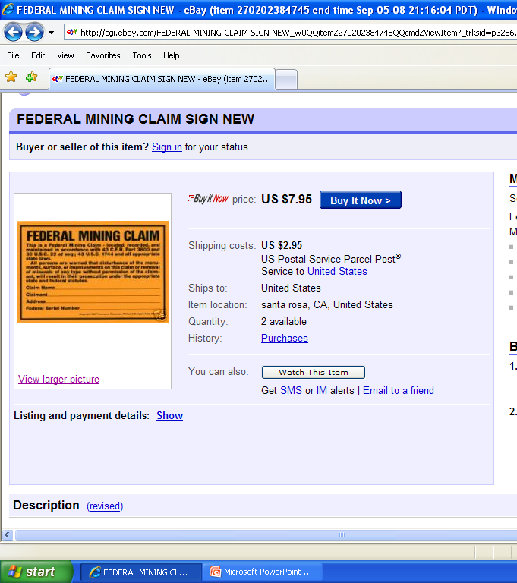
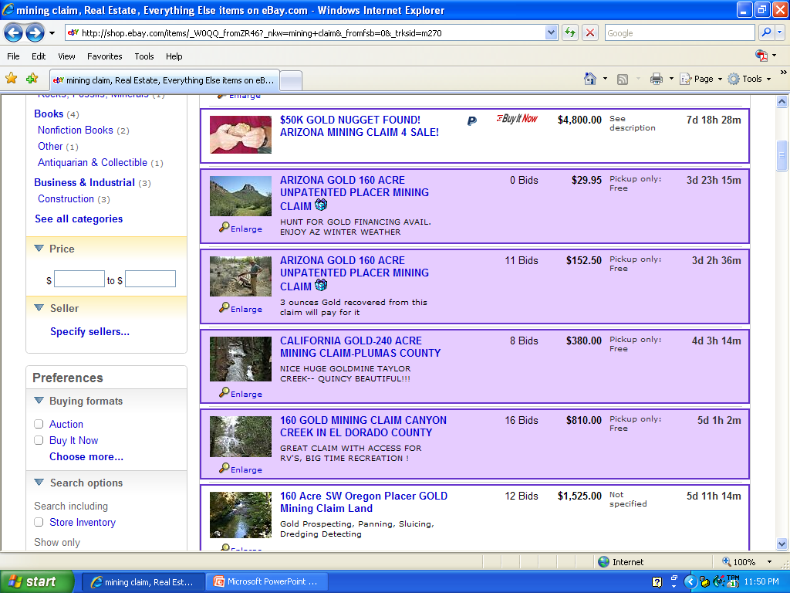
Potential Scams

Slide 22
Policies
Listing Mixed Ownership Mine or Mill Sites Created as a Result of the General Mining Law of 1872 on the Federal Agency Hazardous Waste Compliance Docket
Joint Repositories at Mixed-Ownership Hardrock Mine

Slide 23
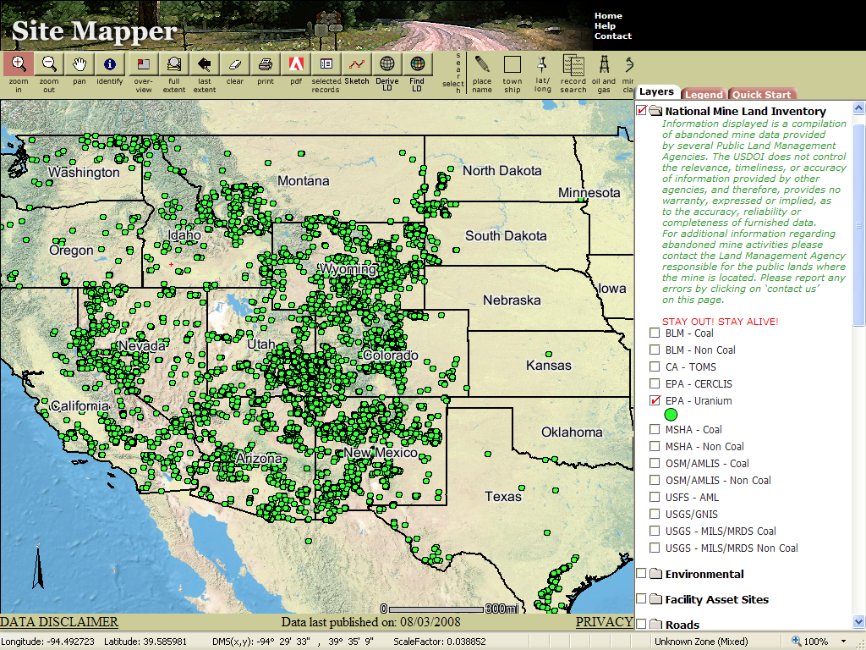
National Mine Land Inventory Prototype

Slide 24
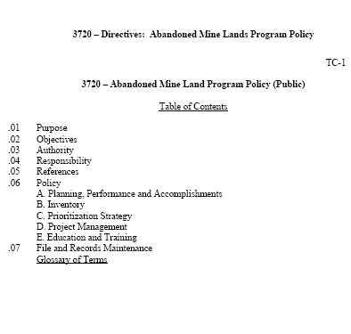
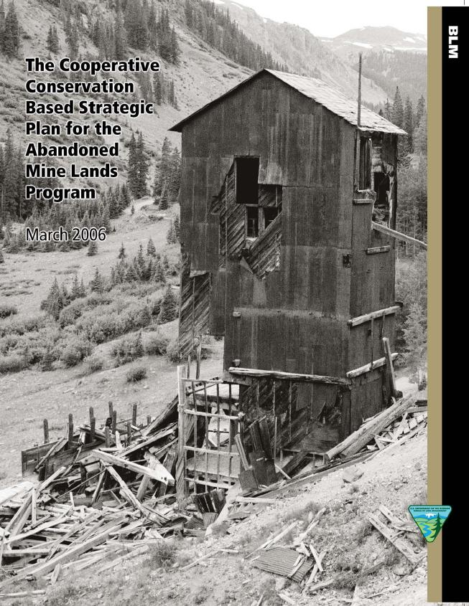
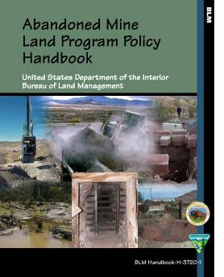
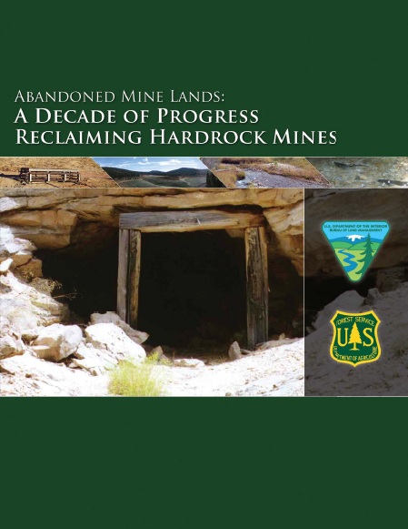

Slide 25
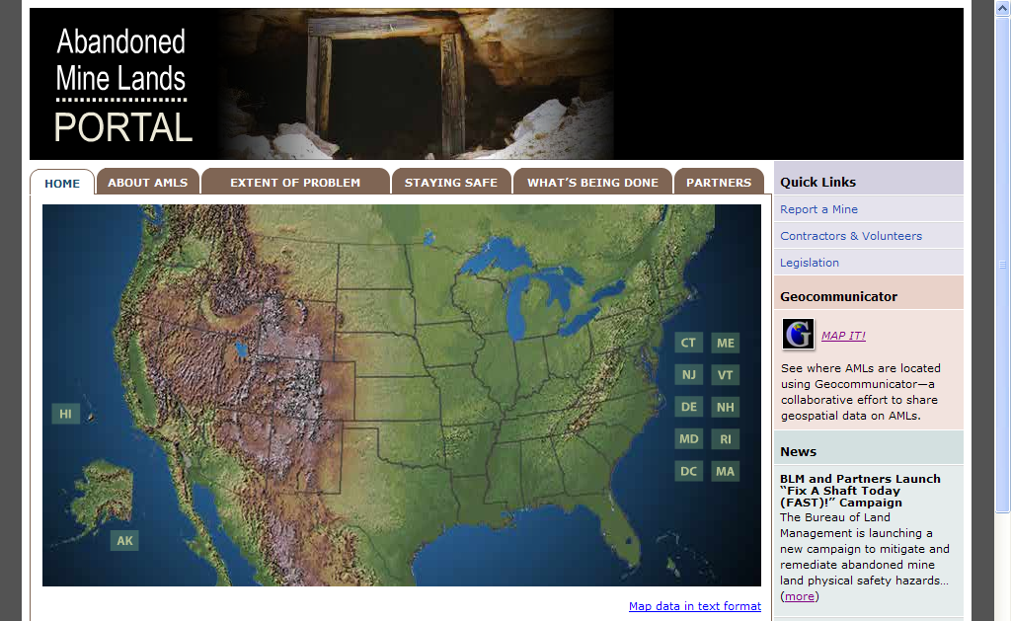
www.abandonedmines.gov

