Slide 1
Utah’s Uranium Activity and Associated Issues/Concerns
Presented at the Uranium Workshop on August 12, 2008
by Terry Snyder

Slide 2
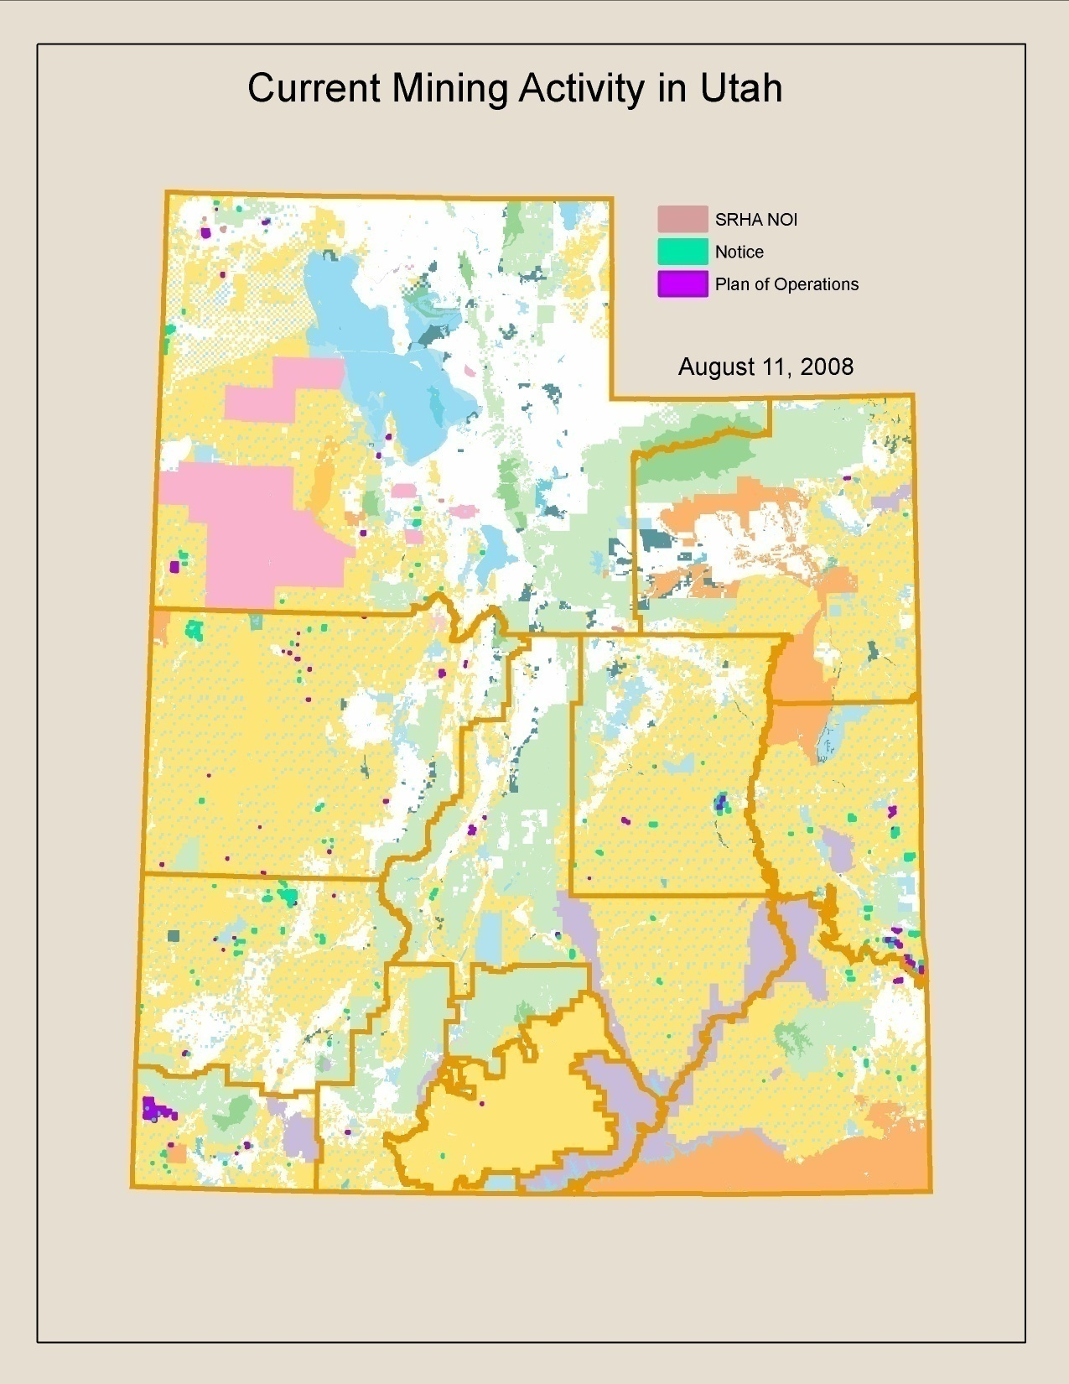

Slide 3
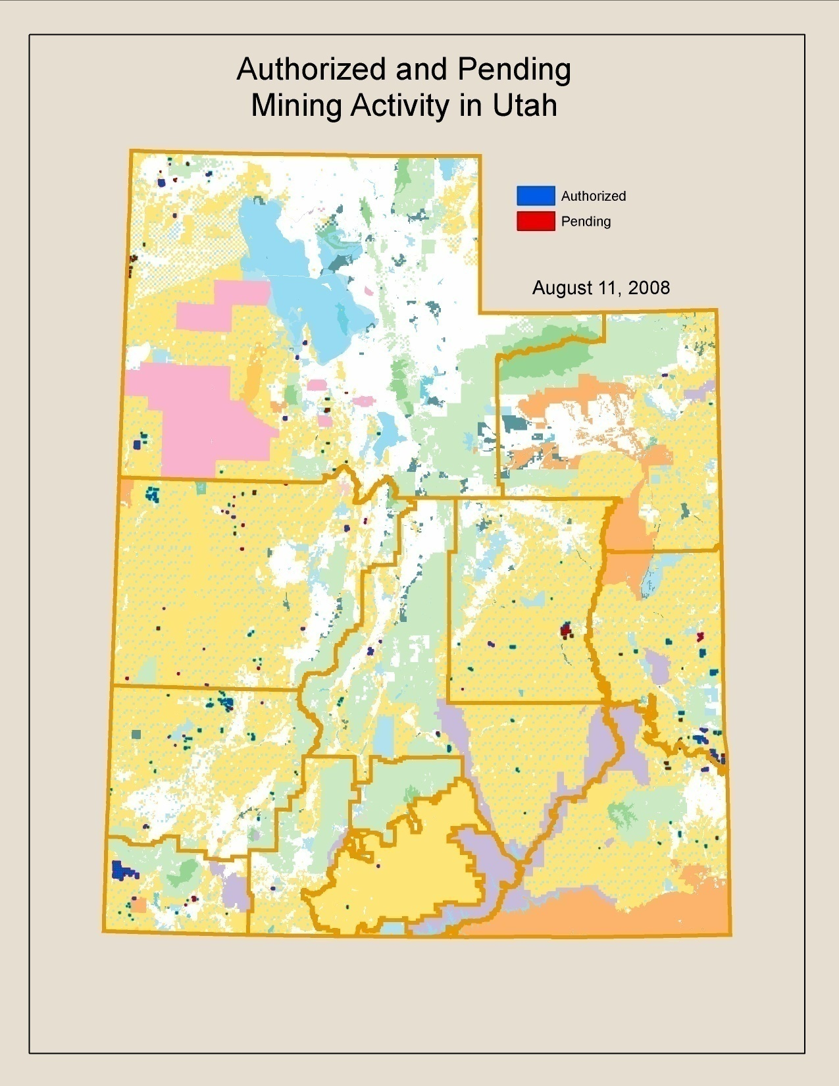

Slide 4
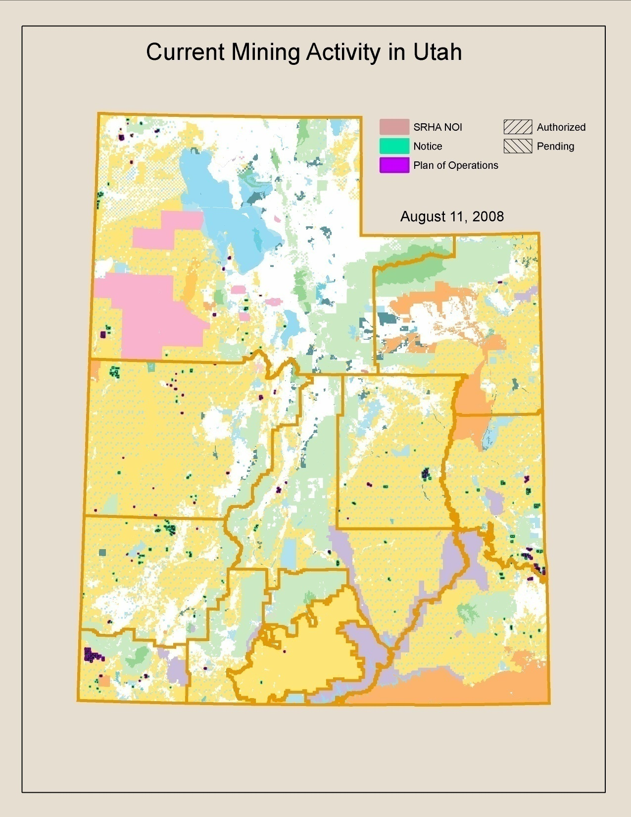

Slide 9
Issues/Concerns
Reclamation measures that are consistent across state lines within BLM.
Reclamation measures consistent with State agencies.
Increased work load difficult to meet regulatory time frames.
The greater the work load the more important communication with State agencies, operator, other federal agencies, etc.

Slide 10
Issues/Concerns continued
Co-lateral duties
Worker safety gamma and radon
Planning

