Slide 1
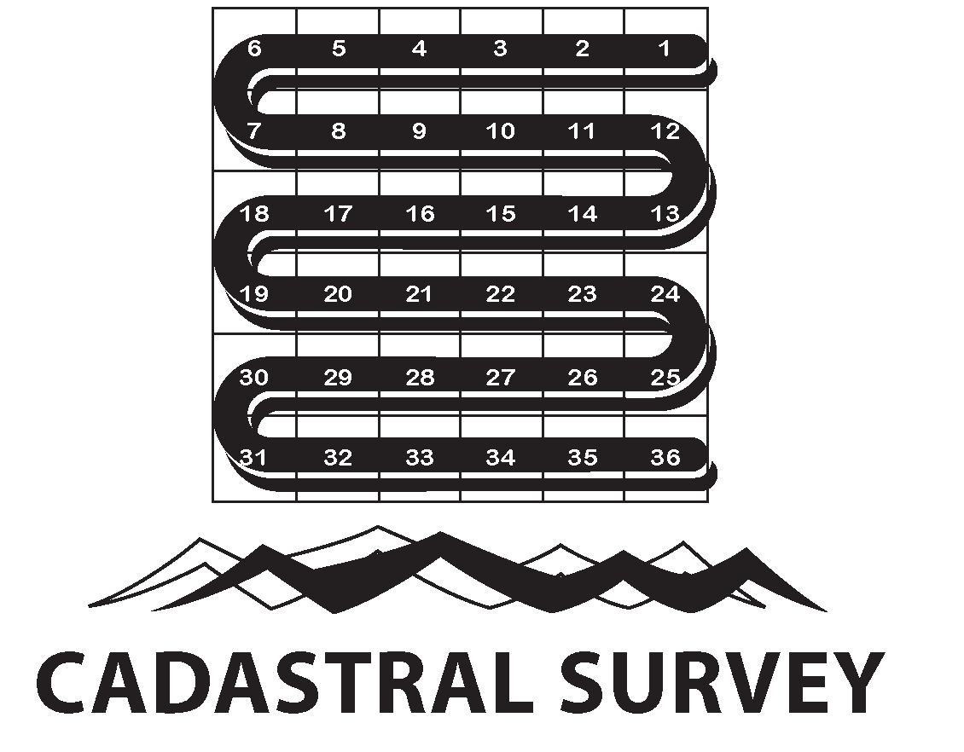
WITHDRAWALS – BEYOND MECHANICS
NTC 2000-07
May 2017, Boise, Idaho
LSRs/Surveys – “What’s the Difference”
FRN (NOI), why do we need a “LSR”
To request and obtain a LSR – “what does the Surveyor want from me”
By: G. Mike Dress, Supervisory Cadastral Surveyor, Idaho State Office

Slide 2
Two Modes of Boundary Evidence
Primary source is a land survey executed by skilled and trained professional surveyors. A cadastral/official survey is the highest form of boundary evidence available to the Federal Government, providing legal evidence of the geographic limits of the Federal interest in land.
Secondary source - Standards for Boundary Evidence (SBE) DOI Manual, Part 600, Ch. 5 (Rel. Nov 2014). An Administrative Opinion by a certified DOI Land Surveyor. Certificates provided:
- Land Description Review/Chain of Surveys (LSR);
- A Physical Inspection of the Land. (CIP); and,
- Boundary Assurance Certificate (BAC).

Slide 3
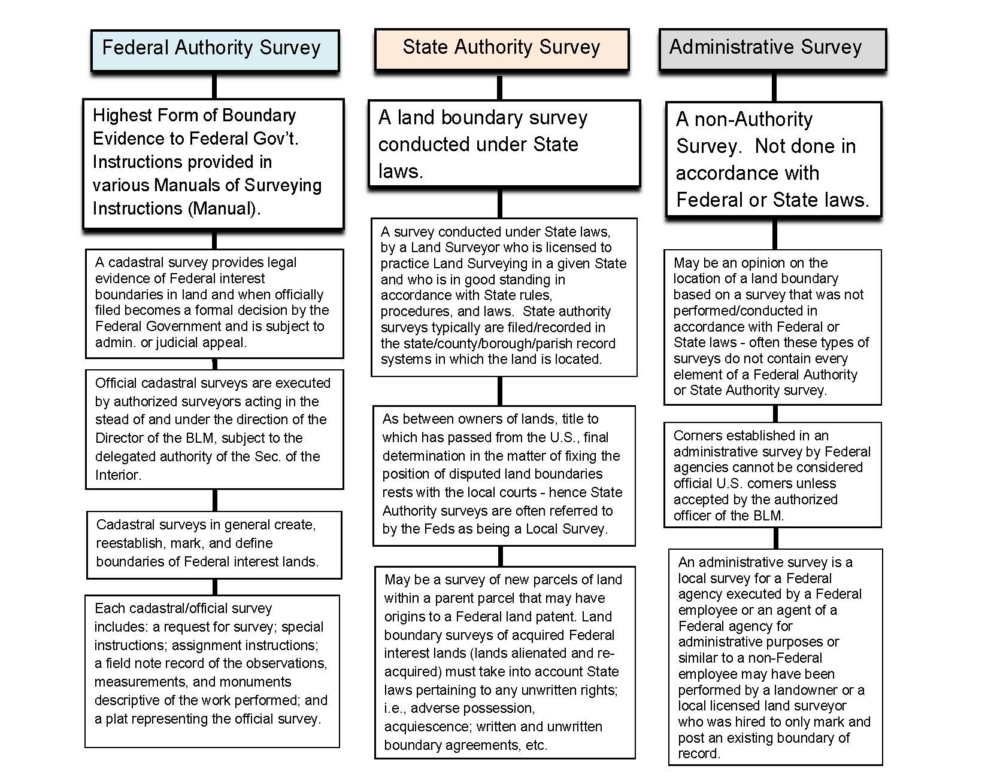

Slide 4
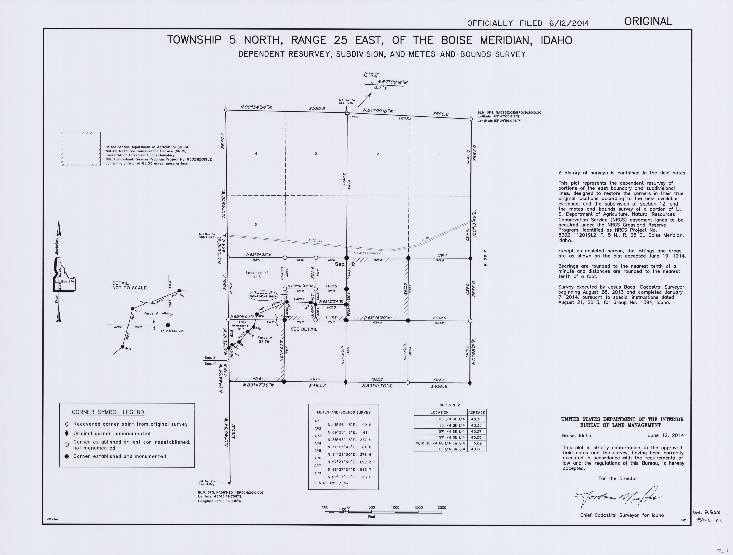
Sample - Federal Authority Surveys
Official Plat

Slide 5
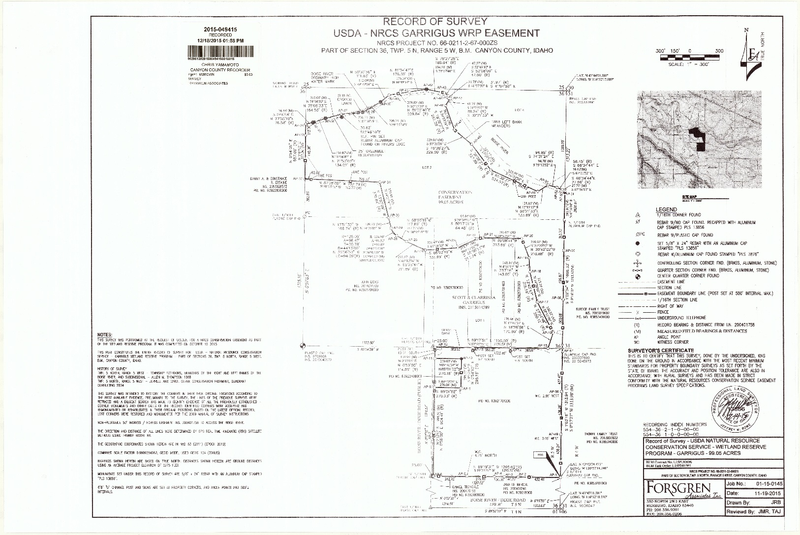
Sample - State Authority Surveys (recorded survey)

Slide 6
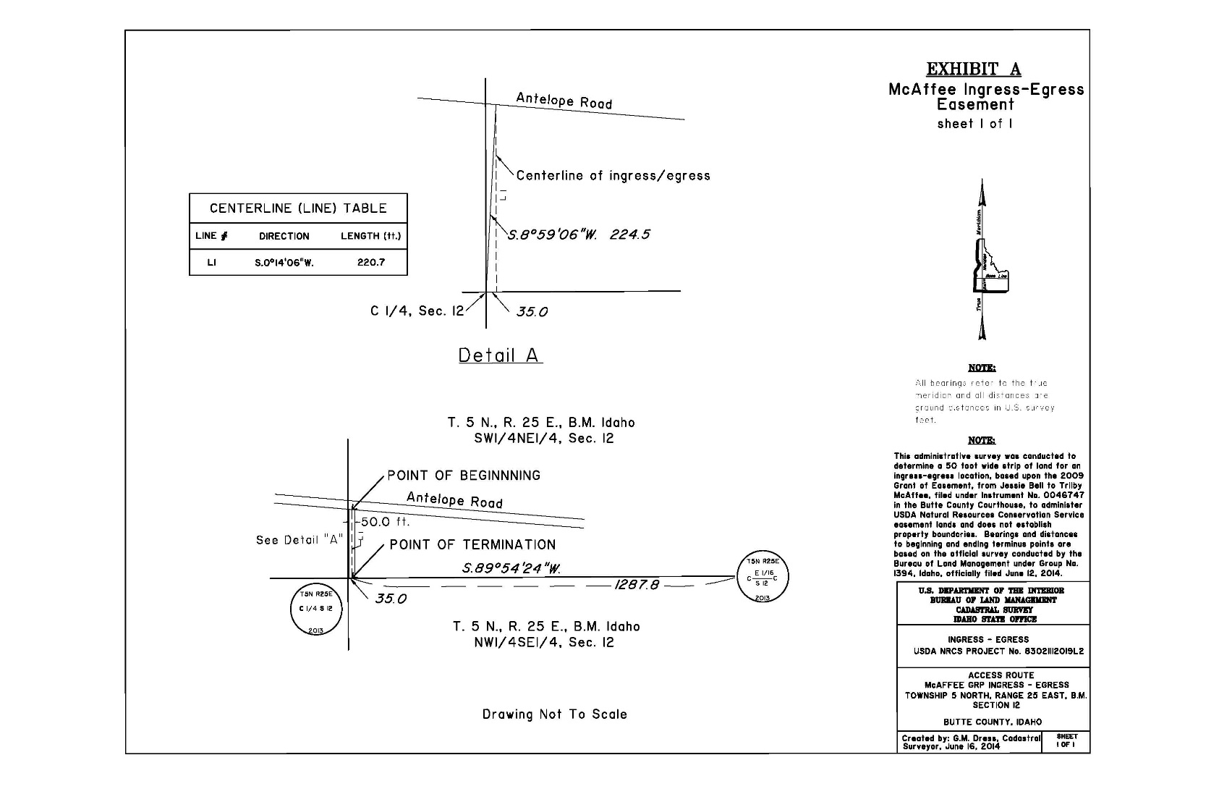
Sample – Administrative Surveys

Slide 7
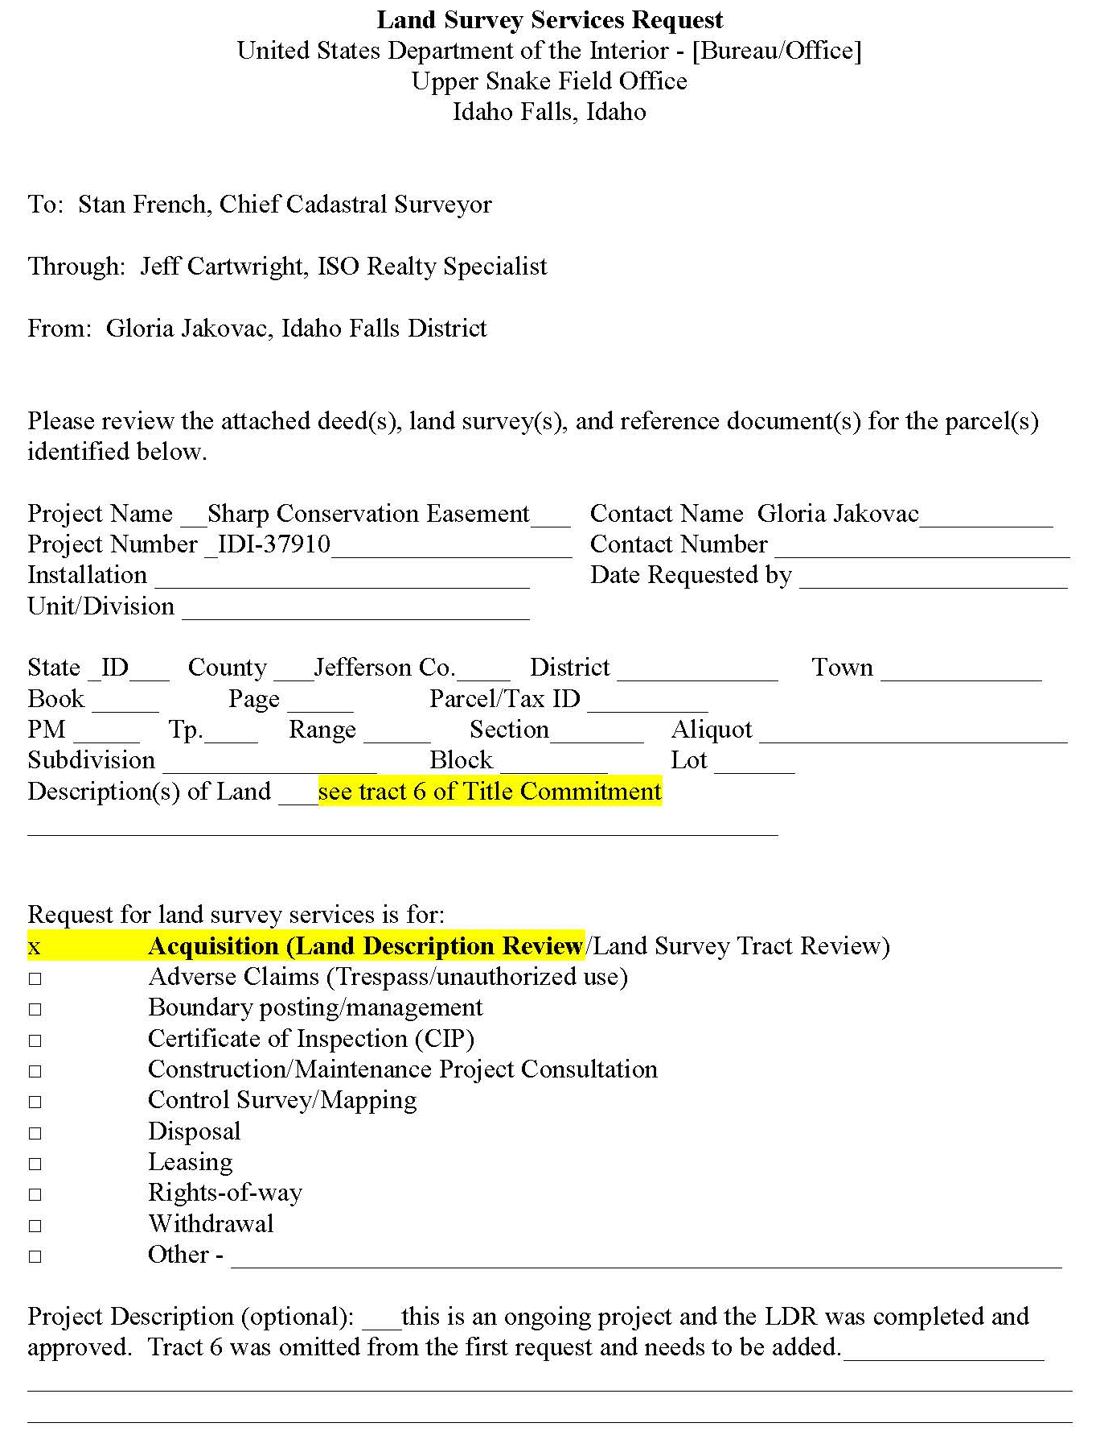
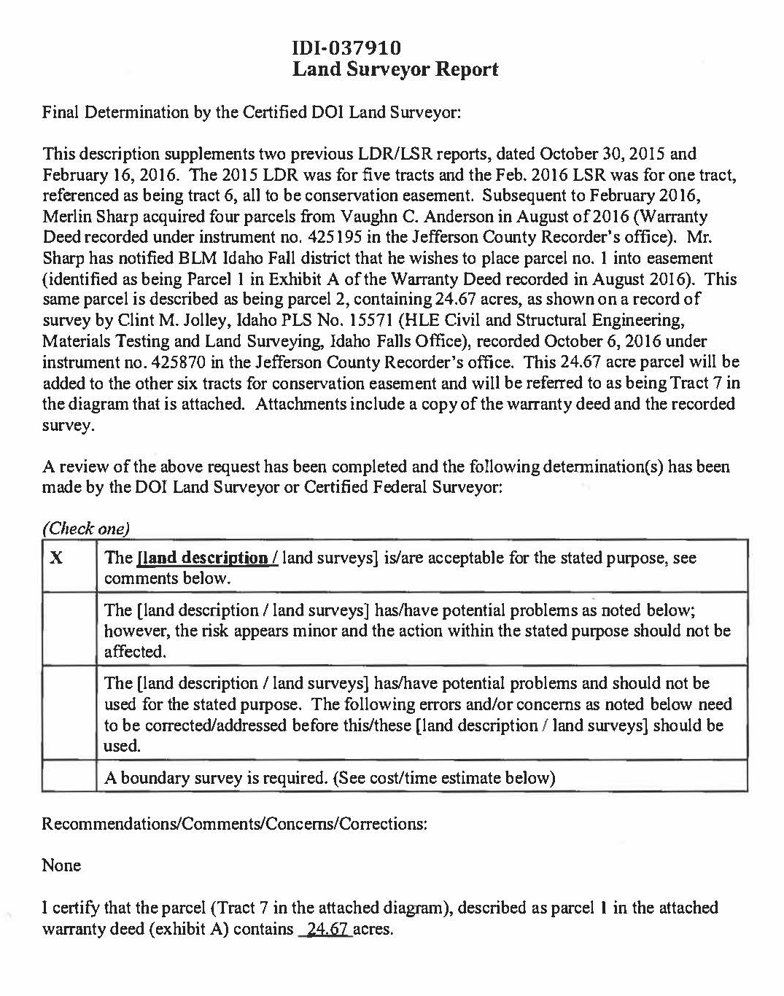
Sample – Administrative Surveys

Slide 8
FRNs (NOI), why do we need a “LSR”
FR Notices that contain land descriptions require DOI and WO review.
All BLM SO Communication Offices must send all non-exempt notices to the WO for review and clearance – to WO Div. of Regulatory Affairs.
- must include a SBE certificate(s)

Slide 9
Why do we need a “LSR”?
Attachment A
Boise Meridian, Idaho
T. 50 N., R. 5 E., Section 4
Application For Proposed Withdrawal
Settler’s Grove of Ancient Cedars Recreation Area
Coeur d’Alene River Ranger District
Idaho Panhandle National Forests
Shoshone County, Idaho
1. Applicant
USDA Forest Service
Northern Region
P.O. Box 7669
Missoula, MT 59807
2. Delegation of Authority
.
.
Aliquot Part | Acres
NW¼NE¼ of lot 1, | 2.95
NW¼ of lot 1, | 11.83
SW¼SW¼ of lot 1, | 2.95
N½SW¼ of lot 1, | 5.91
SE¼NE¼ of lot 2, | 2.95
SE¼ of lot 2, | 11.83
NE¼SW¼NE¼, | 10.00
LOT-A legal subdivision that is not described as an aliquot part! Lots have been erroneously patented in halves or quarters, without explicit evidence of the Federal Government’s intent; i.e., is the division line a straight line that equally divides the area or at proportionate measurement of the opposing lines or ? Leaves open the question of how the areas were determined.
5. Land Description
Lands applied for in this application are wholly under the administration of the Forest Service and have public domain status. See Attachment A for complete legal description

Slide 10
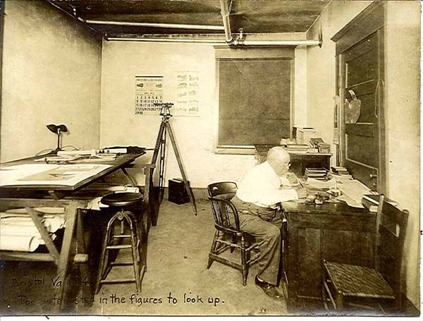
So what does the surveyor want from me?

Slide 11


Slide 12
So what does the surveyor want from me?
Suggested the first step is: “meeting with Cadastral”
“Realty Specialist should bring all of the information they have and Application”
“MTP, Plats, GIS maps are all good things”
“Draft Federal Register Notice with proposed land description (if they are that far along)”

Slide 13
So what does the surveyor want from me?
Obtain the Land Surveyor Services Request (LSSR) form.
Work with your Surveyor to ensure that the proper survey services are requested.
If you have not already obtained “The Parcel Checklist” highly recommend that you do – see 600 DM 5.
Also, be sure to have a copy of “Specifications for Descriptions of Land” for reference.

Slide 14
So what does the surveyor want from me?
“If it is an extension of a withdrawal, the existing FRN would be important (or PLO)”
Copy of the Application for Withdrawal
“If no draft land description has been constructed, one of the parts of the request may be to have Cadastral draft the description”
**”We generally only deliver the final "description acceptable" LSR when the Federal Register Notice is ready for routing to WO”**
Talk with your surveyor to see what works best

Slide 15
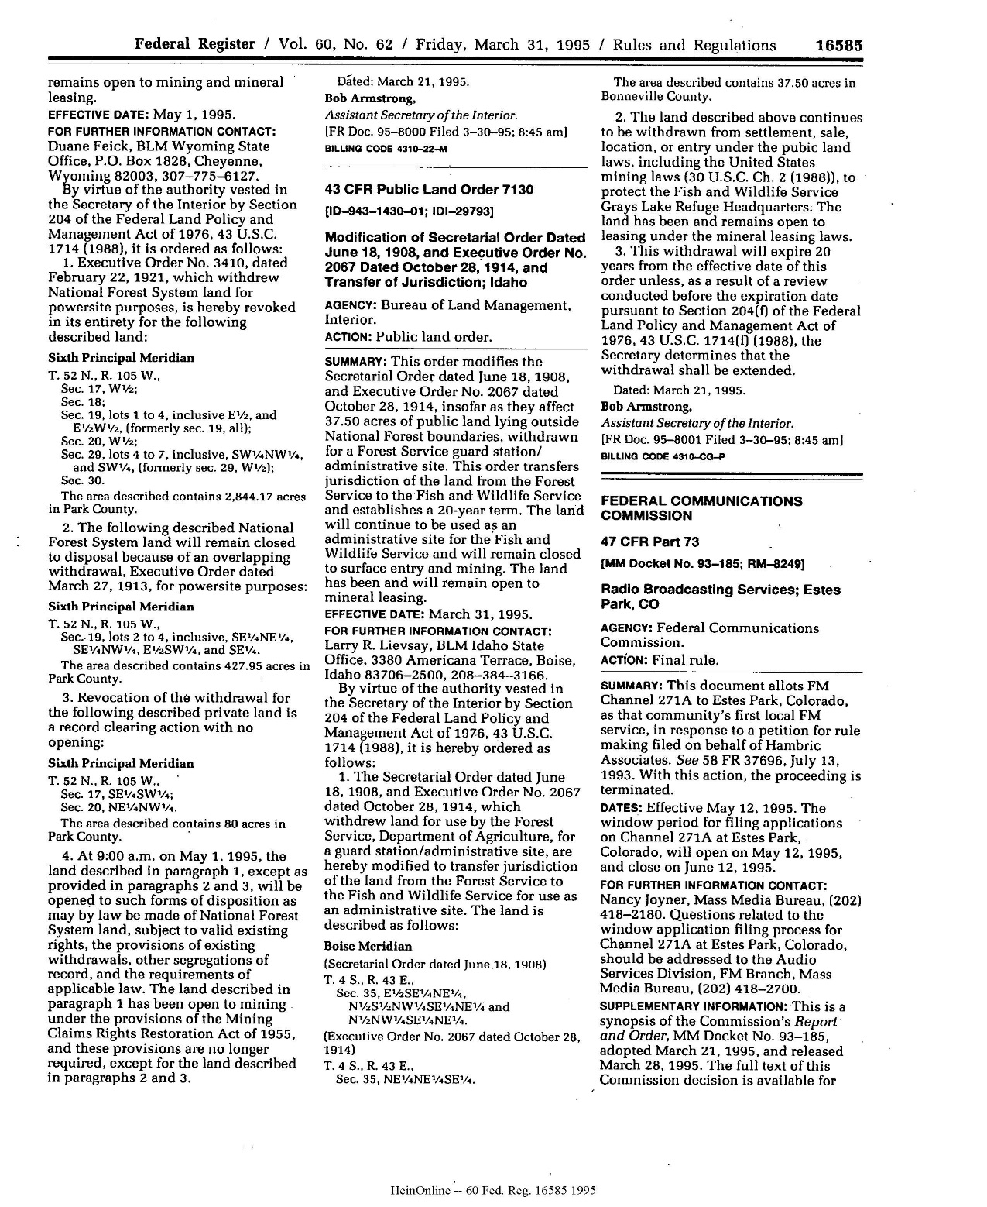
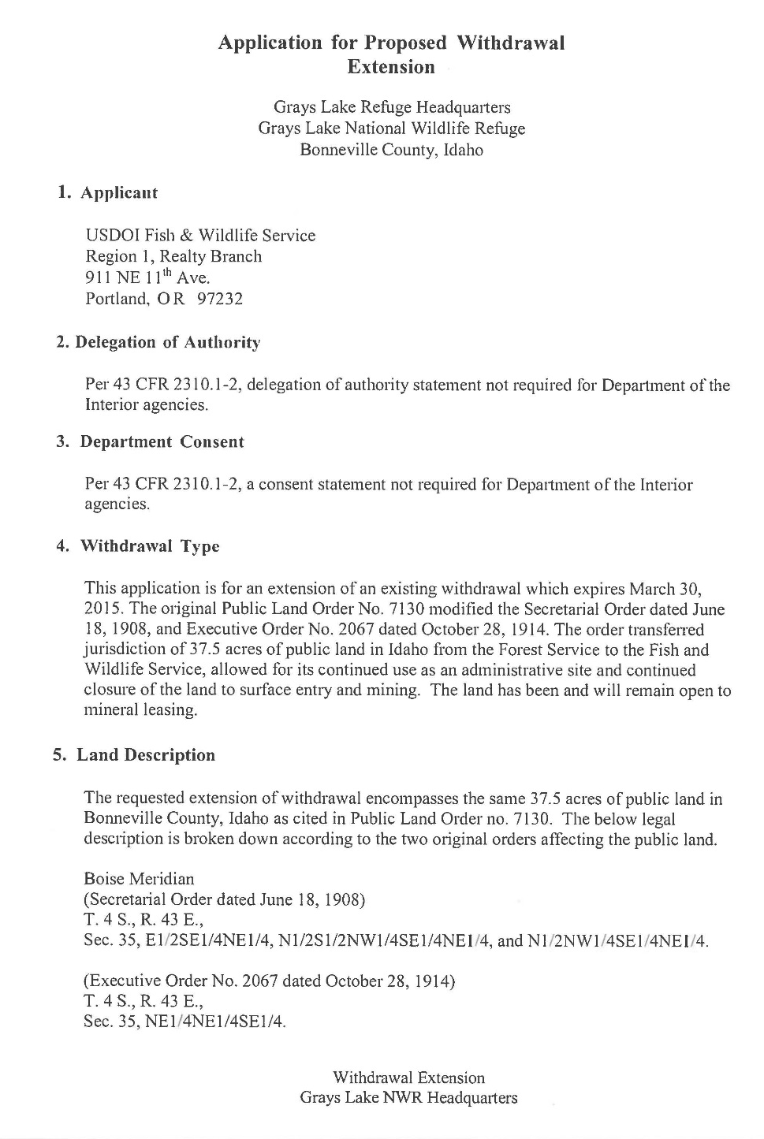
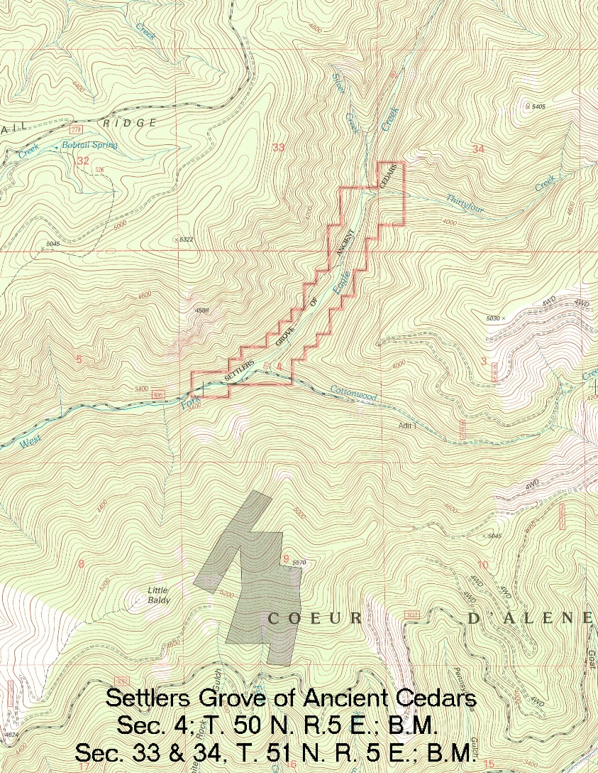
Submit as part of the LSSR

Slide 16
“The most important thing with the map is that it be of a proper scale and be colored/shaded/hatched in a manner so that it is obvious what areas are to be included in the withdrawal. I don't really care if the maps are generated by GIS or hand drawn on MTPs or quad maps, as long as the scale is good and the intent is clear.”
Notes:
OK – well that scale is maybe not too workable – but the labels should show the intent… now it they were just color coded

