Slide 1
Developing the Public Land Order packet
Case File Development
NEPA
Marketing
Maps/Photos
Interagency Agreements
Final Public Land Order (PLO) Packet

Slide 2
Final PLO Packet
It’s Been a While Since We Started
Lets Finish it Up!
Notes:
Recap what has been completed in the process up to this point.
Overview
Case File Development
Reports
NEPA
Marketing
Maps/Photos
Interagency Agreements
Final Public Land Order (PLO) Packet

Slide 3
The General Process
PLO
Application
Pre Application
(Prop/FO/SO)
NEPA and Reports
(Prop/FO Under Cooperating Agency Agreement)
SD Concurrence
Develop Petition/Application and MOU
(Prop/FO/SO)
WO Review
Public Meetings
(Prop/FO)
Submit to SO
(Prop)
Sec. Office Review
FO Review and Concurrence
(Prop/FO)
Application Review
(SO/WO/Sec)
ASLM
Approval
Approval
So Review
(Prop/SO)
Publish PLO
Publish FRN
If BLM is not the Proponent then BLM will function as Cooperating Agency
Notes:
This outlines the general process for a withdrawal action and identifies a 2 phased process.
We will get into detail on many of theses steps, but I just wanted to illustrate the general process of a withdrawal action from front to finish.
Revocation is the one action that is slightly different, which we will cover in detail, however the concepts and outcome of the process are the same.

Slide 4
Case File Development
Starts with Application.
Case Files are Generated for Each Withdrawal.
The BLM Case File is the Official Gov. Record.

Slide 5
Required reports
13 Required Reports (No. 13 for 5,000 or More Acres)
43 CFR 2310.3-1 (b) (Checklist)
Case By Case Requirement
Samples in DTS
May be Done in NEPA or as Separate Reports
Notes:
Reports File “PLO Report List”
Checklist Excel File ” WITHDRAWAL PACKAGE CHECKLISTS Colorado”
DTS List of Examples “DTS# Table”

Slide 6
Interagency Agreements
Used to Identify Roles and Responsibilities for the Project.
Project Specific
May Include an Element of Cost Coding/Cost Recovery
Can affect the Priority of Work for the BLM

Slide 7
NEPA
Who Makes the DECISION
Sample Decision Language.
BLM IM 2015-119, National Environmental Policy Act (NEPA) Review for Land Withdrawals.
When is an EA or EIS Appropriate?
When is a Categorical Exclusion Appropriate?
Notes:
Only someone who has been appointed By the President AND Confirmed by Congress can make, modify, extend, or revoke a withdrawal
FLPMA says Sec of Interior
603 DM 1 Delegates to ASLM
Sample Decision Language in KRC Module 3 Hyperlink “SG FS Decision” and “SG NEPA adoption”
Word Doc “5. Standard Doc Paragraphs PLOs _ PetApln”
IM File PDF “2015_119 Instruction_Memo_NEPA”
Coop Agency and CX Guidance PDF “NEPA Withdrawal Guidance”

Slide 8
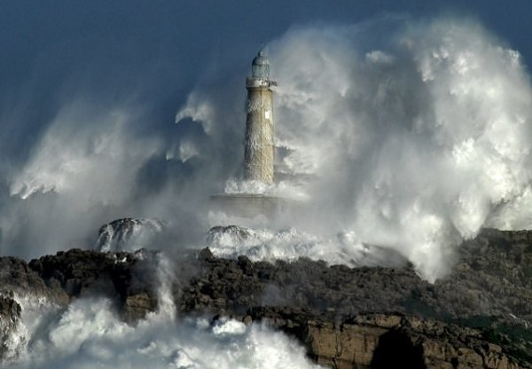
Marketing
Notes:
Telling a compelling story in a snapshot moment of time is far more effective in selling the product to the Department than a lengthy narrative.
When under pressure to complete a number of cases we tend to overlook the minute aspects of the case thinking everyone knows what I am talking about when, in reality, many of those in the WO and Department have never been to the site you’re wanting them to make a decision on.
This segment is on marketing and selling your case to the Department. I am going to show you some great examples and some not so great examples and hope that from these examples you will be able to develop compelling packages the Asst. Secretary will want to sign.

Slide 9
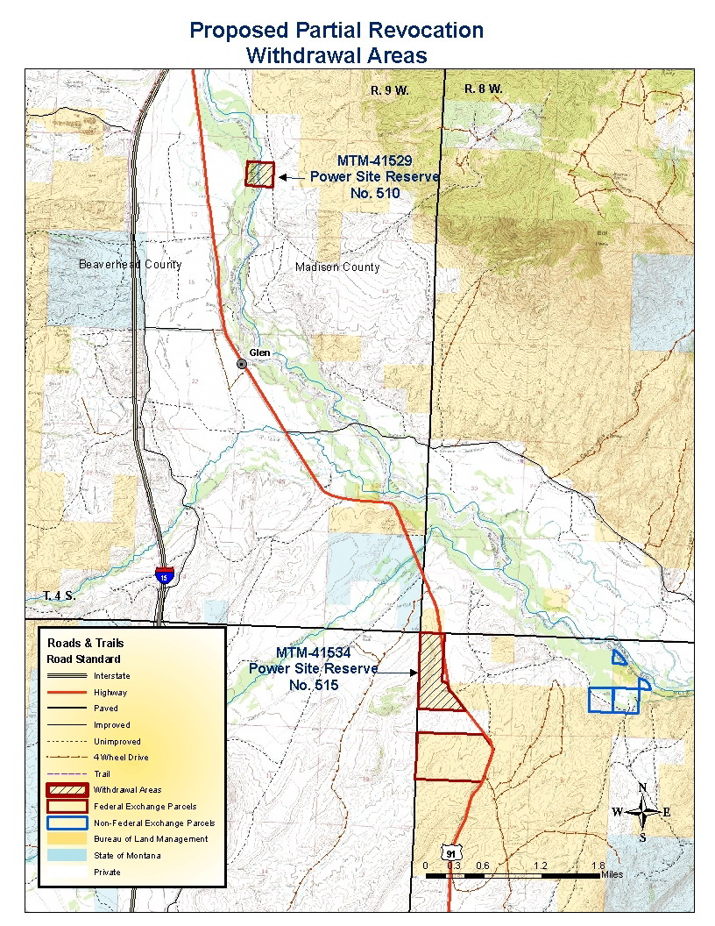
Notes:
This case is a Montana Case for a partial revocation in aid of a land exchange. The map is a 7.5 minute quad showing state land, private, and lands managed by the BLM
The one item missing from this mapping product is the Montana State location.

Slide 10
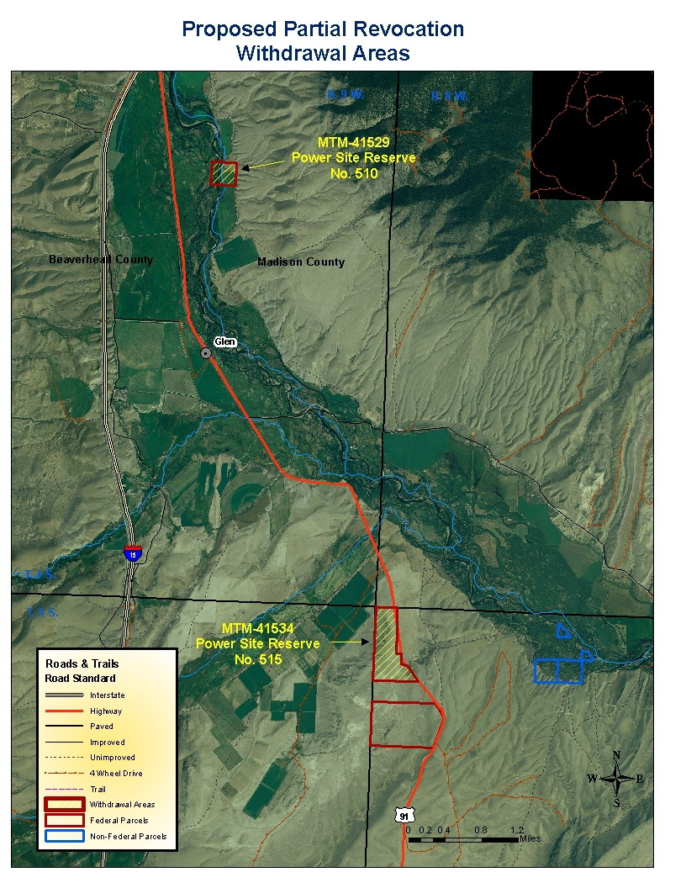
Notes:
This is an ortho photo of the same lands demonstrating the lands relationship to other farm units. It also shows the lands to be acquired and their relationship to the riparian zone.

Slide 13
Notes:
Idaho’s Priest Lake partial revocation to allow for a land conveyance.

Slide 14
Notes:
Idaho’s

Slide 15
THUNDER BAY LIGHTHOUSE - MICHIGAN

Slide 16
NATIONAL DESERT WILDLIFE RANGE NEVADA

Slide 17
??????

Slide 18
ANYTHING GOES

Slide 19
PLO Package
DTS is Your Friend
Use Your Friendly Neighborhood (State) BLM Withdrawal Lead
What is Prepared by Who
Sample Packets – Knowledge Resource Center (KRC)
Notes:
Sample Packets on memory stick, in DTS, or on KRC. KRC is hyperlink Modules 3 and 4

