Slide 1
Interagency Agreements MOU withdrawal review

Slide 2
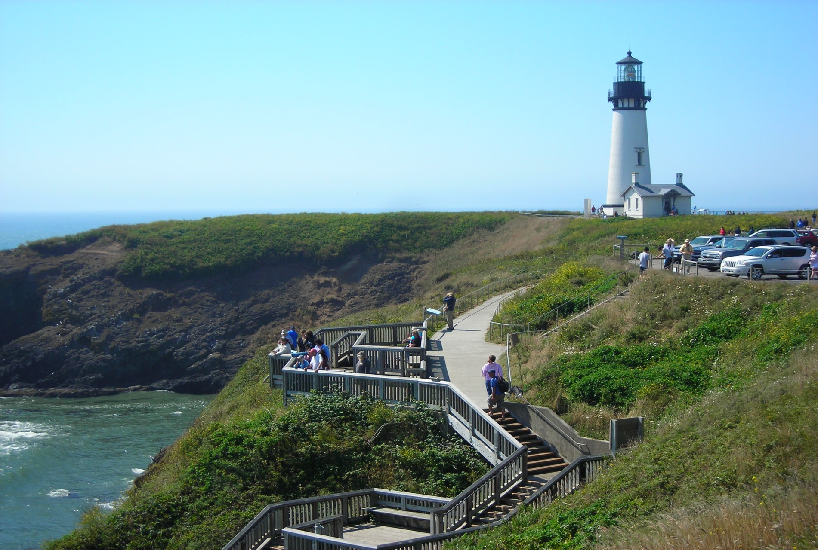
OBJECTIVES
Applying Interagency Agreements and MOU’s
What is a Withdrawal Review?
When is a Review Required?
How do we manage 204(l) Reviews?
Notes:
Photo: Yaquina Head Lighthouse, OR, By Scott Bixler

Slide 3
Interagency Agreements
How Are They Applied.
When Are They Appropriate.
Who Benefits.
Management.
Notes:
Briefly discuss that IAA’s should be part of the relationship between the holding/administrative agency and the underlying land management agency.
Project specific
How are they managed

Slide 4
MOU’s
How Are They Applied.
When Are They Appropriate.
Who Benefits.
Management.
Existing MOU’s
Notes:
Briefly discuss that MOU’s are an alternative to an IAA and may be part of the relationship between the holding/administrative agency and the underlying land management agency.
Project specific or at a national level
How are they managed
National level MOU’s with BOR, etc.

Slide 5
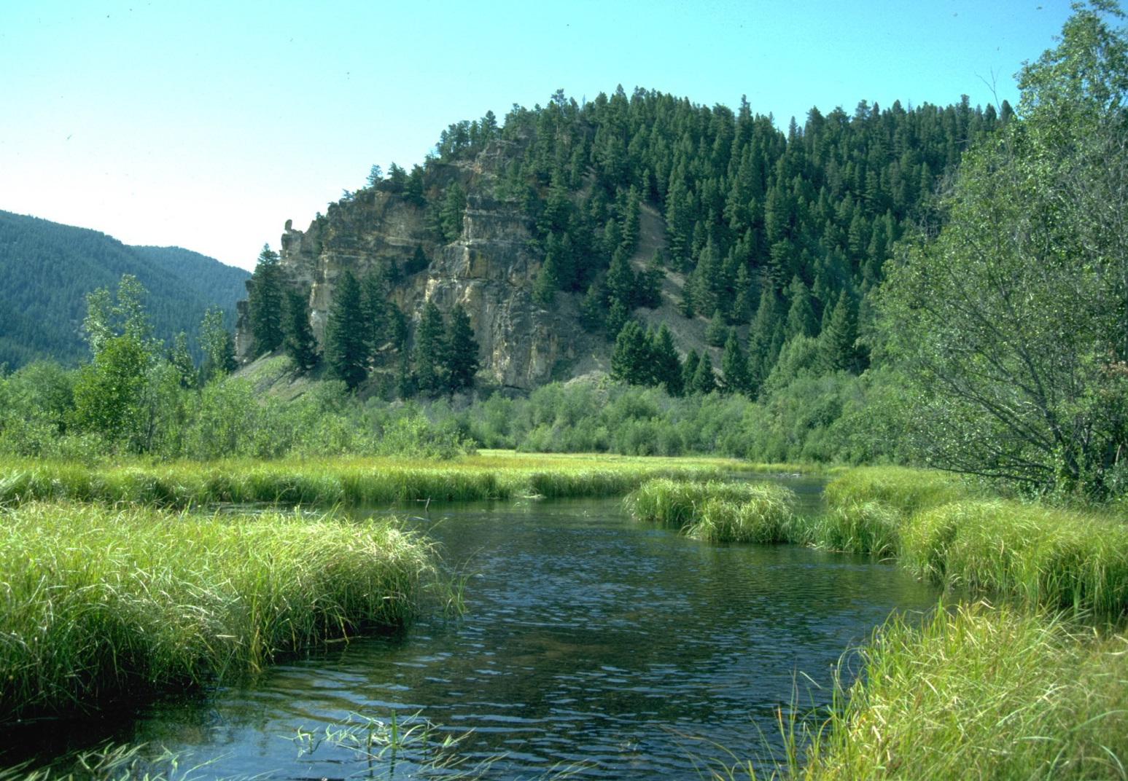
WITHDRAWAL REVIEWS

Slide 6
603 DM 1
1.3 Review & Revocation of Withdrawals
Requires Cooperation
Requires Periodic Systematic Review
Notes:
Photo: Tree, Bonneville Salt Flats, Utah
Refer to Policy and Guidance under 603 Departmental Manual
When is a review required:
During the Agency Planning Cycle
At least every 5 years
Who performs a review and maintain the data?
Fisheries, Forestry, Botanist, Recreation, Archeologist, etc. Whoever the benefiting activity is.
What is required for a review?
How is it noted?

Slide 7
FLPMA Withdrawal Review Status What Ever Happened to them ?
Notes:
Photo: Mt. Fryatt, Montana
204 L Reviews Required by FLPMA done in 15 years. Expired Oct 1991
Documents remain in their files
No action taken

Slide 8
Renewing Old Withdrawal Reviews 1. Review BLM Case Records 2. Check Agency planning 3. File New Application
Notes:
Photo: Coral Pink Sand Dunes Near Kanab Utah
Review the case file for previously submitted documents from the BLM Field Office, FS, or any of the other agencies administering wdls.
Review your agency’s planning to insure that it anticipated the opening of the lands to the public land and mining laws.
File new Application per 43 CFR 2371 refer back to process under relinquishments. This may not apply to BLM or USFS if they manage the lands withdrawn.
Remember, all documents in a proposed action should be no older than 4 years. If nothing changed, at a minimum, provide a memo from the authorized officer stating that they agree with the proposed action and previous documentation on file adequately covers the proposed action.

