Slide 1
POLICY - GUIDANCE & PLANNING
Jeff Cartwright
May 2017
Notes:
Can anyone tell me what policy and guidance you are currently using to guide you through the withdrawal program and name your sources?

Slide 2
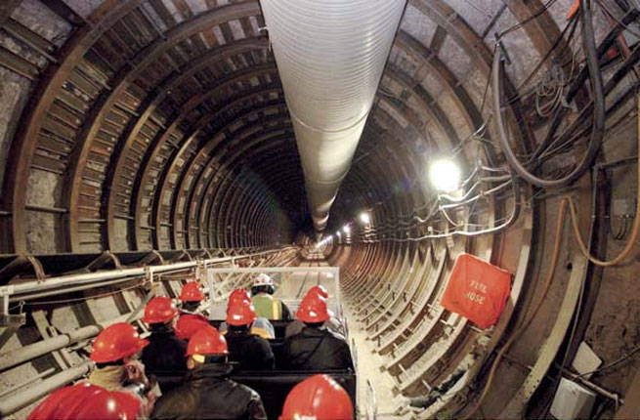
OBJECTIVE
Notes:
Upon completing this session you should be able to locate and identify:
What a withdrawal is.
The legal authorities for making, modifying, extending, and revoking a land withdrawal.
The regulatory authorities for processing a withdrawal.
The Department of Interior’s policy for land withdrawals as described in the Departmental Manual.
The general process of processing a withdrawal action.
The US FS manual for processing withdrawals.
The Bureau of Land Management’s Instruction Memorandums on various withdrawal issues.
Other documents that will guide you through the process.

Slide 3
What is a Withdrawal
Removes a Portion of the Bundle of Rights (Sticks)
Each Withdrawal is Unique
The Law – FLPMA Oct. 10, 1976
Notes:
More than half of the students in the class have not attended any withdrawals training. This slide gives a quick overview of that a withdrawal is and provides a foundation for the course.
A withdrawal removes a portion of the bundle of rights from the Laws affecting public and forest lands.
The course will get into many types of withdrawals and you will see there are many purposes.
Because of the history of withdrawals and the many purposes, you will see that each withdrawal is unique and needs to be treated that way.
The Law… A Copy of FLPMA is in your materials.
Included in your materials is a copy of Sec. 204 of the Federal Land Policy and Management Act – In order to implement anything there must be a law giving the Executive Branch the authority.
Key Points – 204(a) Who has the authority to make, modify or revoke a withdrawal?
That means this is a Departmental level program however, processing the proposed action has been delegated down to the Bureau of Land Management.

Slide 4
Where do we start?
Implementing Regulations – 43 CFR 2300
Departmental Manual – 603 DM 1
Handbooks
Instruction Memos & Bulletins
Knowledge Resource Center (Hyperlink)
Notes:
What follows the law?? The implementing regulations 43 CFR 2310
More specifically, the process to file an application is found under 43 CFR 2310.1-2
2310.3-2 is developing the case and processing it for submission to the Secretary’s office.
2371 is for relinquishing, revoking, and restoring withdrawals
Department of Interior Manual 603.1 Provides General Policy
Note general specifics
Note Delegation of authority
Handbook and Manual??? There is no Handbook or Manual for withdrawals. Included in your materials is a copy of an old Oregon supplemental manual and handbook. This has expired and was not officially adopted. It is a great source of information on processing a withdrawal action.
Instruction Memos???
There are numerous BLM Instruction Memos and Bulletins – I want to point out that we are still following the guidance for preparing Federal Register Notices found in WO IM No 2012-094 and the Data Tracking System (DTS) procedures for processing wdls found in BLM Handbook 1541-1 Appendix 8.
A recent IM was published as it relates to NEPA for the withdrawal process, IM No. 2015-119.
We will be discussing DTS and the NEPA process later in the class.
KRC What is it and where do you find it and how can it help.

Slide 5
The General Process
Application
PLO
Pre Application
(Prop/FO/SO)
NEPA and Reports
(Prop/FO Under Cooperating Agency Agreement)
SD Concurrence
Develop Petition/Application and MOU
(Prop/FO/SO)
WO Review
Public Meetings
(Prop/FO)
Submit to SO
(Prop)
Sec. Office Review
FO Review and Concurrence
(Prop/FO)
Application Review
(SO/WO/Sec)
ASLM
Approval
Approval
So Review
(Prop/SO)
Publish PLO
Publish FRN
If BLM is not the Proponent then BLM will function as Cooperating Agency
Notes:
This outlines the general process for a withdrawal action and identifies a 2 phased process.
We will get into detail on many of theses steps, but I just wanted to illustrate the general process of a withdrawal action from front to finish.
Revocation is the one action that is slightly different, which we will cover in detail, however the concepts and outcome of the process are the same.

Slide 6
Definition
Withdrawals are formal actions that set aside, withhold, or reserve Federal land by statute or administrative order for public purposes. A withdrawal creates a title encumbrance on the land.

Slide 7
Effect
Withdrawals accomplish one or more of the following:
Transfer total or partial jurisdiction of Federal land between Federal agencies.
Close (segregate) Federal land to operation of all or some of the public land laws and/or mineral laws.
Dedicate Federal land to a specific public purpose.

Slide 8
Purpose
Power Site Reserves,
Military Reservations,
Administrative Sites,
Recreation Sites,
National Parks,
Reclamation Projects,
Wilderness Areas,
Etc. (Can You Name More)

Slide 9
Types of Withdrawals
4 Major Categories
Administrative
Presidential Proclamation
Congressional
Federal Power Act or Federal Energy Regulatory Commission
Notes:
Administrative withdrawals are made by the President, the Secretary of the Interior, or other authorized officer of the Executive Branch of the Federal government. Examples include Executive Orders (EO), Presidential Proclamations, Secretarial Orders, Public Land Orders (PLO), Departmental Orders, U.S. Geological Survey Orders, BLM Orders, etc. Currently, only PLOs signed by the Secretary or Assistant Secretary of the Interior are used for administrative withdrawals.
Presidential Proclamation withdrawals are made by the President pursuant to the authority under the Antiquities Act . Bears Ears in Utah.
Congressional withdrawals are legislative actions by Congress in the form of public laws (Acts of Congress). Examples are Wilderness designations, National Parks, Wild and Scenic River designations, military withdrawals in excess of 5,000 acres (Engle Act), etc. NOTE: Congress has also passed some laws which create a withdrawal for some authorizations, i.e. National Forest Service Ski Area Permit Act of 1986.

Slide 10
Authorities
1888
1891
1902
1910
1915
1916
1920
1926
1941
1942
1943
1952
1958
1964
1968
1976
-------
---------
------
---------
---------
---------
---------
Reclamation
Act
------------------
Stock
Driveways
E.O. 9146
E.O. 10355
--------------------
----------------------
Reservoir
Sites
-----------------------
-----------------------
------
Wilderness Act
FLPMA
----------------------------
---------------------------------
-----------------------------------------------
-------------------------------------
PLO No. 1
Pickett Act
Federal Power
Act
Atty. General’s
Opinion
Engle Act
Wild & Scenic
Rivers Act
Forest Reserves
E.O. 9337
Supreme Court
U.S. v Midwest Oil
E.O. 4/17/1926*
PWR 107
implied authority
Reservoir Sites
Forest Reserves
Reclamation Act
Pickett Act
Stock Driveways
Federal Power Act
E.O. 9146
E.O. 9337
E.O. 10355
Engle Act
Wilderness Act
Wild and Scenic
Rivers Act
Federal Land Policy
and Management Act
10/02/1888
03/03/1891
06/17/1902
06/25/1910
12/29/1916
06/10/1920
04/24/1942
04/24/1943
05/26/1952
02/28/1958
09/03/1964
10/02/1968
10/21/1976
43 U.S.C. 662
16 U.S.C. 471
43 U.S.C. 416
43 U.S.C. 141
43 U.S.C. 300
16 U.S.C. 818
43 U.S.C. 155-158
16 U.S.C. 1131
16 U.S.C. 1277
43 U.S.C. 1714
* this executive order used the Pickett Act as the authority to withdraw land.

Slide 11
Withdrawal Relationships
Holding Agency – Holds the Withdrawal
Benefiting Agency – Held by One for Another
Administrative Agency – Administrative Jurisdiction
Notes:
Transfer withdrawal to other agencies with less than bundle. IAA or MOU.
What is proposed is 3rd party interest.

Slide 12
Segregation
The term "segregation" refers to the closure of lands to the operation of all/some of the public land laws and/or mineral laws.
Administrative – Term for Pre-FLPMA and FLPMA
Congressional – Term Established in P.L. or Act.

