Slide 1
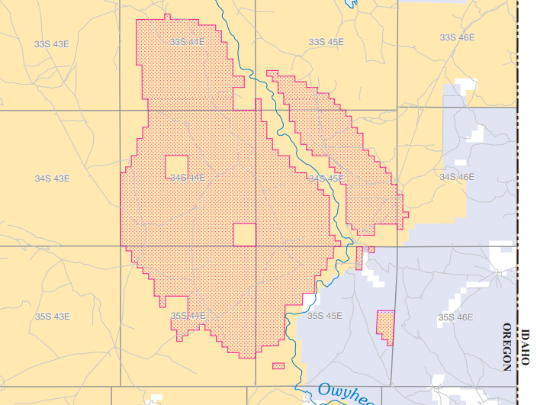
Federal Register and LR2000 Legal Land Description Tool
Byron Clayton
Spatial Products Section Chief 957.3

Slide 2
Case Study: SFA Withdrawal
Sagebrush Focal Area Mineral Withdrawal
6 States
10 Million Acres
Lots of coordination and collaboration!
Realty
Biologists
Surveyors
GCDB/PLSS Data Managers
Washington Office, NOC, States

Slide 3
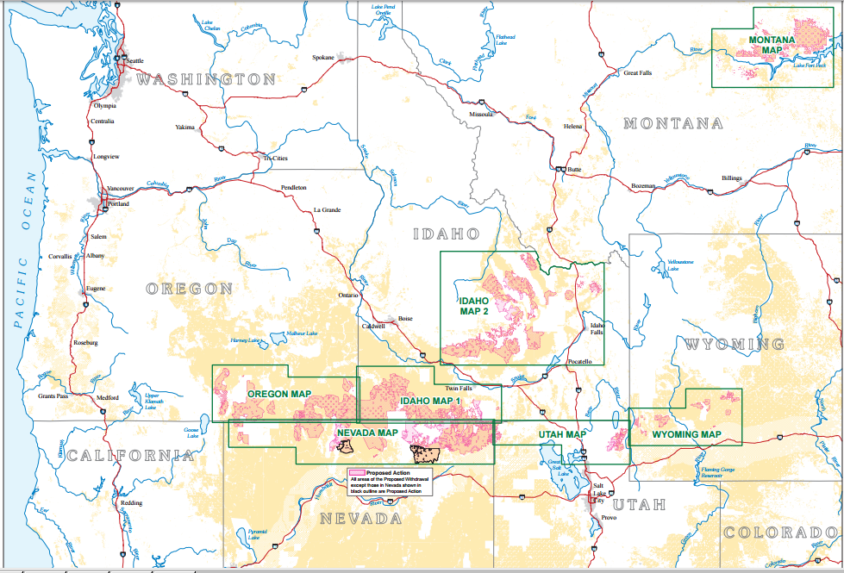
SFA Mineral Withdrawal

Slide 4
New Legal Land Description Tools
Federal Register Land Description
LR2000 Land Description

Slide 5
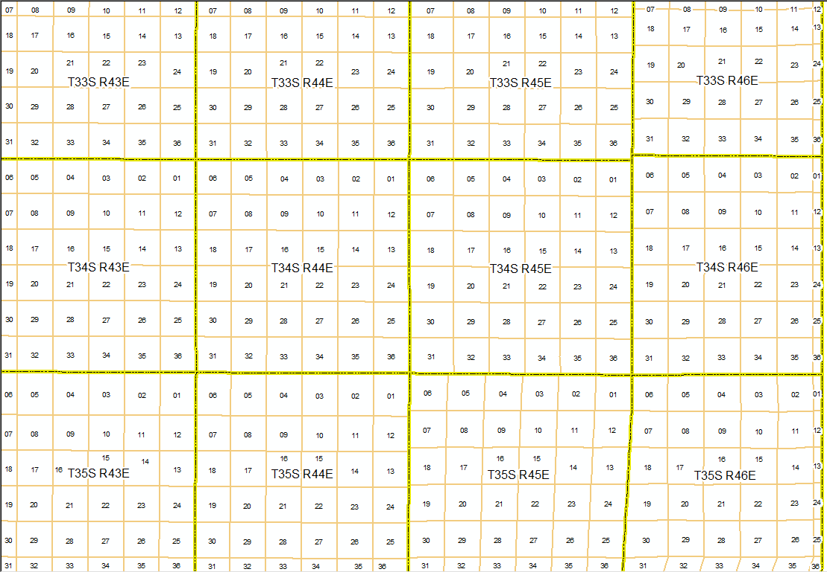
PLSS Data – CadNSDI

Slide 6
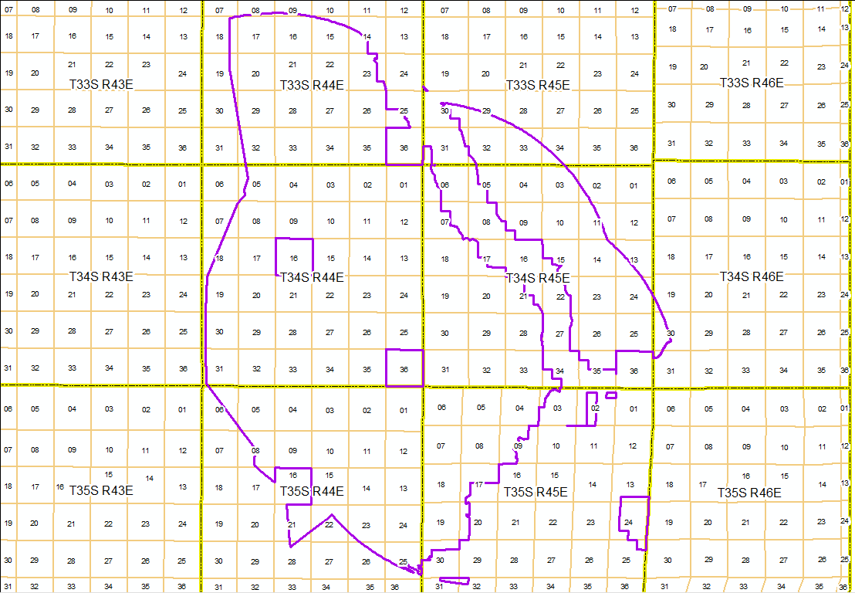
GIS Area of Interest

Slide 7
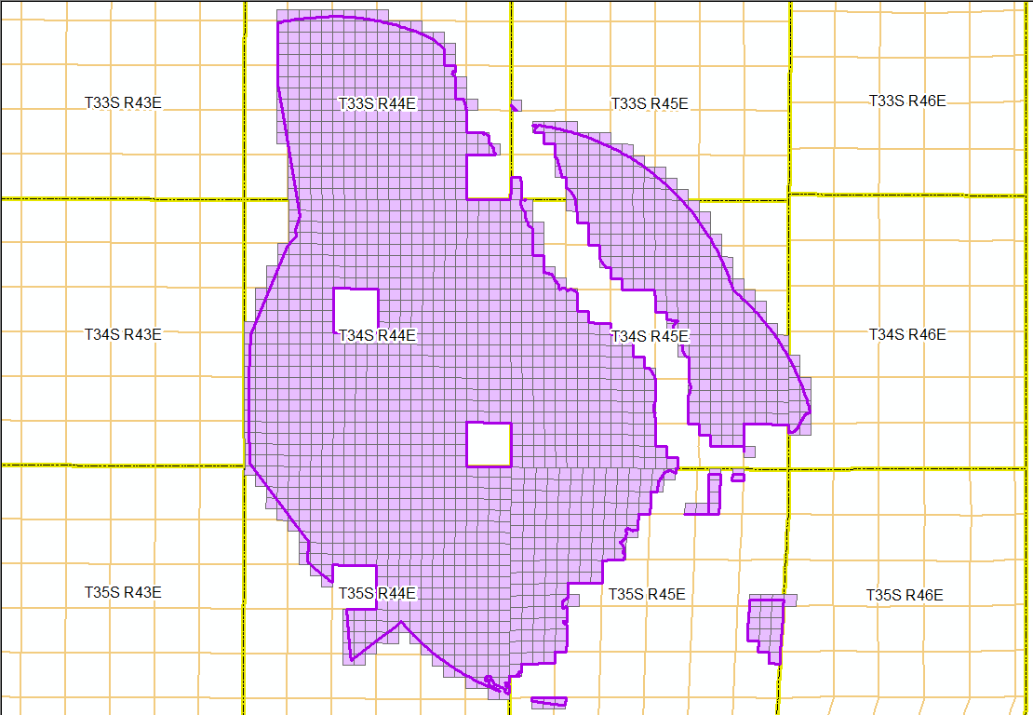
PLSS Data Selection

Slide 8
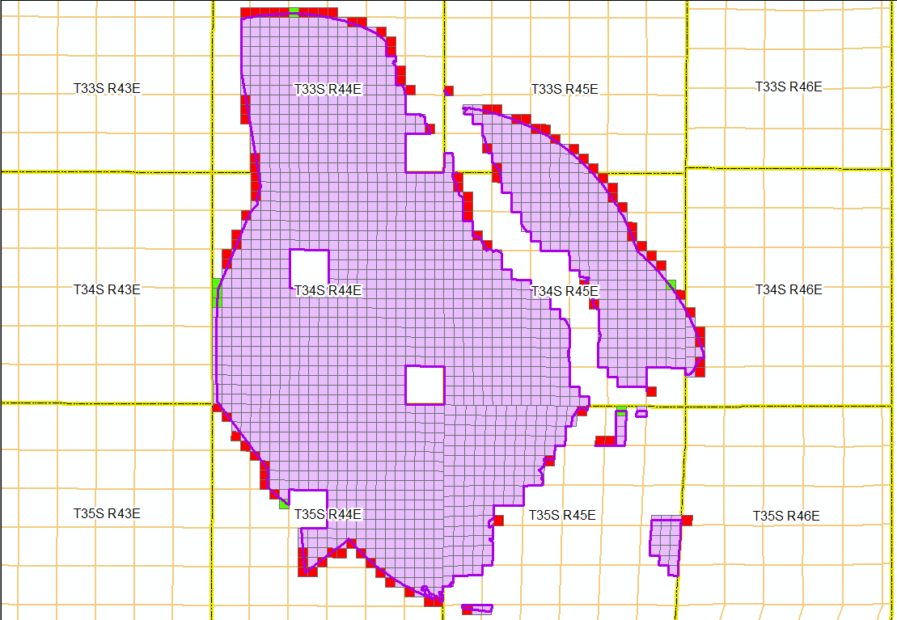
Edge Decisions

Slide 9
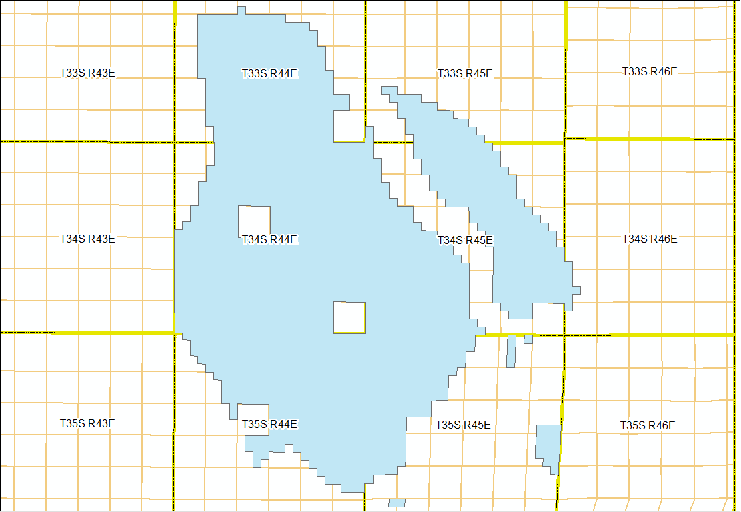
Final PLSS Level Area of Interest

Slide 10
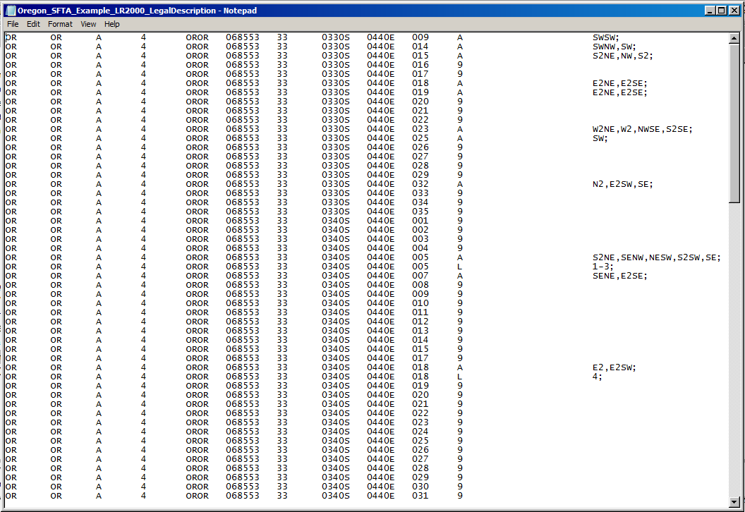
LR2000 Legal Land Description Upload Output

Slide 11
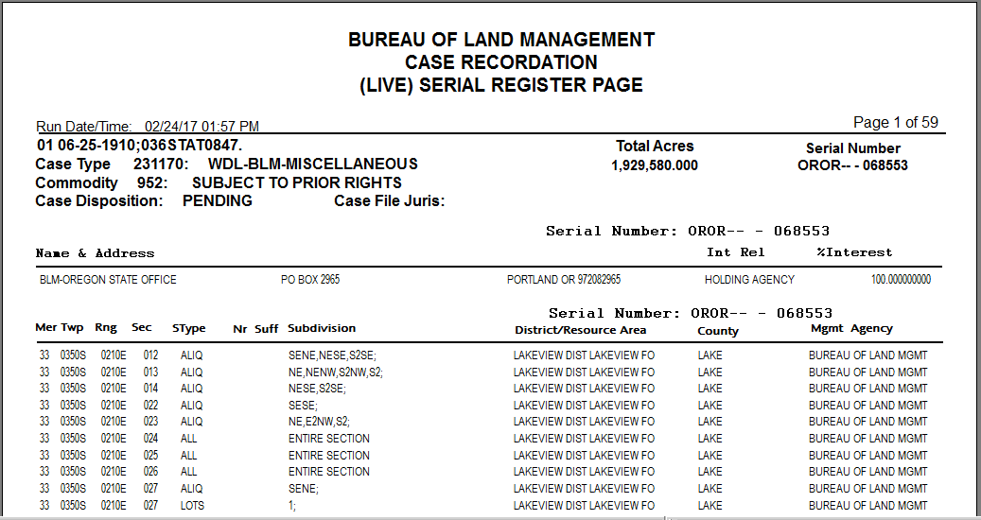
LR2000 Serial Register Page

Slide 12
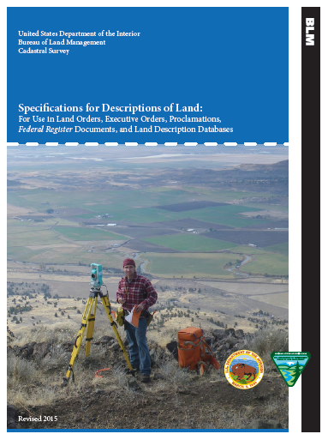

Slide 13
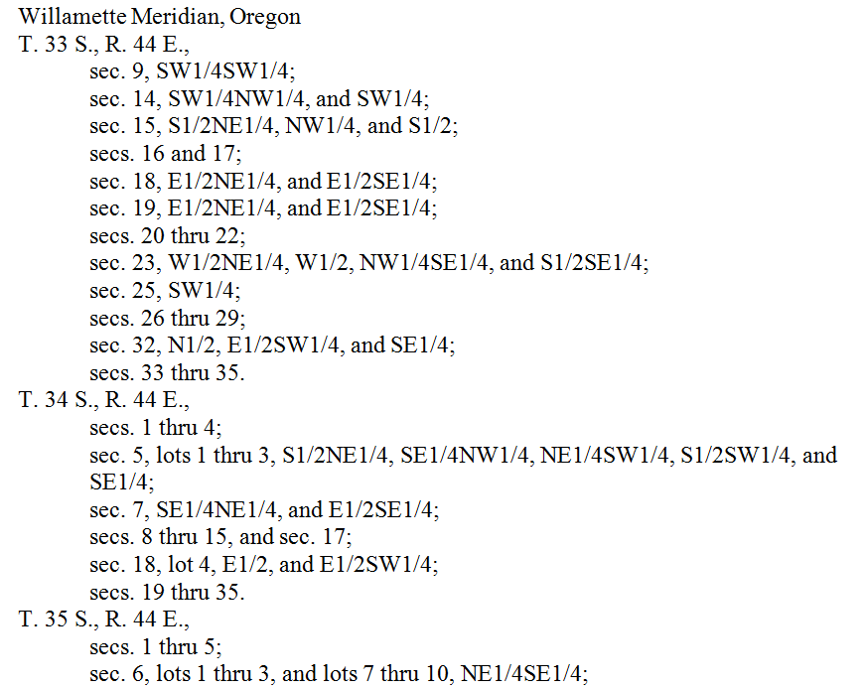
Federal Register Legal Land Description Output

Slide 14
Questions?

