Slide 1
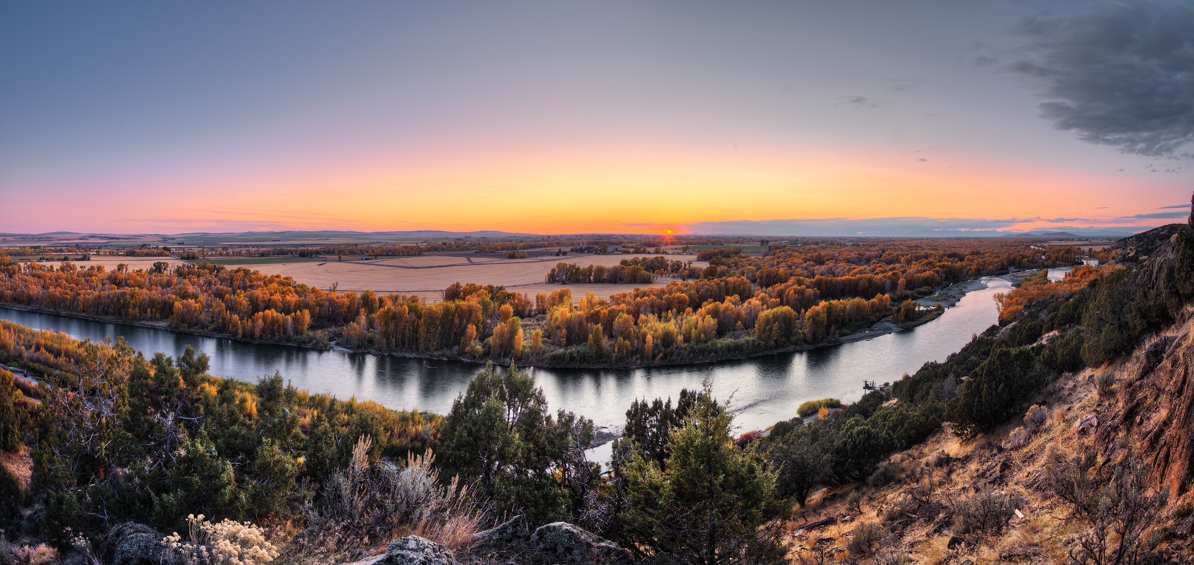
Exercise 1
2017 Withdrawals Beyond Mechanics (Course 2000-07)

Slide 2
MAP
BLM
National Forest
National Wildlife Refuge
Gravel Road
County Road
Area of High Mineral Potential
Proposed Admin Site

