Slide 1
Public Notice Requirements, Amendments, and Corrections

Slide 2
Objectives
Public Notice
Understand the relationship between FR Notice and Application
Identify content of a Federal Register Notice
Understand segregation following Notice
Fulfill Public comment/Public meeting requirements

Slide 3
Where we are in the process…
1. Consultation
2. Application
3. Routing
4. Federal Register Notice
5. Supplemental Materials
6. PLO

Slide 4
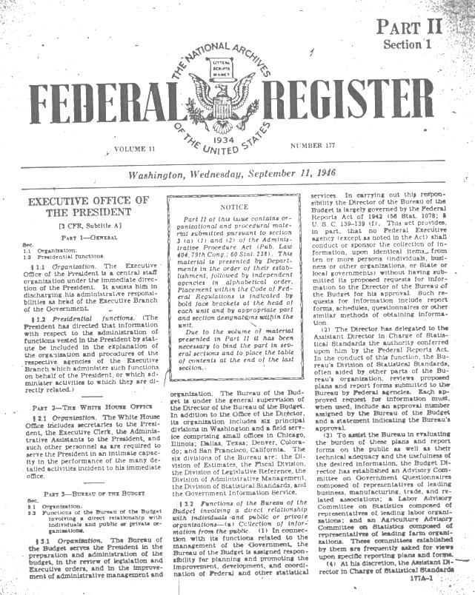
Application approved or Proposal reviewed
FEDERAL REGISTER NOTICE OF PROPOSED WITHDRAWAL
“A notice stating that the application has been submitted or that the proposal has been made…shall be published in the Federal Register by the authorized officer. 43 CFR 2310.2(a)
Notes:
Although the required application materials are listed under Section 2300, but often district and forest offices have questions regarding the exact application. Constant contact between the offices allows for the USFS to reach out to BLM with questions and your BLM counterpart to be able to reach out to their POC in the Forest regarding any questions they have. This ensures that the final application sent to the Secretary is complete and won’t be held up.

Slide 5
ELEMENTS OF FEDERAL REGISTER NOTICE
Key Items
Type and purpose of the proposed withdrawal
A legal description of proposed withdrawal
Proposed Term
The extent/duration of segregation (specific dates)
Provide suitable public comment period (minimum 90 days)
Contact information
A full list of required information is listed in 43 CFR 2310.1-3 & 3-1

Slide 6
Routing Process for Application and FR Notice Package
BLM State Director
A
Visual Aid!
Regulatory Affairs
WO Withdrawal Coordinator
WO Lands Section
WO Solicitor
WO Deputy Director of Operations
F
J
L
D
M
B
I
C
N
G
H
K
E
DOI Assistant Secretary for Land and Mineral Management
Application Reviewed/Approved
Notice of Proposed Withdrawal Published in Federal Register
Notes:
FR Notice is included in application package
Sometimes it may seem like once the application lands on the BLMs desk, it goes into the black hole of bureaucracy only to reappear several months later in the form of a FR Notice, or in worse case scenarios, to vanish all together.
I am going to attempt, in as brief a manner as possible, to explain what happens once a withdrawal application is submitted to the BLM State Director.
In Oregon, I review the application to make sure it is complete. Once reviewed, I will also prepare the FR Notice and Briefing paper and route the notice, along with the application, to my Lands Team to be reviewed by the Branch Chief. Upon approval, the application is sent to the State Director, and after, sent to the……
After the application leaves the State Office, I have limited control over the file, however, I can track the file in the BLM’s database and provide status updates to my USFS counterparts. Sometimes files get stuck in Washington. By having that POC in the BLM, the USFS can inquire about publication dates which in turn, allows the BLM to follow up with Washington and provide that feed back to their USFS counterparts.

Slide 7
Important!
Temporary Segregation
A 2 year segregation begins from the date of publication of Notice of Proposed Withdrawal in the Federal Register.
How is 2 year segregation terminated?
Automatically after 2 years
Withdrawal enacted prior to 2 year mark.
Agency cancels withdrawal application (through FR notice)
PLO application is denied by Secretary
Segregation closes the land to new claims but is subject to prior existing rights.
What does this mean?

Slide 8
Public Comments & Public Meetings
FR Notice published in newspaper of general circulation.
Minimum 90 day public comment period.
Public Meetings if (a) Requested, (b) USFS/BLM decides one is necessary due to circumstances, or (c) withdrawal is 5,000 acres or more.
Notes:
Once the a notice of a proposed withdrawal or withdrawal extension is published in the federal register, it must be republished in a newspaper of general circulation. The public has 90 days from the date of the FR notice to comment on the proposed withdrawal.
Comments: Depending on the nature of the withdrawal, public comments can range in tone and quantity. If the withdrawal is potentially contentious or of interest, it is not uncommon to receive thousands of public comments. Close coordination between BLM and USFS allows for proper assessment and organization of comments. Although comments are addressed to the BLM State Director, comments may be incorporated into the scoping for a NEPA analysis conducted by USFS, and therefore, it is vital that USFS and BLM are working close together to manage and review comments.
Public Meetings: If a public meeting is requested, the authorized officer finds a public meeting to be appropriate, or the proposed withdrawal is over 5,000 acres, a public meeting must be held. BLM and USFS must work together to arrange meetings since both agencies are involved and will have valuable input for the public or can answer agency specific questions.

Slide 9
Federal Register Notice Recap
Public notification that an application has been submitted.
Published immediately following Application review/approval by Assistant Secretary of the Interior
Content sourced to the application & includes duration, location, and purpose of the proposed withdrawal
2 Year Segregation begins on date of publication
Published in newspaper of general circulation
Begins Minimum 90 day public comment period
Public Meetings if (a) Requested, (b) USFS/BLM decides one is necessary due to circumstances, or (c) withdrawal is 5,000 acres or more

Slide 10
Amendments
Objective
Identify when amended application is required
Understand the process for amending an application

Slide 11
Amendments
An Amendment is a substantive change to the proposed withdrawal such as changing the proposed term, purpose, or location.
First steps to determine if Amendment or Correction
Does it change the term of years?
Does it change the purpose?
Does it change the location?
If you answer yes to any of these questions, the proposed change requires an amended application.

Slide 12
The Amendment Process
An Amendment is a new proposal!
All of the requirements for a new withdrawal listed under 43 CFR 2310 must be met
Pre-consultation
Amended Application
Full routing process
Notice of Amended Application in Federal Register
Public Meetings (if required)
New 90 day comment period
Required studies and reports must encompass amendment/change
Why is an amendment a new proposal?
Notes:
Preconsultation – This emphasis the importance of the original consultation and
It’s a new proposal. For example, comments were only collected on a 200 acre withdrawal, but not 250 acre withdrawal. Therefore, if not opended for new public comment, the Secretary cannot approve final PLO application because the public did not comment on size of withdrawal.
why preconsultation is so important

Slide 13
Amendments
No Change to 2 year segregation
An Amended Application does not change the 2 year segregation time frame. In other words, the lands will be opened two years from the original application.
Why is this important?
A: Withdrawals are subject to prior existing rights
Notes:
This should be discussed during pre-consultation
Land Rush

Slide 14
Amendments
Summary
Key Points for of Amending a proposed withdrawal
Type of Notice: Notice of Amended Application
Timing: Post Fed Reg Notice of Proposed Withdrawal
Required: Any change to the proposed term, location, or purpose
Process: Must meet requirements for a new application.
Segregation: Do not change expiration date for 2 year segregation

Slide 15
CORRECTIONS
Objective
Identify when a correction is required
Know correction process

Slide 16
Corrections
A Correction Notice mitigates an unintended mistake in a prior Notice of Proposed Withdrawal or PLO.
Real examples of corrections:
Incorrect spelling
Wrong phone number/contact information
Different position/title than listed
Different Branch Chief (authorized officer) signed than listed in signature block
More accurate/detailed description of the same location
Error of the Federal Register

Slide 17
Amendments and corrections summary
Amendments
Ask if proposed edits change the:
Term of years?
Location?
Purpose?
Anything else of substance?
If yes – Notice Amended Application
Need to make sure all of the CFR requirements are met for the amended application.
Corrections
Ask if the change is substantive (term, location, purpose).
Typographical mistake?
Transmittal error?
Spelling?
No impact to term, location, or purpose?
If yes – Correction Notice
Don’t need to start over
Notes:
CREATES WDRL:
Although withdrawal can be created by other mechanisms, a USFS initiated withdrawal will be in the form of a PLO.
Term: Under FLPMA, Secretary can issue withdrawal for up to 20 years
From initial application to final PLO is a long process that requires close coordination between the two agencies. It is important that this communication and coordination

Slide 18
Question Time!
A Federal Register Notice for a proposed 200,000 acre withdrawal was published in January 2016, followed by a 90 day public comment period, and 3 public meetings.
The proposed withdrawal has attracted a significant amount of public attention from the media, public, and local and federal representative. Most comments received are in support of a 20 year withdrawal.
The Application and Federal Register Notice was for a 10 year withdrawal.
NEPA and Mineral Potential Reports are almost completed. The NEPA analyzed a 20 year term as an alternative.
The applicant would now like to know if they can now change the proposed term to 20-years.
It is now May 2017.
Is a change from 10-year to a 20-year proposed term possible?
What, if anything would this change in term require?
What are some things you would ask the applicant to consider?
Notes:
Amendment
Won’t be completed in time
Pre-application consultation.

