Slide 1
WITHDRAWALS
OBJECTIVE
Describe the need for a new withdrawal or withdrawal extension.
Identify the steps in the withdrawal application process.
Identify alternatives to a withdrawal.

Slide 2
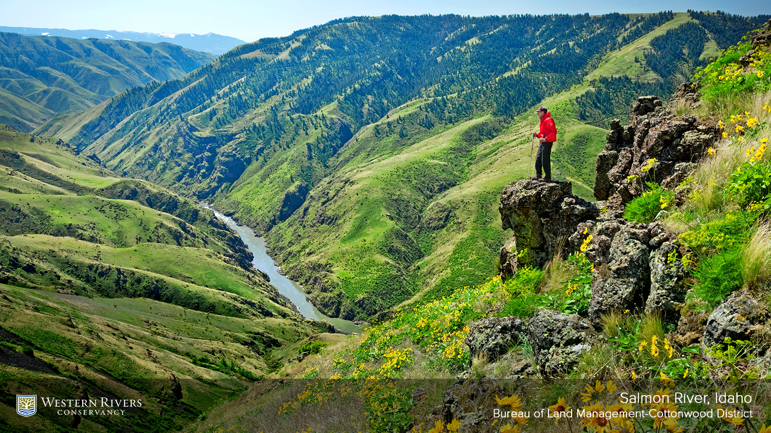
What is the Need
Notes:
Relate the Lower Salmon River Wdl to a Need and Purpose.

Slide 3
3 Steps of the Withdrawal
Application Process
Determination of need
Application
DOI approval & publication of a
Federal Register Notice

Slide 4
PRECONSULTATION
Familiarize applicant with responsibilities
Validate the actual need & ALTERNATIVES
Determine extent of segregation needed
Clarify timeframes
Notes:
The end result is an MOU or IAA

Slide 5
A WITHDRAWAL NEED EXITS WHEN:
Lands occupied by high valued improvements or
contain special features
Lands are identified in Resource Management Plan
Improvements or special features can’t be
protected by alternative methods
Surface value exceeds sub-surface value
Transfer from one Federal Agency to Another

Slide 6
Still Needed ?
Notes:
Since the Withdrawal was put into place the River was designated as an ACEC and SRMA.
Is the withdrawal still needed?
Mineral Potential??

Slide 7
44 LD 513
A pre-FLPMA ROW for federal agencies
Notated on the Master Title Plat and historical index
Serves two purposes:
  Puts public on notice of federal improvements on public land (via notation)
  Protects those improvements when land is conveyed out of federal ownership (via patent exception)
Terminates when federal use and occupancy ends and cannot be transferred to 3d parties
Compare to RS 2477 public highways

