Slide 1
Withdrawal Petition & Application
Presented by Brad Tait
USFS Washington Office, Lands and Realty Management

Slide 2
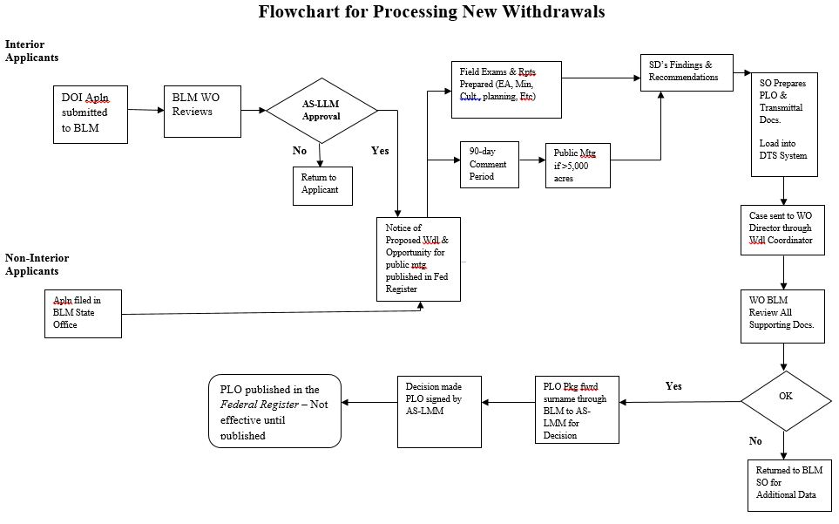
Withdrawal Flowchart

Slide 3
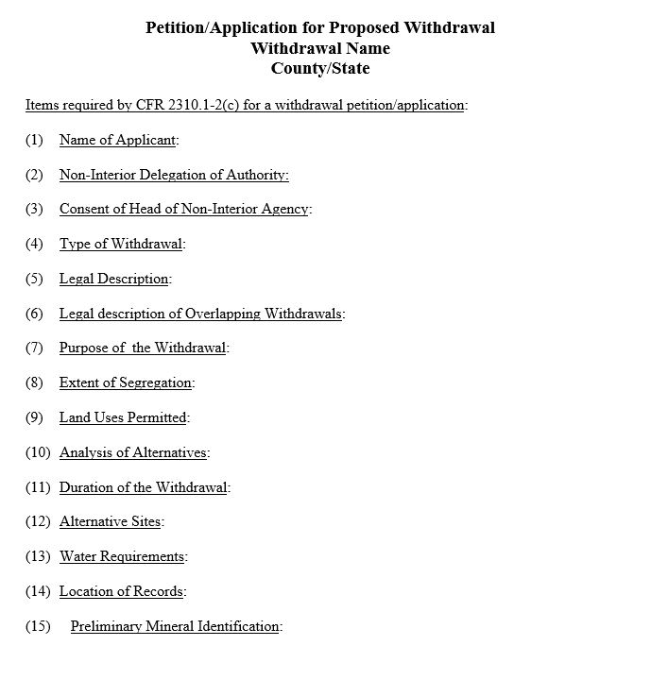
Withdrawal Application
DOI Agency, BLM

Slide 4
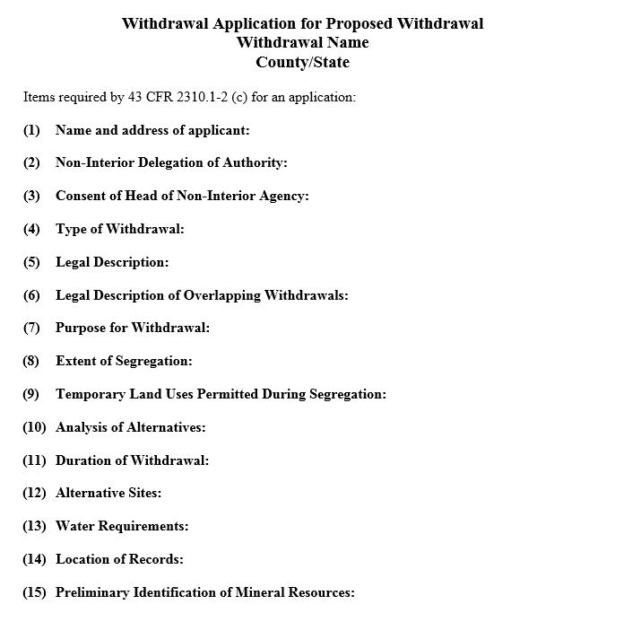
Withdrawal Application
Non-DOI Agency, USFS

Slide 5
Application Materials
USFS materials:
  Application
  Maps
  Cover letter from USFS RO to BLM SO
  Updated Mineral Potential Report
  Request/application from National Forest SO
  BLM materials:
    Petition/application
    Maps
    Cover letter BLM Director to Asst. Sec. Lands & Mineral Mgmt.
    Information memorandum
    Land Description Report
    Federal Register notice and briefing paper

