Slide 1
CLOSING AND ESCROW
KAREN MONTGOMERY, REALTY LEAD
CALIFORNIA STATE OFFICE
K15MONTG@BLM.GOV
916-978-4647

Slide 2
CLOSING VS. ESCROW WHAT’S THE DIFFERENCE?
Closing:
A meeting of the parties to a real estate transaction held to execute and deliver property title documents.
Escrow:
Property or evidence of property deposited by two or more persons with a third person to be delivered under a certain contingency or on the completion of certain terms.
The Dictionary of Real Estate Appraisal, 3rd Edition, Appraisal Institute

Slide 3
CLOSING - A MEETING OF THE PARTIES
Notes:
There are many ways to “meet”

Slide 4
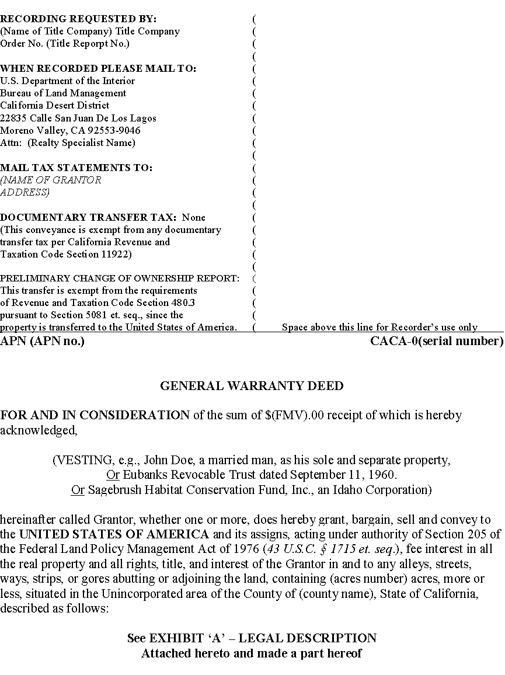
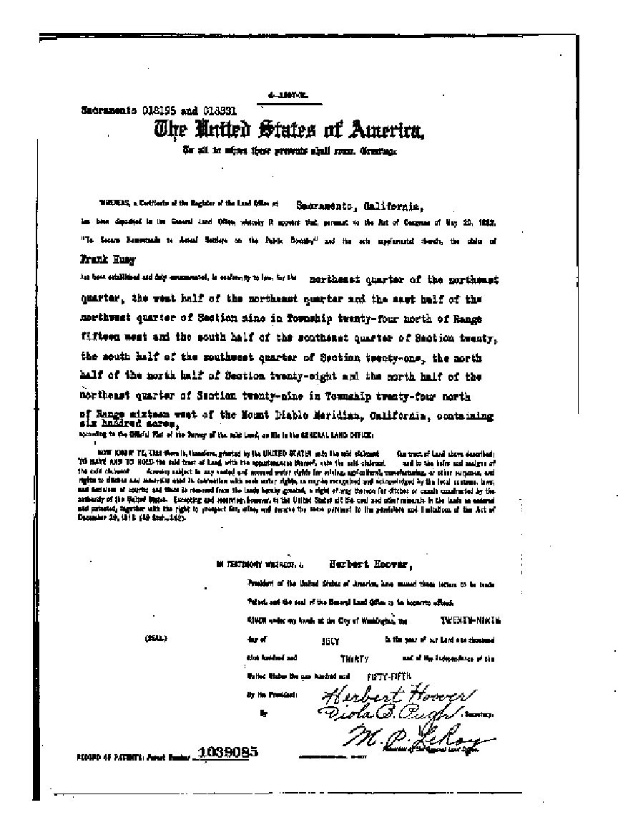
ESCROW
…on the completion of certain terms

Slide 5
ESCROW …ON THE COMPLETION OF CERTAIN TERMS
Escrow Instructions
Policy Form - A.L.T.A. Form 9/28/91 (Revised 12/3/12)
Value of Policy
Ensure all taxes and liens are paid
Deed to US records before patent to patentee
Conformed copy of recorded documents will delivered
Title Insurance Policy can be issued as directed
Remove Unacceptable Exceptions
Notes:
FS often conveys property with a General Exchange deed, or BLM Quit Claim Deed (associated with acquired lands and in lieu lands, can you add deed in there).

Slide 6
ESCROW
Simultaneous exchange is the preferred method
Title passes upon recordation of the conveyance documents
Non-Simultaneous exchange (BLM)
Deed to US is recorded first
Title does not pass until the solicitor issues the Post Acquisition Title Review (FTO)

Slide 7
ESCROW DELIVER TO ESCROW
Escrow Instructions – signed
Exchange proponent may deliver separate escrow instructions
Offer letter
Deeds
Patents
Funding – Cash Equalization and Closing Costs

Slide 8
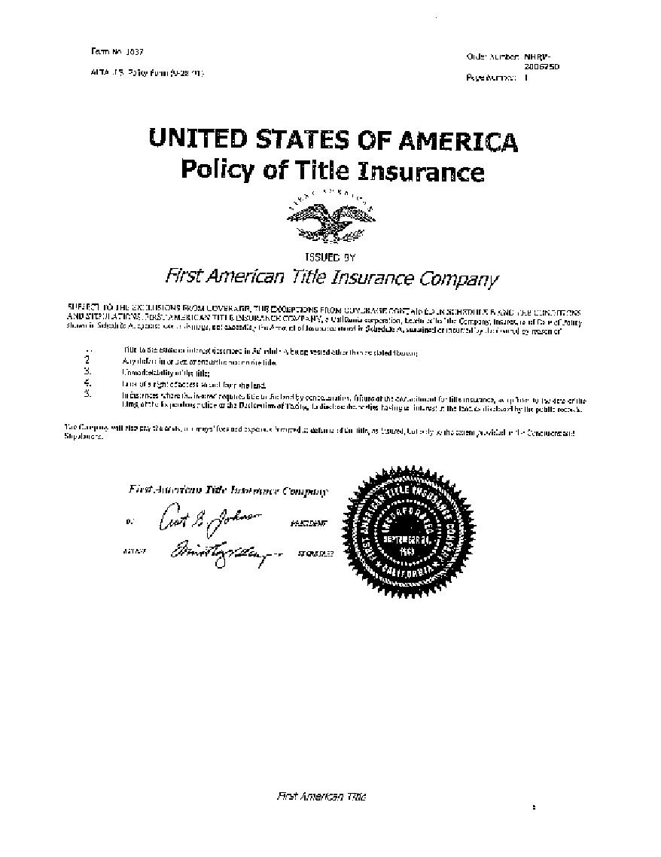
CLOSING ESCROW ENSURE…
Second CIP before closing
Deeds and Patents and any other documents are recorded in the County Offices
Funds are delivered/earned, as appropriate
Conformed Copy of recorded documents
Title Policy Issued on the date of recording
Legal Description is exact
Ensure Escrow Instructions were followed

Slide 9
POST ACQUISITION TITLE REVIEW – (FTO)
NON-FEDERAL LANDS:
Executed and Recorded Deeds
Title Insurance Policy (A.L.T.A. Policy (Revised 12/31/12))
Admin Determination or Certificate of Use and Consent – Address any new Exceptions
Settlement Statement
Second CIP
Approved Pre-Acquisition Title Review (PTO)
Notes:
In Exchanges title transfers at recording, (unless its non-simultaneous).
All other Transaction – title is held by US when Post Acquisition Title Review (FTO) is signed
Solicitors and OGC send a copy to DOJ.

Slide 10
POST CLOSING
Records Notations
LR2000
MTP
LSRS, LADS and Status Atlas
FS transmits info to BLM for notation
Document Third Party Rights
Establish a New Case File for each 3rd party right

Slide 11
FINALLY…
Follow archive schedule for files
Notify Resource Staff and LEO
Report accomplishments
County Letter
Thank You Letters
Press Release
Post and mark new boundary
Notes:
Acquired lands (PT) file should remain in office.
Disposed of lands (FD) can eventually go to the records center.

