Slide 1

Appraisals
Intermediate Land Tenure
June 28, 2017 Salt Lake City, UT
USDOI, Office of Valuation Services
Mike Ward, RPRA
Client Service Manager – BLM/PLD Team
Lakewood, CO 303.969.5375
Doug Braun, MAI, AI-GRS
Team Lead – BLM/PLD Team,
Portland, OR 503.808.6070
Notes:
Introductions
Name
BLM or FS
Duty Station
Experience with Appraisals

Slide 2
What we will cover
Utilizing valuation services effectively
Know how to submit an adequate appraisal request
Understand the appraisal process
Be able to plan for sufficient resources; Time & $$$

Slide 3
APPRAISAL SEGMENT OBJECTIVES
Know your review appraiser and when to talk to them
Complete an IVIS worksheet & request for appraisal services from OVS (or FS) according to agency guidance, including all required elements
Understand the appraisal process sufficient to respond to general appraisal questions from management, landowners, and proponents
Notes:
(See attached list of contacts

Slide 4
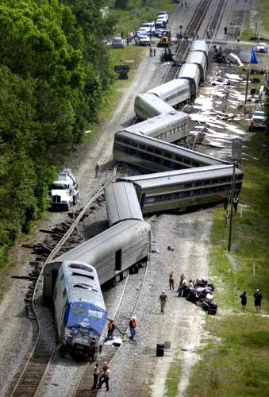
The goal is not to teach you how to be an appraiser
Rather… how to work effectively with OVS/FS appraisers to successfully obtain valuation services needed for a specific agency action.
*Avoid the train wreck!

Slide 5
Why Appraisals?
Appraisals are required for most agency land actions
Transactions are complicated
Allegations that Government gives away or overpays for land
And after all, you don’t want to end up in the paper or on the 10 o’clock news about how your land deal went bad…
Notes:
Shawn

Slide 6
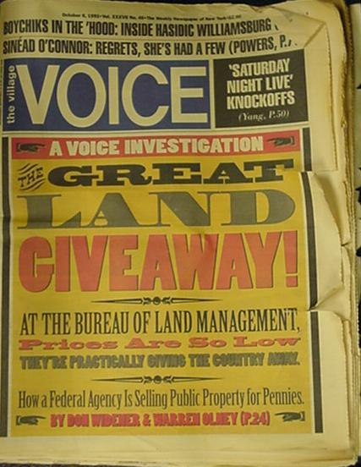

Slide 7
AUDIT COVERAGE HISTORY
DOI - May 1956 – Report of the Committee on Land Appraisal Practices in the Department of the Interior
GAO - June 2000 – BLM and the Forest Service: Land Exchanges Need to Reflect Appropriate Value and Serve the Public Interest
The Appraisal Foundation – Oct. 2002 - Evaluation of the Appraisal Organization of the Department of the Interior Bureau of Land Management
“… the DOI should create a centralized appraisal and appraisal review organization for the Department.”
Sec. Order 3251 Nov. 2003 Consolidated real estate appraisal function into one separate organization.
Forest Service has its own appraisal function.
Notes:
Starting back in 1956 and subsequently 10 other audits brought us to one organization.
Changes coming with the integration of OAS into OS and OVS

Slide 8


Appraisal Standards
Uniform Standards of Professional Appraisal Practice (USPAP)
Uniform Appraisal Standards for Federal Land Acquisition (UASFLA)
Code of Federal Regulations (CFRs)
Agency Policy and Directives
  i.e. FSM 5400, Chapter 5410 and FSH 5409.12
  USDOI – OVS Appraisal Policy Manual

Slide 9
Valuation Products
Appraisal & Review
Review Only – Inherently governmental (BLM/NFS)
Exchange Appraisal
  (2 requests in IVIS, 1 request for NFS)
Consultations – Market Conditions
Land Exchange Feasibility Consultation specific to FLPMA/FLEFA
Waiver Valuations
Mineral Valuations (DME)
Recreation Residence Appraisal (FS)
Notes:
Shawn

Slide 10
The valuation process (usually an appraisal AND the review of that appraisal) establishes market value.
It is based on market value and not public interest value or resource value or landowner value or investment value!
MANY KINDS OF GENERIC “VALUE”
  Emotional
  Sentimental
MARKET VALUE IS OUR CONCERN
Notes:
Tim will discuss difference between Fair Market Value and Market Value ….No difference
The term “fair” hardly adds anything to the phrase “market value”…
[United States vs. Miller, 317 U.S. 369, 374 (1943)]
Market Value is not:
What it takes to make the deal work
Sentimental
Unique to one buyer or seller
Dependent upon unique management
Unique to a use
An appraiser’s guess!

Slide 11
Elements that influence Market Value
Location
Size
Physical Characteristics
Proximity to population centers
Supply and demand
Recreational
Utilities
Access, Physical & Legal
Hazardous Materials
View
Topography
Notes:
Size – Generally the value per unit increases as the size decrease
Recreational (dependent on amenities such as trees, water, view, solitude, etc.)
s

Slide 12

BUNDLE OF RIGHTS
Bundle of Rights includes all interests in the real estate.
Consider outstanding rights, reservations, encumbrances to the property.
All of the interests may affect the estate being appraised and should be identified up front during the appraisal process.
Notes:
IMPORTANT NOTE. THE ESTATE APPRAISED MUST MATCH THE ESTATE CONVEYED

Slide 13
Appraisal Request Process Flow Chart
Approver
Forwards to
OVS Client Service
Manager (CSM)
Agency Submitter
Gathers
Info. and Enters
IVIS Request *
Submitter
Forwards to Agency
Approver for Validation
Key Partnership
CSM
Assigns to Review
Appraiser
Appraiser
Completes/Submits
Assignment to RA
OVS Staff Appraiser
Review Appraiser
Defines Scope* and
Assigns/Contracts
Assignment*
Contract Appraiser
IVIS Notifies
Agency Clients and
OVS Leadership
of Results
RA Prepares
Review Report and
Enters Results
in IVIS
* Key Steps in the Project Appraisal Process
Notes:
Realty Staff submits complete Appraisal Request to IVIS/TLA/Review Appraiser
Review Appraiser issues Statement of Work to contract or staff appraiser
Review Appraiser and Realty Staff coordinate Pre-appraisal Meeting and Site Visit
Review Appraiser submits Appraisal Review Report to realty staff
Public requests documentation by FOIA

Slide 14
Ingredients for Success
Early involvement by the appraisers is key…give your servicing DOI or FS appraiser a call!
Plan time and $$$ for the appraisal
Remember that appraisals have a shelf life
Use the appraisal request to outline an exact, complete, comprehensive articulation of the property and interests affected by the proposed land action.
Notes:
What questions do you need answered?

Slide 15

WHY EARLY AND CLOSE COORDINATION
Transactions are complicated
Appraisals are critical component
Timing is crucial
Things change along the way
Manage expectations
Selection/approval of appraiser
Unsolicited appraisals
Notes:
Identify discussion items….. Examples

Slide 16
The Appraisal Request

Slide 17
Request for Appraisal Services
BLM requests appraisals through the Interior Valuation Information System (IVIS).
All BLM appraisal requests MUST include a completed IVIS worksheet.
USDA Forest Service requests appraisals via a letter, the format of which is specified in the Forest Service Appraisal Manual.
Notes:
All BLM appraisal requests MUST include a completed IVIS worksheet. HANDOUT
USDA Forest Service requests appraisals via a letter, the format of which is specified in the Forest Service Appraisal Manual HANDOUT

Slide 18
Request for Appraisal Services
BLM and FS requests require the following:
Legal description verified by surveyor
  Plat, actual acreage or official acreage?
Estate to be appraised:
  Title Commitment Schedule B Exceptions
  Reservations, outstanding rights, easements, other encumbrances on MTP or land status reports
  Unrecorded encumbrances (leases, permits)
Notes:
All the things covered in the Land Title Section covered on Tuesday afternoon.

Slide 19
Request for Appraisal Services
Agreement to Initiate
  Affects appraisal of property to be exchanged
Improvements, Timber, Water, Minerals
  Inventory of improvements, timber, water sources rights, mineral resources or reserves
  Intended post-conveyance use

Slide 20
Request for Appraisal Services
Case background, controversies, if any
Written permission to appraise
All intended users of the appraisal
Other Property Information
  Good set of maps and aerial photos
  Environmental investigations, clearances
  Special access issues, safety, logistics

Slide 21
Request for Appraisal Services
Special Instructions:
  Hypothetical condition
    conditions contrary to known facts
      Example: Appraise ignoring the existing structure
  Extraordinary assumption
    If found to be false, changes value opinion
      Example: Appraise assuming property is free of hazmat
Appraisers do not introduce uninstructed and unreasonable conditions and assumptions in the valuation process
Instructed conditions and assumptions need to be consistent with conveyance document
Notes:
Discuss who provides the estate……Estate appraised must be same as conveyed.
Hypothetical Conditions now require legal justification with instructions from a Solicitor.
Tim is involved in a working group to identify a process and those situations where a blanket HC can be written.

Slide 22
Frequent questions appraisers have before starting appraisal process
Assembled or single parcel land exchange?
Subsurface rights included? Sand, gravel, fill material? Geologists mineral potential report?
Water rights? Beneficial use? Severability? Intended use?
Timber inventory? Check cruise? Reliability?
Phase 1 hazmat report available?
Conveyance document acreage: Actual or official acres?
Does physical access coincide with legal access?
Will encroachments be resolved prior to conveyance?
Will any of the Schedule B exceptions be removed prior to conveyance?

Slide 23
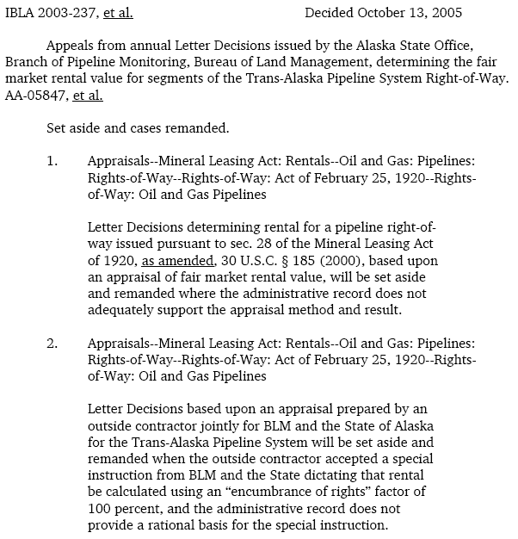

Are the Requested
Special Instructions Reasonable?

Slide 24
Appraisal Statement of Work
Appraisal Statement of Work (OVS) or Appraisal Specifications and Instructions (FS) replicate the information contained in the Request for Appraisal Services
Review appraiser issues Specifications
The Statement of Work specifies what to appraise but not how to appraise.

Slide 25
Client for Appraisal Services
The client for the appraisal is the review appraiser who wrote the SOW (FS)….OVS is the client in DOI
The client for the review is the authorized officer who requested the appraisal (FS)…BLM is client in DOI
“Appraisers must protect confidential nature of appraiser-client relationship” (USPAP – 2012/13, line 270)
Notes:
The client is often not the party who pays for the appraisal!!
Statement of Work is key to client relationship with appraiser………

Slide 26
Intended Users of Appraisal Products
The intended users of appraisal and review are those parties identified in the appraisal request.
Notes:
Parties receiving a copy of the appraisal report or appraisal review report in order to satisfy disclosure requirements under FOIA do not become intended users unless they were identified as such prior to the commencement of the appraisal process.

Slide 27
Pre-Appraisal Meeting and Site Visit
Requirement to invite property owner
Opportunity for appraiser to obtain factual information
Not appropriate for realty staff, review appraiser and landowner to give the appraiser special instructions not contained in the Statement of Work!!
Do not “lead” the appraiser!!
Notes:
Opportunity for appraiser to obtain factual information, i.e. access, use, sales, leases, land use, etc.

Slide 28
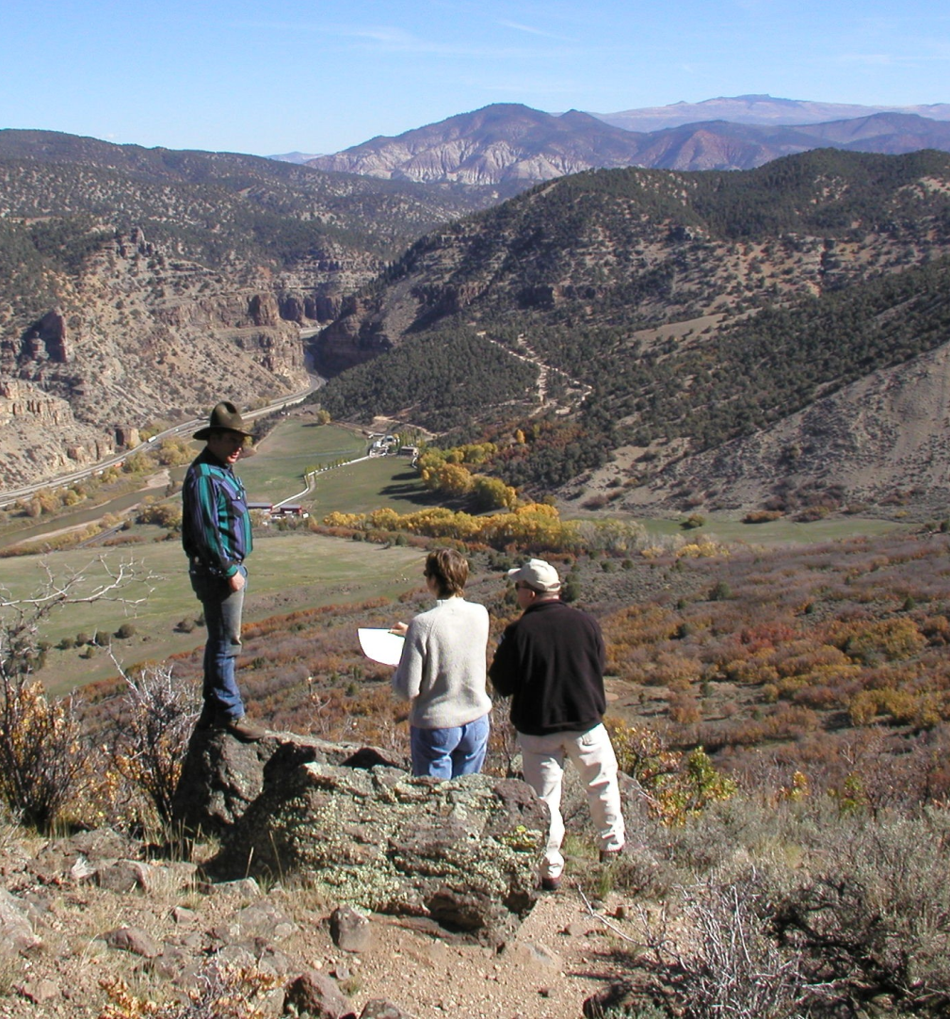

Importance of Site Visit
(The only reward appraisers can hope for?)

Slide 29
The Appraisal

Slide 30
The Appraisal
Market Value
Highest and Best Use
Larger Parcel
Three Approaches to Value

Slide 31
MARKET Value
The term “value” has many connotations.
When modified with “market” it has a very specific meaning.
Market Value is supported by an appraisal
Only licensed appraisers complete appraisals

Slide 32
Market Value - Key Points
Cash
Most probable price
Adequate market exposure
Parties are reasonably informed
No undue influence
Economic basis vs. social
Date sensitive
Notes:
Yb 2016 Section 1.2.4. Does anybody want a copy? Let me know and I can send you one electronically

Slide 33
Highest and Best Use
Who determines highest and best use?
Divergent value opinions are most often caused by differing highest and best use conclusions!
Highest and best use definition:
  The highest and most profitable use for which the property is adaptable and needed or likely to be needed in the reasonably near future (UASFLA 1.4.4)

Slide 34
Highest and Best Use; Tests
Physically Possible
Legally Permissible
Financially Feasible
Maximally Productive
Notes:
Physically Possible
Is it possible to build the necessary improvements on the site?
Are infrastructure improvements sufficient to support the use?
Legally Permissible
Zoning & Covenants
Other land use restrictions, i.e. septic regulations, floodplain, hillsides
Financially Feasible
Does the use generate sufficient income to make it worthwhile?
Maximally Productive
Of all uses that meet the three above criteria, which returns the greatest income to the land?

Slide 35
Larger Parcel
A uniquely governmental concept
Rooted in the 5th Amendment to the Constitution
  “…nor shall private property be taken for public use, without just compensation.”
Three tests used to determine the Larger Parcel:
  Unity of title
  Unity of Use
  Contiguity
Notes:
A uniquely governmental concept
Applies only in acquisitions and exchanges (UASFLA Sections 1.4.6, 2.3.3.1.2 and 4.3.3 & 4.3.4)
Allows the United States to make a property owner whole if the property damaged by the taking was not taken.
Prevents property owners from windfall profits if the government taking of their property affords their remaining property special benefits
Only the Appraiser can determine
Must support the determination using the three tests

Slide 36
Larger Parcel
Responsibilities of the Realty Specialist
  Determine all the property the owner owns in the area
  Determine if the owner uses other properties in conjunction with the Subject, even if they aren’t in the area
  Include information on the appraisal request
Larger Parcel is complicated!
Notes:
LP for exchanges are tied only to the lands identified in the ATI. Those lands can be determined to be more than one LP.
Do we have an example of a larger parcel example??
Larger Parcel is complicated
Don’t worry about figuring it out yourself; Appraisers often disagree
Best practice is to frontload the process by including everything you find in the appraisal request

Slide 37
Three Approaches to Value
Sales Comparison Approach
Cost Approach
Income Approach
NOT unique to Federal acquisitions
Form a “3-legged stool” of Value
All hinge on the Principle of Substitution
Notes:
Sales Comparison Approach
Clear incarnation of the Principle of Substitution
Buyers shop for a property based upon utility
Properties of similar utility in a given area sell for similar $$$
Approach relies on finding similar sales; same Highest & Best Use
Adjust using market pairs for any differences
The Public and the Courts have a strong preference for the approach
Most transparent approach; i.e. most difficult to manipulate
Cost Approach
Informed buyer would pay no more than it would take to build a similar improvement + cost of land
Works well when improvements are relatively new
When improvements are old or a small component of value (like in a cattle ranch), the approach is weak
Income Approach
Investor will not buy an investment without a return appropriate to the level of risk
Viewed from the landlord’s position; flow of rents
Most useful in commercial property where value/rent is by square foot
Easiest approach to manipulate to produce a desired result; like stats
Be particularly cautious of subdivision approach

Slide 38
Before and After Method for Easement Acquisition
Before condition appraised – entire property before encumbrance
After condition appraised – entire property with encumbrance in place
Difference is considered market value
Notes:
Before and after example………..

Slide 39
The Appraisal Review

Slide 40
The Appraisal Review
Appraisal review process is an inherently governmental function for BLM and NFS.
The Reviewer determines:
  If the report complies with applicable standards
  If the value opinion is adequately supported
The Reviewer has the option to:
  Approve the report or disapprove the report
  Reviewers do not approve the value

Slide 41
Release of Appraisals
DOI – OVS Policy:
  OVS—Agency decides, FOIA from OVS
  BLM Land Exchange Handbook—Available at Record of Decision
  BLM—in practice often available when reviewed and approved
  Eminent Domain—up to DOJ

Slide 42
Release of Appraisals
U.S. Forest Service Policy:
  Review Appraiser has official appraisal case file
  If transaction is closed, review report is the only report in the permanent docket
  Regional Director of Lands approves release of appraisal documents based on recommendation from Regional Appraiser
  Regional, forest and district lands staff are not authorized to keep and release appraisal records

Slide 43
Validity Period
Appraisals are a “snapshot” of the market on a specific date, making them a perishable commodity
The Forest Service Review Appraiser determines the validity period based upon knowledge of the market
OVS Policy Does Not Establish Validity Periods
  BLM should look to their own guidelines
  BLM should consider risk of using an “old” appraisal versus cost of obtaining a “new” one.
  OVS will consult, if requested, on general market movements
  Exchange Handbook recommends 6-12 months

Slide 44
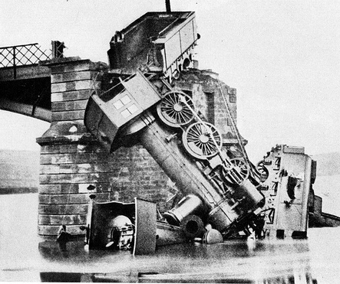
Recipe for Train Wreck
Bad Legal Description
Wrong Property Interest
Complex assignment
High value
Controversies
More than one appraisal
More than one review
Divergence from appraisal standards
Divergence from agency policy
Notes:
Tim – More than one review issue……Interior will only have one review.

Slide 45
The Wrap Up!

Slide 46
APPRAISAL SEGMENT OBJECTIVES
Know your review appraiser and when to talk to them
Complete an IVIS worksheet & request for appraisal services from OVS (or FS) according to agency guidance, including all required elements
Understand the appraisal process sufficient to respond to general appraisal questions from management, landowners, and proponents
Notes:
(See attached list of contacts

Slide 47
In summary
Recognize the need to involve appraisers EARLY
Use appraisal services effectively; Appraisals are time consuming, expensive, and perishable.
Frontload the process…submit a COMPLETE request

Slide 48

Thank you for your attention!
What did we miss?
Questions?
Comments?

